Slide 1
RHIC experiences and challenges
Overview
RHIC Experience - standard diagnostics and their evolution
RHIC Challenges
- standard diagnostics and their applications
- how challenges defined diagnostic developments
- how these developments were applied
RHIC Major New Accelerator Technologies
Summary
Michiko Minty

Slide 2
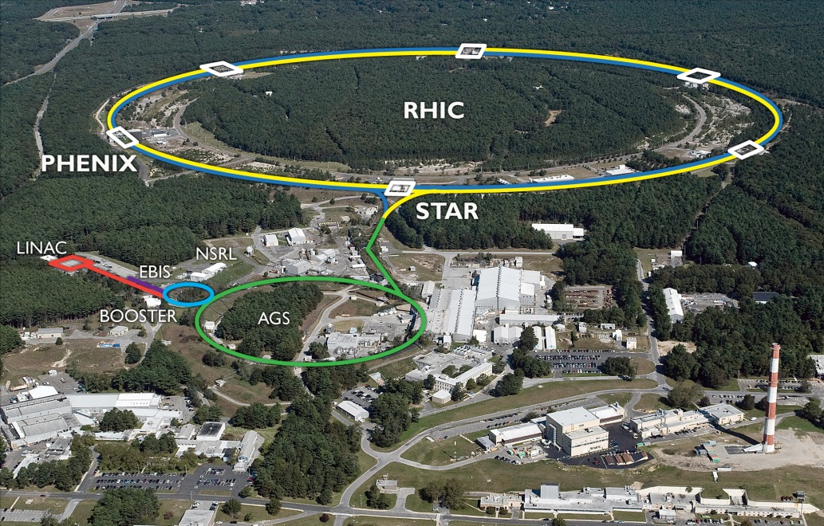
2 superconducting 3.8 km rings
2 large experiments
100 GeV/nucleon ions up to U
255 GeV polarized protons
performance defined by
1. luminosity L
2. proton polarization P
3. versatility (species, E)
RHIC commissioning era (2000 to 2002)
reached Au design energy and 75% of design luminosity
first 100 GeV polarized proton run
RHIC-I era (2003 to 2013)
reached 15x Au+Au design luminosity
stochastic cooling beginning in 2007
steady increase in bunch intensity
long full energy (250 GeV) polarized proton runs
RHIC-II era (2014 to present)
EBIS
2014: full 3D cooling for Au (and other species)
2015: electron lenses for head-on beam-beam compensation
2016: new 56 MHz superconducting cavity for additional longitudinal focussing

Slide 3
Standard diagnostics and their
evolution in RHIC:
beam positions and profiles

Slide 4
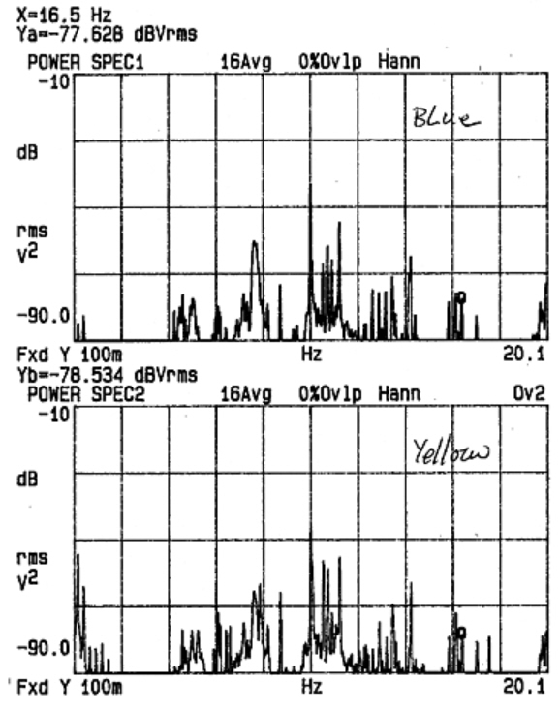
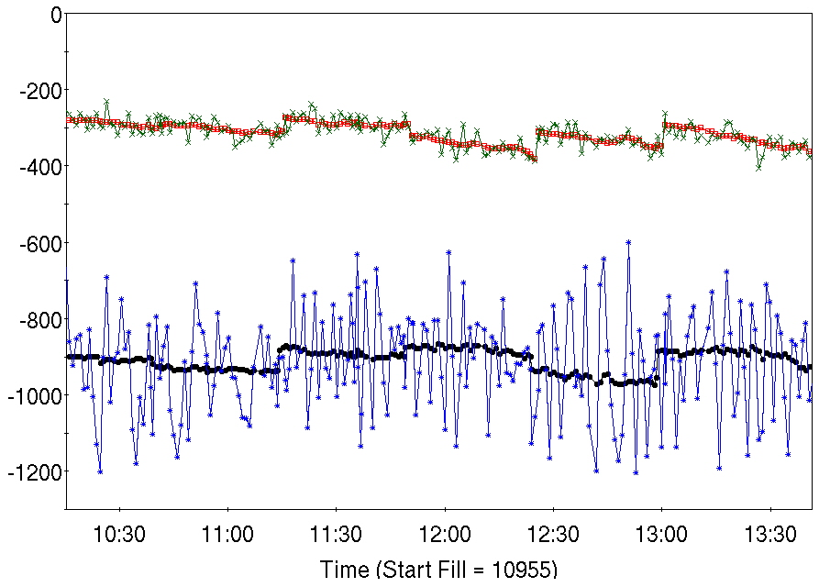
RHIC BPMs - commissioning era
measured orbit spectra
technical issues:
thermal retraction of SMA center conductor and thermal stress
at solder joint (cables then crimped, 2001-2002)
susceptibility of electronics to radiation (so relocated, 2002-2004)
relays and opto-couplers not reliable (removed, 2005)
blue ring
beam issue: triplet vibrations (applied 10 k-turn average orbits, 2001)
yellow ring
RHIC BPMs - RHIC-I era
applied digital equivalent of a single-pole, low pass filter (IIR filter) to
effectively average out predominantly ~ 10 Hz variations in the closed
orbit (2009)
C. Montag et al, Observation of helium flow induced beam orbit oscillations at RHIC, NIM A 564, pp. 26-31 (2006)
y_{old}
y_{new}
X_{new}
(here “old” refers to
10 k-turn average orbit
measurement)
beam position [μm]
X_{old}
precision of average orbit measurements improved by > factor 10
R. Michnoff et al, “RHIC BPM average orbit calculations”, PAC09 (TH5RFP013)

Slide 5
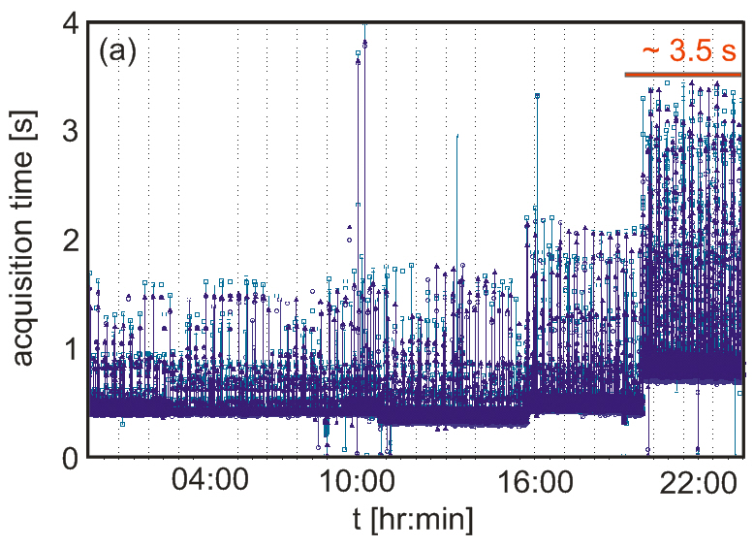
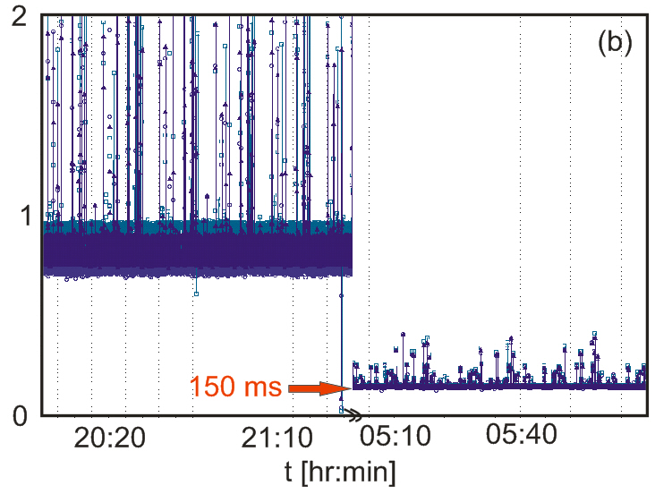
sign of BPM survey offsets changed (2010)
in support of orbit feedback development (2010):
average orbit BPM data acquisition rates
< RUN10
acquisition rate: nominally 0.5 Hz
nondeterministic (“stale” data delivered)
RUN10
acquisition rate: 1 Hz
deterministic
after BPM FEC and ADO code changes, average data delivery rate
reduced to 150 ms (suitable for orbit feedback at 1 Hz rate).
M. Minty et al, “Global orbit feedback in RHIC”, IPAC10 (MOPEC029)

Slide 6
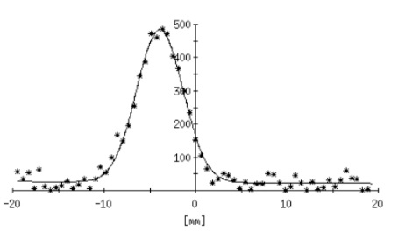
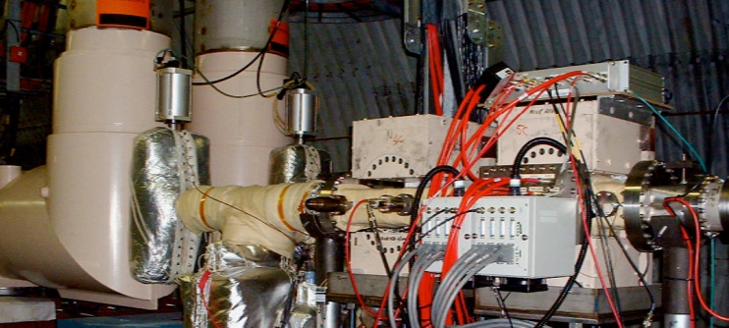
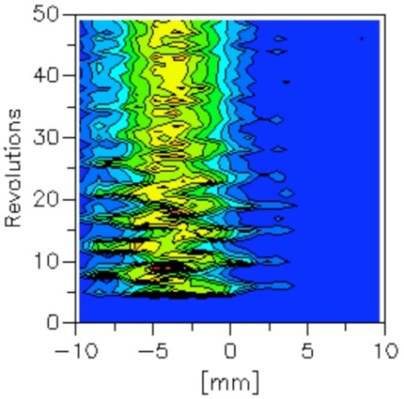
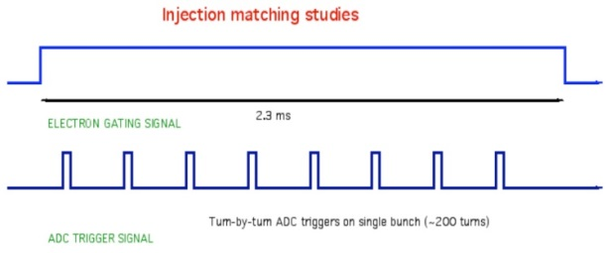
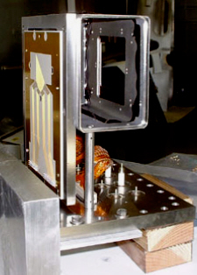
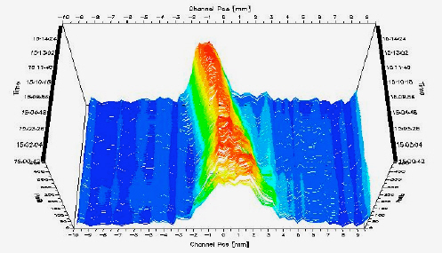
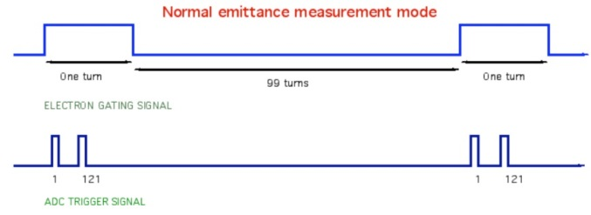
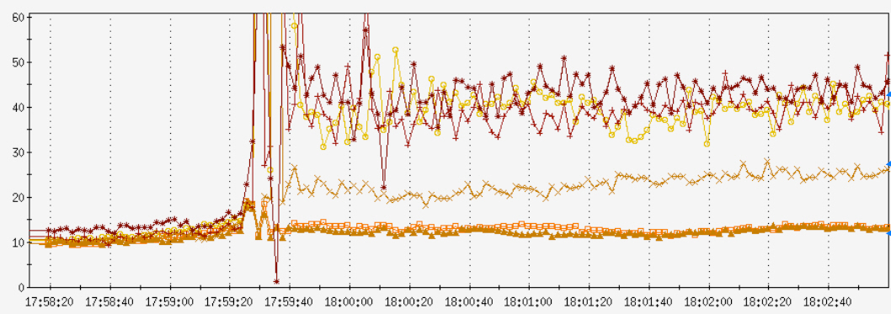
RHIC profile monitors
1. Ionization profile monitors
(utilizing rest gas)
applied for injection matching
(during early commissioning)
used for routing monitoring
of beam size evolution
applied to detect electron cloud
induced instabilities at transition
crossing (~ 2005)
normalized
emittance [μm]
R. Connolly et al, Residual-gas-ionization profile monitors in RHIC, PAC05 (TOPC002)

Slide 7
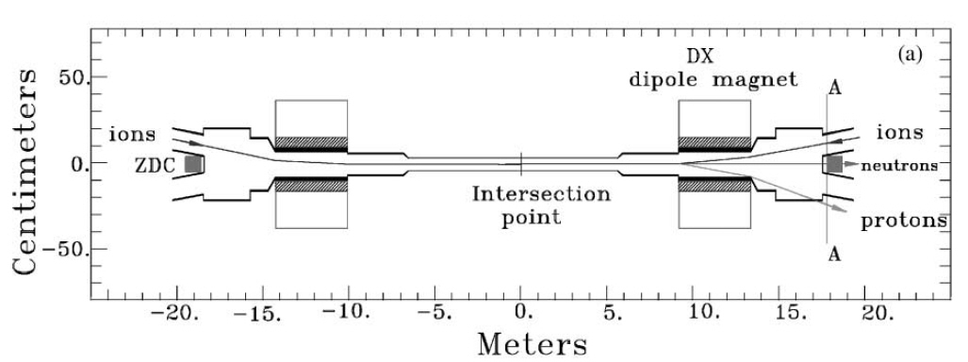
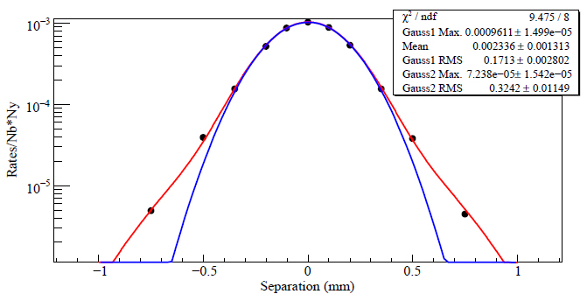
2. Vernier (Van Der Meer) scans
Zero degree calorimeters (ZDCs), used as luminosity monitors and for luminosity optimization, are used to measure the effective beam size by measuring interaction rates as a function of transverse separation (standard approach).
C. Adler et al, NIM A 470 (2001) 488-499.
250 GeV protons
single-Gaussian fit
double-Gaussian fit
A. Drees, Emittance measurements using Vernier scans during run 09 (pp at 250 GeV), C-A/AP/#412 (2010)
During RHIC commissioning and RHIC-I eras, emittance measurement comparisons (Vernier and IPM) were larger than expected. This motivated future studies and developments.

Slide 8
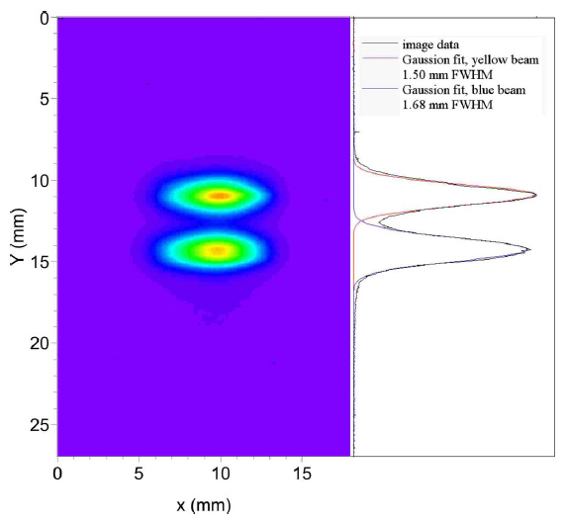
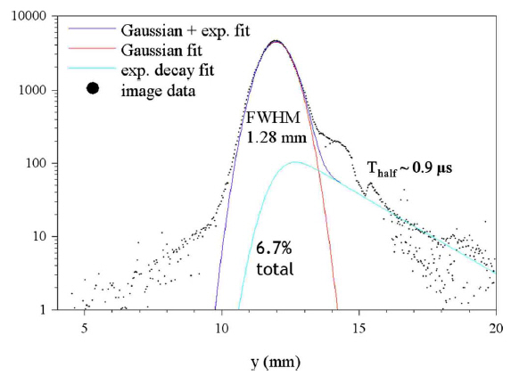
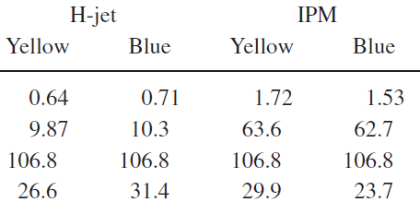
3. Fluorescence monitor (jet)
video image
fitted projection
The polarized atomic hydrogen gas jet, which is part of the polarimeter, was imaged for use as a beam profile fluorescence monitor
yellow beam
blue beam
(decay of
metastable
state of H)
emittance comparisons with IPMs
σ (mm)
β (m)
γε (mm)
~10%
~30%
T. Tsang et al, Optical beam profile monitor and residual gas fluorescence at the relativistic heavy ion collider polarized hydrogen jet,
Review of Sci. Instruments 79, 105103 (2008)

Slide 9
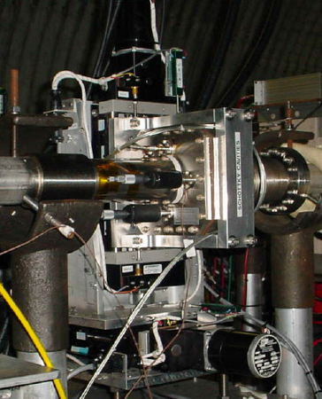
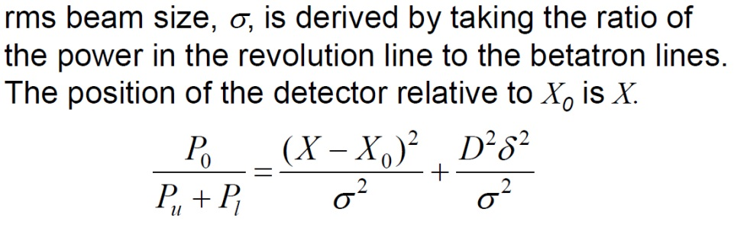

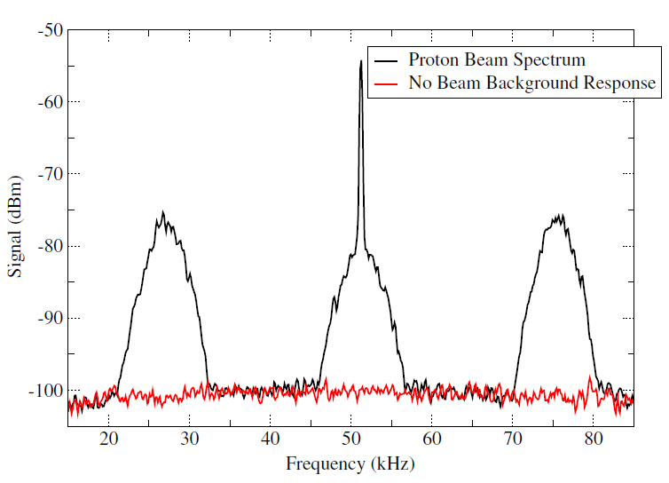
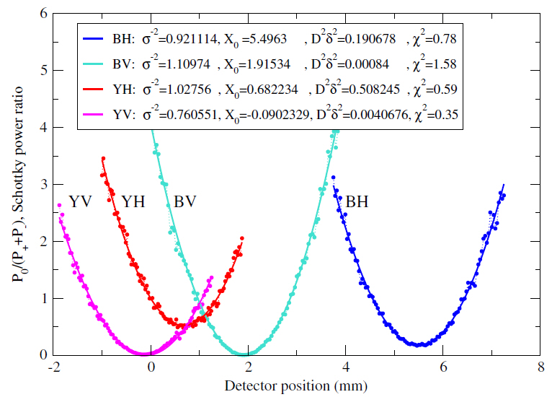
4. (movable) Schottky monitor
bellows
Schottky and background spectra acquired during normal operations
data and fits
K.A. Brown et al, Measuring transverse beam emittance using a 2.07 GHz movable Schottky cavity at the Relativistic Heavy Ion Collider,
Phys. Rev. ST Accel. Beams 12, 012801 (2009)

Slide 10
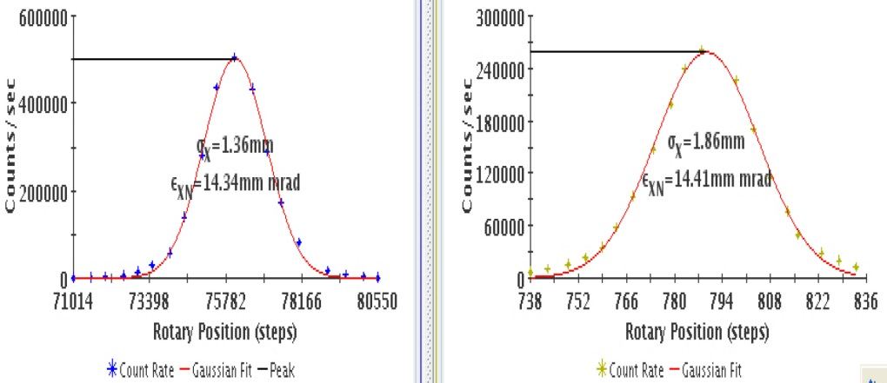
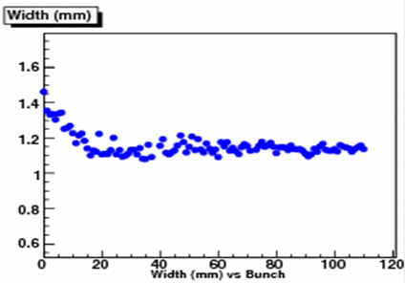
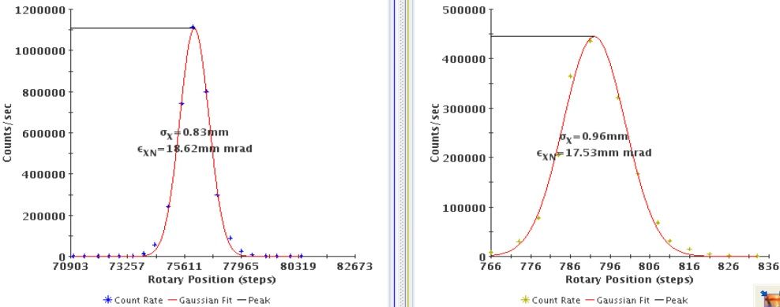

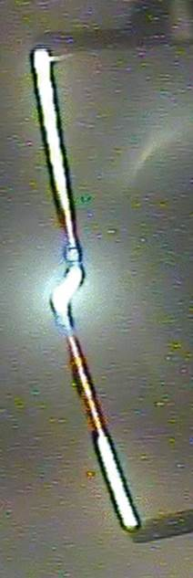
5. Wire scanner, fiber of CNI (Coulomb-nucleon interference) polarimeter
injection
(2008)
bunch-by-bunch measurements
beam size [mm]
store
bunch number
often convincing profiles, good
relative measurements
2013 issue - broken fibers, added video imaging:
this approach for beam profile
measurements not further pursued

Slide 11
RHIC Challenges – standard
diagnostics and their application:
beam emittances and linear optics

Slide 12
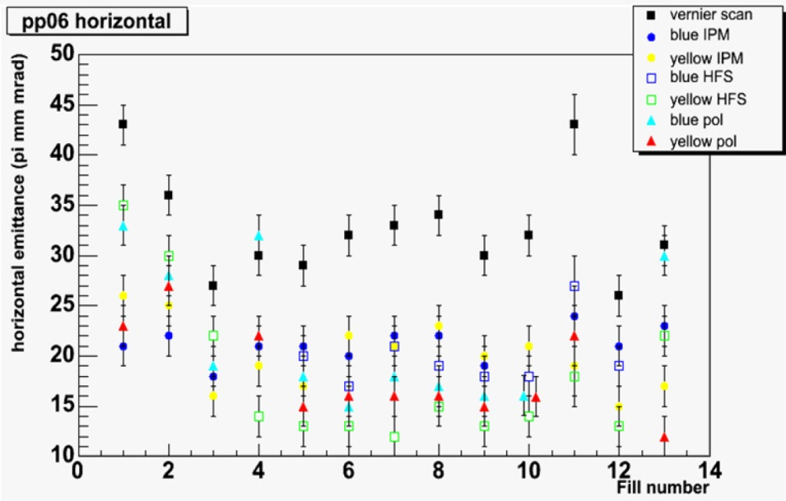
RHIC-I era: emittances derived from beam profile measurements
disparity between methods in reported emittances
Zelenski,
“Emittance measurements at RHIC”
APEX Workshop (2008)
In addition, beta- and phase beating errors were measured with amplitudes much larger than expected based on estimates of plausible magnetic field errors
Major developments in linear optics studies:
(1) Turn-by-turn BPM precision – hardware
(2) Turn-by-turn BPM precision – demonstration
(3) Local coupling correction
(4) Lattice implementation
commissioning
RHIC-I
RHIC-II

Slide 13
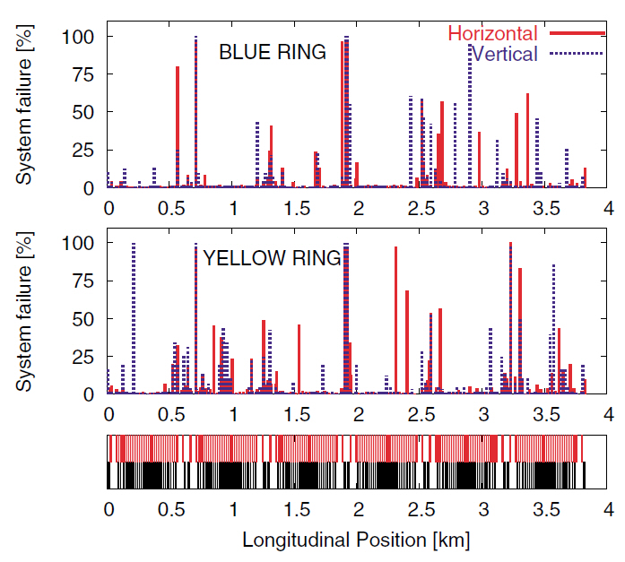
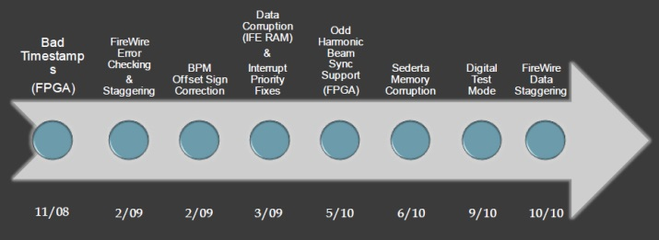
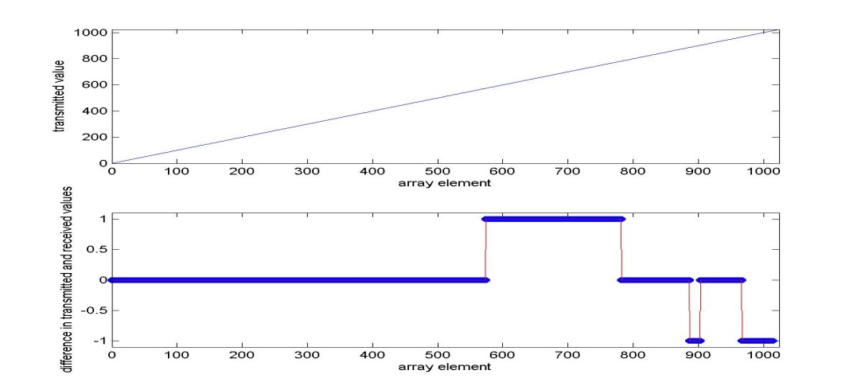
RHIC-I era experience: turn-by-turn BPM measurements
For beam optics measurements, in addition to hardware status checks, statistical analysis methods (SVD and FFT) had to be applied to pre-screen BPM data.
R. Calaga and R. Tomás, Statistical analysis of RHIC beam position monitors performance,
PRSTAB, Vol 7, 042801 (2004)
Numerous hardware improvements resulted:
sent
value
example BPM
During the shutdown prior to run-11, tested digital aspects of data delivery by sending a pre-defined sequence of values and reading these back to check data array alignment
sent less
received
value
errors
array element
errors eliminated by staggering TBT data delivery on IEEE serial bus interface (“FireWire”) and by basing timing delays on the beam sync link turn counter (instead of software delays)
no errors after >100,000 acquisitions (1 acquisition = ~650 BPMs * 1024 values)
~ 100 billion readings

Slide 14
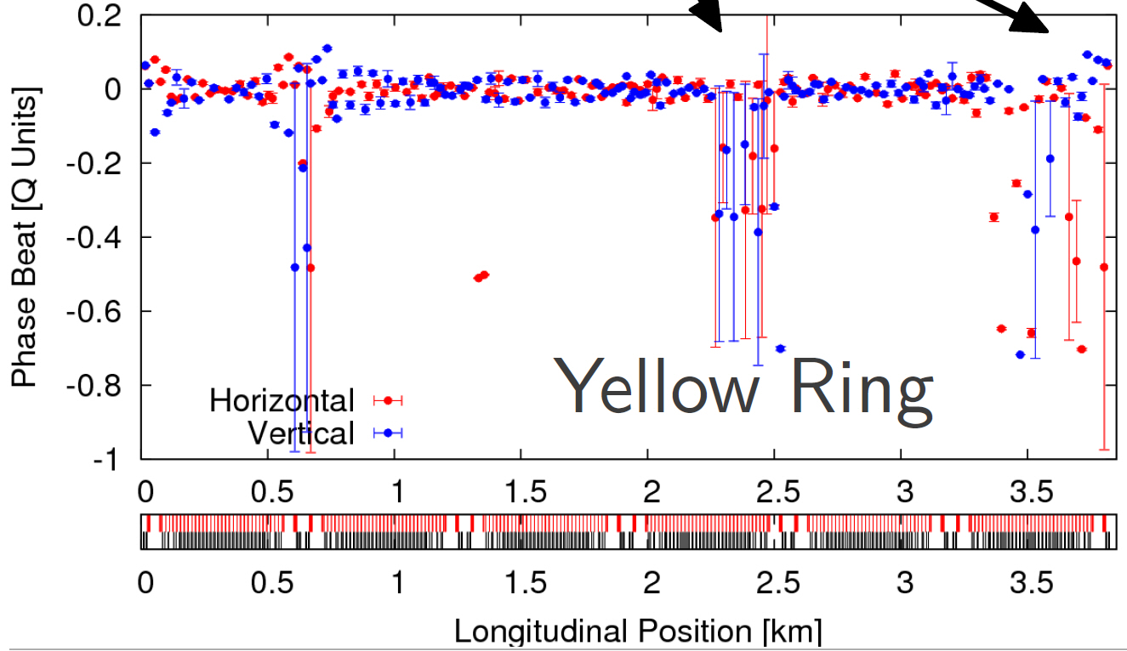
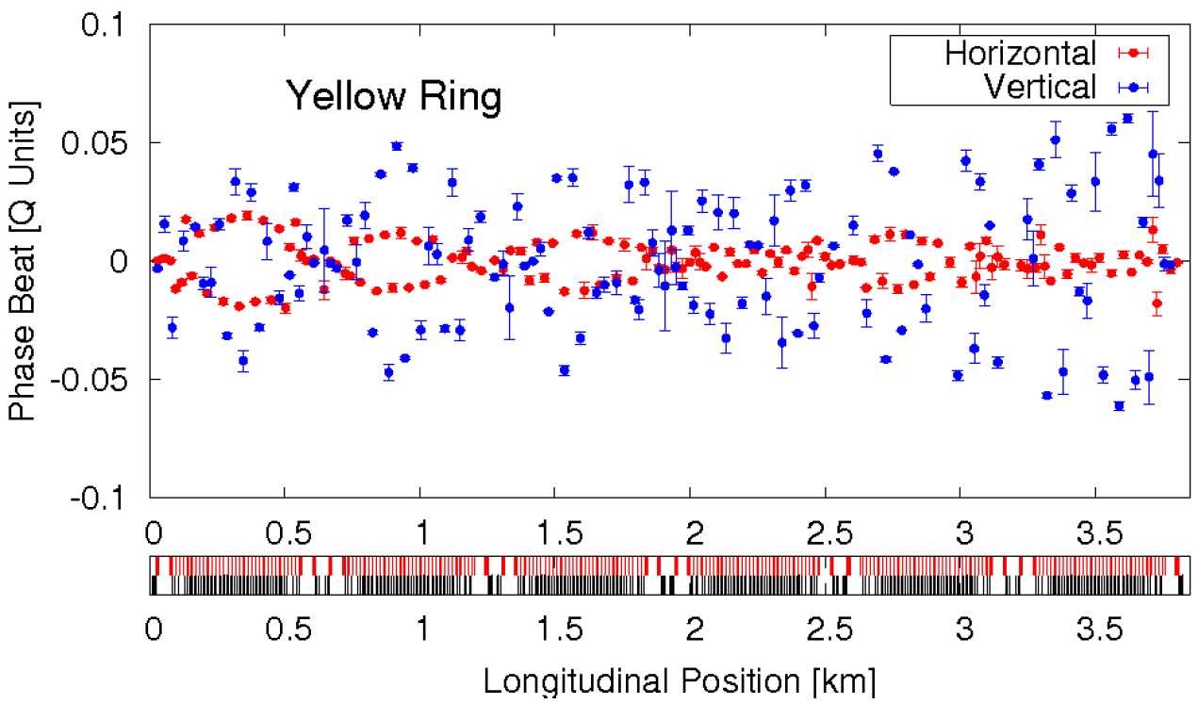
enabled high quality beam optics measurements
(next dominant contribution to error bar size suspected to be due to decoherence)
2009
2011
note change in scale
phase beat [Q units]
yellow ring
p, 250 GeV
yellow ring
Au, 100 GeV
longitudinal position [km]
longitudinal position [km]
R. Calaga et al “Chromatic measurements in RHIC and LHC”,
Optics Measurements, Corrections and Modeling forHigh-Performance Storage Rings Workshop, CERN (06/2011)

Slide 15
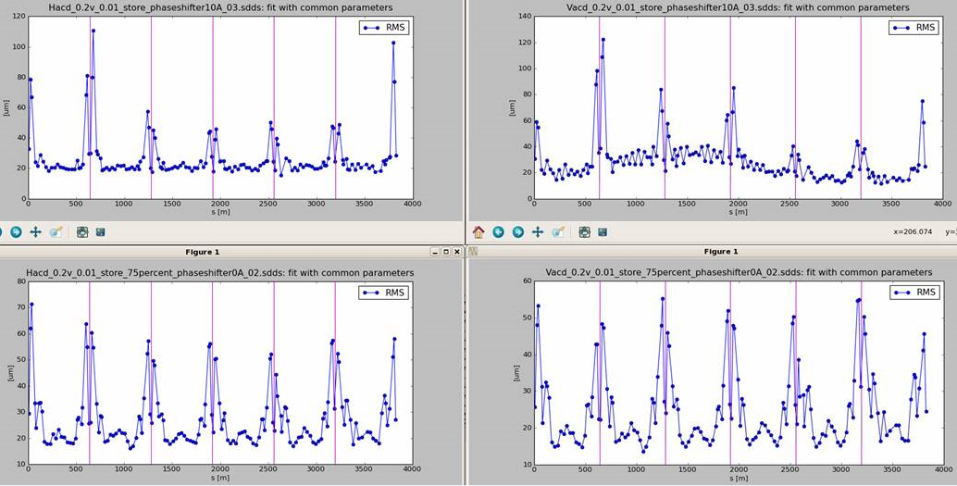
< 2012 FFTs and SVD methods used for beam optics measurements
puzzle: large beta- and phase-beating (suspected to be due to “bad BPMs”)
2012 motivated by quantifying phase measurement accuracy and precision of E-Lens phase shifters,
new approach for data analysis applied: least squares fits in the time domain (with exponential fits)
rms of (data minus fit) at each BPM after kick excitation
blue ring horizontal
yellow ring horizontal
position
rms [μm]
longitudinal position [m]
blue ring vertical
yellow ring vertical
~ 20 μm precision of turn-by-turn BPMs demonstrated, vertically
~ 30 μm precision of turn-by-turn BPMs demonstrated, horizontally
(far better than expected)
difference due to real orbit variations resulting from triplet vibrations
“reinvigorated” beam optics studies with now demonstrated precision input measurements
P. Thieberger et al, unpublished

Slide 16
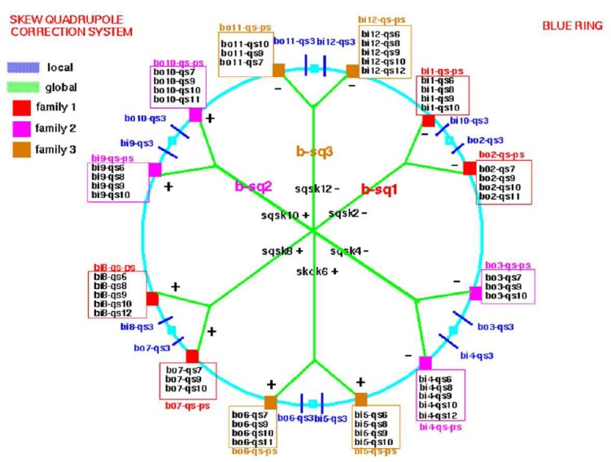
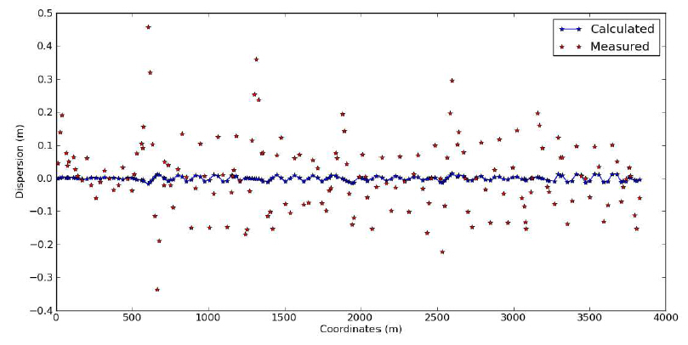
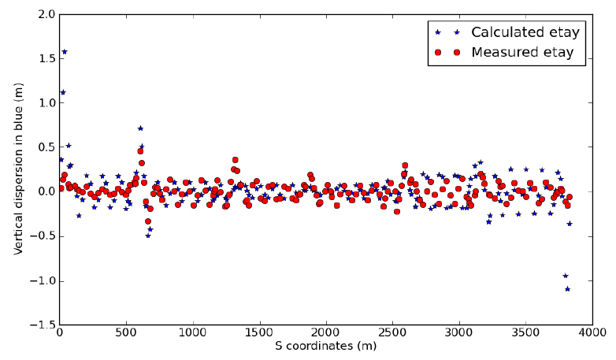
Local coupling correction at RHIC
RHIC skew quadrupole topology
Important because optics corrections schemes
did / do not consider influence of coupling
LOCAL
RHIC commissioning era: coupling found to be
excessive, localized to triplet quadrupole rolls
GLOBAL
RHIC-I era: determined that dispersion η_{y} was
introduced by global decoupling and that global
decoupling was correcting for triplet rolls
(local coupling)
measured η_{y} (red) and calculated η_{y} generated
by correctors (blue)
measured η_{y} (red) and calculated η_{y} generated
by skew quads (blue)
C. Liu et al, “Simultaneous dispersion and coupling correction in RHIC”, NIM A 750 (2014) pp. 56-60
revisited local coupling correction at triplets (24 triplets: 12 per ring)

Slide 17
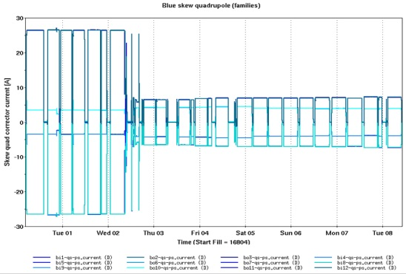
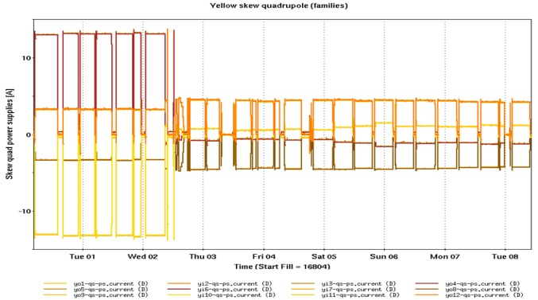
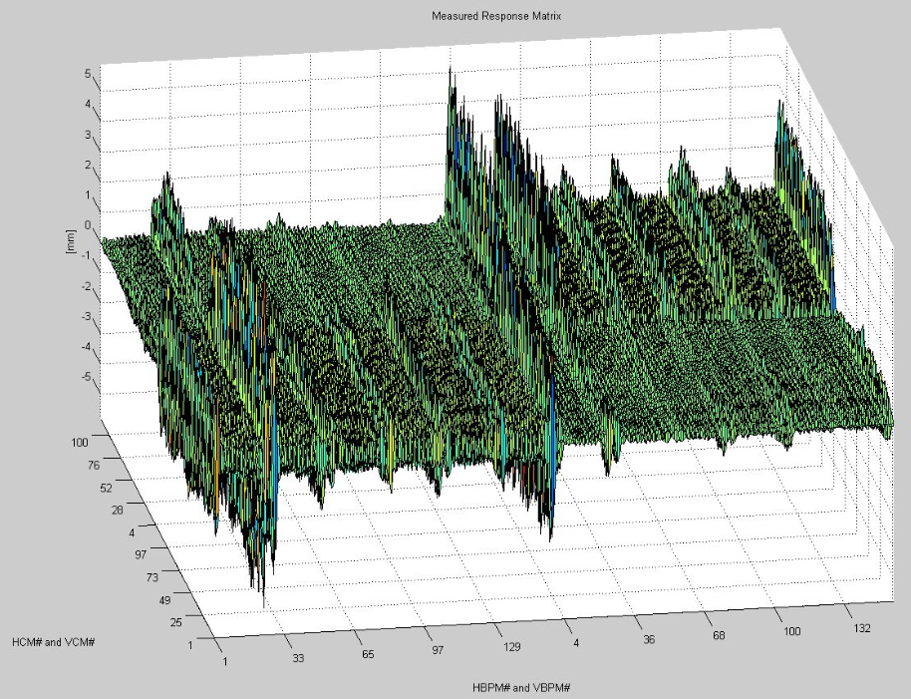
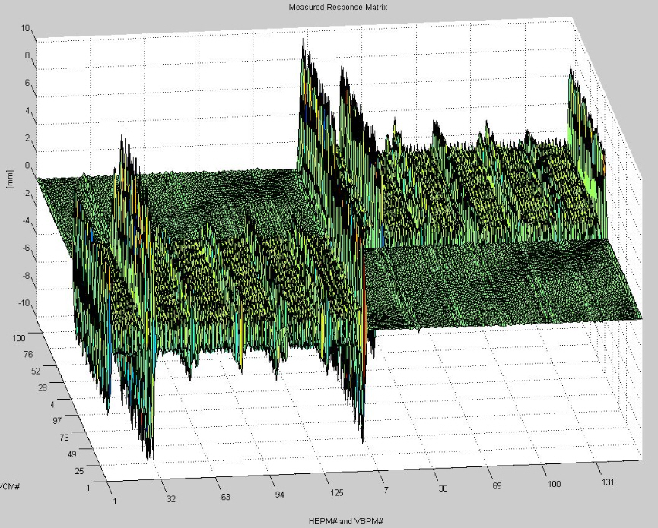
Result: local skew quadrupole strengths after implementation of corrections:
A. Marusic (unpublished)
Result: measured R-matrix elements (ORM - Orbit Response Matrix - method)
before local coupling correction (2010)
after local coupling correction (2012)
R₁₄’s ~ 0
R₃₄
R₁₄
y-COR
R₁₂
R₃₂
R₃₂’s ~ 0
x-COR
x-BPM
y-BPM
T. Summer’s (unpublished)
coupling corrections previously in conflict. Now, both local and global correction corrected locally.
Methodology applied for local coupling correction: F. Pilat, “Correction of triplet skew quadrupole errors in RHIC”, RHIC/AP/58 (1995)

Slide 18
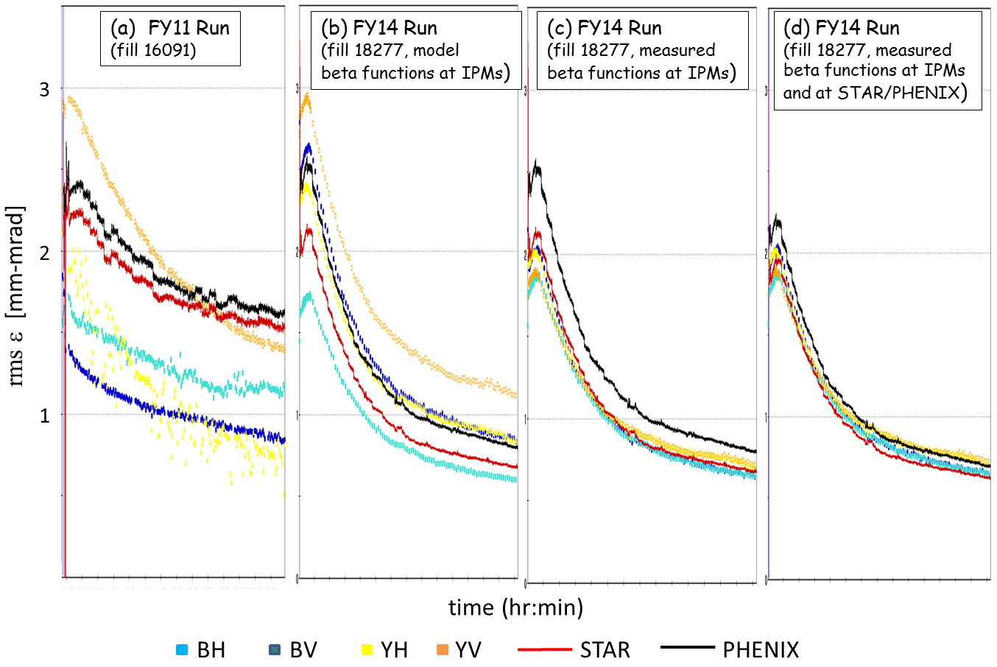
RHIC-II era: IPMs versus ZDC-derived emittances
ZDCs – red and black
IPMs – other colors
FY11: 100 GeV Au+Au
Fy14: 100 GeV Au+Au
(3.5 hours full scale)
absolute emittance measurements in RHIC, consistency between IPMs and ZDCs
M. Minty et al, Absolute beam emittance measurements at RHIC using ionization profile monitors, IBIC14 (MOPF09)

Slide 19
RHIC Challenges – how these
defined diagnostic developments:
feedback systems

Slide 20
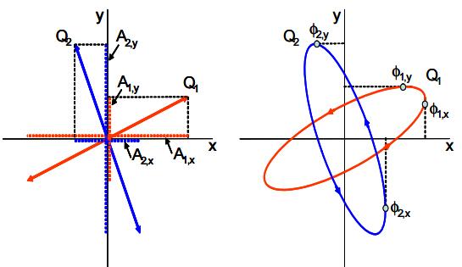
RHIC tune and coupling feedback
development initiated as US-LARP proposal (FY03) with joint agreement BNL/FNAL/LBNL/CERN (FY05)
tune measurement – BBQ method (M. Gasior and R. Jones)
coupling measurement – using methodology of coupling angle measurement (Y. Luo et al)
feedback design – uses eigenmodes for handling betatron coupling (O.R. Jones, P. Cameron and Y. Luo)
demonstrated in RHIC in 2006 (P. Cameron et al)
made operational in 2009 following changes including:
accuracy - by removal of data corruption (due to CPU limits and data overwrites)
precision – by using all available data
8 periods
8 periods
……………….…... (repeat) ………..…..…
1 period used
for BBQ/BTF
1 period used
for BBTF
1 (possibly corrupted) period used BBQ/BTF

Slide 21
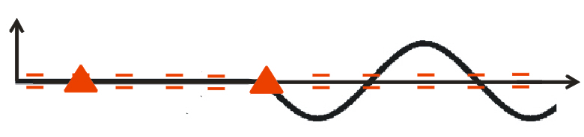
RHIC orbit feedback
motivated by observed trajectory drifts
orbit measurement
based on existing infrastructure (BPMs and networking)
using improved algorithm for measuring average orbit and original survey (offset) data
deterministic data delivery
feedback design
orbit correction algorithm: SVD (singular valued decomposition)
extended to application at 1 Hz rate during energy ramp
M_{ij}
x = M θ
x
x = vector of ~ 320 BPM
measurements
M = matrix of transfer functions
= vector of angular deflection
of ~ 230 correctors
M_{ij}
is the transfer matrix between the
i^{th} BPM and j^{th} corrector dipole
Δθ = M⁻¹ Δx
demonstrated in RHIC in 2010
made operational in 2011 following changes for handling off-energy beams:
constrain average horizontal corrector strengths
use all arc BPMs for energy offset determination (for eliminating dispersive contributions to orbit)

Slide 22
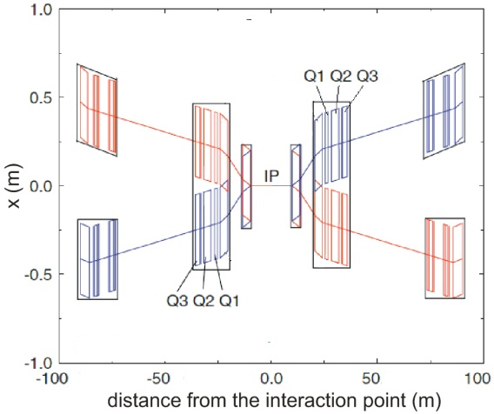
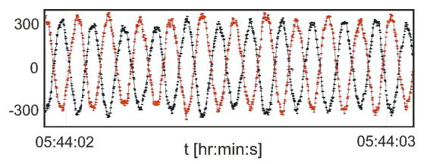
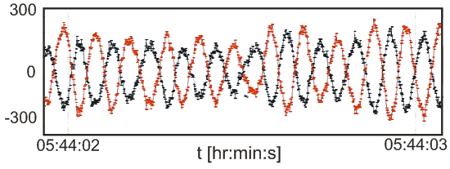
RHIC triplet vibration feedback
motivation: (1) prevented operation at near-integer tunes
(2) modulated crossing angles at IPs
(3) caused modulated betatron tunes
collision point
triplet
triplet
x (μm)
time
time
feedback design
uses existing BPMs with new fast readout and new dedicated correctors
SVD correction algorithm
prototyped in RHIC in 2010
implemented in RHIC (at store) and extended to application during acceleration in 2011
R. Michnoff et al, RHIC 10 Hz global orbit feedback system, IPAC10 (MOP268)

Slide 23
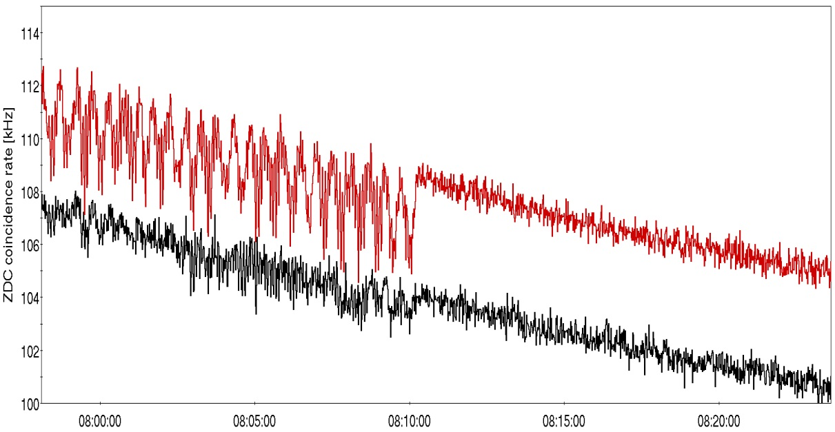
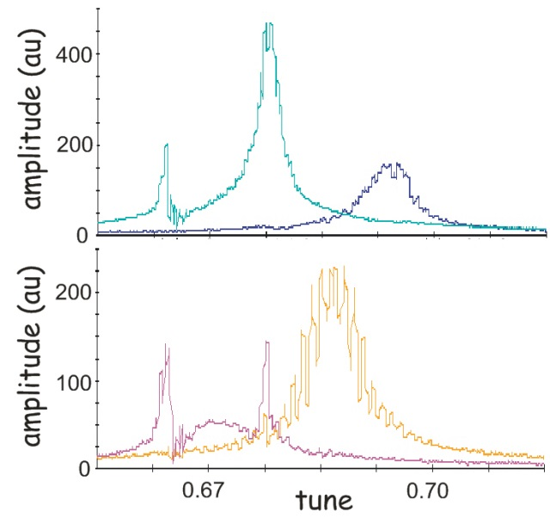
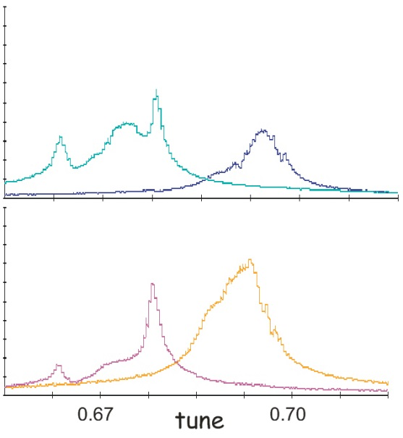
RHIC triplet vibration feedback
ZDC rates at PHENIX and STAR
higher integrated luminosity
feedback on
ZDC coincidence rate [kHz]
2011
time [hrs]
without 10 Hz feedback
with 10 Hz feedback
blue
ring
intrinsic resolution
(versus 10 Hz interferences)
of instrumentation now
observable
vertical
vertical
horizontal
horizontal
yellow
ring
horizontal
horizontal
vertical
vertical

Slide 24
RHIC Challenges – how these
developments were applied

Slide 25
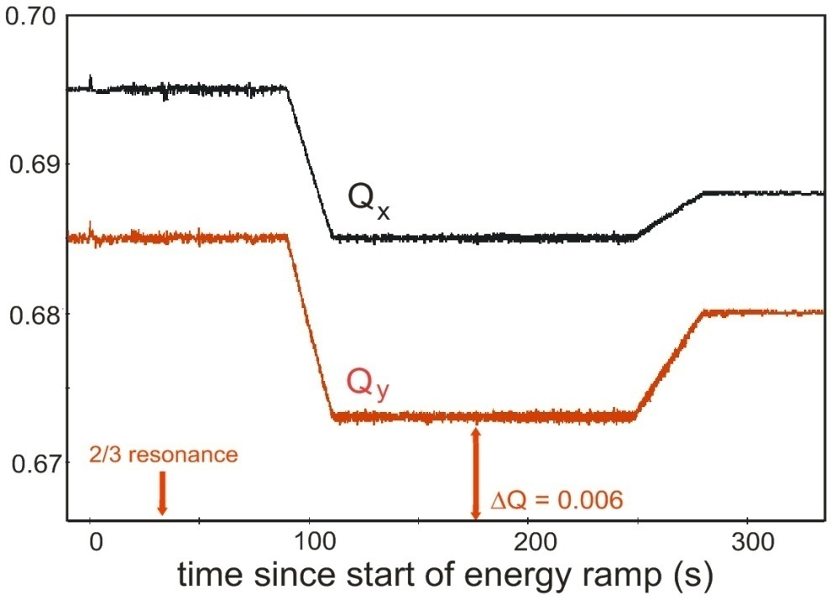
Allowed operation under extreme conditions
7/10 snake
resonance
end of
acceleration
start of
acceleration
ΔQ_{y}= 0.006
2/3 resonance
time since start of acceleration [s]
avoidance of depolarizing snake resonance by acceleration in close
proximity to strong orbit resonance

Slide 26

Consequently increased accelerator performance
figure from M. Bai et al, “Status and plans for the polarized hadron collider at RHIC”, IPAC13 (TUYB203)
run-11
run-9
~ 25 % increase in relative polarization of each beam
huge figure of merit increase (LP² / LP⁴ for transverse/longitudinally polarized beams)

Slide 27


Enabled otherwise not practical/possible experiment: acceleration and
deceleration with orbit, tune/coupling and chromaticity feedback
motivation: cross-calibration of polarimeters at 250 GeV
total charge
[10¹¹]
main dipole current [A]
time [hrs]
action of feedback loops:
acceleration
deceleration
absolutely critical for successful execution

Slide 28

Ramp Optics Measurement and Correction
motivation: improve understanding of emittance evolution during acceleration
correct optics during acceleration cycle
strategy: orchestrate data acquisitions and data delivery using interleaved
average orbit BPM measurements (for orbit feedback) and
turn-by-turn BPM measurements (for optics measurements)
1.
repeat
trigger 1 Hz event
for orbit feedback
4.
1 Hz event for
orbit feedback
ping beam in vertical plane
acquire TBT BPM data
deliver data
5.
ping beam in horizontal plane
acquire TBT BPM data
deliver data
2.
acquire and
deliver BPM
data for orbit
feedback
time (ms)
0
200
1000
3.
trigger turn-by-turn BPM
data acquisition

Slide 29



Luminosity leveling with dynamic β*-squeeze
initial condition: corrected optics to Δβ/β < 10%
(peak-to-peak)
stochastic cooling increases
instantaneous luminosity
implement dynamic β*-squeeze
luminosity
leveling at STAR
experiment
lattice without β*-squeeze
lattice with β*-squeeze
G. Robert-Demolaize, The luminosity upgrade at RHIC, IPAC15 (FRXC1)

Slide 30
Major New
Accelerator Technologies
Developed at RHIC

Slide 31


Bunched-Beam Stochastic Cooling
Motivation: intrabeam scattering (IBS) causes emittance
growth of heavy ion beams
RHIC-I experience: an “IBS suppression lattice (ibs-s)”
was applied in run-8 which successfully reduced
emittance growth however not without operational
difficulties (beam loss at rebucketing / off-momentum
dynamic aperture)
γε [μm]
figure from V. Litvinenko, “Experience with IBS suppression lattice in RHIC”, EPAC08 (WEPP015)
time [s]
V. Litvinenko et al
RHIC-II upgrade included ultimately full 3D, bunched beam stochastic cooling (2014)
average luminosity vs. vertex size
2016 with 56 MHz SRF
demonstrated 2014
full 3D cooling
L +30-50%
demonstrated 2011
long. + ver. cooling
calculations by M. Blaskiewicz
M. Blaskiewicz, J.M. Brennan and F. Severino, Operational stochastic cooling in the Relativistic Heavy Ion Collider, PRL 100, 174802 (2008)
M. Blaskiewicz, J.M. Brennan and K. Mernick, Three-Dimensional Stochastic Cooling in the Relativistic Heavy Ion Collider, PRL 105, 094801 (2010)

Slide 32


RHIC-II Electron Lenses for head-on beam-beam compensation
New lattice (ATS type, S. White) – phase advance kπ between IP8 and e-lens minimizes beam-beam resonance driving terms
Electron lenses – reduce beam-beam induced tune spread
Tune width measurement: imaginary part of complex beam
transfer function (BTF); p+Al – no coherent bb modes
ΔQ reduction
from e-lens
New lattice has larger off-momentum
dynamic aperture and accommodates
higher beam-beam parameter ξ
2x bb
no bb
ξ_{max} = −0.011 per IP (RHIC in operations, to date)
W. Fischer et al, Operational head-on beam-beam compensation with electron lenses in the Relativistic Heavy Ion Collider,
submitted to Phys. Rev. Lett. (2015)

Slide 33






RHIC-II electron back-scattering detector (eBSD)
for electron-proton beam alignment
ELECTRON GUN
in-air scintillator detector
simulated trajectories
use during operations
N_{ppb} [10¹¹]
Van Der Meer scans
I_{e} [mA]
eBSD rate
time [s]
P. Thieberger et al, High energy Coulomb-scattered electrons for relativistic particle beam diagnostics,
submitted to PRSTAB (2015)

Slide 34


RHIC-II Era Performance:
with full 3D Stochastic Cooling for ion beams
with Electron Lenses for polarized proton beams
Run-14
Run-15
Au+Au luminosity from Run-14 exceeds all previous Au+Au runs combined
Run-15 integrated luminosity at √s = 200 GeV exceeds sum of all previous runs
courtesy W. Fischer

Slide 35
Summary

Slide 36
Summary – what worked, what needed further developments
commis- RHIC-I RHIC-II
sioning era era
dI/dt beam loss
I beam intensity
x,y beam position
average, absolute
average, relative
turn-by-turn, relative
σ_{x,y} beam size
IPM
Schottky (na)
CNI (fiber) (na)
fluorescence (na)
ε_{x,y} emittance
luminosity (ZDC)
IPM
Q_{x,y} tune
κ_{x,y} coupling
ξ _{x,y} chromaticity
observable
conventional
diagnostics:
significant efforts invested to achieve better accuracy and resolution
linear optics studies required
better resolution
demonstrated for use in feedback

Slide 37

Summary – what other developments evolved for RHIC operations
Automation using beam-based feedback
increased accelerator availability
enhanced accelerator performance
drives programmatic development (enables numerous different species and energies
within one fiscal year)
RHIC-II era
One-year performances exceeded those of all previous years combined:
FY14: stochastic cooling with 100 GeV Au+Au
FY15: electron lenses: 100 GeV p+p
RHIC future
FY16: continued Au+Au physics; developments for Coherent Electron Cooling (CeC)
FY17: Zi+Zi and/or Rh+Rh with demonstration of Coherent Electron Cooling (CeC)
FY18: installations for low-energy electron beam cooling (LEReC)
FY19/20: Au+Au with bunched-beam electron cooling
Future: experiments with upgraded detectors and preparations for eRHIC

Slide 38

Thank you to everyone in the C-AD department whose collective accomplishments are presented here
And thank you all for your attention!

Slide 39
Reflections (what to do differently) – defer to discussion session
Instrumentation specifications, if documented, seem based on expectations from the at-that-time state-of-the-art. As an example, the BPM system did not meet specifications. Early commissioning was adversely affected and many beam dynamics studies (e.g. linear beam optics measurements, local coupling correction, nonlinear field corrections, resonance driving term measurements, etc.) achieved poor precision as a result.
Recommendation for future accelerators: clear communication of instrumentation specifications and the beam physics that drives them.
Preservation of data quality with high-volume data transfers is critical.
examples: turn-by-turn BPMs - comparing sent and received patterns
monitoring of data transfer rates (BPMs, BBQ)
Recommendation for future accelerators: long term, front-to-end integration should
be included as part of design.

Slide 40
Measurements should be taken seriously (not attributed to “bad data”).
example: linear optics measurements (β-beats were real but
not attributable to magnetic field errors)
Recommendation for future accelerators: if outcomes not as expected, coordinate discussion and look not only for instrumentation-related reasons but also implementational and beam dynamics related reasons.
Beam control at RHIC evolved from manual to automated with benefit not only to overall performance but also to beam dynamics studies.
Recommendation for future accelerators: appropriate methods to control and monitor automated tasks should be included by design for operation in a heavily feedback- and optimization-control-laden environment.

Slide 41


RHIC-II era: absolute emittance measurements
transverse beam emittances with 3D stochastic cooling
model β-functions
measured β-functions

Slide 42


RHIC tune and coupling feedback
run-9 with feedback
run-11 with feedback
run-9 without feedback
C
multiple super-
imposed ramps
time since start of acceleration [s]
time since start of acceleration [s]
tunes and coupling well controlled, reproducibility is excellent

Slide 43




RHIC orbit feedback
run-09
run-11
X_{rms}
04/07/09 - 04/13/09
X_{rms}
02/24/11 - 03/01/11
~20 μm
~250 μm
y_{rms}
y_{rms}
~280 μm
~20 μm
time since start of acceleration [s]
time since start of acceleration [s]
orbits well controlled, reproducibility is excellent
orbit feedback now essential for polarized proton operations

Slide 44


Ramp Optics Measurement
model versus measured β_{y} at IPM
β-function [m]
time since start of acceleration [s]
M. Minty et al, Measurement of beam optics during acceleration in RHIC, NAPAC13 (TUPBA08)
Ramp Optics Correction
rms β-beats before and after correction
rms β-beat
time since start of acceleration [s]
C. Liu et al, Optics measurement and correction during acceleration with beta-squeeze in RHIC, submitted to PRSTAB (2015)

Slide 45

RHIC-II Era Performance with full 3D Stochastic Cooling for ion beams
increase in luminosity lifetime
result of 3D cooling
increase in initial luminosity
result of larger bunch intensity
Run-14
Au+Au luminosity from Run-14 exceeds all previous Au+Au runs combined
courtesy W. Fischer

Slide 46
RHIC-II Era Performance with Electron Lenses for polarized proton beams
Run-15
Run-15 integrated luminosity at √s = 200 GeV exceeds sum of all previous runs
courtesy W. Fischer

