Slide 1

Future trends in diamond detectors for beam diagnostics purposes
Workshop Beam Dynamics meets Diagnostics
Erich Griesmayer, CIVIDEC Instrumentation
Florence, November 4-6, 2015

Slide 2

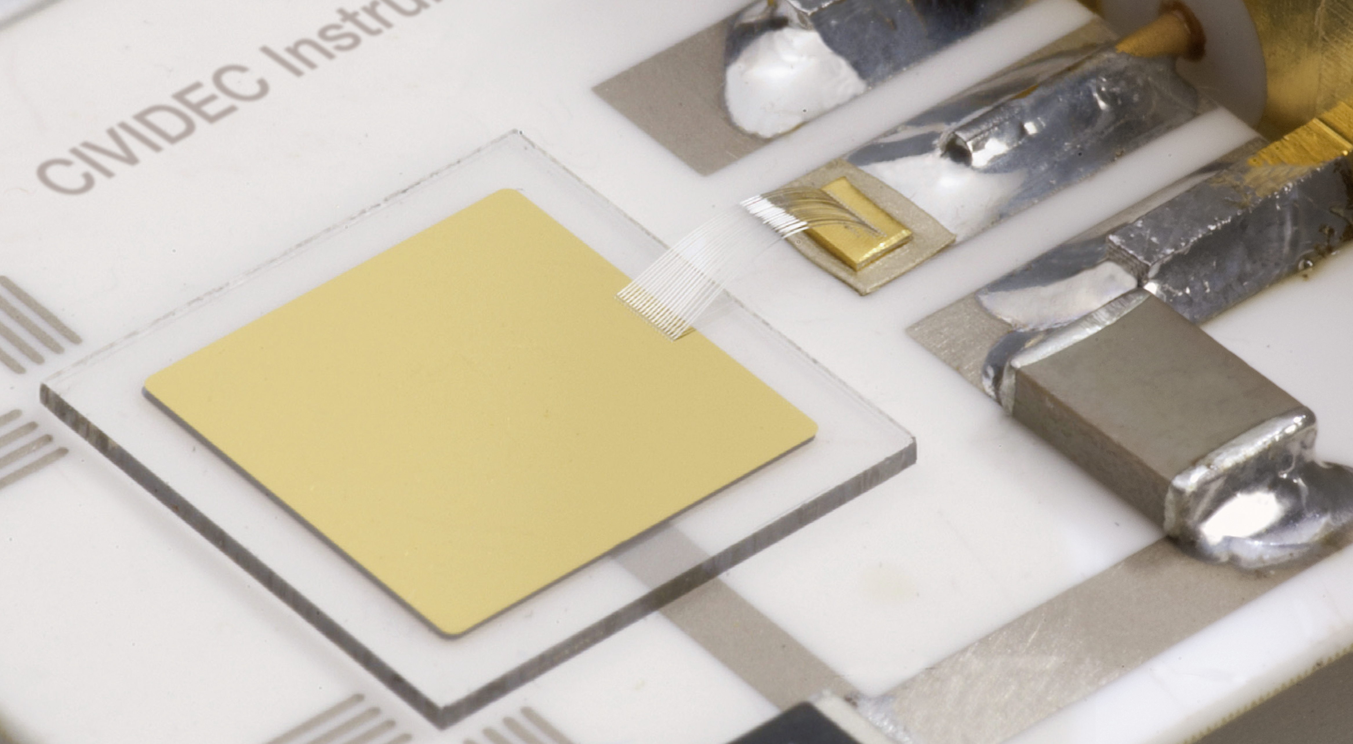
Content
Past
Presence
Future

Slide 3
Content
Past
Presence
Future

Slide 4
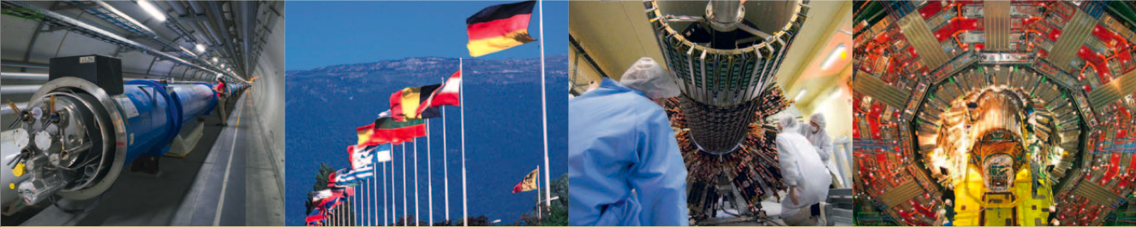
Charged Particles

Slide 5
2003 – First single proton
2003: First single proton pulses with a diamond detector recorded with sub-nanosecond signal response.

Slide 6
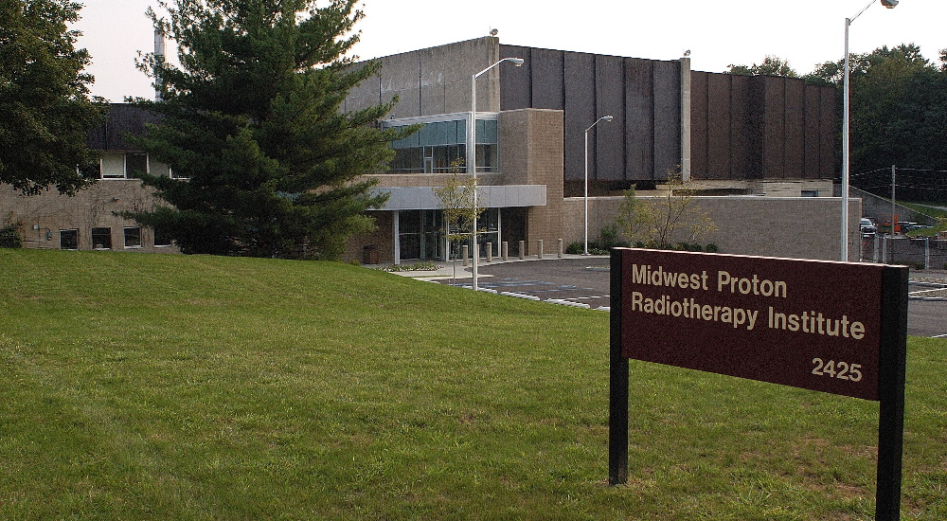
25.11.2003 Bloomington

Slide 7
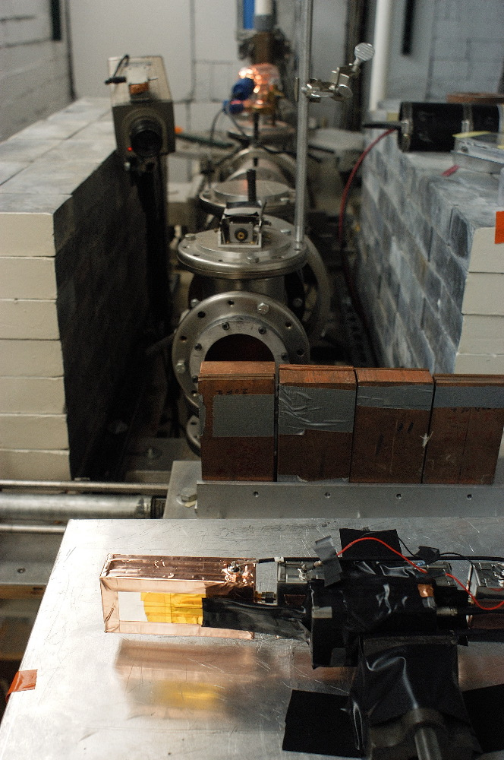
Bloomington, Indiana

Slide 8
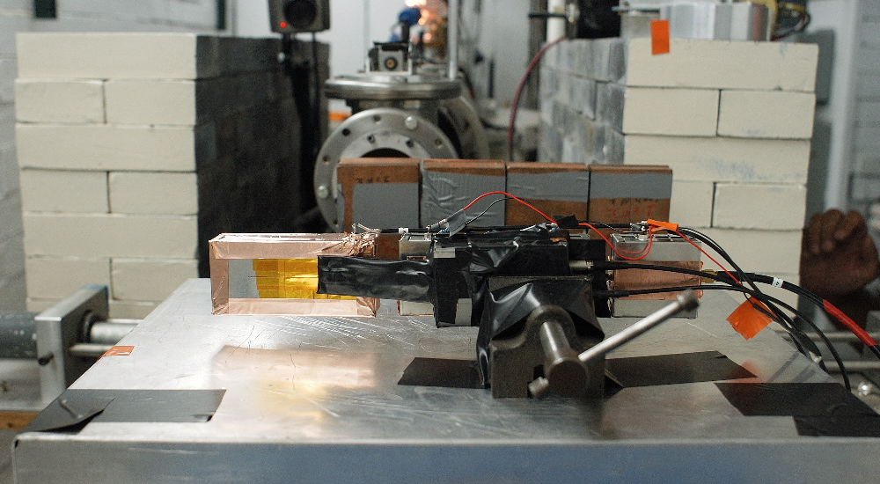
Bloomington, Indiana

Slide 9
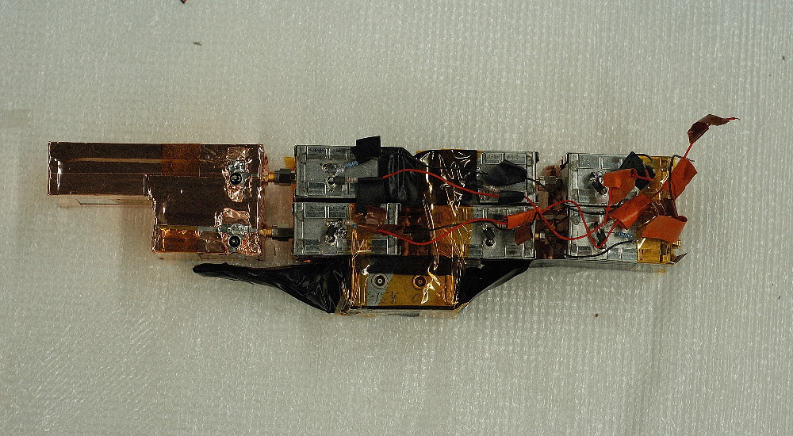
Prototypes ….

Slide 10
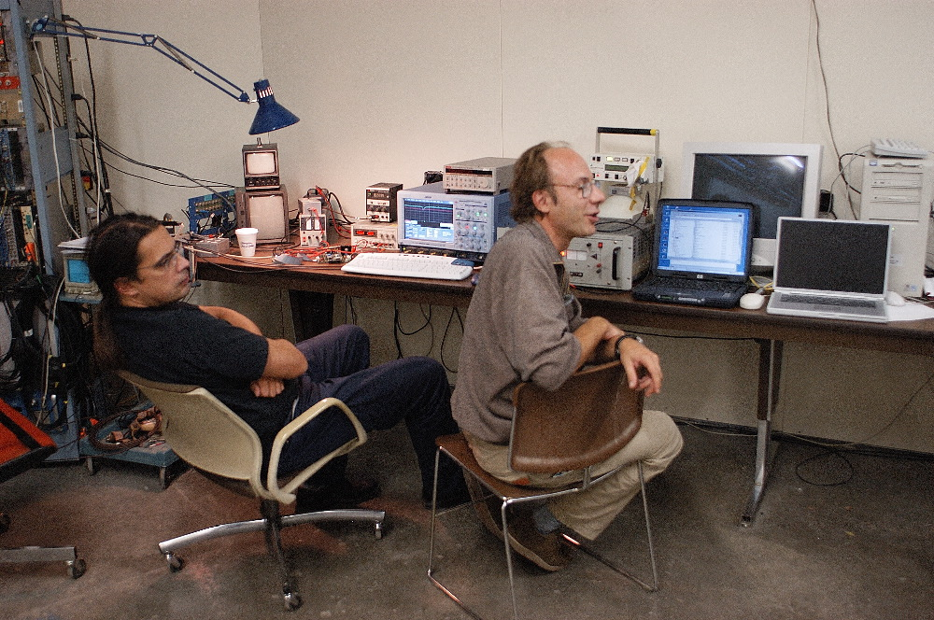
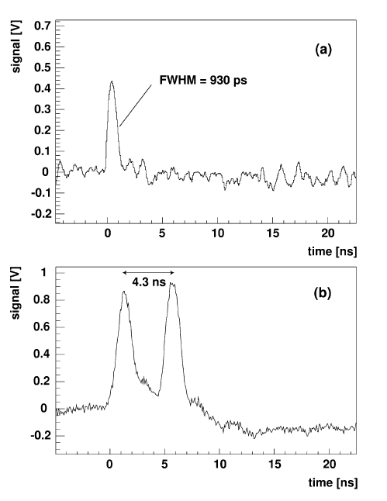
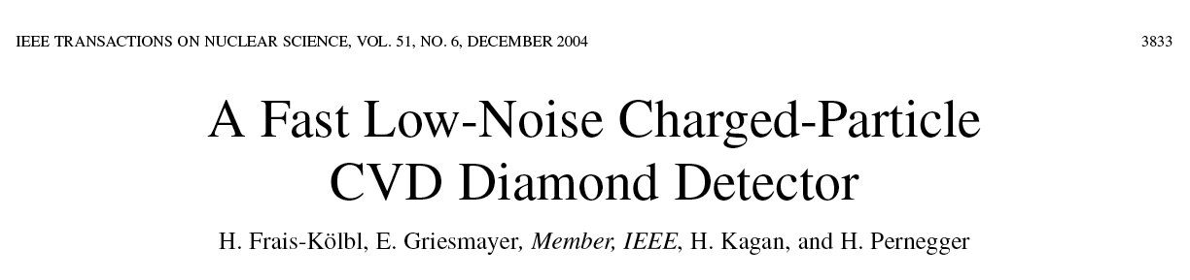
25.11.2003 Bloomington
Bloomington, indiana

Slide 11
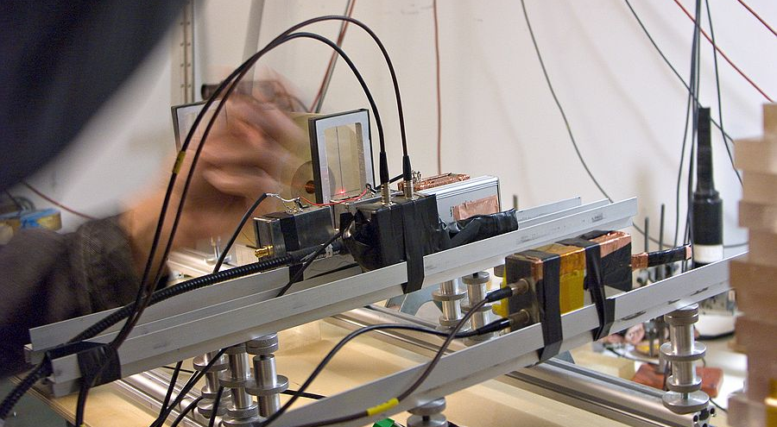
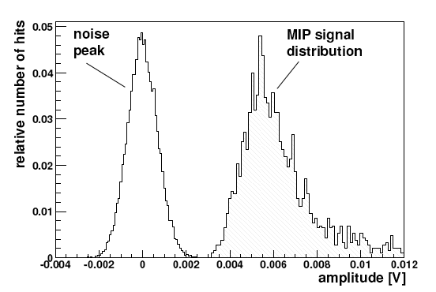
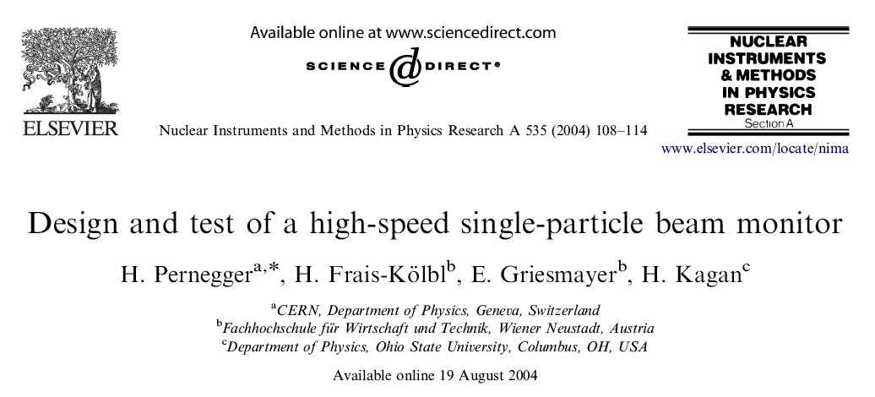
2004 MIT
MIT, MGH

Slide 12
2004 – ATLAS BCM
2004: First diamond detector at CERN for the ATLAS experiment.

Slide 13


Slide 14
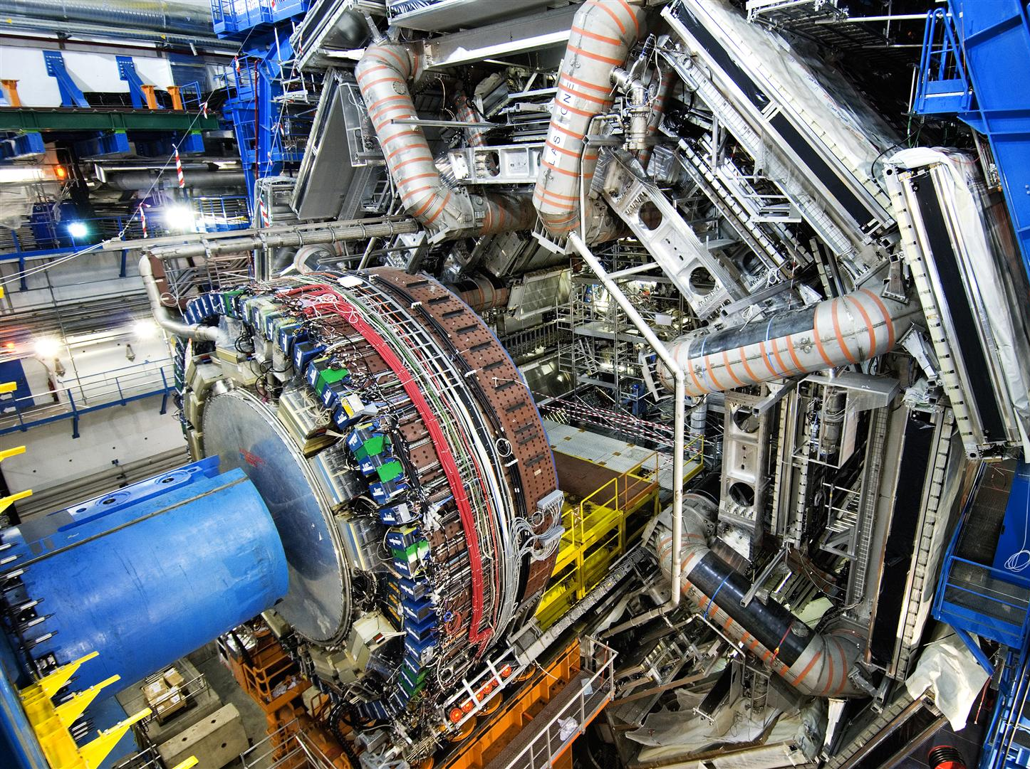

Slide 15
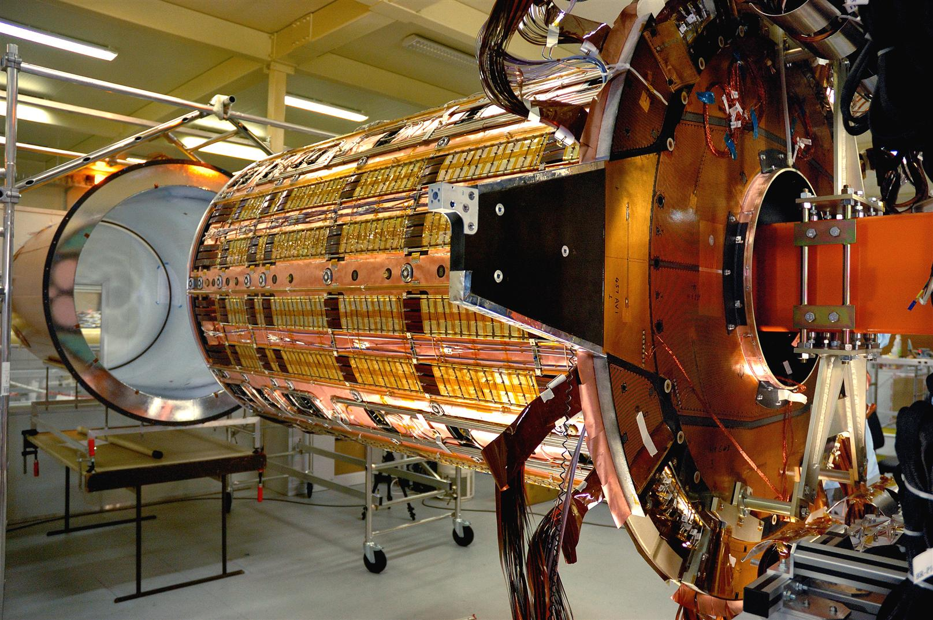
ATLAS inner detector

Slide 16
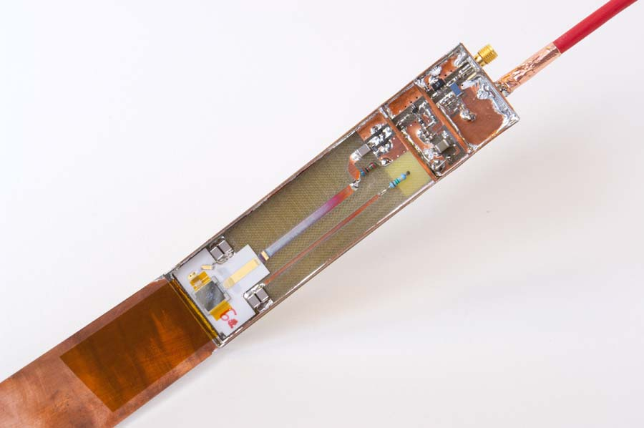
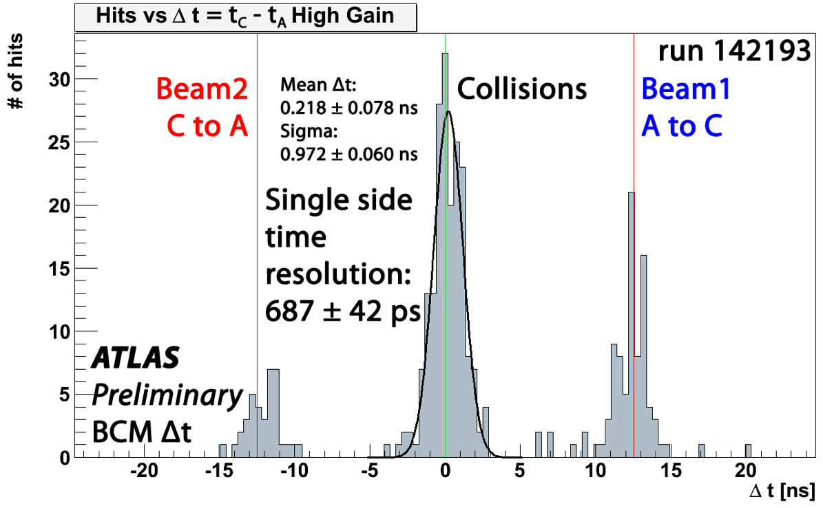
ATLAS BCM
CERN, ATLAS
Bunch-by-bunch analysis of LHC
collisions and background
Courtesy H. Pernegger

Slide 17
Beam Loss Monitoring
2010: Diamond Beam Loss Monitor for the LHC accelerator at CERN for machine protection purposes.

Slide 18
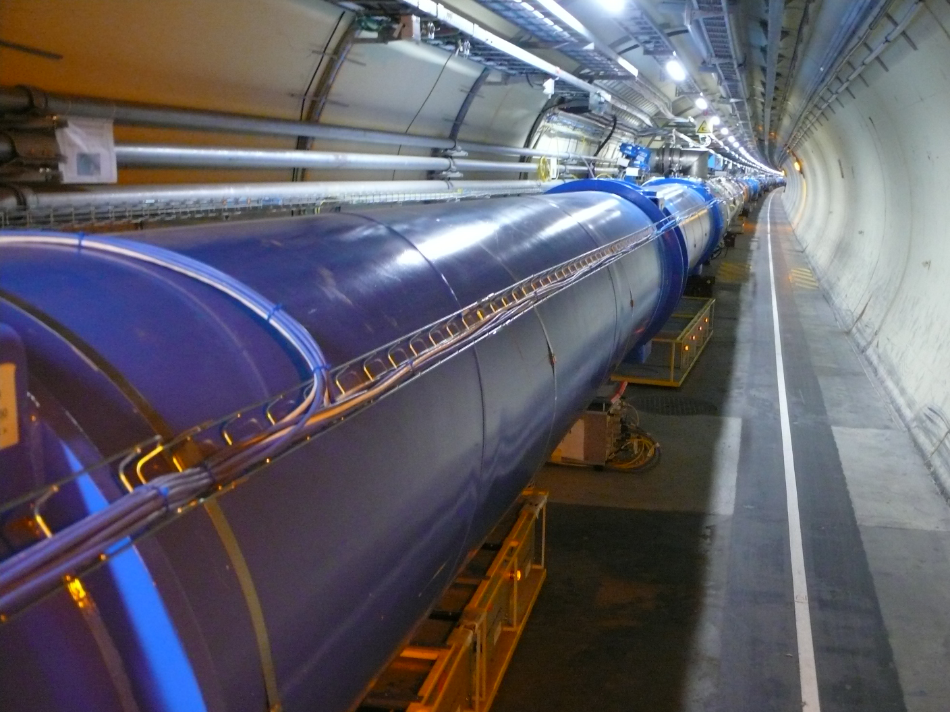

Slide 19

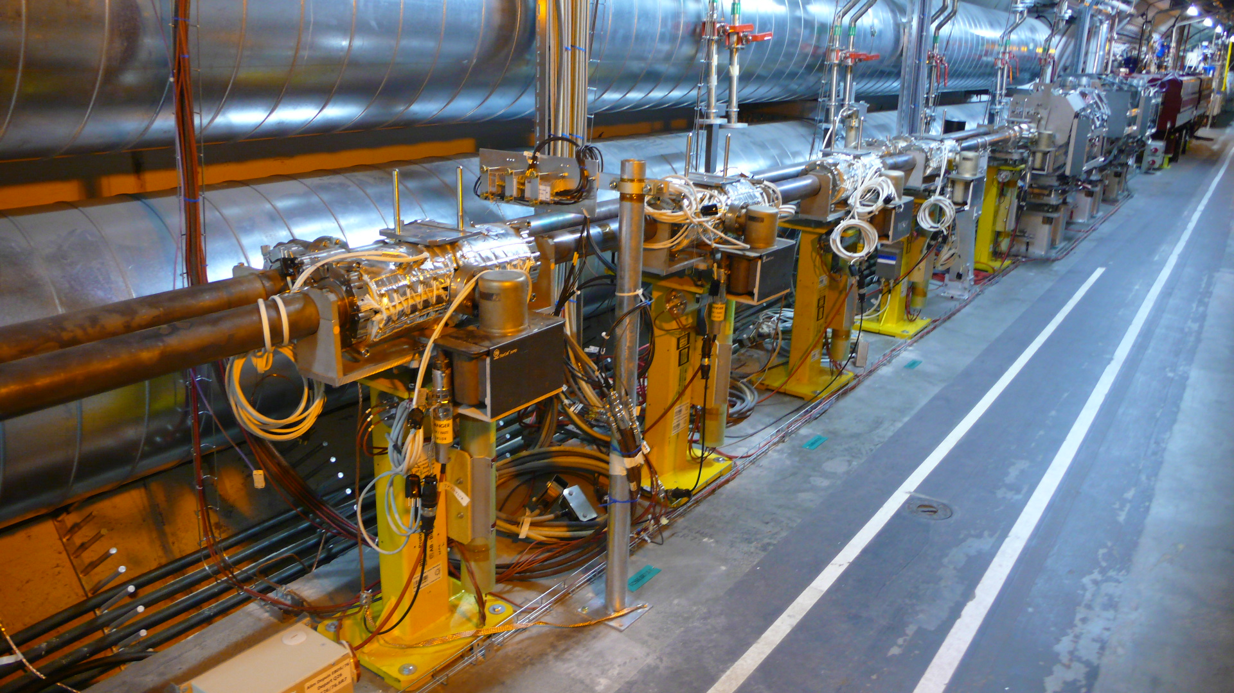
LHC Diamond Beam Loss Monitors
CERN, LHC
CERN LHC IP 7

Slide 20
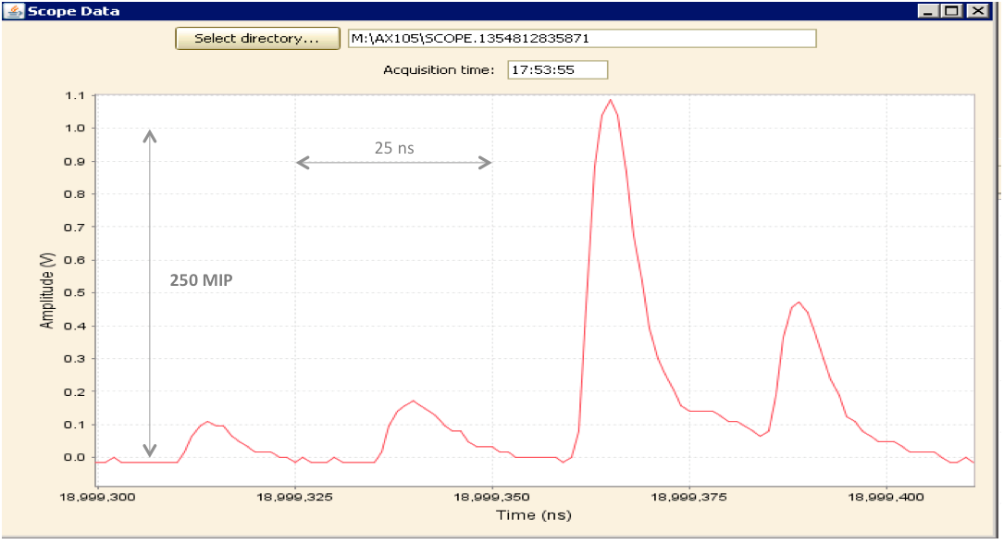
Bunch-by-bunch losses
CERN, LHC
Pulse shape of losses, 25 ns bunch separation, 0.8 ns sampling period.
Courtesy T. Baer

Slide 21
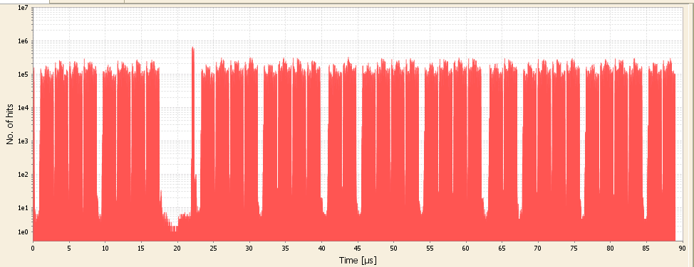
Static operation
CERN, LHC
12 pilot bunches
3 us beam abort gap
1 us LHC injection gap
0.2 us SPS injection gap
Static losses after ramp - 90 us turn period
Batches of 4x36 bunches, 3 us beam abort gap, injection gaps: LHC = 1 us, SPS = 0.2 us
12 pilot bunches
Courtesy T. Baer

Slide 22
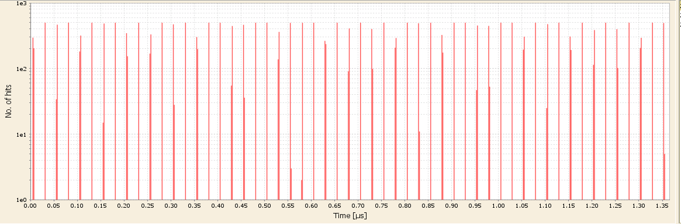
Bunch-by-Bunch Losses
CERN, LHC
# of Losses
1 ns time resolution
Time = Phase
Time loss histogram as recorded with the 40 MHz bunch clock signal, 25 ns loss separation, 1.2 ns time resolution

Slide 23
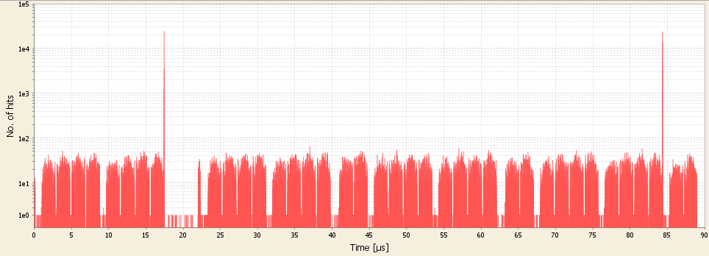
Single-Bunch Instability
CERN, LHC
Single-bunch instability
Single-bunch instabilities at the end of a squeeze
Courtesy T. Baer

Slide 24
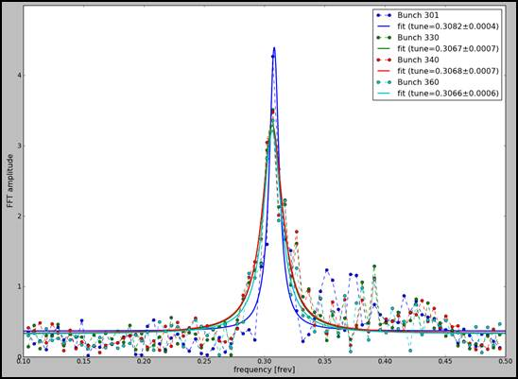
Tune measurement
CERN, LHC
Spectral Amplitude
Tune of a single LHC bunch
Frequency
Horizontal tune = 0.307. Resolution = 10⁻³. Reference tune: BBQ = 0.307.
Courtesy T. Baer

Slide 25
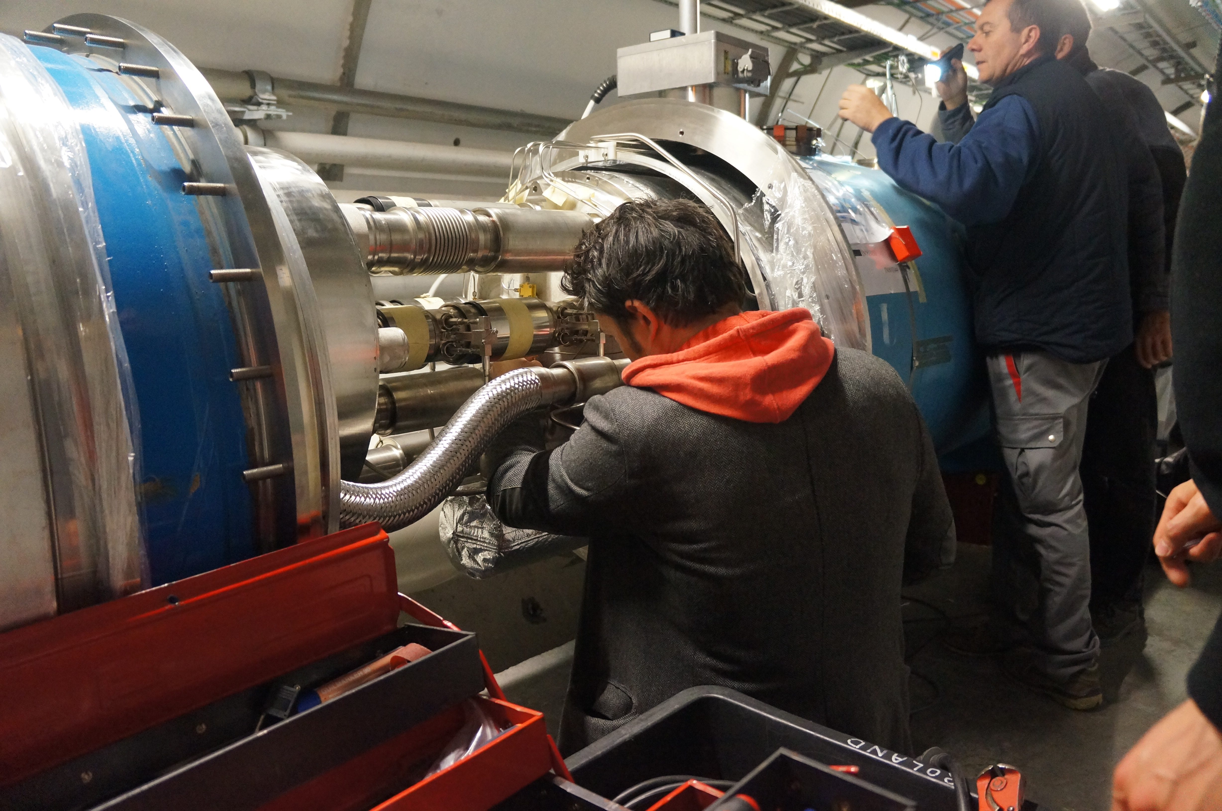
Cryogenic detector: LHC Quadrupole

Slide 26
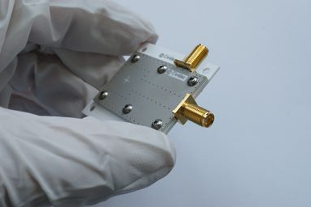
Cryogenic Diamond Detector
Operated inside the LHC quadrupoles
at 20 K and UHV conditions

Slide 27
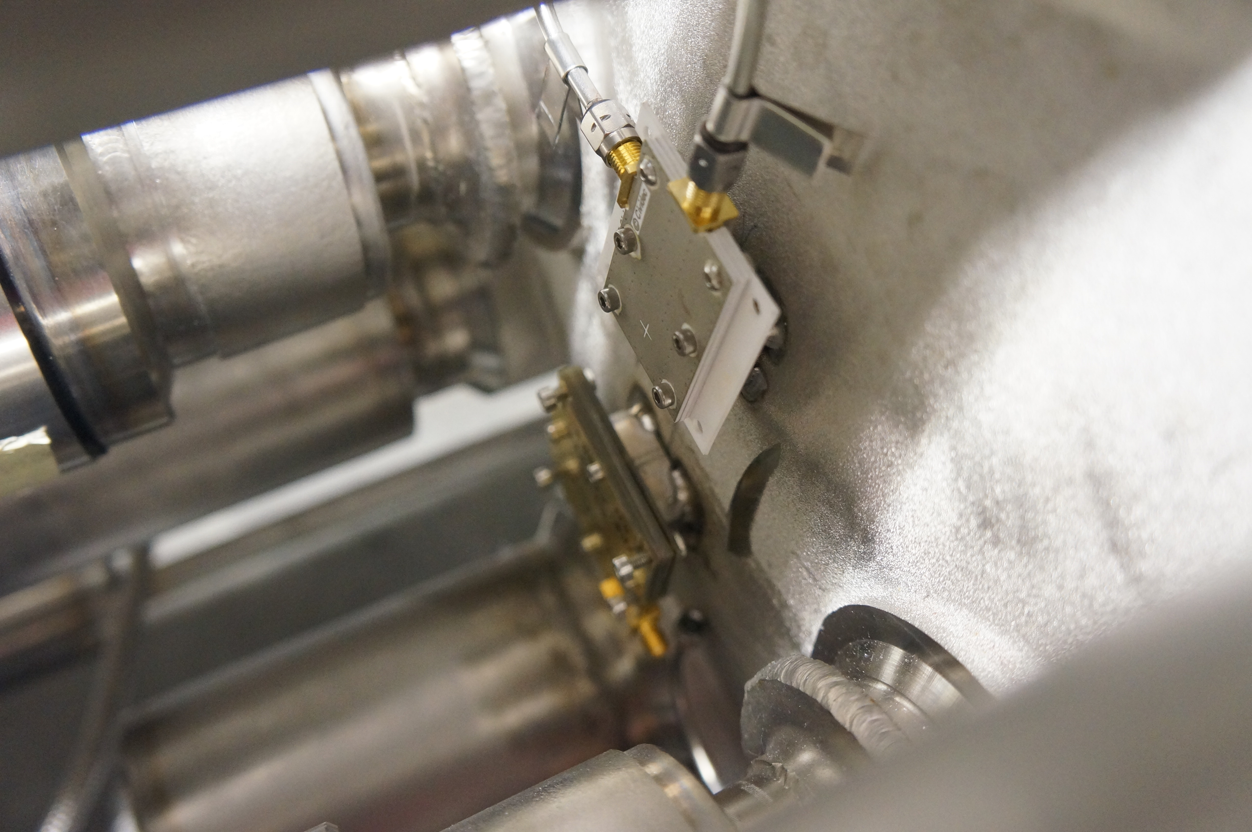
LHC Quadrupole
20 K
10⁻⁴ mbar

Slide 28
Speed-of-Light
2012: Verification of the speed of light at the CNGS experiment at CERN.

Slide 29
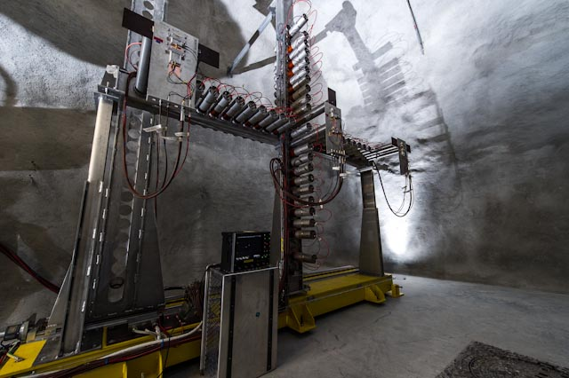
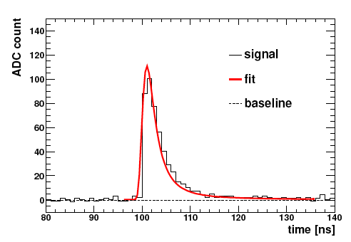
Time resolution
CERN, CNGS
14.6 ns time resolution
Courtesy H. Jansen

Slide 30
Medical application

Slide 31
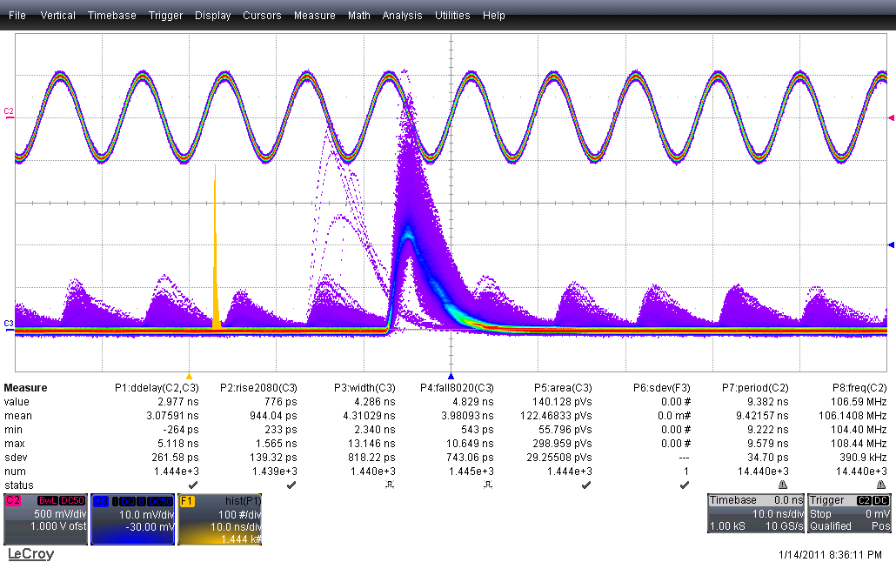
RF Structure
IBA, LLN
RF = 106 MHz (9.4 ns period)
ϕ
Detector signal (3 ns FWHM)

Slide 32
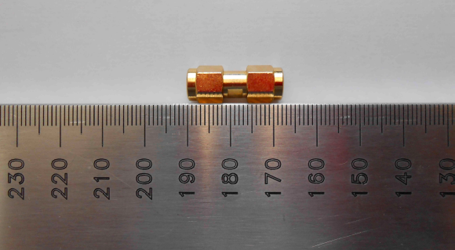
Time resolution
20 ps

Slide 33
High-Radiation Detector

Slide 34
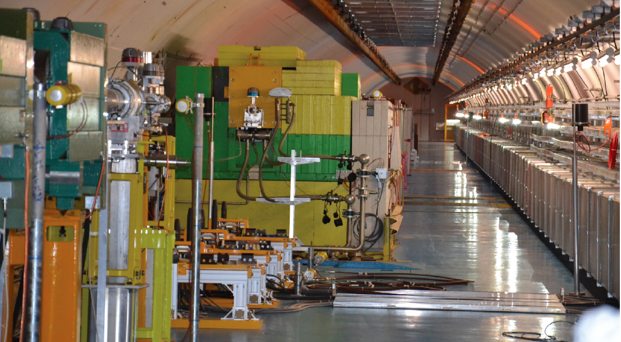
HiRadMat
Courtesy F. Burkart

Slide 35
HiRadMat
1x10⁹ protons per bunch
Courtesy F. Burkart

Slide 36
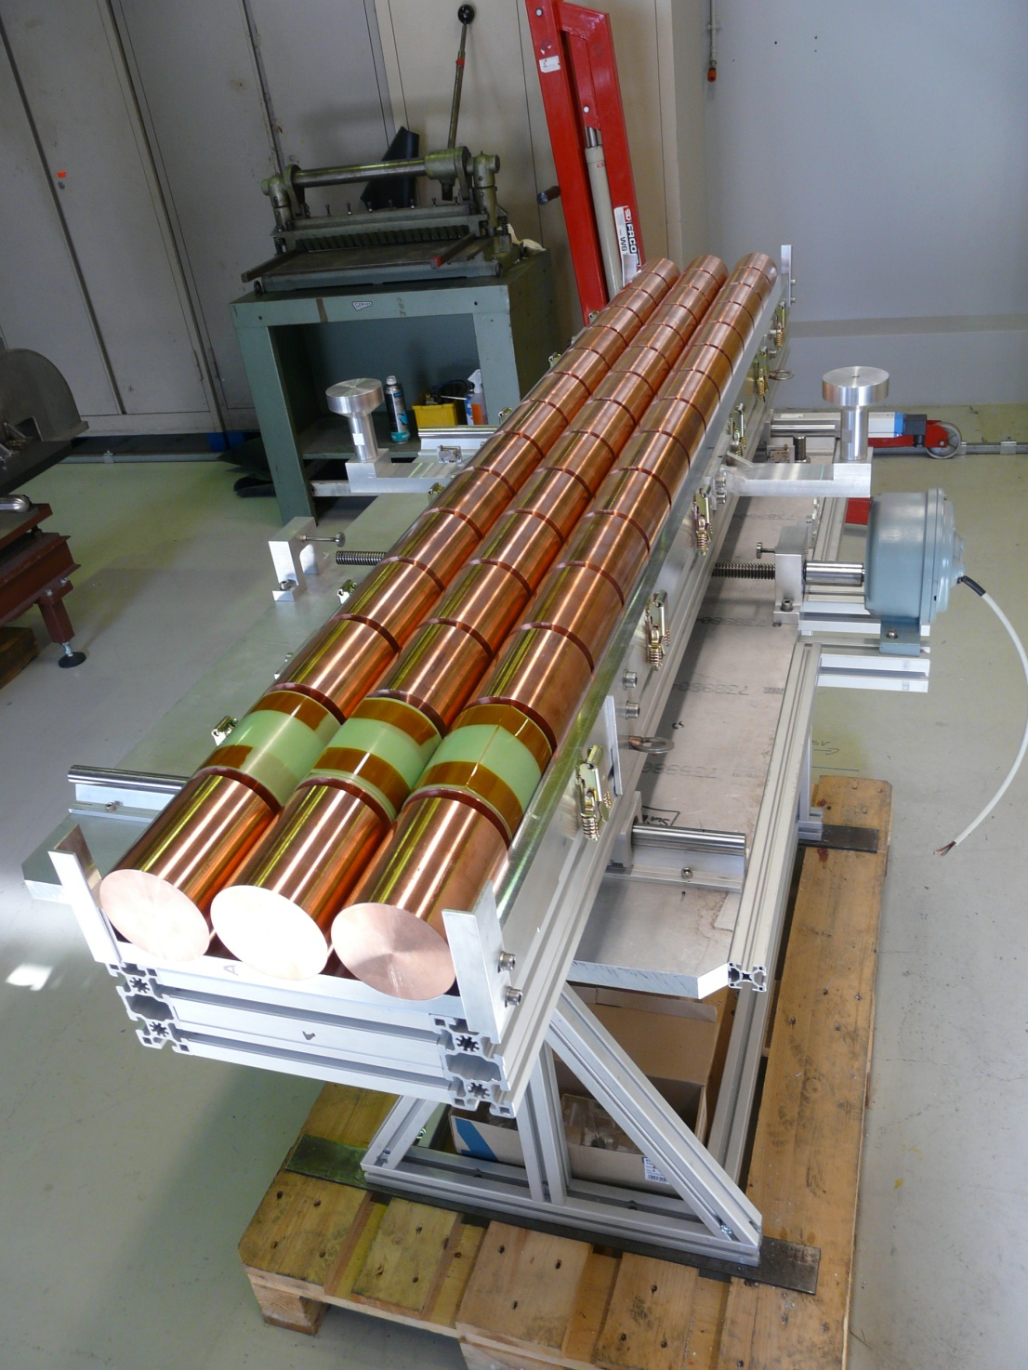
Target
Courtesy J. Sanchez

Slide 37
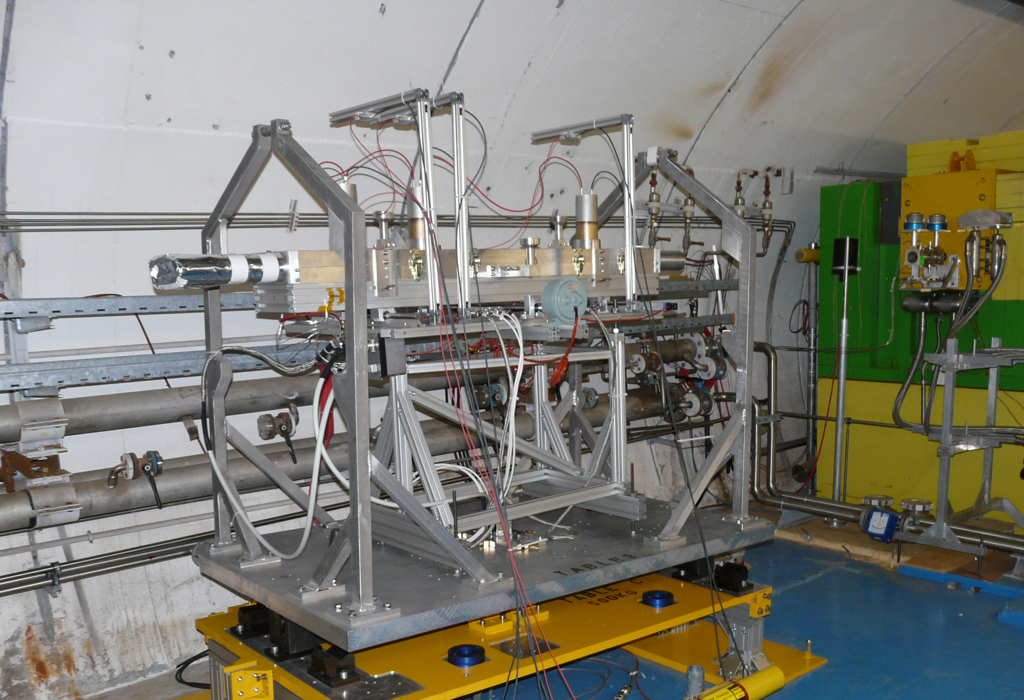

1x10⁹ protons per bunch
Courtesy D. Deboy

Slide 38
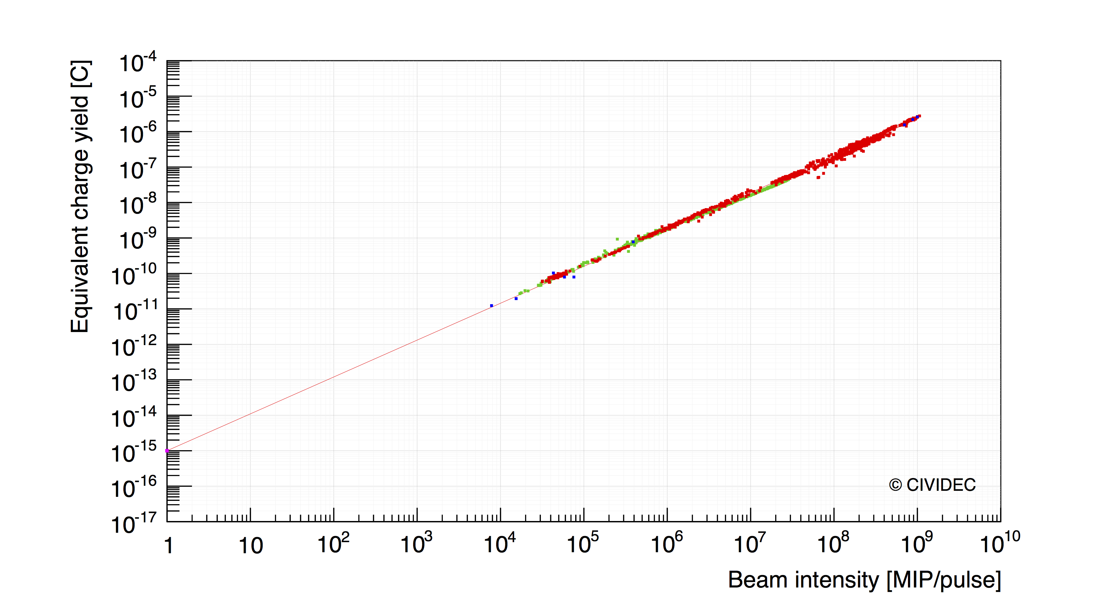
Linearity
HiRadMat
Frascati
CNGS
LHC
Lab source
HiRadMat
Daphne
CNGS
LHC DBLM
Courtesy F. Burkart, O. Stein

Slide 39
Content
Past
Presence
Future

Slide 40
Neutrons

Slide 41
Innovation
Neutron spectroscopy for the n_TOF facility at CERN.

Slide 42
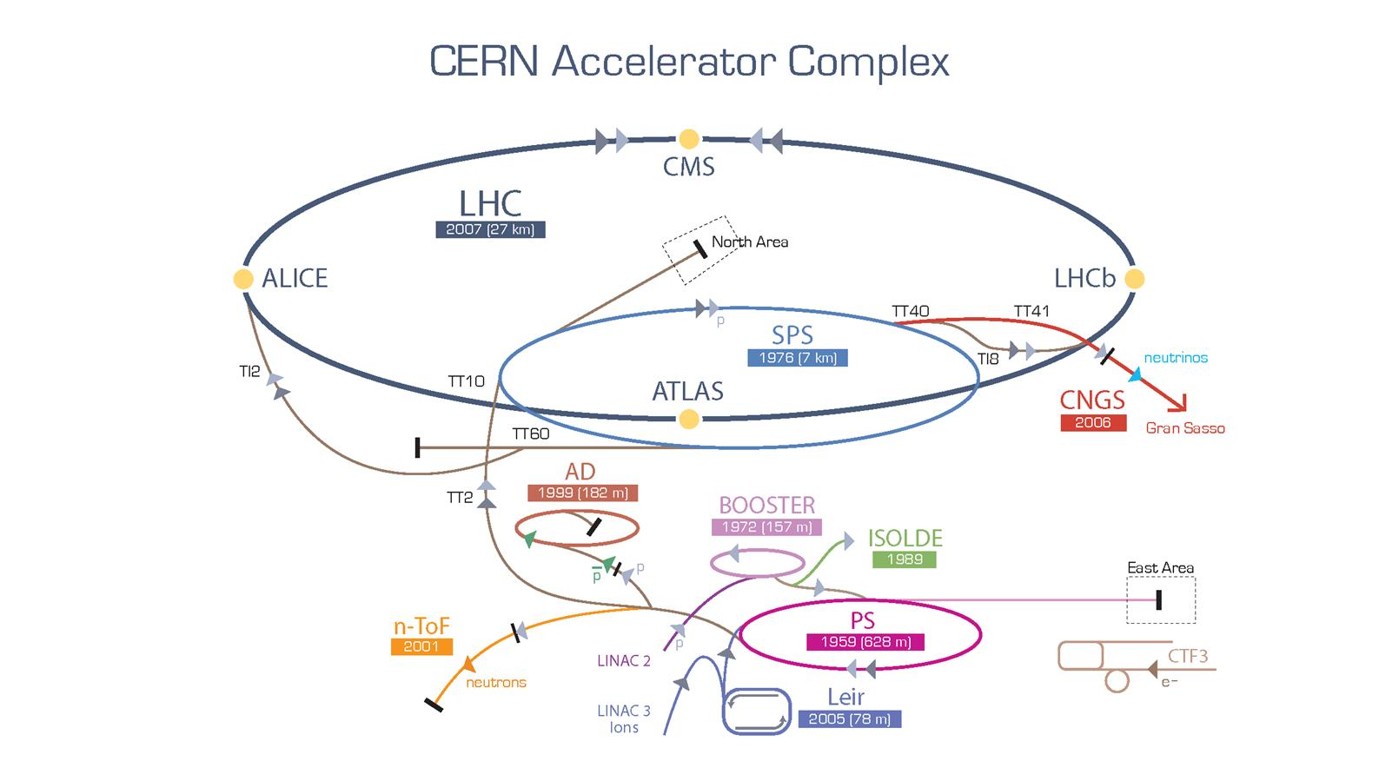
n_TOF Facility

Slide 43
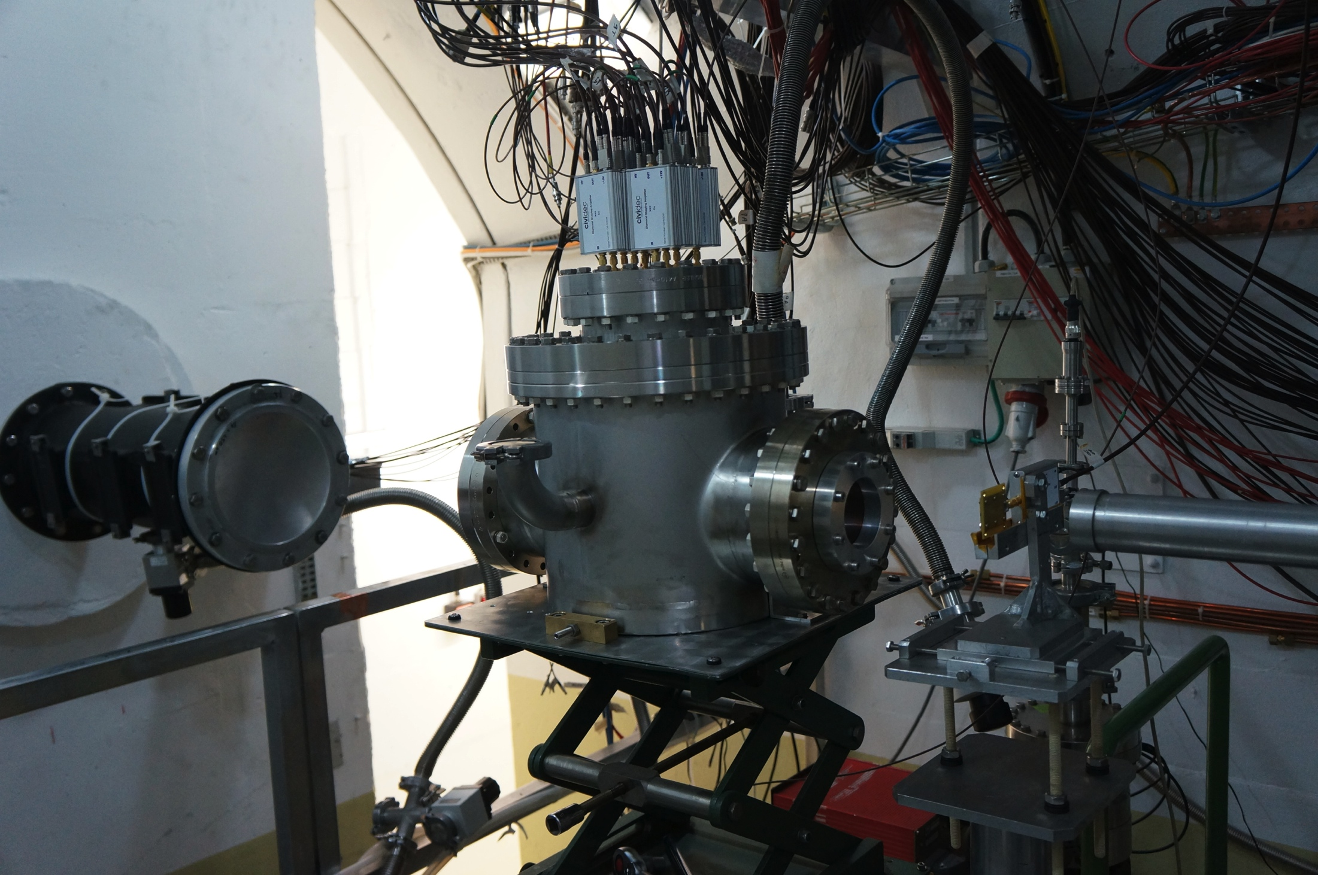
n_TOF at CERN
Spectroscopic amplifiers
Neutrons
Vacuum Chamber

Slide 44
CERN n_TOF facility
Neutrons
Protons
Neutrons
Pb-target
Diamond detector
200 m

Slide 45
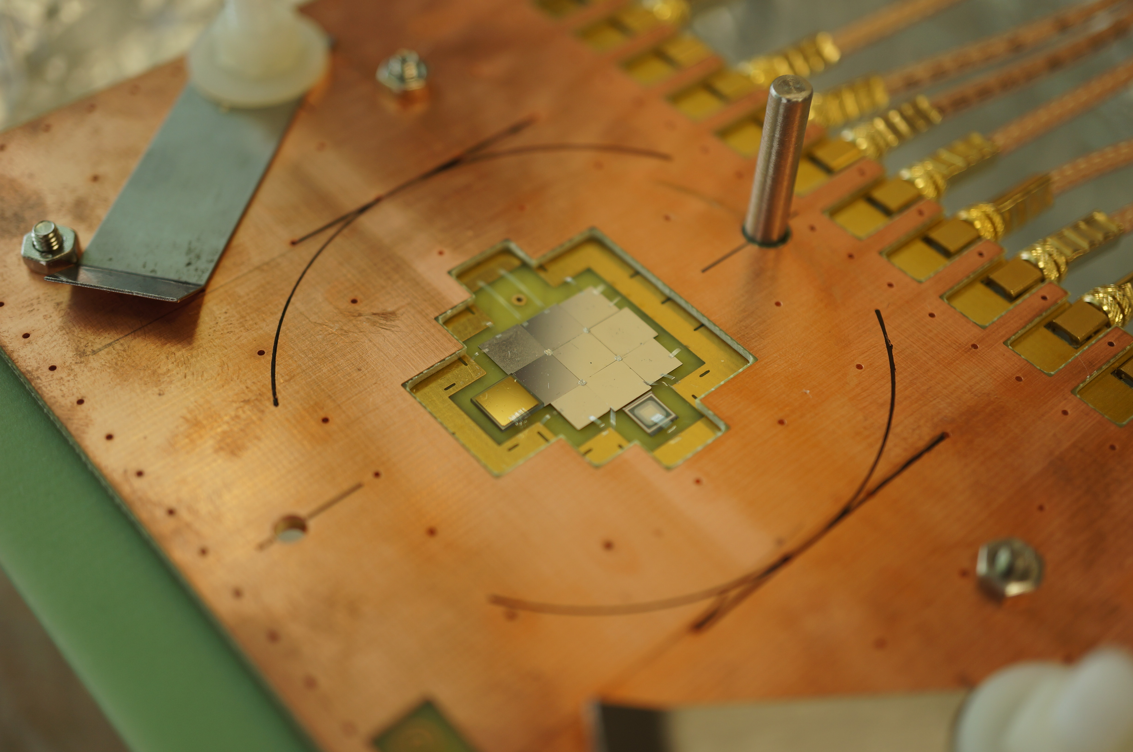
Diamond-Mosaic Detector

Slide 46
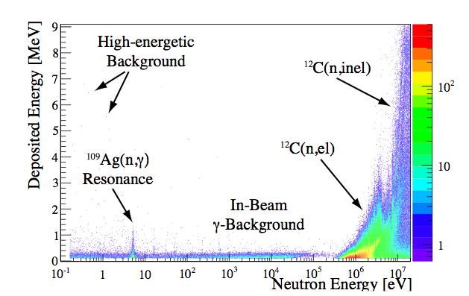
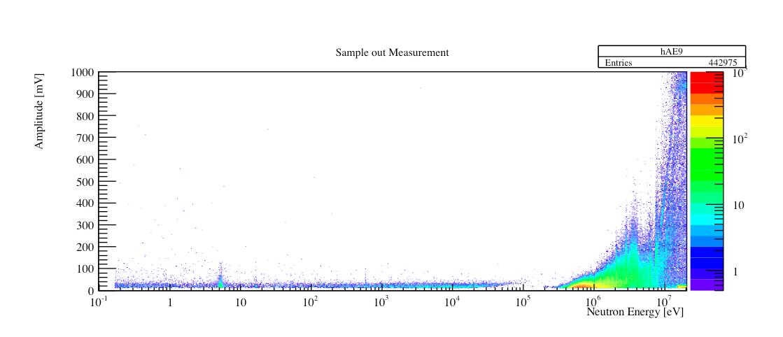
Energy spectrum
CERN, n_TOF
Courtesy C. Weiss

Slide 47
Neutron interaction in diamond
CERN, n_TOF
Courtesy C. Weiss

Slide 48
Vienna TRIGA MARK-II research reactor

Slide 49
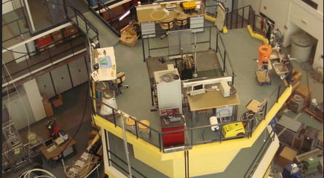
TRIGA MARK-II research reactor

Slide 50
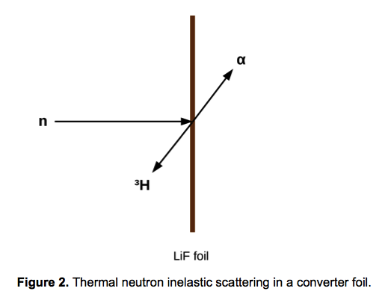
Li - conversion
γ

Slide 51
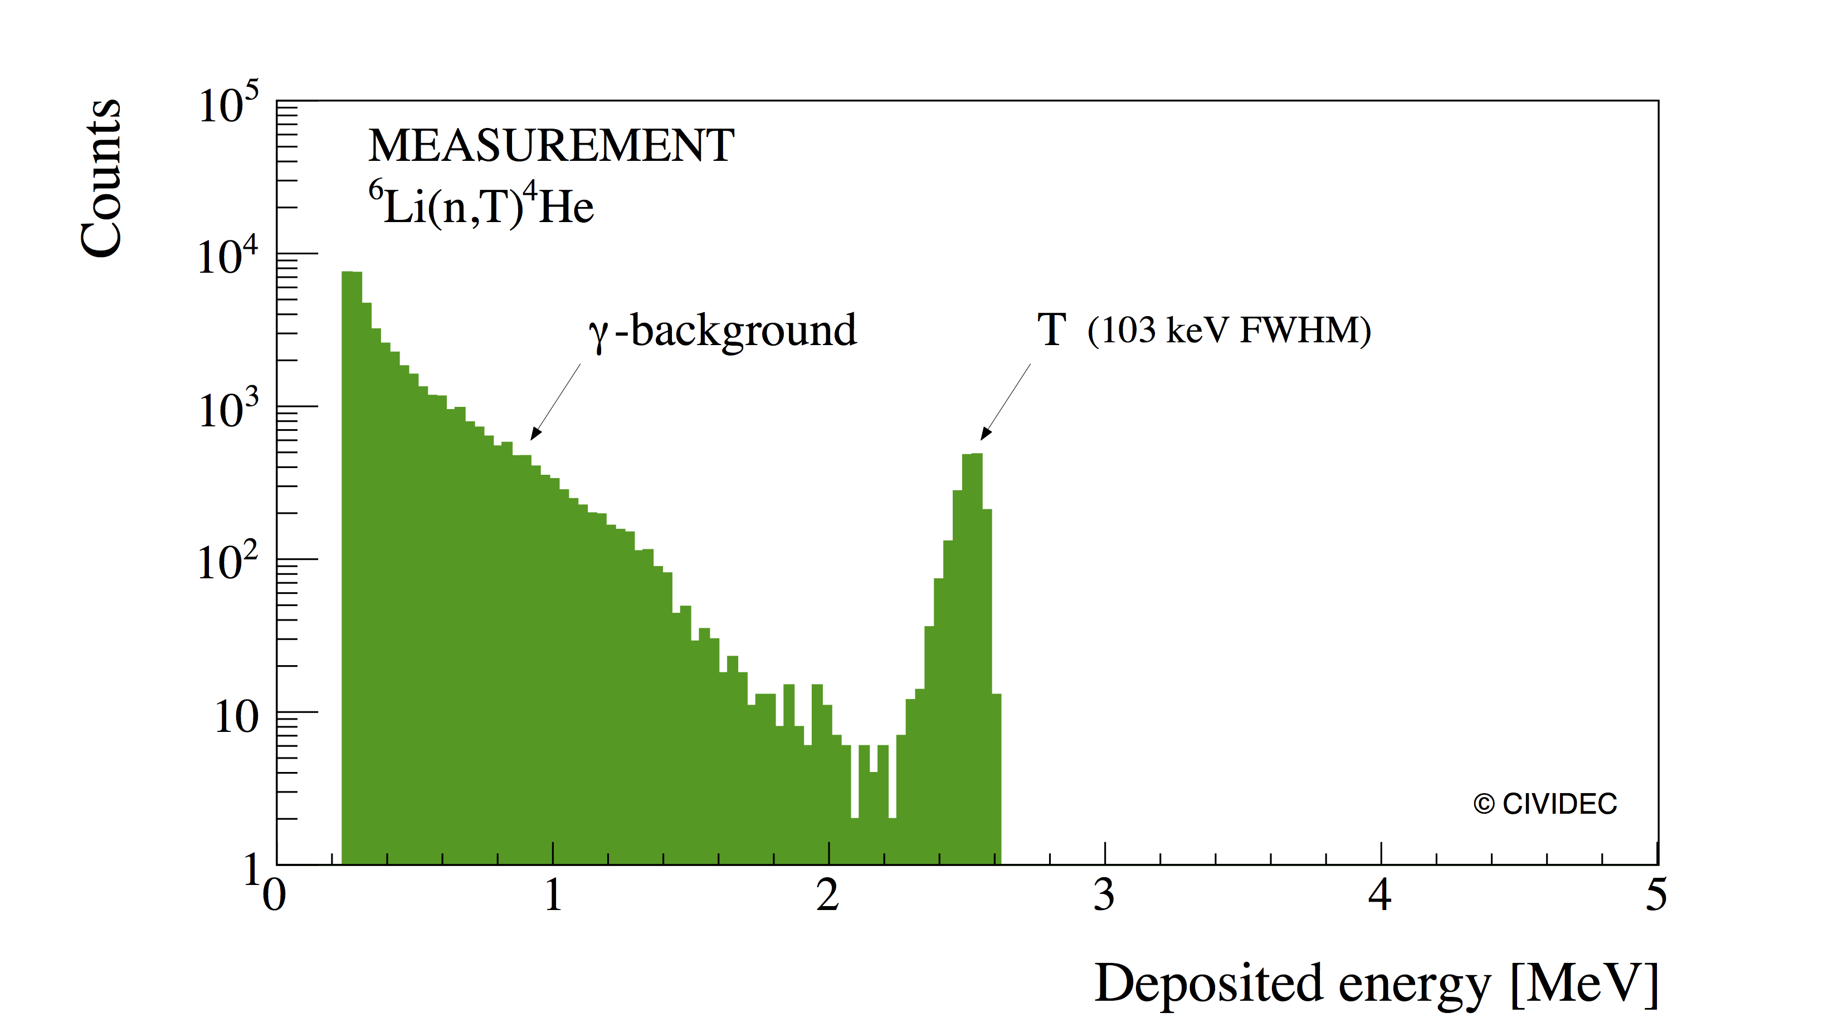
Tritons + gammas
TU Wien, ATI
Conventional spectroscopy
Tritons
Gamma
background
Courtesy P. Kavrigin

Slide 52
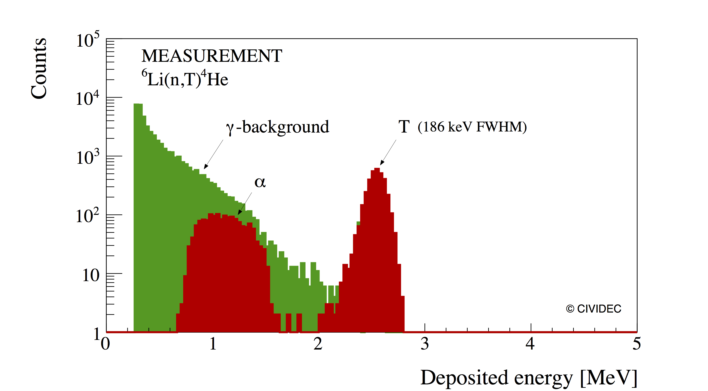
Tritons + alphas + gammas
Selective spectroscopy
Courtesy P. Kavrigin

Slide 53
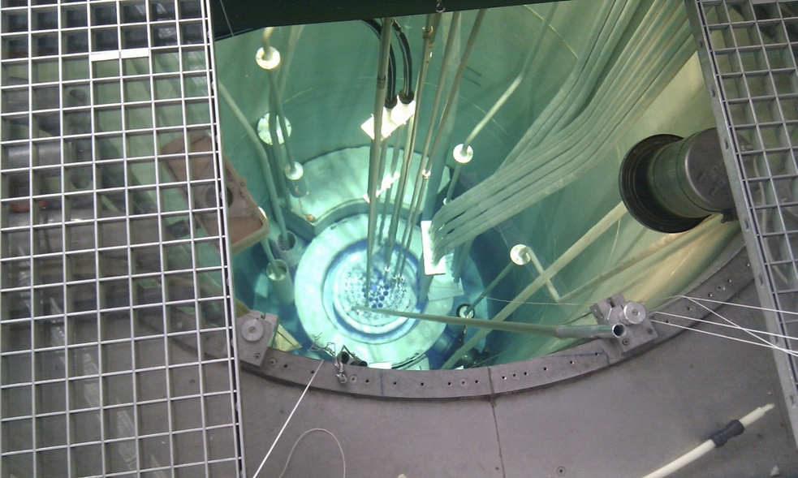
Reactor core

Slide 54
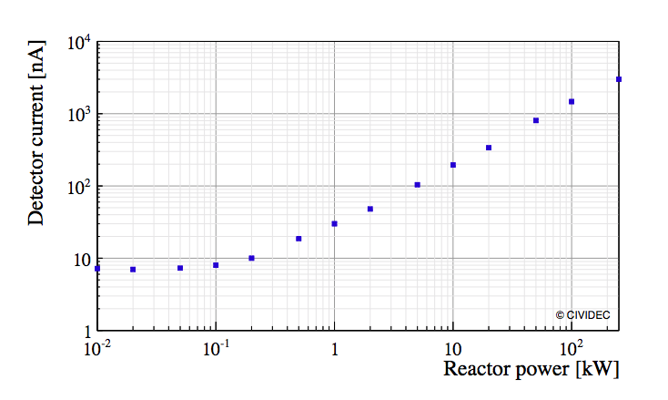
Detector response
TU Wien, ATI
Courtesy B. Morgenbesser

Slide 55
14 MeV Neutrons

Slide 56
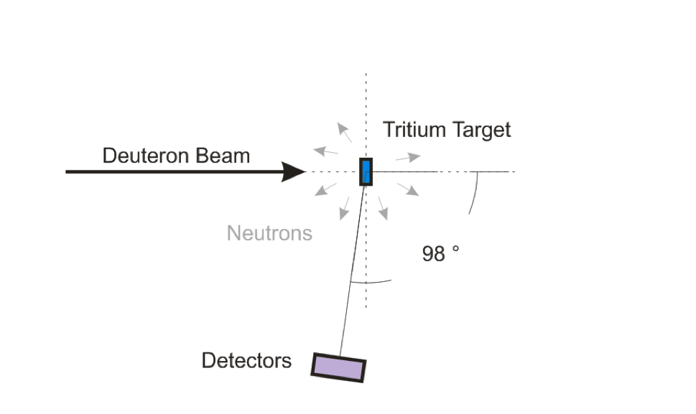
Van de Graaf
IRMM, Belgium
PTB Braunschweig, Germany
IRMM Geel, Belgium
14 MeV neutrons
200 keV FWHM
Courtesy C. Weiss

Slide 57
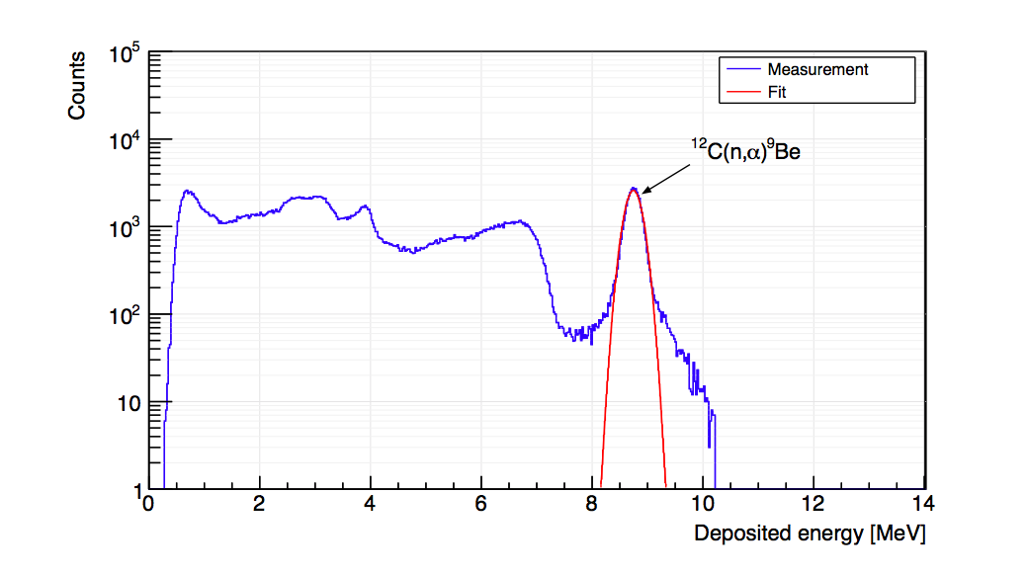
14 MeV neutrons
IRMM, Belgium
Courtesy C. Weiss

Slide 58
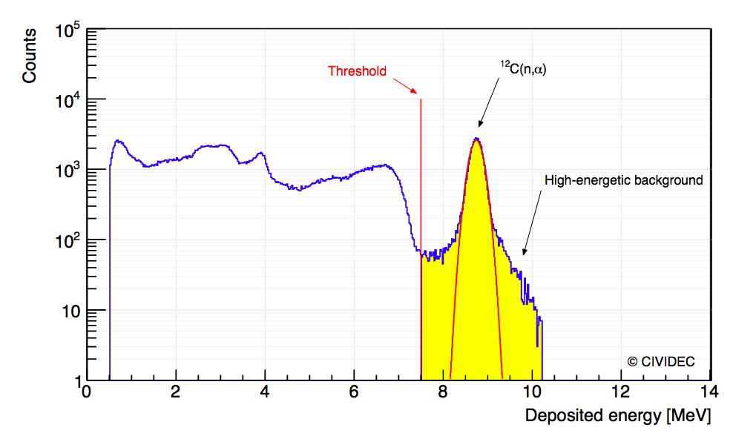
14 MeV neutrons
IRMM Geel, Belgium
Amplitude trigger
Courtesy C. Weiss

Slide 59
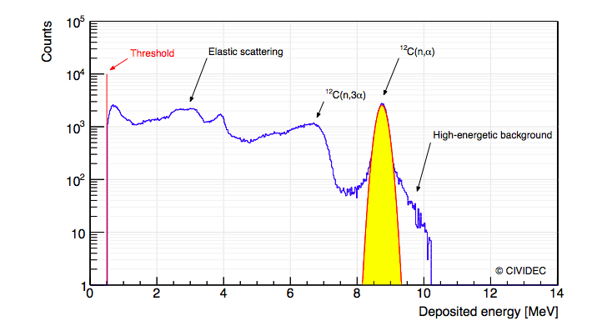
14 MeV neutrons
IRMM Geel, Belgium
Selective spectropscopy
Courtesy C. Weiss

Slide 60
X-Rays

Slide 61
Innovation
X-ray BPM for the Diamond Light Source, UK.

Slide 62
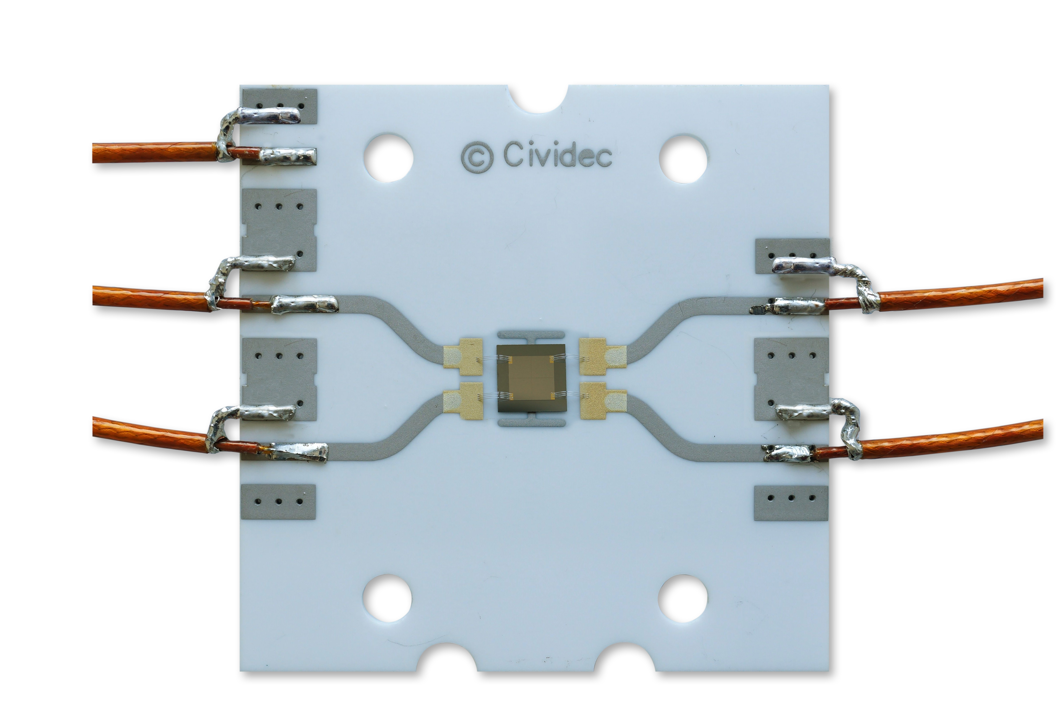
XBPM

Slide 63

Chris Bloomer & B16
Diamond Light Source

Slide 64

XBPM
Diamond Light Source

Slide 65

Detector linearity
Diamond Light Source
34 nA measured
36 nA calculated
Perfect linearity
I[A] = 0.06 ∙ P [W]
Courtesy C. Bloomer

Slide 66

Position response
Diamond Light Source
Courtesy C. Bloomer

Slide 67

Beam position
Diamond Light Source
Calculated beam position
Courtesy C. Bloomer

Slide 68

Position resolution
Diamond Light Source
10⁻²
10⁻³
2 nm
10⁻⁴
Courtesy C. Bloomer
Notes:
In this simple case of a square beam, to convert the Δ/Σ signal imbalance into a real beam position one must multiply it by 0.5×beamsize.

Slide 69

Linear range
Courtesy P. Kavrigin

Slide 70
Content
Past
Presence
Future

Slide 71
Interviews
D. Twitchen, Element Six Ltd
Prof. D S Misra, IIa Technologies Singapore
Jeremy Brison, IBA, Proton Therapy
Bernd Dehning, CERN BI
L. Vitale, INFN Trieste, BELLE and SUPERKEKB
M. Tardocchi, CNR Milano
P. Bergonzo, CEA Saclay
J. Marroncle, CEA, IFMIF

Slide 72
Diamond producing industry
X1
D. Twitchen, Element Six Ltd.
Challenges and opportunities in high-energy phyiscs, medical dosimetry and neutron measurements
Few skilled intermediates like CIVIDEC who had relevant application know-how and device experience to turn a diamond into a detector.
Assuming strong commercial model sCVD detectors with area >25 mm will be available in 3-5 years.

Slide 73
Diamond producing industry
X2
Prof. D S Misra, IIa Technologies Singapore
"The pace of CVD diamond research in growth and application is quickening with new researchers and new suppliers on the horizon.
I visualize appearance of the large sCVD plates of 1cm x 1cm with very high crystalline quality appearing soon.”

Slide 74
Industry
X3
Jeremy Brison, IBA, Proton Therapy
“There is an interesting idea on the use of diamonds to measure directly the beam energy of synchro-cyclotrons, but I have to wait an info from our IP department to know if it’s patentable.”

Slide 75
Beam diagnostics
X4
Bernd Dehning, CERN BI
Radiation hardness
Dynamic range
Time resolution & Counting rate
Cryogenic & compact
Beam observations and not in equipment protection.

Slide 76
Experiments
X5
L. Vitale, INFN Trieste, BELLE and SUPERKEKB
Cope with unprecedented luminosity of 8x10³⁵ cm⁻²s⁻¹.
Monitor radiation rate and radiation dose.
Fast response for system protection.
Diamonds next to interaction regions.

Slide 77
Neutron diagnostics
X6
M. Tardocchi, CNR Milano
Used for DD and DT fusion reactions
Used for spallation processes.
High counting rates, high energy resolution, compact size, gamma discrimination.

Slide 78
Dosimetry
X7
P. Bergonzo, CEA Saclay
Solid market for dosimetry (real-time, tissue equivalent, good signal).
Unpredictable market for synchrotron beam monitoring (one device per beam line due to high stability & life-time).
No market for nuclear plants: diamonds will never match ionization chamber.

Slide 79
New neutron facilities
X8
J. Marroncle, CEA, IFMIF
“New beam facilities are arriving on the market, like neutron sources.
Not easy to manage, in particular in the first stages, fighting space charge at low energies.

Slide 80
New neutron facilities
X8
J. Marroncle, CEA, IFMIF
„…. beam dynamics physicists from Saclay have demonstrated that new ways are necessary for …. ”
... which is a good example where ....

Slide 81
.... Beam Dynamics meets Diagnostics ....
Thank you for your attention!

