Slide 1
Single Particle Detection
with a Resonant Cavity
Markus Steck, GSI Darmstadt

Slide 2
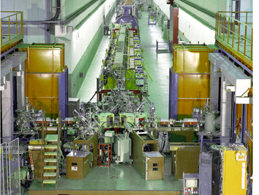
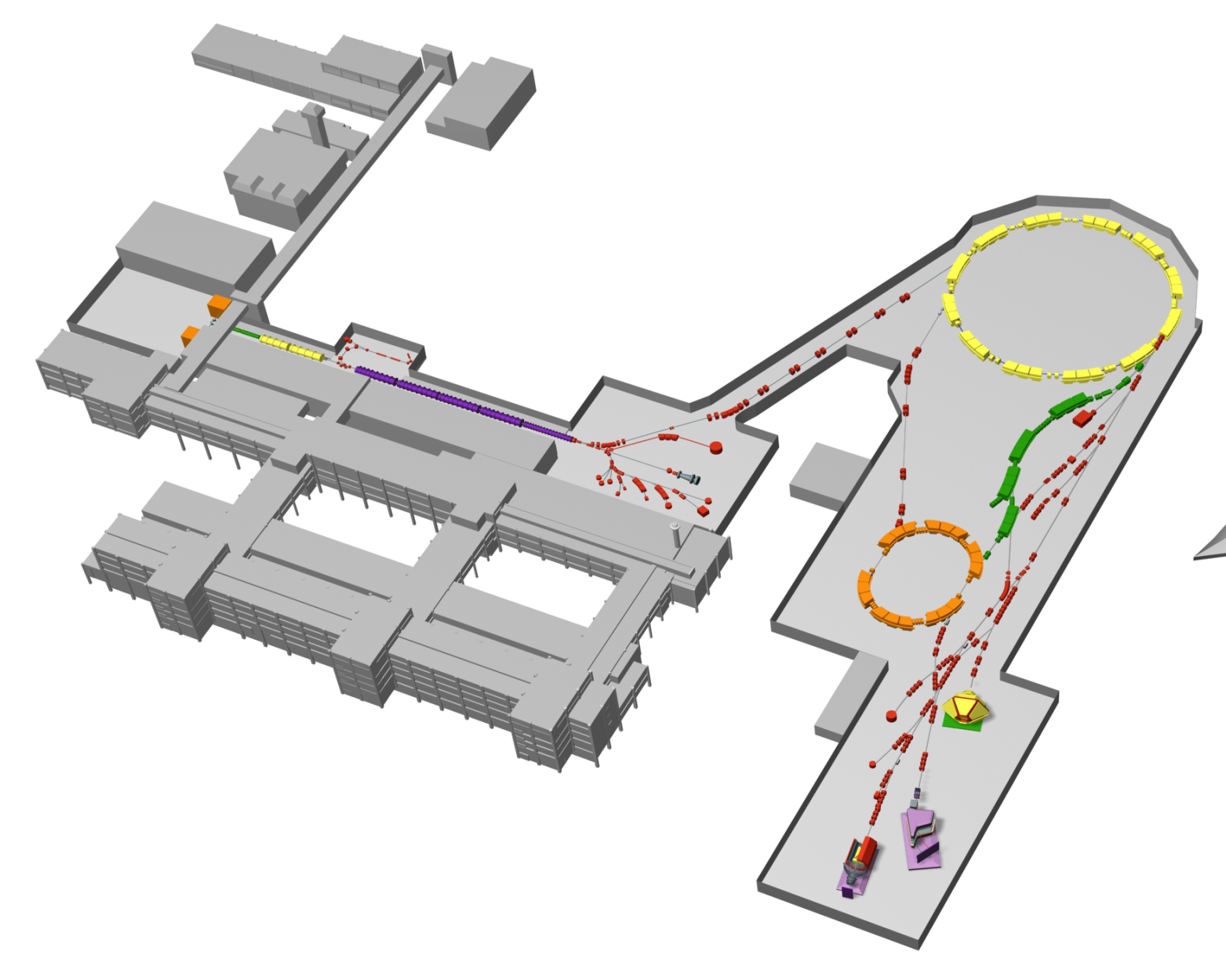
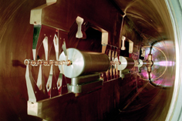
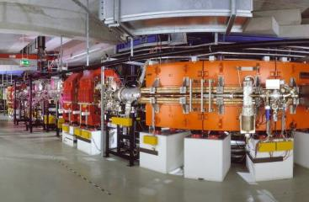
The GSI Accelerators:
UNILAC, SIS18 and ESR
Ion sources
SIS-18
upgrade
for FAIR
SIS18
UNILAC
FRS
IH structure
beams to SIS100
ESR
2

Slide 3
The ESR Storage Ring
Storage of stable ions and RIBs
in the energy range 3-550 MeV/u
Stochastic cooling ( ≥ 400 MeV/u)
Electron cooling ( 3 - 430 MeV/u)
Internal gas jet target
Deceleration (down to 3 MeV/u)
Fast and slow extraction
Beam accumulation
Multi charge state/
multi component operation
Schottky mass spectrometry
Isochronous mode

Slide 4
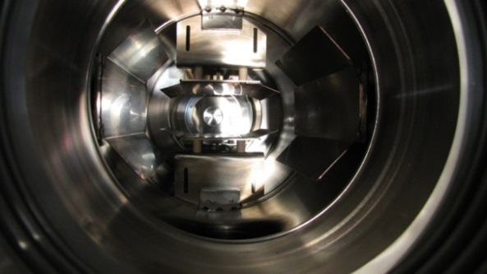
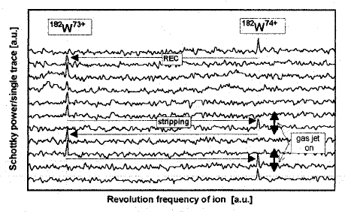
Single Particle detection in ESR
standard capacitive Schottky pick-up
broad band (∼ 1-150 MHz)
resonant circuit (30-80 MHz)
from GSI Scientific Report 1995
single ¹⁸²W ion
cooled by electron cooling
⇒ recombination 74+ → 73+
Interacting with internal target
⇒ ionization 73+ → 74+
Schottky signal power P = N (Qe)² f₀²

Slide 5
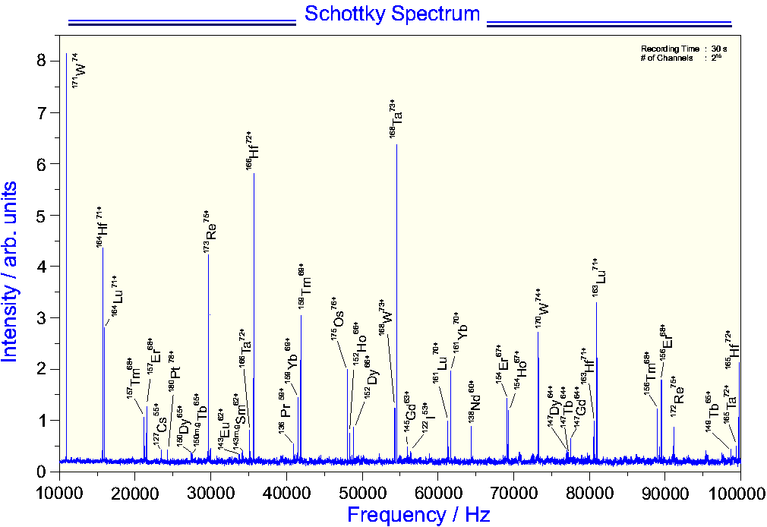
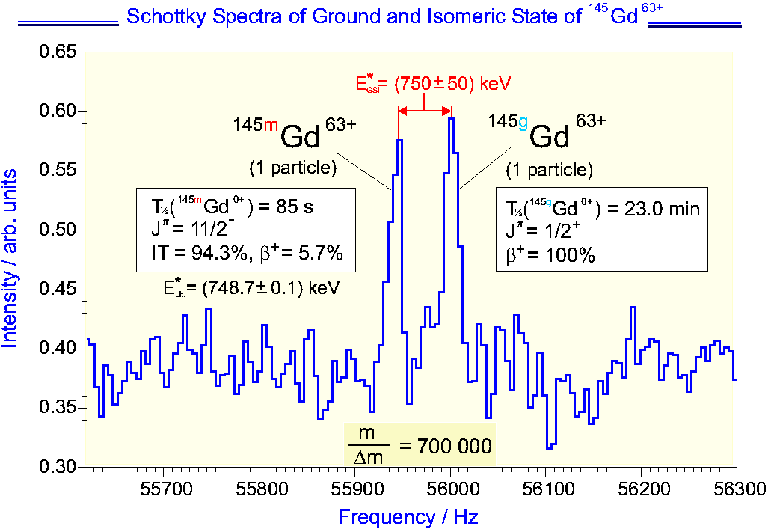
Schottky Mass Spectrometry
Injection of cocktail rare isotope beam from fragment separator FRS
Cooling (stochastic pre-cooling + final electron cooling)
Achieved momentum spread (δp/p = 5×10⁻⁷, δf/f = 2×10⁻⁷)
broad band spectrum
narrow band spectrum
Two single ions !

Slide 6
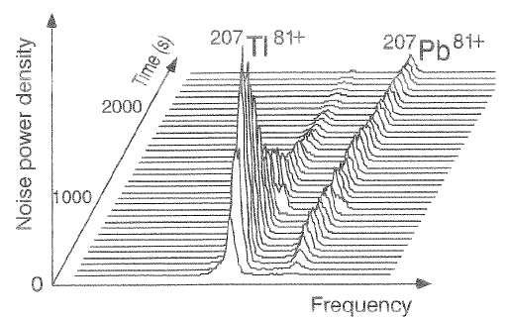
Radioactive Decay of a Single Particle
Schottky noise signal of rare isotopes after stochastic and electron cooling
frequency/Hz - 59950000
low signal to noise ratio
time resolution is limited
averaging over many seconds
from GSI scientific report 2000/2001

Slide 7
Design Considerations for a
Schottky Resonator in the ESR
increased sensitivity to single ions
faster detection of single ions
UHV compatibility
decoupling of the resonator from the beam at high intensity
variable resonant frequency
frequency band width up to one percent
choice of frequency
larger sensitivity <=> better time resolution
(lower frequency) (higher frequency)
mechanical dimensions of cavity

Slide 8
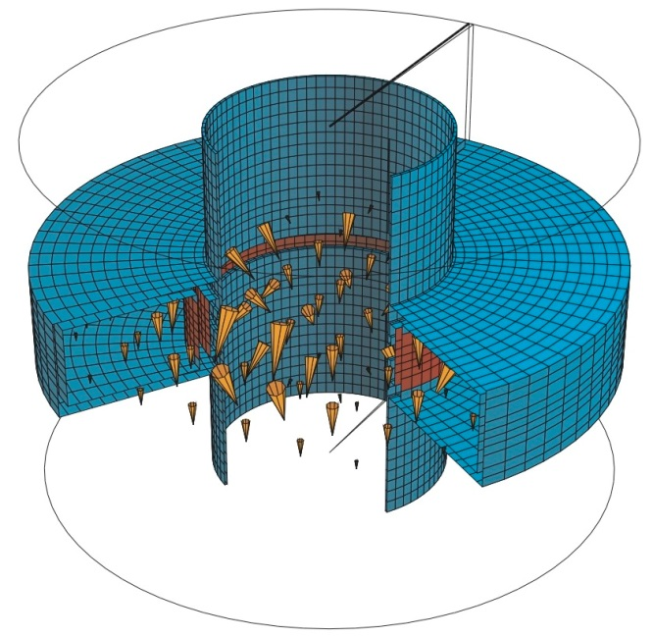
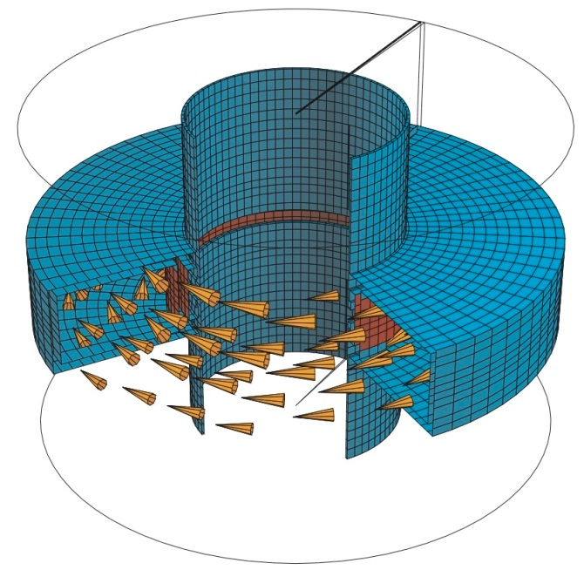
Pillbox Type Cavity
resonant frequency ∼ 244 MHz,
radius 30 cm
SUPERFISH
simulation
coupling to the
longitudinal electric field
generated by the particle
CST-MAFIA
simulation
TM010 mode
cylindrical
symmetry
magnetic field

Slide 9
Signal to Noise Ratio of a Single Particle
single particle power on resonance:
Q_{unloaded} = 1130
R_{s}(β=0.7 ) = 40 kΩ
P (q=1) = 1 × 10⁻²¹ W
δf/f = 10⁻⁶ (extremely cool beams, single particle)
dP_{noise}/df = -173 dBm = 5 × 10⁻²¹ W/Hz
P_{noise} < P(q) ⇒ q > 31

Slide 10
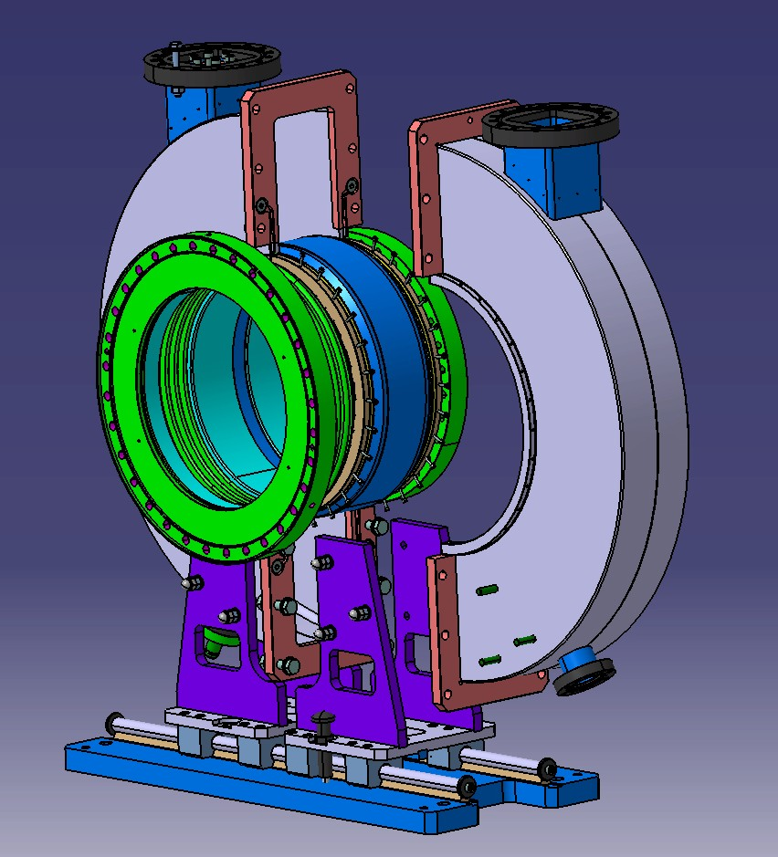
Basic Resonator Design
flanges for frequency tuning
two resonator halves,
air filled
ceramic gap
flange for coupling loop
dismountable assembly

Slide 11
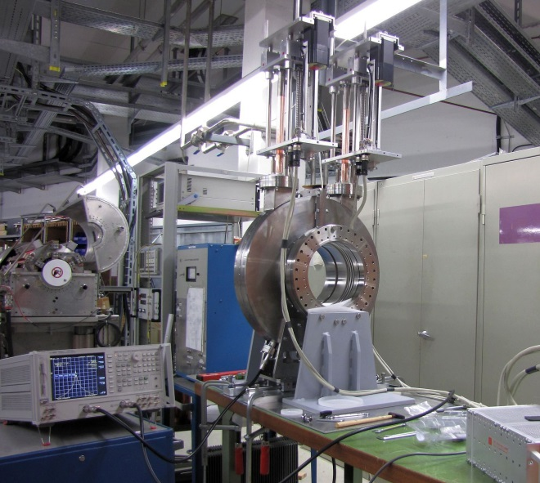
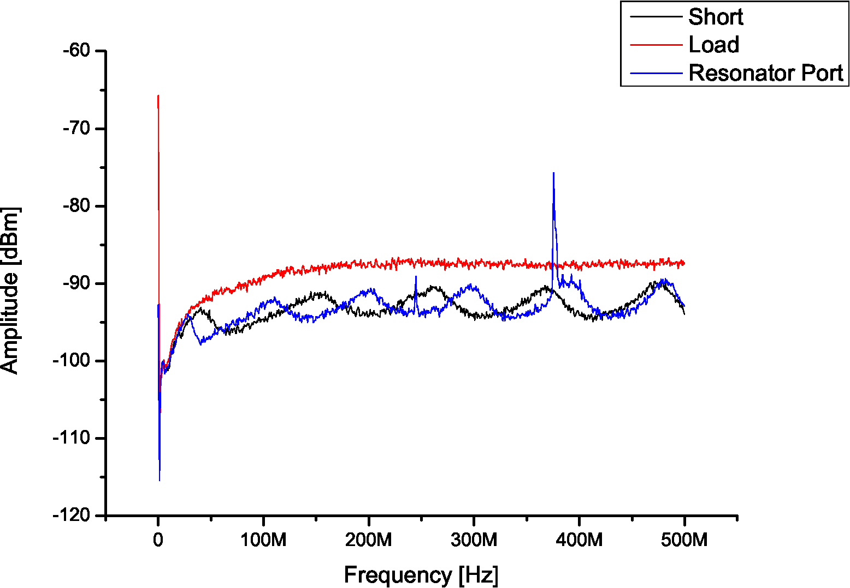
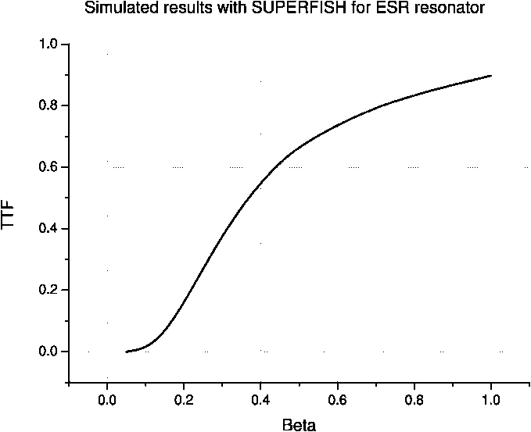
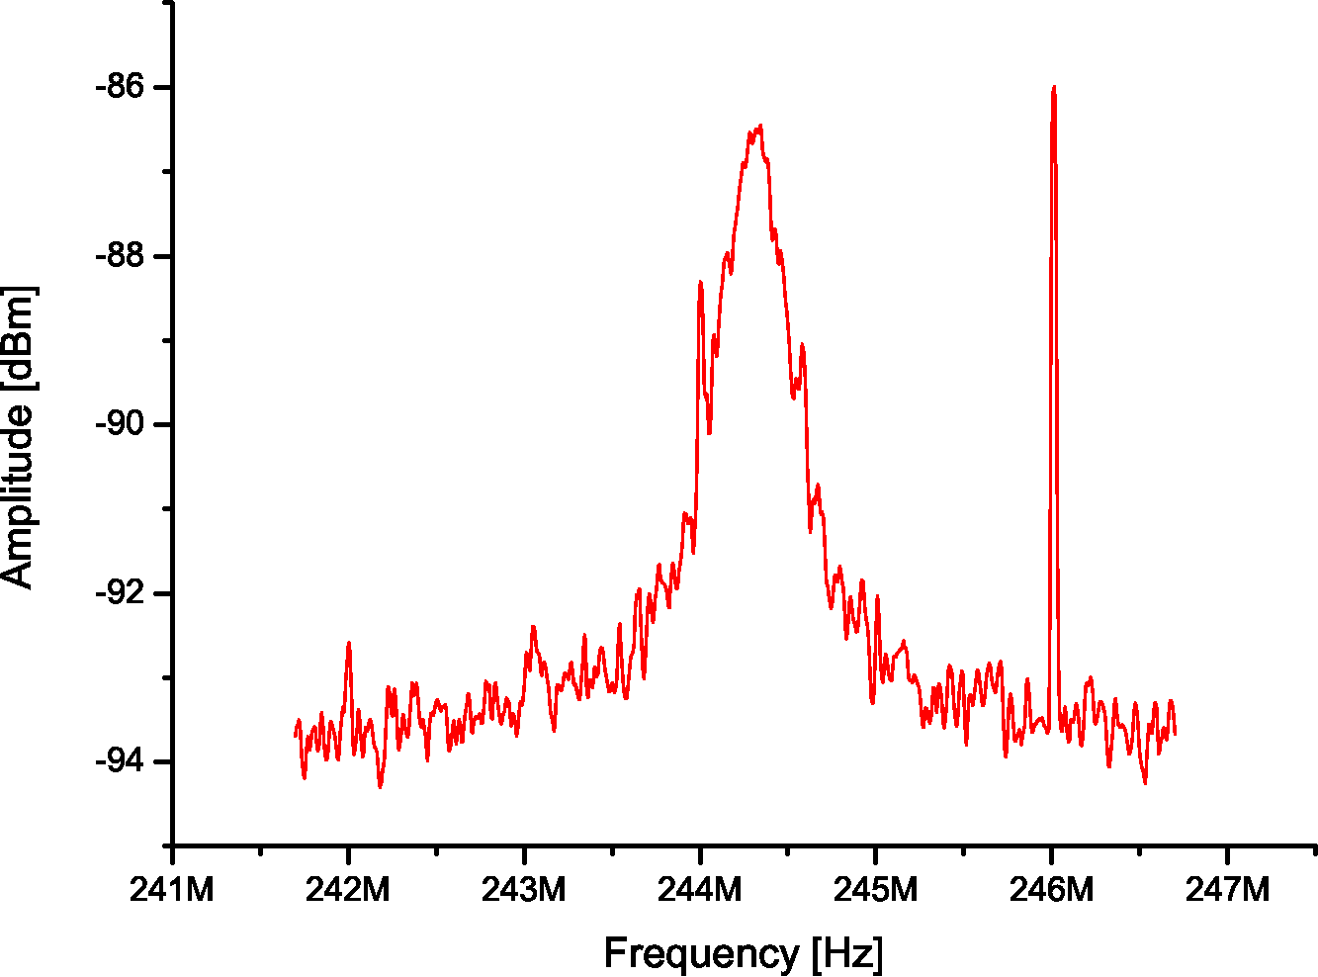
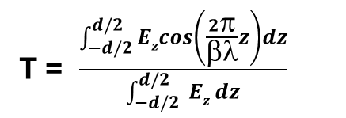
New Schottky Resonator
Frequency 244 ± 2.5 MHz
Quality factor (unloaded) 1130
Quality factor calc. 1940/3837
R/Q exper. 50.7 Ω
noise floor
Transit time factor
(sensitivity vs velocity )
T = $\frac{\int_{−d/2}^{d/2}{Ezcos\left(\frac{2π}{βλ}z\right)}dz}{\int_{−d/2}^{d/2}{ Ez} dz}$

Slide 12
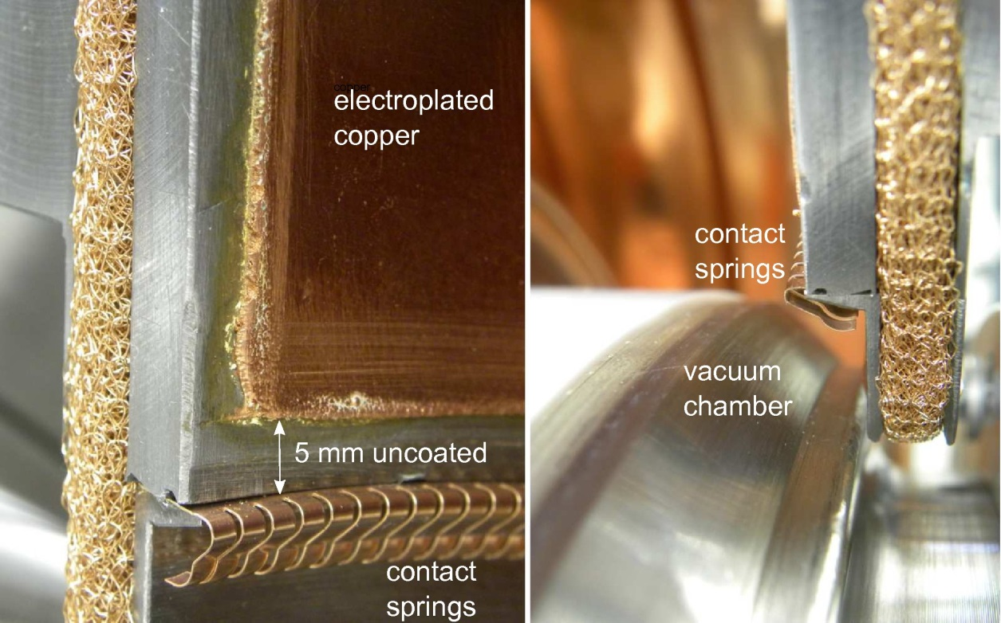
Reduction of Quality Factor
Dielectric losses in ceramics
Losses in stainless steel inside vacuum chamber
Partially exposed construction steel surface
no problem, as larger band width is requested anyhow

Slide 13

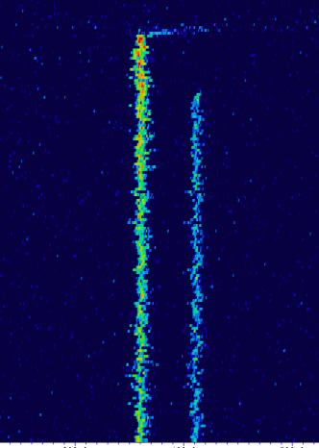
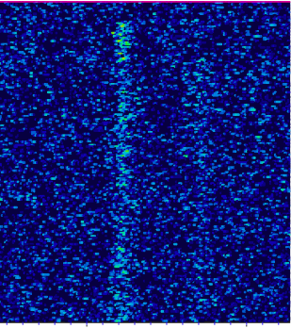
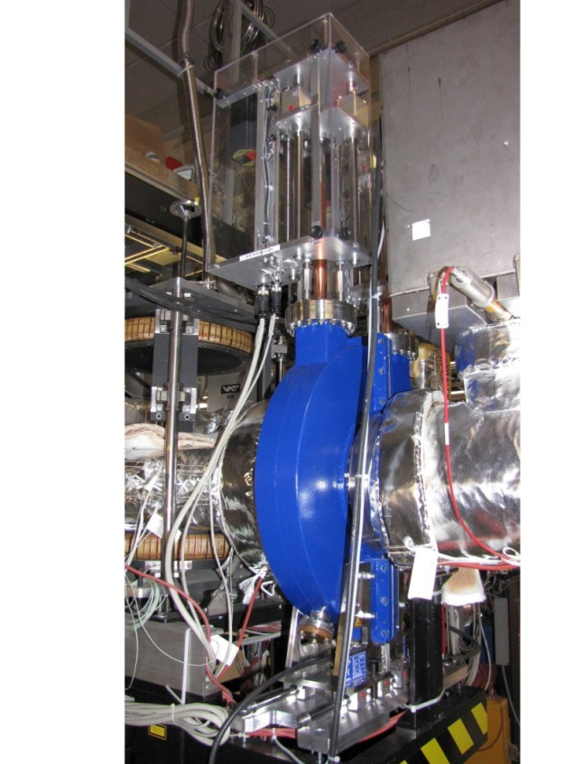
New Schottky Resonator
Old Schottky
Pick-up
Stripline electrode
with resonant circuit
at 30th harmonic
of revolution frequency
142 59+
Pm
142 59+
Nd
142 59+
Nd
142 59+
Pm
New Resonator Cavity
(pill box type)
124th harmonic
of revolution fequency

Slide 14
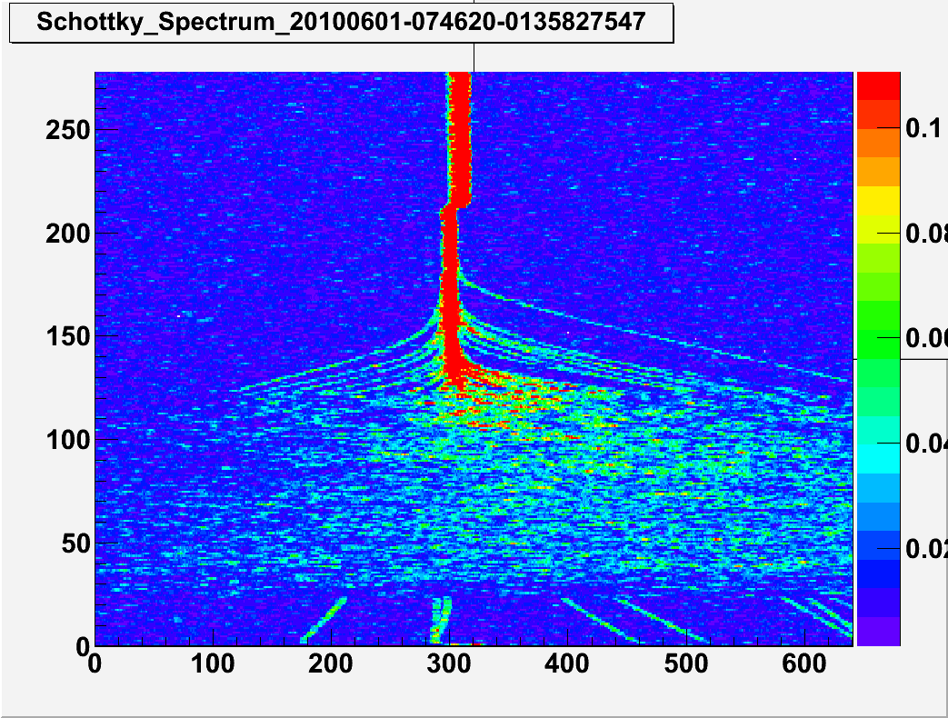
Measurement of Cooling Process
Cooling of
¹⁴²Pr⁵⁹⁺ at 400 MeV/u
Electron cooling
time 32ms/u
Stochastic cooling
+
Electron cooling
Electron cooling
frequency 31.25 Hz/u @ 244 MHz

Slide 15
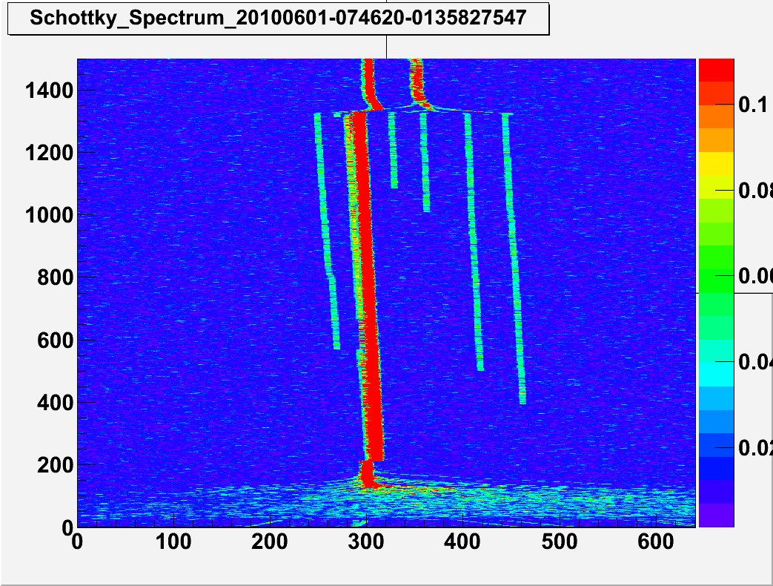
Measurement of Radioactive Decay
Electron cooling
no cooling
time 32ms/u
¹⁴²Pm⁵⁹⁺
¹⁴²Nd⁵⁹⁺
Electron cooling
Stochastic cooling
frequency 31.25 Hz/u @ 244 MHz

Slide 16
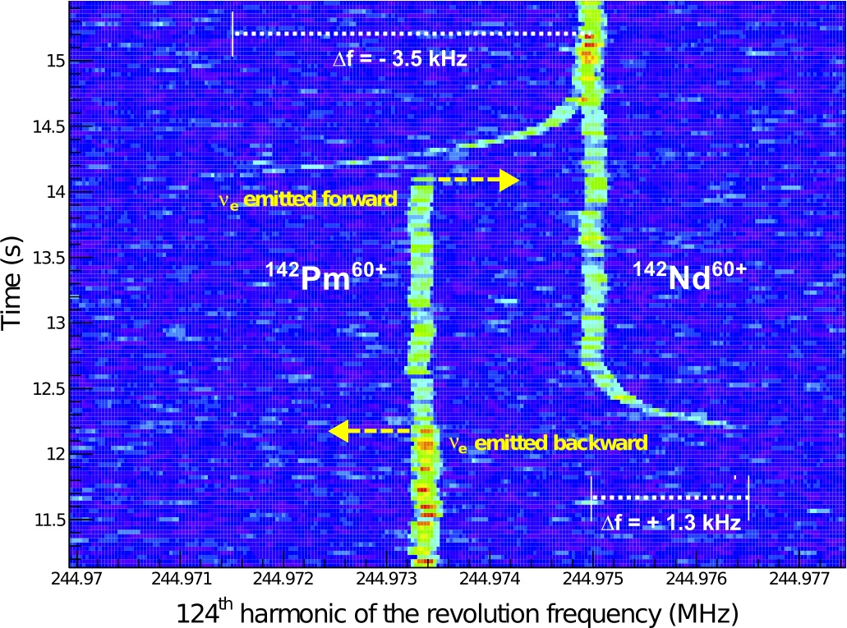
Measurement of Electron Capture Decay
¹⁴²Pm⁶⁰⁺ + e⁻ → ¹⁴²Nd⁶⁰⁺ + ν_{e}
isotropic emission of neutrino ⇒ transfer of energy 90 eV to daughter ion

Slide 17
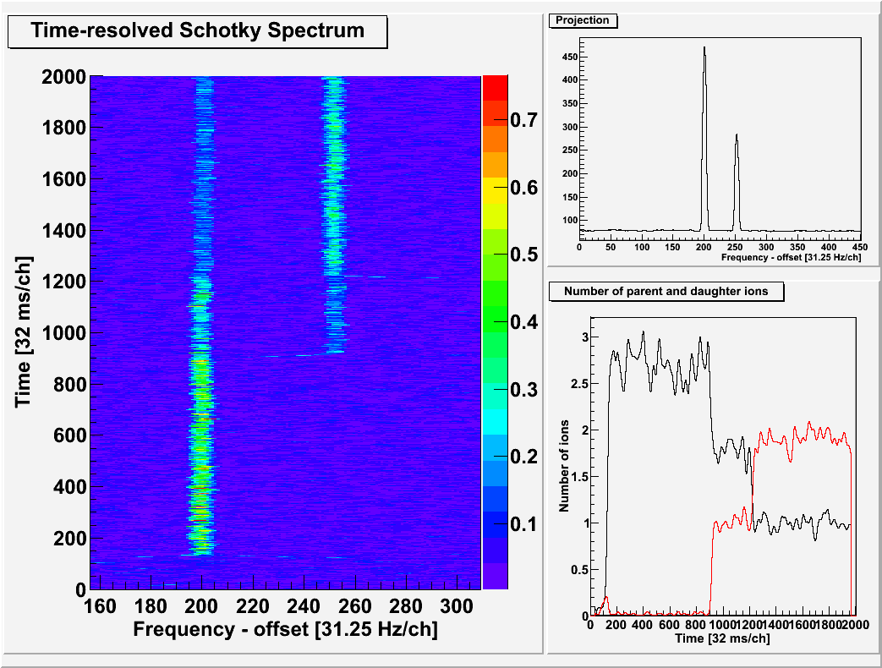
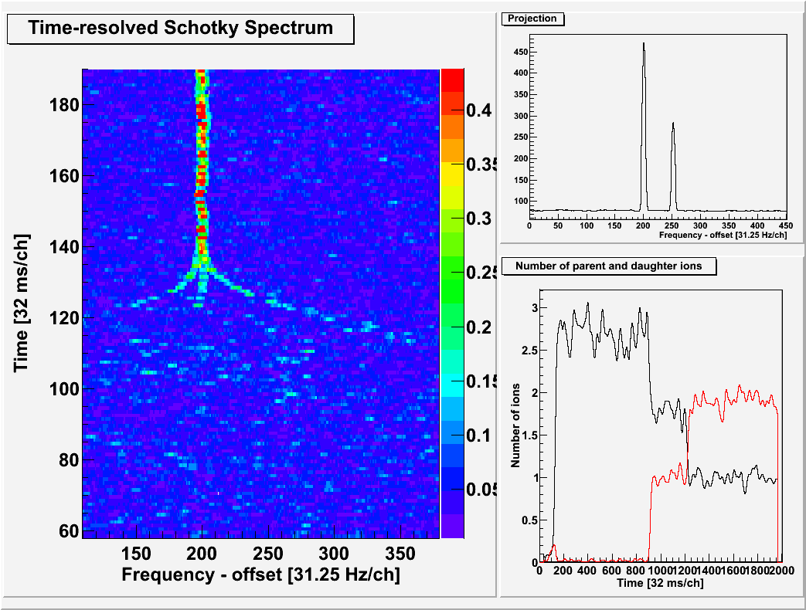
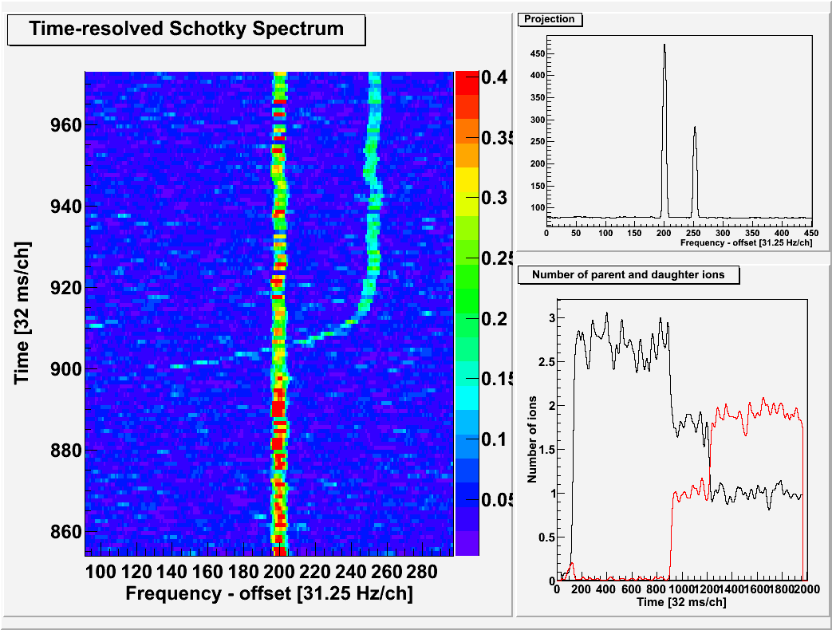
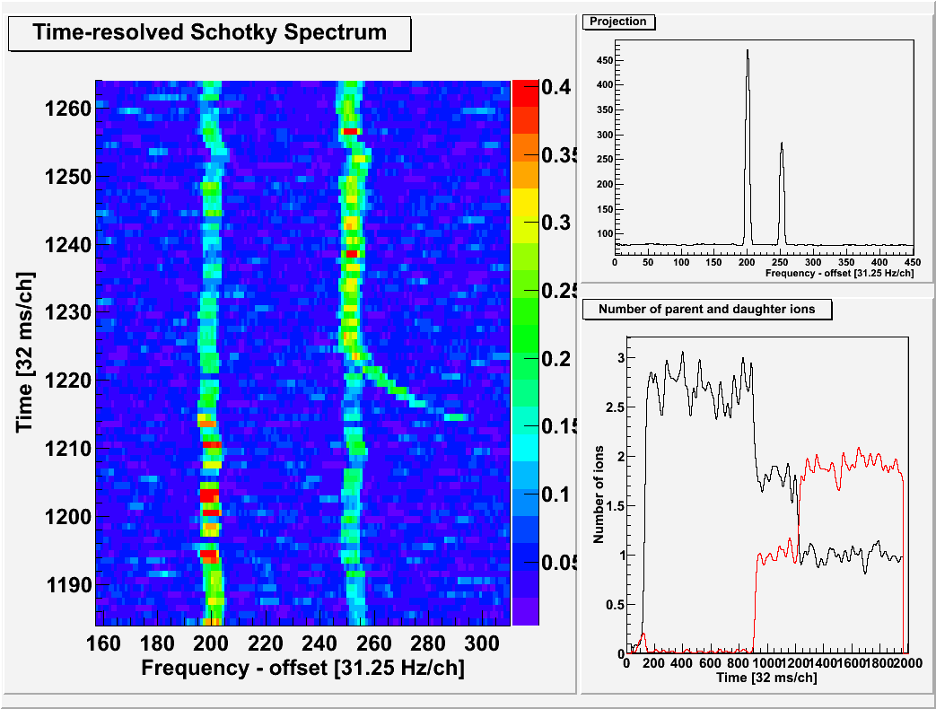
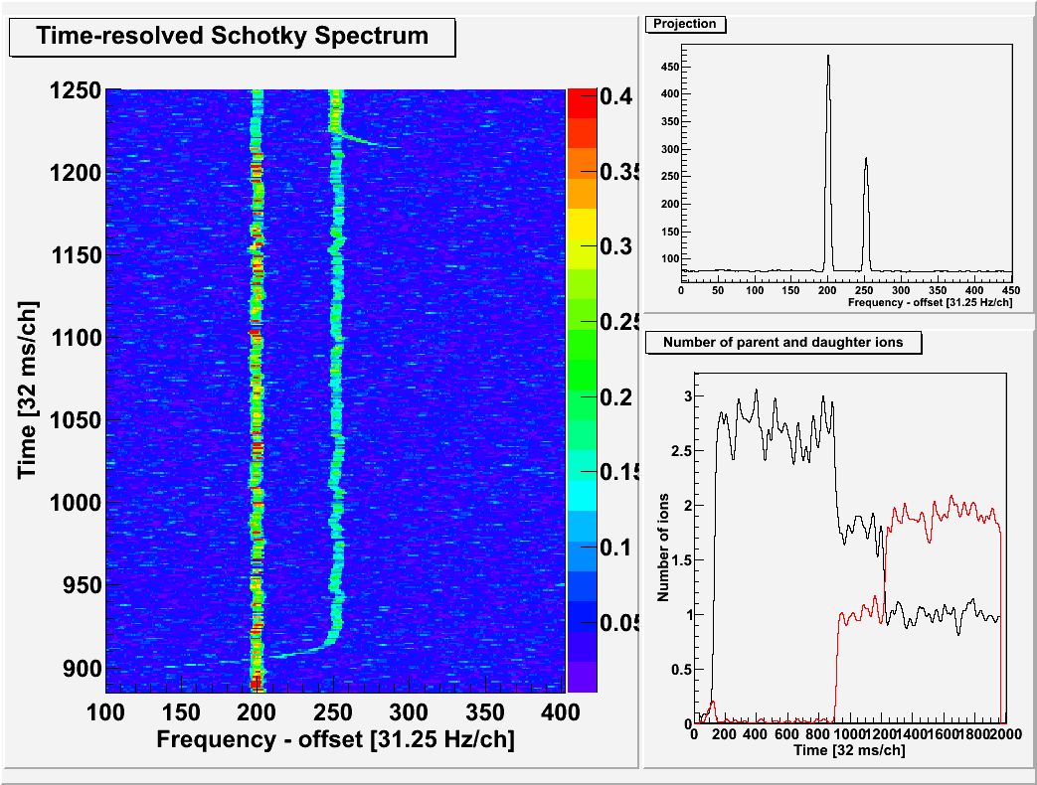
Three Parent He-Like ¹⁴²Pm Ions
CM
ν_{e}
θ
p_{R} cos(θ)
ν_{e} emitted backward
Beam
direction
Δf = ± 3.91 kHz
(120 ch)
recoil
ν_{e} emitted forward

Slide 18
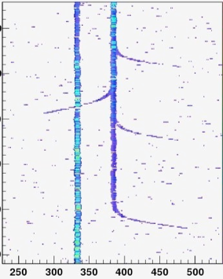
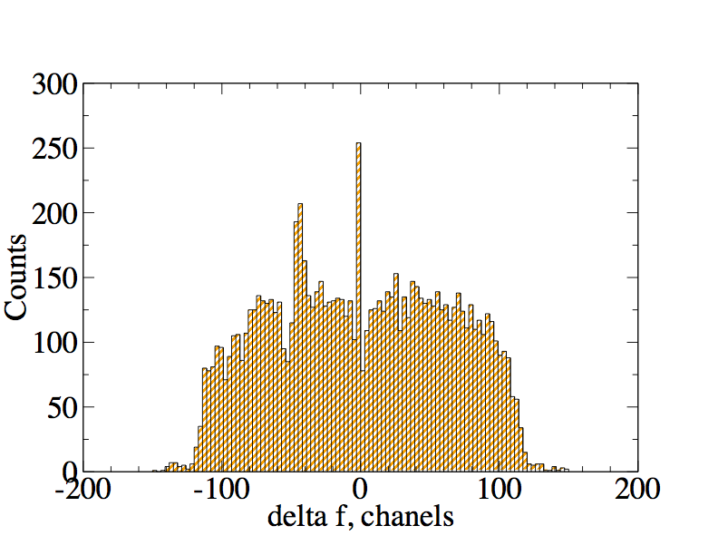
Revolution Frequency Difference δf
of the Recoils just after Decay: δf = f_{dec} - f_{cool}
From v_{d} and m_{d} one gets the momentum of the
(monochromatic) neutrino: (pc)_{d} = m_{d} cv_{d} = (pc)_{ν}
From m_{p} and m_{d} one gets its energy:
E_{ν} = (m_{p} – m_{d}) c² and then β_{ν} = E_{ν} /(pc)_{ν}
decay at f = f_{d} (cool)
decay at
f = f_{p}(cool)
V_{d}
↓
V_{d}
↓
For a (longitudinally) unpolarized beam the
distribution should have a rectangular shape
For a (steadily controlled) polarized beam the distribution would provide the helicity of the neutrino

Slide 19
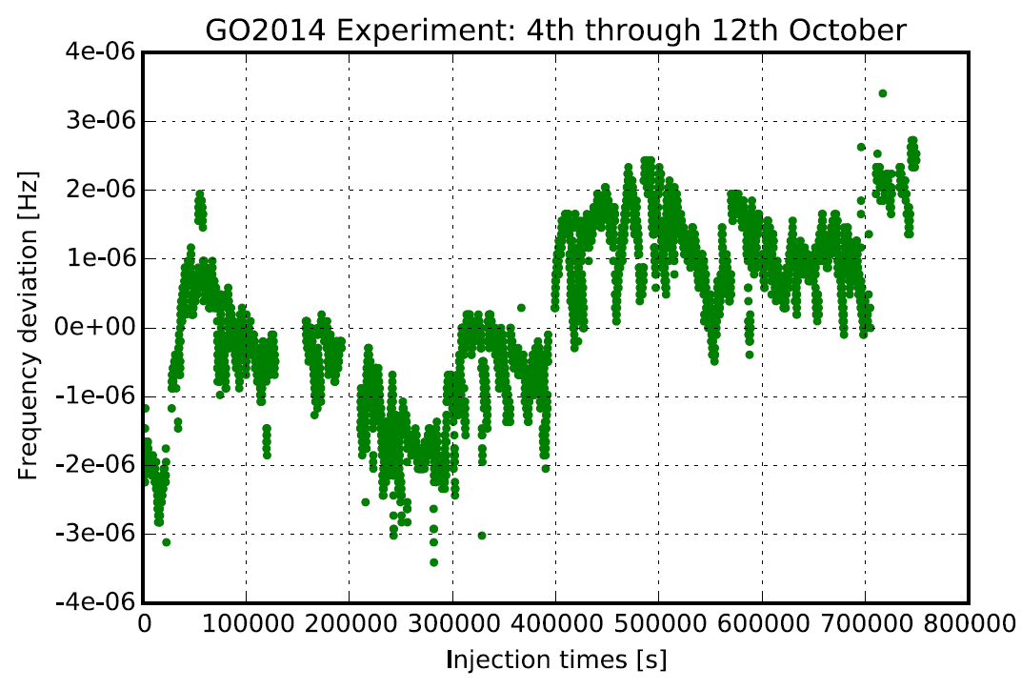
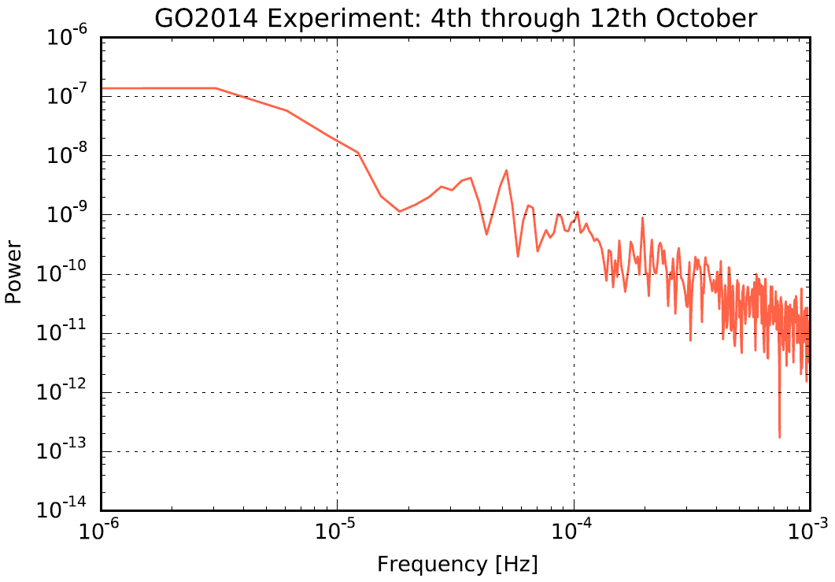
Stability of Revolution Frequency
frequency variation over
one week determined
from the peak position
FFT of temporal variation
variations of revolution frequency
over one week: ≤ ± 3×10⁻⁶
stability of magnet power converters
stability of electron beam (energy)

Slide 20
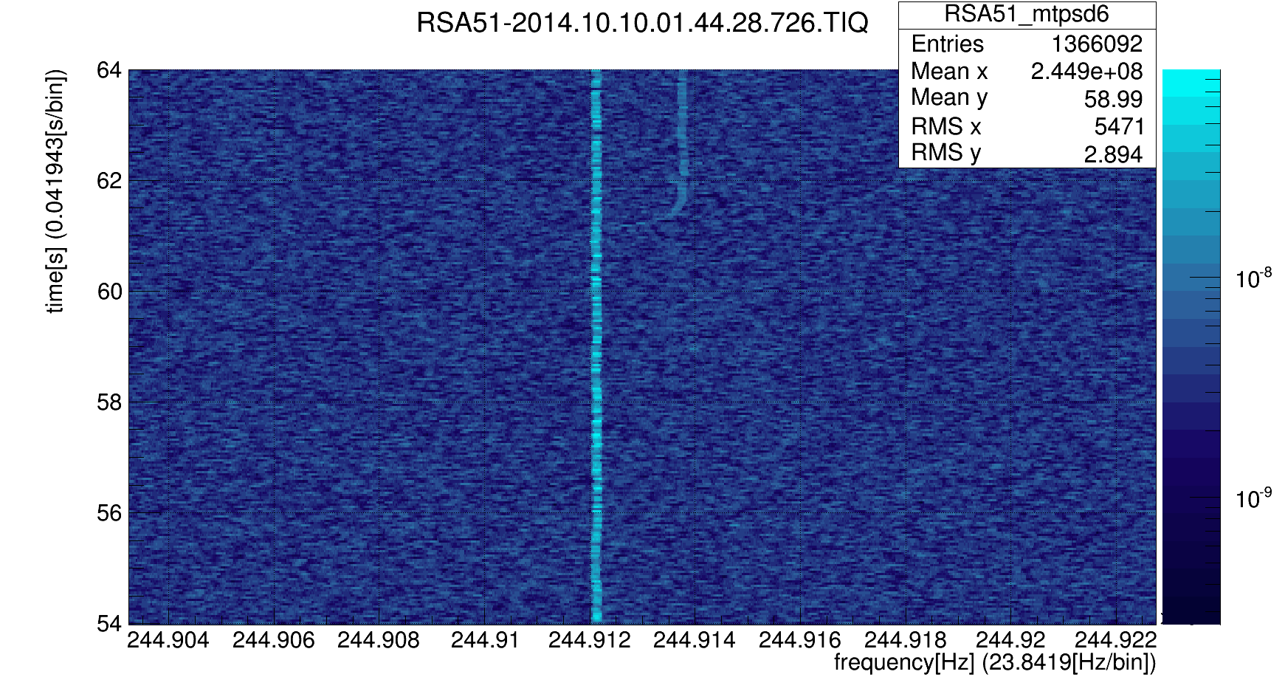
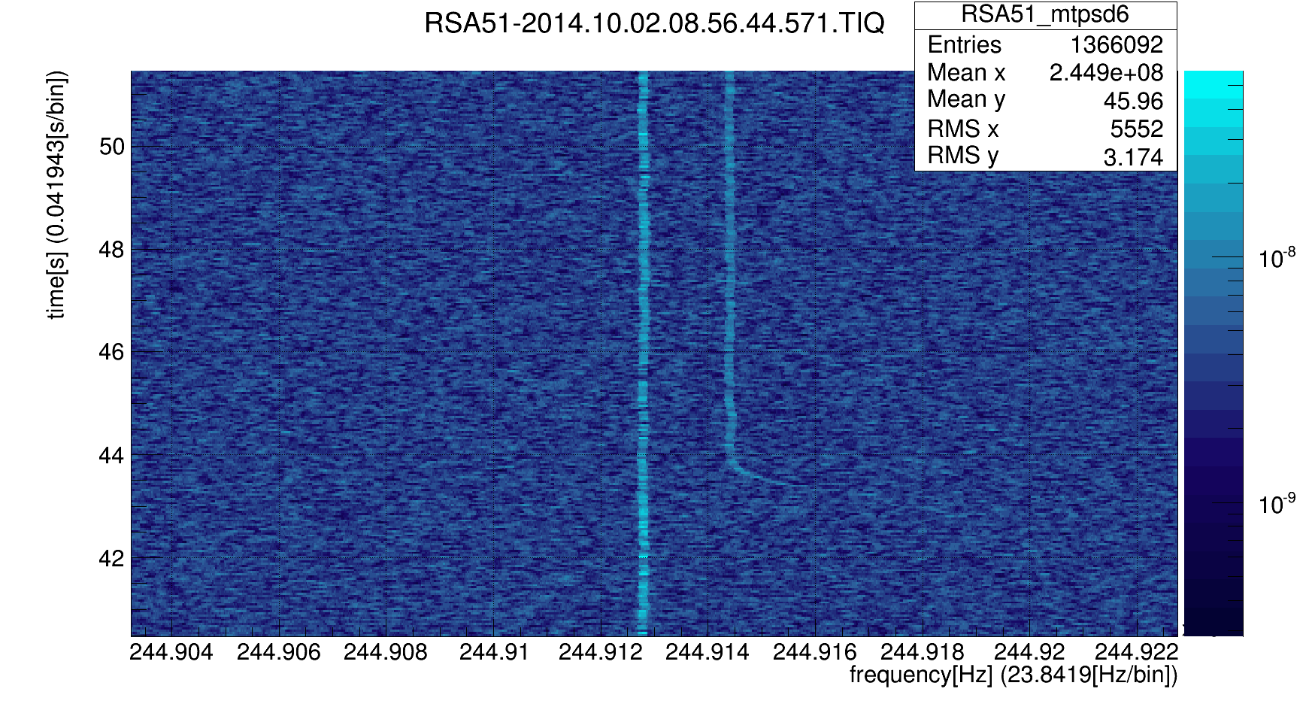
Analysis of Cooling Process
forward emission
(daughter 2)
⇒ deceleration
backward emission
(daughter 1)
⇒ acceleration
¹⁴²Nd⁵⁹⁺ 400 MeV/u

Slide 21
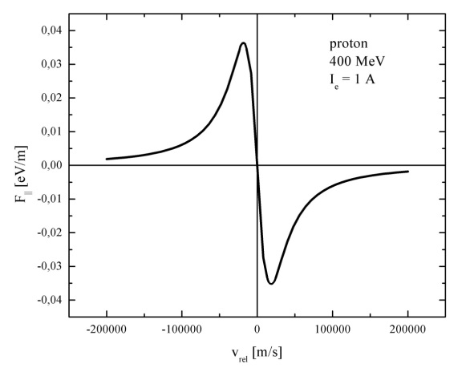
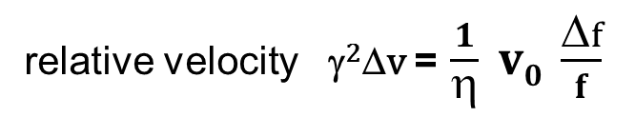
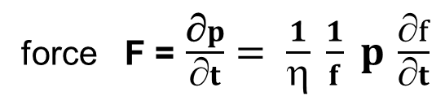
Analysis of Cooling Process
theoretical
cooling force
force F = $\frac{\text{∂}p}{∂t}= \frac{1}{η} \frac{1}{f} p \frac{∂f}{∂t}$
relative velocity γ²Δv = $\frac{1}{η} v0 \frac{Δf}{f}$

Slide 22
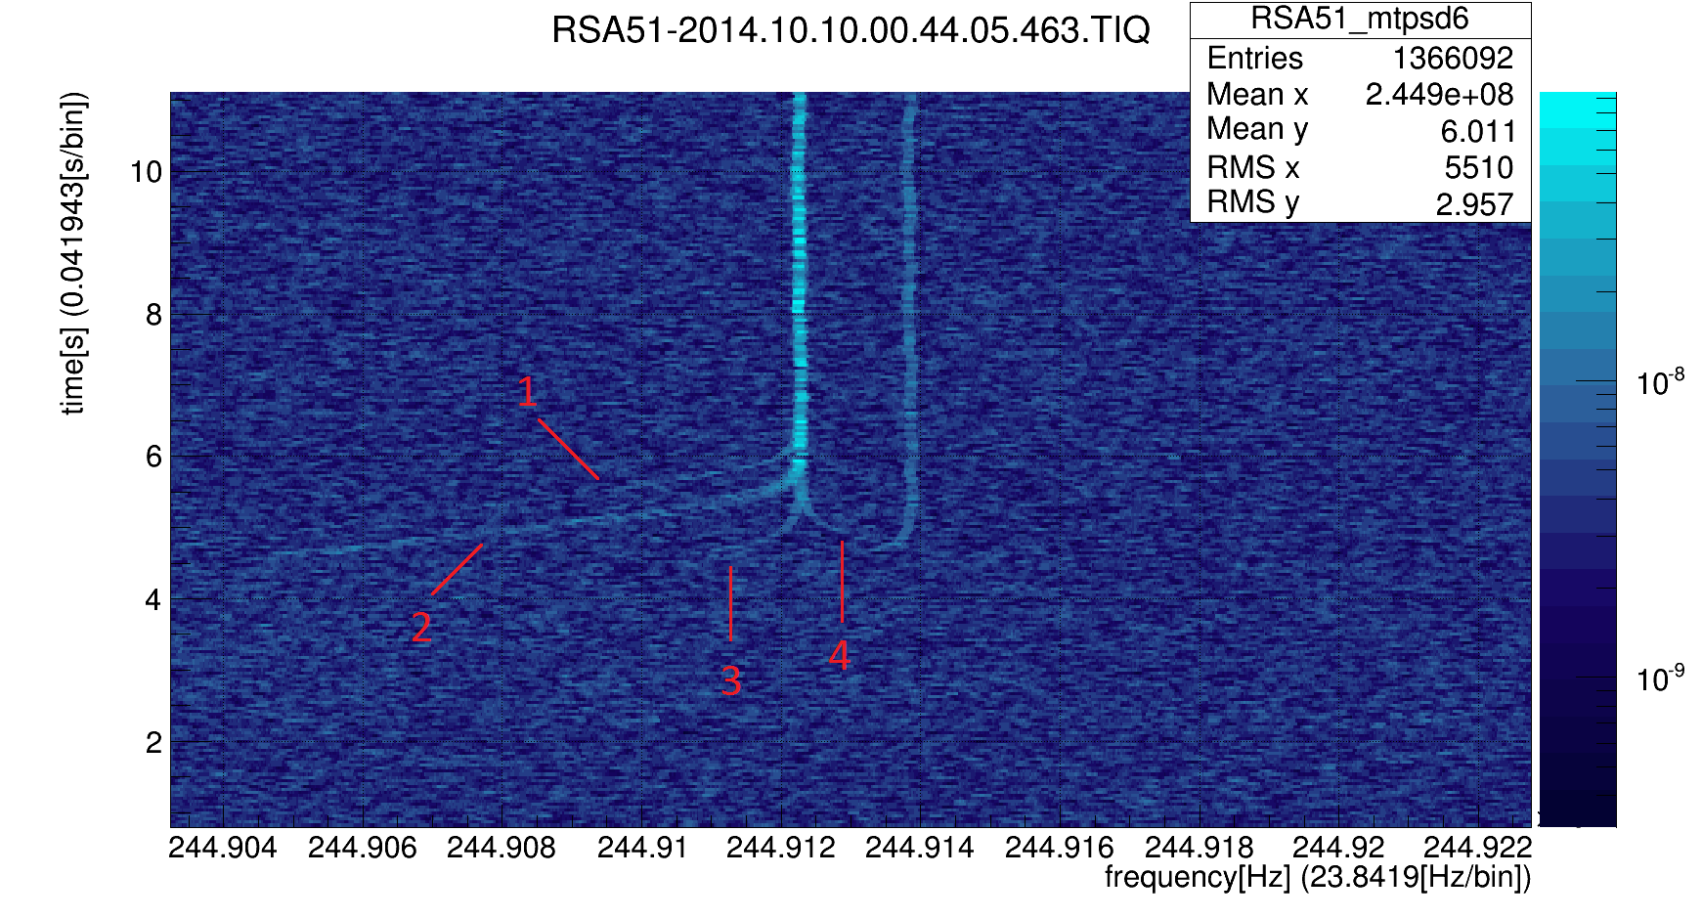
Analysis of Cooling Process
¹⁴²Pm⁵⁹⁺ 400 MeV/u
cooling force depends on initial
parameters of the ion
(single particle emittance)
ions start with different relative
velocities (longitudinal and transverse)

Slide 23
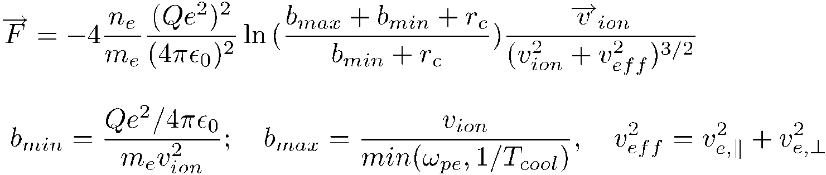
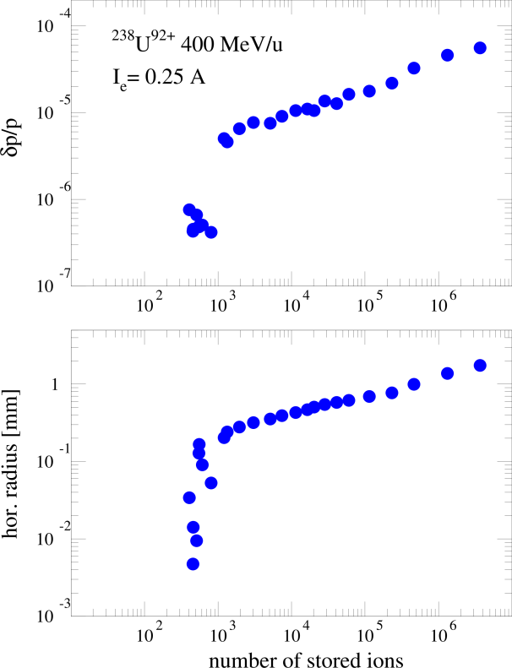
Analysis of Cooling Force
Parkhomchuk formula of electron cooling force:
the ion velocity v_{ion} in many cases exceeds
the electron velocity v_{e}
(due to the spread of the ion distribution)
for single ions this contribution vanishes and allows
measurements of the cooling force for well
controlled ion parameters
v_{ion} ≤ 10⁻⁶ × v₀ ≈ 2×10² m/s
v_{e} ≈ 10³ – 10⁵ m/s
longitudinal
transverse

Slide 24
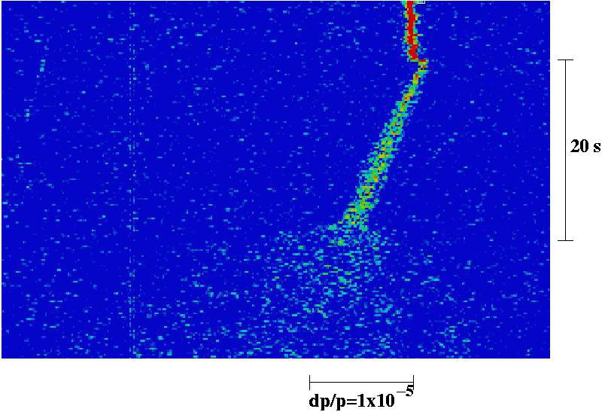
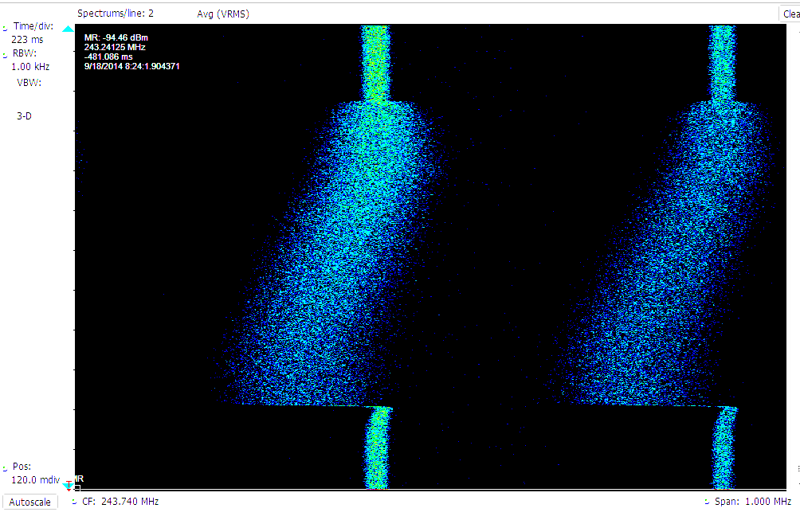
High Sensitivity Measurement of
Interaction with Matter
deceleration in residual gas
deceleration in internal target
Xe⁵⁴⁺
15 MeV/u
time
with internal gas
target operation
40 s
dp/p=1×10⁻⁵
dp/p=1×10⁻³
Measurement of single ions allows the measurement of target effects
without the uncertainty introduced by the beam spread

Slide 25
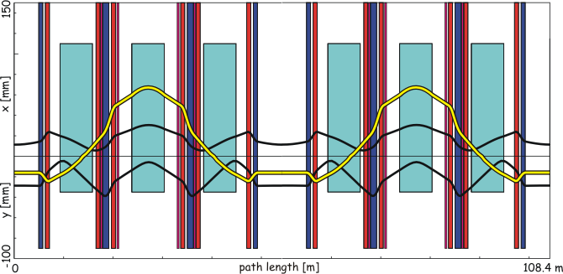
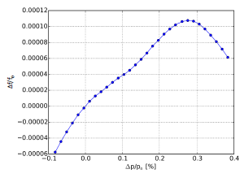
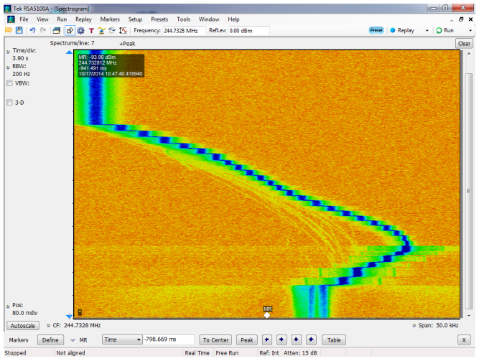
Isochronous Mode of the ESR
for Mass Measurements of Short-lived Isotopes
operation at transition energy:
negative dispersion in straight section
makes revolution frequency
independent of the beam momentum
η = 0 ( γ = γ_{t}, transition energy γ_{t} )
γ < γ_{t}
η = 0
γ = γ_{t}
measurement of
transition energy
by variation of
beam energy
energy
frequency
γ > γ_{t}
from PhD thesis O.Kovalenko

Slide 26
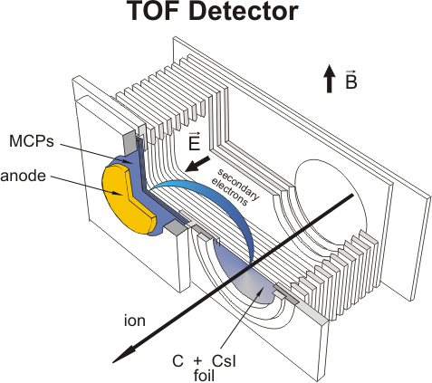
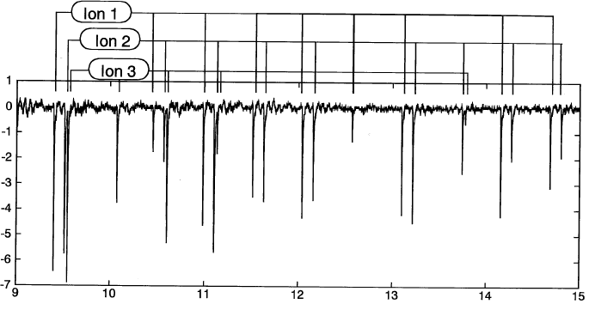
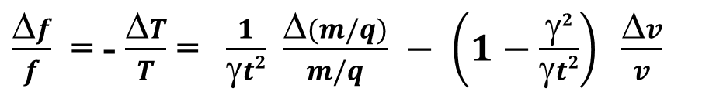
ToF Detector
$\frac{Δf}{f}$ = - $\frac{ΔT}{T}$ = $\frac{1}{γt2}$ $\frac{Δ(m/q)}{m/q} − \left(1−\frac{γ2}{γt2}\right) \frac{Δv}{v}$
(if γ = γ_{t})
passage of single ions
ion is lost after a few thousand
turns due to energy loss in foil,
⇒ a few milliseconds of storage
voltage / a.u.
time / µs
a Schottky detector with millisecond measuring
time should be competitive or even superior

Slide 27
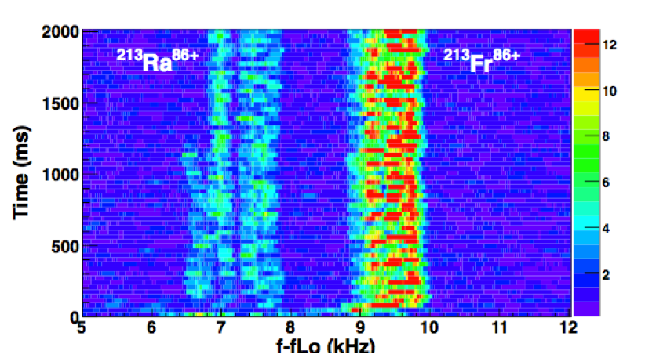
Resonator Measurement in Isochronous Mode
detection of the decay of a radioactive ion in the isochronous mode
injected with a momentum spread of ± 0.2 % (no cooling)
decay
Δm/m = 1.88 ×10⁻⁵
⇒Δf/f=1/γ_{t}² ×Δm/m = 9.2 × 10⁻⁶
(fLo = 245924.5 kHz)
⇒ Δf = 2.3 kHz

Slide 28


Schottky Resonator at the
RIKEN Rare-RI Ring
deceleration in the residual gas of
a single ion in isochronous mode
⁷⁸Kr³⁶⁺ 168 MeV/u
Resonance frequency : 173MHz (TM₀₁₀)
Tuning range : ±1.5MHz
Shunt Impedance R_{sh} : 161kΩ
Quality factor Q₀ : 1880
Ceramic tube size: 290mmΦ, 15mm thick
from COOL‘15:
Y. Yamaguchi et al.
Commissioning of the Rare-RI Ring
at the RIKEN RI Beam Factory

Slide 29

FAIR - Modularized Start Version (MSV)
SIS100: intense, primary
heavy ion beams up to 2.7 GeV/u
SuperFRS: RIB production
CR: isochronous mass measurements
of RIBs with energies 400-740 MeV/u
CRYRING@ESR: low energy ions
and RIBs from ESR
SIS100
p-linac
SIS18
UNILAC
ESR
HESR
SuperFRS
CRYRING
@ESR
pbar target/
separator
CR

Slide 30


Schottky Resonators in the Collector Ring of FAIR
Schottky resonators
for isochronous
mass measurements
will also be useful
for highly sensitive
diagnostics of
antiprotons

Slide 31




Position Sensitive Schottky Resonator
beam pipe offset from cavity center
position dependent shunt impedance
⇒ Schottky noise signal power P(x)
rectangular cavity
elliptic cavity
$\frac{Δf}{f}$ = - $\frac{ΔT}{T}$ = $\frac{1}{γt2}$ $\frac{Δ(m/q)}{m/q} − \left(1−\frac{γ2}{γt2}\right) \frac{Δv}{v}$
horizontal position in dispersive section
is related to particle velocity (momentum)
correction for deviations γ = γ_{t} + δγ
by measurement of δp or δv
(normalization to normal cavity signal)
X. Chen, PhD thesis, supported by
EU-contract No. PITN-GA-2011-289486

Slide 32
thanks to my colleagues
X. Chen, P. Hülsmann, Y. Litvinov, F. Nolden,
C. Peschke, P. Petri, S. Sanjari, I. Schurig, J. Wu

