Slide 1
Electron Beam Profile Monitor measurements of the Montague Resonance in the SNS Ring
W. Blokland*, R. Potts#, S. Cousineau#
* Diagnostics
# Beam Dynamics
Beam Dynamics meets Diagnostics Workshop
4-6 November 2015
Convitto della Calza, Florence, Italy

Slide 2
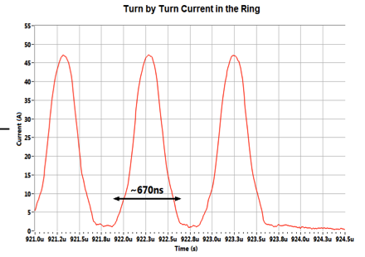
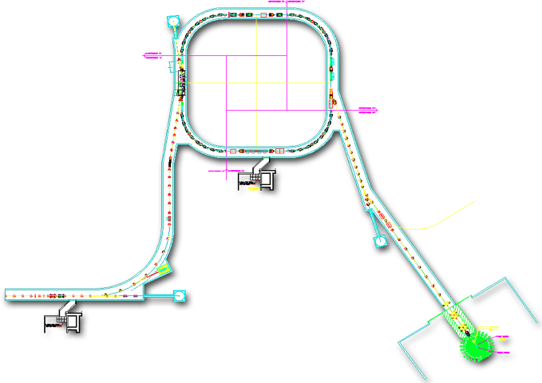
Spallation Neutron Source Accelerator
Accumulated in the Ring
Current
Ring
945 ns
1ms
Current
670 ns
1 ms macro-pulse
Linac
RTBT
Current
16.6ms
Spallation Neutron Source (SNS)
  Materials research with neutrons through spallation of protons in mercury
Power on Target | 1.4 MW at 1.0 GeV
Pulse on Target | 1.5 E14 protons (24 µC) in 670 ns
Macro-pulse in Linac | 1000 mini pulses of ~24 mA average over 1 ms at 60 Hz

Slide 3

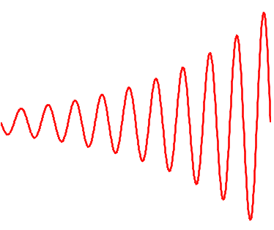
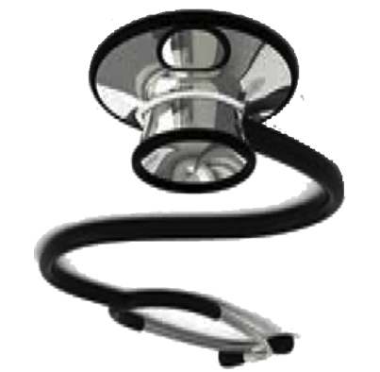
Beam Dynamics meets Diagnostics
Beam Dynamics:
  Define and execute experiment
  Simulate experiment
  Benchmark simulation with experiment
Diagnostics:
  Knows how to setup diagnostics devices for measurements
  Knows how obtain beam parameters from raw data
  Provides application to acquire data and generate results
What the..?
Problem:
  Beam profiles are found to be coupled under certain conditions
  → Setup to get right beam size on target more complicated

Slide 4
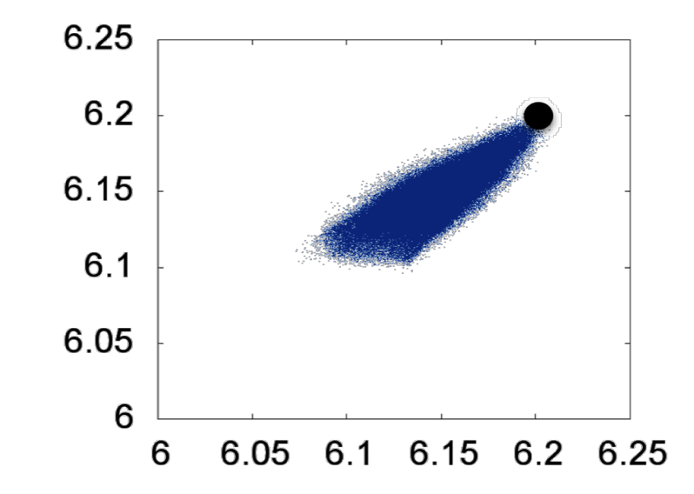
Beam Dynamics: Space Charge Effects
Hill’s equation with space charge as driving force:
with
Nominal tune point without space charge
Tune spread due to space charge effects particles differently based on local density
Simulation of space effect on tune

Slide 5

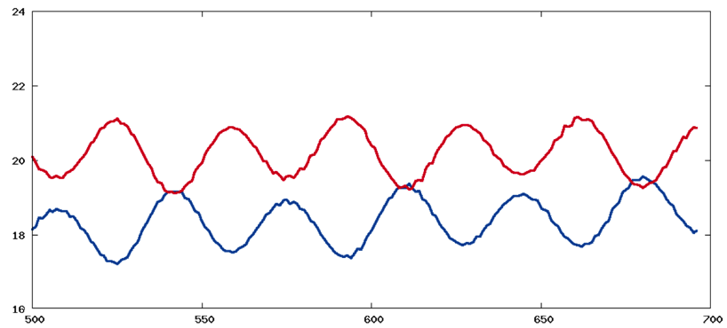
Beam Dynamics: Resonances
Montague Resonance:
2x-2y=0
Characteristics:
  Sensitive to intensity: stronger with more space charge
  Sensitive to tune-split: stronger with closer tunes
  Observe exchange of RMS widths between planes
Second Order Beam Moments
Vertical
Horizontal
Turn
Simulation of space charge effect on RMS width

Slide 6
Experiment
Conditions SNS Ring:
  Different tune-splits with different beam intensities and stored turns
Required Data:
  Profiles (RMS width) during accumulation and storage
Device | Location | Each Injection | Stored turns | Resolu -tion | Time@1Hz | Time per set*
Wire Scanner | RTBT | Profile point extracted | Adjust ring | 50 -100 pts | 100-200 s | 160 min
Harp | RTBT | Full profile extracted | Adjust ring | 30 pts | 1 s | 40 min
Electron Scanner | Ring !!! | Full profile slice any turn | No adjustment | 50 -100 pts | 5 - 40 s | 30 min
*1 min per profile to setup extraction for RTBT measurements
The electron scanner can take a set of data unattended (requires offline analysis)
The wire scanner has the best signal to noise ratio, the harp has lowest resolution
Only the electron scanner can measure directly (no extraction kicker, lattice, etc)

Slide 7
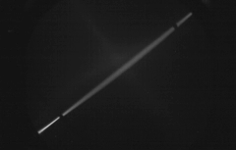
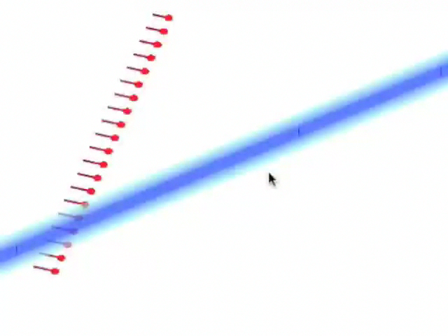
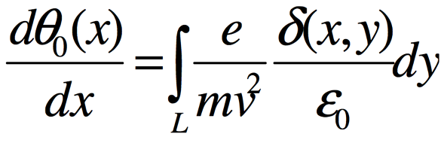
Electron Scanner Principle
Quadrupoles
Deflector
Electrons ➔
Multiple scans
dy
dx
⬅Proton beam
Look at the deflected projection of a tilted sheet of electrons:
  Neglect magnetic field (small displacement of projection)
  Assume path of electrons is straight (they are almost straight)
  Assume net electron energy change is zero
  → take the derivative of curve to get the profile

Slide 8
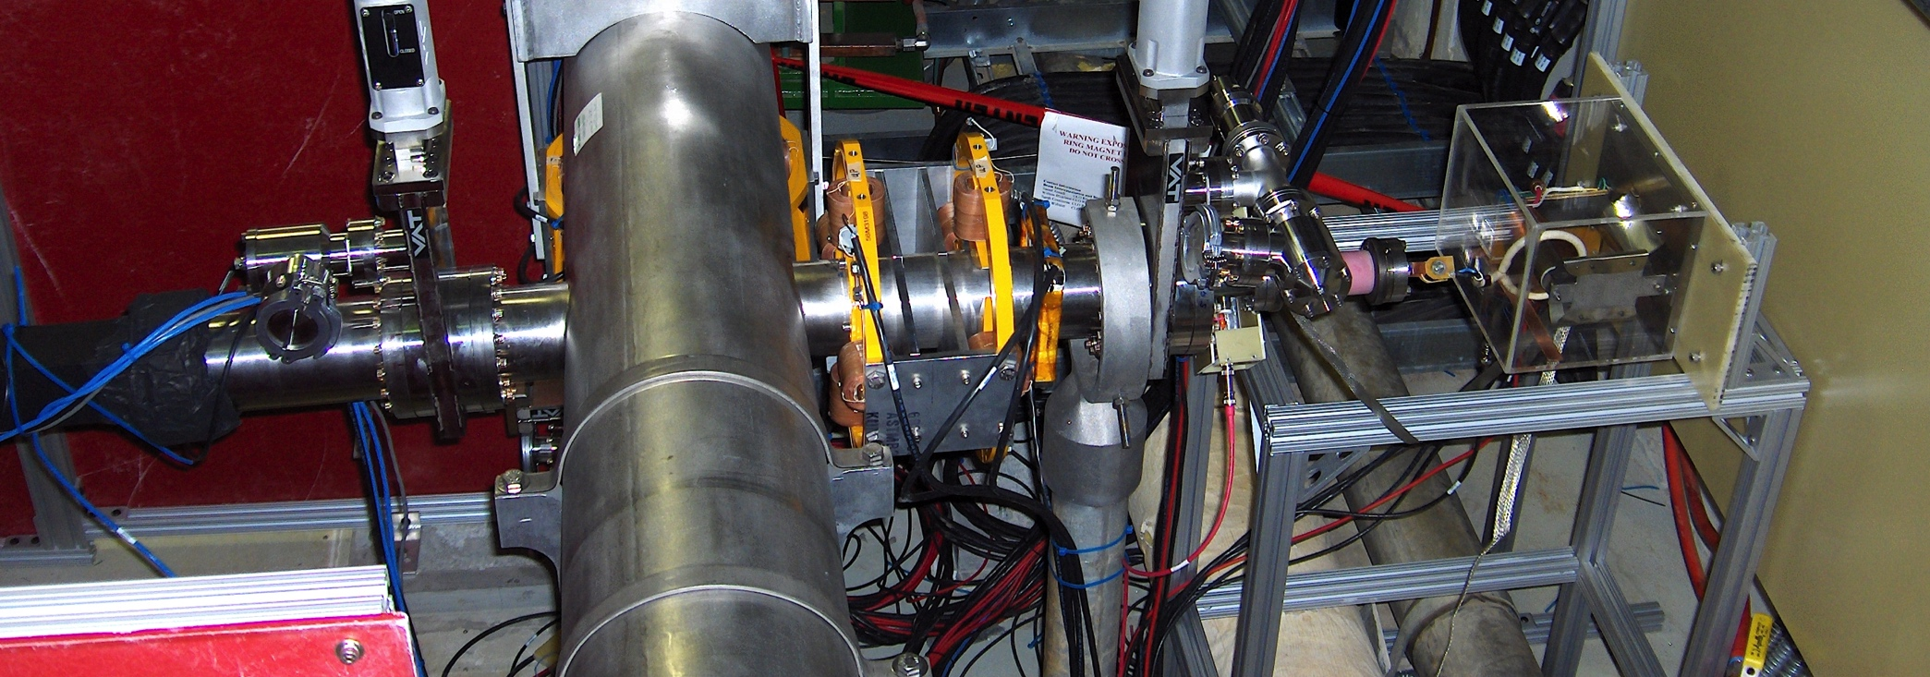
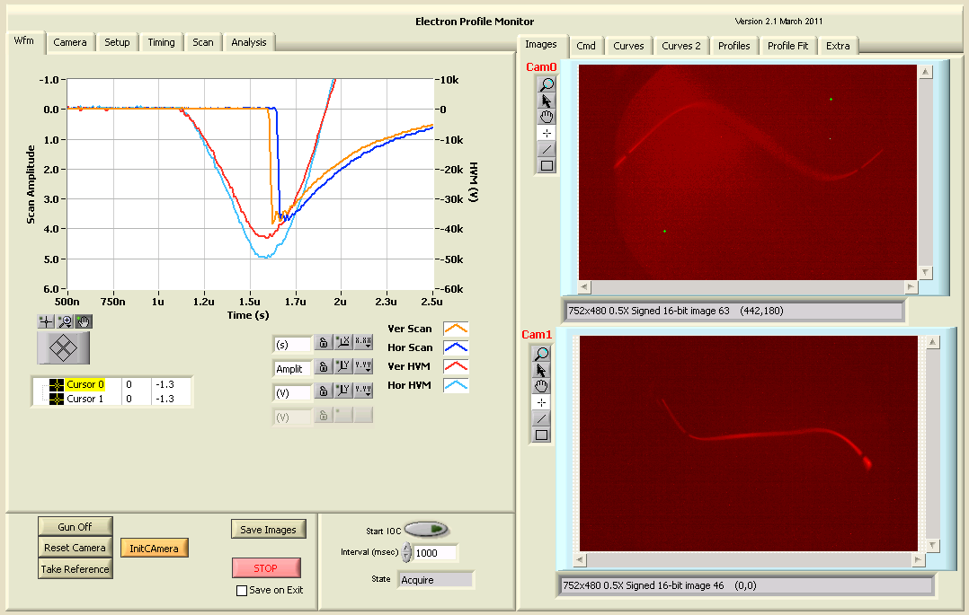
Electron Scanner Hardware
Electron Gun
Dipoles
Deflector
Quadrupoles
HV Transformer
Screen
Electron scanner now covered with magnetic shield
Ring Beam Pipe
Camera

Slide 9
Electron Scanner Capabilities
The SNS Ring presents a good operational spot for the electron scanner:
A lower kV setting requires better magnetic shielding
A higher beam potential requires higher kVs (expensive)
Shorter bunch lengths require faster scans e.g. cavity and result in less electrons
A smaller beam size requires lower electron emittance and projection and better sensor resolution and/or diverging projection
A faster rep rate requires a more expensive electron gun HV supply
Parameter | Range | Implementation | Dependency
Beam Intensity | 50 nC-25 µC (1*600ns) 10’s mA – 10’s A | 10-100 keV | Geometry (deflection)
Beam Potential | Up to ~20kV | Requires 100 keV electrons | Electron momentum
Bunch Length | > 10’s ns < 10’s ns | Deflector single shot profile Cavity or step per position | Amount of electrons to screen
Beam size | > 5 mm < 5 mm | Parallel projection & screen diverging projection & MCP | Geometry
Rep Rate | < 10’s Hz | Screen and Camera | Fluorescent T_{c} and power supply

Slide 10
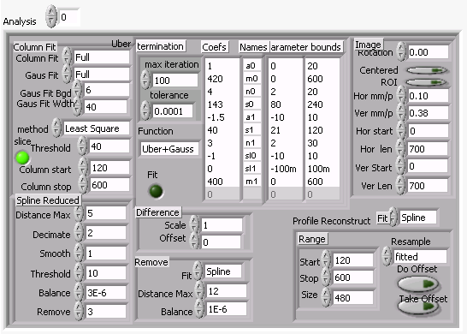
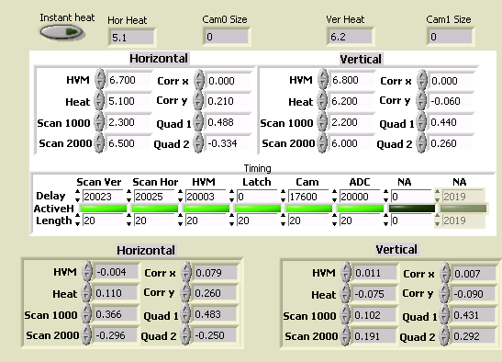
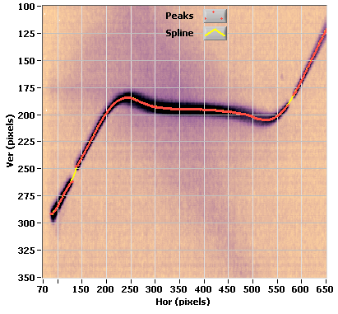
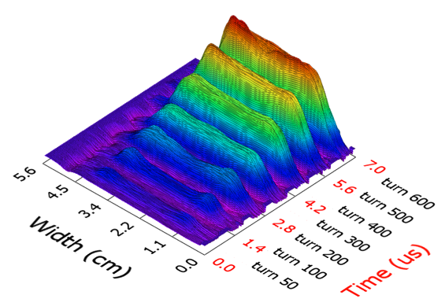
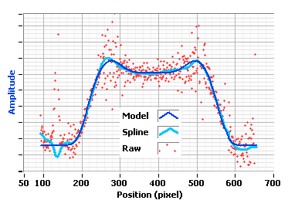
ES: Profile generation
Setup of accelerating voltages, cathode current, deflector voltages, dipoles, quadrupoles, and timing.
Images
Find the curve
But for beam dynamics more is needed:
Automatic acquisition of defined turns and slices
Offline quantitative analysis
Visualize large amounts of data
Take derivative to generate profile
Multi profiles show bunches in the ring during accumulation

Slide 11
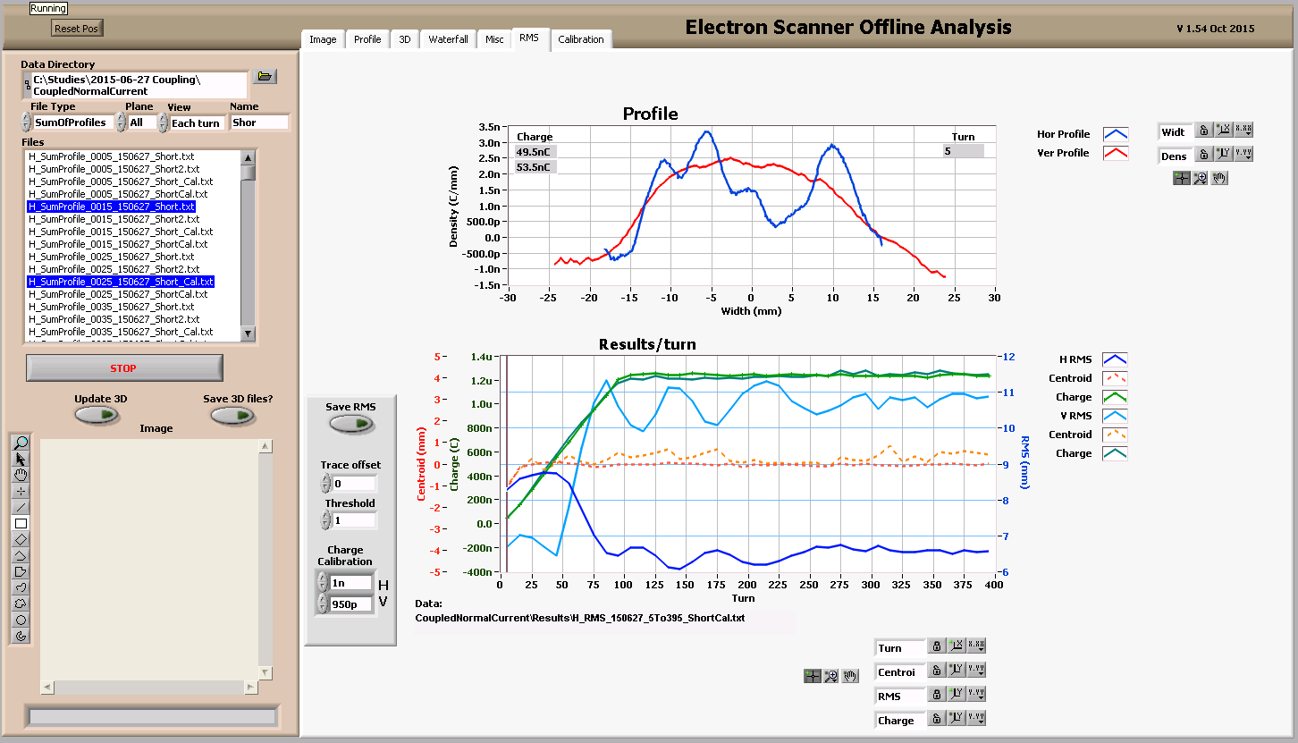
ES: Offline analysis
  Handle large amount of data
  Analyze images in stages for quick re-analysis
    Image to profile (most time-intensive), profile to accumulated profile, profile to RMS
  Visualize and export analysis results
    Results plotted vs. turns
    Verify operation of electron scanner and data

Slide 12
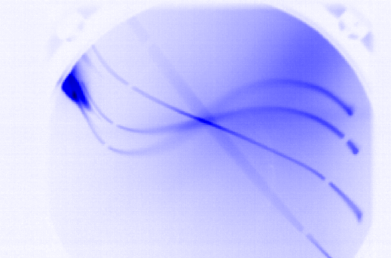
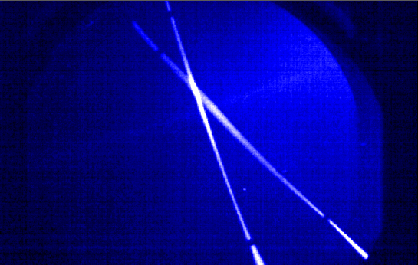
Electron Scanner imperfections
This is a prototype:
Projection not through center of quads:
  Beam pipe of vertical ES not straight
  Projection is not a straight line when no beam
Aperture is too small
  Need to extend analysis beyond marker
  Rotated vertical deflection
Artifacts interfere with image
  Blobs of un-deflected electrons
  Background of lower momentum electrons
  New HV power supply to be installed
These imperfections make the setup (~1 hr. for new conditions) and analysis more time-consuming and also restrict beam conditions (width)
blobs
background
Deflection past markers
Before
Increased aperture between markers by rotating the deflectors
After

Slide 13
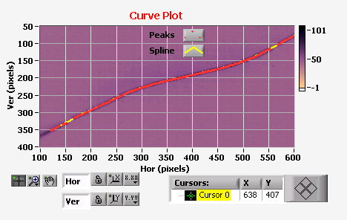
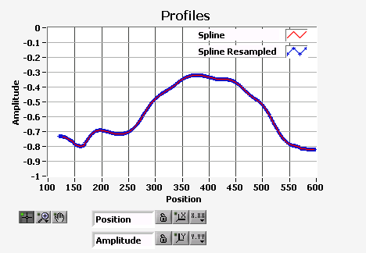
Analyzing: Image to Profile
Find curve in image then take derivative to find profile:
  Use spline fit to reduce noise but not predispose to a certain profile shape
  Shows slope
  Show effect of gap in trace due to marker
Marker
Slope
  ~1.2µC beam

Slide 14
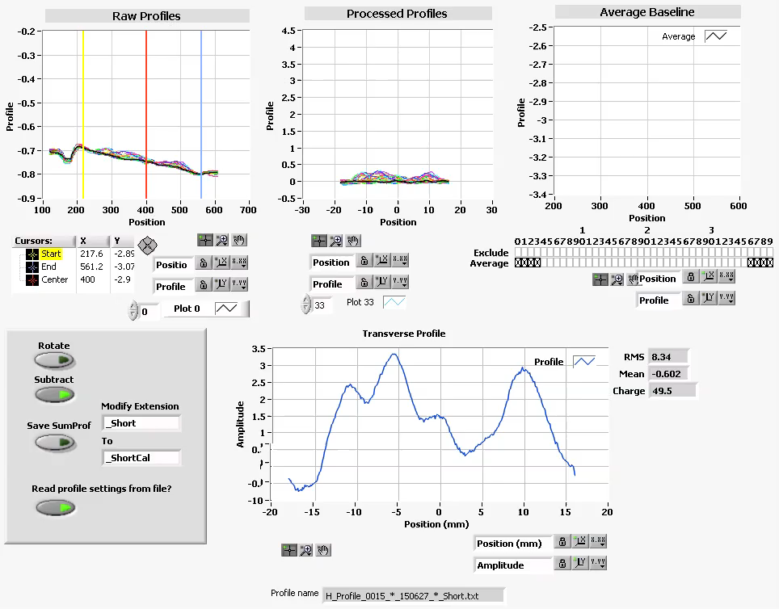
Analyzing the data: Composite Profile
From profile slice to composite profile:
  Shows slope
    Subtract base trace
  Show effect of gap in trace due to marker
    Exclude if no deflection
Animation of analyzing all profiles in this data set (40 turns with each 40 slice profiles of ~1.2µC total accumulation)

Slide 15
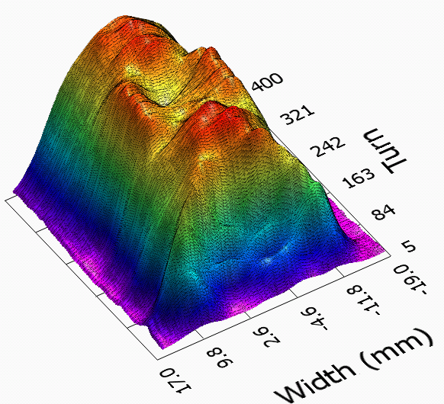
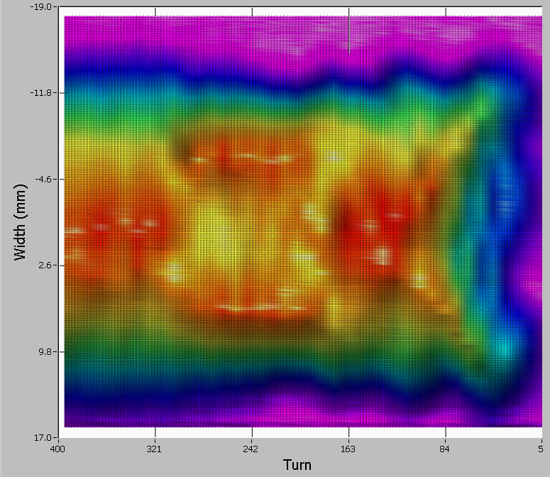
Analyzing the data: display
Beam accumulation for the first 100 turns
The Electron Scanner shows the evolution of transverse profile during the accumulation (and even profiles within the bunch)
Qualitative idea of what is going on. But we need additional quantitative results for beam dynamics
  Checking the electron scanner profiles

Slide 16
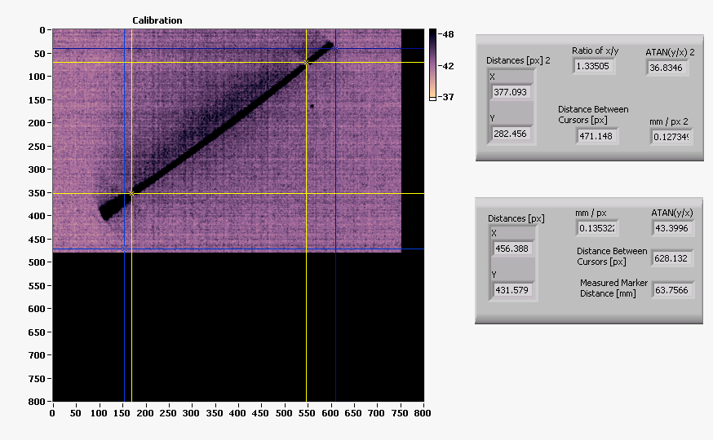
Calibrating the scale
Convert image pixels to mm in the profile
  Horizontal projection isn’t quite at 45 degrees → small correction
  Vertical deflector intentionally rotated → large correction

Slide 17
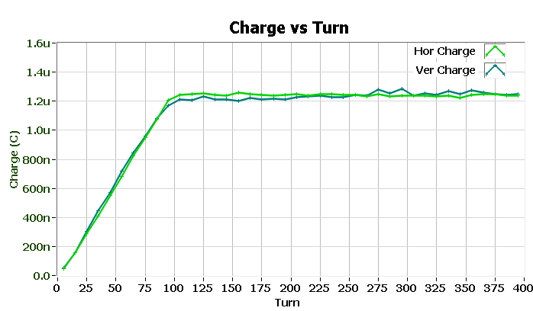
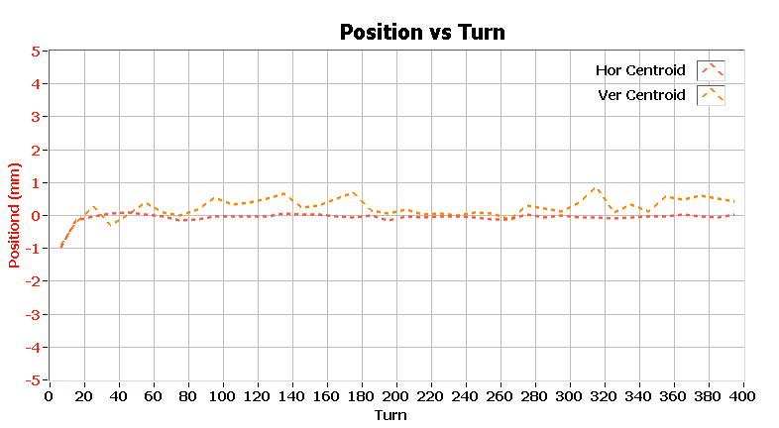
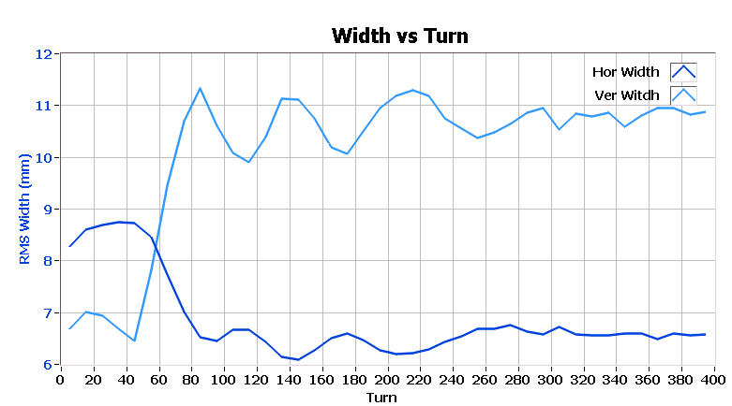
Checking the obtained profiles
Integrate profile to obtain charge
  we clearly see the linear increase in charge up to turn 100 and the charge matches beam accumulation even as profiles are changing (whole profile is captured)
Track centroid through accumulation and storage
  Centroid is stable
Calculate RMS width

Slide 18
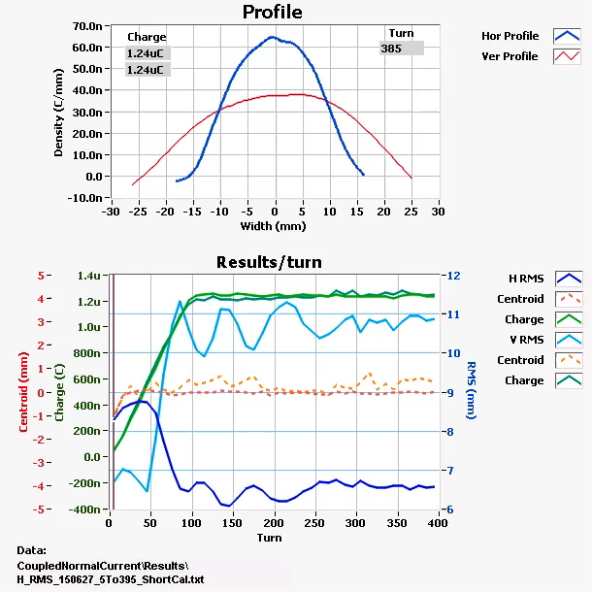
Analyzing the data: Numerical results
Plot the charge, centroid, and RMS width for both planes in same plot
Allow user to view evolution of profile

Slide 19
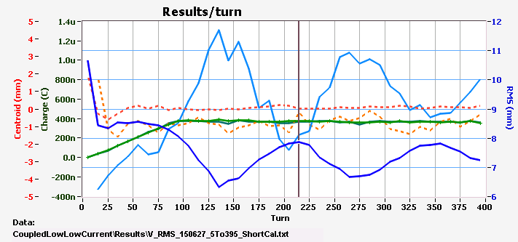
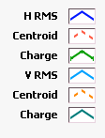
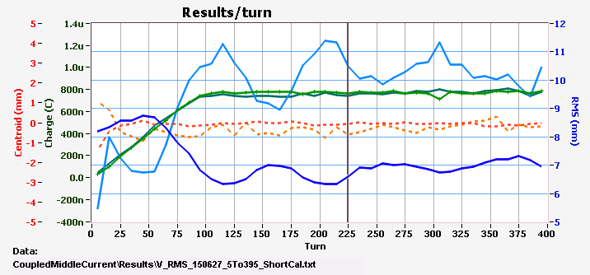
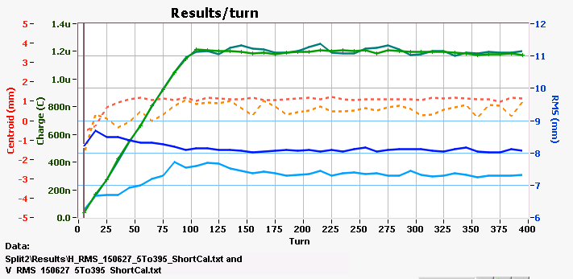
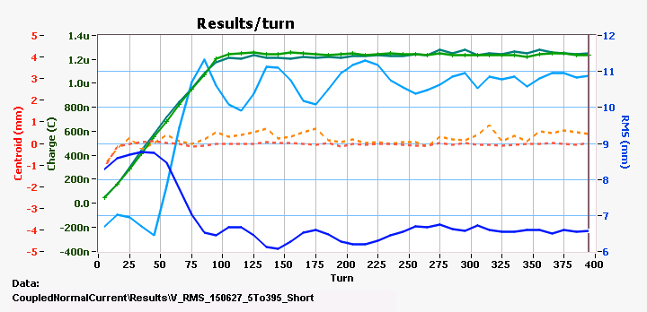
Ring coupled beam study: Initial results
0.4 µC
0.7 µC
1.2 µC
1.2 µC
Split tune does not show RMS oscillation
Case | Hor Tune | Ver Tune | dTune
Equal | 6.19944 | 6.19781 | 0.00163
Split | 6.20898 | 6.16860 | 0.04038

Slide 20
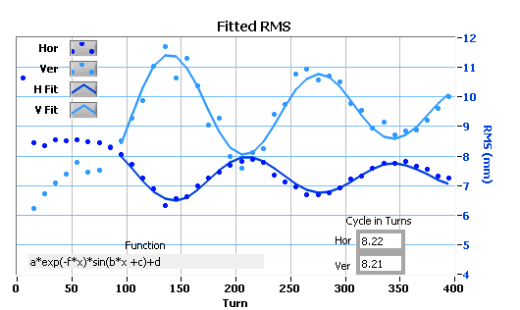
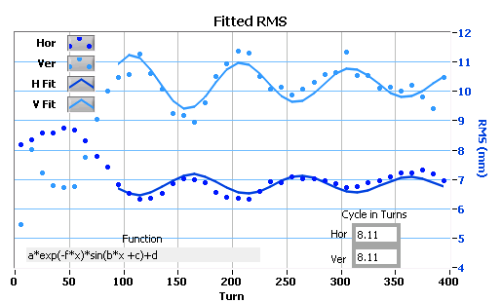
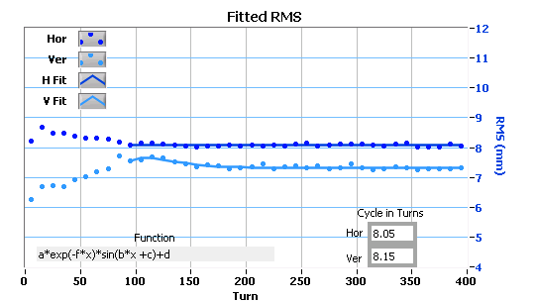
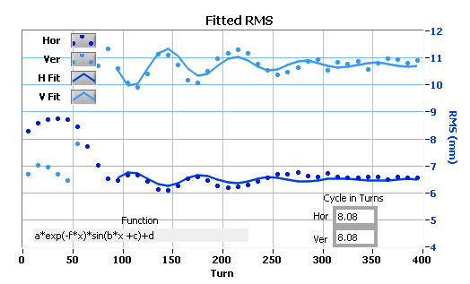
Ring coupled beam study: initial results
Damped oscillator: check its period changes vs charge
0.4 µC
← Lower charge seems to have longer and stronger exchange of RMS
1.2 µC
0.7 µC
1.2 µC
Split tune
Fit to function:
a*exp(-f*x)*sin(b*x +c)+d

Slide 21
Beam Dynamics initial conclusions
Probably not Montague Resonance because coupling stronger at lower intensities
Looks like linear lattice coupling, but this was corrected before experiment started with skew quads
Investigation ongoing…. (e.g. mapping profiles from RTBT to Ring, simulations, verifying calibration)

Slide 22
Beam Dynamics meets Diagnostics
Good example of how to use a complex diagnostic
Has advantages over wire scanner
  Can handle high intensity
  Scans faster
  Not interceptive → No beam losses
The Beam Dynamics experimental needs pushed the development of the electron scanner software
  Manage many turns of data for acquisition and display
  Further verification of analysis
At SNS, the Beam Dynamics and Diagnostics meet every day (Espresso!)

