Slide 1
MVD ASSEMBLY UPDATE
GSI 27th April 2015 - G. Giraudo

Slide 2
GSI 27th April 2015 - G. Giraudo
Power supplies control
To CR
To CR
1.5V
GBT
2.5V
Racks
Optical fiber
Sense wire
Pixel modules
Strip modules
Patch panels
HV
LV
1248 cables
~18000 mm²
HV
LV
Section D
Section A
Section B
Signals
Section A2
DCDC
DCDC
DCDC
Section A1
GBT
Beam pipe
Section C
INSIDE MAGNET

Slide 3
GSI 27th April 2015 - G. Giraudo
MODULARITY AND COOLING lines MVD
LAYER 1
DX Half → 8 staves 4 U tubes 4 lines [4*(1 in 2 U tubes)]
SX Half → 6 staves 3 U tubes 2 lines [2*(1 in 3 U tubes)]
LAYER 2
DX Half layer 14 staves 7 U tubes 6 lines [2*(1 in 3 U tubes); 4*(1 in 2 U tubes)]
SX Half layer 14 staves 7 U tubes 6 lines [1*(1 in 3 U tubes); 4*(1 in 2 U tubes)]
LAYER 3
DX Half layer 10 staves 5 U tubes 4 lines [2*(1 in 3 U tubes); 2*(1 in 2 U tubes)]
SX Half layer 10 staves 5 U tubes 4 lines [2*(1 in 3 U tubes); 2*(1 in 2 U tubes)]
LAYER 4
DX Half layer 13 staves 6 U tubes + 1 single 6 lines [2*(1 in 3 U tubes); 4*(1 in 2 U tubes)]
SX Half layer 13 staves 6 U tubes + 1 single 6 lines [2*(1 in 3 U tubes); 4*(1 in 2 U tubes)]
DISKS 1-2 (pixel disks)
DX Half disk 2 tubes 2 lines [2*(1 in 2 U tubes)]
SX Half disk 2 tubes 2 lines [2*(1 in 2 U tubes)]
DISKS 3-6 (pixel disks)
DX Half disk 12 U tubes 8 lines [8*(1 in 3 U tubes)]
SX Half disk 12 U tubes 8 lines [8*(1 in 3 U tubes)]
DISKS 7-8 (strip disks)
DX Half disk 4 U tubes 4 lines [8*(1 in 2 U tubes)]
SX Half disk 4 U tubes 4 lines [8*(1 in 2 U tubes)]
Manifolds Volume
Inside MVD
→ 66 Cooling lines ←

Slide 4
GSI 27th April 2015 - G. Giraudo
MVD COOLING LINES MODULARITY
LINES FOR 3 U tubes
LINES for 2 U tubes
OUTSIDE MAGNET INSIDE MAGNET
INSIDE MAGNET OUTSIDE MAGNET
PP3
φ_{i} 8 mm
0,9 lit/min
PP4
φ_{i} 6 mm
0,9 lit/min
PP4
φ_{i} 8 mm
0,6 lit/min
φ_{i} 6mm
0,6 lit/min
PP3
30 COOLING LINES
φ_{i} 2,5mm
0,3 lit/min
36 COOLING LINES
Front Door
φ_{i} 2,5mm
0,3 lit/min
MVD
Front Door
φ_{i} 10mm
0,9 lit/min
PP4
φ_{i} 6mm
0,9 lit/min
PP4
PP3
U tubes
(φ_{e} 2mm)
φ_{i} 6mm
0,6 lit/min
PP3
φ_{i} 10 mm
0,6 lit/min
LINES FOR DC-DC CONVERTER & GBT
OUTSIDE MAGNET INSIDE MAGNET
φ_{i} 8mm
0,9 lit/min
PP4
φ_{i} 6 mm
0,9 lit/min
DCDC/GBT
PP4 collects 126 cooling lines
PP3
60 COOLING LINES
Front Door
U tubes
(φ_{i} 5mm)
φ_{i} 10 mm
0,9 lit/min
PP4
φ_{i} 6mm
0,9 lit/min
PP3

Slide 5
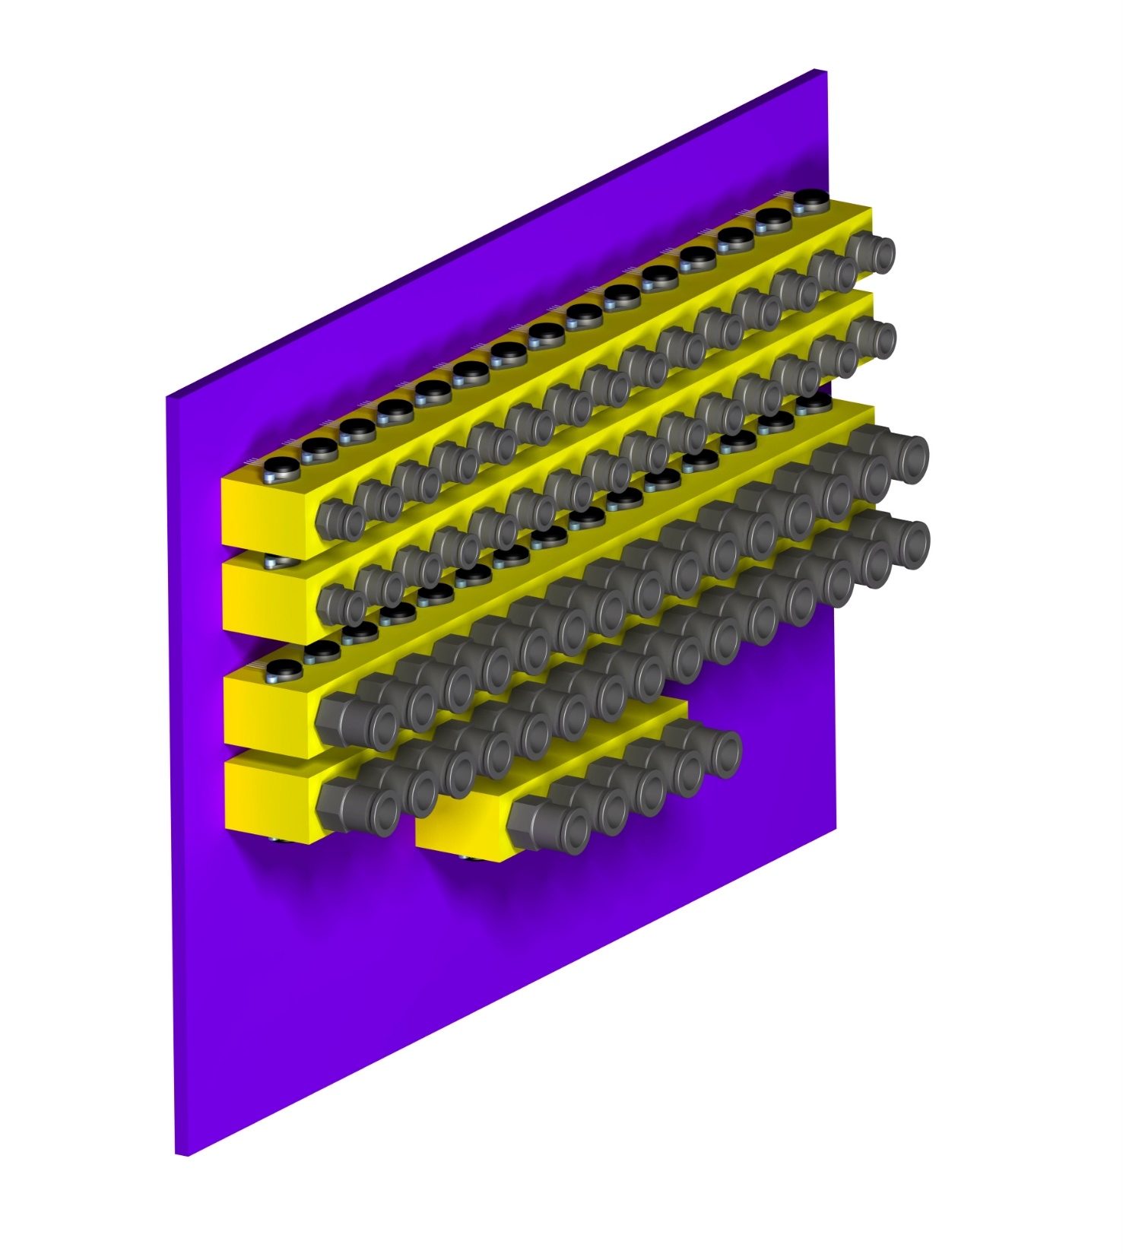
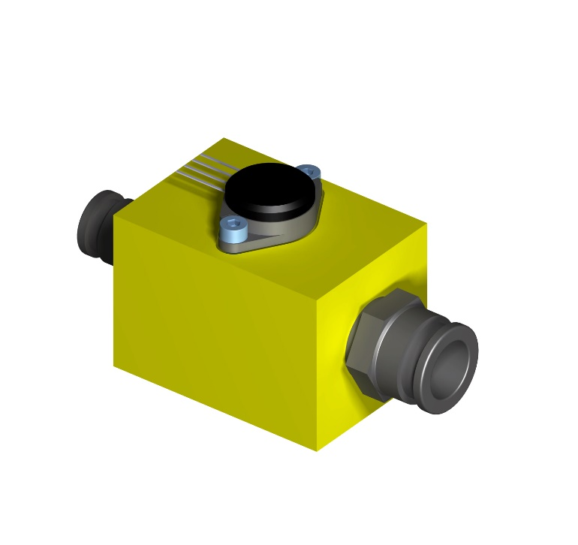
The Patch Panel 4 (Cooling Tubes Transition)
GSI 27th April 2015 - G. Giraudo
Pressure transmitter
Fast Fitting tube 8 mm
600x400x8 (mm)
Fast Fitting tube 12/16 mm
SS transition block

Slide 6
The Patch Panel for Electronics (preliminary sketch)
GSI 27th April 2015 - G. Giraudo
PP LV
300x300x200 (mm)
PP Optical Fibres
200x100x200 (mm)
PP HV
400x100x200 (mm)
PP GBT-LV
600x150x200 (mm)
600x650x200 (mm)

Slide 7
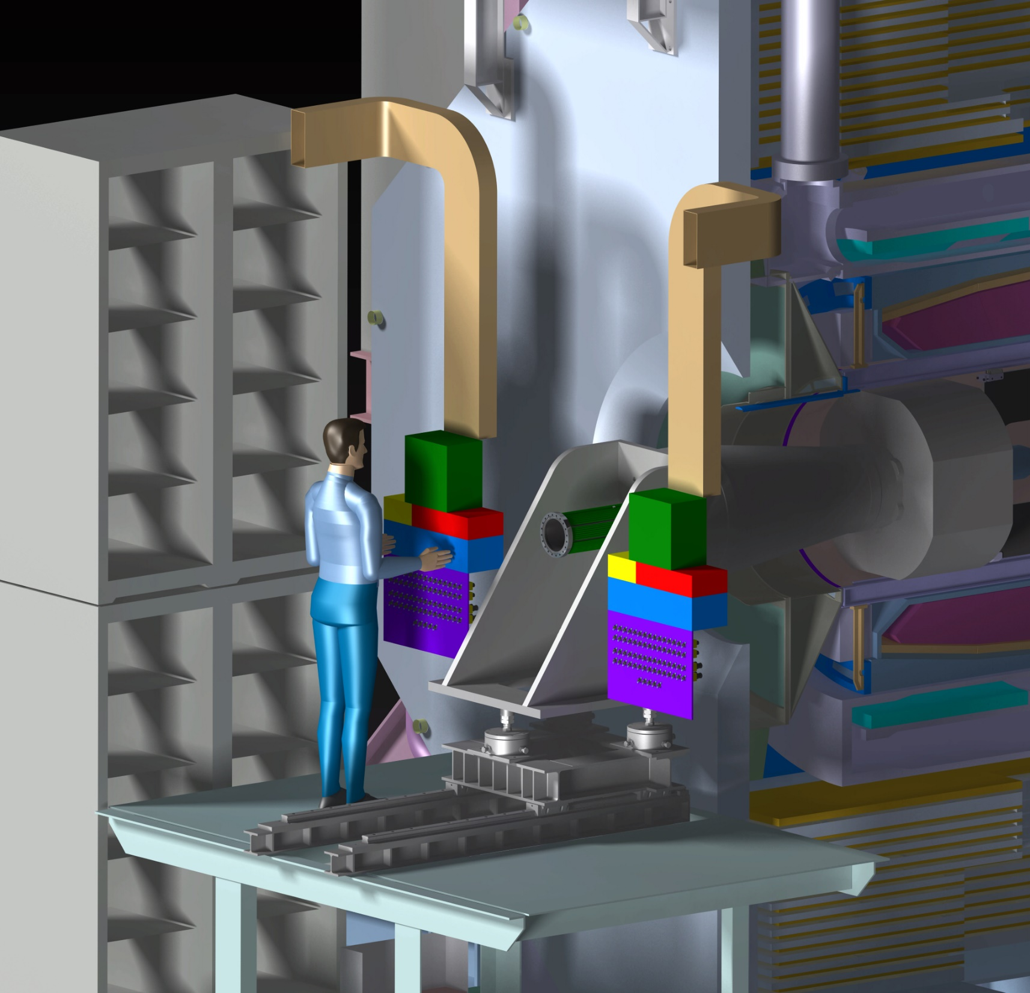
GSI 27th April 2015 - G. Giraudo
The Cooling Path
The PP4s must be located as close as possible to the beam line
To PP3
To PP3

Slide 8
GSI 27th April 2015 - G. Giraudo
The Electric Path
To Racks
To Racks

Slide 9
ASSEMBLY OPEN PROBLEMS
GSI 27th April 2015 - G. Giraudo
This pipe sector must be fixed, cannot stay cantilever
The PPs array should be
suspended and fixed on the platform
QUESTION: could the PPs array stay in place during maintenance?
Vacuum Pump dimension & location must be defined

