Slide 1
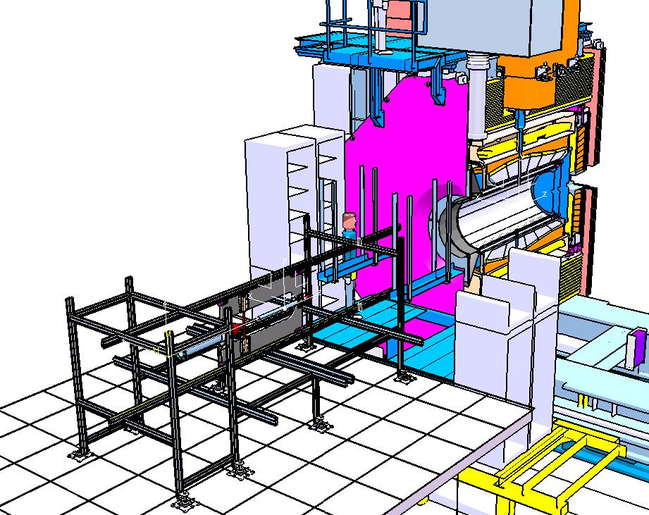
- CT INSTALLATION PROCEDURE OVERVIEW -
THE AUXILIARY STRUCTURE HAS BEEN:
> POSITIONED ON THE MOUNTING PLATFORM;
> THE UPPER AND LOWER RAILS ALIGNED WITH
THOSE OF BARREL DIRC STRUCTURE
> THE CENTRAL SUPPORT FRAME HAS BEEN
PLACED IN THE AUXILIARY STRUCTURE.
CRUCIAL TOPICS:
> THE RECIPROCAL POSITIONS OF THE “DIRC BARREL RAILS”;
> THE ALIGNEMENT PROCEDURE OF THE RAILS SYSTEM;
> THE DEFINITION OF A FURTHER MECHANICAL POSITIONING
SYSTEM OF THE RAIL POSITIONS.
GSI-MECH WORKSHOP_27.4.2015 - D. ORECCHINI

Slide 2
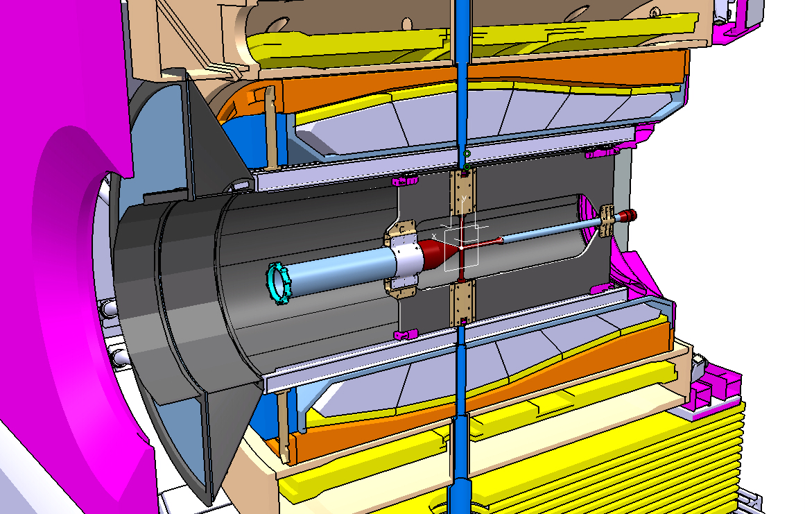
- CT INSTALLATION PROCEDURE OVERVIEW -
THE ROLE OF THE CENTRAL SUPPORT FRAME IS CRUCIAL FOR:
> TO CHECK THE CORRECT ALIGNMENT OF THE RAILS SYSTEM;
> TO CHECK THE CORRECT COUPLING WITH THE TARGET
VERTICAL ARM.
CRUCIAL TOPICS:
> THE INNER VOLUMES MUST BE ACCESIBLE FROM BOTH SIDES;
> THE ALIGNMENT PROCEDURE OF THE CENTRAL SUPPORT FRAME;
> SOME “FAKE COMPONENTS” THAT SIMULATE THE CROSS PIPE COUPLING
PARTS MUST BE IMPLEMENTED IN THE FRAME.
GSI-MECH WORKSHOP_27.4.2015 - D. ORECCHINI

Slide 3
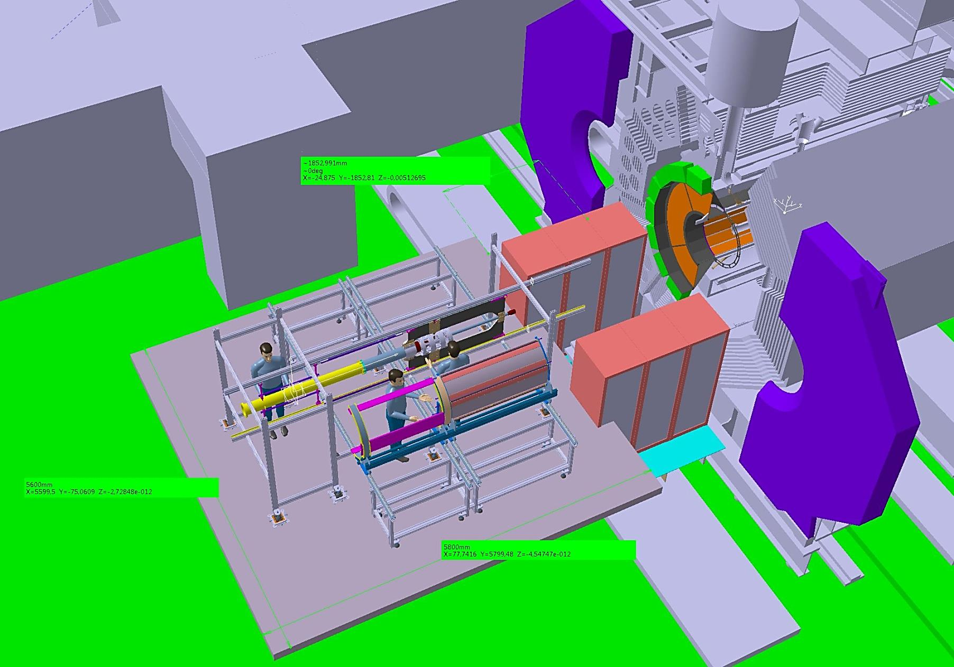
- CT INSTALLATION PROCEDURE OVERVIEW -
THE STEPS OF THE CENTRAL TRACKER ASSEMBLY PROCEED WITH:
> THE VERTEX ASSEMBLY;
> THE STT ASSEMBLY .
VERTEX.
ST_TRACKER.
GSI-MECH WORKSHOP_27.4.2015 - D. ORECCHINI

Slide 4
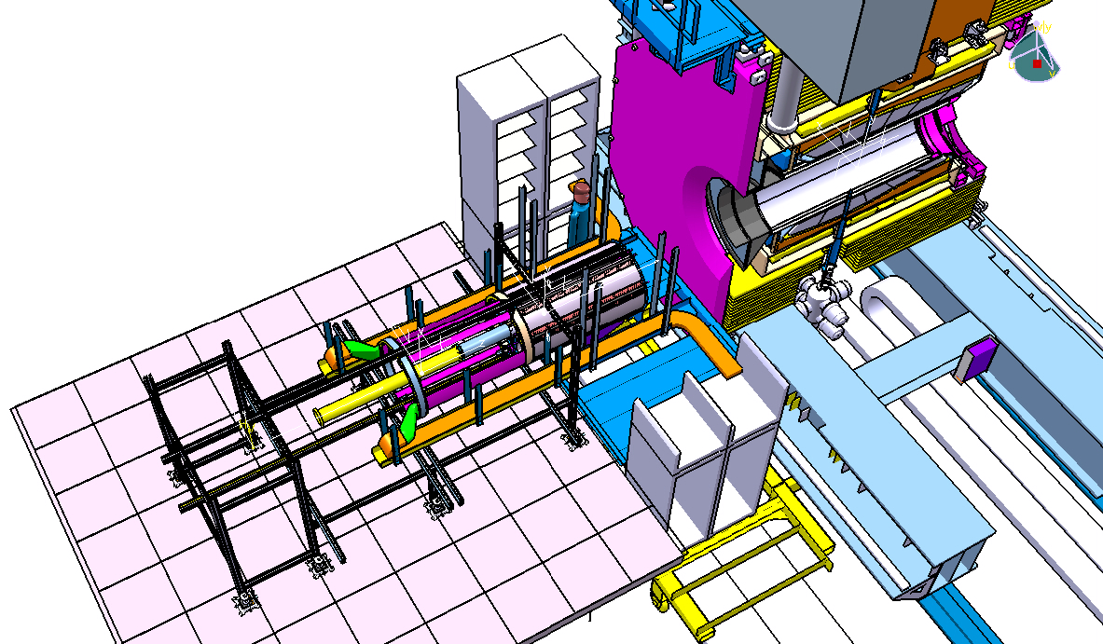
- STT SERVICES (CABLES AND GAS PIPES) PROCEDURE OVERVIEW -
HYPOTESIS FOR STT CABLING/PIPING:
> RACEWAYS ARE MOUNTED ON THE SIDEWAYS OF THE CT
SYSTEM (ONE FOR EACH SIDE);
> THE SERVICES (CABLES AND GAS PIPES) ARE CONVOYED IN
THE RACEWAYS AND CONNECTED TO THE RACKS.
GSI-MECH WORKSHOP_27.4.2015 - D. ORECCHINI

Slide 5
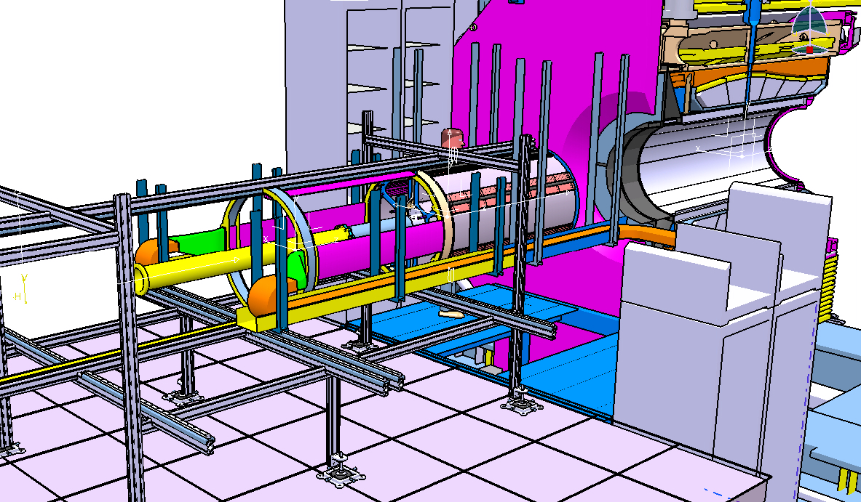
- STT SERVICES (CABLES AND GAS PIPES) PROCEDURE OVERVIEW -
HYPOTESIS FOR STT CABLING/PIPING:
> THE SUPPORT STRUCTURE OF THE RACEWAYS ARE FORMED BY TWO PARTS:
- A BLUE ONE, SUPPORTED ON THE RACKS STRUCTURE;
- A YELLOW ONE, SUPPORTED ON THE AUXILIARY STRUCTURE.
GSI-MECH WORKSHOP_27.4.2015 - D. ORECCHINI

Slide 6
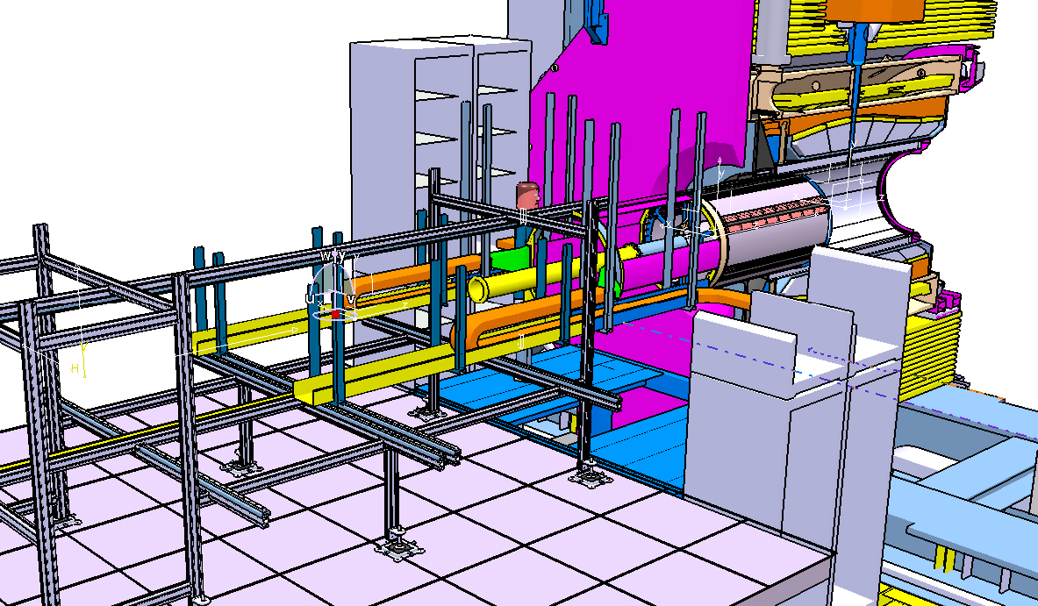
- STT SERVICES (CABLES AND GAS PIPES) PROCEDURE OVERVIEW -
HYPOTESIS FOR STT CABLING/PIPING:
> DURING THE SHIFTING PHASE OF THE CT INSIDE THE MAGNET, THE RACEWAYS FOLLOW
THE MOVEMENT OF THE CENTRAL SUPPORT FRAME.
GSI-MECH WORKSHOP_27.4.2015 - D. ORECCHINI

Slide 7
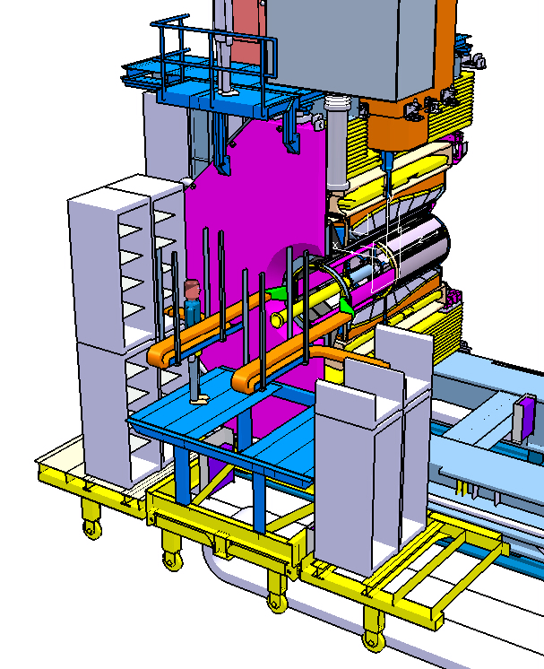
- STT SERVICES (CABLES AND GAS PIPES) PROCEDURE OVERVIEW -
HYPOTESIS FOR STT CABLING/PIPING:
> THE CT IS IN THE FINAL POSITION INSIDE THE MAGNET.
> THE RACEWAYS SUPPORTED ON THE AUXILIARY
STRUCTURE (THE YELLOW ONE), ARE DISMOUNTED
TOGHETER WITH IT.
> THE RACEWAYS SUPPORTED ON THE RACKS STRUCTURE,
(THE BLUE ONE), REMAIN ON SITE.
GSI-MECH WORKSHOP_27.4.2015 - D. ORECCHINI

Slide 8
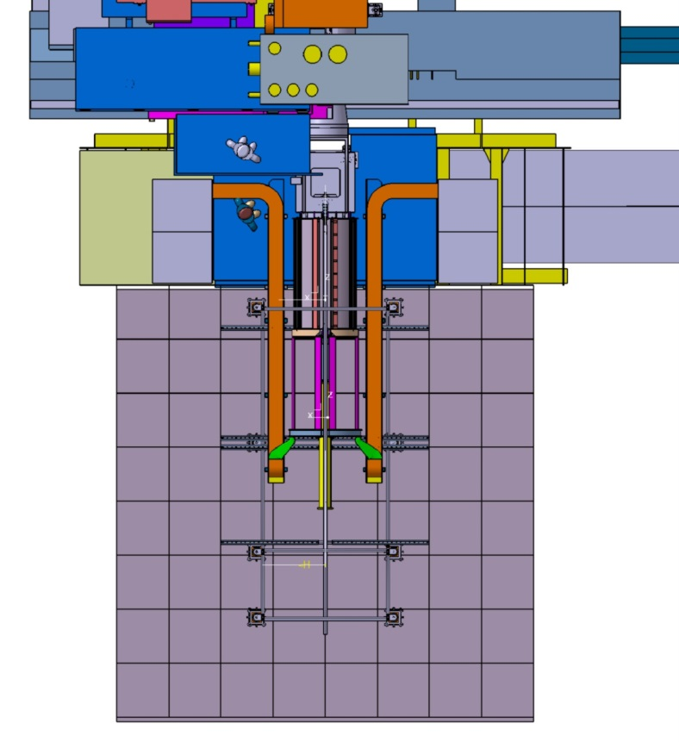
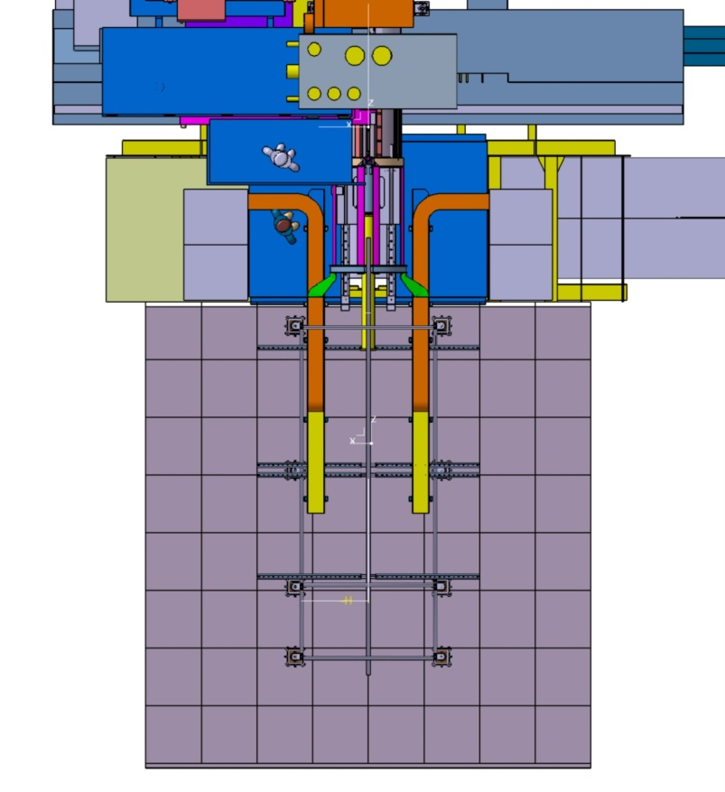
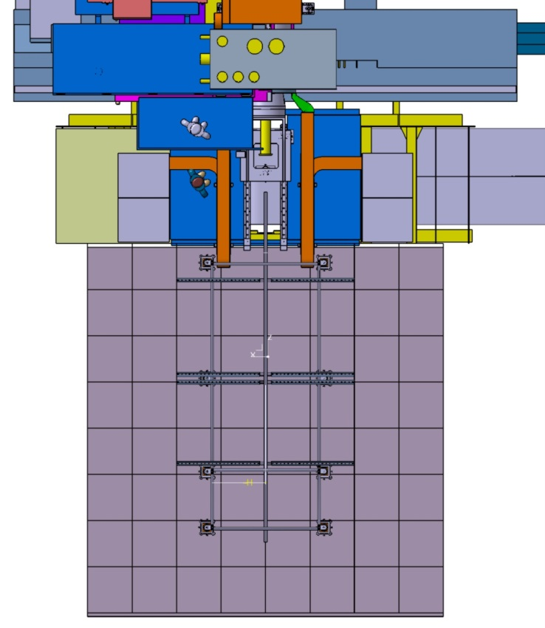
- STT SERVICES (CABLES AND GAS PIPES) PROCEDURE OVERVIEW -
HYPOTESIS FOR STT CABLING/PIPING:
> TOP VIEW OF THE RACEWAYS MOVEMENT.
STEP 1: THE CT IS COMPLETELY
OUTSIDE.
STEP 2: THE CT IS IN AN
INTERMEDIATE POSITION.
STEP 3: THE CT IS IN THE FINAL POSITION.
GSI-MECH WORKSHOP_27.4.2015 - D. ORECCHINI

Slide 9
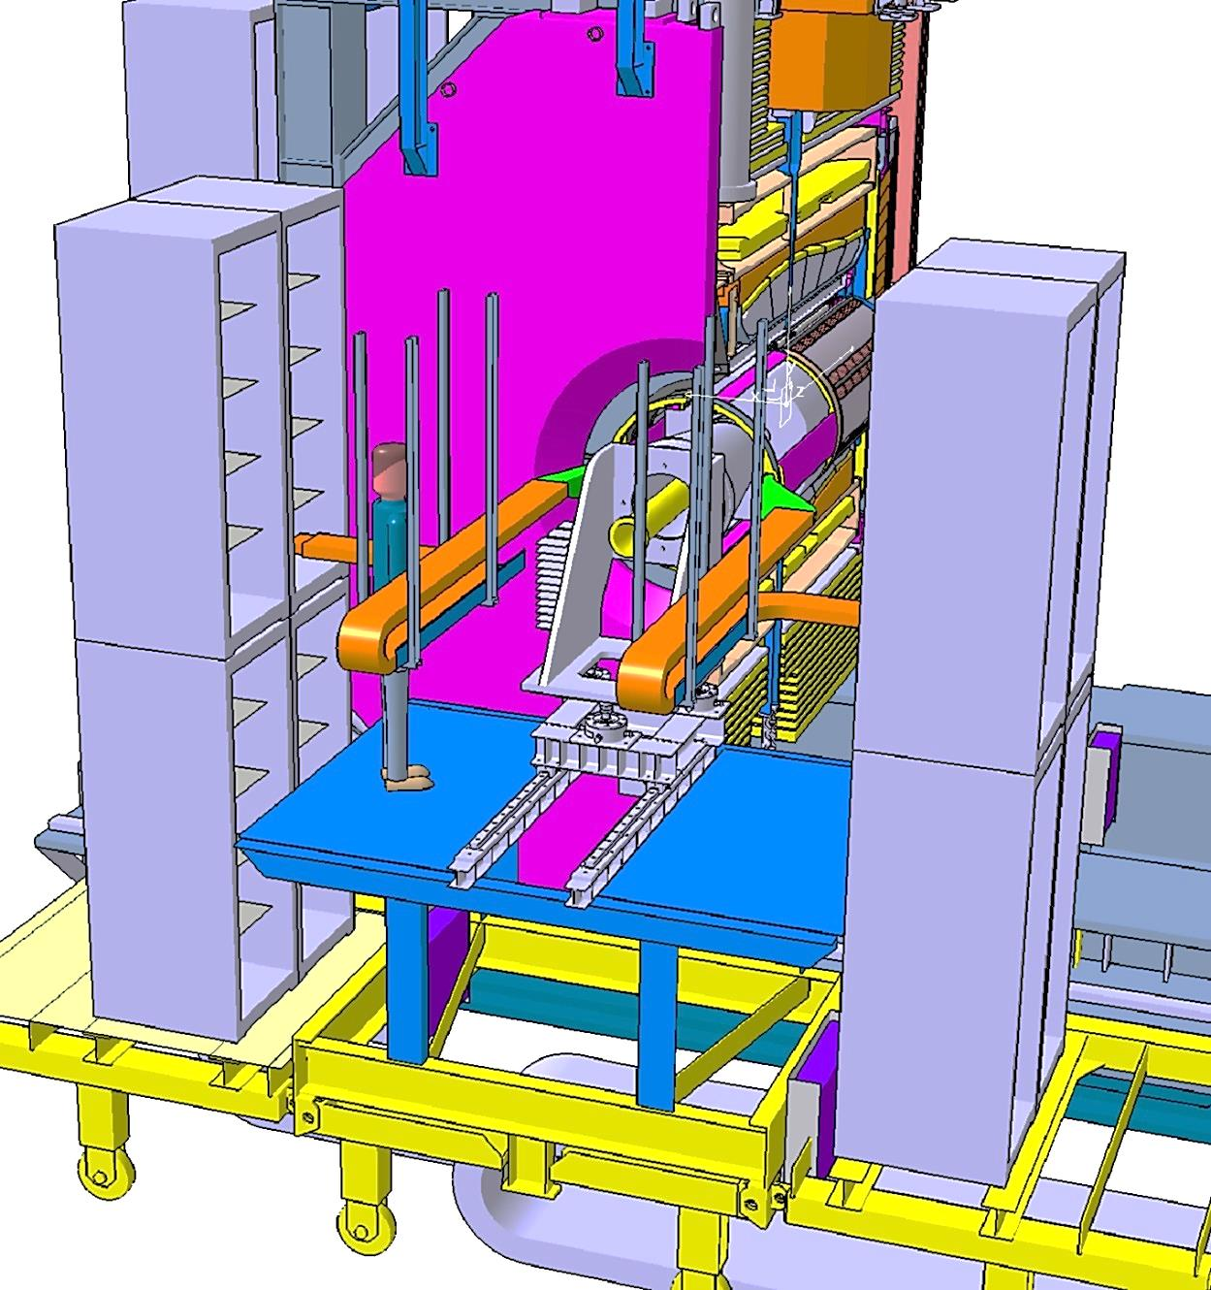
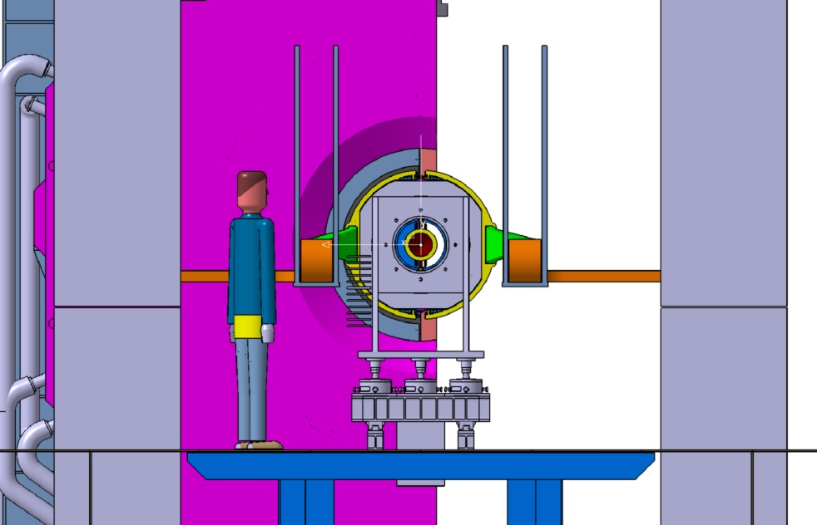
- STT SERVICES (CABLES AND GAS PIPES) PROCEDURE OVERVIEW -
HYPOTESIS FOR STT CABLING/PIPING:
> CT IN FINAL POSITION.
INTERFERENCES WITH OTHER COMPONENTS DO NOT SEEM TO BE…….. ?.
GSI-MECH WORKSHOP_27.4.2015 - D. ORECCHINI

Slide 10
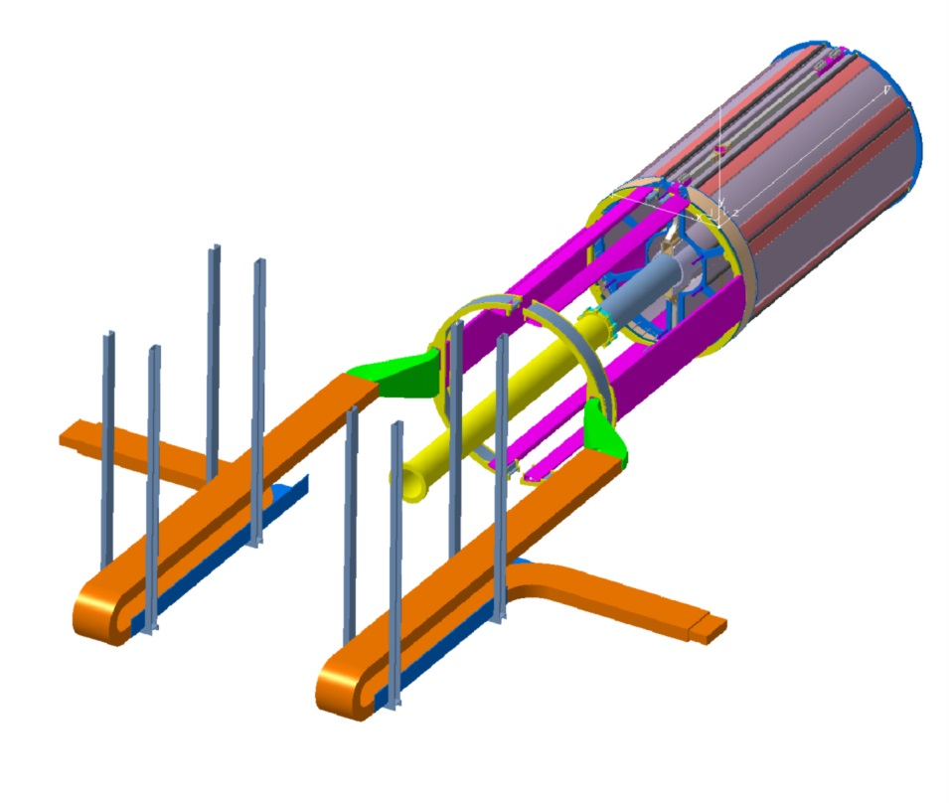
- STT SERVICES (CABLES AND GAS PIPES) PROCEDURE OVERVIEW -
HYPOTESIS FOR STT CABLING PROS:
> THE SYSTEM APPEARS FEASIBLE AND RATIONAL.
> NO PATCH PANELS
> ??????
HYPOTESIS FOR STT CABLING CONS:
> THE SPACE ON THE SIDEWAYS OF THE CT WILL BE OCCUPIED
BY THE RACEWAYS.
> MUST BE MANAGED MORE OF 5 METERS OF CABLES AND GAS PIPES.
> ?????
GSI-MECH WORKSHOP_27.4.2015 - D. ORECCHINI

Slide 11
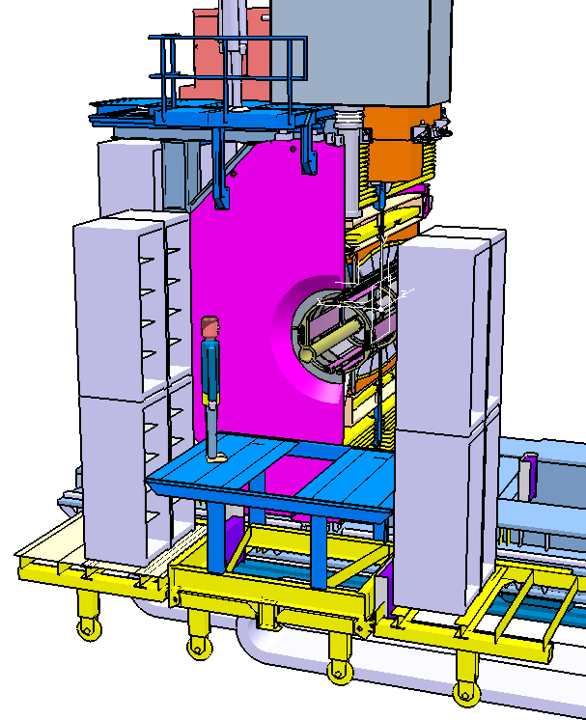
- STT SERVICES (CABLES AND GAS PIPES) PROCEDURE OVERVIEW -
PATCH PANELS.
AN ALTERNATIVE HYPOTESIS FOR STT CABLING (AS SUGGESTED BY DANIELA):
> A SYSTEM OF PATCH PANELS COULD BE SUSPENDED ON THE RACKS STRUCTURE (A SORT OF BRIDGE).
> THE CABLES AND THE GAS PIPES BETWEEN RACKS AND PATCH PANELS REMAIN ALWAYS CONNECTED;
> THE CABLES AND THE GAS PIPES BETWEEN SST AND PATCH PANELS MUST BE CONNECTED AFTER THE
CT INSERTION AND MUST BE DISCONNECTED BEFORE THE CT EXTRACTION.
GSI-MECH WORKSHOP_27.4.2015 - D. ORECCHINI

Slide 12
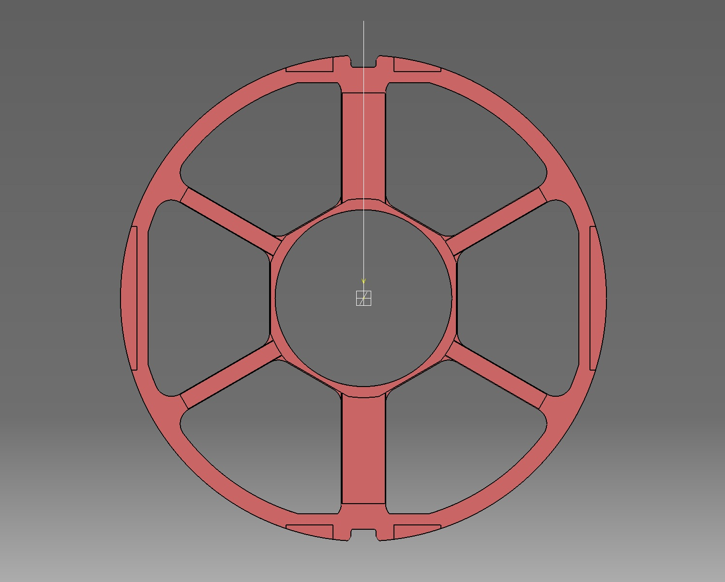
- SIGNALS CABLES AND GAS PIPES CROSS SECTION DATA -
24
17
19
95
13
22
13
- SIGNALS CABLES CROSS SECTION:3000mm^2
9
54
41
53
17
14
- SERVICES TOTAL CROSS SECTION: 3000mm^2
- AVAILABLE CROSS SECTION: 5500mm^2
296 Flates
(2960 Ch.)
106
13
54
41
53
17
9
23
13
19
13
95
17
24
-The encumbrance of the connectors
has not been considered!
GSI-MECH WORKSHOP_27.4.2015 - D. ORECCHINI
Notes:
in reality we would have had considered 3478 = 2318 tubes + 1160 control lines
The surface of the Left and Right cutouts is 6600 mm2

Slide 13
- HV CABLES AND GAS PIPES CROSS SECTION DATA -
15 Gas Pipes
20 HV Cables
5 Gas Pipes
(From the Forward Side)
- HV CROSS SECTION: 200mm^2
13 HV Cables
- GAS PIPE CROSS SECTION: 450mm^2
10 Gas Pipes
(From the Forward Side)
13
COOLING PIPE CROSS SECTION: 70mm^2
(New entry)
7
- SERVICES TOTAL CROSS SECTION: 800mm^2
- AVAILABLE CROSS SECTION: 1400mm^2
14 HV Cables
6
10 Gas Pipes
(From the Forward Side)
13 HV Cables
13
5Gas Pipes
(From the Forward Side)
-The encumbrance of the connectors
has not been considered!
15 Gas Pipes
20 HV Cables
GSI-MECH WORKSHOP_27.4.2015 - D. ORECCHINI
Notes:
The surface of the Up and Down cutouts is 1800 mm2 each

