Slide 1
STT News & Status
Peter Wintz (FZ Jülich) for the STT group
LII. PANDA CM Giessen, TRK session, Mar-18th, 2015

Slide 2
STT Status
News
Project Plan
Construction Status
Plans 2015
Review Beam Tests 2014
Summary

Slide 3
News - Personnel
Sedigheh Jowzaee finished her Ph.D. (Jerzy Smyrski‘s group, Jagiell. Univ.), PID with time-over-threshold simulations, COSY-TOF straw tracker, pp →pKλ analysis
Next: Dominik Przyborowski (Ph.D. thesis, AGH Krakov), Harout Ohannessian (master thesis, FZJ)
Alexandros Apostolou (Johann‘s group, KVI Groningen) started his Ph.D. research visit in Jülich, working on STT, beam data analysis
Solmaz Vejdani (Johann‘s group, KVI Groningen) joined STT group, participates in next beam time

Slide 4
Upcoming Events
March-25/26th: Frascati-Juelich WShop, STT+CFrame prototype assembly
April-9/10th: PANDA DAQT-FEE Wshop at GSI
April-27/28th: PANDA Mechanical WShop at GSI
May 4th-10th: test beam week at COSY (STT + FT), BigKarl beam area
Summer: installation of STT test systems in new beam area (COSY-TOF)
Sep/Nov: further beam tests planned (proton / deuteron), larger test setups
Q4 / 2015: Pre-series test system assembly, one STT sector, ~ 700 straws
Q1 / 2016: Pre-series STT sector with test beam

Slide 5
Project Plan
System timelines separated in construction schedule & installation schedule
STT construction timelines below (milestone loaded schedule)
Propose to extend off-site testing Q2/ 2018 → Q2-Q3/ 2018
option for full pre-commissioning of STT with beam off-site
Test all channels & replace faulty readout boards, full access
Tune readout settings, thresholds with beam (most time consuming task)
Then concentrate on mechanical installation of STT system at FAIR
Definition of installation procedures and schedule in progress ..

Slide 6
STT Status – Mech. Construction
STT construction & system design
Straw mass production ongoing
Profile plate for straw module gluing ordered (new straw pitch 10.14mm)
Next step: straw module gluing (quad-layers)
Overall system design
Assembly of STT / Central Frame prototype (Frascati/Juelich)
Next: mounting & alignment of straw modules in STT frame
General installation, rack positions, cabling scheme .. ongoing
Set up new test & assembly area in Juelich
COSY-TOF beam area, in-beam tests, cosmic tests
Option: STT set up area ..

Slide 7
STT Status – Electronic Readout
Setting up larger-scale readout system ongoing (~ 700 ch)
New PASTTREC(v1) ASIC readout chip
FE-board produced, chips bonded, functional tests done
TRB readout system set up, 10× TRB boards, crate architecture, ..
New: ASIC setting/control by FPGA in TRB
→ Reports by Dominik & Pawel
FADC readout system, FEE-free layout design (HV supply & pre-amp backend), system architecture defined, rack design, connectors ongoing

Slide 8
Beam Requests for 2015
Beam time | Beam | Momentum (GeV/c) | Area | Setups
1 week (May 4th-10th) | Proton | 3.0, 0.8, 0.6 | Big Karl | Existing (2014) + new readout, PANDA-FT prototype
2 weeks (in late Q3) | Proton | 3.0, 2.0, 1.3, 1.0, 0.8, 0.6 | COSY-TOF | Larger straw and readout setups
1 week (in Q4) | Deuteron | 2.0, 1.3, 1.0 | COSY-TOF | Same as before

Slide 9
Beam Requests for 2015
Beam time | Beam | Momentum (GeV/c) | Area | Setups
1 week (May 4th-10th) | Proton | 3.0, 0.8, 0.6 | Big Karl | Existing (2014) + new readout, PANDA-FT prototype
2 weeks (in late Q3) | Proton | 3.0, 2.0, 1.3, 1.0, 0.8, 0.6 | COSY-TOF | Larger straw and readout setups
1 week (in Q4) | Deuteron | 2.0, 1.3, 1.0 | COSY-TOF | Same as before
Beam test week in May approved, STT + FT tests
Beam time for 2nd half 2015 decided at next CBAC meeting (Jun-29/30th)

Slide 10
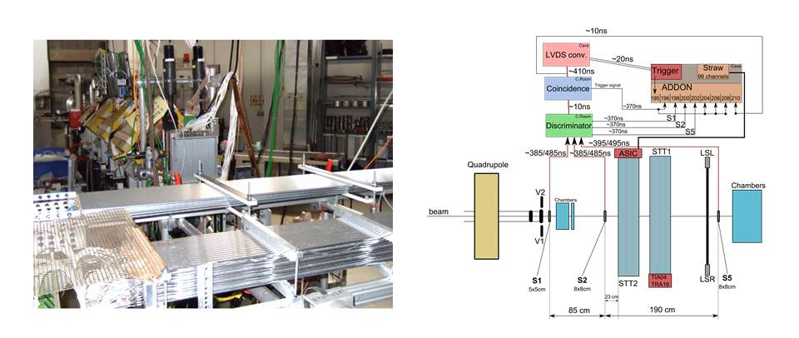
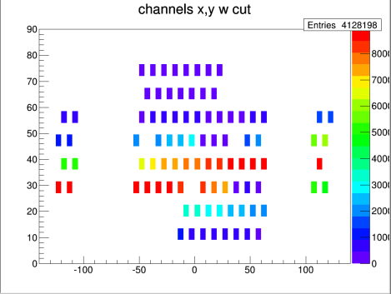
Beam Test Series In 2014
3x 1 week (July / Sep / Dec) at COSY Big Karl beam area
Coverage of large dE/dx region, large signal dynamic range for PID test
6× different proton momenta (0.6, 0.8, 1.0, 1.3, 2.0, 3.0 GeV/c)
3× different deuteron momenta (1.0, 1.3, 2.0 GeV/c)
2 Straw setups for both readouts: time-over-threshold / amplitude readout
Additional scintillators, straw chambers, GEM for triggering & beam monitor
Two straw test setups in Big Karl area. Additional straw and GEM detectors for beam monitoring (beam from back).
Hitmap for one straw setup. Boxes mark straw positions and hit rate by color. Arrow indicates the beam position.
Sketch of setups and data-acquisition for the ASIC/TRB readout (beam from the left).

Slide 11
Data Analysis - Track Reconstruction
Calibration method
Time offset and time-over-threshold shifts for individual channels corrected
Determine isochrone radius – drift time relation, global (same) for all straws
1st step: from time spectra (integration/number of entries)
2nd step: isochrone – drift time re-fit by reconstructed tracks
Track reconstruction (minor hit cuts)
χ² – fit of straight line to isochrone circles
Cut on minimal number of hits (7), on average 12 hits per track (10-15 hits)
Removal of single outlier (δ-electron) hits (distance > 3σ)
No further cuts on track quality (no χ² - cut, ..)
Still some background hits present (multi-tracks, improper timing, ..)
Straggling not corrected, ..
→ Susanna‘s & Harout‘s talk

Slide 12
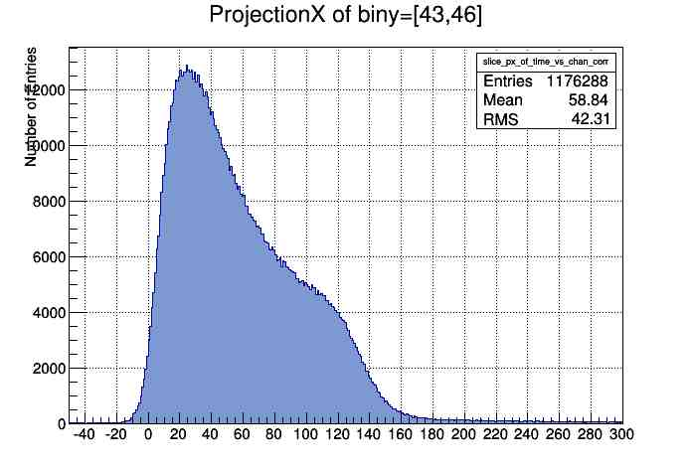
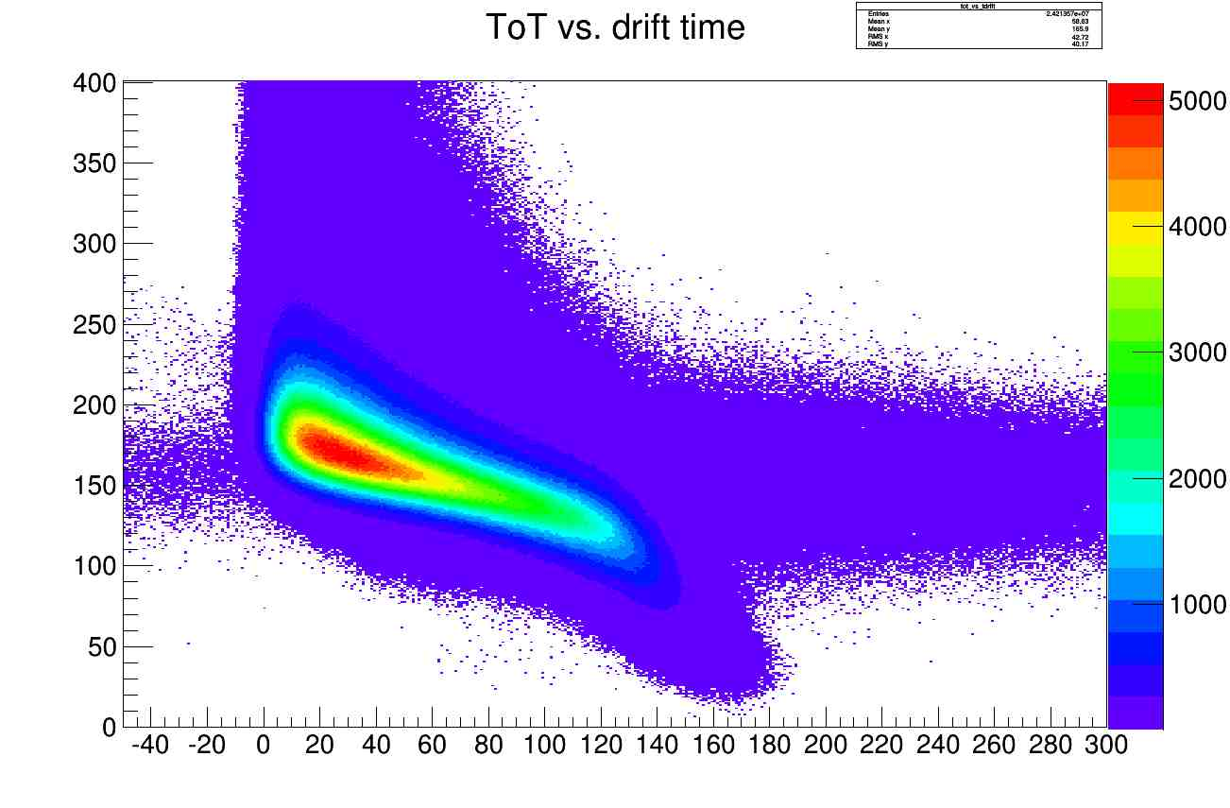
Data Analysis - Raw Tíme Spectra
Here: ASIC/TRB readout data shown
Clean beam data, similar for FADC data
Drift time spectra (all channels)
Time range ~ 160ns
Time-over-threshold (ToT) vs drift times
ToT function of dx, but not linear
Landau tail in ToT visible
Beam-related background hits
visible (multiple tracks), low % level
Entries
Drift times (ns)
Time-over-threshold (ns)
Drift times (ns)

Slide 13
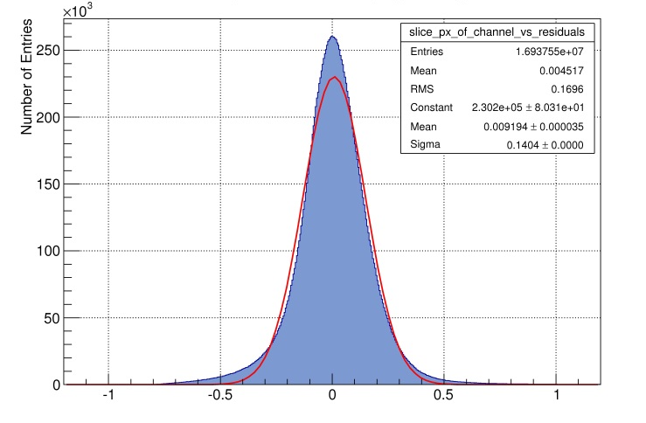
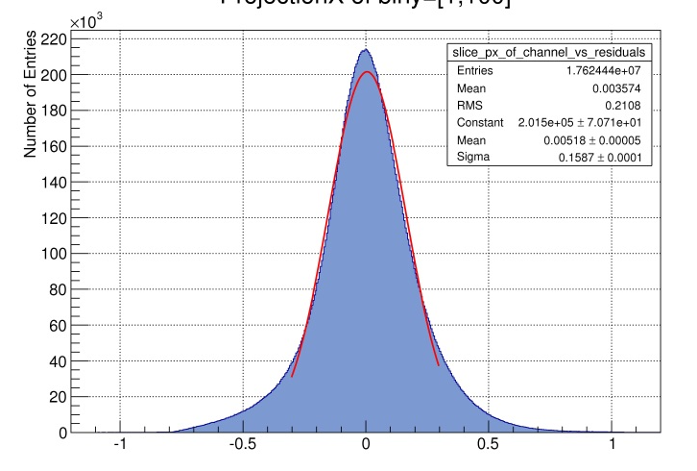
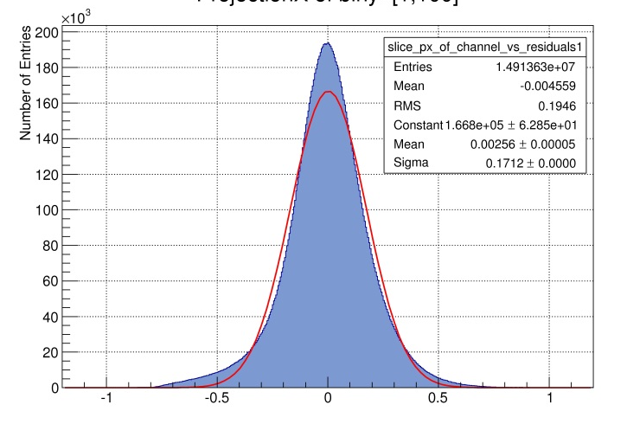
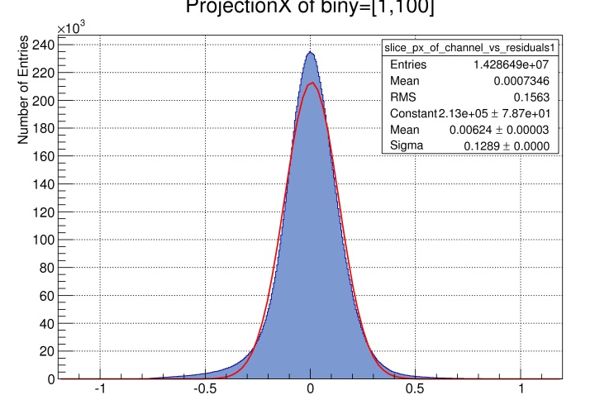
Data Analysis - Track Hit Residuals
Radial distribution of track hit residuals (all straws)
1800V
Residual (mm)
Distance to Wire (mm)
1900V
129µm (σ)
R > 0.8mm
1800V
171µm (σ)
R > 0.8mm
1900V
140µm (σ)
all Radii
1800V
159µm (σ)
all Radii
Entries
Track hit residuals (mm)

Slide 14
Spatial Resolution Results (Pre-lim)
List of obtained residuals for 800 MeV/c proton data at different gas gains
Some worst-case conditions → results being upper limits (safety margin)
Beam position at tube middle → max. wire sag (+ deflection) up to 70µm
Perpendicular beam on ~mm wire spot → E-field distortion by space charge
Further room for improvements (some systematic errors still present)
Calibration of isochrone – drift time relation for individual straws
Straggling of tracks not corrected (track passes through 24 straws)
New ASIC with less amplification dispersion
Final goal (150µm) already
in reach with prototype ASIC
Resolutions at 1900V prove
mechanical set up precision
Similar results for FADC readout
Residuals (µm) for different high voltages
High voltage | 1800V | 1850V | 1900V
Gas gain | 5×10⁴ | 8×10⁴ | 13×10⁴
Residuals all hits | 186 | 161 | 140
Only R > 0.8 mm | 171 |  | 129
Central gaussian | 159 | 142
default for STT

Slide 15
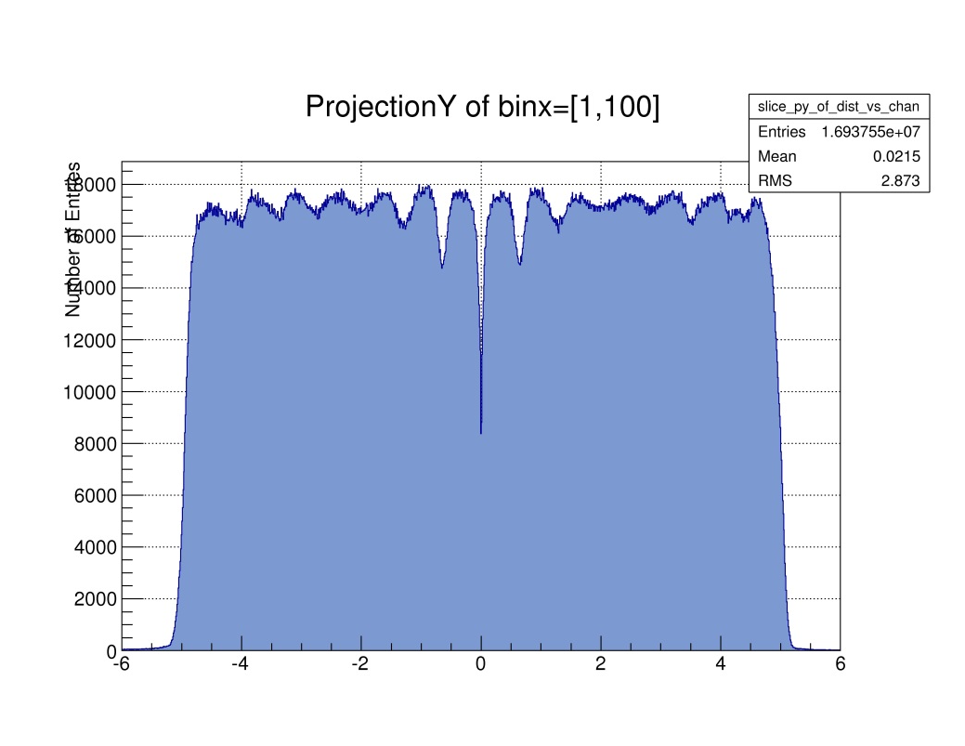
Radial Distribution Of Straw Hits
Distance to wire position from reconstructed tracks if straw hit (all straws)
Inefficiency pattern from tracks with low number of hits (rejected if <7hits)
Per layer 12 straws (16-4), up to ~ 4 missing hits from close to wire or close to tube wall
Estimation: few % inefficiency, disappears if larger setups, more straw hits per track
Beam inclination:
1.6cm / 10.1mm x 23 straws
~ 650µm per straw diameter
Counts
1800V
1900V
Distance to Wire (mm)
Distance to Wire (mm)

Slide 16
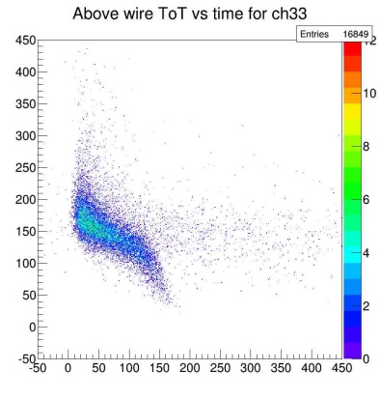
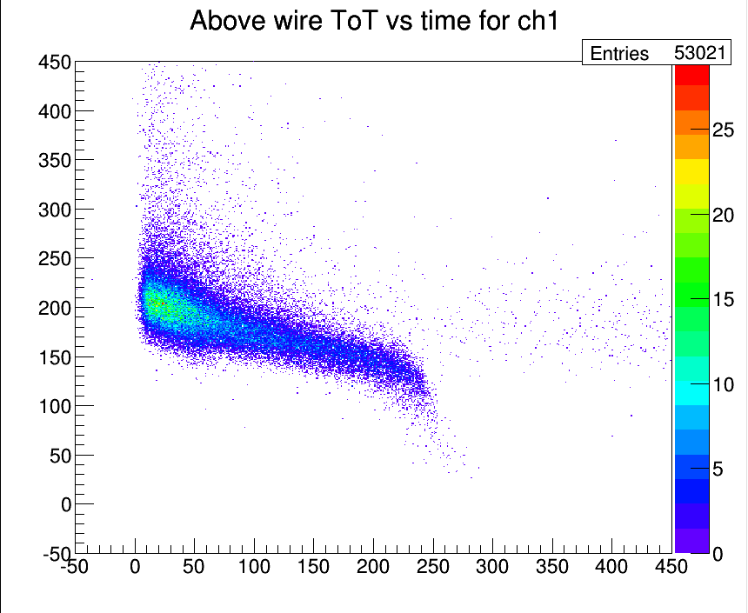
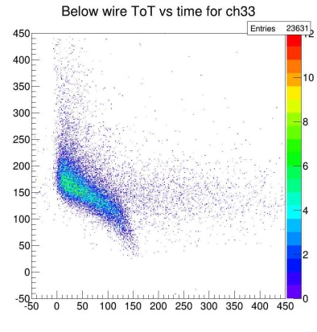
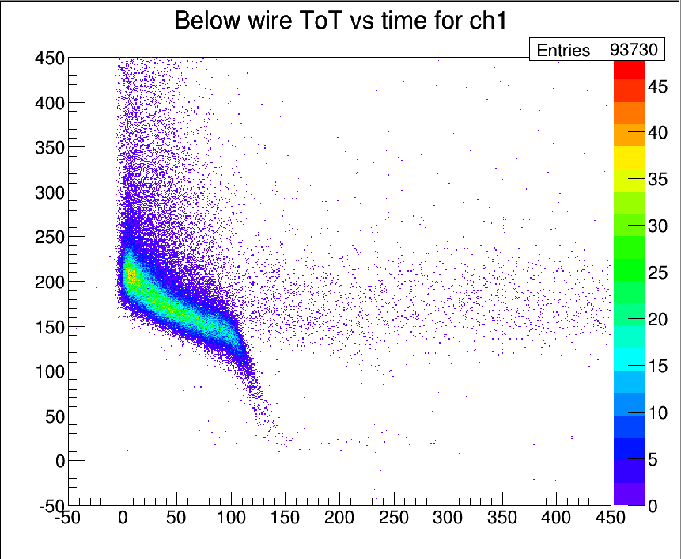
Straw – Beam Tomography
New method developed to check wire in-tube centering: intrinsic & raw data
Measure: end region of time-over-threshold versus drift time is sensitive to tracks passing close to straw tube wall
Check time differences for track hits above and below the wire position
Further studies ongoing, ~100 µm precision ?
time-over-thresh
versus drift time
hits above wire
hits above wire
wire off
tube center
wire in center
hits below wire
hits below wire

Slide 17
Summary STT Status
Spatial resolution goal (150µm) already in-reach with protoype readout & no high-precision mechanical straw frame setup
dE/dx analysis for PID still ongoing, results soon (truncation, ..)
Time-offset extraction in raw data to be investigated (triggerless readout)
Calibration, track reconstruction & dE/dx analysis methods in development
Alignment concept of straw modules in frame approved by beam data
Intrinsic method ( raw data) for straw wire / tube position measurement developed (straw tomography with slightly inclined beam)
Robust straw operation demonstrated, even if ~1mm wire displacement
No straw operation failure with high-rate beam observed
Data cleaning by selecting hits above/below the wire, 2-fold calibration

Slide 18
Thank you for your
attention

