Slide 1
Micro Vertex Detector of PANDA Strip Detector Disc Finite Element Analysis
LII PANDA Mechanics Meeting
Giessen 17.03.2015

Slide 2
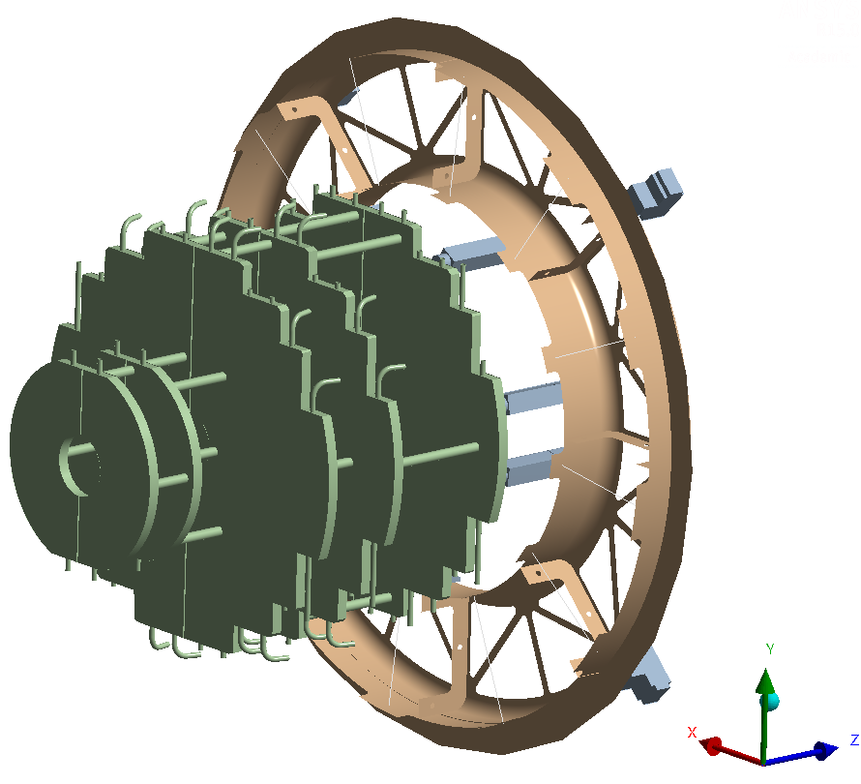
Reducing deflection by optimized holder placement
pixel disc Turin
The inner PEEK-holders are positioned in a manner which leads to unnecessary high deflection at the tip of the pixel disc Turin.
Key-question: Which improvements of deflection can be achieved by optimized positions of the inner PEEK-holders?
CFRP-structure
outer PEEK-holders
inner PEEK-holders

Slide 3
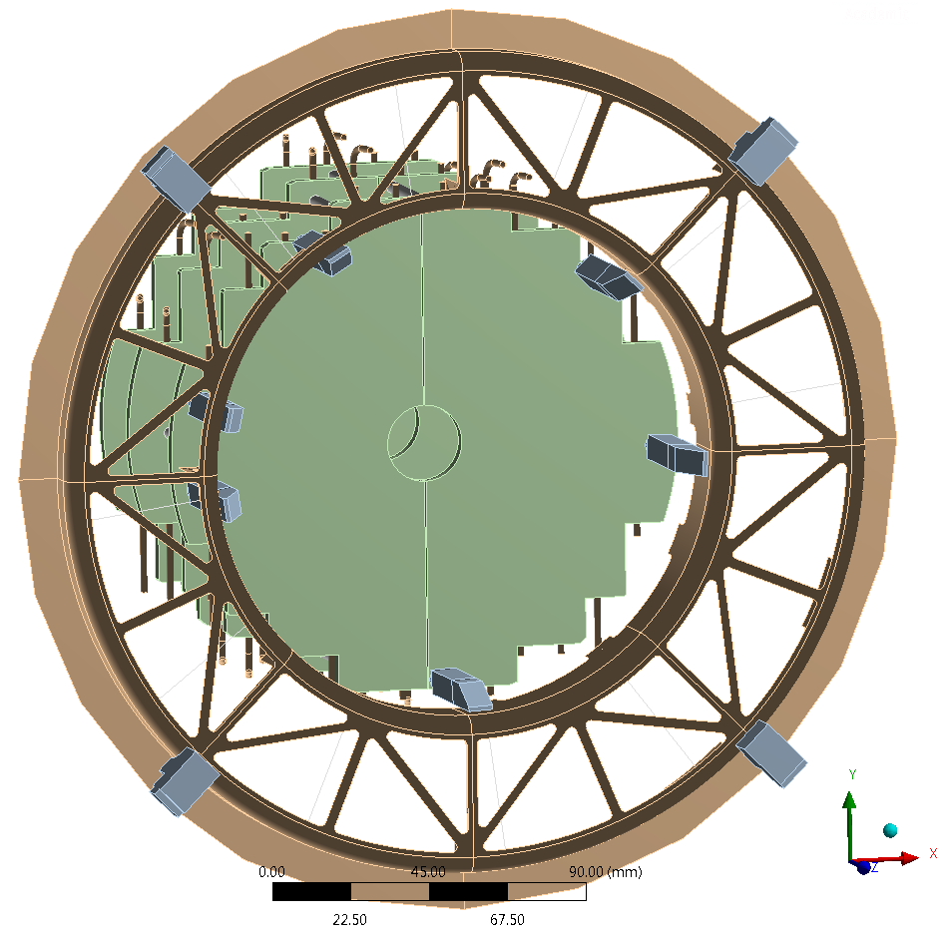
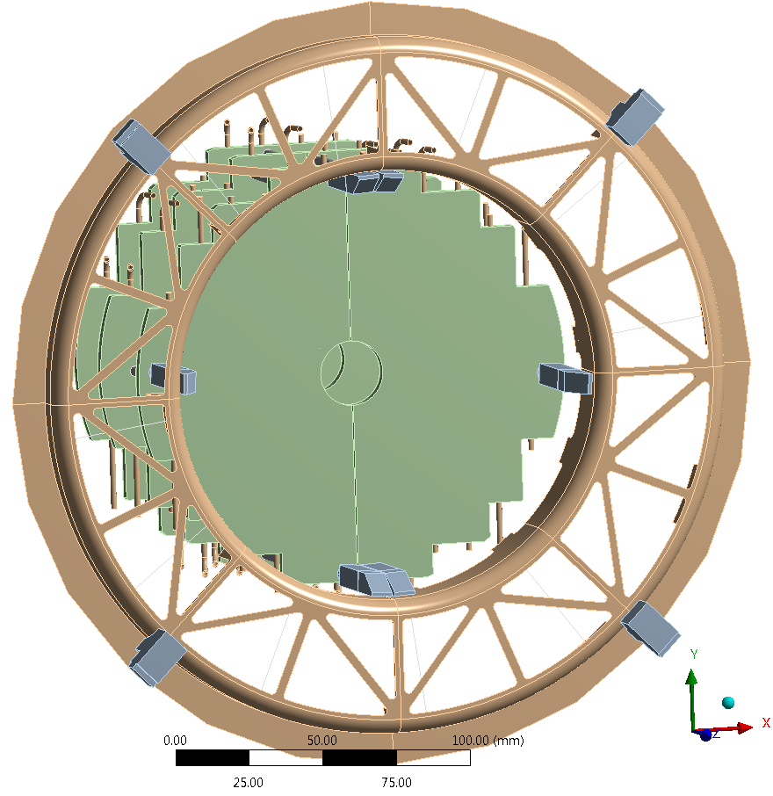
Movement of inner PEEK-holders
Start Position
Optimal Position

Slide 4
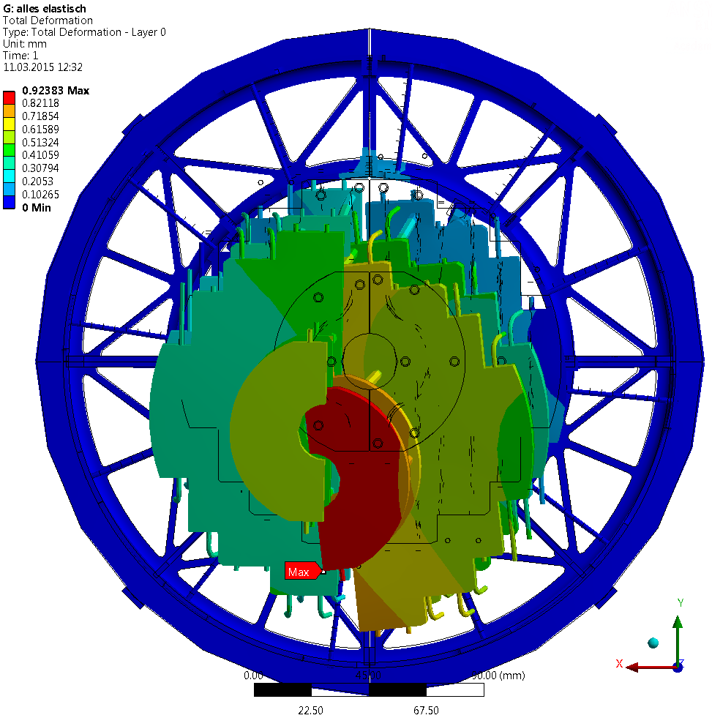
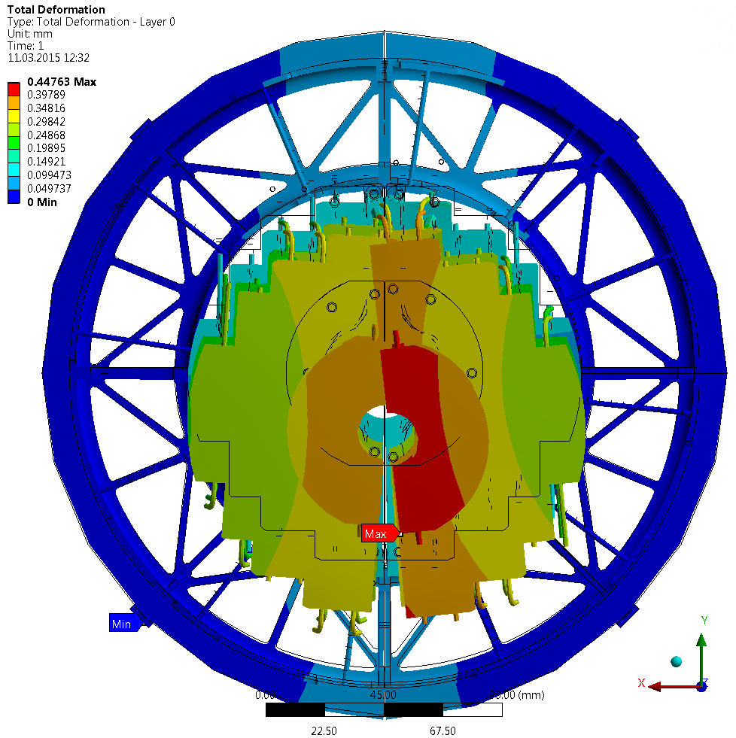
Reduction of tip deflection of pixel disc detector
Front view
Start Position
Optimal Position
deformation scale factor: 60x

Slide 5
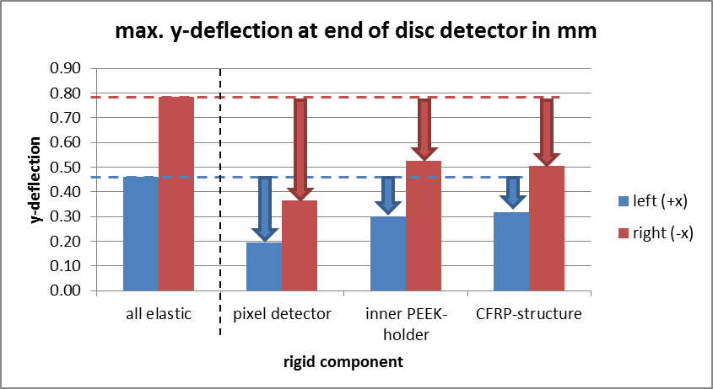
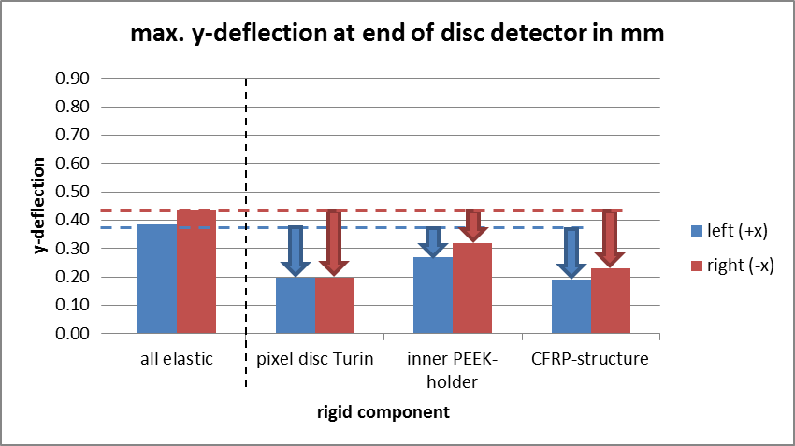
Reduction of tip deflection of pixel disc detector
Start Position
Optimal Position

Slide 6
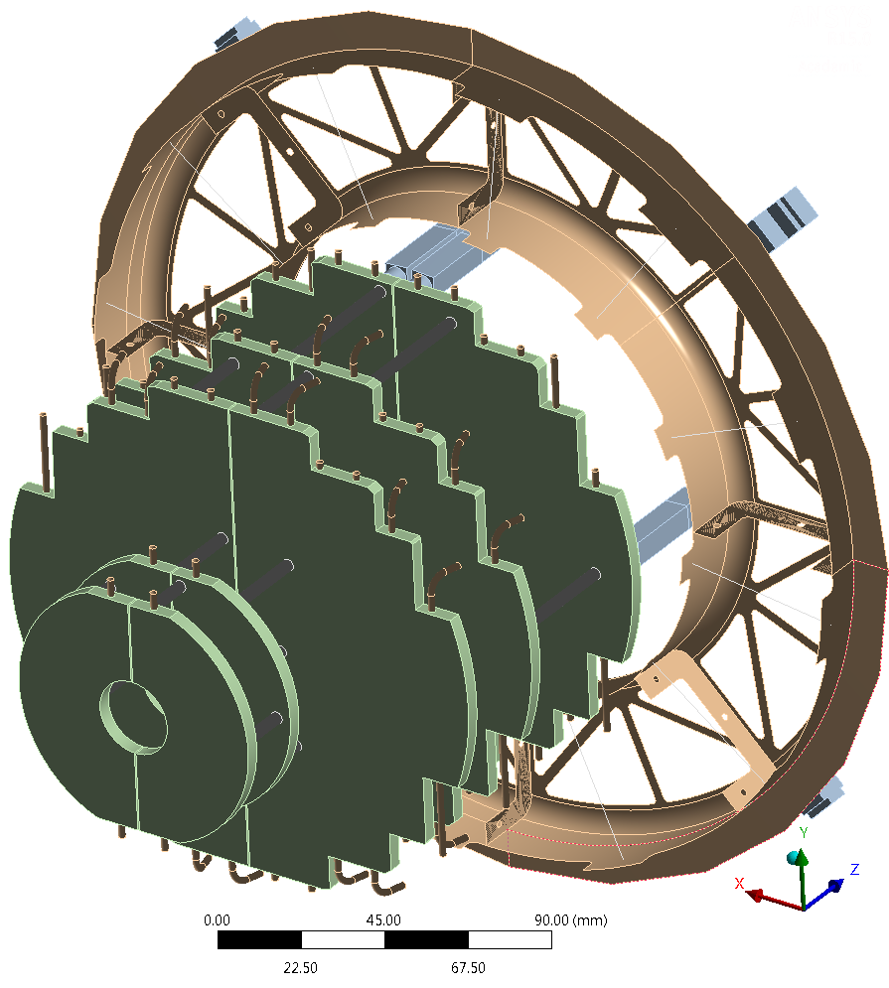
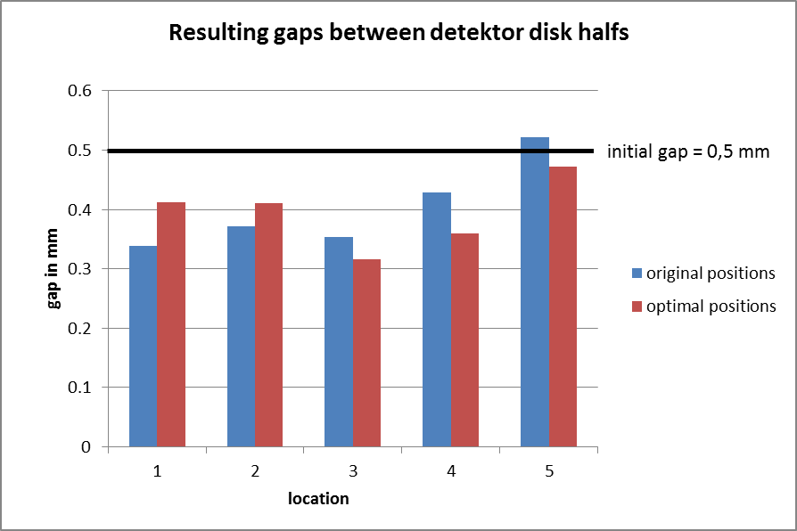
Resulting gaps between half's of detector disk
5
4
3
2
1

Slide 7
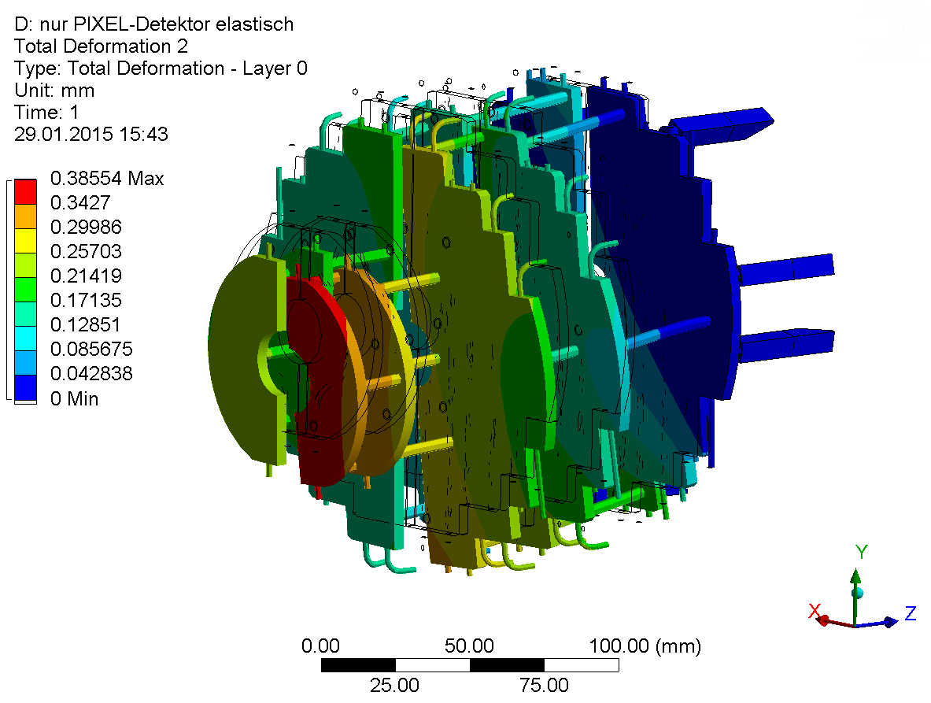
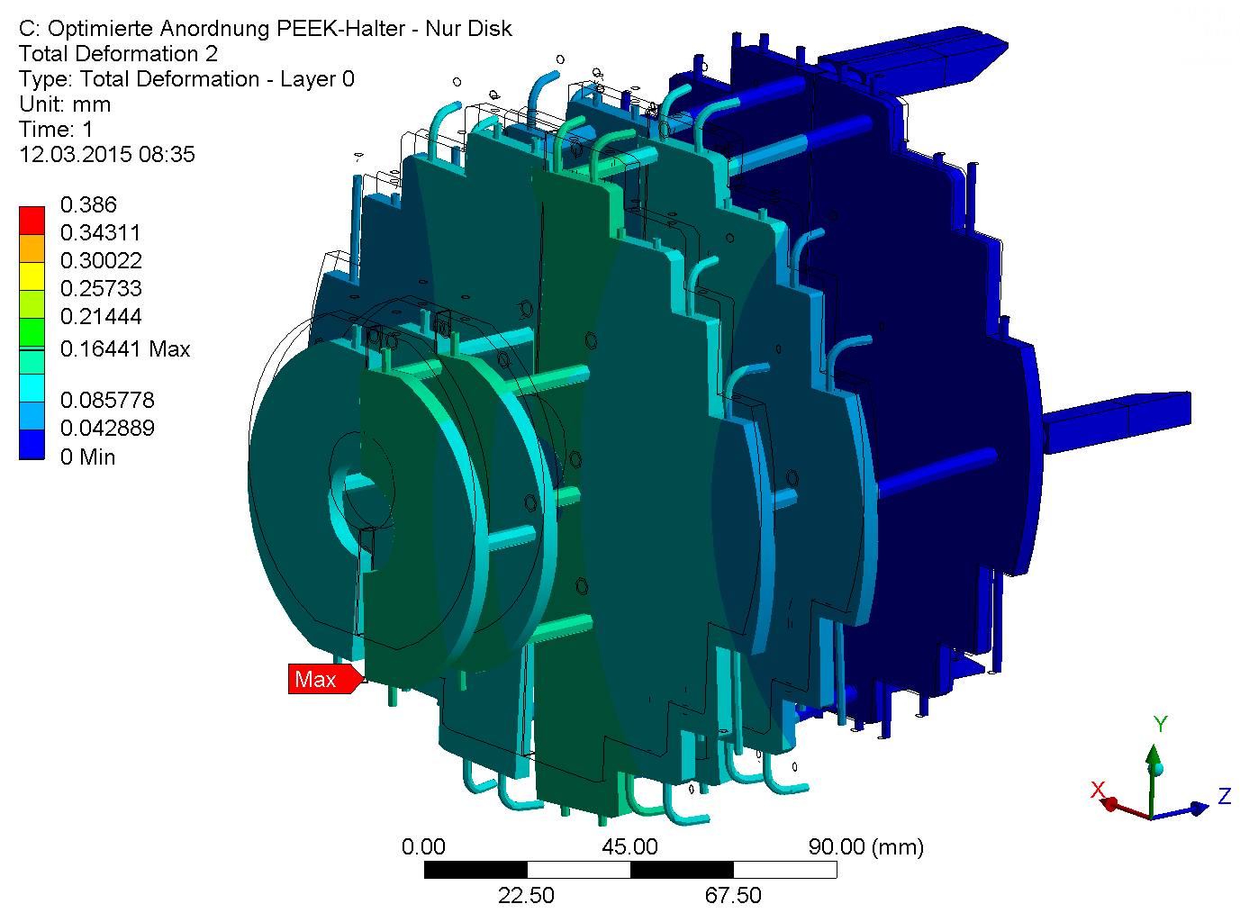
Resulting gaps between half's of detector disk
Calculation with all parts rigid except pixel disc Turin
Start Position
Optimal Position
deformation scale factor: 60 x
The new arrangement of the PEEK-holders has also positive effects onto the deformation inside the pixel disc: less bending of the POCO-foam plates, lower reaction forces transmitted by PEEK-holder

Slide 8
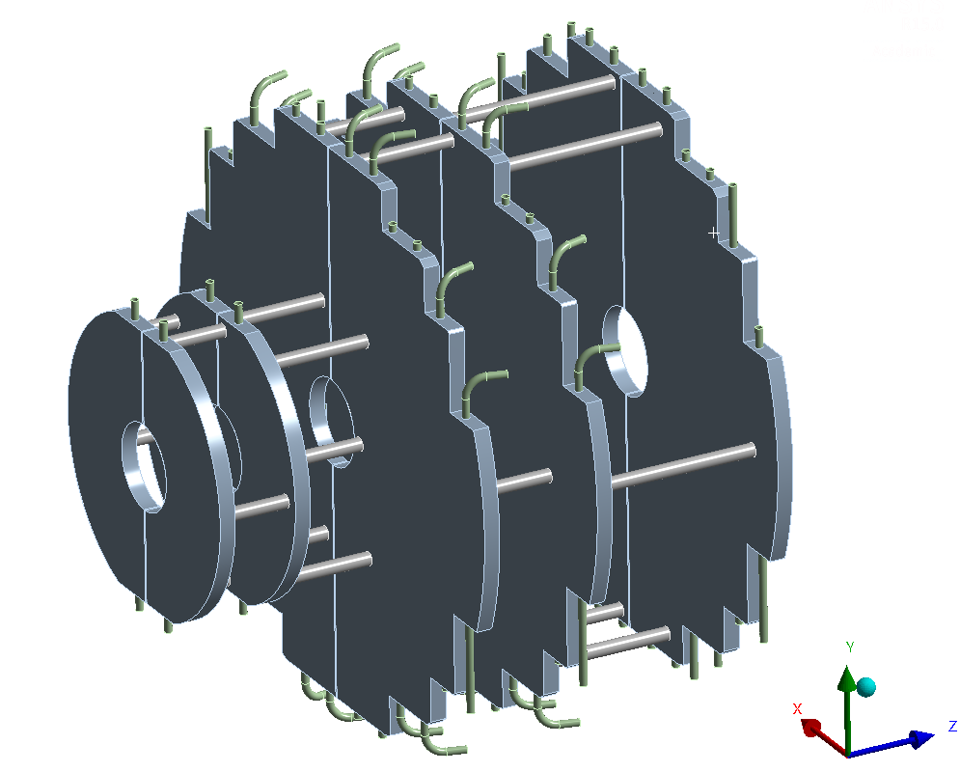
Reduction of tip deflection of pixel disc detector
Uncertainties in modeling the pixel disc detector
cooling pipes (steel)
Simplified model to represent stiffness.
No electronic components and detectors included.
Density of POCO HTC-foam is adjusted to compensate the missing weight of electronic components.
Estimation of total weight of both sides: 1.1 kg
No information about real weight available yet.
cfrp-tubes
POCO HTC-Foam
elastic modulus: 1000 MPa

