Slide 1
PANDA Barrel DIRC
PADIWA & FLASH Studies
Matthias Hoek, Matteo Cardinali, Michael Dickescheid, Werner Lauth, Concettina Sfienti, Michaela Thiel
PANDA PID Meeting | Giessen | 17.03.2015

Slide 2
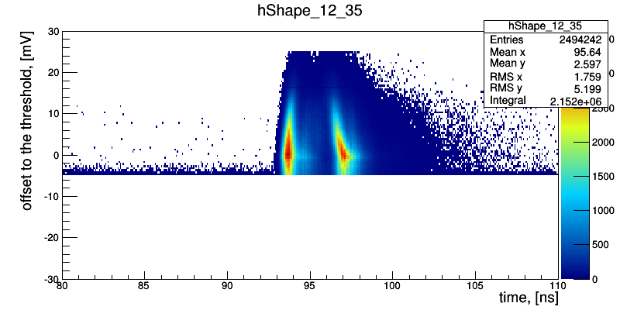
Investigation of PADIWA Response
Crosscheck PADIWA results from GSI test experiment 2014
Use sampled waveforms
  SPE level (avg. amplitude ~8mV)
  Gain ~1e6 w/o pre-amplifier
Filters
Notes:
Status report Feb 2013
Black Box
Construction finished
Some optimisation needed
First tests with laser light
Oscilloscope readout only
Establish filter density settings
Cross check MCP-PMT properties
NINO + TRB
Analysis of 2012 data ongoing
Event hit timing
Possible crosstalk concerns

Slide 3
Investigation of PADIWA Response
Crosscheck PADIWA results from GSI test experiment 2014
Use sampled waveforms
  SPE level (avg. amplitude ~8mV)
  Gain ~1e6 w/o pre-amplifier
Amplitudes range up to ~12mV
Pulse widths from 0.6-2.2ns
  Short pulse detection deficiency?
Filters
Notes:
Status report Feb 2013
Black Box
Construction finished
Some optimisation needed
First tests with laser light
Oscilloscope readout only
Establish filter density settings
Cross check MCP-PMT properties
NINO + TRB
Analysis of 2012 data ongoing
Event hit timing
Possible crosstalk concerns

Slide 4
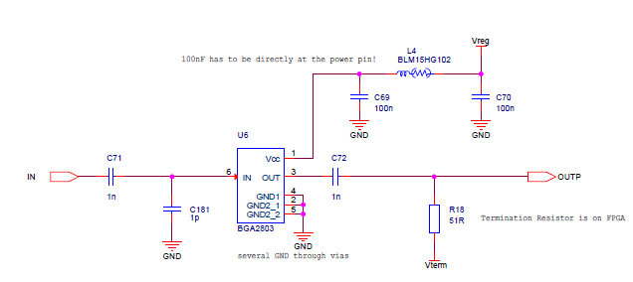
PADIWA Input Stage Modifications
Limit bandwidth to reduce noise
  Standard 1pF (~3.2GHz cut-off)
Study impact on timing
  1pF – 100pF selected (see table)
Input | Cap ID | Capacitance (pF) | Cut-off (GHz)
1 | C196 | 1 | 3.2
2 | C181 | 15 | 0.2
3 | C182 | 1 | 3.2
4 | C189 | 15 | 0.2
5 | C183 | 2 | 1.6
6 | C190 | 20 | 0.16
7 | C184 | 2 | 1.6
8 | C191 | 20 | 0.16
9 | C185 | 4.7 | 0.7
10 | C192 | 47 | 0.07
11 | C186 | 4.7 | 0.7
12 | C193 | 47 | 0.07
13 | C187 | 10 | 0.3
14 | C194 | 100 | 0.03
15 | C188 | 10 | 0.3
16 | C195 | 100 | 0.03
Notes:
Status report Feb 2013
Black Box
Construction finished
Some optimisation needed
First tests with laser light
Oscilloscope readout only
Establish filter density settings
Cross check MCP-PMT properties
NINO + TRB
Analysis of 2012 data ongoing
Event hit timing
Possible crosstalk concerns

Slide 5
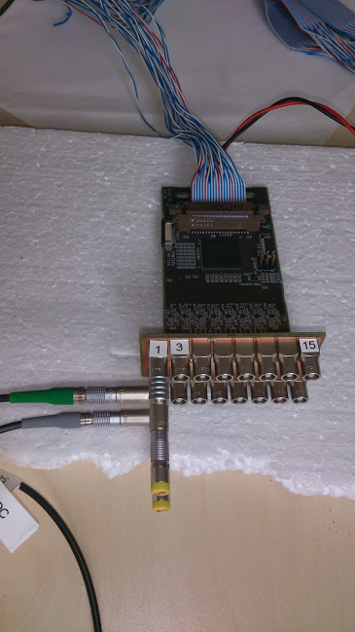
PADIWA Input Stage Modifications
Setup
  Modified PADIWA card
  Tektronix AFG3252 Pulse Generator
    Rectangular pulse
    Slow rise time (~3ns)
    10kHz rate
  Passive attenuator 13dB (adjust to SPE level)
  Use 0xC0 offset (0x20 possible but too much ringing observed)
Split signal
  Channel 1 as reference
Issues
  Signal reflections on input (100kΩ)
  Low efficiency (trigger not synchronised)
  Long signals (400ns)
Notes:
Status report Feb 2013
Black Box
Construction finished
Some optimisation needed
First tests with laser light
Oscilloscope readout only
Establish filter density settings
Cross check MCP-PMT properties
NINO + TRB
Analysis of 2012 data ongoing
Event hit timing
Possible crosstalk concerns

Slide 6
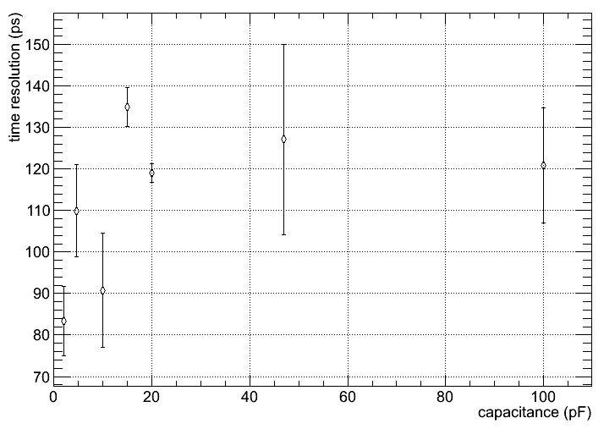
PADIWA Input Stage Modifications
Input | Cap ID | Capacitance (pF)
1 | C196 | 1
2 | C181 | 15
3 | C182 | 1
4 | C189 | 15
5 | C183 | 2
6 | C190 | 20
7 | C184 | 2
8 | C191 | 20
9 | C185 | 4.7
10 | C192 | 47
11 | C186 | 4.7
12 | C193 | 47
13 | C187 | 10
14 | C194 | 100
15 | C188 | 10
16 | C195 | 100
PRELIMINARY
Reference channel contribution (~59ps) removed
Notes:
Status report Feb 2013
Black Box
Construction finished
Some optimisation needed
First tests with laser light
Oscilloscope readout only
Establish filter density settings
Cross check MCP-PMT properties
NINO + TRB
Analysis of 2012 data ongoing
Event hit timing
Possible crosstalk concerns

Slide 7

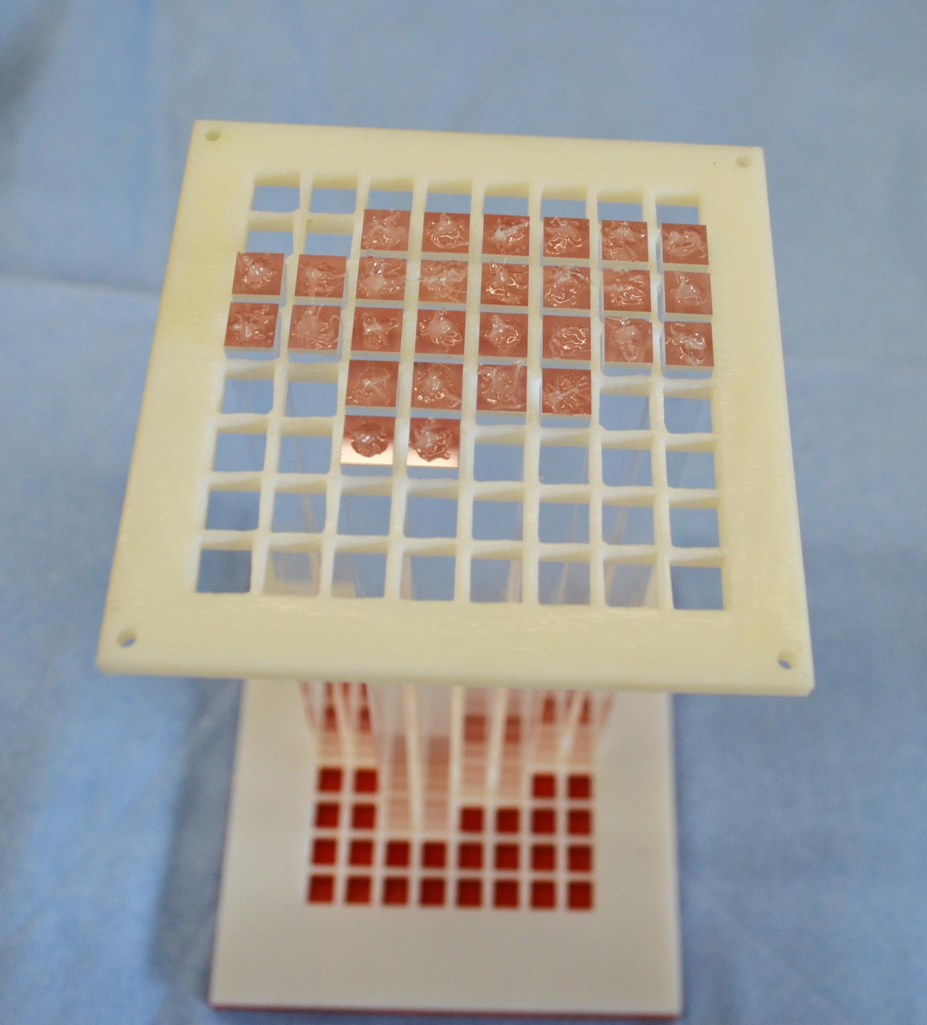
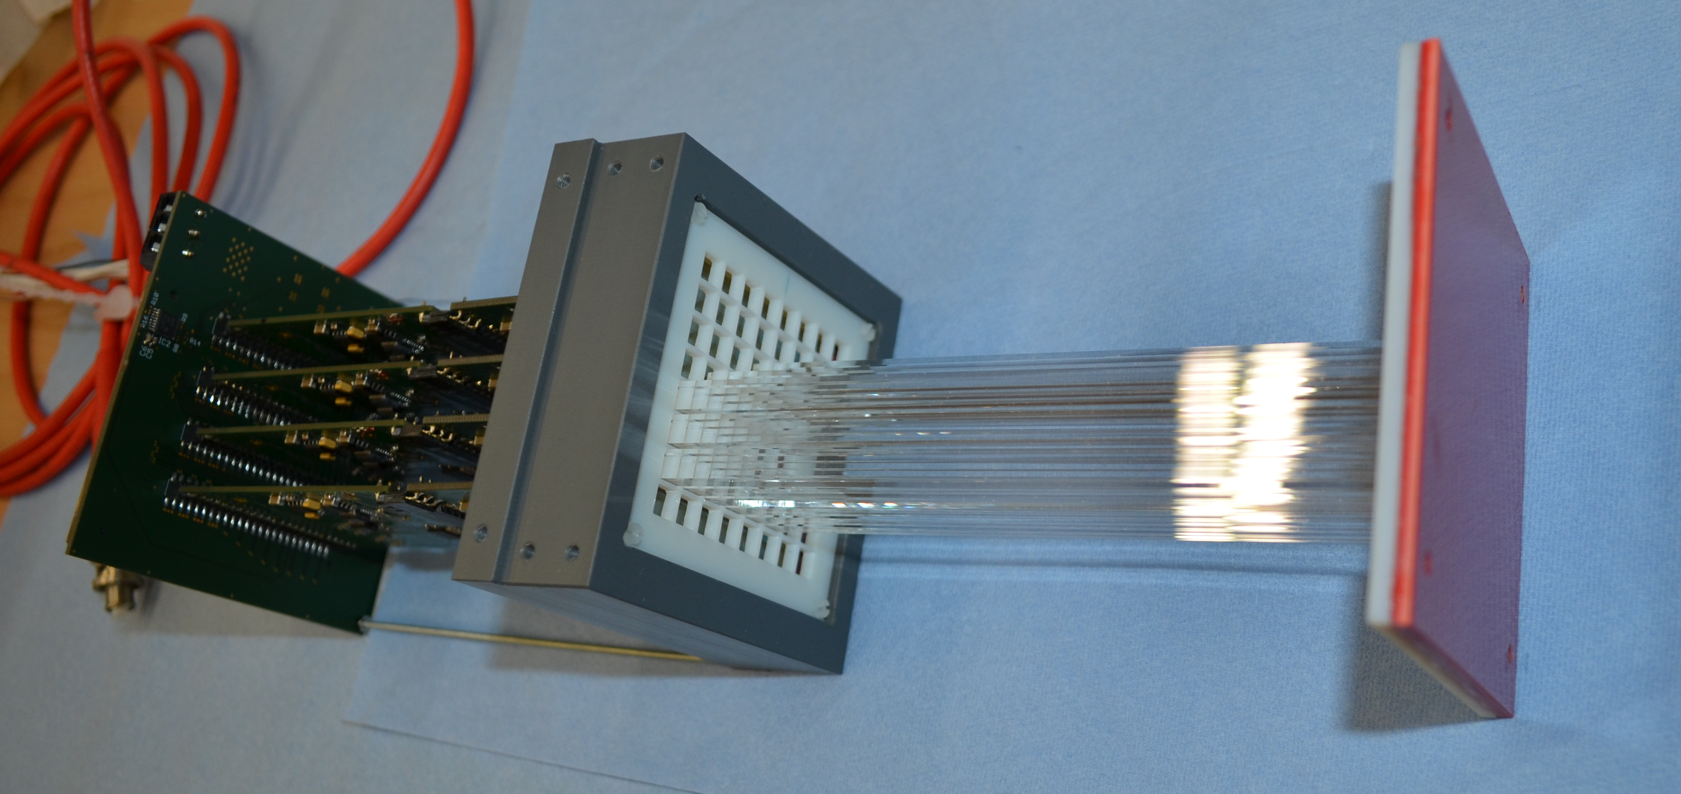
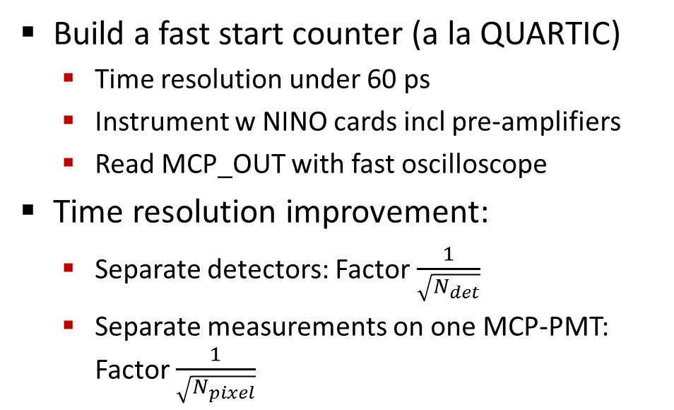
FLASH Test Experiment in Mainz
Build a fast start counter (a la QUARTIC)
  Time resolution under 60 ps
  Instrument w NINO cards incl pre-amplifiers
  Read MCP_OUT with fast oscilloscope
Time resolution improvement:
  Separate detectors: Factor $\frac{1}{\sqrt{N_{det}}}$
  Separate measurements on one MCP-PMT: Factor $\frac{1}{\sqrt{N_{pixel}}}$
Notes:
Status report Feb 2013
Black Box
Construction finished
Some optimisation needed
First tests with laser light
Oscilloscope readout only
Establish filter density settings
Cross check MCP-PMT properties
NINO + TRB
Analysis of 2012 data ongoing
Event hit timing
Possible crosstalk concerns

Slide 8
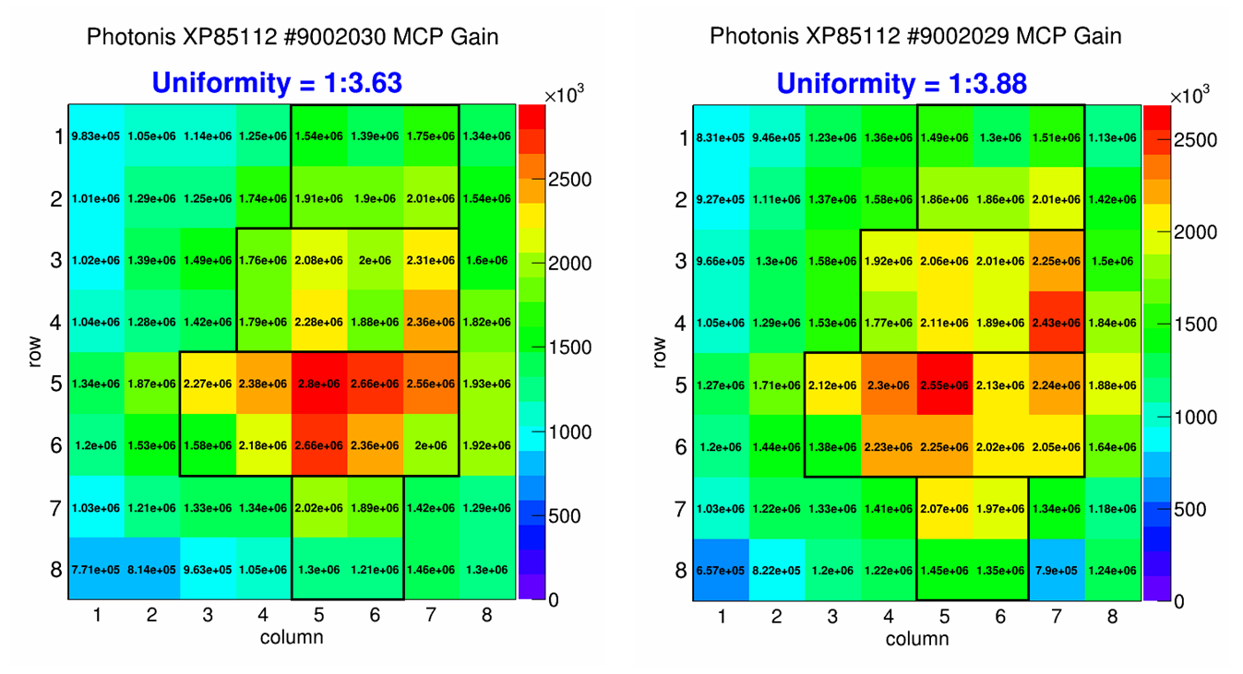
FLASH Test Experiment in Mainz
Match MCP gain map (provided by Erlangen)
Test different geometries
Beam
Filters
Notes:
Status report Feb 2013
Black Box
Construction finished
Some optimisation needed
First tests with laser light
Oscilloscope readout only
Establish filter density settings
Cross check MCP-PMT properties
NINO + TRB
Analysis of 2012 data ongoing
Event hit timing
Possible crosstalk concerns

Slide 9
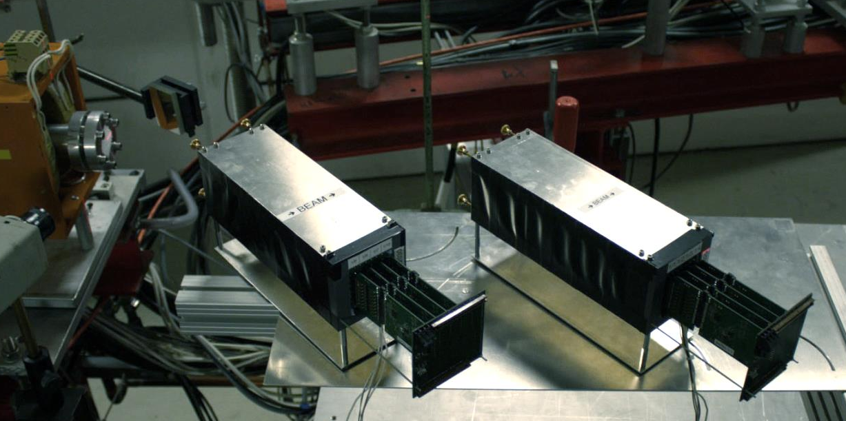
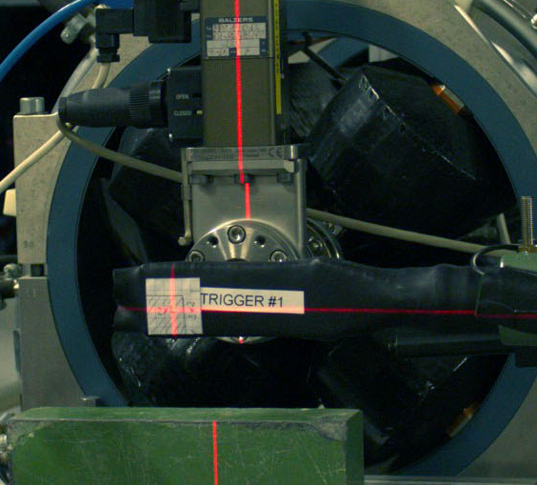
FLASH Setup at MAMI
Coincidence scintillators:
overlap of 3x3cm
FLASH1
FLASH2
2
e⁻
855MeV/c
Beam
3
4
1
Trigger rates ~3-7kHz depending on FLASH configuration

Slide 10
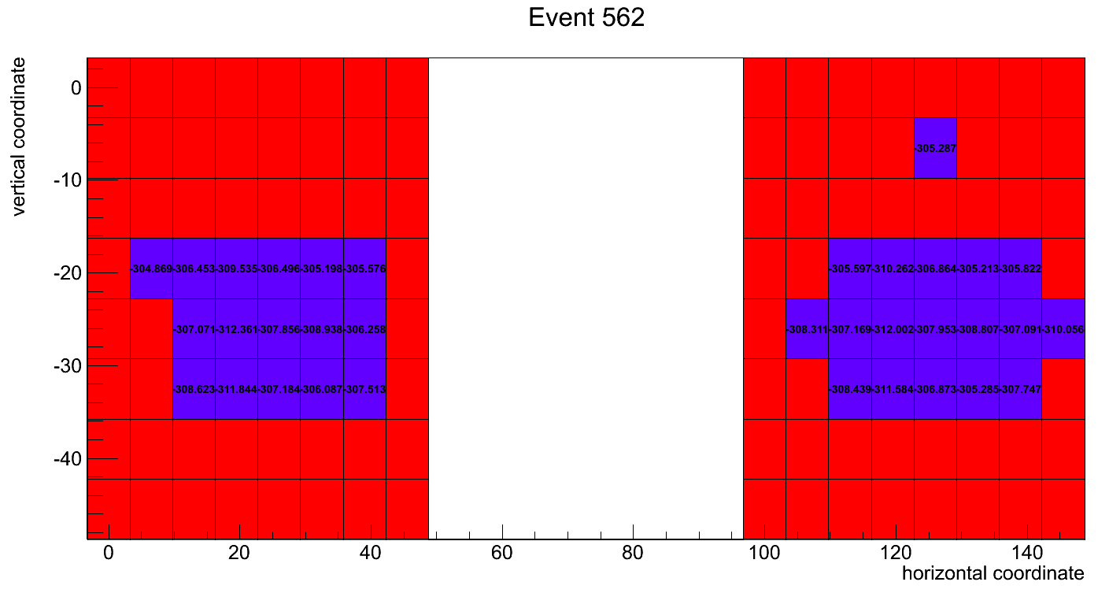
FLASH Event Display - Single Event…
Clear signs of optical crosstalk
High efficiency observed (>98% in first counter)
Notes:
Leading edge times (syncronized and calibrated)

Slide 11
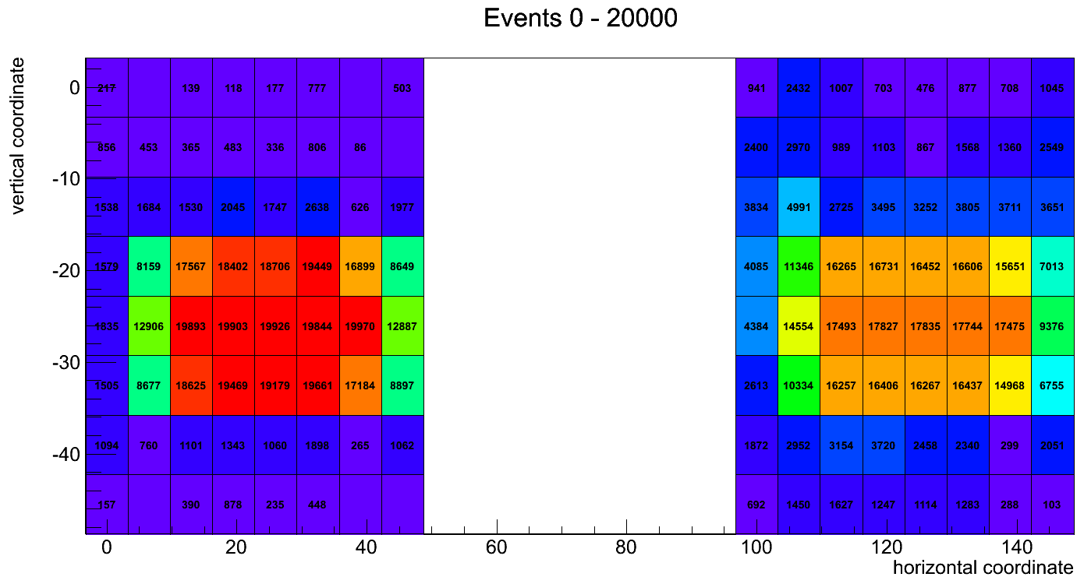
FLASH Event Display – 20000 Events
Clear signs of optical crosstalk
High efficiency observed (>98% in first counter)
Notes:
Guess where the beam went through.
Optical crosstalk, not (just) electronic

Slide 12
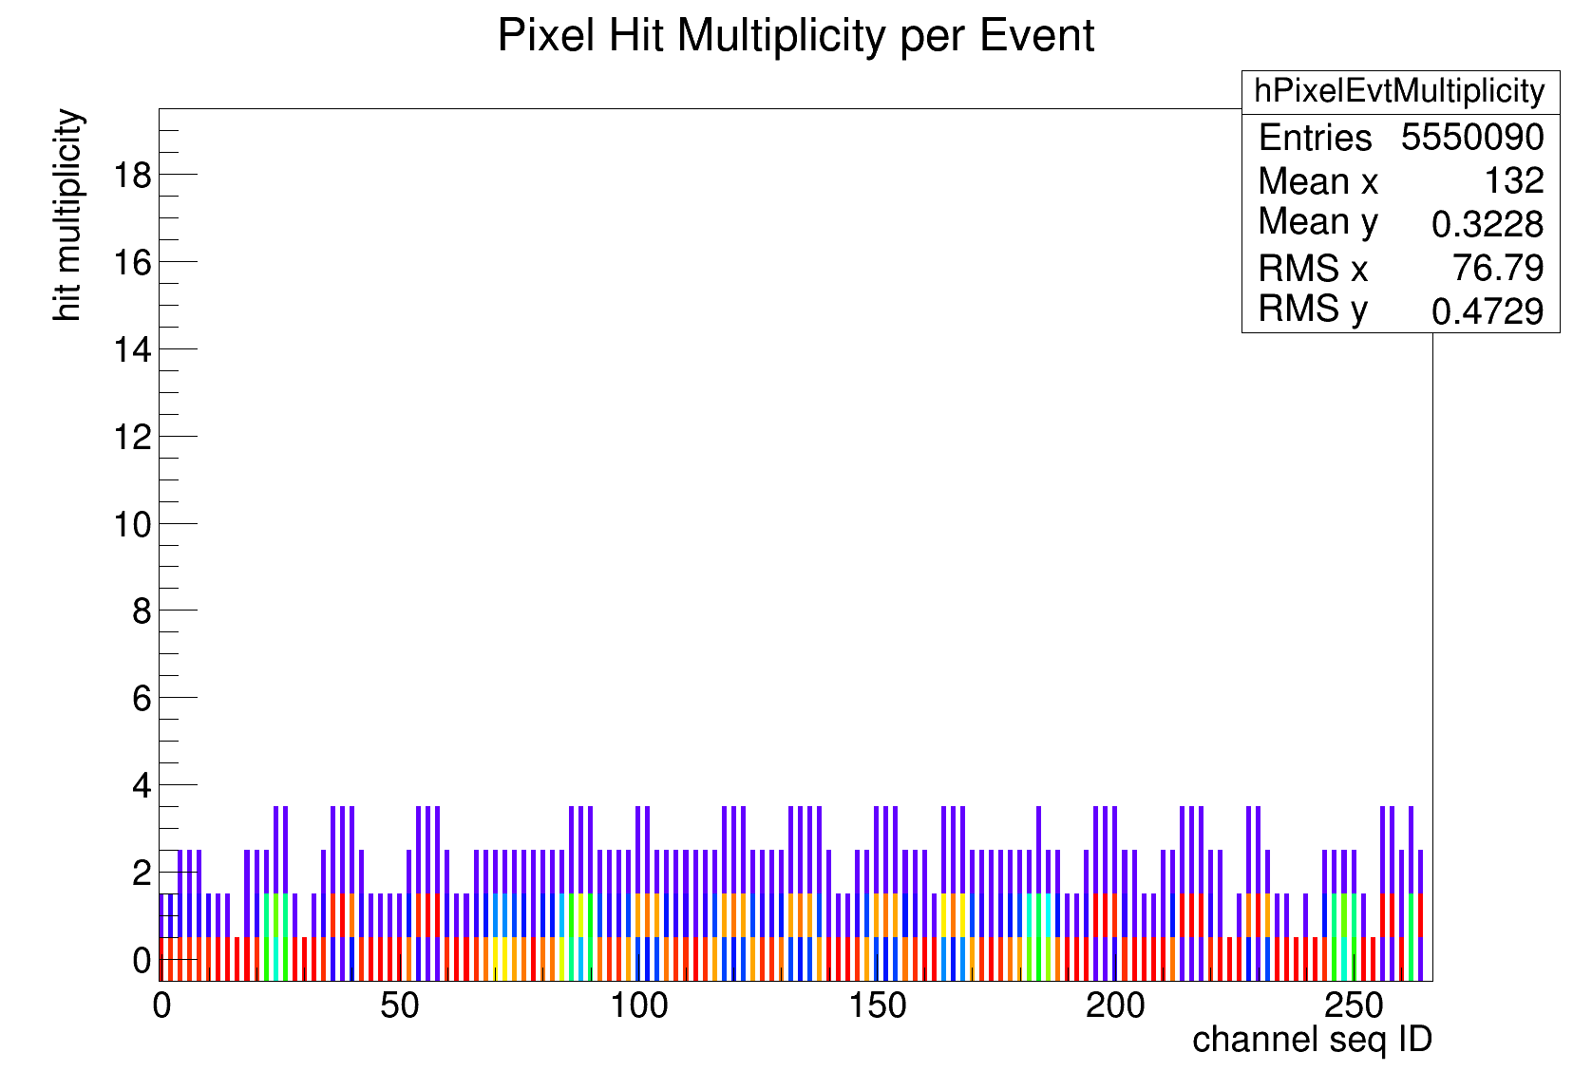
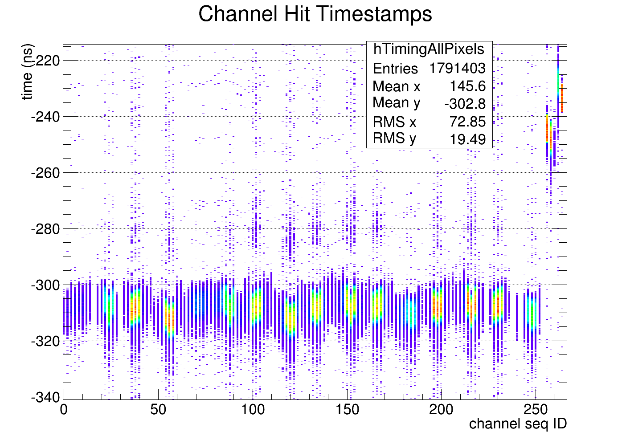
FLASH Event Hit Distributions (-400.0 − 100.0ns)
Very clean hit signatures in time window
Multiple hits negligible
Trigger counters
Clear correlation of leading edge times

Slide 13
FLASH Analysis Outlook
Extract timing resolution
  Observed ~60ps w online corrections
Apply corrections
  Walk corrections are possible, but need optimisation
  Narrow Time-over-Threshold cuts
Characterise performance
  Mapped detector response on 5x8 matrix
  Various gain and threshold combinations tested
Investigate Time-over-Threshold distributions
Study tracking capabilities

