Slide 1
The PANDA Barrel DIRC with wide radiator plates
Marko Zühlsdorf
GSI Helmholtzzentrum für Schwerionenforschung GmbH, Darmstadt
Goethe-Universität Frankfurt

Slide 2
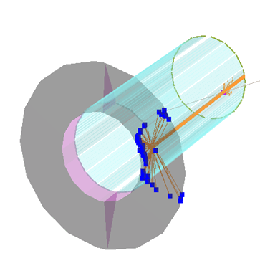
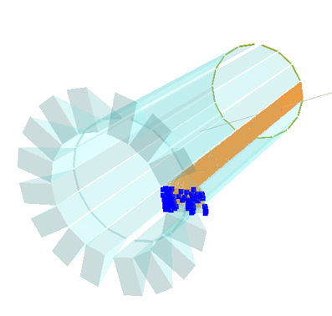
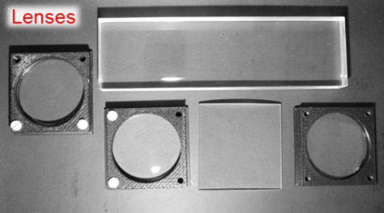
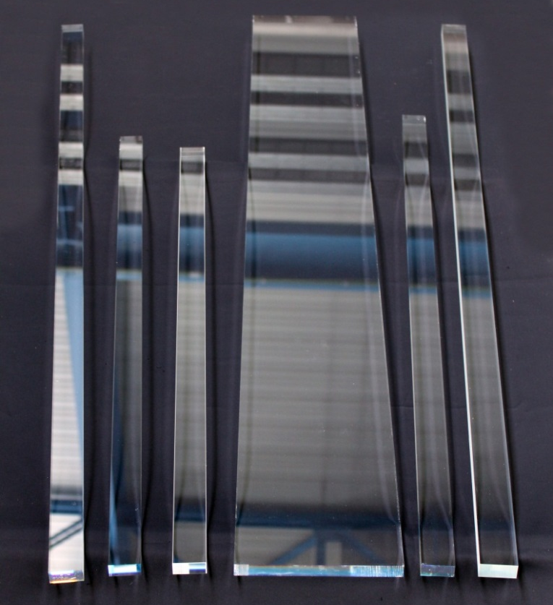
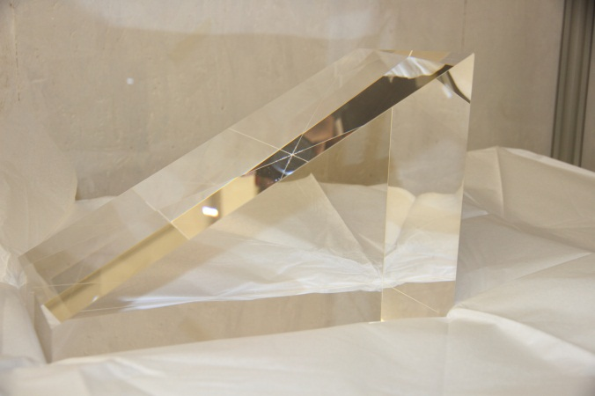
Motivation for Plates
Baseline design working solution for PANDA
Alternative designs to improve performance and reduce cost
Radiator
One wide plate instead of 5 narrow bars per segment
Fewer pieces to be polished
Less strict requirements for optical and mechanical quality of side surfaces
Potential significant cost reduction
Expansion volume (camera)
One synthetic fused silica prism per segment instead of oil tank
Better optical properties
Smaller detection surface
Fewer photon sensors needed
Less readout channels
125 cm
30 cm

Slide 3
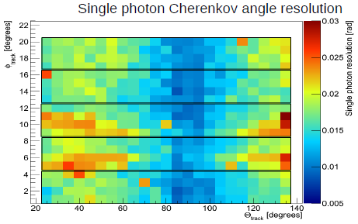
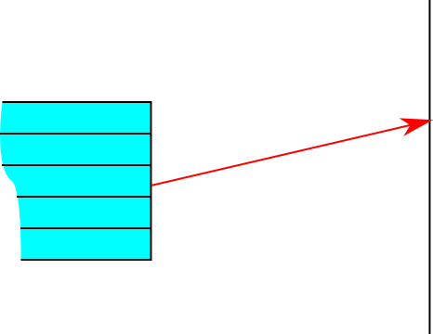
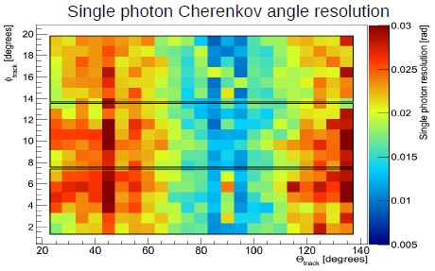
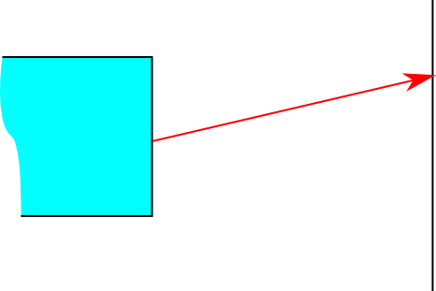
Geometrical Reconstruction
5 narrow bars, unfocused (MC Simulation)
3 wider bars, unfocused
inspired by BaBar DIRC
Geometrical reconstruction uses location of bar and pixel to determine photon vector in the radiator.
Works well for narrow bars but fails for wide plates
Width of radiator not negligible anymore
track azimuth angle
10 mrad 30
20° track polar angle 140°
radiator
detection plane
track azimuth angle
10 mrad 30
20° track polar angle 140°

Slide 4
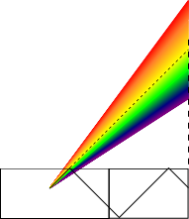
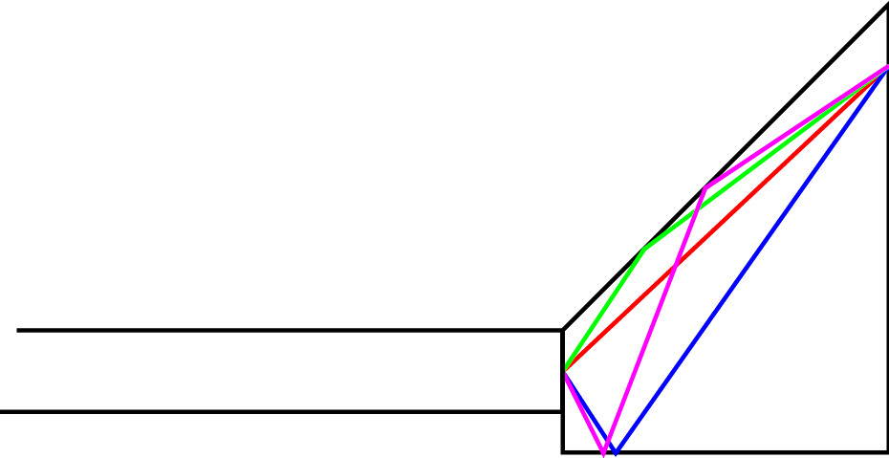
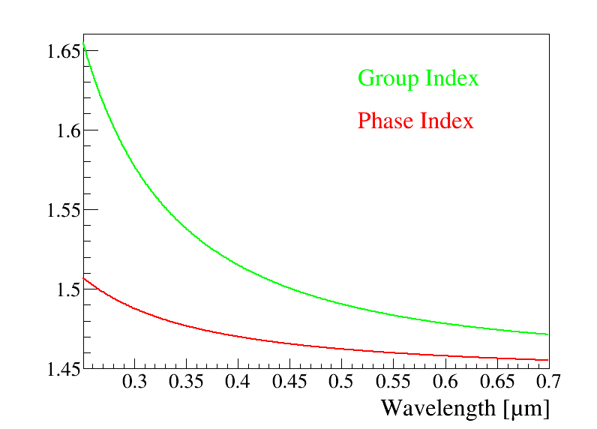
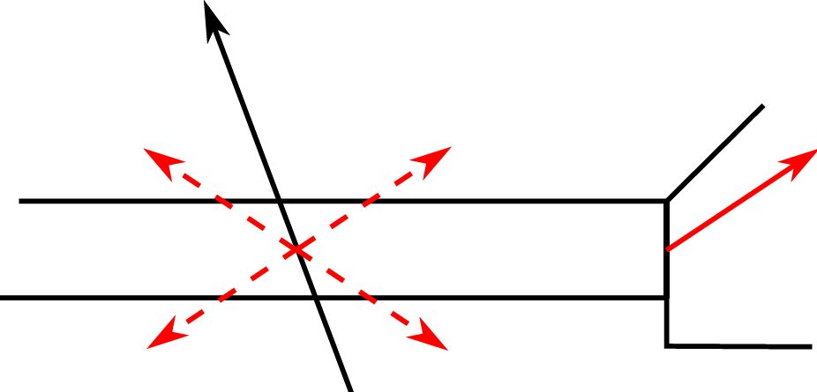
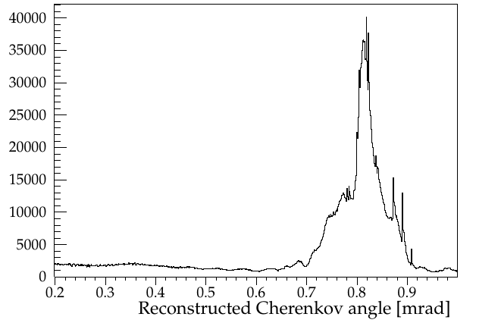
Geometrical Reconstruction
Y-Z projection
4 ambiguities in the prism
4 ambiguities in the bar
X-Z projection
many more ambiguities from dispersion
y
x
z
Cherenkov angle is reconstructed
but with bad signal/background ratio

Slide 5
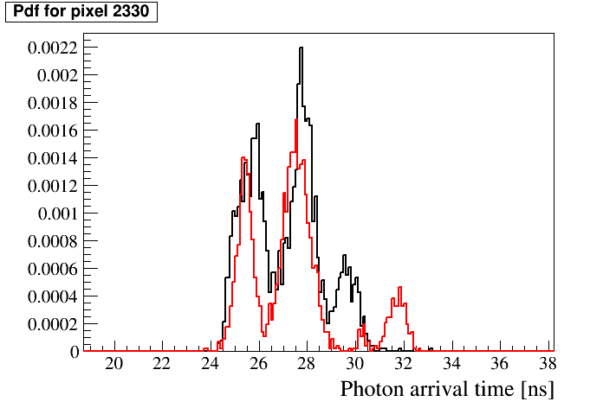
Probability Density Functions
normalized PDF for a specific pixel
MC
Simulation
π
K
p = 3.5 GeV/c
22° polar angle
y
π
K
x
PMT map, with 5 x 3 sensors, 64 pixels each
In 3 dimensions (x, y, t) hit patterns show differences between particle species
π sample
K sample
Probability density functions (pdf) can be generated with ~100k Monte Carlo tracks with same parameters and saved in histograms.
Inspired by Belle II TOP
Likelihood ratio test lnL_{K}-lnL_{P}

Slide 6
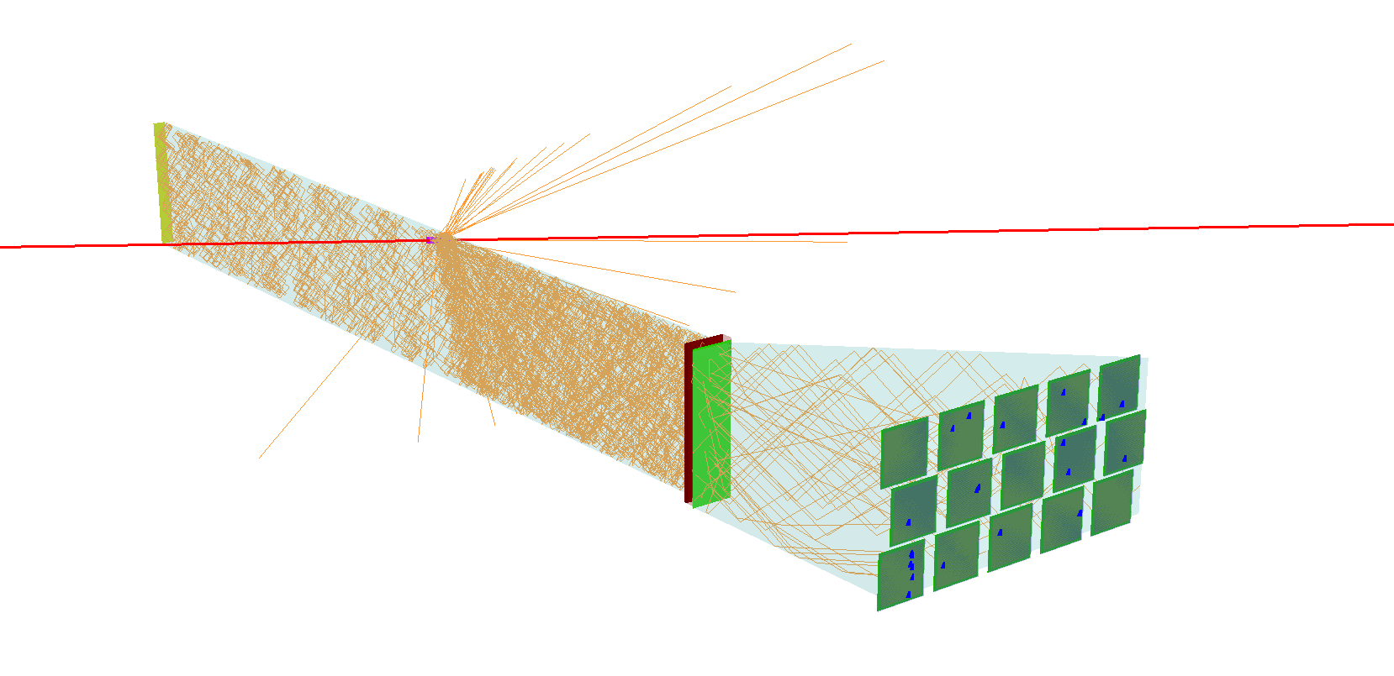
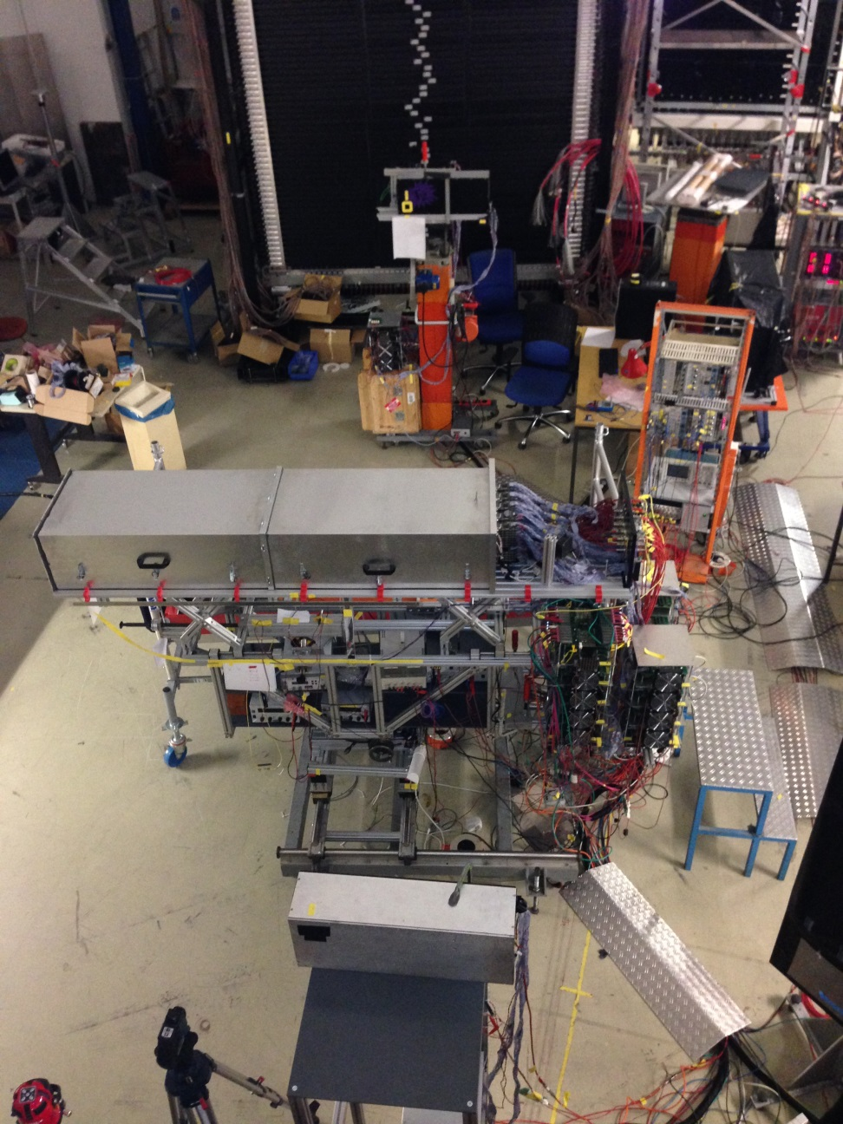
2014 Prototype Test
122.5 cm
Beam time at GSI; 5 weeks in summer 2014
2014 prototype is similar to a module of the final detector
5 x 3 Planacon MCP-PMT
960 pixels (in total >1200 readout channels)
Wide plate w/ and w/o focusing lens
Narrow bar with different lenses
Prototype
Pion beam
1.7 GeV/c

Slide 7
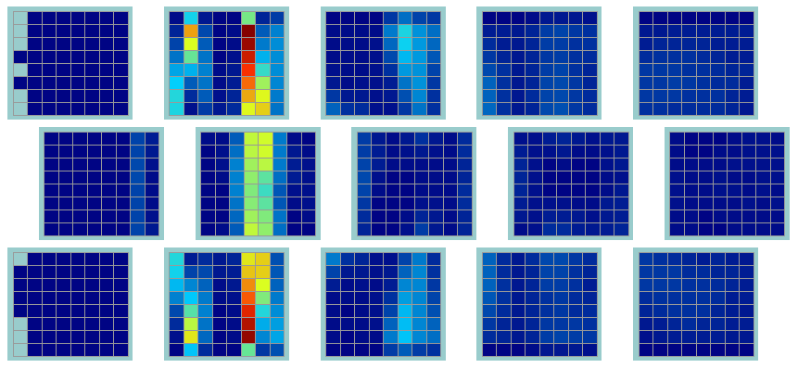
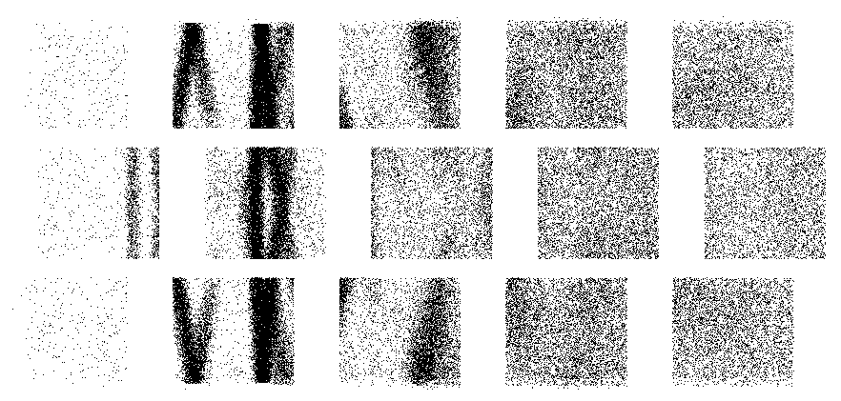
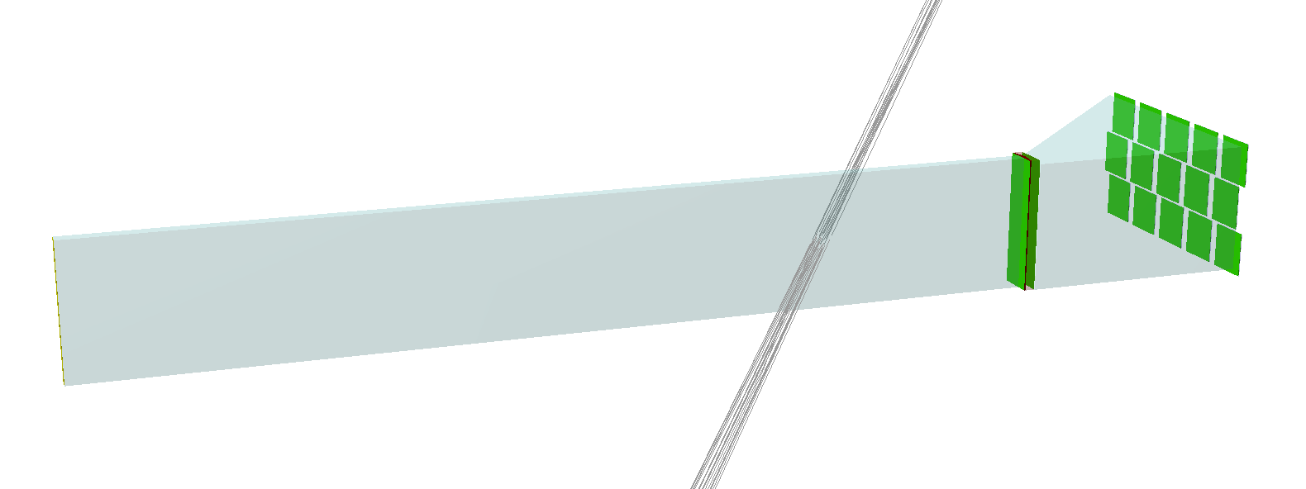
Plate Data Analysis
Wide Plate
Simulation:
Geant 4
Radiator plate
Cylindrical lens
120° polar angle
1.7 GeV/c pions
pixelated:
true locations:

Slide 8
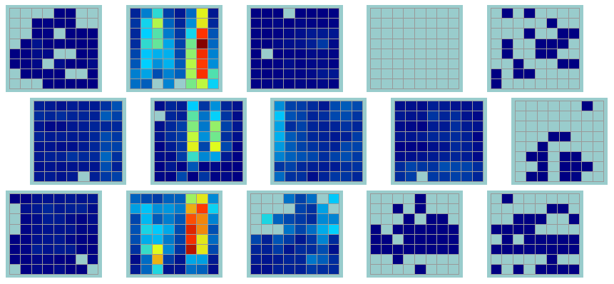
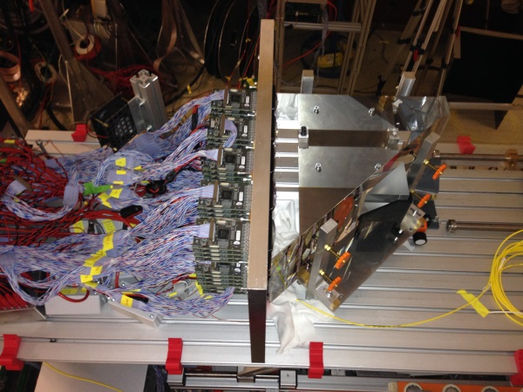
Plate Data Analysis
Wide Plate Data:
Occupancies with cuts on timing and event multiplicity
Simulation predicts
~20 hits/track
Simulation:
120°
Beam data:

Slide 9
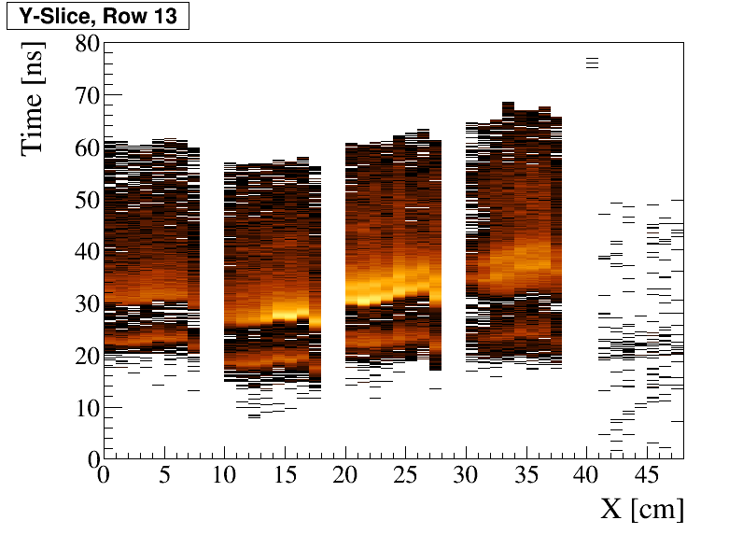
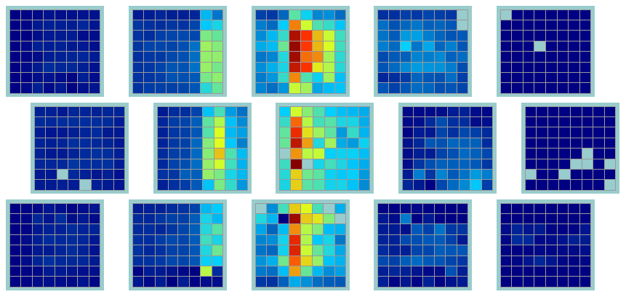
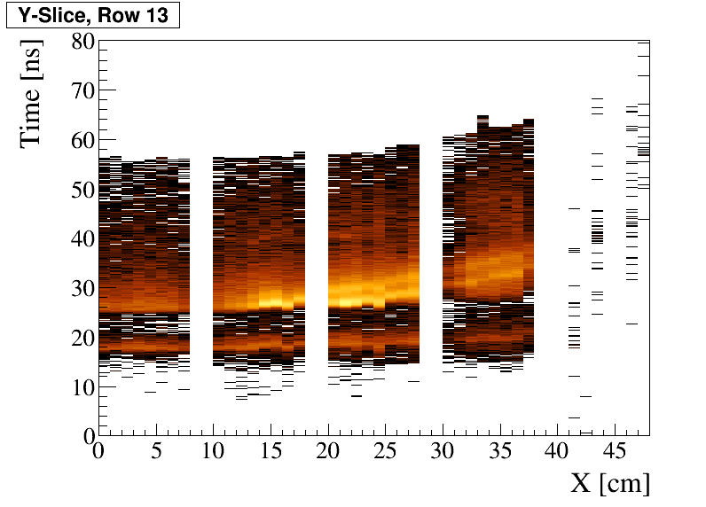
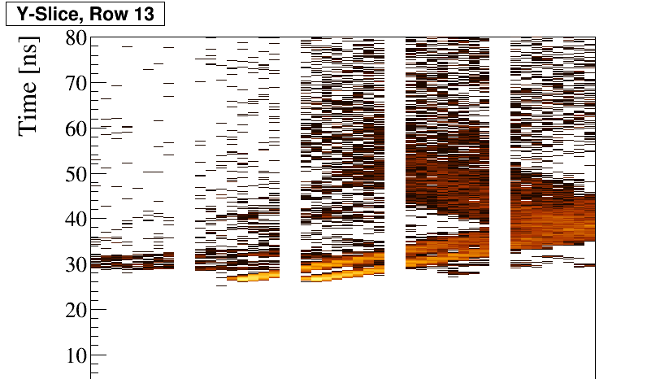
Plate Data Analysis
70° with lens
PiLas time peak positions for
hit time alignment
unaligned:
aligned:
simulation:

Slide 10
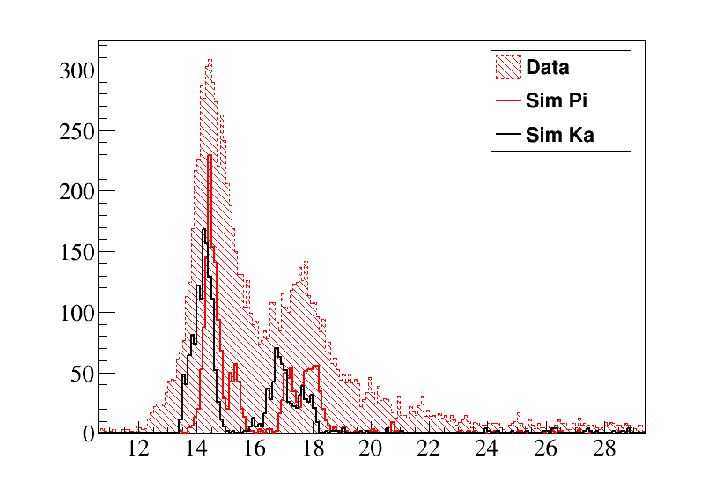
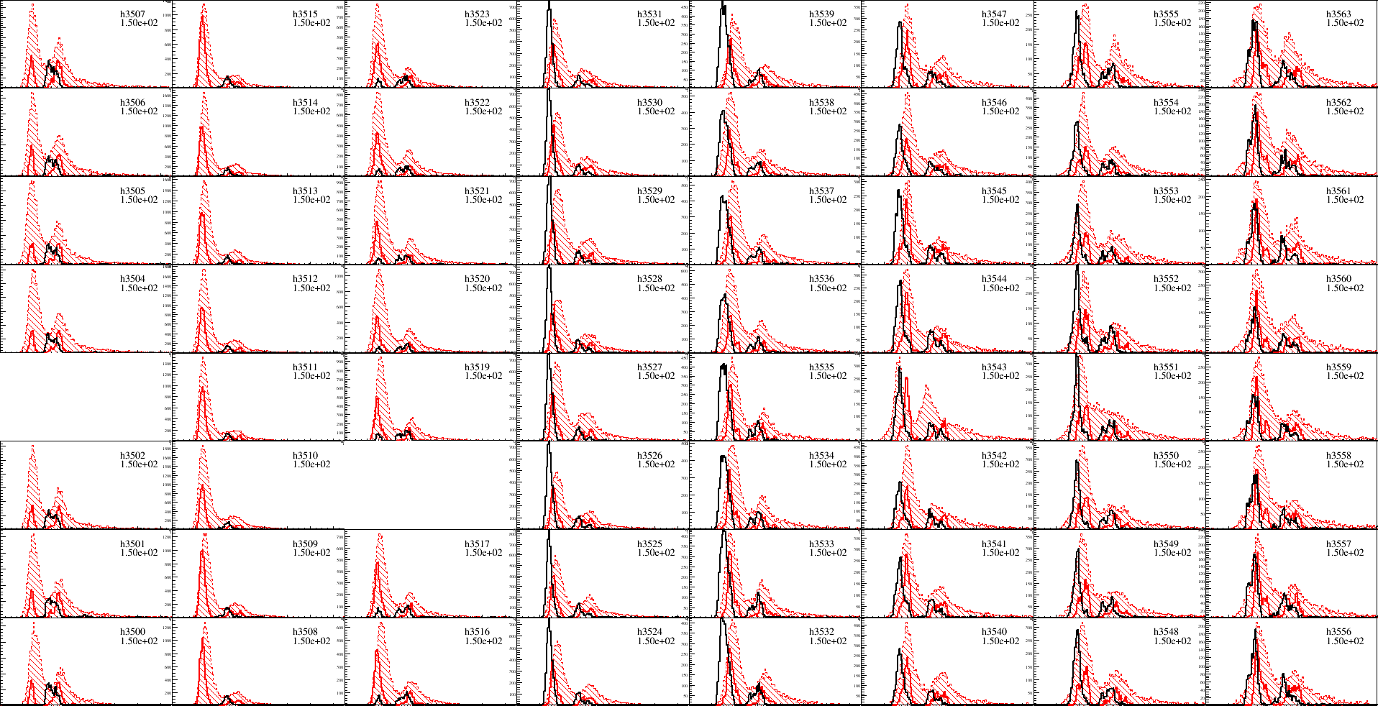
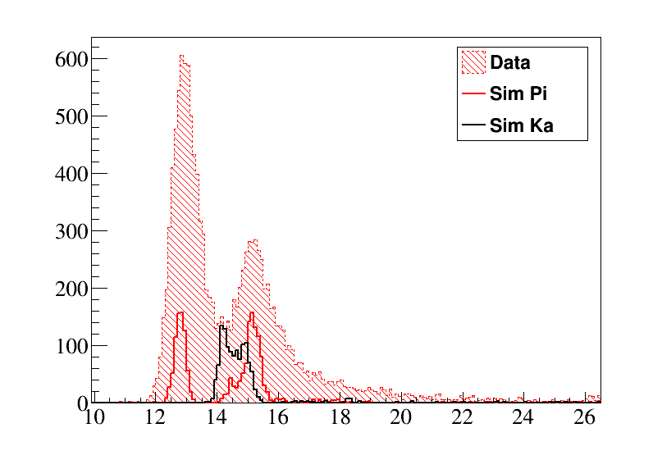
Plate Data Analysis
70° with lens

Slide 11
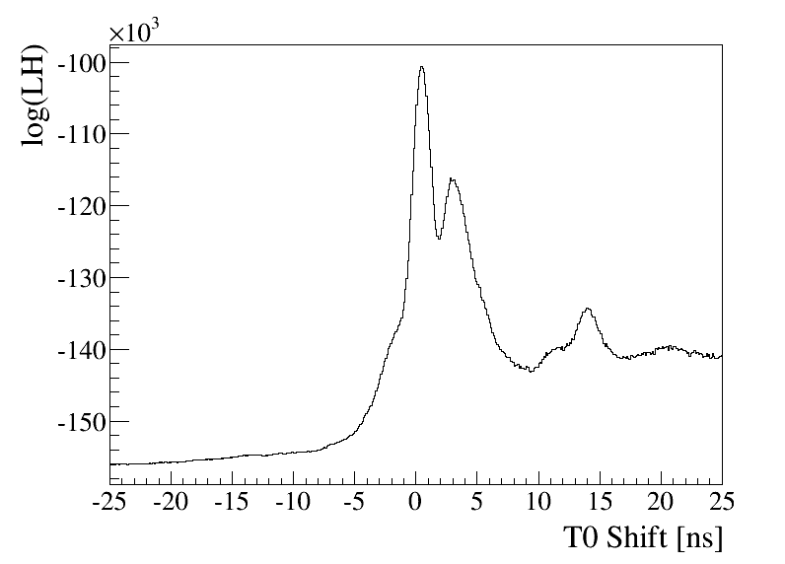
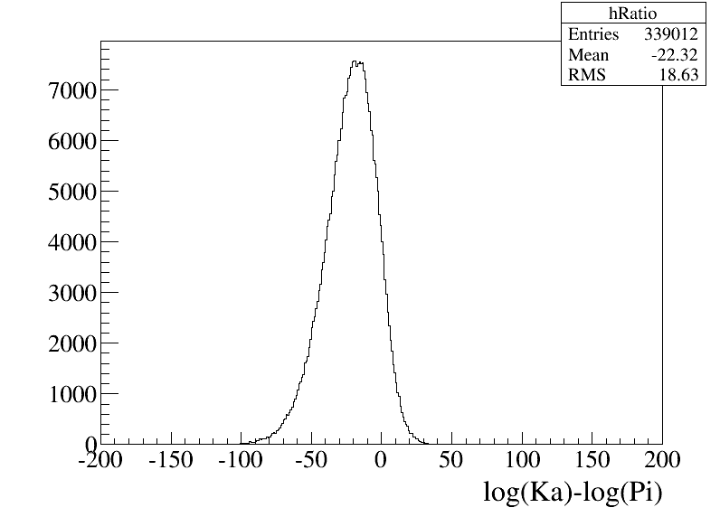
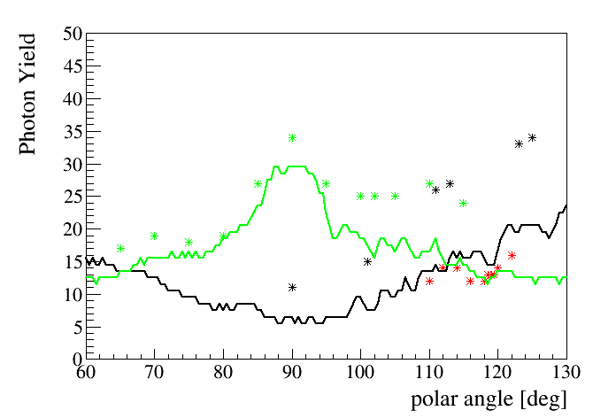
Plate Data Analysis
T₀-fit:
Use the simulated pion data with different
time offsets and perform a Maximum Likelihood fit
on the beam data
Problems:
Time resolution again worse than expected
High noise/PADIWA oscillations
Discriminator thresholds not determined correctly
Likelihood Ratio test
Photon Yield (no lens)
Pions Kaons
* * * Data
-- -- Sim

Slide 12
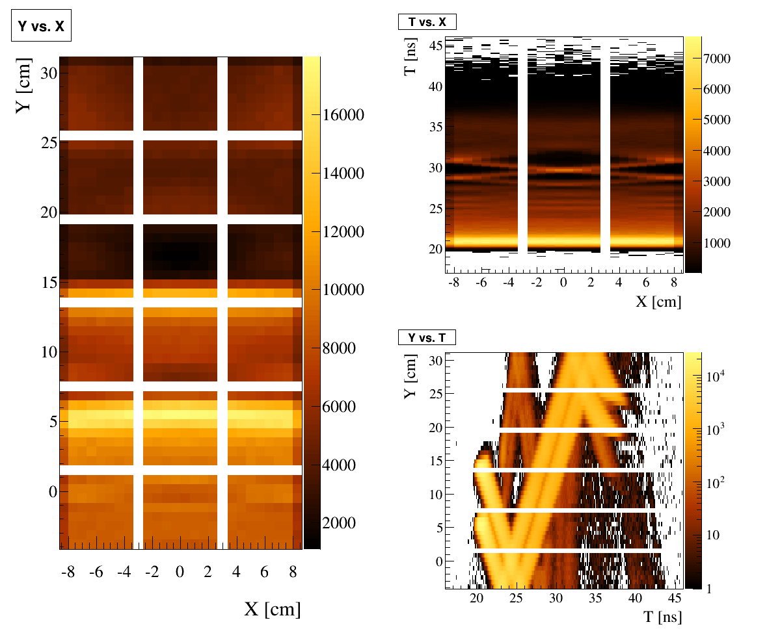
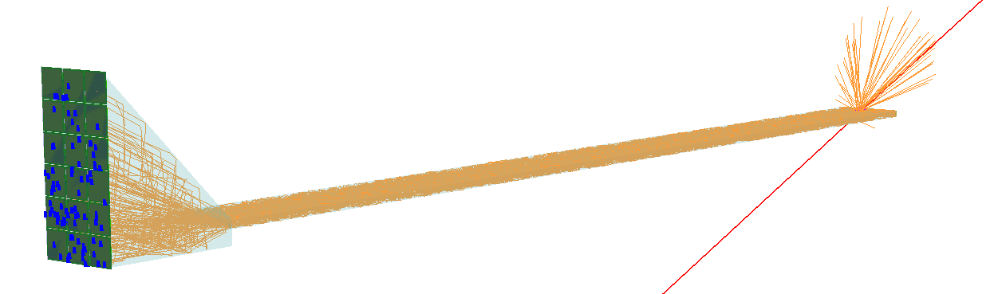
Analytical PDF
Problem:
Can PDF be created efficiently via simulation for each point in track parameter space?
Momentum, hit position, polar angle, azimuth, particle species
High dimensional parameter space, each PDF requires ~100k × 5 simulated particles for hypothesis tests
Without analytical (and fast) generated PDF approach not feasible.
p = 3.5 GeV/c
θ = 22°

Slide 13
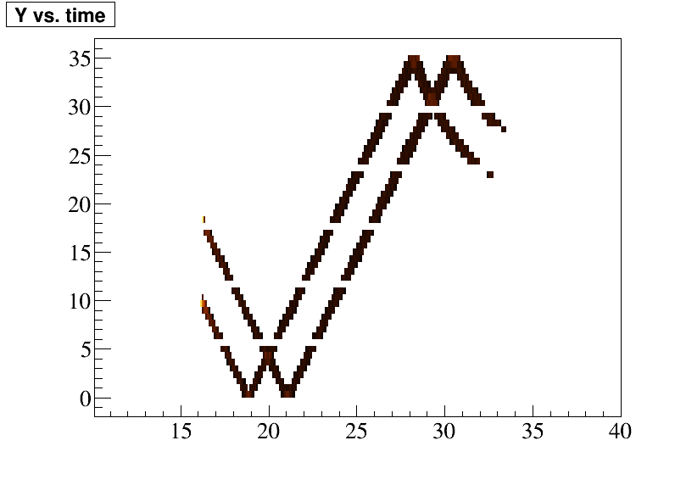
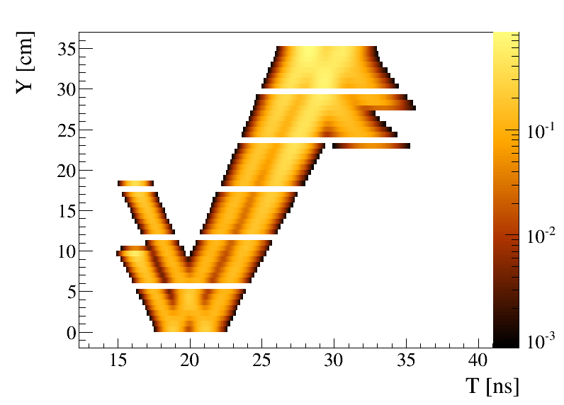
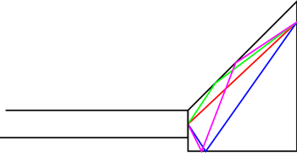
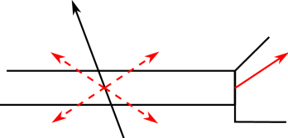
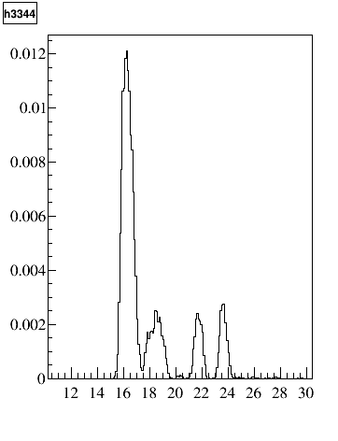
Analytical PDF
Sim
Calc
Calc
$$S=\sum^{j}{\frac{A_{j}}{σ_{j}\sqrt{2π}}×e^{{−\frac{1}{2}\left(\frac{t−t_{j}}{σ_{j}}\right)}^{2}}}$$
The widths σ_{j} are determined by the propagated uncertainties of refraction index, calculated Cherenkov angle, and track parameters.
Normalizations A_{j} are proportional to the fraction of φ_{C} entering the ambiguity and the number of created Cherenkov photons
Calc
Calc
Sim
All ambiguities from geometric reconstruction are calculated and enter the PDF (after cuts)
→ t_{j}
Pixel

Slide 14
Summary and Outlook
Summary
Baseline design of the Barrel DIRC with narrow bars and high-refractive lens meets PANDA PID goals.
Cost optimization identified two design alternatives (wide plate, solid fused silica camera), to be validated with simulation and prototype tests.
Prototype data from the 2014 beam time at GSI shows promising results for radiator plate.
First version of analytically derived probability density functions is finished and feasibility is proven.
Outlook
Beam time scheduled for may and june 2015.
PADIWA noise “features” have to be understood in order to set thresholds properly and achieve good time resolution.
Extensive angular scan with plate will be performed to determine performance.
Thank you

