Slide 1
Tracking QA
| Tobias Stockmanns on behalf of the MVD group

Slide 2
What is the Question?
How many MC tracks were found by the track finder?

Slide 3
What is the Question?
How many MC tracks were found by the track finder?
When is a track found?
Most / some hits of a track?
All hits of a track?
Hits from other tracks?

Slide 4
What is the Question?
Secondary tracks?
DPM?
Physics channels?
What is the sample?
Delayed vertices?
How many MC tracks were found by the track finder?
When is a track found?
Most / some hits of a track?
All hits of a track?
Hits from other tracks?

Slide 5
What is the Question?
How good is the track finder?
How many ghost tracks created?
How many MC tracks were found by the track finder?
How fast is it?
How good does the track fit match?

Slide 6
Quality Marks
Different basis for different questions:
How many tracks of all MC tracks found?
How good can we make our physics?
Includes detector design
How many tracks of all tracks with hitpoints found?
How good is the track finder compared to others?
For primary tracks: at least three hits without Z info or two hits with Z info
For secondary tracks: at least four hits without Z info or three hits with Z info
Other more strict criteria?
How many tracks of all possible tracks found?
Algorithm specific!

Slide 7
When is a track found?
If the hits in the MC track are the same than the ones in the reconstructed track?
If the transversal and the longitudinal momentum are the same?
If the momentum vector and the position vector are the same?

Slide 8
When is a track found?
Fully Found | : | 100 % of MC Hits found AND no other hits
Partialy Found | : | > 3 MC Hits found AND no other hits
Spurious | : | > x % of hits are from one MC track
Ghosts | : | None of the above

Slide 9
TrackingQA Code
Operates on FairLinks
Two versions exist for old and new implementation of FairLinks
Easy to add different criteria for possible tracks by functors
Analyses MC tracks if they are reconstructable
Analyses found tracks if they match to a MC track

Slide 10
Example Output
Event Info:
Analyse Track: 0
PndTrackingQualityData::AnalyseTrackCand: TrackInfo
TrackInfo: (MC-ID/NHits) : AllHits : (2/4) || MVDHitsPixel : (2/4) || MVDHitsStrip || STTHit ||
Ideal Tracking: Track 2: MVDHitsPixel 4 | MVDHitsStrip 0 | STTHit 2 |
MostProbableTrack: 2 Quality: 2
Analyse Track: 1
PndTrackingQualityData::AnalyseTrackCand: TrackInfo
TrackInfo: (MC-ID/NHits) : AllHits : (2/6) || MVDHitsPixel : (2/4) || MVDHitsStrip || STTHit : (2/2) ||
Ideal Tracking: Track 2: MVDHitsPixel 4 | MVDHitsStrip 0 | STTHit 2 |
MostProbableTrack: 2 Quality: 3
TrackID: 0 MCQuality: -5 Quality: -5 Found: 0 MCData: MVDHitsPixel 1 | MVDHitsStrip 0 | STTHit 0 |
TrackID: 2 MCQuality: -2 Quality: 3 Found: 2 MCData: MVDHitsPixel 4 | MVDHitsStrip 0 | STTHit 2 |

Slide 11
Example Output
Run Info:
QualyHisto: All Tracks: 4042
Primary Tracks < 3 hits: 691
All Tracks with hits: 3351. Not Found: 975
Primary Tracks with >= 3 hits, but not a possible track: 152. Not Found: 66
Secondary Tracks with >= 3 hits, but not a possible track: 1180. Not Found: 889
Primary Tracks possible: 2019. Not Found: 20
Secondary Tracks possible: 0. Not Found: 0
FullyFound: 1276 38.0782% (of all tracks), 63.1996% (of all tracks possible) PartlyFound: 1166 34.7956% 57.7514%
Spurious: 176 5.25216% 8.71719% Ghosts: 822 24.53% 40.7132%

Slide 12
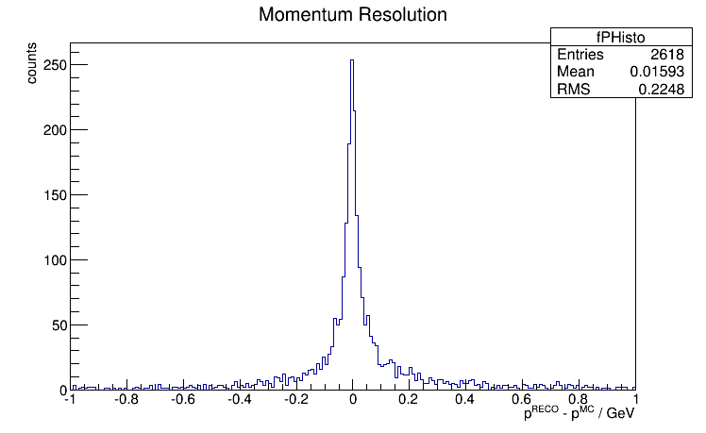
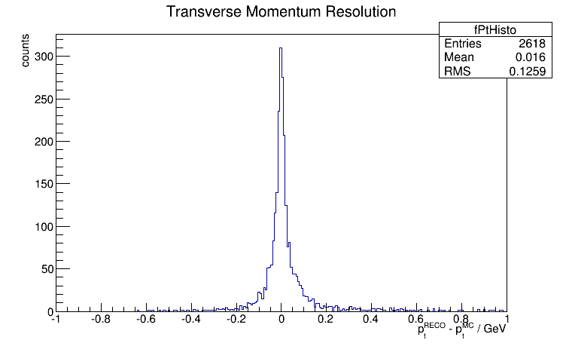
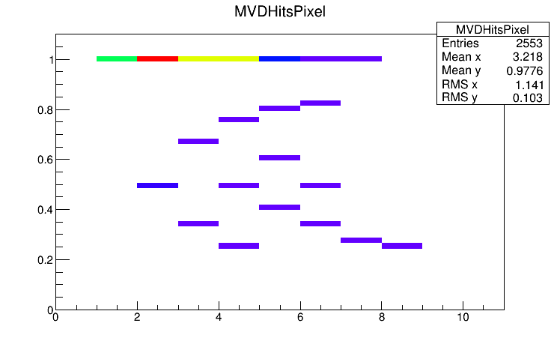
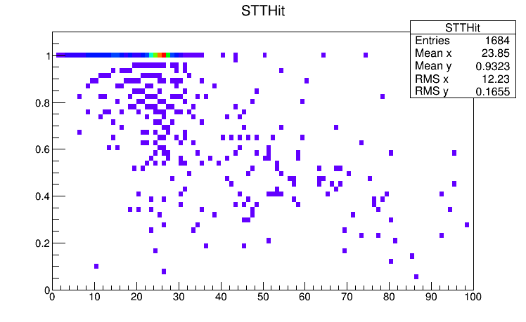
Additional Information

Slide 13
Additional Informations
NTupel with:
Event number
TrackID
How often one MC Track was found
Track quality
MC quality
MC Momentum
Track Momentum
Particle Id (PDG number)

Slide 14
Questions to discuss
Classification of PndTrackCands:
What classes?
Which criteria?
Classification of MCTracks
What classes?
Which cirteria
Common data set
DPM
Physics channels?
Generic sets?
Which features are missing?

