Slide 1
Gieβen March 16th, 2015
Status of
the Cleanup procedure
in the ‘Road Method’
pattern recognition
Universita’
di Pavia
Italy
Gianluigi Boca
Universita’ di Pavia and INFN, Italy

Slide 2
The Cleanup procedure
Efficiency of the Pattern recognition code with the use of both a road finding and a Hough transform algorithms has been shown to be satisfactory many times in the past in the ideal situation when no
pileup caused by the 20 MHz interaction rate.
As I said many times when the realistic pileup situation is turned on a ‘Cleanup’ procedure is necessary to eliminate the spurious tracks
remnant of previous events OR subsequent events.
Both the central Stt detector and the Mvd detector are used to
check if all the hits that are supposed to be there for any given track
are actually present. If not, the track is eliminated as spurious.
G.Boca U. Pavia & INFN, Italy

Slide 3
The Cleanup procedure
Presently I am finalizing the Mvd part of the Cleanup procedure.
All tracks found are required to have at least 90% of the Mvd hits
that are supposed to be there after taking into account the Mvd
sensitive layers.
Progress is slow because of my obligations in teaching and the
other experiment I am involved, nevertheless :
I managed to use the root file of the official Mvd geometry :
geometry/Mvd-2.1_FullVersion.root
to extract the info on each sensitive volume : position relative to
MARS and orientation, dimensions, with the root geometry tools.
G.Boca U. Pavia & INFN, Italy

Slide 4
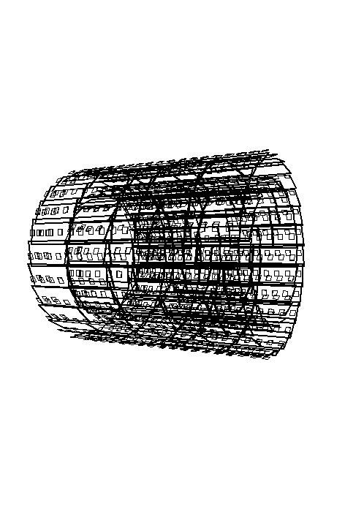
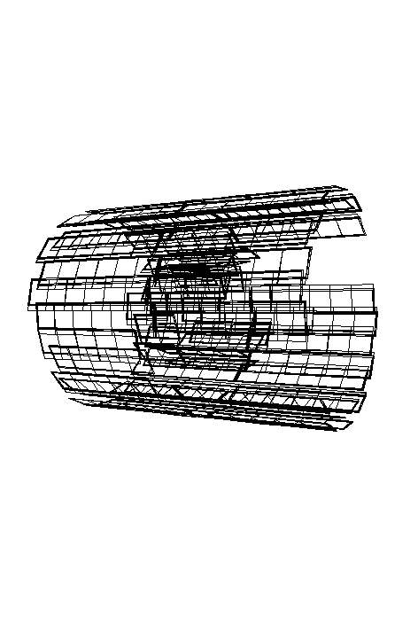
The Cleanup procedure
G.Boca U. Pavia & INFN, Italy

Slide 5
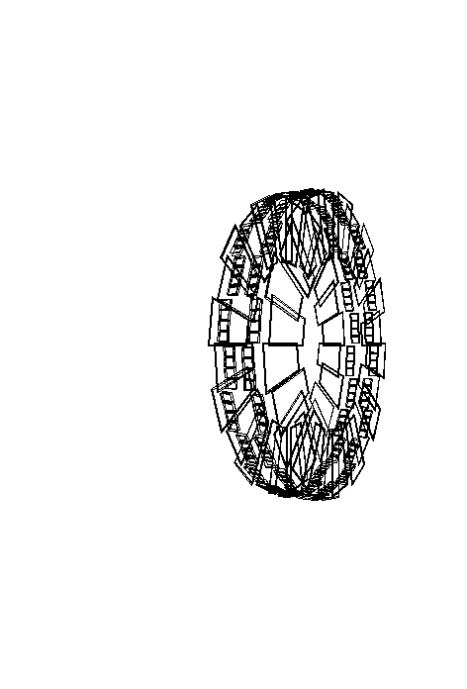
The Cleanup procedure
G.Boca U. Pavia & INFN, Italy

Slide 6
The Cleanup procedure
Now I am writing the class that uses the complete info of the
sensitive volumes to perform the check of the hits present and
missing.
G.Boca U. Pavia & INFN, Italy

