Slide 1
Online Trackfinder
Circle Hough
| Tobias Stockmanns and Andreas Herten

Slide 2
Idea
STT Isochrone
(0,0)

Slide 3
Idea
Track (circle) tangent to isochrone

Slide 4
Idea
Track (circle) tangent to isochrone
Goes through (0,0)

Slide 5
Idea
Track (circle) tangent to isochrone
Goes through (0,0)

Slide 6
Idea

Slide 7
Idea

Slide 8
Idea

Slide 9
Idea

Slide 10
Idea

Slide 11
Idea
Calculate possible circles for all hits
Fill circle centers into xy-histo
Find peaks
Hits in peaks are part of a track
Calculate track parameters from circle centers

Slide 12
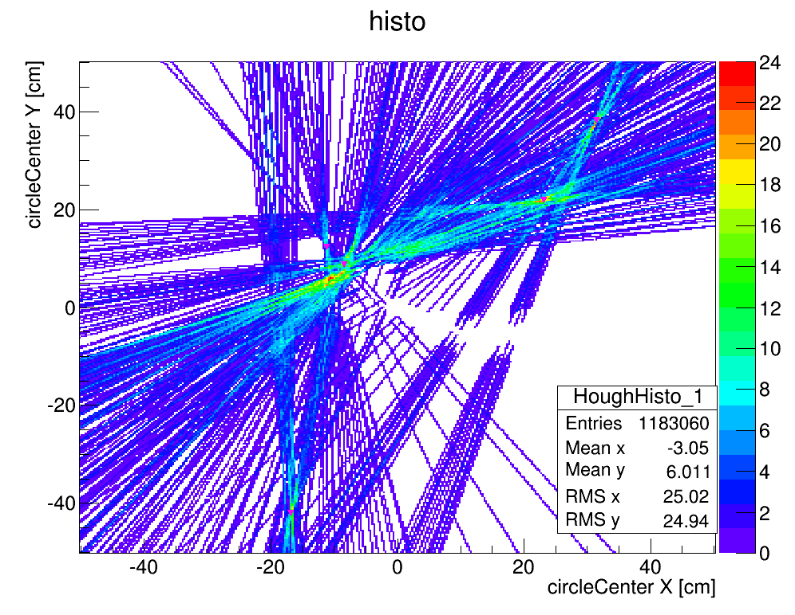
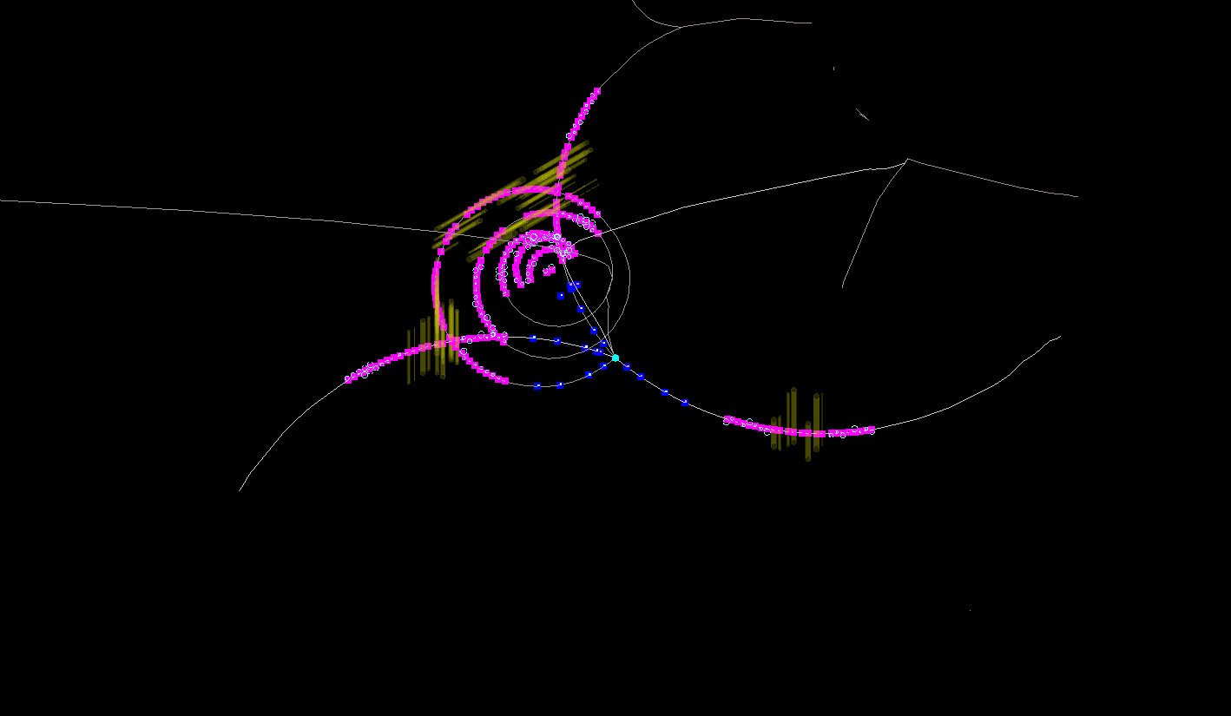
DPM Example 2

Slide 13
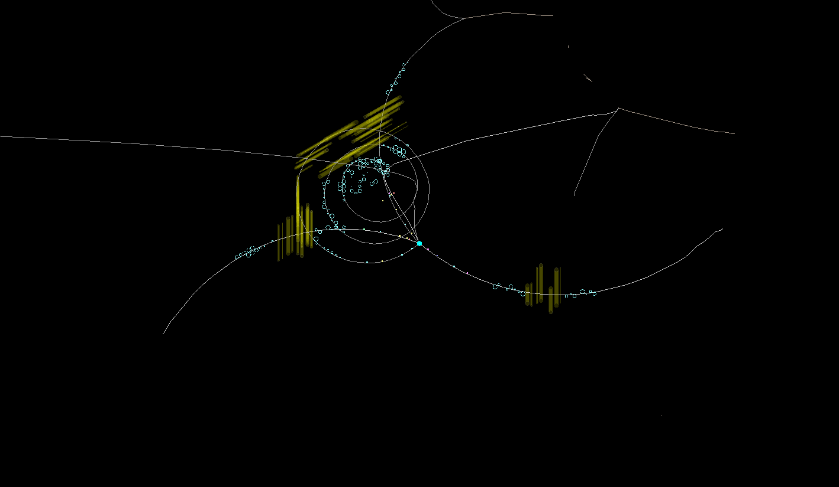
DPM Example 2

Slide 14
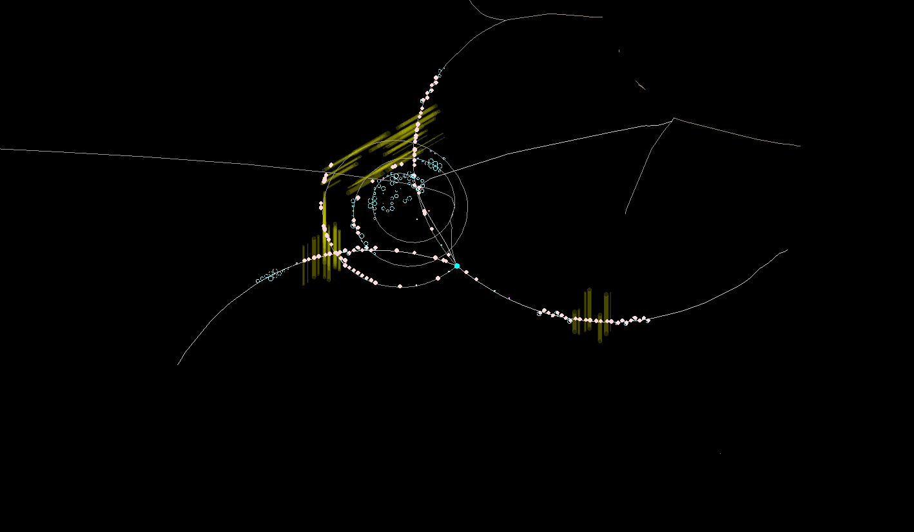
DPM Example 2

Slide 15
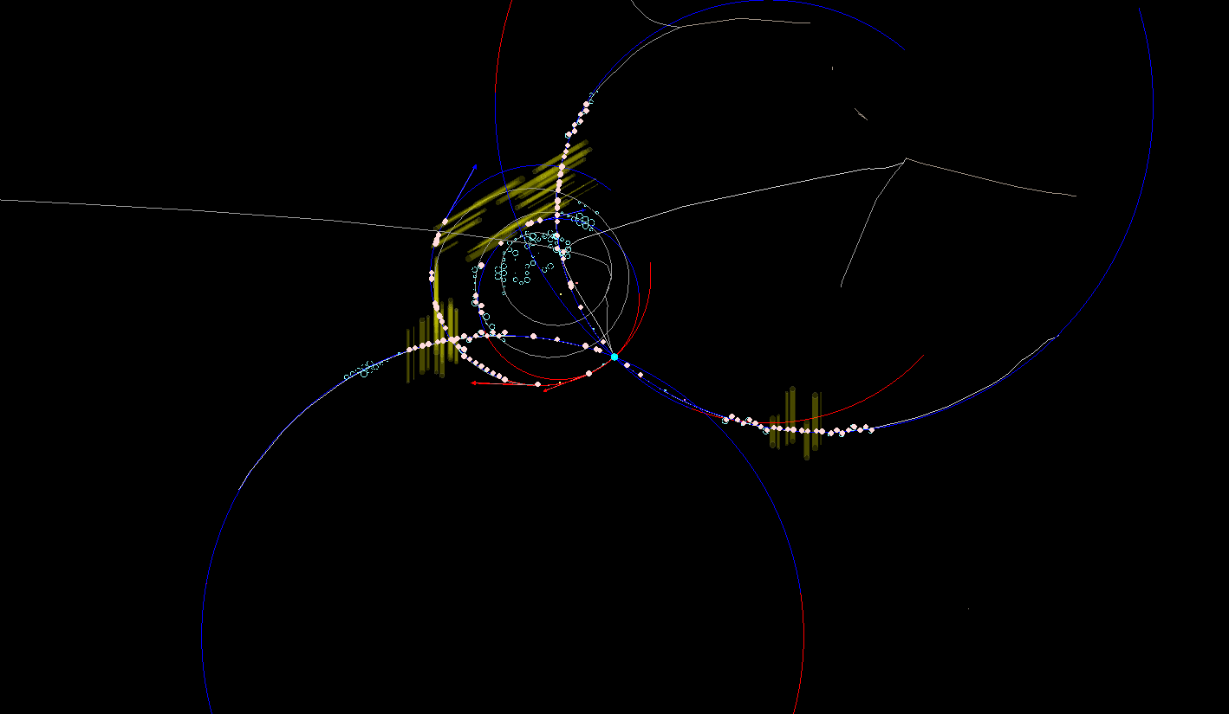
DPM Example 2

Slide 16
Efficiency D→Kππ
A. Herten

Slide 17
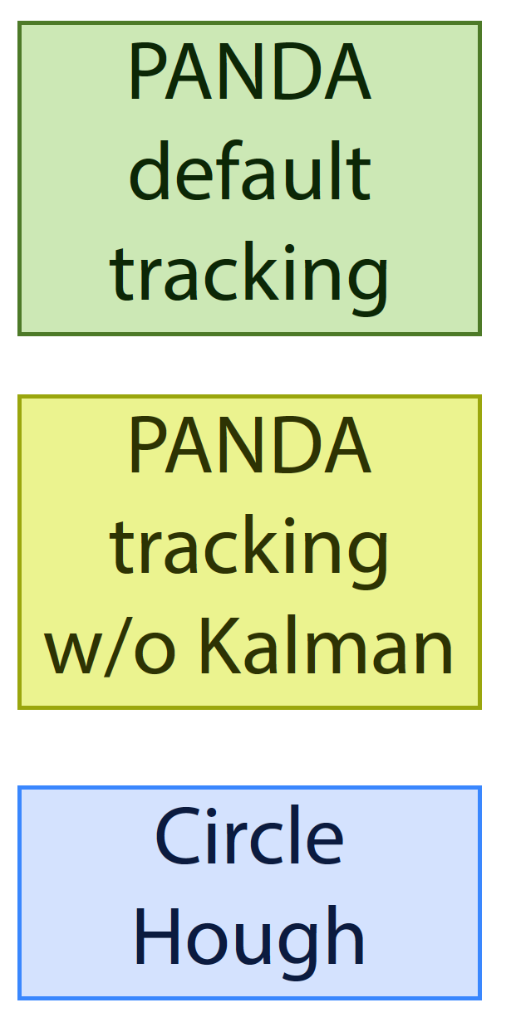
Momentum Resolution
A. Herten

Slide 18
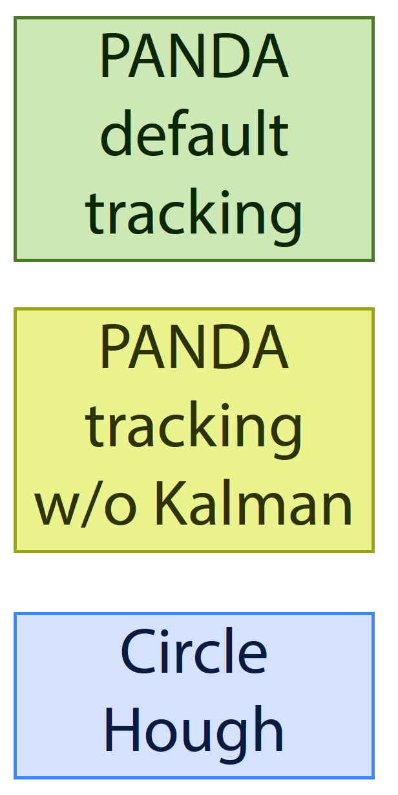
Track Quality
A. Herten

Slide 19
Efficiency
A. Herten

Slide 20
Modification of Algorithm
1. Start with MVD only

Slide 21
Modification of Algorithm
Start with MVD only
All circle centers are on a straight line

Slide 22
Modification of Algorithm
Start with MVD only
All circle centers are on a straight line
Calculate crossings between MVD hits

Slide 23
Modification of Algorithm
Start with MVD only
All circle centers are on a straight line
Calculate crossings between MVD hits
Each crossing gives possible track cand
Check sz-ratio

Slide 24
Modification of Algorithm
Start with MVD only
All circle centers are on a straight line
Calculate crossings between MVD hits
Each crossing gives possible track cand
Check sz-ratio
Define ROI
Search for STT hits
Region of Interest

Slide 25
Hough Histo with ROI

Slide 26
Advantages
MVD hits found separately from STT hits
Due to multiple scattering and energy loss MVD hits and STT hits often not on a circle ➔ loss in track finding efficiency
Less computations for MVD and STT ➔ faster
Possible to use time information from MVD in ROI for STT isochrone calculation

Slide 27
Efficiency
Found Prim./
Generated Prim. > 2 hitpoints

Slide 28
Performance
1000 DPM events at 6.5 GeV/c
Track finding efficiency of primary tracks with more than 2 hitpoints per track 96 %
Fully found: > 50 %
Partially found: > 40 %
Spurious found: < 10 %
Similar numbers for D → Kππ

Slide 29
Summary and Outlook
Circle Hough seems to be good online algorithm for fast track finding with high efficiency
Tests on event based data with given t0 very promising
First test with time-based data done
Use t0 from MVD hits for STT reconstruction
Check performance
Optimize cut criteria

