Slide 1
Study of T₀ Extraction in the Online Tracking Algorithm
Yutie Liang, Martin Galuska, Thomas Geßler, Wolfgang Kühn,
Jens Sören Lange, David Münchow, Björn Spruck, Milan Wagner
II. Physikalisches Institut, JUSTUS-LIEBIG-UNIVERSITÄT GIESSEN
Mar. 16. 2015

Slide 2
Outline
1. Introduction
2. T0 extraction from tracking
Performance study with C++
4. Summary and outlook

Slide 3
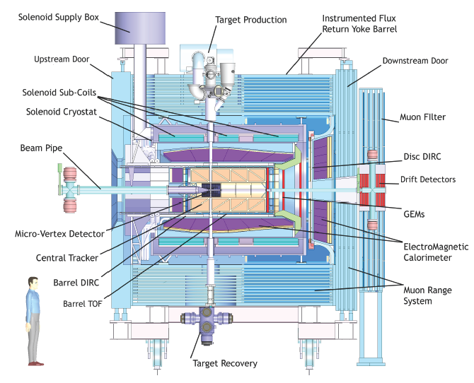
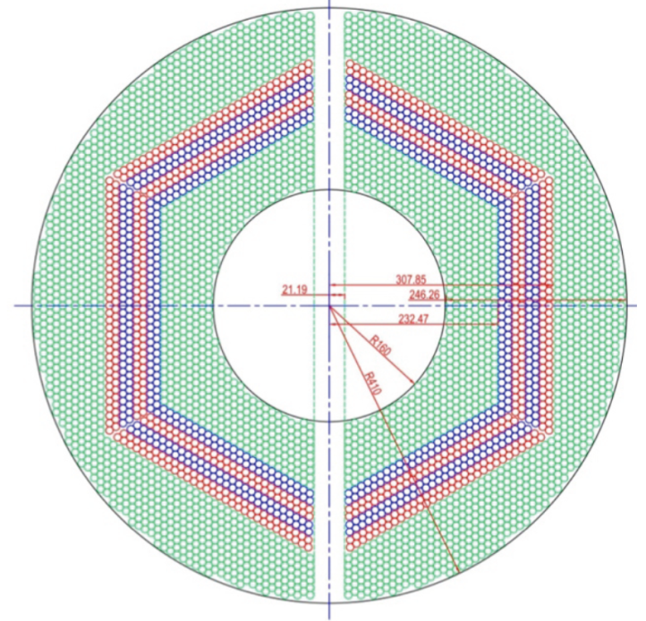
Straw Tube Tracker (STT)
4636 Straw tubes
23-27 planar layers
15-19 axial layers (green) in beam direction
4 stereo double-layers for 3D reconstruction,
with ±2.89 skew angle (blue/red)
From STT : Wire position + drift time

Slide 4
Tracking Algorithm -- Road Finding
Layer_ID
Hit
Hit
Hit
Hit
Hit
Hit
Hit
Hit
Hit
Hit
Hit
Tube_ID
Hit: Seg_ID (3 bits) + LayerID (4 bits) + Tube_ID (6 bits) + Arrival time
1: Start from inner layer
2: Attach neighbour hit to tracklet layer by layer
Boundary between two segments.
Number of neighbor:
4 in axial layer; 6 in stereo layer

Slide 5
Tracking Algorithm -- helix parameters calculation
Known : x_{i} , y_{i} , d_{i}
Question: To determine a circle,
x² + y² + ax + by + c = 0
Method: Minimize the equation
E² = ∑(x_{i}² + y_{i}² + a x_{i}+ b y_{i} + c)² (1/d_{i})²
y
x_{c}, y_{c}, R
x
S_{x} = ∑x_{i} …
S_{xx} = ∑x_{i}x_{i} …
S_{xxx} = ∑x_{i}x_{i}x_{i} …
1) Circle para.
2) Track quality.

Slide 6
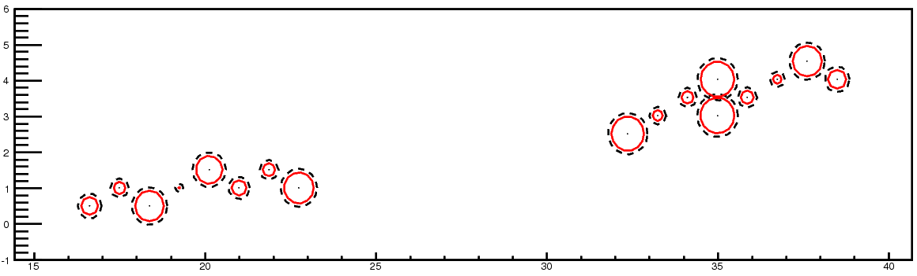
Event Structure -- pile-up
20 MHz
2000 ns revolution time
200 ns gap
T_{Mean} between 2 events: 50 ns
Drift time: ~200 ns
Event pile-up
Wrong T0 → Wrong drift circle → bad track quality

Slide 7
Previous Tracking Strategy with experimental data
Hits are sorted according to their arrival time.
In case of T₀ provided:
T₀ as a start point → hits in 220 ns window → run tracking algorithm → assign track to right event
In case of T₀ not provided:
Do a time-consuming T₀ scan

Slide 8
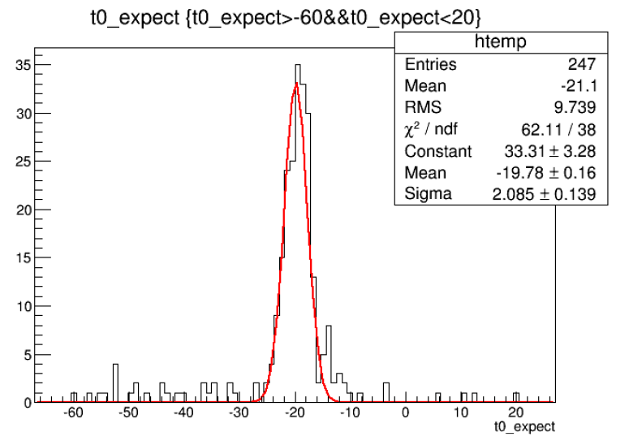
A better Method to Extract T₀
T0 shift = Ʃdi /N / const (N: number of hits
di: signed distance of circle to track)
T0 shifted by:
-50 ns:
-20 ns:
10 ns:
20 ns:
Extracted T0:
-47.0±4.0 ns
-19.8±2.1 ns
9.4±2.5 ns
19.0±2.3 ns

Slide 9
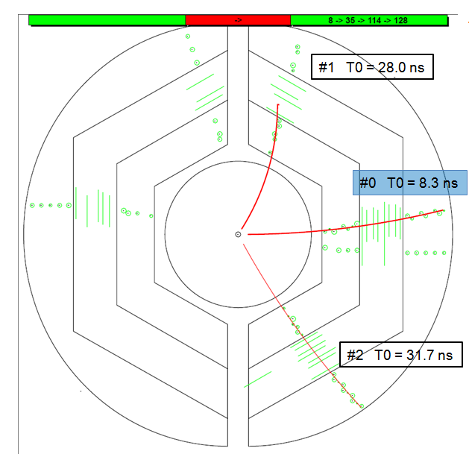
New Tracking Strategy in case of unknown T₀
1) Start from 0
2) hits in 220 ns window
3) run tracking algorithm
4) extract T₀ of next event
5) go back to 2)
Two time-based simulations:
1 GeV single muon
DPM

Slide 10
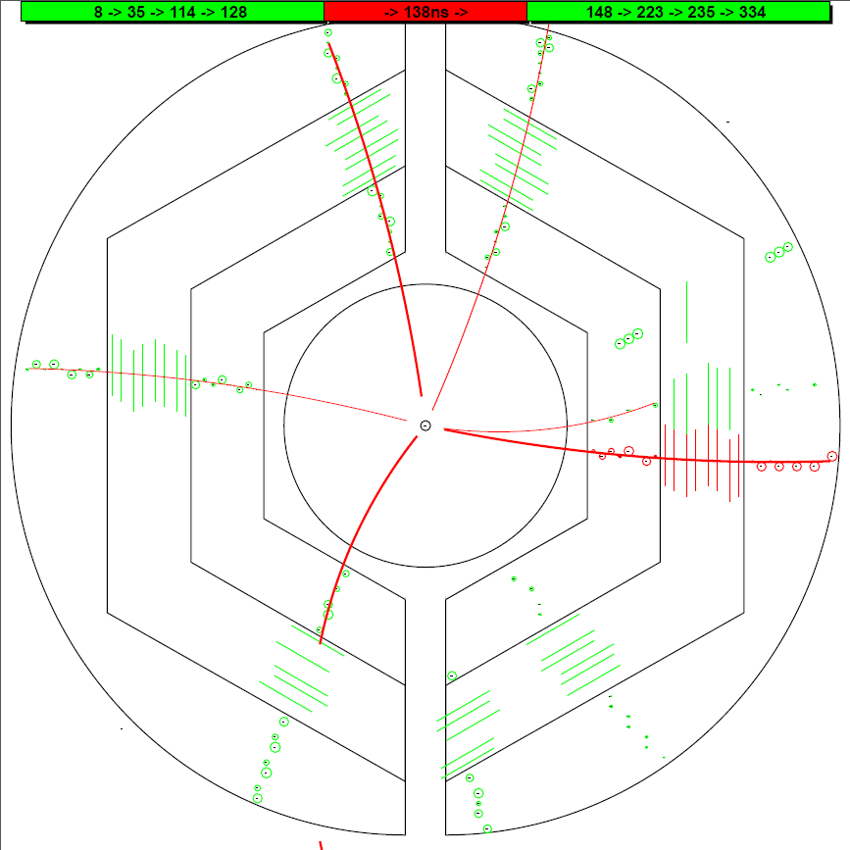
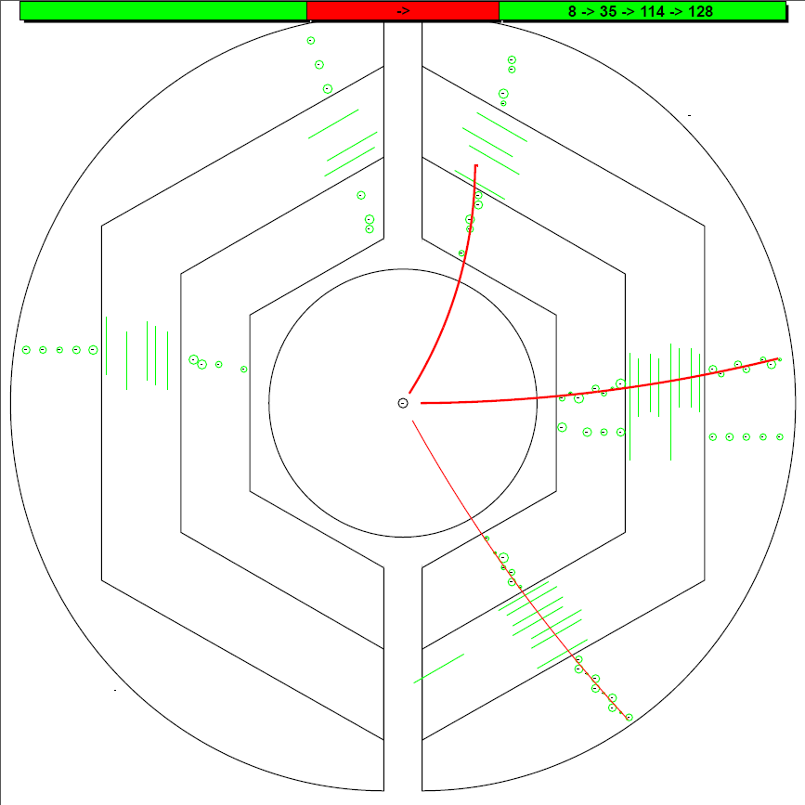
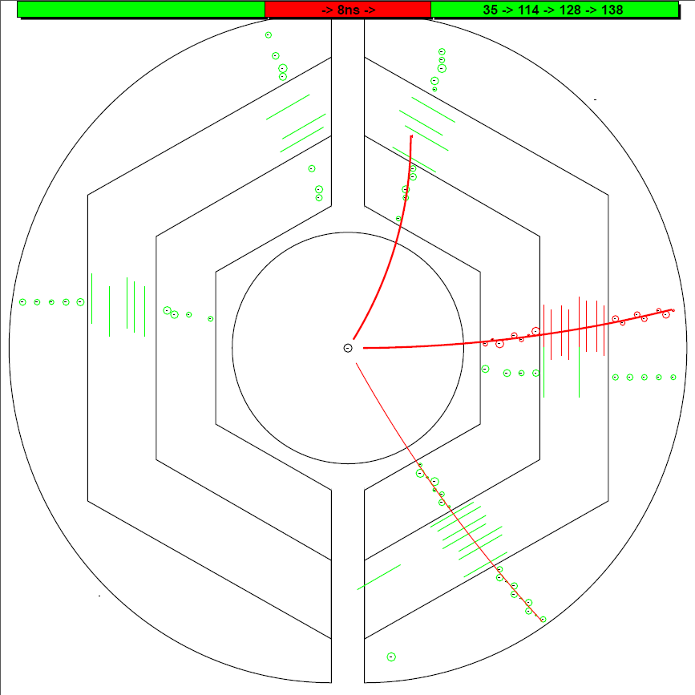
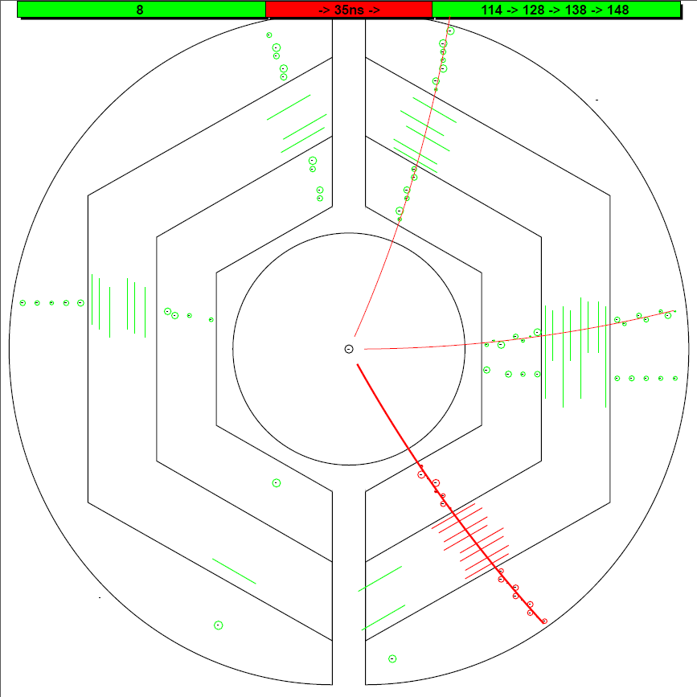
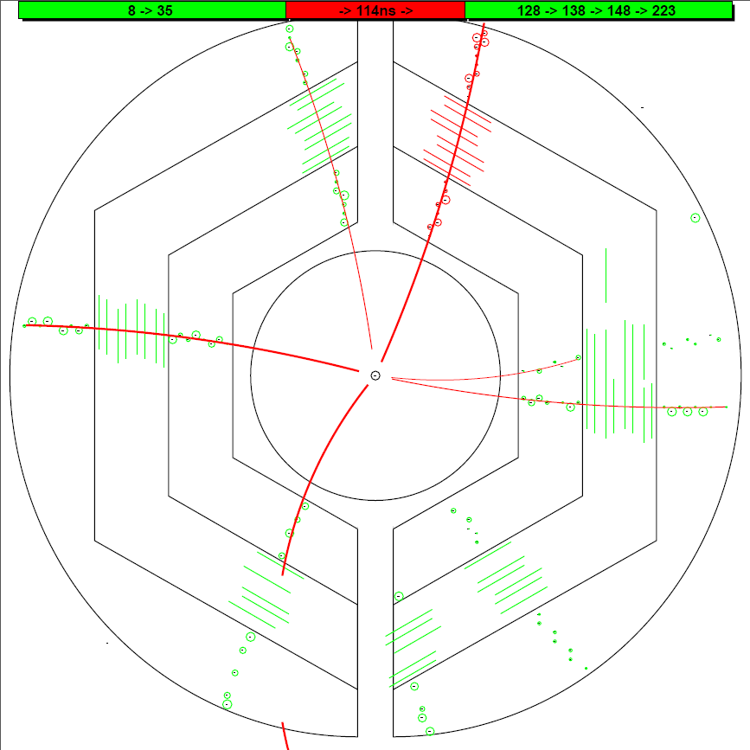
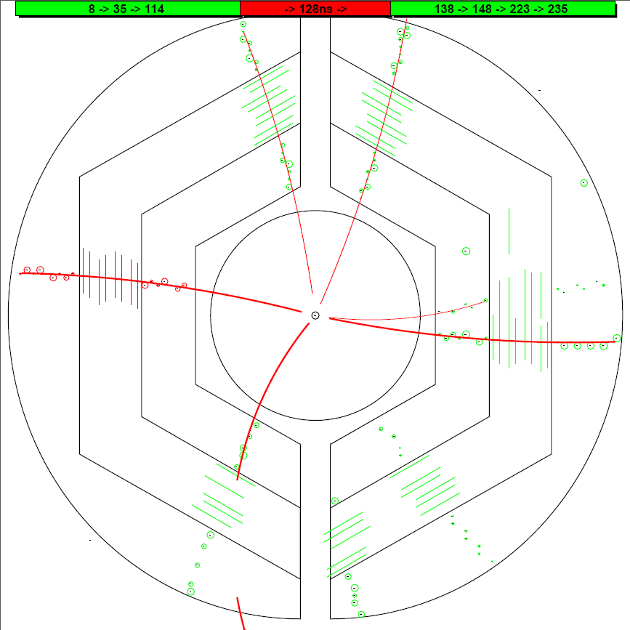
T0 (ns) : MC Input Iter_2
T0 (ns) : MC Input Iter_2
T0 (ns) : MC Input Iter_2
T0 (ns) : MC Input Iter_2
T0 (ns) : MC Input Iter_2
T0 (ns) : MC Input Iter_2
0.0
0.0
0.0
0.0
0.0
0.0
#1 T0 = 146.1 ns
#1 T0 = 147.4 ns
#1 T0 = 147.4 ns
#1 T0 = 28.0 ns
#1 T0 = 36.3 ns
#1 T0 = 112.4 ns
#1 T0 = 116.0 ns
#1 T0 = 116.6 ns
#1 T0 = 117.1 ns
8.4
8.4
8.4
8.4
8.4
8.4
8.3
8.3
8.3
8.3
8.3
8.3
8.5
8.5
8.5
8.5
8.5
34.6
34.6
34.6
34.6
34.6
35.9
35.9
35.9
35.9
35.9
35.9
35.9
35.9
35.9
35.9
#1 T0 = 128.0 ns
#1 T0 = 128.0 ns
#1 T0 = 128.1 ns
#0 T0 = 8.3 ns
#0 T0 = 8.5 ns
#0 T0 = 9.7 ns
#0 T0 = 65.7 ns
#0 T0 = 67.8 ns
#0 T0 = 97.0 ns
114.1
114.1
114.1
114.1
114.1
114.1
112.4
112.4
112.4
112.4
116.0
116.0
#1 T0 = 137.2 ns
116.0
#1 T0 = 138.4 ns
#1 T0 = 139.2 ns
128.0
128.0
128.0
128.0
128.2
128.0
128.2
128.2
128.2
128.2
#1 T0 = 127.2 ns
128.2
#1 T0 = 158.1 ns
#1 T0 = 167.0 ns
#2 T0 = 34.6 ns
#2 T0 = 35.9 ns
#2 T0 = 31.7 ns
138.4
139.0
138.4
139.2
139.0
139.0
139.0
139.0
139.0
148.3
147.4
148.3
148.3
148.3
148.3
148.3

Slide 11
Time-based simulation with DPM events

Slide 12
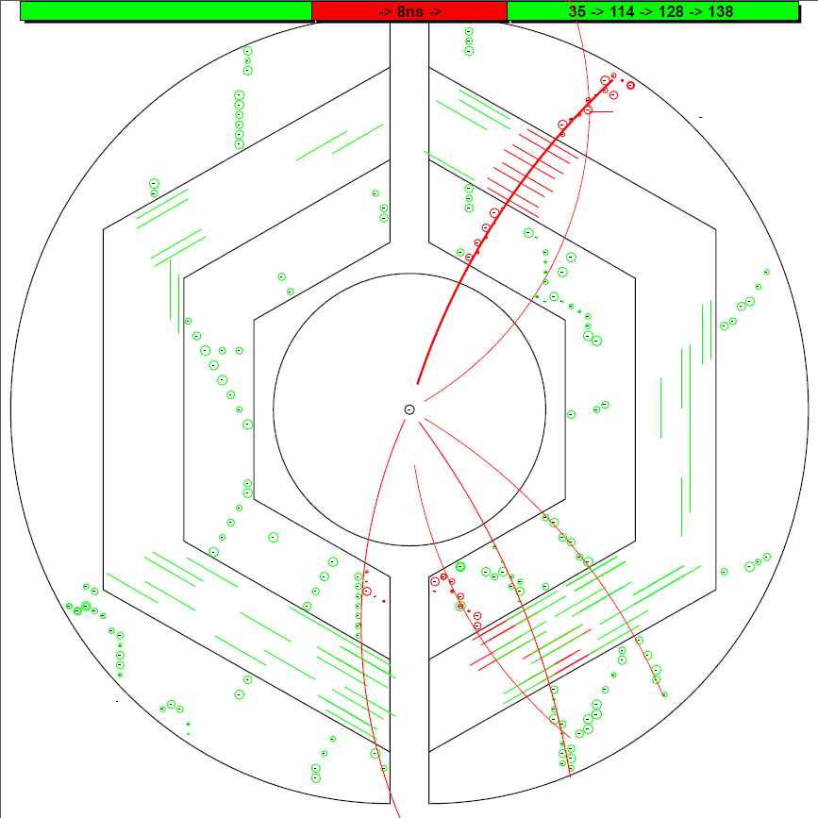
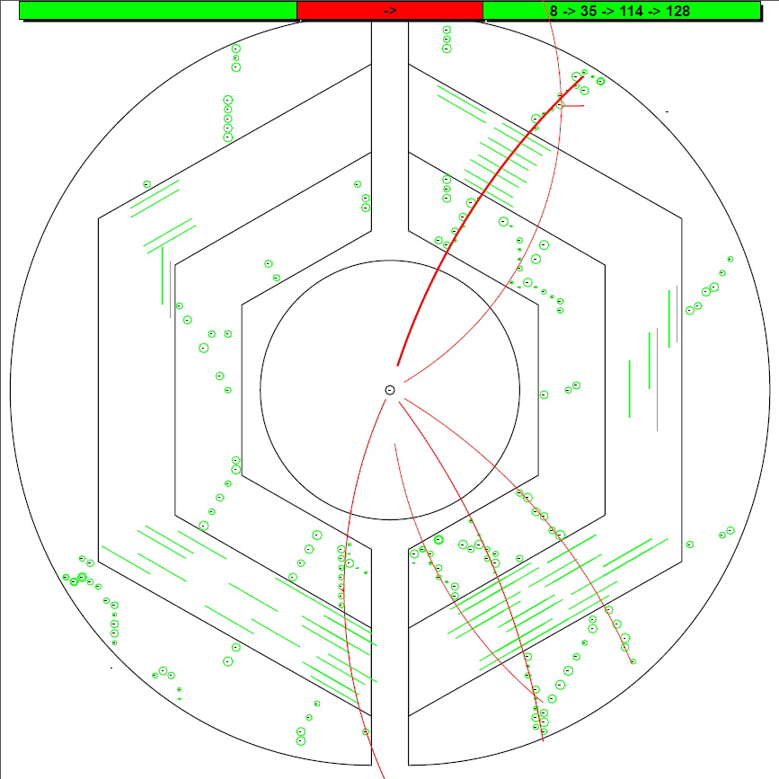
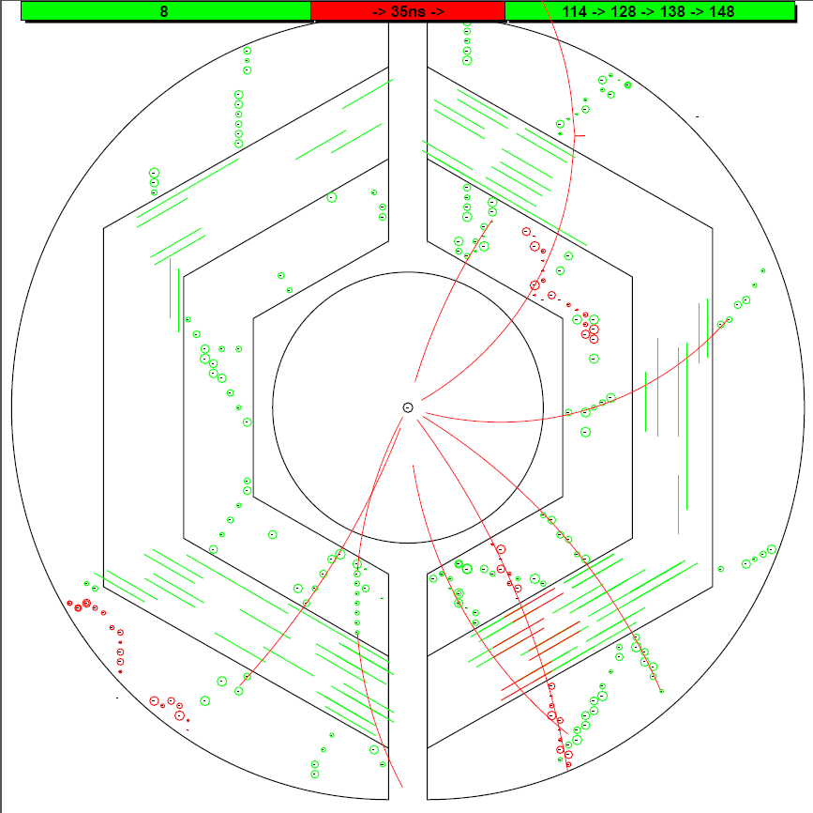
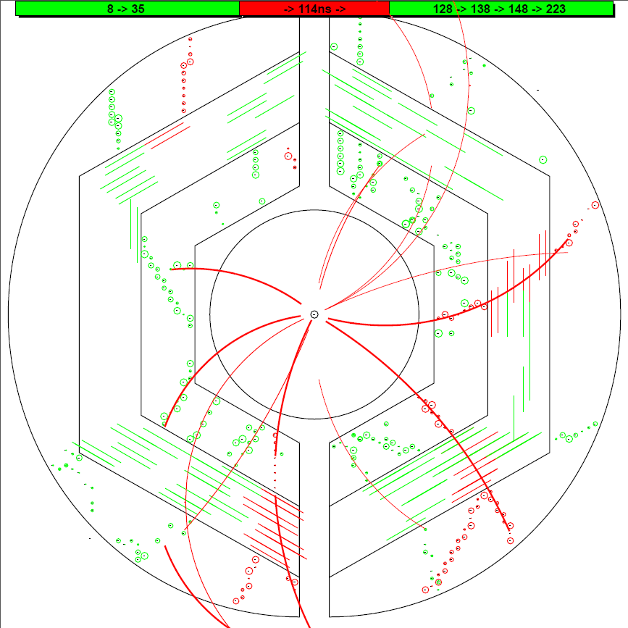
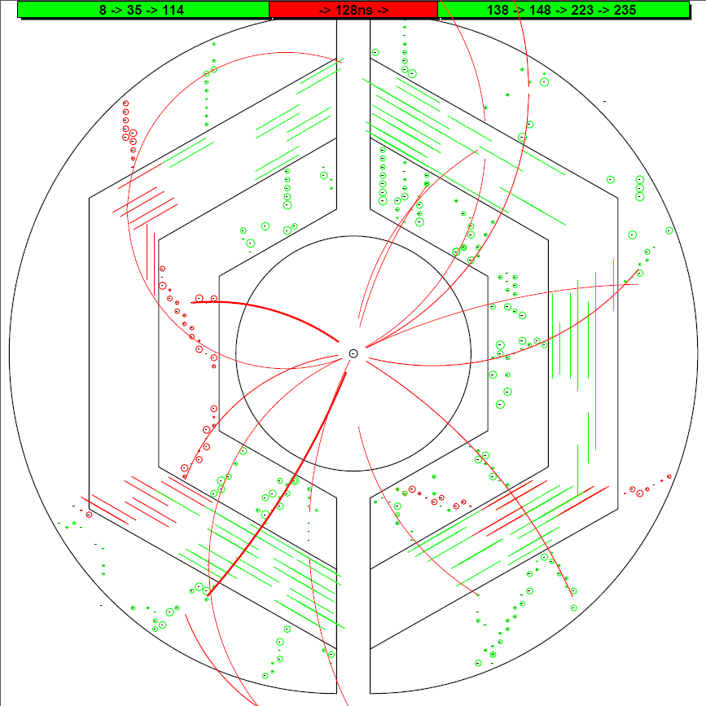
T0 (ns) : MC Input Iter_2
T0 (ns) : MC Input Iter_2
T0 (ns) : MC Input Iter_2
T0 (ns) : MC Input Iter_2
T0 (ns) : MC Input Iter_2
#1 T0 = 140.9 ns
0.0
0.0
0.0
0.0
0.0
8.4
8.4
8.4
8.4
8.4
9.0
9.0
9.0
9.0
9.0
9.4
9.4
9.4
9.4
#1 T0 = 9.4 ns
#0 T0 = 9.0 ns
37.2
37.2
37.2
37.2
38.2
38.2
35.9
38.2
35.9
35.9
35.9
35.9
#1 T0 = 115.3 ns
#1 T0 = 116.8 ns
114.1
114.1
114.1
114.1
114.1
114.5
114.5
114.5
116.6
115.3
#1 T0 = 98.3 ns
#1 T0 = 95.3 ns
#1 T0 = 114.5 ns
#1 T0 = 116.6 ns
128.2
128.2
128.2
128.2
128.2
140.9
139.0
140.9
141.1
139.0
139.0
139.0
139.0
148.3
150.9
148.3
148.3
148.3
148.3
#1 T0 = 128.0 ns
#1 T0 = 119.0 ns
#1 T0 = 35.7 ns
#0 T0 = 37.2 ns
#0 T0 = 38.2 ns
12

Slide 13
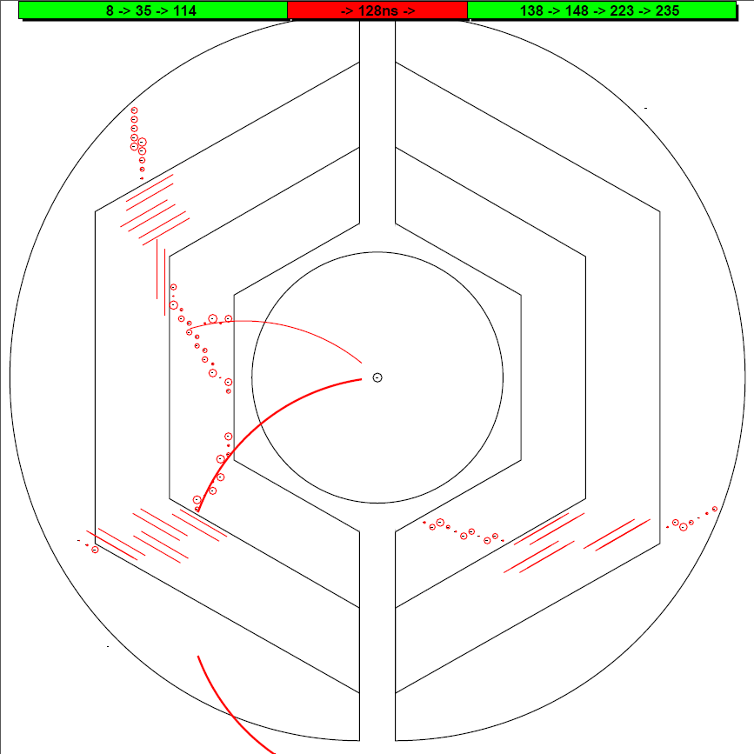
The Missing Event at Event-based simulation
Tracks in this event are not well reconstructed.
In this case, it is hard to extract a T₀.
13

Slide 14
New Tracking Strategy with experimental data
Hits are sorted according to their arrival time.
In case of T₀ provided:
T₀ as a start point → hits in 220 ns window → run tracking algorithm → assign track to right event
In case of T₀ not provided:
Dynamic T₀ extraction (fast)

Slide 15
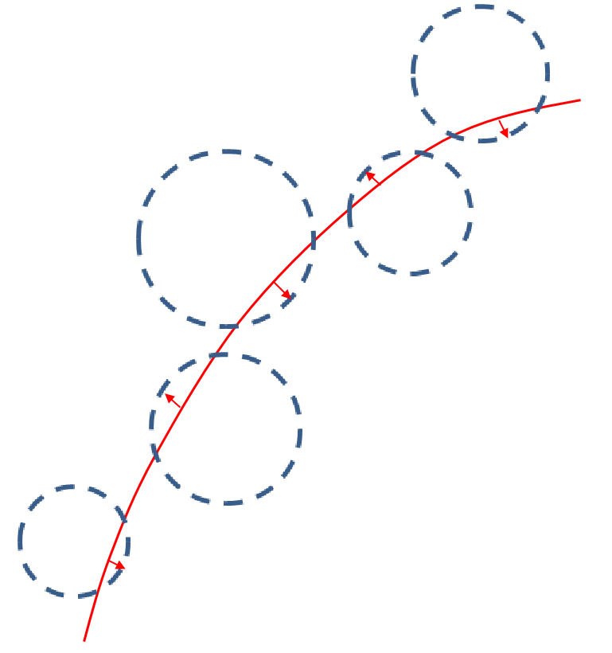
Summary and Outlook
Extract T₀ using the distance of drift circles to track.
Simultaneous tracking and Dynamic T₀ extraction: fast
Secondary vertex does not work yet.

Slide 16
Thank you

Slide 18
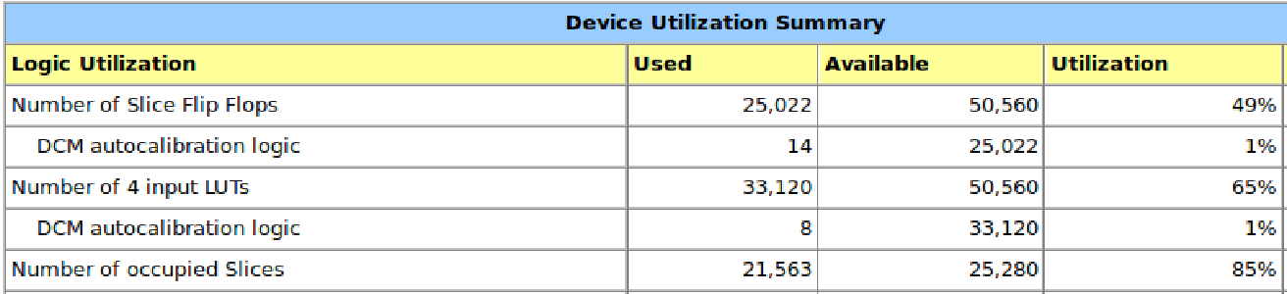
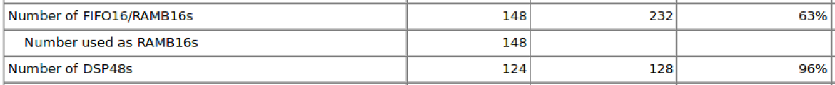
Performance at FPGA
For one event with 100 hits (6 tracks): 7 μs
Hit reading
Road finder
Pt extraction
Pz extraction
(100 cc)
(50 cc X 6)
(120 cc X 2 X 6)
(60 cc X 2 X 6)

Slide 19
Tracking at FPGA -- at low event rate
Data flow: Hit information at PC → FPGA, extract helix para. → PC
PC is used to draw hits and helix in the plot. The helix parameters come from FPGA.

Slide 20
Tracking at FPGA -- 20 MHz
Data flow: Hit information at PC → FPGA, extract helix para. → PC
PC is used to draw hits and helix in the plot. The helix parameters come from FPGA.

Slide 21
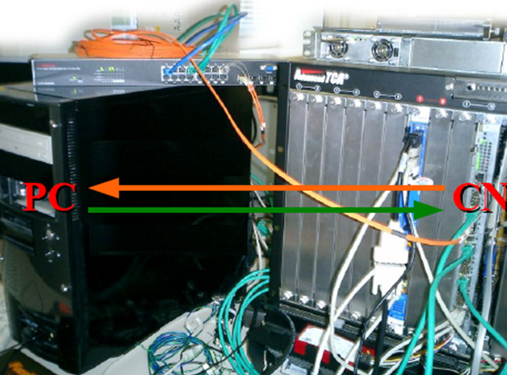
 | C++ | VHDL
P_{t} 1st iteration | √ | √
P_{t} 2nd iteration | √ | √
χ² calculation | √ | √
P_{z} 1st iteration | √ | √
P_{z} 2nd iteration | √ | √
σ_pt : ~ 3.2% σ_pz : ~ 4.2%
7 μs/event (6 tracks) , 140 FPGA @ 20MHz

Slide 22
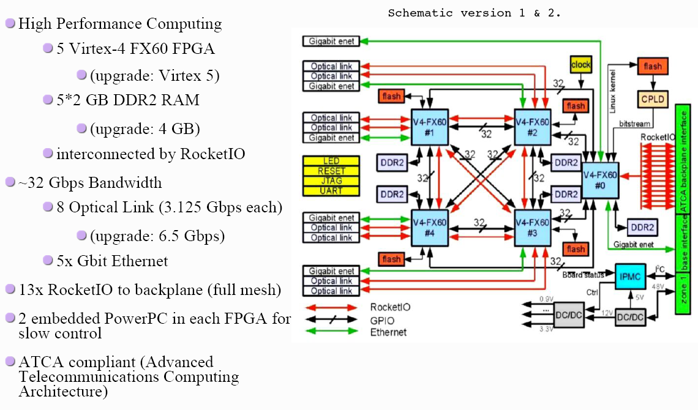
The Compute Node (CN)

Slide 23

Hardware Description Language
VHDL, Verilog, SystemC
VHDL: Very-high-speed integrated circuits Hardware Description Language.
It’s a dataflow language, unlike procedural computing languages such as C++ which runs sequentially, one instruction at a time.
Signal A3_B1 …;
Signal A4_B2 …;
A3 <= A3_B1;
B1 <= A3_B1;
A4 <= A4_B2;
B2 <= A4_B2;
A1
A
A3
B1
B
B3
A2
A4
B2
B4

Slide 24
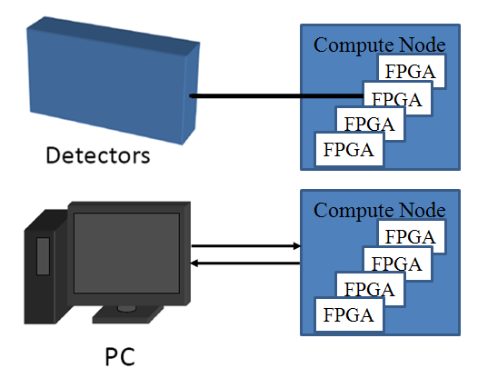
Setup and Test
PC as data source and receiver.
Ethernet.
Optical link (UDP by Grzegorz Korcyl )
(not integrated yet)
Ethernet via
Optical Link
FPGA
FIFO
Tracking algorithm
FIFO

Slide 25
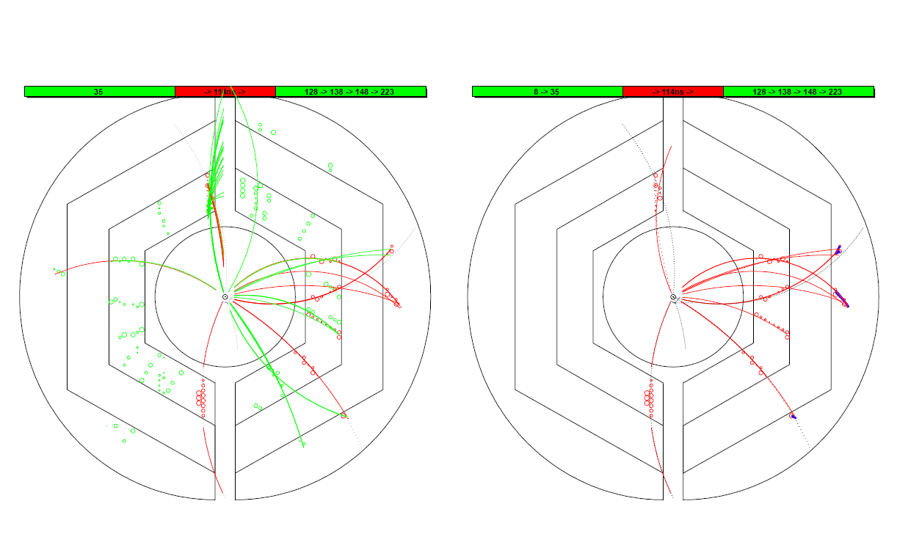
Assign a track to the correct event
T₀ information: current event(Red) or other events(Green)
Black dashed line: track by MC truth
Red line: recon. track
Blue: recon. using outer layers
drift circles belong to current event (Red) or other events (Green)
Event #2
Event #2

Slide 26
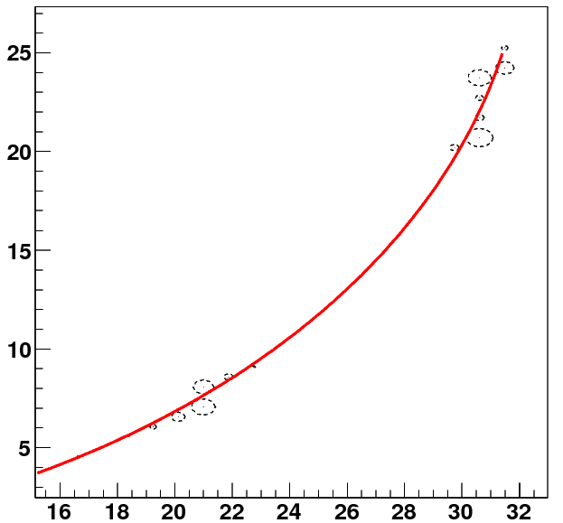
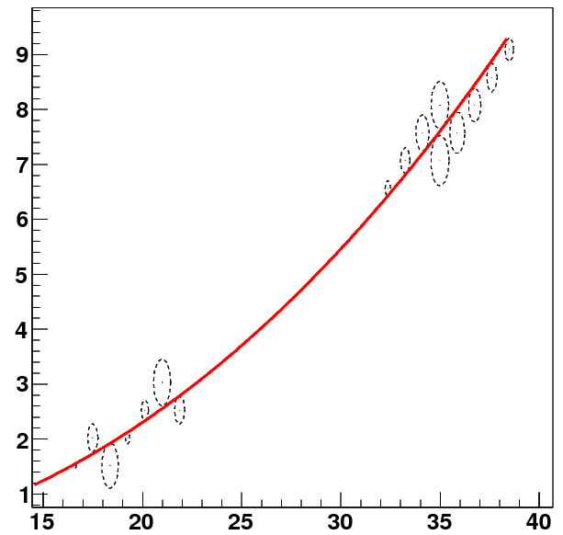
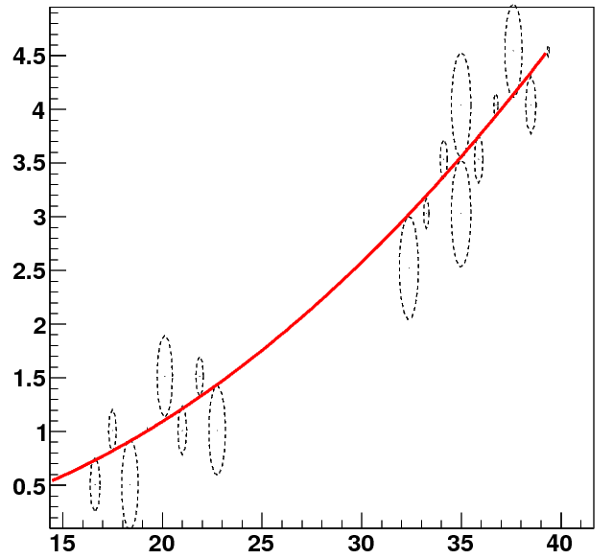
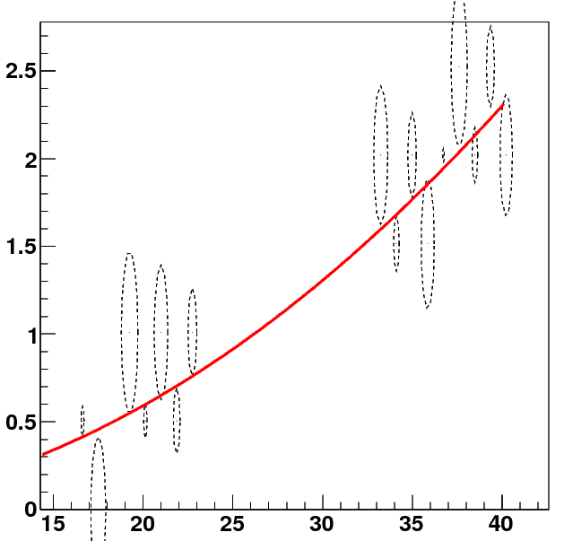
Performance study – single track
y(cm)
0.2GeV
y(cm)
0.5GeV
x(cm)
x(cm)
1GeV
2GeV
y(cm)
y(cm)
x(cm)
x(cm)

Slide 27
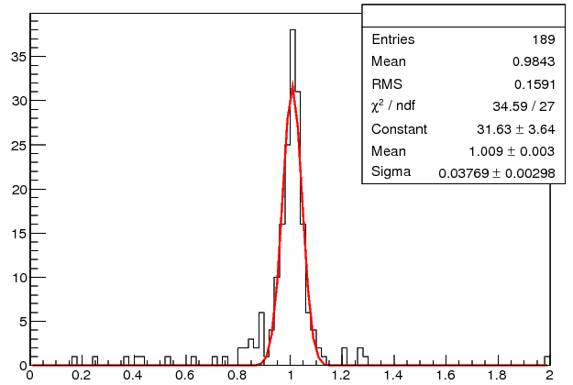
Pz reconstruction
Pt = 0.5 GeV/c
Pz(input)
0.25 GeV/c : 3.7 %
0.50 GeV/c : 4.0 %
1.00 GeV/c : 4.3 %
Pt = 1.0 GeV/c
Pz(input)
0.5 GeV/c : 3.1 %
1.0 GeV/c : 3.8 %
2.0 GeV/c : 4.2 %
Pt = 2.0 GeV/c
Pz(input)
1.0 GeV/c : 3.7 %
2.0 GeV/c : 4.8 %
4.0 GeV/c : 5.2 %

Slide 28
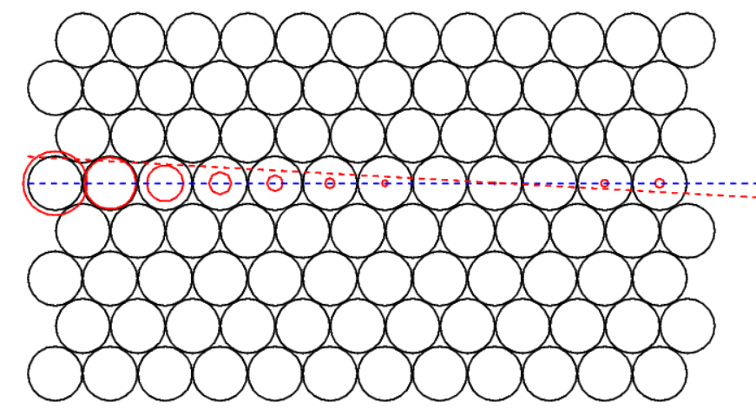
Event #2
Beam test data
Red Solid circle : drift circle
Blue dashed line : track from 1st iteration
Red dashed line : track from 2nd iteration

Slide 29
A better Method to Extract T₀

