Slide 1
Target Spectrometer Updates CM-MEC Session Giessen, March 2015 J. Lühning, GSI
Auxiliary platform update
Routing at the barrel yoke of the TS
EDMS status

Slide 2
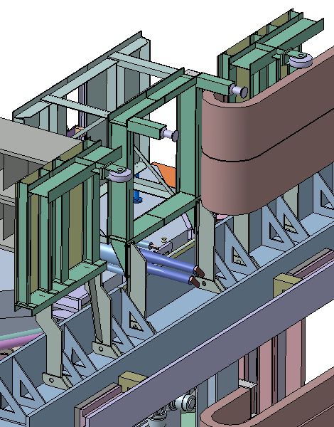
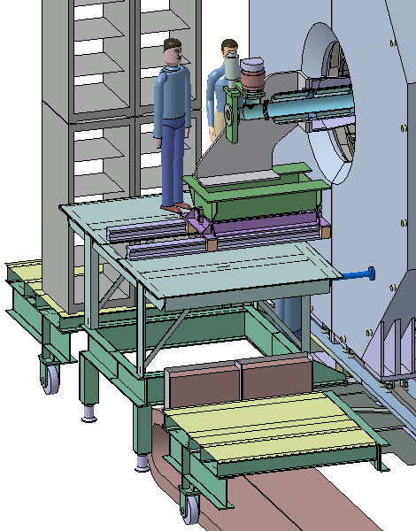
Auxiliary platform update
castors for rack trolleys
static support (no contact to floor when moving)
Hinges

Slide 3
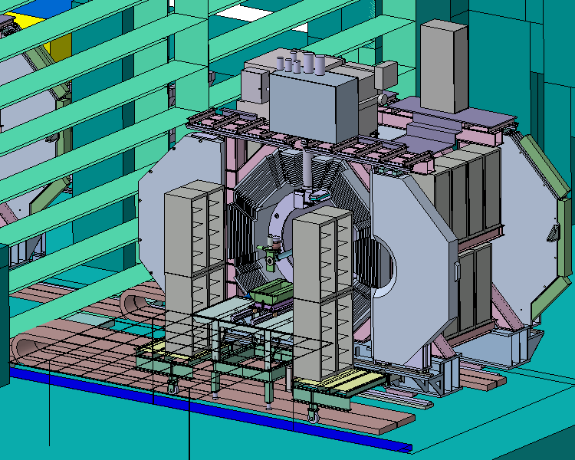
Auxiliary platform update
Loop ends outside of cave
Length of the cable chains defined by maintenance position (15 meters away from beam position)

Slide 4
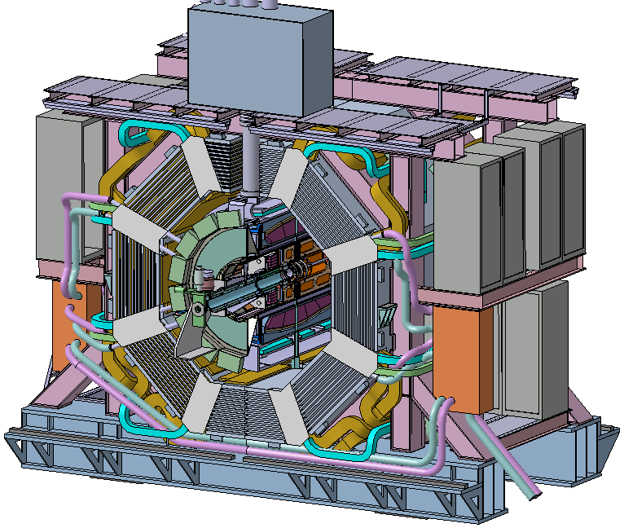
Routing at the barrel yoke
Muon
GEM (next page)
DIRC
EMC
EMC det.
EMC det.
EMC manifold boxes at the upstream side

Slide 5
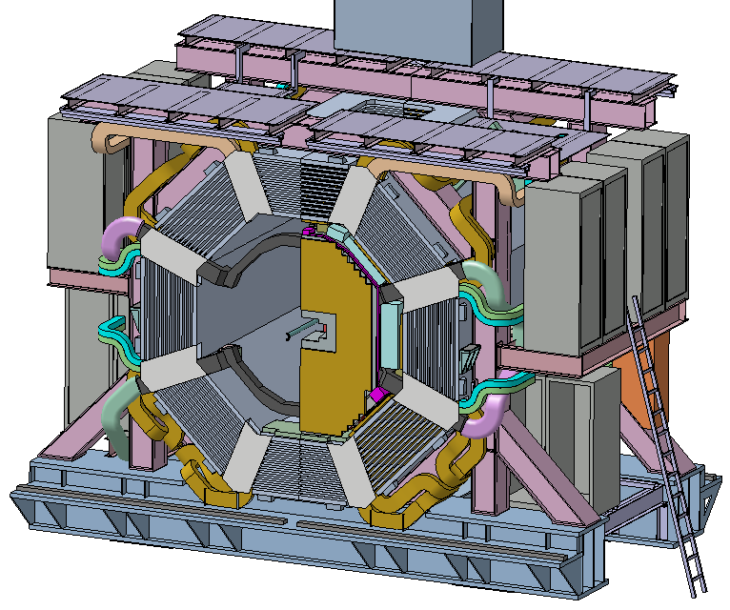
Routing at the barrel yoke
Muon
GEM
DIRC
EMC
EMC det.
EMC det.
Downstream side

Slide 6
Updates of 3D-models of PANDA components at EDMS since October ’14
(status 2015-03-16)
Cluster Jet Target
MVD
STT
FE-EMC
BE-EMC
Barrel-DIRC
Mechanical Integration
PANDA Hall

