Slide 1
The Barrel’s Cooling System Status

Slide 2
The Slice cooling system (J. Xu and Christine)
  The cooling system’s principle
  The upper cooling system’s change
  The front insulation system
  The dew point problem
The cooling system for the Barrel (Y. Guarnelli, Philippe and Christine)
  The principle
  The pipes insulation
  The installation in the Panda Hall
  The pressure requirement (pressure drop study)
The cooling machine (M. Josselin, Tobias, C. Thaï and Philippe)
  Installation schematic of the cooling machine
  Things done and things to do
  Technical anomalies discovered
  Technical problem

Slide 3
The Slice cooling system (J. Xu and Christine)
  The cooling system’s principle
  The upper cooling system’s change
  The front insulation system
  The dew point problem
The cooling system for the Barrel (Y. Guarnelli, Philippe and Christine)
  The principle
  The pipes insulation
  The installation in the Panda Hall
  The pressure requirement (pressure drop study)
The cooling machine (M. Josselin, Tobias, C. Thaï and Philippe)
  Installation schematic of the cooling machine
  Things done and things to do
  Technical anomalies discovered
  Technical problem

Slide 4
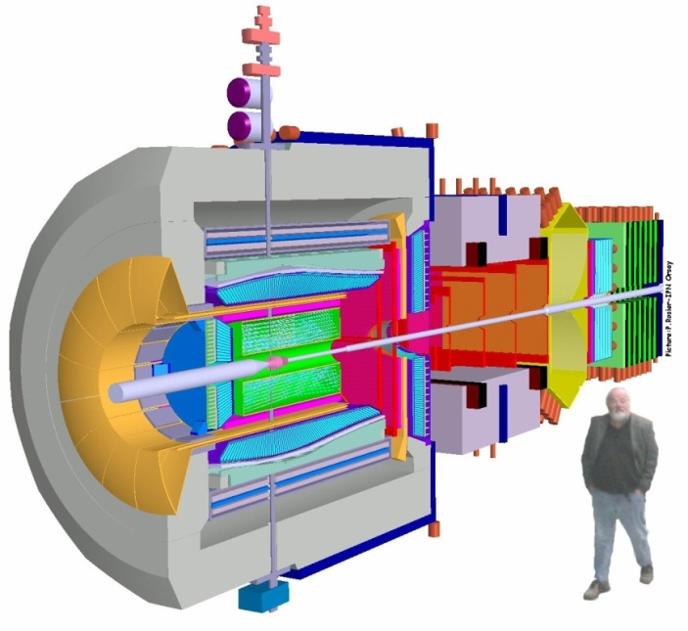
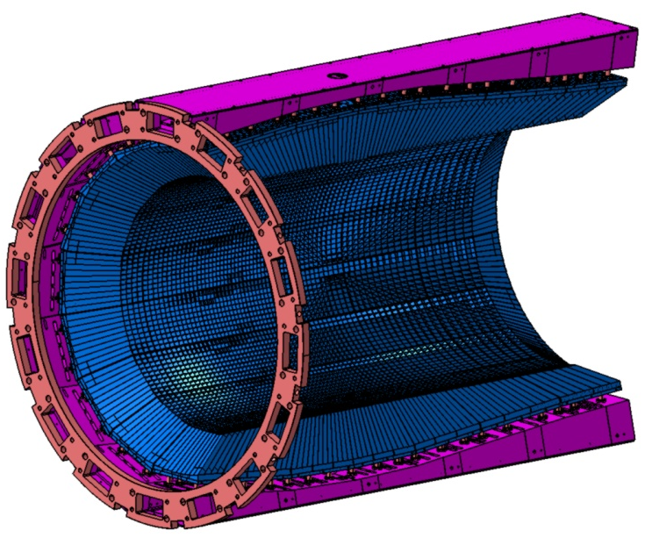
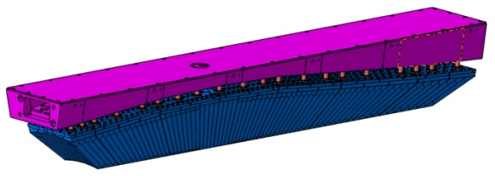
The Slice cooling system
  The cooling system’s principle
  The upper cooling system’s change
  The front insulation system
  The dew point problem
The cooling system principle
Barrel
16 Slices
1 Slice
Upstream Ring
Crystals
Support Beam
Crystals temperature = -25°C
⇓
Each Slice need a cooling system and an insulation

Slide 5
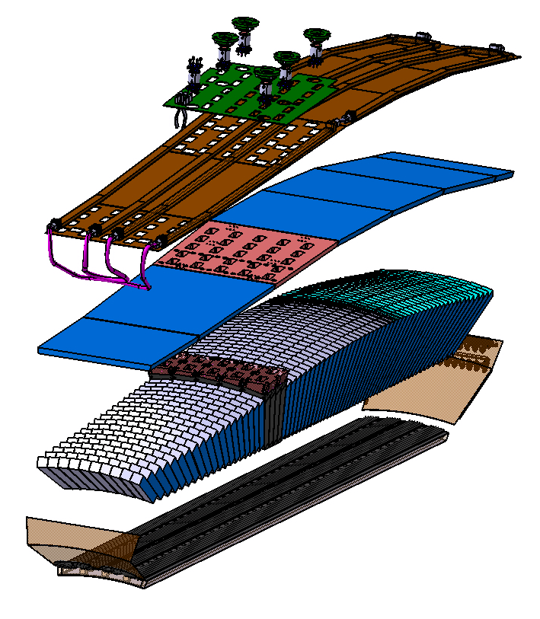
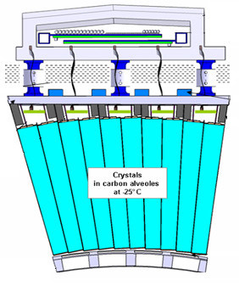
The Slice cooling system
  The cooling system’s principle
  The upper cooling system’s change
  The front insulation system
  The dew point problem
Old cooling system
The cooling system principle
Upper cooling system
Back side
Upper cooling system
+20°C
50mm
-25°C
Lower cooling system
+20°C
26mm
Front side
Lower cooling system

Slide 6
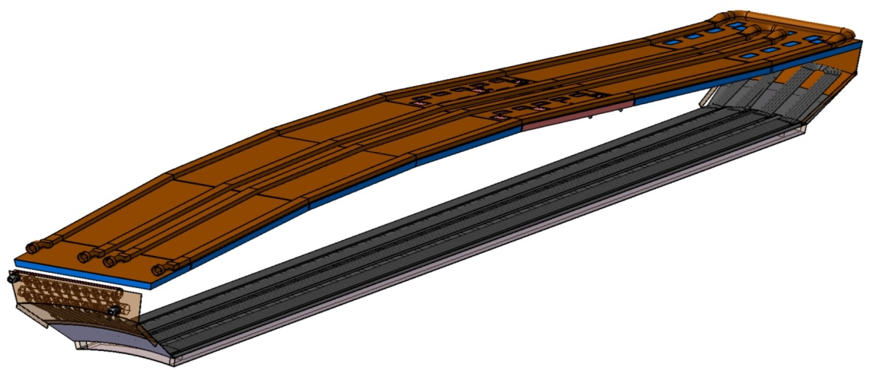
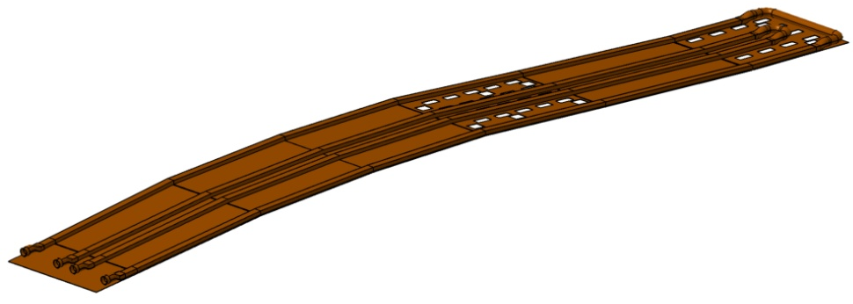
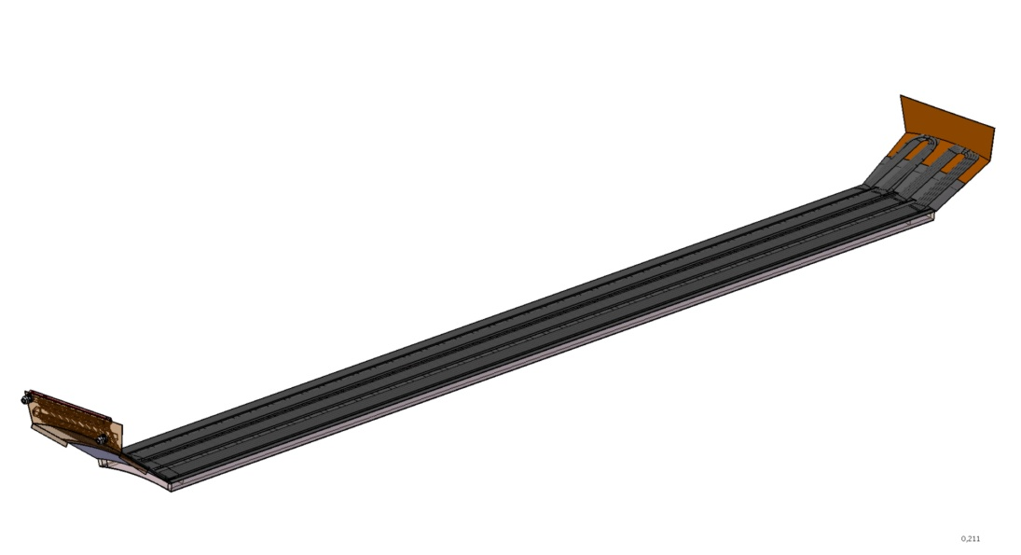
The Slice cooling system
  The cooling system’s principle
  The upper cooling system’s change
  The front insulation system
  The dew point problem
The upper cooling system’s change
Old cooling system for a working temperature of -25°C ± 0.1°C
Upper cooling system =
2 copper rectangular pipes (10x20mm²)+ 1 copper plate
D_{v}= 24 l/mn
Copper and Brass forbidden
3 brass Manifolds
Lower cooling system =
10 Polyurethane circular pipes φ 6x4 +
a composite sandwich
D_{v}= 3.5 l/mn
Total pressure drop with Water Methanol for 16 Slices = ~ 230 mbar for ± 0.1°C

Slide 7
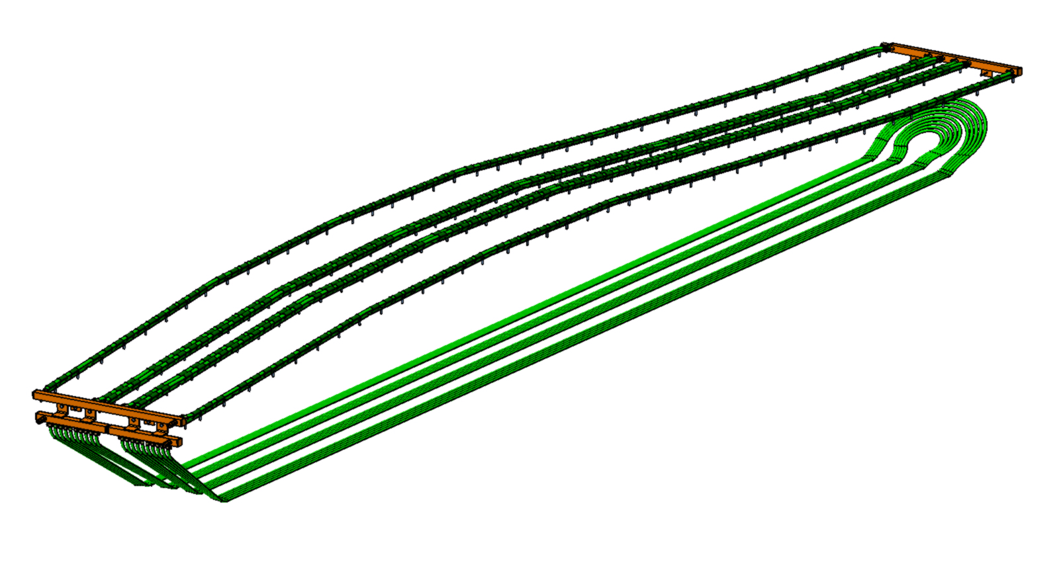
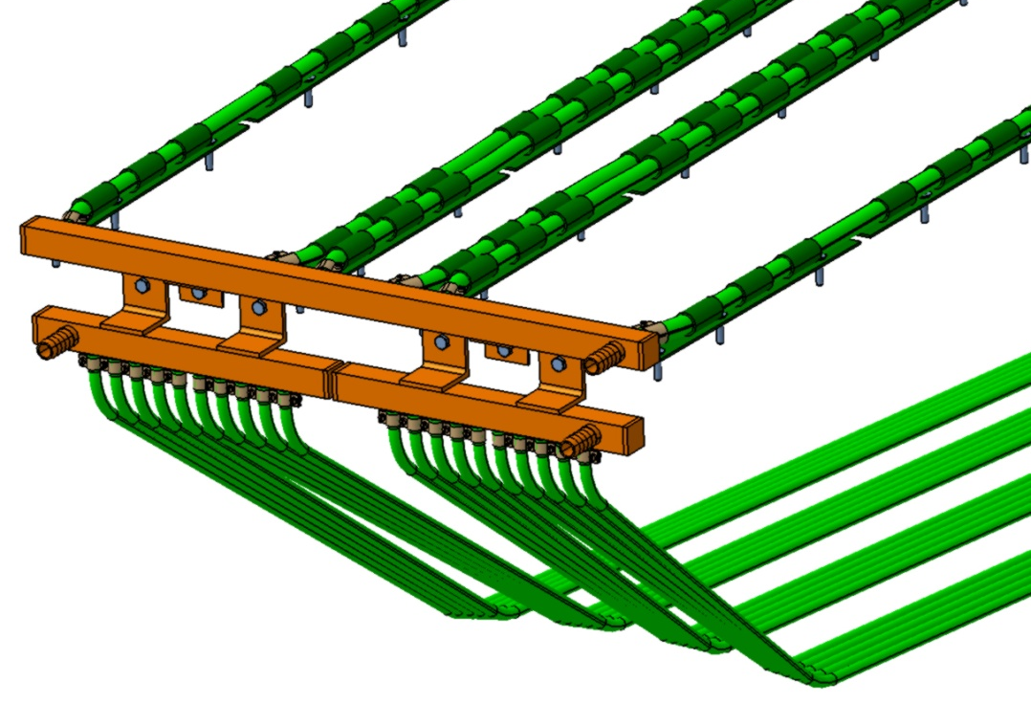
The Slice cooling system
  The cooling system’s principle
  The upper cooling system’s change
  The front insulation system
  The dew point problem
The upper cooling system’s change
New cooling system for a working temperature of -25°C ± 0.3°C
Composed of Polyurethane (PU) circular pipes
fixed on the Back Plates with small pipes
and plates made in Stainless steel
Upper cooling system =
3 PU pipes φ 8x6
D_{v}= 4 l/mn
4 stainless steel manifolds
Lower cooling system =
10 PU pipes φ 5.5x3.5
D_{v}= 0.75 l/mn
Total pressure drop with Water Methanol for 16 Slices = ~ 630 mbar ± 0.3°C

Slide 8
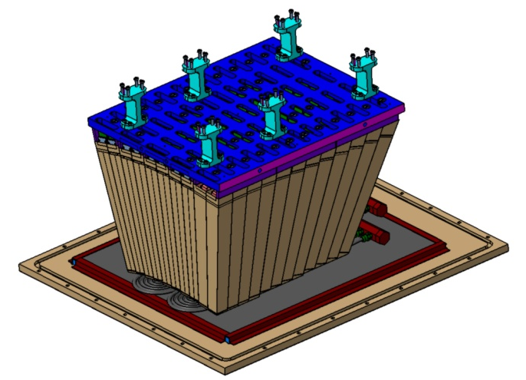
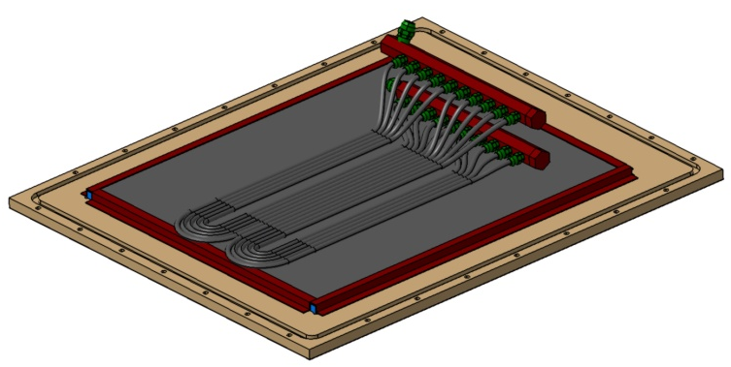
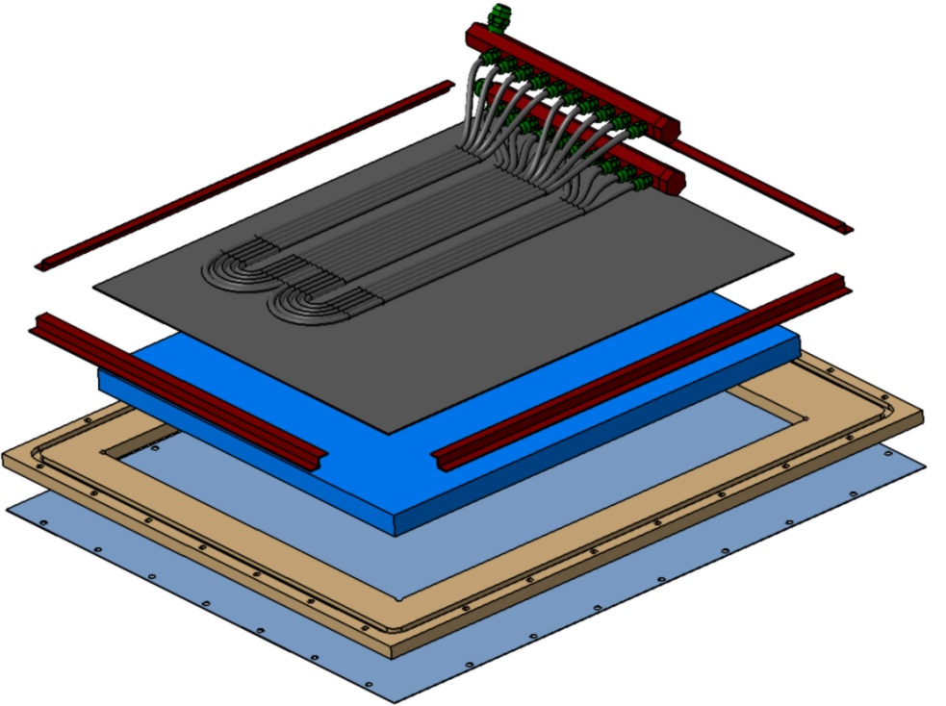
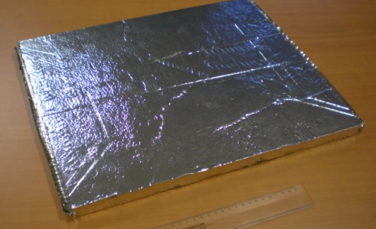
The Slice cooling system
  The cooling system’s principle
  The upper cooling system’s change
  The front insulation system
  The dew point problem
The front insulation system :
the principle = composite sandwich technology
Proto120 technology
PU Pipes
VIP (Vacuum Insulation Plate) Part (VAQTEC®)
Carbon foil
Plastic support
Aluminium foil

Slide 9
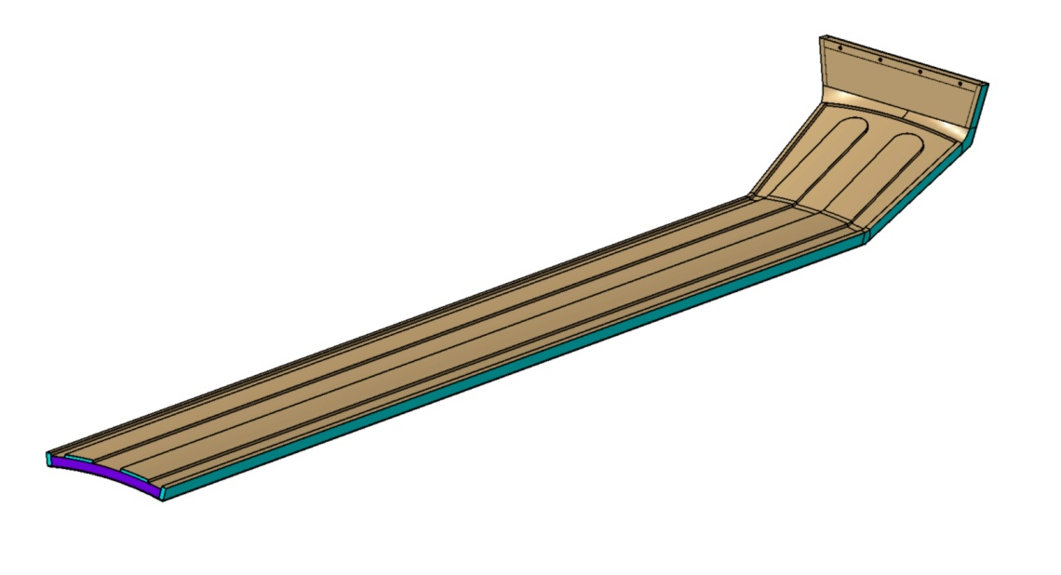
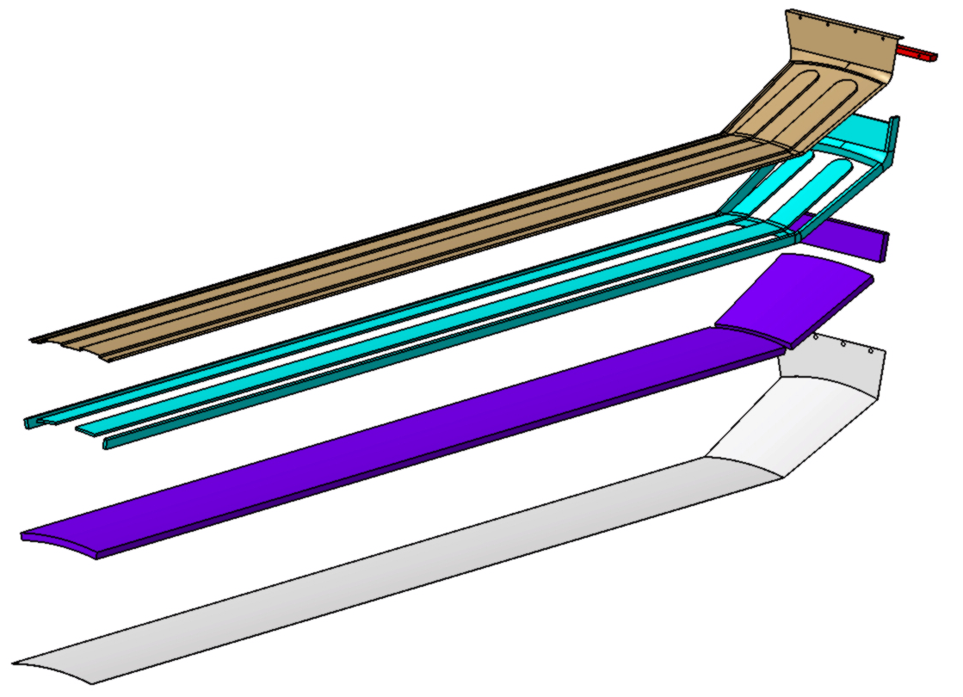
The Slice cooling system
  The cooling system’s principle
  The upper cooling system’s change
  The front insulation system
  The dew point problem
The front Insulation system :
the principle = composite sandwich technology
Epoxy fixation part
26mm
Shapes for the PU pipes
Carbon plate
Filling foam part
VIP ”bending” Plate
Aluminium foil

Slide 10

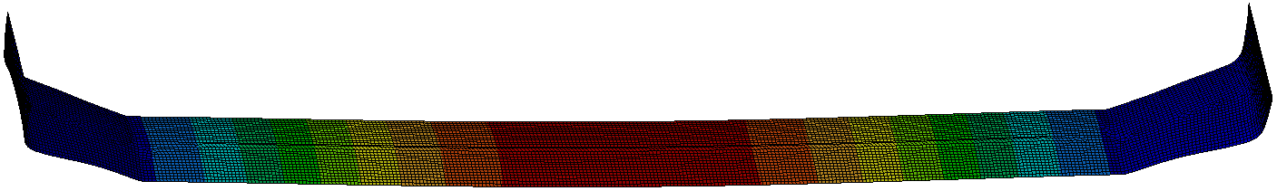
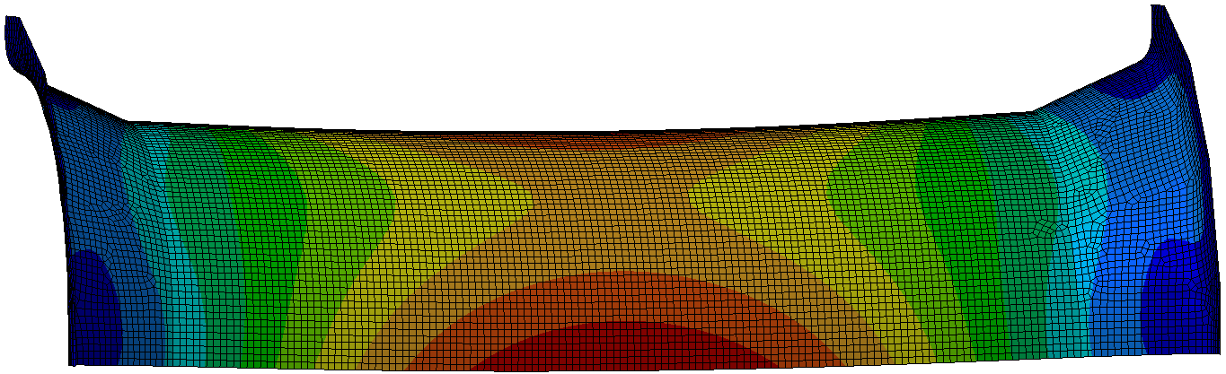
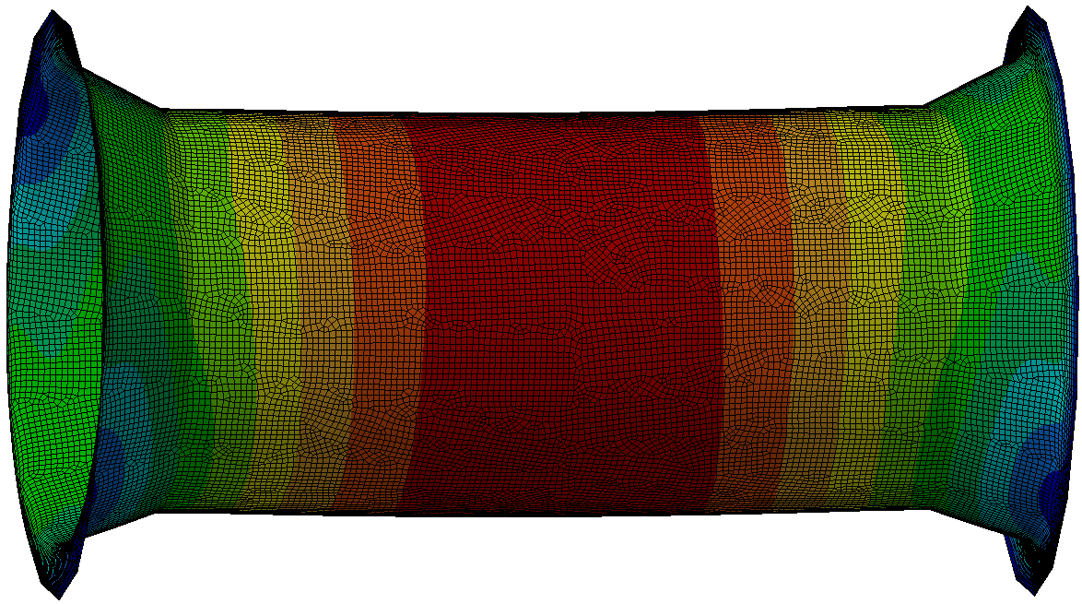
The Slice cooling system
  The cooling system’s principle
  The upper cooling system’s change
  The front insulation system
  The dew point problem
The front insulation system :
the calculations made with Ansys®
Shell calculus
Fixations on the edges
q = total distributed load (water methanol + pipes + sandwich)
Equivalent Young Modulus for the 4 materials
~ 2400 mm
All the calculi are based on an equivalent Young Modulus Composite structure = Carbon + VIP + Foam + Aluminium glued together
Need to make some tests with this composite structure to measure the “real” Young Modulus
First calculus = 1 Slice
Δ
Δ=0.45mm
Second calculus = 4 Slices
Δ=0.035mm
Third calculus = 16 Slices
Best deflection
Easier to seal the enclosure for the nitrogen
Δ=0.0013mm

Slide 11
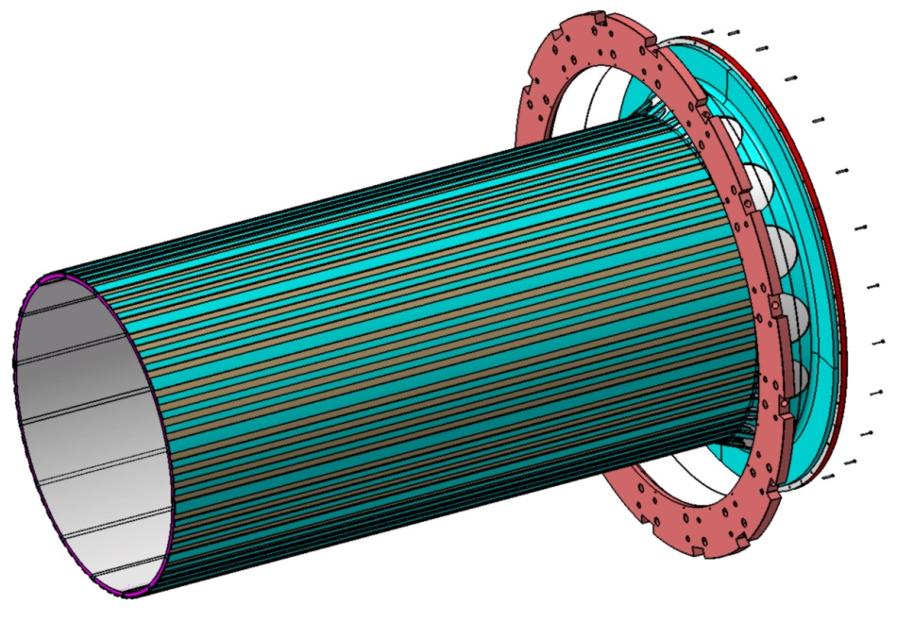
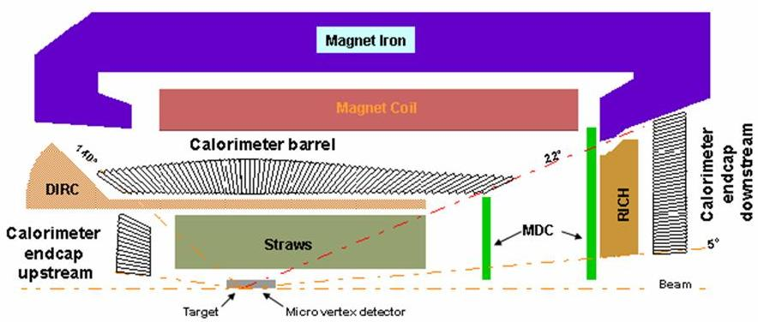
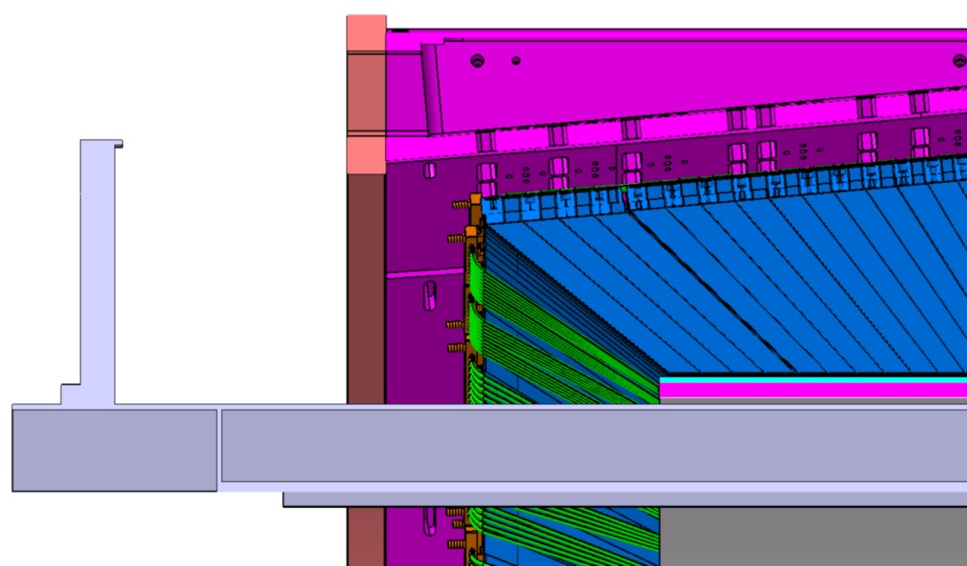
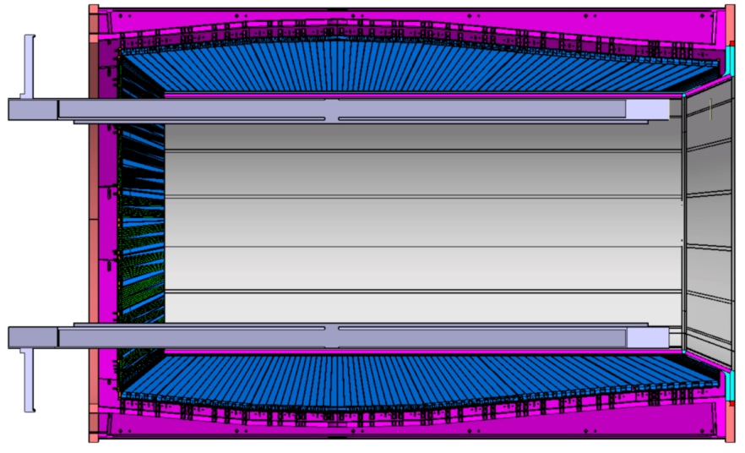
The Slice cooling system
  The cooling system’s principle
  The upper cooling system’s change
  The front insulation system
  The dew point problem
The front insulation system :
the last shape
Fixation on the Downstream Ring
No design on the Upstream Side
Services outlets ??

Slide 12
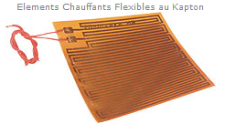
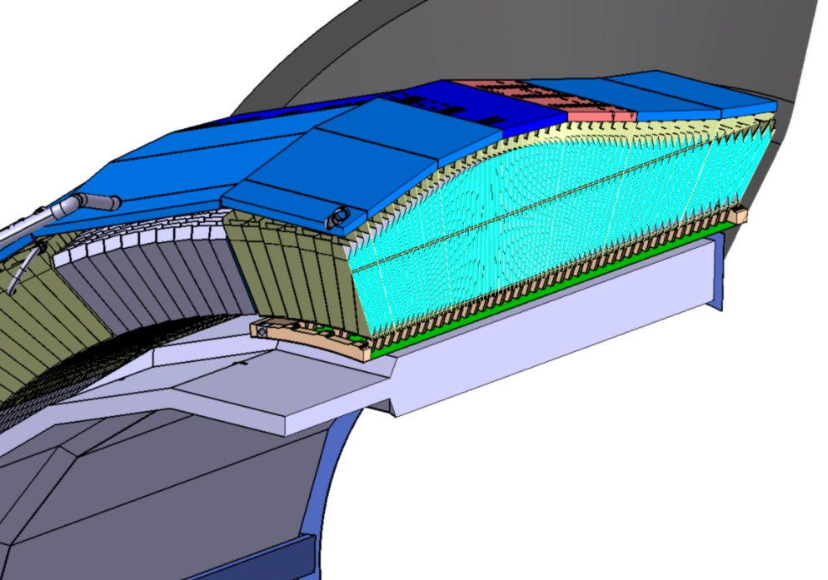
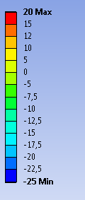
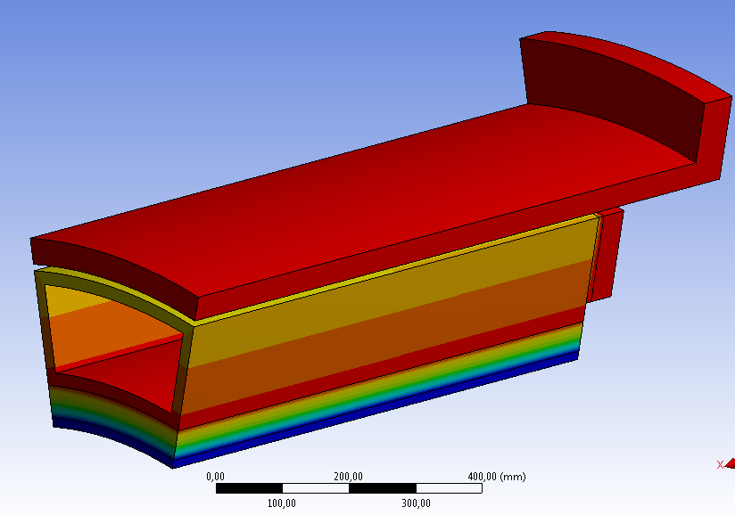
The Slice cooling system
  The cooling system’s principle
  The upper cooling system’s change
  The front insulation system
  The dew point problem
The upper cooling system’s change
The dew point problem
Power in the Support Beam created by the electronic = 300 W
Need to have pipes with water (D_{v}≈ 0.4 l/mn) in the Support Beam in order to :
  have cool water to prevent the reheating of the Support Beam when its electronic is on
  Have hot water to prevent a big cooling in the Support beam when its electronic is off
The Dirc and the Crystals = very closed
Need to have heating resistance in order to prevent the creation of ice between these two systems :
Power of 11.25 W/m²
  Resistance = 51Ω
    Intensity = 470mA
Use kapton heating resistance with a thickness ≈ 0.15 mm
Temperature chart of the Support Beam

Slide 13
The Slice cooling system (J. Xu and Christine)
  The cooling system’s principle
  The upper cooling system’s change
  The front insulation system
  The dew point problem
The cooling system for the Barrel (Y. Guarnelli, Philippe and Christine)
  The principle
  The pipes insulation
  The installation in the Panda Hall
  The pressure requirement (pressure drop study)
The cooling machine (M. Josselin, Tobias, C. Thaï and Philippe)
  Installation schematic of the cooling machine
  Things done and things to do
  Technical anomalies discovered
  Technical problem

Slide 14
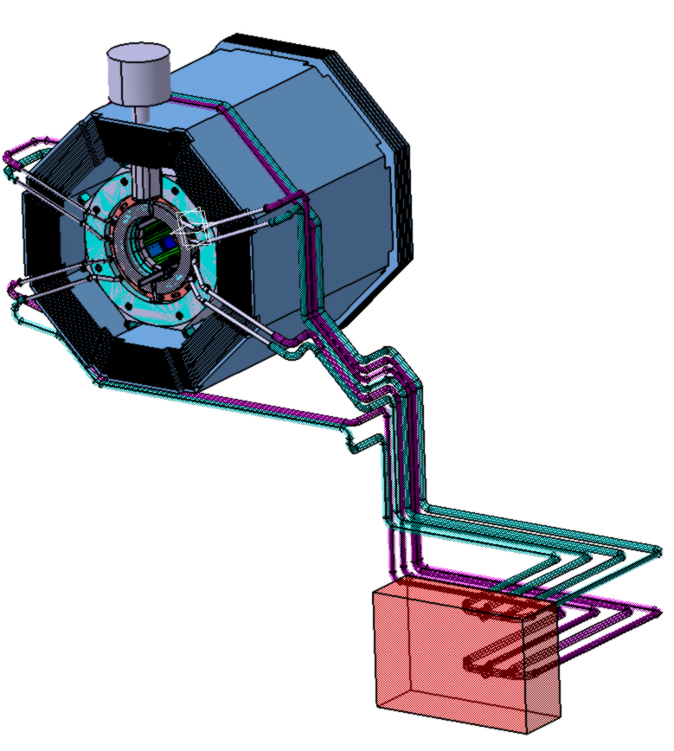
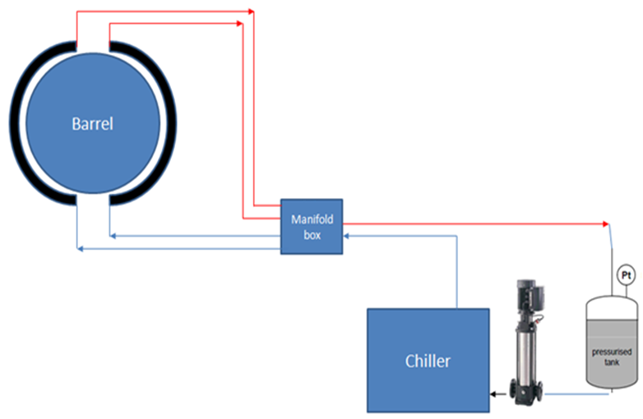

The cooling system for the Barrel
  The principle
  The pipes insulation
  The installation in the Panda Hall
  The pressure requirement (pressure drop study)
The pipes insulation
The principle :
2 Outlets
Connection Pipes
(Box?)
20 m
2 Inlets
D(outlet) _{int} = 38 mm
Pomp
L = 90 mm
D(inlet) _{int} = 16.7mm
Best insulation

Slide 15
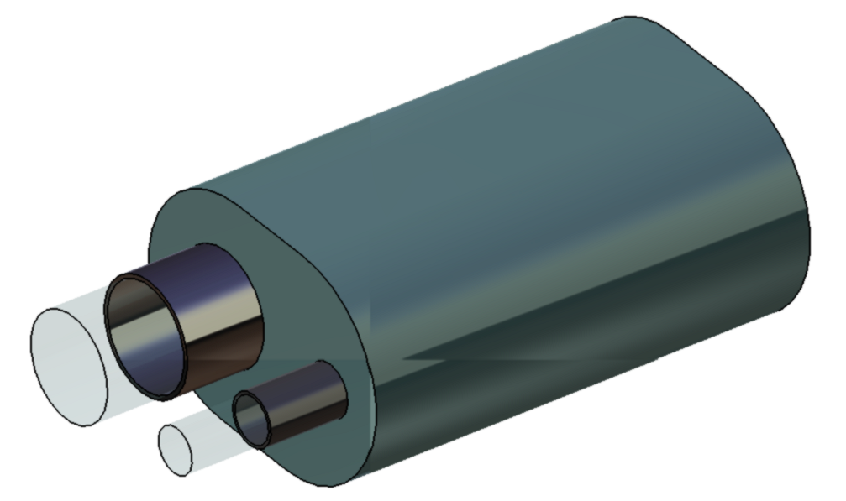
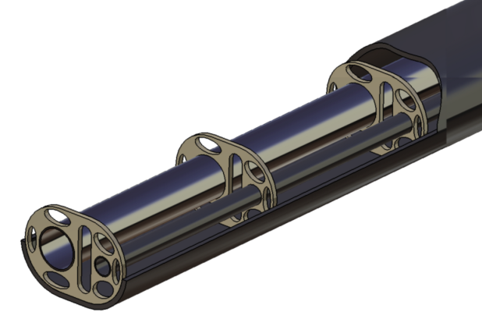
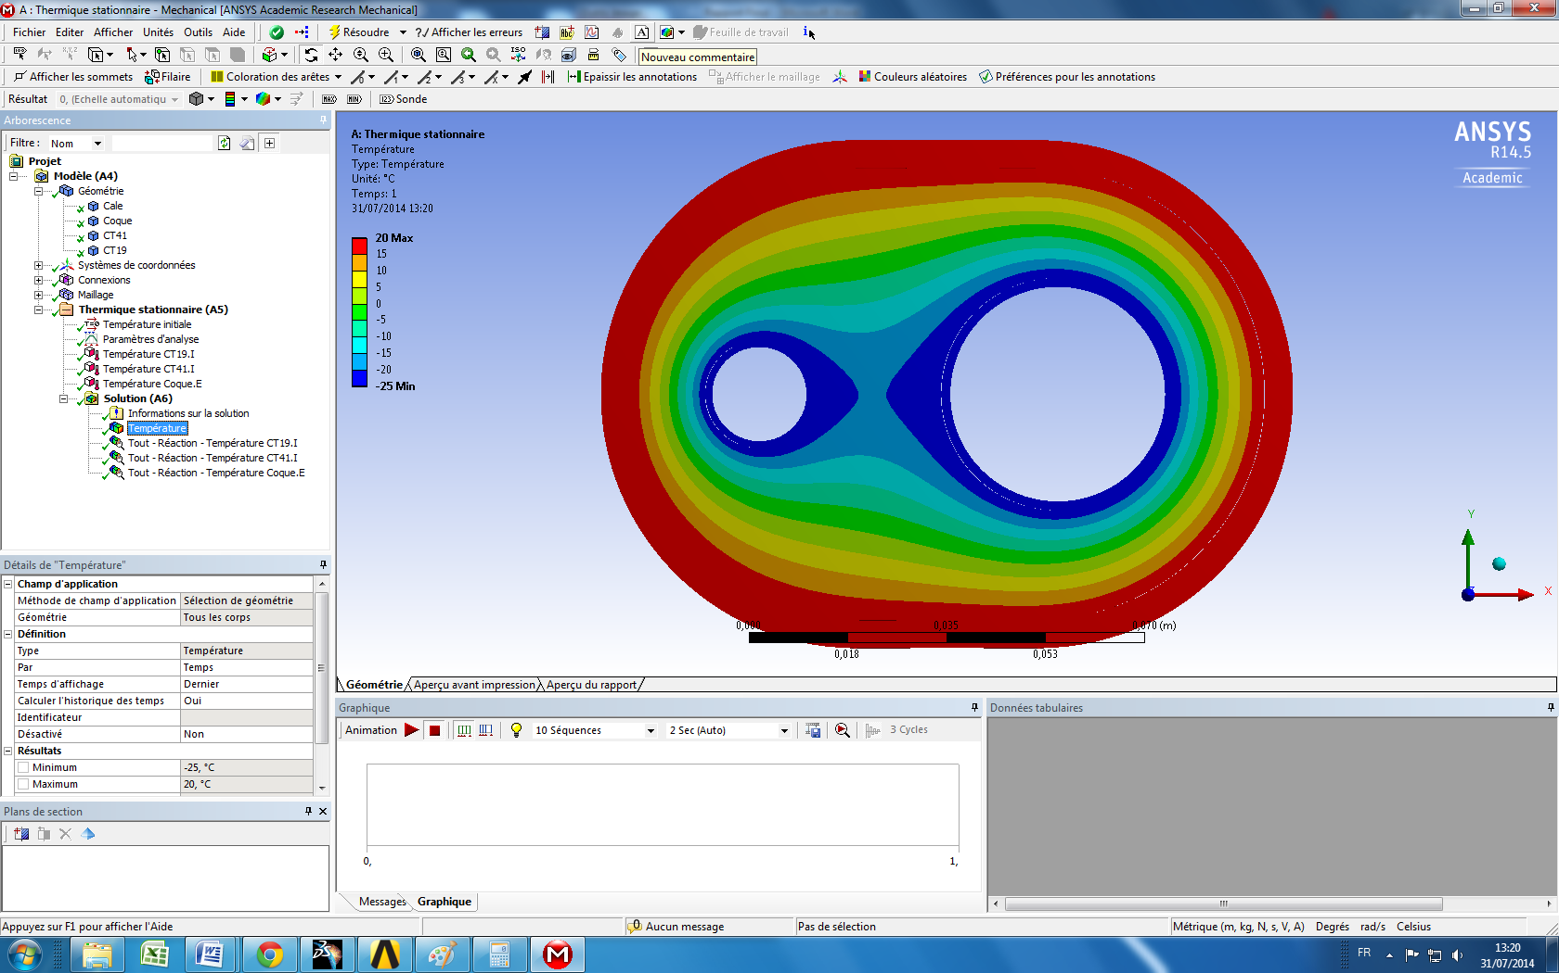
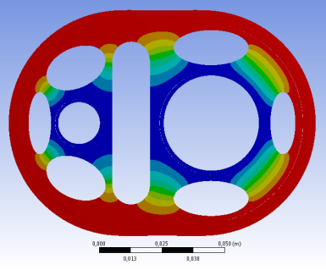
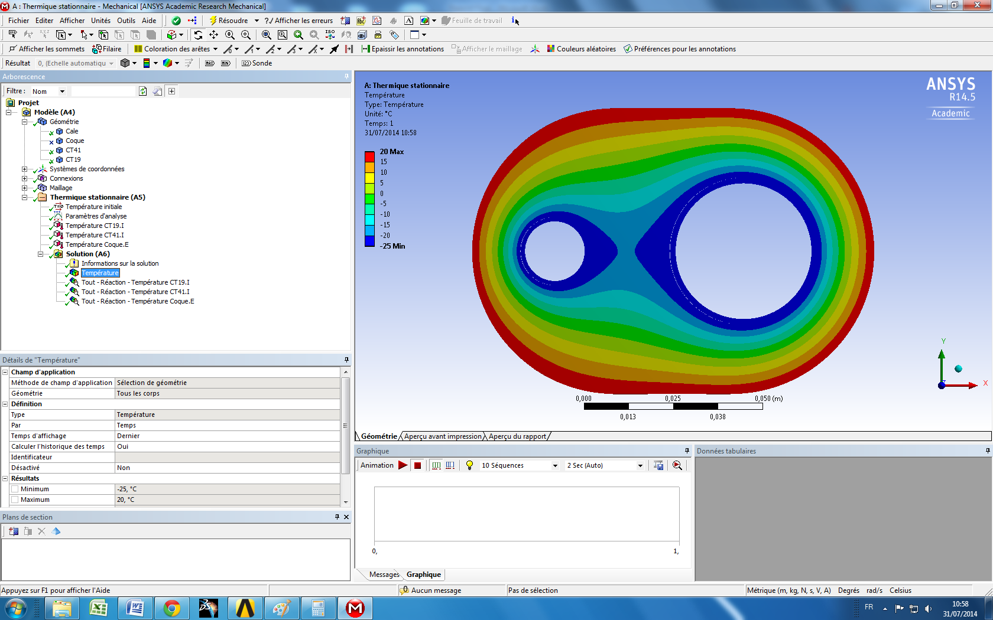
The cooling system for the Barrel
  The principle
  The pipes insulation
  The installation in the Panda Hall
  The pressure requirement (pressure drop study)
The pipes insulation :
Solution 1 :
Solution 2 :
Styrofoam
2 Stainless steel pipes
Vacuum
Insulating jacket
2 Stainless steel pipes with super insulation material
The best solution :
Power drop for 20m ≈ 330 W
Temperature drop for 20m ≈ 0.023°C
Easier to do
Cheaper
Epoxy shim
Total power drop = 16.6 W/m
For Water Methanol :
Total temperature drop = 0.001°C/m
Total power drop = 1.93 W/m
For Water Methanol
Total temperature drop= 0.0001°C/m

Slide 16
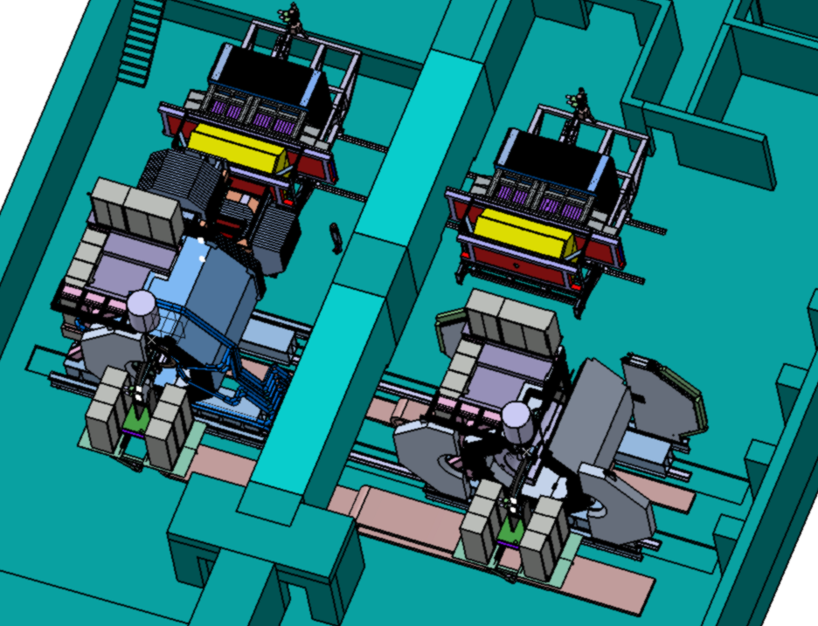
The cooling system for the Barrel
  The principle
  The pipes insulation
  The installation in the Panda hall
  The pressure requirement (pressure drop study)
The installation in the Panda Hall :
Working position
Services position
How to disconnect and connect easily?

Slide 17
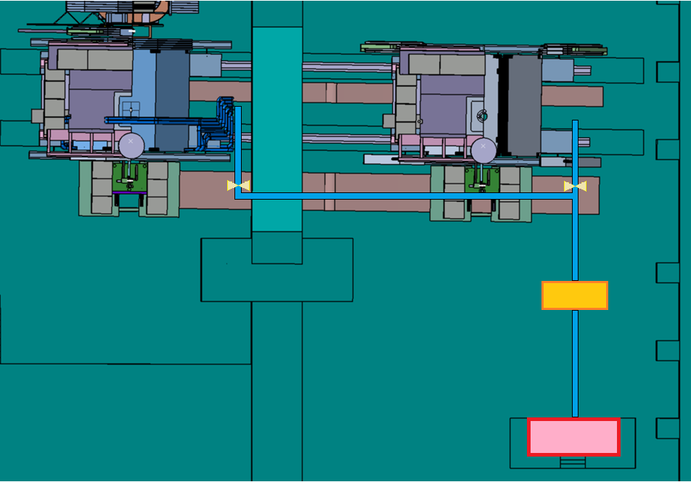
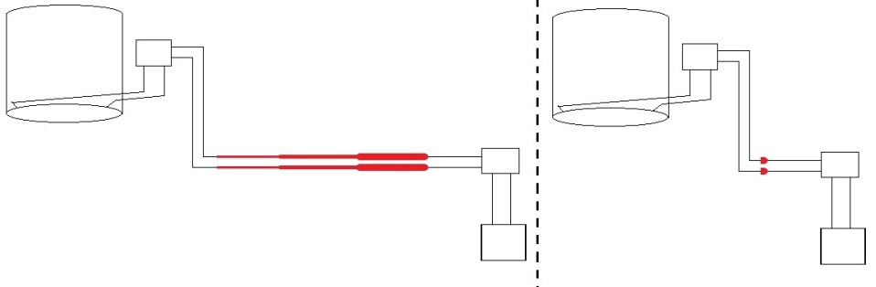
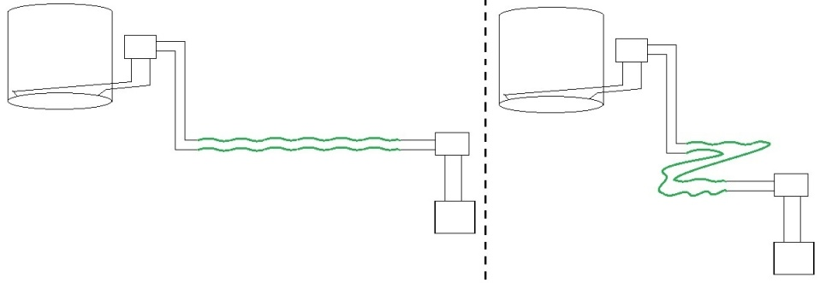
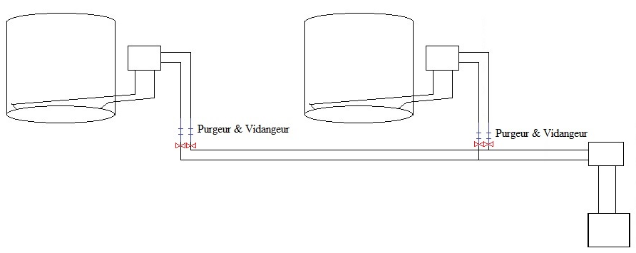
The cooling system for the Barrel
  The principle
  The pipes insulation
  The installation in the Panda Hall
  The pressure requirement (pressure drop study)
The installation in the Panda Hall :
Three solutions
Working position
Services position
Telescopic pipes
Flexible pipes
Chiller
Bleeder & drain valve
Bleeder & drain valve
Double circuit
Pomp

Slide 18
The cooling system for the Barrel
  The principle
  The pipes insulation
  The installation in the Panda Hall
  The pressure requirement (pressure drop study)
The pressure requirements :
Z =+ 4.3 m
P > 0.2 bar (Leak less method)
Pressure drop in the slice ?
Z =+ 3.55m
Pressure drop _{Outlet} ?
Z =+ 2.8 m
Pressure drop due to the gravity ?
Pressure drop _{Inlet} ?
-25°C
Z = -2 m
P< 3 bars (Characteristics of the machine)

Slide 19
The cooling system for the Barrel
  The pipes insulation
  The installation in the Panda hall
  The pressure requirement (pressure drop study)
The pressure requirements :
Bernoulli equation
Exchange energy between the coolant and the machine
Change in kinetic energy
Change in potential pressure energy
Change in gravitational potential energy
Pressure drop
The Pomp-Slice way :
The Slice-Pomp way :

Slide 20
The cooling system for the Barrel
  The pipes insulation
  The installation in the Panda hall
  The pressure requirement (pressure drop study)
The pressure requirements :
ΔJ_{xxx} = linear pressure drop
P_{Pomp-Slice} = 2 bar
ΔE’_{p}= gravitational potential energy drop
Z =+ 4.3 m
0.2 bar<P_{Pomp-Slice} <3 bar
⇒OK
ΔJ_{xxx} = singular pressure drop
Z =+ 3.55 m
ΔE’_{p slice-slice} = - 0.57 bar
ΔJ_{Slice}=+0.63 bar
ΔJ_{manifold outlet} = -0.002 bar
ΔE’_{p slice-slice} = +0.14 bar
Z =+ 2.8 m
ΔJ_{pompe outlet} = -0.08 bar
p = 1.21 bar
P_{Slice-Pomp} = 1.35 bar
ΔJ_{manifold inlet}= +0.02 bar
ΔJ_{chiller} = +0.67 bar
ΔE’_{p chiller-slice} = +0.44 bar
Z = -2 m
ΔJ_{pompe inlet}= +0.08 bar

Slide 21
The Slice cooling system (J. Xu and Christine)
  The cooling system’s principle
  The upper cooling system’s change
  The front insulation system
  The dew point problem
The cooling system for the Barrel (Y. Guarnelli, Philippe and Christine)
  The principle
  The pipes insulation
  The installation in the Panda Hall
  The pressure requirement (pressure drop study)
The cooling machine (M. Josselin, Tobias, C. Thaï and Philippe)
  Installation schematic of the cooling machine
  Things done and things to do
  Technical anomalies discovered
  Technical hitch

Slide 22
The cooling machine
  Installation schematic of the cooling machine
  Things done and things to do
  Technical anomalies discovered
  Technical accident
  The Installation schematic of the cooling machine:
380 V 16 A
Chiller
Skid
(for Orsay or without external cooled water)
Emergency ON/OFF
CROUZET
ON/OFF
15m
External water in Giessen
Aerocooler
(for Orsay or without external cooled water)
25m
5m
Set °C
Real °C
380 V 32 A
15m
EMC Temperatures -25°C
ECAL detector
Temp. EMC inlet
(security -40°C)
Vacuum pump
Pump
Pump ON
Remote control
380 V 16 A
Manometer
Nitrogen bottle
Flowmeter
1,5kW heater
220 V
Water methanol exhaust
220 V
ON/OFF
Temperatures EMC + Inlet EMC (4-20mA)
Arrival at Orsay end of 2014
Running check with water at 16°C
The housing box and tubes connections were made in January
Computer
RS485 connection
Control panel
(Distribution box?)
EMC °C
EMC inlet °C
Set °C

Slide 23
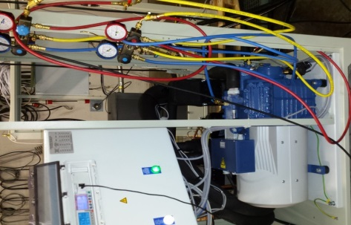
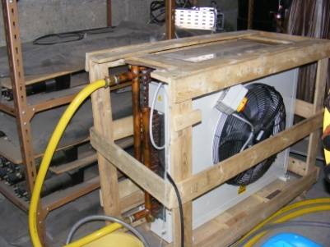
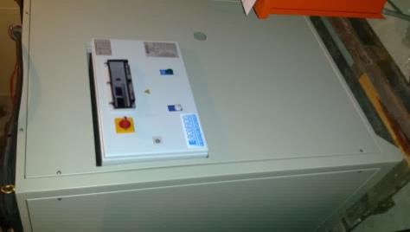
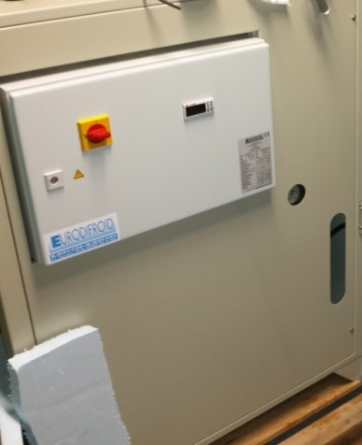
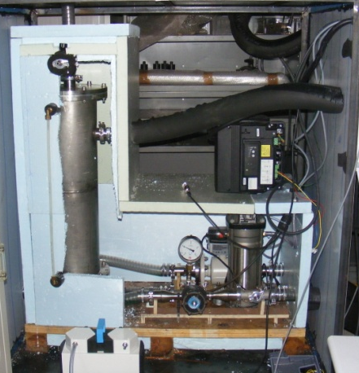
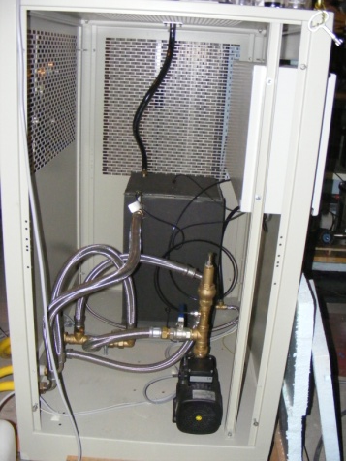
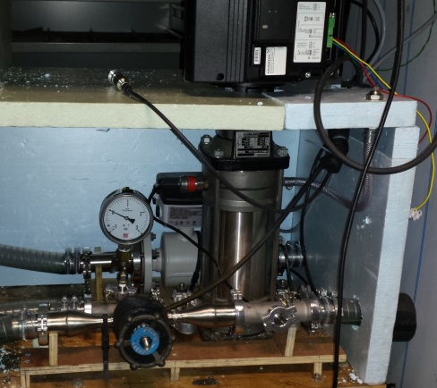
The cooling machine
  Installation schematic of the cooling machine
  Things done and things to do
  Technical anomalies discovered
  Technical problem
  The Installation schematic of the cooling machine:
Some pictures
Internal view
Chiller
Skid
(for Orsay or without external cooled water)
Emergency ON/OFF
CROUZET
Aerocooler
(for Orsay or without external cooled water)
Set °C
Real °C
Electromagnetic flowmeter
ECAL detector
Internal view
Vacuum pump
Pump
Pump ON
Remote control
Flowmeter
1,5kW heater
Pump circulator of the chiller

Slide 24
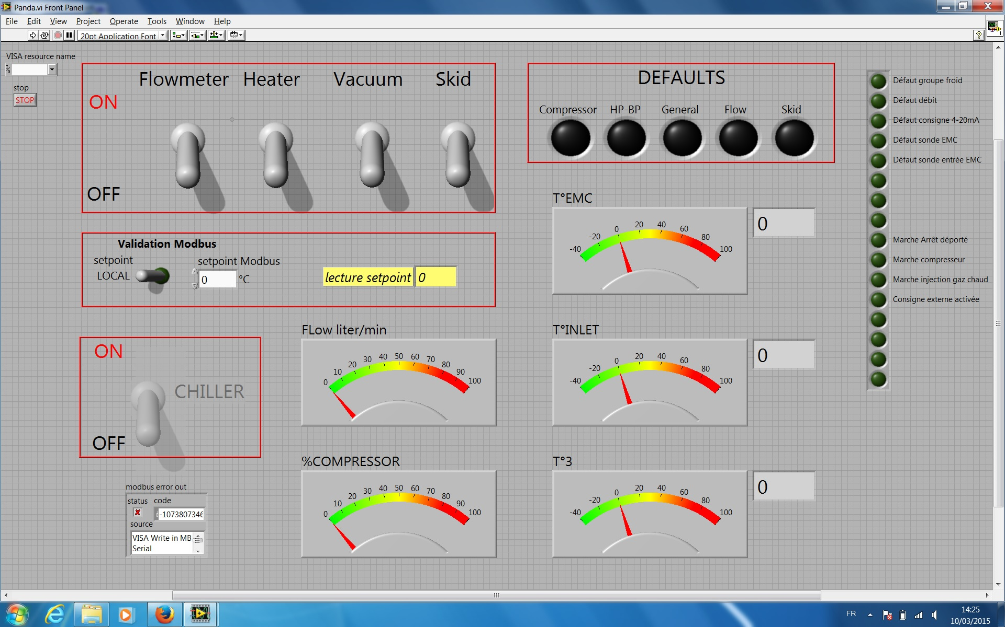
The cooling machine
  Installation schematic of the cooling machine
  Things done and things to do
  Technical anomalies discovered
  Technical problem
The control panel is done on a PC with Labview (compatible with EPICS used by Bochum)
  The Installation schematic of the cooling machine:

Slide 25
The cooling machine
  Installation schematic of the cooling machine
  Things done and things to do
  Technical anomalies discovered
  Technical problem
Things done and things to do :
Chiller
Skid
(for Orsay or without external cooled water)
Emergency ON/OFF
CROUZET
ON/OFF
Aerocooler
(for Orsay or without external cooled water)
Set °C
Real °C
EMC Temperatures -25°C
ECAL detector
Temp. EMC inlet
(security -40°C)
Vacuum pump
Pump
Pump ON
Remote control
Manometer
Security valve
The RS485 connections with the flowmeter and the pump are done
Installation of a security 3 bar valve (chiller over-pressure problem)
Flowmeter
1,5kW heater
But
We can’t read out the electronic manometer (pin-out problem)
We can’t control the Vacuum pump (Grundfos drivers not found yet)
The control command is still to be finished (with Tobias)
ON/OFF
Computer
EMC °C
RS485 connection
Control panel
(Distribution box?)
EMC inlet °C
Set °C

Slide 26
The cooling machine
  Installation schematic of the cooling machine
  Things done and to do
  Technical anomalies discovered
  Technical hitch
Technical anomalies discovered :
Chiller
Skid
(for Orsay or without external cooled water)
Emergency ON/OFF
CROUZET
ON/OFF
Aerocooler
(for Orsay or without external cooled water)
Set °C
Real °C
EMC Temperatures -25°C
ECAL detector
Temp. EMC inlet
(security -40°C)
Anomalies discovered:
Severe electromagnetic compatibility affected the thermal sensors if not chiller earth connected => the manufacturer gave an anti-parasitic device. We still need to test it
The thermal sensors are very fluctuating. The manufacturer provide a new program to change the channels hub. Looks better but still need to check it.
Vacuum pump
Pump
Pump ON
Remote control
Manometer
Flowmeter
1,5kW heater
ON/OFF
Temperatures EMC + Inlet EMC (4-20mA)
Computer
The hot gas technology to regulate the power is too strong. Need a new program to control it.
EMC °C
RS485 connection
Control panel
(Distribution box?)
EMC inlet °C
Set °C

Slide 27
The cooling machine
  Installation schematic of the cooling machine
  Things done and to do
  Technical anomalies discovered
  Technical problem
The technical problem :
Chiller
Skid
(for Orsay or without external cooled water)
Emergency ON/OFF
CROUZET
ON/OFF
Aerocooler
(for Orsay or without external cooled water)
Set °C
Real °C
EMC Temperatures -25°C
Consequences :
Repair of the chiller is undergoing …
At the return mid April, the run will be done by the company and we still need to show that we CAN achieve the required stability. (Only two months to do it…)
We expect to do all the tests with glycol water coolant to get a good control on the ice protection (instant reading with refractometer)
Due to :
a bad user manual
a lack of security in the ice risk (even with water coolant at 10°C) because the flow meter protection foreseen in the study is not enough
ECAL detector
Temp. EMC inlet
(security -40°C)
Vacuum pump
Pump
Pump ON
Remote control
Manometer
Flowmeter
1,5kW heater
⇒ The heat exchanger exploded locally
and the compressor drank coolant…
Question :
We are working on the water methanol mixture icing risk.
How to control it ?
At -32°C, the chiller will run at -42°C and the mixture must not go down 50% to avoid freezing.
ON/OFF
Computer
EMC °C
RS485 connection
Control panel
(Distribution box?)
EMC inlet °C
Set °C

Slide 28
Reminder:
IPN Orsay has officially stopped its activities on Panda since last June.
At the end of August 2015, no more technical contribution from Orsay.
To do or to finish:
  For the Slices :
      Test a sample sandwich to know the real Young Modulus of the Front insulation system
      The Upstream front insulation and its fixation
      Integration of the Front Heating resistances
      Integration of the Support Beams cooling system
      Integration of the other services (cables, pipes and optic fibers)
  For the Barrel :
      The final design of the pipes, the Manifold box and the double circuit in the Panda Hall
      The pipes connection between the Slices and the Manifold box(the distribution pipes for the Barrel)
  For the Cooling machine :
      Test the anti-parasitic device and the new program to change the channels hub for the thermal sensors at Orsay
      Read the electronic manometer and control the Vacuum pomp with the control command at Orsay
      Be able to achieve the required stability at Orsay
      Install the cooling machine and test it at Giessen
      Finish the control command (Tobias)
      ...
??
Orsay
+
Giessen
+
Bochum

Slide 29
Thank you for your attention

