Slide 1
Status of the PANDA Barrel DIRC
Marko Zühlsdorf^{1,2}
for the PANDA Cherenkov Group
Outline
PANDA DIRC introduction
Resolution requirements
Optical components
Electronic components
Summary
5th HIC for FAIR Physics Day Expert Group 3
¹GSI Helmholtzzentrum für Schwerionenforschung GmbH, Darmstadt
²Goethe-Universität Frankfurt

Slide 2
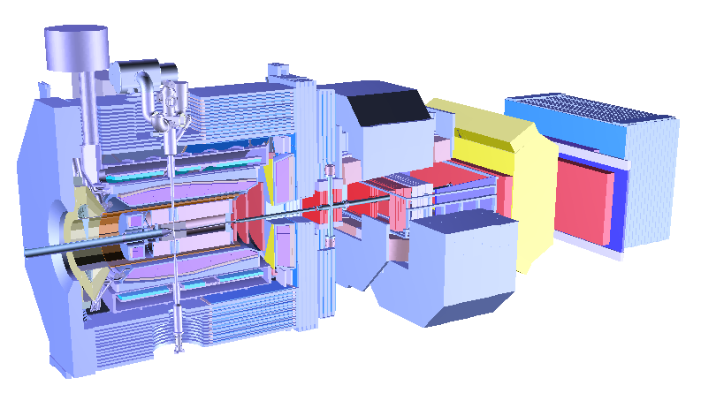
AntiProton ANnihilation at DArmstadt
target
p
12 m
Hadron physics experiment at FAIR
Cooled antiprotons up to 15 GeV/c on a fixed target
Wide range of fields (e.g. charm physics, exotics, hypernuclear physics, …)
Target spectrometer and forward spectrometer for almost 4π coverage

Slide 3
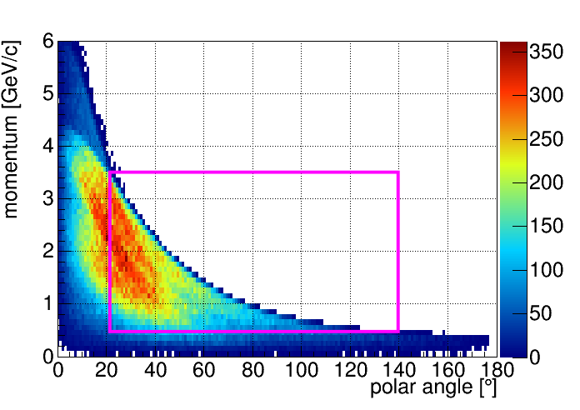
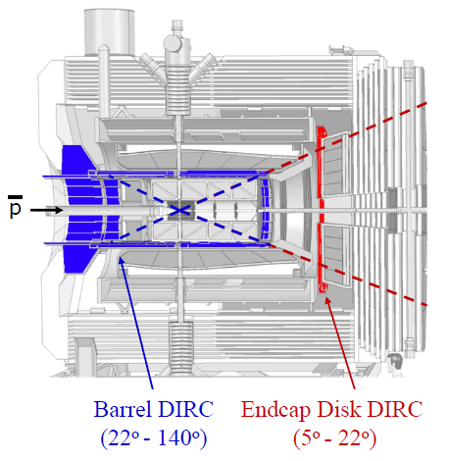
AntiProton ANnihilation at DArmstadt
Cumulative kaon phase space coverage for reactions with antiproton momenta 6 GeV/c < p < 15 GeV/c
Hadronic PID required over large momentum and angular range
PANDA Target Spectrometer
Hadronic PID in the target spectrometer covered by two DIRC detectors
Barrel DIRC
for polar angle range 22° - 140°
pion/kaon separation up to 3.5 GeV/c
Endcap Disk DIRC
for polar angle range 5°/10° - 22°
pion/kaon separation up to 4 GeV/c

Slide 4
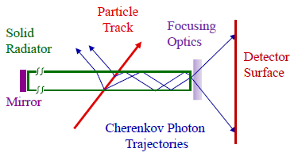
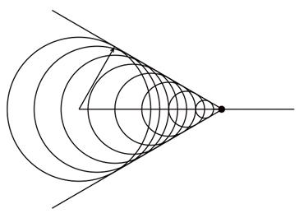
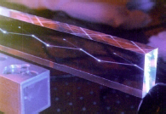
Detection of Internally Reflected Cerenkov Light
Condition for Cherenkov radiation:
$$β>\frac{1}{n}$$
$$⇒\cos{θ_{C}}=\frac{1}{βn}$$
$$θC$$
$$β$$
If $n>\sqrt{2}$ always some Cherenkov photons are totally internally reflected for $β=1$
Propagation to the readout end of the radiator bar
Focused on readout plane
Radiator material: synthetic fused silica
Radiator shape: long rectangular bars
Sensors: single photon sensitive

Slide 5
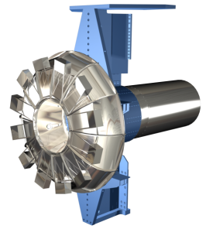
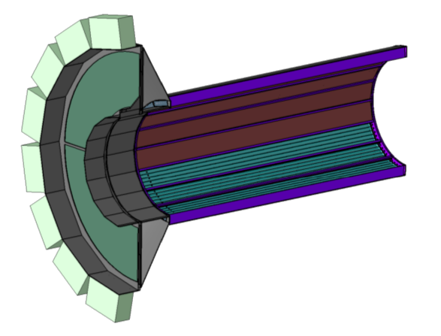
PANDA Barrel DIRC
Barrel DIRC is based on the successful BaBar DIRC with important improvements:
Focusing optics Compound lens system for a better Cherenkov angle resolution
Compact photon detectors Smaller expansion volume Better spatial resolution
Fast photon detection Better background reduction Chromatic dispersion correction New reconstruction methods
BaBar
5 m
5 m
PANDA
̴2 m
2.4 m

Slide 6
Barrel DIRC Resolution
At 3.5 GeV/c: $θ_{C}^{π}−θ_{C}^{K}=8.5 \text{mrad} \overset{→}{}σ_{θ_{C}}^{track}<2.8 \text{mrad}$
$$σ_{θ_{C}}^{track}=\sqrt{\frac{{\left(σ_{θ_{C}}^{photon}\right)}^{2}}{N}+\left(σ_{θ_{C}}^{correlated}\right)²}$$
Expected performance:
$σ_{θ_{C}}^{photon}≈10$ mrad;
$σ_{θ_{C}}^{correlated}$ Tracking resolution, multiple scattering
$σ_{θ_{C}}^{photon}$ Single photon Cherenkov angle Resolution
$N$ Number of detected photons
$σ_{θ_{C}}^{bar}$ Contribution from image of radiator thickness
$σ_{θ_{C}}^{pixel}$ Contribution from image of pixel size
$σ_{θ_{C}}^{chrom}$ Cherenkov angle spread (chromatic)
$$N>20$$
$$σ_{θ_{C}}^{photon}=\sqrt{{\left(σ_{θ_{C}}^{bar}\right)}^{2}+{\left(σ_{θ_{C}}^{pixel}\right)}^{2}+{\left(σ_{θ_{C}}^{chrom}\right)}^{2}}$$

Slide 7
PANDA Barrel DIRC
Readout
Expansion
volume
Baseline Design (based on BaBar)
80 radiator bars, synthetic fused silica
Bar dimensions: 1.7 cm × 3.2 cm × 240 cm
Focusing optics: lens system
Expansion volume:
30 cm depth
Mineral oil
15k channels of MCP-PMT
Photon detection with good time resolution
Radiator
Focusing optics
Design Options
Baseline design provides technical solution for PANDA
Alternative designs to improve performance and reduce cost

Slide 8
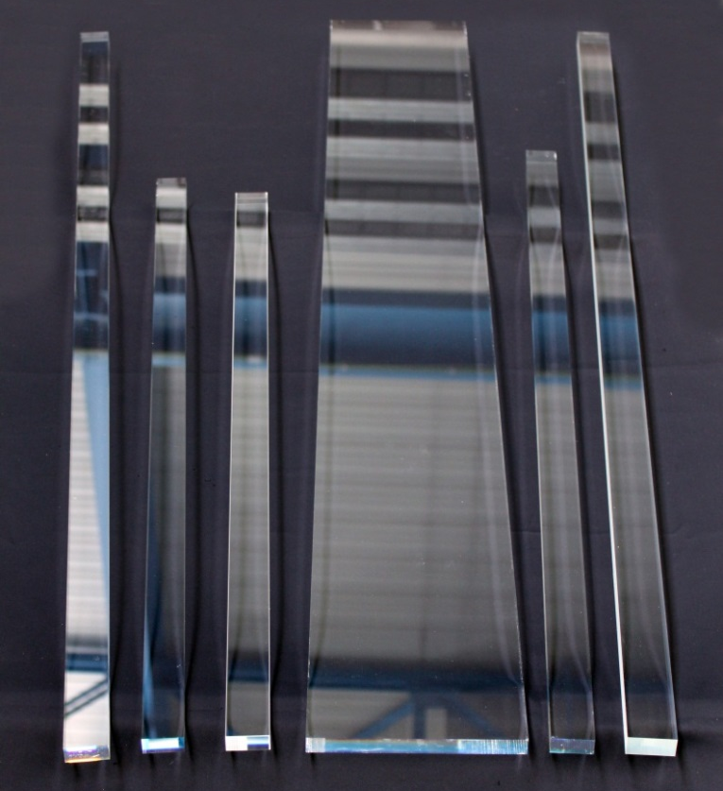
Radiator Requirements and Options
Radiator Quality:
DIRCs have tight mechanical requirements on flatness, squareness, and parallelism of the radiator surfaces
Surface roughness $≈$ 10 Å rms
Squareness $≈$ 0.5 mrad
Total thickness variation $≈$ 25µm
Production difficult, potentially expensive
Using 1 wide plate instead of 5 narrow bars per segment would reduce number of pieces to be polished by factor 5
Worked with vendors in Germany, Russia, USA, and Japan to produce a number of radiators using different fabrication techniques.
125 cm

Slide 9
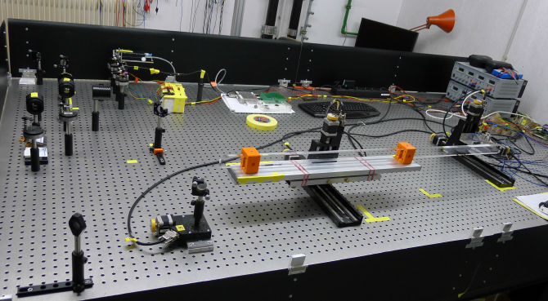
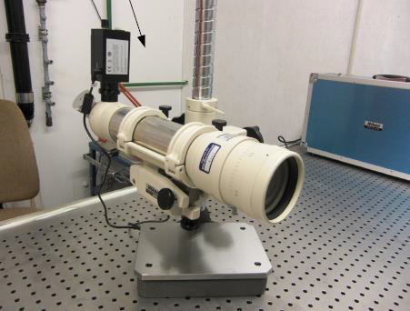
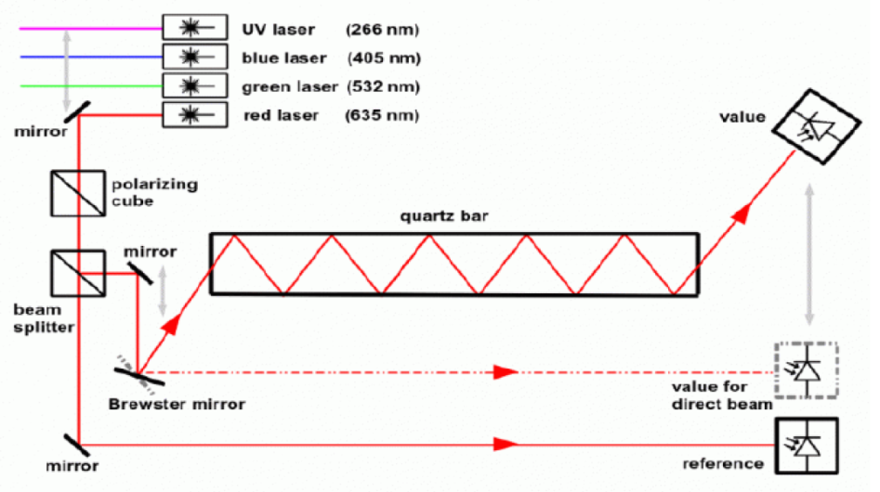
Radiator Quality Studies
Surface studies
Squareness, parallelism studies
Autocollimator

Slide 10
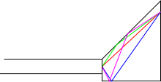
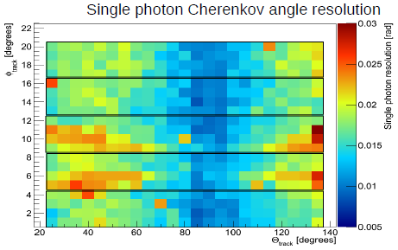
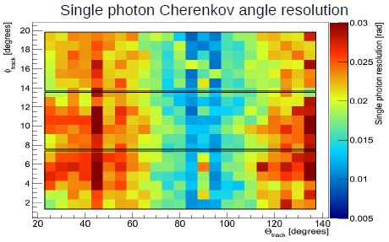
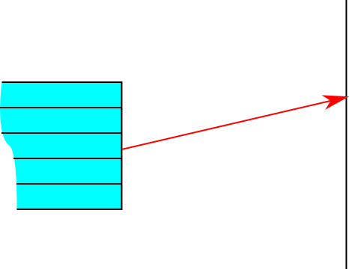
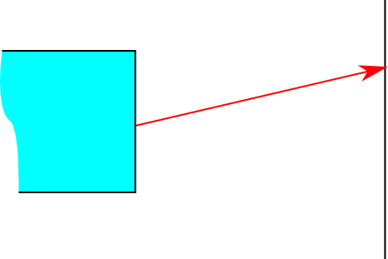
Geometrical Reconstruction
5 narrow bars, unfocused (MC Simulation)
3 wider bars, unfocused
inspired by BaBar DIRC
Geometrical reconstruction uses location of bar and pixel to determine photon vector in the radiator.
Combinatorial background due to ambiguous solutions.
side view
track azimuth angle
10 mrad 30
20° track polar angle 140°
track azimuth angle
10 mrad 30
Works well for narrow bars but fails for wide plates.
Width of radiator not negligible anymore.
top view
20° track polar angle 140°
bars
plate
detection plane
detection plane

Slide 11
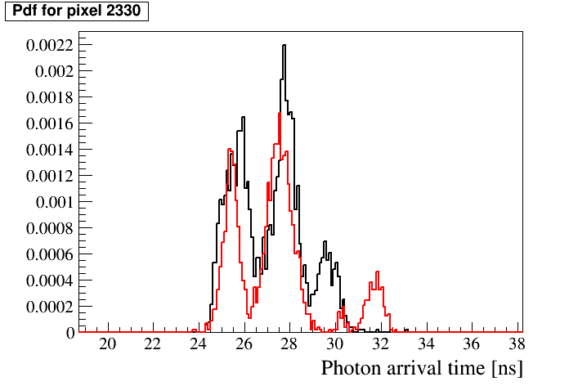
Probability Density Functions
normalized PDF for a specific pixel
MC
Simulation
π
K
p = 3.5 GeV/c
22° polar angle
y
π
K
x
PMT map, with 5 x 3 sensors, 64 pixels each
In 3 dimensions (x, y, t) hit patterns show differences between particle species
π sample
K sample
Probability density functions (pdf) can be generated with ~100k Monte Carlo tracks with same parameters and saved in histograms.
Inspired by Belle II TOP
Likelihood ratio test lnL_{K}-lnL_{P}

Slide 12
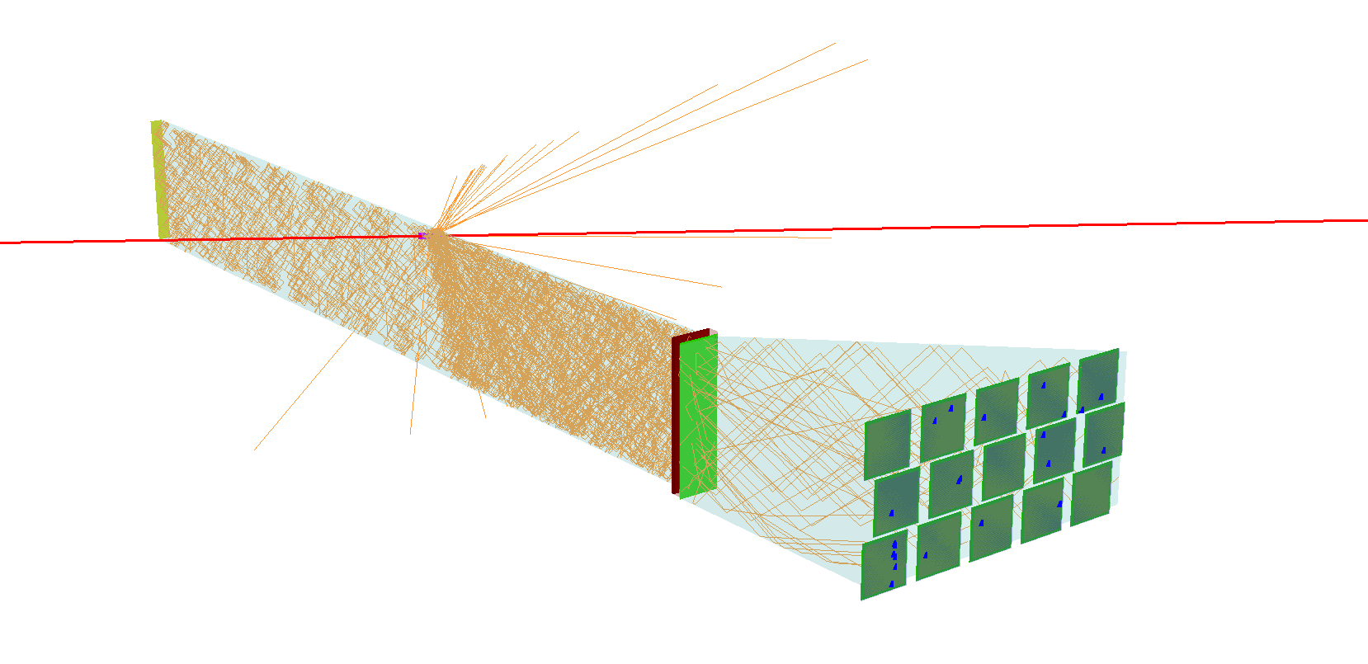
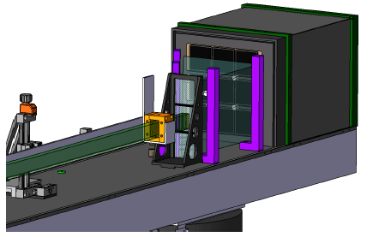
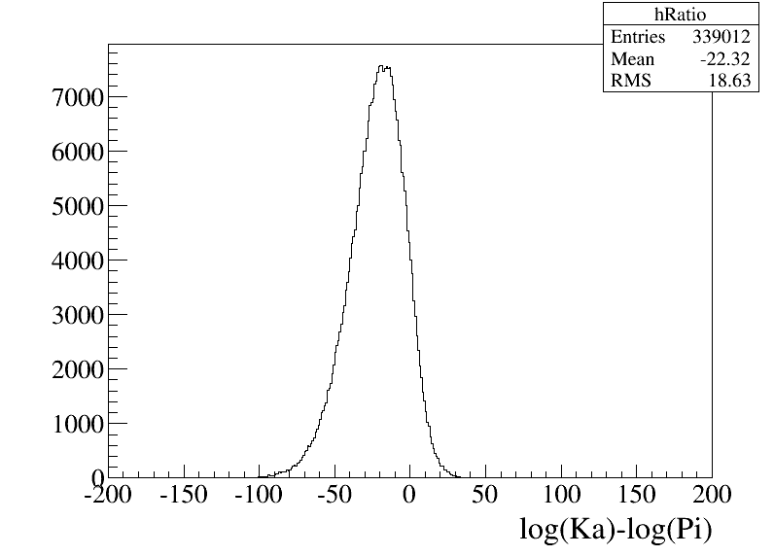
Radiator Shape Studies
Wide plate Narrow bar
CERN 2012
1.7 GeV/c pion beam @ GSI 2014
Mixed hadron beam, 1.5 GeV/c < p < 10 GeV/c
Likelihood ratio test
σ = 13 mrad
pions
kaons
log(L_{K} )-log(L_{π})
Beam data

Slide 13
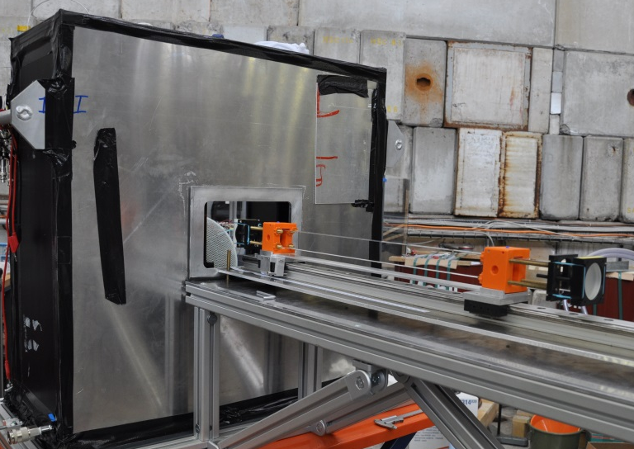
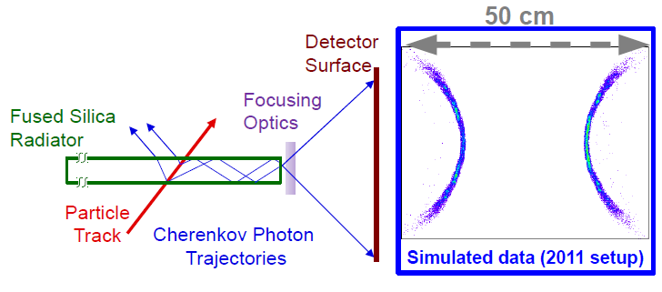
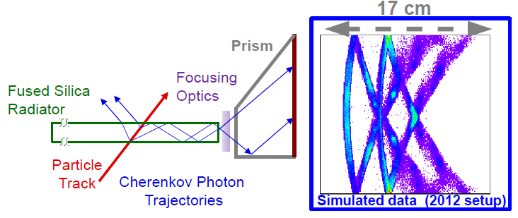
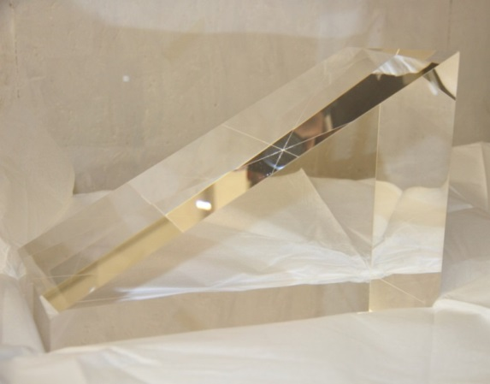
Expansion Volume Shape
Compact expansion volume using fused silica instead of oil
Better optical properties
Fewer readout sensors/channels needed
Optically independent segments
30 cm

Slide 14
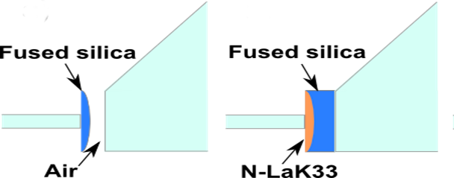
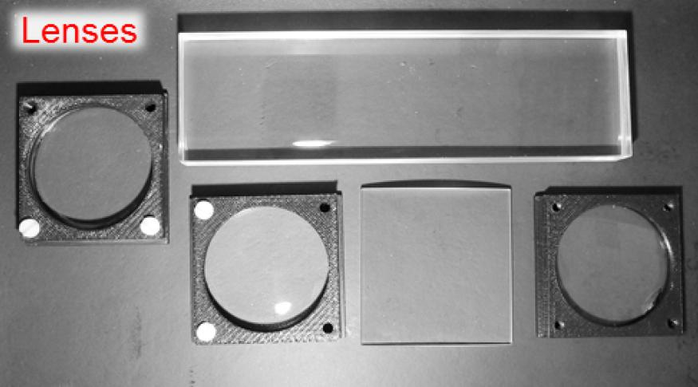
Focusing Optics
Different types of lenses were tested
Fused silica
N-LaK33
Simulation
Beam data
Beam data

Slide 15
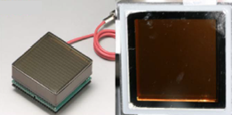
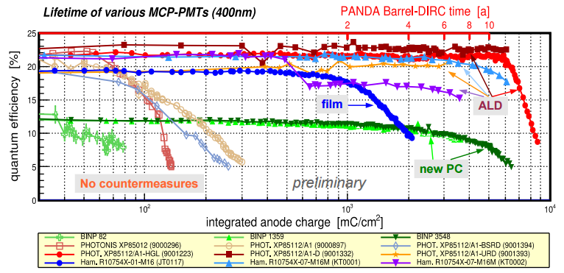
Photon Sensors
Requirements:
Single photon sensitivity, low dark count rate
High photo detection efficiency
Fast timing: $σ<$ 100 ps
Operation in magnetic field (1T)
Long lifetime: 0.5 C/cm²/yr
Best candidates: MCP-PMTs
Ongoing ageing tests show
breakthrough in
MCP-PMT lifetime
(Photonis Planacon)
Situation in 2011

Slide 16
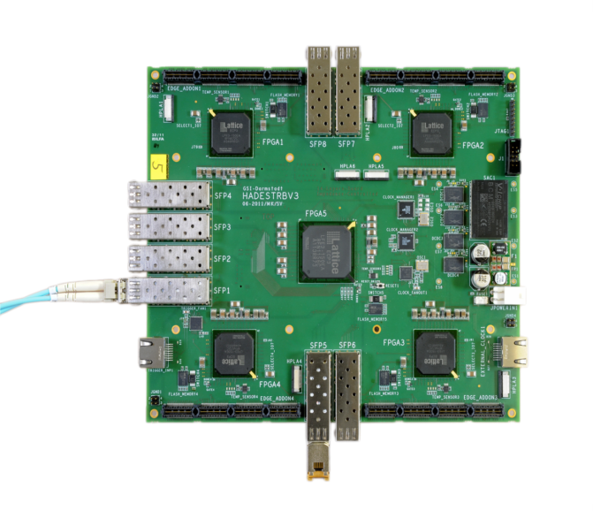
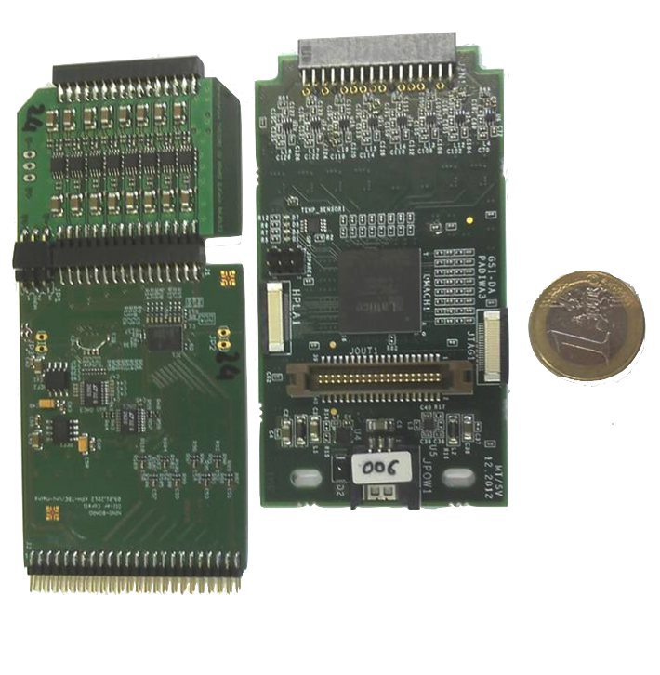
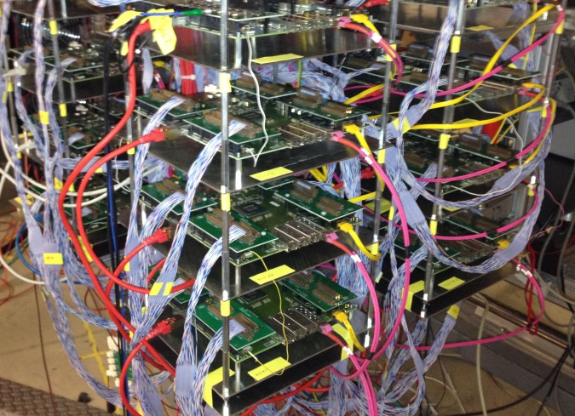
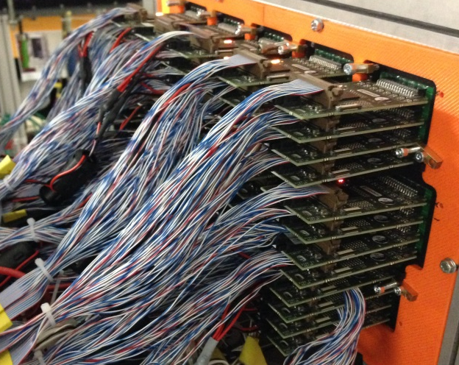
FEE Concept
NINO Card; PADIWA Card
Trigger Readout Board
TRBv3
MCP-PMT connector
Amplifier and discriminator card
NINO card, developed in Mainz NINO ASIC
PADIWA, developed at GSI FPGA
4 FPGAs programmed as TDC
<10 ps RMS time precision
700 kHz max trigger rate
67 MHz max hit rate
Close cooperation with CBM RICH group

Slide 17
Summary and Outlook
Summary
The Barrel DIRC is a key component of the PANDA particle identification system.
Baseline design with narrow bars and high-refractive lens meets PANDA PID goals.
Cost optimization identified design alternatives (wide plate, solid fused silica camera, compound lenses), validated with simulation and prototype tests.
QA tests of radiator surfaces, validation of different lenses and radiator shapes are ongoing.
Readout electronic is produced and tested in prototype test, using synergies with the HADES DAQ and CBM RICH group.
Outlook
Measure PID performance of design options in mixed hadron beam at CERN in summer 2015.
Decision on a design and PANDA Barrel DIRC TDR (due in early 2016).
The PANDA Cherenkov Group
1

