Slide 1
The Silicon Tracking System of the CBM experiment at FAIR
The CBM experiment, physics, technical challenges
The Silicon Tracking System
design constraints
layout
tracking performance
Prototype components
Laboratory and in-beam tests
System Integration
Summary
Minni Singla, GSI
for the CBM Collaboration
HIC for FAIR Physics Day
10-04-2015

Slide 2
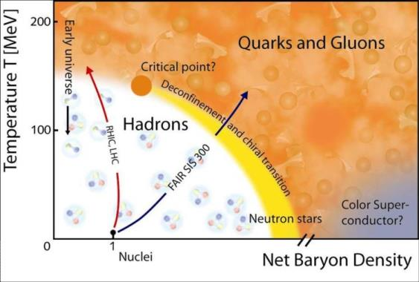
The CBM experiment at FAIR
TOF
ECAL
TRD
STS
MUCh
PSD
MVD
RICH
explore QCD phase diagram in the regions of high net baryon density and moderate temperatures
Tracking
MVD
STS
s.c. Dipole Magnet
PID
RICH + TRD
MUCH
TOF
Event Characterization/photons:
PSD
ECAL

Slide 3
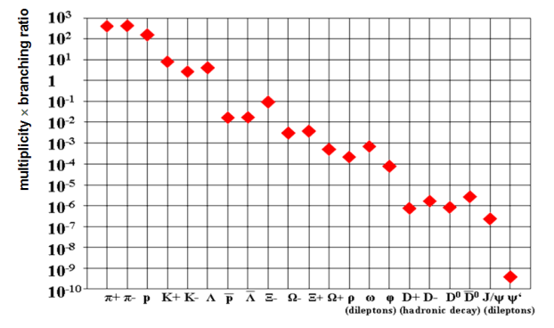
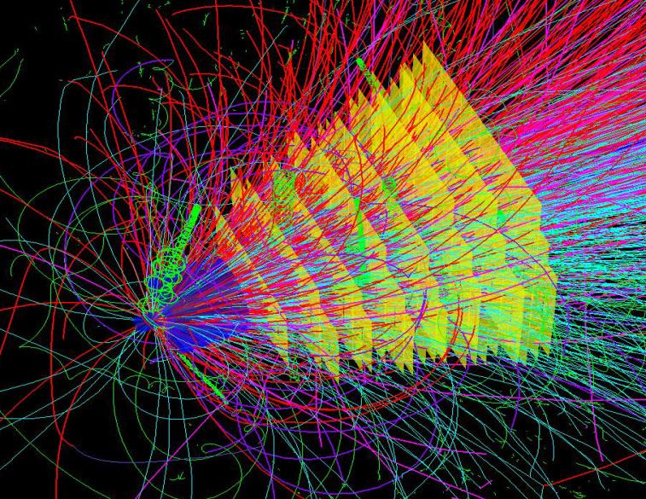
Technical challenges
GEANT simulation of STS from (UrQMD) one Au+Au collision at 25 GeV/nucleon
Rare probes:
CBM challenge
rare probes: require 10⁵ - 10⁷ Au+Au reactions/sec
Avoid multiple scattering ➔ Low material budget
Max. Fluence 1×10¹⁴n_{eq}cm⁻² ➔Radiation tolerant sensors

Slide 4
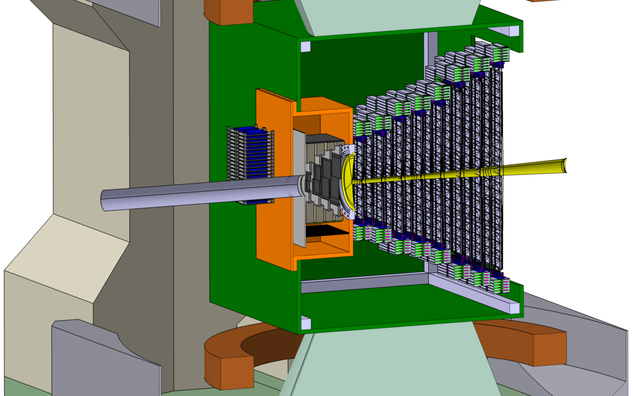
Design Constraints in STS
coverage
rapidity from center-of mass to close to beam
aperture 2.5° < Θ < 25°
low mass large-area detector
high-resolution momentum determination
track matching into MVD and RICH/MUCH
momentum resolution
δp/p ≅ 1%
field integral 1 Tm
25 µm single-hit spatial resolution
material budget per station up to 1% X₀
efficient hit & track reconstruction
close to 100% hit and tracking eff.
read-out
free-streaming fast readout
online event selection
STS
Beam
2.5°
25°

Slide 5
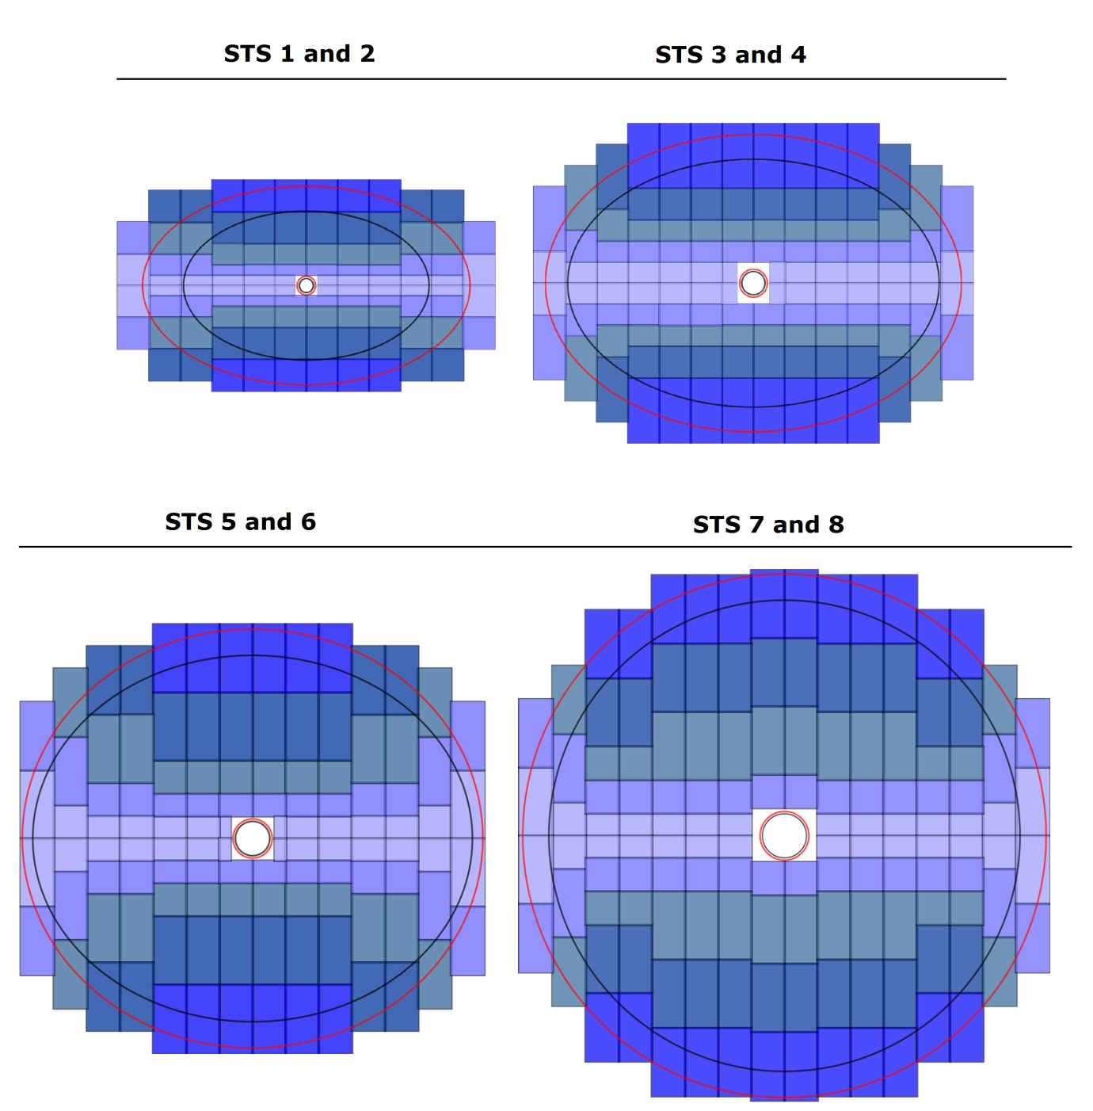
Layout: Silicon Tracking Station
8 tracking stations
stations arranged in 4 duplets
minimizing amount of modules
double-sided micro-strip silicon sensors
a few different sensor sizes
granularity according to the hit densities
minimized material budget 0.3 -1.1% X₀
read-out electronics outside the physics aperture

Slide 6
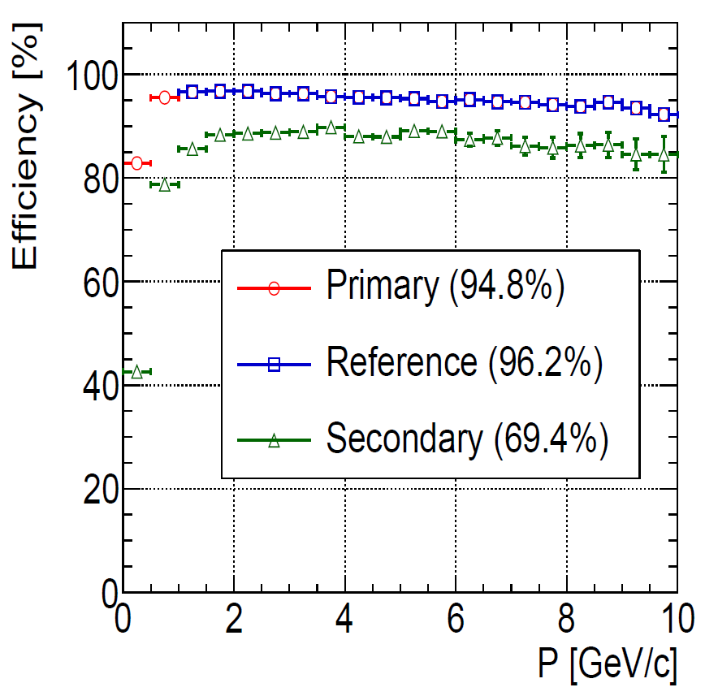
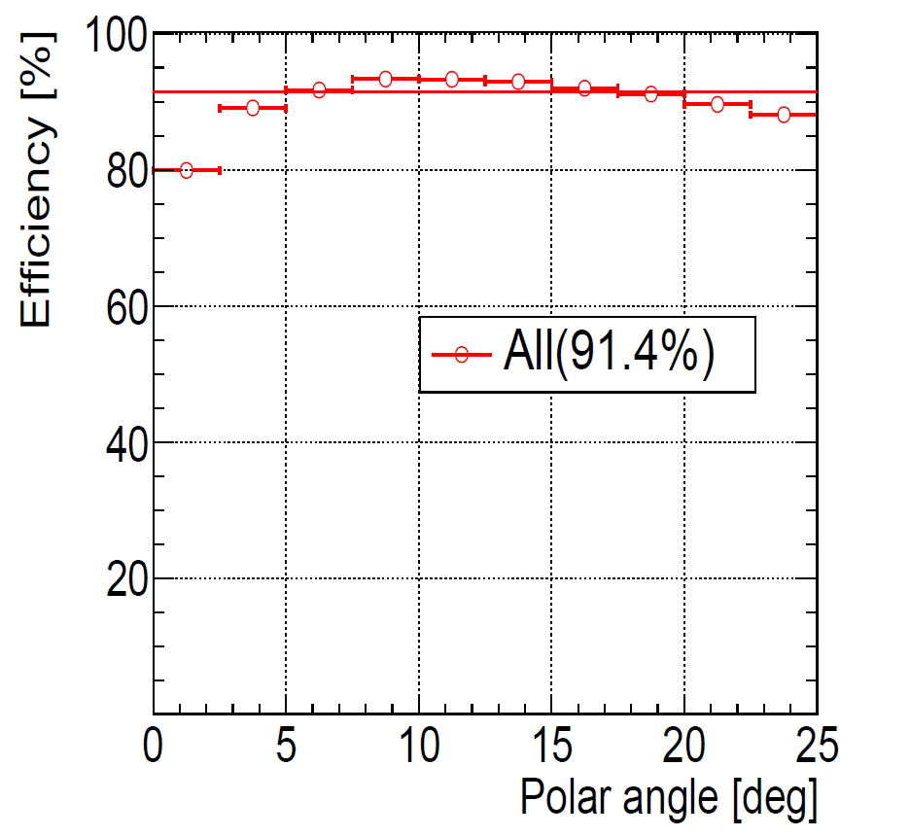
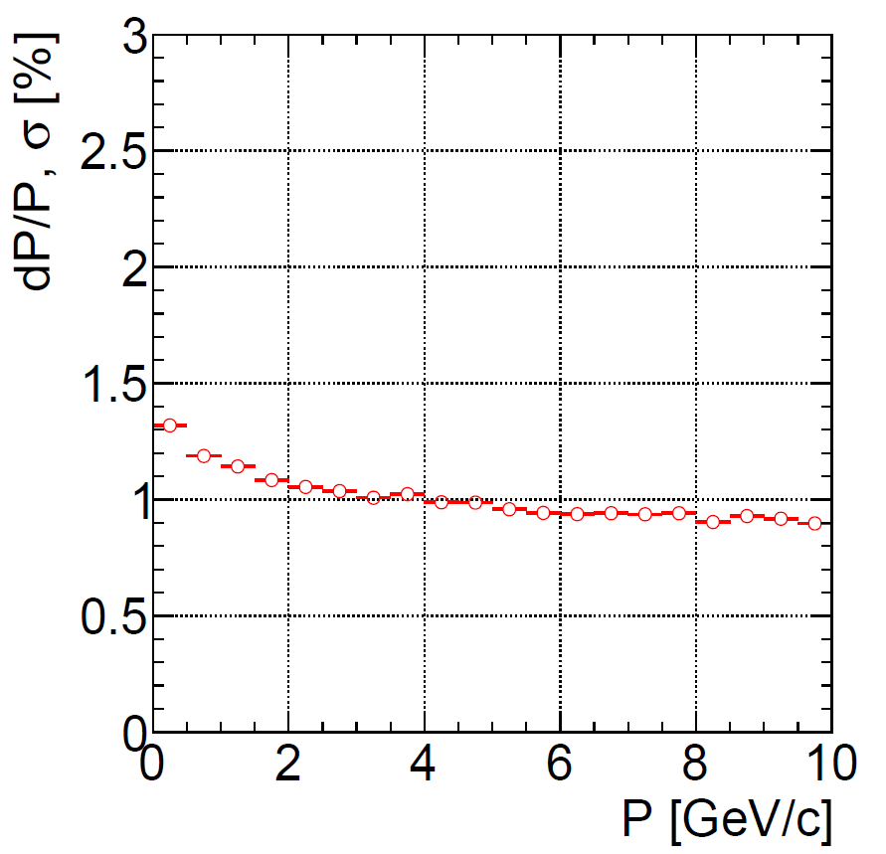
STS performance
UrQMD + Geant+ CBMRoot, Au+Au @ 25 GeV/nucleon
momentum resolution
δp/p ≅ 1%
track reconstruction efficiency

Slide 7
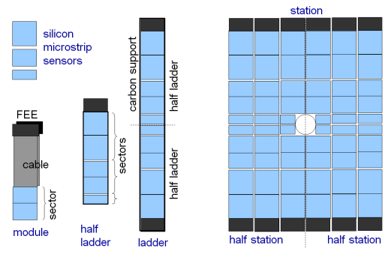
STS building blocks
Components breakdown:
106 ladders (17 types)
896 modules
1220 sensors
14144 chips
1.8 Mio channels
Mechanical prototype module: sensor + cables + electronics
FEE
sensor
read-out cables

Slide 8
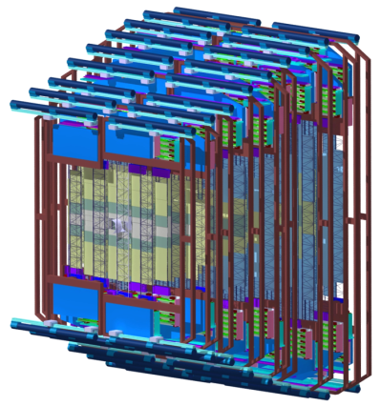
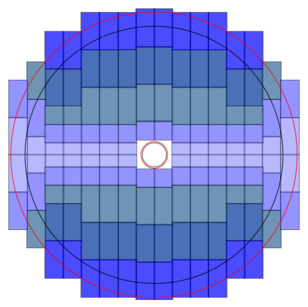
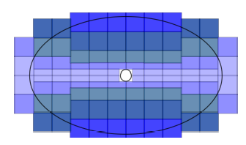
Microstrip sensor for CBM-STS
8 tracking stations
252 single sensors
648 sensors, daisy-chained in pairs, yielding 324 sensors (6.2 cm × 12.4 cm)
sum: 900
daisy-chained pair of 6.2 cm × 6.2 cm sensors
1.4 m
6.2 cm × 6.2 cm
station 8
6.2 cm × 4.2 cm
sum: 260
Station 1
sum: 60
6.2 cm × 2.2 cm
+ small number of sensors
3.2 cm × 2.2 cm

Slide 9
Daisy chained sensors
Step 1:
Step 2:
Alternative:
exploring with CiS
2 micro cables
interconnecting the AC pads of the top and bottom sensor on the p and the n sides:
attached to the sensors via tab-bonding
Cons
complicated handling
dead region between the two sensors (due to guard rings, no overlap possible)
6 cm × 6 cm
+
6 cm × 12 cm
6 cm × 12 cm
6 cm × 6 cm
6.2 cm x 12.4 cm sensor on “one piece” of silicon

Slide 10
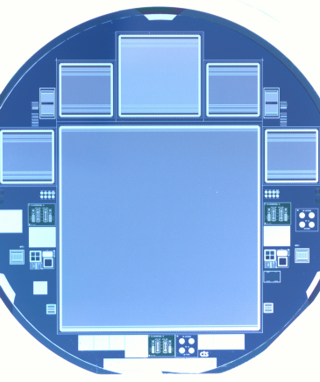
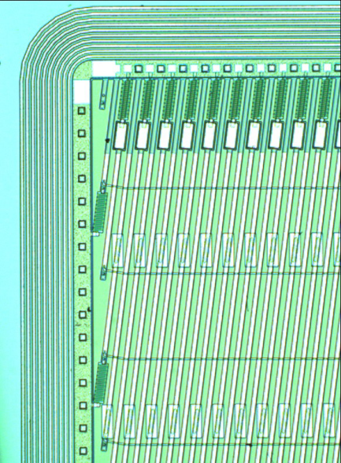
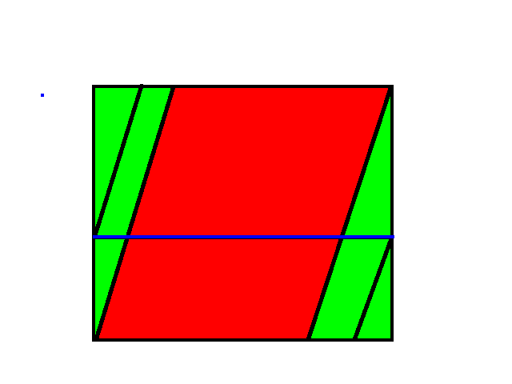
Sensor Specifications
double-sided sensors, p-n-n structure
strip lengths: 2, 4, 6 cm, 12 cm (daisy chained or not)
width: 6 cm
1024 strips per side with 58 μm pitch
integrated AC-coupled read-out
stereo angle front-back sides 7.5°
n side: straight strips (0⁰ )
routing lines on 2nd metal layer or replacement with an external micro cable on the stereo angle side
radiation tolerance up to 1 × 10¹⁴ n_{eq}/cm²
readout direction
End strips
Center strips
7.5⁰
routing line
9

Slide 11
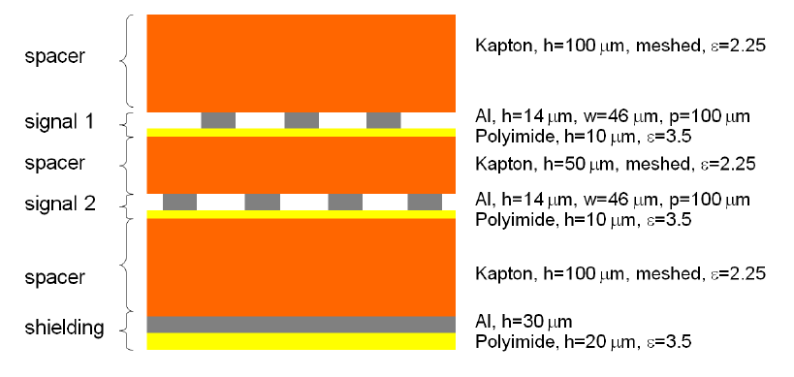
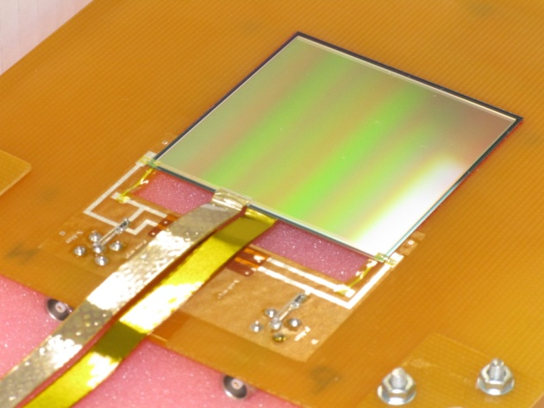
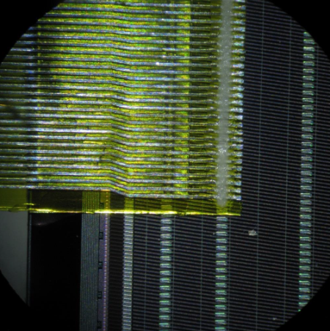
low-mass read-out cables
sensor
cable
radiation length: 0.1% X₀
two signal layers
strip pitch 116 µm
thickness 24 µm
additional spacer to reduce the capacitance
TAB bonded to sensor
1024 channels to connect per side
in prototypes 128 channels on each side are connected
cable
sensor

Slide 12
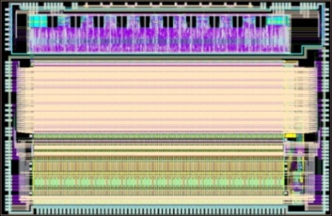
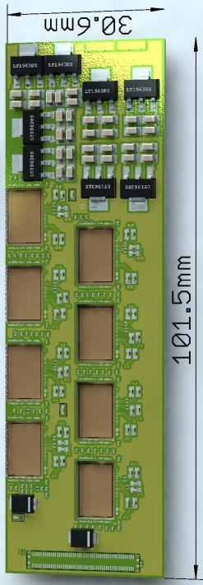
Readout chip: STS-XYTER
Front-end Board
Read-Out Board
full-size prototype
signal detection from the 2-sided sensors
fast ⇔ low noise ⇔ low power dissipation
Data Processing Board
time-slicing
FLES farm online event computing
STS-XYTER ASIC
v1.0 produced (v2.0 under design) UMC 180 nm CMOS
channels | 128, polarity +/-
noise | 900 e⁻ at 30 pF load
ADC range | 16 fC, 5 bit
clock | 250 MHz
power | < 10 mW/channel
timestamp | < 5 ns resolution
out interface | 4(5) × 500 Mbit/s LVDS
time-stamped data
data combining
8 STS-XYTER chips
1/2/5 LVDS links out separate power boards
GBTx chip-set (CERN)

Slide 13
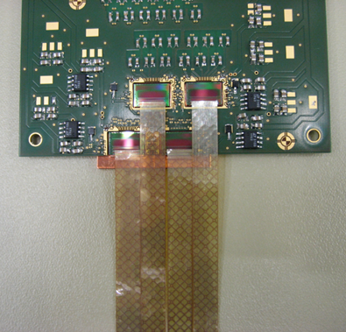
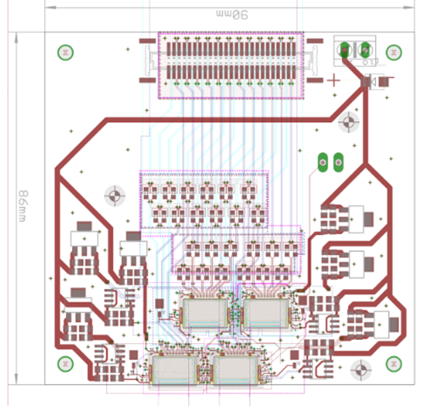
Front-end board
FEB4 – 4 STS-XYTERv1 ASICs (under study)
intermediate prototype with less spatial constraints
FEB8 – 8 STS-XYTERv2 ASICs
under development
challenge with high via density
Test assembly of FEB4

Slide 14
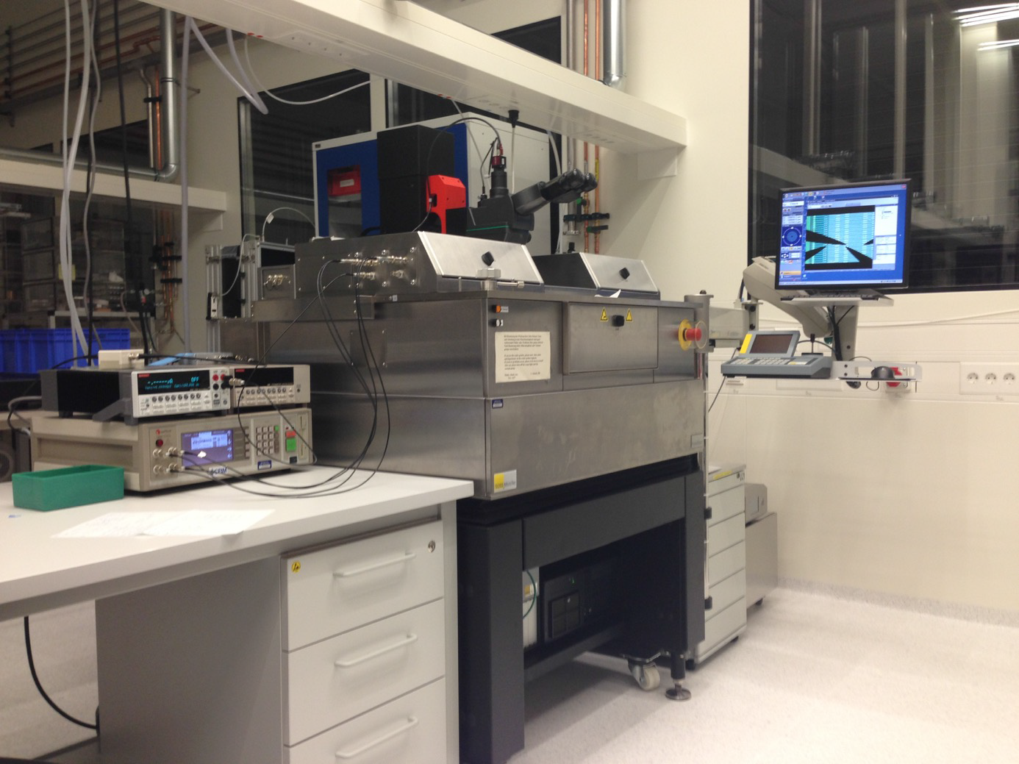
Quality Assurance procedures
Components
sensors
ASICs
Cables
Composite objects
modules
ladders
PC with LabView
wafer
prober
Keithley,
LCR meter
Cleanroom @ GSI Darmstadt

Slide 15
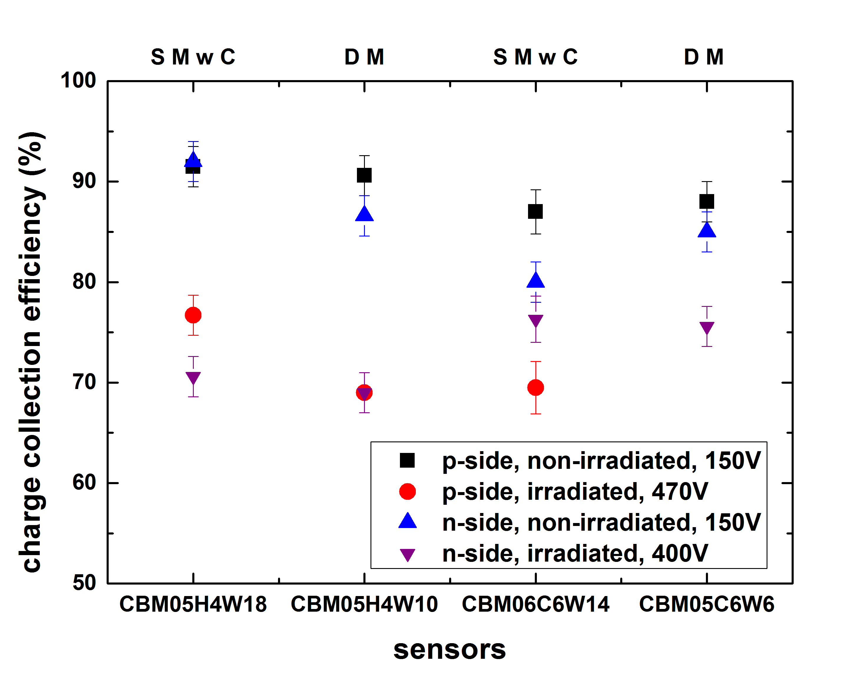
Irradiation studies: comparison single and double metal sensors
SMwC: Single Metal with external cable
DM: Double metal
End strips
Center strips
routing line
interconnection type :
Double metallization
external cable
sensor size (6x4, 6x6 cm²)
irradiated to 2x10¹⁴n_{eq}cm⁻²
⁹⁰Sr

Slide 16
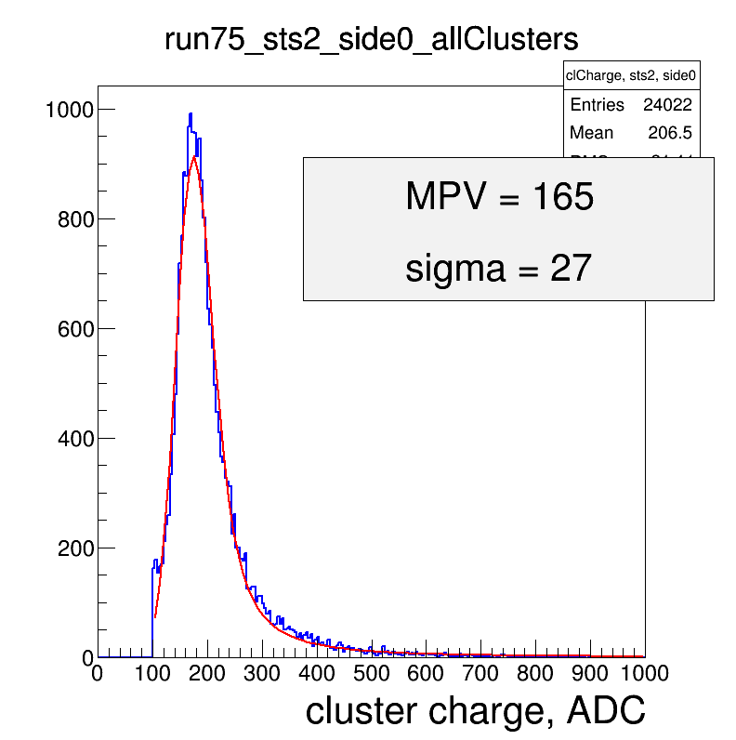
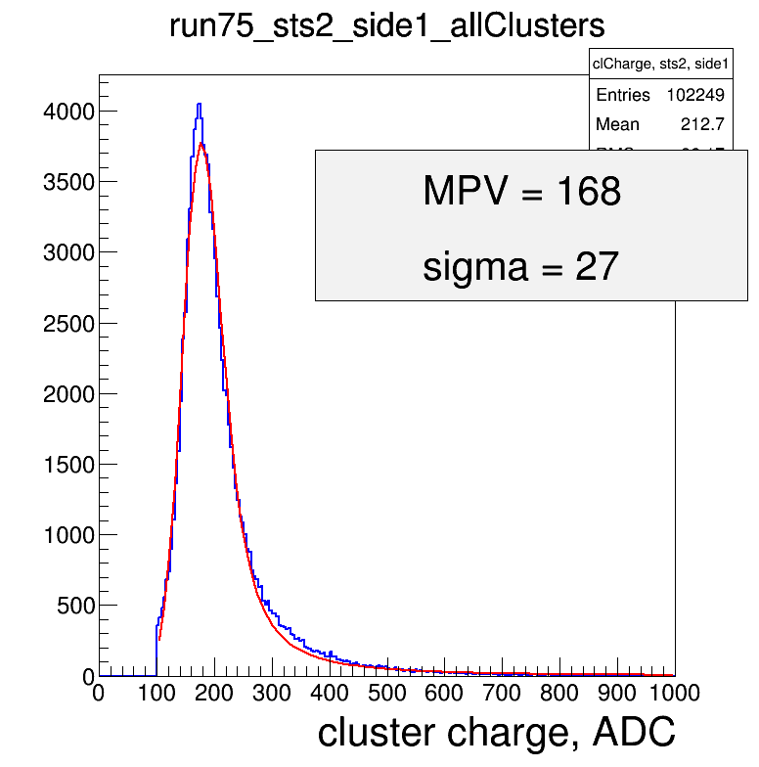
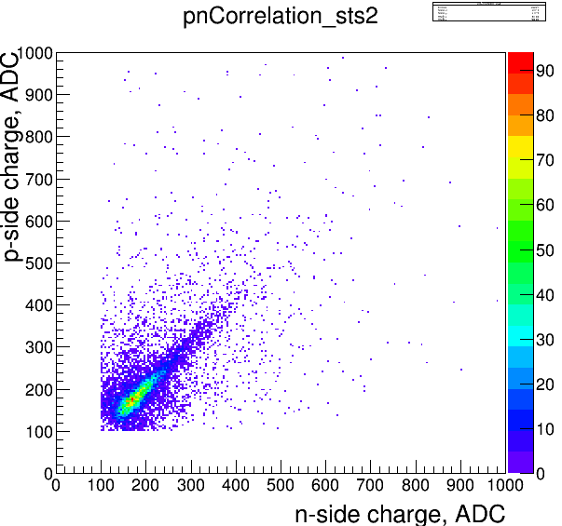
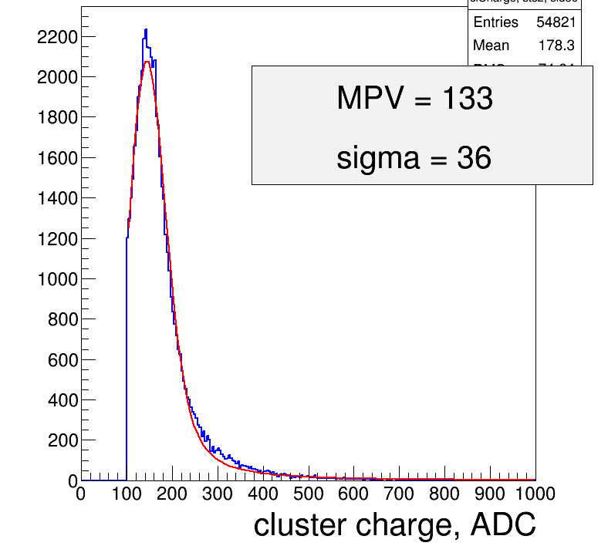
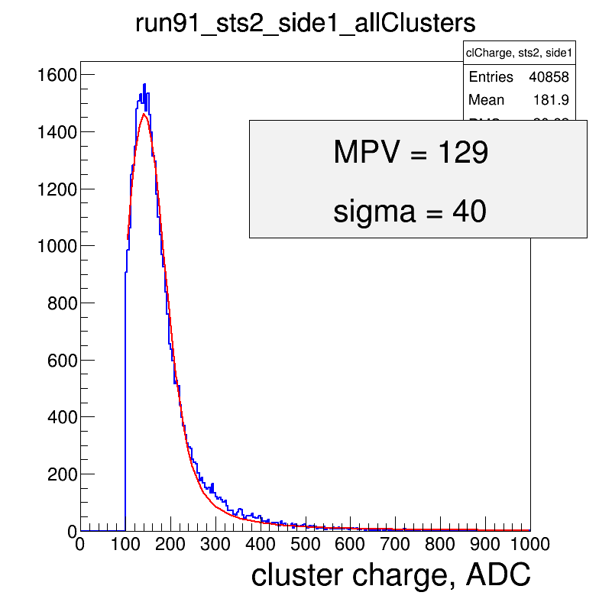
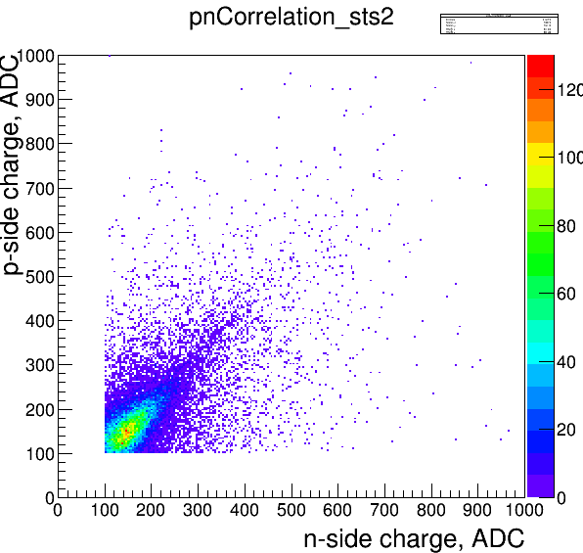
In beam test: sensors before and after n-irradiation
COSY, 2.4 GeV protons (Dec. 2014)
n side
p side
Non-Irradiated, double metal
~20% loss in charge collection after
neutron irradiation dose of 2x10¹⁴n_{eq}cm⁻²
☺S/N still large enough
~39 ADC
~32 ADC
Irradiated,
double metal

Slide 17
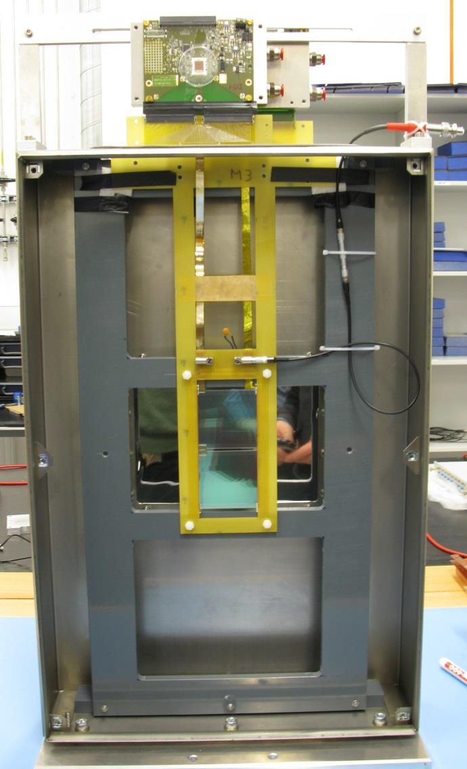
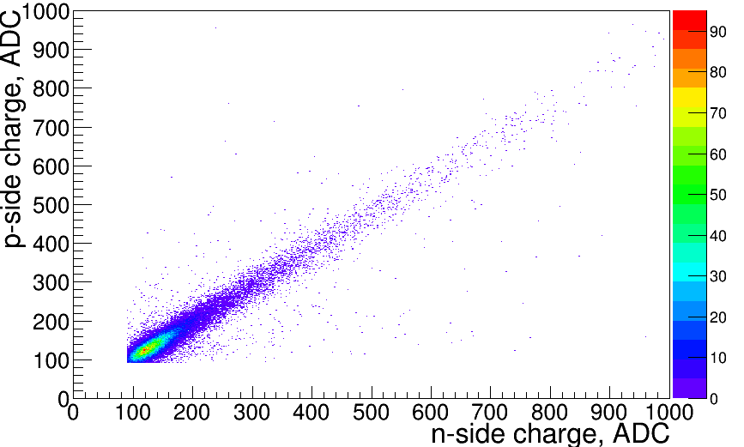
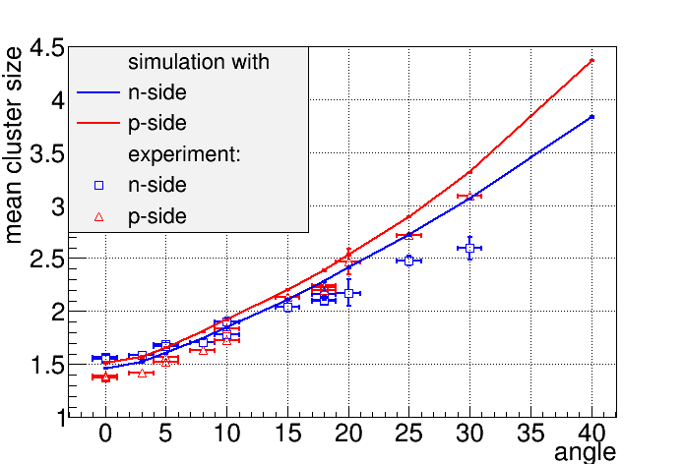
In-beam test: prototype module
COSY, 2.4 GeV protons (Dec. 2014)
2nd module prototype
with CBM05 sensor
2nd batch of the
low-mass micro-cables

Slide 18
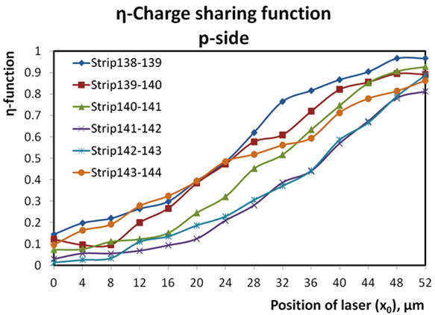
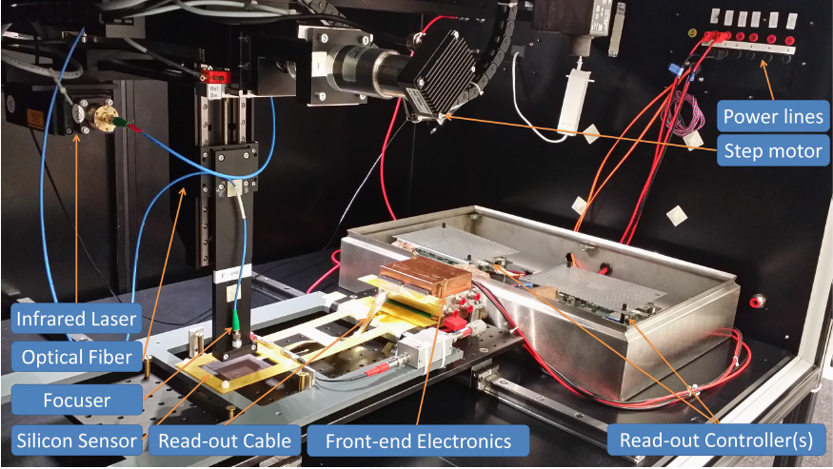
Tests with a laser beam
signal generation in precisely known location
test stand with focused 1060 nm infrared laser
mimic minimum ionizing particles
study e.g. charge sharing

Slide 19
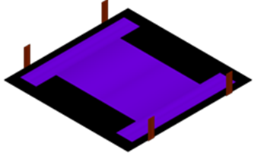
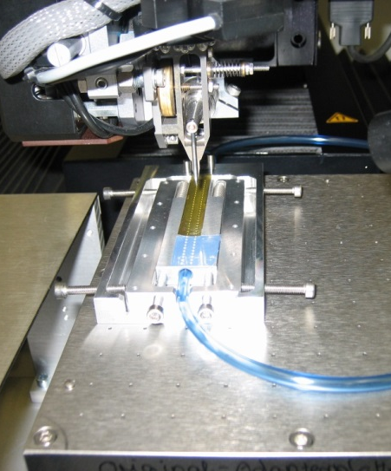
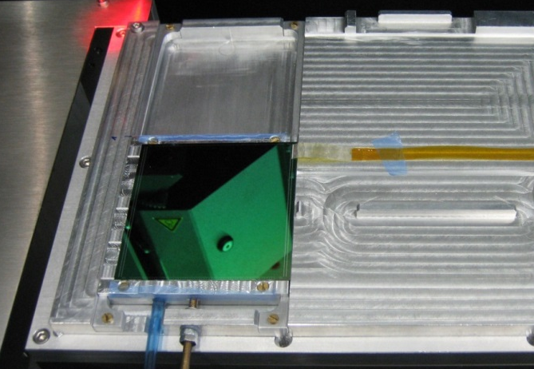
Module assembly
Inter-strip cable
chip cables
32 pcs
71 (+3) components per module
non-reworkable assembly
high-yield components essential
most work-intensive part of construction effort
assembly procedures under development
FEB STS-chips
Sensor
“chip-cable” to sensor bonding
“chip-cable” assembly

Slide 20
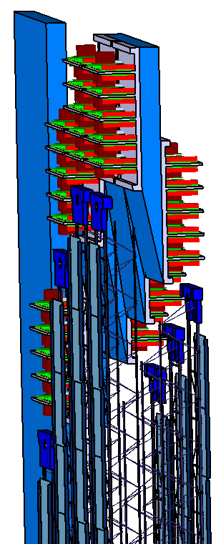
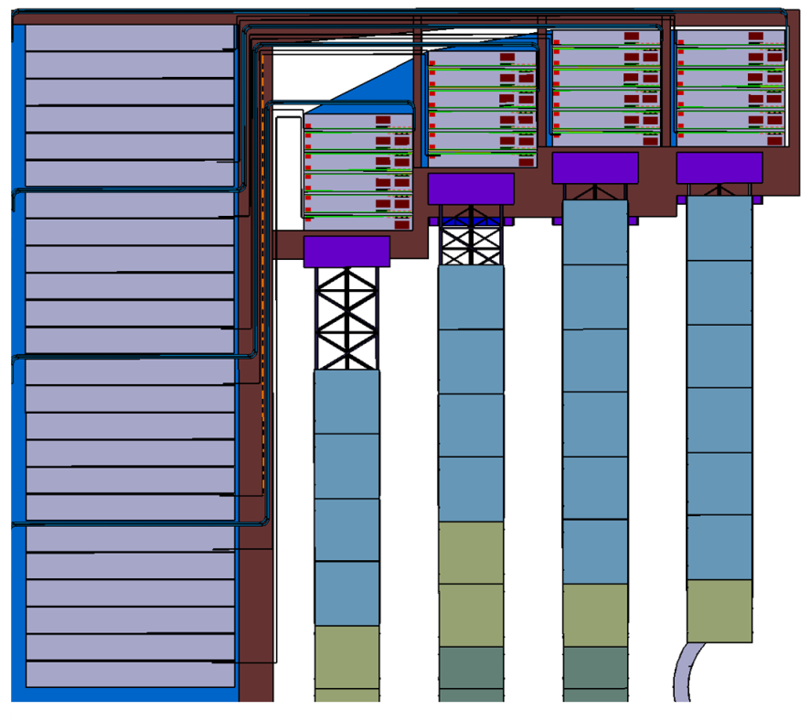
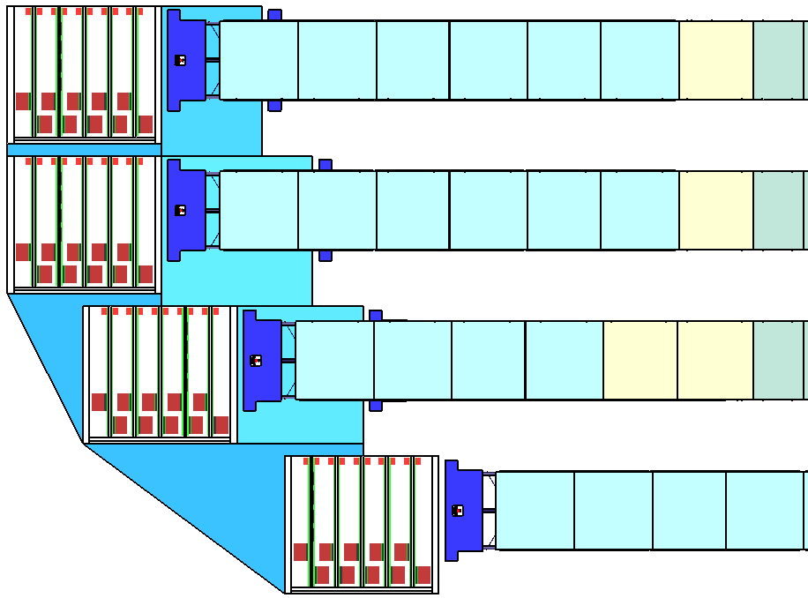
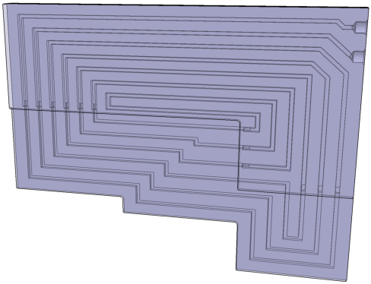
System integration: stations/cabling/cooling
ROB & power supply
FEB
FEB stack
cooling plant:
bi-phase CO₂ 2PACL
prototype TRACI-XL: 1 kW
STS electronics total: 42 kW
prototype cooling plate

Slide 21
The Silicon Tracking System
ladders
1340 mm
cooling plates
1632 mm

Slide 22
Summary
STS system concept and layout has been worked out
Radiation tolerance of sensors confirmed
Prototype modules tested in beam
Module assembly and system integration in progress
Full read-out chain under preparation
Full-size STS mock-up under construction
Readiness for series production of components: end of 2016

Slide 23
Institutions participating in CBM-STS
From Germany, Poland, Russia, Ukraine:
Darmstadt, Germany, GSI Helmholtz Center for Heavy Ion Research GmbH
Dubna, Russia, Joint Institute for Nuclear Research (JINR)
Katowice, Poland, University of Silesia
Kharkov, Ukraine, LTU Ltd ^{* Partner} ^{Institut}
Kiev, Ukraine, Kiev Institute for Nuclear Research (KINR)
Krakow, Poland, AGH University of Science and Technology
Krakow, Poland, Jagiellonian University
Moscow, Russia, Institute for Theoretical and Experimental Physics (ITEP)
Moscow, Russia, Moscow State University
Protvino, Russia, Institute for High Energy Physics (IHEP)
St. Petersburg, Russia, Ioffe Physical-Technical Institute
St. Petersburg, Russia, Khlopin Radium Institute (KRI)
St. Petersburg, Russia, St. Petersburg State University
Tübingen, Germany, Eberhard Karls University
KIT, germany

Slide 24
back up

Slide 25
STS Technical Design Report
Approved by FAIR in Summer 2013

Slide 26
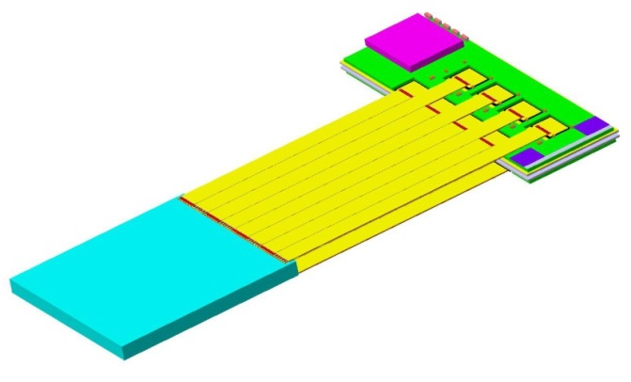
STS Module: smallest assembled functional unit
front-end electronics board
6 cm
sensor
read-out cables
2, 4, 6, (12) cm
10 – 50 cm

Slide 27
STS pre-series prototype sensors
Prototype | Year | Vendor | Processing | Size [cm²] | Comment
CBM05C6 | 2013 | CiS | DSDM | 6.2 × 6.2 | Sensor R&D GSI 2007 – 2013: CBM01 – CBM05
CBM05H4 | 2013 | Hamamatsu | DSDM + DSSM | 6.2 × 4.2
CBM05H2 | 2013 | Hamamatsu | SSSM, 0+7.5 deg | 6.2 × 2.2 | BMBF-JINR funded: pre-series sensors completed
CBM06C6 | 2014 | CiS | DSSM FZ + DOFZ | 6.2 x 6.2
CBM06H6 CBM06H2 | 2014 | Hamamatsu | DSSM | 6.2 × 6.2 6.2 × 2.2
CBM06H6 CBM06H2 | 2015 | Hamamatsu | DSDM DSSM | 6.2 × 6.2 6.2 × 2.2 | BMBF-JINR funded: pre-series sensors in production
CBM06C6 | 2015 | CiS | DSDM | 6.2 x 6.2
CBM06C4 | 2015 | CiS | DSDM | 6.2 × 4.2
CBM06C2 | 2015 | CiS | DSDM | 6.2 × 2.2
CBM06C12 | 2015 | CiS | DSDM | 6.2 x 12.4

Slide 28
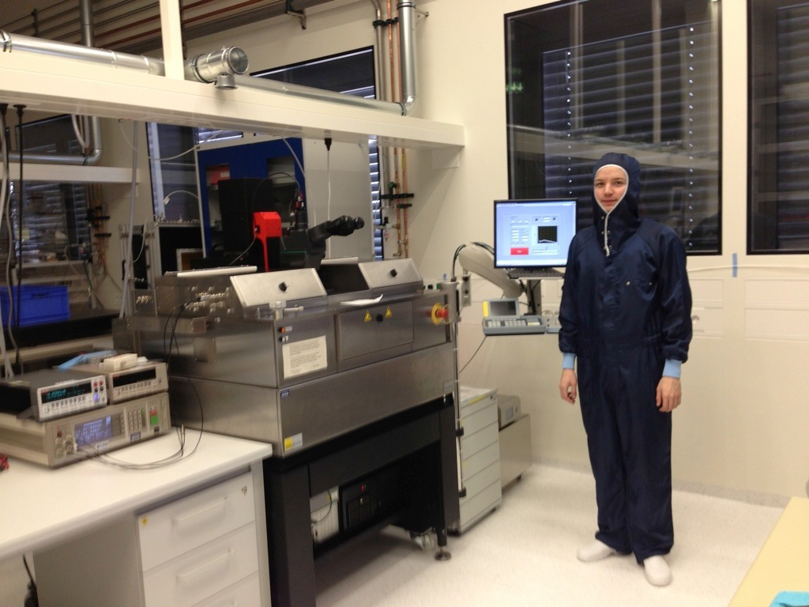
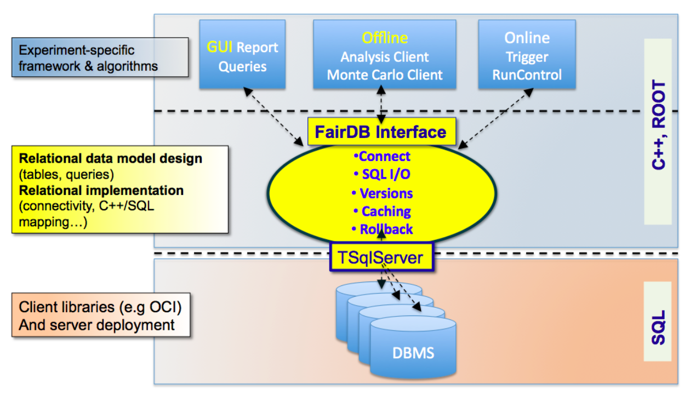
Quality Assurance procedures
HK 12.2 Mon 17:30 M/HS1, Anton Lymanets
Quality assurance database for the CBM Silicon
Tracking System
PC with LabView
wafer
prober
Keithley,
LCR meter
Cleanroom @ GSI Darmstadt
HK 21.2 Tue 15:00 M/HS1, Pavel Larionov
Quality Assurance of double-sided silicon microstrip
sensors of STS
HK 2.6 Mon 16:00 M/HS1, Evgeny Lavrik
Development of optical quality assurance procedures
for the sensors
Notes:
whats the cleanroom class??

Slide 29
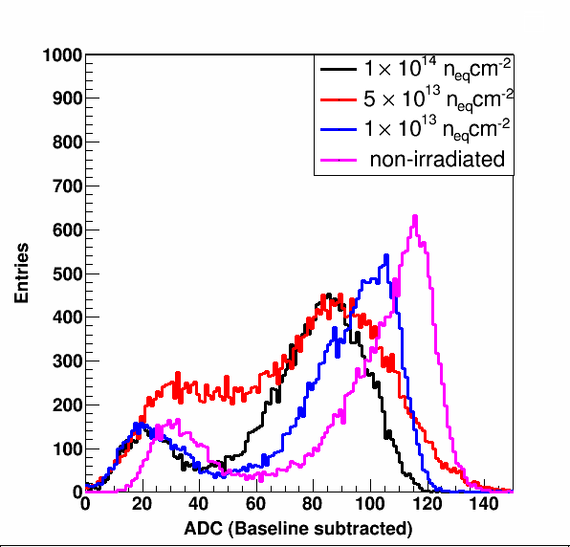
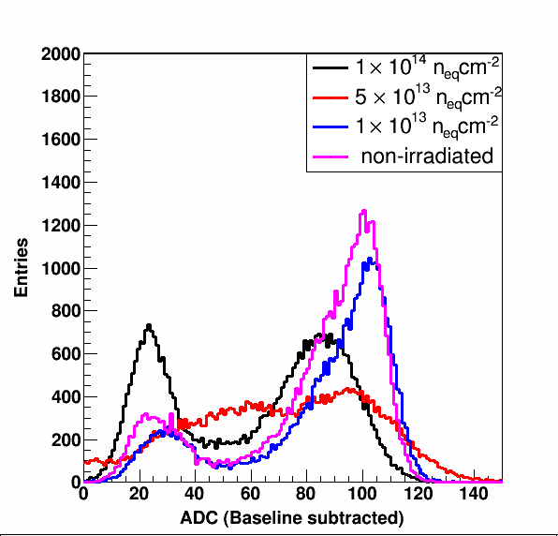
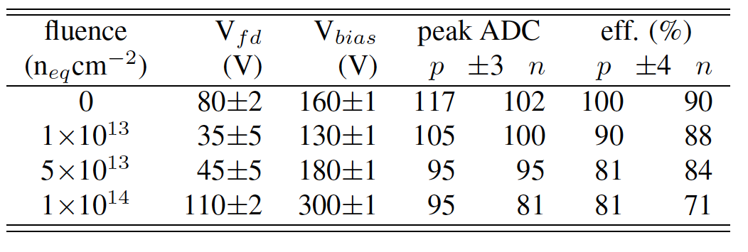
Radiation tolerance tests: ²⁴¹Am
59.5 keV, γ line ➔ ~16 ke⁻ in silicon = 2.65 fC = 116 ± 3 ADC
p-side
n-side
S/N for MIP > 20
Notes:
Calibration:
Q– [fC] = 0.54 + 0.0159 · A + 7.0 · 10–6 · A²
Q⁺ [fC] = 0.76 + 0.0137 · A + 9.5 · 10–6 · A²

Slide 30
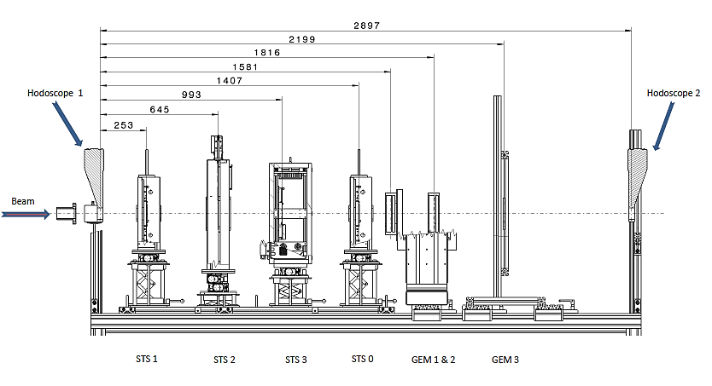
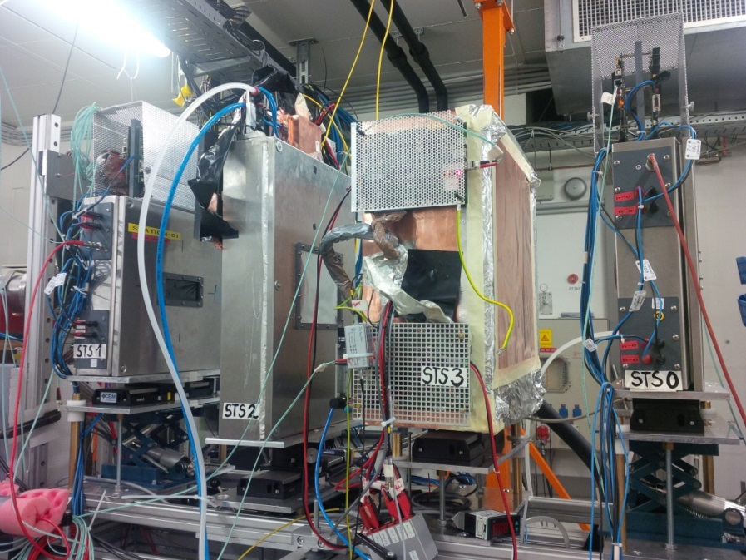
In beam set up
STS 0: Reference station 1
STS 1: Reference station 2
STS 2: Station under test
BEAM

Slide 31
Module prototype tests
Second module prototype with CBM05 sensor and second batch of the low-mass micro-cables and n-XYTER FEB
Detailed analysis in progress
COSY @ Jülich
Notes:
New prototypes were build from the new CBM05 full size sensors with low-mass micro-cables. Such modules were also under beam tests which took place in COSY Julich in December of last year. Two STS sensors were used as reference stations and middle station was the one under test having the CBM05 sensor. Modules were tested using 2.4 GeV protons and since the detailed analysis is still in progress I am able to show the beam profile as seen in reference station and ADC response from the n-side of the module.

Slide 32
Radiation environment in STS
STATION 1
(Au+Au @ 10MHz)
radiation hard sensors
compatible with the CBM physics program
1 × 10¹³ n_{eq}/cm² (SIS100)
1 × 10¹⁴ n_{eq}/cm² (SIS300)
exchange of sensors after 1 × 10¹⁴ n_{eq}/cm²

Slide 33
Material budget in STS

Slide 34
CBM running scenario @ SIS100
Assumption: beam for 2 month/year x 5 years = 10 month
Physics case | Beam intensity 1% int. target | NIEL n/cm²/2 month | Beam time (month) | Total NIEL n/cm²
Au+Au at 2, 4, 6, 8, 10 A GeV Hadrons, e+e- | 10⁷ | STS1 max: 5x10¹⁰ STS8 max: 1x10¹⁰ | 6 | STS1 max: 1.5x10¹¹ STS8 max: 3x10¹⁰
C+C at 2, 4, 6, 8, 10 A GeV Hadrons, e+e- | 10⁷ | about 20 times less than Au+Au | 2 | ---
p+A | 10⁹ | Similar to 10⁷ Au+Au | 1 | about 2x10¹⁰
Au+Au 10 A GeV J/ψ→μμ | 10⁹ | STS1 max: 5x10¹² STS8 max: 5x10¹² | 1 | STS1 max: 2.5x10¹² STS8 max: 2.5x10¹²
Sum SIS100 |  |  | 10 | STS1 max: 2.7x10¹² STS8 max: 2.5x10¹²

Slide 35
CBM running scenario @ SIS300
Assumption: beam for 2 month/year x 15 years = 30 month
Physics case | Beam intensity 1% int. target | NIEL n/cm²/2 month | Beam time (month) | Total NIEL n/cm²
Au+Au at 15, 20, 25, 30, 35 A GeV Hadrons, e+e- | 10⁷ | STS1 max: 2x10¹¹ STS8 max: 1x10¹⁰ | 12 | STS1 max: 1.2x10¹² STS8 max: 6x10¹⁰
C+C at 15, 20, 25, 30, 35 A GeV Hadrons, e+e- | 10⁷ | about 20 times less than Au+Au | 6 | ---
p+A | 10⁹ | Similar to 10⁷ Au+Au | 6 | about 6x10¹¹
Au+Au at 15, 20, 25, 30, 35 A GeV J/ψ→μμ | 10⁹ | STS1 max: 2x10¹³ STS8 max: 2x10¹³ | 6 | STS1 max: 6x10¹³ STS8 max: 6x10¹³
Sum SIS300 |  |  | 30 | STS1 max: 6.2x10¹³ STS8 max: 6.1x10¹³

Slide 36
Readout chip: STS-XYTER
full-size prototype dedicated to signal detection from the double-sided micro-strip sensors in the CBM environment
fast ⇔ low noise ⇔ low power dissipation
new w.r.t. n-XYTER architecture:
effective two-level discriminator scheme
STS-XYTER ASIC
v1.0 produced (v2.0 under design) UMC 180 nm CMOS
channels | 128, polarity +/-
noise | 900 e⁻ at 30 pF load
ADC range | 16 fC, 5 bit
clock | 250 MHz
power | < 10 mW/channel
timestamp | < 5 ns resolution
out interface | 4(5) × 500 Mbit/s LVDS
HK 48.56 Wed 17:00 C/Foyer, Iurii Sorokin
The STS-XYTER ASIC – a dedicated front-end
chip for the CBM Silicon Tracking System
FEB cooling box
with FEB boards
Notes:
ask tomas about this slide....

Slide 37
Cooling in STS
STS read-out electronics dissipates ca. 40 kW
cooling with bi-phase CO2:
high efficiency at small spatial requirement
standard for tracker upgrades at LHC
cooperation of GSI with CERN: TRACI-XL
20 kW
20 kW
“2-phase accumulator controlled loop”
TRACI-XL:
1 kW test cooling system
HK 31.5 Tue 18:00 M/HS2, Jorge Sanchez Rosado
Development of a CO2 Cooling System for the CBM
Silicon Tracking System
EU-FP7 CRISP Work Package CO₂ cooling
(http://www.crisp-fp7.eu/)

