Slide 1
PANDA Software Trigger Status/Plans
PANDA DAQT-FEE Workshop
Apr. 2015, GSI Darmstadt
K. Götzen, D. Kang, R. Kliemt, F. Nerling GSI Darmstadt/HI Mainz

Slide 2
Software Trigger within Trigger System
Raw Data
Configuration
Online Trigger System (FPGA, GPU, CPU)
Online Reco
Tracking
Event Building
Software Trigger
PID
Neutral Reco
Trigger Tag
Data Storage

Slide 3
Strategy for Investigation
EvtGen
Physics Channel 1
Physics Channel 2
...
Physics Channel m
DPM/FTF
Background
Event Generation
Signal
Background
Simulation &
Reconstruction
Fast MC
Full MC
Event Filtering
Combinatorics
Mass Window Selection
Trigger Specific Selection → Event Tagging
Trigger 1
Trigger 2
Trigger 3
...
Trigger n
Trigger Decision (Logical OR)
Global Trigger Tag

Slide 4
Extended Trigger Scheme
Status report 2014
n = 10 trigger lines
m = 10 signal event types
4 energies:
E_{cm} = 2.4, 3.77, 4.5, 5.5 GeV
Extended scheme 2015
n = 57 trigger lines (added subdecays and new modes)
Trigger of 17 different particle/reaction types
m = 791 signal event types (considering different recoils)
10 Recoils: - / γ / π⁰/ η / π⁰π⁰/ π⁺π⁻ / K⁺K⁻ / K⁰K⁰ / ηη / π⁺π⁻π⁰
7 energies:
E_{cm} = 2.4, 3.0, 3.5, 3.8, 4.5, 5.0, 5.5 GeV

Slide 5
'Complete' List of Triggers
Tr# | Res. | Channels (BR[%]) | N | Code | Σ BR[%]
1 | η_{c} | K⁺K⁻π⁰ (1.2), K_{S}K±π∓ (2.4), γγ , K⁺K⁻π⁺ π⁻π⁰ (3.5), K_{S}K±π⁺π⁻π∓ (1.8) | 5 | 22x | 8.3
2 | J/ψ | e⁺ e⁻ (5.9), μ⁺ μ⁻ (5.9) | 2 | 20x | 11.9
3 | χ_{c0} | π⁺ π⁻ K⁺ K⁻ (1.8), K± π∓ K_{S} π⁰ (0.8) | 2 | 24x | 2.6
4 | D⁰ | K⁻π⁺ (3.9), K⁻π⁺π⁰ (13.9), K⁻2π⁺π⁻ (8.1), K_{S}π⁺π⁻π⁰ (3.7), K_{S}π⁺π⁻ (2.0) | 5 | 10x | 31.6
5 | D⁺ | K⁻2π⁺ (9.4), K⁻2π⁺π⁰ (6.1), K_{S}2π⁺π⁻ (2.1), K_{S}π⁺π⁰ (4.8) | 4 | 12x | 22.4
6 | D_{s}⁺ | K⁺ K⁻ π± (5.5), K⁺ K⁻ π± π⁰ (5.6) | 2 | 14x | 11.1
7 | D*⁰ | D⁰ π⁰ (61.9), D⁰ γ (38.1) | 10 | 11x | 31.6
8 | D*⁺ | D⁰ π⁺ (67.7), D⁺ π⁰ (30.7) | 9 | 13x | 28.7
9 | D_{s}*⁺ | D_{s}⁺ γ (94.2) | 2 | 15x | 10.5
10 | Λ | p π⁻ (63.9) | 1 | 400 | 63.9
11 | Λ_{c}⁺ | p K∓ π± (5.0), p K∓ π± π⁰ (3.4), p K_{S} π⁰ (1.2) | 3 | 42x | 9.6
12 | Σ⁺ | p π⁰ (51.6) | 1 | 410 | 51.6
13 | φ | K⁺ K⁻ (48.9) | 1 | 500 | 48.9
14 | e⁺ e⁻ X | NR; X = none / γ / π⁰ | 3 | 60x
15 | μ⁺ μ⁻ X | NR; X = none / γ / π⁰ | 3 | 62x
16 | γ γ X | NR; X = none / γ / π⁰ | 3 | 64x
17 | γπ⁰ | NR | 1 | 660
Triggers/modes from report
All K_{S} mode include BR(K_{S} → π⁺ π⁻)
Σ=57

Slide 6
Charmonia
Reaction | Trigger # | via decay | Taggable
η_{c} + X | 1 |  | 8.3%
J/ψ + X | 2 |  | 11.9%
χ_{c0}(1P) + X | 3 |  | 2.6%
χ_{c1}(1P) + X | 2 | J/ψ γ (34,4%) | 4.1%
χ_{c2}(1P) + X | 2 | J/ψ γ (19,5%) | 2.3%
h_{c} + X | 1 | η_{c} γ (54,3%) | 4.5%
η_{c}(2S) + X | -- |  | 0.0%
ψ(2S) + X | 2 | J/ψ X (59,6%) | 7.1%
ψ(3770) + X | 4,5 | D⁰D⁰ (52%), D⁺D⁻(41%) | 44,0%
X(3823) + X | 2 | χ_{c1} γ (?) | < 4.1%
X(3872) + X | 2 | J/ψ π⁺ π⁻ (>2,6%), D⁰D⁰π⁰ (>32%) | > 17.4%
Z_{c}⁺(3900) + X | 2,4,5,7,8 | J/ψ π⁺ (?), (DD*)+ (?) | < 11.9%
Z_{c}⁰(3900) + X | 2 | J/ψ π⁰ (?) | < 11.9%
χ_{c0}(2P) + X | 4,7 | D⁰*D⁰ (>71%) | 32.0%
χ_{c2}(2P) + X | 4,5 | DD (?) | < 39%
X(3940) + X | 4,5,7,8 | DD* (>45% @ 90CL) | > 20%
Z⁺(4020) + X | 7,8 | D*D* (?) | < 49%
ψ(4040) + X | 4,5 | DD (?) | < 40%
Z⁺(4050) + X | 2 | χ_{c1} π⁺ (?) | < 4.1%
ψ(4160) + X | 4,5,7,8 | DD, DD*, D*D* (?) | < 40%
X(4160) + X | 7,8 | D*D* (?) | < 49%
X(4250) + X | 2 | χ_{c1} π⁺ (?) | < 4.1%
X(4260) + X | 2 | J/ψ X (?) | < 11.9%
X(4350) + X | 2,13 | J/ψ φ (?) | < 54.9%
X(4360) + X | 2 | ψ(2S) π⁺ π⁻ (?) | < 7.1%
ψ(4415) + X | 4,5,6,7,8,9 | DD, D_{s}⁺D_{s}⁻ (?) | < 20%
Z⁺(4430) + X | 2 | ψ(2S) π⁺ (?) | < 7.1%
X(4660) + X | 2 | ψ(2S) π⁺ π⁻ (?) | < 7.1%

Slide 7
Open Charm
Reaction | Trigger # | via decay | Taggable
D⁰ D⁰ + X | 4 |  | 53.3%
D⁰ D⁰* + X | 4,7 |  | 45.0%
D⁰* D⁰* + X | 7 |  | 35.3%
D⁺ D⁻ + X | 5 |  | 39.8%
D⁺ D⁻* + X | 5,8 |  | 44.3%
D⁺* D⁻* + X | 8 |  | 48.6%
D_{s}⁺ D_{s}⁻ + X | 6 |  | 21.0%
D_{s}⁺ D_{s}⁻* + X | 6,9 |  | 20.4%
D_{s}⁺* D_{s}⁻* + X | 9 |  | 19.8%
D_{s}⁺ D_{s0}*(2317)⁻ | 6 | D_{s}⁺ π⁰ (?) | >11.1%
D_{s}⁺* D_{s0}*(2317)⁻ | 6,9 | D_{s}⁺ π⁰ (?) | >10.5%
D_{s}⁺ D_{s1}(2460)⁻ | 6,9 | D_{s}⁺* π⁰ (48%), D_{s}⁺γ (18%) | 17.3%
D_{s}⁺* D_{s1}(2460)⁻ | 6,9 | D_{s}⁺* π⁰ (48%), D_{s}⁺γ (18%) | 16.7%
D_{s}⁺ D_{s1}(2536)⁻ | 6,8 | D*⁺ K⁰ (85%) | 32.5%
D_{s}⁺* D_{s1}(2536)⁻ | 8,9 | D*⁺ K⁰ (85%) | 32.0%
D_{s}⁺ D_{s2}*(2573)⁻ | 4,6 | D⁰ K (?) | >11.1%
D_{s}⁺* D_{s2}*(2573)⁻ | 4,9 | D⁰ K (?) | >10.5%

Slide 8
Baryons & Light Hadrons
Reaction | Trigger # | via decay | Taggable
ΛΛ + X | 10 |  | 87.0%
Σ⁺ Σ⁻ + X | 12 |  | 76.5%
Σ⁰ Σ⁰ + X | 10 | Λ γ (100%) | 87.0%
Σ⁻ Σ⁺ + X | -- |  | 0.0%
Ξ⁰ Ξ⁰ + X | 10 | Λ π⁰ (99,5%) | 86.7%
Ξ⁻ Ξ⁺ + X | 10 | Λ π⁻ (99,9%) | 86.9%
Ω⁻ Ω⁺ + X | 10 | Λ K(67,8%), Ξ⁰ π⁻ (23,6%) | 82.6%
Λ_{c}⁺ Λ_{c}⁻ + X | 11 |  | 18.2%
Λ_{c}⁺(..), Σ_{c}⁺(..), Ξ_{c}(..) | 4,11 | Λ_{c} X (?), p D⁰ (?) | ?
Reaction | Trigger # | via decay | Taggable
φ + X | 13 |  | 48.9%
e⁺ e⁻ | 14 |  | 100.0%
e⁺ e⁻ X | 14 |  | 100.0%
μ⁺ μ⁻ | 15 |  | 100.0%
μ⁺ μ⁻ X | 15 |  | 100.0%
γ γ | 16 |  | 100.0%
γ γ X | 16 |  | 100.0%
other light hadrons | min bias |  | 100.0%
→ Looks quite complete (at least for spectroscopy & EMP)!

Slide 9
Data Types
Target data modes for individual trigger lines are defined as:
E.-M. modes (10 in total)
excl.: e+e- / μ+μ- / γγ + (none, γ, π⁰)
excl.: γπ⁰
Charmonium / ϕ (up to 10 each)
cc / ϕ + X
Baryons (up to 10 each)
B B + X (and c.c.)
Open-Charm (up to 20 each)
D D + X / D D* + X (and c.c.) for D decays
D* D* + X / D* D + X (and c.c.) for D* decays
In total: up to 791 data types (depending on E_{cm}) 32 ∙ 20 open charm + 15 ∙ 10 cc/ϕ/baryons + 10 excl. – 9 (too high E_{cm})

Slide 10
Event Based Efficiency
Only interested in event efficiencies
Event with signal X (e.g. D⁰ → K π) is tagged by corresponding trigger line due to true/random candidate
Event with signal X is tagged by another trigger line due to random candidate (cross tagging)
ε_{X}
ε_{tot}
T_{D0->Kπ}
T_{Λc->pKπ}
cross tagging
Events with X: 1, 2, 3
True Cand:
Rand. Cand:
Accept region:
tag: 1,2
tag: 3
m(Kπ)
m(pKπ)

Slide 11
Automatized Selection Optimisation
For each trigger line (TL) @ each energy, apply procedure:
Reconstruct signal candidates based on full event information
Perform preselection: cut on inv. mass (+ D* mass diff. cut)
Define variables for further selection:
Event shape variables (~ 40)
Candidate specific variables (~ 50, depending on decay)
While background fraction for TL > 0.1‰ (0.05 ‰ for E_{cm}>3.5)
Inspect all available variables
Find variable+cut with max bkg reduction @ ε_{signal} = 95% relative to previous efficiency (MC truth matched signals)
Apply cut on this variable → re-iterate
Applied for Fast MC and Full MC

Slide 12
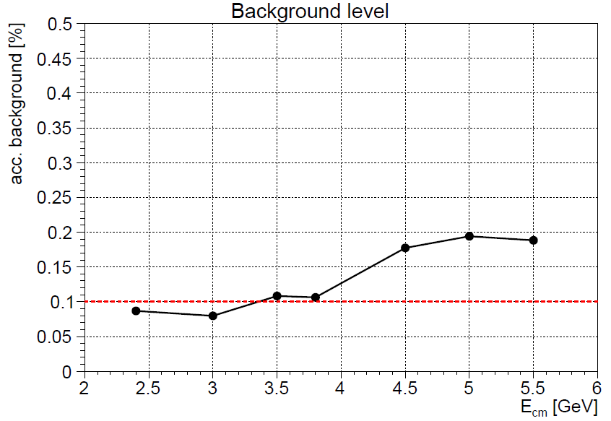
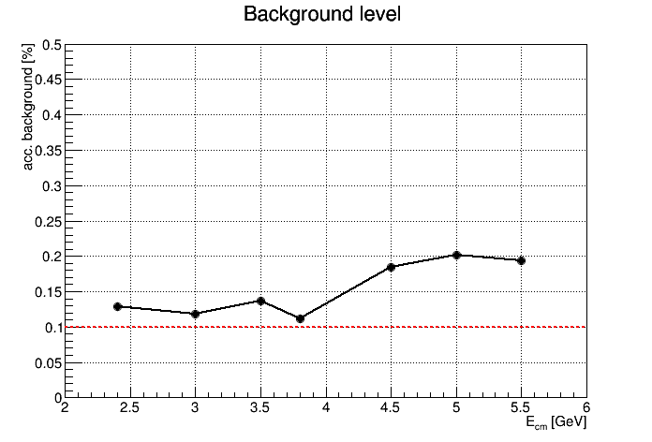
Total Background Level vs. E_{cm} (Fast & Full)
Fast MC
As expected:
4x more trigger lines
2x harder suppr./TL
→ 2x total background lvl
Full MC

Slide 13
Total Efficiencies & Bgk Levels @ 2.4 GeV (Fast MC)
ε_{tot}
ε_{X}
e⁺e⁻
μ⁺μ⁻
γπ⁰
γγ
Efficiencies
for different
data modes
Λ Σ φ
Acceptance
of different
trigger lines
on DPM data

Slide 14
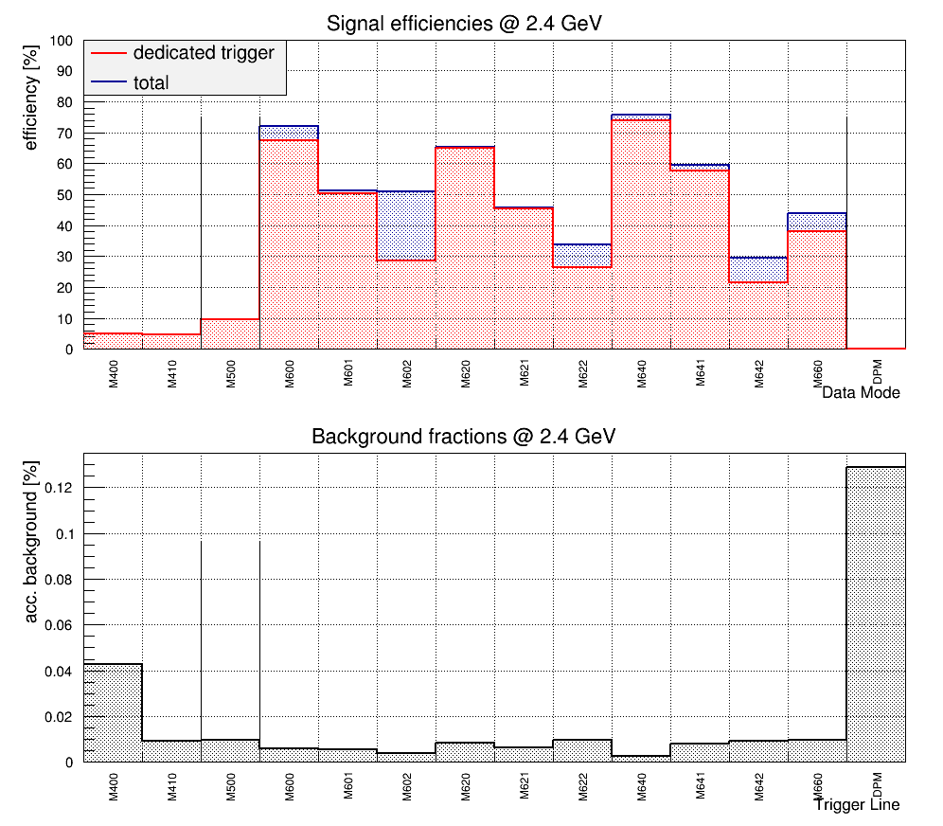
Total Efficiencies & Bgk Levels @ 2.4 GeV (Full MC)
ε_{tot}
ε_{X}
e⁺e⁻
μ⁺μ⁻
γπ⁰
γγ
Efficiencies
for different
data modes
Λ Σ φ
Acceptance
of different
trigger lines
on DPM data

Slide 15
Total Efficiencies & Bgk Levels @ 5.5 GeV (Fast MC)
ε_{tot}
cc
Bary.
E.M.
ε_{X}
φ
D⁰
D*⁰
D⁺
D*⁺
D_{s}^{(*)+}
Efficiencies
for different
data modes
For D modes
cross tagging
is strong effect
Acceptance
of different
trigger lines
on DPM data

Slide 16
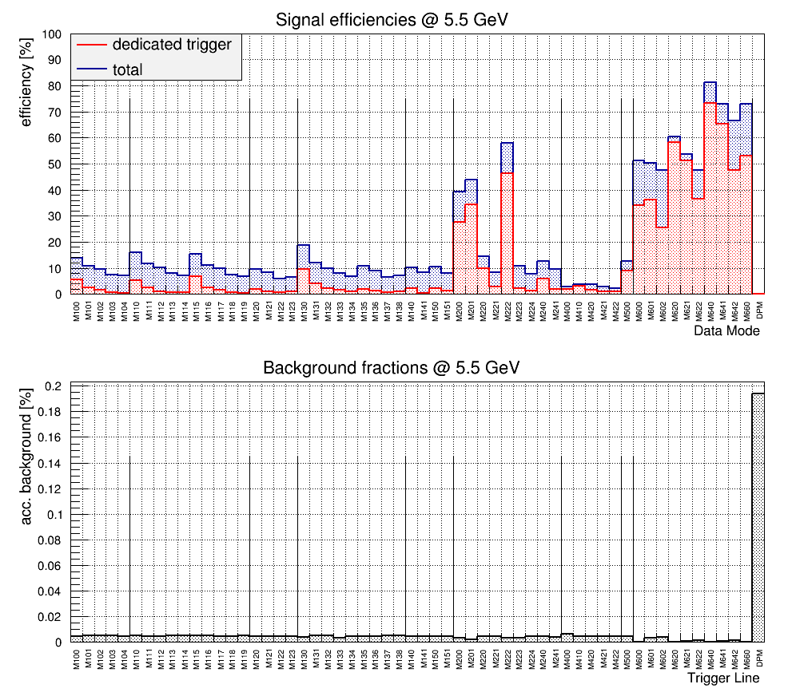
Total Efficiencies & Bgk Levels @ 5.5 GeV (Full MC)
ε_{tot}
cc
Bary.
E.M.
ε_{X}
φ
D⁰
D*⁰
D⁺
D*⁺
D_{s}^{(*)+}
Efficiencies
for different
data modes
Full Sim looks
much worse
Acceptance
of different
trigger lines
on DPM data

Slide 17
Total Signal Efficiencies (ε_{tot}) vs. E_{cm} (Fast MC)
D⁰
D*⁰
D⁺
D*⁺
D_{s}^{(*)+}
cc
Bary./φ
E.M.
(Each point → selection optimization for a TL @ energy, N=247 in total)

Slide 18
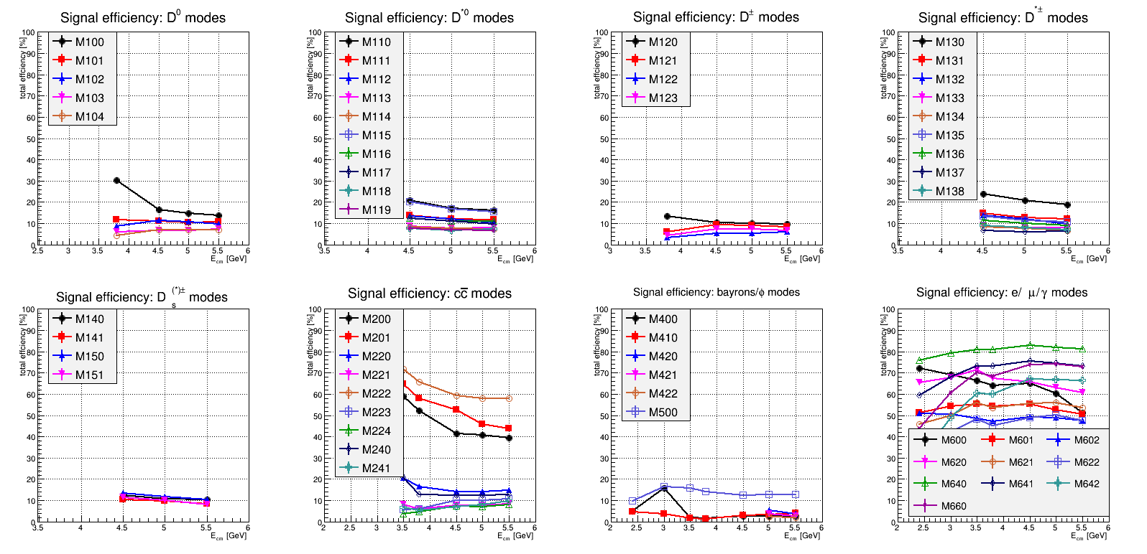
Total Signal Efficiencies (ε_{tot}) vs. E_{cm} (Full MC)
D⁰
D*⁰
D⁺
D*⁺
D_{s}^{(*)+}
cc
Bary./φ
E.M.
(Each point → selection optimization for a TL @ energy, N=247 in total)

Slide 19
Prerequisites for "reliable" prediction
# | Subject | Idealized | Realistic | Requires
1 | Simulation detail | Fast Sim | Full Sim
2 | Simulation stream | event based | event building (timebased)
3 | Reco quality | offline | online | 8
4 | Selection observables | unlimited | available online | 2, 3, 8
5 | Trigger signatures | ad-hoc | requested/agreed on
6 | Reliability of bkg shape | single generator | various generators
7 | Pre-reco BG veto | not needed | needed? (i.e. online reco impossible for all events) | 2, 3, 8
8 | Implementation | standard PC | dedicated hardware
Available
Partly available
Not available
Performance expected to drop even more with more realistic simulation.

Slide 20
Computing Effort for Scenario Analysis
E_{cm} [GeV] | 2.4 | 3.0 | 3.5 | 3.8 | 4.5 | 5.0 | 5.5 | Sum
Data modes | 26 | 45 | 85 | 118 | 550 | 741 | 792 | 2357
Events [M]* | 2.25 | 3.20 | 5.20 | 6.85 | 28.5 | 38.0 | 40.6 | 124.5
Optimisations | 13 | 13 | 22 | 31 | 54 | 57 | 57 | 247
*per E_{cm}: 1M bkg events + N x 50k events/signal mode
Full Simulation
300,000 jobs on Prometheus@GSI (1000 events/job)
1 week for simulation (2000 cores in parallel)
ca. 20 TB of data constisting of
Simulation data (8.5 TB)
SoftTrigger specific output (11.5 TB)
247 automated optimisations on n-tuples & re-application
10 days additional run time

Slide 21
Plans
Impact on signal phase space distributions (e.g. Dalitz plots)
Further test of robustness of efficiencies/bkg suppression
Investigate interpolation of selection algorithms w.r.t. E_{cm}
Systematic study of TMVA application
Choice of variables, TMVA types, parameter settings
When according ingredients available
Impact of realistic event building & event mixing
Impact of online reco quality
Investigate pre-reco background rejection
Investigate performance issues (e.g. CPU demand)
Extend for: hypernuclei, hadrons in matter

Slide 22
Implementation Online Hardware
What could already be implemented on online hardware:
Concrete info about variables can be found in report: https://panda.gsi.de/system/files/user_uploads/k.goetzen/TN-SOF-2014-001.pdf
→ Let us know if you need further info/support!
Item | Requirement
Online reco tracks & neutrals | realistic digi stream
Combinatorics | tracks & neutral candidates
Candidate variables (e.g. m, p, ...) | tracks & neutral candidates
Event variables (e.g. p_{max}, shapes, ...) | event candidates
Configurable selection scheme with variable handling | event candidates

Slide 23
Conclusion
Studies of extended triggering scheme
Developed tools for efficient scenario analysis
Results of Fast and Full MC differ significantly
Background level < 0.2% over full energy range
Fast MC: Typically ε_{sig} > 20%, up to 50% ... 90%
Full MC: Typically ε_{sig} ≈ 10% (better for J/ψ and E.M.)
Reliable predictions depend on many more prerequisites
Performance will probably drop even more
Do we need to modify the concept?
Suppression factor <1000
Selection of fewer dedicated trigger lines for certain runs
...

Slide 24
BACKUP

Slide 25
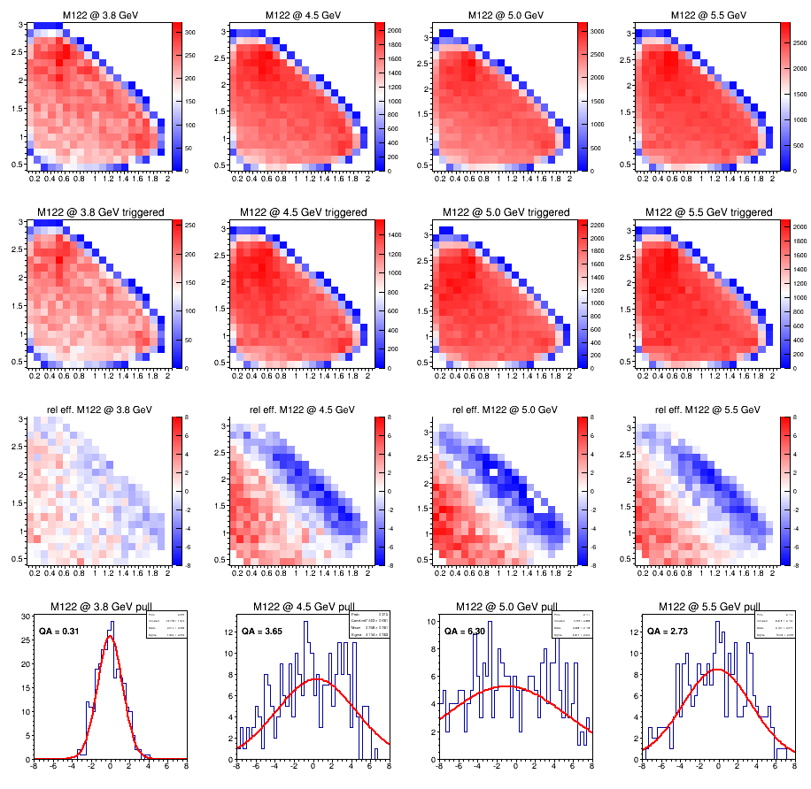
Idea for Phasespace QA (Fast MC)
E.g. M122:
D⁺ → K_{S}⁰ π⁺ π⁰
E_{cm} = 3.8
4.5
5.0
5.5 GeV
no trigger
trigger
8
(ε – ε_{avg})
Δε
#sigmas
deviation
from avg
-8

Slide 26
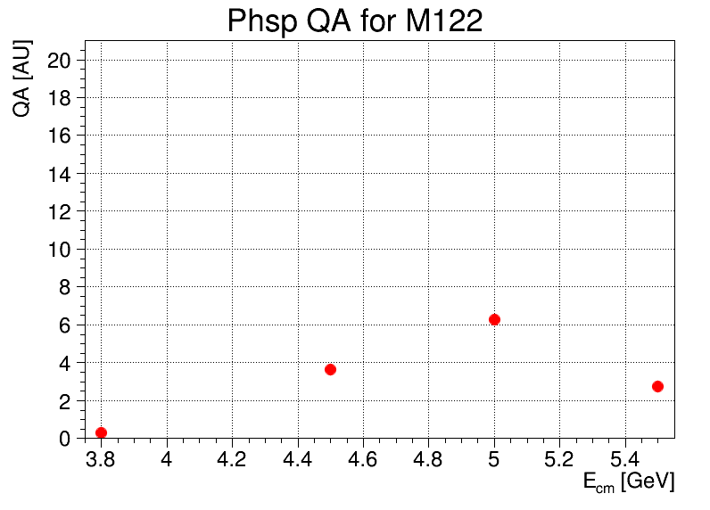
Idea for Phasespace QA (Fast MC)
E_{cm} = 3.8
4.5
5.0
5.5 GeV
QA = 0.31
QA = 3.65
QA = 6.30
QA = 2.73
(ε – ε_{avg})
Δε
QA = |σ_{fit} – 1|
+ μ_{fit}
+ |χ²/N_{df} – 1|
+ |1 – f_{coverage}|
acceptance limit
could be defined

Slide 27
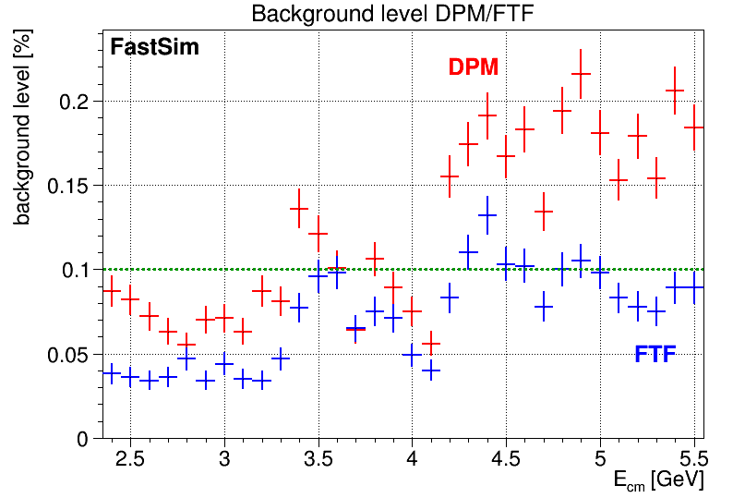
Robustness of Background Level (Fast MC)
Training with DPM → apply to events from FTF generator
training
energies

Slide 28
Why a Software Trigger at all?
Low signal cross sections σ_{signal} ≈ pb ... nb scale → Need high luminosity to achieve enough signal statistics
High lumi L = 2·10³² cm⁻²s⁻¹ + large σ_{tot} = 50 ... 100 mb → Reaction rate up to 10 ... 20 MHz → Signal fraction ≤ O(10⁻⁴)
Data rate with 10 kB/event: 200 GB/s
Data amount with 50% duty cycle: 3000 PB/year → Completely unaffordable to store and keep all! → Required reduction factor ≈ 1/1000
Signal and background events look very similar Sophisticated event filter on high level information needed!

Slide 29
Event Based Efficiency
T_{X}
T_{Y}
cross tagging
Events with X: 1, 2, 3
Background: 4
True Cand:
Rand. Cand:
Accept region:
tag: 1,2
tag: 3,4
V_{X}
V_{Y}
Different cases for positive tag on signal/background
Trigger T_{X} tags due to correctly reconstructed candidate X
T_{X} tags due to random cand. from event containing signal X
T_{Y} tags due to random cand. from event containing signal X
T_{i} tags due to random cand. from background
ε_{X}
ε_{tot}

Slide 30
Recoils X under study
10 different recoils under consideration
Not necessarily all recoils are accessible at the same time for a certain E_{cm}
Data sets of one signal mode with different recoils are merged → Here: Efficiencies are averaged over recoils (→ possible bias)
Number | Mode
00 | no recoil
01 | γ
02 | π⁰
03 | η
04 | π⁰ π⁰
05 | π⁺ π⁻
06 | K⁺ K⁻
07 | K⁰ K⁰
08 | ηη
09 | π⁺ π⁻ π⁰

Slide 31
Tagging @ 2.4 GeV (Fast MC)
ε_{X}
ε_{tot}
Bary.
efficiency
φ
E.M.
DPM

Slide 32
Tagging @ 5.5 GeV (Fast MC)
ε_{X}
ε_{tot}
efficiency
D⁰
D*⁰
D⁺
D*⁺
D_{s}^{(*)+}
cc
Bary.
φ
E.M.
DPM

Slide 33
Trigger Line Decay Modes
100 : D0 -> K- pi+ cc
101 : D0 -> K- pi+ pi0 cc
102 : D0 -> K- pi+ pi+ pi- cc
103 : D0 -> K_S0 pi+ pi- cc
104 : D0 -> K_S0 pi+ pi- pi0 cc
110 : D*0 -> D0 [K- pi+] pi0 cc
111 : D*0 -> D0 [K- pi+ pi0] pi0 cc
112 : D*0 -> D0 [K- pi+ pi+ pi-] pi0 cc
113 : D*0 -> D0 [K_S0 pi+ pi-] pi0 cc
114 : D*0 -> D0 [K_S0 pi+ pi- pi0] pi0 cc
115 : D*0 -> D0 [K- pi+] gam cc
116 : D*0 -> D0 [K- pi+ pi0] gam cc
117 : D*0 -> D0 [K- pi+ pi+ pi-] gam cc
118 : D*0 -> D0 [K_S0 pi+ pi-] gam cc
119 : D*0 -> D0 [K_S0 pi+ pi- pi0] gam cc
120 : D+ -> K- pi+ pi+ cc
121 : D+ -> K- pi+ pi+ pi0 cc
122 : D+ -> K_S0 pi+ pi0 cc
123 : D+ -> K_S0 pi+ pi+ pi- cc
130 : D*+ -> D0 [K- pi+] pi+ cc
131 : D*+ -> D0 [K- pi+ pi0] pi+ cc
132 : D*+ -> D0 [K- pi+ pi+ pi-] pi+ cc
133 : D*+ -> D0 [K_S0 pi+ pi-] pi+ cc
134 : D*+ -> D0 [K_S0 pi+ pi- pi0] pi+ cc
135 : D*+ -> D+ [K- pi+ pi+] pi0 cc
136 : D*+ -> D+ [K- pi+ pi+ pi0] pi0 cc
137 : D*+ -> D+ [K_S0 pi+ pi0] pi0 cc
138 : D*+ -> D+ [K_S0 pi+ pi+ pi-] pi0 cc
140 : D_s+ -> K+ K- pi+ cc
141 : D_s+ -> K+ K- pi+ pi0 cc
150 : D*_s+ -> D_s+ [K+ K- pi+] gam cc
151 : D*_s+ -> D_s+ [K+ K- pi+ pi0] gam cc
200 : J/psi -> e+ e-
201 : J/psi -> mu+ mu-
220 : eta_c -> K+ K- pi0
221 : eta_c -> K_S0 K- pi+ cc
222 : eta_c -> gam gam
223 : eta_c -> K+ K- pi+ pi- pi0
224 : eta_c -> K_S0 K- pi+ pi- pi+ cc
240 : chi_0c -> pi+ pi- K+ K-
241 : chi_0c -> K+ pi- K_S0 pi0 cc
400 : Lambda0 -> proton pi- cc
410 : Sigma+ -> proton pi0 cc
420 : Lambda_c+ -> proton K- pi+ cc
421 : Lambda_c+ -> proton K- pi+ pi0 cc
422 : Lambda_c+ -> proton K_S0 pi0 cc
500 : phi -> K+ K-
600 : pbp0 -> e+ e-
601 : pbp0 -> e+ e- gam
602 : pbp0 -> e+ e- pi0
620 : pbp0 -> mu+ mu-
621 : pbp0 -> mu+ mu- gam
622 : pbp0 -> mu+ mu- pi0
640 : pbp0 -> gam gam
641 : pbp0 -> gam gam gam
642 : pbp0 -> gam gam pi0
660 : pbp0 -> pi0 gam

Slide 34
Partial tagging w/o reco + event building?
Tag part of the signal channels before reco/event building?
Events:
Bkg
Sig 1
Sig 2
Sig 3, 4, ...

Slide 35
Partial tagging w/o reco + event building?
Tag part of the signal channels before reco/event building?
Problems
Even with pre reco tags for Sig 1 (≈0.01%) and Sig 2 (≈0.01%) → Full reco needed for 99.98% of events for Sig 3, 4, ...
Events:
Bkg
Sig 1
Sig 2
Sig 3, 4, ...

Slide 36
Partial tagging w/o reco + event building?
Tag part of the signal channels before reco/event building?
Problems
Even with pre reco tags for Sig 1 (≈0.01%) and Sig 2 (≈0.01%) → Full reco needed for 99.98% of events for Sig 3,...
Without event building: What data packages to be stored?
Pre-reco tagging only useful as common bkg veto for all signals
Events:
Bkg
Sig 1
Sig 2
Sig 3,...

