Slide 1
FPGA Helix Tracking Algorithm for PANDA
Yutie Liang, Martin Galuska, Thomas Geßler, Wolfgang Kühn,
Jens Sören Lange, David Münchow, Björn Spruck, Milan Wagner
II. Physikalisches Institut, JUSTUS-LIEBIG-UNIVERSITÄT GIESSEN
PANDA Workshop on Data Acquisition, Trigger and Frontend Electronics
9-10 Apr. 2015

Slide 2
Outline
Introduction
Tracking algorithm
T0 extraction from tracking
Summary and outlook

Slide 3
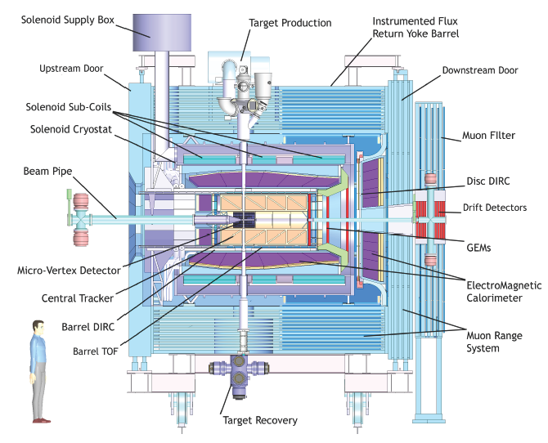
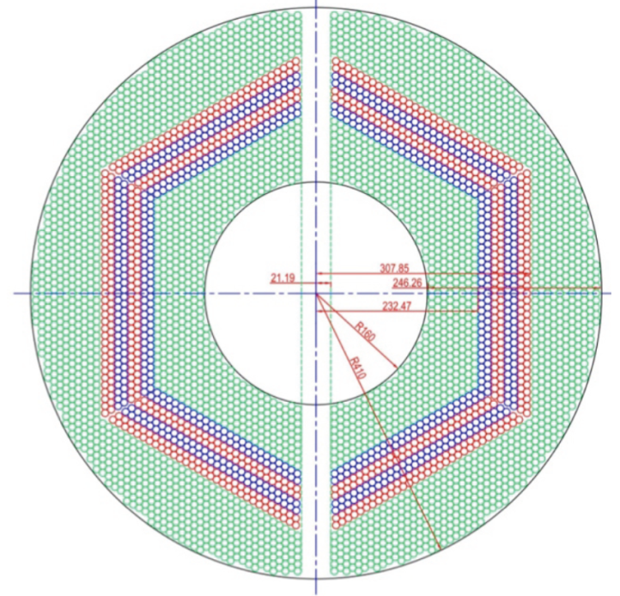
Straw Tube Tracker (STT)
4636 Straw tubes
23-27 planar layers
15-19 axial layers (green) in beam direction
4 stereo double-layers for 3D reconstruction,
with ±2.89 skew angle (blue/red)
From STT : Wire position + drift time

Slide 4
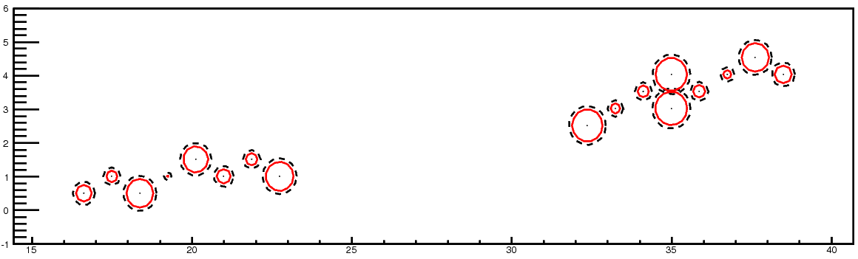
Event Structure -- pile-up
20 MHz
2000 ns revolution time
200 ns gap
T_{Mean} between 2 events: 50 ns
Drift time: ~200 ns
Event pile-up
Wrong T0 → Wrong drift circle → bad track quality

Slide 5
Tracking Algorithm -- Road Finding
Layer_ID
Hit
Hit
Hit
Hit
Hit
Hit
Hit
Hit
Hit
Hit
Hit
Tube_ID
Hit: Seg_ID (3 bits) + LayerID (4 bits) + Tube_ID (6 bits) + Arrival time
1: Start from inner layer
2: Attach neighbour hit to tracklet layer by layer
Boundary between two segments.
Number of neighbor:
4 in axial layer; 6 in stereo layer

Slide 6
Tracking Algorithm -- helix parameters calculation
Known : x_{i} , y_{i} , d_{i}
Question: To determine a circle,
x² + y² + ax + by + c = 0
Method: Minimize the equation
E² = ∑(x_{i}² + y_{i}² + a x_{i}+ b y_{i} + c)² (1/d_{i})²
y
x_{c}, y_{c}, R
x
S_{x} = ∑x_{i} …
S_{xx} = ∑x_{i}x_{i} …
S_{xxx} = ∑x_{i}x_{i}x_{i} …
1) Circle para.
2) Track quality.

Slide 7
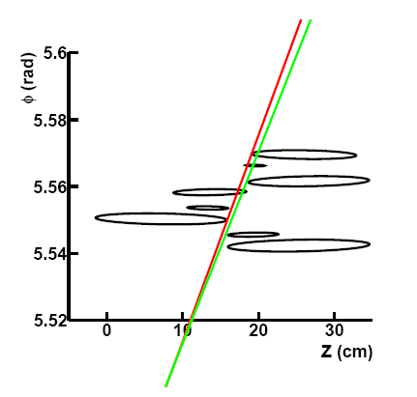
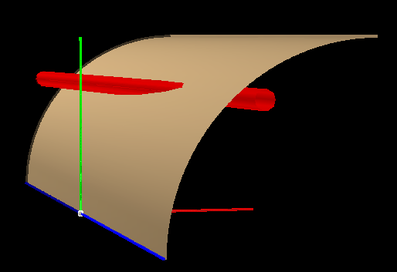
Pz reconstruction
1: The radius, the position of the helix center in the XY plane are determined.
2: Φ = kZ + Φ₀
One cylinder the helix lies in.
Based on Pt determined before
y
Crossing points
(ellipse)
One straw tube
x
z
Track need to be tangent to the crossing ellipse.
Gianluigi Boca and Panda Collaboration, Panda STT TDR, 2012

Slide 8
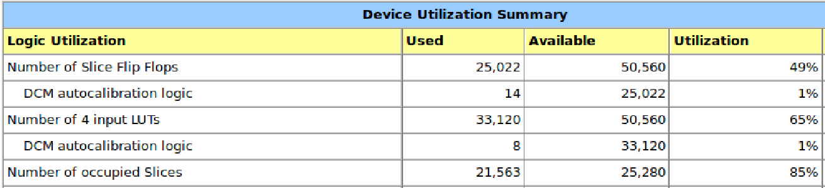
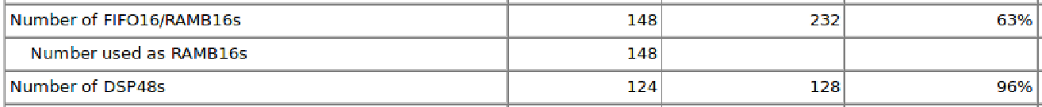
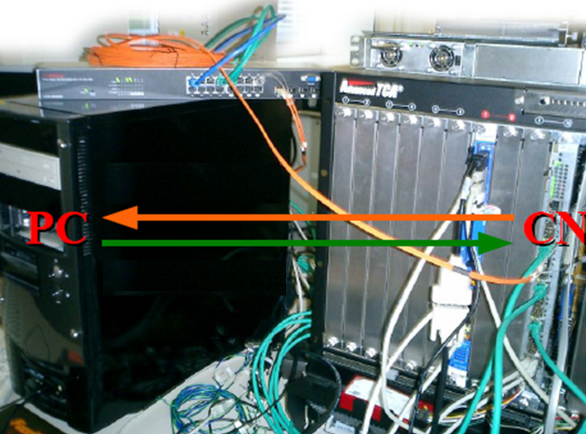
Performance at FPGA
σ_pt : ~ 3.2% σ_pz : ~ 4.2%
7 μs/event (6 tracks)
140 FPGA @ 20MHz

Slide 9
Tracking at FPGA
Data flow: Hit information at PC → FPGA, extract helix para. → PC
PC is used to draw hits and helix in the plot. The helix parameters come from FPGA.

Slide 10
Previous Tracking Strategy with experimental data
Hits are sorted according to their arrival time.
In case of T₀ provided:
T₀ as a start point → hits in 220 ns window → run tracking algorithm → assign track to right event
In case of T₀ not provided:
Do a time-consuming T₀ scan

Slide 11
T0 extraction from tracking

Slide 12
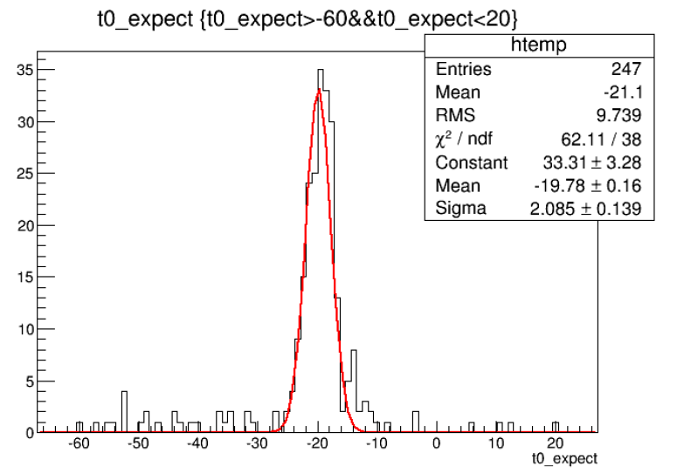
Method to Extract T₀ from tracking
T0 shift = Ʃdi /N / const (N: number of hits
di: signed distance of circle to track)
T0 shifted by:
-50 ns:
-20 ns:
10 ns:
20 ns:
Extracted T0:
-47.0±4.0 ns
-19.8±2.1 ns
9.4±2.5 ns
19.0±2.3 ns

Slide 13
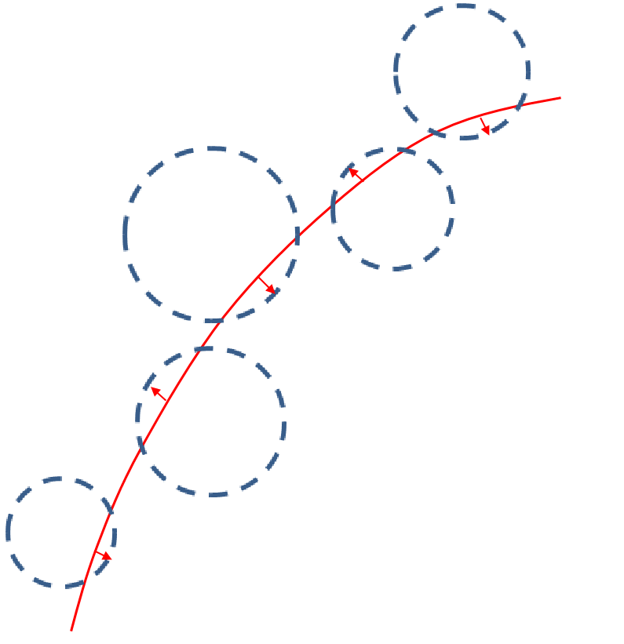
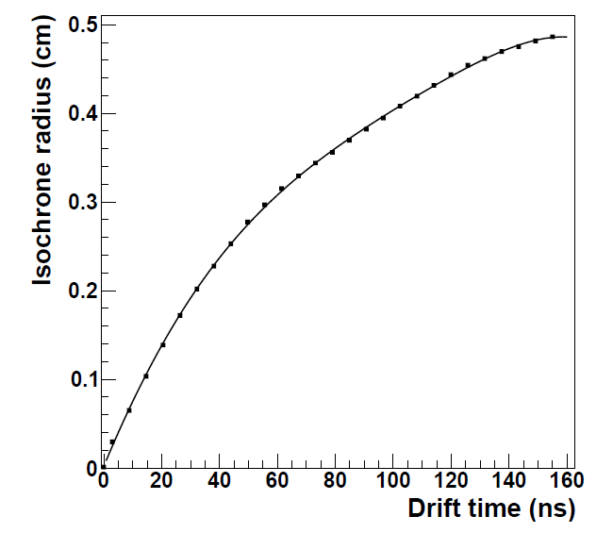
Method to Extract T₀ from tracking
T0 shift = Ʃdi /N / const (N: number of hits
di: signed distance of circle to track)
T0 shift = ƩTi /N

Slide 14
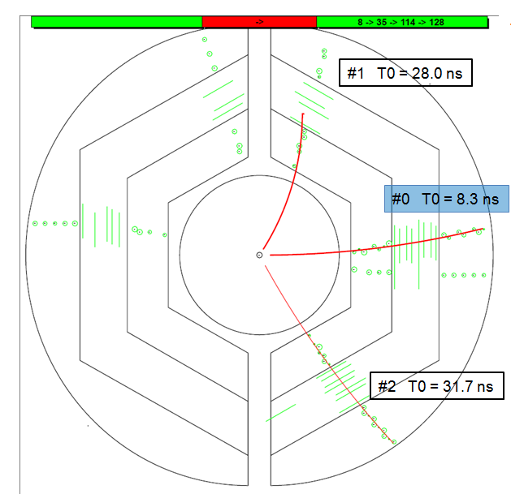
New Tracking Strategy in case of unknown T₀
1) Start from 0
2) hits in 220 ns window
3) run tracking algorithm
4) extract T₀ of next event
5) go back to 2)
Two time-based simulations:
1 GeV single muon
DPM

Slide 15
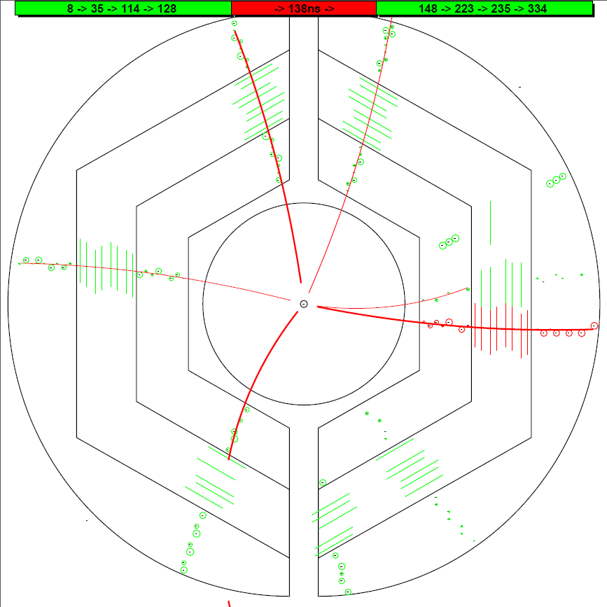
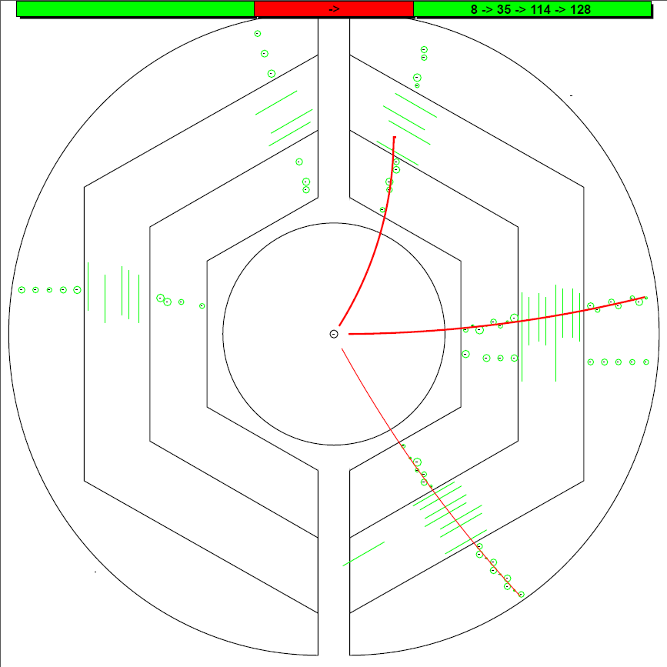
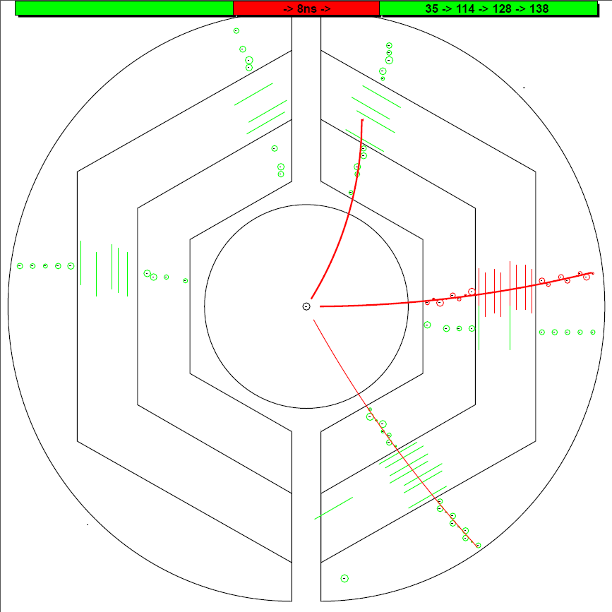
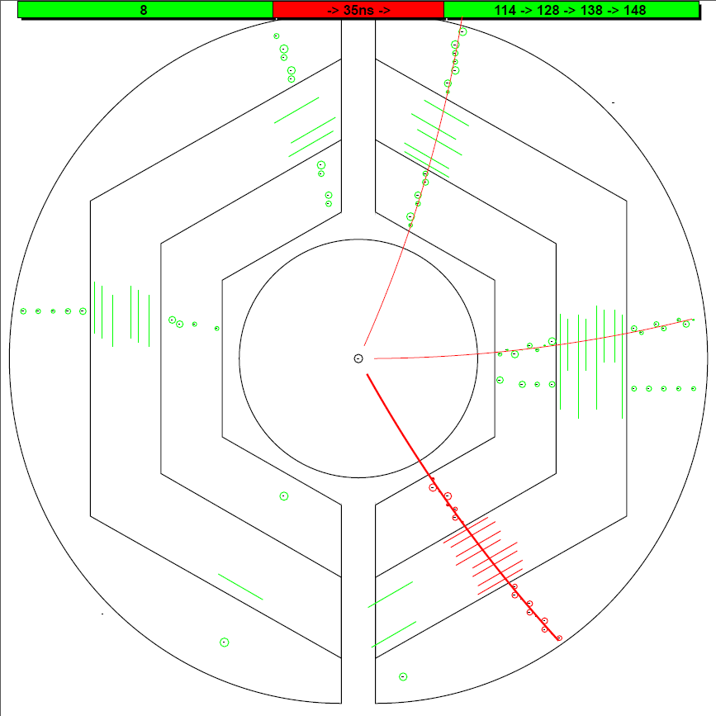
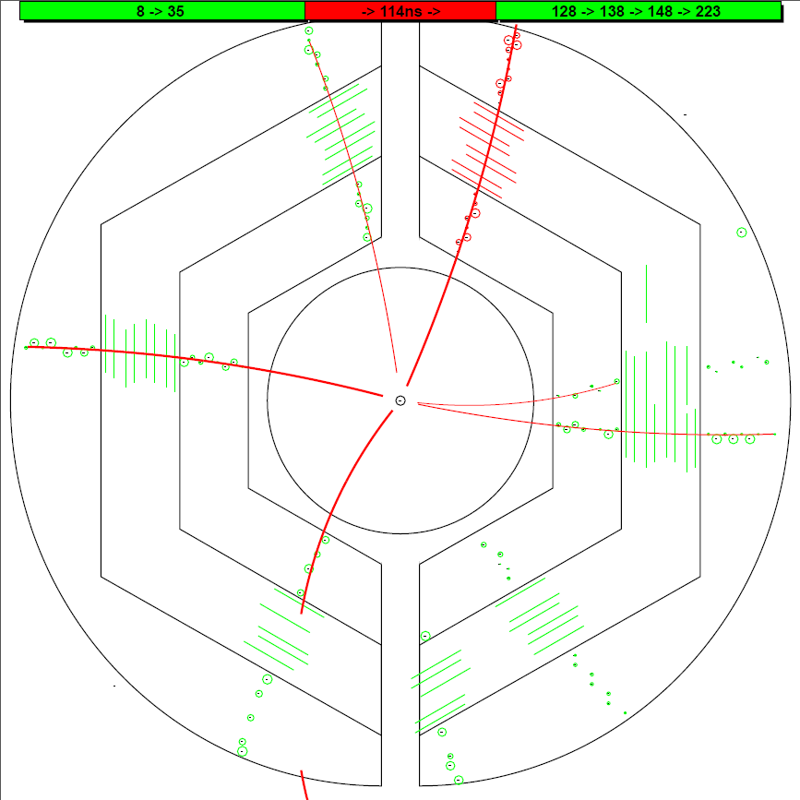
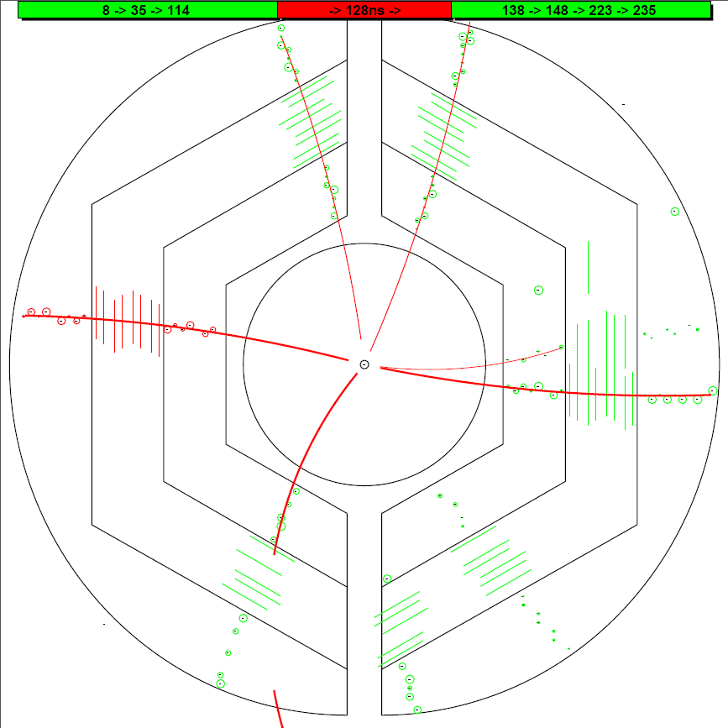
T0 (ns) : MC Input Iter_2
T0 (ns) : MC Input Iter_2
T0 (ns) : MC Input Iter_2
T0 (ns) : MC Input Iter_2
T0 (ns) : MC Input Iter_2
T0 (ns) : MC Input Iter_2
0.0
0.0
0.0
0.0
0.0
0.0
#1 T0 = 146.1 ns
#1 T0 = 147.4 ns
#1 T0 = 147.4 ns
#1 T0 = 28.0 ns
#1 T0 = 36.3 ns
#1 T0 = 112.4 ns
#1 T0 = 116.0 ns
#1 T0 = 116.6 ns
#1 T0 = 117.1 ns
8.4
8.4
8.4
8.4
8.4
8.4
8.3
8.3
8.3
8.3
8.3
8.3
8.5
8.5
8.5
8.5
8.5
34.6
34.6
34.6
34.6
34.6
35.9
35.9
35.9
35.9
35.9
35.9
35.9
35.9
35.9
35.9
#1 T0 = 128.0 ns
#1 T0 = 128.0 ns
#1 T0 = 128.1 ns
#0 T0 = 8.3 ns
#0 T0 = 8.5 ns
#0 T0 = 9.7 ns
#0 T0 = 65.7 ns
#0 T0 = 67.8 ns
#0 T0 = 97.0 ns
114.1
114.1
114.1
114.1
114.1
114.1
112.4
112.4
112.4
112.4
116.0
116.0
#1 T0 = 137.2 ns
116.0
#1 T0 = 138.4 ns
#1 T0 = 139.2 ns
128.0
128.0
128.0
128.0
128.2
128.0
128.2
128.2
128.2
128.2
#1 T0 = 127.2 ns
128.2
#1 T0 = 158.1 ns
#1 T0 = 167.0 ns
#2 T0 = 34.6 ns
#2 T0 = 35.9 ns
#2 T0 = 31.7 ns
138.4
139.0
138.4
139.2
139.0
139.0
139.0
139.0
139.0
148.3
147.4
148.3
148.3
148.3
148.3
148.3

Slide 16
Time-based simulation with DPM events

Slide 17
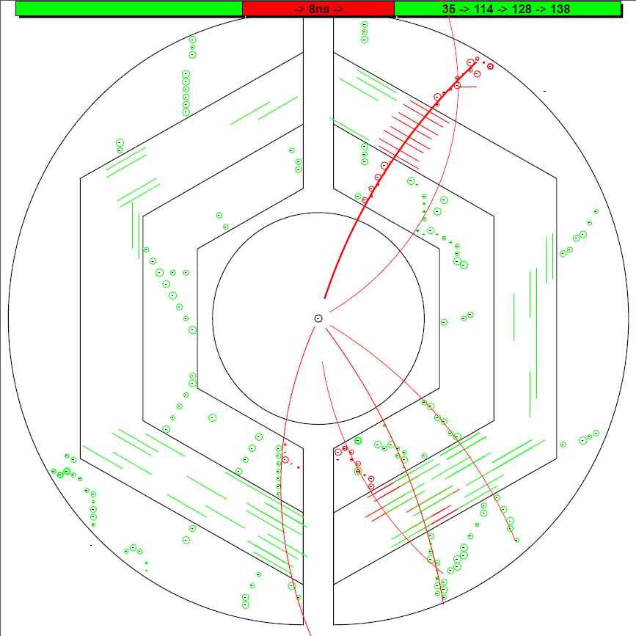
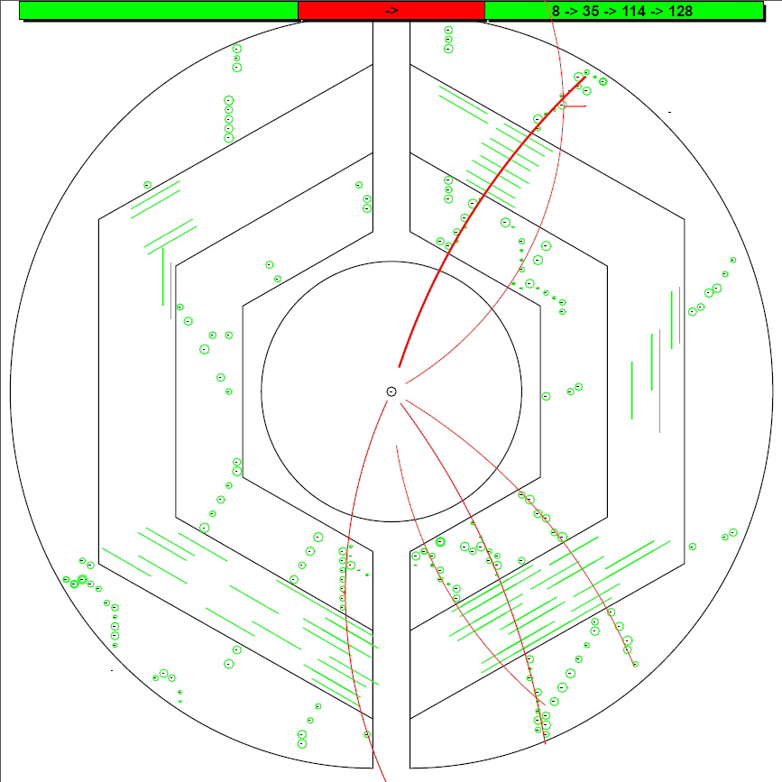
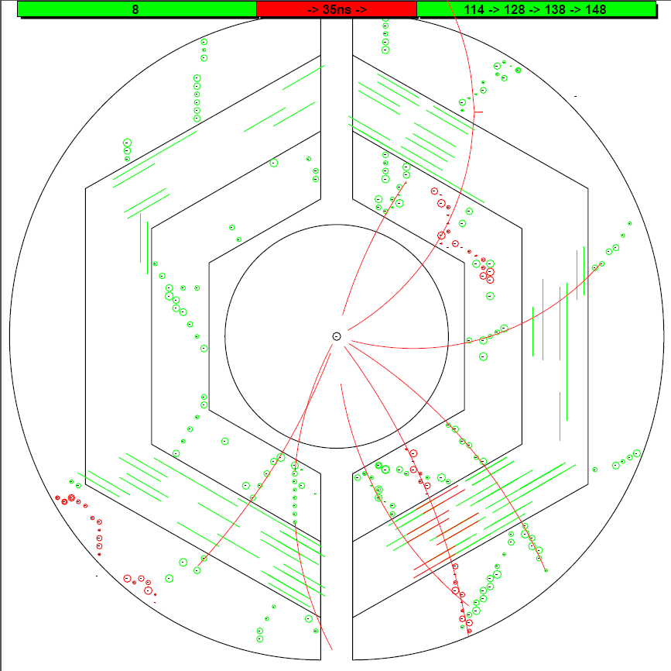
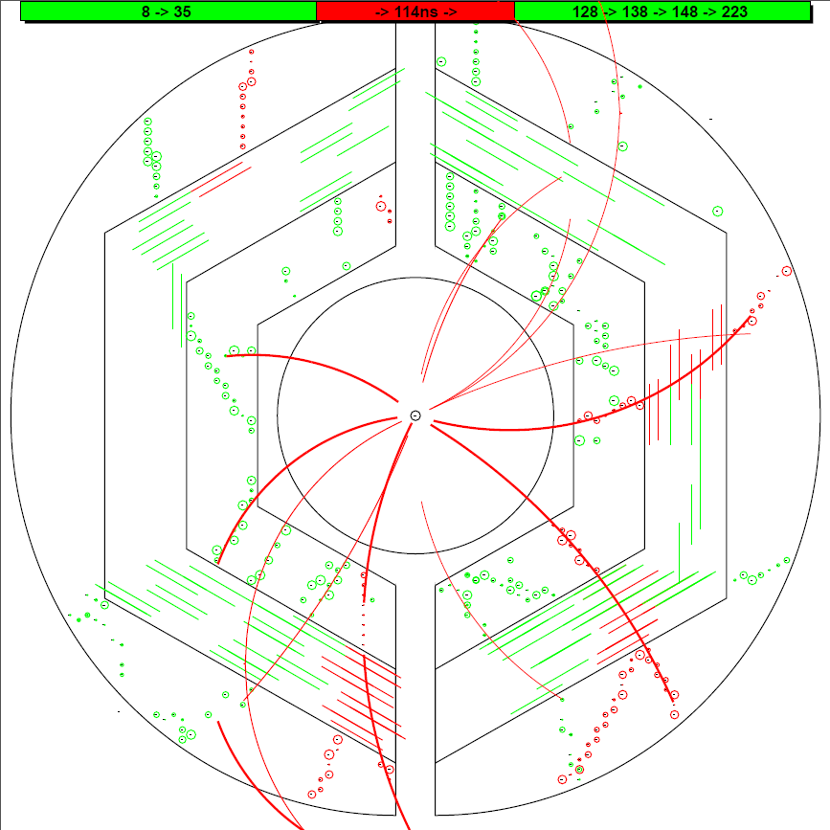
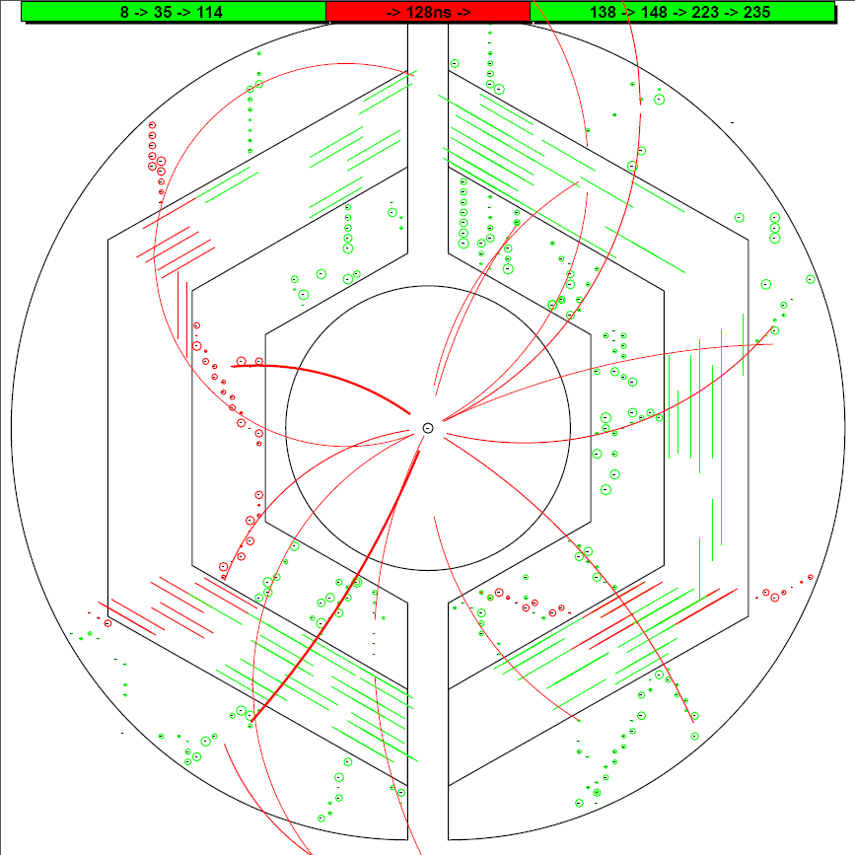
T0 (ns) : MC Input Iter_2
T0 (ns) : MC Input Iter_2
T0 (ns) : MC Input Iter_2
T0 (ns) : MC Input Iter_2
T0 (ns) : MC Input Iter_2
#1 T0 = 140.9 ns
0.0
0.0
0.0
0.0
0.0
8.4
8.4
8.4
8.4
8.4
9.0
9.0
9.0
9.0
9.0
9.4
9.4
9.4
9.4
#1 T0 = 9.4 ns
#0 T0 = 9.0 ns
37.2
37.2
37.2
37.2
38.2
38.2
35.9
38.2
35.9
35.9
35.9
35.9
#1 T0 = 115.3 ns
#1 T0 = 116.8 ns
114.1
114.1
114.1
114.1
114.1
114.5
114.5
114.5
116.6
115.3
#1 T0 = 98.3 ns
#1 T0 = 95.3 ns
#1 T0 = 114.5 ns
#1 T0 = 116.6 ns
128.2
128.2
128.2
128.2
128.2
140.9
139.0
140.9
141.1
139.0
139.0
139.0
139.0
148.3
150.9
148.3
148.3
148.3
148.3
#1 T0 = 128.0 ns
#1 T0 = 119.0 ns
#1 T0 = 35.7 ns
#0 T0 = 37.2 ns
#0 T0 = 38.2 ns
17

Slide 18
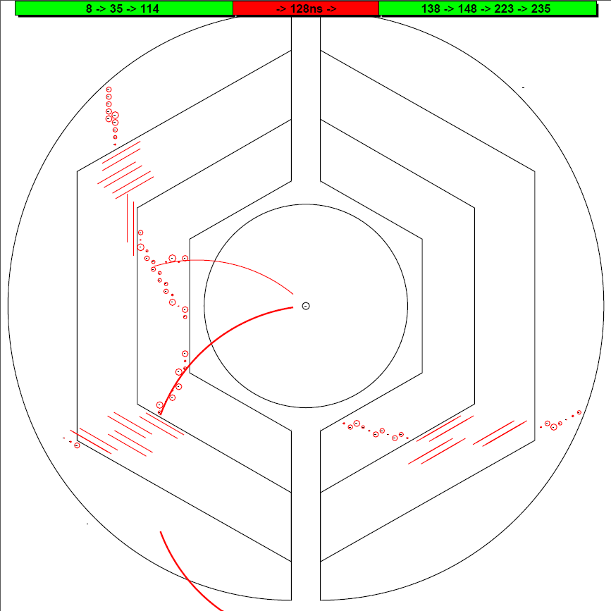
The Missing Event at Event-based simulation
Tracks in this event are not well reconstructed.
In this case, it is hard to extract a T₀.
18

Slide 19
New Tracking Strategy with experimental data
Hits are sorted according to their arrival time.
In case of T₀ provided:
T₀ as a start point → hits in 220 ns window → run tracking algorithm → assign track to right event
In case of T₀ not provided:
Dynamic T₀ extraction (fast)

Slide 20
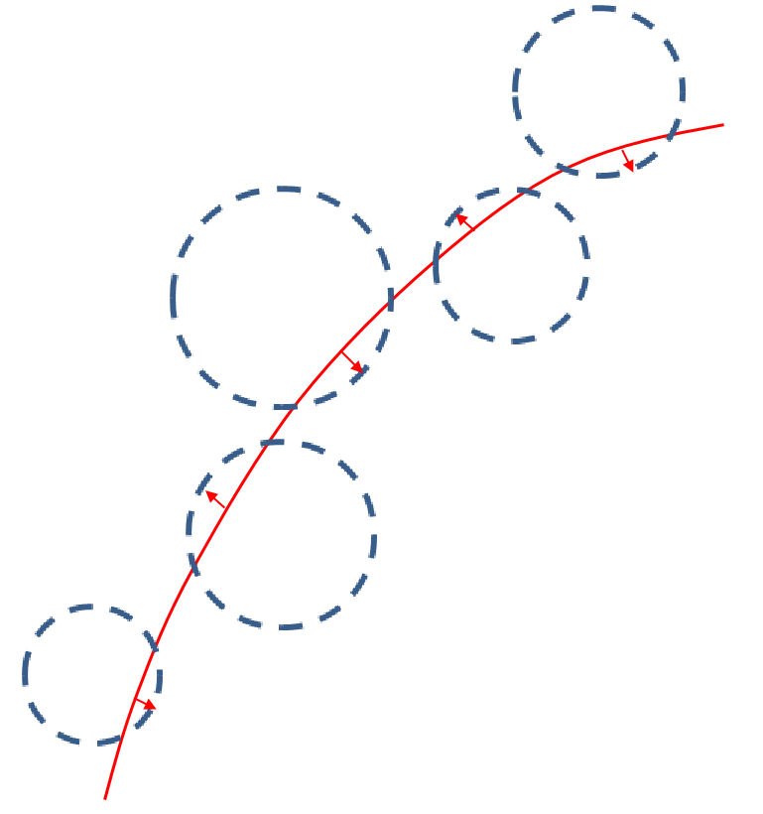
Summary and Outlook
Extract T₀ using the distance of drift circles to track.
Simultaneous tracking and Dynamic T₀ extraction: fast
Secondary vertex does not work yet.

Slide 21
Thank you

Slide 23
Performance at FPGA
For one event with 100 hits (6 tracks): 7 μs
Hit reading
Road finder
Pt extraction
Pz extraction
(100 cc)
(50 cc X 6)
(120 cc X 2 X 6)
(60 cc X 2 X 6)

Slide 24
Tracking at FPGA -- at low event rate
Data flow: Hit information at PC → FPGA, extract helix para. → PC
PC is used to draw hits and helix in the plot. The helix parameters come from FPGA.

Slide 25
Tracking at FPGA -- 20 MHz
Data flow: Hit information at PC → FPGA, extract helix para. → PC
PC is used to draw hits and helix in the plot. The helix parameters come from FPGA.

Slide 26
 | C++ | VHDL
P_{t} 1st iteration | √ | √
P_{t} 2nd iteration | √ | √
χ² calculation | √ | √
P_{z} 1st iteration | √ | √
P_{z} 2nd iteration | √ | √
σ_pt : ~ 3.2% σ_pz : ~ 4.2%
7 μs/event (6 tracks) , 140 FPGA @ 20MHz

Slide 27
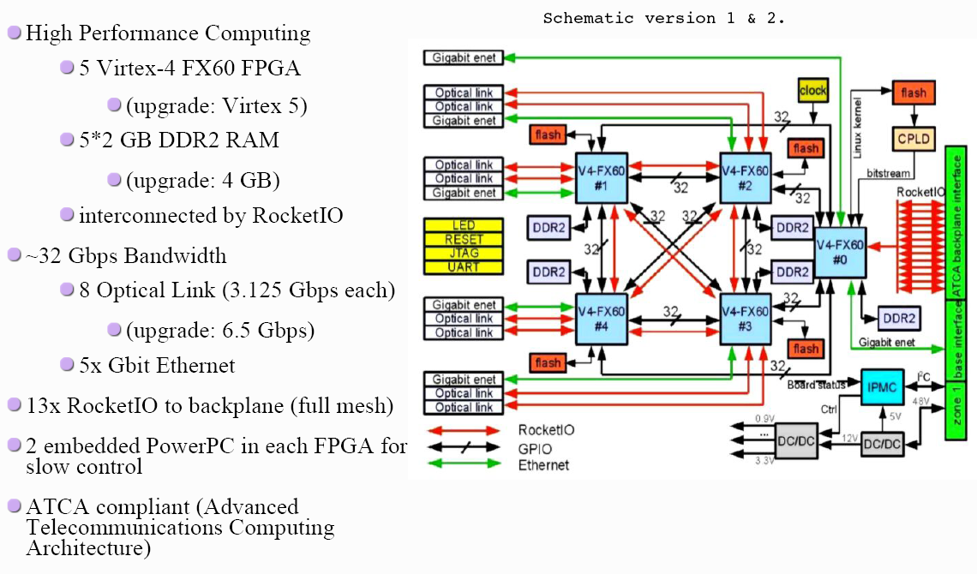
The Compute Node (CN)

Slide 28

Hardware Description Language
VHDL, Verilog, SystemC
VHDL: Very-high-speed integrated circuits Hardware Description Language.
It’s a dataflow language, unlike procedural computing languages such as C++ which runs sequentially, one instruction at a time.
Signal A3_B1 …;
Signal A4_B2 …;
A3 <= A3_B1;
B1 <= A3_B1;
A4 <= A4_B2;
B2 <= A4_B2;
A1
A
A3
B1
B
B3
A2
A4
B2
B4

Slide 29
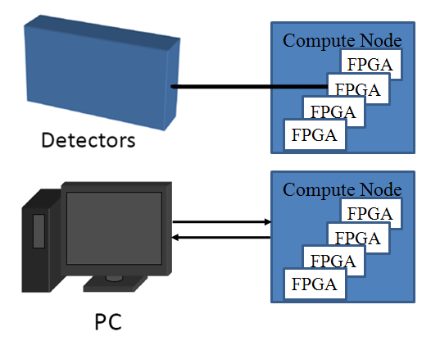
Setup and Test
PC as data source and receiver.
Ethernet.
Optical link (UDP by Grzegorz Korcyl )
(not integrated yet)
Ethernet via
Optical Link
FPGA
FIFO
Tracking algorithm
FIFO

Slide 30
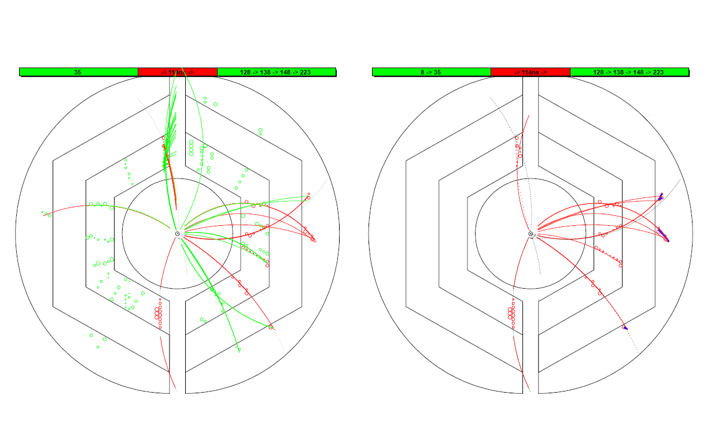
Assign a track to the correct event
T₀ information: current event(Red) or other events(Green)
Black dashed line: track by MC truth
Red line: recon. track
Blue: recon. using outer layers
drift circles belong to current event (Red) or other events (Green)
Event #2
Event #2

Slide 31
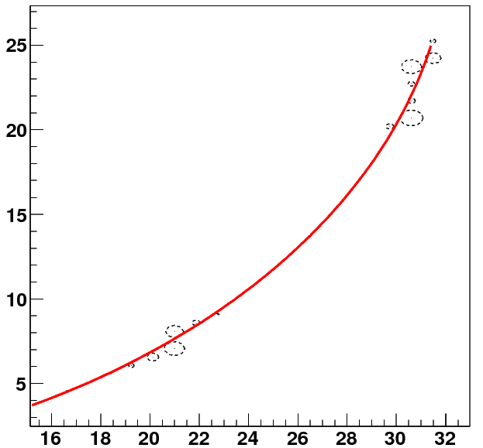
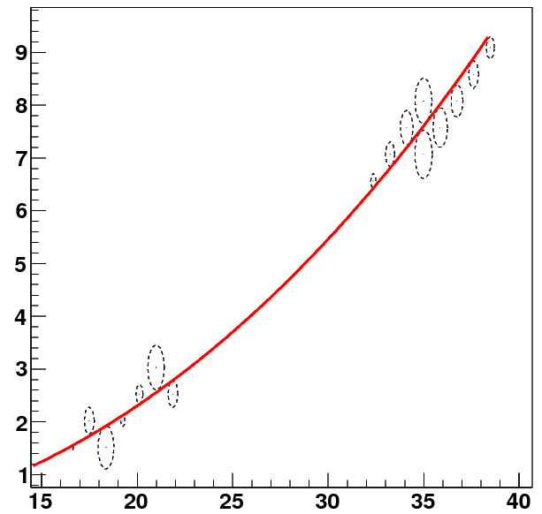
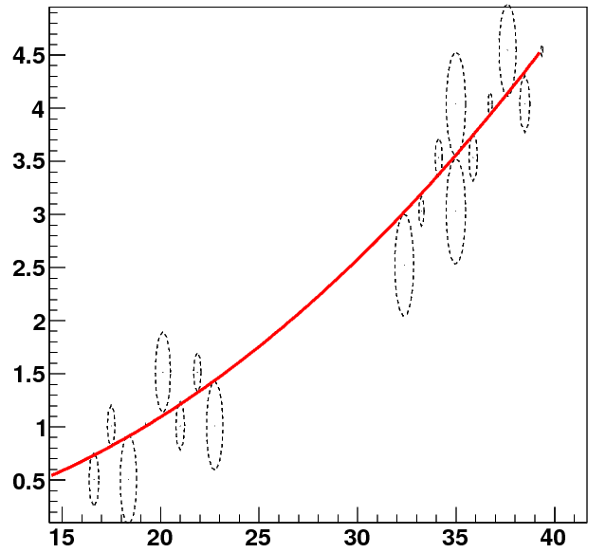
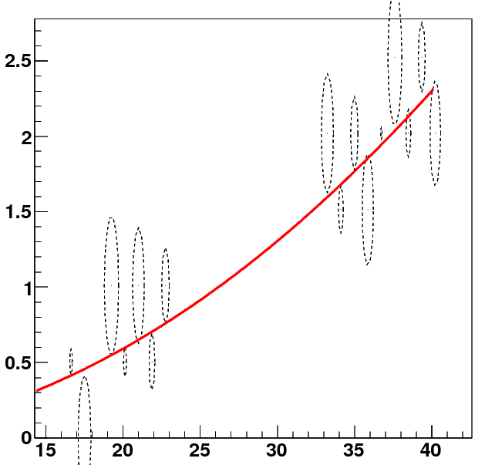
Performance study – single track
y(cm)
0.2GeV
y(cm)
0.5GeV
x(cm)
x(cm)
1GeV
2GeV
y(cm)
y(cm)
x(cm)
x(cm)

Slide 32
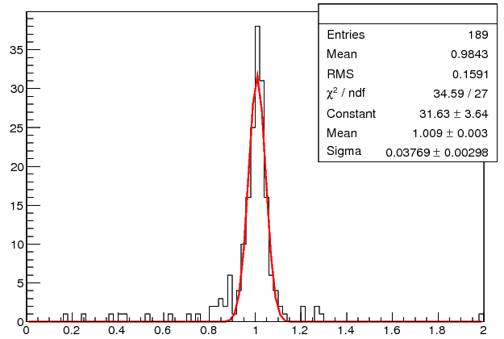
Pz reconstruction
Pt = 0.5 GeV/c
Pz(input)
0.25 GeV/c : 3.7 %
0.50 GeV/c : 4.0 %
1.00 GeV/c : 4.3 %
Pt = 1.0 GeV/c
Pz(input)
0.5 GeV/c : 3.1 %
1.0 GeV/c : 3.8 %
2.0 GeV/c : 4.2 %
Pt = 2.0 GeV/c
Pz(input)
1.0 GeV/c : 3.7 %
2.0 GeV/c : 4.8 %
4.0 GeV/c : 5.2 %

Slide 33
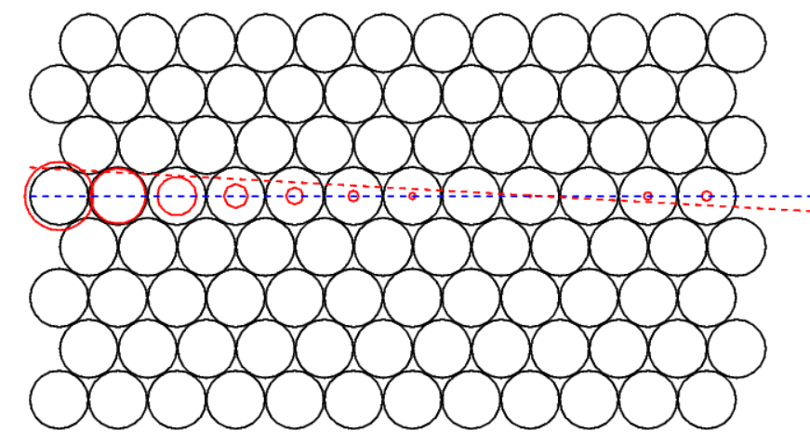
Event #2
Beam test data
Red Solid circle : drift circle
Blue dashed line : track from 1st iteration
Red dashed line : track from 2nd iteration

Slide 34
A better Method to Extract T₀

