Slide 1
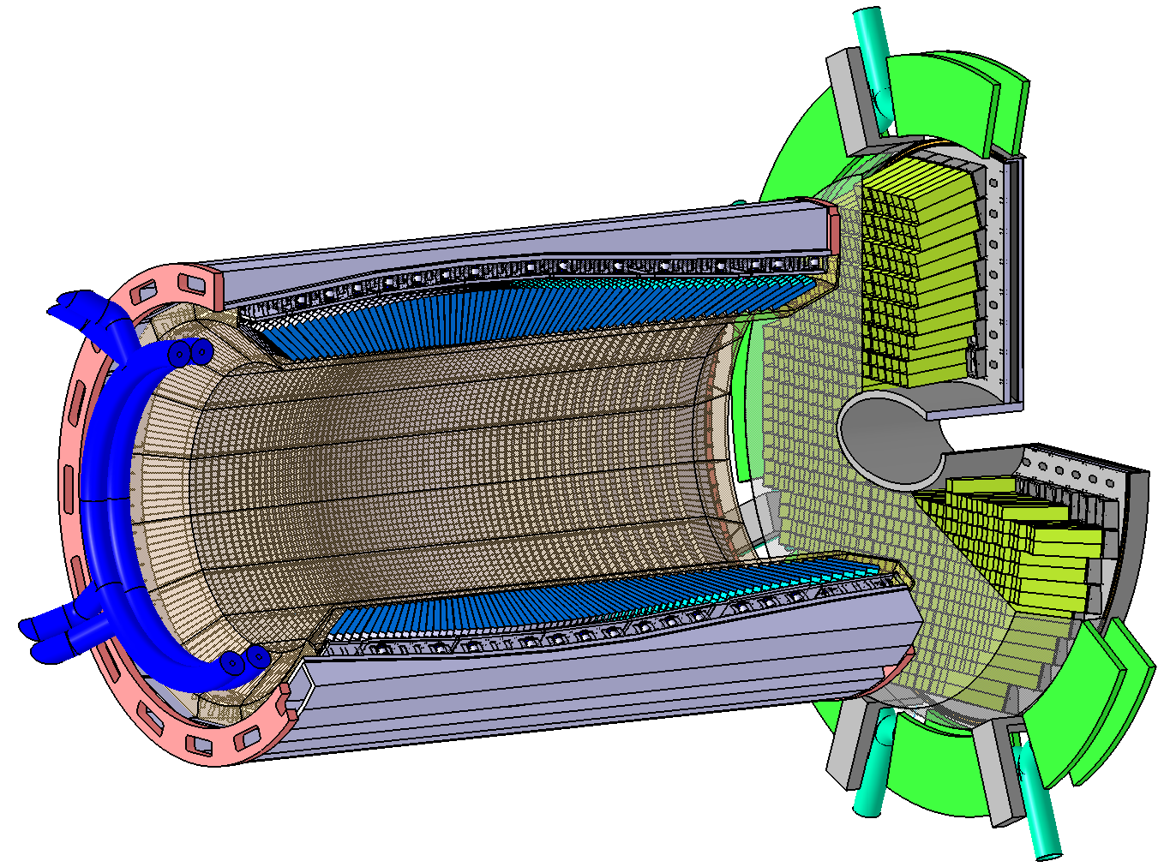
ADC for EMC
- PANDA EMC Readout System
3,600
14400
Preamplifier
Basel
Photosensor
VPTT
ADC
64-ch, 14-bit
80-MSPS
Compute Node
Data Concentrator
16-ch
Ca. 1,000
Compute Node
65
Compute Node
11,952
Photosensor
APD
47,808
Preamplifier
APFEL (GSI)
Pawel Marciniewski, PANDA DAQ Workshop, GSI 19.02.2015

Slide 2
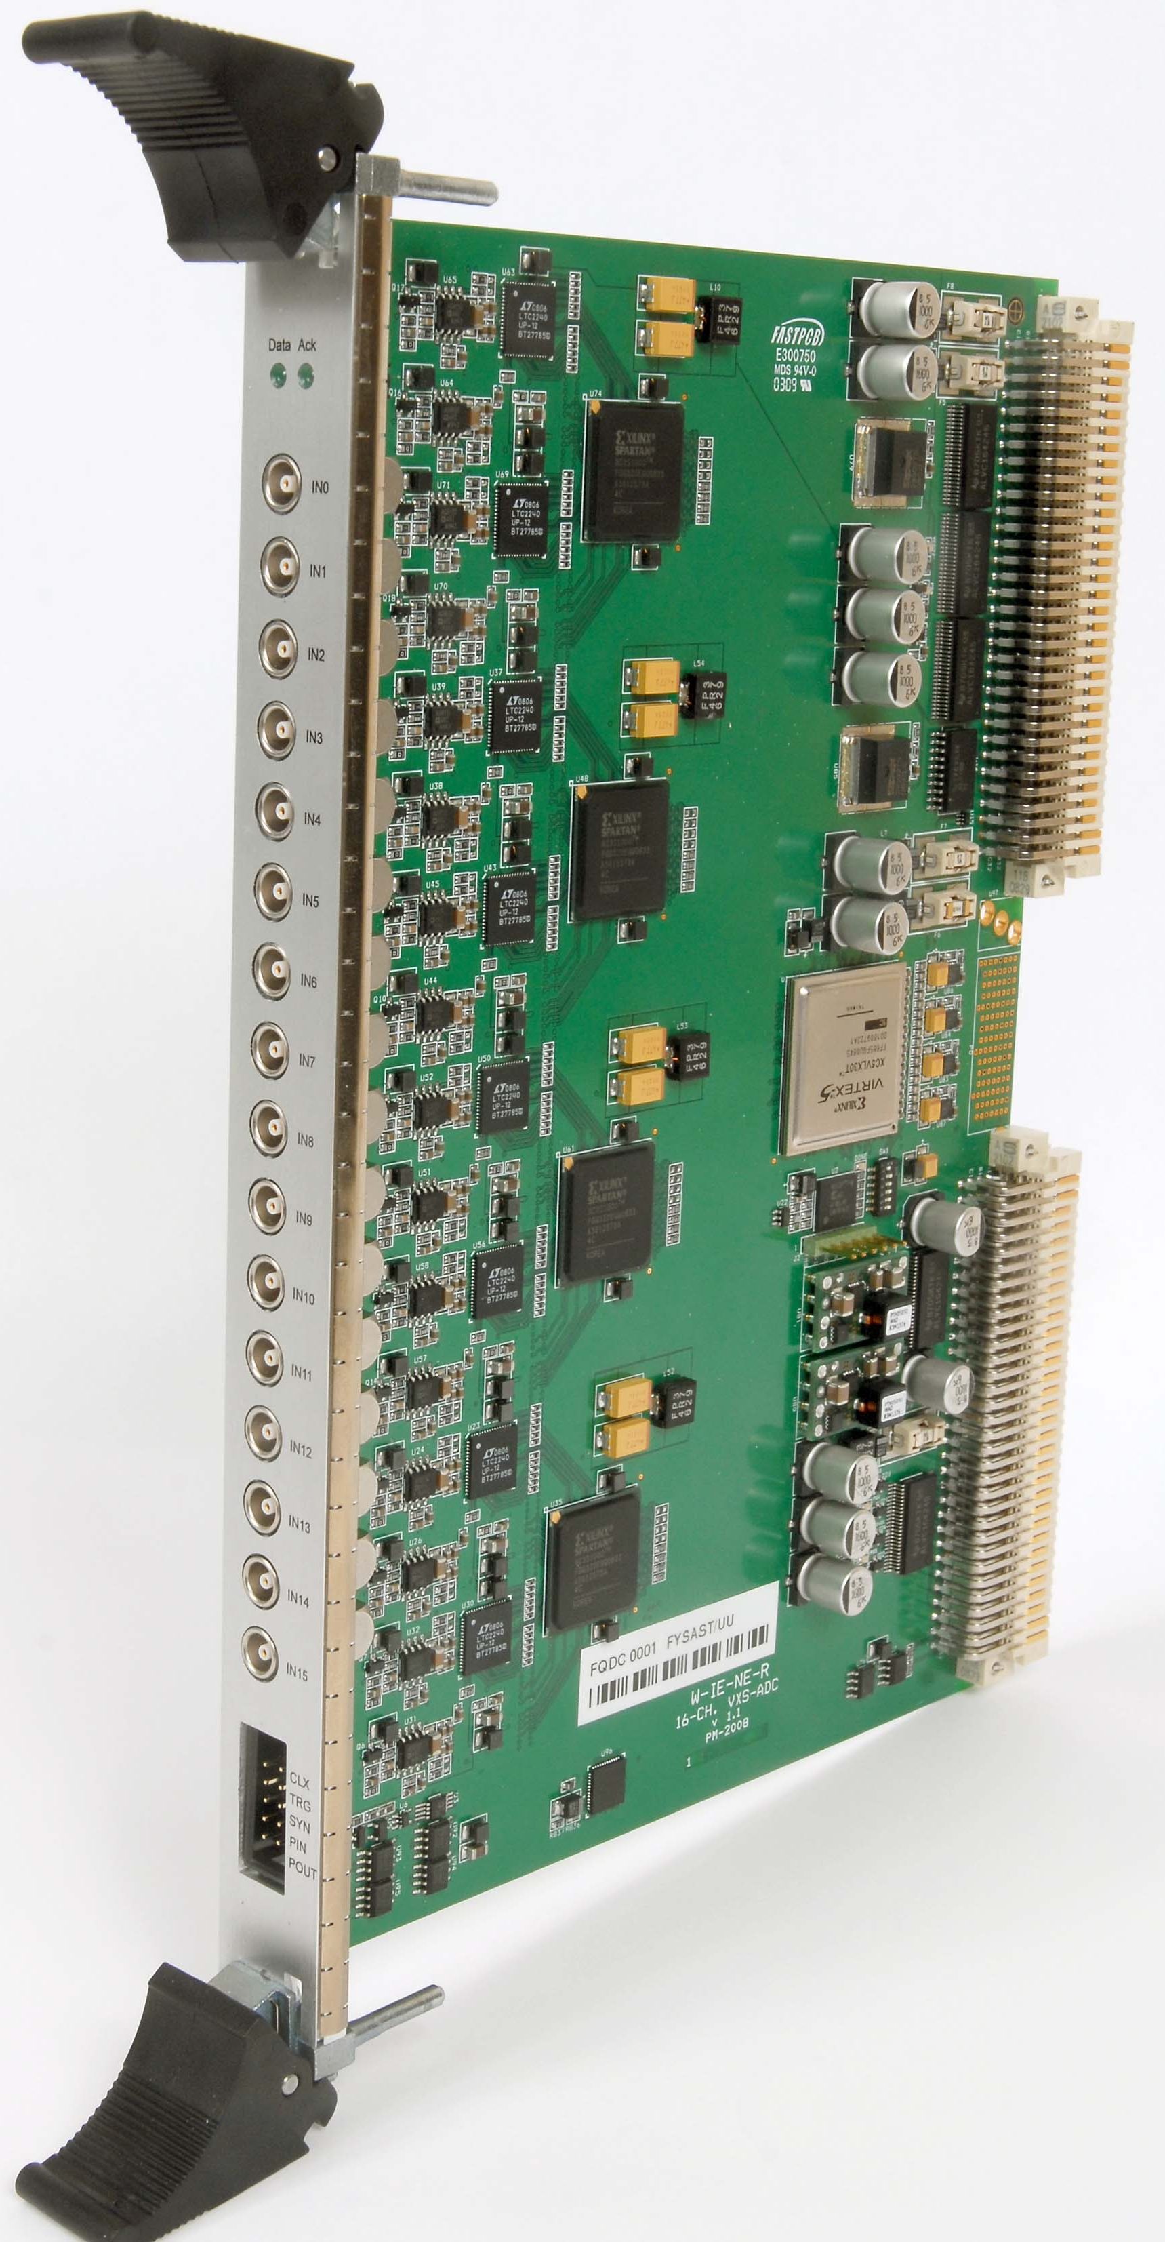
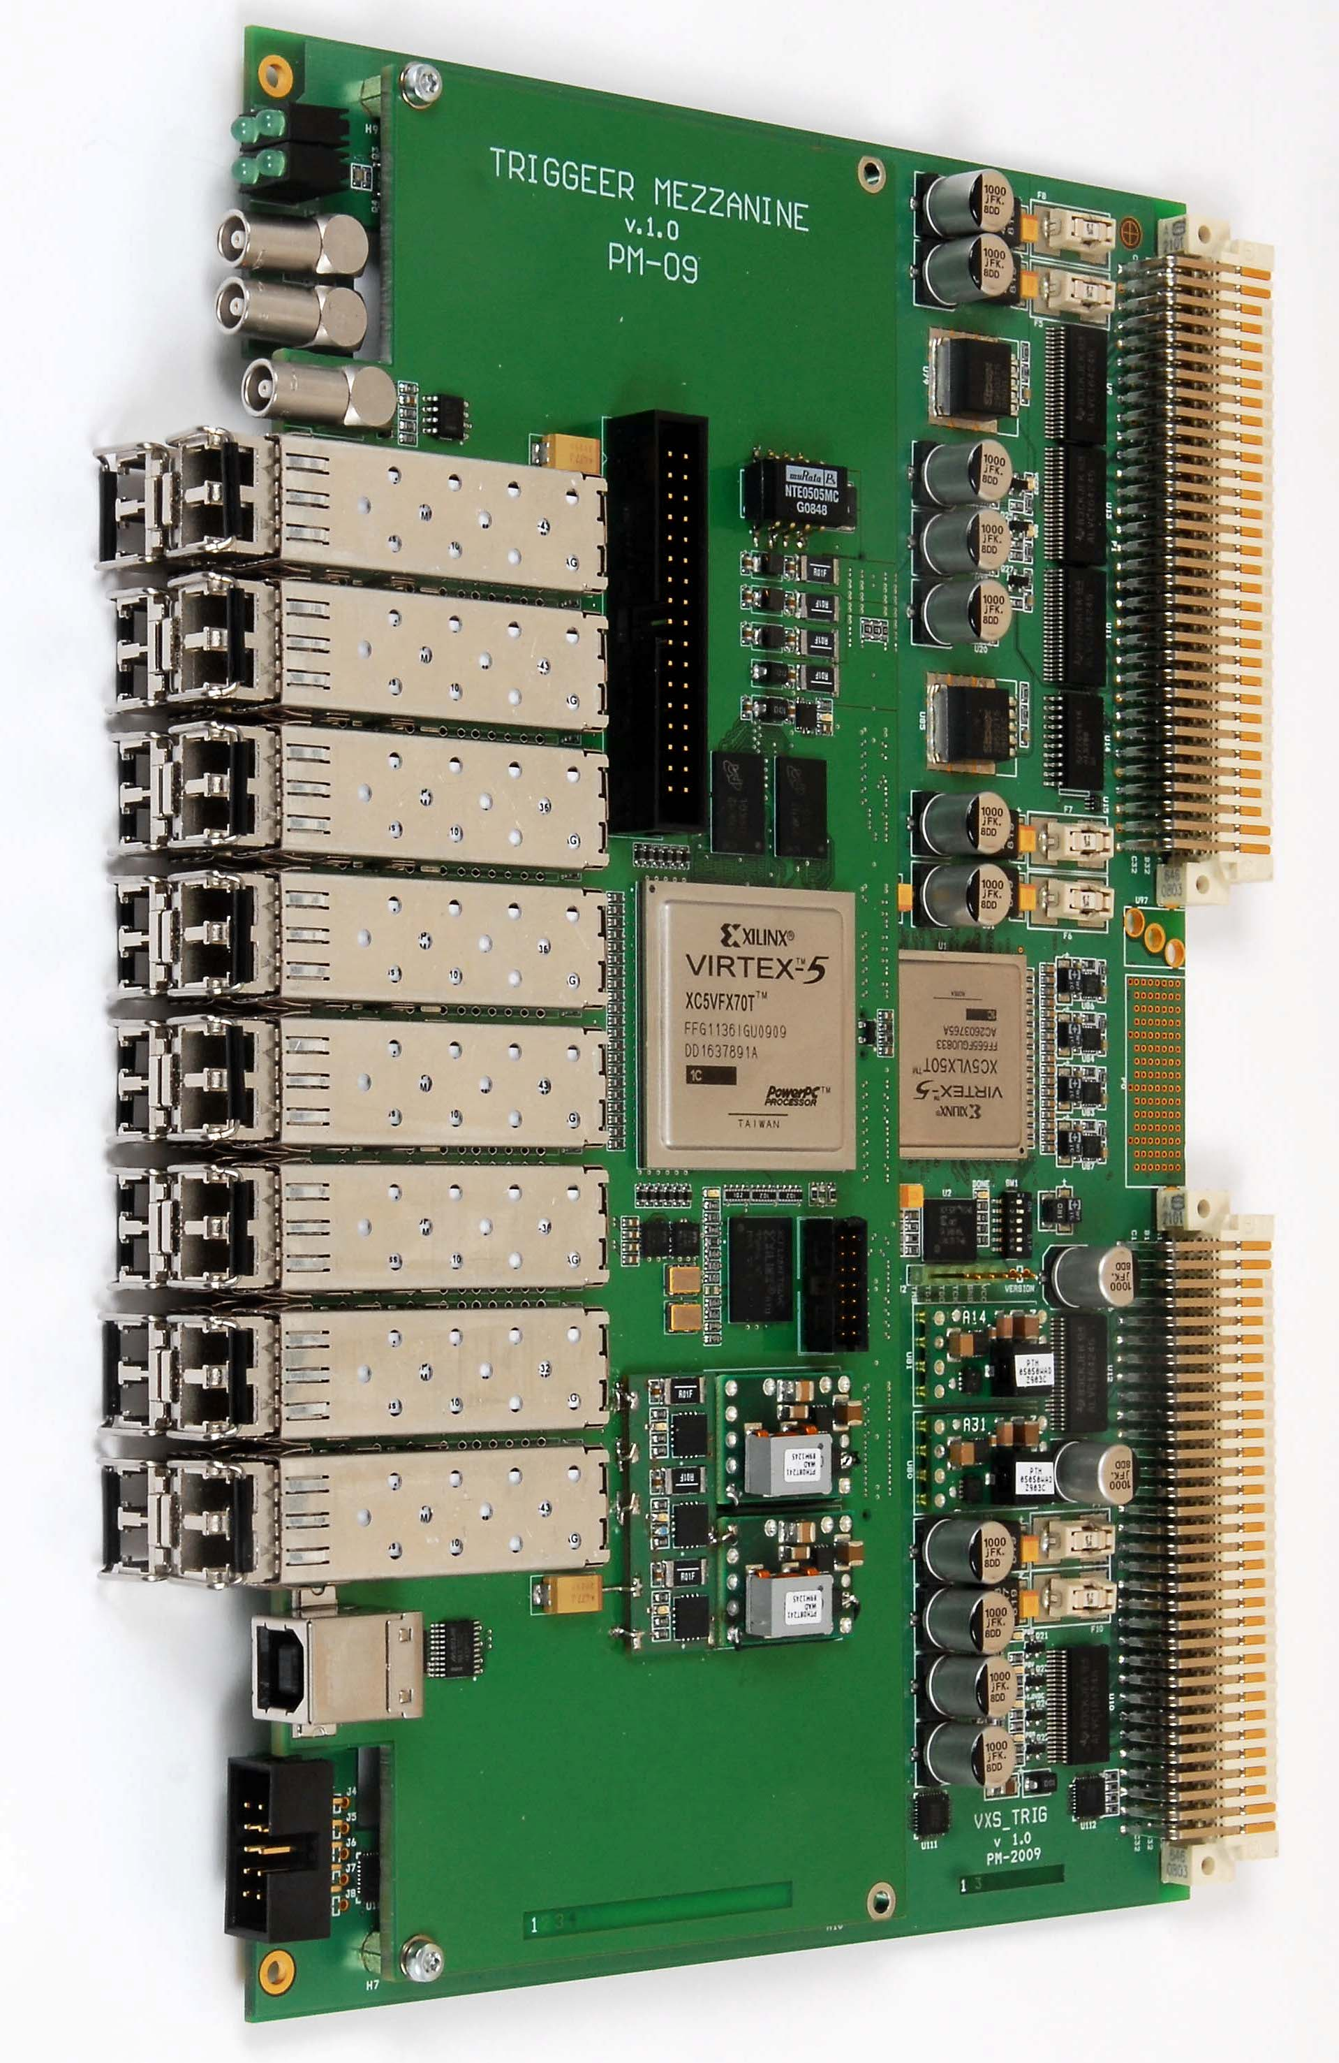
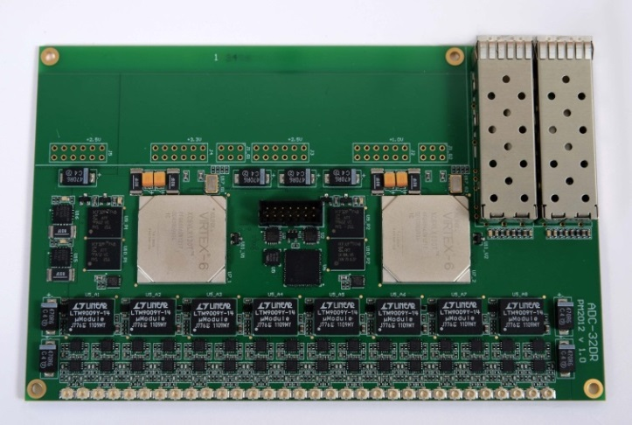
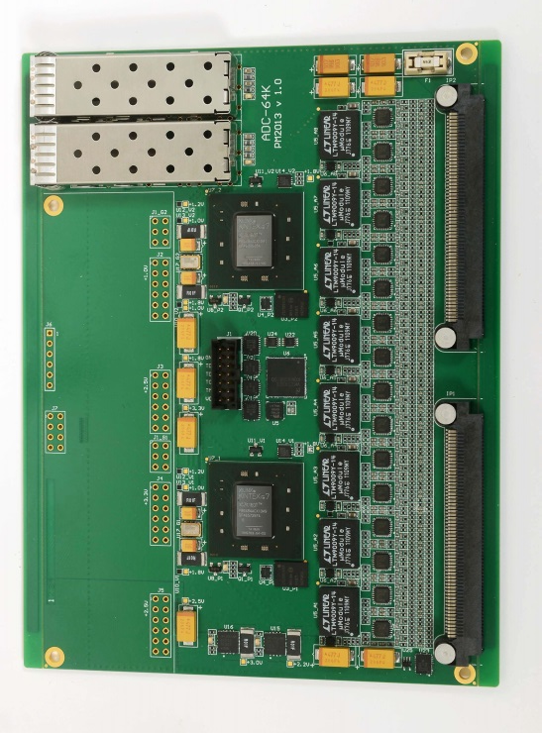
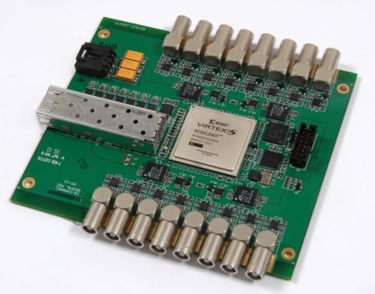
ADC for EMC
- SADC development for PANDA
2008
16-ch, 12-bit
160 MSPS ADC
Used for the first tests, sold to WIENER
2010
16-ch, 2GBit/s
Optical Data Concentrator
Used in many experiments including WASA, KLOE2
2011
16-ch, 14-bit
125 MSPS ADC
Virtex-5
Used for evaluation of DSP algorithms
2012
32-ch, Dual-range, 14-bit
80 MSPS ADC
Virtex-6
Used for first data taking and durability tests
2013
64-ch, 14-bit
80 MSPS ADC
Kintex-7
Close-to-final prototype
Pawel Marciniewski, PANDA DAQ Workshop, GSI 19.02.2015

Slide 3
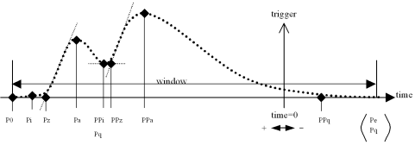
ADC for EMC
- ADC_64K
ADC Model | ADC_32DR | ADC_64V |  | ADC_64K
No. of channels | 32 (64) | 64 |  | 64
Sampling rate | 80-125 MSPS
Input coupling | DC, positive, negative, diff
Resolution (ampl) | 14-bit dual range | 14-bit
Input Connector | uFL | Samtec
Baseline | 0V
Input range (dual) | ±1.0V, ±60 mV | ±1.0V, ±100 mV
Noise | 100uV
Data retention/ch. | 25us
Input filter | Active-filter/Amplifier |  | CR-passive | Active filter/Amplifier
Interface | Optical, SFP, LC-type, 2 Gbit/s
Feature extraction:
Pawel Marciniewski, PANDA DAQ Workshop, GSI 19.02.2015

Slide 4
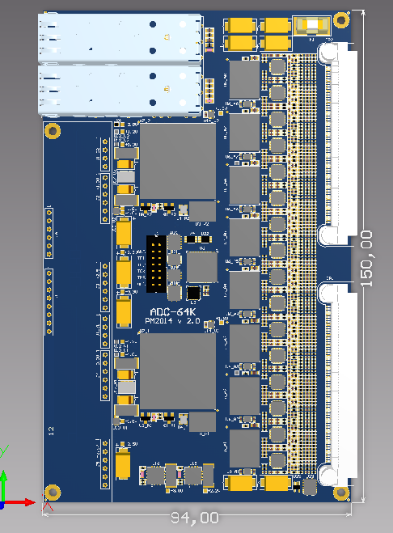
ADC for EMC
- ADC_64K_2
ADC_64K_2
List of recent changes/improvements
Overall error correction
Input can be galvanically de-coupled from the ground
Improved analog/digital ground separation
All low-voltage power supplies can be distributed via backplane connectors
Space optimization
Baseline shifting (?)
Pawel Marciniewski, PANDA DAQ Workshop, GSI 19.02.2015

Slide 5
ADC for EMC
- Common Platform
Optical
Data Concentrator
Shashlyk
250 MSPS
14-bit ADC
uTCA Carrier board
uTCA Carrier board
FMC Mezzanine Board
Custom Mezzanine Board
SFP+
SFP+
SFP+
SFP+
SFP+
FPGA
(XC7KU040)
SFP+
FPGA
(XC7KU040)
16-ch. ADC
(8 * AD9250)
SFP+
16-ch. AMP/SHP
(16 * LTC6403)
SFP+
SFP+
SFP+
SFP+
SFP+
SFP+
SFP+
PLL
(LMK
04806)
SFP+
AMC Connector
AMC Connector
SFP+
SFP+
SFP+
SFP+
Pawel Marciniewski, PANDA DAQ Workshop, GSI 19.02.2015

Slide 6
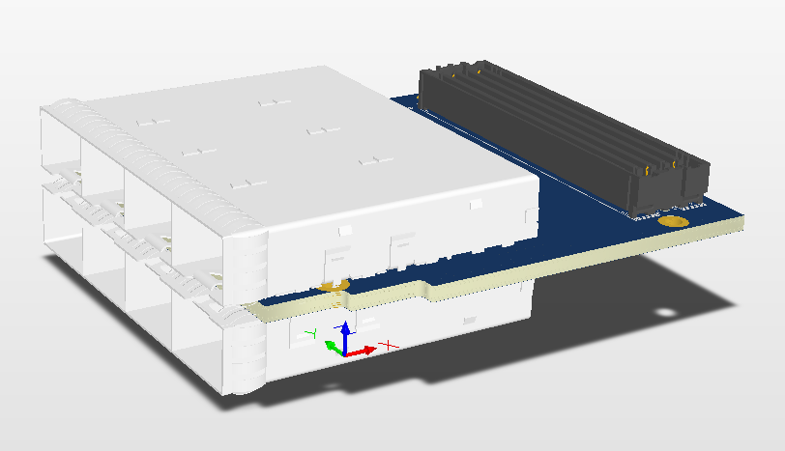
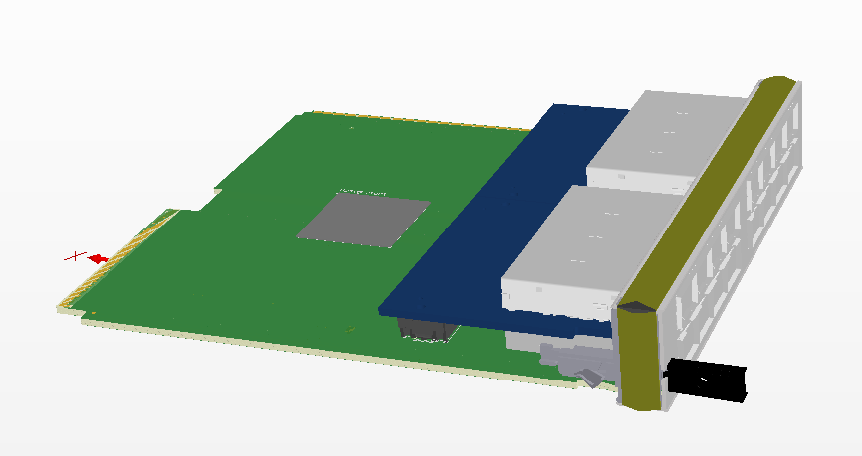
ADC for EMC
- Data Concentrators
VME64x
AMC (uTCA)
Pawel Marciniewski, PANDA DAQ Workshop, GSI 19.02.2015

Slide 7
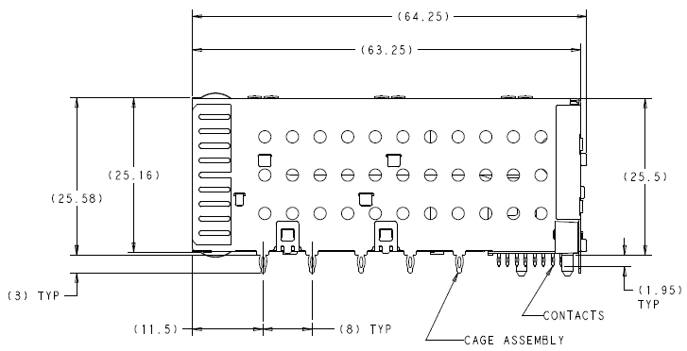
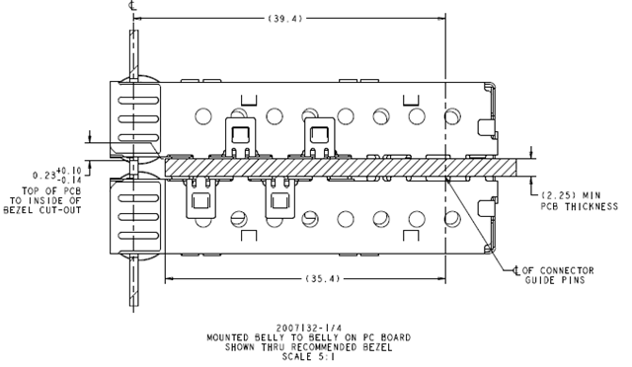
ADC for EMC
- Stacked SFP cages
Pawel Marciniewski, PANDA DAQ Workshop, GSI 19.02.2015

Slide 8
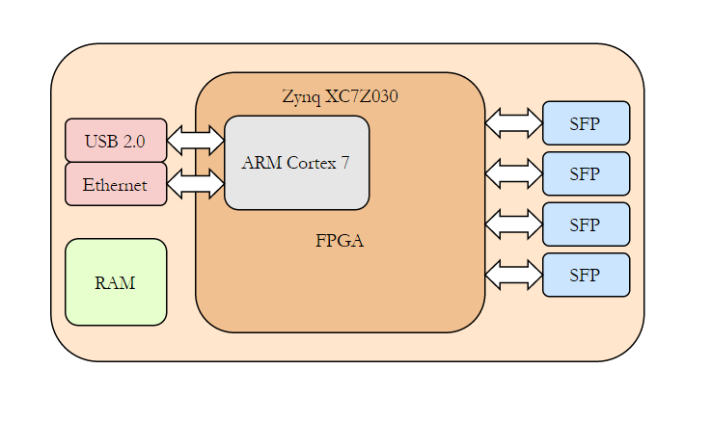
ADC for EMC
- Data Concentrators
Stand Alone
Pawel Marciniewski, PANDA DAQ Workshop, GSI 19.02.2015

Slide 9
ADC for EMC
- Schedule
 | 2014 |  |  |  | 2015 |  |  |  | 2016 |  |  |  | 2017 |  |  |  | 2018
EMC SADC
ADC tests
Final design
Final version production
Firmware development
Radiation immunity test
First production batch
Batch testing
Batch burn-in
Partial assembly
Second production batch
Final implementation
EMC Data Concetrators
DC design
DC testing
Prototype production
Batch production
System testing
Pawel Marciniewski, PANDA DAQ Workshop, GSI 19.02.2015

Slide 10
ADC for EMC-Endcap
- Manpower
Manpower
Uppsala
Hardware design - Pawel Marciniewski
System integration - Postdoc
Stockholm
Firmware - PhD
KVI Groningen
Firmware - Peter Schakel
Uni Bonn
Firmware/Integration - PhD (Johannes Muellers)
Pawel Marciniewski, PANDA DAQ Workshop, GSI 19.02.2015

Slide 11
ADC for EMC-Endcap
Thank You !
Pawel Marciniewski, PANDA DAQ Workshop, GSI 19.02.2015

