Slide 1
In-Kind Contributions to the
European XFEL Facility
In-Kind Contributions to the European XFEL Facility
_____________
Antonio Bonucci– IKC Supply Chain Manager at European XFEL Company
Notes:
How to edit the title slide
Upper area: Title of your talk, max. 2 rows of the defined size (55 pt)
Lower area (subtitle): Conference/meeting/workshop, location, date,
your name and affiliation,
max. 4 rows of the defined size (32 pt)
Change the partner logos or add others in the last row.

Slide 2
Overview
Short overview of the European XFEL project
Place of IKCs in the construction phase
IKCs management
IKC follow-up:
  Milestones validation
  Specific issues
Quality management in IKCs and risk analysis
Examples of difficulties encountered
Conclusions

Slide 3
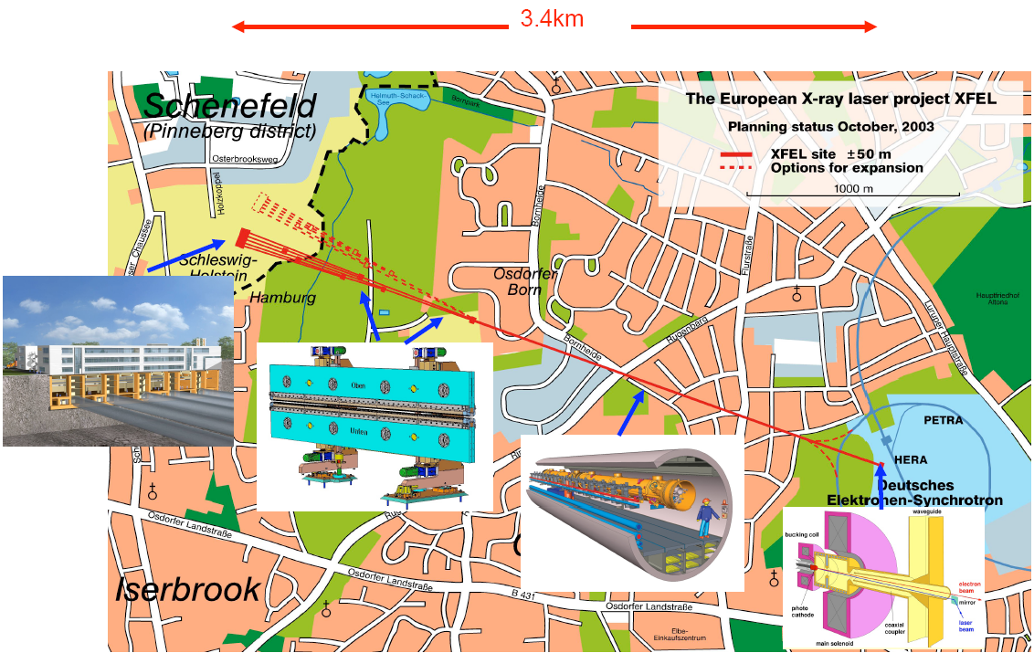
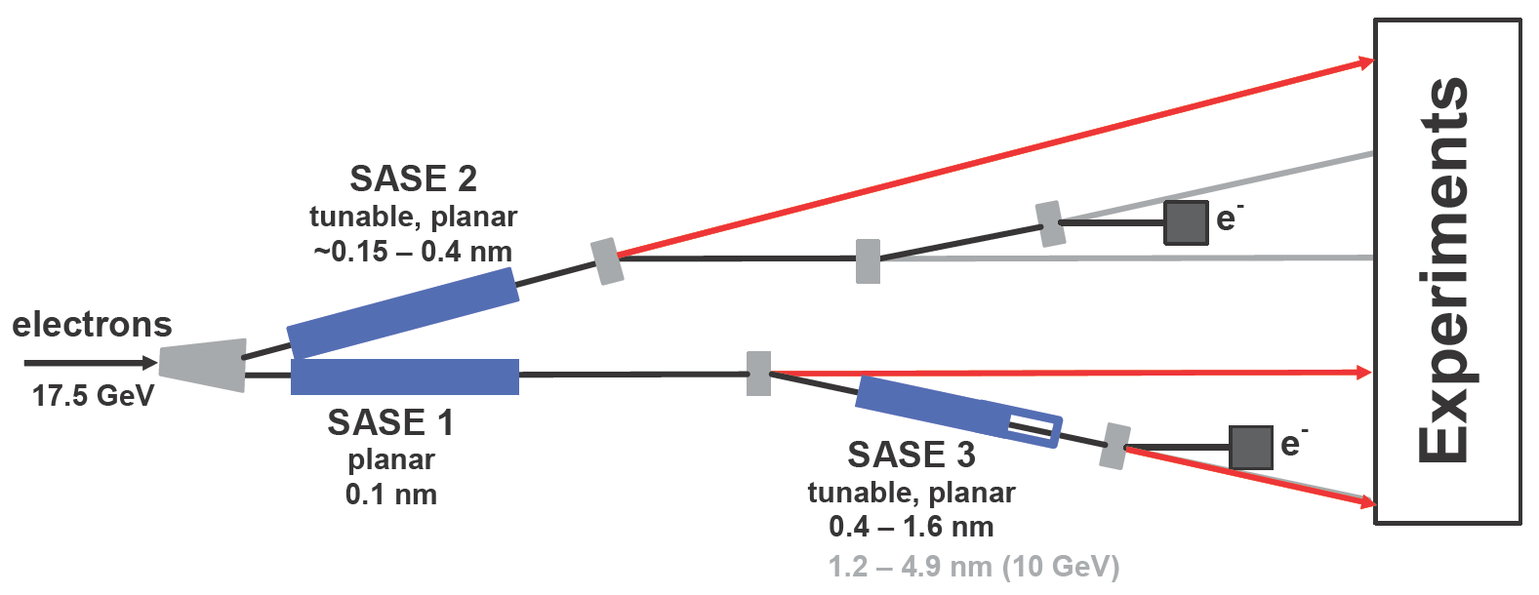
The European XFEL
Some specifications
Photon energy 0.24– >24 keV
Pulse duration ~ 10–100 fs
Pulse energy few mJ
Superconducting linac 17.5 GeV
10 Hz (27 000 b/s)
5 beamlines / 10 instruments
  Start version with 3 BLs and 6 instruments
Several extensions possible:
  Self-Seeding
  More undulators
  More instruments
  …..
  CW operation
SASE2
(= SASE1)
SASE1, λ_{u}= 40 mm
0.2–0.05 nm
SASE3, λ_{u}= 68 mm
1.7–0.4 nm

Slide 4
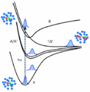
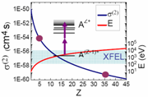

Six “day-one” scientific instruments
SPB/SFX: Single Particles, Clusters, and Biomolecules
Serial fs Crystallography
  Structure determination of single particles: atomic clusters, bio-molecules, virus particles, cells.
MID : Materials Imaging & Dynamics
  Structure determination of nano-devices and dynamics at the nanoscale.
FXE : Femtosecond X-ray Experiments
  Time-resolved investigations of the dynamics of solids, liquids, gases
HED : High Energy Density Matter
  Investigation of matter under extreme conditions using hard X-ray FEL radiation, e.g. probing dense plasmas
SQS: Small Quantum Systems
  Investigation of atoms, ions, molecules and clusters in intense fields and non-linear phenomena
SCS: Soft x-ray Coherent Scattering/Spectroscopy
  Electronic and real structure, dynamics of nano-systems and of non-reproducible biological objects
Hard X-rays
Soft x-rays

Slide 5
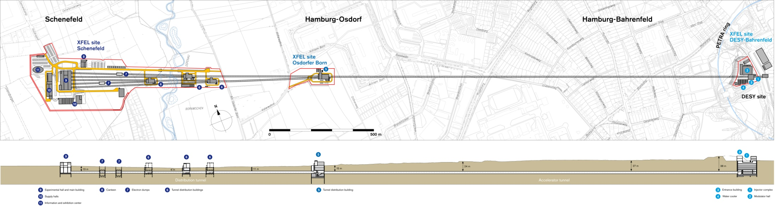
Main facts about the project
The European XFEL Facility in Hamburg is an applied research facility
Generation of X-ray flashes: 27 000/s
Superconducting linear accelerator for electrons (energy level 17.5 GeV)
3.4 km long machine in 5.8 km underground tunnels
3 sites above ground and 5 experimental stations (3 in the start-up)
Construction :
Cost 1.15 B€ (2005)
9 countries participate in the construction through 22 institutes
49 Work Packages
79 in-kind contributions
Lifetime 20 years 2017-2037

Slide 6
Schematic distribution of the instruments
MID
HED
SASE2
SPB
/SFX
FXE
SASE1
SASE3
SQS
SCS

Slide 7
European XFEL Facility—Time Structure
Electron bunch trains
(with up to 2700 bunches, 0.1–1 nC)
600 μs
t
100 ms
100 ms
10–100 fs
Photon pulses
Δt = 222 ns
FEL
process
t
t
t
4.5 MHz

Slide 8
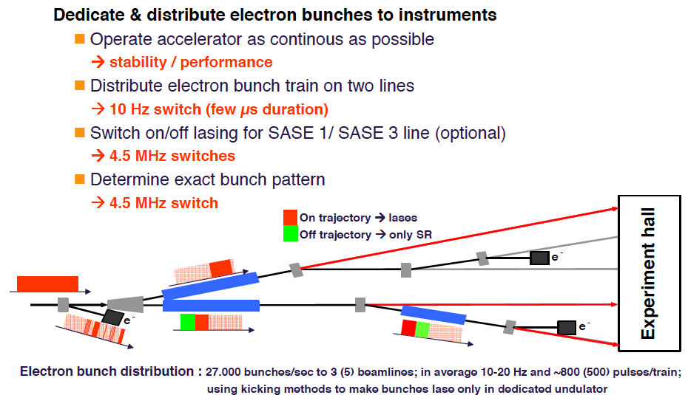
Serving many instruments at one time
Massimo Altarelli

Slide 9
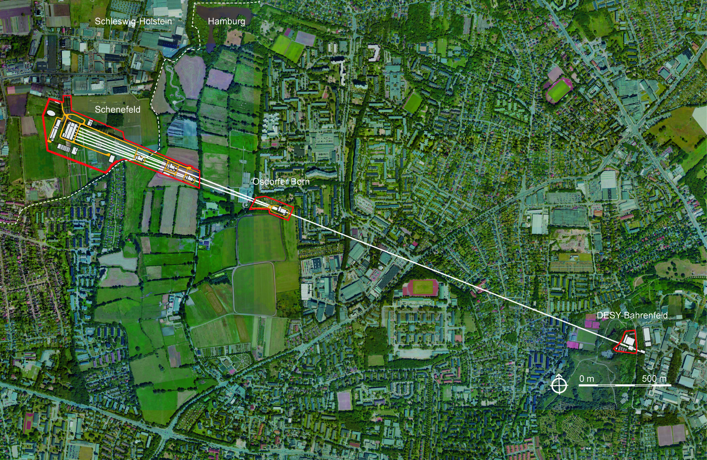
The European XFEL
First users: 2017
Undulator Tunnels
Injector at DESY campus
Experimental Hall
in Schenefeld
Linear Accelerator
2 km long
17.5 GeV (construction led by DESY)

Slide 10
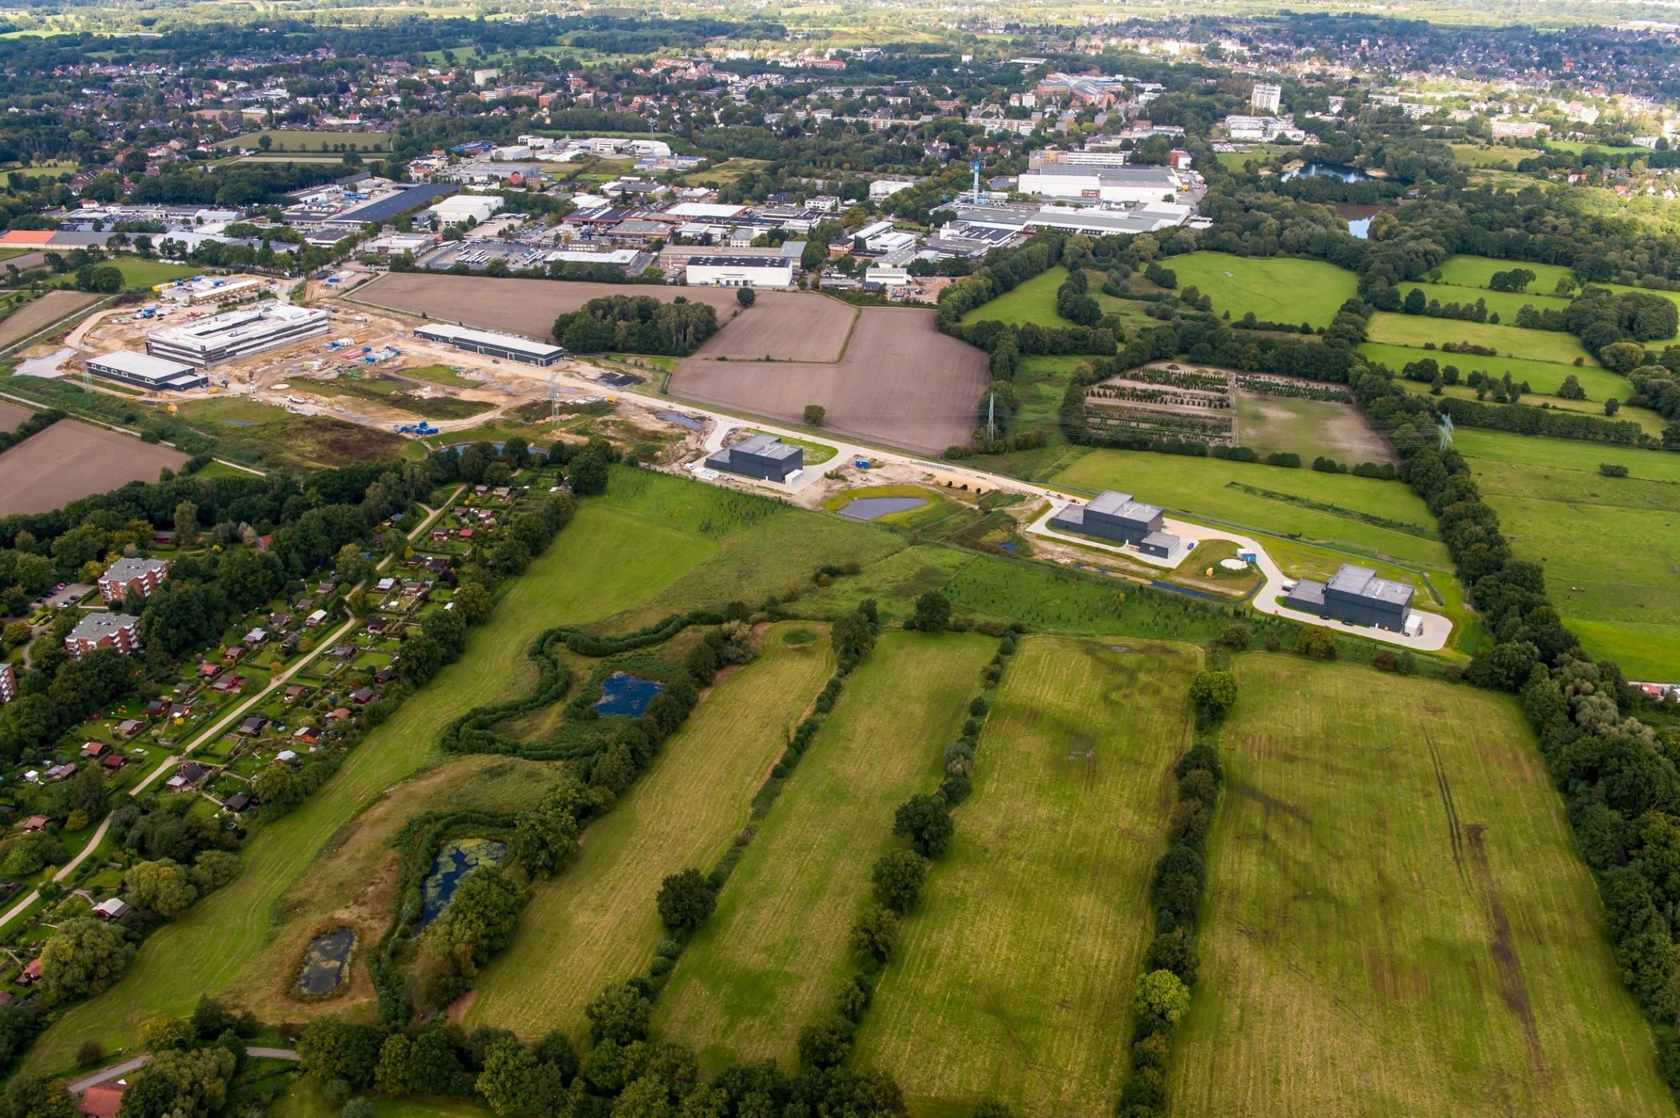
The European XFEL…becoming reality!

Slide 11
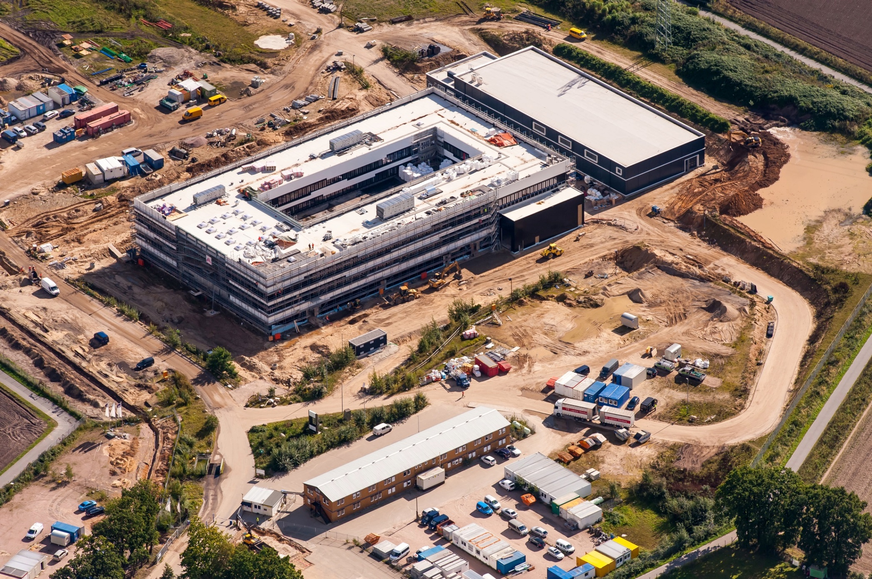
Headquarters…moving in early June 2016

Slide 12
The European XFEL
First users: 2017
Undulator Tunnels
Injector at DESY campus
Experimental Hall
in Schenefeld
Linear Accelerator
2 km long
17.5 GeV (construction led by DESY)

Slide 13
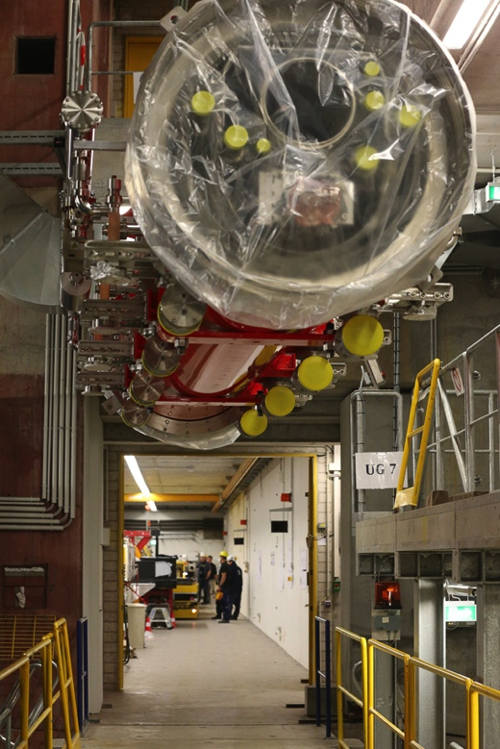
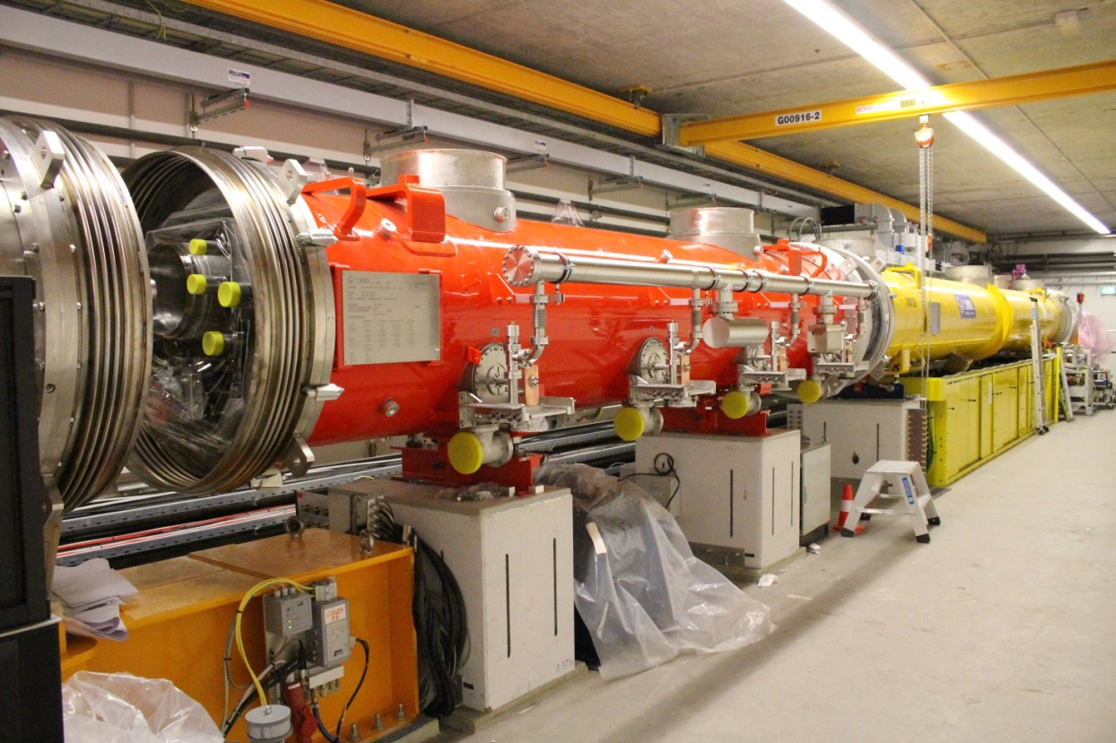
Injector: beam commissioning starts Dec. 2015
Yellow: 1.3 GHz module
Red: 3.9 GHz 3rd harmonic module

Slide 14
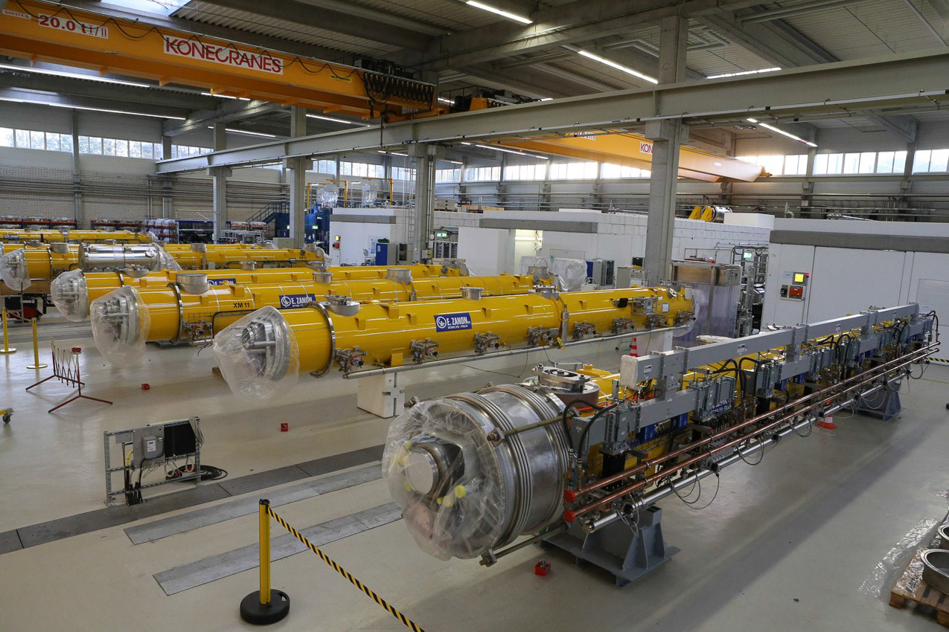
Modules in AMTF – Over 68 (out of 103) received

Slide 15
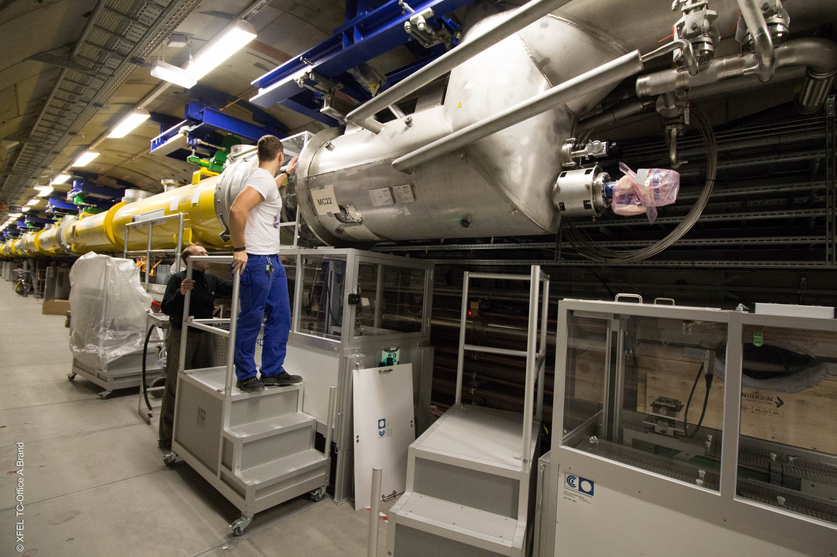
Modules plus cryogenic end cap (October 09)
49 Modules installed
1 RF-Station ready
9 RF-Stations in preparation

Slide 16
Present best estimates Linac installation
Last module (XM100) in Hamburg end of April or May 2016
Installed in tunnel end of June to mid July 2016
Tunnel closing and start of cool down 3rd quarter 2016

Slide 17
Undulators and Photon Beamlines
*Shall be equipped for self-seeding
SASE2*
(= SASE1)
SASE1
0.2–0.05 nm
SASE3
1.7–0.4 nm
35 X 5m sections, 40 mm period
21 X 5m sections, 68 mm period

Slide 18
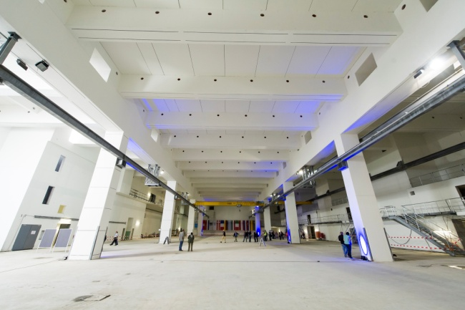
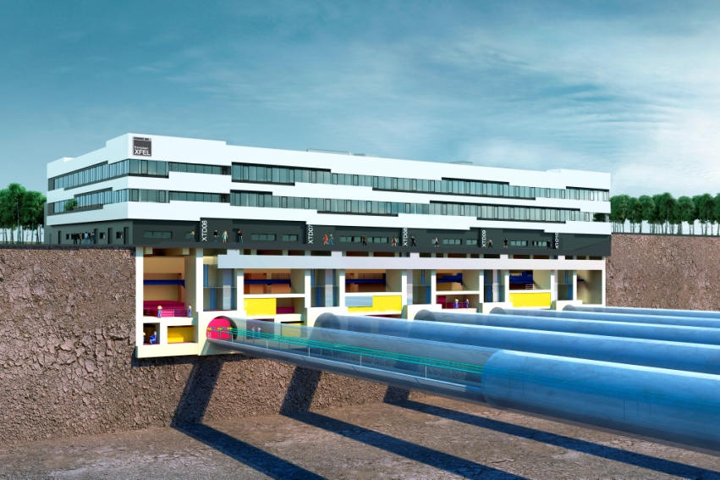
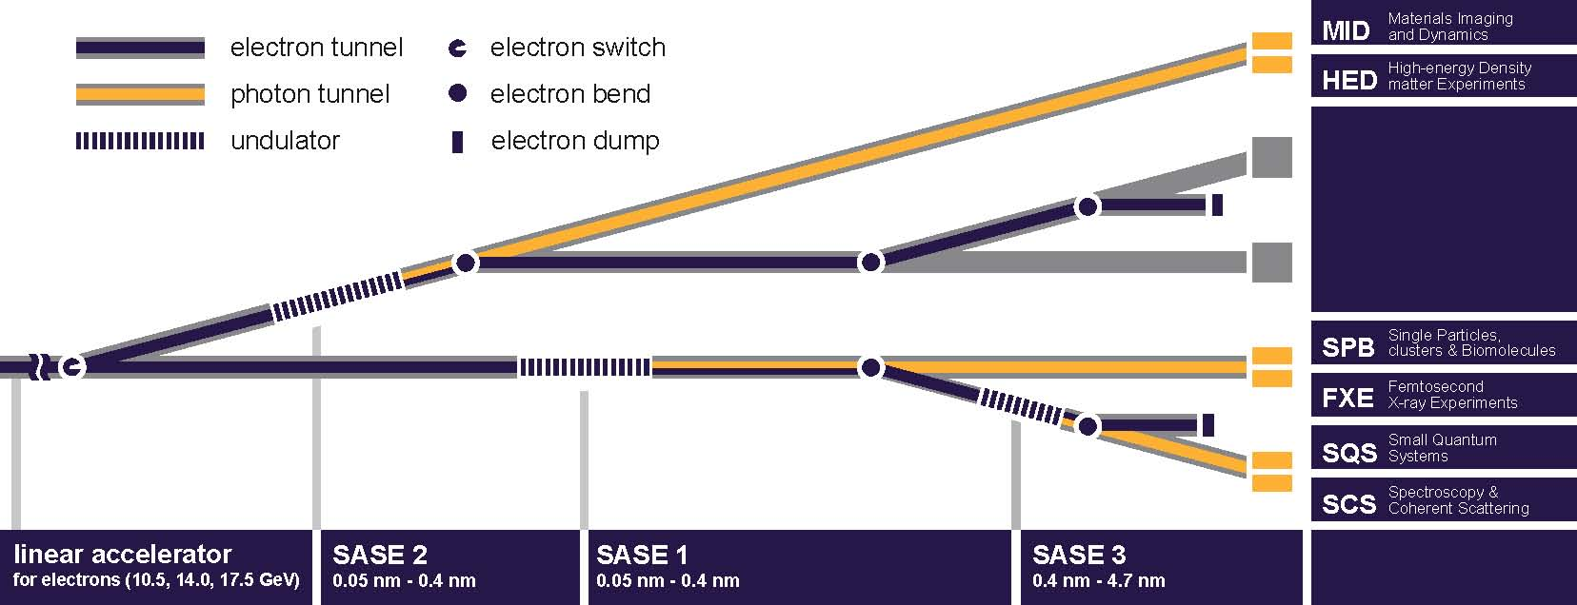
Experimental Hall: 90 m x 50 m (h 14 m)
Experimental hall will be crowded in a few months
Labs and offices building will be built above experimental hall (2014-2015)

Slide 19
12 countries contribute to the European XFEL Facility end 2015
Each country contributes either in cash, in-kind, or both
to the construction phase
Distribution of total contributions
Greece is unfortunately recently out but UK is going to participate to the project.

Slide 20







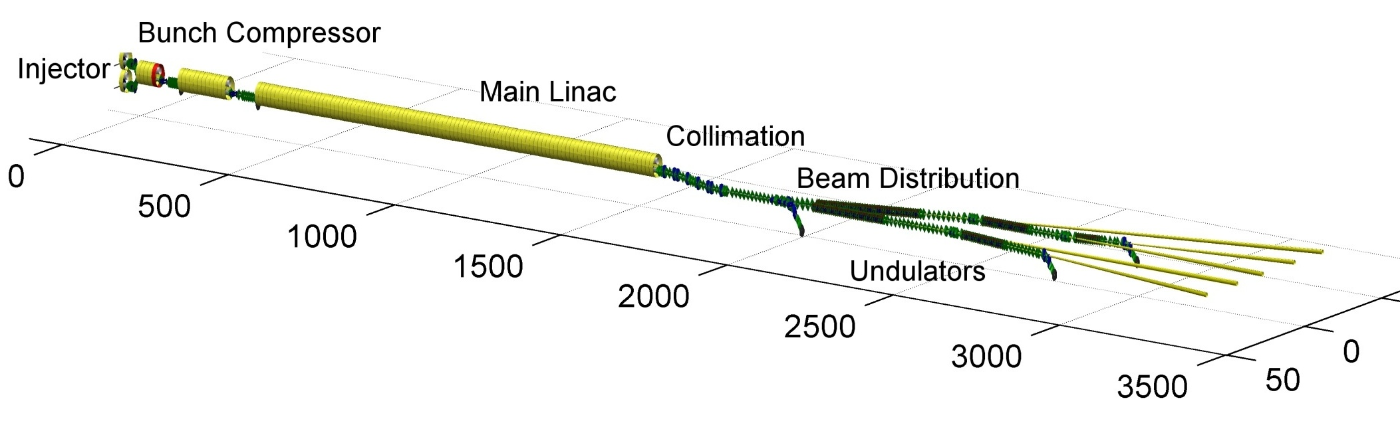













Institutes contributing in-kind to the construction
Notes:
How to edit the title slide
Upper area: Title of your talk, max. 2 rows of the defined size (55 pt)
Lower area (subtitle): Conference/meeting/workshop, location, date,
your name and affiliation,
max. 4 rows of the defined size (32 pt)
Change the partner logos or add others in the last row.

Slide 21
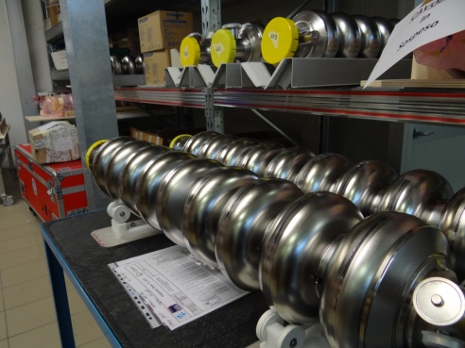
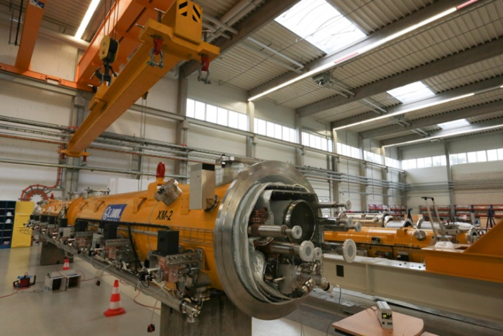
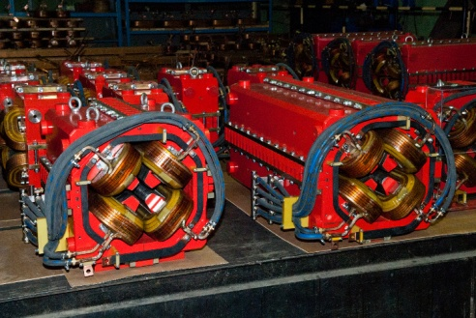
Overview of in-kind contributions 2015
9 Countries
22 Institutes
80 IKCs
644 Milestones
584 M€ (2005)
Prepare agreements
Implement changes
Validate milestones
Follow-up and control
Verify achievements
Efforts by IKC Office
Status end 2015
79 IKCs allocated
247 Milestones completed
10 IKCs completed
Project delay, but already many components delivered
Main components delivered
Super-conducting cavities: 800/800
Cryostats: 100/100
Warm magnets: 715/715
Cold magnets: 100/100

Slide 22
Objectives of in-kind contributions for the construction phase
Budget of the European XFEL Facility:
  In-Kind contributions ~ 50%
  Cash ~ 50%
Reasons why IKCs are an attractive solution:
  For the contributing institute:
    Implementing and developing its know-how
    Local development
    Image and reputation
  For the project:
    Delegation of responsibilities (technical, management)
    Delegation of risks (technical, costs)

Slide 23
Drawbacks of in-kind contributions
But
Drawbacks of IKCs
  For the contributing institute :
    Technical risks
      Manufacturing risks
      Risk of not achieving expected performance
    Financial risks
    Human risks: loss of competences
    Risk of change of strategy by funding agency
  For the project:
    Technical follow-up and control can be more demanding than expected
      For project groups
      For IKC office
    Other risks appear:
      Failure to deliver on schedule, in quality
      Assistance may require unforeseen effort

Slide 24
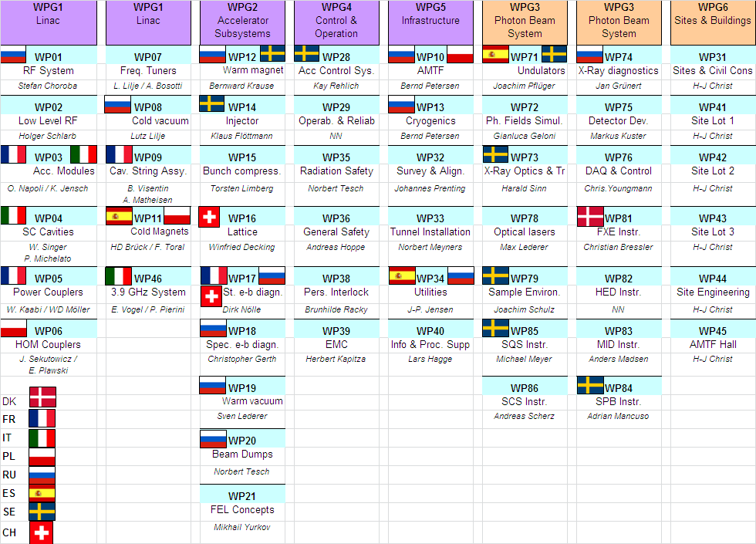
Work Packages in the construction phase

Slide 25
Tasks of the IKC controlling office
1 – Assistance to the project management and to the administration:
  Follow-up of the technical progress at the various in-kind contributions
  Reporting to the management and associated committees
  Organize meetings of the In-Kind Review Committee
  Inform the controller and finance group
2 – Close cooperation with the project teams in:
  Preparation of the technical part of IKC agreement
  Enforcement of engineering standards and safety rules
  Traceability of parts
  Documentation
  Technical validation of achievements at milestones
  Acceptance tests
3 – Assistance to the contributing Institute:
  Preparation of the contract (IKC Agreement)
  Preparation of quality plan
  Validation of the achievements
  Solving difficulties: procurements, delays, etc..
  Maintain close relationship

Slide 26
Process of an IKC in the construction phase
Input
Extent of contribution
Value
Specifications
Interfaces
Schedule
Standards & QA requirements
Output
Hardware
Services
Manpower
Software
Documents
Work
Management
Engineering
Production
QA control
Tests
Shipment
Assistance
Resources
Manpower
Factory, halls
Machines & equipment
Offices
Budget
Agreement +
Technical annex
Project team
Acceptance tests
Integration
Commissioning
Allocation by XFEL Council
AFC
financial recommendation
IKRC
technical recommendation
XFEL technical groups
Contributor’s responsibility
EoI by Institute
Notes:
Before you start editing the slides of your talk change to the Master Slide view:
Menu button “View”, Master, Slide Master:
Edit the following 2 items in the 1st slide:
1) 1st row in the violet header:
Delete the existent text and write the title of your talk into this text field
2) The 2 rows in the footer area: Delete the text and write the information
regarding your talk (same as on the Title Slide) into this text field.
If you want to use more partner logos position them left
beside the DESY logo in the footer area
Close Master View

Slide 27
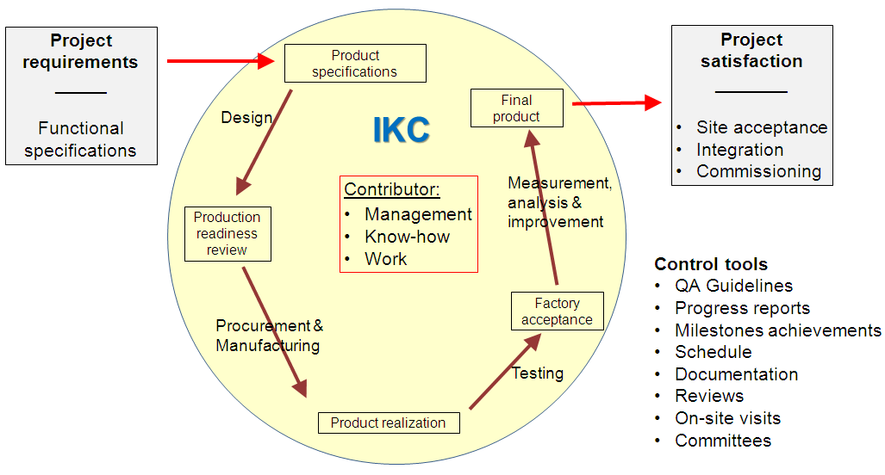
Major control milestones

Slide 28
Interaction with the contributor
Assist him from the beginning:
  How to present his contribution → IKRC Committee
  How to prepare the documents (financial agreement and technical annex)
  Assist him during the work
    Procurements
    Follow-up
    Quality assurance
    Milestones validation
  Assist him at the end
    Final acceptance
    Final notification, appraisal
  Treat him as a project partner
Yes, but: the contributor must be controlled !!!
  Monitor closely his progress with respect to plan
  Make regular on-site visits
  Control the documentation and traceability of parts

Slide 29
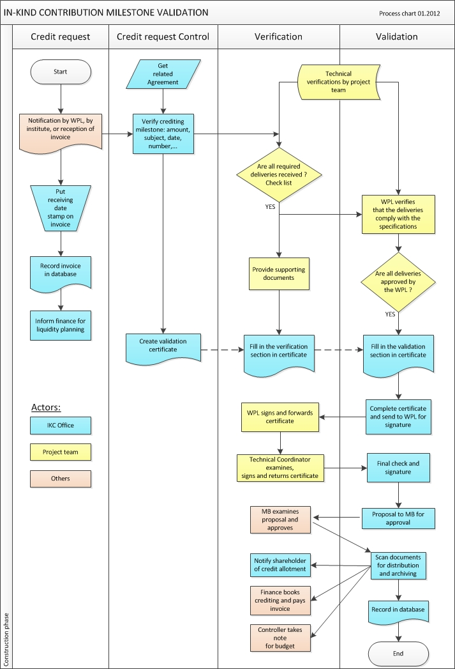
IKC follow-up: Validation of Milestone’s achievement
The progress of a contribution is monitored through specific contractual milestones detailed in the agreement:
  Milestone name, date expected, validation criteria
About 644 milestones cover all IKCs of European XFEL
For each milestone,
when corresponding task is completed:
Institute or project team → notifies IKC Office
IKC Office prepares specific certificate
Project team → evaluates the deliveries / criteria:
        Documents
        Test reports
        Equipment
  → gives his approval of satisfactory achievement
IKC Office:
→ presents for signatures the certificate to validate the milestone
→ notifies the shareholder and accounts credit of value

Slide 30
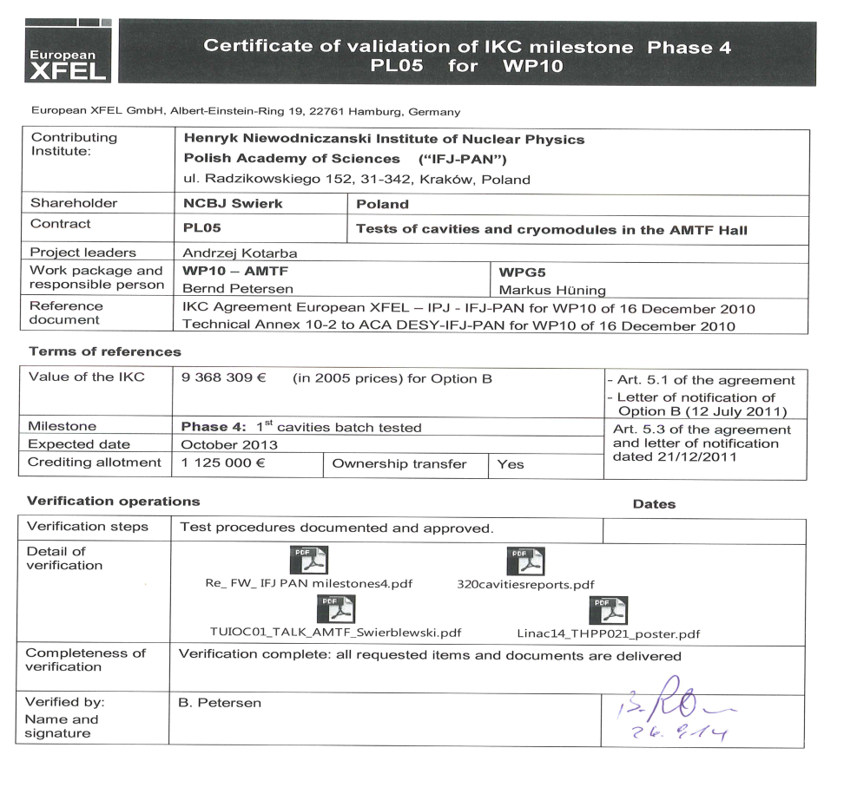
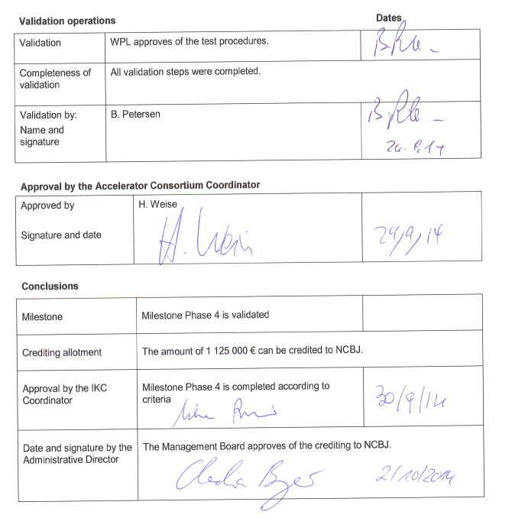
IKC follow-up: Certificate of Validation (example)
Validation involves the approval and signatures by:
  Technical team
  Technical coordinator
  IKC Office
  Administrative Director
Management Board gives a formal approval
Shareholder’s account is credited
Shareholder is notified
Supporting documentation is uploaded in database

Slide 31
Specific issues of in-kind contributions
Coordination of several different actors in space and time needs a big effort:
Technical difficulties:
  Different environment (procedures, language, CAD software, units…)
  Different standards
  Different raw materials (same quality ?)
  Different style of management
  Follow-up is difficult
Financial:
  Budget is in current prices, but IKCs are in 2005 prices
  Controller takes note of completed IKC milestones
  Custom taxes for equipment coming from outside EU
Logistics:
  Transports
  On-time delivery and temporary storage
  Installation must fit with global integration plan
Legislation:
  National legal rules are different
  Procurement rules can be different

Slide 32
Intellectual property in in-kind contributions
How to deal with IP must be precisely defined in the agreement:
Free exchange of knowledge between parties
  Background
  Foreground
Confidentiality agreement
Rights
  Background remains property of inventor
  Right for the project to use, adapt, and reproduce all foreground
Publications
  Flexibility
  Acknowledge the collaboration
Inventions

Slide 33
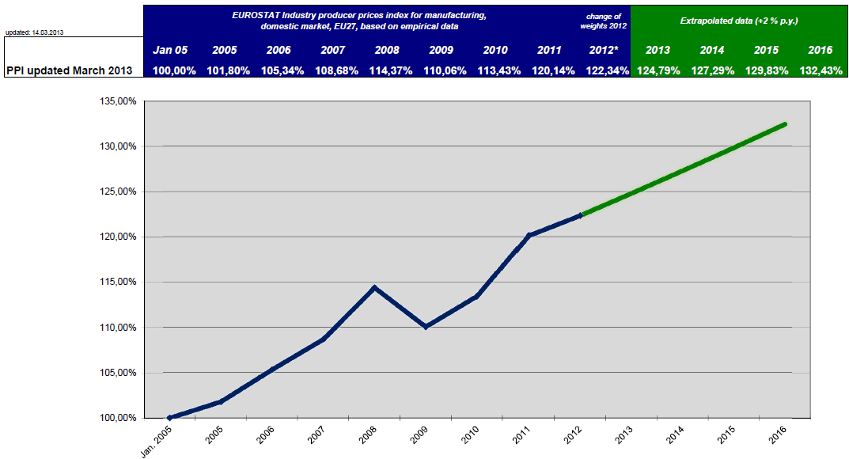
Finance and controlling aspects of IKCs
At milestones achievements
  All milestones achievements are reported by the IKC Office (see procedure)
  For each completed milestone the accrued value is notified to the shareholder
  Delivery of a single tangible object implies the transfer of ownership
  Delivery of prototypes or intangible objects (like design drawings, reports and documents) do not imply the transfer of ownership
  Transfer of ownership of the complete IKC is effective after final acceptance
Calculation of 2005 value
  from current value
By Council decision, producer price index for manufactured products EU27, published by EUROSTAT, must be used to deflate cash contributions and all types of expenditures to the 2005 price level.
Index changes every month → yearly updates of balance sheet must be made

Slide 34
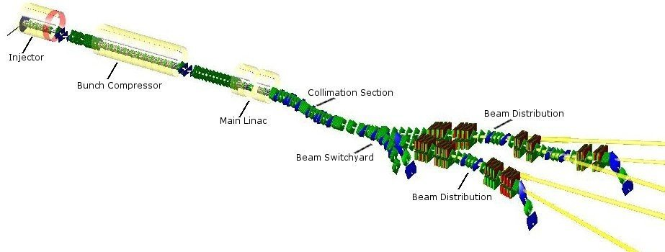
Quality management issues
48 WPs
9 Countries
22 Institutes
80 IKCs
Many interfaces
Materials of different origins
Different ways of work
Equipment transported from Europe and Asia
Different processes of acceptance
European XFEL machine
Common rules of good practice are necessary !
Quality management must be implemented

Slide 35
Examples of difficulties encountered (Design and manufacturing)
Difficulties of detailed design underestimated
  Very often the effort or time necessary for detailed design by contributor is underestimated
  → critical delays
  To avoid this: spend more time in the evaluation of design effort (external reviewers, expert panel…)
Approval by project is too long
  Too many stakeholders delay approval of design by contributor (subjects with many interfaces)
  → manufacturing is delayed pending approval
  Set up approval process in a way to avoid delays
Raw material or special component specified in IKC contract is not available at the contributor
  Look for local equivalent, or
  Buy the material or component and send it to the contributing institute (→ shift from IKC to cash)
Loss of competences (example: qualified welders) , or failure to produce equipment
  IKC must be re-allocated to another actor, or
  Equipment must be contracted to industry

Slide 36
Examples of difficulties encountered (Cost)
Case of over-specifying tolerances
  Very tight geometrical tolerances are specified (although not justified) by the project
  → leads to unexpected high price of manufacturing
    Include a review of tolerances in the design review (functional analysis)
    The “best” is not right!
Case of exceptional cost increase
  Very high increase of material cost (copper, steel…) since date of cost book
    Procedure for exceptional cost increase:
      Panel of experts analyses the case & reports to Council
      Council decides on higher value of IKC
Case of wrong cost estimate in cost book
  It is found that the cost estimate of a specific equipment made in 2005 was wrong, and the contributor does not (cannot) take the cost overrun in charge
    Case is brought to the Council for discussion among shareholders and decision
    At European XFEL a funding shortfall was discovered in 2011, and 3 main shareholders decided to increase their cash contribution to the project by 145 M€

Slide 37
Examples of difficulties encountered (Schedule and quality)
Delayed achievements
  Contributor does not deliver on-time → delay of whole project
    Preventive actions:
      Define precise responsibilities (agreements and internal provisions)
      Close follow-up and reporting
      Risk analysis (think of plan B in case of high risk)
    Corrective actions:
      Provide assistance to the contributor to find a solution
      Decide on an alternative
Default in quality
  Equipment delivered does not satisfy the specified performance
    Preventive actions:
      Design review before start of production
      Close follow-up and reporting
      Risk analysis
    Corrective action:
      Provide assistance to the contributor to find a solution

Slide 38
Top 10 Dos and Don’ts
Do
Consider contributor as project partner
Define precisely what is expected
Define specific goals of achievements
Share important project info
Define precisely acceptance criteria
Visit regularly contributors
Provide assistance in solving difficulties
Plan the unexpected (risk analysis)
Verify completeness of documentation
Appraise value of accomplishments
Don’t
Change requirements repeatedly
Underestimate difficulties of design
Develop conflictual relationship
Let a contributor work without a signed agreement
Consider contributor as a vendor
Discredit contributor’s know-how
Hide important project info
Ignore help request or warning signals of problem
Believe or accept anything without verifying
Delay unduly acceptance of achievements

Slide 39
Conclusions
Management and control of IKCs need significant efforts (technical & administration)
Precise processes must be established before start
Define precise responsibilities, deliverables, and criteria of acceptance for each IKC
Contributors must be treated as project partners (share info, reviews, dialogue)
Be prepared, think of the unexpected
IKCs management involve all groups in the project

