Slide 1
Diagnostics concept
for CR @ BINP
Yury Rogovsky
BINP, Novosibirsk
6th BINP-GSI-FAIR workshop
02.12.2014
1

Slide 2
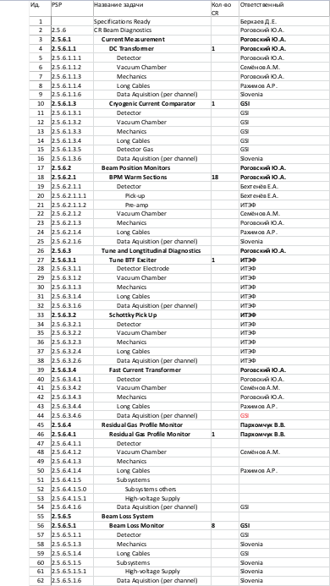
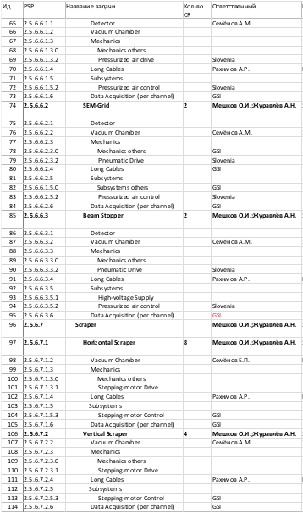
2

Slide 3
Beam diagnostics parts
GSI contribution (O. Chorniy talk)
Cryogenic Current Comparator (1)
Beam Loss System (1)
ITEP contribution (really only production <= according O. Dolinsky talk)
Shottky pickup (1)
Tune BTF exciter (1)
BPM Preamplifiers (18)
BINP contribution
Beam position monitors (18)
DC transformer (1)
Fast current transformer (1)
Residual Gas profile Monitor (1)
Scintillation Screen (2)
SEM-grid monitor (2)
Beam Stopper (aka Faraday Cup) (2)
Scrapper Horizontal (1, consist from 2 parts)
Scrapper Vertical (1, consist from 2 parts)
Slovenia contribution
Various data acquisition electronics
Controls electronics
3

Slide 4
5th Workshop summary
New optics (so called Koop’s optics) was established by BINP team
One of the aim (not least) – make changes in elements positions, so that prepare free spaces between elements for beam diagnostics and correctors
First presentation on 6th GSI-BINP workshop shows that this optics brings new possibilities and looks like good
4

Slide 5
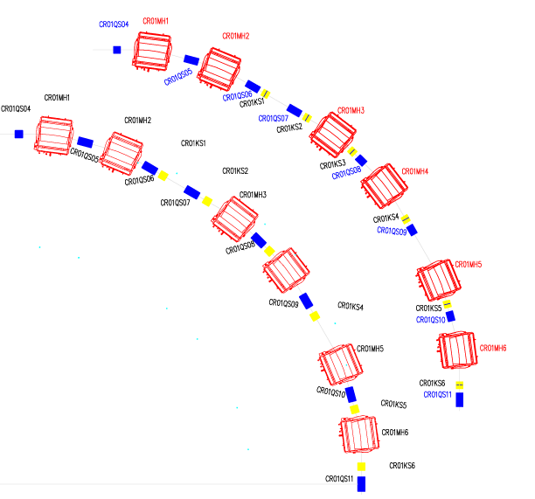
CR arc layout changes
KV – Vertical corrector
KV
QW 70 cm
TDR’s arc layout
with QW 100 cm
The proposed arc changes:
Some quads and sextupoles are shifted longitudinally to optimize the ring acceptance.
Provide a space for vertical correctors, by making 3 quads/quadrant shorter (70 cm instead of 100 cm )
KV
5

Slide 6
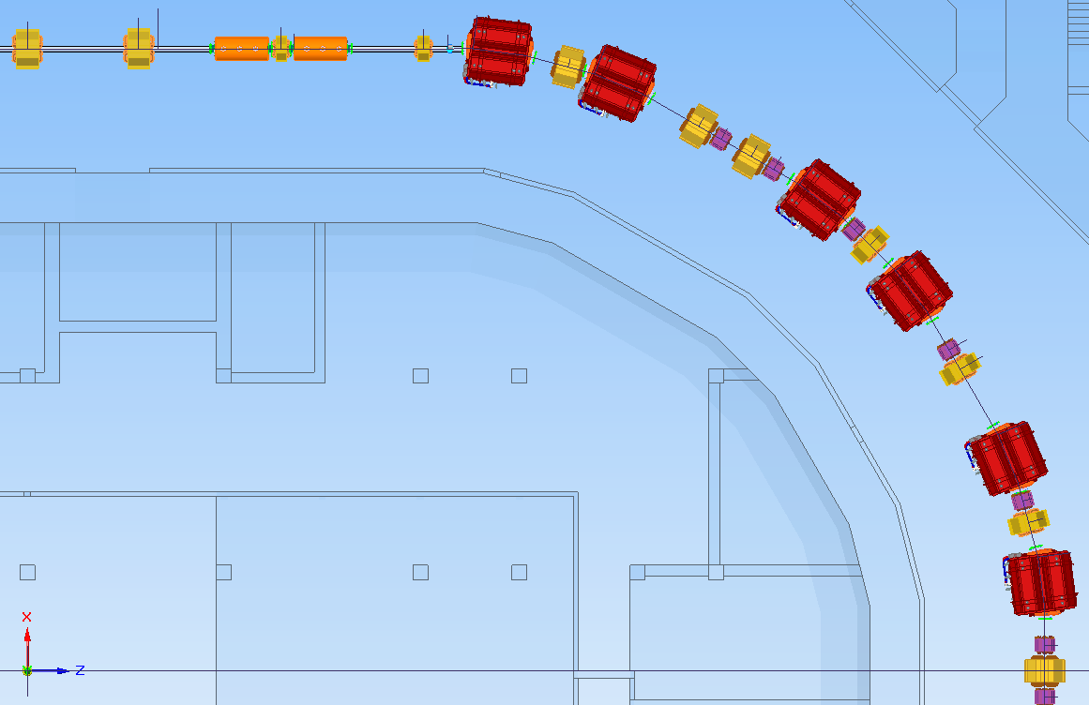
Proposed BPM positions
(±100, ±80)
(±80, ±75)
(±130, ±65)
(±130, ±80)
BPMs are located inside vertical correctors or in free space between elements
3 families of BPMs with different apertures [Yu. Rogovsky talk]
4 BPMs in each half-arc
2 BPMs not far injection/extraction or near symmetry point in arc
(±165, ±80)
(±190, ±75)
6

Slide 7
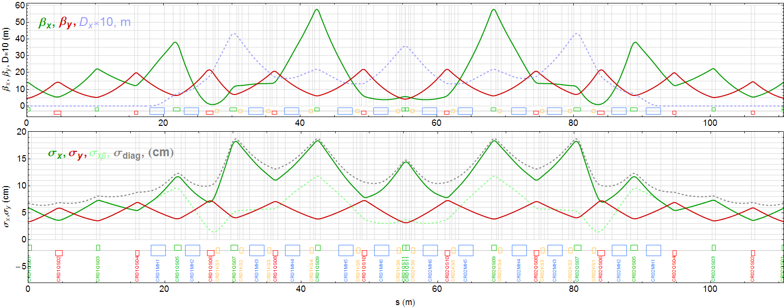
Pbar optics
Lattice functions of one half-period.
beamsizes
Pbar: full betatron frequencies => (4.260, 3.612)
Phase advances normalized by 2 Pi x: 0.128 0.270 0.319 0.763 0.870 0.998 z: 0.116 0.368 0.456 0.603 0.797 0.842
7

Slide 8
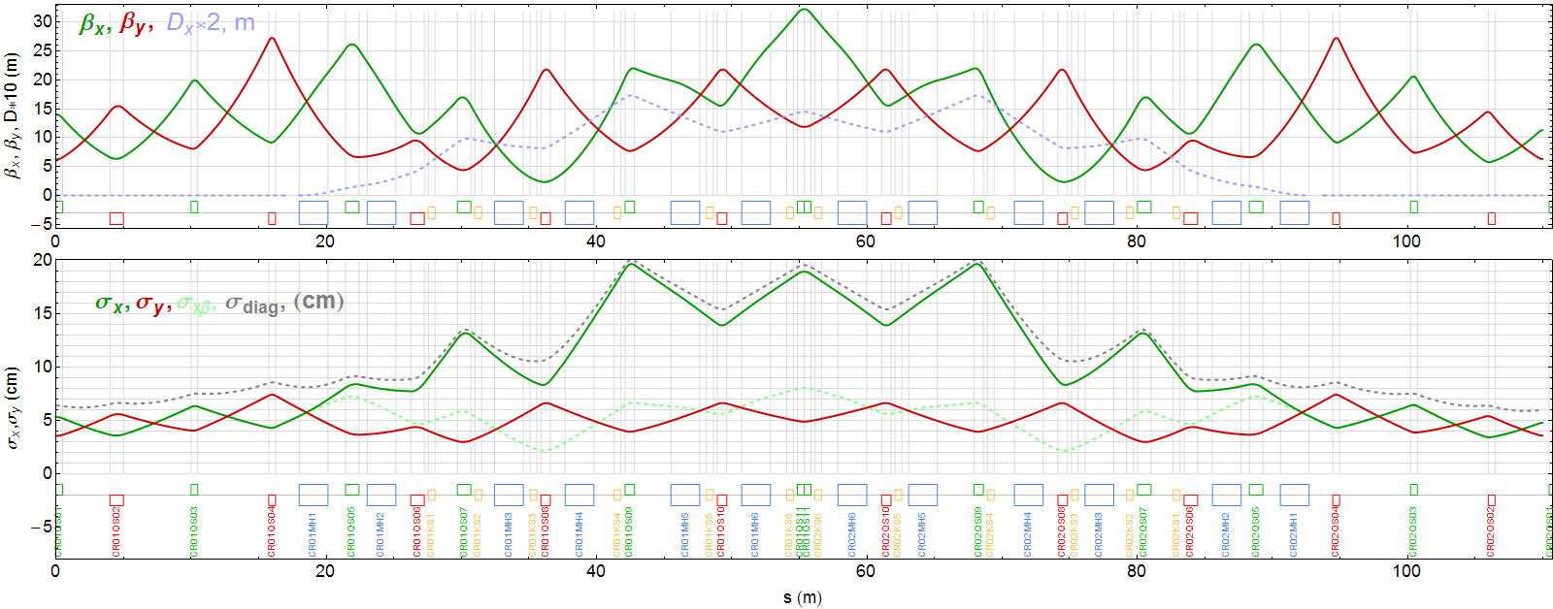
RIB optics
Lattice functions of one half-period.
beamsizes
RIB: full betatron frequencies => (3.2586, 3.2863)
Phase advances normalized by 2 Pi x: 0.116 0.286 0.324 0.610 0.781 0.804 z: 0.095 0.271 0.377 0.599 0.766 0.797
8

Slide 9
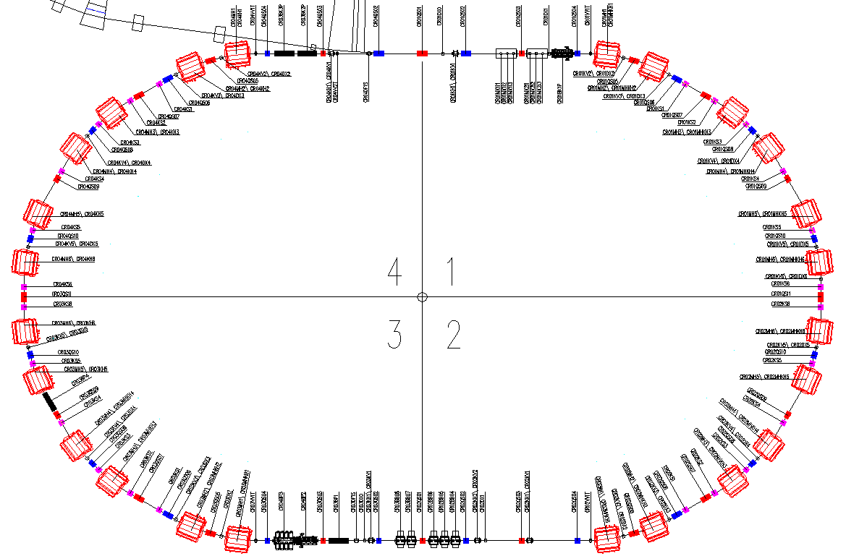
Proposed BPM positions (cont.)
Scraper
Scintillator Screen
SEM-grid
Beam Stopper
FCT
9

Slide 10
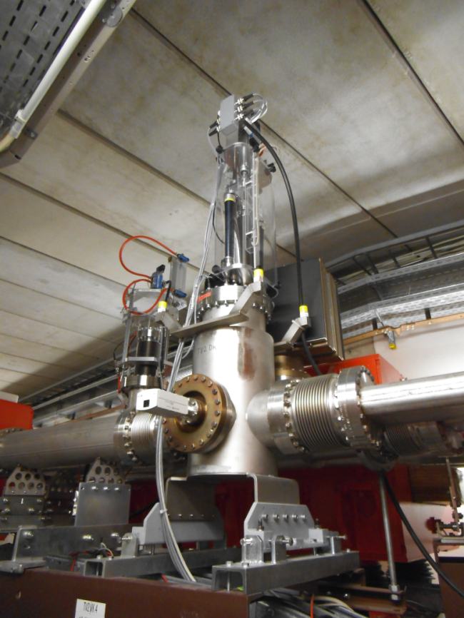
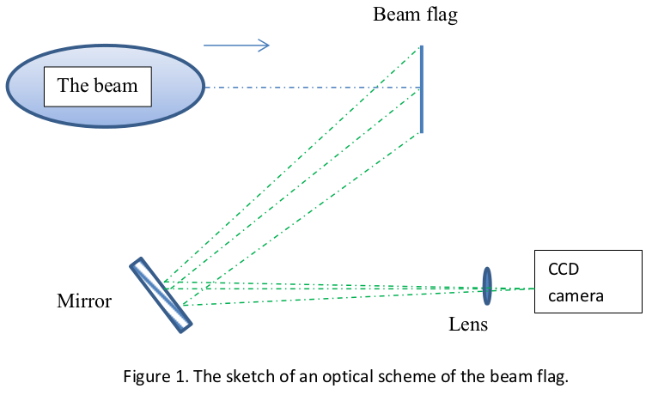
First turn diagnostics (I)
The observation field has dimensions about 200x200 mm. We propose to use a “semaphore type” design for insert of the flag into vacuumchamber of CR. In this case it looks natural to collect the light radiated by phosphor under 45-degree angle to the beam direction (Fig. 1).
10

Slide 11
First turn diagnostics (II)
It seems reasonable to have the flags at both semi-rings and straight sections and at the points of injection and extraction of the beam, so about six flags at all. Is a time about 3-5 seconds small enough for insertion and replacement of the beam flag? We have a prepared design for “semaphore”, but it is driven by electrical engine.
The utility of the multi-wire detector is a subject for discussion. It looks as a sophisticated diagnostics that deliver the same data as beam flags do.
The beam scraper looks as most obvious subject for design. Nevertheless the limit for insertion of it into a vacuum chamber must be determined. In other words, what is a minimal distance between scraper’s neb and axis of vacuum chamber?
11

Slide 12
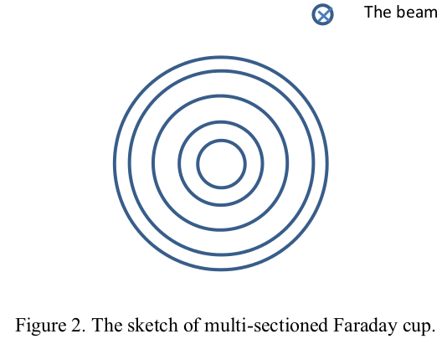
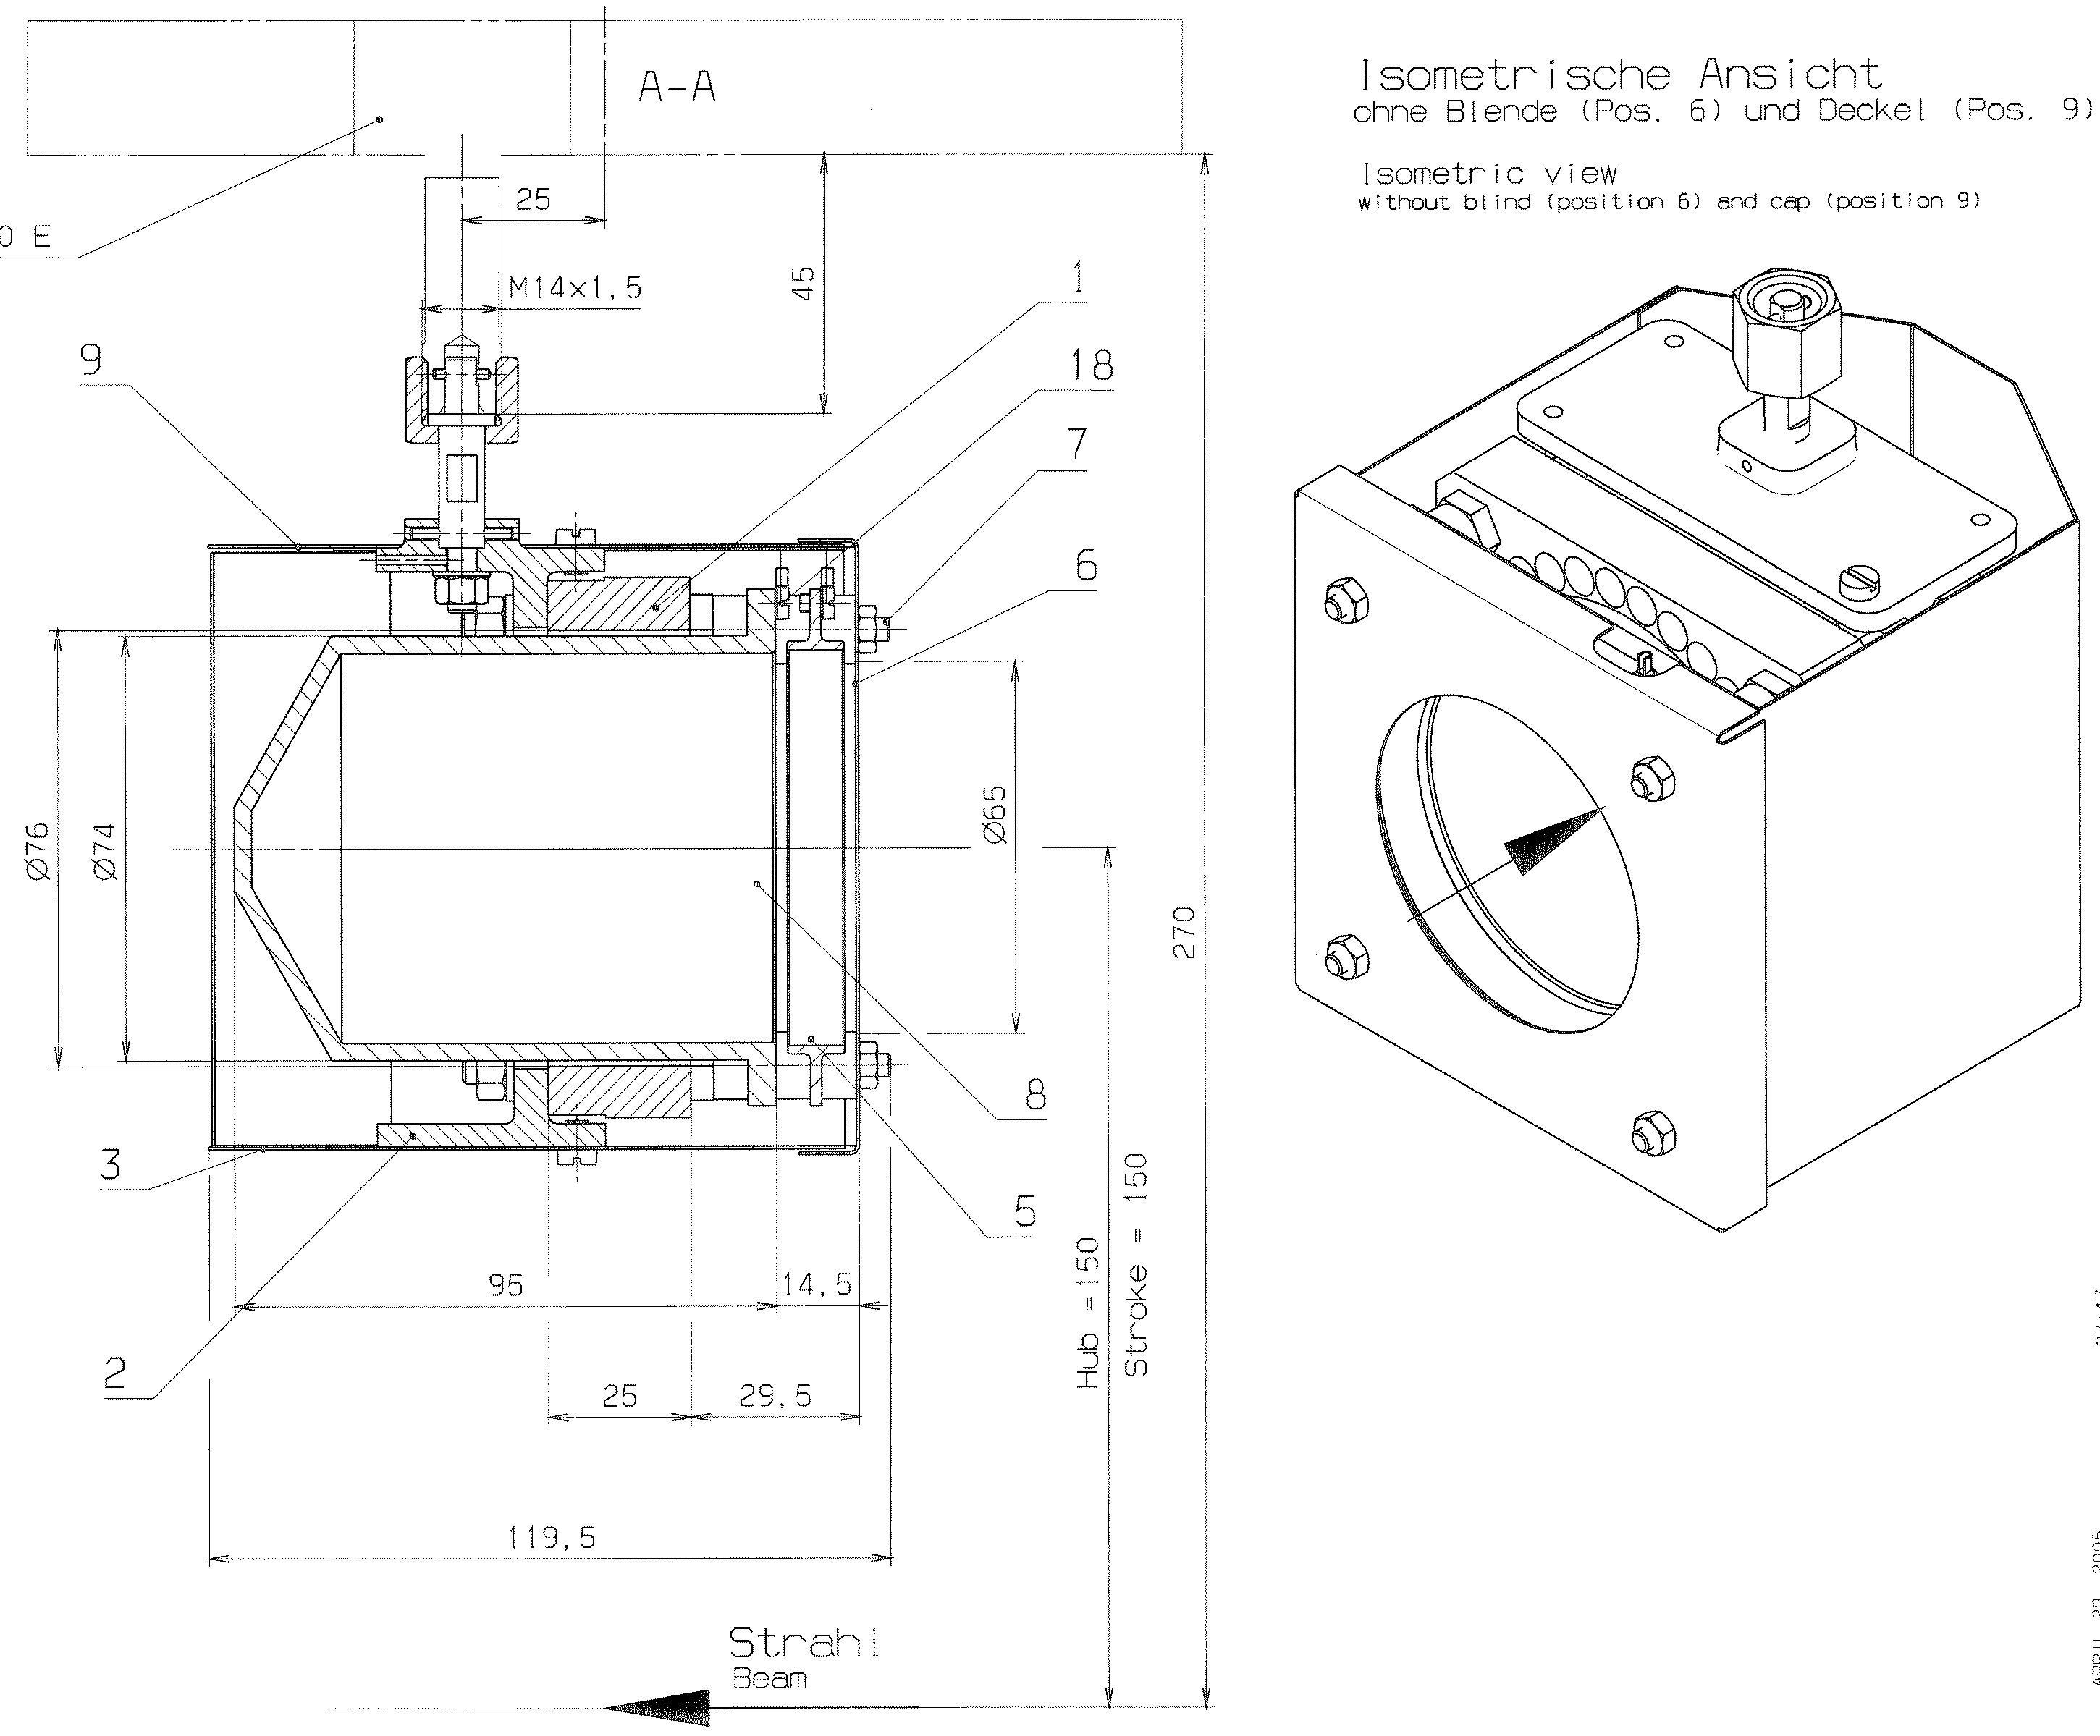
First turn diagnostics (III)
What is a diameter of Faraday cup? We can propose a multi-section design (Fig.2). Will it help for tune of injection or just sophisticate the diagnostics? The reasonable number of sections is about five.
12

Slide 13
Conclusion
Beam position monitors layout seems to be not bad
First turn diagnostics (as zero approximation) needs to be mo clarified
We need to make special meeting concerning RGM (maybe on Friday)
Actually there is no full understanding of layout of all components in a moment, so we should clarify our understanding step by step
13

