Slide 1
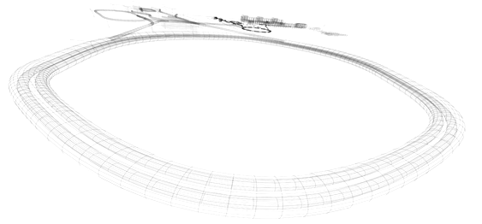
Injection/Extraction Kicker CR Aleksey Kasaev BINP-FAIR-GSI workshop 01.12.2014

Slide 2
Main parameters of the kicker
Maximum magnetic field, mT | 46.3
Direction of kick | horizontal
Horizontal gap X, sm | 18
Vertical gap Y, sm | 10
Integrated field of kicker, mT x m | 167
Number of modules | 6
Effective length , sm | 60
Length of ferrite, sm | 50
Inductance of module, µH | 1.3
Peak current on the kickers plates, kA | 3.7
Rise/fall of pulse (requirement), nsec | 200
Maximum pulse duration, µsec | 0.8
PFN impedance (requirement), Ohm | 6.5
dI/dt for switch (not less), kA/µs | 18.5
Maximum Charging voltage of PFN, kV | 47
Type of thyratron | CX2610
Magnetic Material | 8C11
Ferrite thickness | 3 sm
Field inhomogeneity, no more | 2%
Undershoot, no more | 1.5%

Slide 3
Magnetic field calculation

Slide 4
Parameters of the ferrite
Thickness of ferrite 30 mm
Weight of ferrite per module 50 kg
Weight of one block C-type 25 kg
Total weight of ferrite for 6 modules 300 kg
For calculating take the maximum magnetic field equal 0.15T

Slide 5
Magnetic field distribution along axis X
Window dimension along axis X 180 mm
Nominal magnetic field 46.3 mT
Field nonuniformity in this direction 0.1%

Slide 6
Magnetic field per kicker section
Length of the module 50 sm. The spacing between modules 10 sm.
Integrated field effective 83 mTm.
Calculated in 2D FEMM.

Slide 7
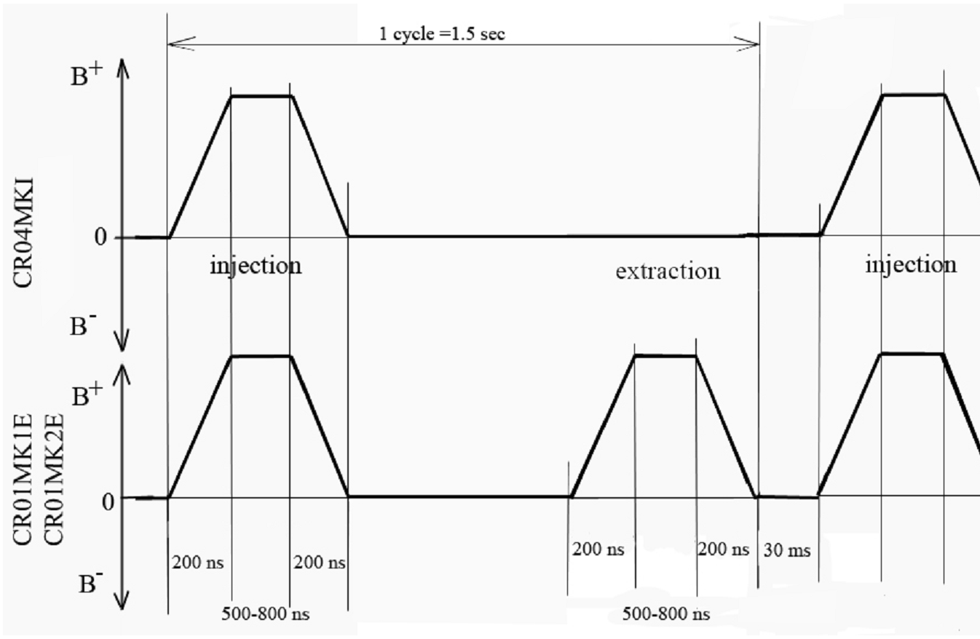
The time cycle of injection/extraction
The time cycle of kicker in the antiproton mode
The time cycle of kicker in the RIB mode

Slide 8
Scheme of the Power Supply
Three methods of PFN construction:
Cable line – connected in parallel for to obtain requirement wave impedance.
Line with concentrated parameters – allow to get the requirements parameters with compact dimensions.
Special line with distributed parameters - also as previous variant.
This scheme provides a different polarity
and duration of the current pulse.
PFN may be consist from the cable line with nominal working voltage 47 kV.
Parameters of the pulse forming line
PFN Impedance 6.7 Ohm
PFN capacity 450 nF
Maximum charging voltage 47 kV

Slide 9
The kickers current simulation

Slide 10
Parameters of the switch
Peak forward anode voltage 47 kV
Peak forward anode current 3.7 kA
Rate of rise anode current 20 kA/µsec
Variants of switch:
Thyratron
Semiconductor
Pseudospark
Thyratron variant
Type CX2610 produced by E2V
Peak forward anode voltage 55 kV
Peak forward anode current 10 kA
Rate of rise anode current 100 kA/µsec
The peak inverse voltage, including spike, must not exceed 5 kV for the first 25 ms after the anode pulse. It is necessary to put a diode in parallel to the thyratron.
Trigger module MA2709A produced by E2V

Slide 11
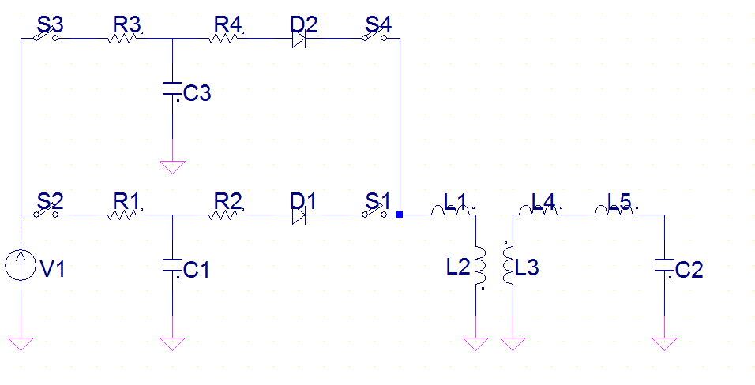
Charging scheme
V1 - power supply (nominal voltage 260V, nominal power 600W)
C1, C2 - capacity storage
S1, S4 - charging switch (nominal current 150A)
L1-L4 pulse transformer (transformation coefficient 192)
C2- PFN capacity
Two capacity storage allow to use low power supply. The time charging of this capacities 1sec.

