Slide 1
Oleksiy Dolinskyy
December 1st, 2014
GSI activity at CR project

Slide 2

Last main events
  The Collaboration Contract for technical coordination of Construction of CR machine between FAIR and BINP has been signed in August 2014.
  In frame of this contract the first two working meetings of BINP with GSI and FAIR experts took place last month

Slide 3
GSI activity after last workshop
- Dipole magnet specifications
- Optics simulations
System design
RF system construction
- SC cooling construction
- Beam diagnostic
- Experimental devices

Slide 4
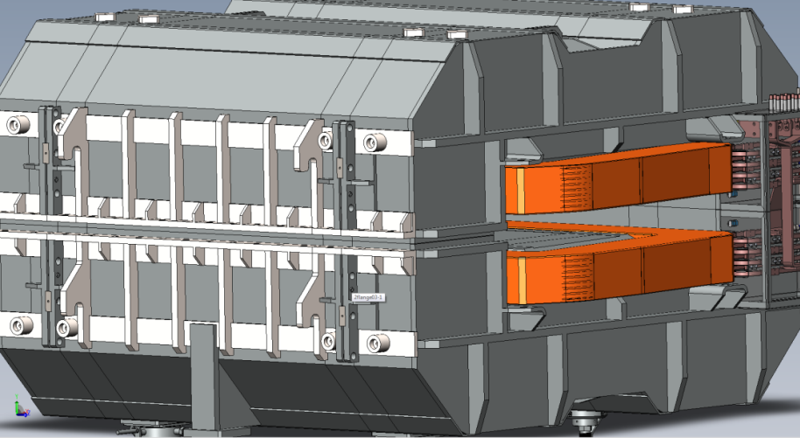
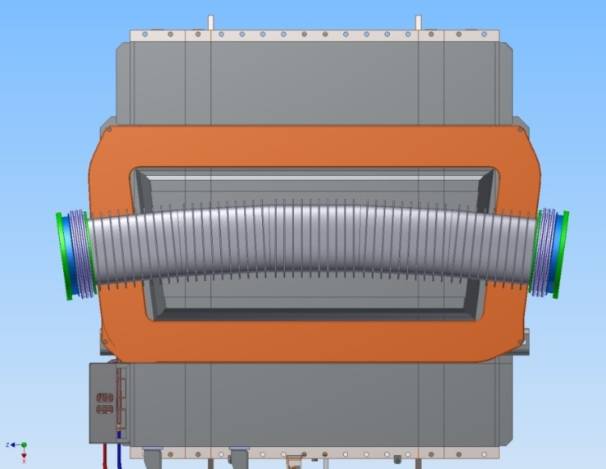
Dipole magnet specifications
  The final specifications prepared by GSI and BINP experts has been officially approved by all parties (FAIR, BINP and GSI) in September 2014.
  The contract between FAIR and BINP for the dipole production is under preparation by FAIR.

Slide 5
Optics simulations
Ion optical simulations were performed together with BINP colleagues. Some results of simulations have been presented in the STORI14 Conference.
Antiproton yield in the chain “target –separator-ring” has
been proved for GSI and BINP optics
(see the Dolinskyy’s talk)
2. Octupole correction in Isochronous mode was analyzed
(see Litvinov’s talk)
3. Possible improvement of pbar-beam parameters for the
HESR has been studied (see the special session
“Stochastic cooling at CR”).

Slide 6
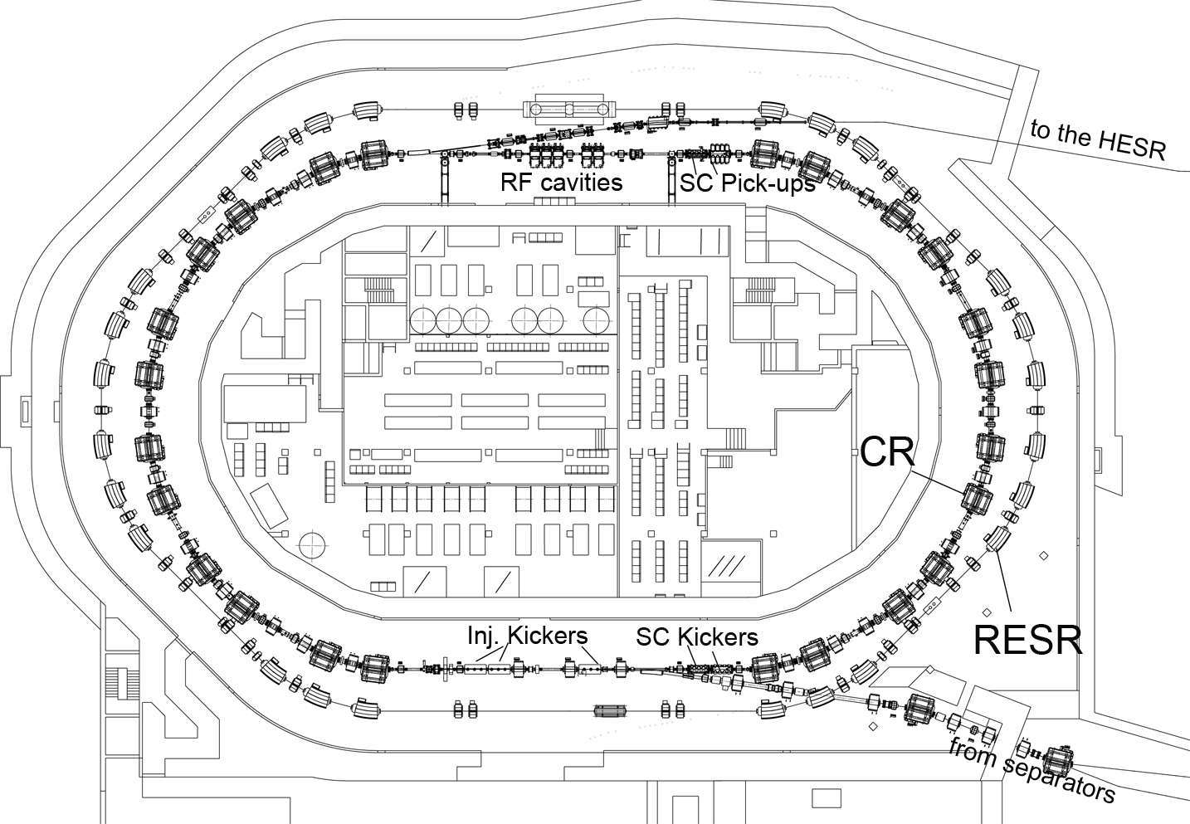

System Design
present layout of the CR, RESR and building
3D CATIA model of the ring and building is continued and completed .
the supply room for the RF cavities has been modified. Change Request has been prepared and submitted for approval.
The MSV version of the CR machine shown in figure

Slide 7
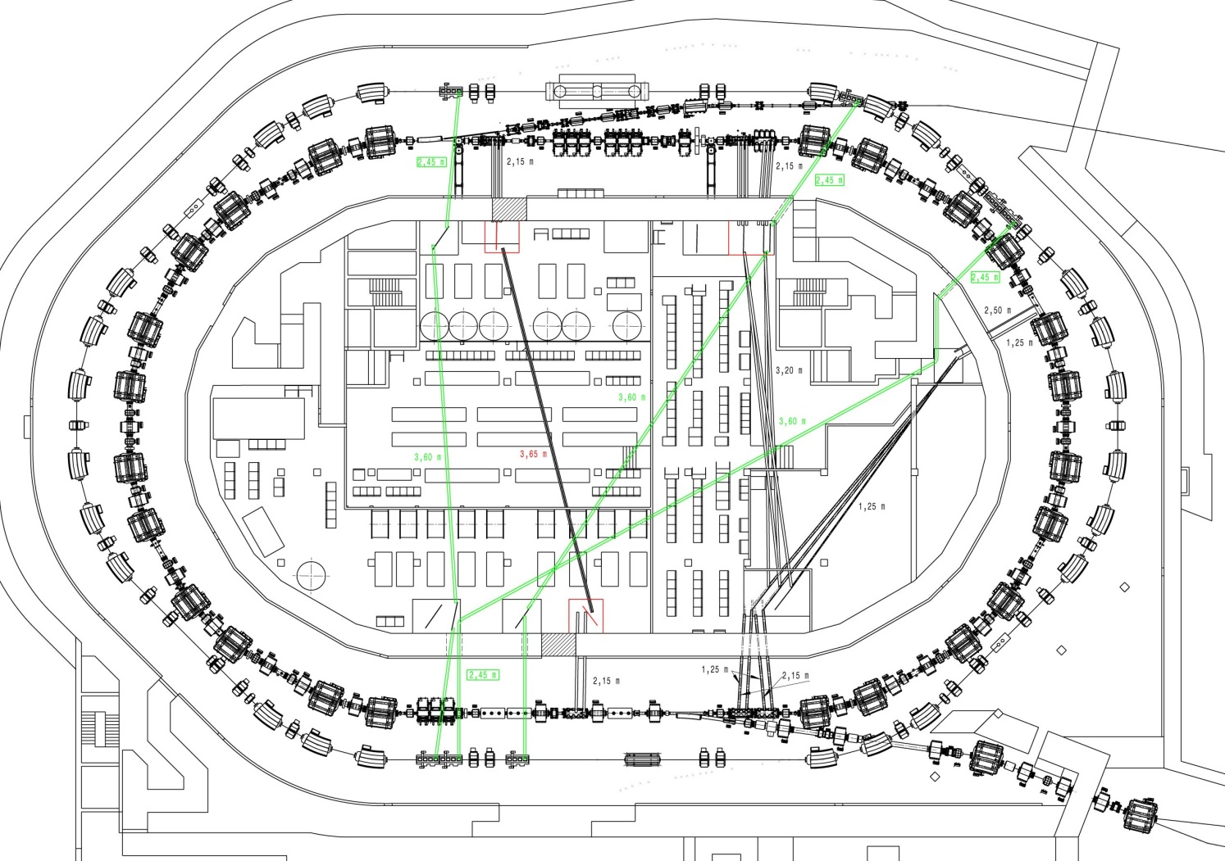
System Design
After upgrade the following components must be added: RESR ring, 5 RF cavities;
SC Pick-UP and Kicker; power supply, cables. The planning of these components is done now.
Thorsten Ziglasch
gives the presentation
about building and cable planning.
The MSV version of the building without RESR and its infrastructure is under preparation.

Slide 8
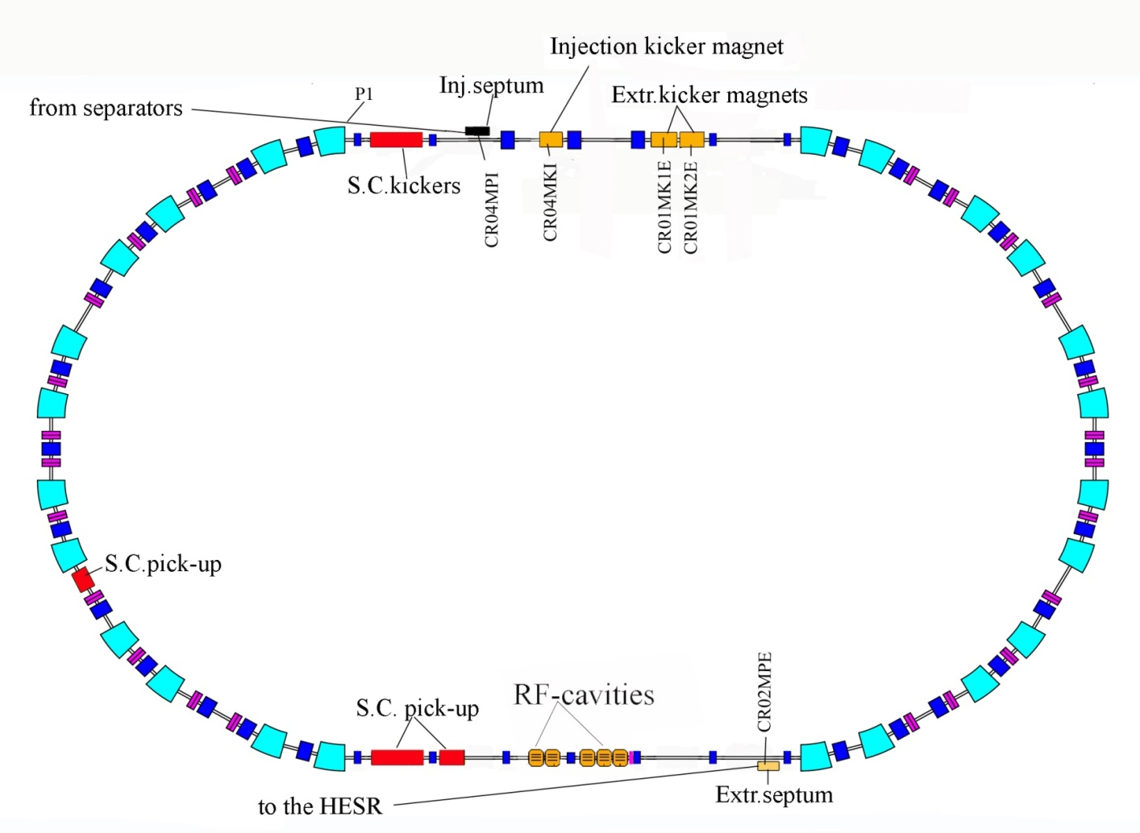
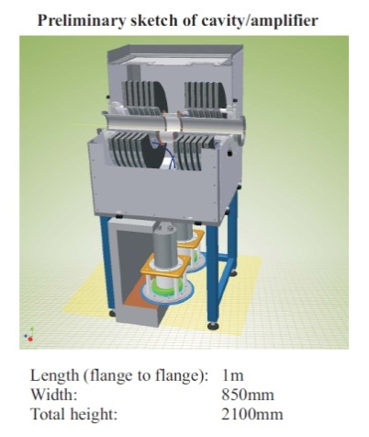
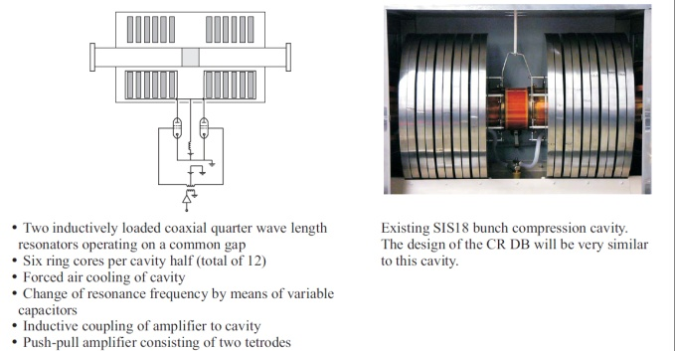
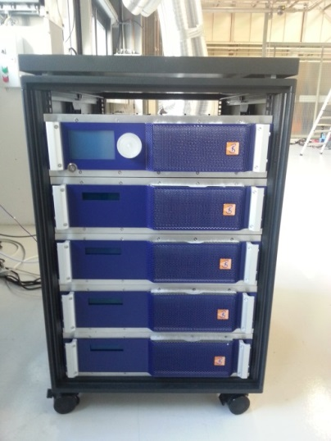
RF sytsem
5 RF cavities produced by GSI must be integrated into the CR.
The space for the 5 additional RF cavities must be reserved

Slide 9
Status RF system
Cavity, power amplifier, amplitude control
- Contract with Research Instruments (Germany) is signed
Final set of manufacturing documents has been reviewed. Minor modifications are required.
Revised mechanical models of cavity and power amplifier included in CR DB DMU.
Production of pre-series system is running
Power supply units
- Conceptual Design Report has been delivered to GSI
- Procurement of 5 power supply units is started
- Pre-series system is expected in the middle of 2015

Slide 10
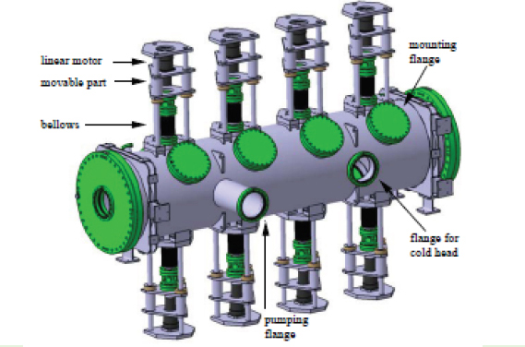
Stochastic cooling
1 Kicker (2-4 GHz)
MSV version
2 Pickup tanks (1-2 GHz)
2 Kicker tanks (1-2 GHz)
1 Palmer Pickup tank
produced by GSI must be
integrated in the CR
After CR upgrade
1 – Pickup tank (2-4 GHz)
1 – Kicker tank (2-4 GHz)
The space and infrastrucutre
must be reserved now.
Palmer cooling PU
1 Pick-Up (2-4 GHz)
2 Pick-Ups (1-2 GHz)

Slide 11
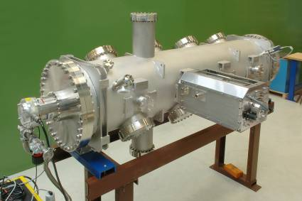
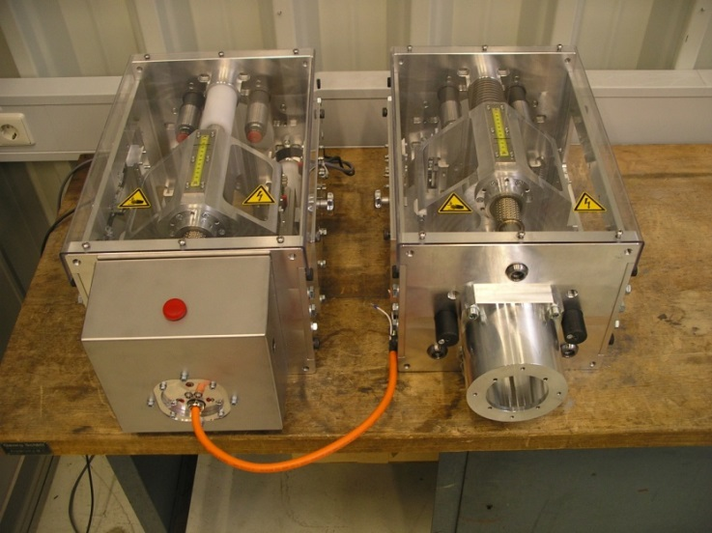
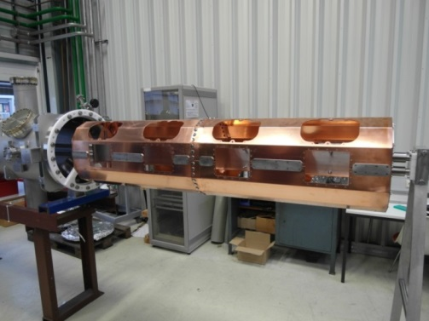
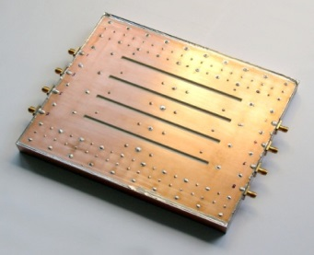
Status Stochastic Cooling System
2 new linear motor drive units designed and manufactured, assembled and now under test
(mechanical, electronics, software)
Prototype stochastic cooling tank with PU movers, cold heads (20 K) and cooled pre-amplifiers
Prototype electrode
(ß = 0.83-0.97)

Slide 12
Status Stochastic cooling
Pick-up tanks and electrodes:
Prototype Pick-Up tank is ongoing to reassembly, tests at very low temperature.
-Motor drive units: successfully tested, improvements underway; emergency switch in fabrication for work safety.
-First successful function test of He cryoheads and cryocompressors.
-Ongoing preparations for cryotests in the tank.
Palmer pick-up:
Engineering activities for Faltin electrodes:
-Manufacturing/procurement of prototype Faltin electrodes underway;
-HF Simulations on mode damping in the tank.
Kicker electrodes and it tanks:
No activity
Software:
- FOPLEQ 1D, 2D codes has been developed (Solution of Focker-Planck Equation (1D, 2D))
-MPT code is developed (Multi Particle Tracking in time domain approach)
RF- electronics:
Contract for production of 34 power amplifiers has been signed. Procurement is started. First (prototype) amplifier is expected in the middle of 2014. Preparation of infrastructure for SAT.
(see the C.Domopoulou’s talk for more details)

Slide 13
Beam diagnostic
Cryogenic Current Comparator (CCC) (GSI in - kind)
One common design (for SIS100, HEBT, CR, CERN AD is under
development by GSI and CERN collaboration.
Schottky Pick-Up ( ITEP in-kind, Moskow ) (the specs is reconsidered by GSI experts)
Tune BTF exciter (ITEP in-kind, Moskow ) (the specs is under
prepararation by GSI experts)

Slide 14
Beam diagnostic (Schottky detector)
The specifications for Schottky pick-up has been prepared and approved
Schottky pick-up construction is assigned to ITEP, Moskow (Russia In-Kind)
The prepared specifications of Schottky pick-up is checked by experts from ILIMA collaboration. Final decision will be done in December 2014

Slide 15
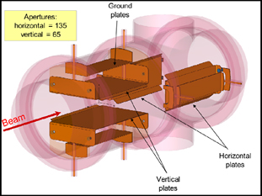
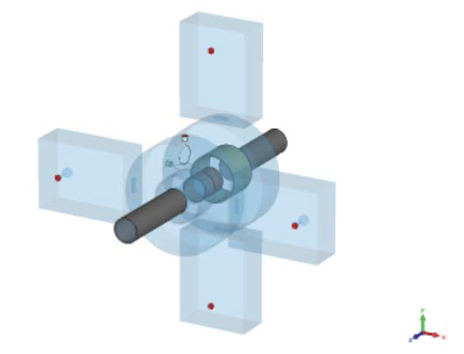
Schottky detector
CR Schottky
Schottky pick-up
Number of elements | 1
Overall length | mm |  | 1000
Horizontal aperture | mm |  | 200
Vertical aperture | mm |  | 200
Bandwidth | MHz |  | 5-100
Frequency resolution | 2×10⁻⁷
Absolute frequency value | 2×10⁻⁷
Tune measurement resolution | 10⁻⁵
Intensity range |  | 10⁶ -10¹¹
SIS100 Schottky
Which type of Schottky detector to apply at CR
Pick-up plates (like SIS100) ?
Resonator cavity type (R@D is still required)
Narrow band resonator cavities (several units are needed)

Slide 16
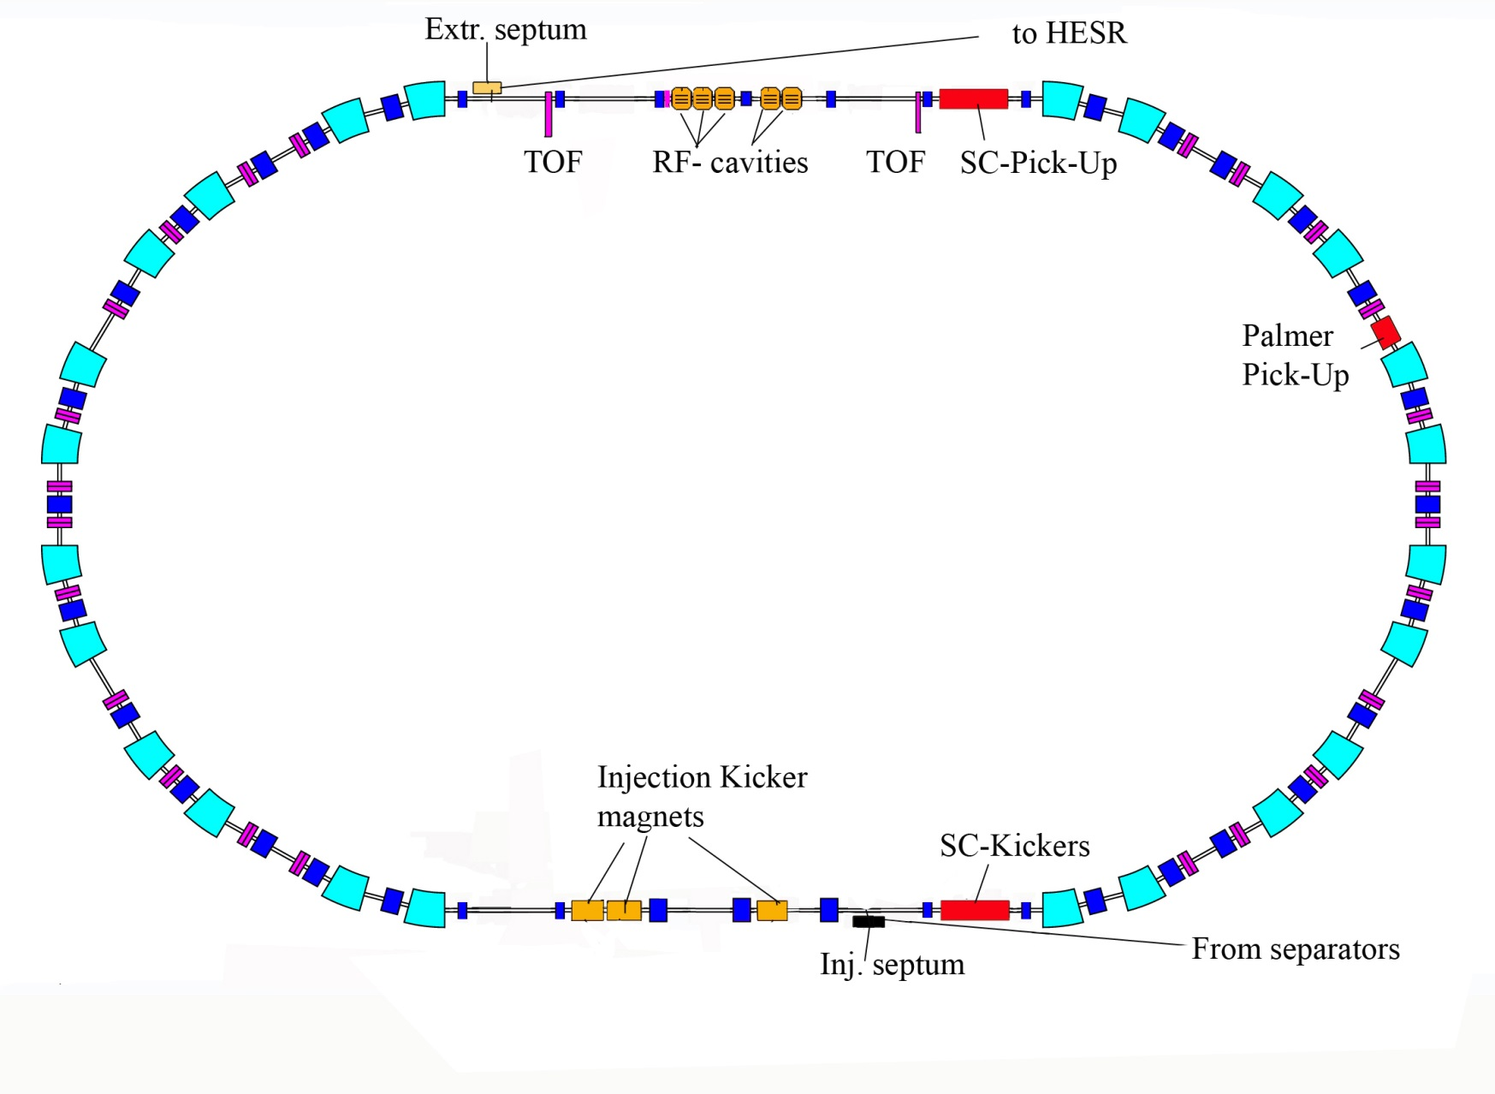
Schottky resonators in CR
14 Schottky resonators are planned to install in the ring for mass measurements.
Shahab Sanjari will present the conceptual design of these resonators.

Slide 17
Other activities
- Stability properties of the dipole magnet versus current ripple was studied by Y.Shim (see his talk in this workshop).
- TOF detectors is under development at Giessen University (see the talk of M.Diwisch).

