Slide 1
Status of CR and activity at BINP
I.Koop, D.Berkaev, BINP, Novosibirsk
01.12.2014, 6-th FAIR-GSI-BINP workshop, GSI, Darmstadt

Slide 2
CR status
TDR last update was made by GSI’s team in February 2014.
Main goals and parameters of a facility are listed there and serve us as a reference.
BINP team introduced some CR layout and lattice improvements aimed to increase the beam capture efficiency by 20-30 %.
A short contract between GSI and BINP was made to work out the dipole magnet design. The result is positive. We are ready to sign with FAIR a contract for series production of 26 dipoles.
Inscribed radii of quads are defined to be 100, 160 and 185 mm. The corresponding lengths are 500, 1000 (or 700) and 1000 mm.
Design of quads, sextupoles and orbit correctors is in progress. Specs for them and for all power supplies will be prepared to May 2015.

Slide 3
CR status, continued
Linear and non-linear optics studies are continued.
The pbar transport line geometry seems is fixed (TCR1 part).
A new concept for injection septum magnet was introduced. Its design is based on use of short pulse and ceramic vacuum tube.
Optics calculations for CR pbar transport line are updated taking into account these new septum magnet parameters. Matching of 4-d beam phase-space with CR is almost perfect!
The kicker magnet design just starts. Their location in CR are changed. One of the tank is moved to the place behind of Q3. This leads to smaller magnet aperture and saves the needed power.
Design of pickups and other beam diagnostic just starts.
We are working hard on the vacuum system concept. Specs will be prepared to May 2015.

Slide 4
BINP activity
Introduction
Linear and nonlinear CR optics (I.Koop, D.Shwartz)
Pbar channel optics (P.Shatunov)
Injection kickers design (A.Kasaev)
Dipole and other magnets design (A.Starostenko)
Power supplies (D.Senkov)
Vacuum chamber issues (A.Krasnov)
Beam diagnostics (Yu.Rogovsky)
Discussions on CR-infrastructure issues (D.Berkaev, A.Sukhanov, S.Shyankov, A.Zhirkova)
Conclusion

Slide 5

Introduction
  The TDR CR has been updated and approved in February 2014.
  IKRB meeting (01.04.20014) assigns a major part of the CR (63 %) and antiproton separator components to the BINP.
  Contract on transfer of the CR and TCR1 line system responsibility to BINP is signed in August 2014.
  The collaboration work of GSI and BINP experts is going on.
  Five FAIR-GSI-BINP Workshops were held at GSI. The 6-th is on!

Slide 6
Revision of the CR optics
Under optimization are 3 different optics: pbar, RIBs and isochronous (with γ=1.43, 1,67, 1.84)
Apertures in quads need to be increased: r=160 mm in most QW, r=185 mm in 3 QW for the injected beam (Q1, Q2), r=100 mm in all QN
Length of few QW is 70 cm but others are 100 cm
Isochronous optics study is in progress
First dynamic aperture studies are performed by O.Gorda – MADX and D.Shwartz – SAD, all is OK.

Slide 7
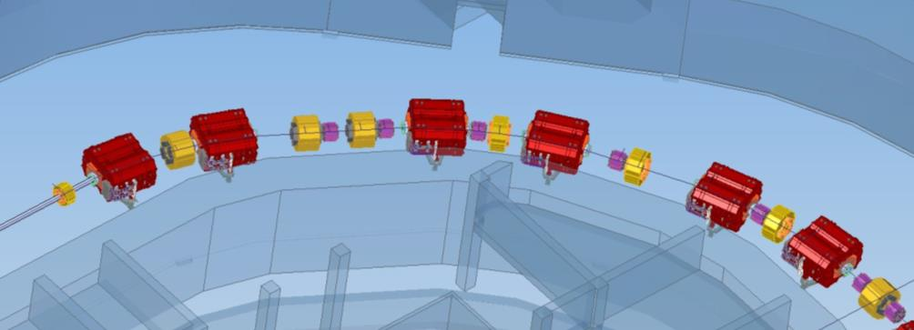
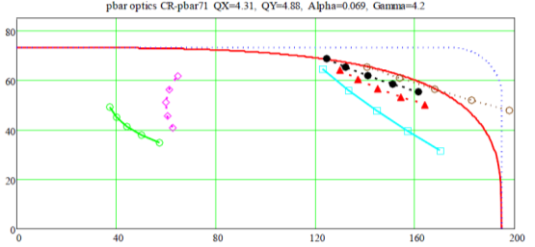
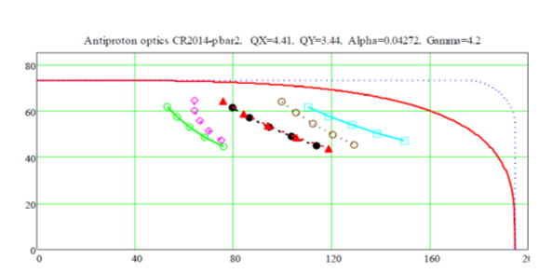
Optimizations of CR layout 1:
The positions of Quadrupole and
Sextupole Magnets in the CR arcs were
changed to reduce the beam sizes both in Quadrupole and Sextupole Magnets and in Dipole Magnets approximately by 20% as compared to the initial variants of antiproton and ion optics. Thus, the necessary margins for possible closed orbit distortions or increasing of beam sizes due to nonlinear effects were achieved, which needed to be 10% or more. The result of such layout optimizations is more reliable optics at modes of CR operation.
before
after

Slide 8
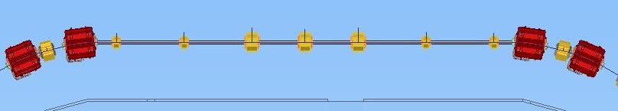
Optimizations of CR layout 2:
Straight section Quadrupole Magnets (Q02, Q03, and Q04) were moved by 0.5 m closer to the “central” Quad (Q01) retaining the total length of a long straight section. This movement allowed a further reduction of the beam sizes at the places of superconducting cryogenic comparator and the FR cavities. The latter was quite necessary to fit the beam size to current CR FR cavities project (responsibility of GSI GmbH).
Beam sizes evolution along location of RF1 – RF3 cavities (red dots) and RF9 – RF10 cavities (blue dots).
Beam sizes evolution along location of RF1 – RF3 cavities (red dots) and RF9 – RF10 cavities (blue dots)
RIB-326-328 optics

Slide 9
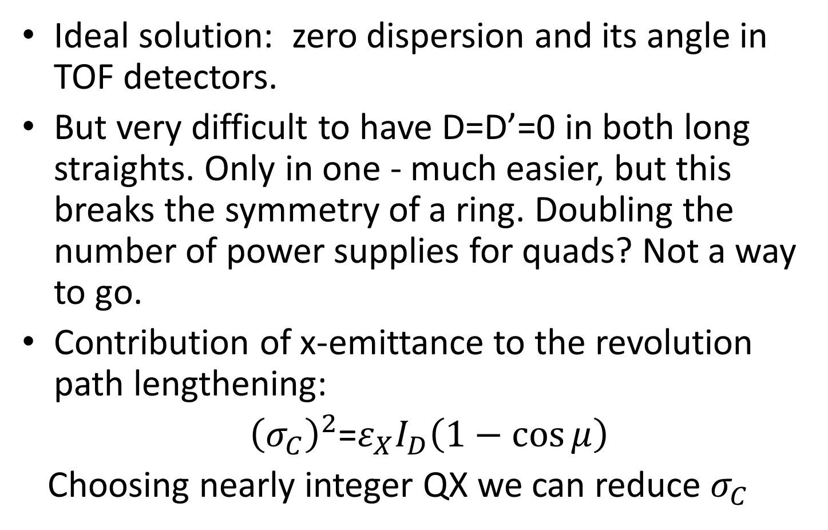
Isochronous optics optimization
Ideal solution: zero dispersion and its angle in TOF detectors.
But very difficult to have D=D’=0 in both long straights. Only in one - much easier, but this breaks the symmetry of a ring. Doubling the number of power supplies for quads? Not a way to go.
Contribution of x-emittance to the revolution path lengthening:
${\left(σ_{C}\right)}^{2}$=$ε_{X}I_{D}\left(1−\cos{μ}\right)$
Choosing nearly integer QX we can reduce $σ_{C}$

Slide 10
Proposed antiproton optics changes
Qx=4.26, Qy=3.61 (CR71: Qx=4.31, Qy=4.88)
Momentum compaction α=0.04272 (CR71: 0.069)
Slip factor: η=α - γ⁻²= -0.014 (CR71: η=0.012)
Local slip factor: η_pk=0!
SC phase advances: dQx_pk=1.76, dQy_pk=1.25
Q8 – Q10 quads permuted with nearby sextupoles to minimize beam sizes in dipoles

Slide 11
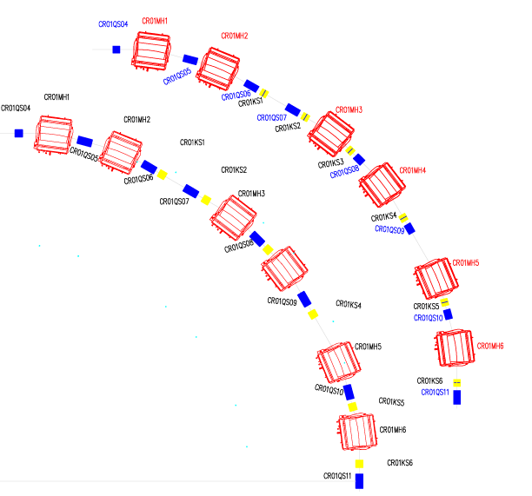
Proposed CR arc layout changes
KV – Vertical corrector
KV
QW 70 cm
TDR’s arc layout
with QW 100 cm
The proposed arc changes:
Some quads and sextupoles are shifted longitudinally to optimize the ring acceptance.
2. Provide a space for vertical correctors,
by making 3 quads/quadrant shorter
(70 cm instead of 100 cm )
KV

Slide 12
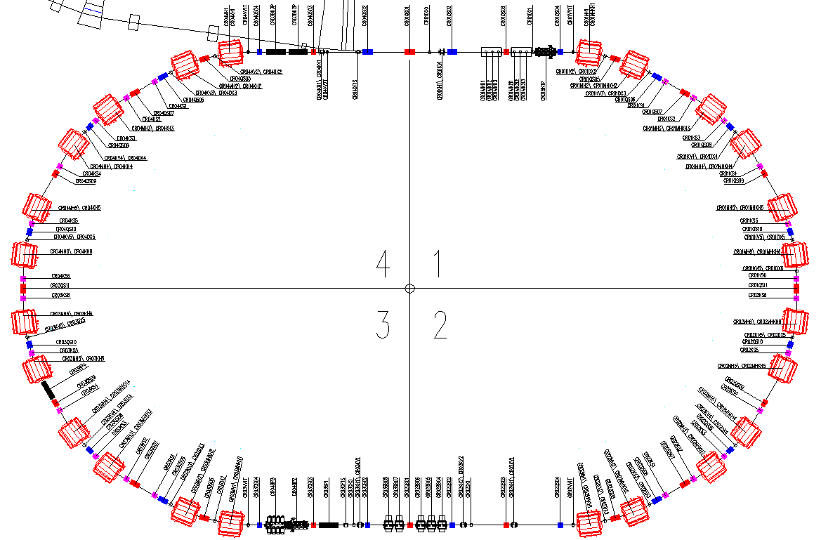
CR new layout

Slide 13
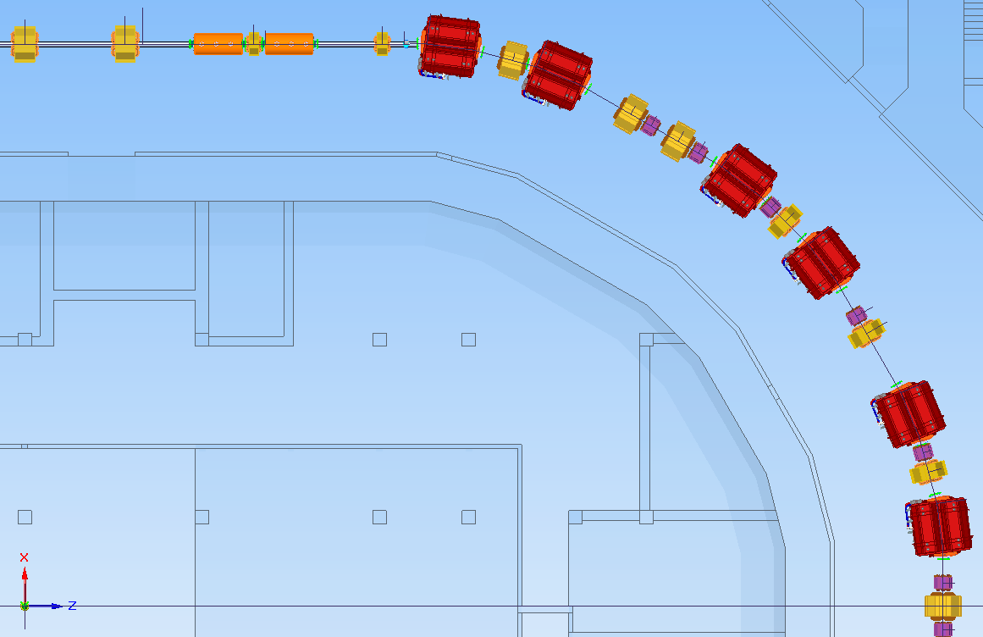
CR layout. Cont.

Slide 14
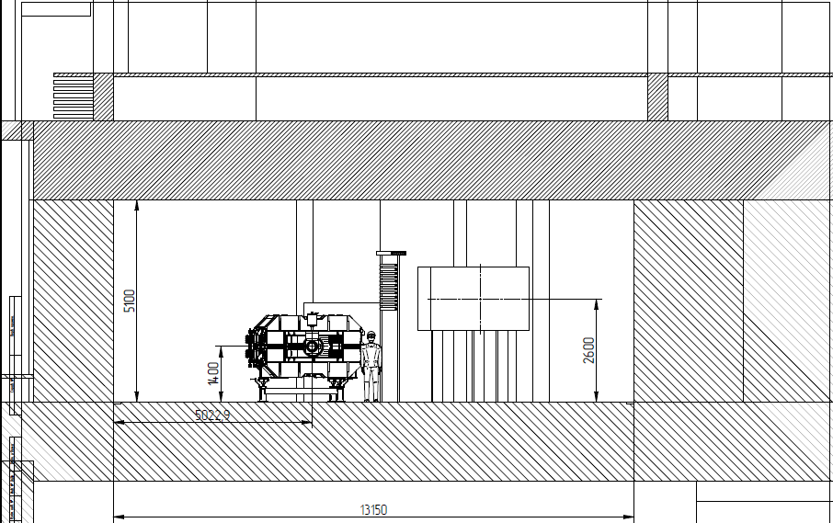
CR in the tunnel

Slide 15
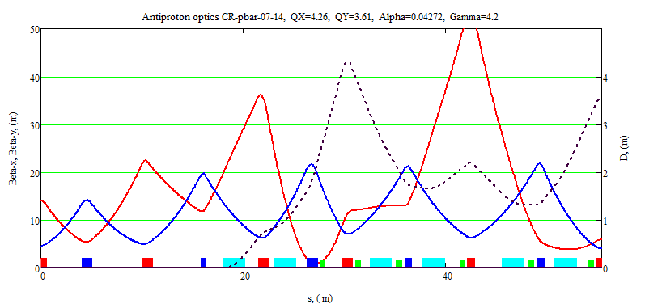
BINP version of pbar optics: Qx=4.26, Qy=3.61
βx
D
βy
Dmax= 4.4 m (CR71-version: Dmax = 5.05 m), γ=4.2, γ_tr=4.84

Slide 16
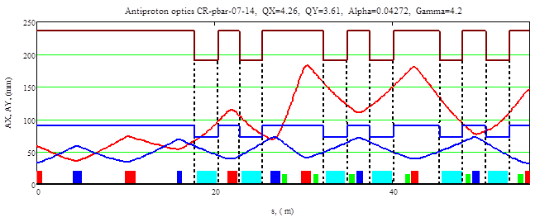
BINP version of pbar optics: Qx=4.26, Qy=3.61
Ax
Ay

Slide 17
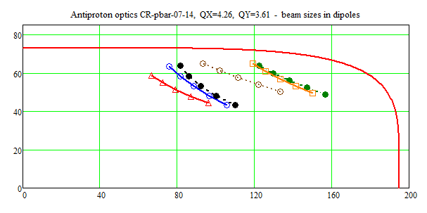
BINP version of pbar optics: Qx=4.26, Qy=3.61
y, mm
Ax
x, mm
X_{max} =157 mm, Y_{max} =65 mm, α=0.04272, η= - 0.01397, γ=4.2

Slide 18
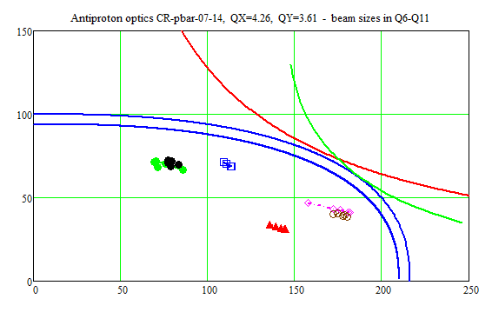
BINP pbar optics: Qx=4.26, Qy=3.61
X_{max} =182 mm, Y_{max} =73 mm, R_{QW} =160 mm, R_{SX} =185 mm

Slide 19
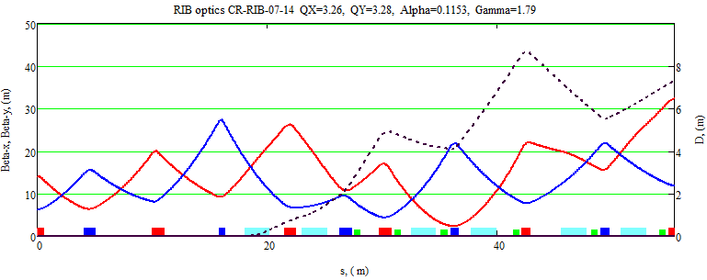
BINP version of RIB optics: Qx=3.26, Qy=3.28
D_{max} =9.25 m, α=0.1153, η= - 0.1968, γ=1.79, γ_{tr}=2.945

Slide 20
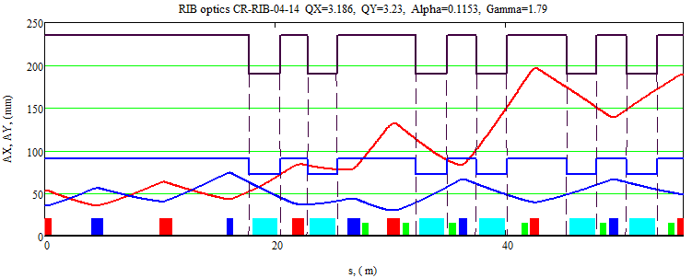
BINP version of RIB optics: Qx=3.26, Qy=3.28
Ax
Ay

Slide 21
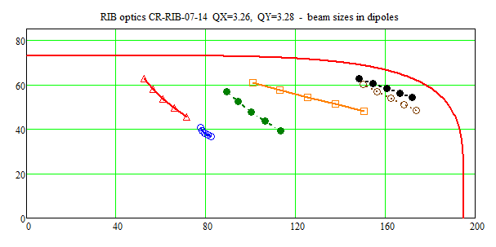
Beam sizes in dipoles
BINP version of RIB optics: Qx=3.26, Qy=3.28
X_{max} =174 mm, Y_{max} =63 mm, α=0.1153, η= - 0.1968, γ=1.79

Slide 22
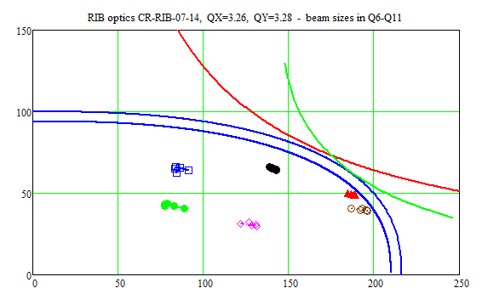
BINP RIB optics: Qx=3.26, Qy=3.28
Beam sizes in quads Q6 – Q11
X_{max} =196 mm, Y_{max} =66 mm, R_{QW} =160 mm, R_{SX} =185 mm

Slide 23
CR Dipole Magnet (PSP 2.5.2.1) 1
The approach proposed by BINP assumes straight magnet yoke with sector poles only
Though, this approach leads to widening of the magnet cross section and, in turn, to increasing of the yoke weight up to 50 tons, it helps to simplify significantly magnet production and equipment for it. Moreover, this approach provides significantly higher achievable mechanical precision of poles manufacturing and item-to-item identity.

Slide 24
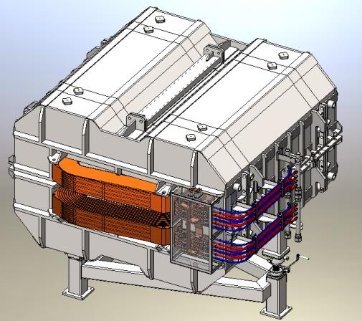
CR Dipole Magnet (PSP 2.5.2.1) 2
For convenience of assembling and shipment each half of the yoke is separated into three parts: 3.8 t, 17.6 t and 3.8 t, which are assembled with bolting
The status is: BINP has a design of a magnet, preliminary manufacturing technology, commercial offers or official pricelists from different suppliers for the main materials: iron for yoke, copper, stainless steel and other.
Magnet type | H – type
Geometry | Straight yoke, sector pole
Edge focusing | No
Coils | Race Track
Iron | M1200-100A
Lamination thickness | 1 mm
Cost (November, 2014) | 636 k€
Number | 24+2
Expenses | Cost
Laminas for yoke | 198 k€
Copper | 65 k€
Other materials & components | 15 k€
Manufacturing | 304 k€
Shipment & Taxes | 54 k€

Slide 25
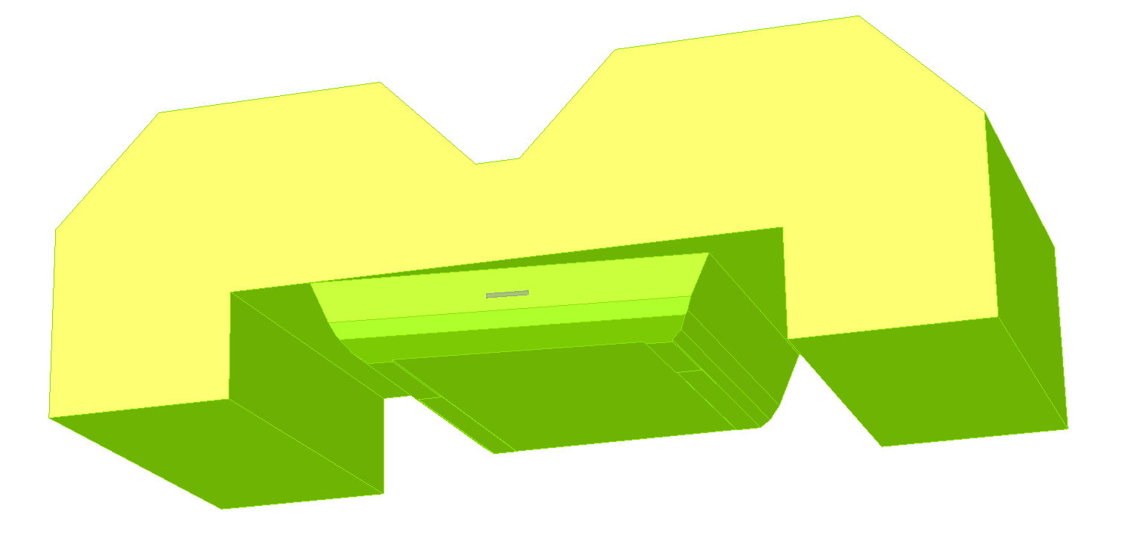
CR laminated sector type dipole iron

Slide 26
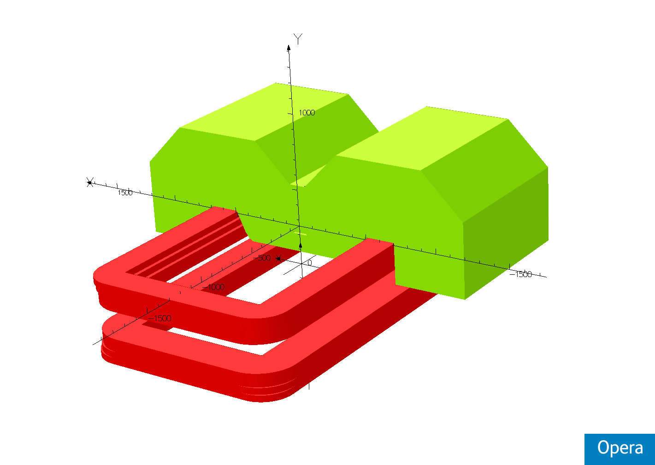
3d model of CR dipole

Slide 27
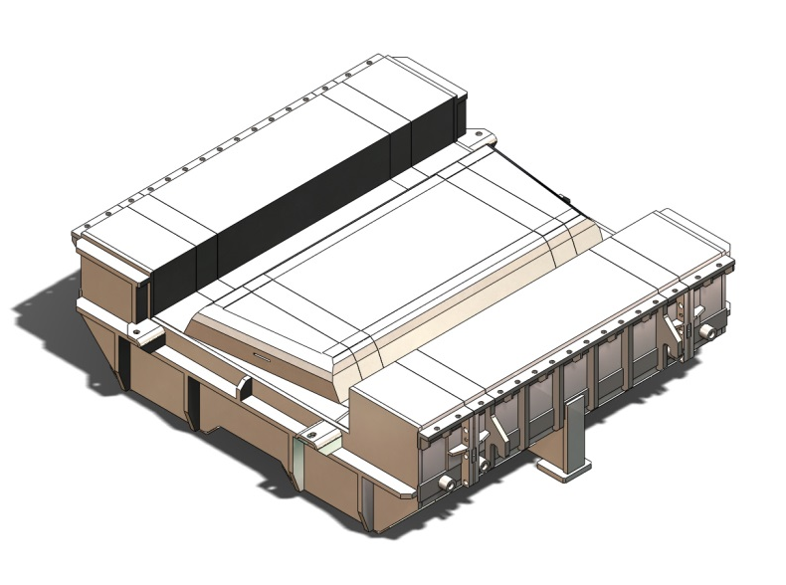
CR dipole lower yoke

Slide 28
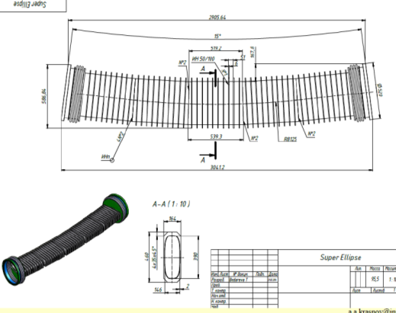
CR Dipole Vacuum Chamber (PSP 2.5.7.1.2.2)
CR Dipole Vacuum Chamber is assumed to be bake-able at the temperature of 350 °С within 24 hours and fits all the requirements for CR beam sizes and dynamics.
The chamber consists of five 519-mm long straight sections argon welded with each other. Wall thickness is 2 mm, bending radius – 8125 mm, length – 2.9 m approximately. The super elliptic cross-section vacuum chamber has the outside ribs with thickness of 5 mm for mechanical resistance. At the ends the chamber is equipped with “Conflat” flanges. Besides the opportunity of the bake-ability such approach can significantly reduce of the material costs but requires from the producer a very accurate assembling and welding technique.
Further increasing of the vacuum chamber aperture requires increasing of the ribs thickness or reduction of the ribs space (50 mm in the proposal), which in turn leads to complication of production and increase in materials cost.

Slide 29
Bake-able rectangular vacuum chamber

Slide 30
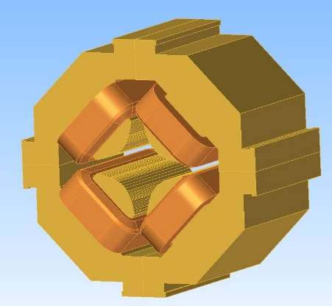
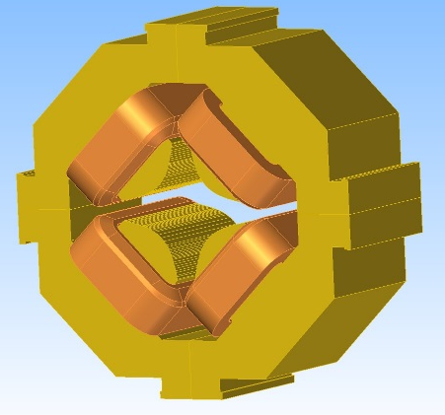
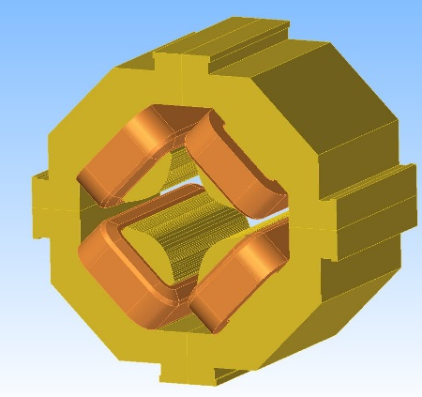
Quadrupole Magnets 1
WQ
After such CR layout optimization appeared to be rational to increase the number of types of Quadrupole Magnets with a wide aperture from one to three:
  WQ type. 14 Quadrupole magnets in the arcs have an inscribed radius of 160 mm with an effective length of 1000 mm, G_{max} = 4.7 T/m;
  SWQ type (Short Wide Quads). The rest 12 arc Quadrupole magnets have the same inscribed radius of 160 mm, but effective length is reduced to 700 mm, G_{max} = 4.7 T/m. It can be done due to a smaller integral of quadrupole field required and the remained drift space can be used for other CR items (see 4) ;
  EWQ type (Extra Wide Quads). 3 Quadrupole magnets right after the injection point should have additional aperture to avoid injected beam losses. An inscribed radius of 185 mm at an effective length of 1000 mm, G_{max} = 3.5 T/m.
SWQ
EWQ
All these types of wide Quadrupole Magnets have the same production technology, very similar electric properties and properties of their PS.

Slide 31
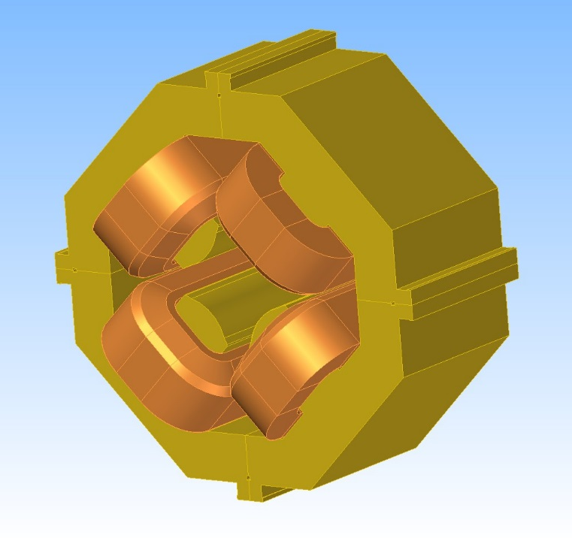
Quadrupole Magnets 2
Increased number of CR Narrow Quadrupole Magnets
(11 instead of 4 in TDR) replaces weak but Wide
(and more expensive) Quadrupole Magnets at all the places of CR where it is possible while maintaining all required CR parameters. Besides the advantages of new optics it promotes reduction of the total cost of CR magnet system where possible.
All the Quadrupole magnets, narrow and wide, use the same copper current conductor as the dipole magnets: 20.1×20.1 mm² with cooling hole Ø11 mm. Thus the PS current of the Quadrupole Magnets must not exceed 1.5 kA.
On the one hand, such reduction of the current (4.5 kA in TDR) will simplify the power converters requirements and, on the other hand, will give the possibility to use the same approach in cabling as for Dipole Magnets.

Slide 32
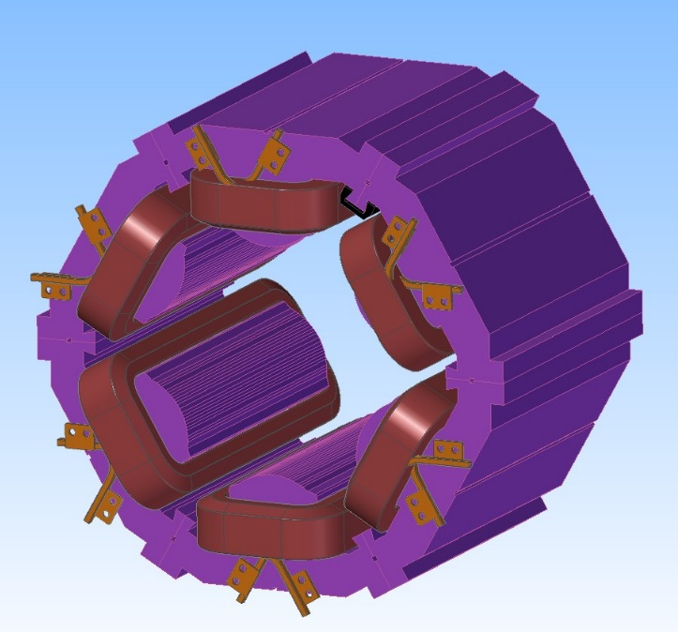
CR Sextupole Magnets (PSP 2.5.2.3.1)
The main advantages of the reviewed CR Sextupole magnets:
Vertical corrector is moved from this magnet. As a consequence the aperture of the Sextupole Magnet (inscribed radius) is reduced down to 185 mm (210 in TDR). Thus, the PS requirements are reduced too: 455 A, 21.4 V (580 A and 34.2 V in TDR).
Accurate magnetic and mechanical calculations have shown the necessity of the “return” yoke thickness increasing. Otherwise this magnet will not have enough mechanical strength (hardness). Nevertheless, total weight of the magnet is also reduced down to 1.2 t (1.4 in TDR).

Slide 33
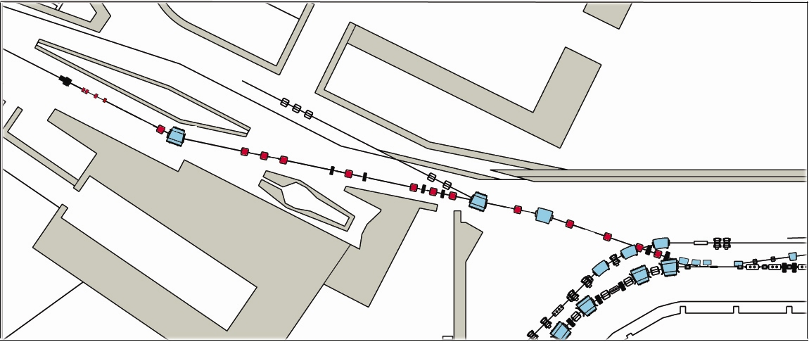
Beams from separators
29 GeV protons from SIS100
740 MeV/u RIBs
From the SFRS
target station
3 GeV antiprotons
TCR1
Pbar TL
CR

Slide 34
BINP approach to injection-extraction
Divide septum magnet into 2 pieces: short 0.8 m, B=0.5 T,
30 mr pulsed septum and 2.5 m with the same field 96 mr
DC magnet (~60 kW), connected in series with main CR dipoles.
Ceramic vacuum chamber in the septum, 5 mm thick, 150 mm
inner diameter. Stainless steel chamber looks not feasible due to
large heat generated by eddy currents.
Stainless steel vacuum chamber for the stored beam with iron
shield wrapped around it. Squared oval shape preferable to
reduce distance between the injected and stored beams.
Ferrite kickers placed inside of vacuum tank, as proposed in TDR.

Slide 35
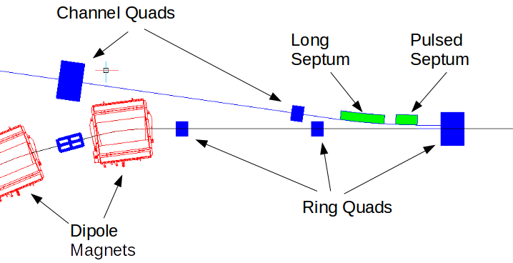
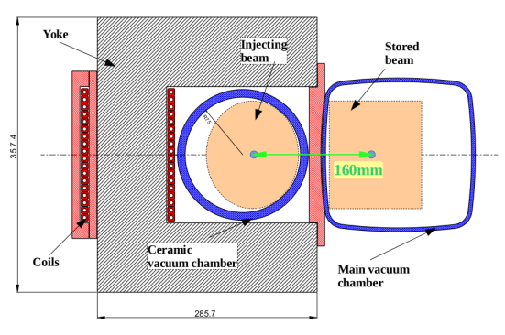
CR Injection Septum (PSP 2.5.7.1.2.2)
Injection scheme: split septums
Pulsed Septum
Width and height of the gap | w, h | 200 , 175 | mm
Magnetic field | B | 0.5 | T
The number of windings | n | 18
Effective length | l | 0.78 | m
Angle | α | 0.03 | r
Current | I | 4000 | A
Pulse duration, period | T | 6 | ms
Vacuum chamber thickness | δ | 10 | mm
Septum magnet thickness | Δ | < 15 | mm
Long Septum Params
Width and height of the gap | w, h | 200 , 100 | mm
Magnetic field | B | 0.5 | T
The septum sickness windings | δ | <25 | mm
Effective length | l | 2.318 | m
Angle | α | 0.09353 | r
Current | Matched with CR dipoles
Pulse duration, period | T | 6 | ms
Vacuum chamber thickness | δ | 5 | mm
Field quality |  | 0.001

Slide 36
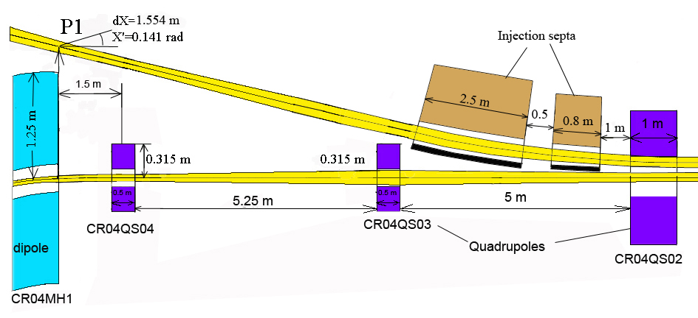
CR-injection (BINP proposal)

Slide 37
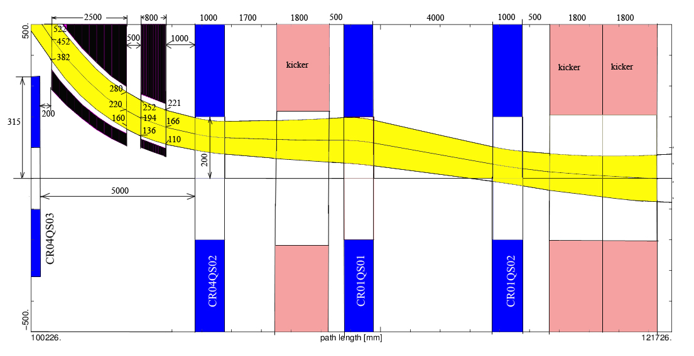
Injection into CR (BINP proposal)

Slide 38
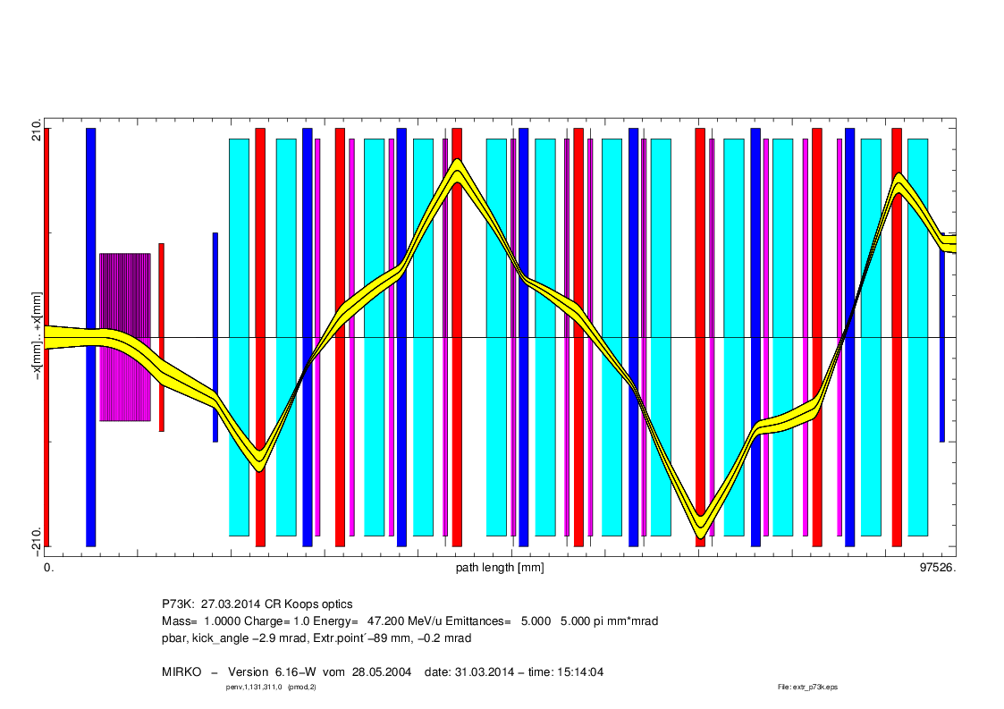
BINP pbar extraction: Option 1
Option 1: 2 kickers (6 modules)
Total kick=5.8 mrad
Extraction (BINP pbar-optics)
95 mm
13 mrad
89 mm
-0.2 mrad

Slide 39
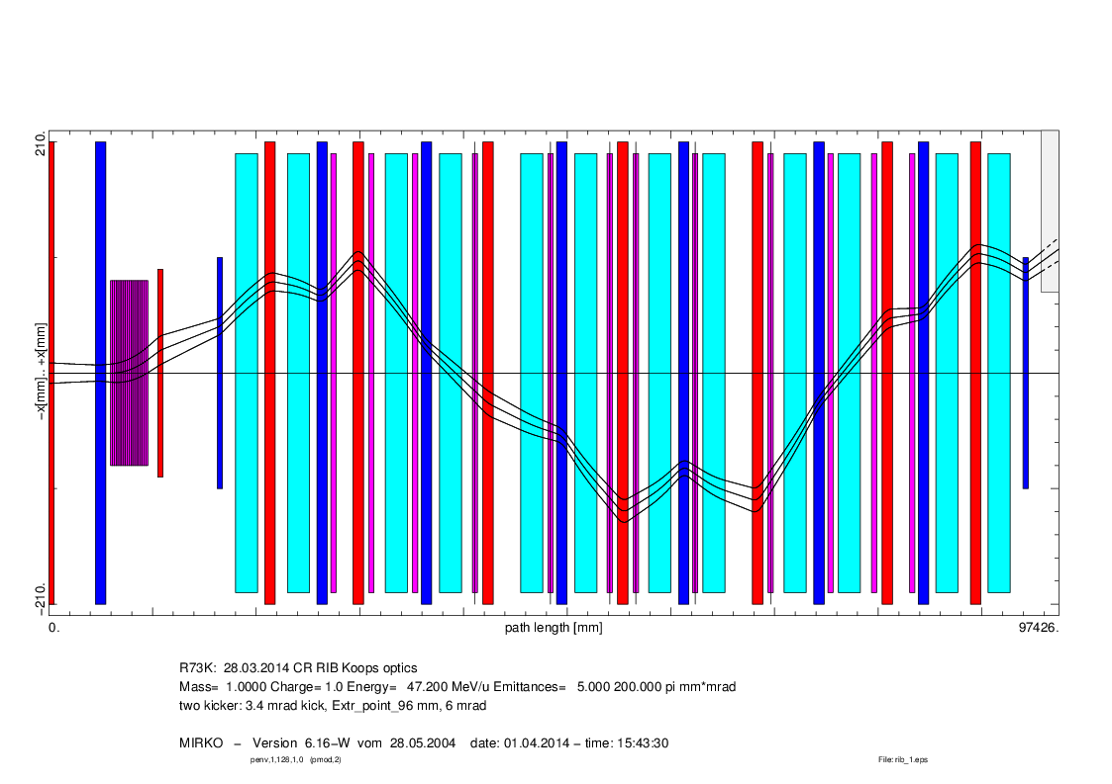
BINP RIBs extraction: Option 1
Option 1: 2 kickers (6 modules)
Total kick=6.8 mrad
Extraction (BINP RIB optics)
95 mm
13 mrad
96 mm
6 mrad

Slide 40
Injection / Extraction Kicker CR
U.Blell design looks OK!
2 tanks instead of 3 ?
3 Modules in each tank

Slide 41
BINP activity plan for year 2015
Finalize the CR lattice study
Continue CR magnets design and prepare all specs
Work out specs for all power supplies
Continue pbar transport line optics optimization
Make design of the injection septum and of the kicker module
Start design work on the extraction septum
Start design work of specific 1-st dipole in pbar TCR1 line
Activate design work of pickups and other diagnostic
Make design of main vacuum chambers
Sign contract with FAIR on dipole magnets manufacturing
Keep close contact with GSI team!

