Slide 1
Some Updates on Mechanics CM-MEC Session Dec. 2014 J. Lühning, GSI
Layout of auxiliary platform
Set-up on upstream side of Target Spectrometer
EDMS status
STEP-format: Problem with very fine details
Collisions in 3D model

Slide 2
Layout of auxiliary platform
Functional specifications for auxiliary platform:
Estimated total weight of structure, BE-EMC, instrumented racks, cables: 8 tons
Upper level of auxiliary platform 130 cm below beam height
Support by wheels (castors), and by hinges at the big TS-upstream platform beam
Estimated drag of wheels and cable chains while moving: 5 kN
Space for cable chains underneath: width 2 × 75 cm (z-direction), outer loop diameter 80 cm

Slide 3
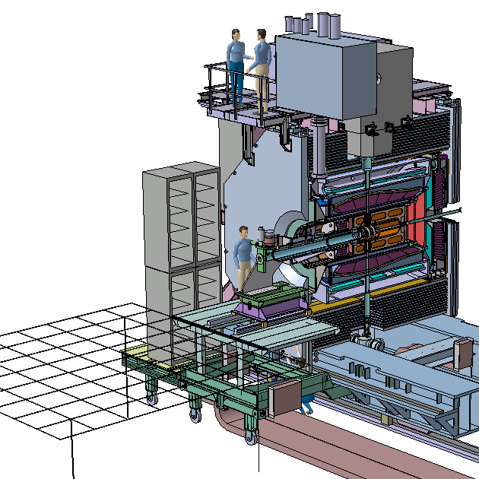
Set-up on upstream side of Target Spectrometer
Four racks (42U) on west side of platform
(2 racks stacked),
same arrangement on east side (not shown)
Upper level of auxiliary platform at y = -130 cm,
width: x = ±150 cm
Service platform in maintenance position,
extension in x: 5.6 m,
extension in z: 5.8 m,
upper level at y = -130 cm
Platform ends at
z = -4.3 m,
smallest distance to cave wall when passing the gate: 60cm

Slide 4
Status of 3D-models of PANDA components at EDMS
(2014-12-05)
Component | Last update
Interaction region | 2010 - 12
Target | 2013 - 12
MVD | 2014 - 11
STT | 2014 - 11
GEM-trackers | 2011 - 09
FT1 to FT6 | 2012 - 10
Barrel-DIRC | 2014 - 11
SciTil | ?
F-TOF | ?
Disc-DIRC | 2013 - 10
Barrel-EMC | 2014 - 05
FE-EMC | 2014 - 09
BE-EMC | 2014 - 04
Shashlyk-EMC | 2013 - 07
Solenoid coil & cryostat | 2010 - 05
Iron yoke | 2014 - 02
Dipole magnet | 2013 - 11
Muon counters | 2012 - 03
Luminosity monitor | 2012 - 09
Mechanical integration | 2014 - 12
PANDA hall | 2014 - 11

Slide 5
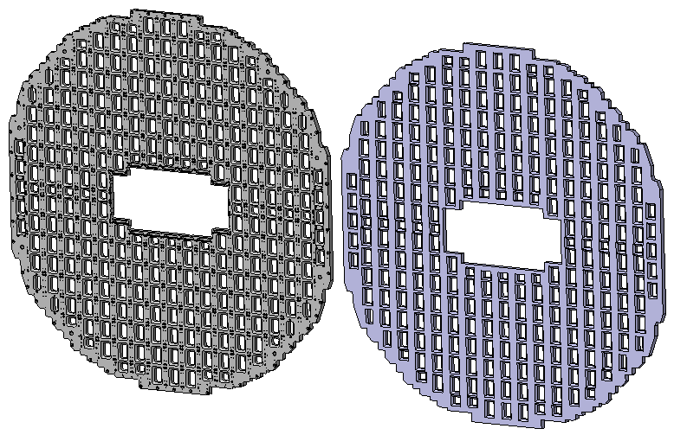
STEP-format: Problem with very fine details
STP-file size 52 MB
STP-file size 3 MB
Storage efficiency of STEP-format on Part-level not very good.
The fewer the details the better the usability.
Some parts which are very rich in detail can no more be read by some CAD programs.

Slide 6
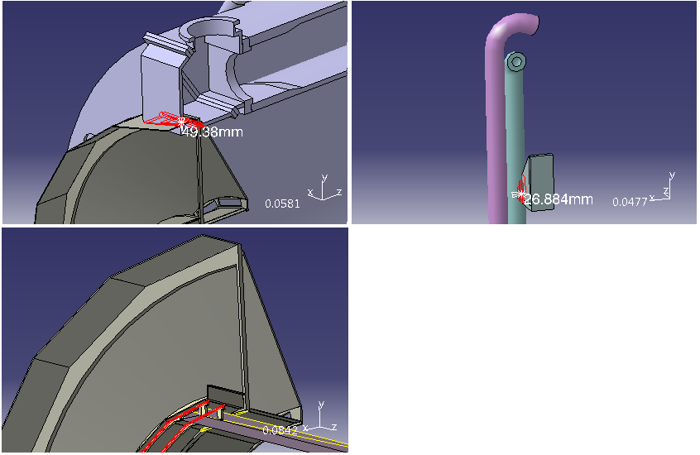
Some collisions in 3D model
Overview model available here:
https://edms.cern.ch/document/1347314/1

