Slide 1
Status of the PANDA Magnet mechanics (yoke & cryostat)
Joint Institute for Nuclear Research (Dubna)
Evgeny Koshurnikov,
Jülich
December 10, 2014

Slide 2
Status of the Magnet Yoke
Yoke technical documentation is ready to be given to industry
Coordination of some magnet interfaces still continues to be at the stage of finalization
Preliminary discussions with the supposed yoke producers will be started within the next weeks

Slide 3
Available information on the yoke design
FAIR Project, PANDA, Magnets, Solenoid yoke https://edms.cern.ch
3D model of the yoke ID = 1064509 v. 2
Technical Description ID= 1387740 v.1
Technical Specification ID = 1387741 v.1
ZIP – package of the PANDA yoke drawings (3NM1004.00.100)
https://dl.dropboxusercontent.com/u/14556206/PANDA_Yoke_drawings_eng.ZIP

Slide 4
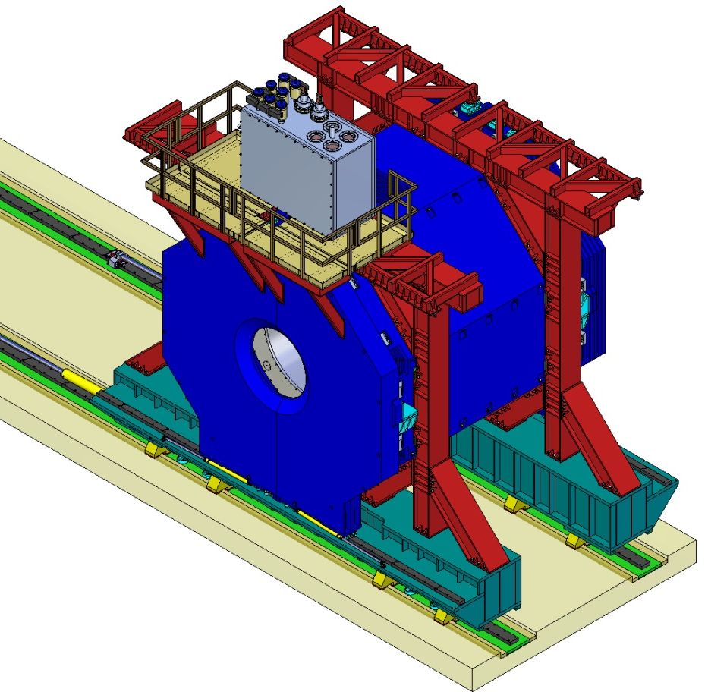
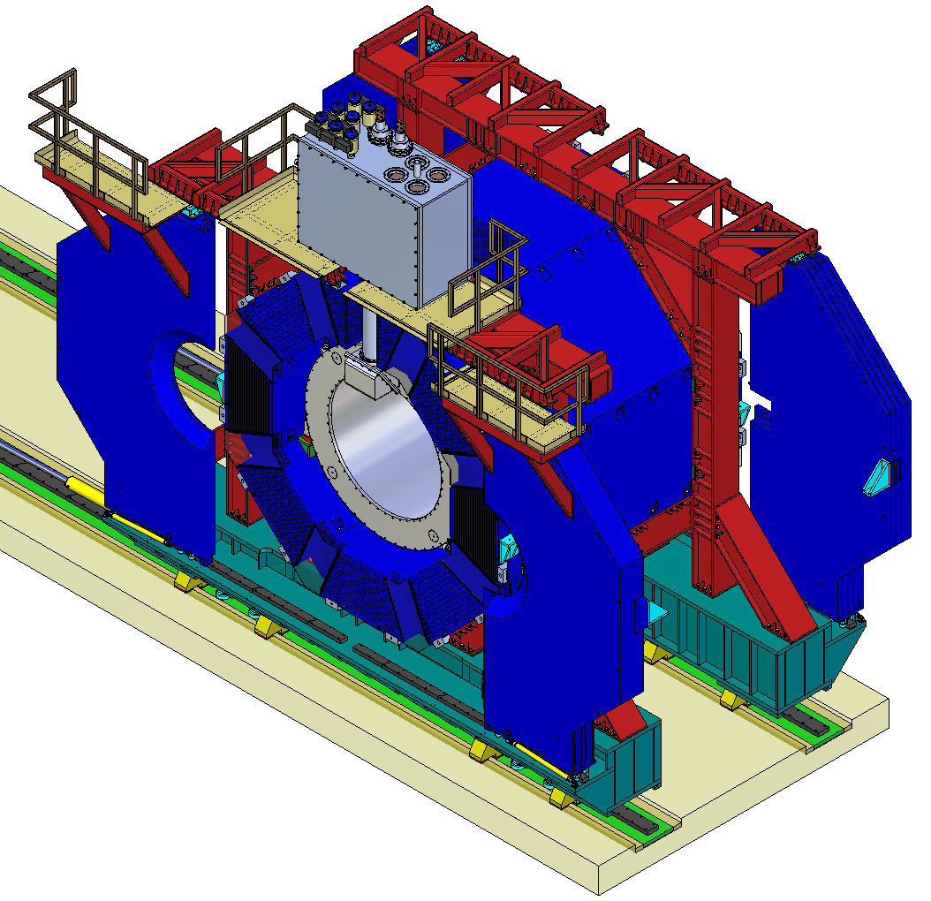
Assembled TS magnet

Slide 5
Cryostat fixation units

Slide 6
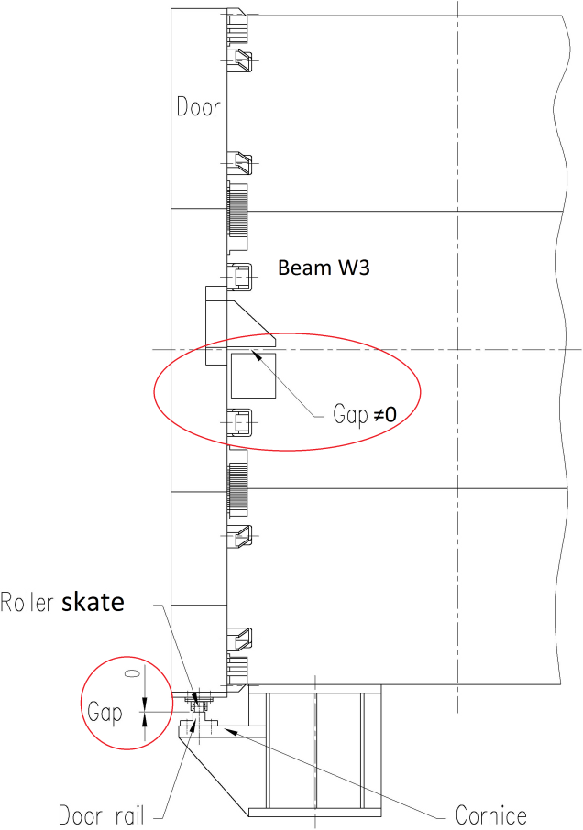
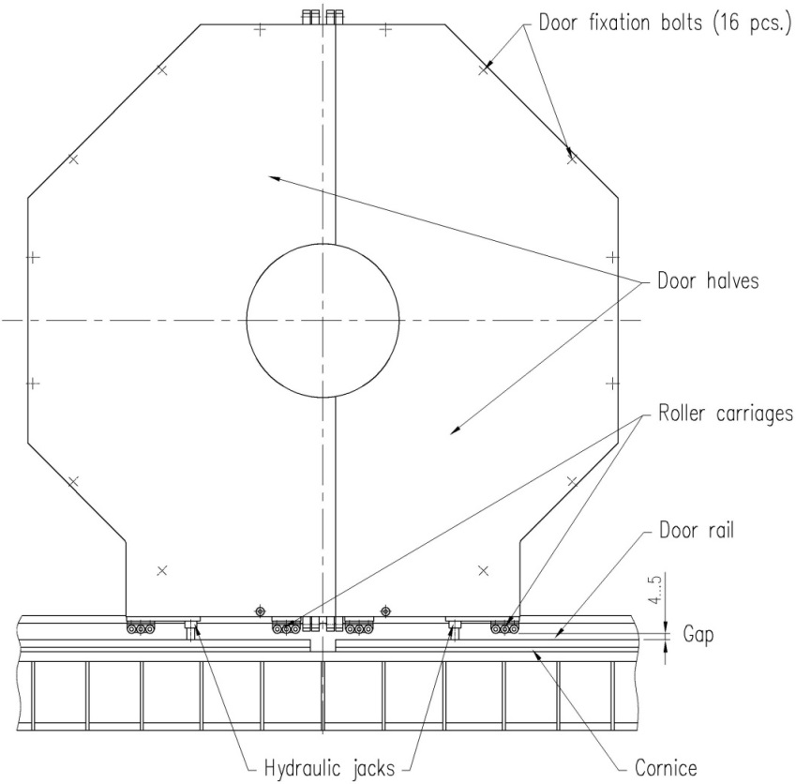
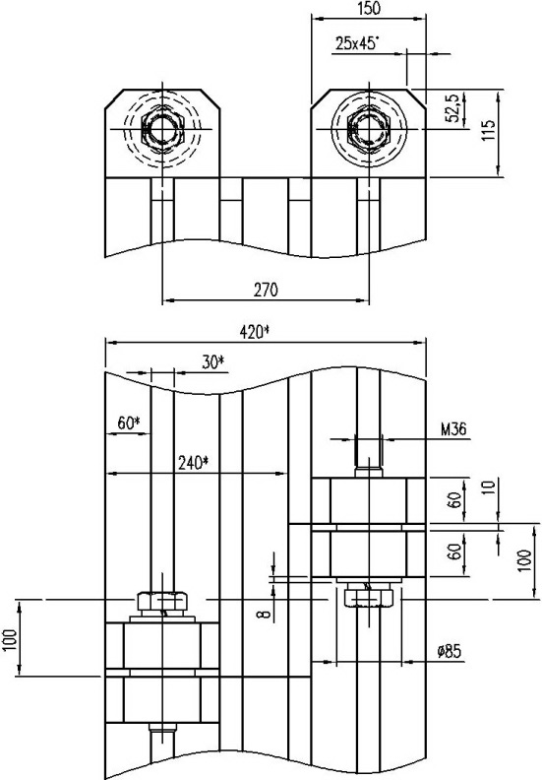
Magnet door component arrangement

Slide 7
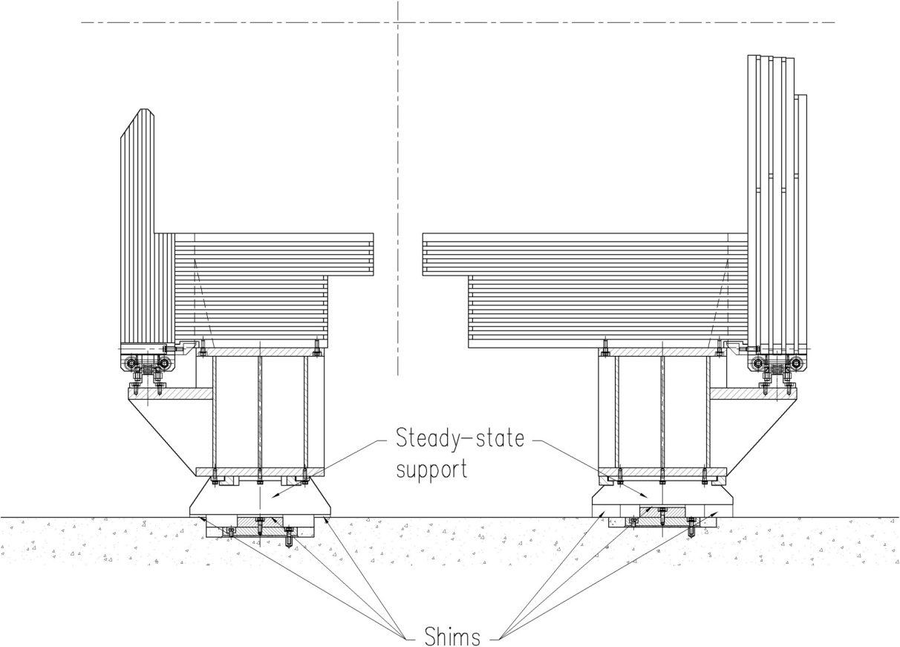
Magnet supports and roller skates

Slide 8
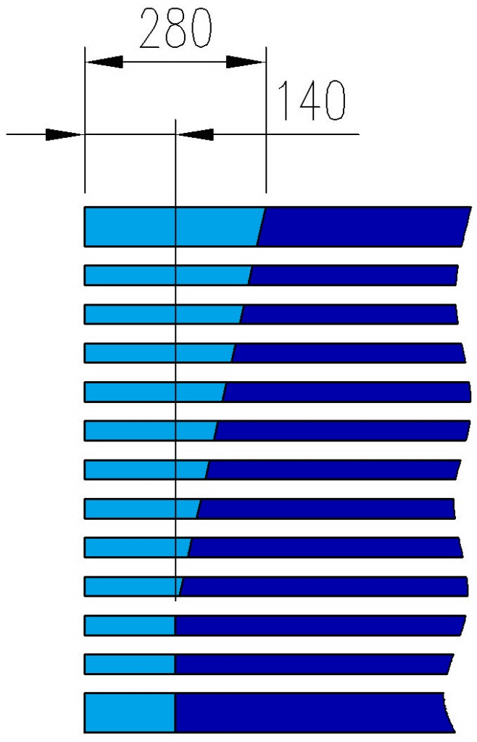
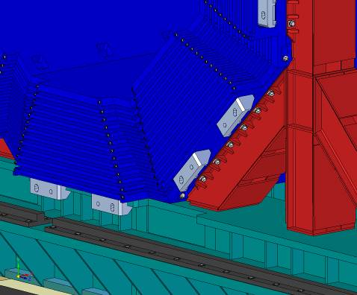
Passages for tubing and cabling
Additional space requested for muon cabling

Slide 9
Hydraulic of the PANDA magnet

Slide 10
List of Load Cases of the yoke for FE analysis
LC# | Support scheme |  | Door position and fixation type* |  |  | Gravity load |  |  | Magnetic forces are applied to the yoke and to the coil at maximal current and for nominal position of the cryostat | Magnetic forces applied to the cryostat and to the yoke at maximal current due to tolerable misalignments of the cryostat |  |  | Horizontal seismic forces (acceleration) applied to the yoke parts and to the cryostat |  | Run over an on-path irregularity of 1 mm in height | Separation of platform beams due to misalignment of the rails
 |  |  | Doors at the cornices | Doors weight is applied to the barrel (without stiffness) | Doors stiffness is applied (without weight) |  |  |  |  | F_{X} = -45 kN | F_{Y} = +45 kN | F_{Z} = -100 kN | a_{X} = -0.75 m\s² | a_{Z} = -0.75 m\s²
 | Two supports for every platform beam (magnet transportation) | Fife steady-state supports for every platform beam (magnet assembly and magnet operation) |  |  |  | Gravity of the yoke | Gravity of cryostat | Gravity of the inner detectors |  |  |  |  |  |  |  | Δ₁₁ = +1mm | Δ₁₁= -1mm | Δ₁₂ = +1mm | Δ₁₂ = -1mm
51 |  | x |  |  |  | x
52** |  | x | x |  |  | x | x | x
53** |  | x | x |  |  | x | x | x
54 |  | x |  | x |  | x | x | x
55** |  | x | x |  |  | x | x | x
61 | x |  |  | x |  | x | x | x
63 | x |  | x |  |  | x | x | x
64 | x |  |  | x | x | x | x | x |  |  |  |  |  |  | x
65 | x |  |  | x | x | x | x | x |  |  |  |  |  |  |  | x
66 | x |  |  | x | x | x | x | x |  |  |  |  |  |  |  |  | x
67 | x |  |  | x | x | x | x | x |  |  |  |  |  |  |  | x |  | x
68 | x |  |  | x | x | x | x | x |  |  |  |  |  |  |  |  | x |  | x
69 | x |  |  | x | x | x | x | x |  |  |  |  |  |  |  | x |  |  | x
71 |  | x |  | x |  | x | x | x | x
72 |  | x |  | x | x | x | x | x |  |  |  |  |  | x
73 |  | x |  | x | x | x | x | x | x | x |  | x |  | x
74 |  | x | x |  |  | x | x
75 |  | x |  | x | x | x | x |  | x | x | x | x
76 |  | x |  | x | x | x | x | x |  |  |  |  | x
77 |  | x |  | x | x | x | x | x | x | x |  | x | x
78 |  | x |  | x | x | x | x | x | x | x |  | x
81*** |  | x |  | x |  | x | x | x
82**** |  | x |  | x |  | x | x | x
83 | x |  |  | x |  | x | x | x
84 | x |  |  | x | x | x | x | x |  |  |  |  |  |  | x
85 |  | x |  |  | x | x | x | x | x | x |  | x
86 |  | x |  |  | x | x | x | x | x | x |  | x | x
87 |  | x |  | x |  | x | x | x | x | x |  | x

Slide 11
Margin of safety for fixation units
 |  | η_{tension} | η_{shear} | Position | Load case
1. | Barrel bolts M24x2 | 1.7 |  | B5(W8/W1) | LC67
2. | Platform bolts M24x2 | 1.4 |  | B8P2 | LC63
3. | Cryostat support boltsM24x2 | 2.1 |  | B6CR | LC75
4. | Space frame bolts M24x2 |  | 1.9 | B7(W2/F2PL2) | LC85
5. | Door/barrel bolts M36x3 |  | 4 | B1(D1/W3) | LC64
6. | Door wings bolts M36x3 |  | 9 | B1(D11/D12) | LC83
 | η_{min=} | 1.4 |  | B8P2 | LC63

Slide 12
Status of the Cryostat and cooling system
Works started and performed in 2014
Cryostat
Design of vacuum shells, thermal screen, suspension system and target entry unit;
Stress analysis of the cryostat shells;
Stress analysis of the suspension units
Control Dewar and Chimney
Design of vacuum shells, pipe and valve system, Cryostat/Contr.Dewar tubing;
Stress analysis of the control Dewar shell;
Cooling system of the solenoid
Computations of natural convection mode;
Analysis of cooling efficiency of the coil

Slide 13
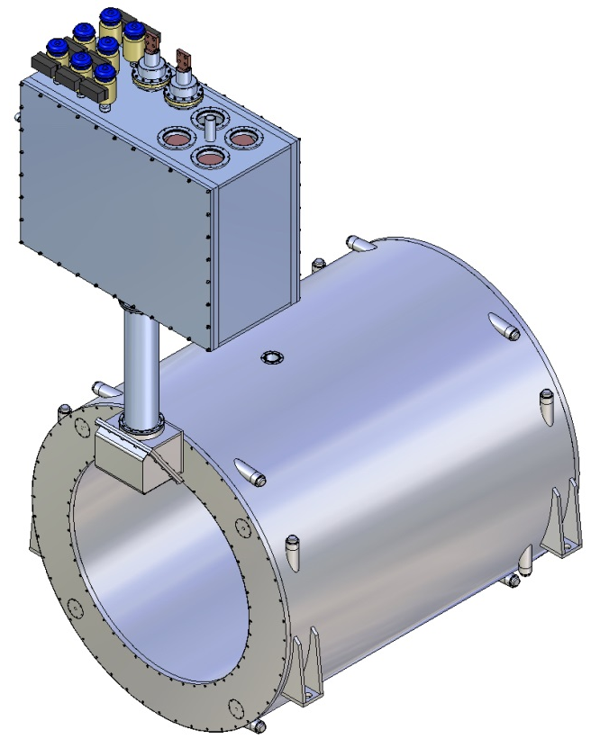
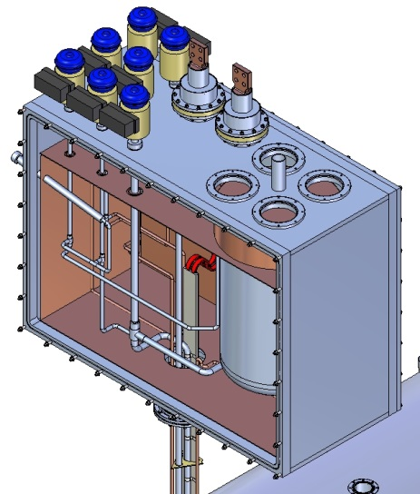
Cryostat and control Dewar
Coil&Cryostat weight ~100 kN
Control Dewar weight ~40 kN

Slide 14
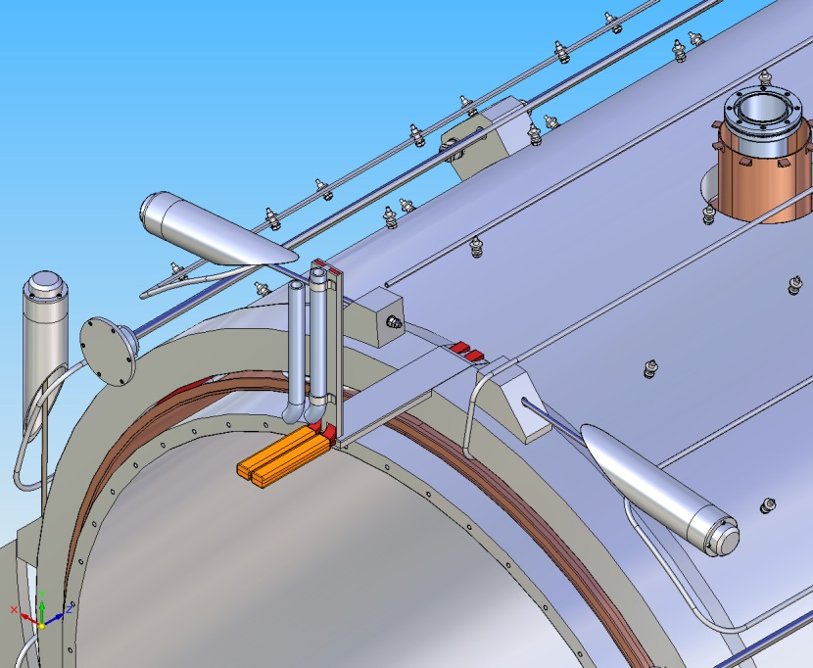
Thermal screen of the cryostat
Thermal screen four blocks
dI/dt ≤400A/sek
Ieddy curr<10 A

Slide 15
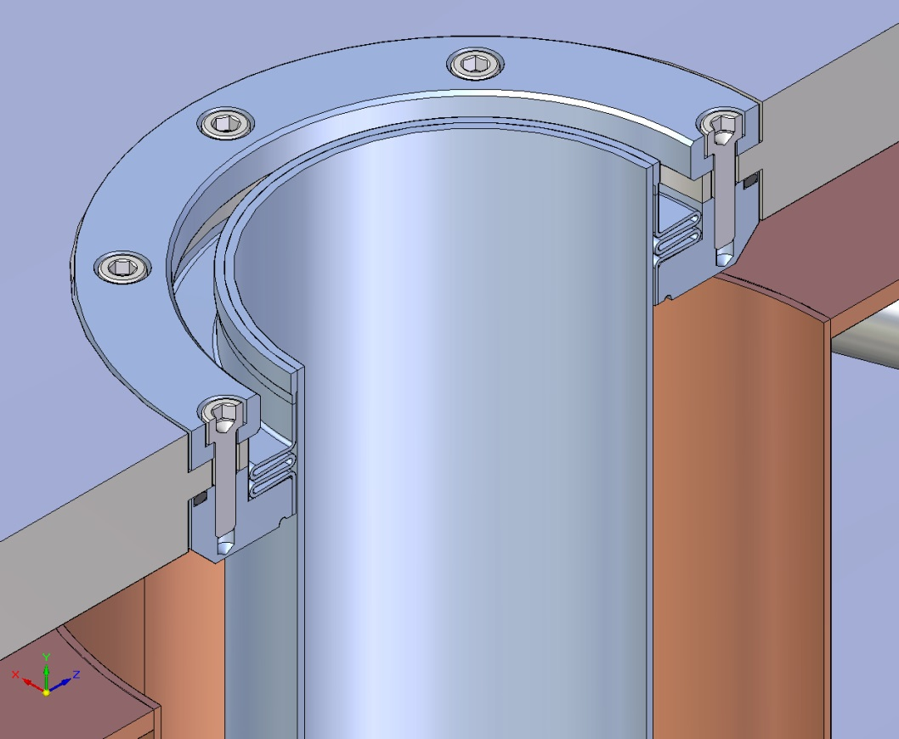
Passageways for Target

Slide 16
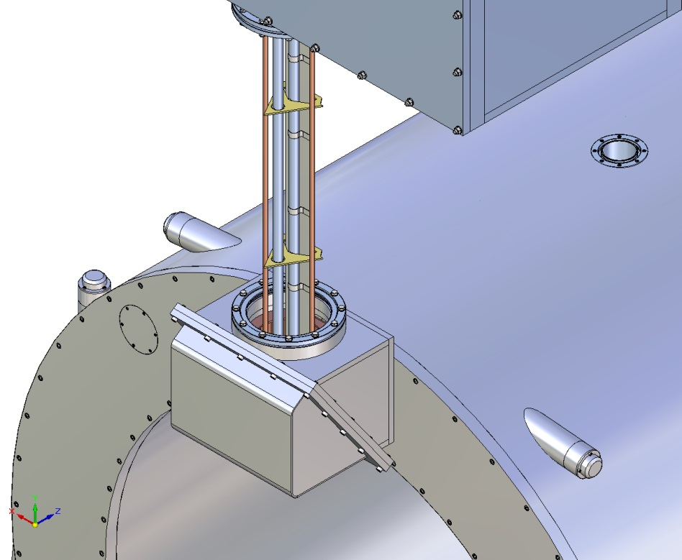
Chimney

Slide 17
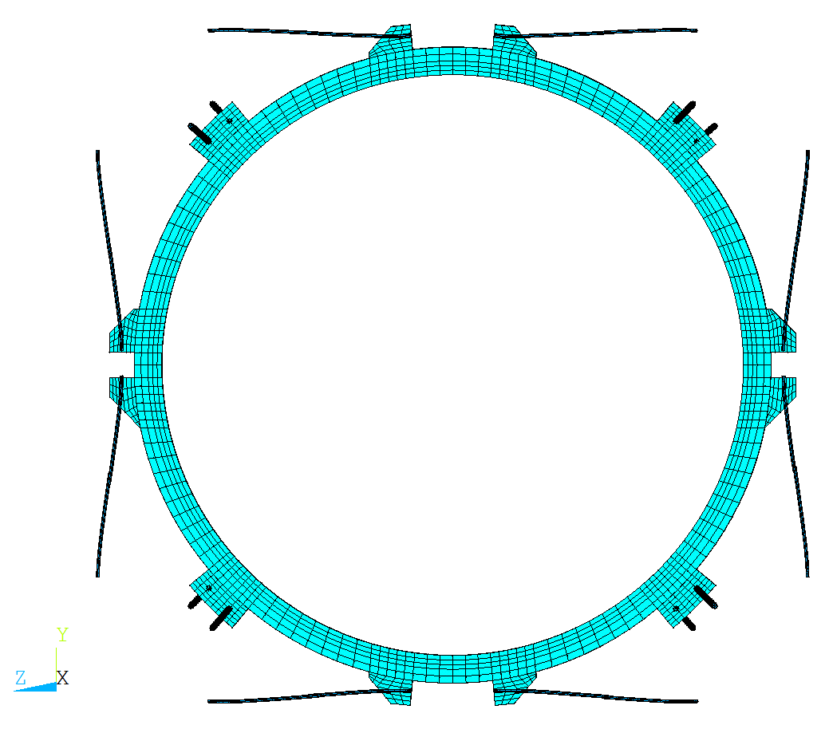
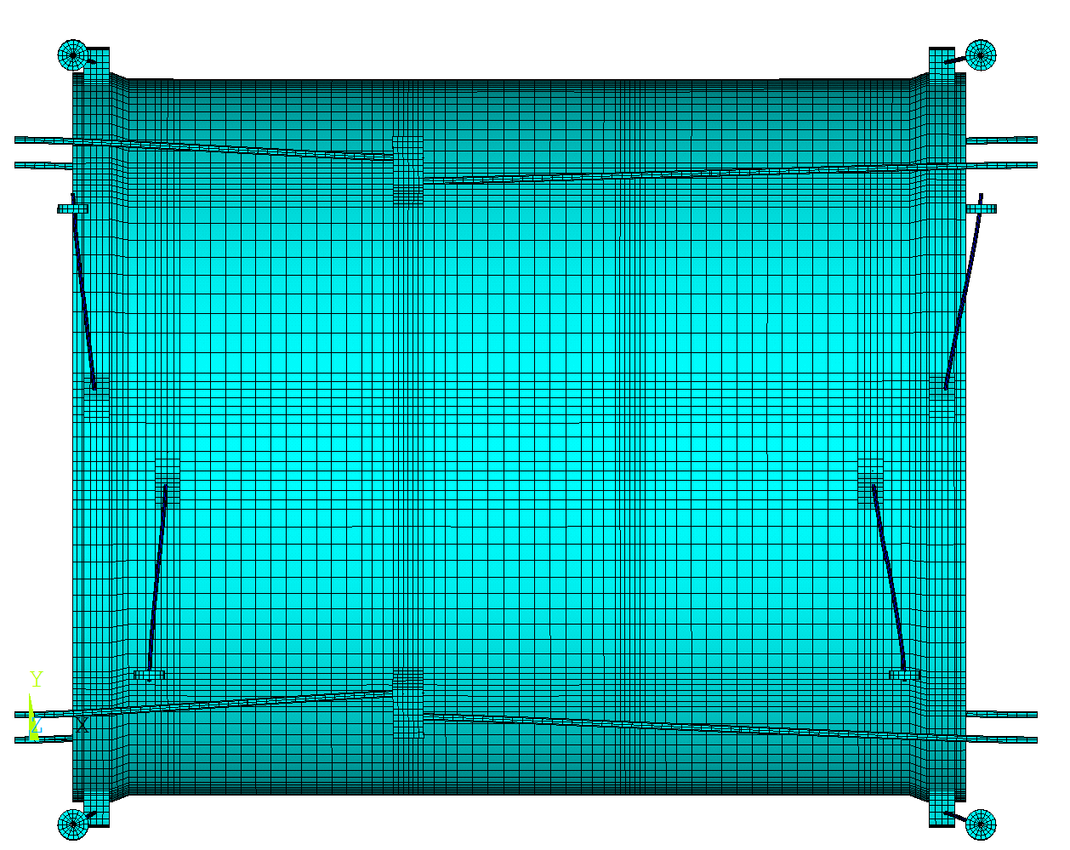
Bending of the radial suspension ties after cool down

Slide 18
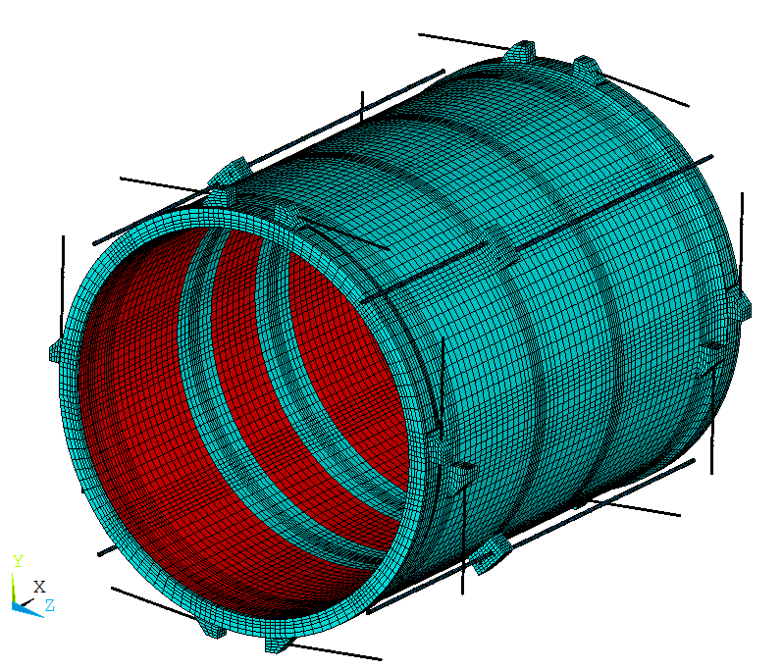
Maximal stresses in the ties of the suspension system
 |  | W/o pre-bending |  | Pre-bending in z direction |  | Pre-bending in z direction and in plane XY
 |  | Stress, MPa | Safety factor | Stress, MPa | Safety factor | Stress, MPa | Safety factor
Radial ties | σ_{m} | 499 | 1.38 | 489 | 1.4 | 473 | 1.46
 | σ_{mb} | 786 | 1.15 | 648 | 1.4 | - | -
Axial ties | σ_{m} | 392 | 1.76
 | σ_{mb} | 450 | 2
RG3_top
RV3_top
RG2_top
The bending and thermal stresses are the main problems of the suspension system of the cold mass.
For example:
The bending stress of about 287 MPa will appear in the radial suspension rod if the preliminary bending is not applied.
Thermal stress in the rods of the axial suspension is about 350 MPa
RG4_top
RV4_top
RV2_top
RG1_top
RV2_bot
RG2_bot
RG4_bot
RG1_bot
RV1_bot
RV1_top

Slide 19
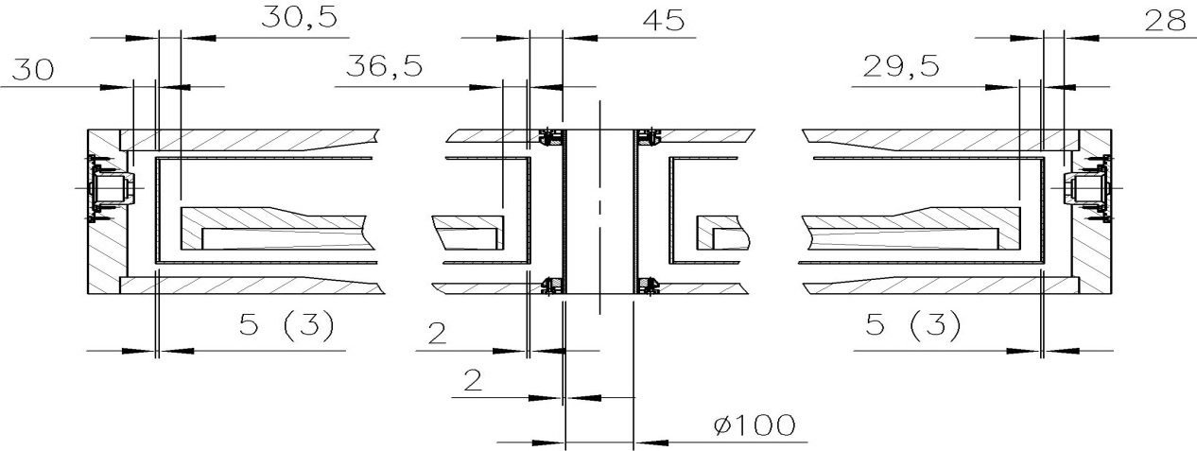
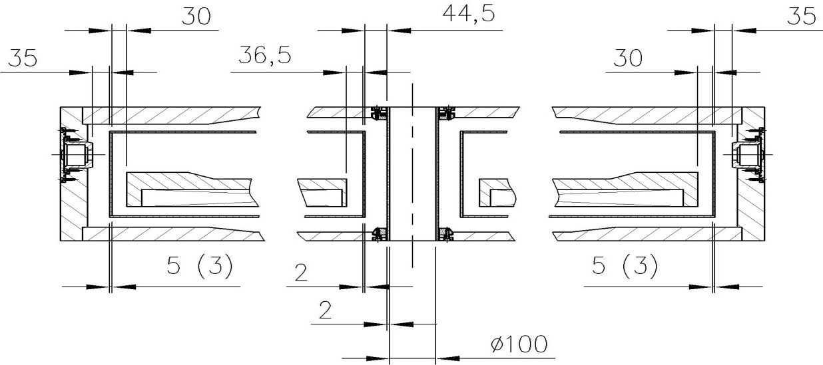
Interface of the cryostat and cold mass in nominal position
Cold mass and thermal shield - warm
Cold mass and thermal shield - cold
Correction of the sc coil position relative the yoke aperture by spaces in the cryostat supports.
These adjustments can be limited by the cryostat surrounding detectors
Although we have some space for axial corrections of the cold mass position inside the cryostat (~±20 mm), it can’t be implemented practically due to the limitations imposed by stresses in radial suspension rods.

Slide 20
Movement of the cold mass under action of the magnetic field
Contribution to axial displacement of the cold mass due to
deformation of the axial rods is equal to 0.436 mm,
deformation of the cryostat structure in the area of the support legs - ~0.260mm,
deformation of the end flanges of the cryostat outer shell - ~0.053 mm,
elasticity of the threaded connection, washers and mounting unit - ~ 0.017 mm
The total axial movement of the cold mass under action of the magnetic force is 0.77mm
Contribution to lateral displacement of the cold mass due to
deformation of the suspension rods is equal to ~ 0.3 mm,
elasticity of mounting elements in head parts of the rods - 0.16 mm,
deformation of the head part - 0.1 mm.
The total lateral displacement is 0.56 mm

Slide 21
THANK YOU FOR YOUR ATTENTION!

