Slide 1
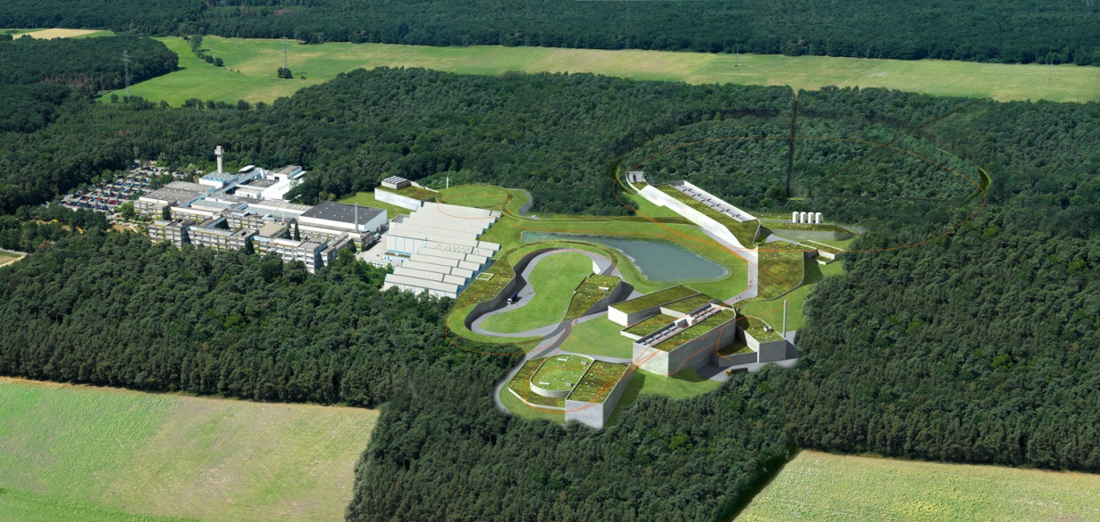
- SHORT REPORT FROM MECHANICAL WORKSHOP (GSI OCTOBER 2014) .
STT SYSTEM, A PROPOSAL FOR A NEW ASSEMBLY LAYOUT.
DECEMBER 2014 / JULICH / PANDA GM / D. ORECCHINI (LNF-INFN)

Slide 2
- RECOMMENDATIONS MADE BY LARS DURING THE FRASCATI MEETING……..
SPLIT SETUP OF STT ADVANTAGES …
…… ACCESS FOR MAINTENANCE EASY & SMART,
SIMPLER MOUNTING/DISMOUNTING PROCEDURE,
TRANSFER TO HYPERNUCLEAR SIMPLIFIED …….
- ALTERNATIVE PROPOSAL FOR THE CENTRAL TRACKER ASSEMBLY PROCEDURE (PRELIMINARY).
… FOR THE STT ASSEMBLY PROCEDURE HAS BEEN
DEVELOPED TWO MAIN TOOLS…
DECEMBER 2014 / JULICH / PANDA GM / D. ORECCHINI (LNF-INFN)

Slide 3
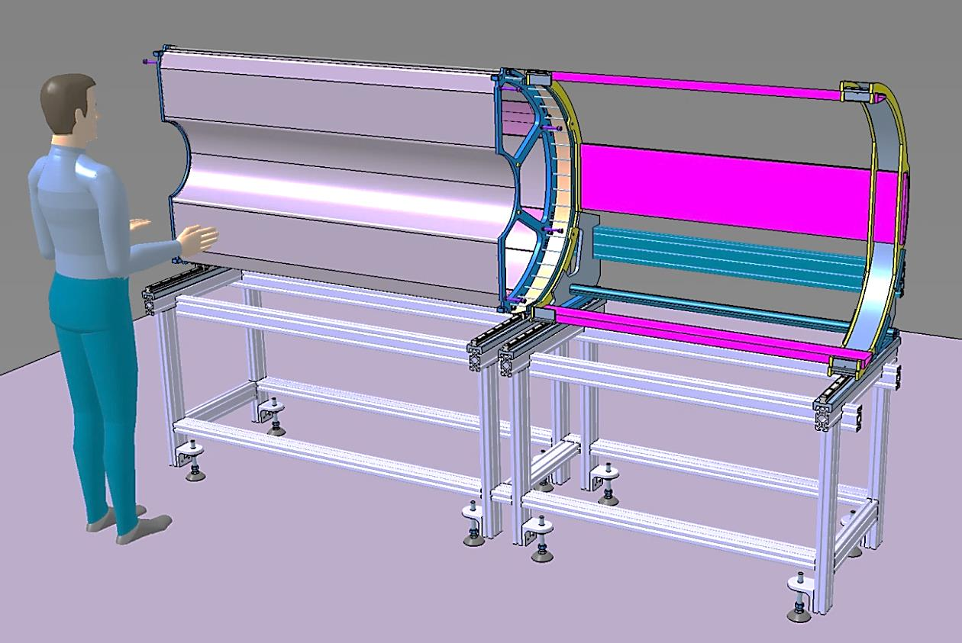
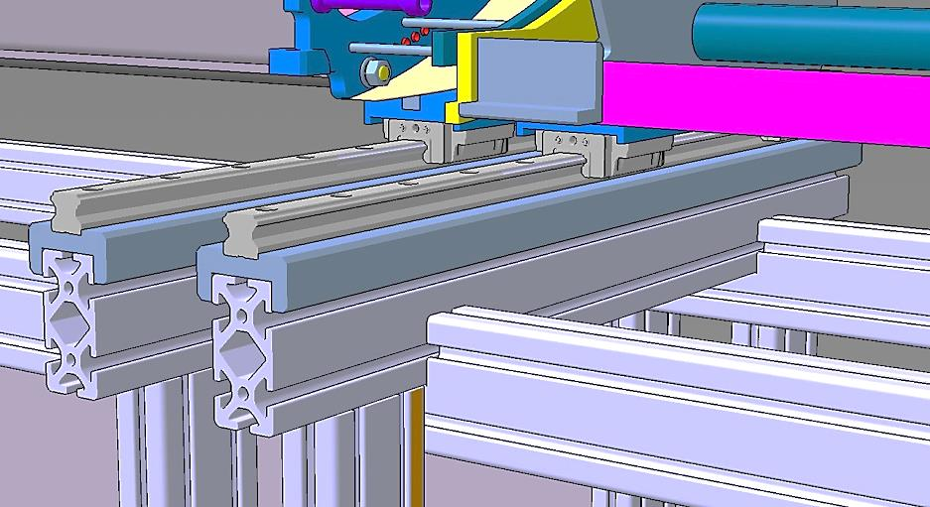
1^ TOOL) -THE STT ASSEMBLING AND HANDLING TOOL: BASIC CONCEPTS……..
- HALF ST_TRACKER
- HALF SERVICES SUPPORT FRAME
THE STT ASSEMBLING AND HANDLING TOOL
IS FORMED BY:
- A RIGID AND PRECISE SUPPORT TABLE;
- A SHIFTING SYSTEM WITH RAILS AND
SKATES.
THE STT HALVE IS FIXED ON THE HANDLING TOOL.
THE SERVICES FRAME IS FIXED ON THE HANDLING TOOL.
ALL THE CABLES AND THE GAS PIPES ARE ASSEMBLED. (CABLES PATH ARE NOT SHOWED)
INSIDE VIEW
RAILS AND SKATES DETAILS
DECEMBER 2014 / JULICH / PANDA GM / D. ORECCHINI (LNF-INFN)

Slide 4
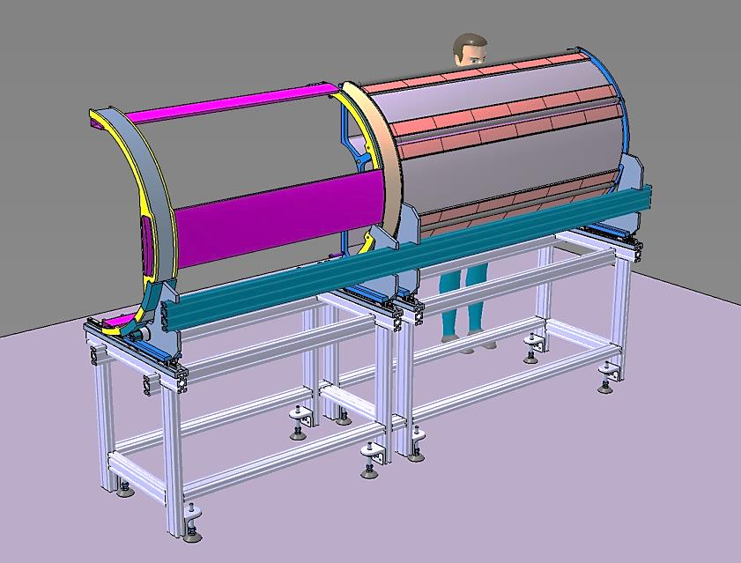
1^ TOOL) -THE STT ASSEMBLING AND HANDLING TOOL: BASIC CONCEPTS……..
OUTSIDE VIEW
- CONCERN
THE STABILITY OF CABLE DUCT HAVE TO BE VERIFIED.
- IMPROVEMENT
THE SERVICES ASSEMBLING MENAGEMENT APPEARS OPTIMIZED.
DECEMBER 2014 / JULICH / PANDA GM / D. ORECCHINI (LNF-INFN)

Slide 5
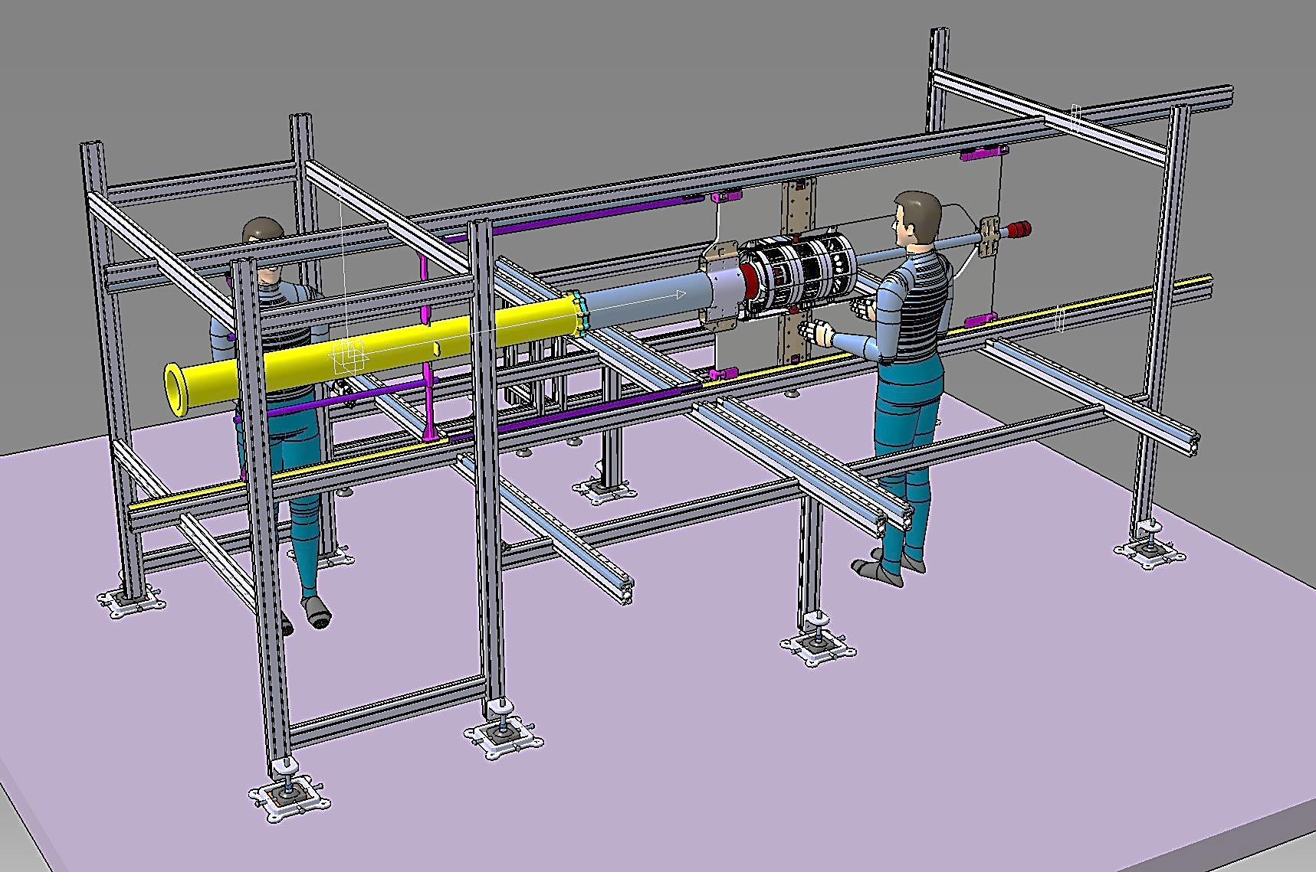
2^T0OL) -THE AUXILIARY SUPPORT STRUCTURE: BASIC CONCEPTS …..
AUXILIARY SUPPORT STRUCTURE
CENTRAL SUPPORT FRAME
VERTEX
CROSS PIPE
PIPE SECTOR 1
RAILS SYSTEM FOR SHIFTING
THE CROSS PIPE, THE VERTEX WITH SERVICES, AND THE PIPE SECTOR 1, ARE ASSEMBLED ON THE “AUXILIARY SUPPORT STRUCTURE”.
- A RAILS SYSTEM HAS BEEN IMPLEMENTED.
DECEMBER 2014 / JULICH / PANDA GM / D. ORECCHINI (LNF-INFN)

Slide 6
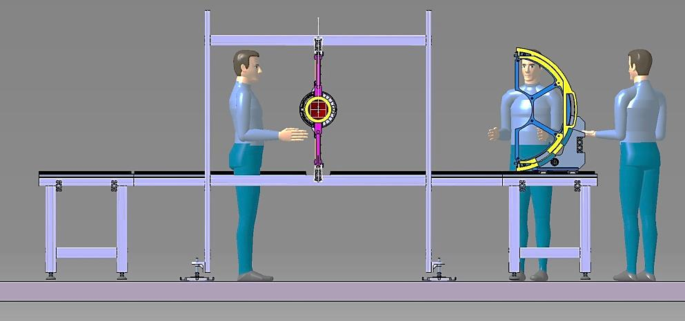
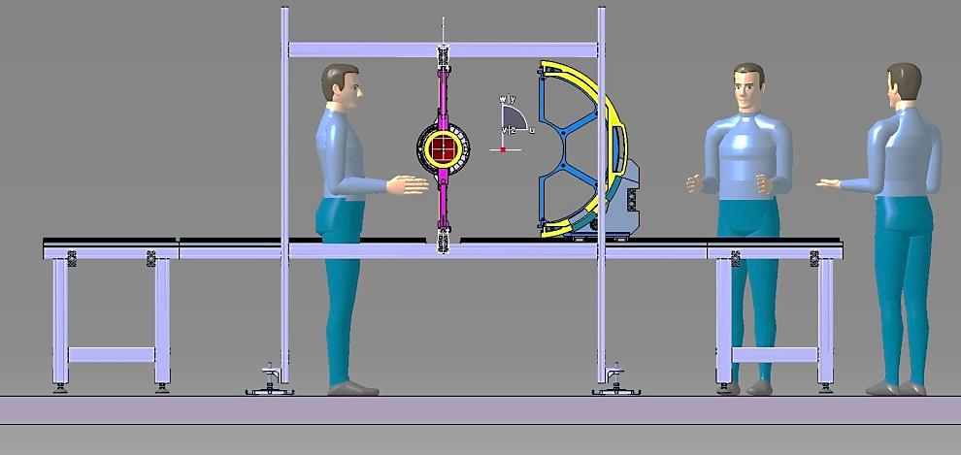
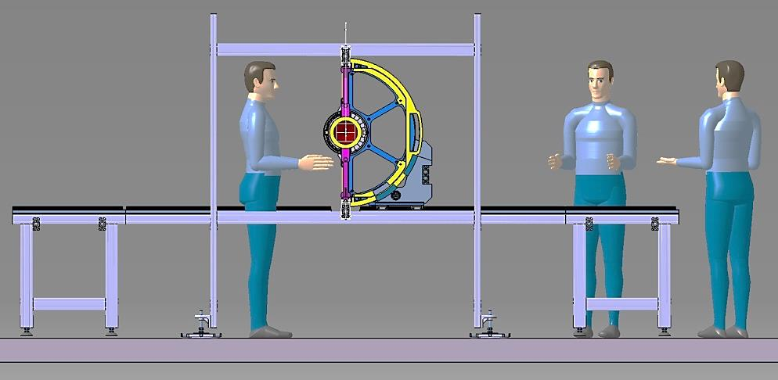
- STT AND SERVICES FRAME: ASSEMBLY PHASE ON THE AUXILIARY SUPPORT SCTRUCTURE ……..
1 STEP
THE STT HANDLING TOOL IS PLACED NEAR THE
AUXILIARY STRUCTURE, ALIGNED AND FIXED ON IT.
STT HANDLING TOOL
2 STEP
THE “STT SYSTEM” (STT PLUS SERVICES FRAME) IS
SHIFTED TOWARD THE “CENTRAL FRAME”.
3 STEP
THE “STT SYSTEM” IS CONNECTED ON THE
CENTRAL FRAME.
AUXILIARY SUPPORT STRUCTURE
DECEMBER 2014 / JULICH / PANDA GM / D. ORECCHINI (LNF-INFN)

Slide 7
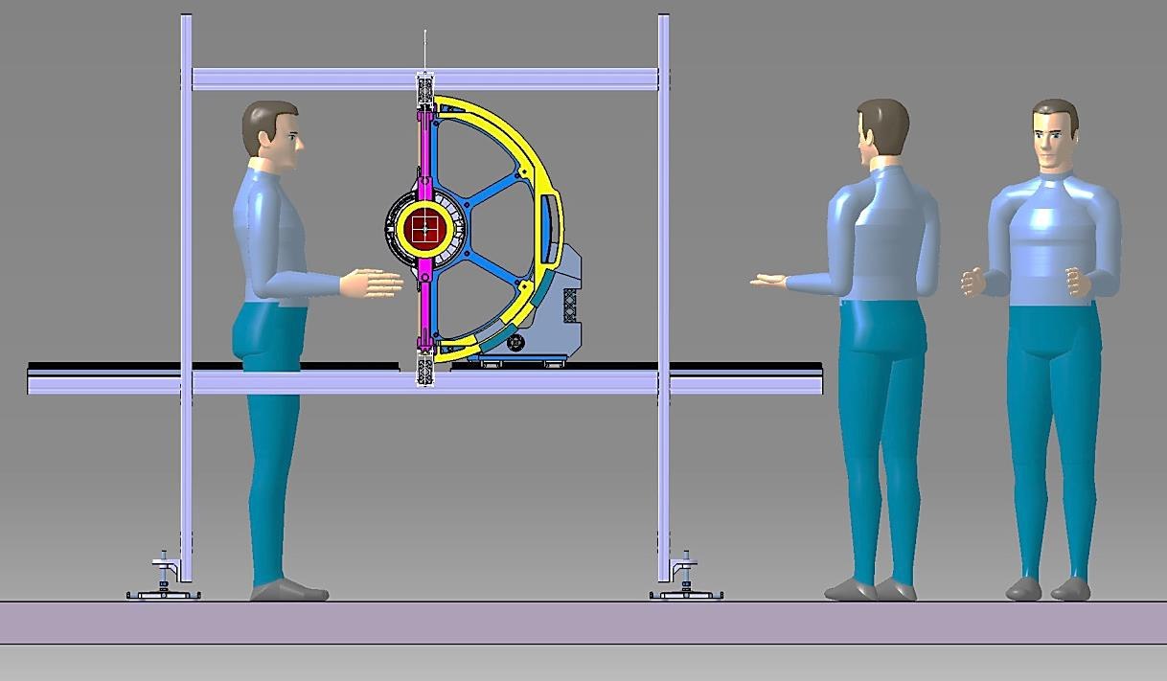
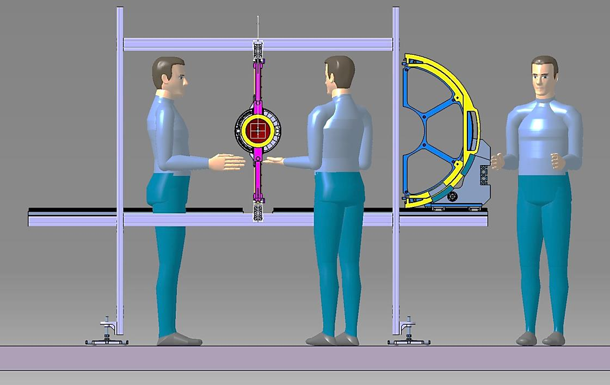
- CENTRAL TRACKER OPENING SYSTEM DURING THE MAINENTANCE PHASE……..
1 STEP
THE STT AND SERVICES FRAME ARE
DISCONNETED FROM THE SUPPORT FRAME
AND CONNECTED ON THE HANDLING TOOL.
2 STEP
THE STT AND SERVICES FRAME ARE SHIFTED
OUT ON THE RAIL SYSTEM.
AUXILIARY SUPPORT STRUCTURE
NB. IF IT IS NOT 'NECESSARY TO CARRY OUT THE STT, THE
HANDLING TOOL IS NOT NEEDED.
DECEMBER 2014 / JULICH / PANDA GM / D. ORECCHINI (LNF-INFN)

Slide 8
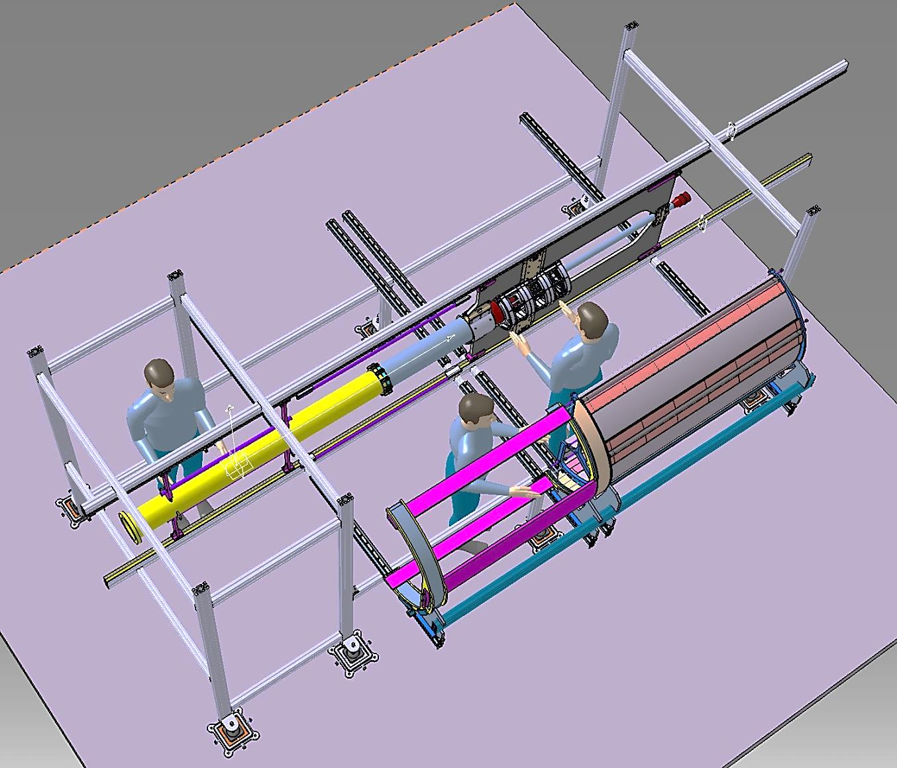
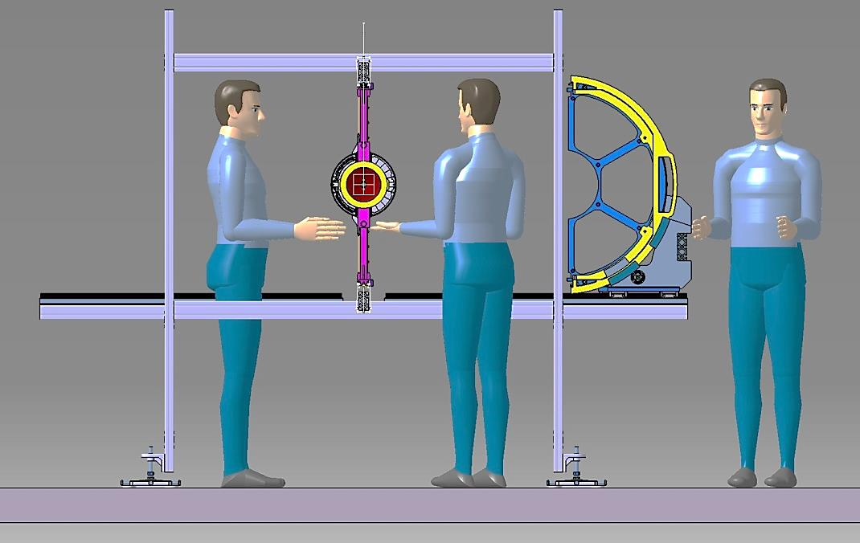
- CENTRAL TRACKER OPENING SYSTEM DURING THE MAINENTANCE PHASE……..
AUXILIARY PLATFORM
STT AND SERVICES FRAME ARE SHIFTED TOGHETER ON THE RAIL SYSTEM
FREE SPACE TO OPERATE AT THE SAME TIME ON THE VERTEX AND ON THE STT.
AUXILIARY SUPPORT STRUCTURE
DECEMBER 2014 / JULICH / PANDA GM / D. ORECCHINI (LNF-INFN)

Slide 9
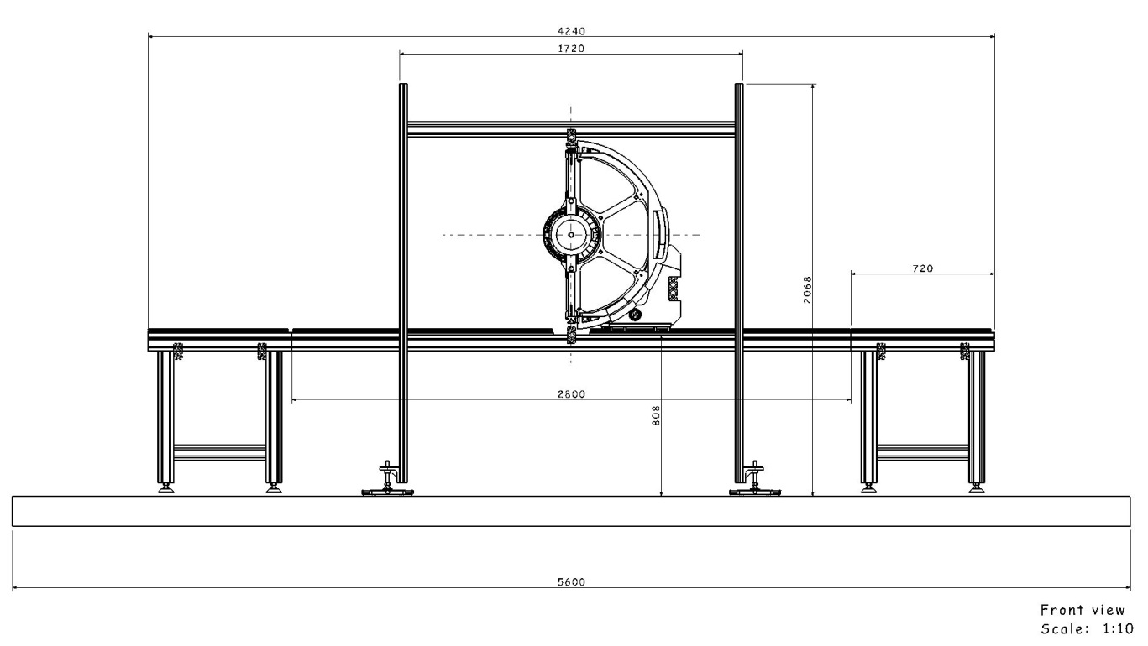
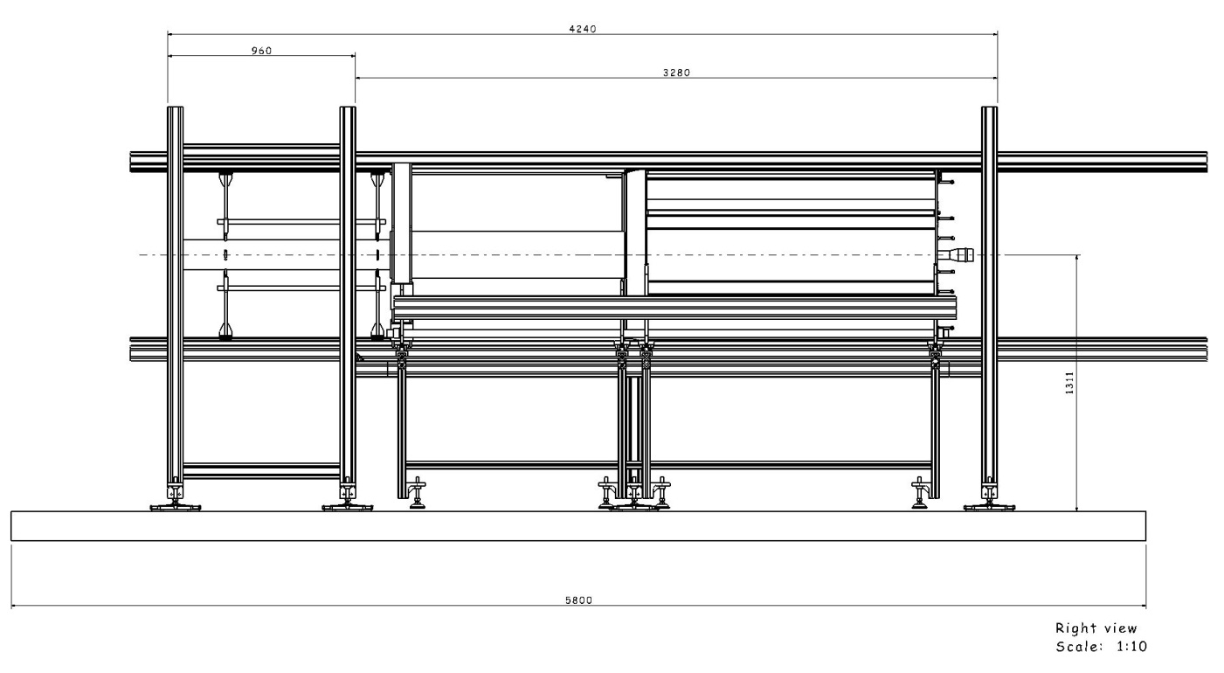
- AUXILARY SUPPORT STRUCTURE PLUS STT ASSEMBLING AND HANDLING TOOL MAIN DIMENSIONS ……..
4300mm
FRONT VIEW
4500mm)
LATERAL VIEW
DECEMBER 2014 / JULICH / PANDA GM / D. ORECCHINI (LNF-INFN)

Slide 10
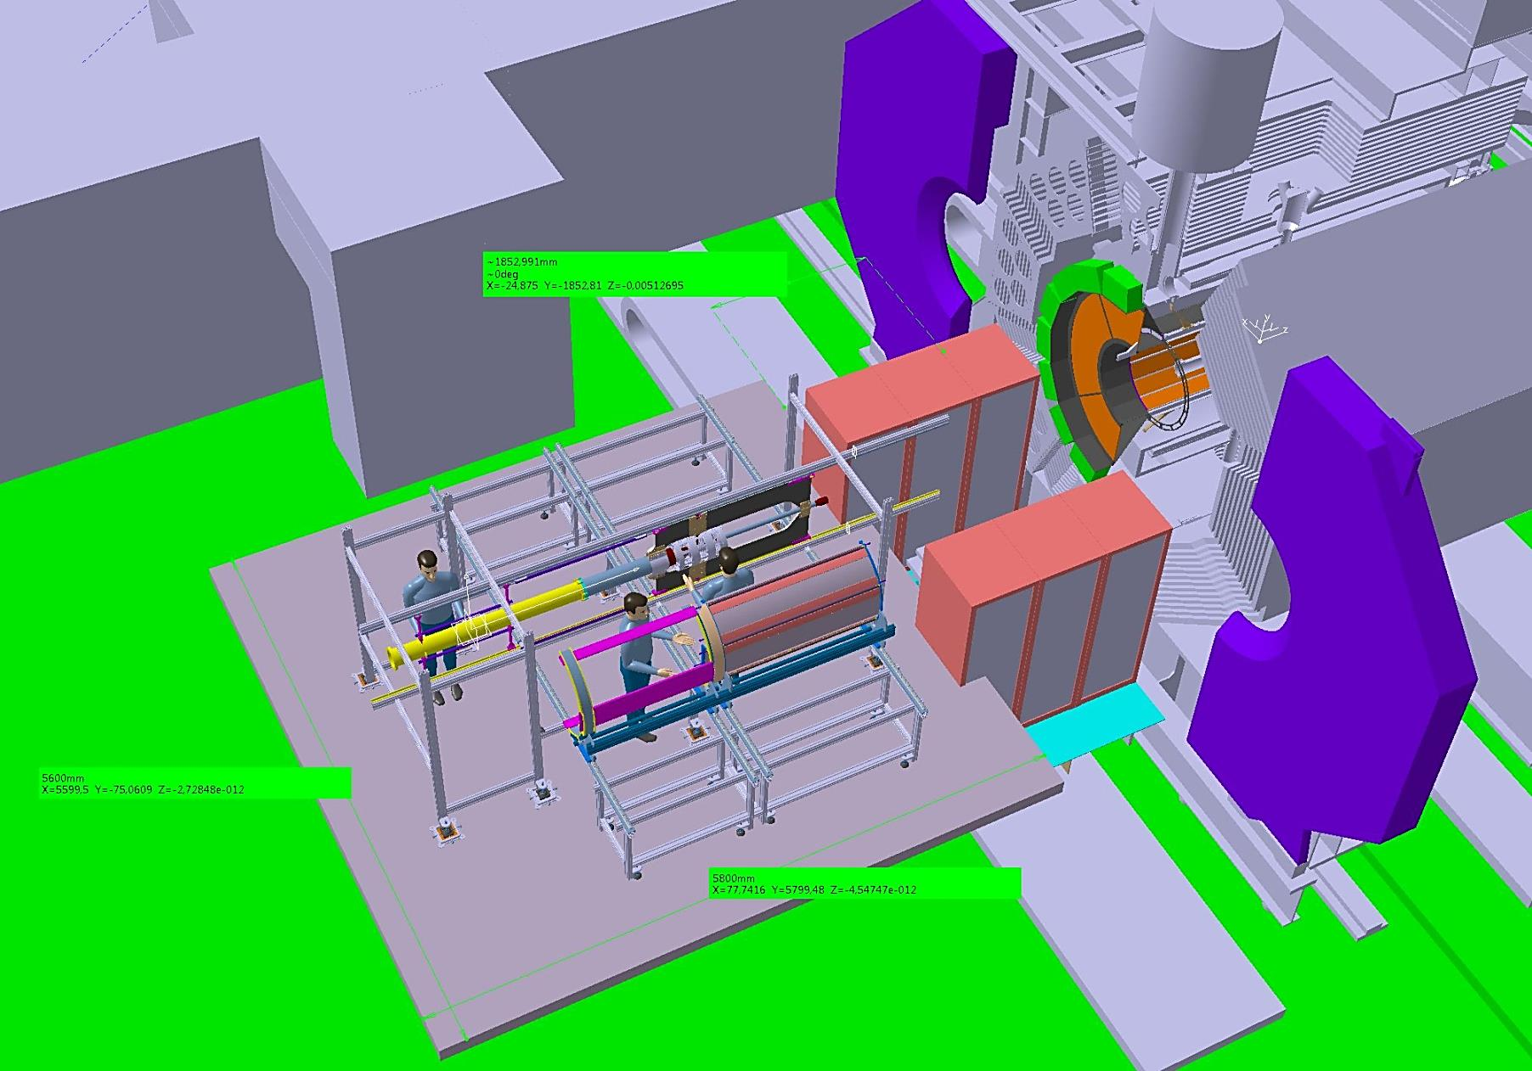
- CENTRAL TRACKER INSERTION SYSTEM IN EXPERIMENTAL HALL ……..
PICTORIAL TOP VIEW
IT DEPENDS ON THE ARRANGEMENT OF THE RACKS
1800mm (DISTANCE PLATFORM / MAGNET DOORS)
AUXILIARY PLATFORM
5600mm (PLATFORM
DIMENSION)
5800mm (PLATFORM
DIMENSION)
AUXILIARY SUPPORT STRUCTURE
- TO BE AGREED WITH THE EMC-BW PEOPLE
DECEMBER 2014 / JULICH / PANDA GM / D. ORECCHINI (LNF-INFN)

Slide 11
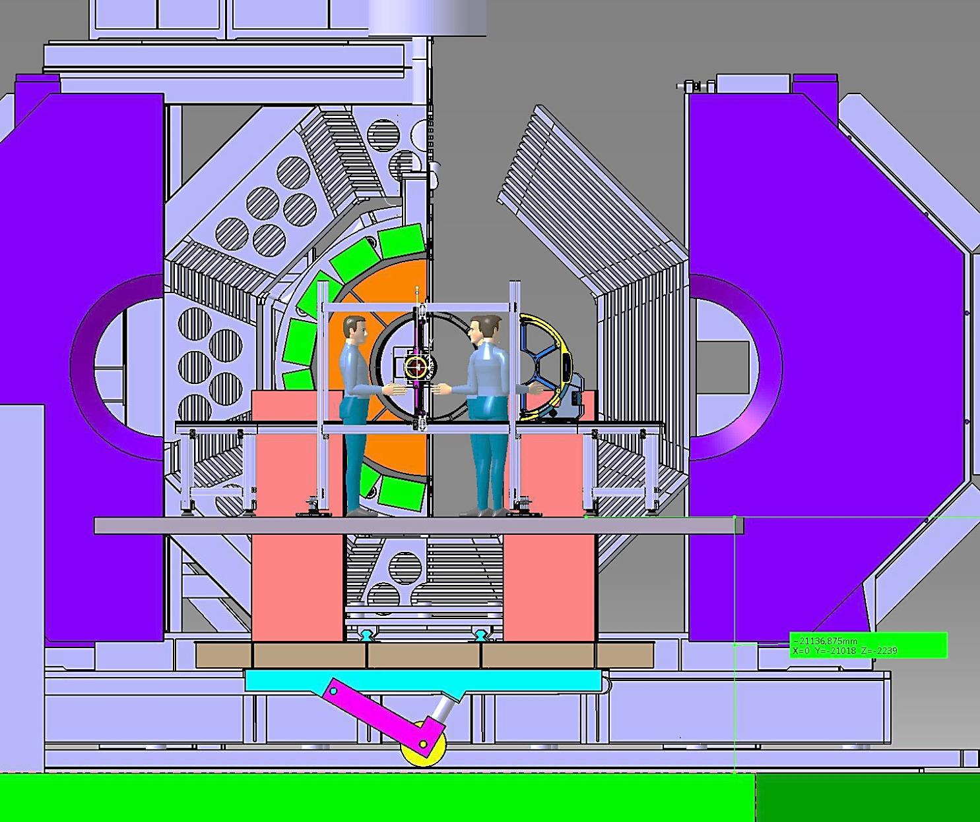
- CENTRAL TRACKER INSERTION SYSTEM IN EXPERIMENTAL HALL ……..
PICTORIAL FRONT VIEW
AUXILIARY SUPPORT STRUCTURE
AUXILIARY PLATFORM
1300mm (DISTANCE BEAM AXIS / PLATFORM
- TO BE AGREED WITH THE EMC-BW PEOPLE
DECEMBER 2014 / JULICH / PANDA GM / D. ORECCHINI (LNF-INFN)

Slide 12
- NEW AND OLD PROBLEMS YET TO BE RESOLVED……..
- PRELIMINARY ANALYSIS OF THE CONSEQUENCES ARISING FROM THE CHANGES MADE …….
DUE TO THE MODIFICATION OF MANY COMPONENTS:
1) IT MUST PROCEED TO VERIFY LOADS , SKATES FRICTION AND GENERAL MECHANICAL
BEHAVIOUR.
(IN PARTICULAR IT SEEMS PROBLEMATIC THE STABILITY OF THE SERVICES FRAME)
2) THE FUNCTIONAL ASPECTS OF THE PROPOSED SOLUTIONS HAVE TO BE FURTHER VERIFIED.
3) THE WHOLE “CENTRAL TRACKER INSERTION “ OPERATION MUST BE CHECKED AND REORGANIZED.
- ALL PHASES THAT INVOLVE THE CROSS PIPE ARE STILL TO BE ADDRESSED.
- OTHER ITEMS TO BE SOLVED -
- ALL PHASES THAT INVOLVE THE PIPE SECTOR_1 ARE STILL TO BE ADDRESSED.
DECEMBER 2014 / JULICH / PANDA GM / D. ORECCHINI (LNF-INFN)

