Slide 1
MVD updates
SUMMARY OF MECH-MEETING @ GSI OCTOBER 28th -29th
The MVD has been redesigned – 3D updated model in EDMS
Minor changes compared to the old model
Services routing under study
Locations for pipe holders & manifolds fixed (approval needed)
Homework …
G. Giraudo
MVD Mechanics 09-12-2014

Slide 2
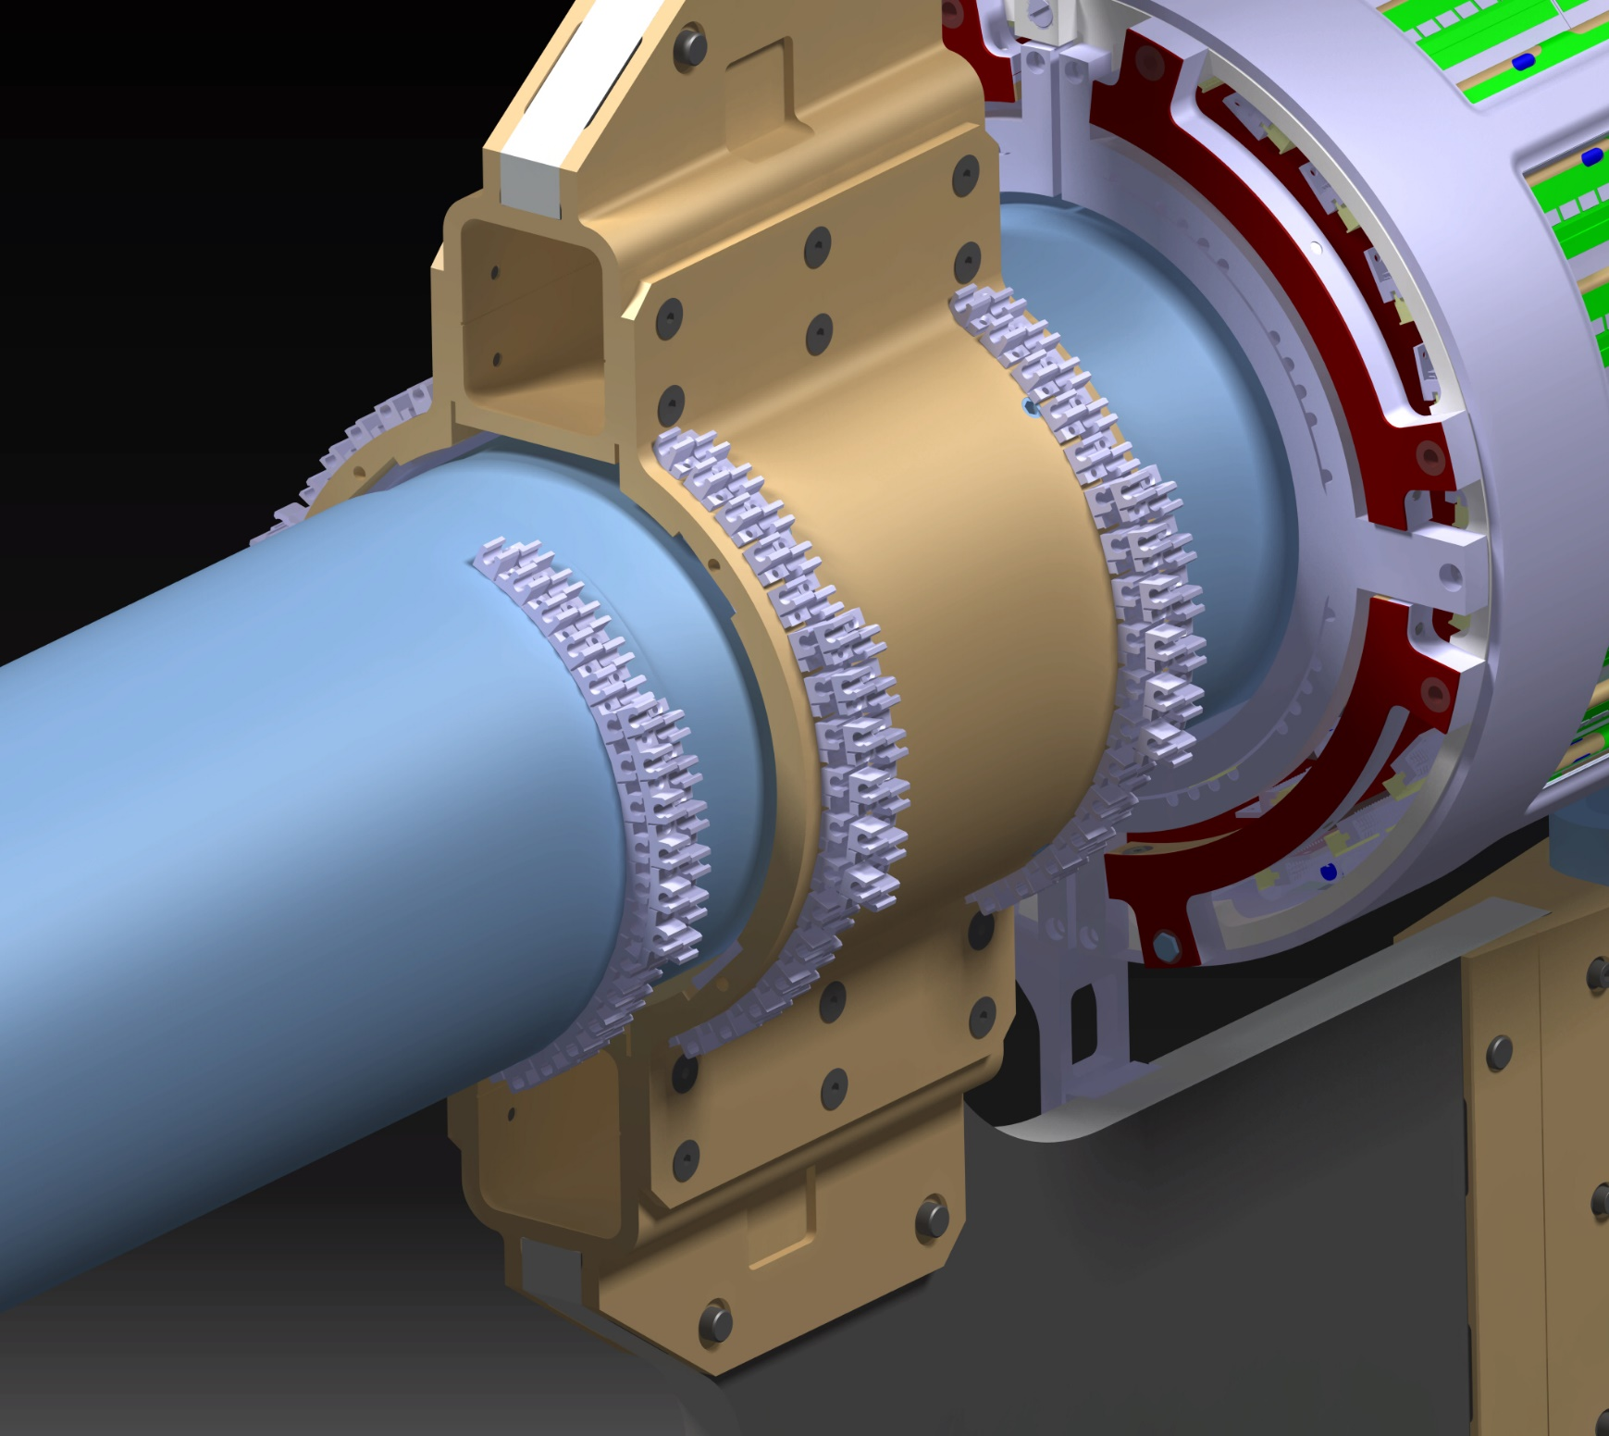
PIPE HOLDERS
SMC: POLYURETHANE – NYLON
IN HOUSE: ABS WITH 3D PRINTING
SCREWED
GLUED?
FIXED ON WELDED BOSS?
G. Giraudo
MVD Mechanics 9-12-2014

Slide 3
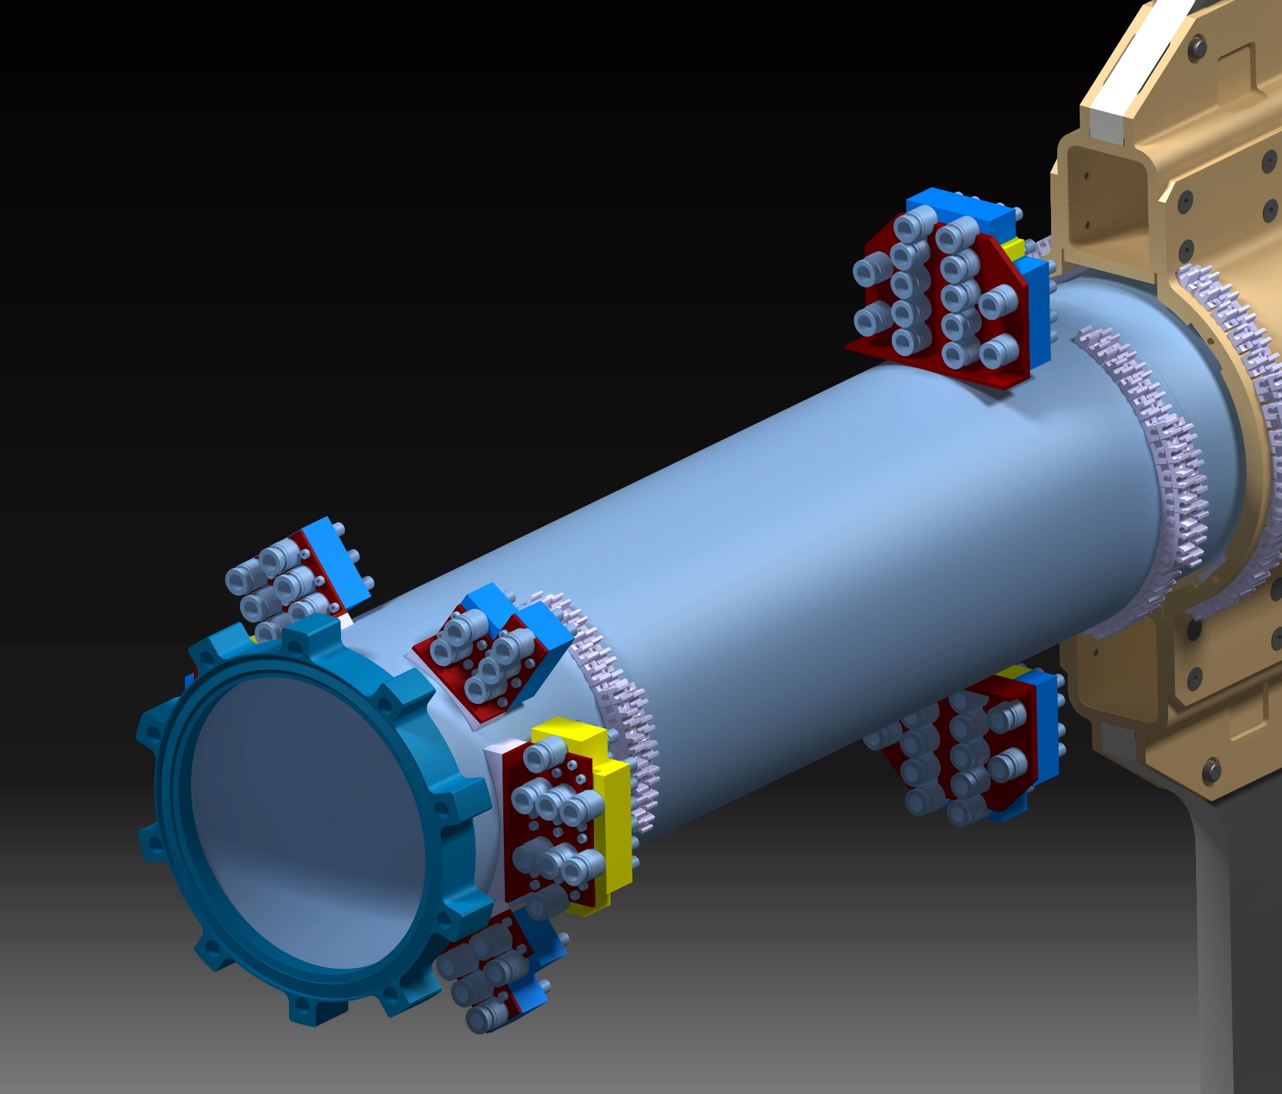
MANIFOLDS LOCATION
WELDED BOSSES
This sector of cross pipe contains:
6 welded bosses holding manifolds
4 gluing area for pipe holders
or
4 welded bosses for pipe holders
disk manifolds suspended on GBT’s frame
G. Giraudo
MVD Mechanics 9-12-2014

Slide 4
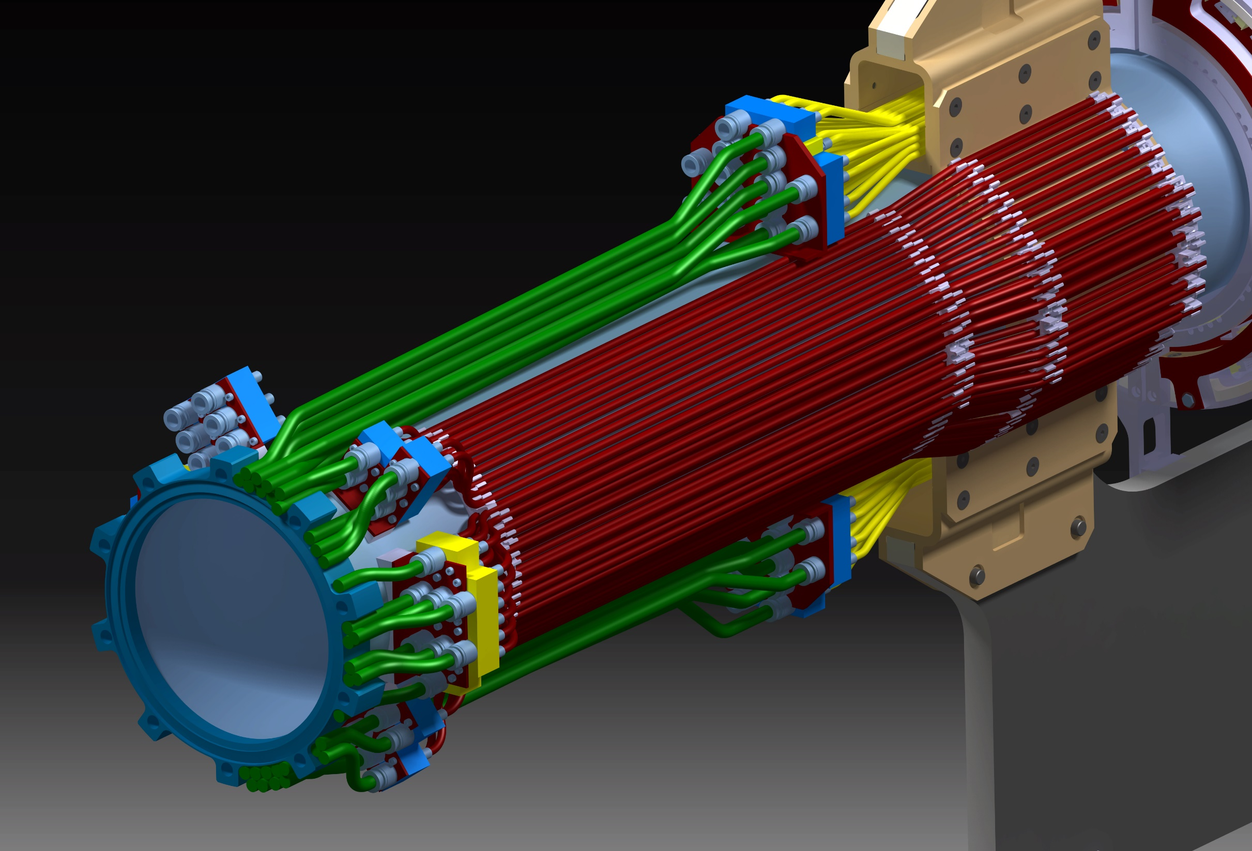
HALF MVD EQUIPPED WITH COOLING PIPES
G. Giraudo
MVD Mechanics 9-12-2014

Slide 5
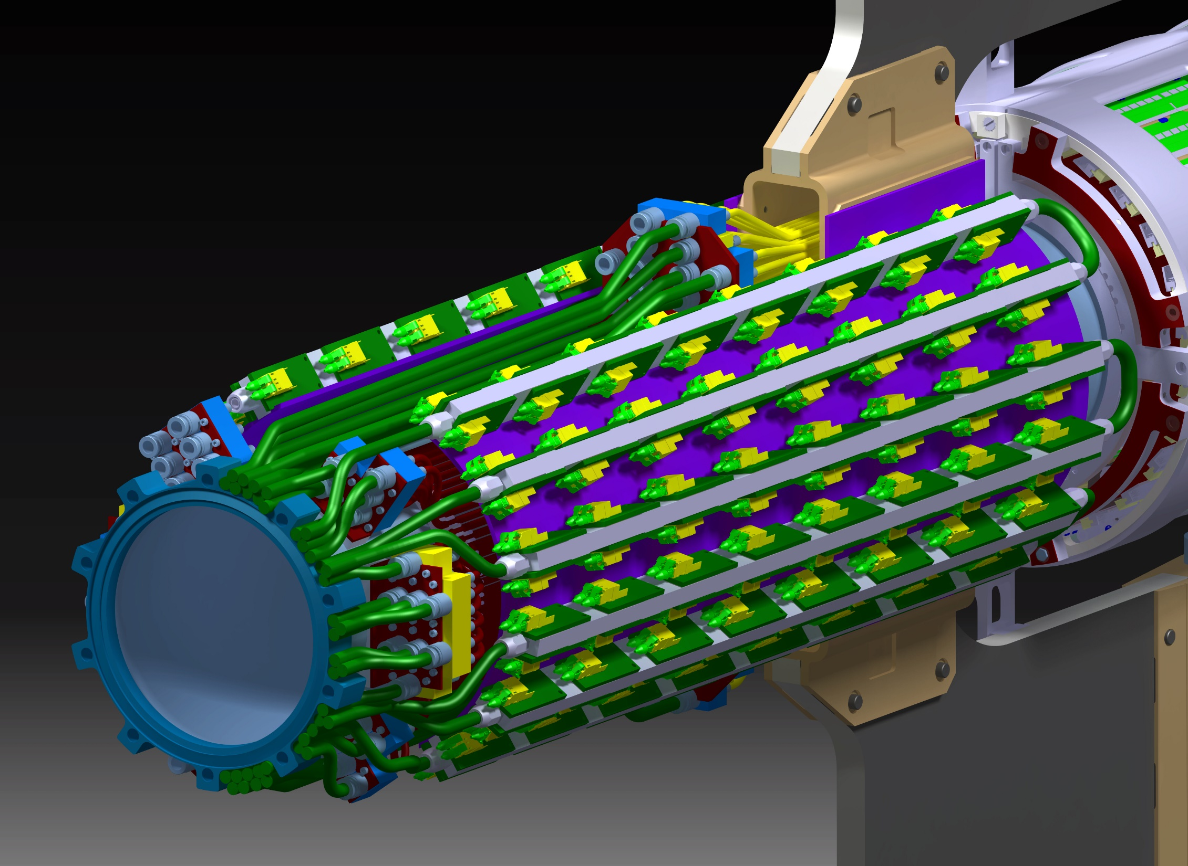
MVD FULLY EQUIPPED WITH COOLING SERVICES
GBT SECTOR ADDED TO THE SYSTEM (preliminary design)
G. Giraudo
MVD Mechanics 9-12-2014

Slide 6
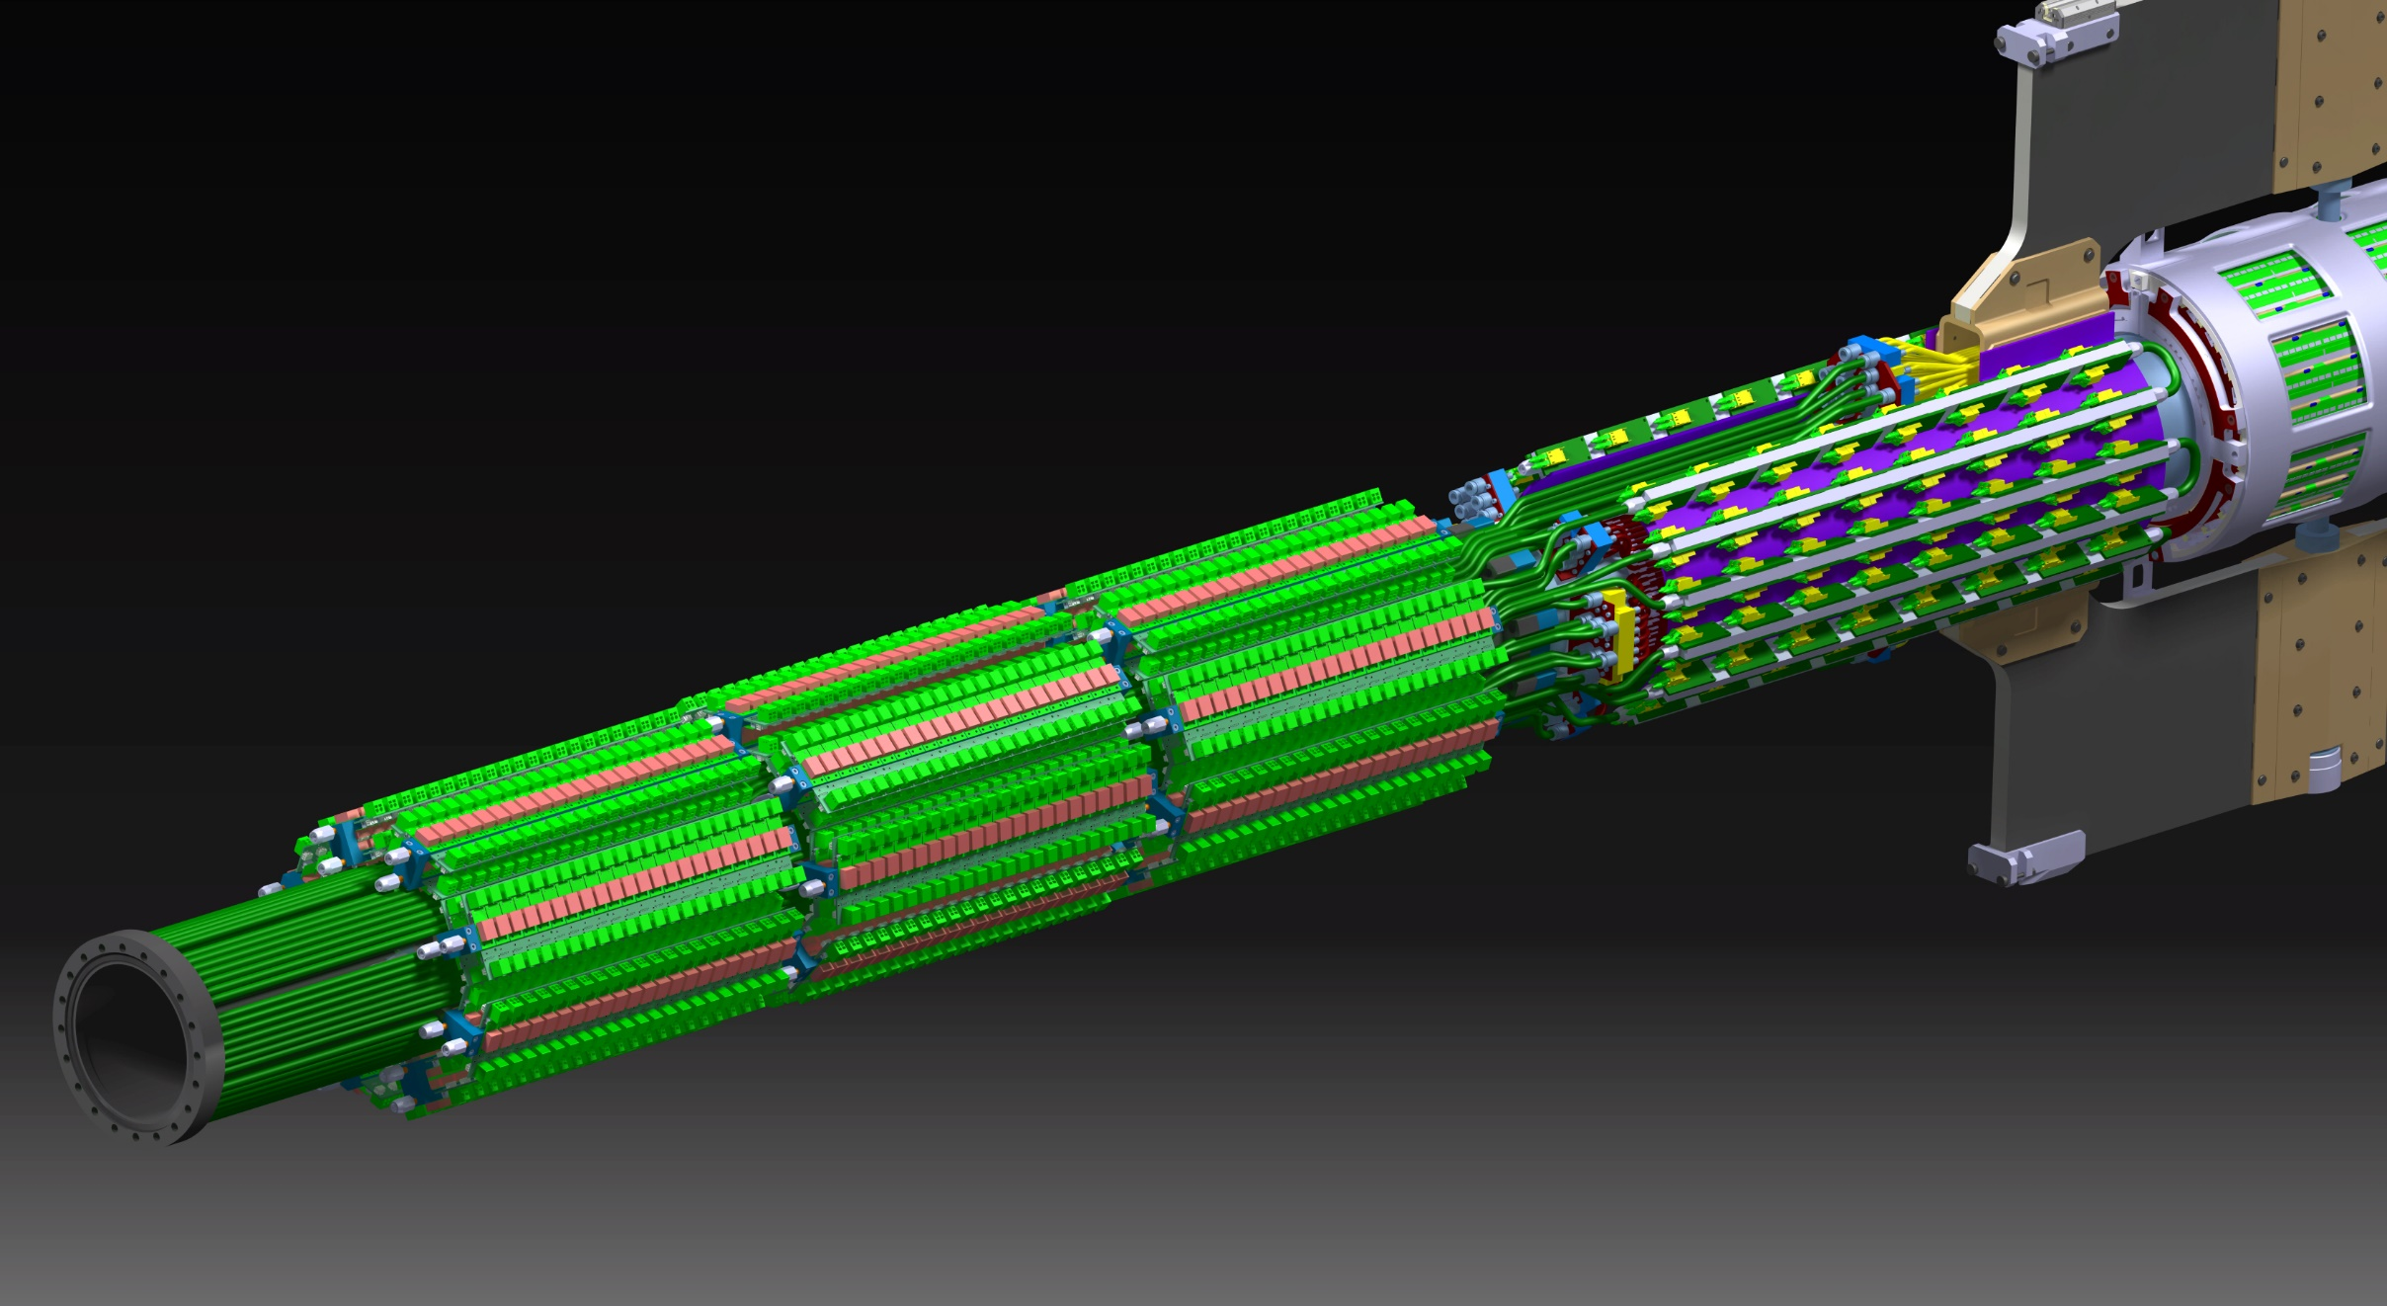
THE DC-DC PIPE SECTOR ADDED TO THE SYSTEM
POSITION OF THIS FLANGE MUST BE FIXED
-VACUUM PUMP-
HOW CAN WE HOLD THE WHOLE SYSTEM?
HOW CAN WE TRANPORT THE WHOLE SYSTEM TO THE EXPERIMENTAL AREA?
G. Giraudo
MVD Mechanics 9-12-2014

Slide 7
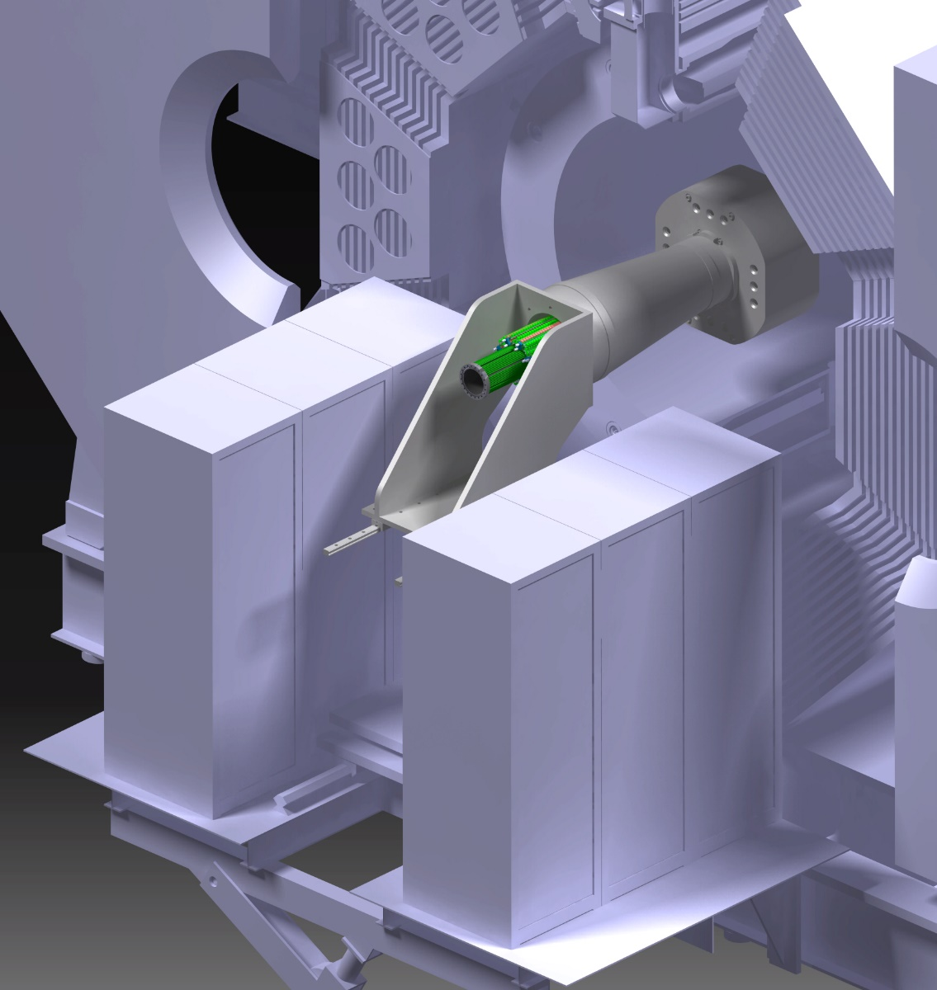
HOMEWORK
PPs location
Evaluation of the services cross section
PatchPanels design
Cooling Pressure sensors
Optical Fibres
Cables
Routing from racks to PPs & to MVD
G. Giraudo
MVD Mechanics 9-12-2014

Slide 8
HOMEWORK
Power supplies control
To CR
1.5V
To CR
GBT
2.5V
Racks
Optical fiber
Sense wire
Pixel modules
Strip modules
Patch panels
HV
LV
HV
LV
Section A
Section D
Section A1
Section A2
Section B
Signals
DCDC
DCDC
DCDC
GBT
Section C
Beam pipe
G. Giraudo/T. Quagli
MVD Mechanics 9-12-2014

Slide 9
Summary - Services Occupancy
Section name | HV | Optical fibers | LV GBT |  | LV FEE | Total
A | 477 1.3 633 28.4 | 396 1 317 20 | 25 8.5 1418 42.5 | 50 7 1924 49.5 | 300 7.5 13226 130 | 1248 17518 149.5
A1 | X | X | X | X |  | 948 4292 74
A2 |  |  |  |  | X | 300 13226 130
Cable number
Cable diameter [mm]
Total cable section [mm²]
Equivalent diameter [mm]
No safety margin has been applied
G. Giraudo/T. Quagli
MVD Mechanics 9-12-2014

Slide 10
Summary - Services Occupancy
Section name | HV | Optical fibers | LV GBT |  | LV FEE | Signal | Total
B | 477 1.3 633 28.5 | 396 1 317 20 | 25 8.5 1418 42,5 | 50 7 1924 49,5 | 3584 0.75÷1.3 2579 57,3 |  | 4532 - 6871 93,5
C |  | X | X | X |  |  | 471 - 3659 68
D | X |  |  |  | X | 230 0.5x10÷14 1502 - | 4291 - 4714 -
Cable number
Cable diameter [mm]
Total cable section [mm2]
Equivalent diameter [mm]
No safety margin has been applied
G. Giraudo/T. Quagli
MVD Mechanics 10-03-2014

Slide 11
SUMMARY
Welded bosses on the cross/beam pipe (to be approved – HESR group)
Assembly location & transport (to be decided – collaboration)
Assembly sequence & tooling (to be decided – collaboration)
PatchPanels design & location (MVD group – homework)
Services routing from MVD toward racks (MVD group – homework)
G. Giraudo
MVD Mechanics 9-12-2014

