Slide 1
Internal Target: Progress Report
F. Balestra*@, F. I*@., R. Introzzi*@, S. Ferrero@, L. Scaltrito@
  (* INFN @ DISAT)
Contents:
  Second target: production and tests
  Density of the target under pbar beam: theoretical evaluation
  Density of the target under pbar beam: plan for experimental tests

Slide 2
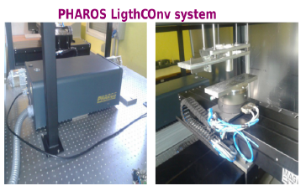
Internal Target: production of a second target
Made in Politecnico, using:
a) Diamond disk on Si ring, 3μm thick; b) LASER PHAROS to cut as wire
LASER type: Femtosecond, Ytterbium doped, solid state (Short impulse Femto edge)
wavelength: 343 nm (1064)
pulse duration: 220 fs (100)
power: 1.5 W (3W)
Wire width :145 μm, in order to verify the change of structure diamond-graphite after the cut, on a larger width

Slide 3
Internal Target: FESEM test on second target
Wire target images with FESEM at different close-up
750 x (LENS detector)
Measured width ≈ 144 ± 2.3 μm
(99.9 ± 0.5)
Quite good precision in cutting & discrete uniformity
(could be useful in overlapping the beam spot)
1000 x (SE2 detector)
Presence of granularity in the border region
agglomerates of C atoms in a phase less ordered than diamond ?
(to be confirmed by Raman spectroscopy)

Slide 4
Internal Target: Raman test on the second target
Internal Target: Raman test on the second target
Internal Target: Raman test on the second target
] → border
→ near center
A) one peak in D phase (center ≈1332 [cm⁻¹], FWHM ≈ 2 [cm⁻¹])
B) removal of the diamond content, only nc-Graphite
C) 3 features:
one D-band (center ≈1321 [cm⁻¹], FWHM ≈93 [cm⁻¹]);
one D-peak (center ≈1330 [cm⁻¹], FWHM ≈ 10 [cm⁻¹]);
one G-band (center ≈1585 [cm⁻¹], FWHM ≈ 83 [cm⁻¹])
The results in the wire border suggest the presence of a residual cluster of diamond in the graphitization column, which, instead, shows the typical nc-G features.

Slide 5
Internal Target: conclusions about 2° target
The cutting of the wire targets can be performed at Politecnico,
nearly with the same characteristics as the first one (made in Vienna),
and with acceptable precision in sizes,
the effects of the LASER cut are nearly the same, confirm the G-phase appearance in the border, even if some residual region with D-phase is present
Therefore these effects look inherent to the cutting process

Slide 6
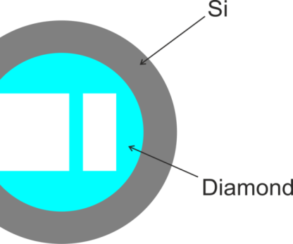
Target density consumption: theoretical estimation
Recall: beam steering technique
annihilation rate R_{a}^{Max} ≈ constant
Beam spot
With:
R_{a}^{Max} ≈ 5 ×10⁶ [s⁻¹]
= beam density width ≈ 1[mm]
w_{w} = target width ≈ 100[μm]
w_{th} = target thickness ≈ 3[μm]
Assumptions
Annihilations occur uniformly in a volume V_{I} ≈ S_{I} ×w_{th} of the target (very small target thickness, small width)
The target surface relevant to the annihilation is: S_{I} ≈ 2× (2σ)× w_{w} (assuming that contribution beyond 2× FWHM is negligible)

Slide 7
Target density consumption: theoretical result
Where:
δ ≈ 5 ×10¹⁹ [nuclei/cm²]
n₀ = initial # of nuclei inside V_{I}
ρ₀ = initial density inside V_{I}
Results (full day data taking)
Remark:
actually the «consumption» time should be decreased by:
a factor 200/570, due to the ratio of the bunch to the ring length
Duty cycle (<0.5)
1 day → ≈ 5 effective days

Slide 8
Target density variation: experimental test
Even if the results of the theoretical calculations are not worrying, an experimental test should be welcome
Since antiprotons are not yet available, new projectiles and new reactions have to be chosen to simulate the effects of the annihilations
Fragmentation seems to have the most similar effects on the target:
destroys nuclei like annihilation, although with different products in the final state
due to the small sizes of the target, the final state products are expected to have not any secondary effects on the target
Which energy?
Which projectiles?
Which experimental apparatus (detector, trigger…)?
Where?

Slide 9
Experimental test on density: energy, projectile and where
In the ¹²C fragmentation one has to take into account that:
Binding energy: B(¹²C) ≈ 90 MeV
Energy of projectile: E (¹²C) > B(¹²C) → E (¹²C) ≈ 120-130 MeV → σ_{F} ≈ 60 [mb]
Protons are the best projectiles because
only the nucleus-target is fragmented
easy trigger
@ LNS:
max E/n = 62 [MeV/n]
Max power: 100 [W]
max proton energy: E(p) = 62 [MeV]
@COSY:
proton energy range: 175 < E(p)<2880 [MeV ]
Flux: 10 ⁷ [p/pulse]; pulse duration = 200 [ns] ?

Slide 10
Experimental test on density: @ LNS
Experimental test on density: @ LNS
Max E/n = 62 [MeV/n] → E(α) = 124 [MeV]
α is a bound system: low probability of projectile fragmentation
Max power: 100 [W] → flux I_{α} ≈ 2×10 ¹³ [α/s]
(from: )
The fragmentation rate is :
and : ,
The ratio of the fragmentation time t_{F} equivalent to the annihilation time t_{a} is: t_{F} / t_{a} ≈ 2.3

Slide 11
Experimental test on density: t_{F} vs σ
Which is the cross section for fragmentation?
It depends on:
Projectile
Energy
1 day of annihilations becomes →

Slide 12
Experimental setups @ LNS & COSY
Features of detector CHIMERA:
4π acceptance
Si and CsI detectors
up to 20 detected particle/event → good trigger performances for fragmentation
But: too low projectile flux → too long time for test
Features of COSY:
Good energy range & proton projectiles
Beam intensity: ?
Experimental setup: ?

Slide 13
CONCLUSIONS
  Second target production:
    the LASER cutting of the diamond disks can be performed at home with same precision in size
  Second target tests:
    also the tests can be performed at home
    FESEM microscopy and Raman spectroscopy showed the same features as the first target
  Density of the target under beam (calculations):
    The theoretical calculations show an optimistic picture: annihilations will change the target density less than 10⁻⁶
  Density of the target under beam (experimental):
    @LNS: good detector but needs too long time (low α flux)
    @COSY: good projectile (p) and energy (175 MeV → 2280); setup to be discussed

Slide 15
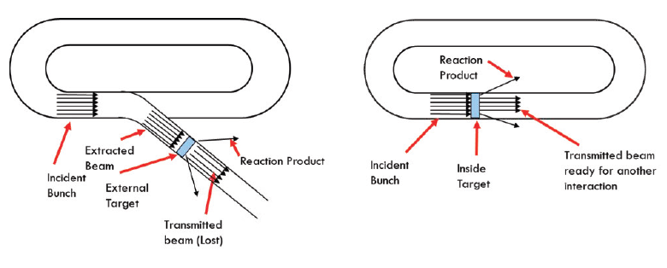
External or Internal Target in HESR?
Some features for solid target.
It has to meet conditions of density (to produce a satisfying slowing down of Ξ⁻ in it.
Maximize the production of Ξ⁻
Transmitted beam donot perturb
The target should not damage
Internal target option allows to avoid wasting antiprotons
Best compromises after feasiblity studies A=12 ( Diamond Target)
Geometry: wire shaped

