Slide 1
Update on the FPGA Online Tracking Algorithm
Yutie Liang, Martin Galuska, Thomas Geßler, Wolfgang Kühn,
Jens Sören Lange, David Münchow, Björn Spruck, Milan Wagner
II. Physikalisches Institut, JUSTUS-LIEBIG-UNIVERSITÄT GIESSEN
Dec. 10. 2014

Slide 2
Outline
1. Introduction to the STT
2. Road finding and momentum calculation
3. Implementation with VHDL
Beam test data
5. Summary and outlook

Slide 3
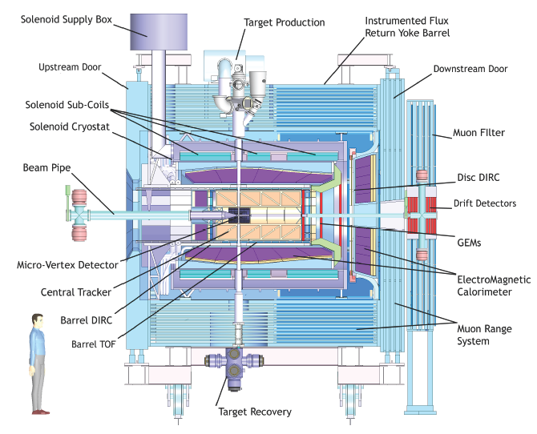
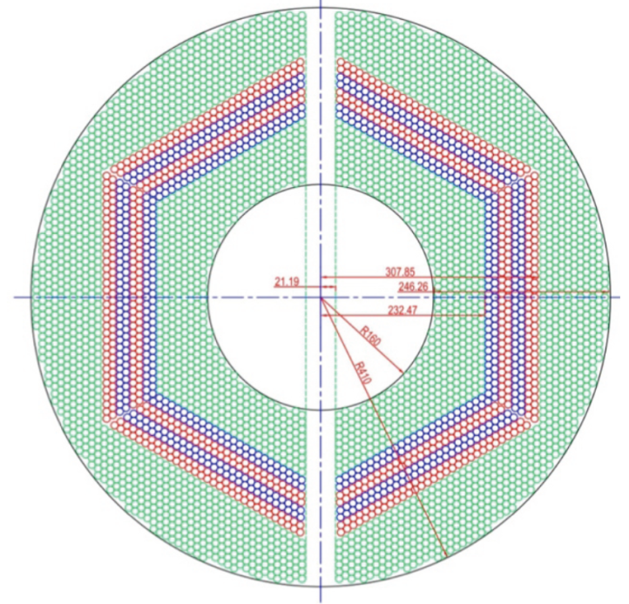
Straw Tube Tracker (STT)
4636 Straw tubes
23-27 planar layers
15-19 axial layers (green) in beam direction
4 stereo double-layers for 3D reconstruction,
with ±2.89 skew angle (blue/red)
From STT : Wire position + drift time

Slide 4
Tracking Algorithm -- Road Finding
Layer_ID
Hit
Hit
Hit
Hit
Hit
Hit
Hit
Hit
Hit
Hit
Hit
Tube_ID
Hit: Seg_ID (3 bits) + LayerID (4 bits) + Tube_ID (6 bits) + Arrival time
1: Start from inner layer
2: Attach neighbour hit to tracklet layer by layer
Boundary between two segments.
Number of neighbor:
4 in axial layer; 6 in stereo layer

Slide 5
Tracking Algorithm -- helix parameters calculation
Known : x_{i} , y_{i} , d_{i}
Question: To determine a circle,
x² + y² + ax + by + c = 0
Method: Minimize the equation
E² = ∑(x_{i}² + y_{i}² + a x_{i}+ b y_{i} + c)² (1/d_{i})²
y
x_{c}, y_{c}, R
x
S_{x} = ∑x_{i} …
S_{xx} = ∑x_{i}x_{i} …
S_{xxx} = ∑x_{i}x_{i}x_{i} …
1) Circle para.
2) Track quality.

Slide 6
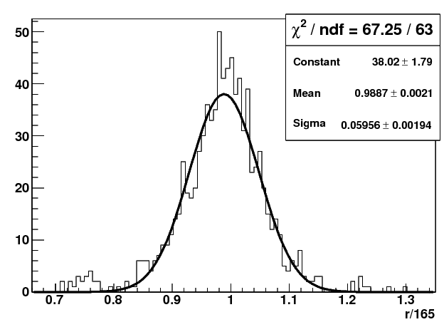
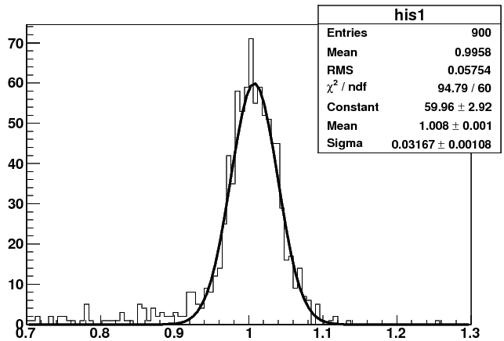
To Improve the Momentum Resolution -- using a 2nd iteration
y
Pt(input) 1st iteration 2nd iteration
0.2GeV/c : 0.195 ±0.0068 0.195±0.0068
0.5GeV/c : 0.5 ±0.0212 0.5 ± 0.0164
1.0GeV/c : 0.99 ±0.0595 1.0 ± 0.0317
2.0GeV/c : 1.85 ±0.213 2.0 ± 0.073
x_{c}, y_{c}, R
x
1st iteration
2nd iteration
Pt(GeV/c)
Pt(GeV/c)

Slide 7
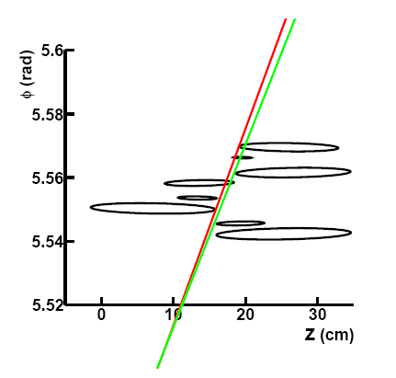
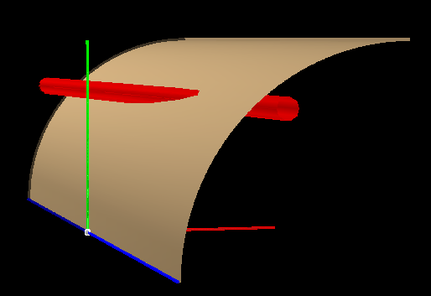
Pz reconstruction
1: The radius, the position of the helix center in the XY plane are determined.
2: Φ = kZ + Φ₀
One cylinder the helix lies in.
Based on Pt determined before
y
Crossing points
(ellipse)
One straw tube
x
z
Track need to be tangent to the crossing ellipse.
Gianluigi Boca and Panda Collaboration, Panda STT TDR, 2012

Slide 8
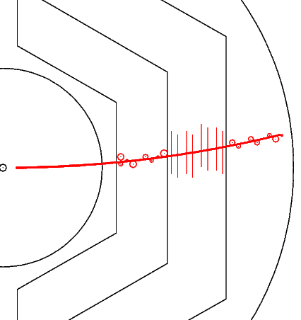
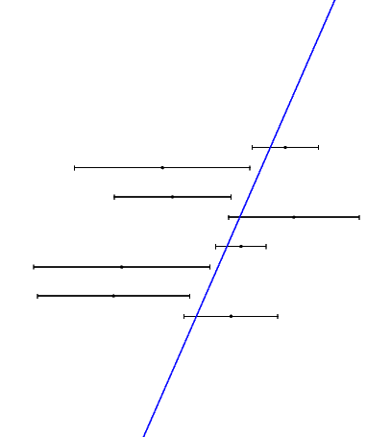
Pz reconstruction
Known : z_{i} , Φ _{i} , d_{i}
Question: To determine a line,
Φ + kz + Φ₀= 0
Method: Minimize E² = ∑(Φ_{i} + kz_{i} + Φ₀)² (1/d_{i})²

Slide 9
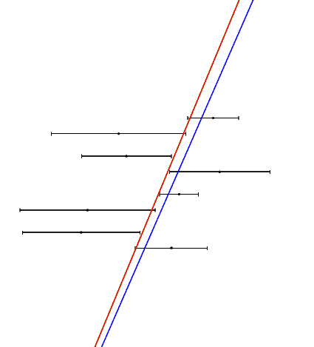
Pz reconstruction
Pt = 0.5 GeV/c
Pz(input)
0.25 GeV/c : 3.7 %
0.50 GeV/c : 4.0 %
1.00 GeV/c : 4.3 %
Pt = 1.0 GeV/c
Pz(input)
0.5 GeV/c : 3.1 %
1.0 GeV/c : 3.8 %
2.0 GeV/c : 4.2 %
Pt = 2.0 GeV/c
Pz(input)
1.0 GeV/c : 3.7 %
2.0 GeV/c : 4.8 %
4.0 GeV/c : 5.2 %

Slide 10
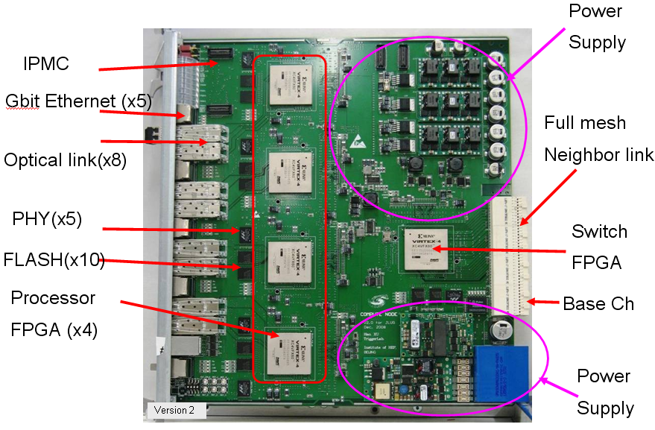
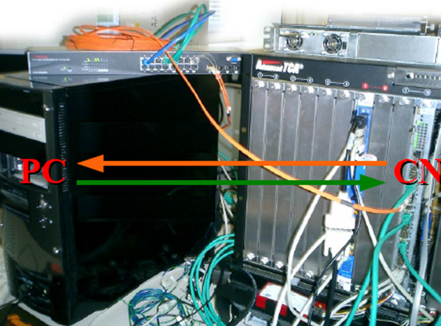

VHDL Implementation
VHDL: Very-high-speed integrated circuits Hardware Description Language.
Square root : Look-up table
(1-2000) → 1-4 4-16 16-64 64-256 …
Division: Look-up table
a/b = (a*2^n) / (b*2^n) b*2^n in (0.5-1)

Slide 11
Structure of the Algorithm in VHDL
..
..
……
9
..
8
7
5
6
4
3
T0
1
2
Tracking module
Input Interface
2D Mapping
Road Finder
Pt Calc.
Pz Calc.
Index
Ring Buffer
T0: 1) from other detector 2) scan in small step

Slide 12
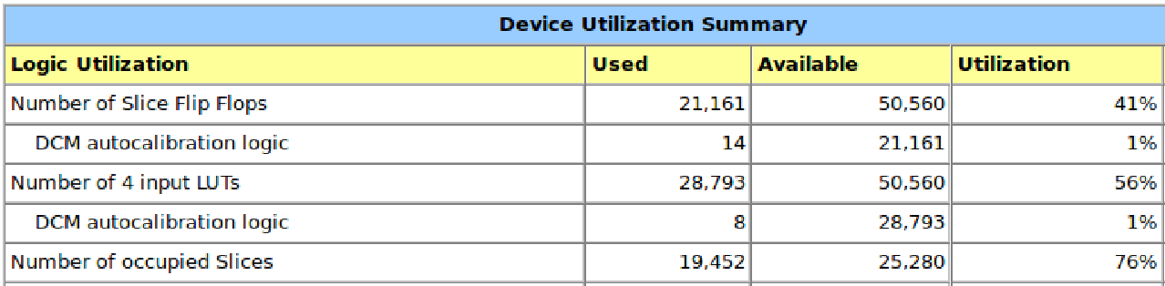
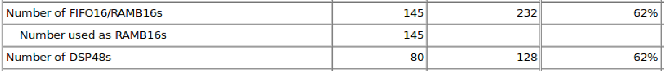
Performance at FPGA
For one event with 100 hits (6 tracks): 14 μs
Hit reading
Road finder
Pt extraction
Pz extraction
(100 cc)
(50 cc X 6)
(120 cc X 2 X 6)
(60 cc X 2 X 6)

Slide 13
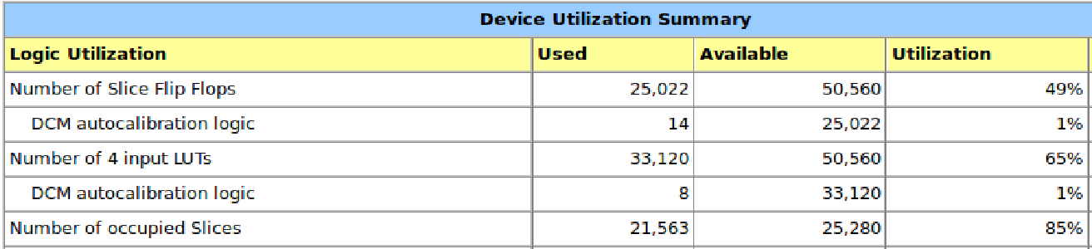
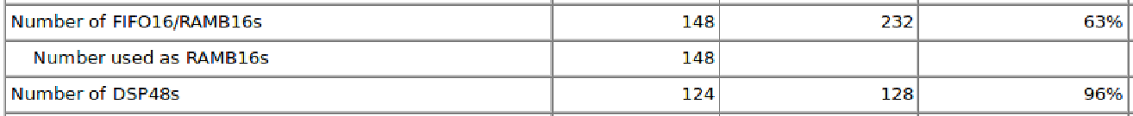
Performance at FPGA
For one event with 100 hits (6 tracks): 7 μs
Hit reading
Road finder
Pt extraction
Pz extraction
(100 cc)
(50 cc X 6)
(120 cc X 2 X 6)
(60 cc X 2 X 6)

Slide 14
Tracking at FPGA -- at low event rate
Data flow: Hit information at PC → FPGA, extract helix para. → PC
PC is used to draw hits and helix in the plot. The helix parameters come from FPGA.

Slide 15
Tracking at FPGA -- 20 MHz
Data flow: Hit information at PC → FPGA, extract helix para. → PC
PC is used to draw hits and helix in the plot. The helix parameters come from FPGA.

Slide 16
Beam test data
Proton beam.
Date: Jul. 22 2014.
Momentum: 0.8 GeV/c.

Slide 17
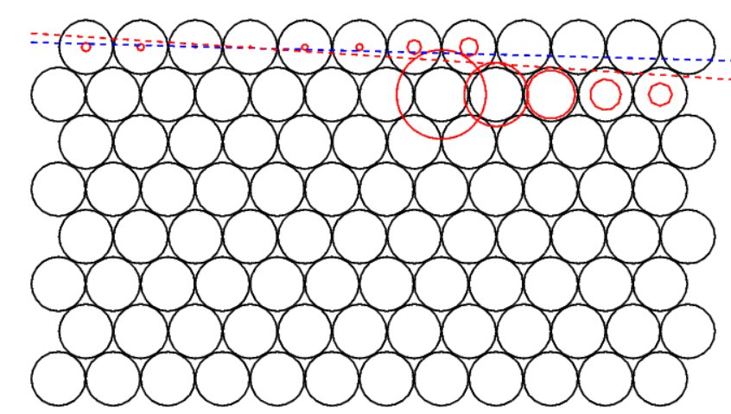
Event #1
Beam test data
Red Solid circle : drift circle
Blue dashed line : track from 1st iteration
Red dashed line : track from 2nd iteration

Slide 18
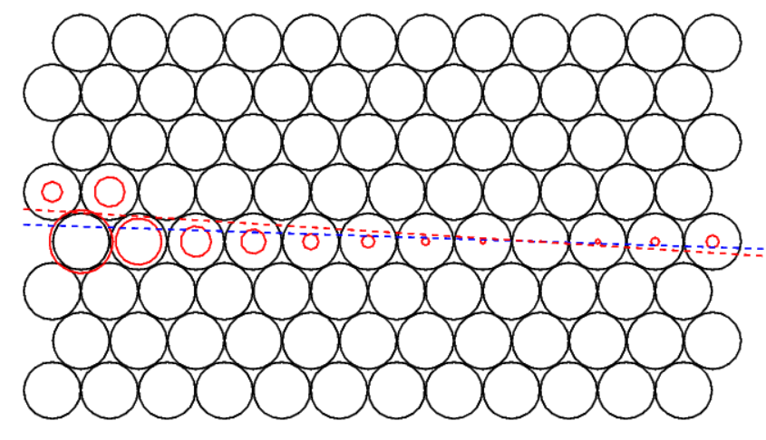
Event #4
Beam test data
Red Solid circle : drift circle
Blue dashed line : track from 1st iteration
Red dashed line : track from 2nd iteration

Slide 19
Summary and Outlook
 | C++ | VHDL
P_{t} 1st iteration | √ | √
P_{t} 2nd iteration | √ | √
χ² calculation | √ | √
P_{z} 1st iteration | √ | √
P_{z} 2nd iteration | √ | √
σ_pt : ~ 3.2% σ_pz : ~ 4.2%
7 μs/event (6 tracks) , 140 FPGA @ 20MHz
Next to do:
Optimize the VHDL code.
Include MVD points
Test with PTDAQ.

Slide 20
Thank you

Slide 22
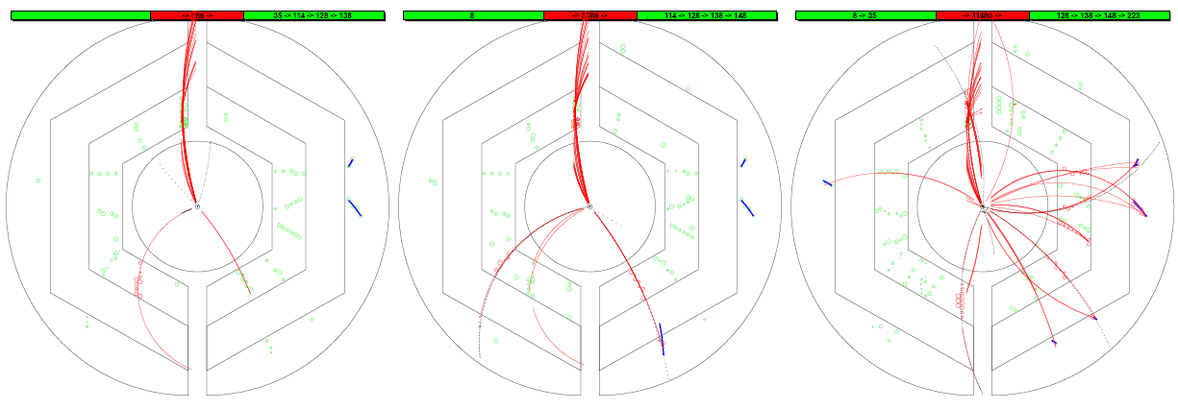
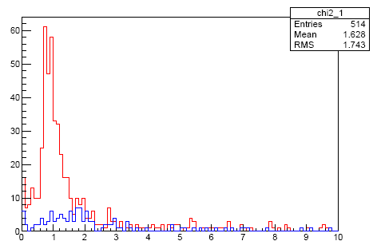
Assign Track to Correct Event
1: Number of hits in the track
2: χ² of the track
χ²

Slide 23
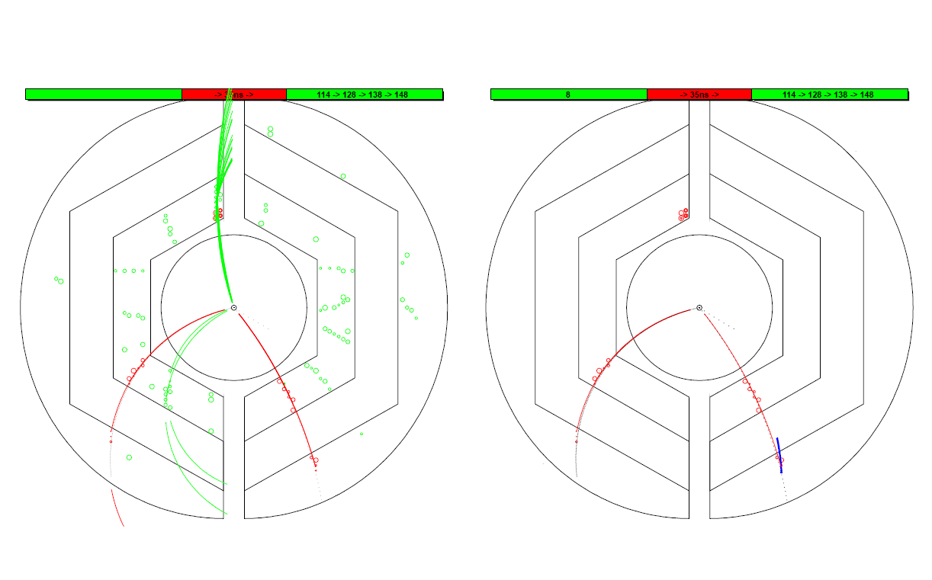
Assign Track to Correct Event
T₀ information: current event(Red) or other events(Green)
Black dashed line: track by MC truth
Red line: recon. track
Blue: recon. using outer layers
drift circles belong to current event (Red) or other events (Green)
Event #1
Event #1

Slide 24
VHDL implementation
T0
T0
..
..
9
..
Hit
Hit
Hit
Hit
8
7
Hit
Hit
Hit
Hit
Hit
Hit
Hit
Hit
5
6
ToT
4
3
1
2
T0
Tracking module
Input Interface
2D Mapping
Form tracklet
Calc Mom
Index
Ring Buffer

Slide 25
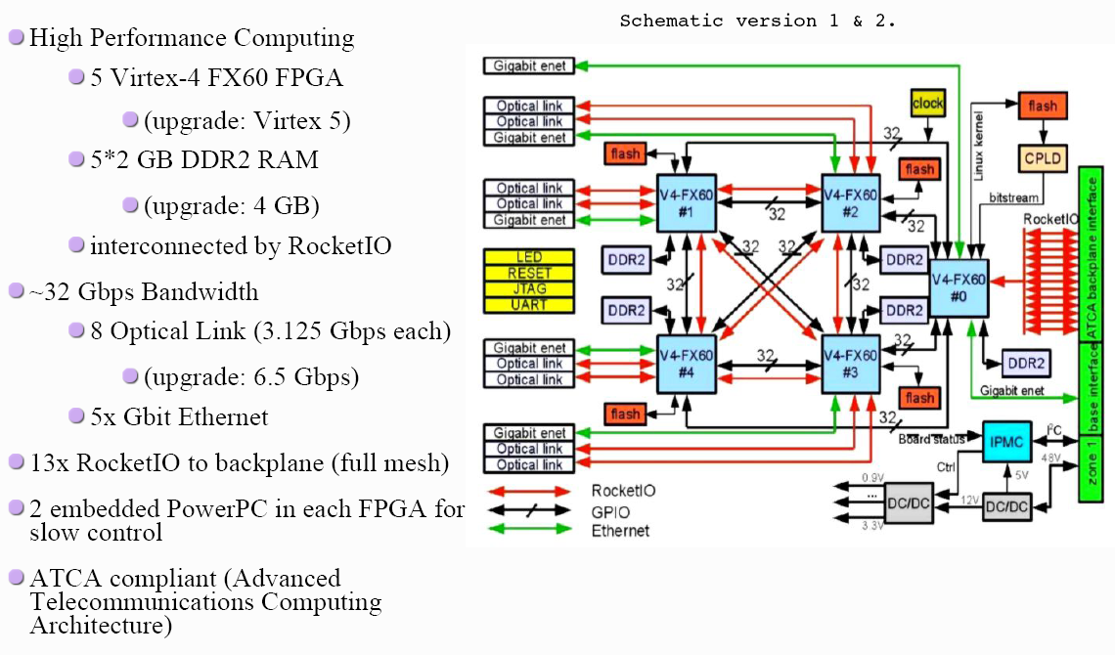
The Compute Node (CN)

Slide 26
Hardware Description Language
VHDL, Verilog, SystemC
VHDL: Very-high-speed integrated circuits Hardware Description Language.
It’s a dataflow language, unlike procedural computing languages such as C++ which runs sequentially, one instruction at a time.
Signal A3_B1 …;
Signal A4_B2 …;
A3 <= A3_B1;
B1 <= A3_B1;
A4 <= A4_B2;
B2 <= A4_B2;
A1
A
A3
B1
B
B3
A2
A4
B2
B4

Slide 27
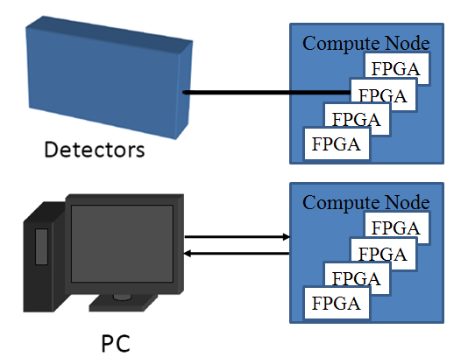
Setup and Test
PC as data source and receiver.
Ethernet.
Optical link (UDP by Grzegorz Korcyl )
(not integrated yet)
Ethernet via
Optical Link
FPGA
FIFO
Tracking algorithm
FIFO

Slide 28
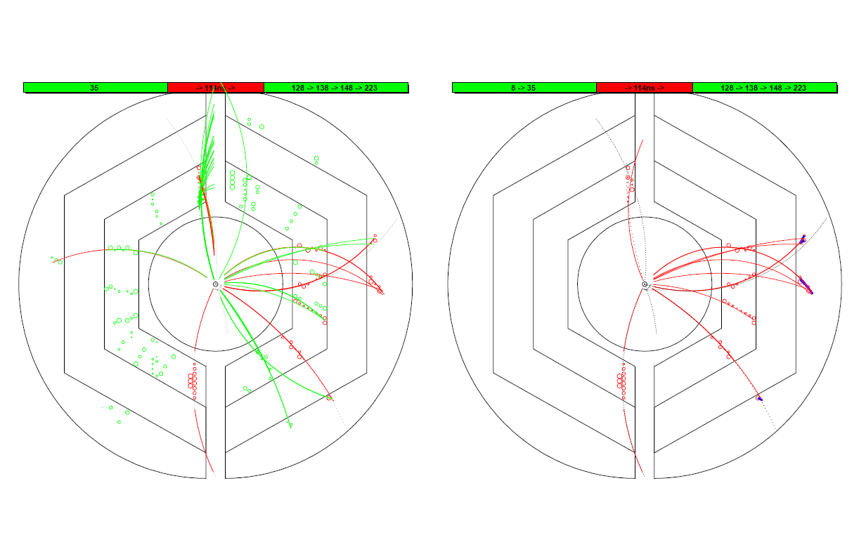
Assign a track to the correct event
T₀ information: current event(Red) or other events(Green)
Black dashed line: track by MC truth
Red line: recon. track
Blue: recon. using outer layers
drift circles belong to current event (Red) or other events (Green)
Event #2
Event #2

Slide 29
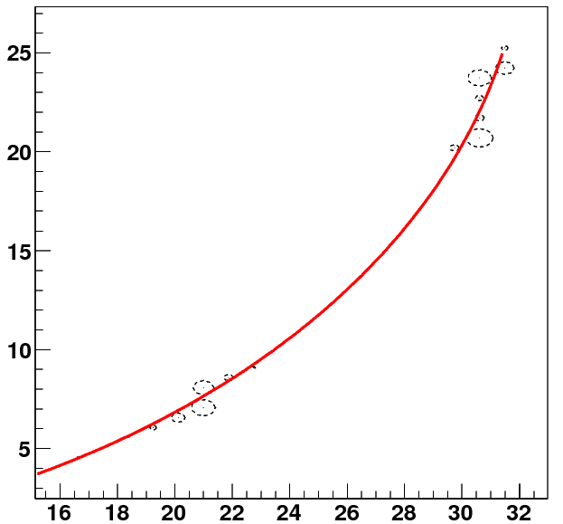
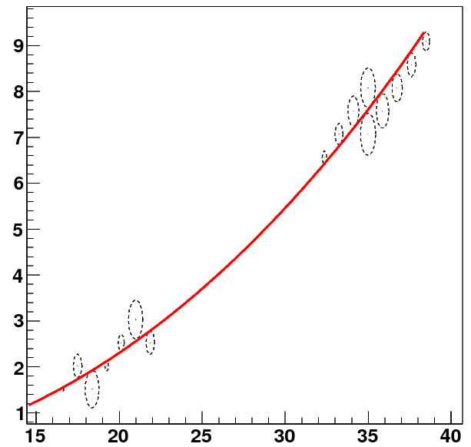
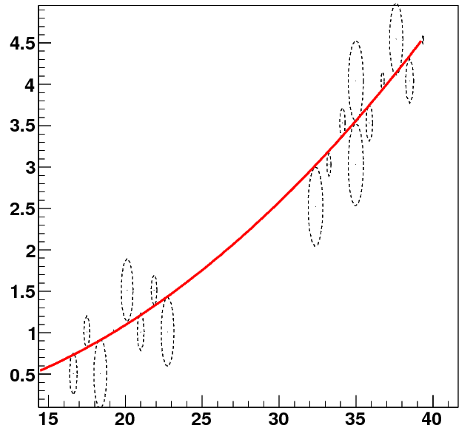
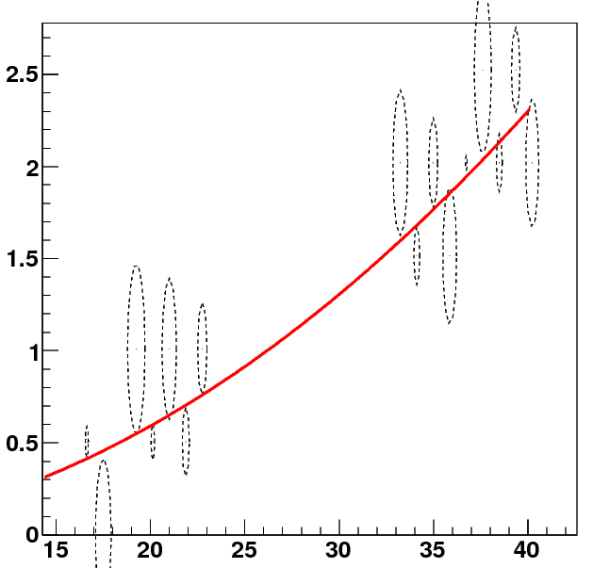
Performance study – single track
y(cm)
0.2GeV
y(cm)
0.5GeV
x(cm)
x(cm)
1GeV
2GeV
y(cm)
y(cm)
x(cm)
x(cm)

Slide 30
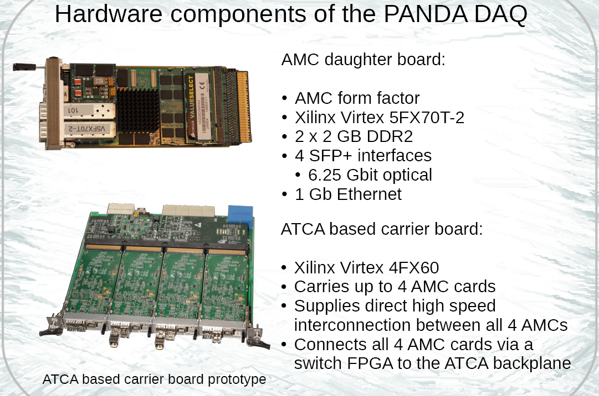

Slide 31
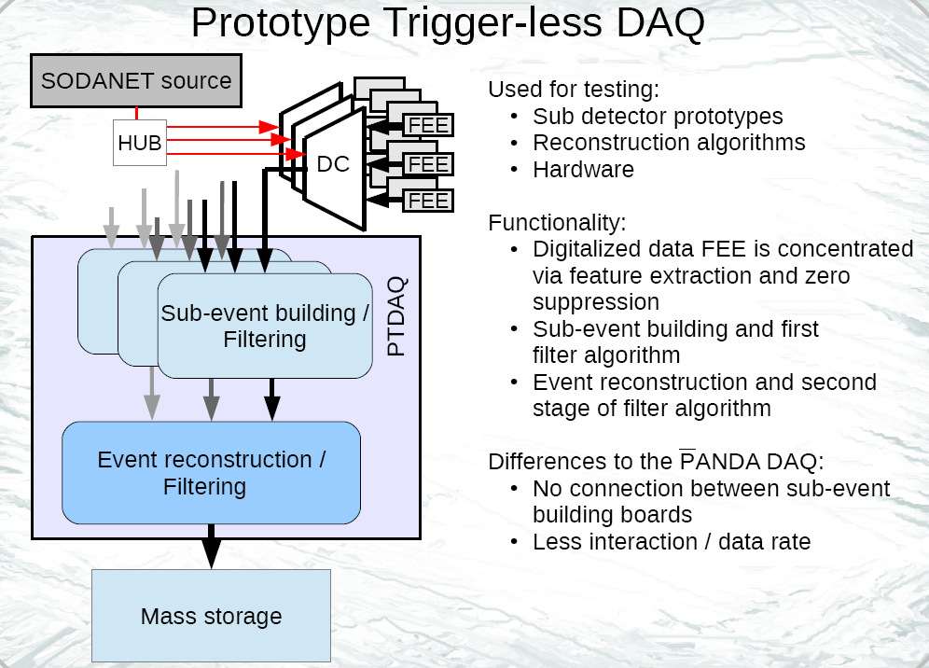

Slide 32
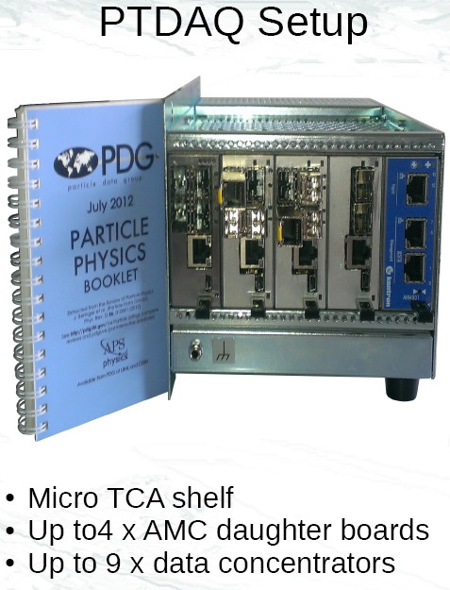

Slide 33
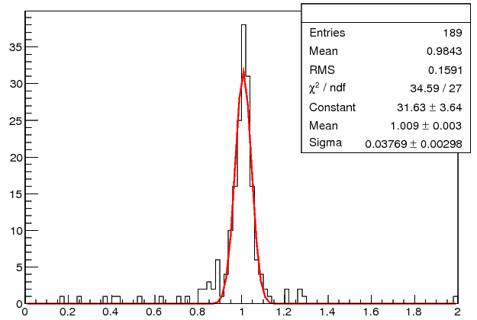
Pz reconstruction
Pt = 0.5 GeV/c
Pz(input)
0.25 GeV/c : 3.7 %
0.50 GeV/c : 4.0 %
1.00 GeV/c : 4.3 %
Pt = 1.0 GeV/c
Pz(input)
0.5 GeV/c : 3.1 %
1.0 GeV/c : 3.8 %
2.0 GeV/c : 4.2 %
Pt = 2.0 GeV/c
Pz(input)
1.0 GeV/c : 3.7 %
2.0 GeV/c : 4.8 %
4.0 GeV/c : 5.2 %

Slide 35
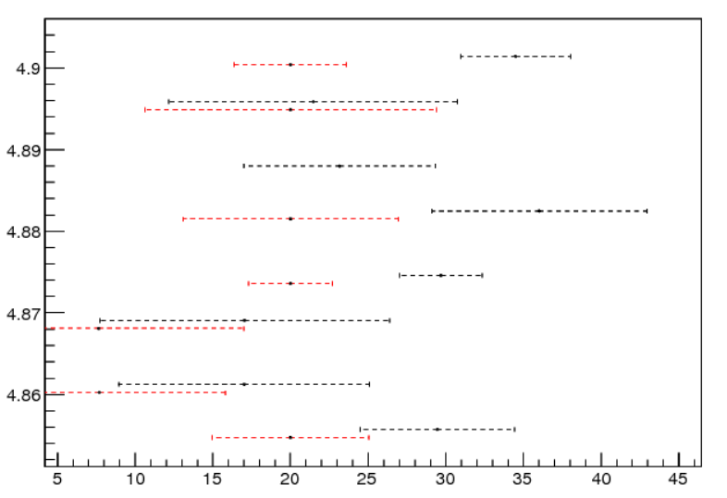
Square Root Operation
384 bins in the range of 1 ~ 4, error ~ 0.4%
sqrt_array_dyn(0) <= "00000001000000000000000000000000"; -- 1.00000
sqrt_array_dyn(1) <= "00000001000000001111111110000000"; -- 1.00390
……
sqrt_array_dyn(383) <= "00000001111111110111111111110000"; -- 1.99805
(Xc, Yc) → R
C++ VHDL
Xc: 0.7286 0.7278
Yc: 161.153 161.138
R: 161.155 160.624 (0.33%)
Zi:
C++ VHDL
29.4 ±5.0 20.0 ±5.1
17.0 ±8.1 7.7 ±8.1

Slide 36
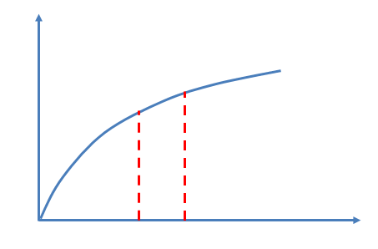
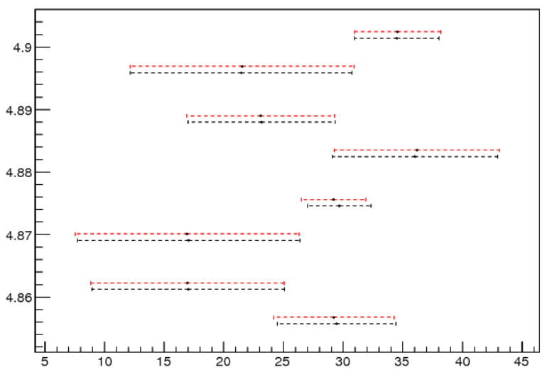
Square Root Operation
384 bins in the range of 1 ~ 4, error ~ 0.4%
Linear extrapolation, precision improves
C++ VHDL
Xc: 0.7286 0.7278
Yc: 161.153 161.138
R: 161.155 161.167 (0.01%)
Zi:
C++ VHDL
29.4 ±5.0 29.23 ±5.1
17.0 ±8.1 16.93 ±8.1

Slide 37
Performance at FPGA
Pt extraction
Pt extraction
sqrt
div
sqrt
sqrt
div
div
Number of 4 input LUTs: 70%
Number of Occupied Slices: 89%
Number of 4 input LUTs: 65%
Number of Occupied Slices: 85%

Slide 38
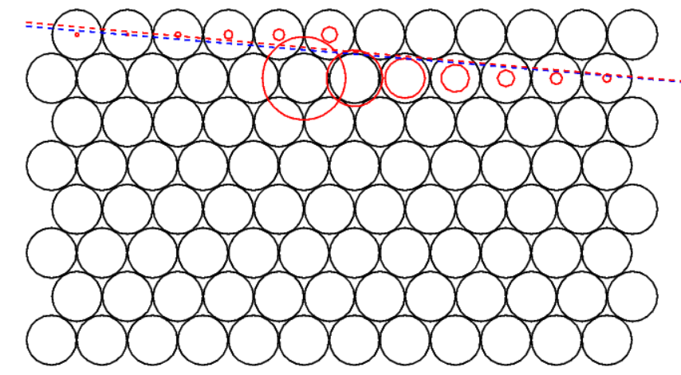
#0

Slide 39
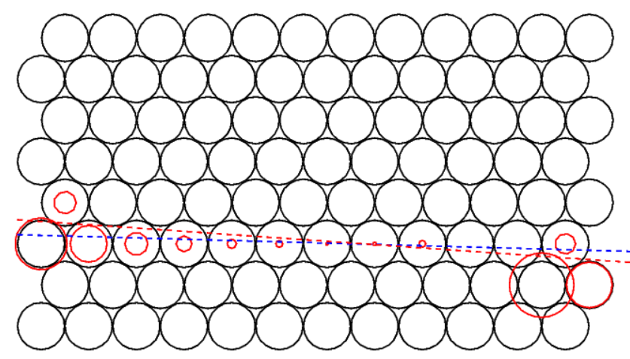
Event #3

Slide 40
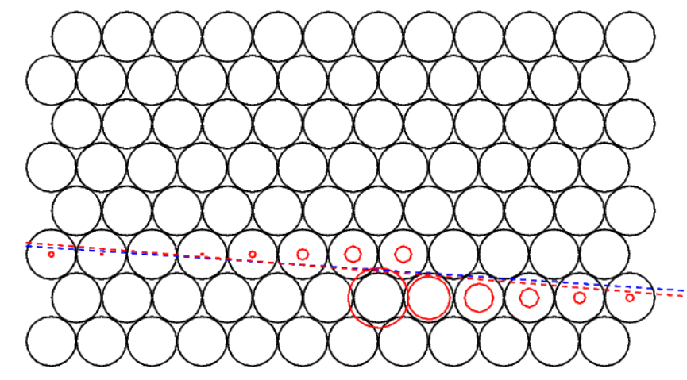
Event #6

Slide 41
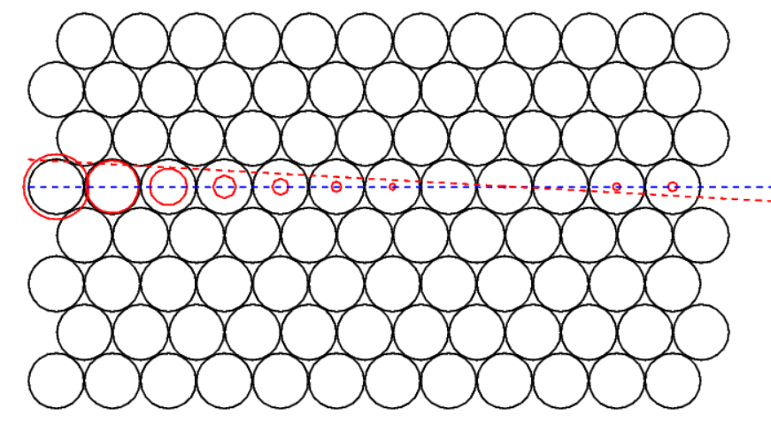
Event #2
Beam test data
Red Solid circle : drift circle
Blue dashed line : track from 1st iteration
Red dashed line : track from 2nd iteration

Slide 42
Structure of the Algorithm in VHDL
..
..
……
9
..
8
7
5
6
T0
4
3
1
2
Hit reading
Road finder
Pt extraction
Pz extraction
T0: 1) from other detector 2) scan in small step

