Slide 1
Update on PANDA solenoid design
Herman ten Kate, Alexey Dudarev, Gabriella Rolando, Helder Pais Da Silva
Panda Collaboration Meeting @ Jülich, December 9, 2014
Content: 1. Conductor
2. Coil layout
3. Eddy current loss in coil windings and casing
4. Magneto structural analysis
5. Cold mass warm dimensions
6. Shrink fit FEM analysis
7. Cryostat - Cold mass integration and test layout
8. Conclusion, next steps

Slide 2
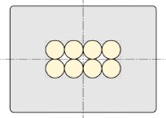
1. Conductor
Final conductor chosen:
8-strands Al-stabilized Rutherford cable with low height-to-width-ratio
Two serious suppliers identified and cost per meter confirmed and within expected range (and budget) of 100-120 €/m
Final specification ready, waiting for budget confirmation and tender !!
Parameter | TDR design | Final design
Shape
No. of strands | 20 | 8
Strand diameter [mm] | 0.8 | 1.4
Cu : nonCu ratio | 1.5 | 1.0
Cable dimensions [mm] | 8 x 1.15 | 2.6 x 5.3
Conductor bare dimensions [mm] | 24.6 x 3.4 | 7.9 x 10.9
Temperature margin ΔT [K] | 1.8 | 2.4

Slide 3
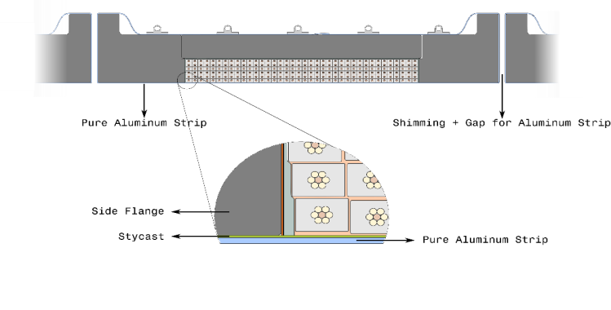
2. Coil sizes, small modification of center coil
Parameter | TDR design | Final design
I_{op} [kA] | 5 | 4.96
Inner radius [mm] | 1050.0 | 1050.1
Outer radius [mm] | 1100.0 | 1099.9
Layers / coil | 2 | 6
Upstream coil [mm] | -1025.0 < z < -143.4 | -1024.9 < z < -143.5
 | turns = 464 | turns = 468
Center coil [mm] | 157.4 < z < 552.6 | 157.25 < z < 552.75
 | turns = 208 | turns = 210
Downstream coil [mm] | 853.4 < z < 1735.0 | 853.5 < z < 1734.9
 | turns = 464 | turns = 468
One extra turn/layer in center coil to avoid sign change in the integral of the radial field component over the tracker region

Slide 4
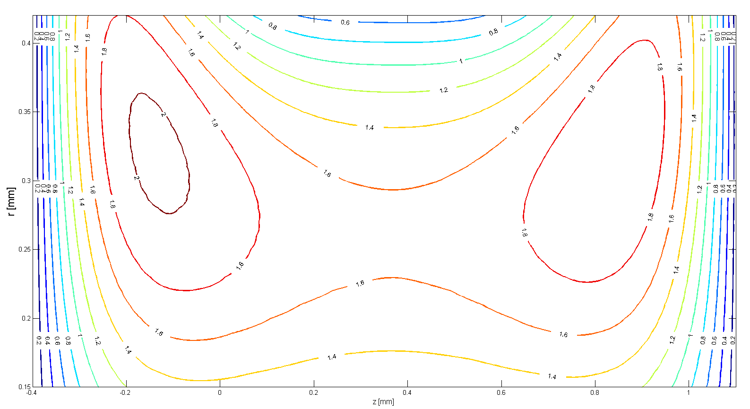
Integral of the radial field component
Integral of the radial field component over the tracker region, in mm.

Slide 5
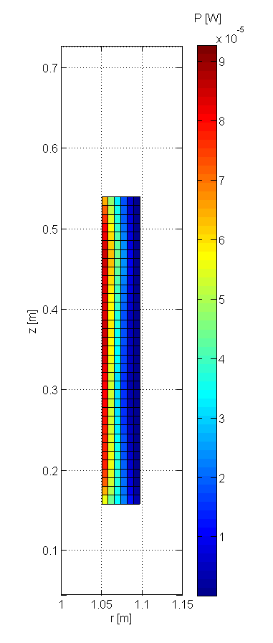
3.1. Eddy current loss in the coil windings
Parameter | TDR design | Final design
B_{peak} [T] | 3 | 3
ρ_{Al-RRR=1000} @ 4.5 K [Ω·m] | 2.480 e-11 | 2.480 e-11
t_{ramp} [s] | 2000 | 2000
P_{conservative} [W] | 2.9 | 0.3 !
P_{realistic} [W] | 0.7 | 0.09 !
Eddy current loss in center coil during 2000 s current ramp with the Final conductor design
Conservative estimate:
B = B_{peak} on all the turns
No magneto-resistance
Realistic estimate:
B = local field on each turn
Magneto-resistance included
P_{realistic} is peak value during ramp as induced current decreases with magneto-resistance

Slide 6
3.2 Eddy current loss in the casing
Eddy currents loss in the casing assessed with analytic formulas
$P= \frac{V^{2}}{R_{casing}} ; V=M∙\frac{dI}{dt}$
and
FEA (Opera/ ANSYS)
Eddy currents in the casing produce the main loss contribution during ramp & slow dump
Parameter | Value
I [kA] | 5
ρ_{Al-5083} @ 4.5K [Ωm] | 3.03e-8
t_{ramp} [s] | 2000
P_{analytic} [W] | 9.8
P_{FEA} [W] | 8.8

Slide 7
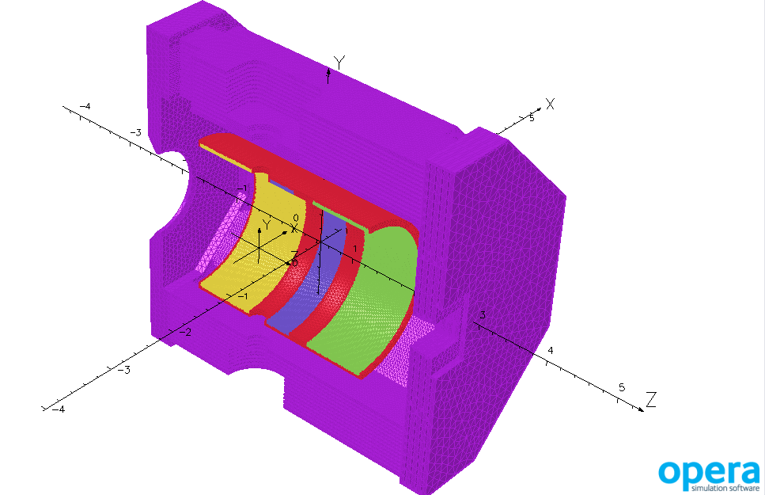
4. Magneto-structural analysis
Work in progress:
verification of 2D and 3D FE magneto-structural models
stress analysis for different coil-casing contact conditions,
i.e. bonded versus sliding interface
Expect no problems, just for verification

Slide 8
5. Cold mass warm dimensions
Analytical approximations used:
thin coil
infinite coil
no axial stress
no bonding between support shell and coil
FEA model takes analytical warm dimensions and applies:
shrink fit
bond coils to support shell
cool down
energize the magnet
 | Analytical warm dimensions [mm] | FEM cold dimensions mismatch [mm]
Coil Ri | 1054.3 | 9x10⁻²
Coil thickness | 50.0 | 2x10⁻²
Support Cylinder Ri | 1103.6 | 7x10⁻²
Support Cylinder thickness | 40.0 | 1x10⁻²
Position upstream coil | -1029.29<z<-144.10 | 0.21 / 6x10⁻²
Position Center Coil | 163.58<z<549.43 | 2x10⁻² / 6x10⁻²
Position downstream coil | 857.09<z<1742.28 | 0.11 / 0.22
 | Analytical warm dimensions [mm]
Coil Ri | 1054.3
Coil thickness | 50.0
Support Cylinder Ri | 1103.6
Support Cylinder thickness | 40.0
Position upstream coil | -1029.29<z<-144.10
Position Center Coil | 163.58<z<549.43
Position downstream coil | 857.09<z<1742.28

Slide 9
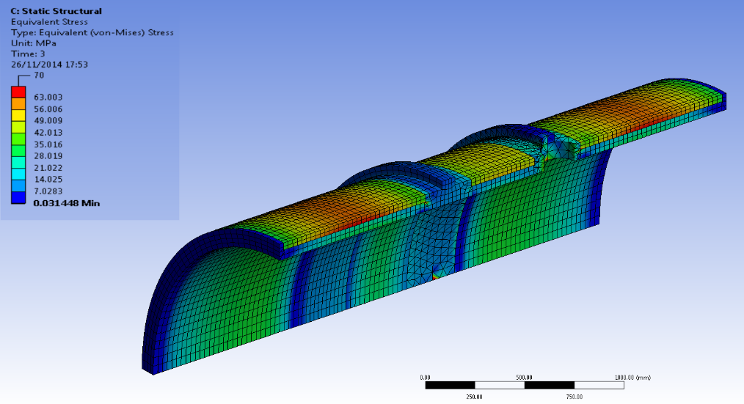
6. Shrink fit FEA analysis of support cylinder
The stress in the FEA model is about the same as with the analytical approximation.
 | Max stress (MPa)
 | Cylinder |  | Coil
 | Analyt-ical | FEM | Analyt-ical | FEM
Shrink Fit | 29 | 26 | 15 | 20
Cold | 21 | 27 | 15 | 14
Operational | 59 | 66 | 23 | 24

Slide 10
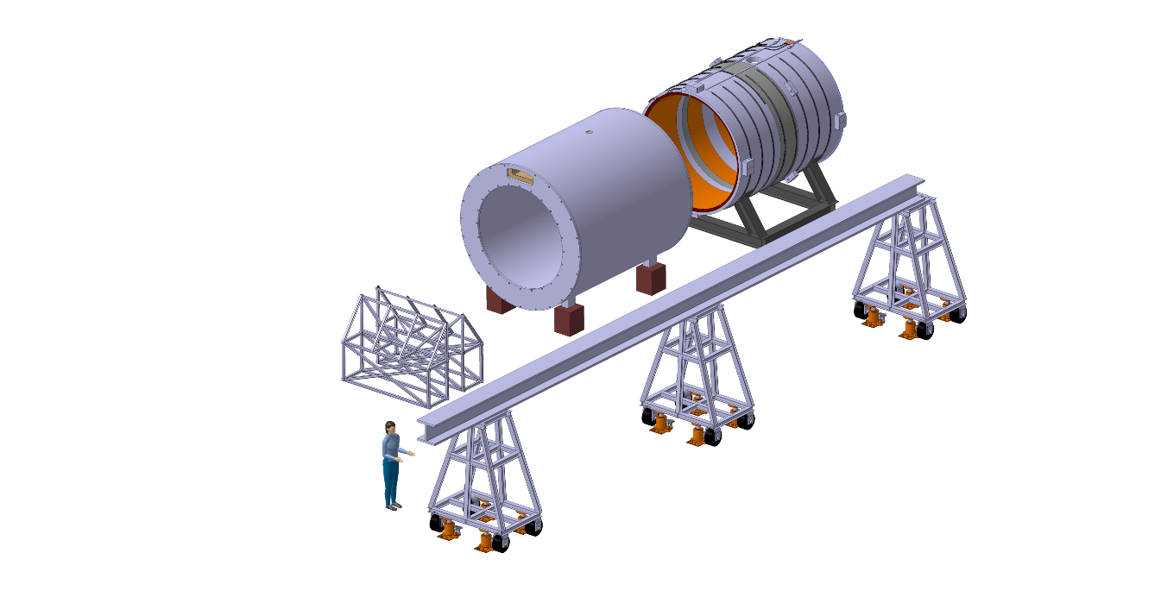
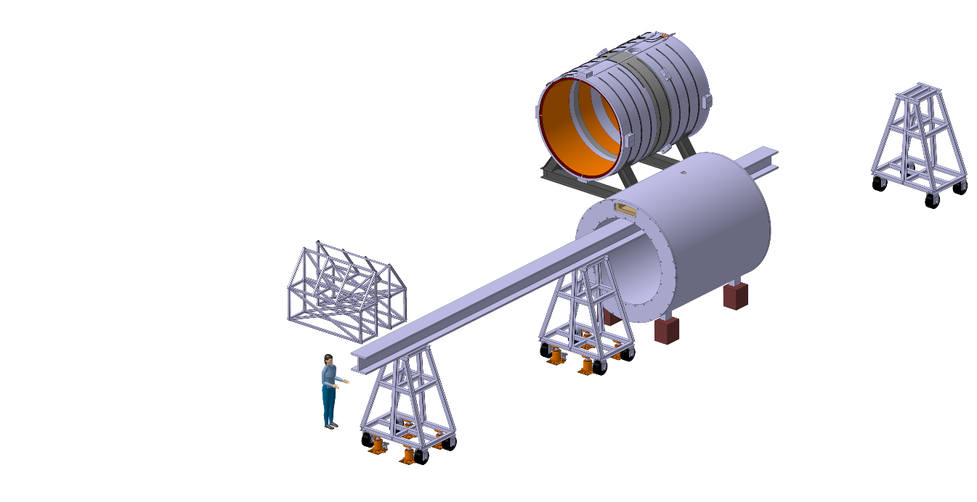
7.1 Integration: cryostat disassembly procedure
1 - Cryostat and cold mass on supports
2 - Move the vacuum vessel on to the beam

Slide 11
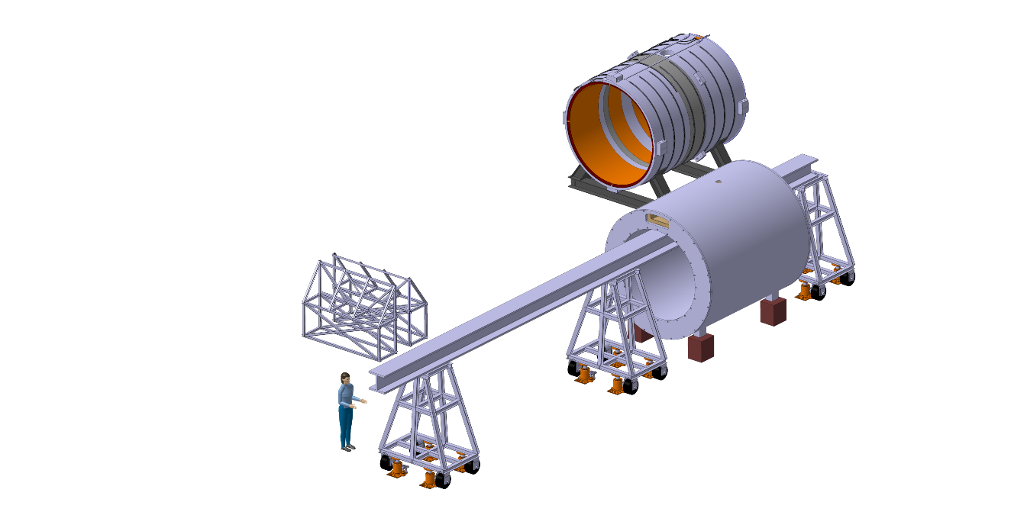
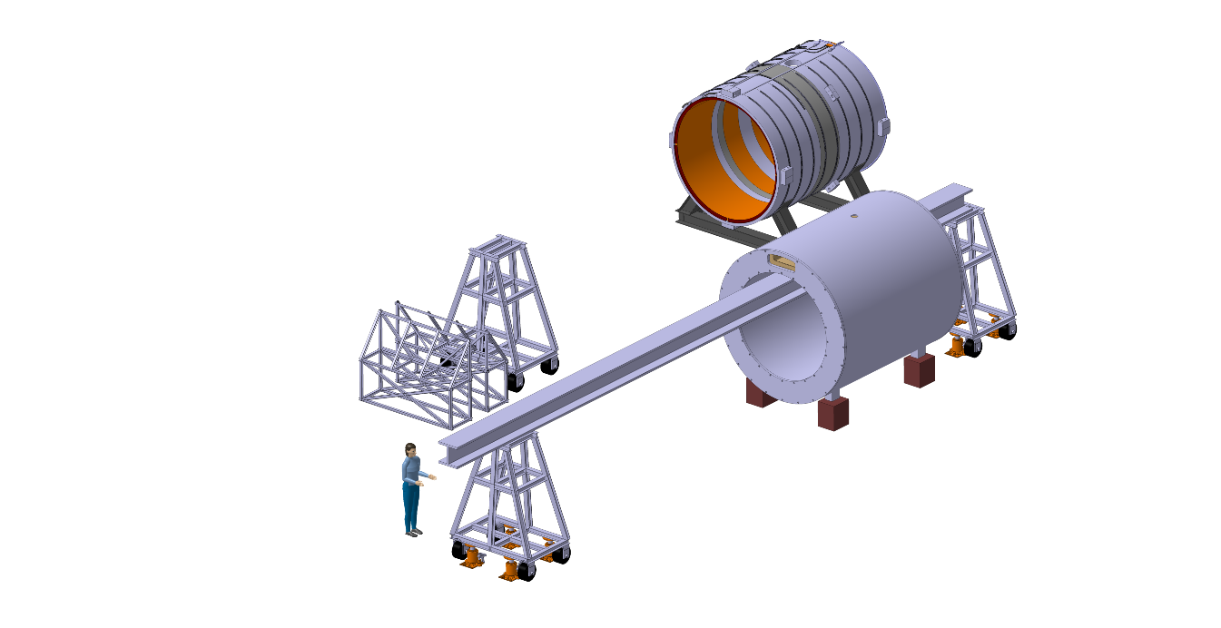
Cryostat disassembly procedure
Disassembly ryostat
1-Cryostat and cold mass on supports
2-Move the vacuum vessel on to the beam
3 - Move outer support in and remove central support

Slide 12
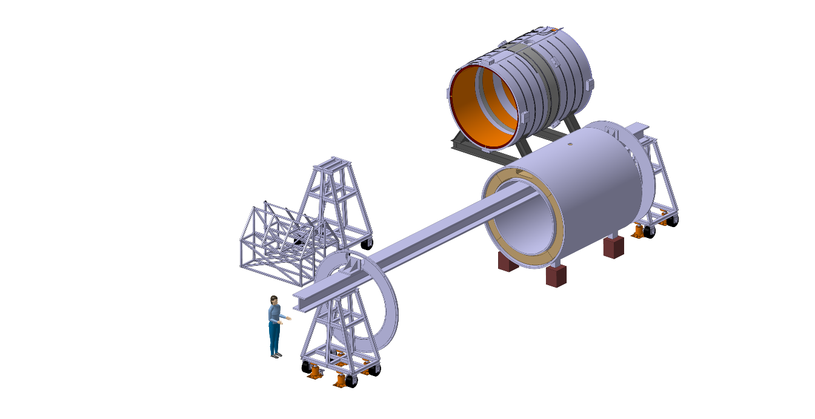
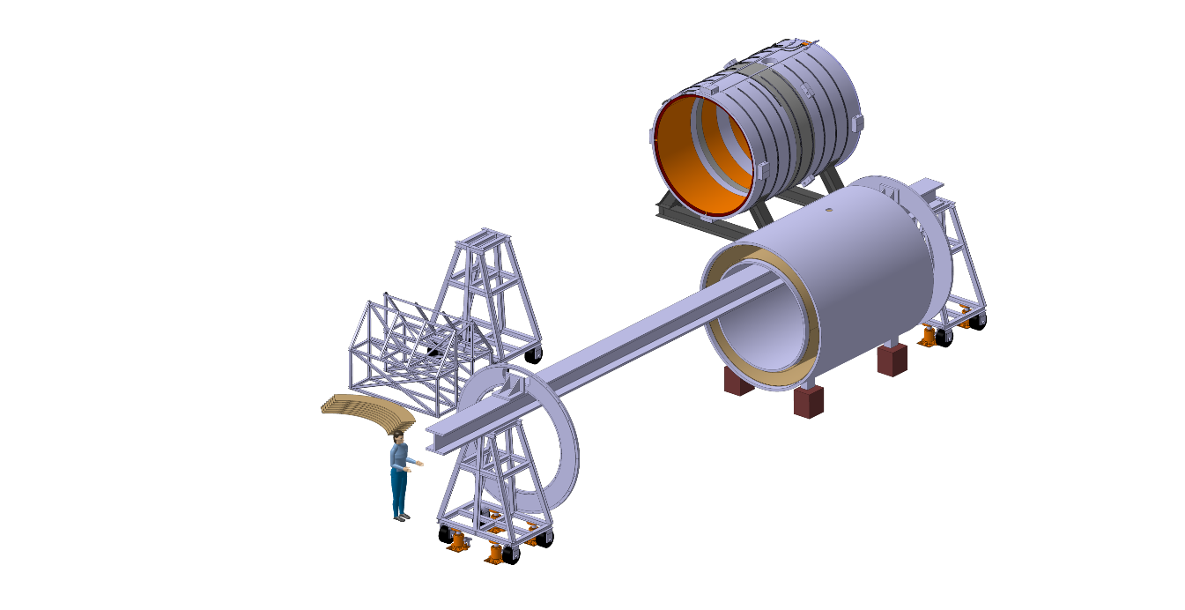
Cryostat disassembly procedure
1-Cryostat and cold mass on supports
2-Move the vacuum vessel on to the beam
3-Move outer support in and remove central support
4 - Remove cryostat flanges
5 - Remove thermal shield flanges

Slide 13
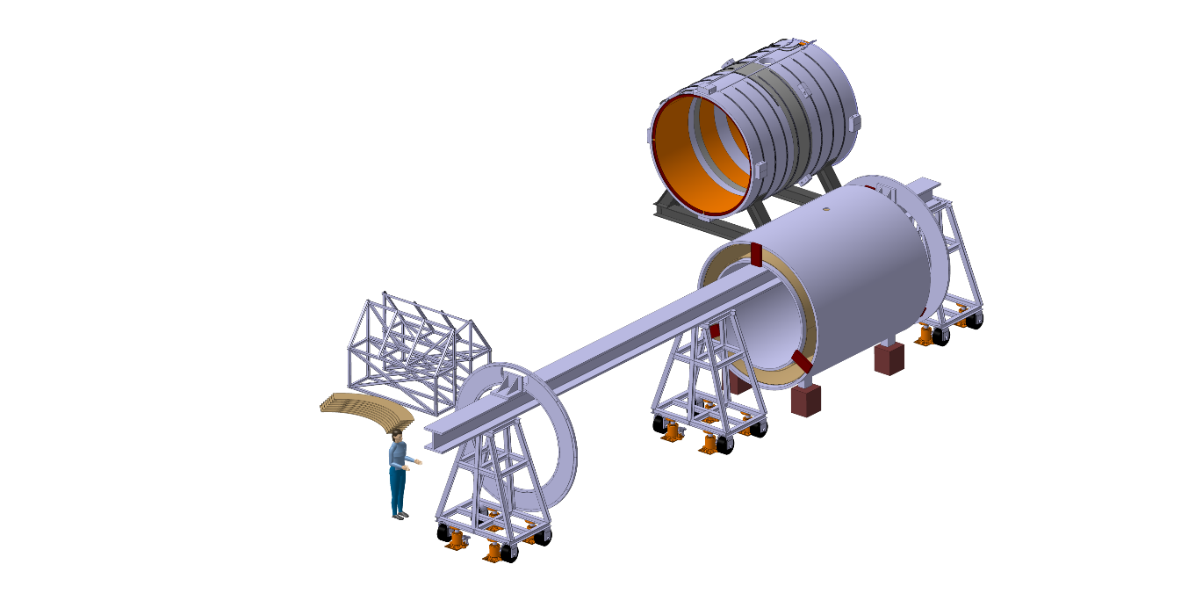
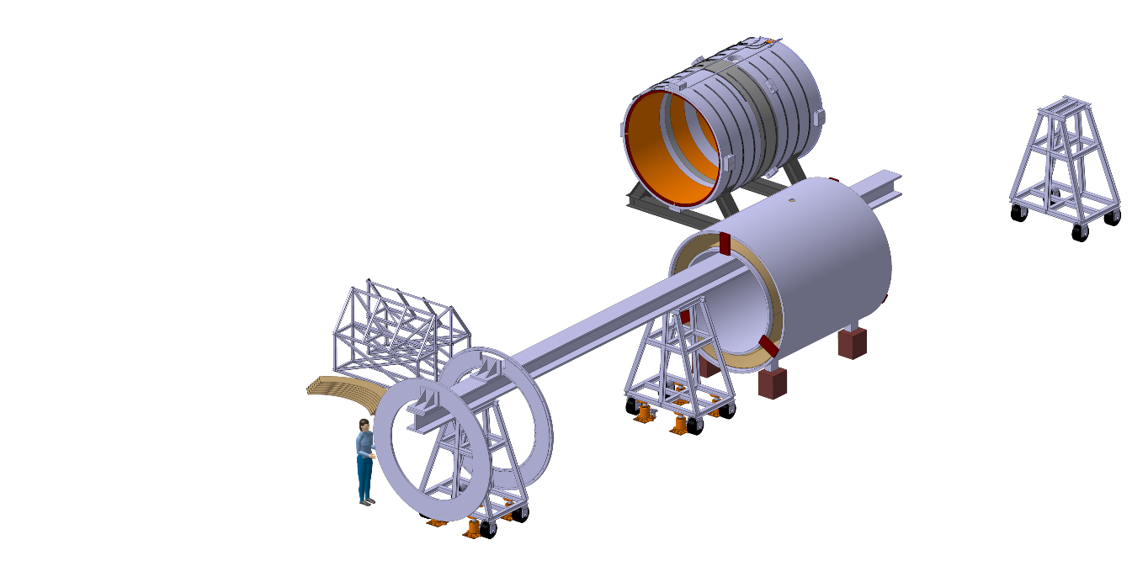
Cryostat disassembly procedure
1-Cryostat and cold mass on supports
2-Move the vacuum vessel on to the beam
3-Move outer support in and remove central support
4-Remove cryostat flanges
5-Remove thermal shield flanges
6 - Hold inner shell on temporary supports and move central support in
7 - Store remaining flange

Slide 14
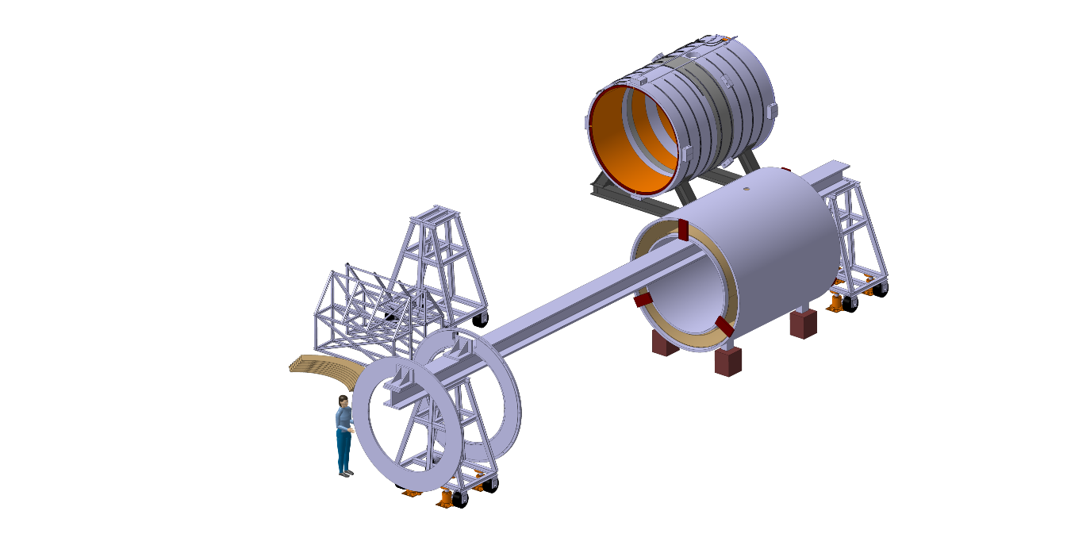
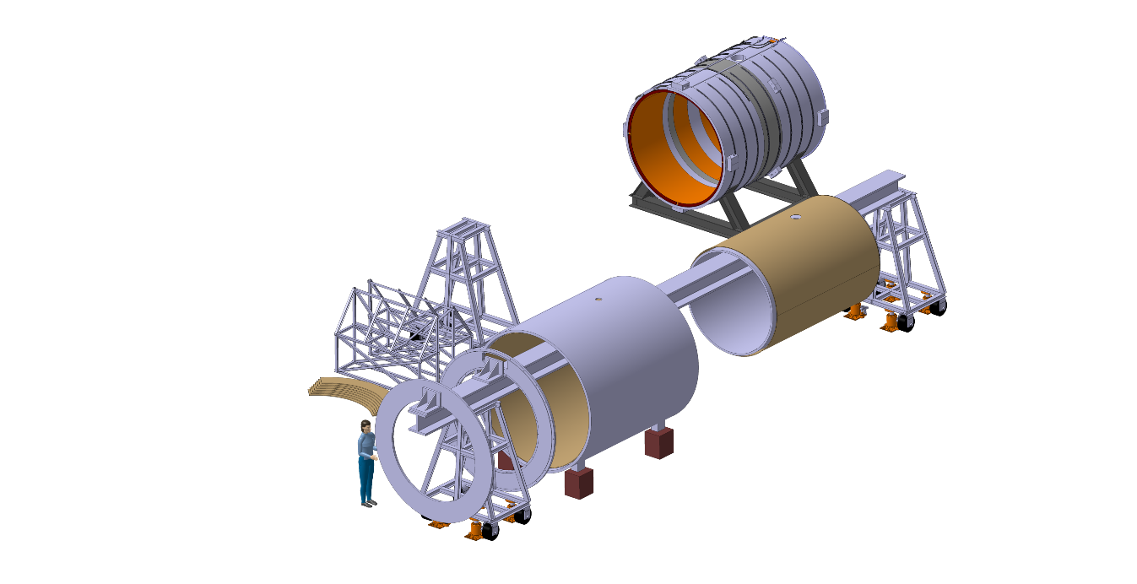
Cryostat disassembly procedure
1-Cryostat and cold mass on supports
2-Move the vacuum vessel on to the beam
3-Move outer support in and remove central support
4-Remove cryostat flanges
5-Remove thermal shield flanges
6-Place inner shell temporary supports and move central support in
7-Store remaining flange
8 - Put beam’s outer support in and remove the central support
9 - Remove inner shell temporary supports. Slide the outer shell to the other side of the beam

Slide 15
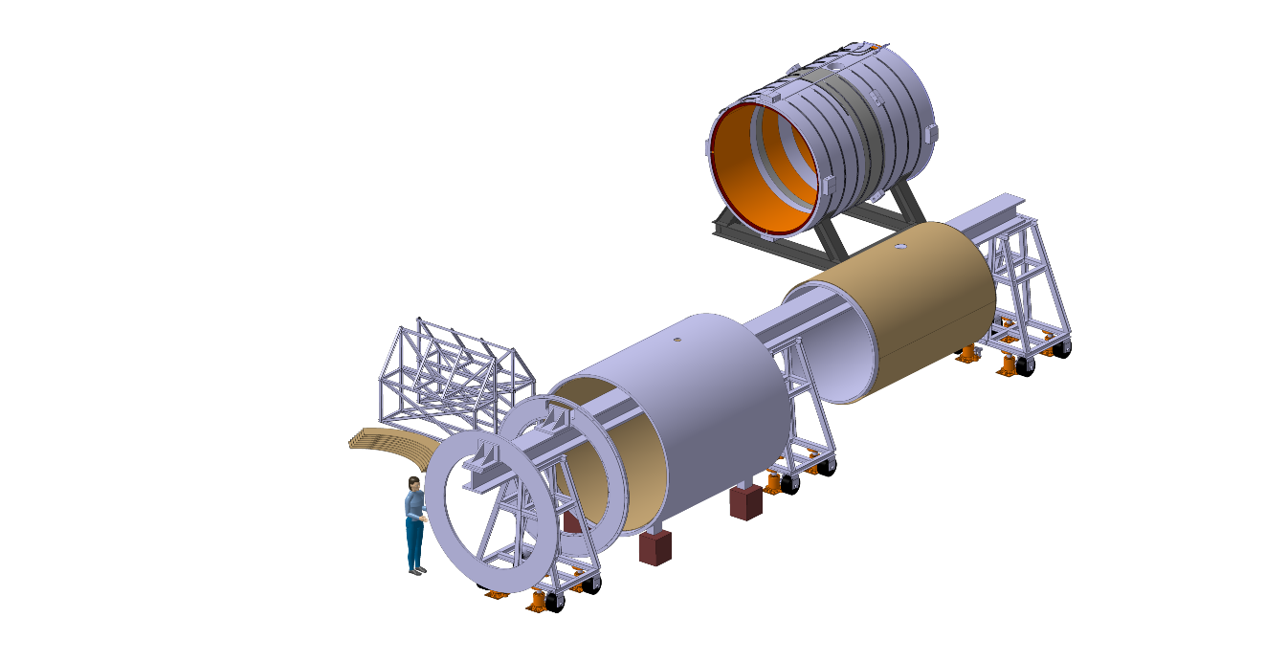
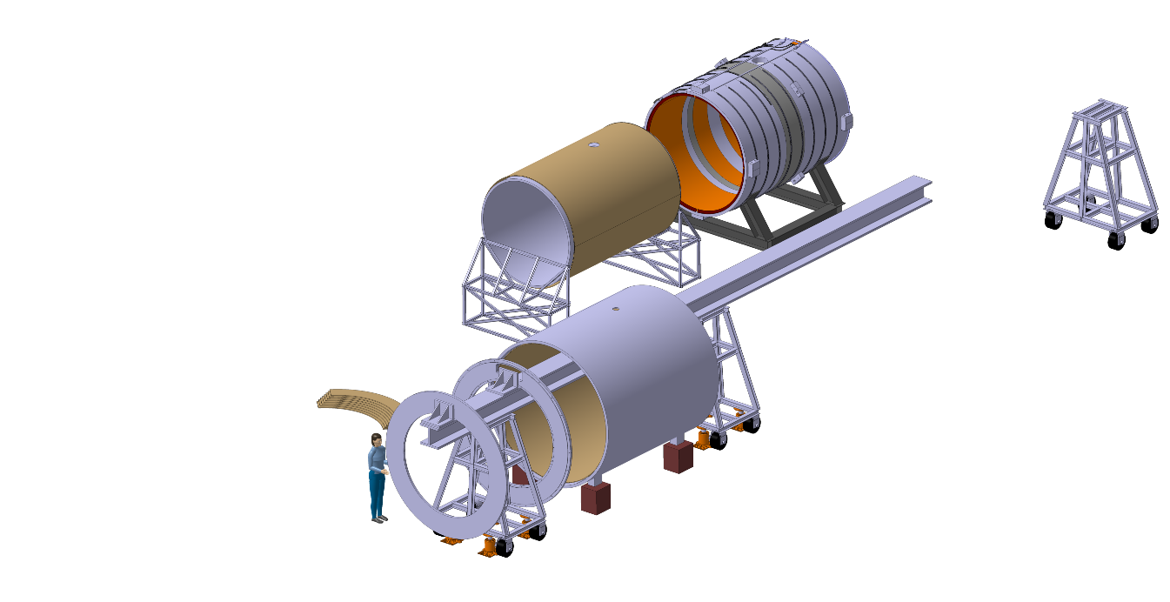
Cryostat disassembly procedure
1-Cryostat and cold mass on supports
2-Move vacuum vessel on to the beam
3-Move outer support in and remove central support
4-Remove cryostat flanges
5-Remove thermal shield flanges
6-Place inner shell temporary supports and move central support in
7-Store remaining flange
8-Put beam’s outer support in and remove the central support
9-Remove inner shell temporary supports. Slide the outer shell to the other side of the beam
10 - Move beam’s central support in
11 - Store inner shell and thermal shield

Slide 16
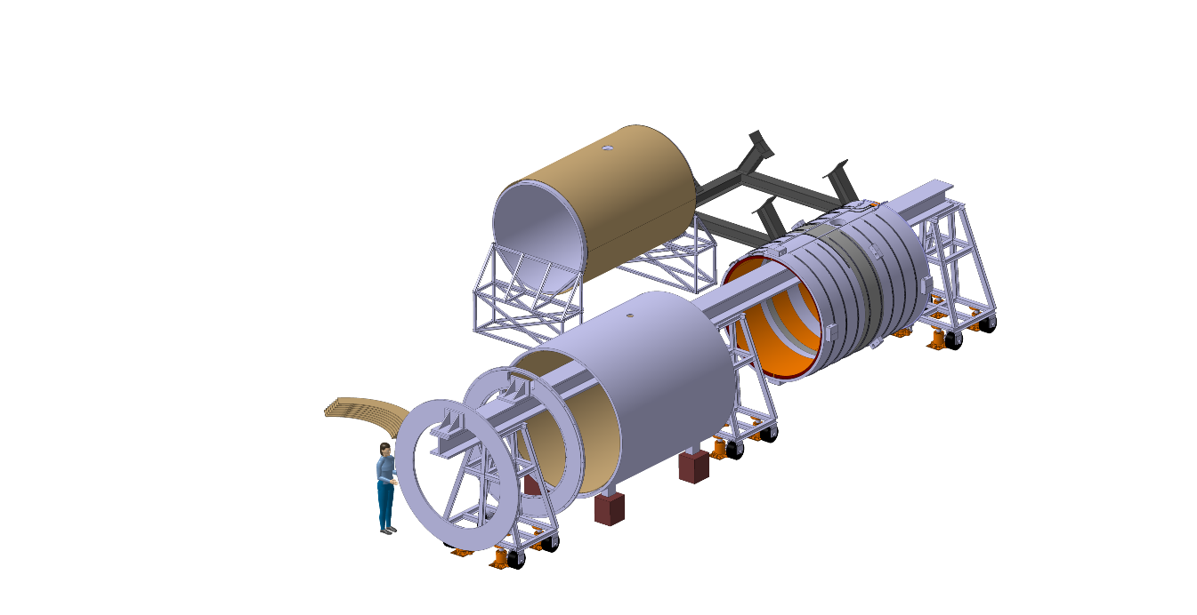
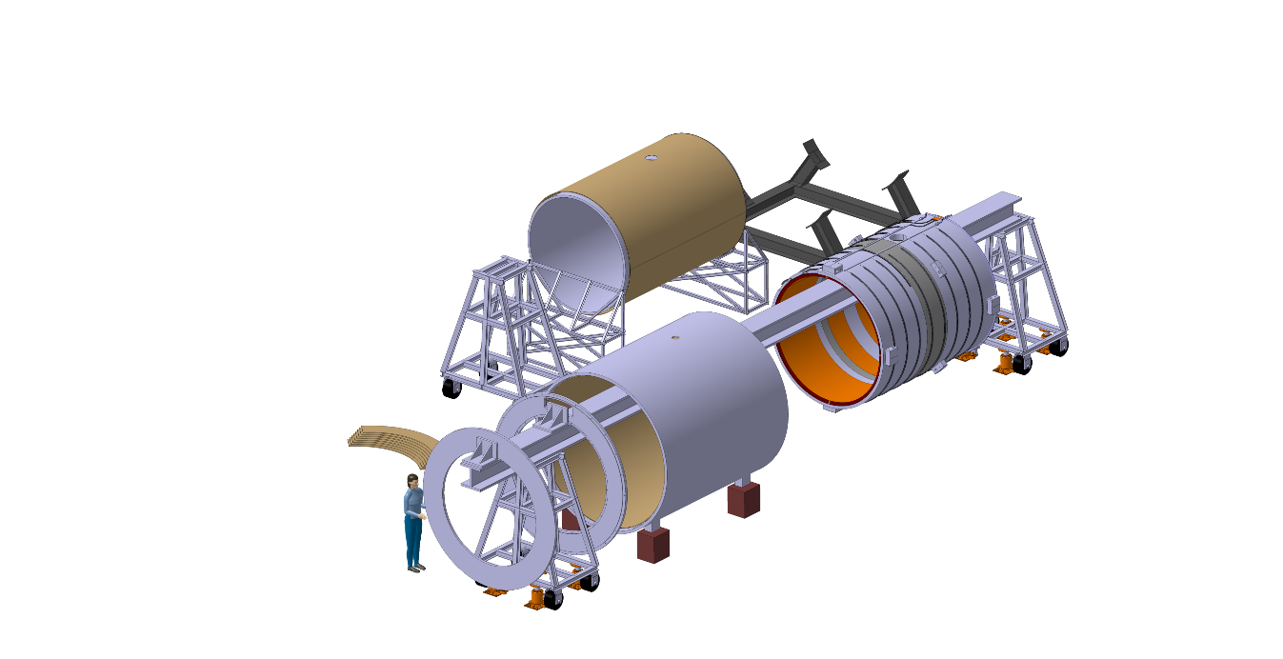
7.2 Integration: magnet assembly procedure
1 - Move cold mass to the beam
2 - Remove central support

Slide 17
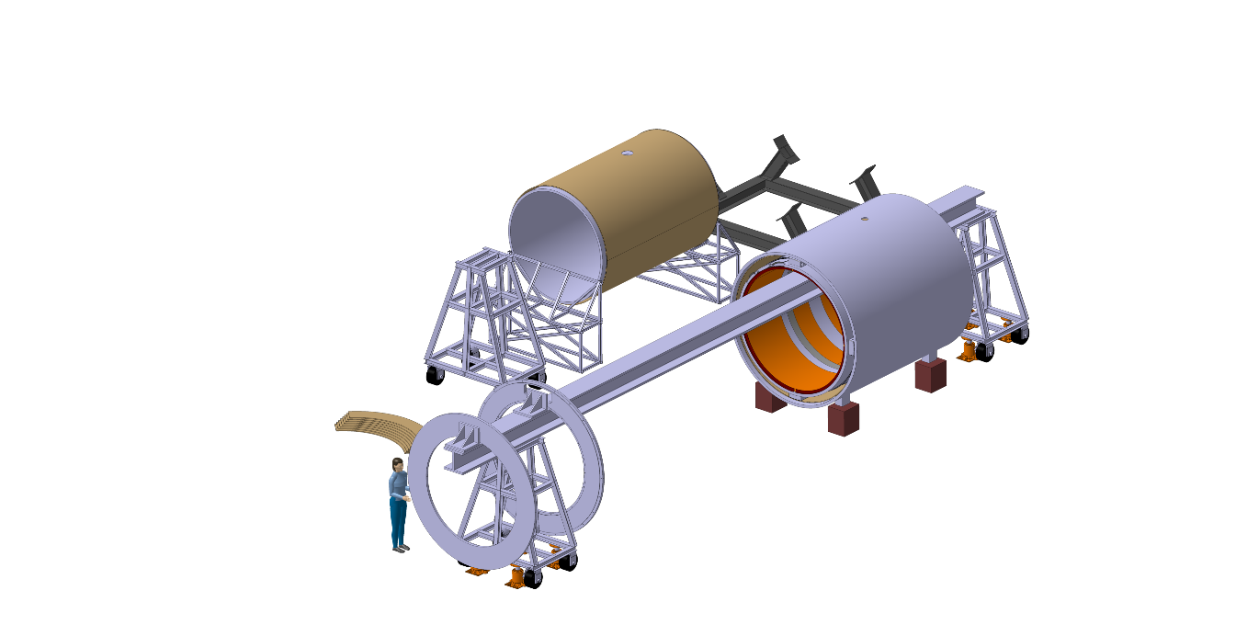
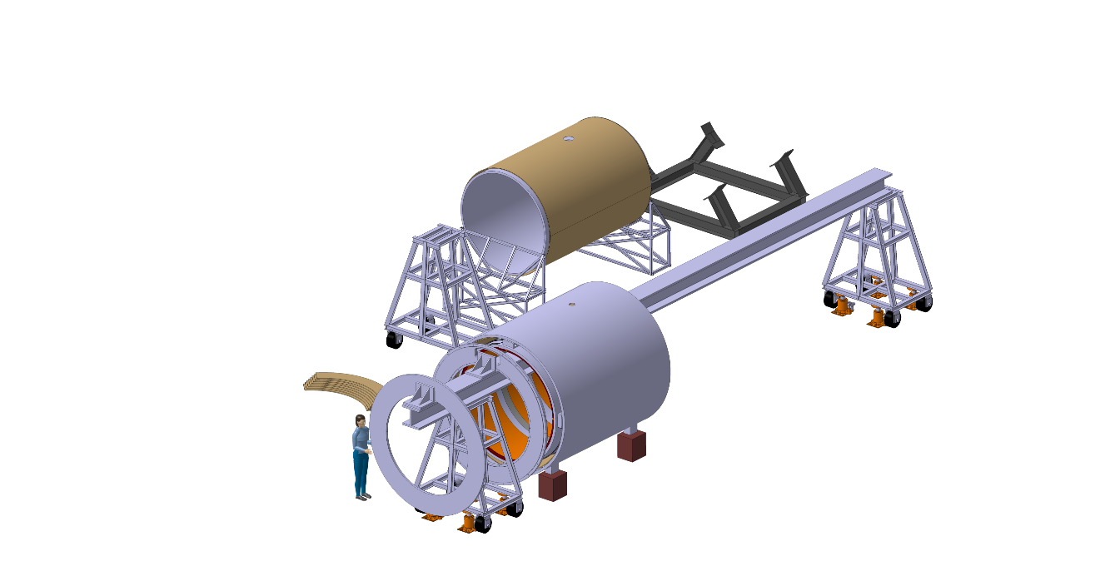
Magnet assembly procedure
1 – Move cold mass to the beam
2- Remove central support
3 - Slide outer shell over the cold mass and install the radial supports
4 - Move outer shell and cold mass to the other side of the beam

Slide 18
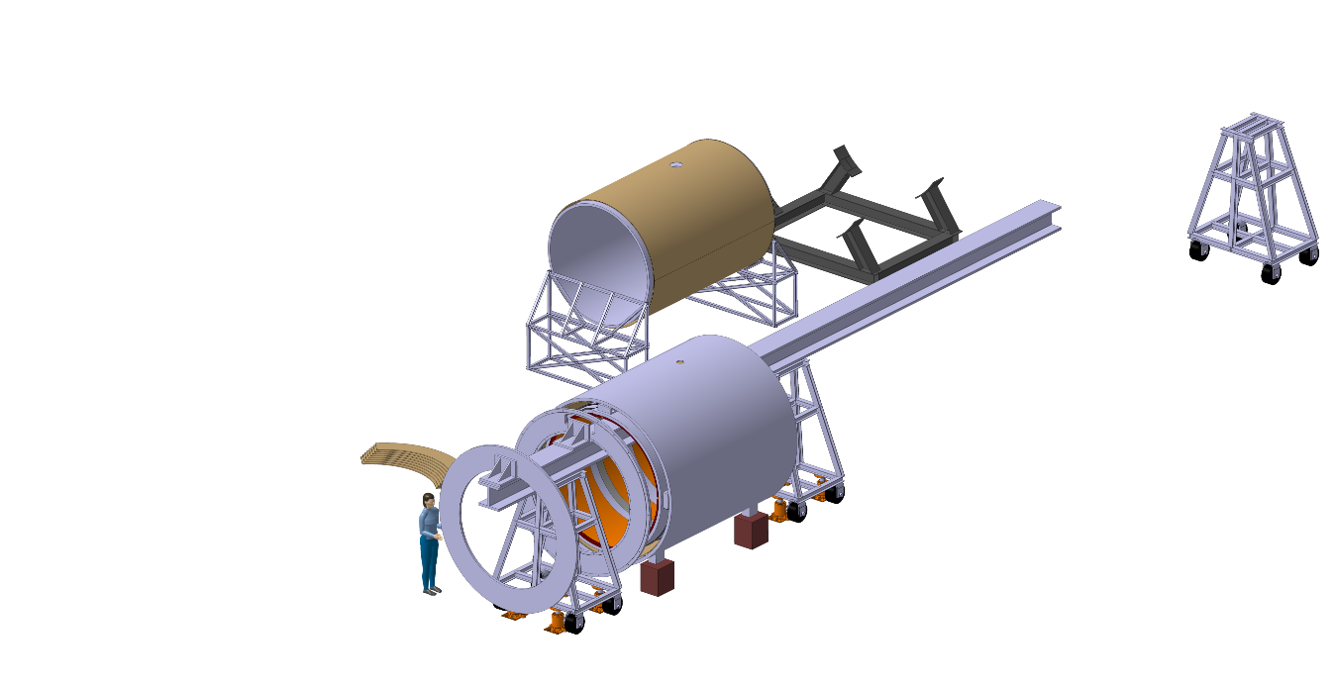
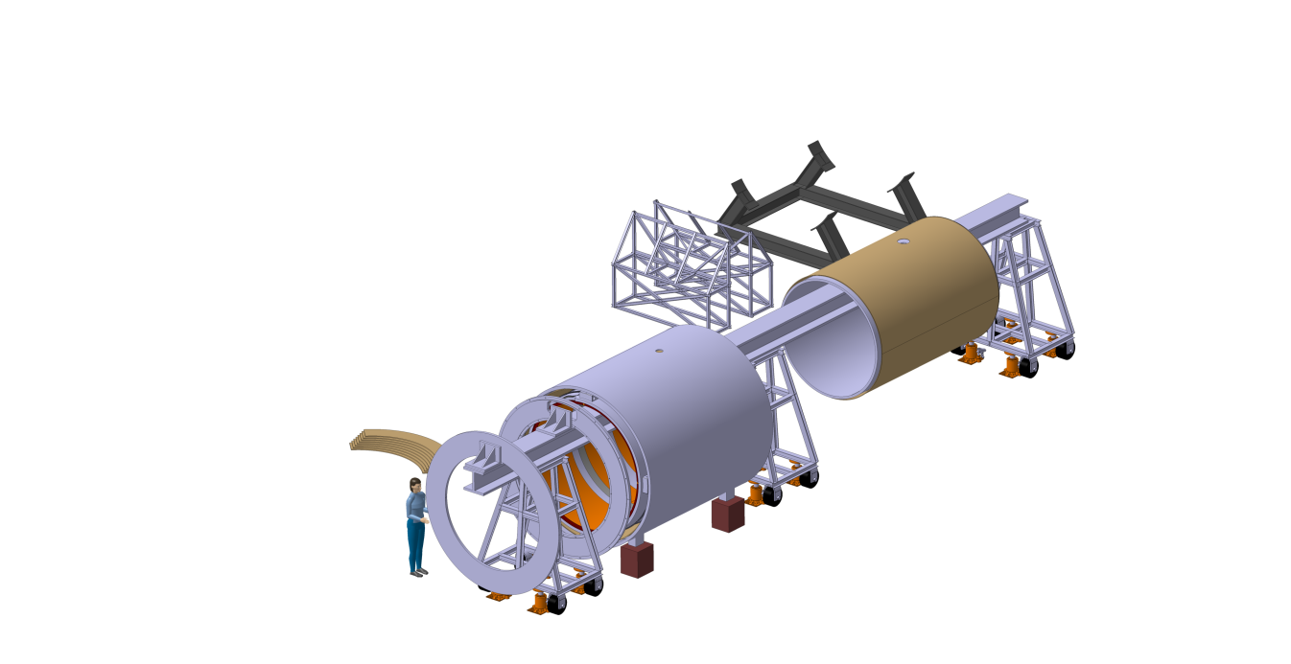
Magnet assembly procedure
1 – Move cold mass to the beam
2- Remove central support
3-Slide outer shell over the cold mass and install the radial supports
4-Move outer shell and cold mass to the other side of the beam
5 - Place beam’s central support in and remove outer one
6 - Place inner shell on the beam

Slide 19
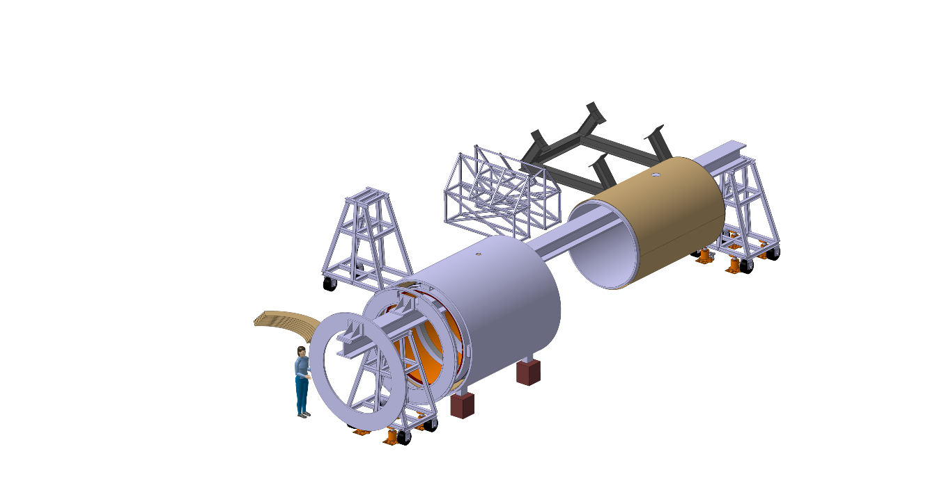
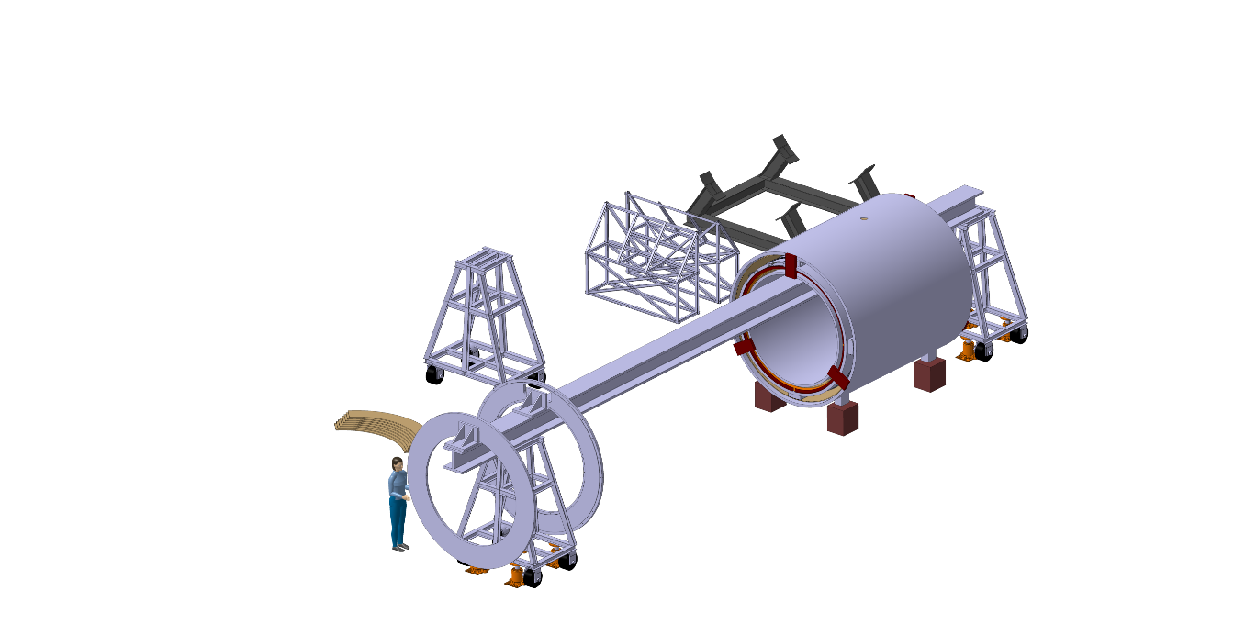
Magnet assembly procedure
1 – Move cold mass to the beam
2- Remove central support
3-Slide outer shell over the cold mass and install the radial supports
4-Move outer shell and cold mass to the other side of the beam
5-Move in beam’s central support in and remove outer one.
6-Place inner shell on the beam
7 - Remove beam’s central support
8 - Attach the inner shell to the outer shell

Slide 20
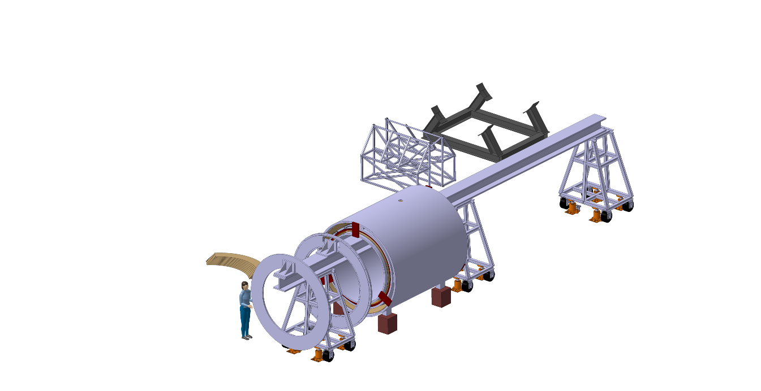
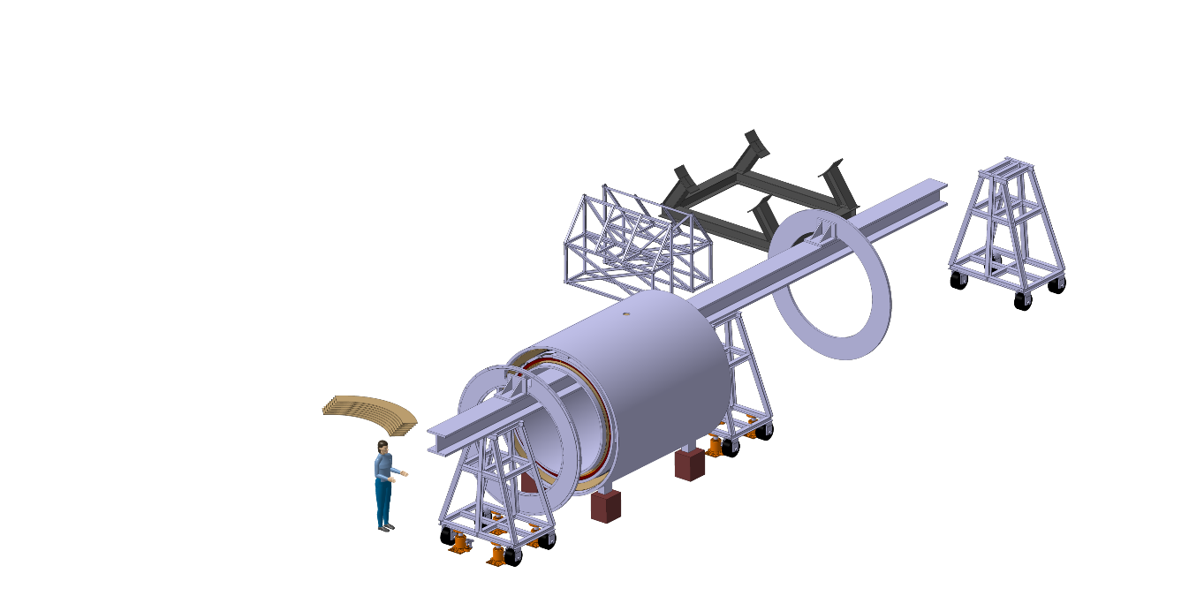
Magnet assembly procedure
1 – Move cold mass to the beam
2- Remove central support
3-Slide outer shell over the cold mass and install the radial supports
4-Move outer shell and cold mass to the other side of the beam
5-Move in beam’s central support in and remove outer one.
6-Place inner shell on the beam
7- Remove beam’s central support
8-Attach the inner shell to the outer shell
9 - Move magnet to the other side of the beam
10 - Move stored flange into the beam

Slide 21
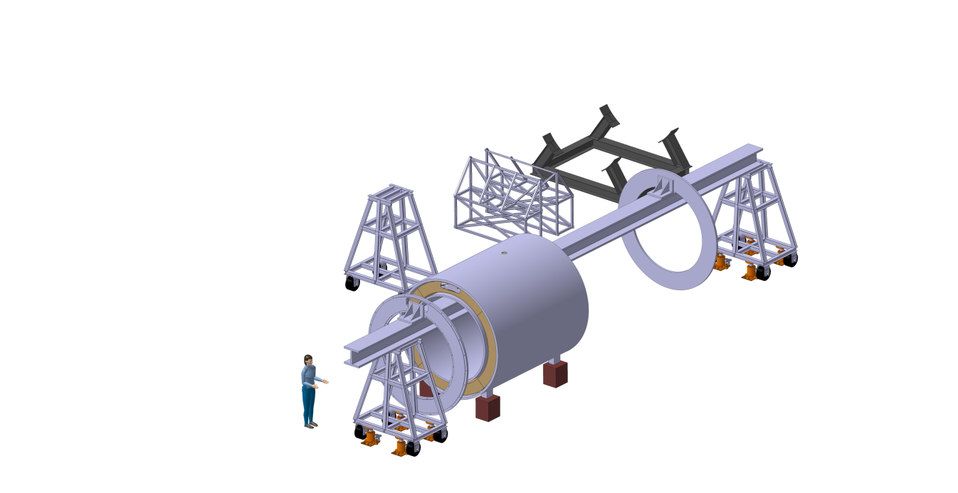
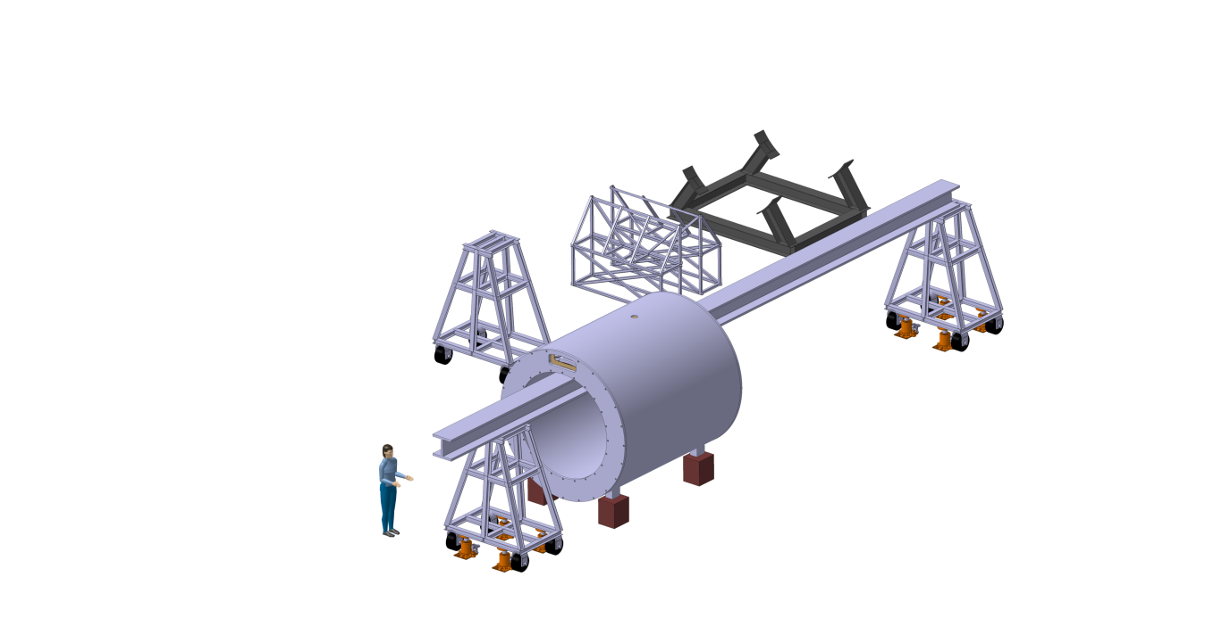
Magnet assembly procedure
1 – Move cold mass to the beam
2- Remove central support
3-Slide outer shell over the cold mass and install the radial supports
4-Move outer shell and cold mass to the other side of the beam
5-Move in beam’s central support in and remove outer one.
6-Place inner shell on the beam
7- Remove beam’s central support
8-Attach the inner shell to the outer shell
9-Move magnet to the other side of the beam
10-Move stored flange into the beam
11 - Install thermal shield flanges
12 - Close end flanges

Slide 22
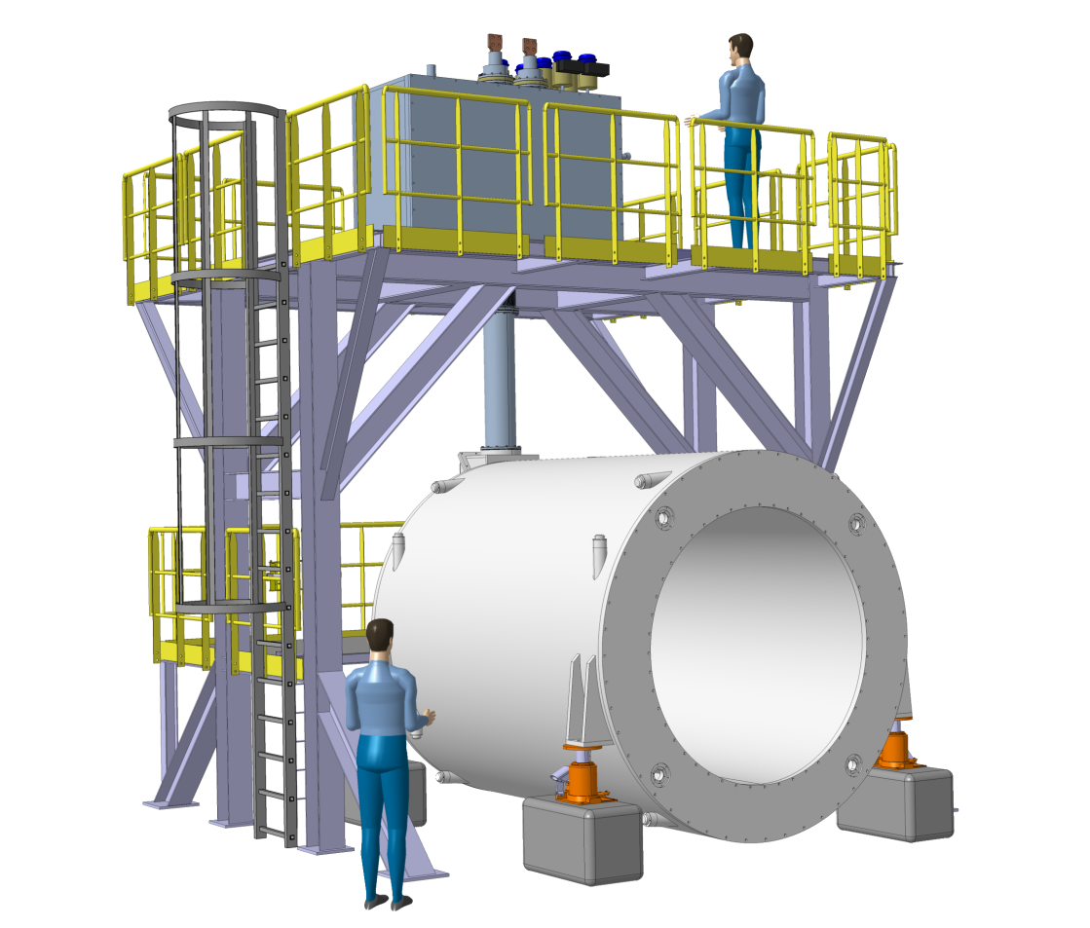
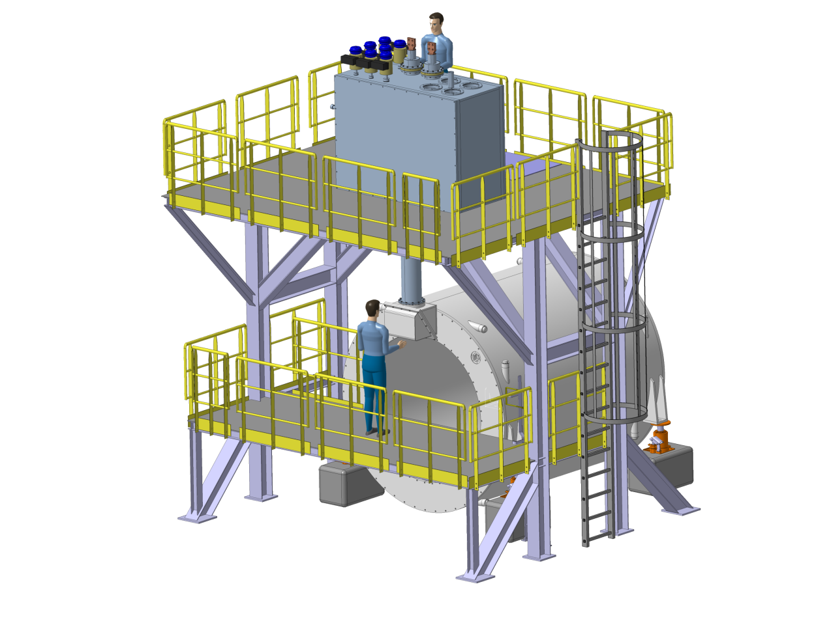
7.3 Integration: work on turret and test platform
Test and services integration set-up to be put in place in early stage to allow routing of services: cryolines, bus bars, control cables
A main frame supports the control dewar
Light beams for supporting the floors
Floor can be partially removed giving access for crane manipulations

Slide 23
8. Conclusion, next steps
Conductor specification ready, waiting for release of budget needed for starting the tender
Cold mass design in advanced state, working on details, technical specification in progress, decision needed on way of tendering
Winding pack slightly adapted to avoid sign change in Int-Br
Eddy currents in conductor and casing cross-checked with FEM, much lower values (and thus gradients) than in TDR due to shape of conductor, great!
Eddy current loss in coil casing calculated and result acceptable
Magneto-structural analysis on details of cold mass in progress
Technology for coil winding and integration drafted
Cryostat and cold mass integration scenario, and space needed worked out
Final test set-up sketched, area preparation in progress
However, resources now exhausted ! ! work urgently requires funding!

