Slide 1

Status of work
(cryostat, control Dewar, cooling system).
Plans for 2015
Joint Institute for Nuclear Research (Dubna)
Evgeny Koshurnikov,
Jülich
December 9, 2014

Slide 2
Topics of the presentation
Works performed in 2014
  Cryostat
    Design of vacuum shells, thermal screen, suspension system and target entry unit;
    Stress analysis of the cryostat shells;
    Stress analysis of the suspension units
  Control Dewar and Chimney
    Design of vacuum shells, pipe and valve system, Cryostat/Contr.Dewar tubing;
    Stress analysis of the control Dewar shell;
  Cooling system of the solenoid
    Computations of natural convection mode;
    Analysis of cooling efficiency of the coil
  Coordination of Interfaces
    Interfaces of the cryostat;
    Interfaces with He Transfer Line and Refrigerator
  Plans for 2015

Slide 3
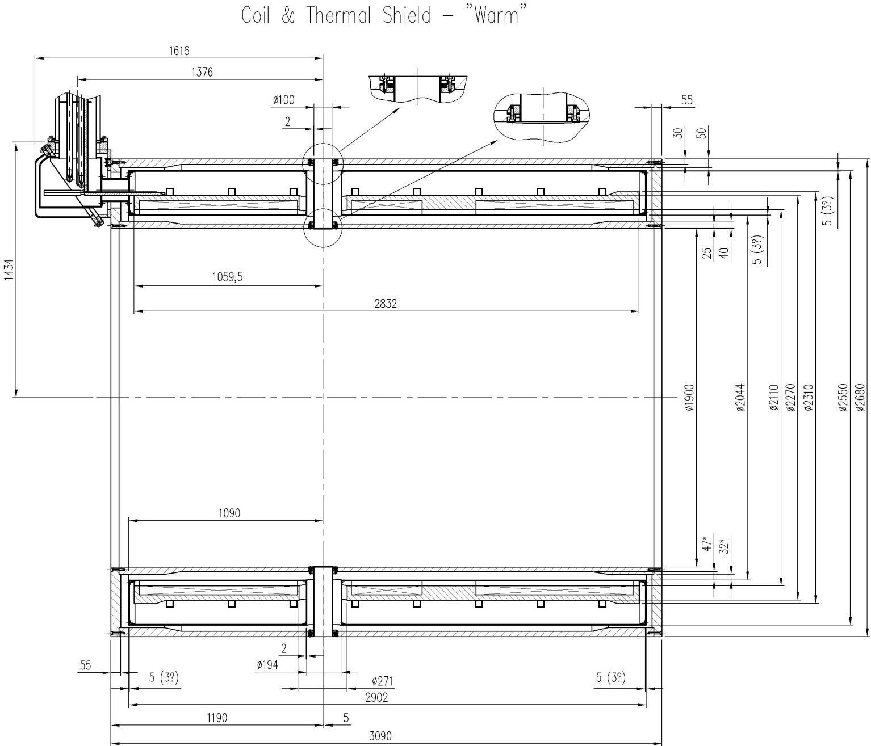
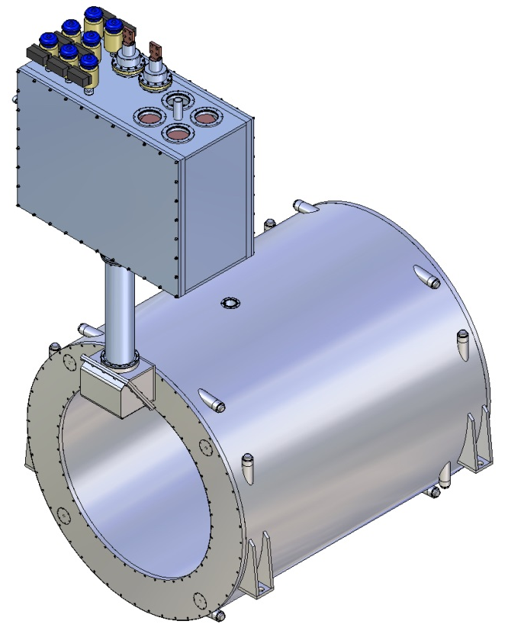
Cryostat main dimensions
To avoid additional discussions and coordination with the detector groups we kept all main dimensions and the material of the cryostat vacuum shells proposed by INFN

Slide 4
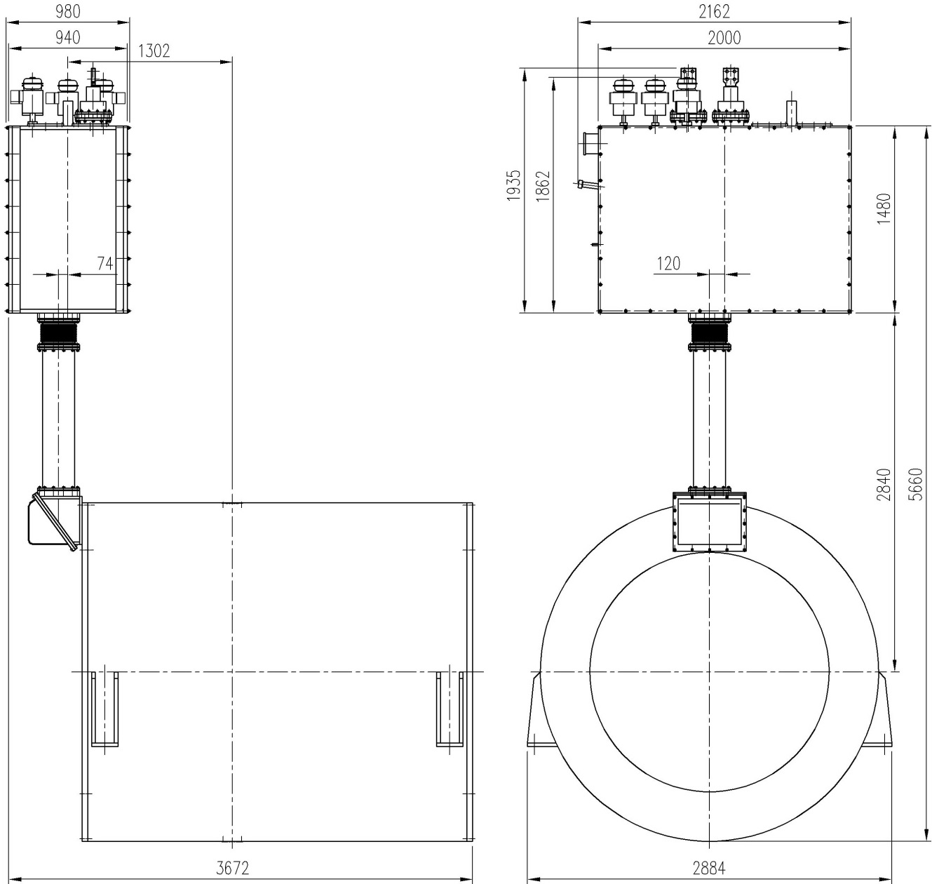
Overall dimensions of the solenoid and control Dewar
Coil&Cryostat weight ~100 kN
Control Dewar weight ~40 kN
Cap of the Control
Dewar weight ~4.9 kN
Weight of the Inner
detectors ~140 -200 kN
Mechanically the control Dewar and cryostat are decoupled by the bellow decoupling.

Slide 5
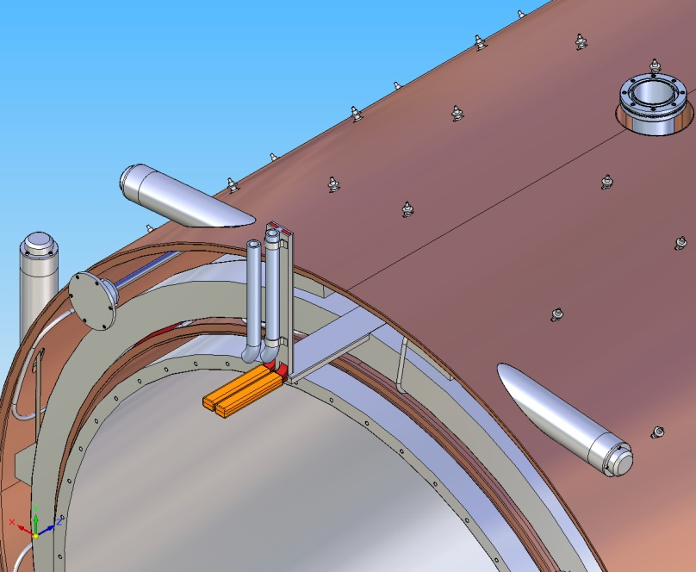
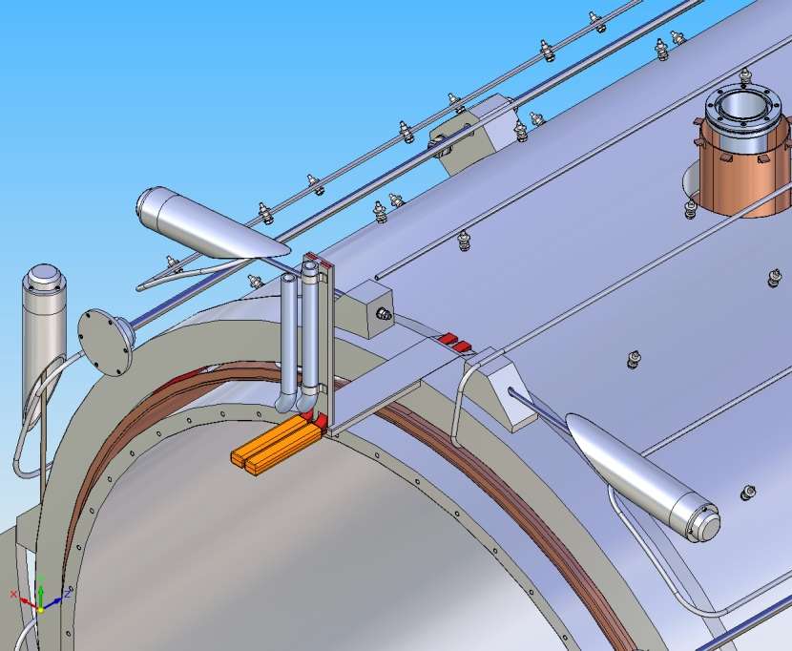
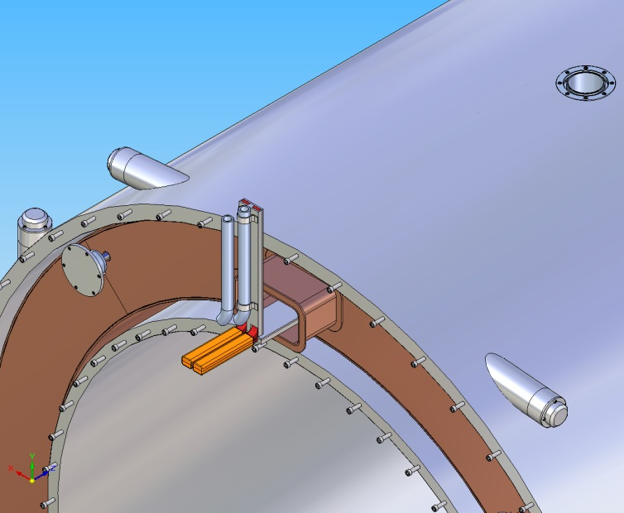
Thermal screen of the cryostat
Thermal screen four blocks
Screen supports
dI/dt ≤400A/sek
Ieddy curr<10 A
Heat exchanger serpentine of the outer screen shell
Material of the thermal screen aluminium 5083
Shell thickness t=3 (5?) mm,
Number of radial supports ~192
Mass M=377 kg
Material of the heat exchanger tube aluminium 5083
Length of the heat exch. tube L= 157 m
Diameter 13x1.5 mm
Distance between the serpentine branches 700 mm
Maximal pressure drop ΔP_{max} = 6 bar
Maximal helium flow rate G= 2.5 gr/sec
Mean temperature T_{mean} = 60 K

Slide 6
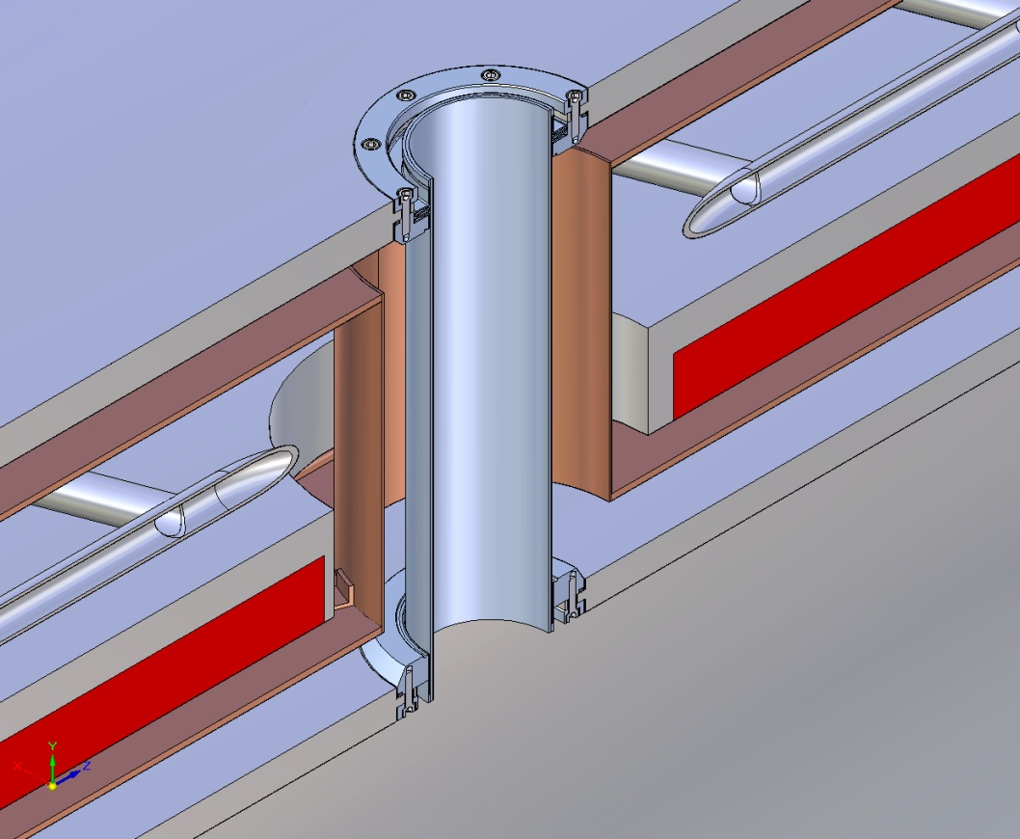
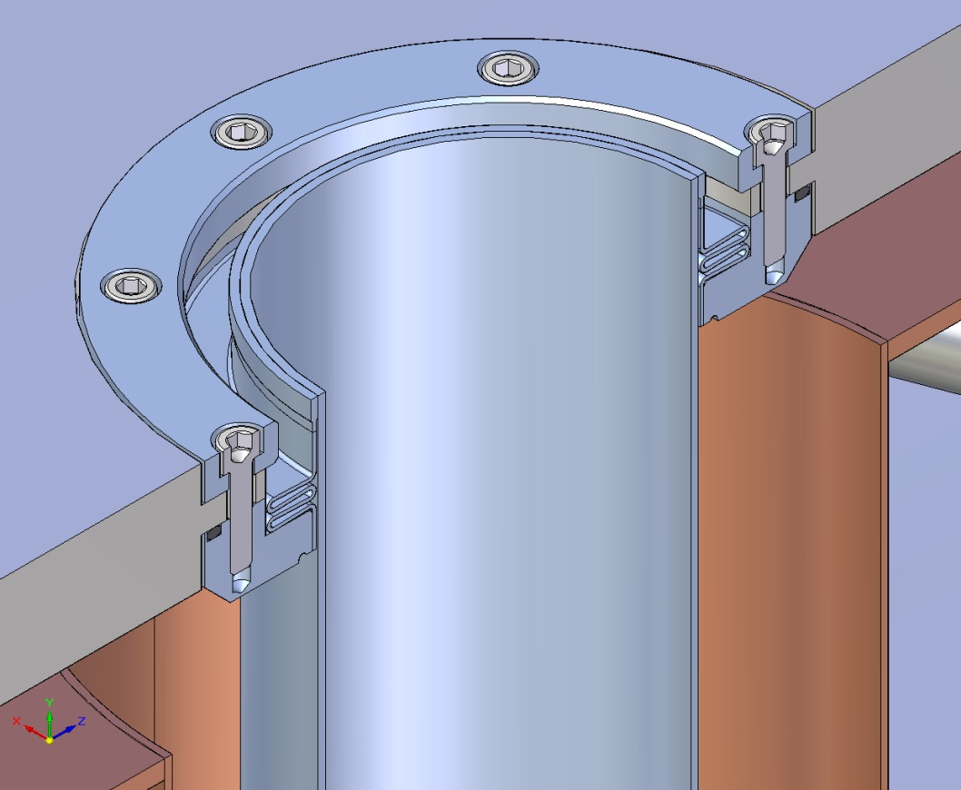
Passageways for Target
It takes to cut two weld seams to disassemble the cryostat
Accepted design allows several re-welding of the seams
It is planned to change the design to avoid cutting of the weld seems. For this purpose the space previously intended to correct the position of the cold mass inside the cryostat will be used

Slide 7
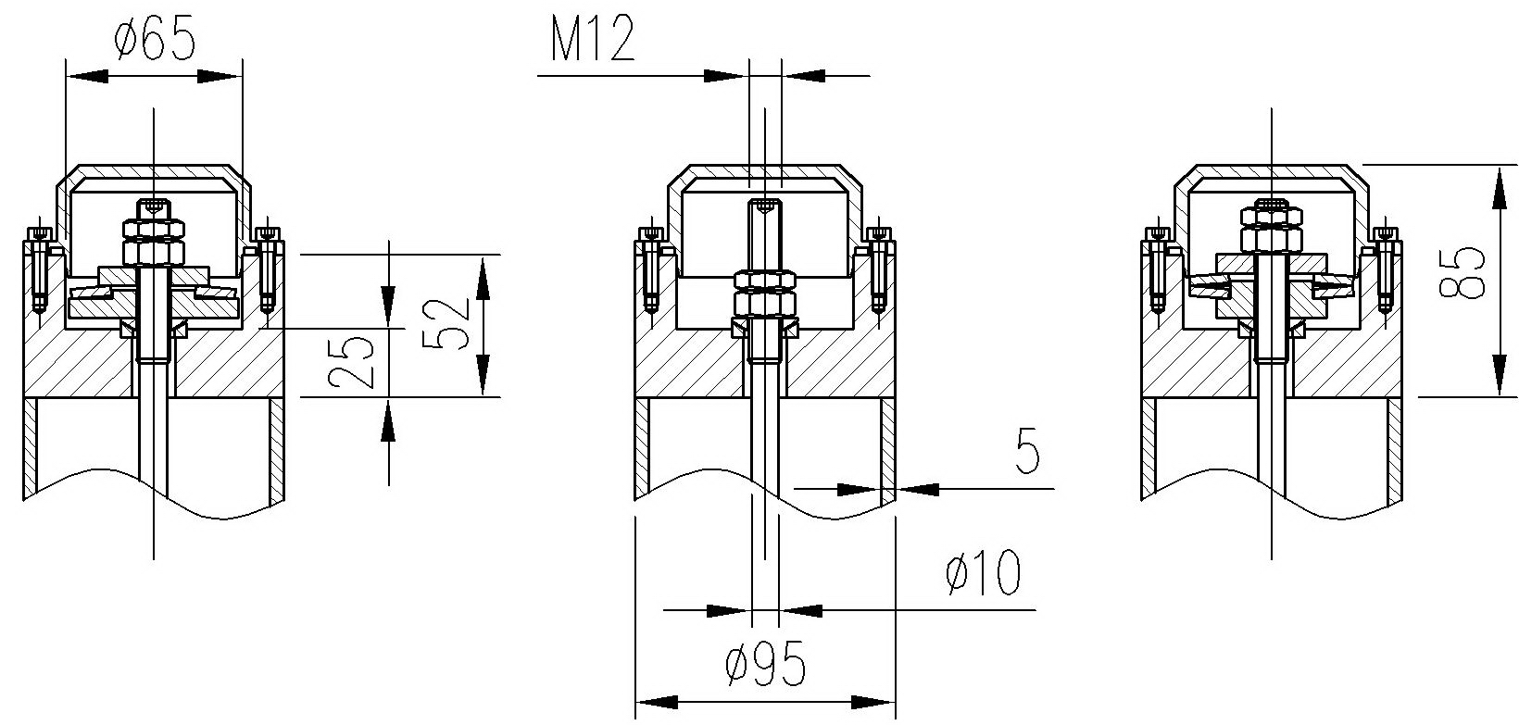
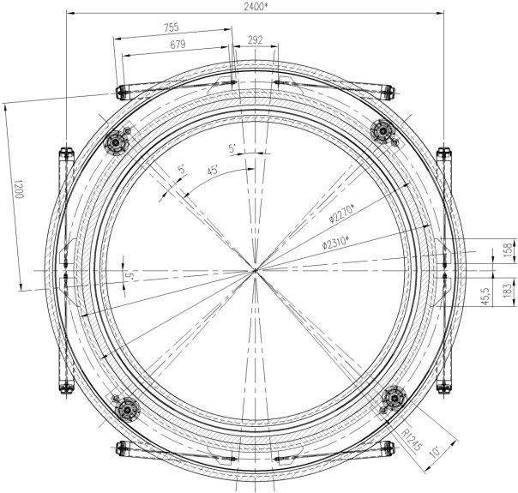
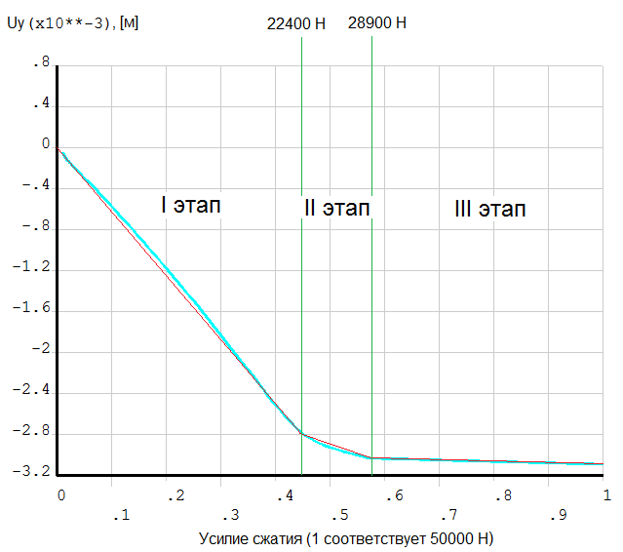
Head parts of the radial ties
Bottom vertical ties
Horizontal ties
Upper vertical ties
Characteristic of the head part of a bottom vertical tie

Slide 8
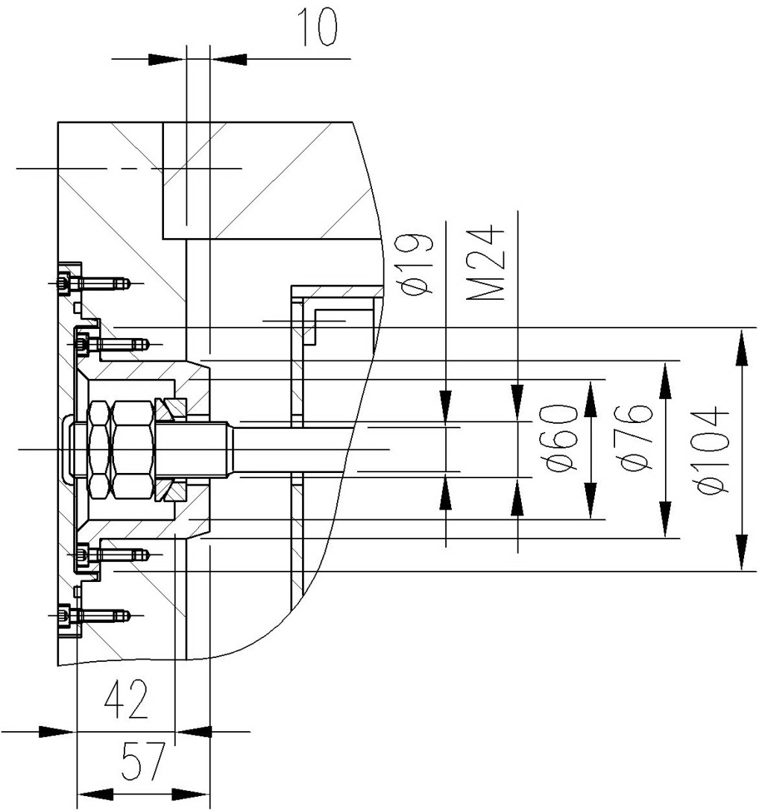
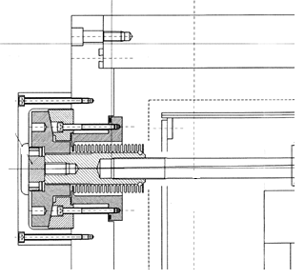
Options of the head parts of the axial ties

Slide 9
Loads on the vacuum shell of the cryostat
Radial loads
  Weight of the cold mass ~42 kN
  Weight of the thermal screen 3.77 kN
  Weight load of the barrel EMC and inner detectors 140 kN
  Pre-stress from the barrel EMC support system 6.6 kN
  Maximal radial decentering magnetic force 51 kN
  Seismic load a_{sx} = 0.075 g
  Tightening force of the radial rods Q_{tz}=6.6 kN
  Dynamic loads during lifting and lowering a_{y}= ±1.4 g
Axial loads
  Magnetic load -47±108 kN
  Seismic load a_{sz} = 0.075 g
  Tightening force of the axial rods Q_{tz}=2.6 kN
Loads on the vacuum shell
  External pressure on the vacuum shell 0.1 MPa
  Internal pressure in an emergency 0.05 MPa

Slide 10
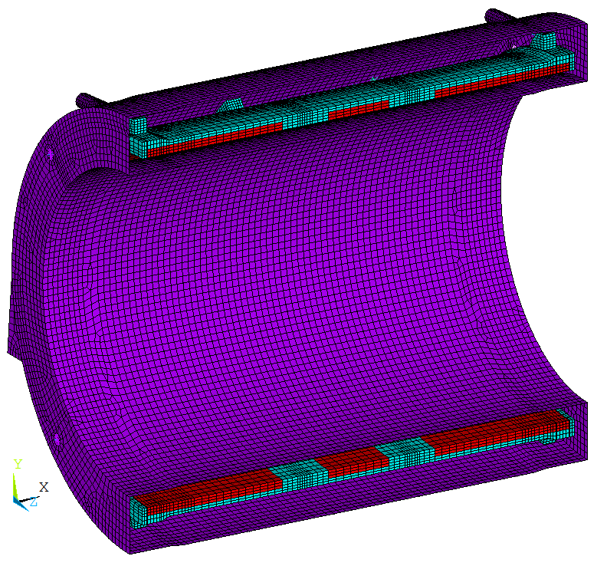
FE model of the cryostat with cold mass.
Load Cases
For FE computations it was considered 7 load cases in all. The next sequence of loading is the most dangerous for suspension units of the cold mass
Load Case | Loading sequence during the FE computations
1 | Initial tightening of the suspension ties
2 | + application of the weight loads + external pressure on the vaccum shell
3 | + temperature loads
4 | + decentering axial and radial magnetic forces F_{mz} = -140 kN and F_{mx} = 45 kN , seismic load a_{sz}= 0,075 g

Slide 11
Design Criteria for the ties of the suspension system in accordance with the codes of structural design
The nominal allowable tensile stress for the suspension ties made of Inconel 718 equals to the nominal allowable stress for fastening elements:
R^{T}_{p0,2} = 1060 MPa - minimum yield stress at the reference temperature
(σ)_{3w} - the group of reduced stresses, defined as the sum of the average tensile stresses over the cross section of the suspension rod, caused by mechanical loads, including a tightening force, and temperature effects
(σ)_{4w} - the group of reduced stresses due to mechanical and thermal effects, including a tightening force, defined by components of tensile stresses, bending and torsion stresses in the rod
 | Normal Operating Conditions |  |  |  |  | Normal Operating Conditions +Planned Earthquake
 | (σ)₁ | (σ)_{3w} | (σ)_{4w} | τ_{p} | τ_{p}^{T} | (σ_{s})_{mw} | (σ_{s})_{4w}
Inconel 718 | [σ]_{w} | 1,3[σ]_{w} | 1,7[σ]_{w} | 0,25·R^{T}_{p0,2} | 0,32·R^{T}_{p0,2} | 1,5[σ]_{w} | 2,3[σ]_{w}
 | MPa
 | 530 | 689 | 901 | 265 | 339 | 795 | 1219

Slide 12
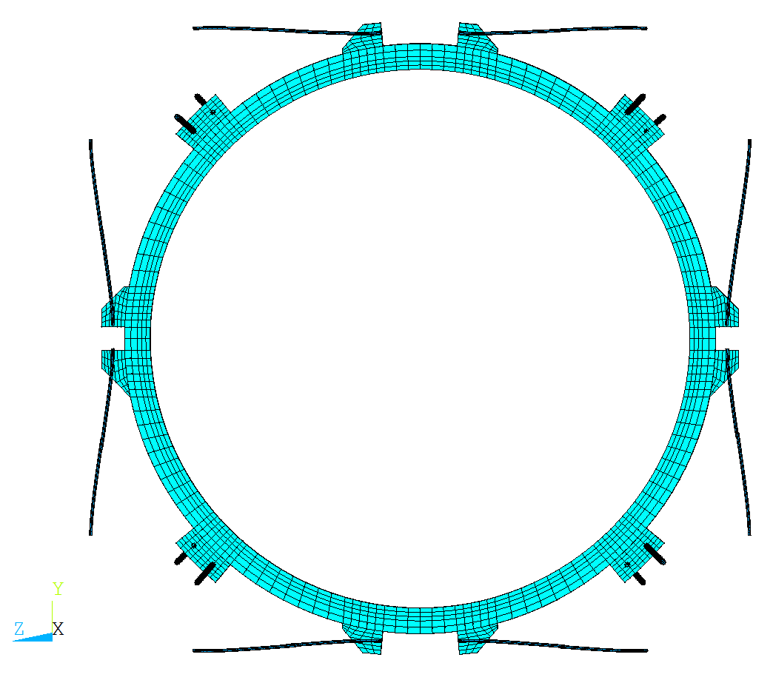
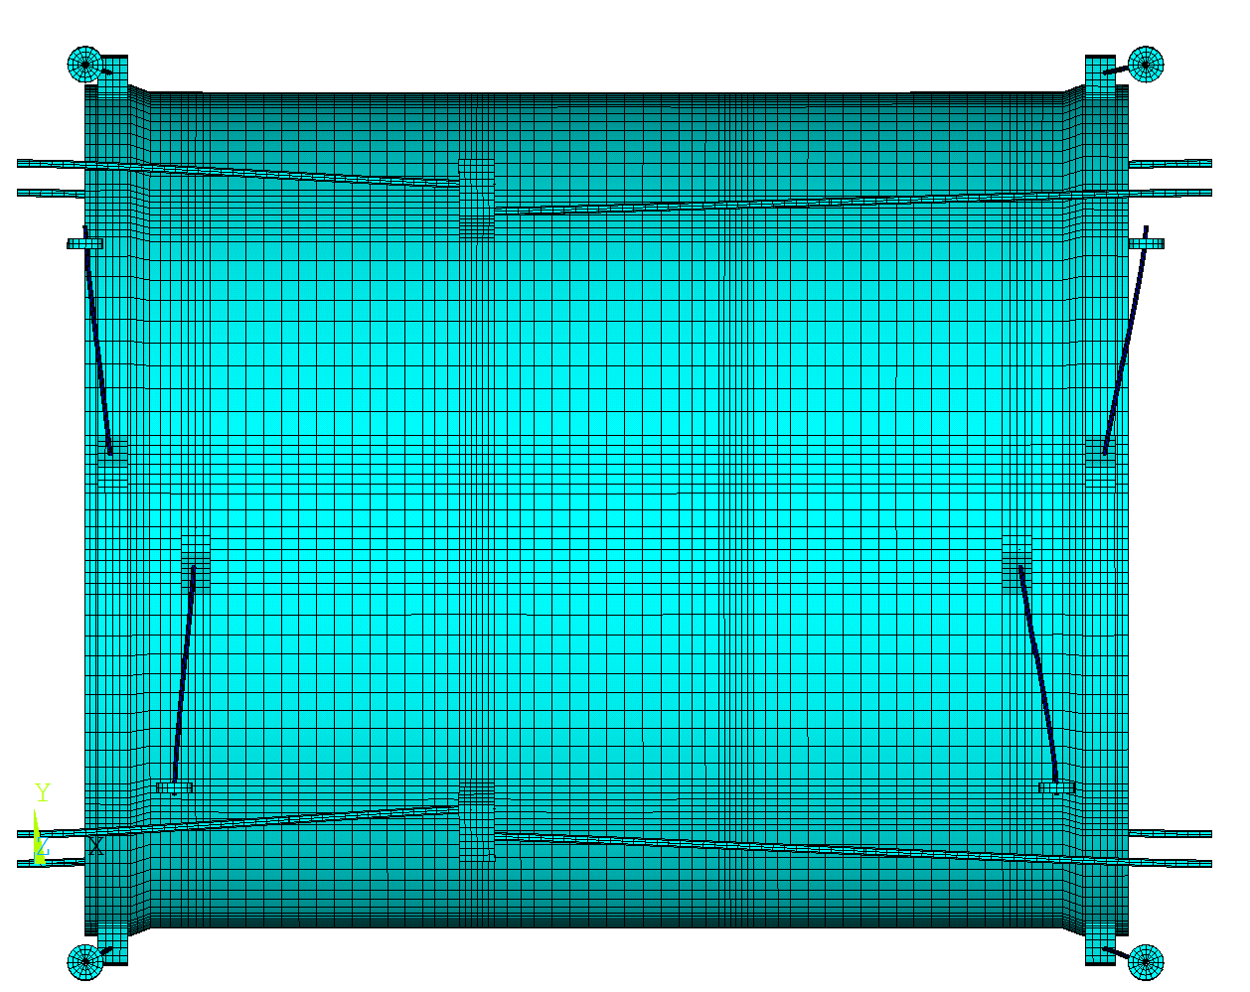
Pre-bending of the radial ties in the coil axial direction to decrease the bending stresses after cool down
Deformation of the radial ties after cool down (w/o pre-bending)
Procedure of pre-bending of the radial ties in the coil axial direction
1.
2.
F_{z1}
warm
warm
3.
4.
5.
warm
warm
cold

Slide 13
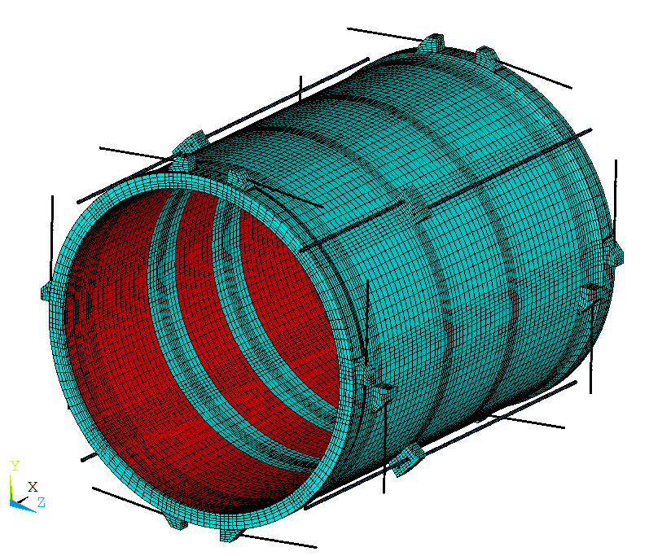
Maximal stresses in the ties of the suspension system
 |  | W/o pre-bending |  | Pre-bending in z direction |  | Pre-bending in z direction and in plane XY
 |  | Stress, MPa | Safety factor | Stress, MPa | Safety factor | Stress, MPa | Safety factor
Radial ties | σ_{m} | 499 | 1.38 | 489 | 1.4 | 473 | 1.46
 | σ_{mb} | 786 | 1.15 | 648 | 1.4 | - | -
Axial ties | σ_{m} | 392 | 1.76
 | σ_{mb} | 450 | 2
RG3_top
RV3_top
RG2_top
The bending and thermal stresses are the main problems of the suspension system of the cold mass.
For example:
  The bending stress of about 287 MPa will appear in the radial suspension rod if the preliminary bending is not applied.
  Thermal stresses in the rods of the axial suspension are about 350 MPa
RG4_top
RV4_top
RV2_top
RG1_top
RV2_bot
RG2_bot
RG4_bot
RG1_bot
RV1_bot
RV1_top

Slide 14
Movement of the cold mass under action of the magnetic field
Displacement of the cold mass under action of the magnetic force
Contributions to axial displacement due to
  deformation of the axial rods 0.436 mm,
  deformation of the cryostat structure in the area of the support legs 0.260mm,
  deformation of the end flanges of the cryostat outer shell 0.053 mm,
  elasticity of the threaded connection, washers and mounting unit 0.017 mm
The total axial displacement 0.77mm
Contributions to lateral displacement due to
  deformation of the suspension rods 0.3 mm,
  elasticity of mounting elements in head parts of the rods 0.16 mm,
  deformation of the head part 0.1 mm.
The total lateral displacement 0.56 mm

Slide 15
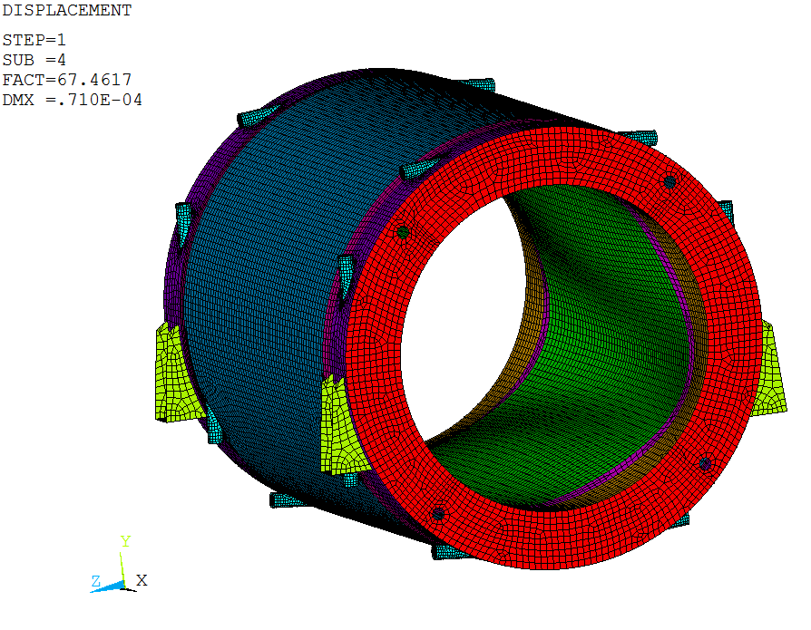
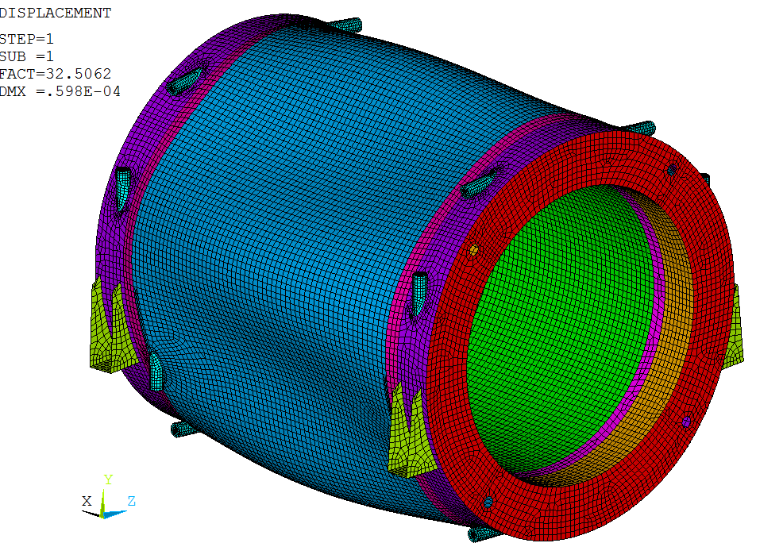
Stability of the cryostat shells
The first form of loss of stability of the cryostat shell from exposure to external pressure.
Pcr = 2.83 MPa. Safety factor for the external pressure of 0.1 MPa is equal to 28.3
The first form of loss of stability of the cryostat shells from exposure to internal pressure
P_{cr} = 3.25 MPa. Safety factor for the internal pressure of 0.05 MPa is equal to 65

Slide 16
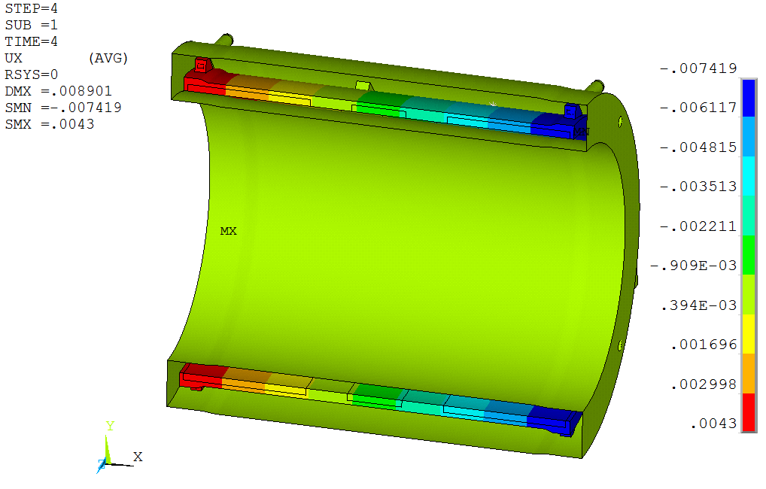
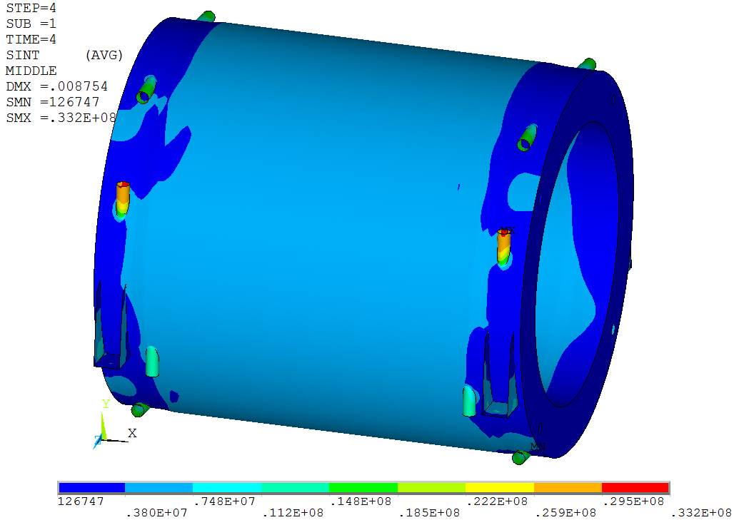
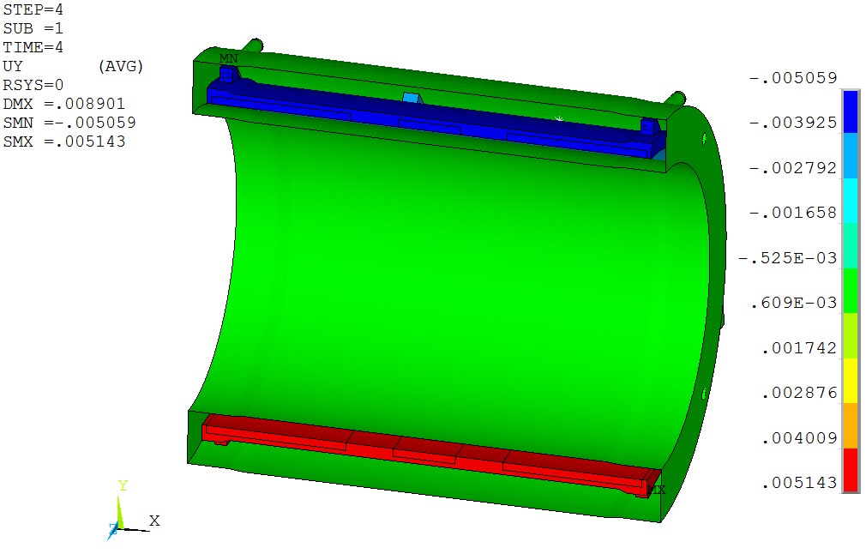
Deformations and stresses of the cryostat

Slide 17
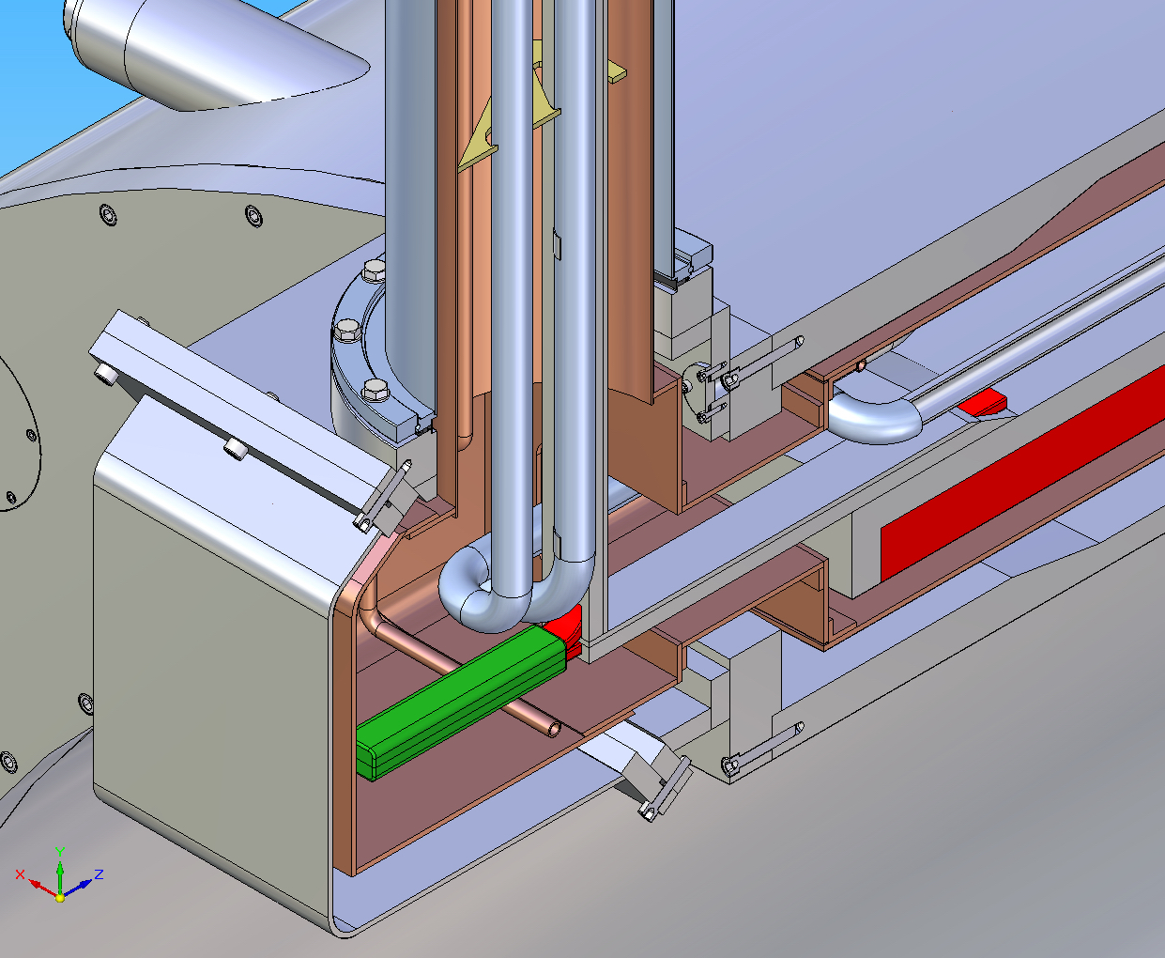
Cryostat interface box
Feeding LHe tube
Temperature intercept
Flexible connections of four helium pipes and connections of the current bus bars with the current leads are implemented in the interface box
Aluminium bars

Slide 18
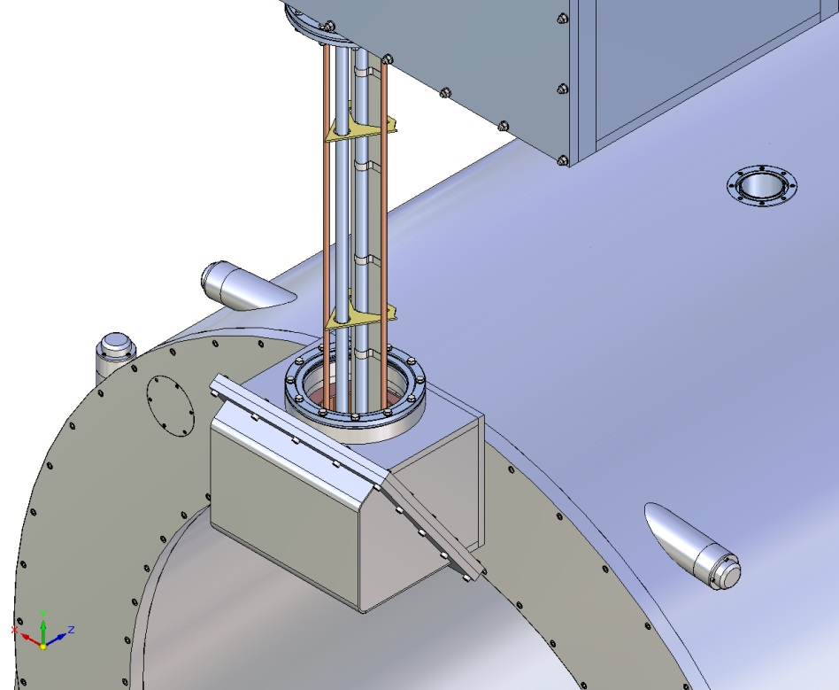
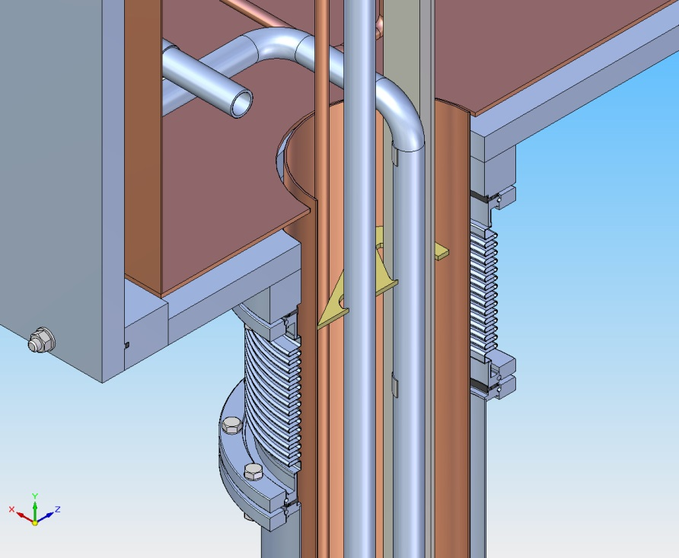
Chimney
Thermal screen of the chimney is fixated in the control box
The 77 K tubes are rigidly fixated to the thermal screen (the return tube is thermally connected with the screen)
Two 4.5 K tubes in chimney are rigidly connected with control Dewar piping and can slip relative the spacers in the chimney.
Feeding LHe tube provides heat interceptions on the aluminium bar by pure aluminium flexible tapes

Slide 19
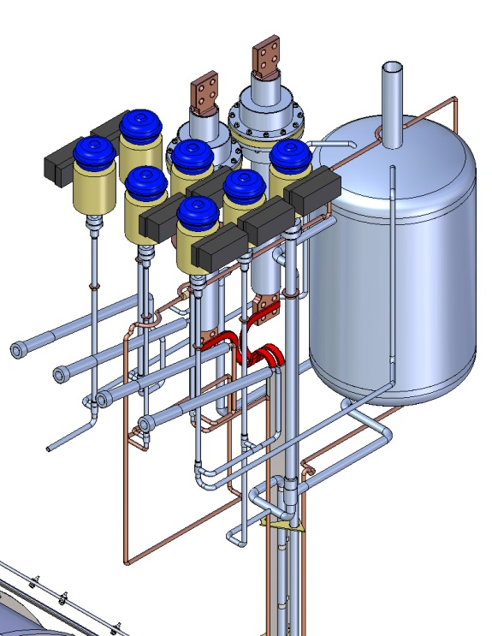
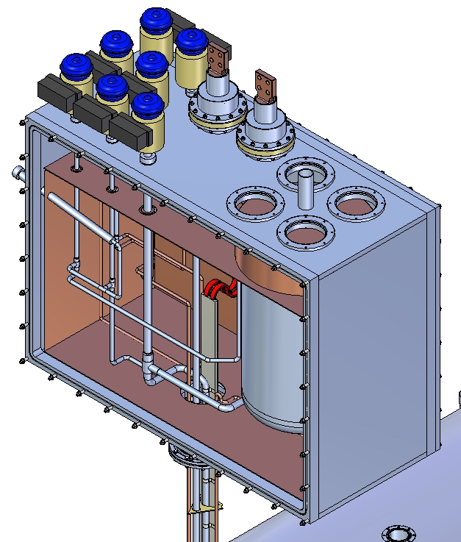
Control Dewar
CV5
CV9
CV4
CV2
CV1
CV8
CV3
Helium vessel volume 300 liters
Mass of the equipped Control Dewar and Chimney ~4000 kg

Slide 20
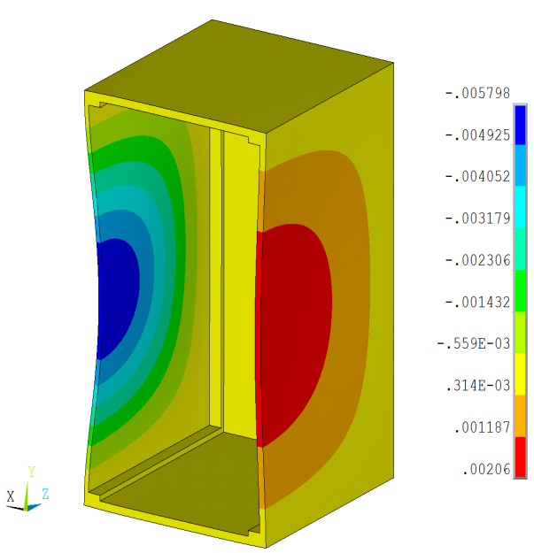
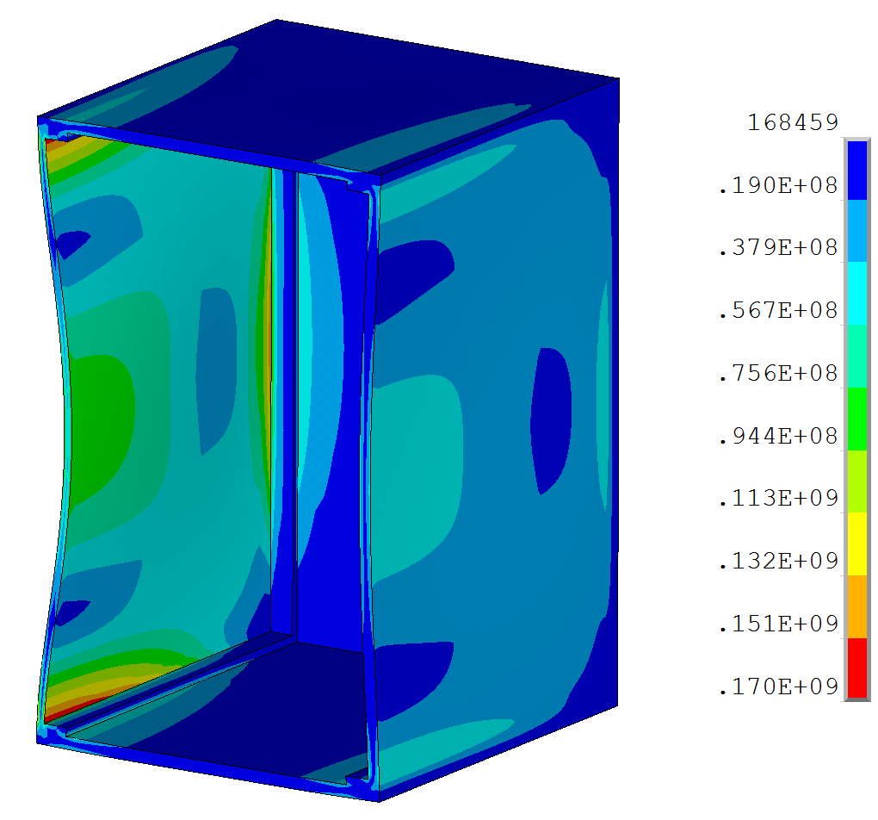
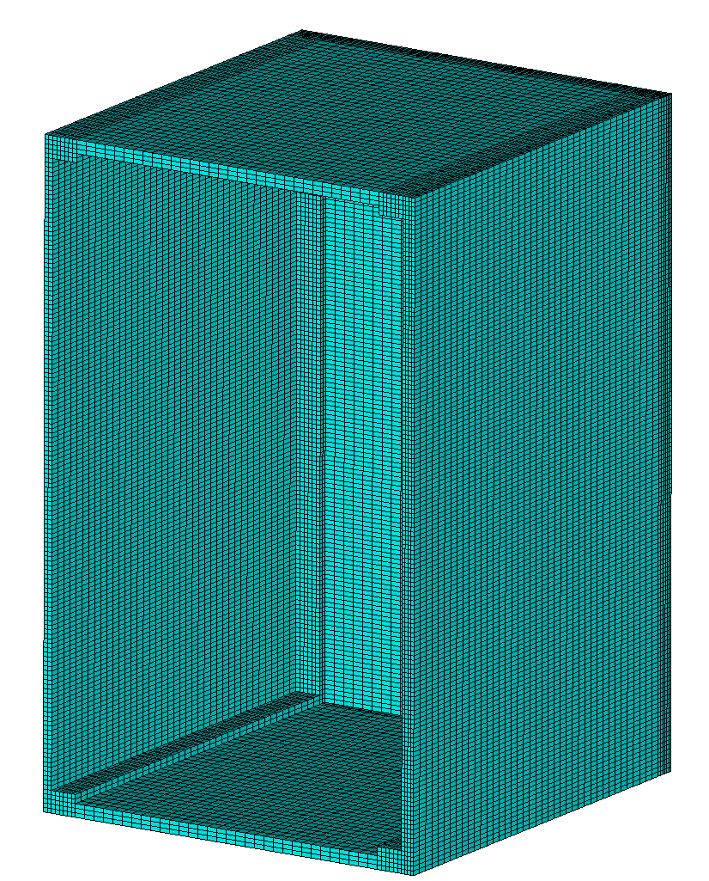
Evaluation of the strength of the control Dewar shell
91 MPa
Design scheme of the Control Dewar shell.
(1/2 of the actual design)
Distribution of displacements Ux in the shell of the control Dewar because of external pressure of 0.1 MPa. The maximum deflection of the cover is 5.8 mm
Reduced stress in the shell of the control Dewar.
σ_{max}=91 MPa < [σ]=98 MPa
Stability of the shell against external pressure of 0.1 MPa is provided with a safety margin of 4
It is necessary to increase the number of studs M12 twice and apply for their production material with a yield strength of 640 MPa.
It is recommended to use a spacer to reduce the stress and strain in the covers of the control Dewar

Slide 21
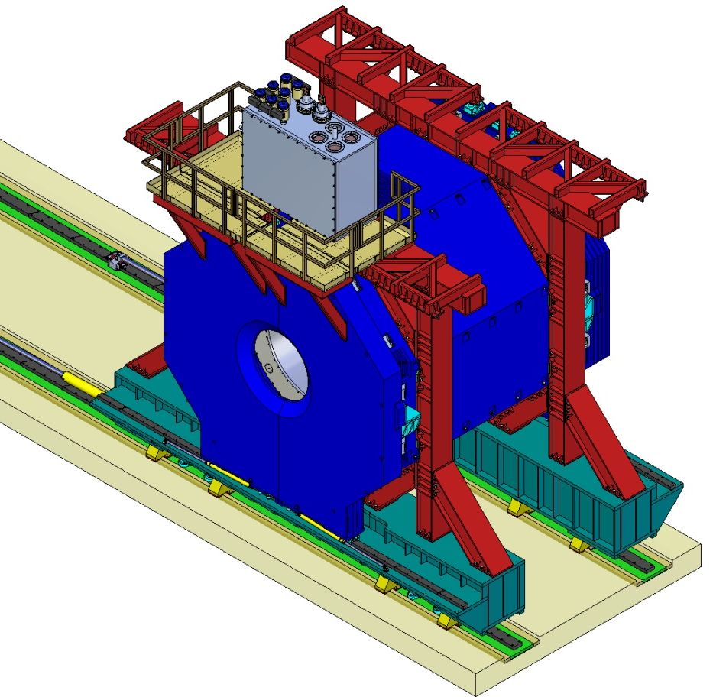
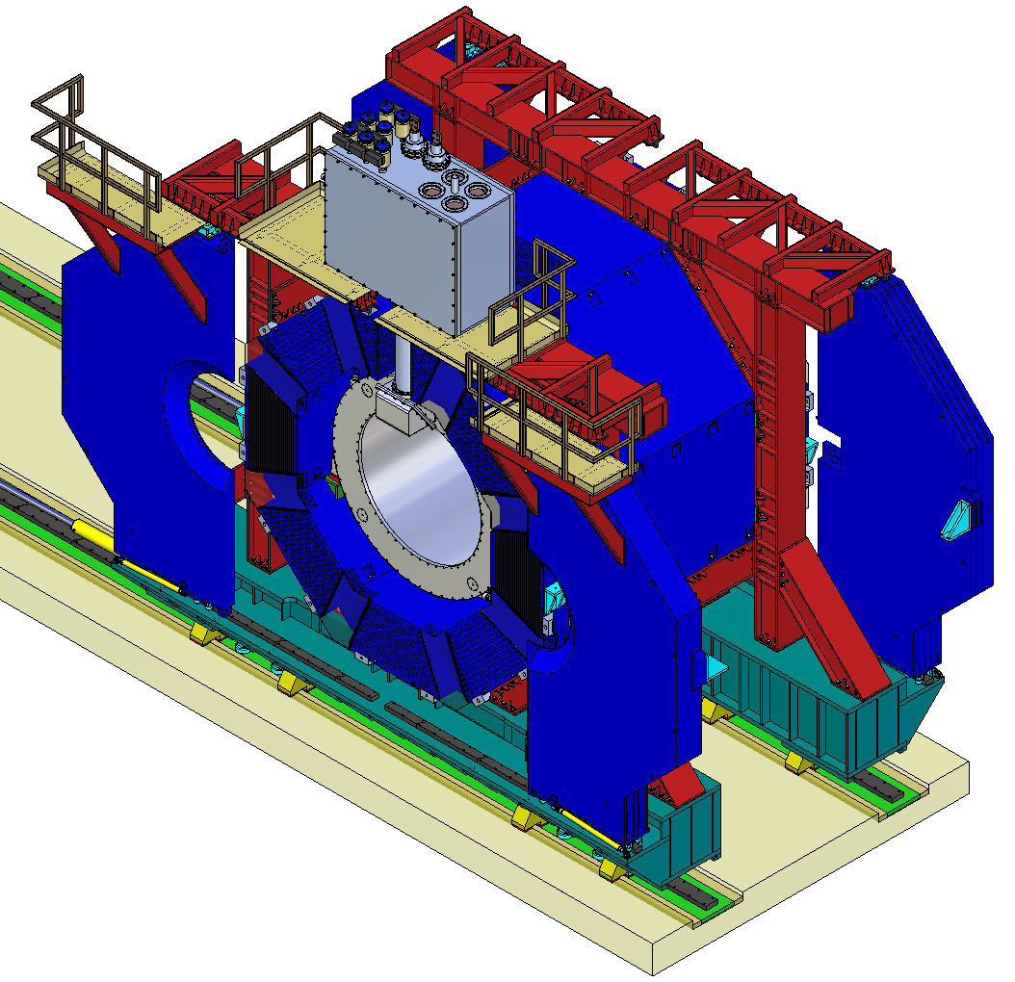
Assembled TS magnet

Slide 22
Heat influxes to the cold mass and thermal shield
T=4.5 K | Thermal load, W | Thermal load, W (TDR)
Cryostat
Radiation (0.06 W/m² x 44 m²) | 2.6
Heat inflow to the cold mass supports | 2.2
Conductor joints | 1
Gas load | 1
Eddy current losses in the Al cylinder | 10
Cryogenic chimney and Control Dewar
LHe vessel, tubing, valves, supports | 3.3
Transfer line | 9.7
Total (normal/transit regime) with safety factor 2: | 39.6/59.6 | 57
Current leads
without current | 6.2 (10 l/h)
with current | 10.5 (17 l/h)
T=60 K
Cryostat
Radiation (1.3 W/m² x 44 m²) | 57
Heat intercepts of the coil supports | 12.6
Shield supports | 115
Gas load | 2
Wires | 1
Cryogenic chimney and Control Dewar
Thermal screen, valves, supports | 19.7
Transfer line | 14.1
Total with safety factor 2: | 442 | 474

Slide 23
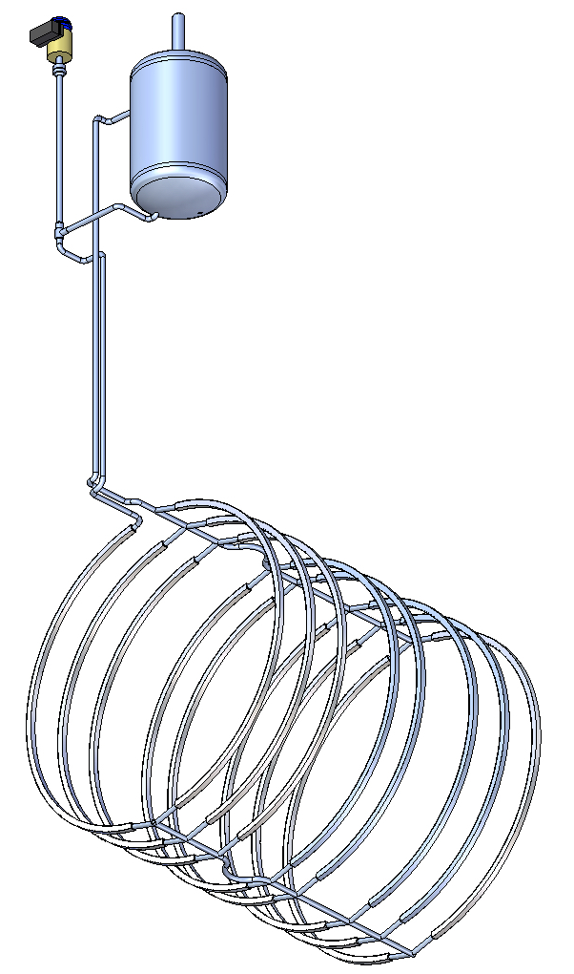
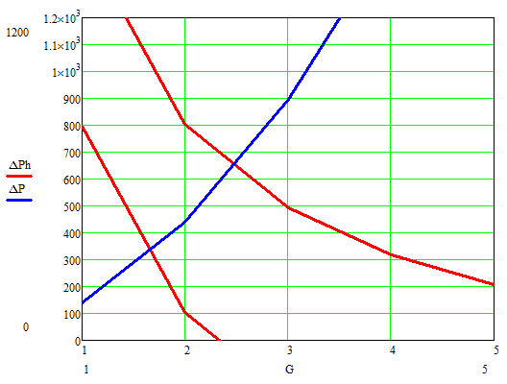
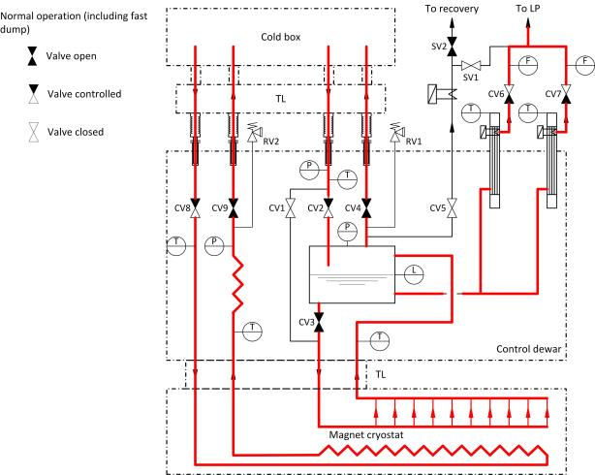
Natural circulation mode
Flow for one rib of the heat exchanger
(Pa)
h_{LHe}=100 mm
h_{LHe}=700 mm
, g/sec
Total flux for all ribs in transient regime 38 g/sec (h_{LHe}=700 mm)
25 g/sec (h_{LHe}=100 mm )
Chosen parameters of the cooling circuit provide a stable circulation of liquid helium irrespective of the level of LHe in the vessel of the control Dewar

Slide 24
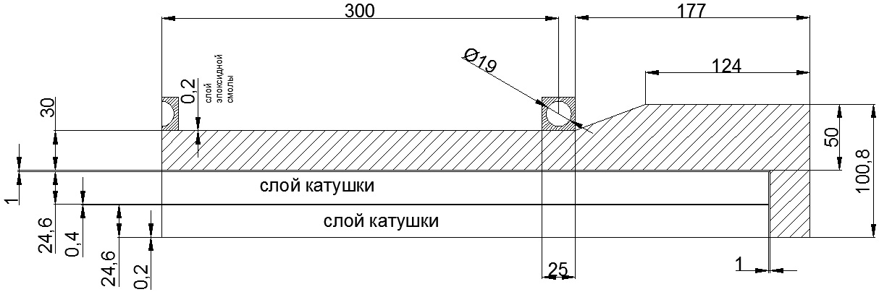
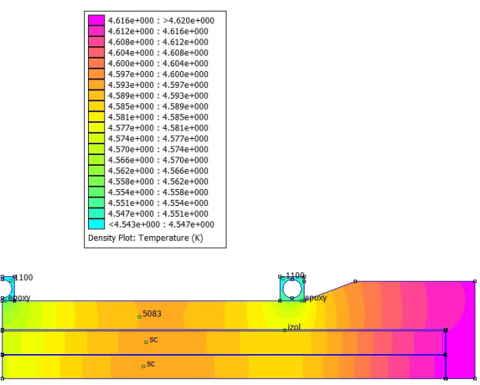
Maximal temperature in the superconducting coil
The maximum temperature
of the superconducting coil 4,62 K
in the steady state regime at
Minimal level of LHe in the bath

Slide 25
Optimization of the cooling efficiency of the heat exchanger on the support cylinder surface
№ | Mode of solenoid operation | Heat influx to the cold mass, W | Sizes of the heat exchanger rib, mm | Level in helium bath, mm | Helium mass flow in a rib, g/s | Maximal temperature in the coil, K | Temperature increase, above 4.5 K, K | Temperature drop on the glue connection of a rib, K
 | Steady state | 19.5 | 15x15, d=10 | 100 | 0.6 | 4.64 | 0.14 | 0.04
 |  |  |  | 700 | 0.8 | 4.63 | 0.13 | 0.04
2. | Steady state | 19.5 | 25x25, d=19 | 100 | 1.0 | 4.62 | 0.12 | 0.03
 |  |  |  | 700 | 1.8 | 4.61 | 0.11 | 0.03
3. | Current ramping | 39.5 | 15x15, d=10 | 100 | 0.75 | 5.05 | 0.55 | 0.16
 |  |  |  | 700 | 0.95 | 5.04 | 0.54 | 0.16
4. | Current ramping | 39.5 | 25x25, d=19 | 100 | 1.65 | 4.96 | 0.46 | 0.10
 |  |  |  | 700 | 2.5 | 4.94 | 0.44 | 0.10

Slide 26
Factors influencing the efficiency of the coil cooling
Bigger rib side of the heat exchanger provides smaller temperature drop in the coil. Increase of the rib side from 15 to 25 mm gives decrease of the temperature drop to 23%.
Temperature rise in the coil grows proportionally the thickness of the glued connections of the ribs. For a thickness of 0.2 mm it can reach 20-30% of the temperature rise
Variations of the level in the helium vessel (from 100 mm to 700 mm) has practically negligible effect on the maximum winding temperature.
Heat exchanger rib section 25x25 mm with a hole of 19 mm (or slightly smaller) adhered to the surface of the supporting cylinder (gluing layer of a thickness up to 0.2 mm) looks optimal in terms of cooling efficiency, size and volume of accumulated LHe (~16 liters)

Slide 27
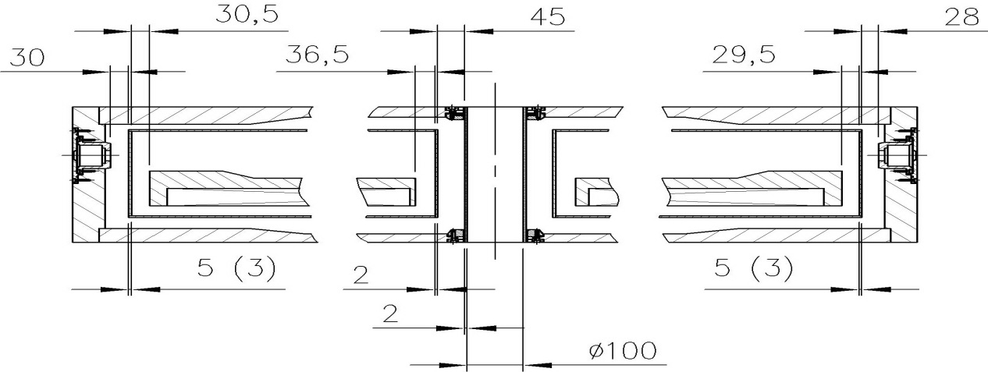
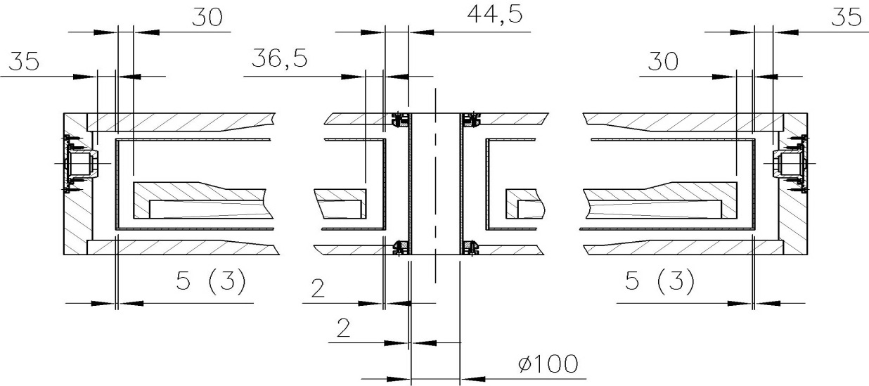
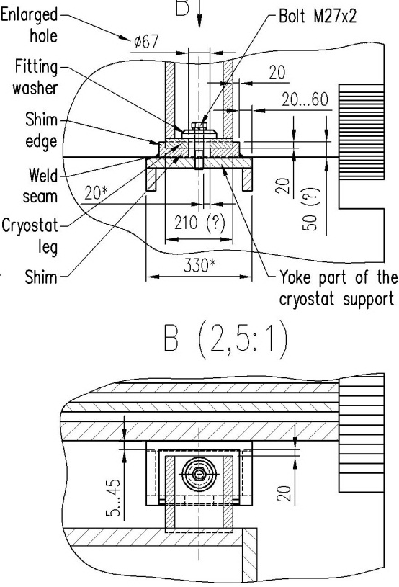
Interface of the cryostat and cold mass in nominal position
Cold mass and thermal shield - warm
Cold mass and thermal shield - cold
Correction of the sc coil position relative the yoke aperture by spaces in the cryostat supports.
These adjustments can be limited by the cryostat surrounding detectors
Although we have some space for axial corrections of the cold mass position inside the cryostat (~±20 mm), it can’t be implemented practically due to the limitations imposed by stresses in radial suspension rods.

Slide 28
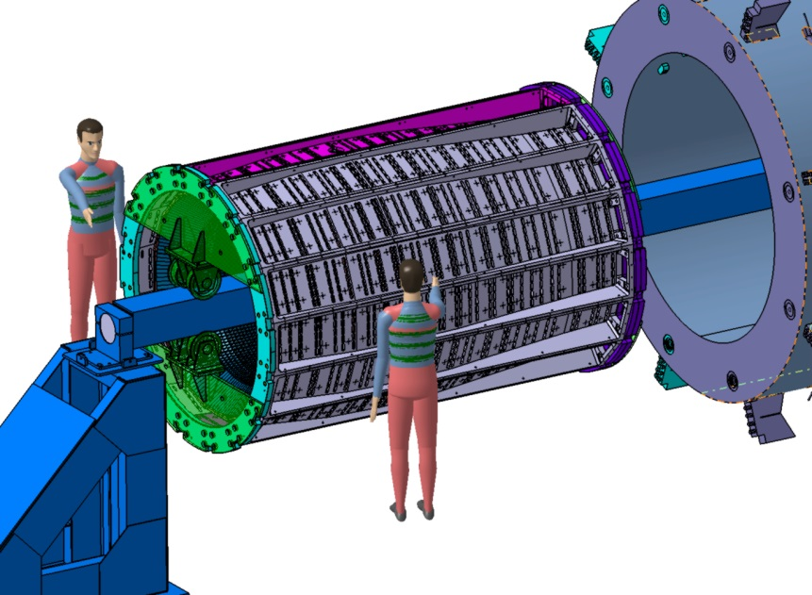
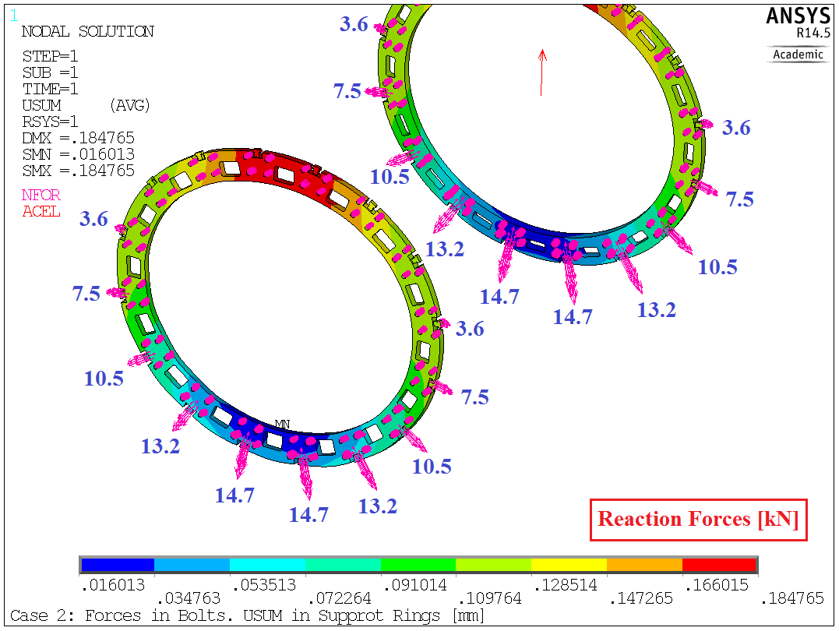
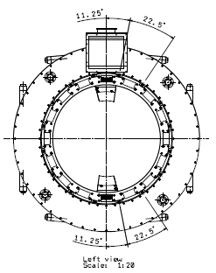
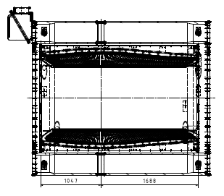
Cryostat interface with the barrel EMC
Barrel weight – 220 kN
140 kN or 180 kN?
Positions of the barrel EMC supports on the inner vacuum shell of the cryostat

Slide 29
Parameters of the helium fluxes in the transfer lines
Object | Stream | Parameters | Regime
 |  |  | steady-state (normal operation) | cool-down/warm-up | slow dump
Cold mass | incoming flow | gas/liquid | LHe (saturated liquid) | GHe | -
 |  | flow | 2.71 g/s (81.3 l/h) | 2.5 g/s (1 К/h) | -
 |  | temperature | 4.5 К | 300 – 4.5 К | -
 |  | pressure | 1.3 bara | ≤ 10 bara | -
 |  | vapor quality | < 5 % | - | -
 | return flow | gas/liquid | GHe (saturated vapor) | GHe | -
 |  | flow | 2.14 g/s | 2.5 g/s (1 К/h) | -
 |  | temperature | 4.45 К | 300 – 4.5 К | -
 |  | pressure | 1.25 bara | ≈ 1.5 bara | -
Current leads | - | gas/liquid | GHe | - | GHe
 |  | flow | 0.57 g/s (17 l/h) | - | 0.57 g/s (17 l/h)
 |  | temperature | ≈ 300 К | - | ≈ 300 К
 |  | pressure | 1.25 bara | - | 1.25 bara
Thermal shield | incoming flow | gas/liquid | GHe | GHe | -
 |  | flow | 2.1 g/s | - * | -
 |  | temperature | 40 К | 300 – 40 К | -
 |  | pressure | 2 bara | 6 bara | -
 | return flow | gas/liquid | GHe | GHe | -
 |  | flow | 2.1g/s | - * | -
 |  | temperature | 80 К | 300 – 80 К | -
 |  | pressure | 1.6 bara | ≈ 1.5 bara | -
Recovery line | - | gas/liquid | - | - | GHe
 |  | flow | - | - | 2.17 g/s (65.1 l/h)
 |  | temperature | - | - | 4.45 К
 |  | pressure | - | - | 1.25 bara

Slide 30
  Plans for 2015
Some changes of the cryostat design will be required in the next year to take into consideration the last results of computations, changes of the cold mass design and technological capabilities of the producer
Refinements of the cryostat and control Dewar design will be continued to ensure an adequate safety factor of the suspension system of the cold mass and to prepare the design of external piping (valves, pipes, gages etc.) of the control Dewar
In January 2015 A.Vodopianov and me are waited for design and pre-contractual discussions in Novosibirsk
The chapter of the TDR has to be prepared

Slide 31
Plans for 2015
We have found a high level of cold mass movements under the action of uttermost decentering magnetic forces F_{zmax}=-140 kN, F_{rmax}=45 kN. Maximal displacements under the action of these forces Δz=0.77 mm and Δr=0.56 mm exceed the acceptable value of 0.5 mm. Subsequently the sources of increased yields of the suspension system are to be eliminated
It takes to define limitations for axial corrections of the cold mass position inside the cryostat according to the results of field measurements. These limitations are imposed by allowable stresses in radial suspension rods and they are significantly less than the available space allows

Slide 32
THANK YOU
FOR YOUR ATTENTION!

