Slide 1
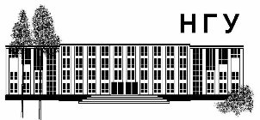
Forward RICH mirror study
Sergey Kononov
Budker Institute of Nuclear Physics SB RAS
Novosibirsk State University
FRRC - SSC RF ITEP of NRC “Kurchatov Institute”
9 December 2014

Slide 2
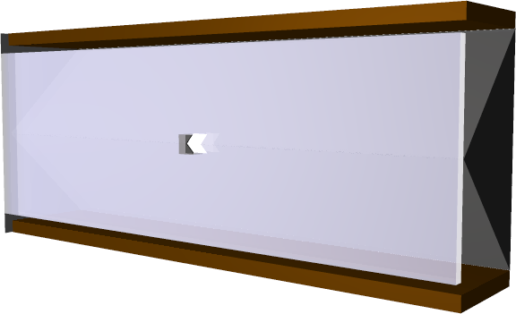
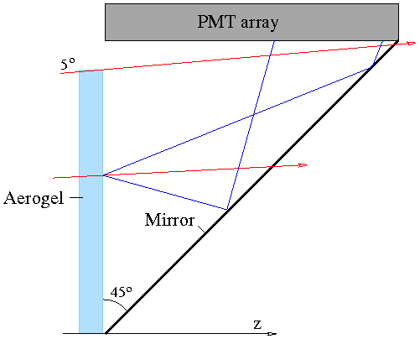
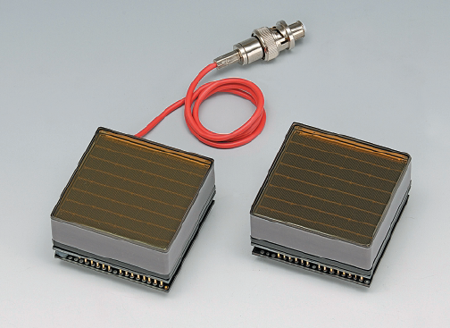
Conceptual design based on FARICH S. Kononov (2010)
3000 mm
1020 mm
Hamamatsu H8500 MaPMT
flat panel,
8x8 anode pixels of 6mm size
89% active area ratio
Bialkali photocathode
Gain: 1.5∙10⁶
Relatively cheap (≈€1800 / unit)
Robust
Long lifetime
2-layer aerogel n₁=1.050, n₂=1.047 (no gas)
Flat mirrors only
MaPMT readout
MC simulated PID performance:
π/K up to P = 10 GeV/c
μ/π up to P = 2 GeV/c

Slide 3
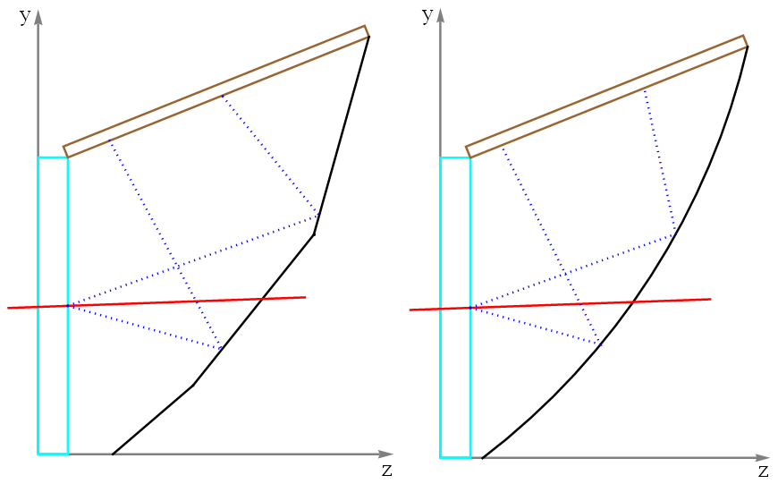
RICH geometry optimization K.I Beloborodov (BINP)
Upper half of the detector
PD width
Mirror with several flat segments
Cylindrical mirror

Slide 4
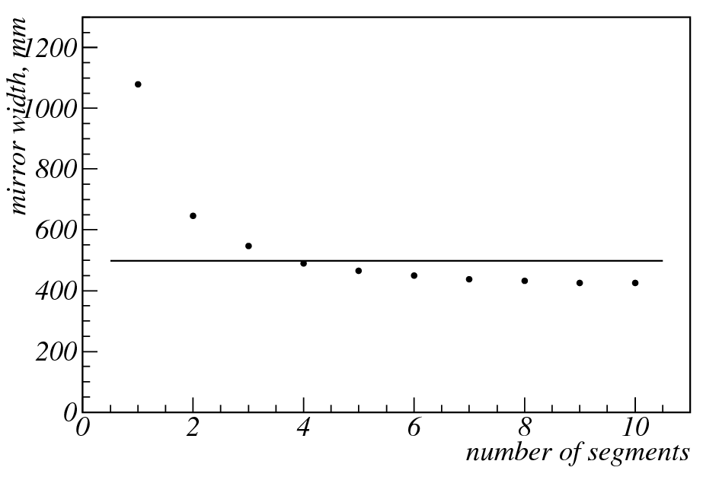
Photon detector width for different mirror geometries K.I Beloborodov (BINP)
For 100% photon geometric efficiency
Mirror | PD width, mm
flat (1 segment) | 1079
2 segments | 645
3 segments | 547
4 segments | 489
5 segments | 465
10 segments | 425
Cylindrical (R=1203mm) | 498
Design 2010 | 515

Slide 5
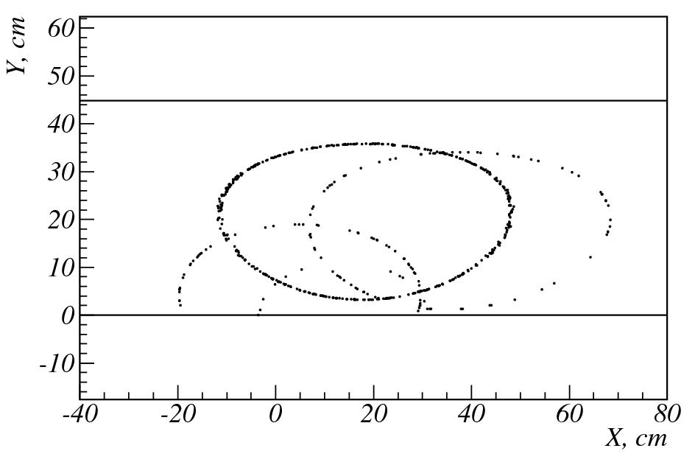
Example of event in PandaRoot K.I Beloborodov (BINP)
muon of 10 GeV/c from IP
Cylindrical mirror
No detection yet. All photons counted.

Slide 6
Mirror requirements K.A. Martin (BINP)
Photoelectron spectrum from aerogel
Hamamatsu bialkali pc with BS window
Philips DPC
Maximum reflectivity in the wavelength range 300-750 nm (>80%)
Low image distortions (<1 mrad)
Minimum material budget (< 5%X₀)
Radiation hardness

Slide 7
Mirror material options review by K.A. Martin (BINP)
Substrate material | Producers | Pros | Cons | Applications
Glass | FLABEG, Germany JLO, Czech Compas, Czech Lytkarino, Russia | Many producers Robust, old technology Low price | Fragility Heavy, X0=13cm | COMPASS RICH1, CBM RICH
Berillium | Kompozit, Russia | Lightweight, X0=35cm | High price Toxic | Considered for LHCb RICH1
Carbon fiber cell structure | CMA, USA | Lightweight, X0=275cm | Outgassing possible | LHCb RICH1, HERMES RICH
Al honeycomb | MLT, Italy | To be studied | To be studied | CLAS12 RICH
Reflective material: Al covered by MgF₂ or SiO₂

