Slide 1
STORAGE RINGS MEETING
GSI Helmholtz Center for Heavy Ion Research, Darmstadt
RESIDUAL ACTIVITY
INDUCED BY HEAVY-ION BEAMS IN MATTER
[ P. Katrik^{1,2} | E. Mustafin¹ | D. Hoffmann^{1,2} | I. Strasik¹ | M. Pavlovic³ ]
¹GSI Darmstadt, Germany | ²TU Darmstadt, Germany | ³STU Bratislava, Slovakia
Ing. Peter KATRIK
[ 10th December 2014 | Storage Rings Meeting | Peter KATRIK | TU Darmstadt | p.katrik@gsi.de ]

Slide 2
Content
RESIDUAL ACTIVITY INDUCED BY HEAVY-ION BEAMS IN MATTER.
. motivation
. activation of the material
. experimental settings
. depth-profiling
. beam loses criteria
. review of previous results | FLUKA 2008.3.6
. new results | FLUKA 2011.2b.5
. conclusion
[ 10th December 2014 | Storage Rings Meeting | Peter KATRIK | TU Darmstadt | p.katrik@gsi.de ]

Slide 3
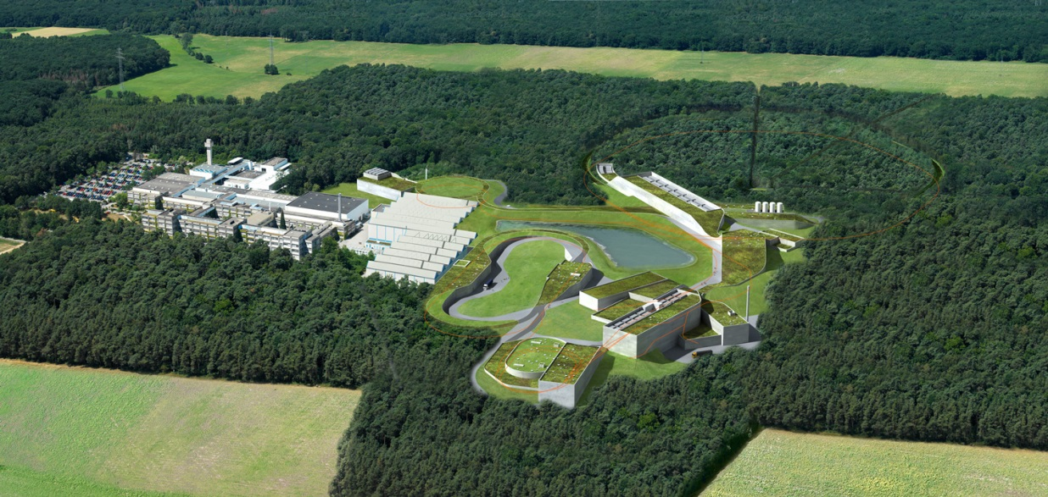
Motivation
SIMULATIONS & EXPERIMENTS.
. Beam-loss criteria
. „Hands-on“ maintenance
. FLUKA verification
. Previous experiments at GSI
. Preparation work at FAIR
[ 10th December 2014 | Storage Rings Meeting | Peter KATRIK | TU Darmstadt | p.katrik@gsi.de ]

Slide 4
Motivation
SIMULATIONS & EXPERIMENTS.
. Beam-loss criteria
. „Hands-on“ maintenance
. FLUKA verification
. Previous experiments at GSI
. Preparation work at FAIR
Target | Beam energy | Beam
Stainless steel | 1GeV/u | U
Stainless steel, Cu, Al, Pb | 950 MeV/u | U
Stainless steel, Cu, Al, Pb , Graphite, Carbon-composite | 500 MeV/u | U
Pb | 345 MeV/u | U
Al | 300 MeV/u | U
Al, Cu | 200 MeV/u | U
Al, Cu | 125 MeV/u | U
Carbon-composite | 100 MeV/u | U
Cu, Al, Pb | 500 MeV/u | Ta
Al | 300 MeV/u | Xe
Cu | 100 MeV/u | Xe
Cu | 700 MeV/u | N
Cu, Al, Pb | 500 MeV/u | N
Cu, Al | 1 GeV/u | Ar
Cu, Al | 500 MeV/u | Ar
[ 10th December 2014 | Storage Rings Meeting | Peter KATRIK | TU Darmstadt | p.katrik@gsi.de ]

Slide 5
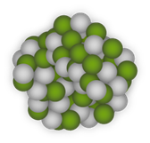
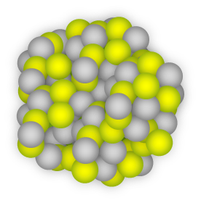
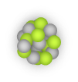
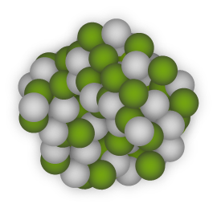
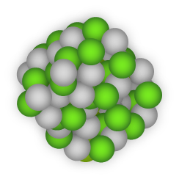
Fragment of primary ion
Activation
²³⁸U
Fragment of primary ion
Energy = 200 MeV/u
Fragment of target atom
Scattered neutrons

Slide 6
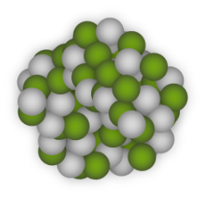
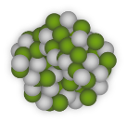
Atoms of U, Al and Fragments
BEAM-LOSS.
. motivation

Slide 7
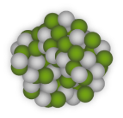
Interactions of neutrons with matter
. illustration of (n, α) reaction
α
. illustration of (n,γ) reaction
emitted
charged particle
gamma
rays
A
Z*
A
Z*
Z
incident
neutron
target
nucleus
compound
nucleus
C
incident
neutron
target
nucleus
compound
nucleus
final
nucleus
final
nucleus
. illustration of fission reaction
D
fission fragment
. illustration of inelastic neutron scattering
A
Z*
scattered neutron
fission neutrons
A
Z*
incident
neutron
target
nucleus
compound
nucleus
E
A*
fission fragment
incident
neutron
target
nucleus
compound
nucleus
excited nucleus
. illustration of elastic neutron scattering
gamma
rays
A
scattered neutron
ground-state nucleus
A
Z*
. the compound nucleus is unstable
incident
neutron
target
nucleus
compound
nucleus
A
. can disintegrate into various products
. can emit gamma rays
ground-state
nucleus
[ 10th December 2014 | Storage Rings Meeting | Peter KATRIK | TU Darmstadt | p.katrik@gsi.de ]

Slide 8
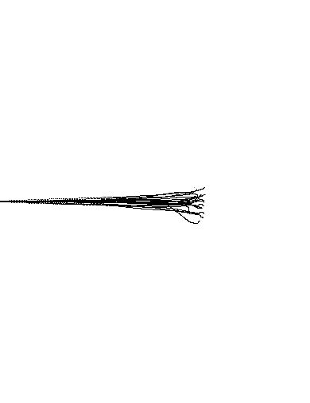
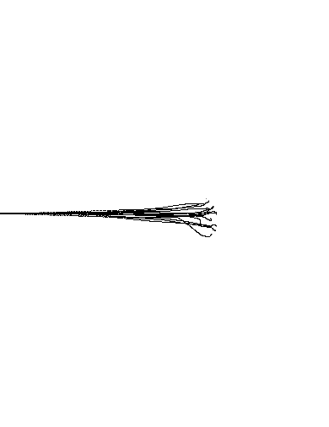
Activation
. simulated by SRIM
HEAVY-ION BEAM PENETRATION.
. Δ_{x} - the range
. E₀ - the initial kinetic energy of the particle
. S(E) - the stopping power
Experimental target
Range
Stopping power, dE/dx
Kinetic energy, E(x)
dE/dx
E(x)
. combination of the foils and discs
. different thickness | resolution of the depth-profiling
Depth
[ 10th December 2014 | Storage Rings Meeting | Peter KATRIK | TU Darmstadt | p.katrik@gsi.de ]

Slide 9
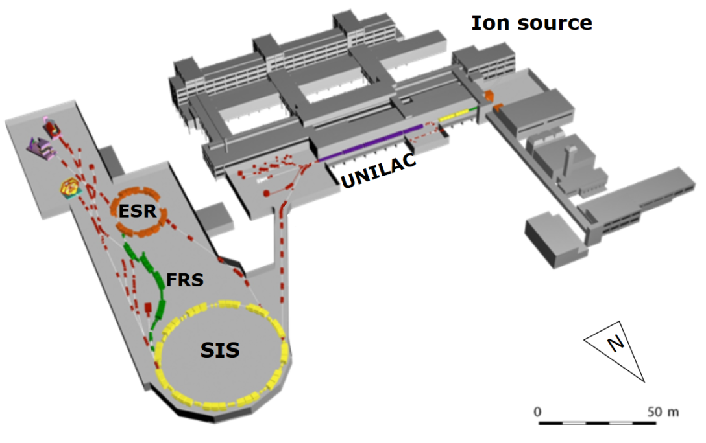
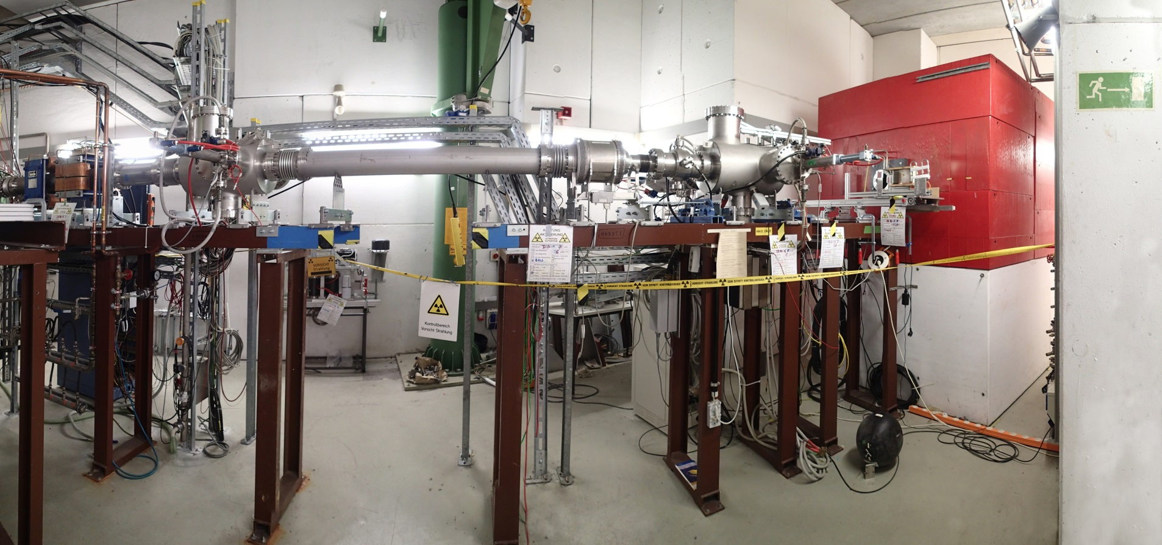
Experimental station
IRRADIATION.
. remote control from MCR
. 3 analog cameras
. 2 moving platforms for ~ 5÷10 targets
HHD cave
[ 10th December 2014 | Storage Rings Meeting | Peter KATRIK | TU Darmstadt | p.katrik@gsi.de ]

Slide 10
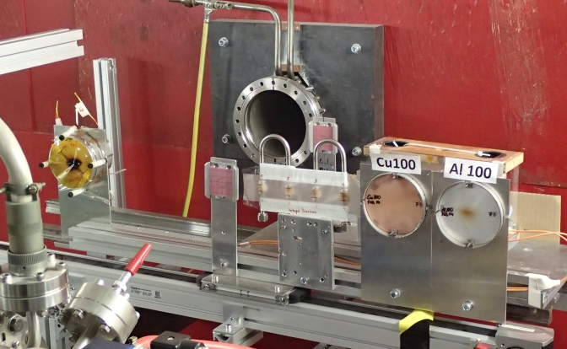
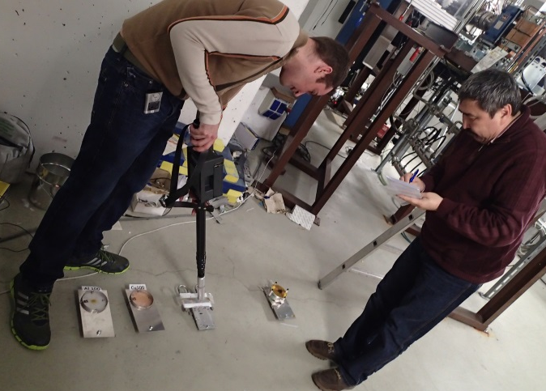
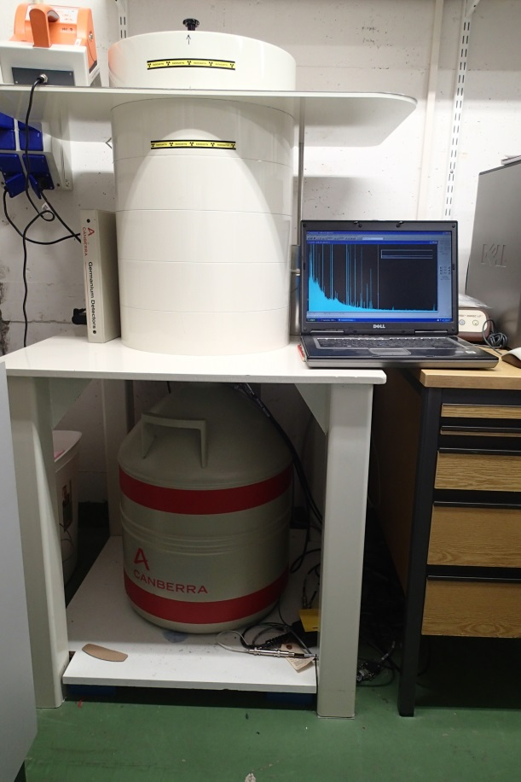
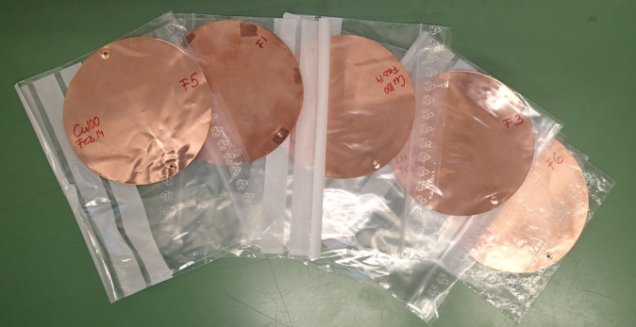
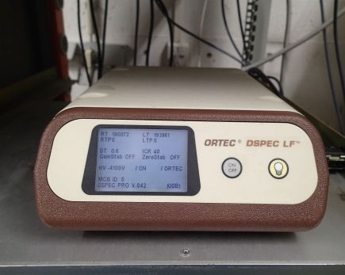
Experimental station
AFTER IRRADIATION.
. detector Canberra® HPGe – GC3518
. spectrometer ORTEC® DESPEC LF TM
. software GammaVision ®
Energy resolution ~ 1.8keV FWHM at the 1332 keV 60Co line
Model A66-B32
[ 10th December 2014 | Storage Rings Meeting | Peter KATRIK | TU Darmstadt | p.katrik@gsi.de ]

Slide 11
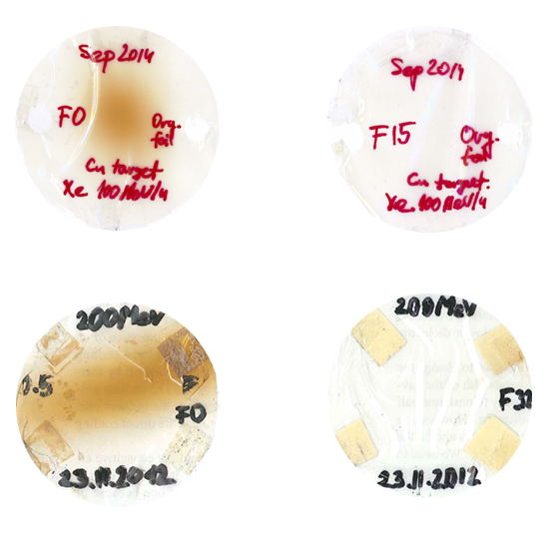
Organic foils
BEAM SPOT MEASUREMENT.
. radiation sensitive material
. polycarbonate
. kapton
. pokalon
. bisphenol
. important for simulation | dose distribution calculations
[ 10th December 2014 | Storage Rings Meeting | Peter KATRIK | TU Darmstadt | p.katrik@gsi.de ]

Slide 12
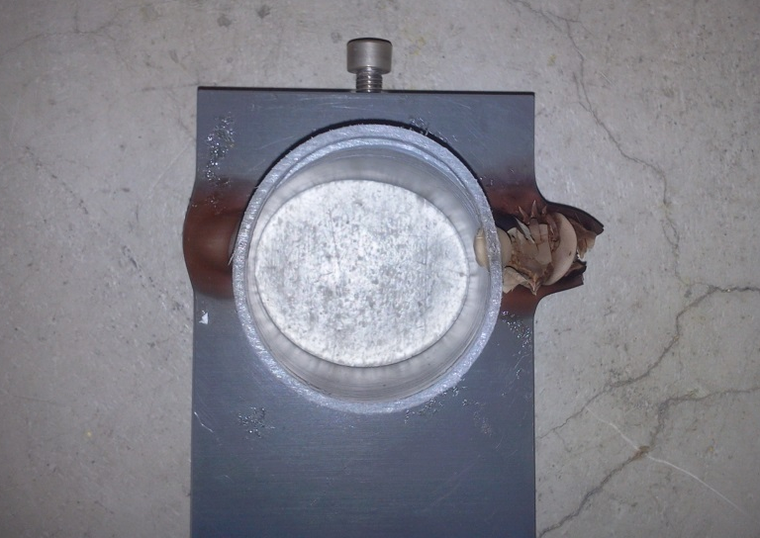
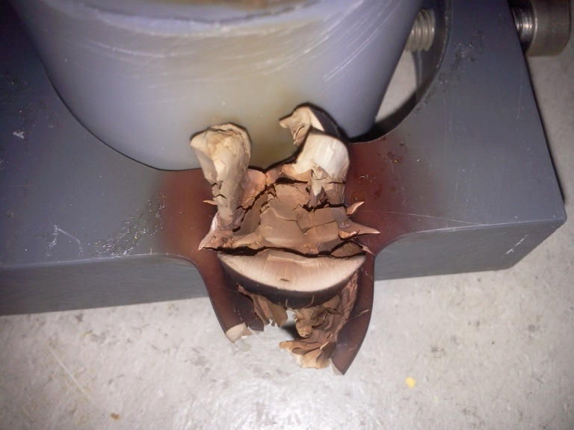
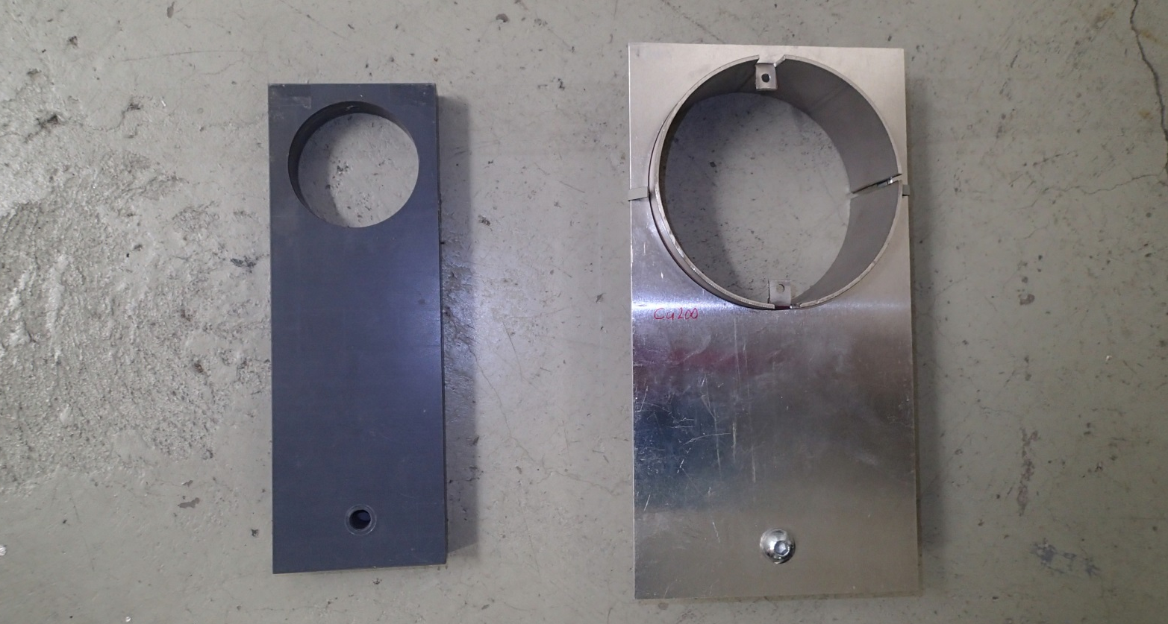
Focusing issue
[ 10th December 2014 | Storage Rings Meeting | Peter KATRIK | TU Darmstadt | p.katrik@gsi.de ]

Slide 13
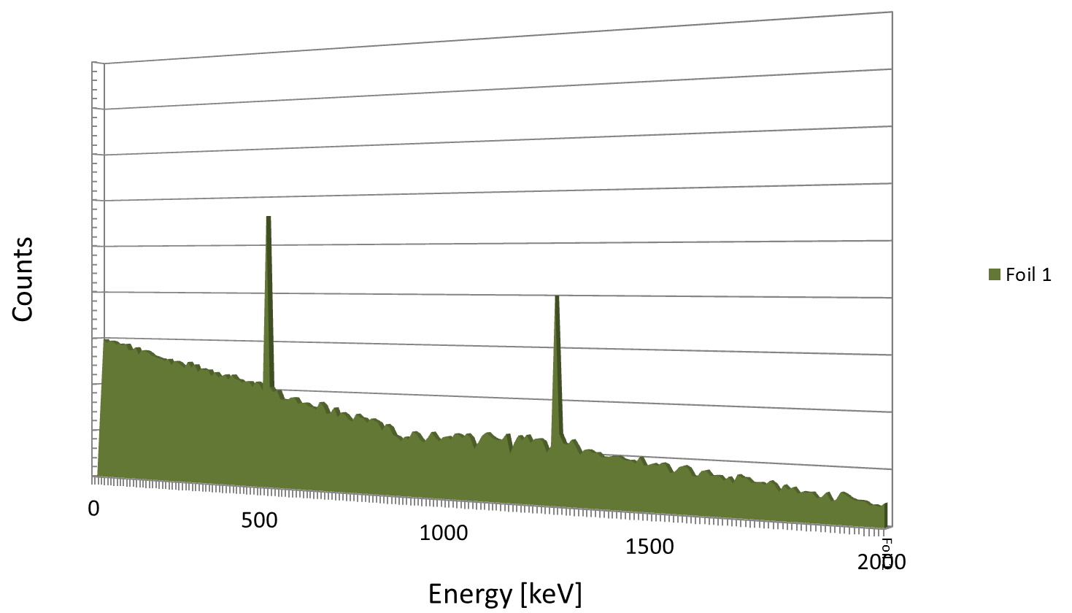
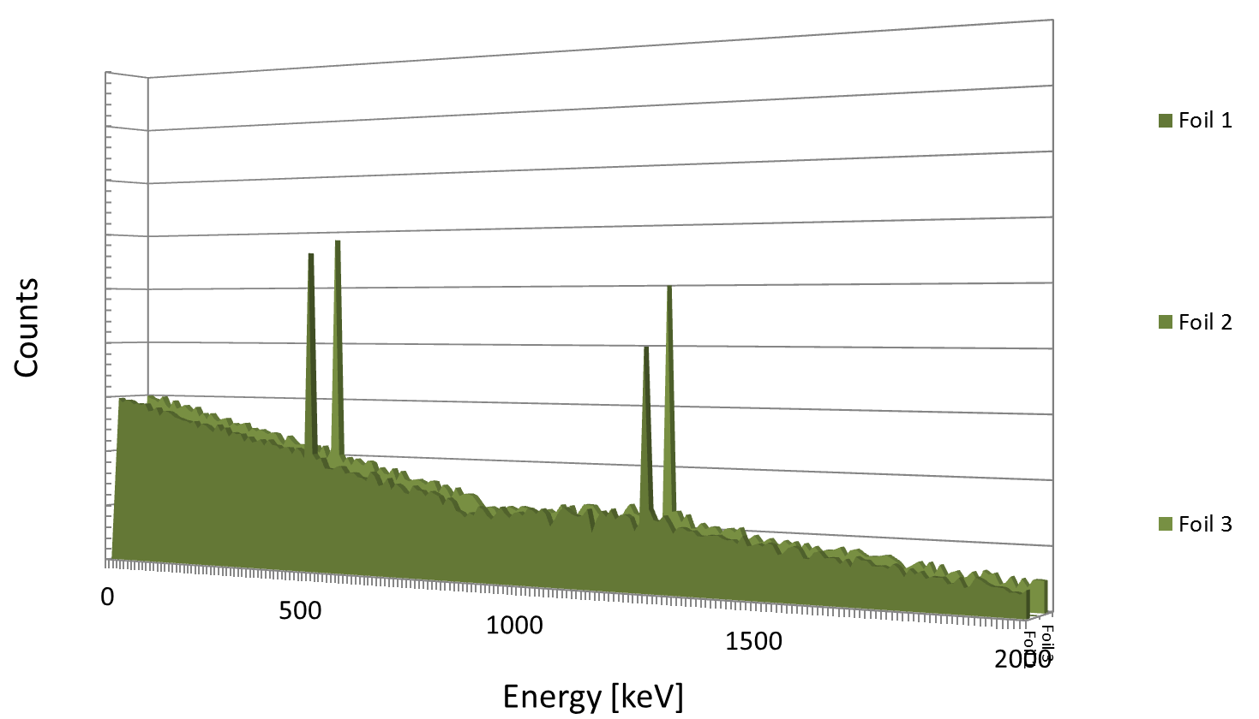
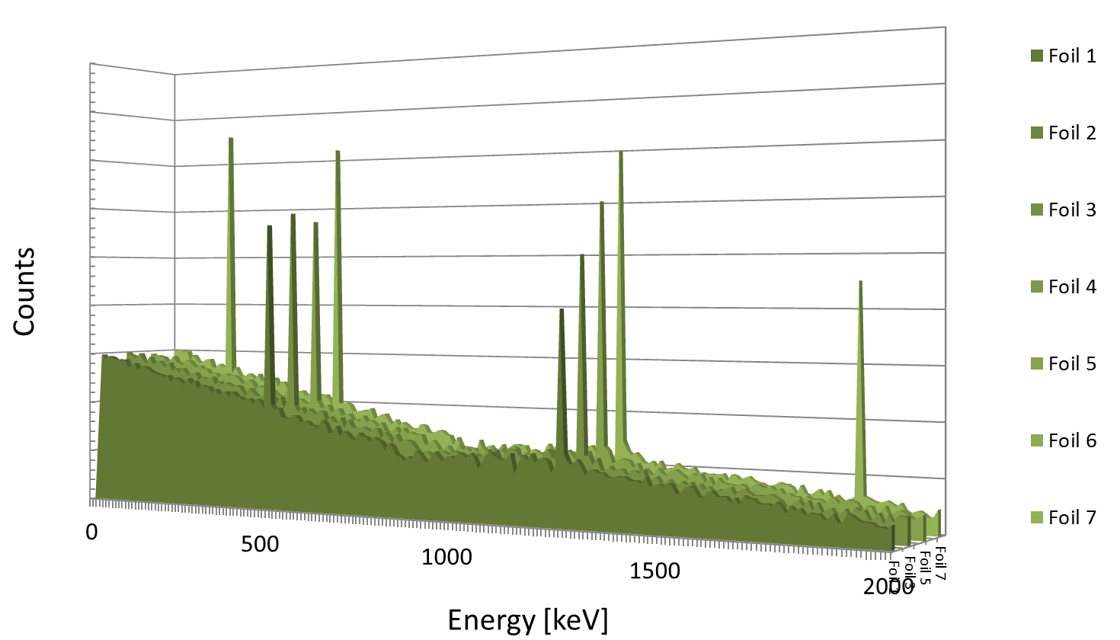
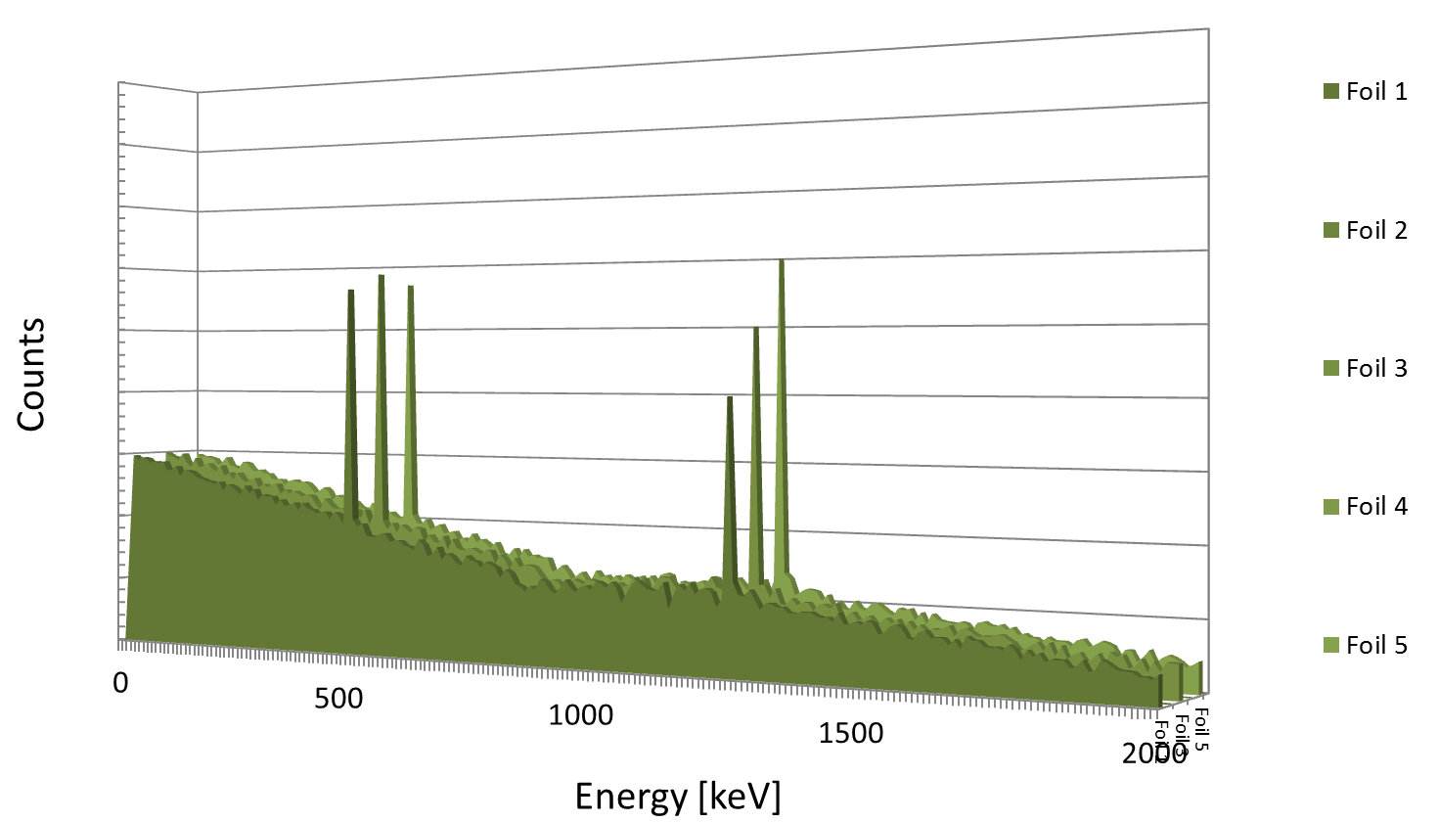
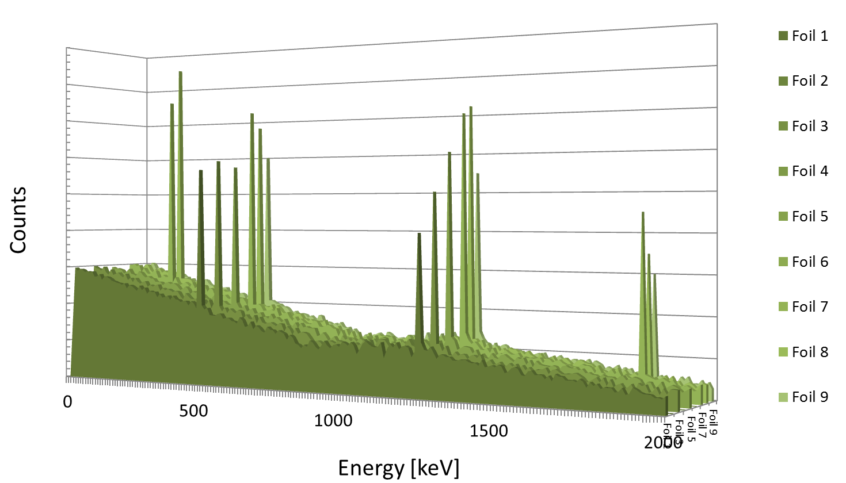
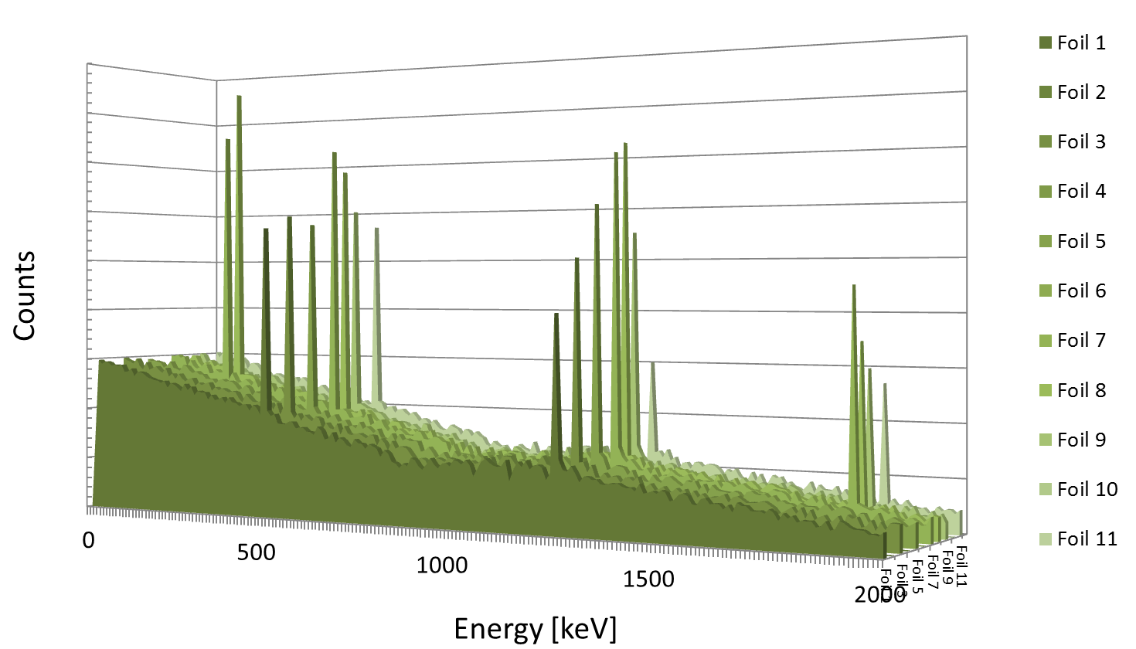
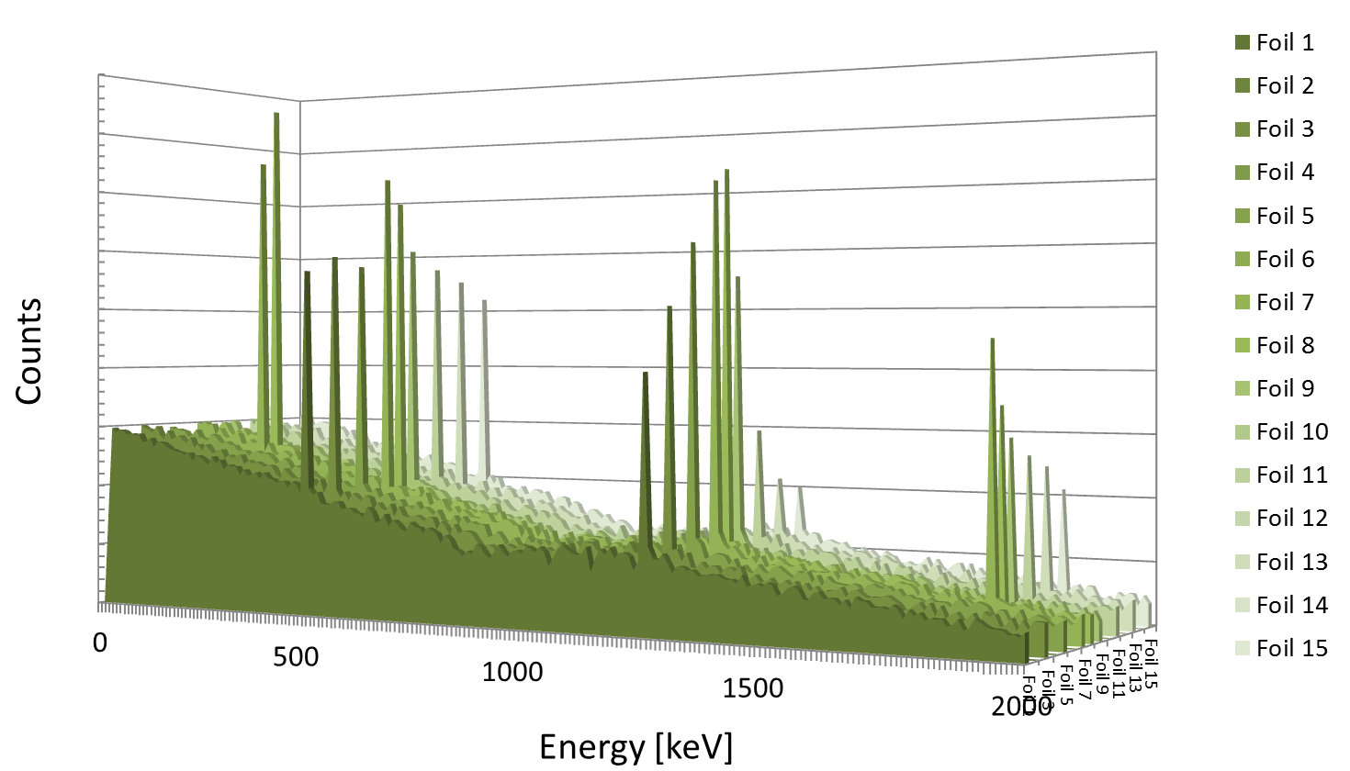
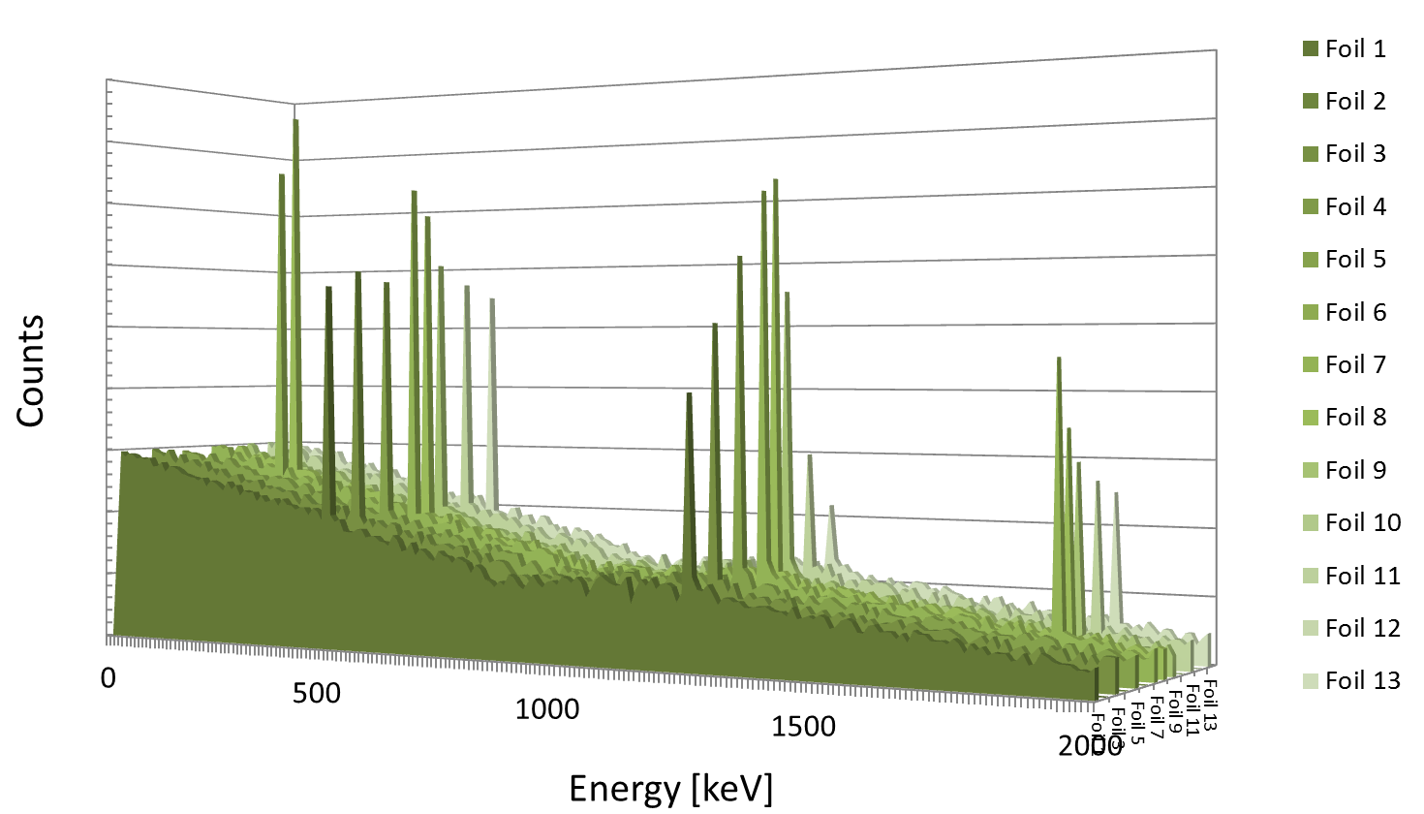
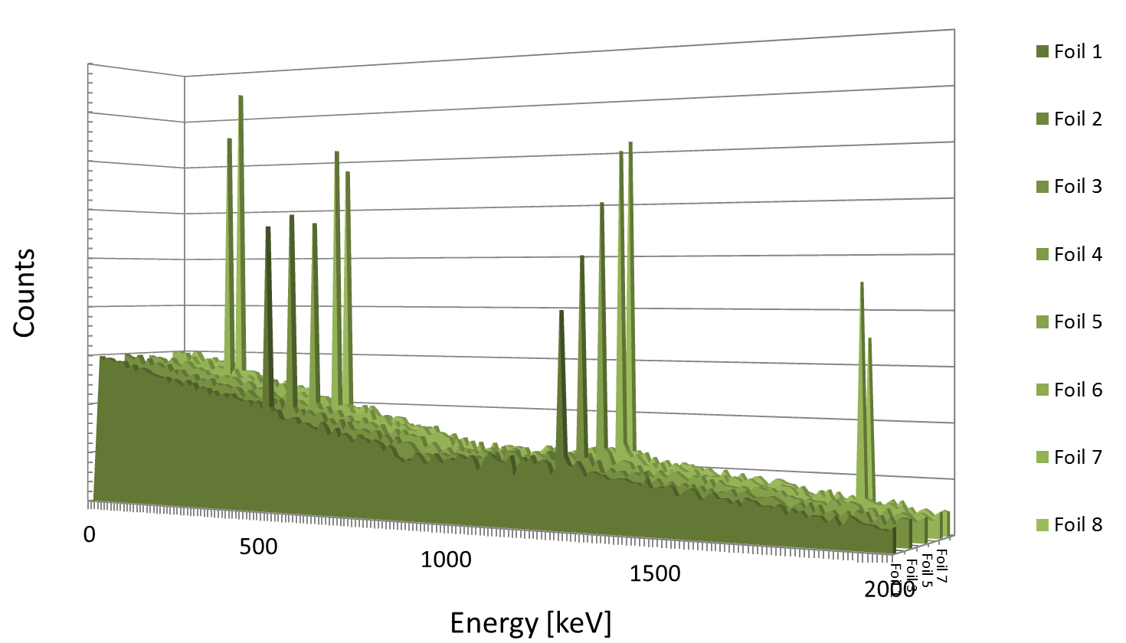
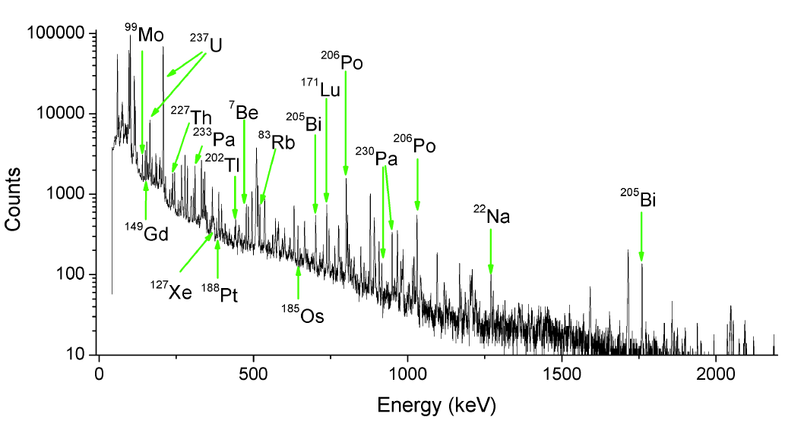
Depth-profile
Experimental target
[ 10th December 2014 | Storage Rings Meeting | Peter KATRIK | TU Darmstadt | p.katrik@gsi.de ]

Slide 14
Depth-profile
. better resolution of depth profile = more foils
. more foils = longer total time of measurement of whole target
. better measurement statistic = longer measurement time
. short-living isotopes = short time till all nuclides die
[ 10th December 2014 | Storage Rings Meeting | Peter KATRIK | TU Darmstadt | p.katrik@gsi.de ]

Slide 15
[ 10th December 2014 | Storage Rings Meeting | Peter KATRIK | TU Darmstadt | p.katrik@gsi.de ]

Slide 16
Depth-profile
Examples of the produced nuclides in Aluminium target
after irradiation by Uranium beam with energy 200MeV/u
[ 10th December 2014 | Storage Rings Meeting | Peter KATRIK | TU Darmstadt | p.katrik@gsi.de ]

Slide 17
Beam-loss criteria
N. V. Mokhov and W. Chou (Eds.), Beam Halo and Scraping, The 7th ICFA Miniworkshop on High Intensity High Brightness Hadron Beams, Wisconsin, USA, 13-15 September 1999
. the tolerable beam-loss level of 1 W/m
. proton beam
. energy above100 MeV
. uniformly distributed along the beam line
. 100 days of operation
. at 30 cm (1 foot) from the component surface
. 4 hours after shutdown
. Dose rate bellow 1 mSv/h
[ 10th December 2014 | Storage Rings Meeting | Peter KATRIK | TU Darmstadt | p.katrik@gsi.de ]

Slide 18
Beam-loss criteria
. beam-loss criteria for heavy-ion accelerators
Ion 1GeV/u | Number of particles/s equivalent to 1W
¹ H | 6.24E+09
⁴ He | 1.56E+09
¹² C | 5.20E+08
²⁰ Ne | 3.12E+08
⁴⁰Ar | 1.56E+08
⁸⁴ Kr | 7.43E+07
¹³² Xe | 4.73E+07
¹⁹⁷ Au | 3.17E+07
²³⁸ U | 2.62E+07
[ 10th December 2014 | Storage Rings Meeting | Peter KATRIK | TU Darmstadt | p.katrik@gsi.de ]

Slide 19
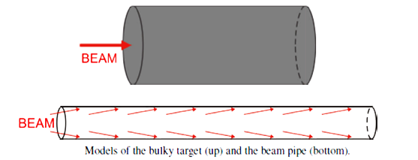
Previous simulations
FLUKA 2008.3.6
I.STRASIK, E.MUSTAFIN, M.Pavlovic: Residual activity induced by heavy ions and beam-loss criteria for heavy-ion accelerators, Phys. Rev. ST accel. Beams 13, 071004 (2010)
. target materials: stainless steel, cooper
. primary beams: ¹H, ⁴He, ¹²C, ²⁰Ne, ⁴⁰Ar, ⁸⁴Kr, ¹³²Xe, ¹⁹⁷Au, ²³⁸U
. beam energies: 200MeV/u ÷ 1GeV/u
. target geometry: beam-pipe, bulky target
. normalized induced activities | beam power of 1 W | 3 months of irradiation
. several time points after irradiation
[ 10th December 2014 | Storage Rings Meeting | Peter KATRIK | TU Darmstadt | p.katrik@gsi.de ]

Slide 20
Previous simulations
FLUKA 2008.3.6
BULKY TARGET.
. target materials: cooper
. diameter 20 cm
. length 60 cm
[ 10th December 2014 | Storage Rings Meeting | Peter KATRIK | TU Darmstadt | p.katrik@gsi.de ]

Slide 21
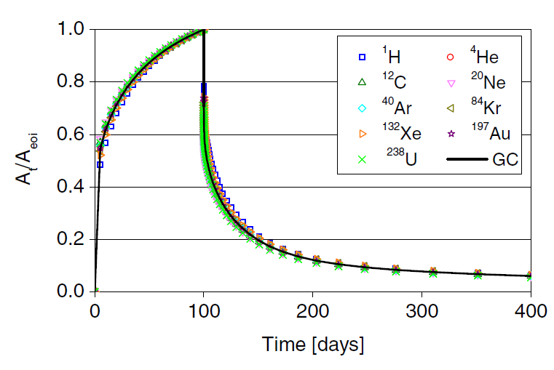
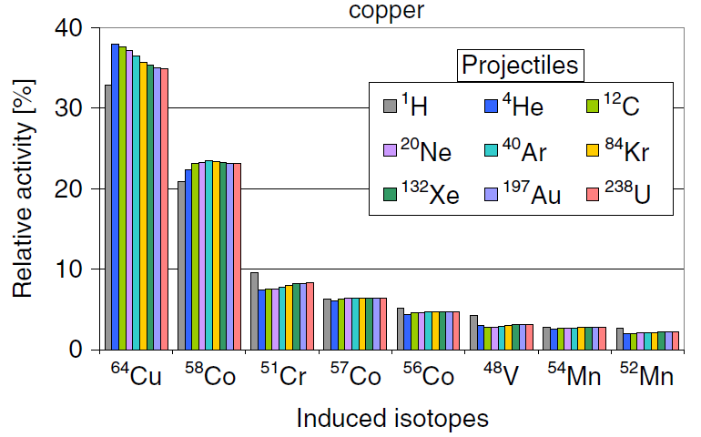
Generic curve
FLUKA 2008.3.6
. time evolution of the activity
. independent from the projectile mass
. activity normalized to the activity at the end of irradiation
. obtained by averaging the data points of the individual curves corresponding to different primary ions
. Time evolution of the relative activity in the Beam pipe by different projectiles at 500 MeV/u
. Inventory of nuclides produced in the Beam pipe by different projectiles at 500 MeV/u
[ 10th December 2014 | Storage Rings Meeting | Peter KATRIK | TU Darmstadt | p.katrik@gsi.de ]

Slide 22
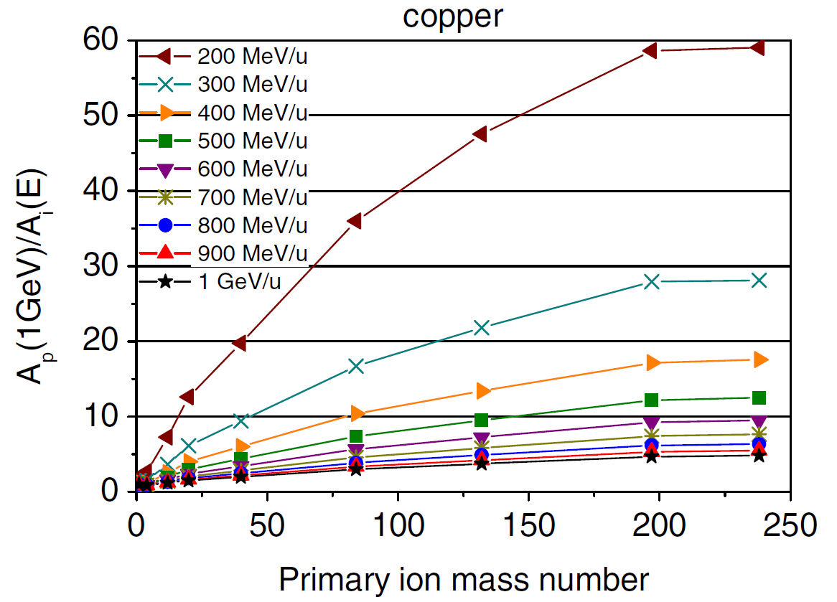
Scaling law
FLUKA 2008.3.6
SCALING LAW FOR BEAM-LOSS TOLERANCE.
. relative activities
. are not strongly depend on the projectile species
. dependent on the target material
( isotopes produced mostly by secondary particles)
. the activity induced by 1 W/m of beam losses is decreasing
. with increasing ion mass
. with decreasing energy
. The Scaling factor is represented by the ratio of the normalized activity induced by 1 GeV proton beam, A_{p} (1GeV), to the normalized activity induced by the beam of interest at given energy, A_{i}(E).
. The activities were calculated by FLUKA at the end of Irradiation.
. The relative standard uncertainty of the presented data is less than 0.76%.
[ 10th December 2014 | Storage Rings Meeting | Peter KATRIK | TU Darmstadt | p.katrik@gsi.de ]

Slide 23
FLUKA versions
FLUKA 2008.3.6
. beam energies: 200MeV/u ÷ 1GeV/u
. threshold for inelastic nucleus-nucleus interaction = 100MeV/u
FLUKA 2011.2b.5
. new version allows a treatment below 100MeV/u for heavy ion
[ 10th December 2014 | Storage Rings Meeting | Peter KATRIK | TU Darmstadt | p.katrik@gsi.de ]

Slide 24
New simulations
FLUKA 2011.2b.5
. target materials: cooper
. primary beams: ¹H, ⁴He, ¹²C, ²⁰Ne, ⁴⁰Ar, ⁸⁴Kr, ¹³²Xe, ¹⁹⁷Au, ²³⁸U
. beam energies: 25 MeV/u ÷ 1GeV/u
. target geometry: bulky target
. normalized induced activities | beam power of 1 W | 3 months of irradiation
. several time points after irradiation
[ 10th December 2014 | Storage Rings Meeting | Peter KATRIK | TU Darmstadt | p.katrik@gsi.de ]

Slide 25
New simulations
FLUKA 2011.2b.5
INPUT FILES.
DEFAULTS NEW-DEFA
BEAM -2.0 0.0 0.0 -0.58875 -0.58875 4-HELIUM
BEAMPOS 0.0 0.0 -31.0
PHYSICS 3. EVAPORAT
PHYSICS 1. COALESCE
PHYSICS 2. EM-DISSO
IONTRANS 4-HELIUM (HEAVYION, 0.0)
GEOBEGIN COMBNAME
. evaporation model with heavy-fragment evaporation
. emission of high-energy light fragments through the coalescence mechanism
. ion electromagnetic dissociation
. the heavy-ion transport with nuclear interactions
. low-energy neutron transport was simulated down to thermal energies
. residual nuclei from low-energy neutron interactions were scored
[ 10th December 2014 | Storage Rings Meeting | Peter KATRIK | TU Darmstadt | p.katrik@gsi.de ]

Slide 26
Generic Curves | 1 GeV/u
[ 10th December 2014 | Storage Rings Meeting | Peter KATRIK | TU Darmstadt | p.katrik@gsi.de ]

Slide 27
Generic Curves | 900 MeV/u
[ 10th December 2014 | Storage Rings Meeting | Peter KATRIK | TU Darmstadt | p.katrik@gsi.de ]

Slide 28
Generic Curves | 800 MeV/u
[ 10th December 2014 | Storage Rings Meeting | Peter KATRIK | TU Darmstadt | p.katrik@gsi.de ]

Slide 29
Generic Curves | 700 MeV/u
[ 10th December 2014 | Storage Rings Meeting | Peter KATRIK | TU Darmstadt | p.katrik@gsi.de ]

Slide 30
Generic Curves | 600 MeV/u
[ 10th December 2014 | Storage Rings Meeting | Peter KATRIK | TU Darmstadt | p.katrik@gsi.de ]

Slide 31
Generic Curves | 500 MeV/u
[ 10th December 2014 | Storage Rings Meeting | Peter KATRIK | TU Darmstadt | p.katrik@gsi.de ]

Slide 32
Generic Curves | 400 MeV/u
[ 10th December 2014 | Storage Rings Meeting | Peter KATRIK | TU Darmstadt | p.katrik@gsi.de ]

Slide 33
Generic Curves | 300 MeV/u
[ 10th December 2014 | Storage Rings Meeting | Peter KATRIK | TU Darmstadt | p.katrik@gsi.de ]

Slide 34
Generic Curves | 200 MeV/u
[ 10th December 2014 | Storage Rings Meeting | Peter KATRIK | TU Darmstadt | p.katrik@gsi.de ]

Slide 35
Generic Curves | 150 MeV/u
[ 10th December 2014 | Storage Rings Meeting | Peter KATRIK | TU Darmstadt | p.katrik@gsi.de ]

Slide 36
Generic Curves | 100 MeV/u
[ 10th December 2014 | Storage Rings Meeting | Peter KATRIK | TU Darmstadt | p.katrik@gsi.de ]

Slide 37
Generic Curves | 50 MeV/u
[ 10th December 2014 | Storage Rings Meeting | Peter KATRIK | TU Darmstadt | p.katrik@gsi.de ]

Slide 38
Generic Curves | 25 MeV/u
[ 10th December 2014 | Storage Rings Meeting | Peter KATRIK | TU Darmstadt | p.katrik@gsi.de ]

Slide 39
INDUCED ISOTOPES | 1 GeV/u
[ 10th December 2014 | Storage Rings Meeting | Peter KATRIK | TU Darmstadt | p.katrik@gsi.de ]

Slide 40
INDUCED ISOTOPES | 1 GeV/u
[ 10th December 2014 | Storage Rings Meeting | Peter KATRIK | TU Darmstadt | p.katrik@gsi.de ]

Slide 41
INDUCED ISOTOPES | 900 MeV/u
[ 10th December 2014 | Storage Rings Meeting | Peter KATRIK | TU Darmstadt | p.katrik@gsi.de ]

Slide 42
INDUCED ISOTOPES | 800 MeV/u
[ 10th December 2014 | Storage Rings Meeting | Peter KATRIK | TU Darmstadt | p.katrik@gsi.de ]

Slide 43
INDUCED ISOTOPES | 700 MeV/u
[ 10th December 2014 | Storage Rings Meeting | Peter KATRIK | TU Darmstadt | p.katrik@gsi.de ]

Slide 44
INDUCED ISOTOPES | 600 MeV/u
[ 10th December 2014 | Storage Rings Meeting | Peter KATRIK | TU Darmstadt | p.katrik@gsi.de ]

Slide 45
INDUCED ISOTOPES | 500 MeV/u
[ 10th December 2014 | Storage Rings Meeting | Peter KATRIK | TU Darmstadt | p.katrik@gsi.de ]

Slide 46
INDUCED ISOTOPES | 400 MeV/u
[ 10th December 2014 | Storage Rings Meeting | Peter KATRIK | TU Darmstadt | p.katrik@gsi.de ]

Slide 47
INDUCED ISOTOPES | 300 MeV/u
[ 10th December 2014 | Storage Rings Meeting | Peter KATRIK | TU Darmstadt | p.katrik@gsi.de ]

Slide 48
INDUCED ISOTOPES | 200 MeV/u
[ 10th December 2014 | Storage Rings Meeting | Peter KATRIK | TU Darmstadt | p.katrik@gsi.de ]

Slide 49
INDUCED ISOTOPES | 150 MeV/u
[ 10th December 2014 | Storage Rings Meeting | Peter KATRIK | TU Darmstadt | p.katrik@gsi.de ]

Slide 50
INDUCED ISOTOPES | 100 MeV/u
[ 10th December 2014 | Storage Rings Meeting | Peter KATRIK | TU Darmstadt | p.katrik@gsi.de ]

Slide 51
INDUCED ISOTOPES | 50 MeV/u

Slide 52
INDUCED ISOTOPES | 25 MeV/u
[ 10th December 2014 | Storage Rings Meeting | Peter KATRIK | TU Darmstadt | p.katrik@gsi.de ]

Slide 53
SCALING LAW
Energy Mass | 1 GeV/u | 900 MeV/u | 800 MeV/u | 700 MeV/u | 600 MeV/u | 500 MeV/u | 400 MeV/u | 300 MeV/u | 200 MeV/u | 150 MeV/u | 100 MeV/u | 50 MeV/u | 25 MeV/u
¹ H | 1.00 | 1.01 | 1.02 | 1.05 | 1.09 | 1.16 | 1.28 | 1.49 | 1.90 | 2.25 | 2.81 | 4.17 | 8.51
⁴ He | 0.87 | 0.87 | 0.87 | 0.88 | 0.91 | 0.97 | 1.09 | 1.33 | 1.98 | 2.85 | 4.61 | 9.31 | 19.86
¹² C | 1.18 | 1.23 | 1.30 | 1.42 | 1.59 | 1.88 | 2.37 | 3.35 | 5.96 | 9.76 | 17.12 | 35.28 | 74.36
²⁰ Ne | 1.51 | 1.61 | 1.77 | 2.00 | 2.34 | 2.86 | 3.77 | 5.54 | 10.15 | 16.39 | 28.33 | 60.41 | 138.25
⁴⁰Ar | 1.97 | 2.17 | 2.42 | 2.79 | 3.34 | 4.19 | 5.63 | 8.42 | 15.17 | 23.08 | 37.29 | 76.62 | 194.25
⁸⁴ Kr | 3.03 | 3.39 | 3.88 | 4.58 | 5.57 | 7.10 | 9.69 | 14.60 | 25.67 | 36.69 | 54.69 | 107.10 | 254.56
¹³² Xe | 3.85 | 4.34 | 4.99 | 5.89 | 7.23 | 9.24 | 12.59 | 18.71 | 32.10 | 43.74 | 62.94 | 116.75 | 261.93
¹⁹⁷ Au | 4.92 | 5.56 | 6.41 | 7.58 | 9.29 | 11.88 | 16.15 | 23.75 | 39.92 | 52.88 | 73.26 | 124.72 | 262.71
²³⁸ U | 5.12 | 5.77 | 6.63 | 7.84 | 9.61 | 12.21 | 16.50 | 24.25 | 39.49 | 51.59 | 70.07 | 113.18 | 245.72
[ 10th December 2014 | Storage Rings Meeting | Peter KATRIK | TU Darmstadt | p.katrik@gsi.de ]

Slide 54
CONCLUSION
Activity induced by Uranium beam vs. 1GeV protons
Tolerable beam loss for U beam | FLUKA 2008.3.6 | FLUKA 2011.2b.5
1GeV/u | 5 W/m | 5 W/m
500 MeV/u | 12 W/m | 12 W/m
200 MeV/u | 60 W/m | 40 W/m
150 MeV/u |  | 52 W/m
FLUKA 2008.3.6
FLUKA 2011.2b.5
[ 10th December 2014 | Storage Rings Meeting | Peter KATRIK | TU Darmstadt | p.katrik@gsi.de ]

Slide 55
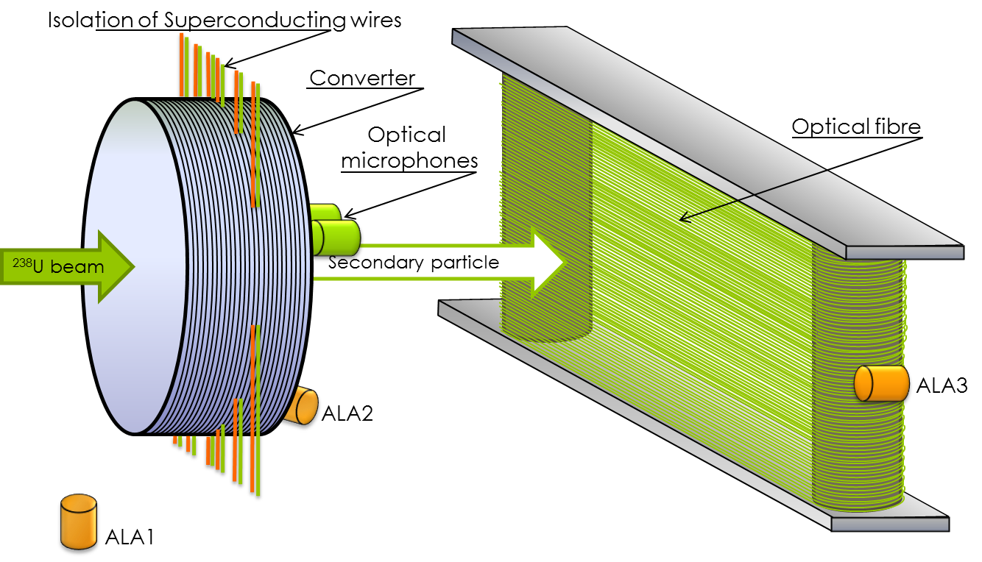
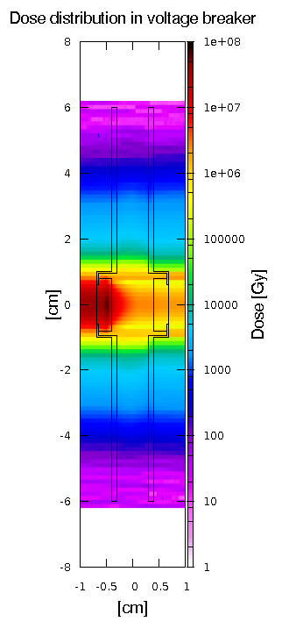
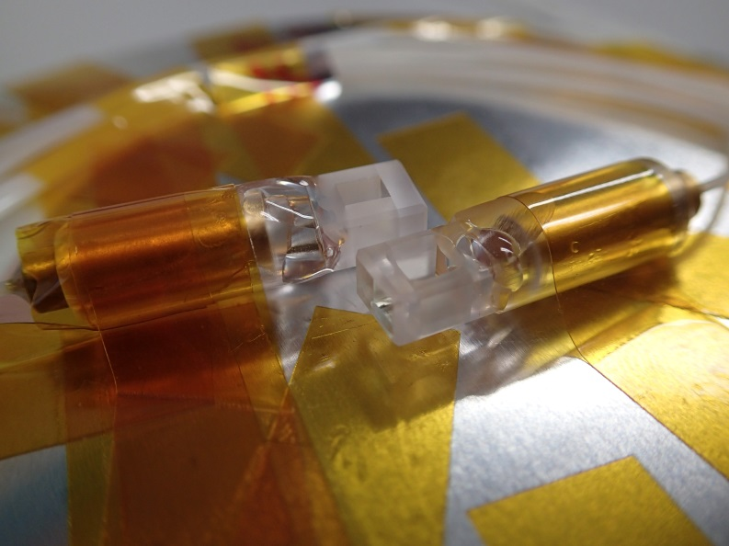
COLABORATION
. control systems
. sc magnets & testing
. material research
. voltage breakers
. optical microphones
[ 10th December 2014 | Storage Rings Meeting | Peter KATRIK | TU Darmstadt | p.katrik@gsi.de ]

Slide 56
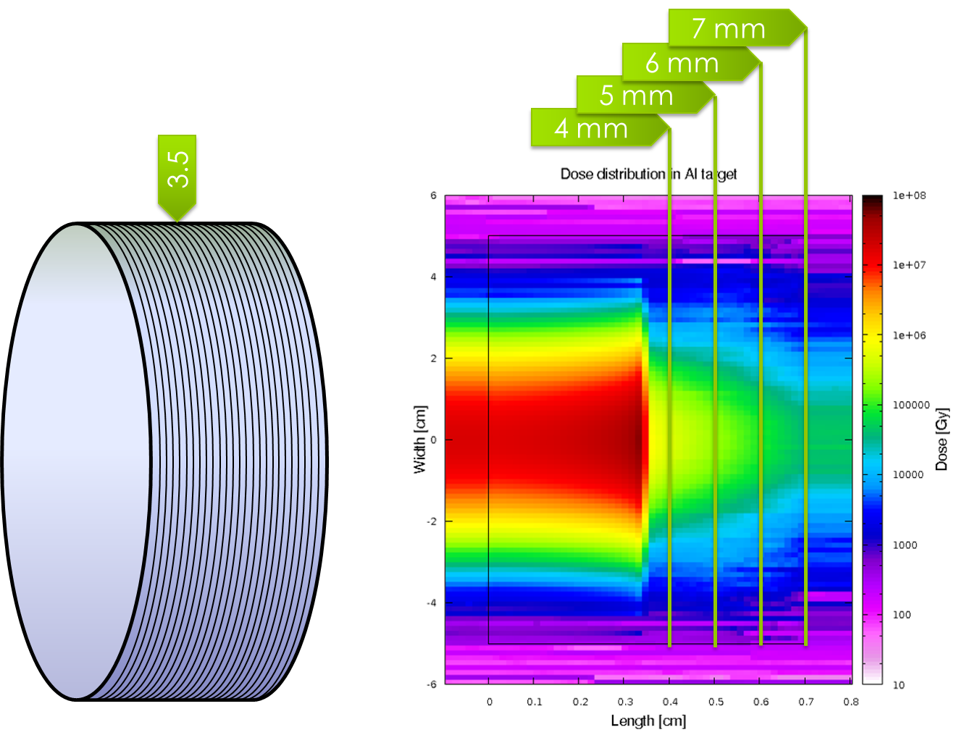
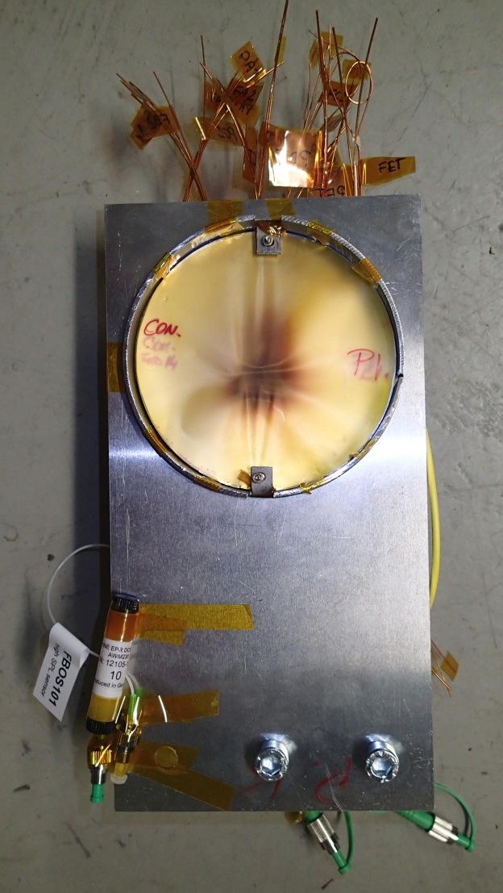
Dose rate
RANGE AREA.
. range = 3.5mm
.elliptical beam shape
[ 10th December 2014 | Storage Rings Meeting | Peter KATRIK | TU Darmstadt | p.katrik@gsi.de ]

Slide 57
THANK
YOU
f o r y o u r
ATTENTION
[ p.katrik@gsi.de ]
[ 10th December 2014 | Storage Rings Meeting | Peter KATRIK | TU Darmstadt | p.katrik@gsi.de ]

