Slide 1
GSI Scientific IT for FAIR
Thorsten Kollegger
11.11.2014

Slide 2
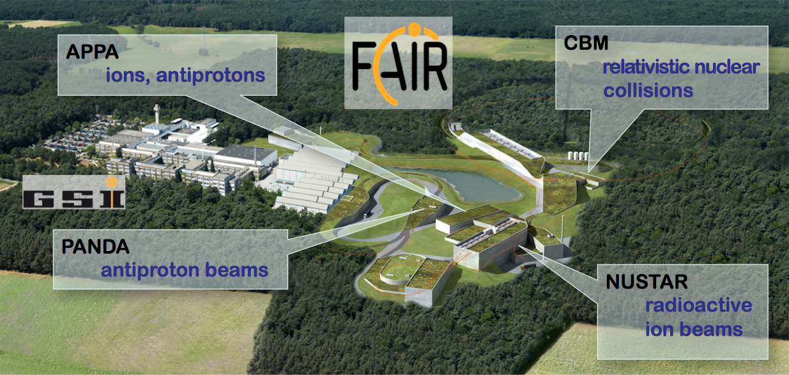
FAIR Computing
The FAIR experiments will
produce tens of PetaBytes of raw data per year,
which need to be safely and permanently stored
analyze these datasets over several years, requiring
also extensive simulations and theory calculations

Slide 3
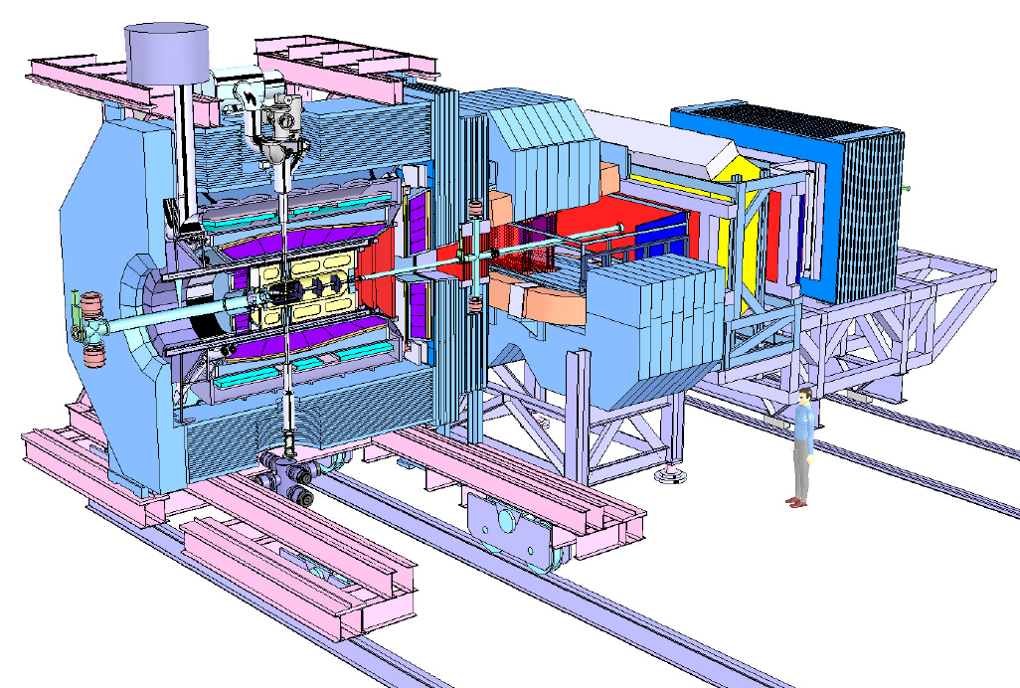
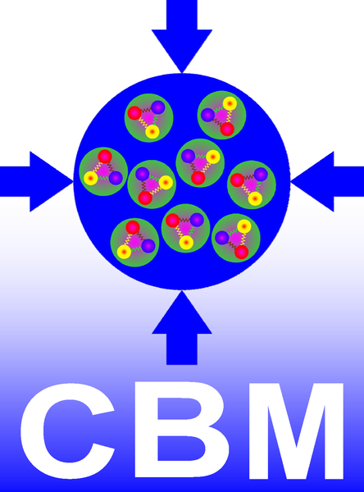

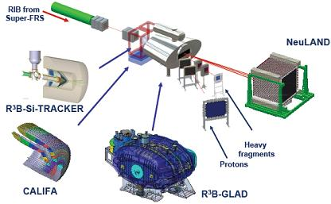
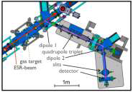

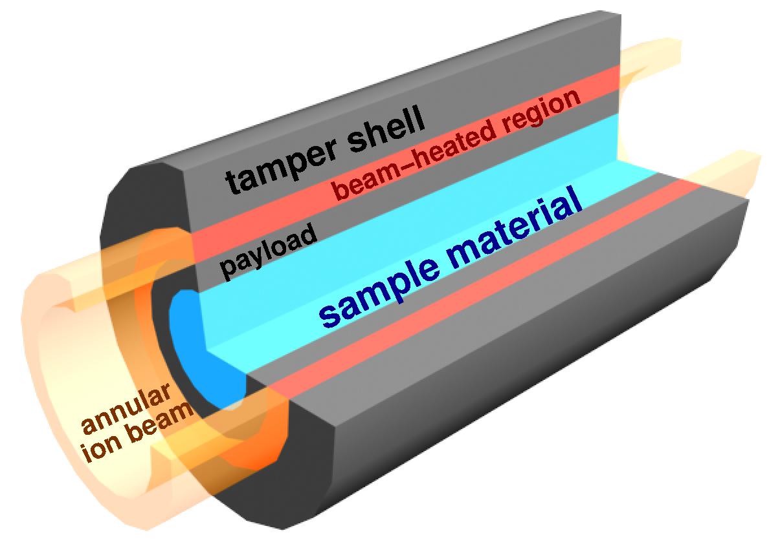
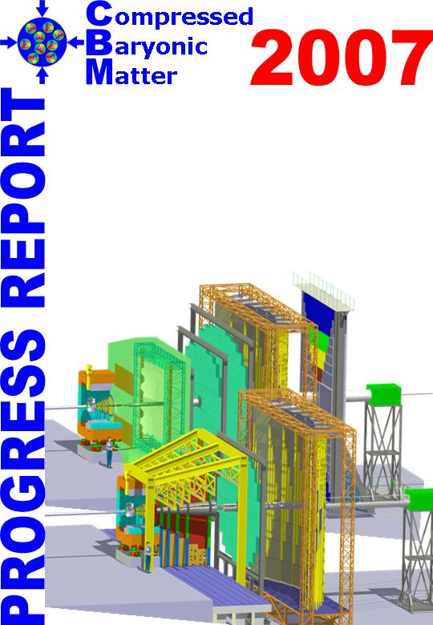
FAIR Experiments
CBM & PANDA
Large detector systems
100s of collaboration members
O(1) TByte/s from detector to computing center
NUSTAR & APPA
Many smaller, independent systems
100s of collaboration members
O(100) MByte/s from detector to computing center
APPA

Slide 4
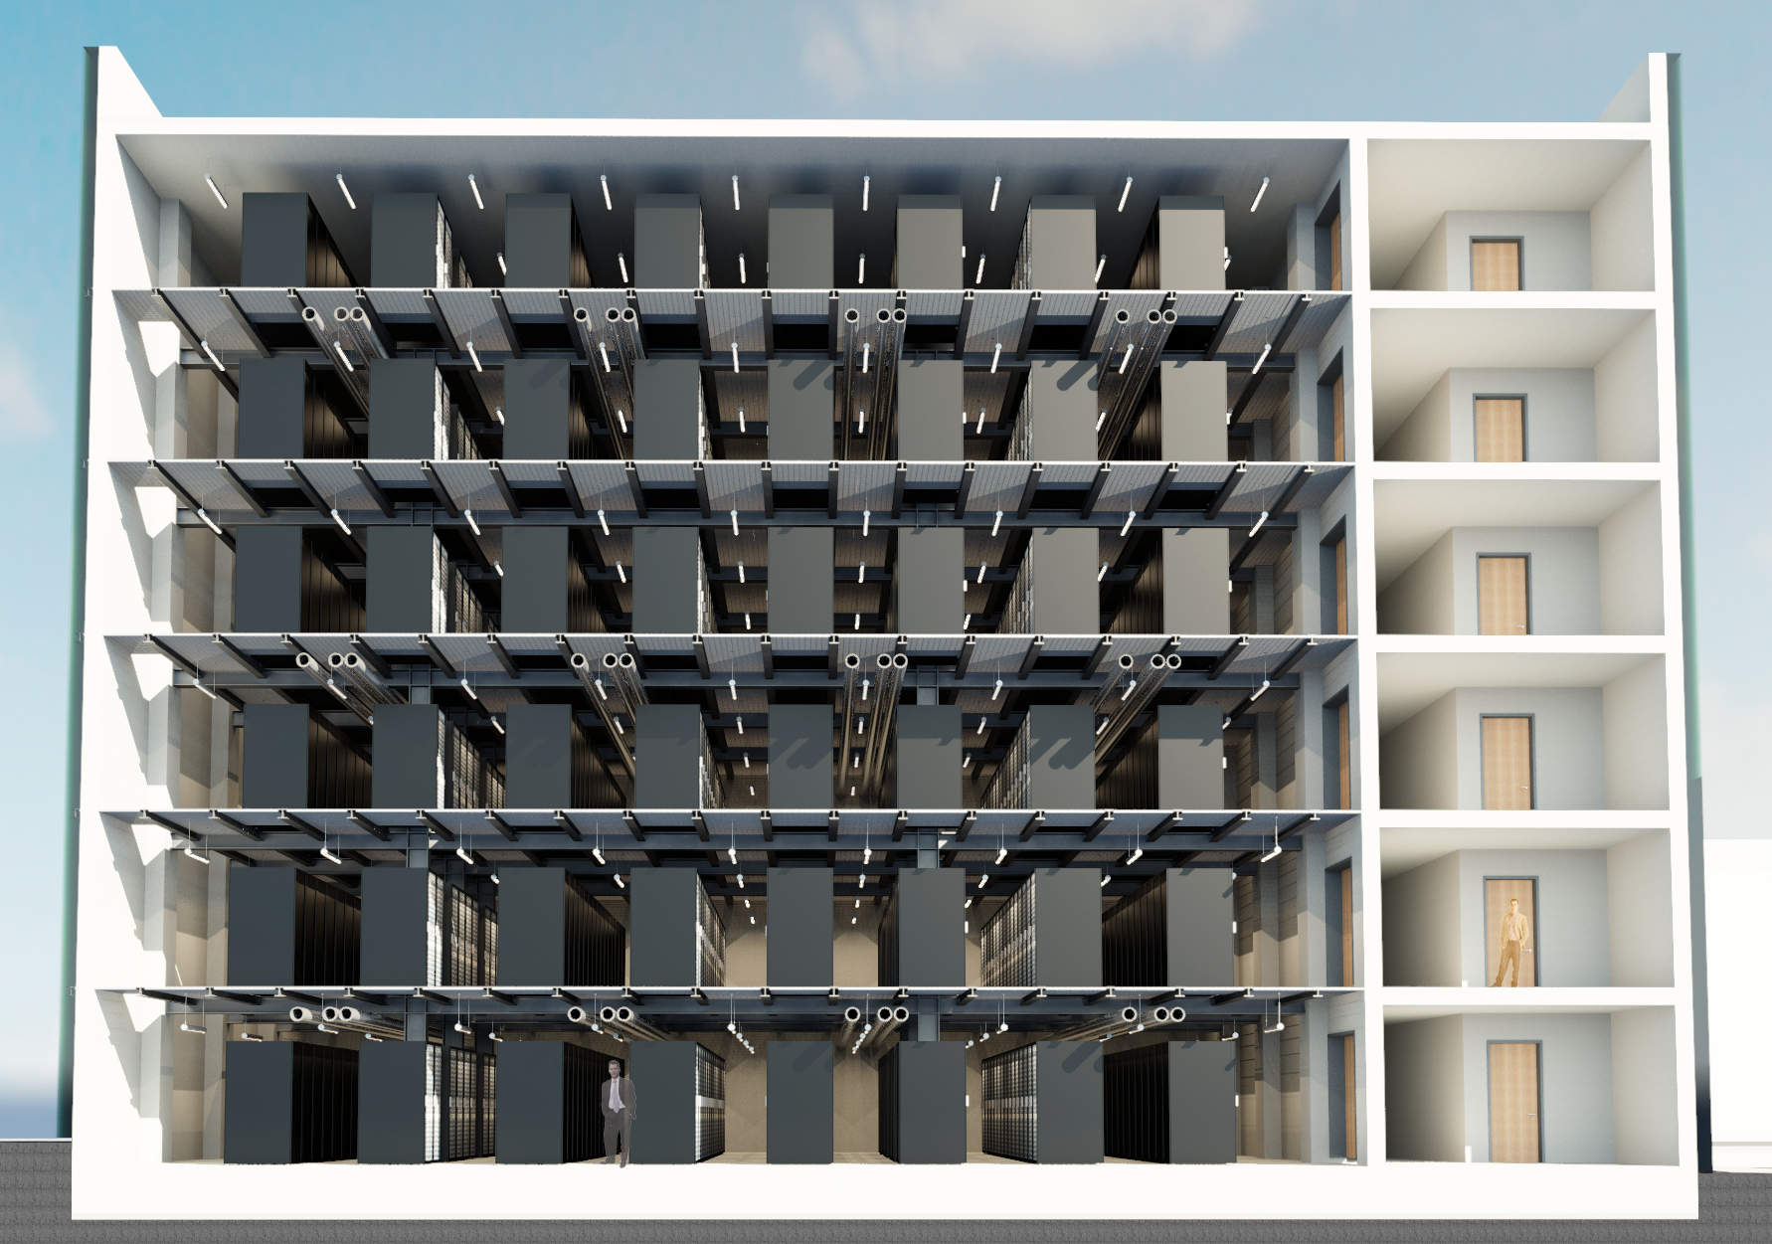



GSI Scientific IT
Support FAIR experiments by providing
the necessary common infrastructure
FAIR Computing Center (Green IT-Cube)
FAIR Tier 0@GSI
  High-Performance Storage System
  Shared Compute Cluster
  Integration of HPC Systems
  of surrounding Universities
Common software packages
  Data management for
  distributed computing
  Simulation, Reconstruction
  and Analysis Framework
  Support for use of modern
  compute architectures
FairRoot

Slide 5
GSI Scientific IT
Scientific IT has 2 departments
High Performance Computing
  FAIR/GSI campus specific
  implementations, e.g. Data Center
Experiment Systems
  software frameworks and
  development tools for the
  FAIR experiments,
  interfaces from T0 to the
  international partners

Slide 6
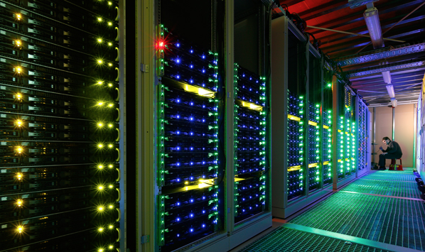
FAIR Data Center
A common data center
for FAIR (Green-IT Cube)
Low Cap.-Exp.
Lop Op.-Exp. (PUE <1.07)
6 floors
Space for 768 19” racks (2,2m)
Max cooling power 12 MW
4 MW cooling (baseline)
Fully redundant (N+1)
MiniCube Prototype

Slide 7
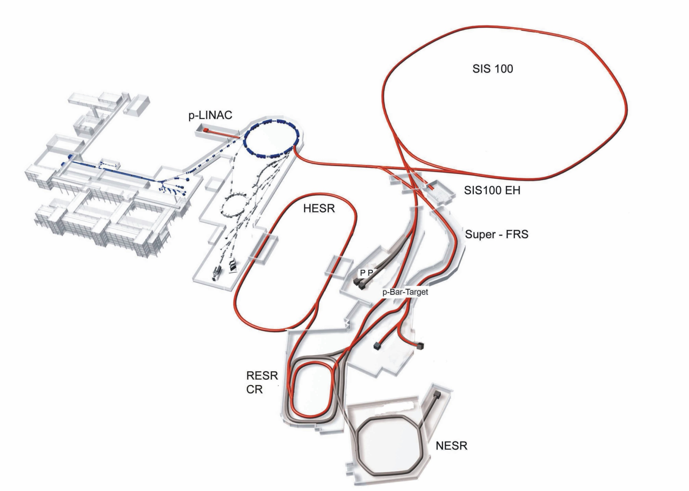
FAIR Data Center
Construction has
started
Currently
infrastructure
preparation
Completion foreseen
for end of Q3/2015
Scientific IT systems
will move to the
Green IT-Cube
CBM/HADES
APPA
PANDA
NuSTAR

Slide 8








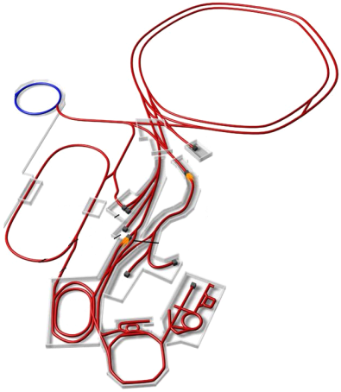
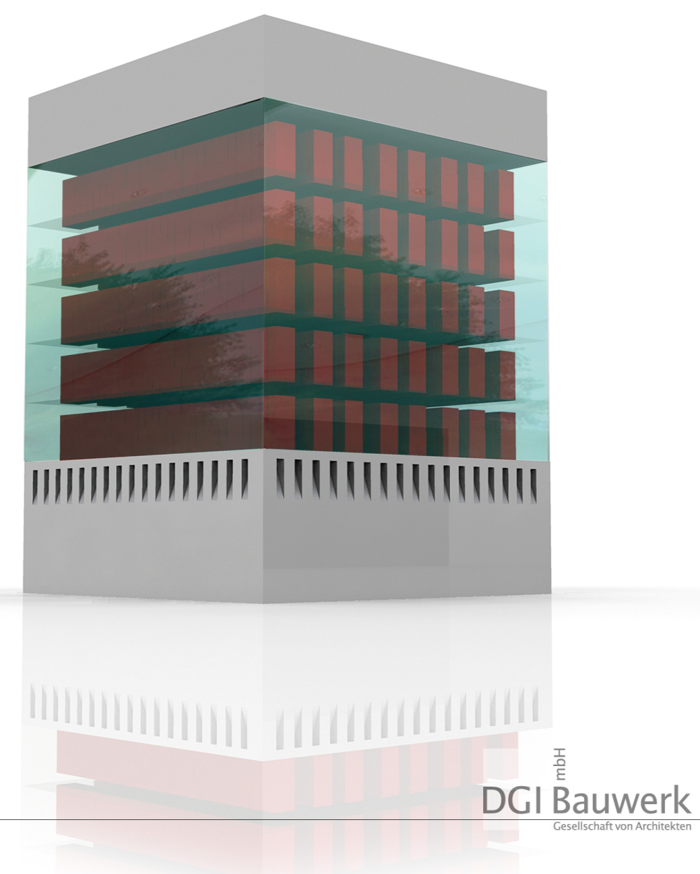











FAIR Computing Concept 2009
Estimated total for full FAIR
FAIR Tier 0
300.000 CPU-cores
35 PByte/year Online-Storage (HDD)
30 Pbyte/year Permanent-Storage (Tape)
Comparable resources in FAIR
partner countries
Key Points
Few big, highly efficient
data centers
Further partner connected
via regional federations

Slide 9
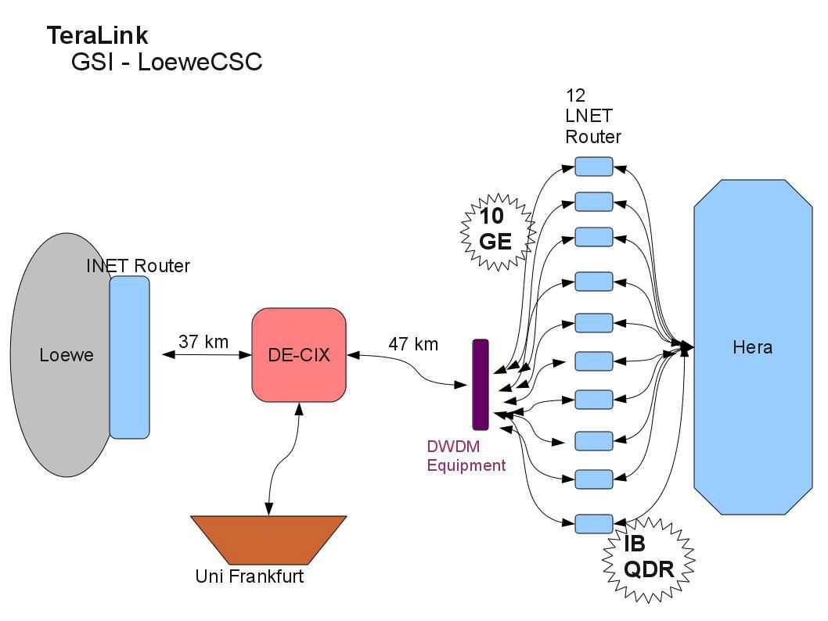
TeraLink
Building HPC router cluster (LNET) for the TeraLink 12 x 10 Gbit Ethernet => lustre IB loadbalancing
●
120Gbit => lustre

Slide 10
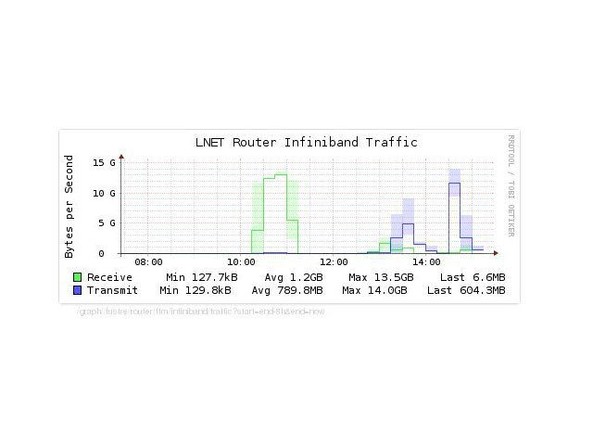
TeraLink
…. and it really worked :-)
lustre clients at Gauss Supercomputer Frankfurt Hera lustre cluster at GSI
Reading: 13.5 GB/s
Writing: 14GB/s

Slide 11
FairRoot
FairRoot
Common Software Framework for Simulation,
Reconstruction and Analysis for the FAIR Experiments

Slide 12
FairRoot

Slide 13
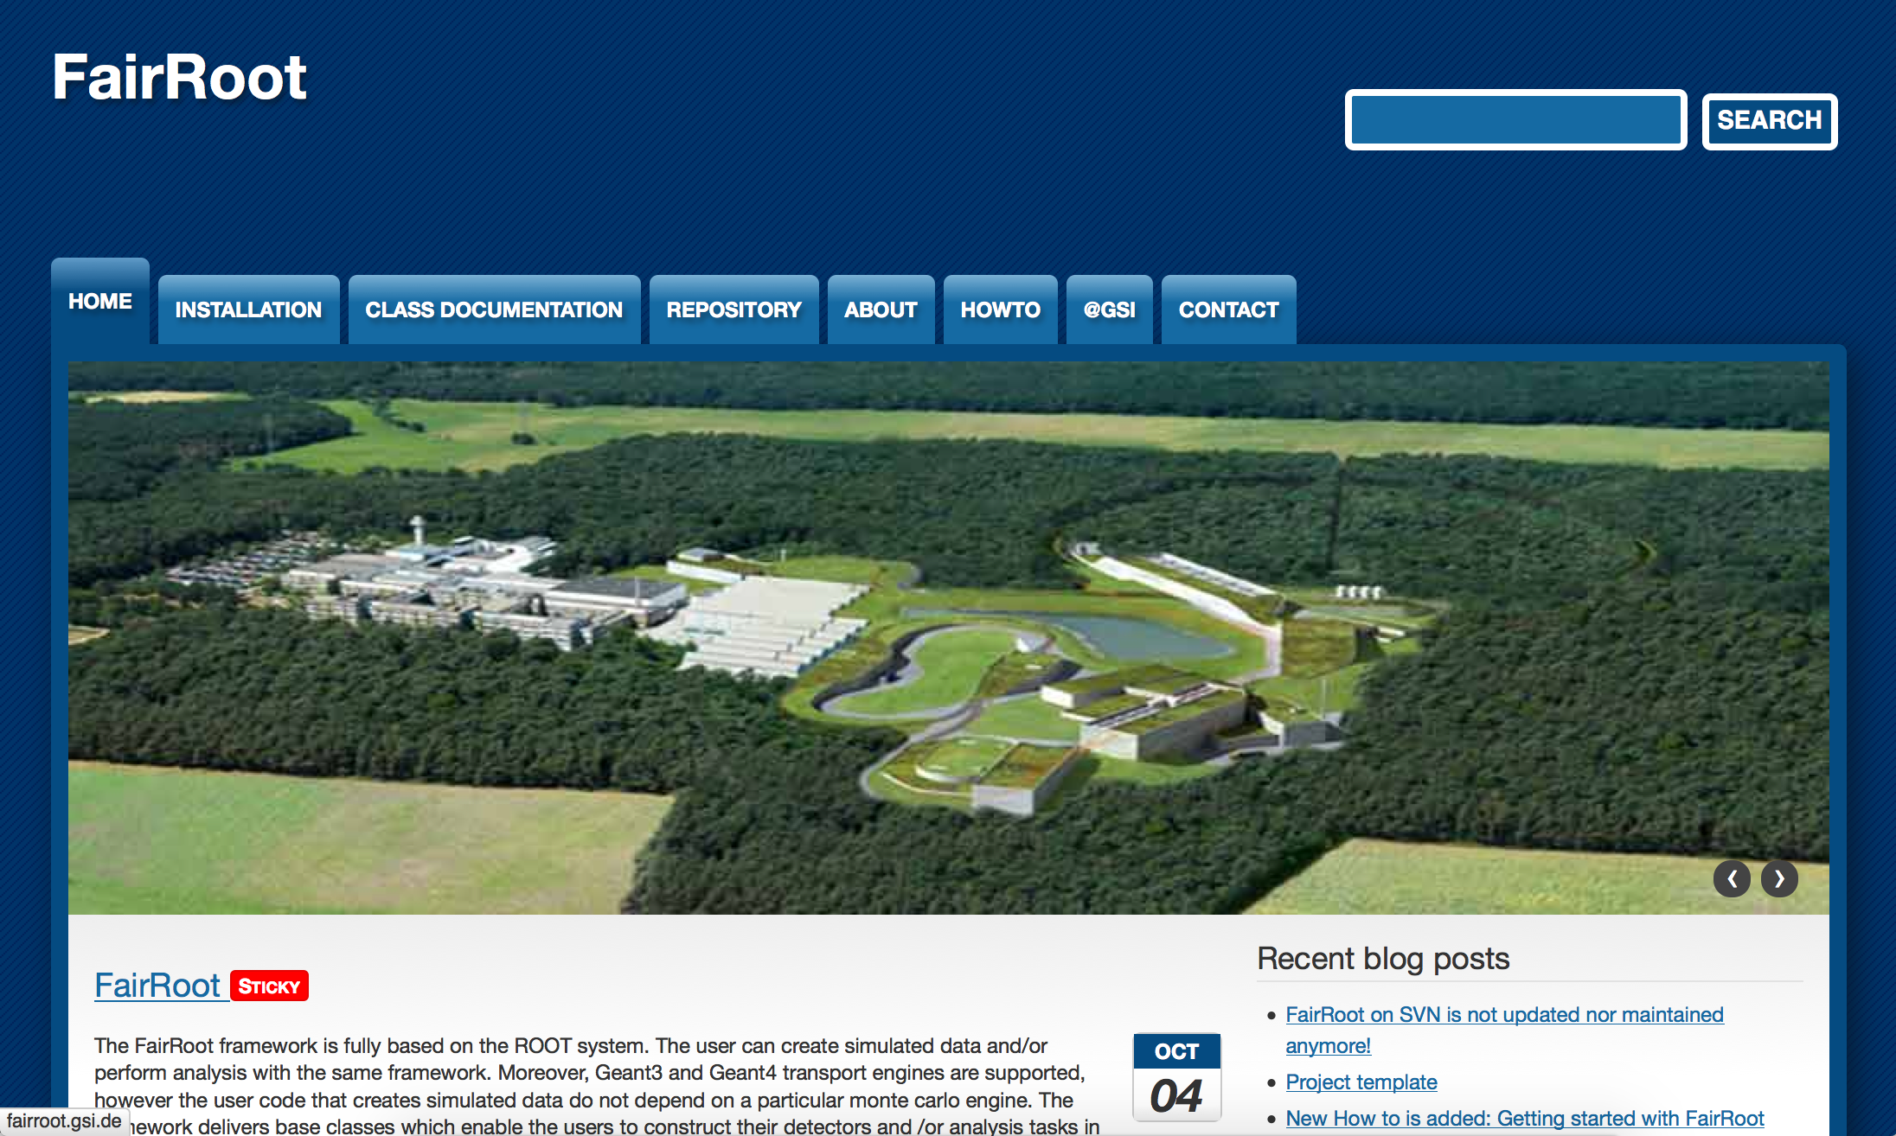
New Developments in 2014
Changed license to LGPLv3
Switched to git
as revision control system
Hosted on github
https://github.com/FairRootGroup/FairRoot
Modularized Framework
A new development partner…
http://fairroot.gsi.de/

Slide 14
FairRoot

Slide 15
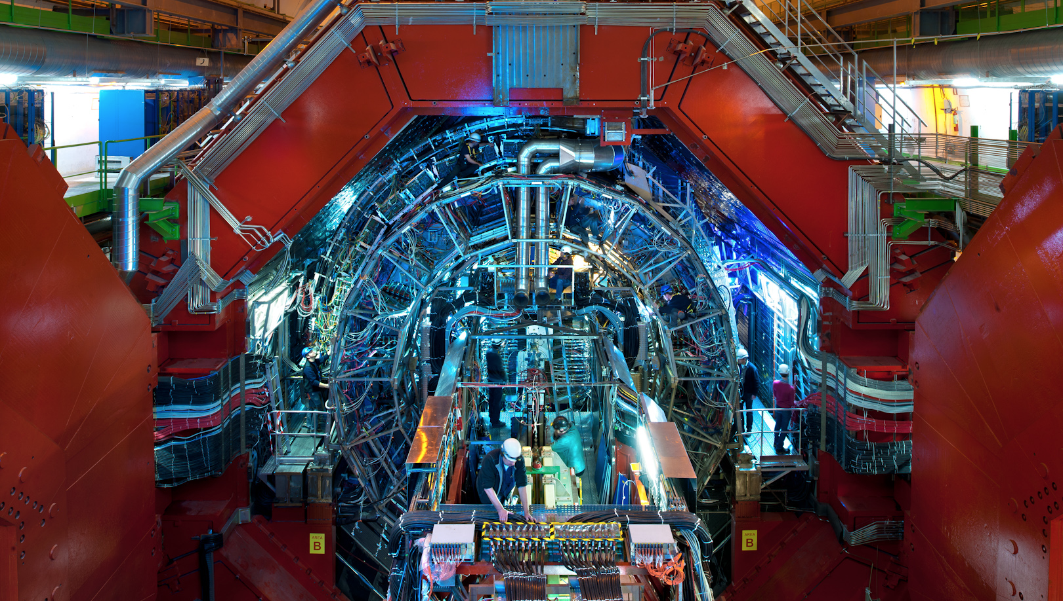
A new partner: ALICE
One of the four large LHC experiments
Upgrade planned for LS2 (2019)

Slide 16
ALICE Upgrade Requirements
Focus of ALICE upgrade on physics probes requiring high statistics: sample 10 nb⁻¹
Online System Requirements
Sample full 50kHz Pb-Pb interaction rate
(current limit at ~500Hz, factor 100 increase)
⇨ ~1.1 TByte/s detector readout
However:
storage bandwidth limited to ~20 GByte/s
many physics probes have low S/B:
classical trigger/event filter approach not efficient
(N.B. trigger: selecting “interesting” events)

Slide 17

ALICE Upgrade Strategy
~1.1 TByte/s detector readout
However:
storage bandwidth limited to ~20 GByte/s
many physics probes have low S/B:
classical trigger/event filter approach not efficient
Store only reconstruction results, discard raw data
Data reduction by (partial) online
reconstruction and compression
⇨ Implies much tighter coupling between
online and offline reconstruction software

Slide 18
ALICE O² System from the Letter of Intent
~ 2500
DDL3s
10 Gb/s
2x10
or 40
Gb/s
10 or
40
Gb/s
ITS
FLP
Farm
Network
Storage
Network
RORC3
EPN
TPC
FLP
RORC3
TRD
FLP
RORC3
Data
Storage
EPN
EMCal
FLP
RORC3
L0
PHOS
FLP
Data
Storage
RORC3
EPN
TOF
FLP
RORC3
Muon
FLP
RORC3
L0
L1
EPN
FTP
FLP
RORC3
Trigger Detectors
~ 250 FLPs ~ 1250 EPNs

Slide 19


ALICE and FAIR: Why?
Two projects – same requirements
Massive data volume reduction (1 TByte/s input)
Data reduction by (partial) online reconstruction
Online reconstruction and event selection
Much tighter coupling between online and offline
reconstruction software
Lets work together

Slide 20
ALICE and FAIR: Why?
A common framework will be beneficial for the FAIR experiments since it will be tested with real data and existing detectors before the start of the FAIR facility.
  E.g.: Concepts for online calibrations and alignment can be tested in a real environment, similar to that of the planned FAIR experiments.
ALICE will benefit from the work already performed by the FairRoot team concerning already implemented features (e.g. the continuous read-out, building and testing system, FairMQ, ..etc)

Slide 21

ALICE and FAIR: What?
A data-flow model based framework
It will contain
  Transport layer (FairMQ)
  Configuration tools
  Management (DDS) and monitoring tools
Provide unified access to configuration parameters and databases.
It will include support for a heterogeneous and distributed computing system.
Incorporate common data processing components

Slide 22
FairRoot and ALFA

Slide 23
FairMQ
Key requirements: reliability, performance, ease-of-use
Multi-process concept with message queues
for data exchange
Each "Task" is a separate process, which can be also
multithreaded, and the data exchange between the different
tasks is done via messages.
Different topologies of tasks that can be adapted to the
problem itself and the hardware capabilities.
Each process assumes limited communication and reliance
on other processes
  Easier to scale horizontally through instantiating
  new processing instances (devices)

Slide 24
FairMQ
sampler
processor
sink
Push
Push
sampler
processor
Proxy
Proxy
sink
sampler
processor
sink
sampler
processor
Ethernet
Infiniband
Multi-process concept with message queues
for data exchange

Slide 25


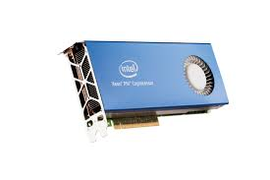

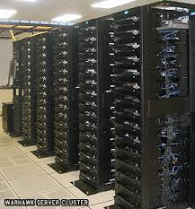
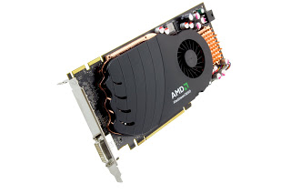
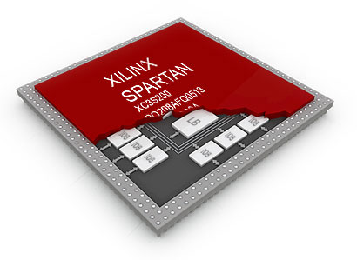
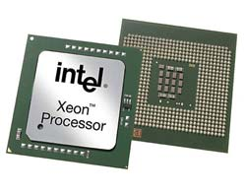
FairMQ Transport Library: ØMQ
BSD sockets API
Bindings for 30+ languages
Lockless and Fast
Automatic re-connection
Multiplexed I/O

Slide 26
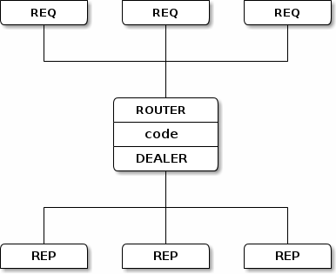
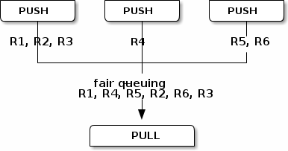
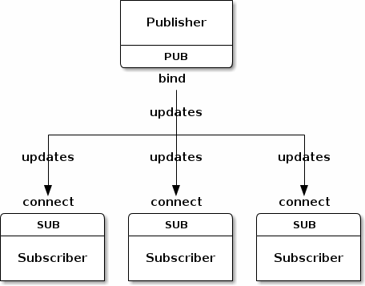
ØMQ Connection Patterns
Request-reply, which connects a set of clients to a set of services.
Publish-subscribe, which connects a set of publishers to a set of subscribers.
Pipeline, which connects nodes in a fan-out / fan-in pattern that can have multiple steps, and loops.
Exclusive pair, which connect two sockets exclusively

Slide 27

Alternative Transport: nanomsg
Pluggable Transports:
  ZeroMQ has no formal API for adding new transports (Infiniband, WebSeockets, etc). nanomsg defines such API, which simplifies implementation of new transports.
Zero-Copy:
  Better zero-copy support with RDMA and shared memory, which will improve transfer rates for larger data for inter-process communication.
Simpler interface:
  simplifies some zeromq concepts and API, for example, it no longer needs Context class.
Numerous other improvements, described here: http://nanomsg.org/documentation-zeromq.html

Slide 28

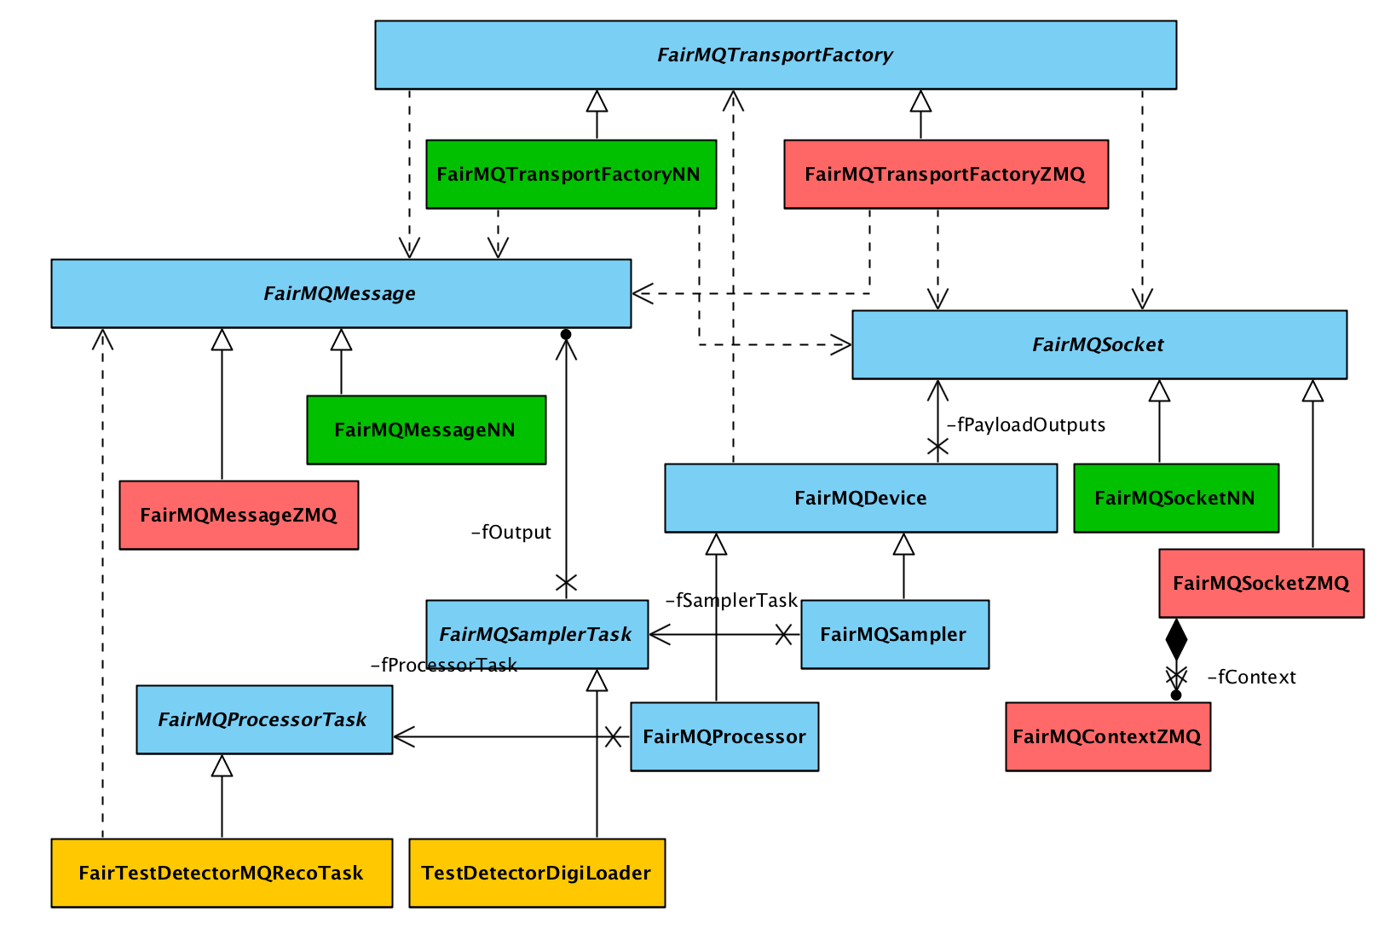
FairMQ Abstract Transport Layer
FairRoot is independent from the transport library
  Modular/Pluggable/Switchable transport libraries.

Slide 29
Tests on the GSI test cluster
IP over IB
EPN
lxb1193
FLP
EPN
lxb1196
lxb1194
EPN
lxb1197
Push-Pull pattern
Message size= 10 Mbyte

Slide 30
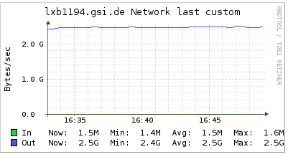
FLP Network load
IP over IB

Slide 31
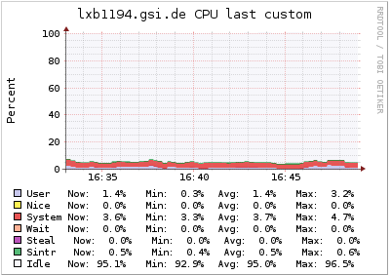
FLP CPU load
IP over IB

Slide 32
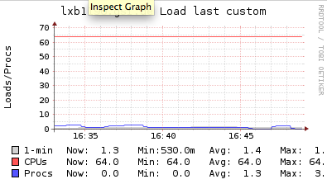
EPN CPU load
IP over IB

Slide 33
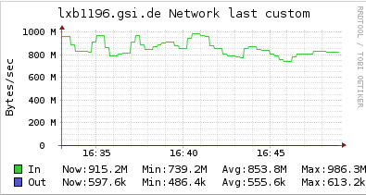
EPN Network load
IP over IB

Slide 34
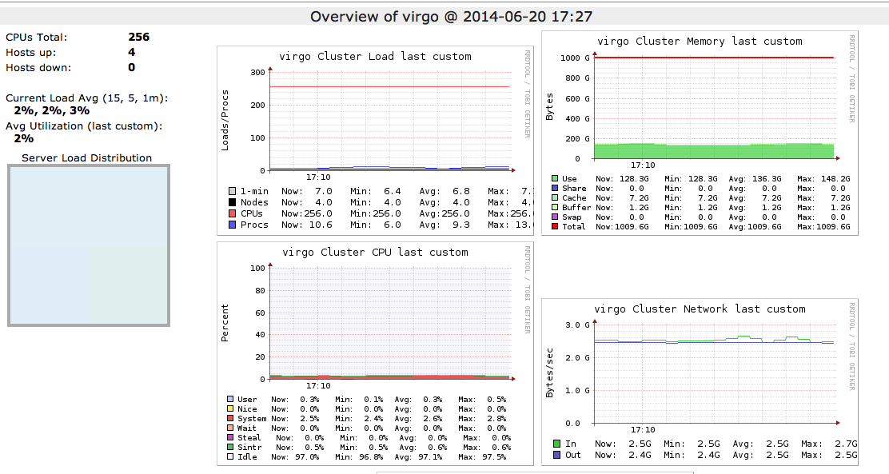
Cluster load
IP over IB

Slide 35
Running the Zero MQ performance test on the DAQ test cluster

Slide 36
Data Serialization Formats
Serialization is the process of translating data structures or object state into a format that can be stored (for example, in a file or memory buffer, or transmitted across a network connection link) and reconstructed later in the same or another computer environment
Important for FairMQ data transfer via Network between possibly different platforms
Options implemented
Google Protocol buffers
Boost serialization
ROOT serialization
Binary serialization

Slide 37
Data Serialization Formats
Boost:
  we are generic in the tasks but intrusive in the data classes (digi, hit, timestamp)
Manual and Protobuf
  we are generic in the class but intrusive in the tasks (need to fill/access payloads from class with set/get x, y, z etc ).
Manual method is still the fastest, protobuf is 20% slower and boost is 30% slower. Root the slowest.
preliminary

Slide 38
Deployment of FairMQ
Processing topologies/graphs can become complex
ALICE HLT: 10k devices
How to distribute/manage them?
Independent of RMS species (Resource Management system) – even run without (ssh)
Support different topologies and process dependencies
Answer: Dynamic Distribution System (DDS)
An independent set of utilities and interfaces, which provide a dynamic distribution of different user processes by any given topology on any RMS

Slide 39
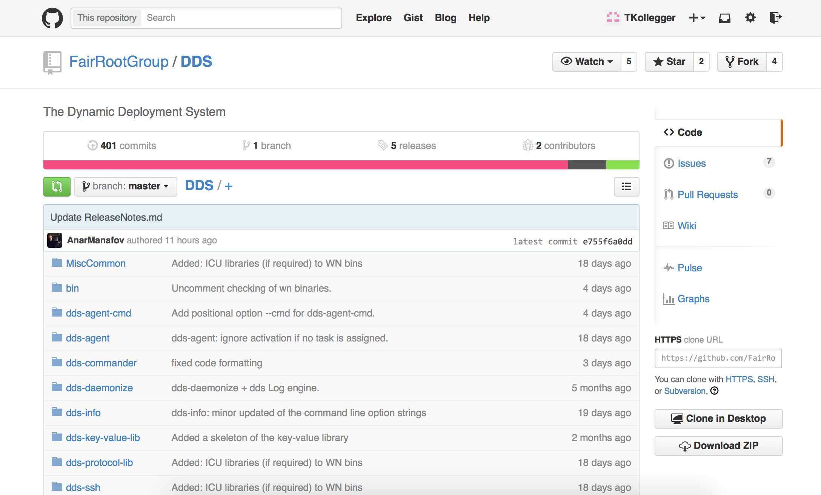
Dynamic Distribution System (DDS)
Deployment and management of tasks/processes
Use any RMS (Slurm, Grid Engine, … )
Secure execution of nodes (watchdog)
Support different topologies and task dependencies
Support a central log engine
https://github.com/FairRootGroup/DDS

Slide 40
DDS Topology Elements
Task
A task is a single entity of the system.
A task can be an executable or a script.
A task is defined by a user with a set of props and rules.
Each task will have a dedicated DDS watchdog process
Collection
A set of tasks that have to be executed
on the same physical computing node
Group
A container for tasks and collections
Only main group can contain other groups
Only group define multiplication factor for all its daughter elements

Slide 41
Summary
GSI Scientific IT is providing some of the major building blocks for FAIR computing
Tier 0 Data Center Infrastructure (Green Cube)
Interfaces to neighboring HPC centers and
international partners
Common software framework for FAIR experiments
Help with optimization for modern computing architectures
…all this in close collaboration with the FAIR experiments and national and international partners

