Slide 1
The PANDA Experiment
| Tobias Stockmanns

Slide 2
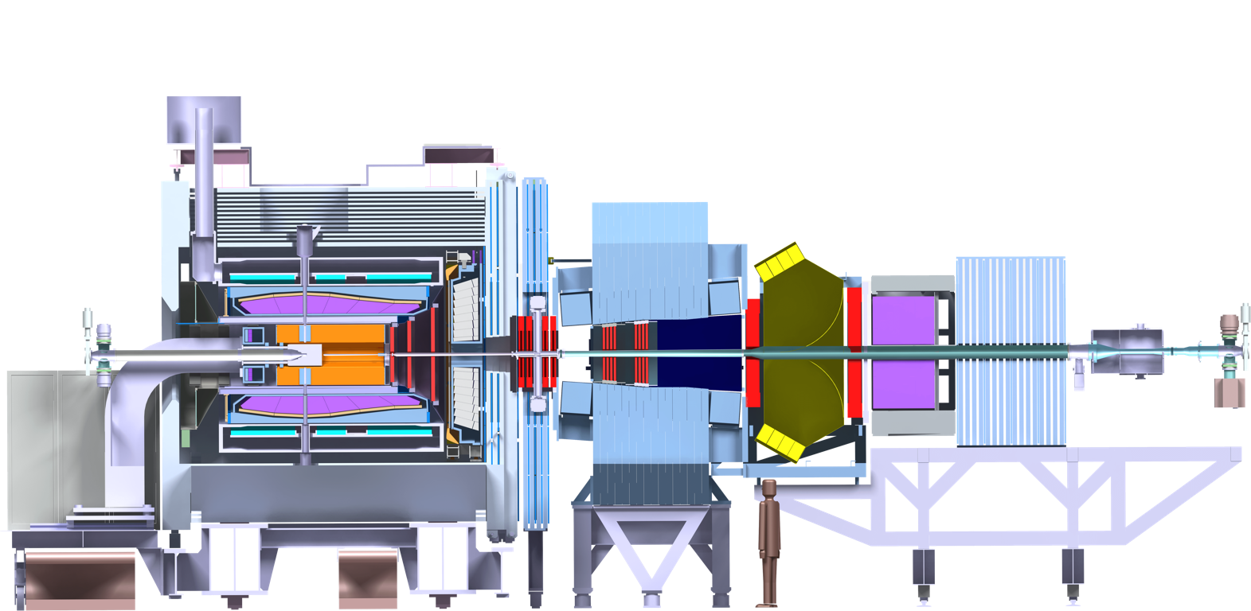
PANDA Detector
p
p
13 m

Slide 3
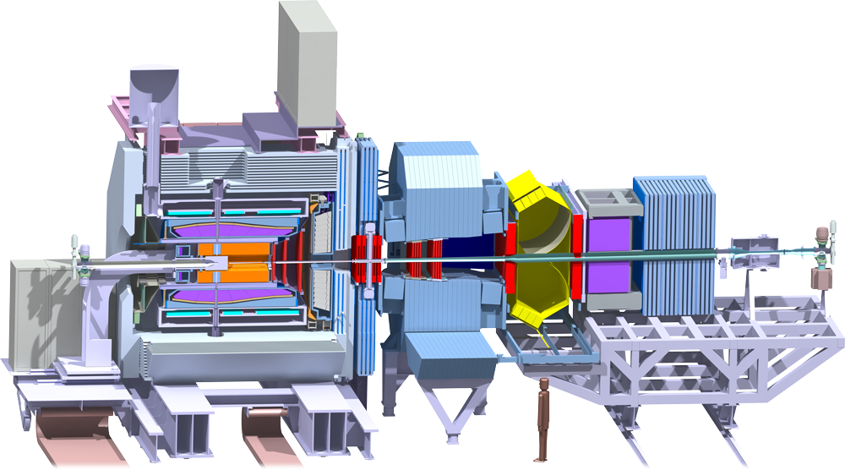


PANDA — Event Reconstruction
Continuous read out
  Novel feature
  Background & signal similar
  No hardware trigger based on few sub-detectors,
  but online event reconstruction using full detector information
Rate
Event:
2 × 10⁷/s
Raw data:
200 GB/s
Reduction
Amount:
~1/1000
Time:
50 ns/evt
(Reject background events, save interesting events)
Mitglied der Helmholtz-Gemeinschaft
Storage space for
offline analysis
3 PB/y

Slide 4
Event Selection
Selection criteria used in the Physics Report Analyses
Channel | TRK | NEUT | Excl. | mult | PID | p | E | ang. | inv M | dist cut | veto | 4C | Vtx C | Mass C | Sig Eff[%]
J/psi pi+ pi- | 4 | 0 | x |  | e, pi |  |  |  | x |  |  |  | J/psi pi+ pi- |  | 30
J/psi pi0 pi0 | 2 | 4 | x |  | e |  | g |  | x |  | J/psi eta pi0 | x | J/psi |  | 17
chi_c1,2 gam | 2 | 2 | x |  | e |  | g |  | x |  |  | x | J/psi |  | 30
J/psi gam | 2 | 1 | x |  | e |  |  |  | x |  |  | x | J/psi |  | 40
J/psi eta | 2 | 2 | x |  | e |  |  |  | x |  |  | x | J/psi |  | 40
h_c -> 3gam | 0 | 3 | x | 3n |  |  | g | h_c | x |  |  | x |  |  | 8
h_c -> 2phi gam | 4 | 1 | x |  | K |  | g |  | x |  | pi0 | x |  |  | 8
D+ D- | 6 | 0 | x |  | ? | D |  |  | x | z(D) |  | x | D+- |  | 8
D*+ D*- | 6 | 0 | x |  | ? | D* |  |  | x | z(D*) |  | x | D0 | D0 | 14
eta_c1 eta | 2 | 7 | x |  | e |  |  |  | x |  |  | x |  | chi, pi0, eta | 7
eta_c1 eta | 4 | 8 | x |  | K, pi |  |  |  | x |  | >1 comb/ev | x | K pi | D0, D0*, eta, pi0 | 5
J/psi omega | 4 | 2 | x |  | e, pi |  |  |  | x |  |  | x | J/psi pi+pi- | J/psi, pi0 | 15
f2(2230) -> 2phi | 4 | 0 | x |  | K |  |  |  | x |  |  | x | phi |  | 20
Ds Ds(2317) | 3 | 0 |  |  | K, pi |  |  | K | x |  |  |  | Ds, phi |  | 20
Xi- Xi+ pi0 | 6 | 2 | x |  | p, pi |  | g |  | x | d(IP-Xi) | >1 comb/ev | x | Lam,Xi+- | Xi Xi pi0 | 16
Lam Lam | 6 | 0 | x |  | p, pi |  |  |  | x | d(IP-Xi) |  |  | Lam |  | 11 ... 23
Xi- Xi+ | 6 | 0 | x |  | p, pi |  |  |  | x |  |  |  | Lam, Lam pi |  | 19
no
multiplicity cuts
PID!
few kinematic cuts
(except mass)
a lot of fitting!
March 8, 2012
K.Götzen

Slide 5
Selection Criteria
Physics Book criteria:
J/psi ( base for many charmonia)
  Invariant Mass: Tracking/Momentum
  Electron ID: Tracking, cluster energy, track/cluster match
  Muon ID: Tracking, Muon detector information
  Vertex: Tracking
D/Ds Mesons
  Pi0s: EMC clusters
  Inv. Mass: Tracking
  Kaon, Pion ID: dE/dx, DIRC info (w/ track match), ToF (track match)
  Vertex: Tracking
Baryons
  Inv. Mass: Tracking
  proton, pion ID: DIRC info (w/ track match)
  Vertex: Tracking
Full events: 4C fitting
Tracking & momentum
→ key information

Slide 6
Event structure in PANDA
Beam structure in HESR quasi-continuous over 1.6 µs then 0.4 µs gap
Mean time between events 50 ns in high luminosity mode
Distribution of events follows Poisson statistics ➔ high probability of short time between events
Time resolution of detectors very different:
  MVD: < 10 ns
  STT: < 250 ns
  GEM: < 10 ns
  SciTil: < 1 ns (but far outside > 1 m)

Slide 7
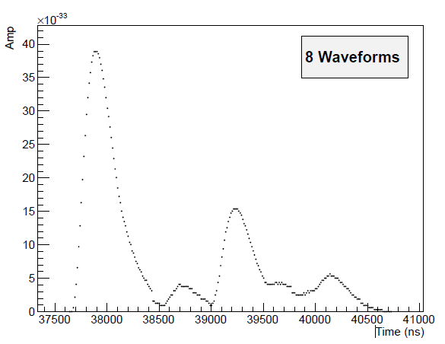
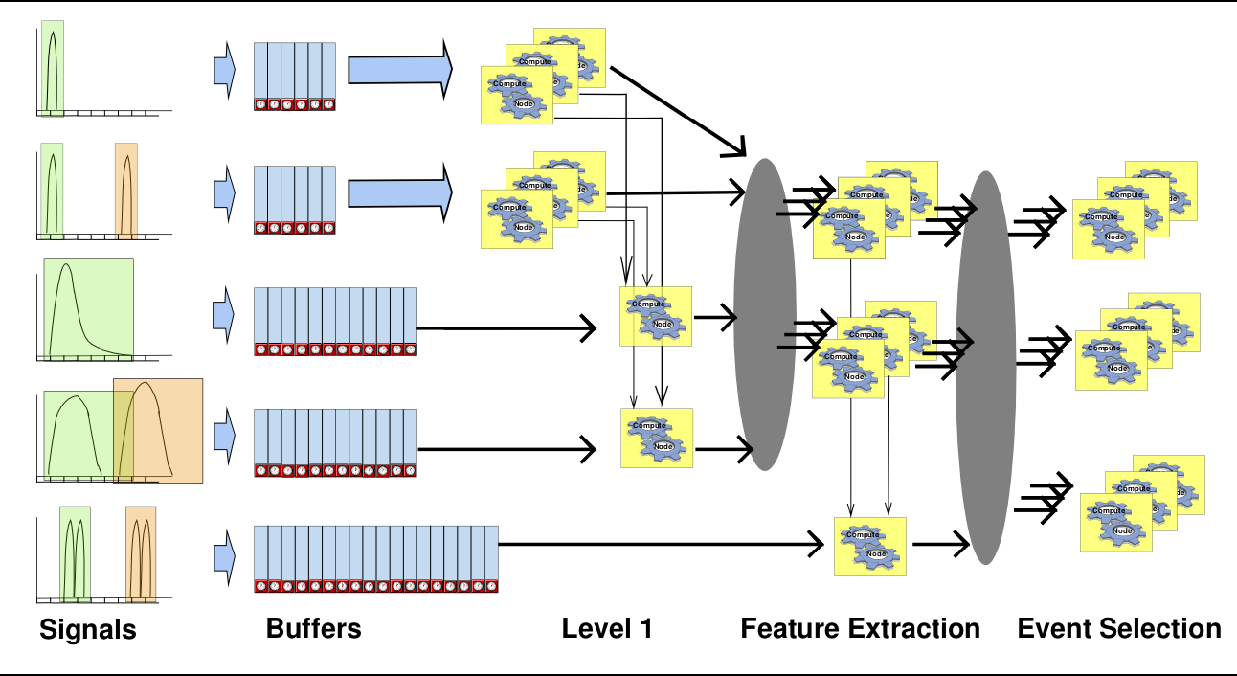
PANDA DAQ
EMC pile-up waveform
continuous sampling DAQ
flash ADC
self-triggered
detector front-end
each signal get a time stamp (160 MHz)
high quality clock distributed
front-end feature extraction
(signal amplitude, shape, …)

Slide 8
Time-based Simulation

Slide 9
Data Path
Event-Generation
Simulation
Event-based
Digitization/
Det. Data
Local Reco
Time-based
sub detector level
(clusterization, hit reco)
Global Reco
Event Building
Time-based
global level
(global tracking, PID)
Analysis
Selection
(Reco)Event-based

Slide 10
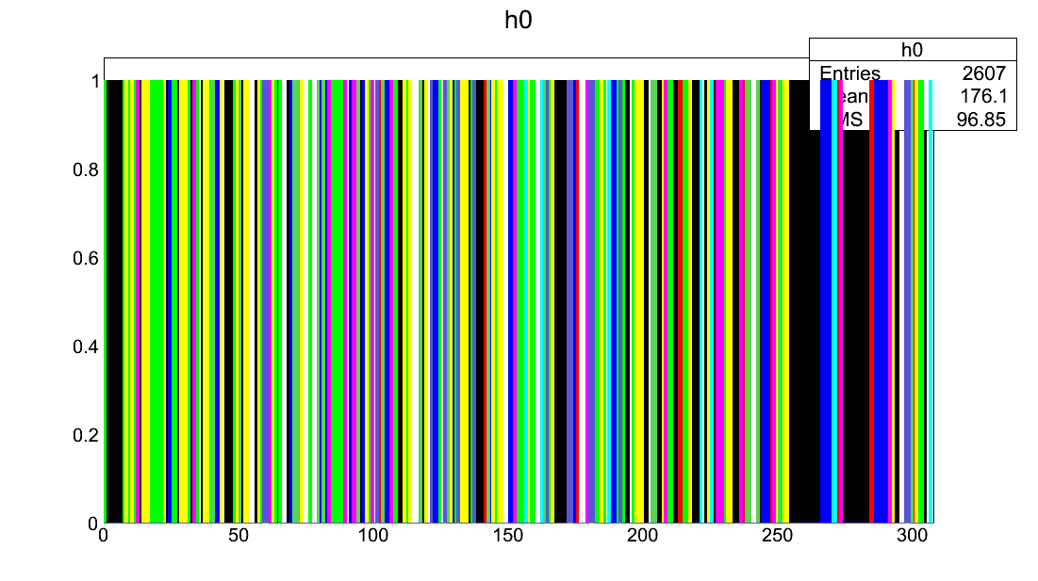
Digi Data randomized
Digi Data Stream
Same color = same event
Digi Index

Slide 11
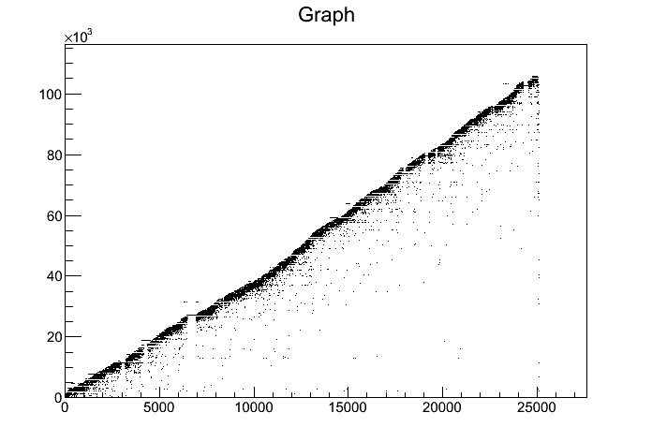
Digi Data randomized
TimeStamp of Digi vs Index
Time Stamp [ns]
Digi Index

Slide 12
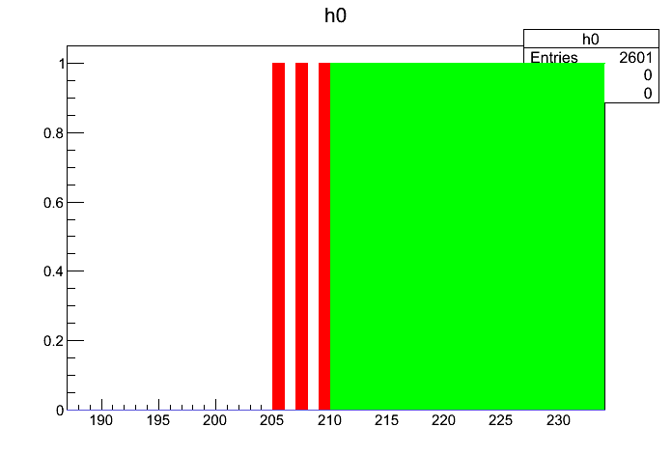
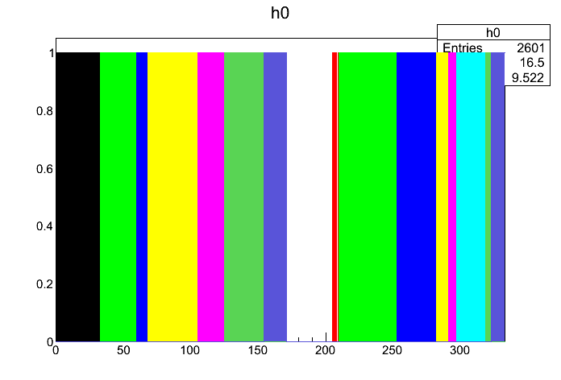
Digi Data Sorted
Digi Data Stream
Same color = same event
Digi Index

Slide 13
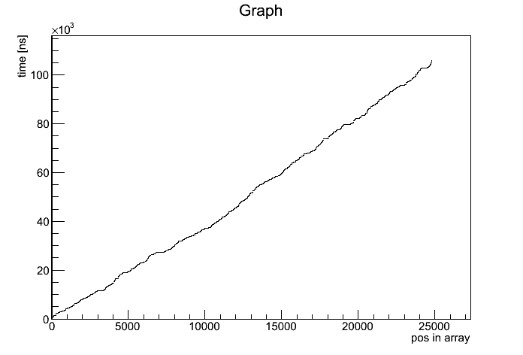
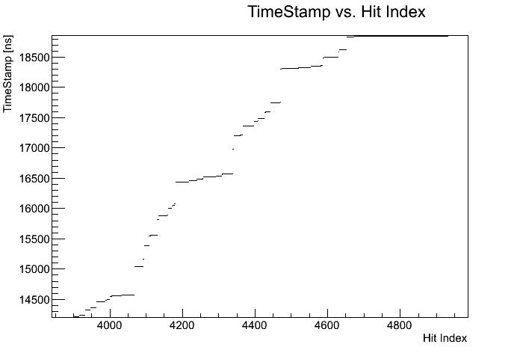
Digi Data Sorted
TimeStamp of Digi vs Index after sorting
Time Stamp [ns]
Digi Index

Slide 14
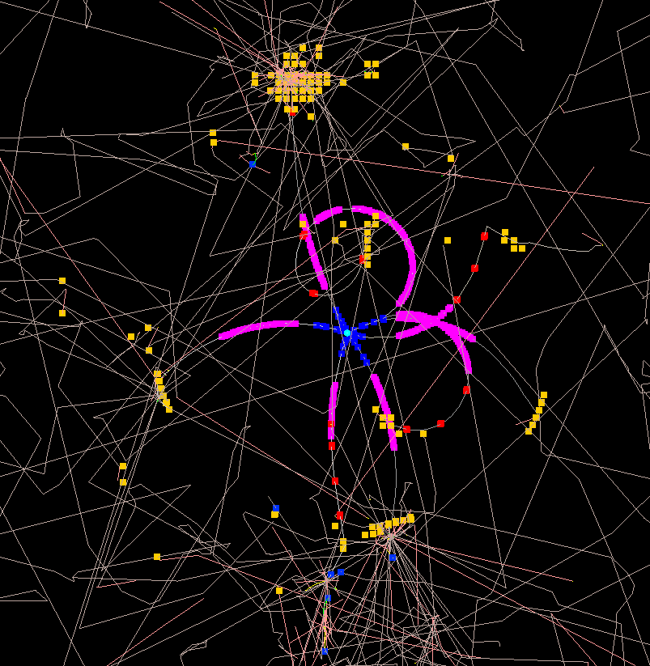
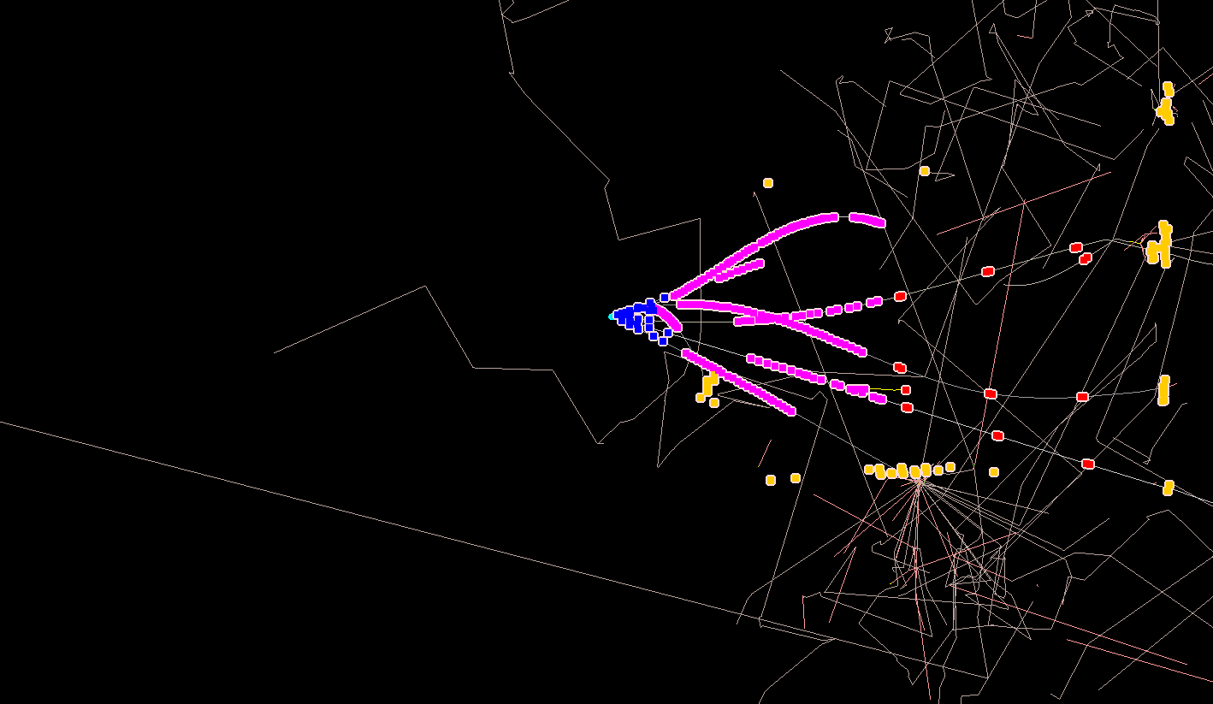
PANDA – Event Simulation

Slide 15
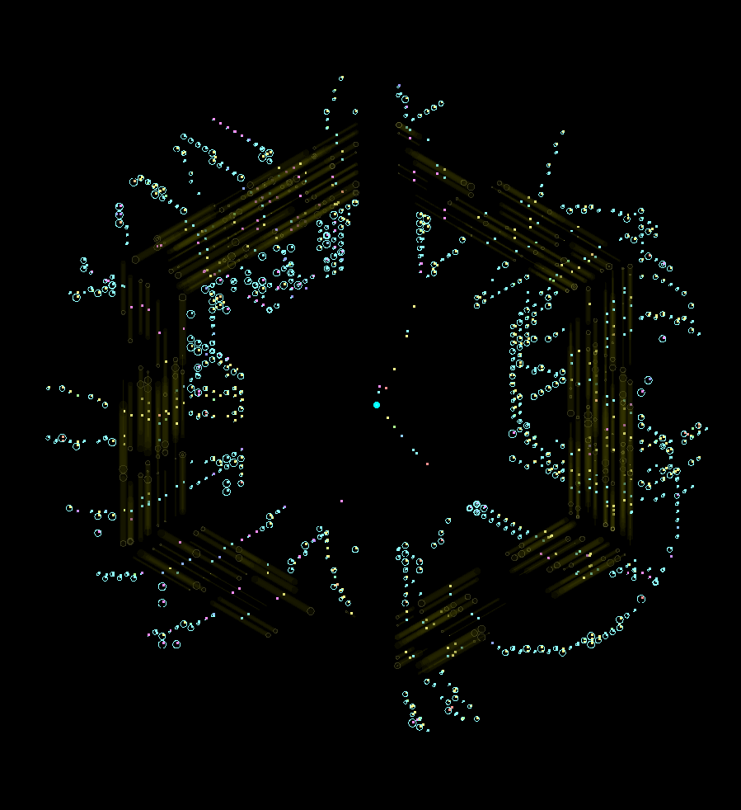
Event Display
Event selected by MVD
via time gap
STT hits matching to MVD time

Slide 16
Time-Based Event Reconstruction

Slide 17
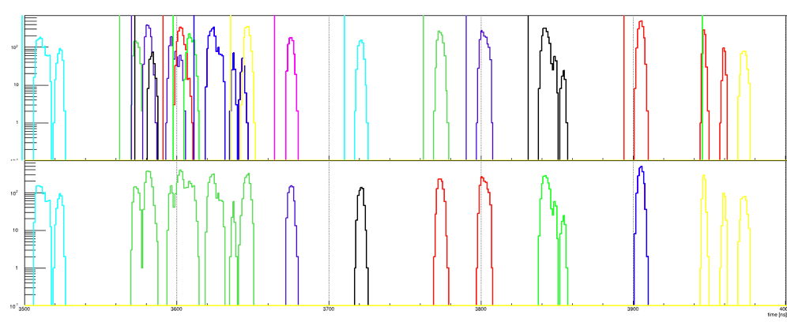
Data packaging
Select data packages according to time gaps between digi clusters
Works very well for detectors with precise time measurement
Example: GEM Digis
MC Truth
Packages
R. Karabowitcz

Slide 18
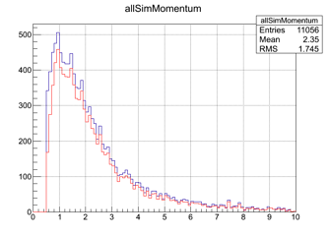
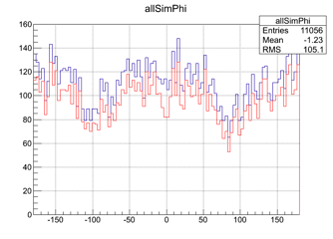
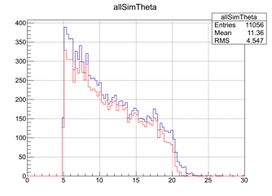
GEM Tracking Efficiency
87% for primaries with |p|>1GeV/c,
compared to ~95% in event-based reconstruction
R. Karabowitcz

Slide 19
GEM Event Building
Use the tracks’ start-time
• Tracks with start-time closer than 3 ns end up in one event (3ns come from the tracks start-times correlation), with event time set to a mean of constituent tracks’ start times
• Even one track can form an event
• Compare reconstructed event times with MC event times, if the difference is smaller than 5 ns the MC event is considered to be reconstructed
R. Karabowicz

Slide 20
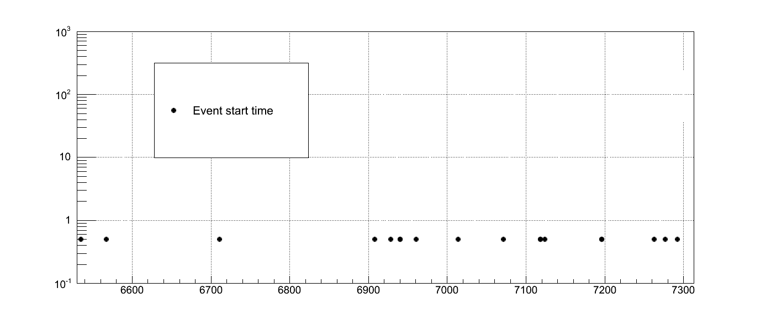
Event Builder
R. Karabowicz

Slide 21
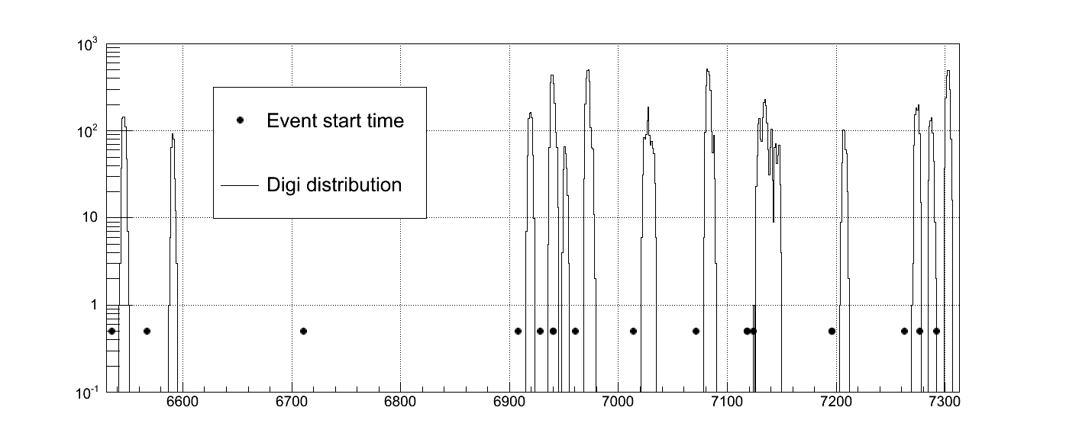
Event Builder
R. Karabowicz

Slide 22
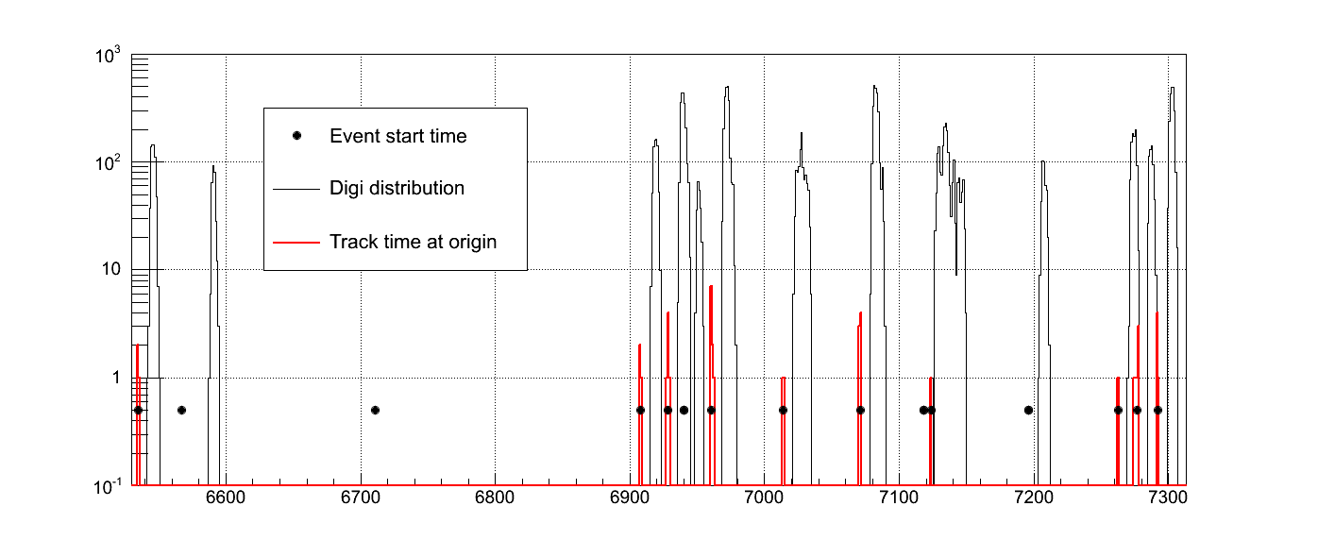
Event Builder
R. Karabowicz

Slide 23
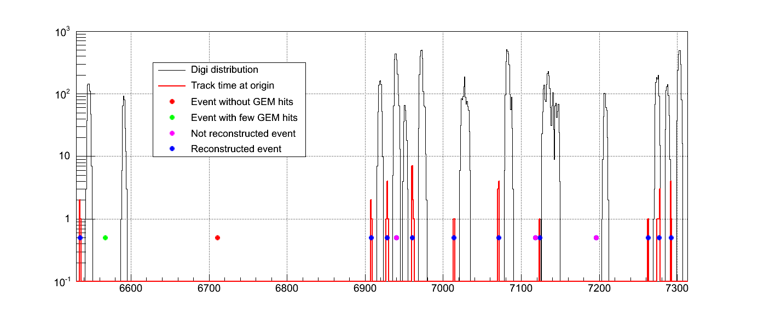
Event Builder
R. Karabowicz

Slide 24
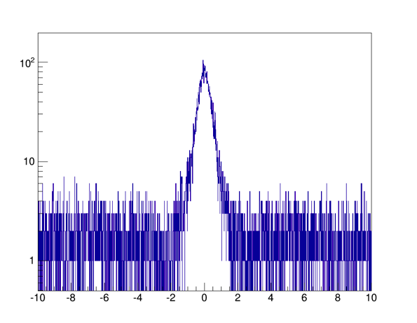
GEM Event Reconstruction
10000 DPM events
simulated
• 8165 events with reconstructable track in GEM tracker
• 7536 events Reconstructed (92.3%)
• 139 ghost events (1.8%)
R. Karabowicz

Slide 25
Event Building Model
Work in progress
SciTil
Find
Events
Data Buffer
Store
Event
Data
MVD
Track
Find
Events
Track Buffer
Store
Event
Data
Events
GEM
Track
Find
Events
Track Buffer
Store
Event
Data
Global
Find
Events
Track Buffer
Store
Event
Data
Event
Buffer
Build
Event
R. Karabowitcz

Slide 26
Track Finding + FItting

Slide 27


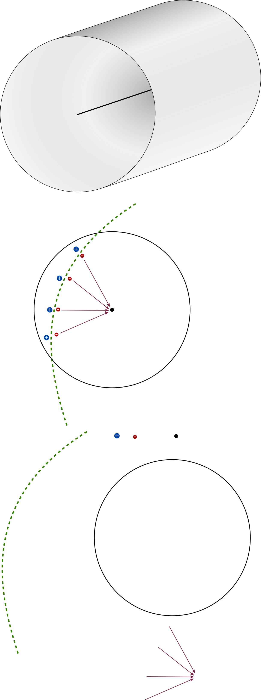
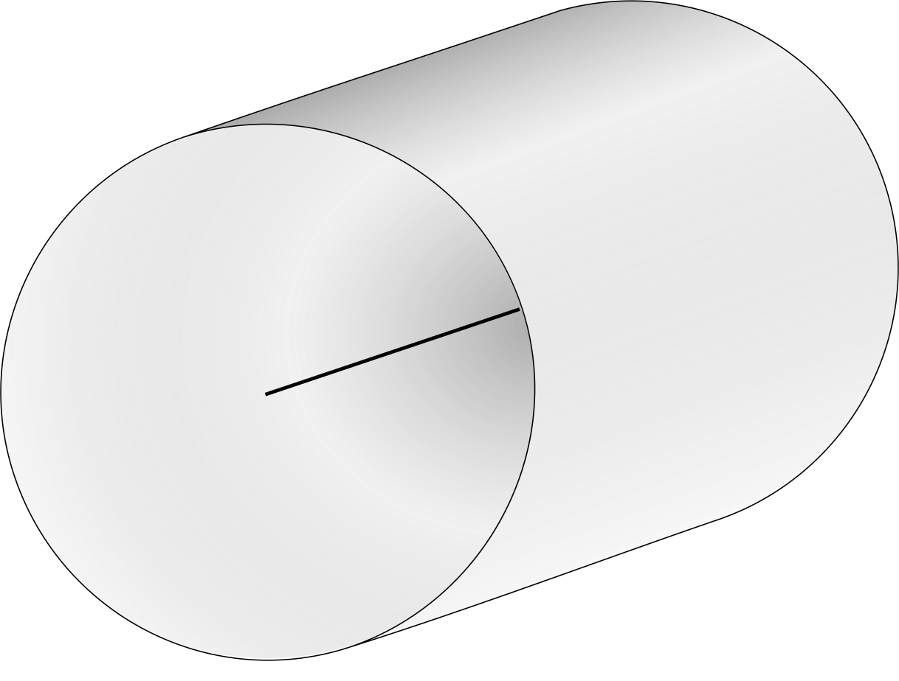
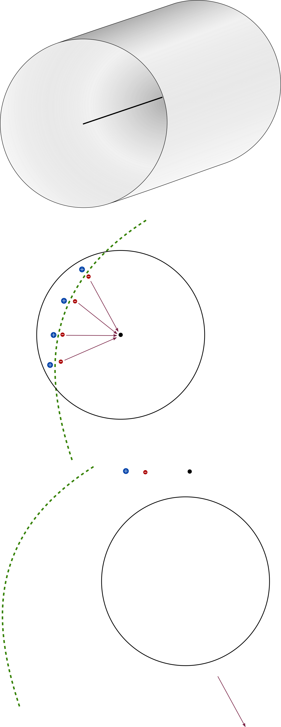
STT — Drift Tubes and t0
Particle ionizes gas atoms in drift tubes
Electrons drift to anode wire, ions to wall
Signal only when electrons arrive at wire
No information about drift duration!
For that, start time (t0) needed:
t0 - tarrival ≈ tdrift
vdrift = const → tdrift • vdrift = risochrone
risochrone
Resolution without t0: 𝒪(0.1 cm)
Resolution with t0: 𝒪(0.015 cm)
Mitglied der Helmholtz-Gemeinschaft
Usual HEP experiment: t0 by trigger
But PANDA has no trigger…

Slide 28
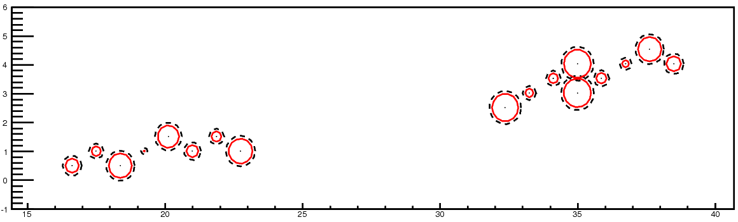
Event Structure -- pile-up
20 MHz
2000 ns revolution time
400 ns gap
T_{Mean} between 2 events: 50 ns
Drift time: ~250 ns
Event pile-up
Wrong T0 → Wrong drift circle → bad track quality
Y. Liang

Slide 29
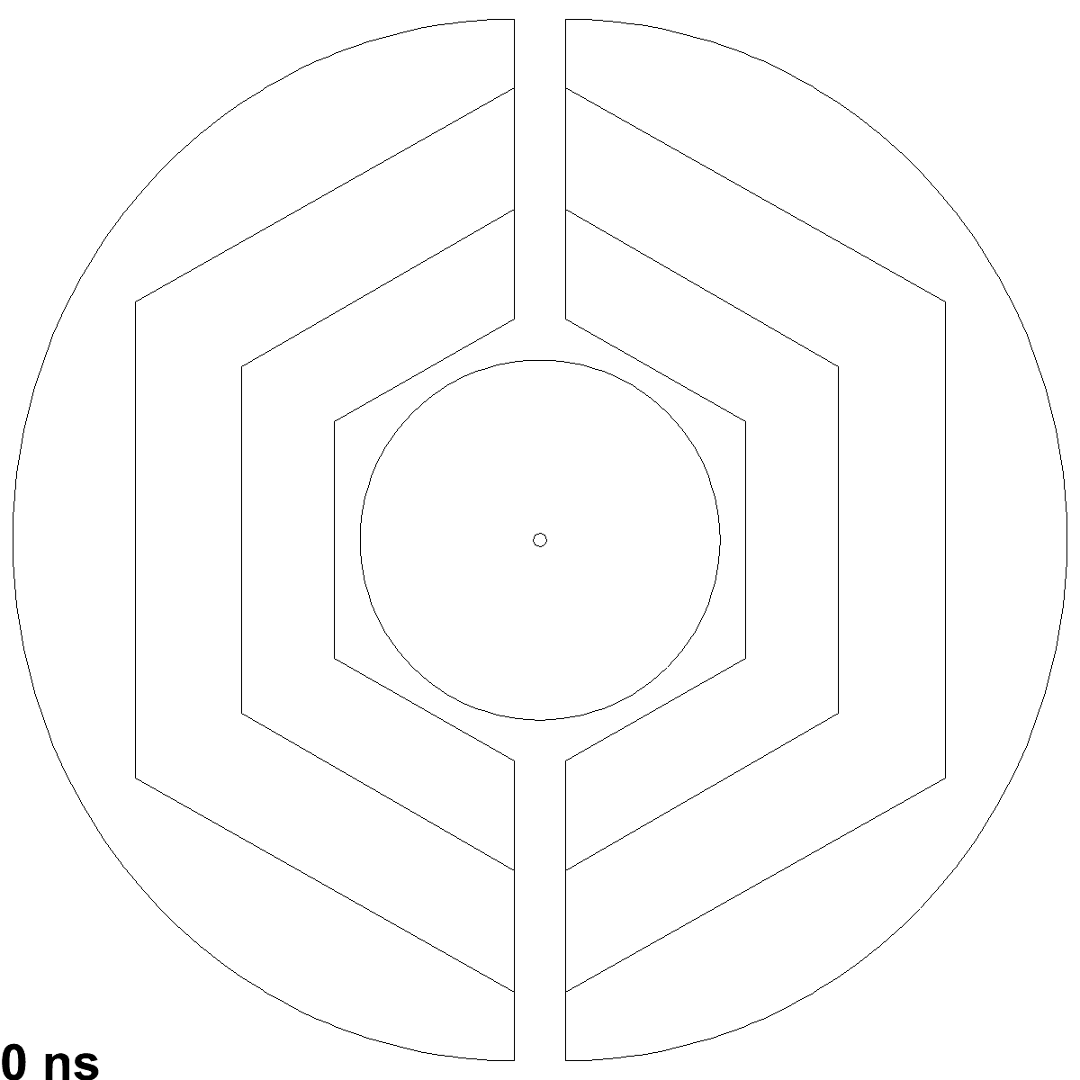
Hitstream Display: 15 GeV/c DPM, 50 ns Mean Time
XY-View
Isochrone early
Isochrone early & skewed
Isochrone close
Isochrone late
MVD hit
Triplet
Track current
Track timed out
  DPM Benchmark:
  Realistic event rate and structure,
  continuous operation
M.Mertens

Slide 30
Cell Track Finder

Slide 31
CellTrackFinder
1. Generation of tracklets in STT
  Primary tracklets: use of cellular automaton
  Combination of tracklets: use of Riemann Fit
  Faulty: Fit to center of the tubes
  Add remaining hits to best fitting Track
→ TrackletGenerator
2. Correction of STT-Hits based on event time
  Correct points for Riemann Fit by calculating tangents to the isochrones
→ HitCorrector

Slide 32

1. TrackletGenerator
Cellular Automaton
Abstract discrete model for dynamic systems
Definition by:
  Cell
  Neighborhood relations
  Discrete number of states
  Transition rules for states
  Simultaneous changes

Slide 33
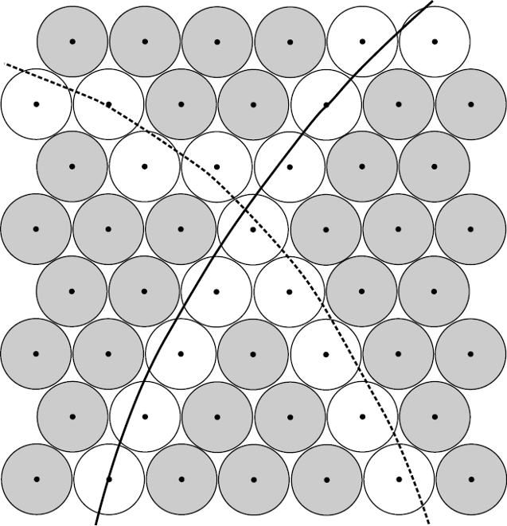
1. TrackletGenerator
Cellular Automaton - Apply to STT

Slide 34
1. TrackletGenerator
Cellular Automaton – Apply to STT
Number of Neighbours:
1
unambiguous
2
> 2
ambiguous

Slide 35
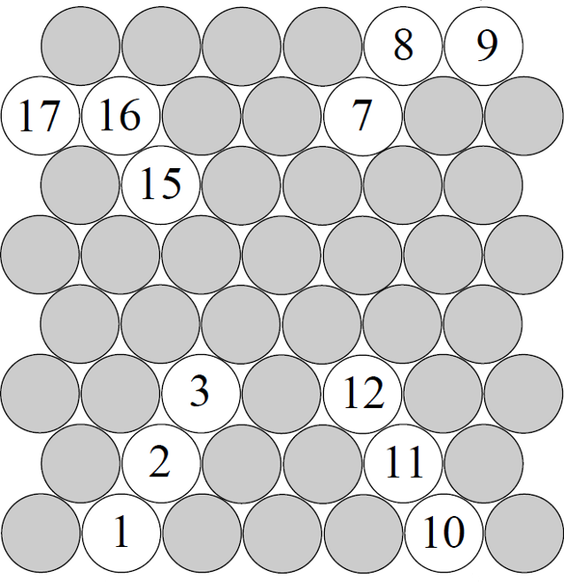
1. TrackletGenerator
Cellular Automaton - Apply to STT
Cell: Straw with hit and one or two neighbours
Rule: Compare your status with the status of your neighbours and take the smallest one

Slide 36
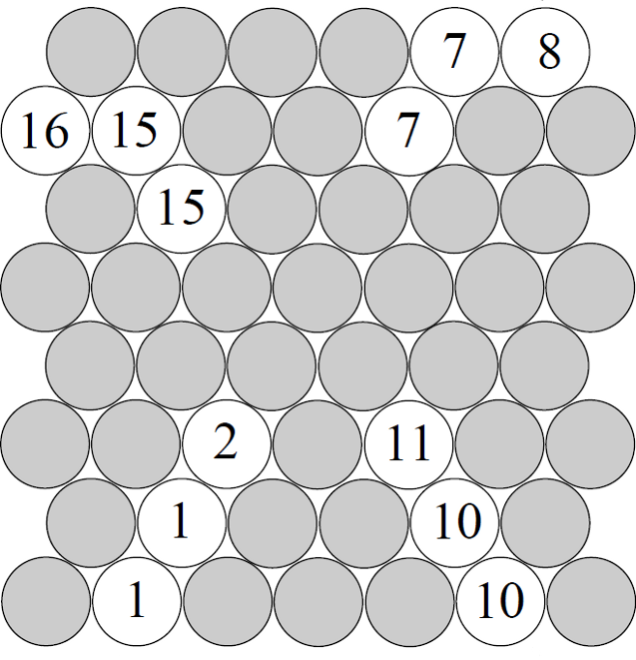
1. TrackletGenerator
Cellular Automaton - Apply to STT
Cell: Straw with hit and one or two neighbours
Rule: Compare your status with the status of your neighbours and take the smallest one

Slide 37
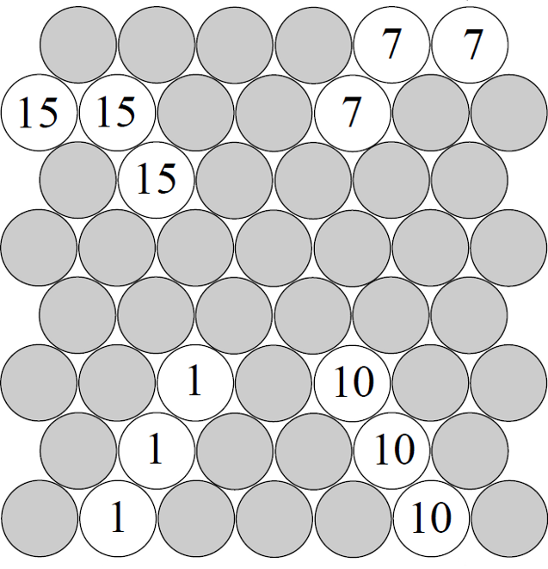
1. TrackletGenerator
Cellular Automaton - Apply to STT
Cell: Straw with hit and one or two neighbours
Rule: Compare your status with the status of your neighbours and take the smallest one

Slide 38
1. TrackletGenerator
Cellular Automaton - Apply to STT
Cell: Straw with hit and one or two neighbours
Rule: Compare your status with the status of your neighbours and take the smallest one

Slide 39
1. TrackletGenerator
Cellular Automaton - Apply to STT
Cell: Straw with hit and more than two neighbours
Rule: Copy the status of all your neighbours into your status

Slide 40
1. TrackletGenerator
Cellular Automaton - Apply to STT
Cell: Straw with hit and more than two neighbours
Rule: Copy the status of all your neighbours into your status
15
7
1
10

Slide 41
1. TrackletGenerator
Cellular Automaton - Apply to STT
Cell: Straw with hit and more than two neighbours
Rule: Copy the status of all your neighbours into your status
7/15
7/15
1/10
7/15
1/10
1/10

Slide 42
1. TrackletGenerator
Cellular Automaton - Apply to STT
Cell: Straw with hit and more than two neighbours
Rule: Copy the status of all your neighbours into your status
1/10
7/15
1/10
7/15
1/10
7/15
1/10
7/15
1/10
7/15

Slide 43
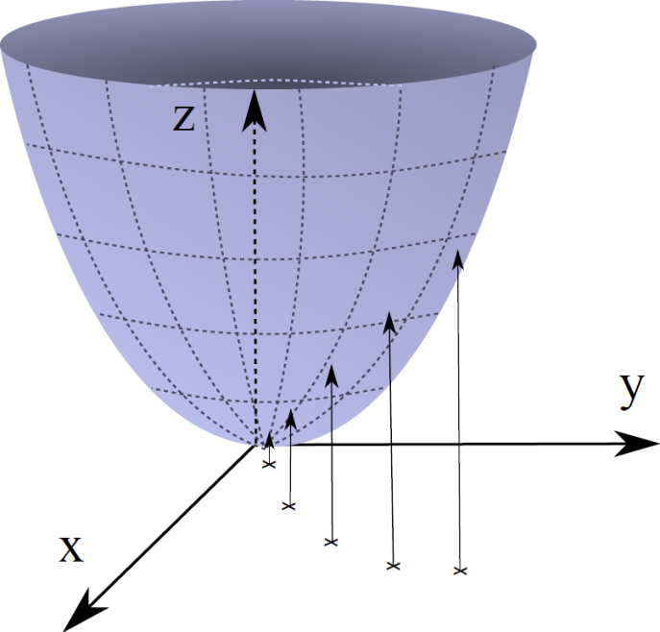
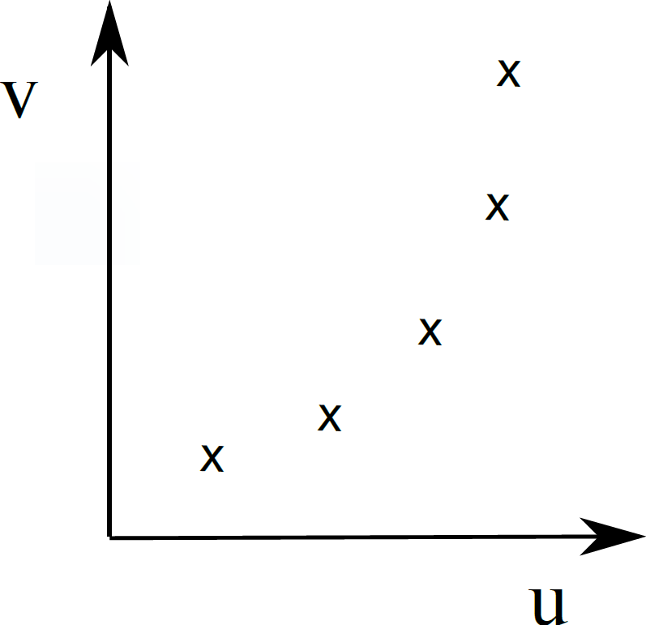
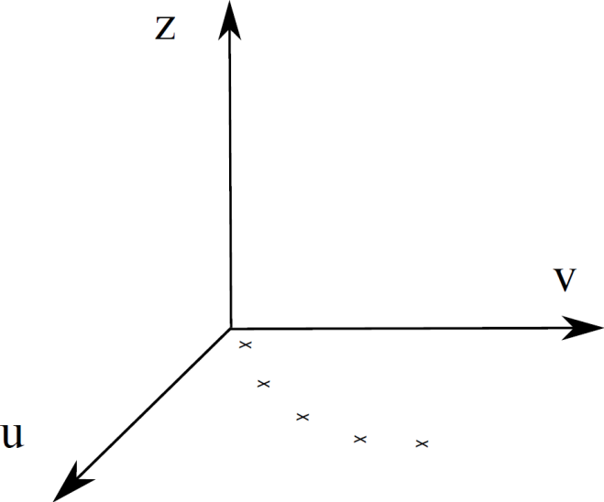
1. TrackletGenerator
Riemann fit
Points to be fitted
Add z-dimension
Map onto paraboloid

Slide 44
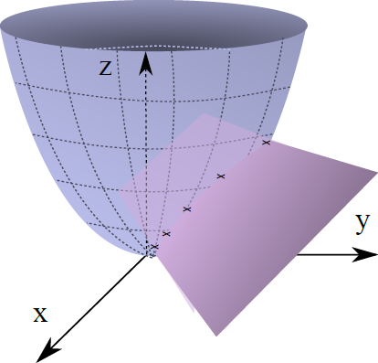
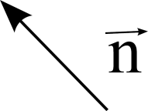
1. TrackletGenerator
Riemann fit
Advantages
quadratic → linear
explicit solution
already implemented in
PandaRoot
Fit Plane
Normal vector → Circle parameters

Slide 45
1. TrackletGenerator
Result of the combination
1/10
7/15
1/10
7/15
1/10
7/15
1/10
7/15
1/10
7/15

Slide 46
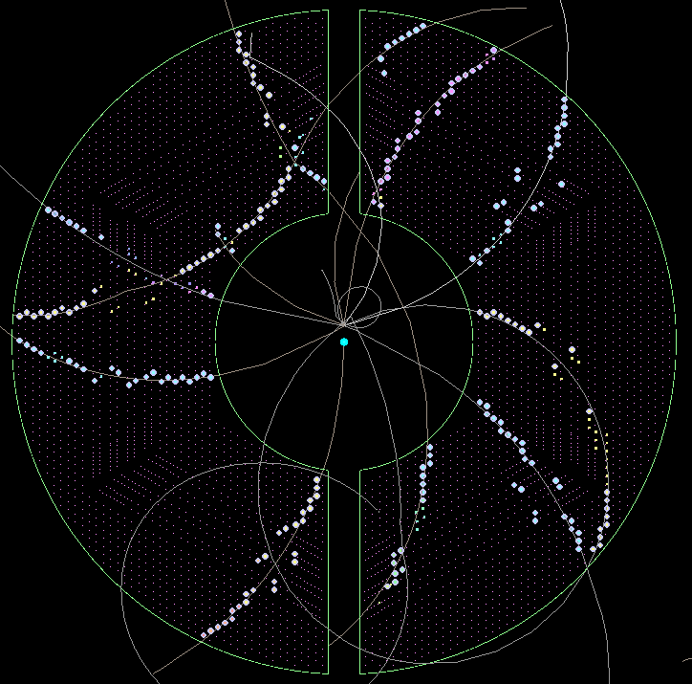
1. TrackletGenerator
Example – Unambiguous hits

Slide 47
1. TrackletGenerator
Example – First tracklets

Slide 48
1. TrackletGenerator
Example – Combined tracklets

Slide 49
Road Finder

Slide 50
Tracking Algorithm -- Road Finding
Layer_ID
Hit
Hit
Hit
Hit
Hit
Hit
Hit
Hit
Hit
Hit
Hit
Tube_ID
Hit: Seg_ID(3 bits) + LayerID(4 bits) + Tube_ID (6 bits) + Arrival time
1: Start from inner layer
2: Attach neighbour hit to tracklet layer by layer
Boundary between two segments.
Number of neighbor: 4
Y. Liang

Slide 51
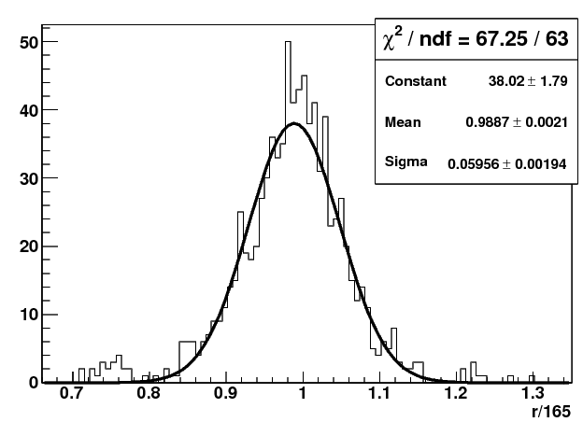
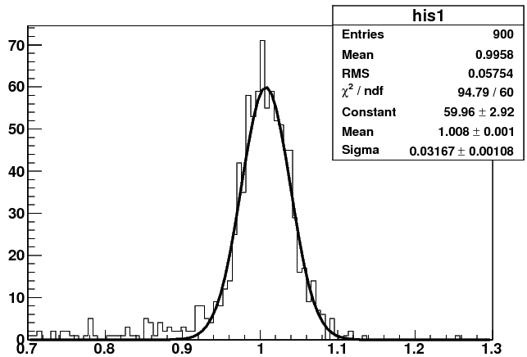
Two iteration circle fit
y
Pt(input) 1st iteration 2nd iteration
0.2GeV/c : 0.195 ±0.0068 0.195±0.0068
0.5GeV/c : 0.5 ±0.0212 0.5 ± 0.0164
1.0GeV/c : 0.99 ±0.0595 1.0 ± 0.0317
2.0GeV/c : 1.85 ±0.213 2.0 ± 0.073
x_{c}, y_{c}, R
x
1st iteration
2nd iteration
Pt(GeV/c)
Pt(GeV/c)

Slide 52
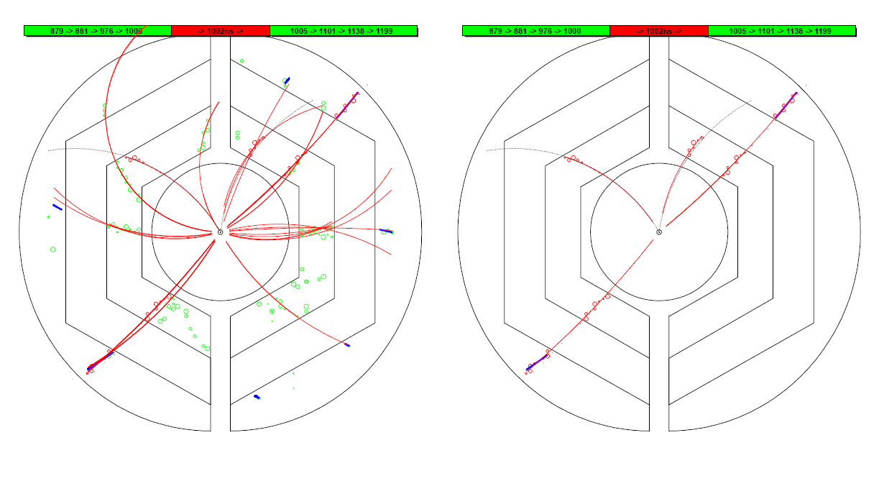
Performance Study
T₀ information: current event(Red) or other events(Green)
Black dashed line: track by MC truth
Red line: recon. track
Blue: recon. using outer layers
drift circles belong to current event (Red) or other events (Green)
Event #4
Event #4

Slide 53
Beyond CPU

Slide 54
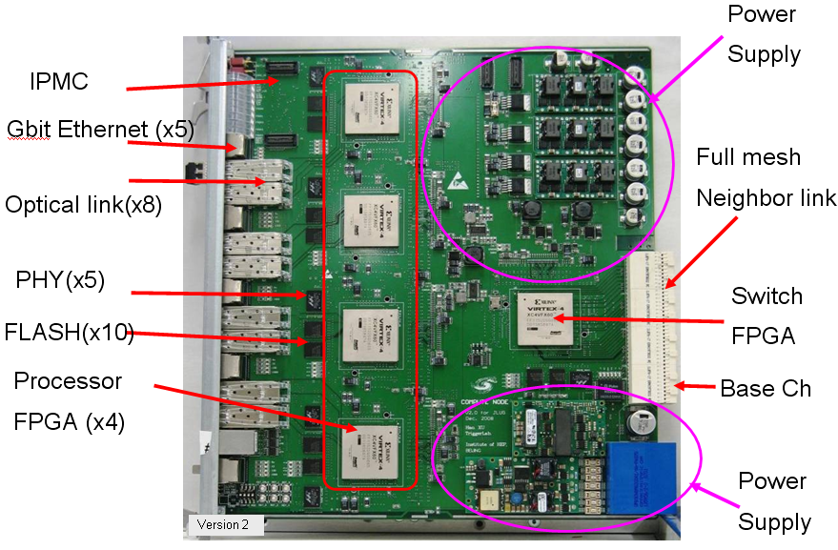
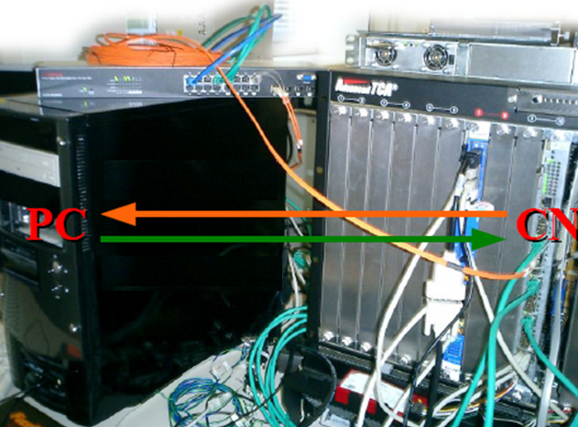
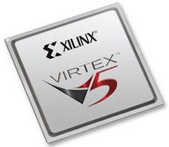
VHDL Implementation
VHDL: Very-high-speed integrated circuits Hardware Description Language.
It’s a dataflow language, unlike procedural computing languages such as C++ which runs sequentially, one instruction at a time.
Y. Liang

Slide 55
Tracking at FPGA -- 20 MHz
Data flow: Hit information at PC → FPGA, extract helix para. → PC
Y. Liang

Slide 56
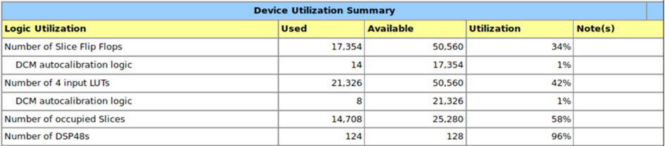
Performance at FPGA
Only 1st iteration is implemented in VHDL
1: Device Utilization Summary:
2: Time per event:
1 burst, 20 MHz, 40 events
→ 260 μs
Y. Liang

Slide 57
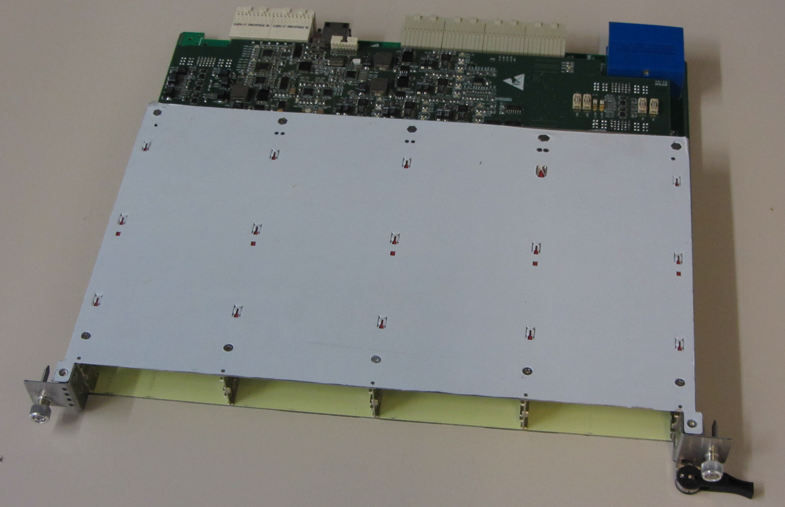
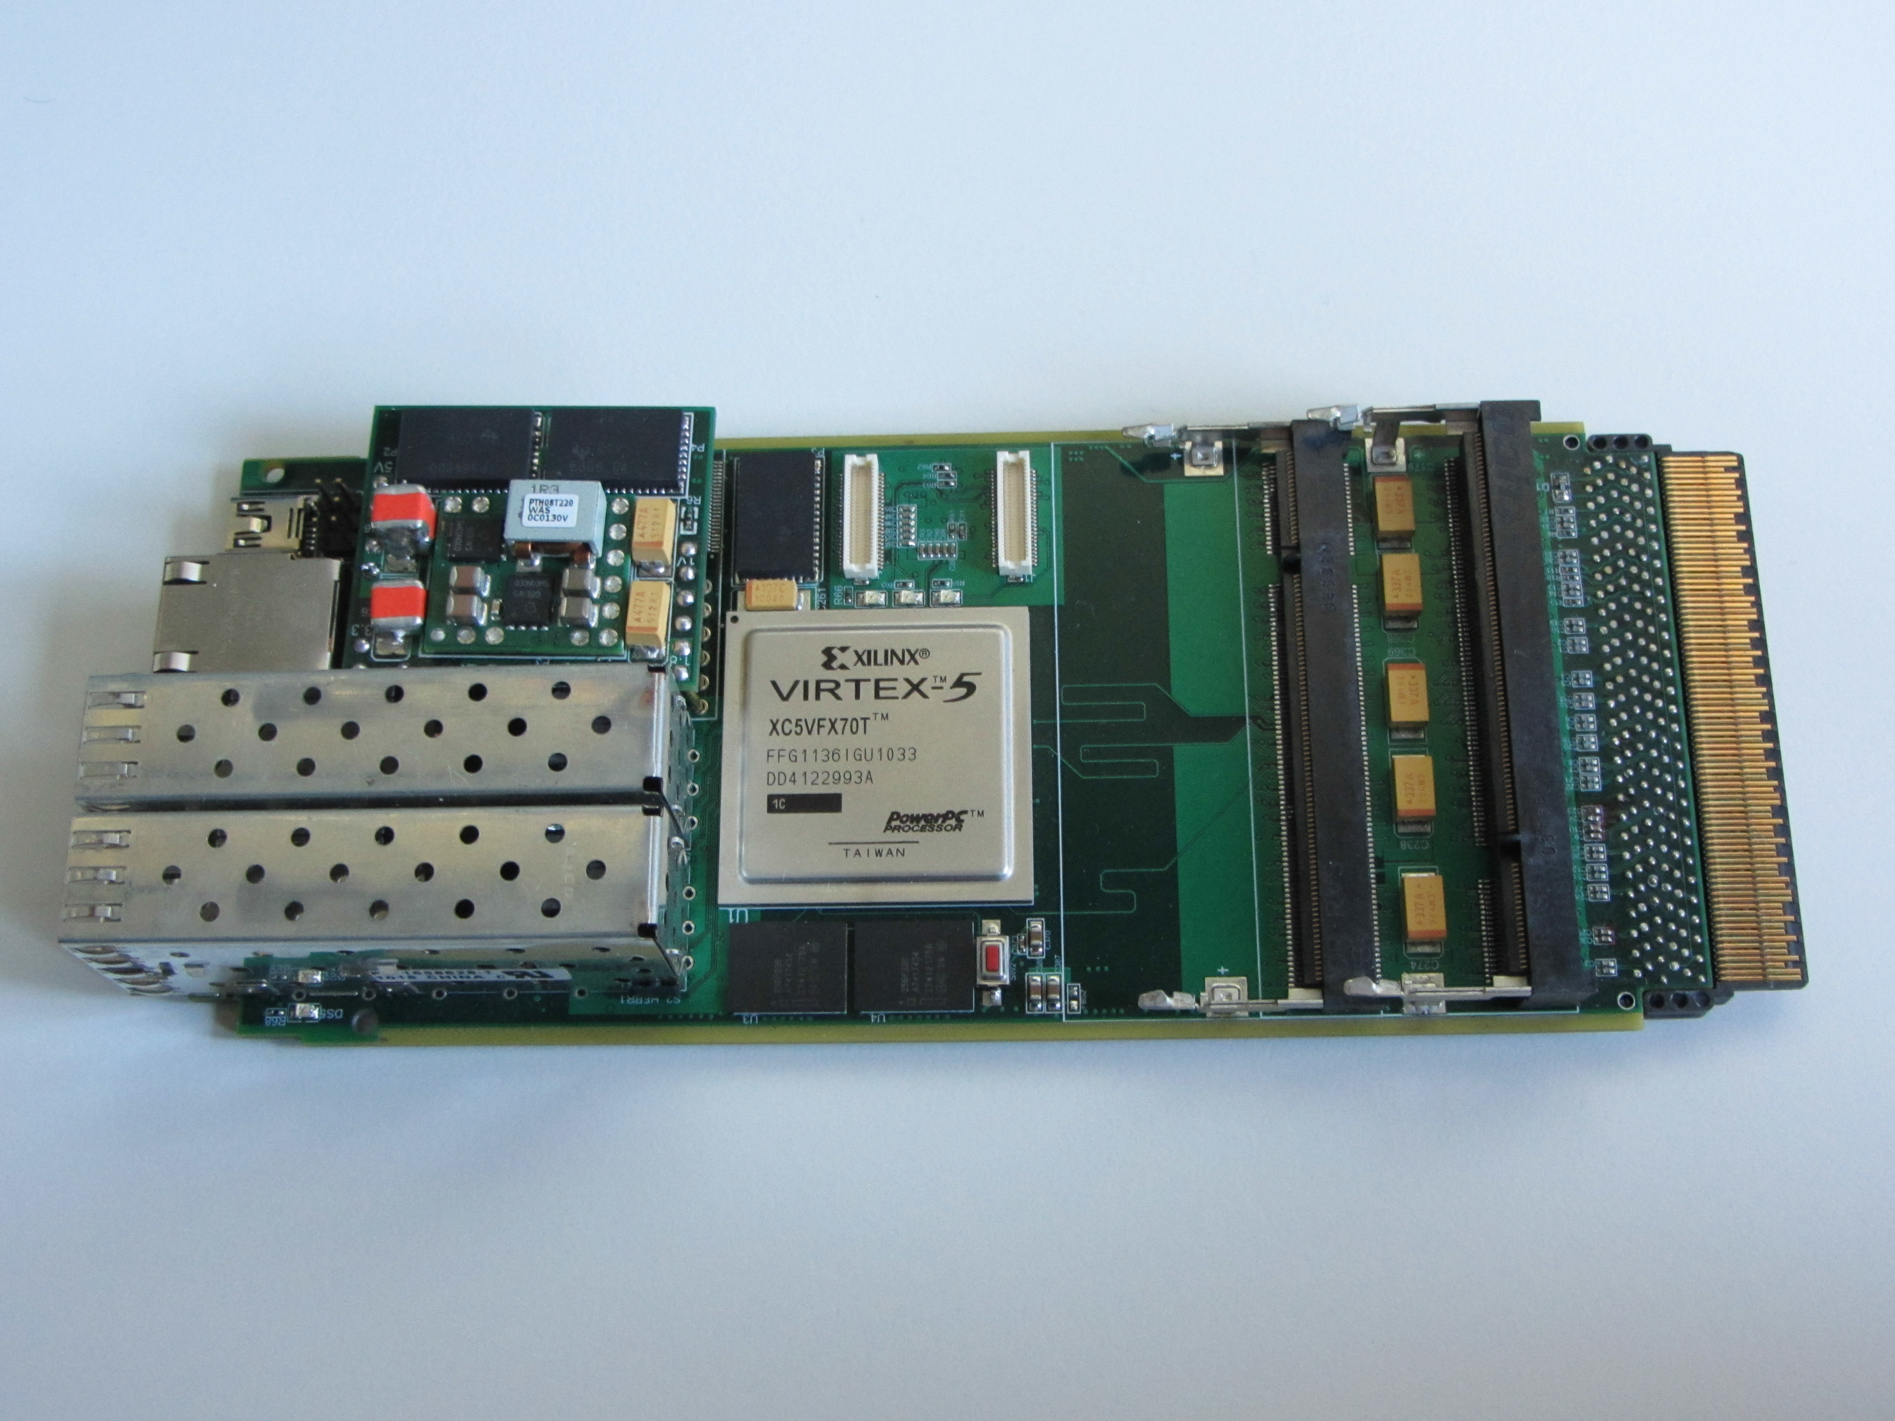
New compute node

Slide 58
GPU Algorithms

Slide 59
Algorithms #1
Hough Transform
Riemann Track Finder
Triplet Finder
Mitglied der Helmholtz-Gemeinschaft

Slide 60
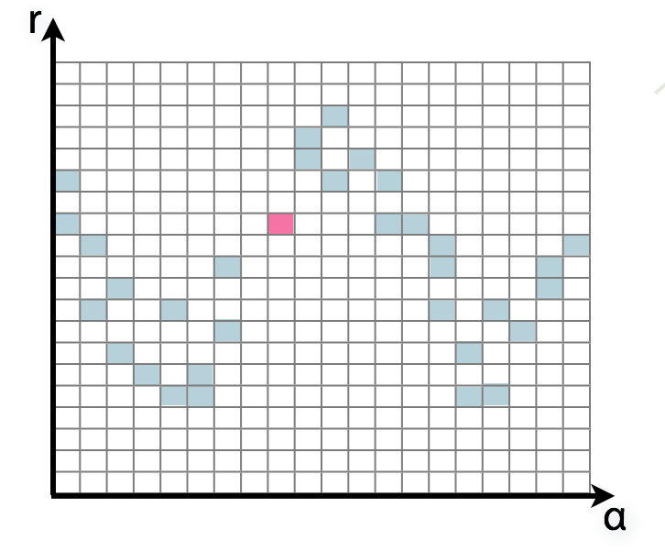
Algorithm: Hough Transform
Idea: Transform (x,y)i → (α,r)ij, find lines via (α,r) space
Solve rij line equation for
  Lots of hits (x,y,ρ)i and
  Many αj ∈ [0°,360°) each
Fill histogram
Extract track parameters
i: ~100 hits/event (STT)
j: every 0.2°
rij: 180 000
y
y
Mitglied der Helmholtz-Gemeinschaft
x
x

Slide 61
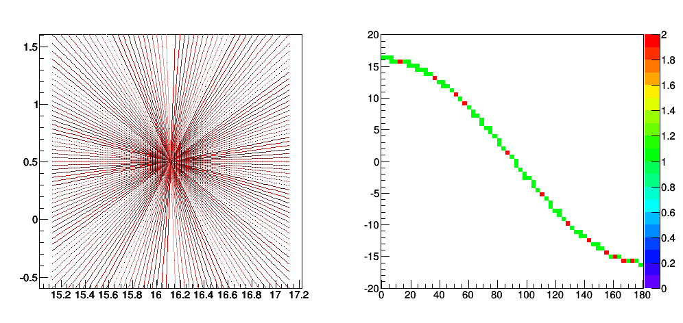
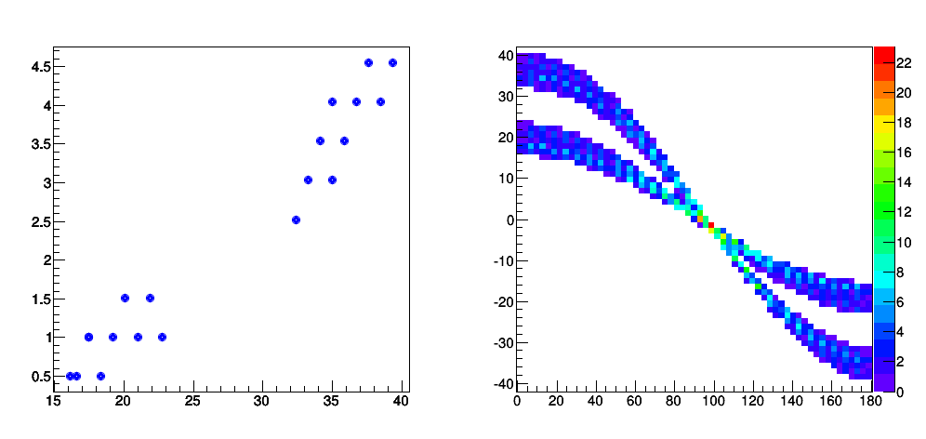
Hough Transform — Granularity
Choice of α granularity determines resolution
α = 0°, 2°, 4°, …
α = 0°, 2°, 4°, …
Mitglied der Helmholtz-Gemeinschaft

Slide 62
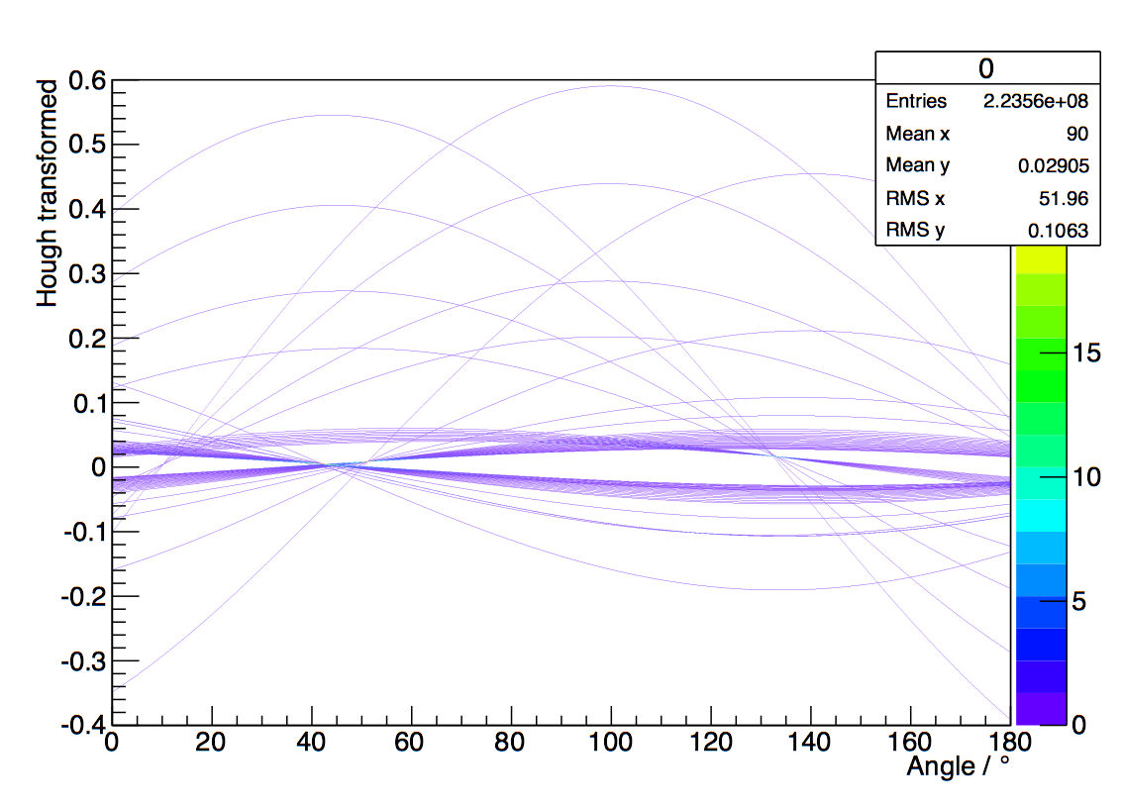

Algorithm: Hough Transform
68 (x,y) points
r
α
Mitglied der Helmholtz-Gemeinschaft
PANDA STT+MVD
1800 x 1800 Grid

Slide 63
Hough Transform — Remarks
Two Implementations
Thrust (CUDA‘s STL)
  Performance: 3 ms/evt
  Reduce to set of standard routines
    Fast (uses Thrust‘s optimized algorithms)
    Inflexible (hard to customize)
    Not yet at performance maximum
Plain CUDA
  Performance: 0.5 ms/evt
  Built completely for this task
    Fitting for PANDA; customizable
    A bit more complicated at parts
Mitglied der Helmholtz-Gemeinschaft
Peakfinding challenging

Slide 64





Hough Transform — Remarks
Iterative Maximum Deleter
Hill Climber
Mitglied der Helmholtz-Gemeinschaft
Peakfinding challenging
current research

Slide 65
Algorithms #2
Hough Transform
Riemann Track Finder
Triplet Finder
Mitglied der Helmholtz-Gemeinschaft

Slide 66
Riemann Track Finder — Method
Idea: Don‘t fit lines (in 2D), fit planes (in 3D)!
Create seeds
  All possible three hit combinations
Grow seeds to tracks
Continuously test next hit if it fits
  Use mapping to Riemann paraboloid (+ s-z fit, det. layer)
1
2
z‘
x
x
x
x
x
x
Mitglied der Helmholtz-Gemeinschaft
x
x
x
x
x
y
y
x
y
More on: Seeds; Growing

Slide 67


Riemann Track Finder — GPU Adaptations
CPU
GPU
1
3 loops to generate seeds serially
Needed: Mapping of inherent GPU indexing variable to triplet index
for (int i = 0; i < hitsInLayerOne.size(); i++) {
for (int j = 0; j < hitsInLayerTwo.size(); j++) {
for (int k = 0; k < hitsInLayerThree.size(); k++) {
/* Triplet Generation */
}
}
}
int ijk = threadIdx.x + blockIdx.x * blockDim.x;
2
Only easy computations; e.g. 3x3 matrices
Port of CPU code; parallelism on seed base
100 × faster than CPU version: ~0.6 ms/event
Still needs merging into PandaRoot
Mitglied der Helmholtz-Gemeinschaft

Slide 68
Algorithms #3
Hough Transform
Riemann Track Finder
Triplet Finder
Mitglied der Helmholtz-Gemeinschaft

Slide 69


Triplet Finder
Idea: Use only subset of detector as seed
  Don’t use STT isochrones (drift times
  Calculate circle from 3 points (no fit)
Features:
  Fast & robust algorithm, no event time needed
  Many tuning possibilities
http://www.fz-juelich.de/ias/jsc/nvlab
Mitglied der Helmholtz-Gemeinschaft
More

Slide 70




Triplet Finder — Display
Isochrone early
Isochrone early & skewed
Isochrone close
Isochrone late
MVD hit
Triplet
Track current
Track timed out
Mitglied der Helmholtz-Gemeinschaft

Slide 71



Triplet Finder — Times
in publication
K20X
Mitglied der Helmholtz-Gemeinschaft

Slide 72



Triplet Finder — Optimizations
Bunching Wrapper
  Hits from one event have similar timestamps
  Combine hits to sets (bunches) which occupy GPU best
Hit
Event
Bunch
𝒪(N²) → 𝒪(N)
Mitglied der Helmholtz-Gemeinschaft

Slide 73



Triplet Finder — Clock Speed / GPU
in publication
K40 3004 MHz, 745 MHz / 875 MHz
K20X 2600 MHz, 732 MHz / 784 MHz
Memory Clock
Core Clock
GPU Boost
Mitglied der Helmholtz-Gemeinschaft

Slide 74
FAIR MQ

Slide 75
FairMQ in PANDA - FPGA
FPGA to FairMQ: Used as fast transport layer in test beam
Control
push
push
push
push
4 x
Monitor
pull
sub
FPGA
Mux
FE
State Machine
Backup
push
pull
pub
sub
Storage
Storage

Slide 76


FAIR MQ in PANDA - GPU

Slide 77
Summary
Event reconstruction in real time challenging enterprise in PANDA
Time-based simulation exists to simulate data stream
Event building scheme and algorithms under development
Most challenging: tracking
Different tracking algorithms tested
Implementations for FPGAs and GPUs exist but still a lot of work necessay
New concept of FairRoot for concurrent processing under study
Open Issues:
  Global event building
  Alignment and calibration
  Online analysis and selection

Slide 78

PANDA — Read Out Scheme
Requirements to Online Tracking
Fast
Sophisticated algorithms possible; reprogrammable
Parallelism beyond single devices
Fast
Limited precision ok
Mitglied der Helmholtz-Gemeinschaft
GPUs

Slide 79

Event Time
Signal and Background Events
Signal Event

Slide 80

Digi Time
MVD Digi Pixel Time

Slide 81

Reco Hit Time
Reco Hit Time

