Slide 1

Summary
HiLuMI LHC Collimation Materials Irradiation Damage Study at BNL
EuCARD
N. Simos
Effort consists of:
IRRADIATION
200 MeV proton irradiation at BNL Linear Isotope Producer (BLIP) of 4 candidate materials (Molybdenum, Glidcop, Mo-Graphite and Cu-CD (copper-diamond). Irradiation parameters: 8-weeks at 110 uA
Neutron irradiation of Cu-CD from 118 MeV protons
28-MeV proton irradiation of Mo (including spallation neutron irradiation of Mo, Glidcop, Cu-CD and Mo-GR)
PIE
X-ray diffraction studies at NSLS X17B1/X17A beamlines (completed)
X-ray diffraction studies at NSLS II XPD beamline (proposed)
Comprehensive macroscopic analysis at BNL Isotope extraction facility (initiated)
Spectral Analysis (initiated)
Nano- micro-structural characterization at Center of Functional Nanomaterials (initiated)

Slide 2
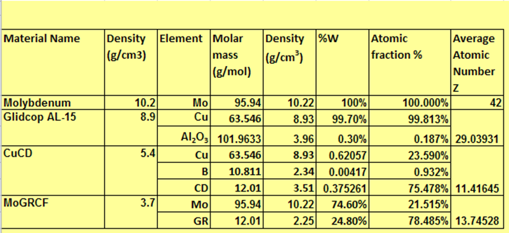
Irradiated LHC HiLuMi Collimation materials
Preliminary Assessment:
200 MeV heavily bombarded LHC array is still in cool-down mode due to extremely high dose levels.
One of the two Molybdenum (Mo) capsules has been opened for visual examination. Mo samples appear to be fully intact.
In coming weeks the proton irradiated array will be opened and examined (followed by transport to the PIE hot cells for sorting and studies)
Neutron irradiated Cu-CD has seen no structural degradation
28 MeV protons and spallation neutrons at Tandem have not affected the structural integrity of the LHC HiLuMI array

Slide 3
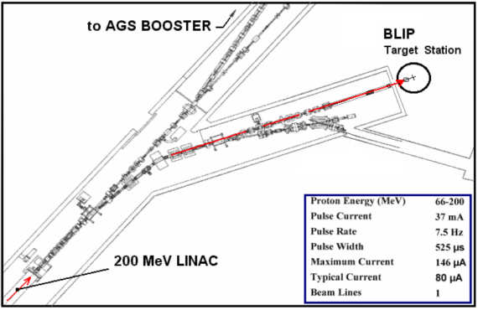
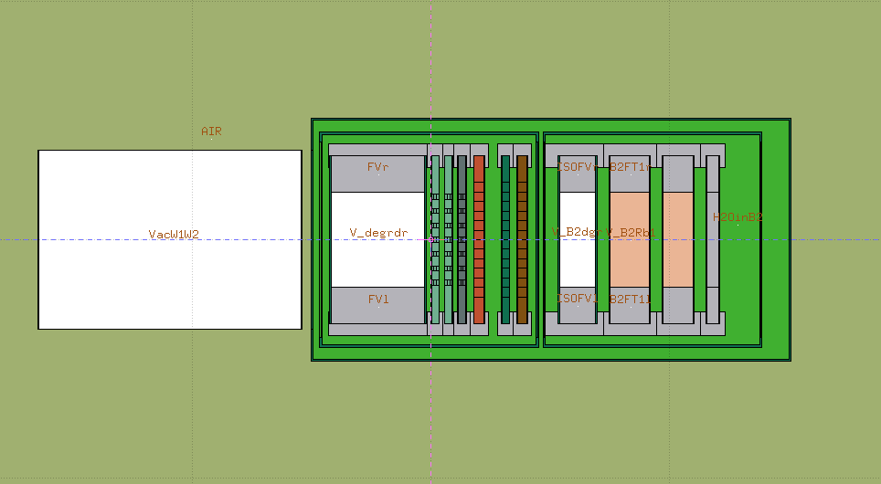
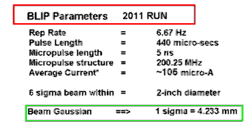
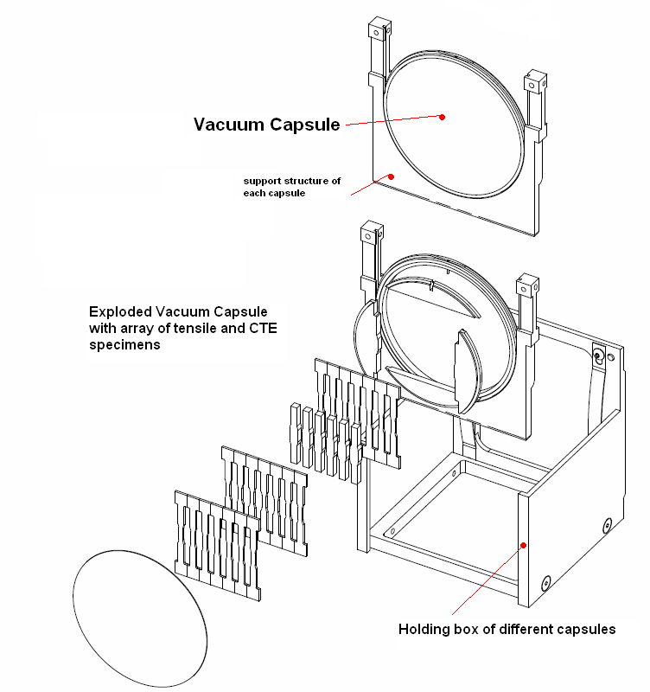
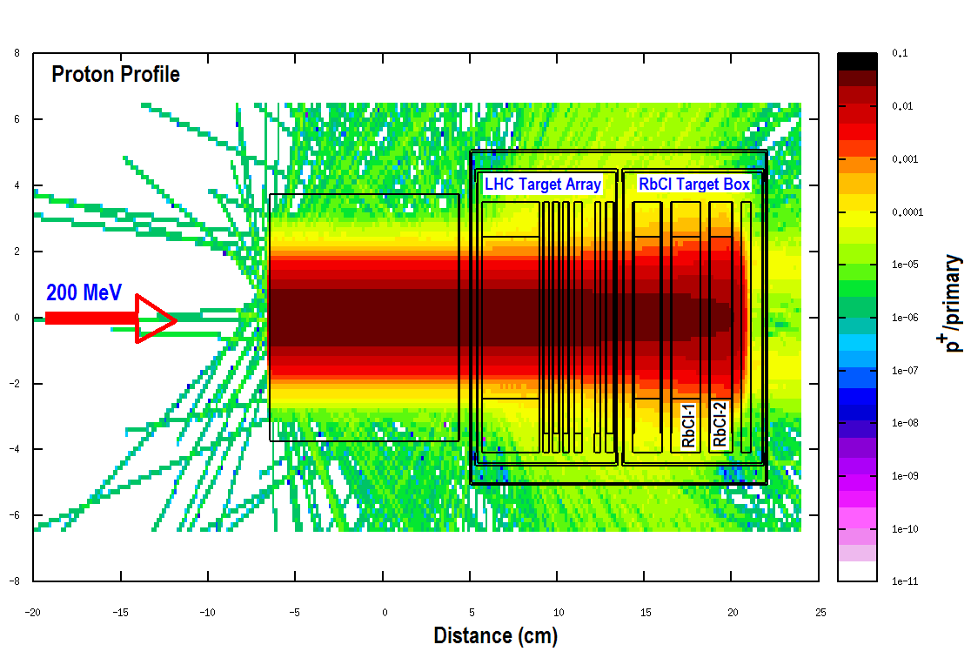
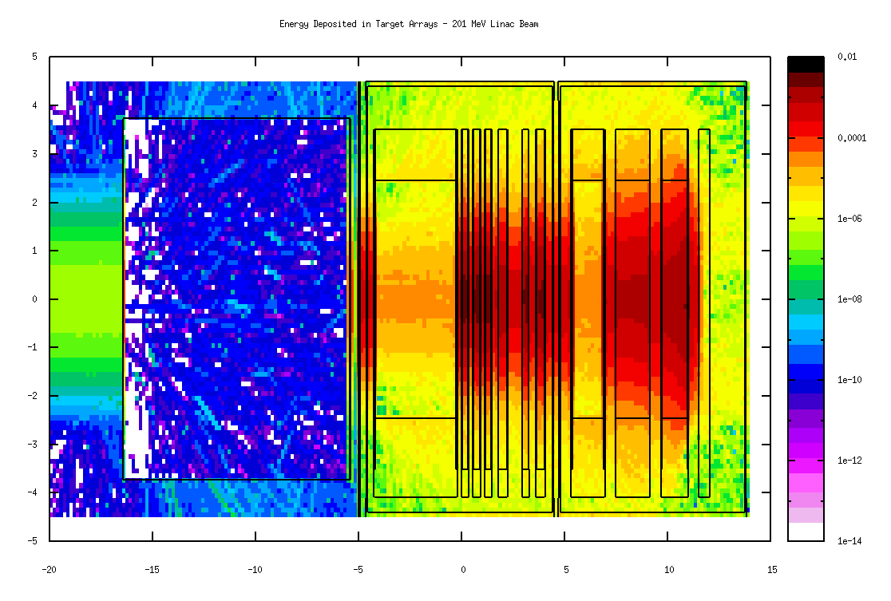
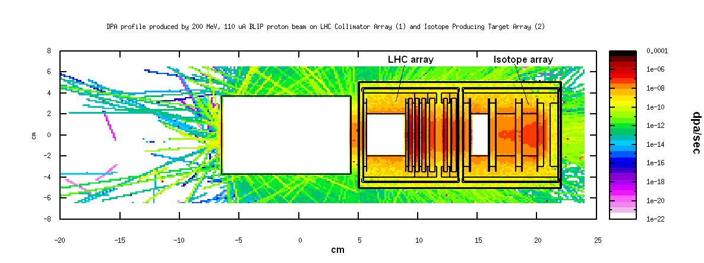
200 MeV Proton Irradiation

Slide 4
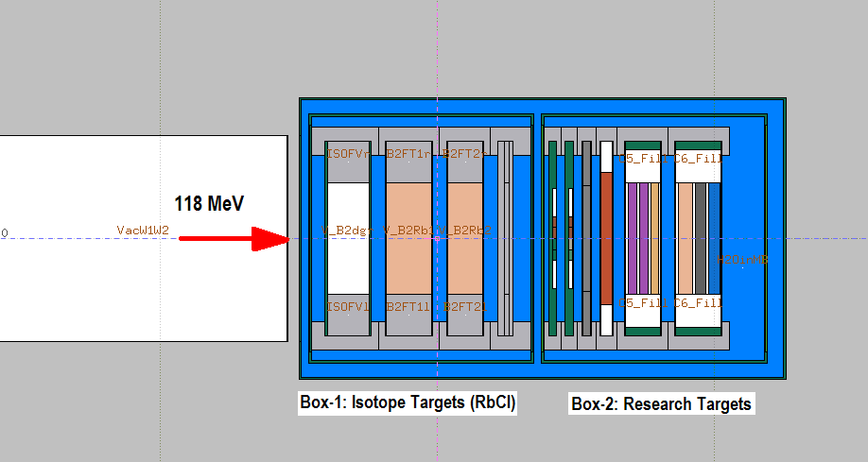
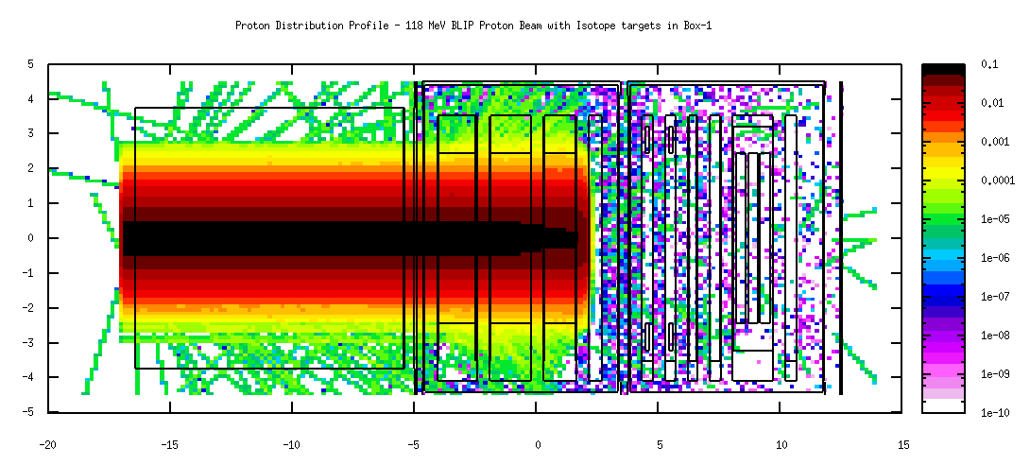
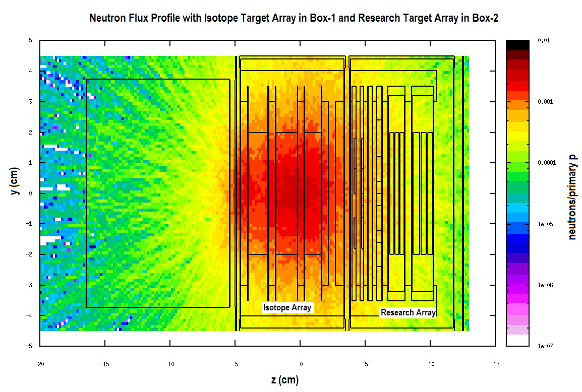
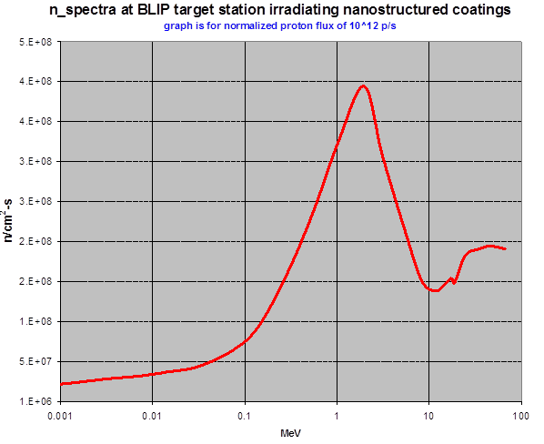
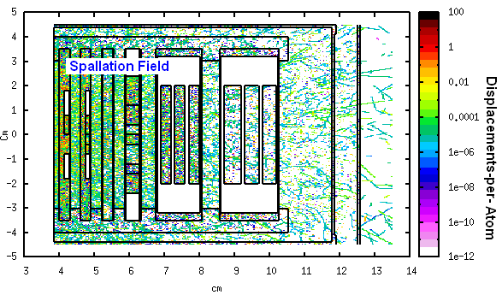
Spallation Neutron Irradiation - Cu-CD
Neutron spectrum downstream of isotope target array

Slide 5
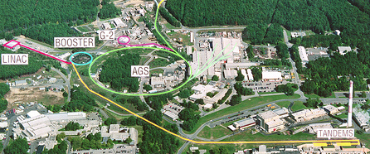
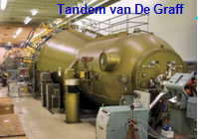
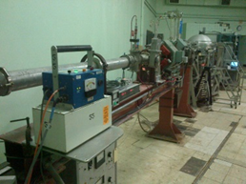
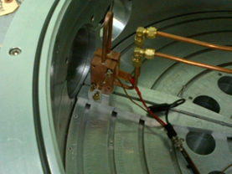
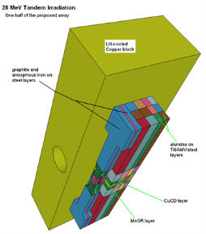
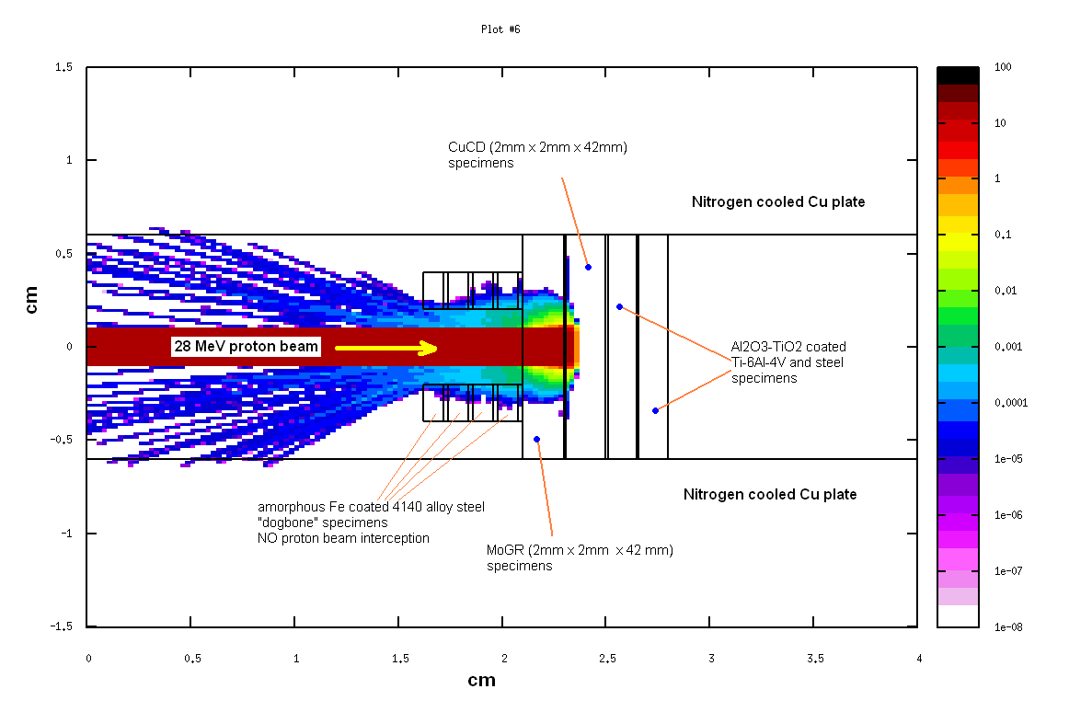
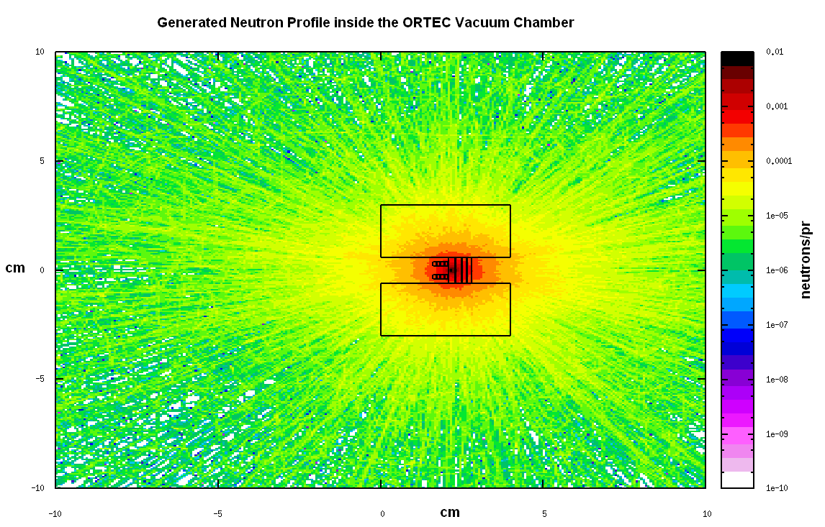
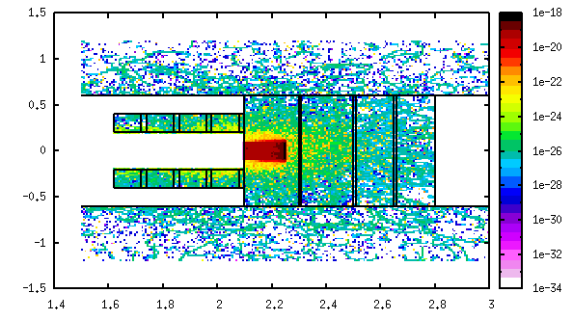
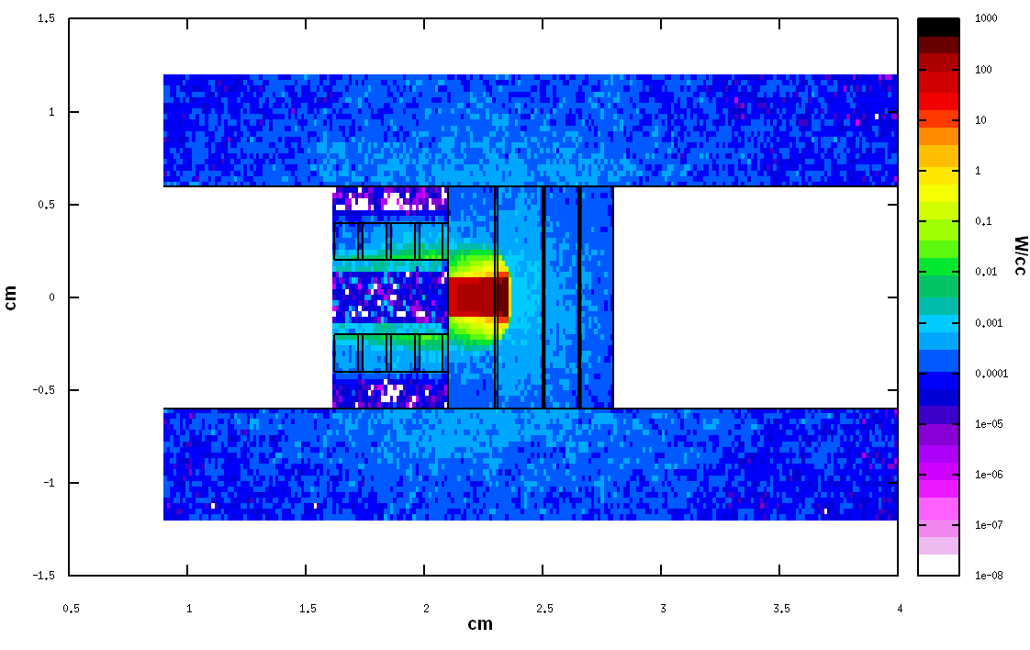
28 MeV Proton (plus spallation neutron) irradiation at Tandem
28 MeV (1 uA, 200 x 200 um x um) protons
Mo – direct 28 MeV protons
Mo/MoGR/CuCD/Glidcop: spallation neutrons

Slide 6
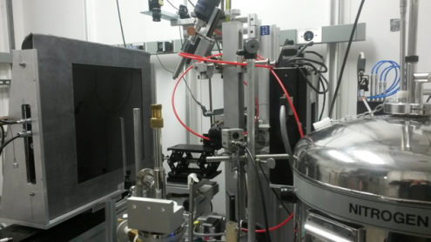
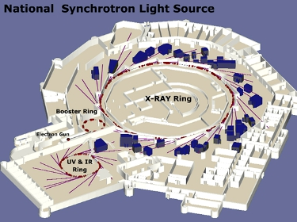
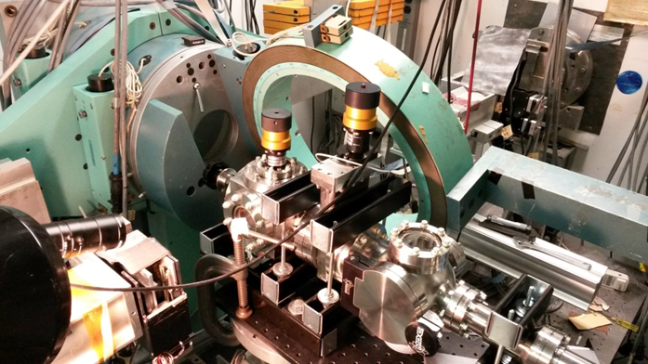
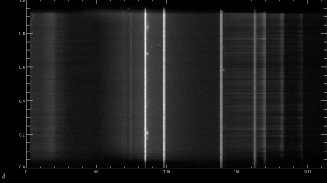
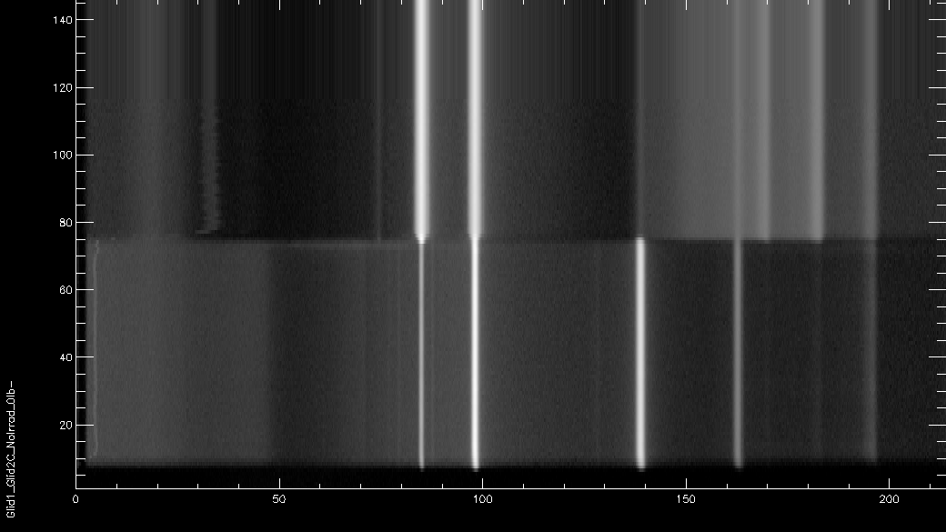
X-ray diffraction studies at NSLS
Monochromatic 70 KeV beam (X17A beamline)
White beam 200 KeV, X17B1 beamline
X17A (monochromatic x-rays)
X-Ray ring
(3 GeV)
X17B1
Mo-GR
Glidcop (SLAC LHC rotating collim)
Glidcop (HiLuMI)

Slide 7
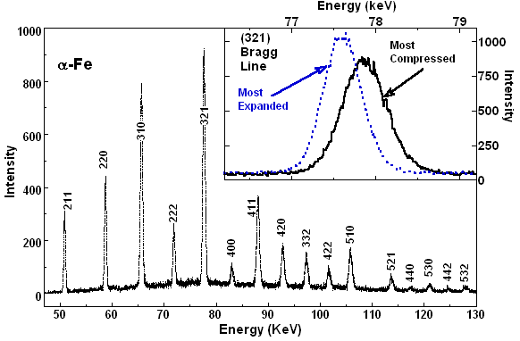
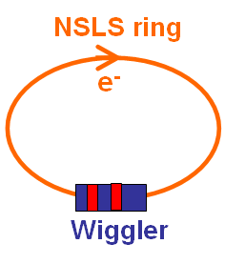
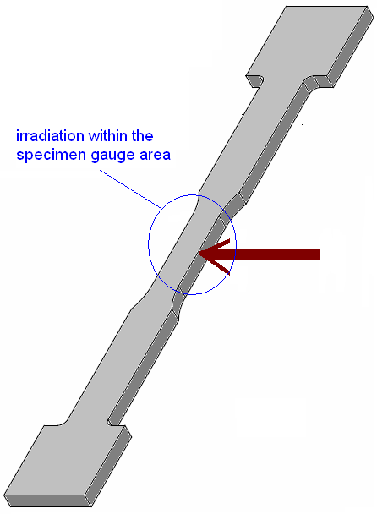
STRAIN MAPPING
Energy Dispersive Diffraction Mode
Like having imbedded inter-atomic strain gauges !!!!
Ge-Detector
“White Beam”
1m diff. coll.
y
incident
collimation
system
Δk
θ
3-12º~
2θ
X-17B1
Transmission
detector
(radiography)
10-50 μm
Diffraction
volume
specimen

Slide 8
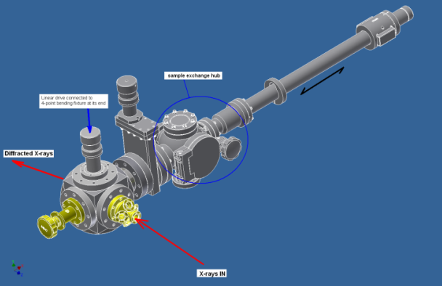
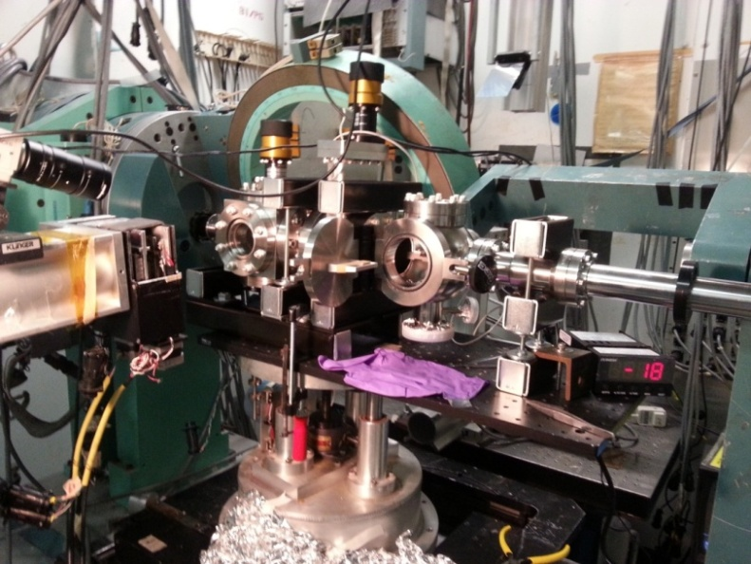
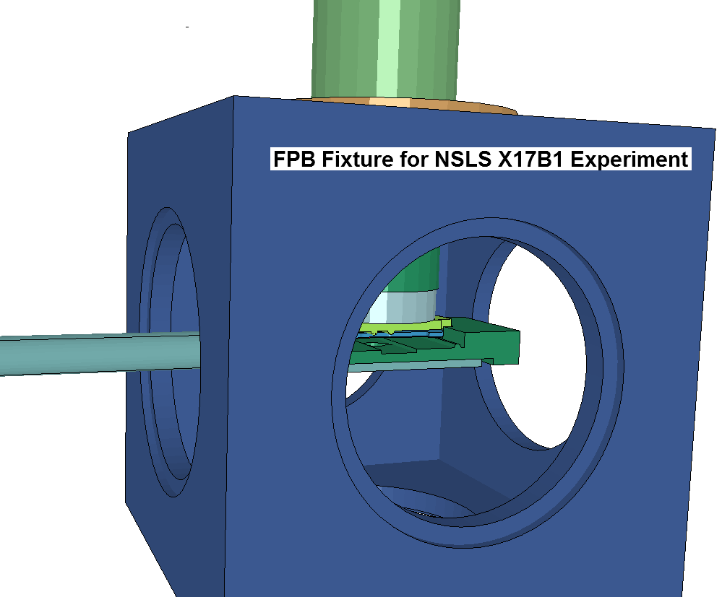
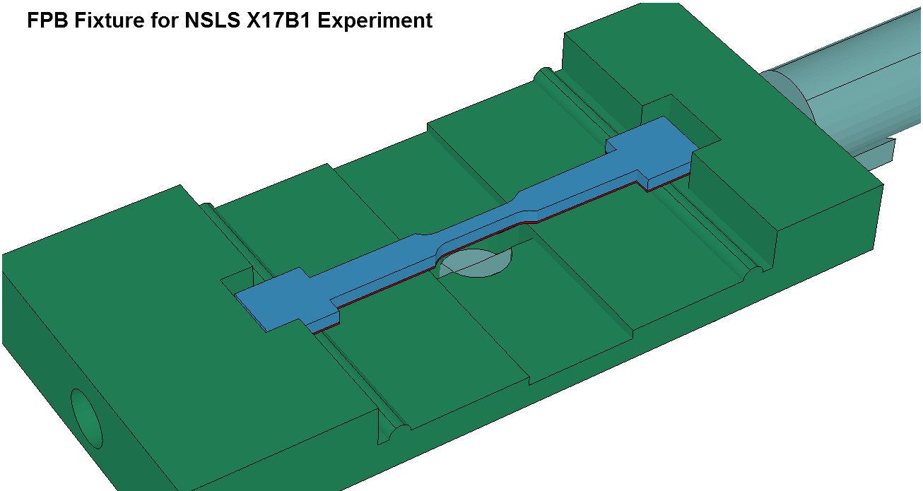
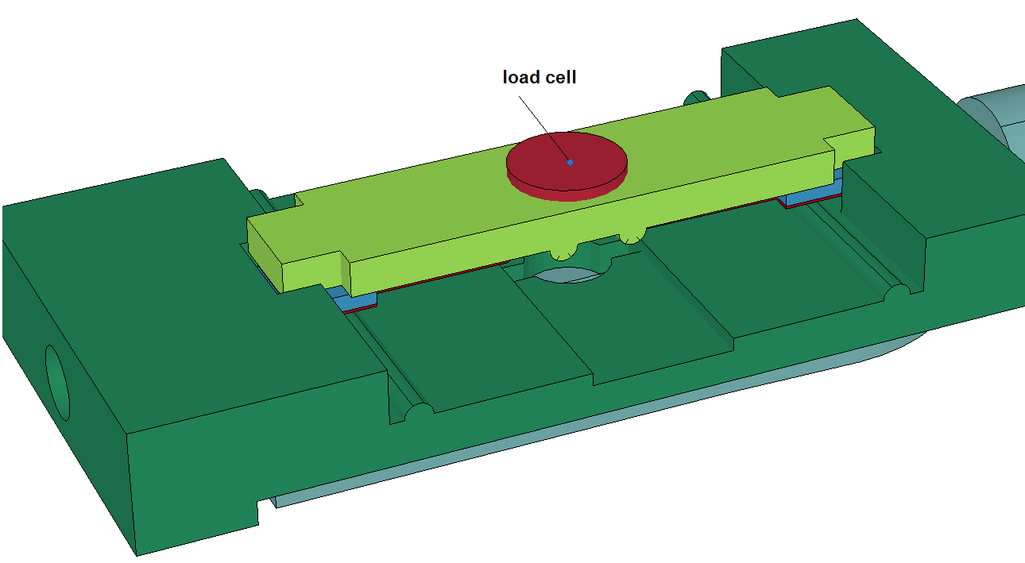
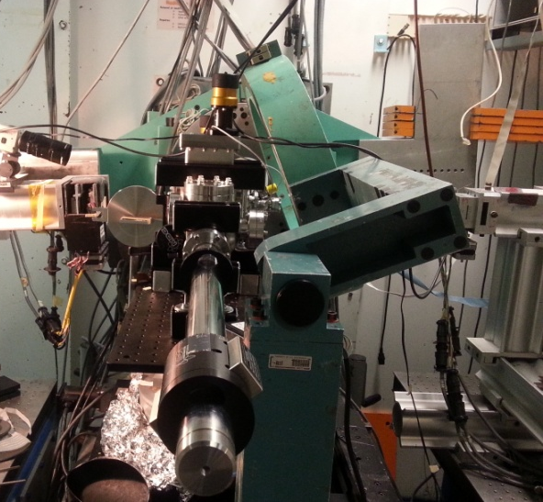
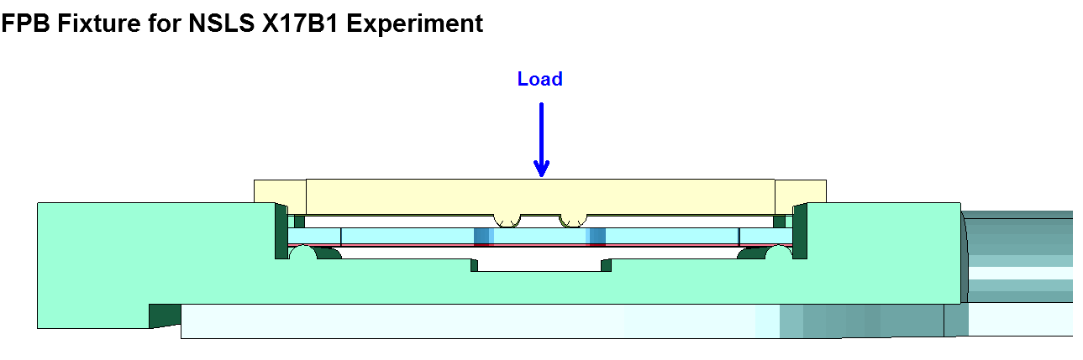
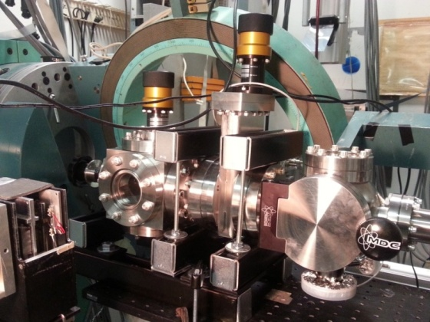
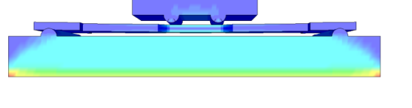
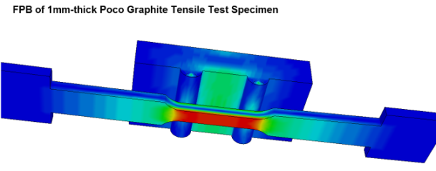
Multi-functional stage capable of handling
  Real size irradiated specimens, under vacuum and four point bending state of stress
  and eventually
  Heating/annealing via a portable, collimated laser beam
  Tensile stress-strain test
From concept to a versatile experimental stage at X17B1 beamline at NSLS

Slide 9
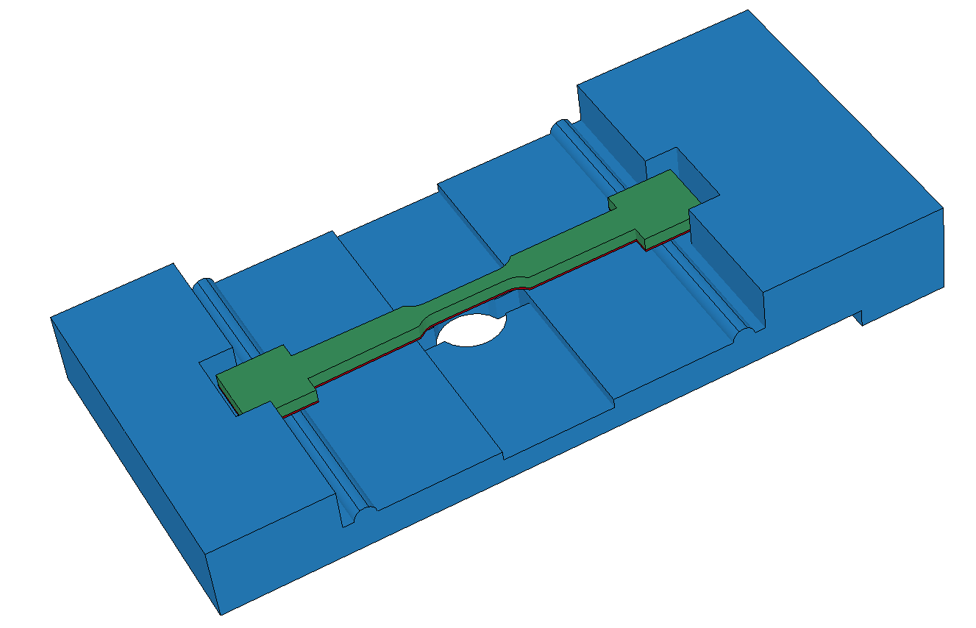
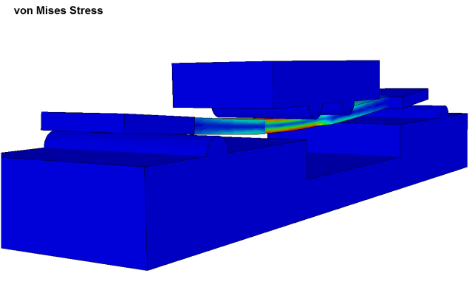
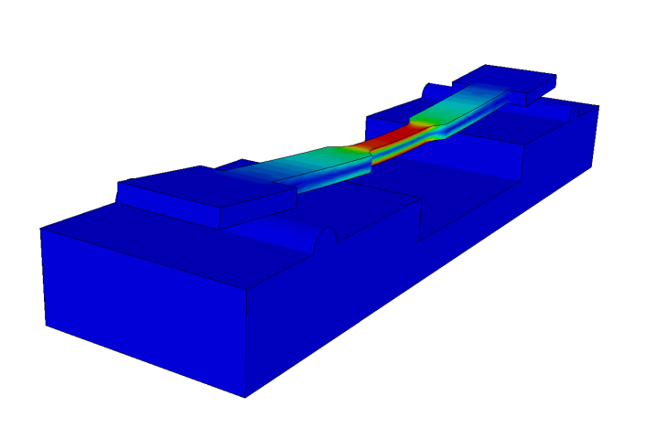
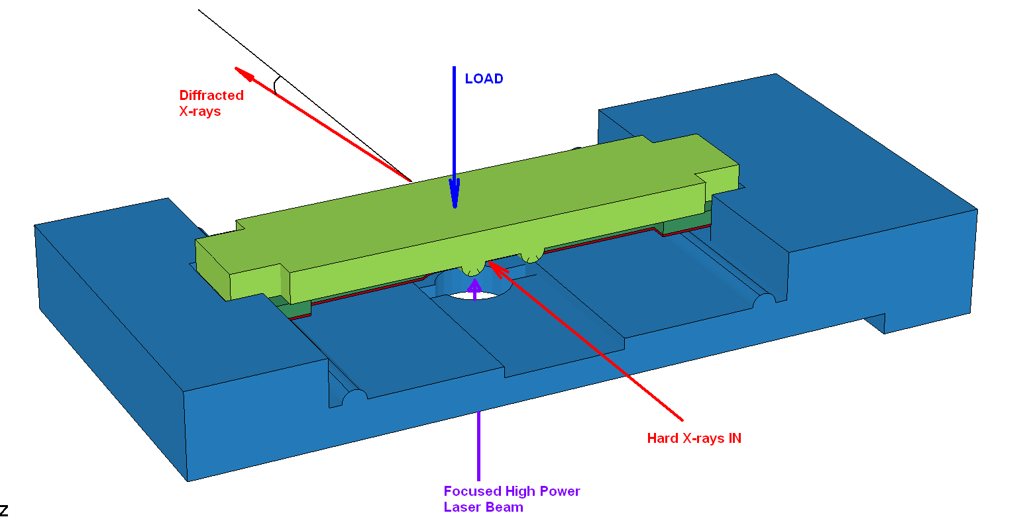
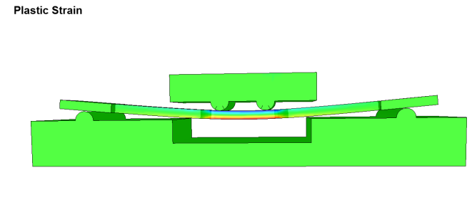
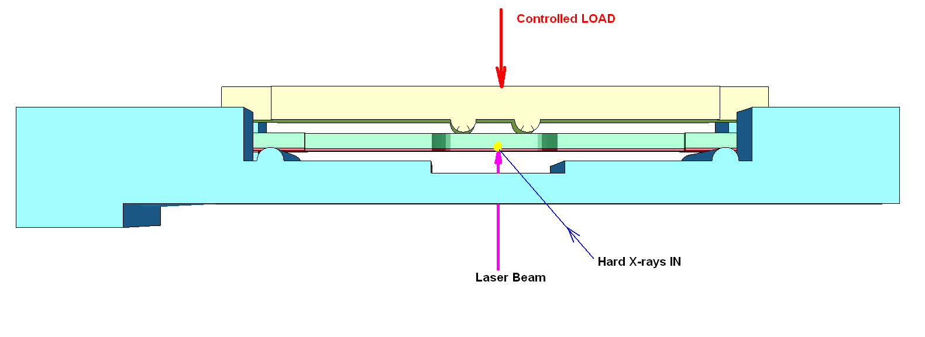
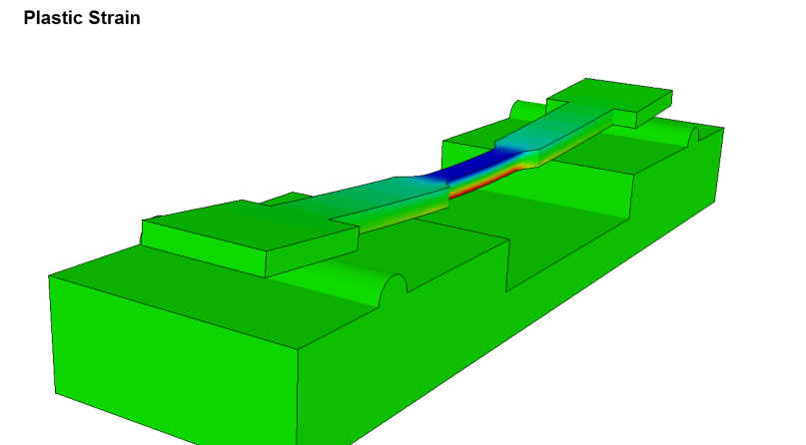
stress
strain

Slide 10
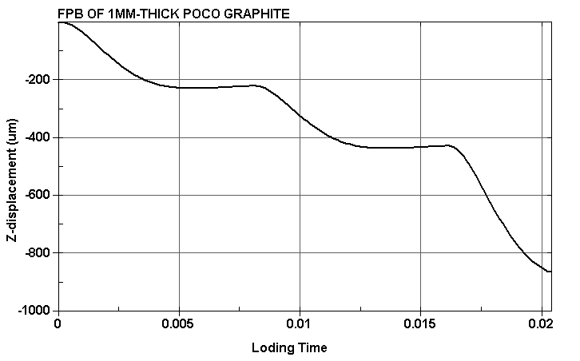
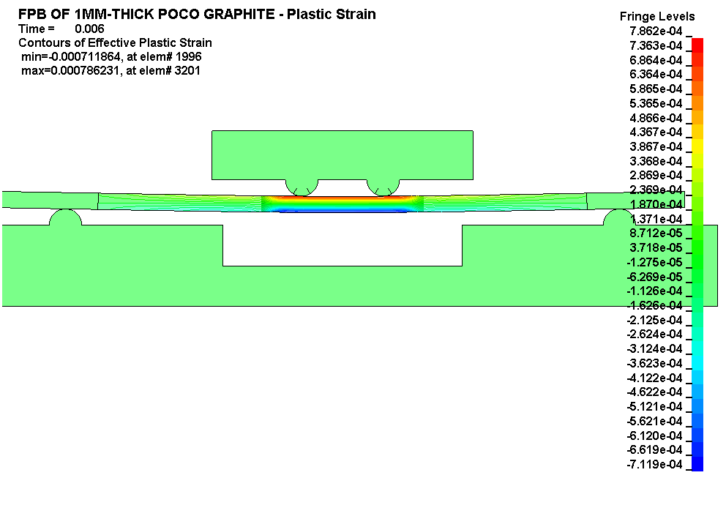
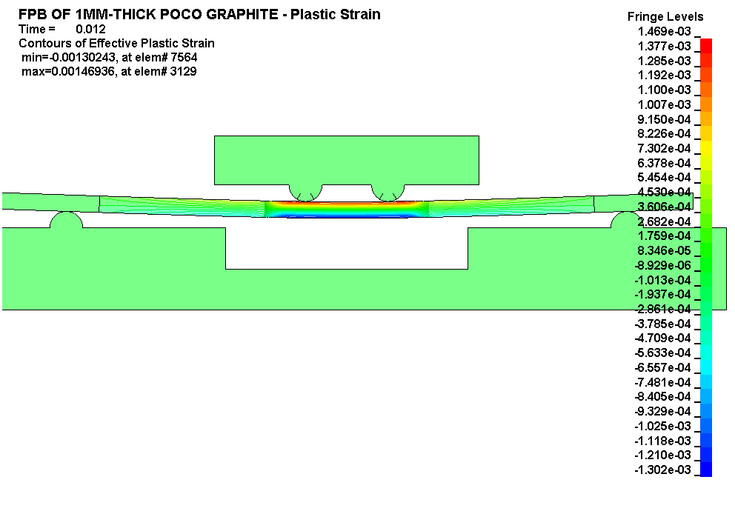



Load 1
Load 2
EXCELLENT matching with the experimental data at X17B1 using x-rays and loading to assess the displacement.
GOAL: LATTICE strain and global strain are very different in magnitude

Slide 11
STATE of PIE
8-week proton Irradiation at BLIP
Target Capsules (still extremely hot) were transported to the Hot Cell Facility for opening and sorting;
Capsules opened so far:
Two proton irradiated Mo
Proton irradiated Glidcop
Proton Irradiated Cu-CD
Low-dose proton irradiated Mo-GR
Neutron irradiated Cu-CD

Slide 12
Status of HiLuMI LHC Irradiation Damage Studies at BNL
BLIP
200 MeV proton irradiation (8 weeks): COMPLETED
Neutron irradiation from 112 MeV protons COMPLETED
Cooling of highly radioactive samples in Hot Cell Lab 66: ON-GOING
TANDEM VAN DER GRAAF
28 MeV proton irradiation: COMPLETED
X-ray Diffraction Experiments at NSLS
X-Ray diffraction studies for phase and strain mapping of some cold and irradiated samples: COMPLETED (to be continued in NSLS II in late 2015)
Data analysis: ON-GOING
X-ray Diffraction Experiments at NSLS II (XPD Beamline)
Beamtime proposal preparation at XPD (due Feb. 2, 2015)
CFN (BNL Center of Functional Nanomaterials)
Annealing and Electron Microscopy analysis: NOT STARTED (foreseen for beginning 2015)
IEF (BNL Isotope Extraction Facility)
Activity and dose measurements per sample: COMPLETED
γ-spectra for selected samples: PARTIALLY COMPLETED

Slide 13





Mo #1
Mo #2

Slide 14



Mo-GR Irradiated with 200 MeV protons full beam for 2 hours at BLIP before it was removed from beam due to overheating and closing the cooling channel
Shows signs of distress even with minimum beam

Slide 15



Mo X-ray Diffraction Studies (preliminary)

Slide 16





Slide 17




X-ray Diffraction of Mo Irradiated with 28 MeV focused PROTON beam at TANDEM

Slide 18




Cu_CD_unirrad
Cu_CD_Irradiated with FAST neutrons at BLIP

Slide 19





Mo-GR_unirrad
Mo-GR: Irradiated with modest FLUENCE of protons at BLIP
Mo-GR: Irradiated with modest FLUENCE of neutrons at TANDEM

Slide 20




Mo-Gr (unirradiated)
Mo-Gr (irradiated at Tandem with neutron flux)

Slide 21




Mo-Gr Irradiated at BLIP with 200 MeV Protons and very modest fluence
Scanning across the irradiated zone
Graphite <002>

Slide 22
SUMMARY
An extensive PIE (both macroscopic at the BNL Hot Cells and Microscopic using X-rays at the new Synchrotron and the XPD beamline and CFN for unirradiated materials studies)
The large volume of experimental data to-date from the different irradiations and X-ray diffraction as well as baseline studies will continue to be analyzed
THE CRUCIAL steps are those associated with the HEAVILY IRRADIATED array of Mo, Mo-Gr, Cu-CD and Glidcop at BLIP
Complete opening all capsules and sort all of them
  Conduct all the macroscopic studies (including photon spectra)
  Anticipate cool-down below levels that they can be studied at the XPD beamline of NSLS II (proposal under preparation)
ASSESS what materials from array should be looked further and which should not

Slide 23
PARENTHESIS
PRELIMINARY ASSESSMENT on LHC Collimator Materials of PHASE I
2-D Carbon/Carbon Composites
Graphite
Glidcop

Slide 24



Glidcop – Irradiated with 200 MeV protons
Unirradiated
Irradiated

Slide 25




Slide 26







Effects of Proton irradiation (180 MeV) on graphite and C/C composite
X-ray diffraction studies at NSLS
Unirradiated GRAPHITE
irradiated GRAPHITE

Slide 27



Effects of Proton irradiation (180 MeV) on graphite and LHC C/C composite

Slide 28








Global volumetric changes vs. crystal-level changes
Activation Energy

Slide 29




Irradiation and Thermal “anomalies” of Tungsten – Possible Similarities to Mo

