Slide 1
HiRadMat Experiments: Simulation, Design and Planning F. Carra^{1,2} A. Bertarelli, E. Berthomé, M. Borg, R. Bruce, F. Cerutti, A. Dallocchio, M. Garlasché, L. Gentini, P. Gradassi, J. Guardia, M. Guinchard, E. Quaranta, S. Redaelli, A. Rossi, O. Sacristan de Frutos, E. Skordis, G. Valentino and many others! (1) CERN – European Organization for Nuclear Research, Geneva, Switzerland (2) Politecnico di Torino, Turin, Italy 2nd EuCARD² ColMat-HDED annual meeting GSI, Darmstadt, Germany – 4 December, 2014

Slide 2
Outline
Context: low-impedance collimators (TCSPM)
TCSPM design
HRMT-23 experiment
Thermo-structural simulations
MultiMat experiment
Summary

Slide 3
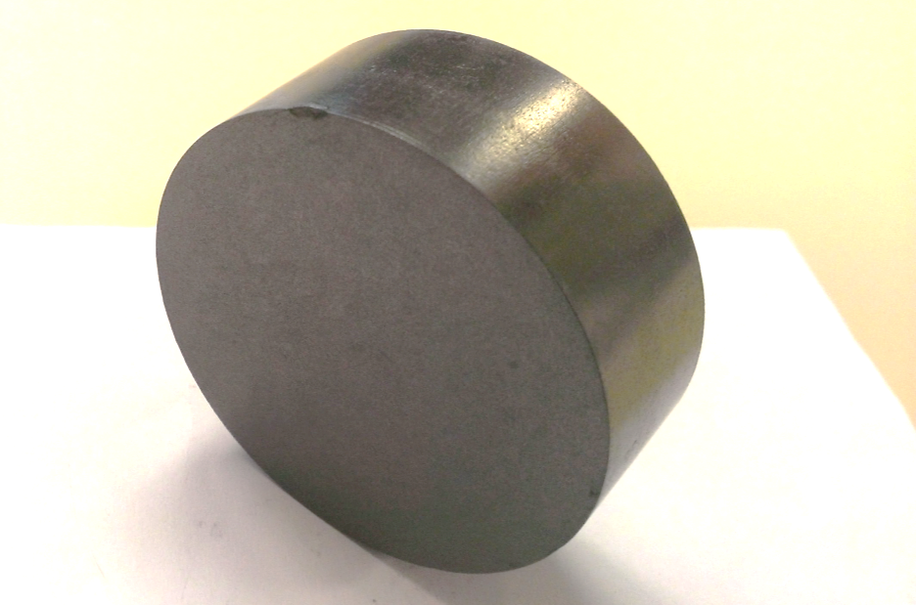
Context
Collimators are the highest contributors to machine RF impedance, which potentially leads to serious instabilities
Resistive-wall impedance is decreased by increasing the electrical conductivity (γ) of jaw materials
R&D is focusing on high-γ materials, also possessing good thermo-mechanical properties to guarantee robustness to beam impacts and geometrical stability in standard operation
Further material requirements include radiation hardness, UHV compatibility, industrial feasibility, machinability
MoGr and CuCD are the candidate materials for replacing CFC in primary and secondary collimators and will be tested in 2015 with a dedicated experiment in the HiRadMat facility
Main objective for collimation (related to WP11): install a new low-impedance secondary collimator prototype (TCSPM) in the LHC in early 2016

Slide 4
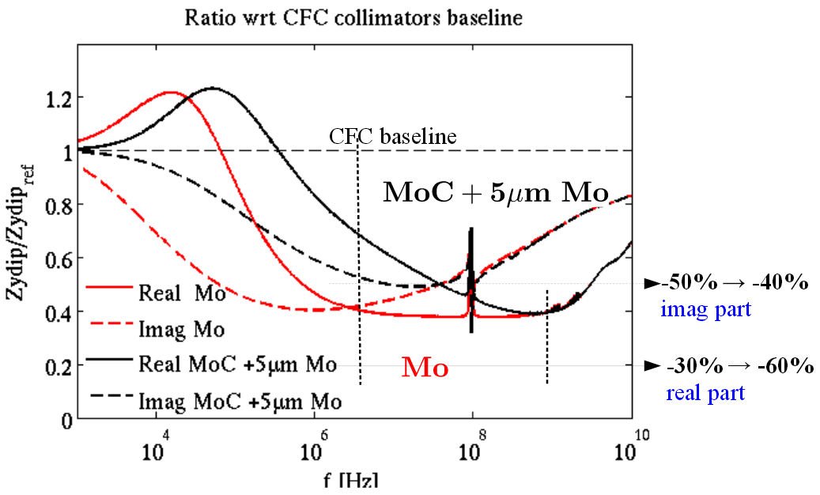
Context
Update on impedance calculations by N. Biancacci at 4th HiLumi annual meeting (Tsukuba, 19 November 2014)
Replacing CFC with MoGr in primary and secondary collimator leads to a ~30% reduction of the total collimators impedance integrated over the whole frequency spectrum
If the MoGr is coated with a 5 μm Mo layer, the reduction is ~50%
Courtesy of N. Biancacci

Slide 5
TCSPM Design
The design of a low-impedance secondary collimator embarking one of the novel composites has been completed
Active jaw can be made of CuCD or MoGr without any modification to the other components
1m active jaw made of 10 composite blocs
Clamped solution to avoid stress concentration on the material, allowing sliding between components with different CTE
Brazed cooling circuit
Screwed stiffener to increase the geometrical stability of the jaw
Screwed back stiffener
Housing
88
Bloc clamps
MoGr or CuCD blocs
Brazed cooling circuit

Slide 6
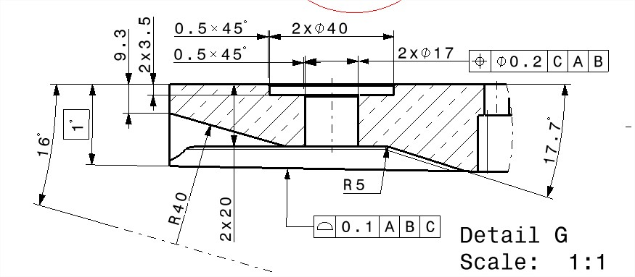
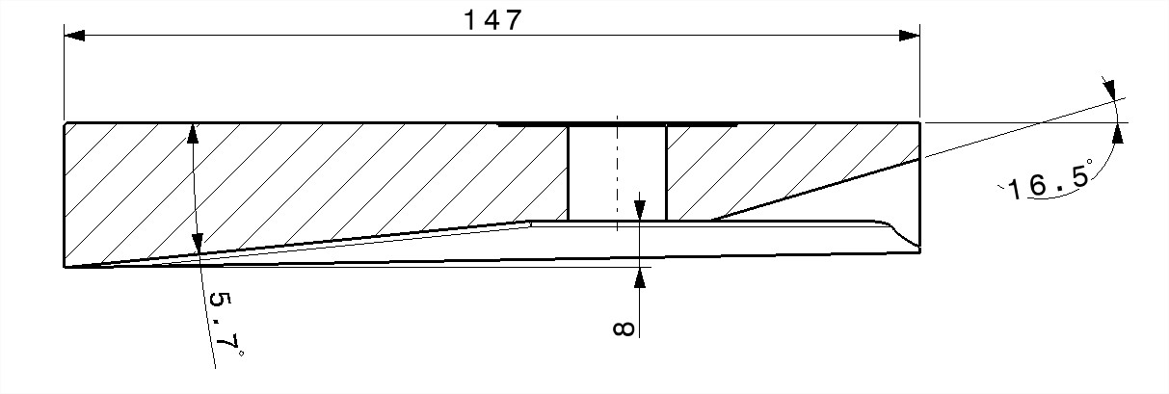
TCSPM Design
1000 mm
1294 mm
Jaw 100 mm longer than TCSP, allowing a reduction of the tapering angle to further decrease the collimator impedance
The tapering will also be made of a novel composite, to increase its robustness to particle beam impact
TCTP section
TCSX section

Slide 7
HRMT-23 Experiment
The final choice of the active jaw material can be made only after a robustness test against particle beam impacts at the highest possible intensity (ideally HL-LHC beam parameters)
With this goal, an experiment named HRMT-23 will be performed in Spring 2015 in the HiRadMat facility
Objectives of the experiment include:
Test collimator jaws under beam intensity and energy density as close as possible to HL-LHC parameters
Determine damage thresholds for secondary collimators with BPM buttons (TCSP) and for TCSPM
Acquire online data about response of complete jaws to beam impact
Assess impact consequences on jaws components after irradiation
Approved by the HiRadMat Scientific Committee and recently submitted to the HiRadMat Technical Board

Slide 8
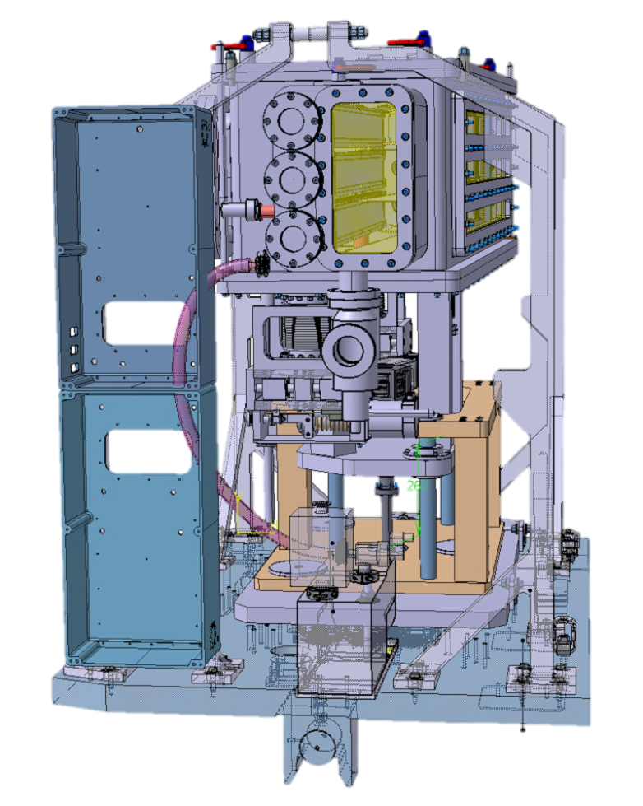
HRMT-23 Experiment
3 separate complete jaws extensively instrumented.
Stainless steel vacuum vessel (p > 10⁻³ mbar). Quick dismounting system to access and manipulate jaws in a glove box
Control system derived from HRMT-14. Horizontal (jaws) and vertical (whole tank) movement enabled.
Total expected number or protons ~ 3e14 p

Slide 9
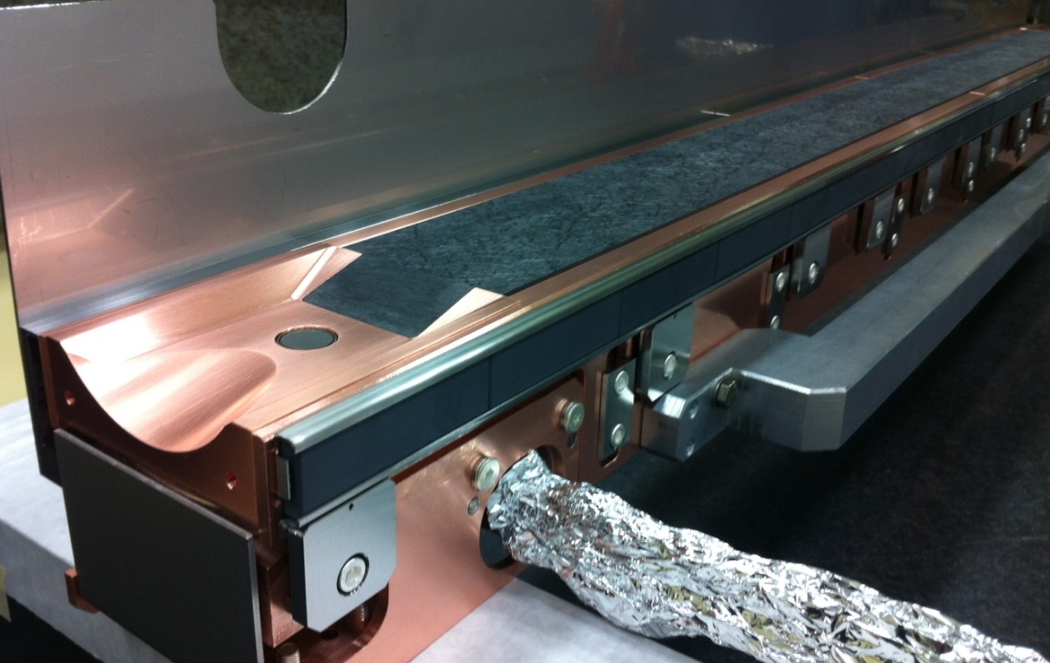
HRMT-23 Experiment
Currently envisaged proposal for Jaws:
TCSPM with 10 Molybdenum-Graphite inserts (some inserts possibly coated)
TCSPM with 10 Copper–Diamond inserts
TCSP jaw: to verify the resistance of CFC jaw, metallic taperings and BPM buttons to beam injection accident with HL-LHC parameters

Slide 10
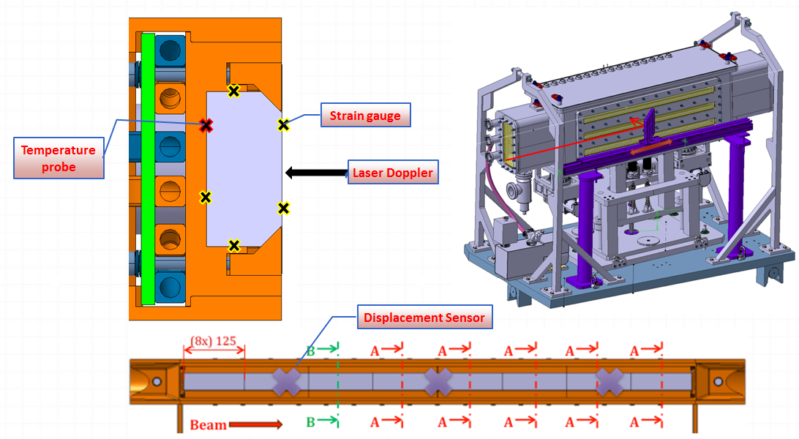
HRMT-23 DAQ
Instrumentation objectives:
Acquire online pressure waves
Acquire online temperatures
Detect online high speed vibrations
Detect online low speed oscillations
Detect offline permanent jaw deformation
Visually record jaw explosion / fragmentation
Detect offline internal material damage (e.g. delamination, cracks, tunneling …)
Record online pressure burst in water cooling pipes
Thermo-mechanical simulations necessary to evaluate the frequency and amplitude of the dynamic response!
Acquisition System: the DAQ hardware and infrastructure should be designed and implemented with a comprehensive view on a larger spectrum of HiRadMat Experiments ⇨ Synergy with and contribution from other experiments and projects

Slide 11
Simulations of HRMT-23 jaws
Thermo-structural simulations with ANSYS launched to evaluate the response of the three jaws (TCSG, TCSPM with CuCD, TCSPM with MoGr) to the beam impact
The results obtained are used as a reference for the design of the DAQ
Particularly important for the choice of the instrumentation are:
Temperatures reached in the measuring points
Frequency and amplitude of the shockwaves
Residual deformation of the jaw after the impact
HL-LHC beam injection error simulated (ultimate impact)
FLUKA energy maps courtesy of L. Skordis
Simulation parameters:
288 bunches
6.4∙10¹³ total protons (HL-LHC)
440 GeV
7.2µs impact duration
Beam sigma 1mm
Impact depth 5mm

Slide 12
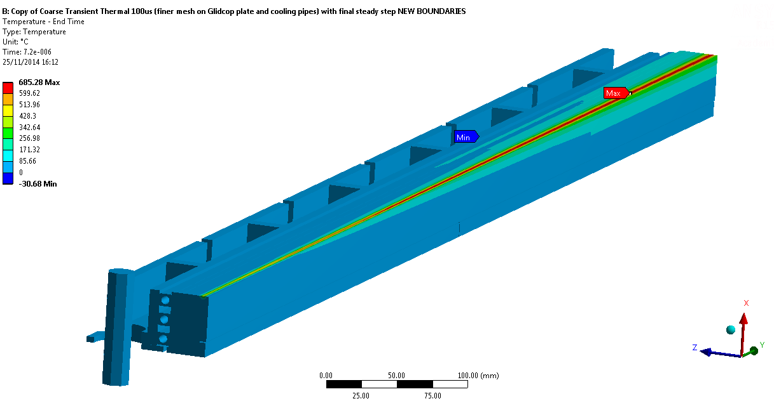
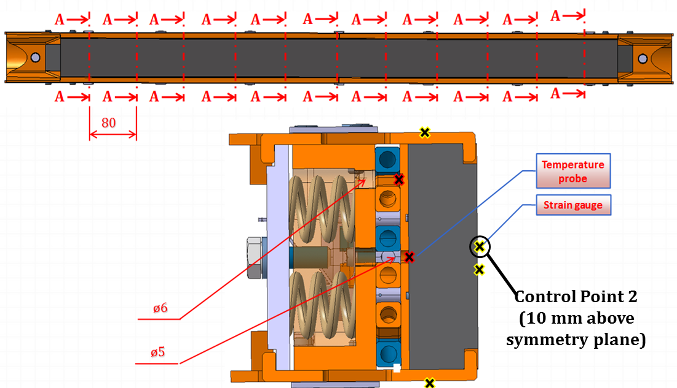
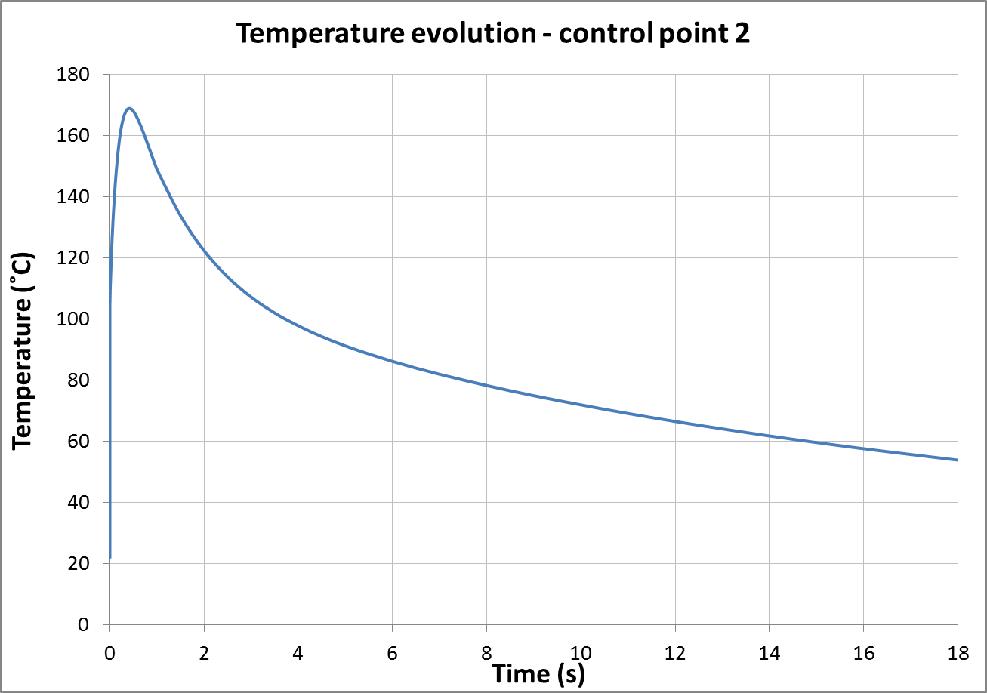
Simulations: TCSG
Temperatures
Maximum temperature reached on the CFC jaw: 685 ˚C
Maximum temperature in the instrumented points ~170 ˚C
Sensors glue is specified for operating temperatures up to 250 ˚C
Temperature at the impact
Beam

Slide 13
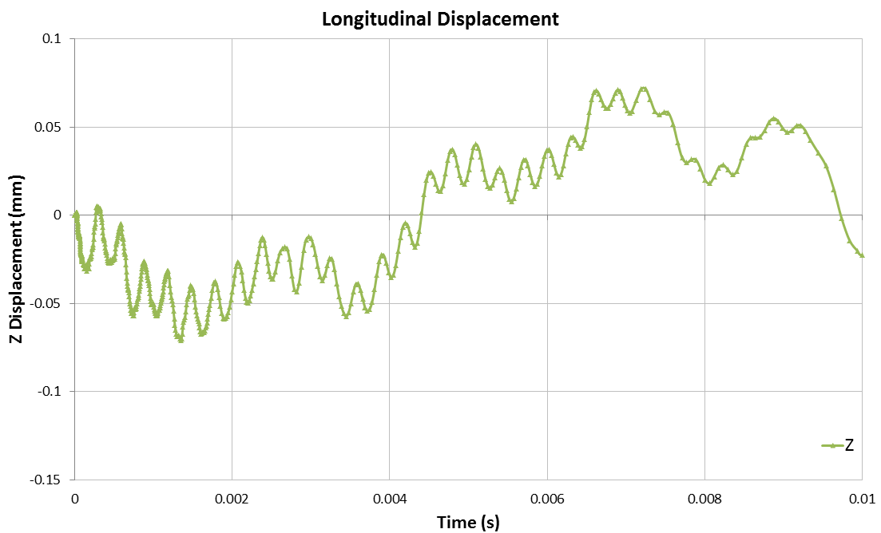
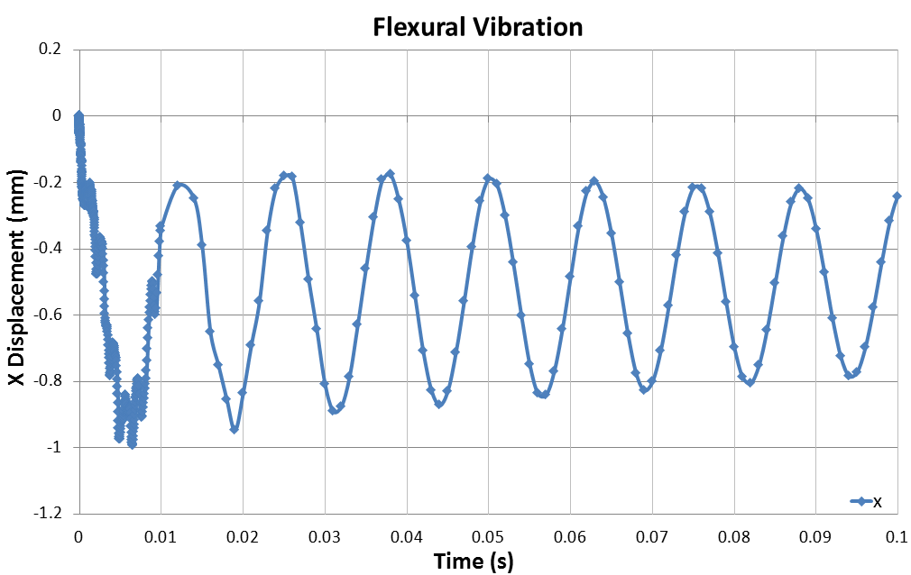
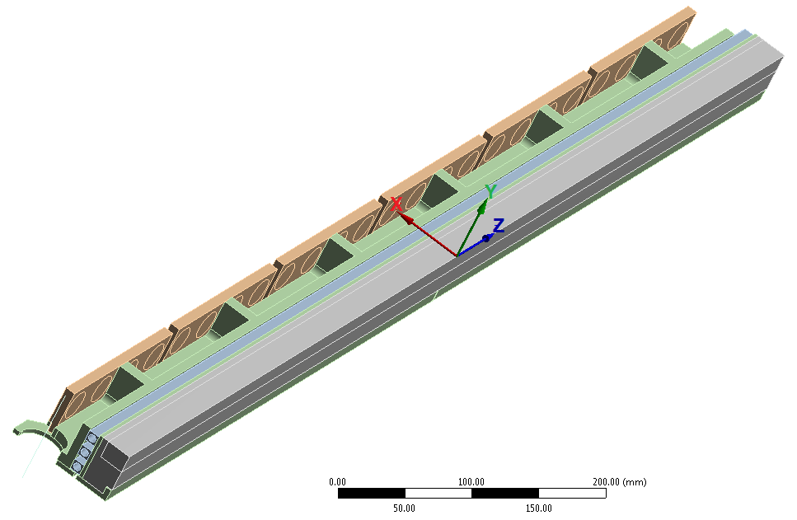
Simulations: TCSG
Shockwaves
The frequency of the shockwaves to be acquired ranges from 3 kHz (longitudinal) to 45 kHz (transversal); maximum strains to be acquired ~3000 microstrain
Jaw flexural oscillation has a frequency of ~80 Hz and a maximum amplitude of ~1 mm
Transverse velocity of the external surface ~5 m/s
300 μs
Reference System
12.5 ms

Slide 14
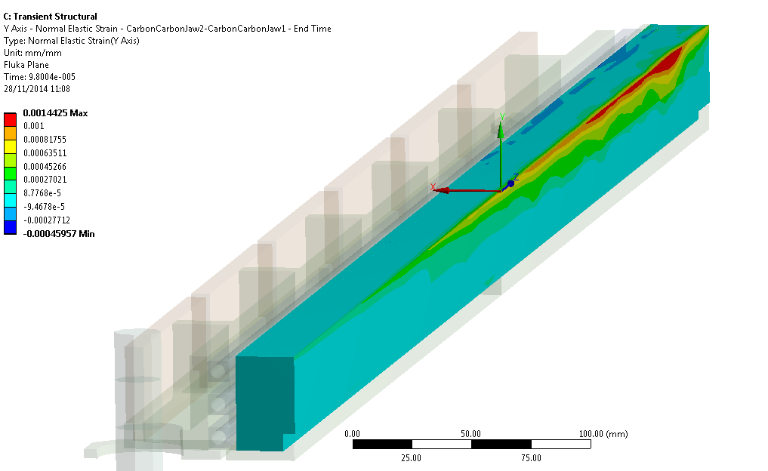
Simulations: TCSG
More details on measurements: “Thermo-physical and mechanical characterisation of collimator materials”, O. Sacristan
Does CFC withstand the impact?
Reference values for material ultimate strain come from flexural and compressive static measurements at EN/MME mechanical lab (T_{room})
Factor of 2 in resistance between Y and Z directions found by the measurements!
With this model, mostly critical is the high tensile stress/strain in Y direction
Reference System
Normal strains on CFC jaw
 | Maximum over time Simulation [microstrain] | Reference value Ultimate strain [microstrain]
ε_{+x} | 2000 | 2600
ε_{+y} | 1400 | 850
ε_{+z} | 740 | 1800
ε_{–x} | -10000 | -150000
ε_{–y} | -1000 | -8000
ε_{–z} | -560 | -7500
ε_{y} on CFC
ε_{y+}>1000
microstrain

Slide 15
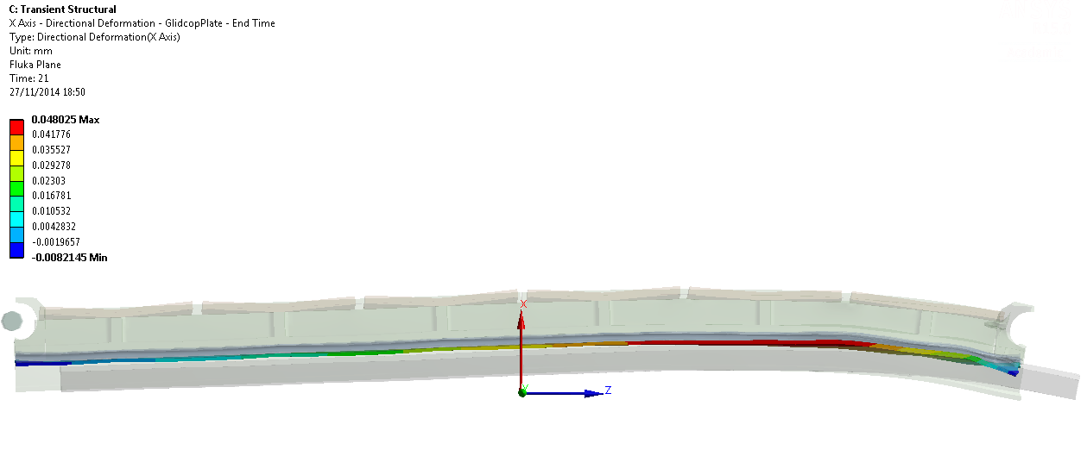
Simulations: TCSG
Plasticity of the Glidcop support and residual deformation
The compressive stress provoked by the impact on the Glidcop plate exceeds the material yield strength
Equivalent plastic strain is ~0.17%
This compressive state remains once the jaw comes back to room temperature → permanent deflection induced ~50 μm
Jaw permanent deflection
Beam

Slide 16
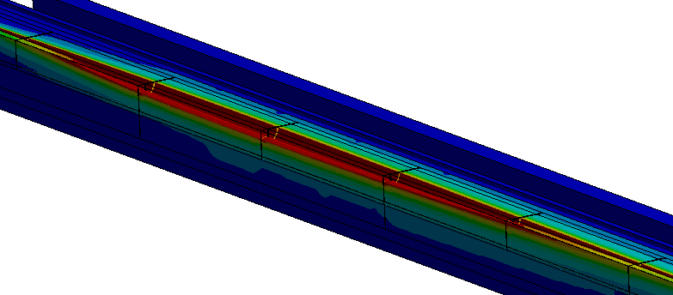
Simulations: TCSPM with CuCD
CuCD energy absorption is much higher than CFC and MoGr (higher density and Z)
Relevant jaw volume melted by the impact
A simulation with Autodyn can be useful to visualize the jaw explosion and ejecta propagation
New simulations will be performed at lower intensities to evaluate the material damage threshold
Complete characterization of CuCD is missing → CuCD samples are needed!
Temp (˚C)
Molten region!
T_{max}>>T_{melt,Cu}

Slide 17
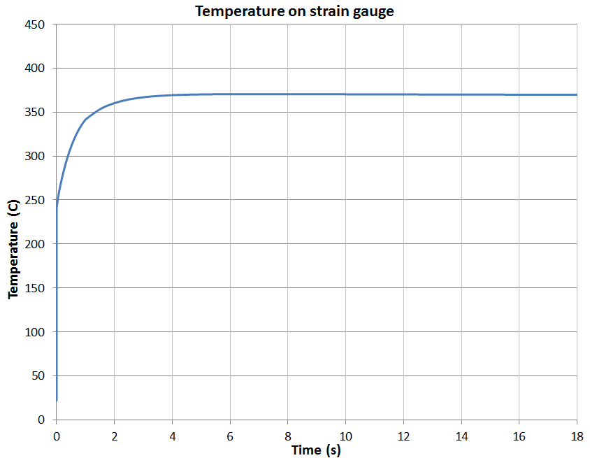
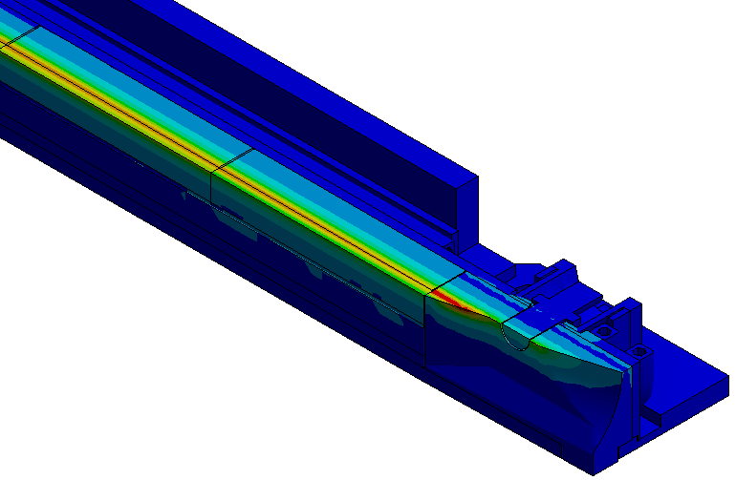
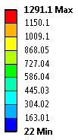
Simulations: TCSPM with MoGr
Temperatures
Maximum temperature on MoGr ~1200˚C, much lower than MoGr melting point (~2590˚C)
The temperature peak of 1290˚C is found on the Aluminium tapering → local melting
Another calculation performed with Glidcop tapering still shows T>T_{melt} → alternative solution to be found (proposal: MoGr tapering)
On the strain gauge closer to the beam impact, T~360˚C > T_{lim}
OK if this occurs only at the very last shot: the strain gauge will register the dynamic phenomenon before being detached by the incoming thermal wave
T_{max}<T_{melt,MoGR}
Al tapering
melting
Temp (˚C)

Slide 18
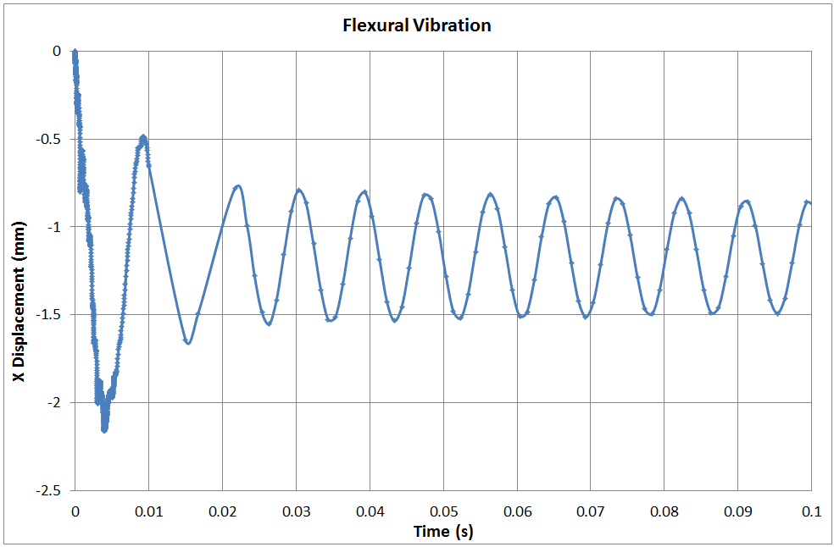
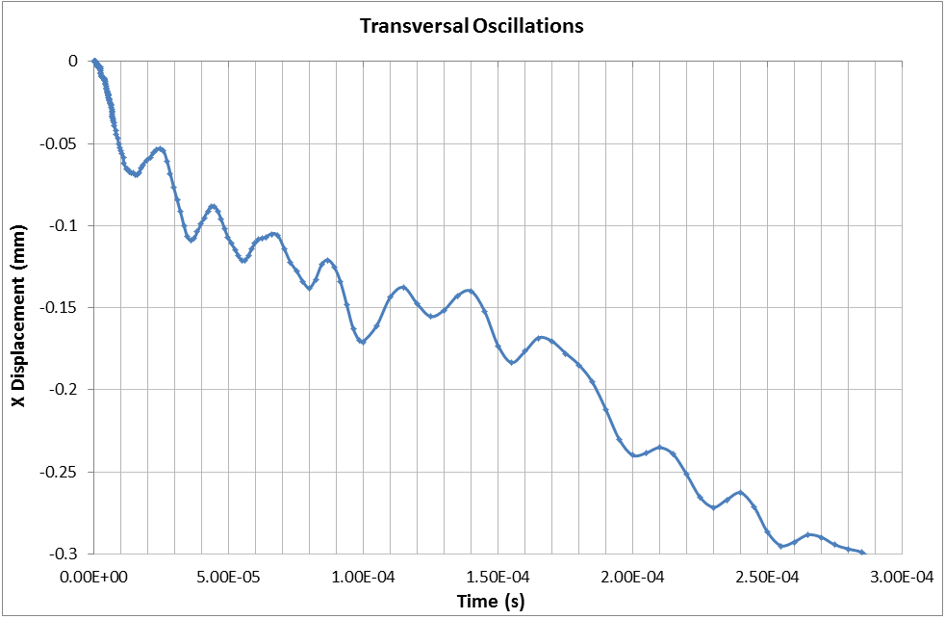
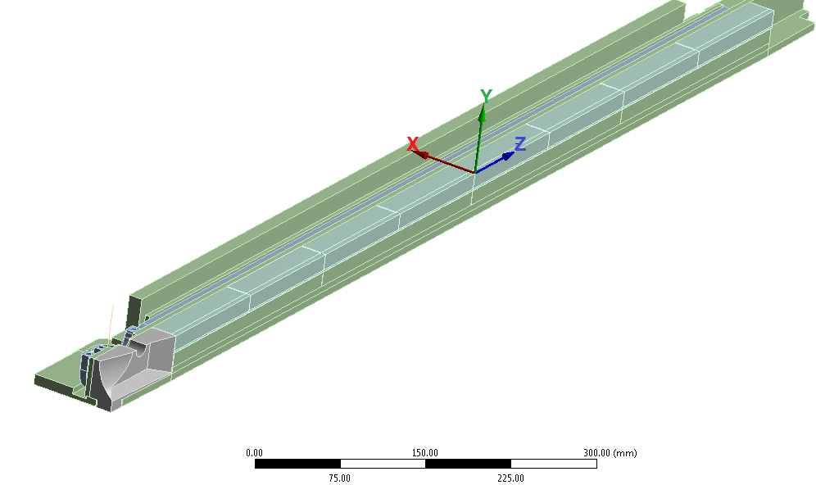
Simulations: TCSPM with MoGr
Shockwaves
The frequency of the shockwaves to be acquired ranges from 2.5 kHz (longitudinal) to 50 kHz (transversal); maximum strains around 5000 microstrain
Jaw flexural oscillation has a frequency of ~125 Hz and a maximum amplitude of ~2.1 mm
Transverse velocity of the external surface ~12 m/s
20 μs
Reference System
8 ms

Slide 19
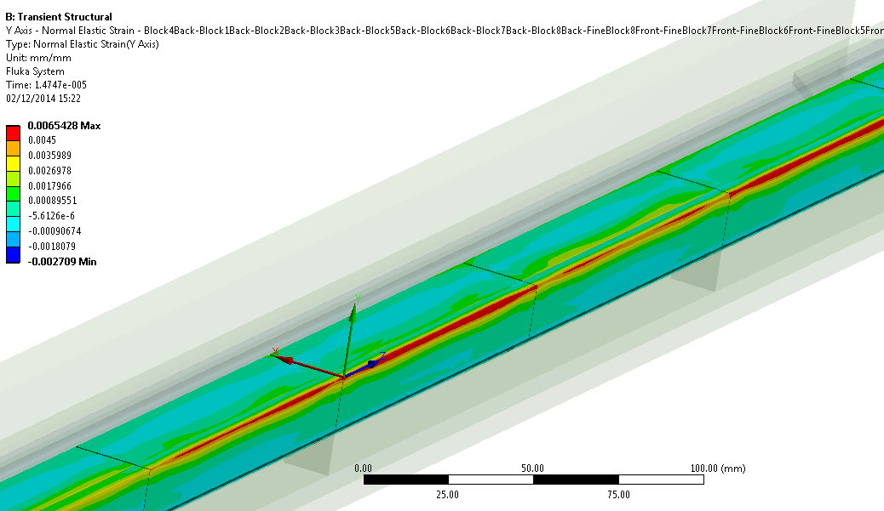
Simulations: TCSPM with MoGr
Does MoGr withstand the impact?
Flexural and compressive measurements on MG-5220-S grade
Higher strains than CFC jaw, but similar ratio against reference ultimate strain
Again, Y is the most critical direction
Plasticity induced on the Glidcop housing is similar to the TCSG case
Reference System
Normal strains on MoGr jaw
 | Maximum over time Simulation [microstrain] | Reference value* Ultimate strain [microstrain]
ε_{+x} | 4500 | 3000 (6530A grade: 4800)
ε_{+y} | 6500 | 2000
ε_{+z} | 1800 | 2000
ε_{–x} | -10000 | -21000
ε_{–y} | -5000 | -5600
ε_{–z} | -3000 | -5600
ε_{y} on MoGr
ε_{y+}>4500
microstrain
*MG-5220-S grade

Slide 20
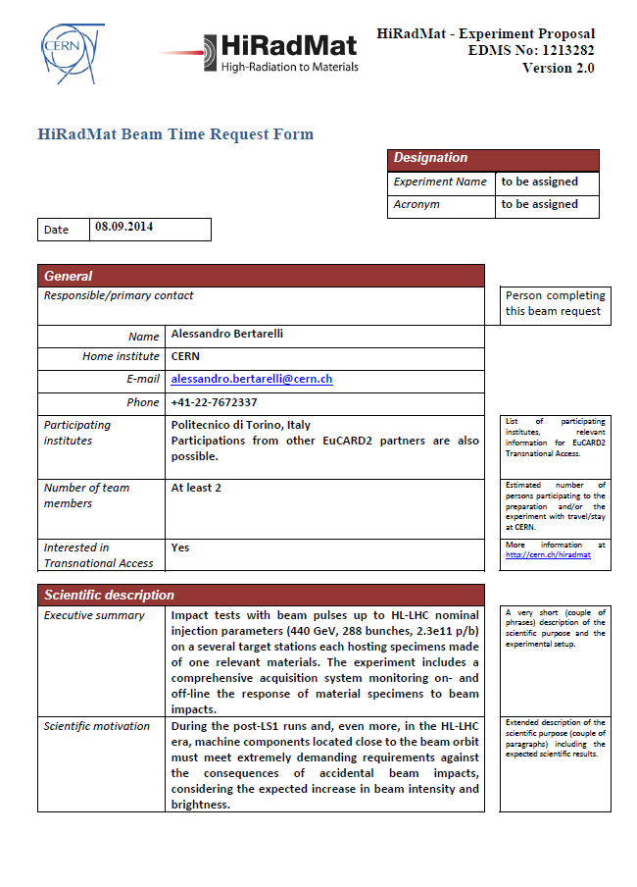
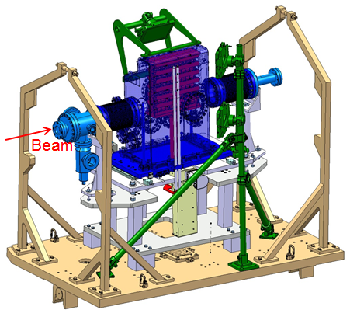
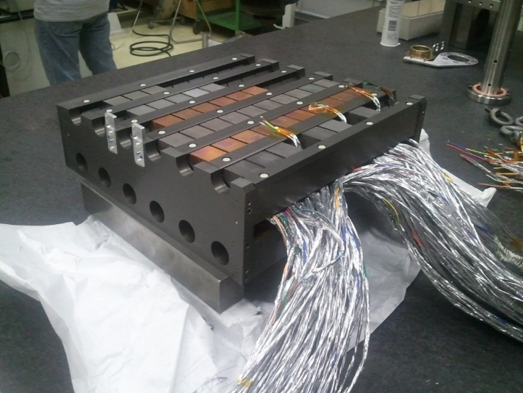
MultiMat Experiment Proposal
After HRMT-23, a multi-material sample experiment is proposed in the HiRadMat facility
Test material specimens of simplified shape of interest for LHC collimators, injection and dump absorbers, protection devices, etc
Possibility to create synergy with other projects such as TDI, TCDI, etc.
Proposal to join forces, optimize resources and share costs between BE/ABP, BE/OP, EN/MME, EN/STI, TE/ABT …
Beam intensity up to 288 bunches, 2.3e11 p/b, beam size down to 0.5x0.5 mm² (down to 0.3x0.3 mm² if LIU intensity cannot be reached)
Design and instrumentation inspired by HRMT14 experiment. 12 target stations each hosting several specimens
20

Slide 21
MultiMat Design Main Features
Design of the experiment inspired by HRMT14
HiRadMat standard test stand table
2 beryllium/C-C windows withstanding up to 288 SPS bunches, sigma 0.3x0.3 mm²
Vacuum Tank (primary vacuum) containing up to 12 target stations
Each station hosting several specimens (possibly of different shapes) made of one material
Each stations aligned through 2 DoF actuation system (beam-based alignment). Required position tolerance: ±0.2 mm
Estimated size: 2100x1200x400mm
Estimated weight: 1600kg

Slide 22
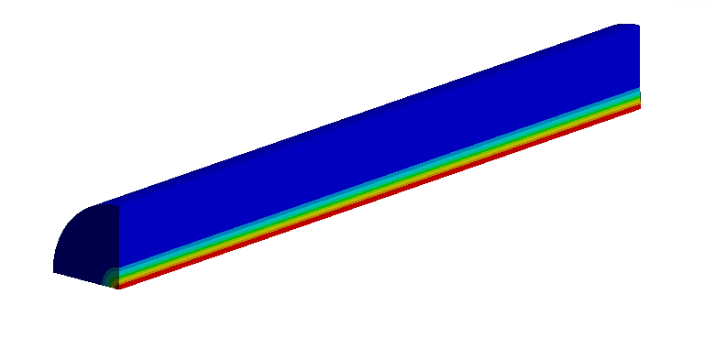
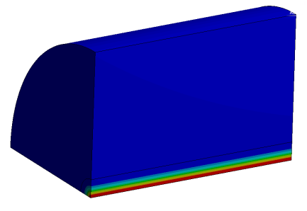
MultiMat Materials
Materials to be tested will likely include:
Molybdenum Carbide - Graphite
Copper - Diamond
Other Ceramic-Graphite composites (under development)
Carbon/Carbon (both 2D and 3D grades)
Graphite
Boron Nitride
Glidcop
Molybdenum
Tungsten heavy alloys (Inermet, W-Re etc.)
Specimen shapes and dimensions under optimization to improve measurements sensitivity and explore different pressure wave regimes
∅=30 mm, L=40 mm
∅=12 mm, L=100 mm

Slide 23
Summary (1/2)
Bringing LHC beyond nominal performances (HL-LHC) will require a new generation of collimators embarking novel advanced materials
An ambitious R&D program is focusing on the development, simulation and test of such materials: the most promising are CuCD and MoGr
In particular, the use of these composites would decrease the collimators impedance by a factor of 2
A new collimator design based on these two novel materials has been studied: thanks to its flexibility, it permits a late choice of the active jaw material
To provide indications about the material choice, and to validate the proposed design and the simulations performed, a new experiment called HRMT-23 is scheduled in 2015 in HiRadMat
On the basis of HRMT-23 results, a TCSPM prototype will be built and installed in the LHC in early 2016
A future experiment to study in details materials for BIDs, called MultiMat, has also been proposed to the HiRadMat management and is tentatively scheduled in 2016

Slide 24
Summary (2/2)
Thermo-structural simulations of the three jaws installed in HRMT-23 have been performed, to be used as a reference for the DAQ design
A linear model has been imposed for the active jaw and the simulated case is the beam injection error HL-LHC (6.4E13 protons @440GeV)
Preliminary results show that CFC and MoGr are at the limit of their resistance (or above); plastic deformation of the Glidcop housing is expected, as well as local melting of the metallic tapering
CuCD jaw: relevant damage, with extensive molten volume. Simulations to be performed at lower intensities in order to predict the threshold of damage
Comprehensive CuCD characterization is needed!
Proposed models will be improved to consider material pseudo-plasticity and tension/compression asymmetry, as well as temperature and strain-rate contributes to the mechanical resistance

Slide 25
Thank you for your attention!

Slide 26
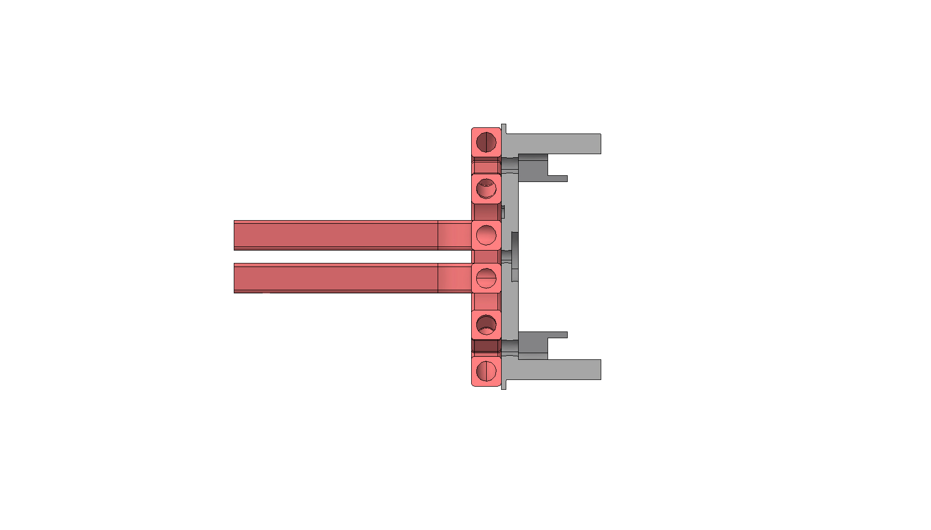
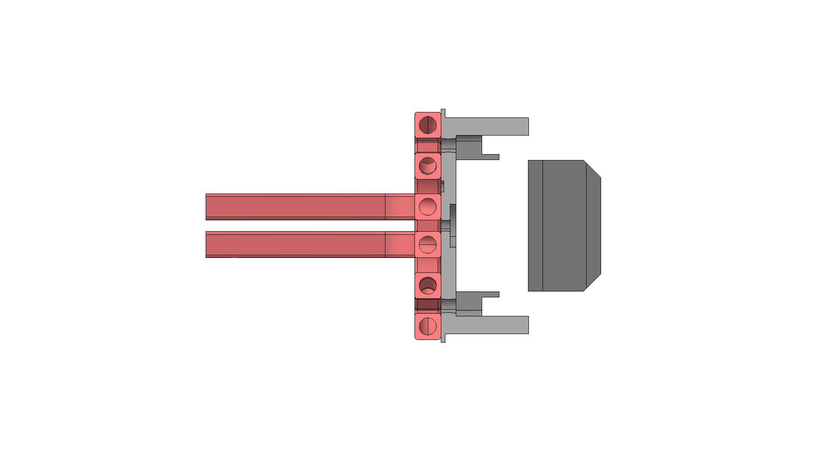
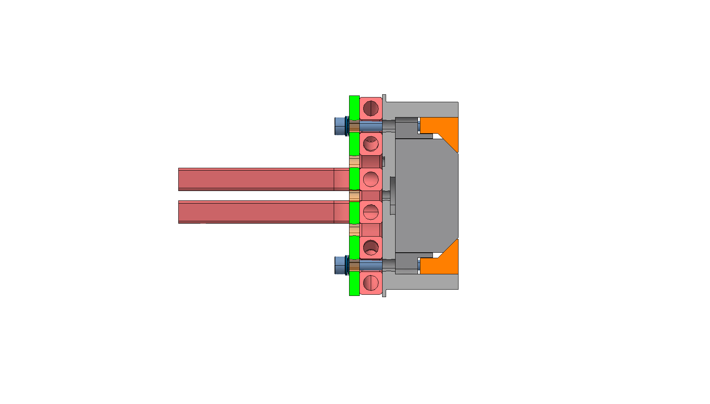
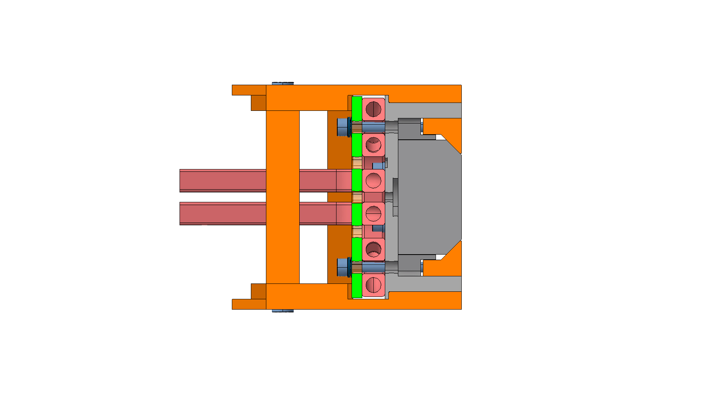
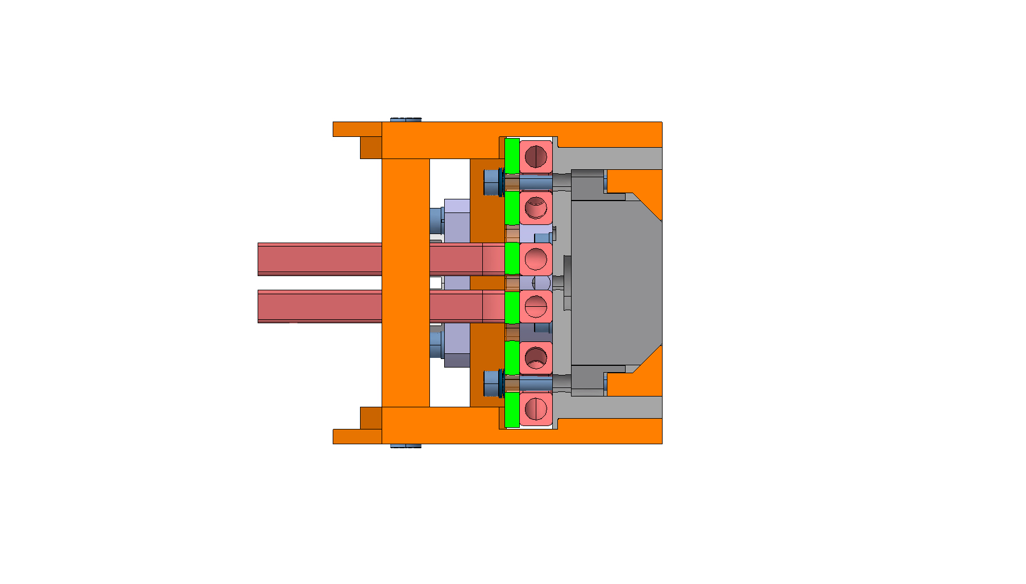
TCSPM Assembling Procedure

