Slide 1
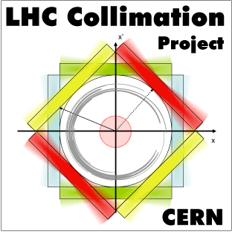
Introduction to the 2nd EuCARD2 ColMat HDED annual meeting
GSI, Dec. 4-5, 2014
Adriana Rossi on behalf of

Slide 2
ColMat-HDED collaboration and beyond
ColMat-HDED partners
Partnership agreement with CERN (KN2045)
Collaboration CERN with US-LARP
Notes:
Main founding to Kurchatov lab. From CERN Collimation Project
Complementarity with irradiation tests at BLN, different energies and additional materials tested .
Glidcop, Molybdenum, CuCD, MoGr
BNL Features:
Irradiation with proton beam at 200 MeV
Indirect water cooling and T~100°C (samples encapsulated with inert gas)
Thermo-physical and mechanical characterization for fluence up to 10²⁰ p/cm²
Possibility to irradiate with neutrons (simulate shower on secondary coll.)

Slide 3
Why new collimator materials
Accelerator performance with ever increasing beam brightness and stored energies pushes material requirements for collimators into more challenging grounds: Collimators (and all Beam Intercepting Devices) are inherently exposed to extreme events.
Several effects can cause continuous beam losses (few % of the beam):
Collisions in the interaction points (beam burn up)
Interaction with residual gas and intra-beam scattering
Beam instabilities (single-bunch, collective, beam-beam)
Dynamics changes during OP cycle (orbit drifts, optics changes, energy ramp, ...): “operational losses”
Beam resonances.
Capture losses at beginning of the ramp.
Injection and dump losses.
Fast beam losses (1 -few bunches) due to injection or dump failure
Studies on Collimation Materials
Numerical simulations (tracking, thermo-mechanical, equation of state, …)
Material R&D
Validation before machine installation (thermo-physical, mechanical, irradiation studies, HiRadMat)
Higher robustness (LHC beam energy density up to 15 GJ/mm², 2-3 orders > other machines).
Lower impedance since collimators give, by far, the highest contribution to machine impedance, potentially leading to serious beam instabilities.
Larger resistance to radiation (1E16 p/y doses in LHC betatron cleaning insertion)
Higher absorption (clean efficiency for machine protection)

Slide 5
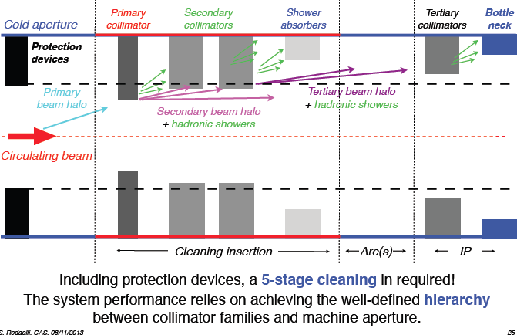

Slide 6
Programme Day 1
Progress, in particular with materials R&D, radiation damage assessment and mechanical characterisation of materials for collimators.
How do different materials behave?
Outcome of the meeting should be:
A work plan for future work
Immediate deadline: M24 milestone (MS70 Present results on material damage from irradiation).
Define contribution of partners to ongoing beam-test programme at CERN.
Notes:
Già per il caso attuale vogliamo migliorare il sistema, e HL-LHC richiede parametri + stringenti
Primari e secondari – specifiche
Terziari – specifiche
Definire lista di contributi dei vari istituti ai vari programmi (programmi di collimazione che vanno menzionati).

Slide 7
Day 1 morning
Adriana ROSSI
Introduction, scope and programme 10:00 - 10:15
Oscar SACRISTAN DE FRUTOS
Thermo-physical and mechanical characterisation of collimator materials (20 + 10 min discussion)
10:15 - 10:45
Lorenzo PERONI
New methods for high strain rate and high temperature characterisation of collimator materials (20 + 10 min discussion) 10:45 - 11:15
Federico CARRA
HiRadMat experiment: simulation, design and planning (20 +10 min discussion) 11:15 - 11:45
Elena QUARANTA
Updated failure scenarios and damage limit of TCTs and status of SixTrack simulations (20 + 10 min discussion) 11:45 - 12:15

Slide 8
Day 1 afternoon
Visit to GSI 13:45 - 15:00
Marilena TOMUT
GSI tests status and preliminary results (45 + 15 min discussion) 15:00 - 16:00
Coffee break 16:00 - 16:30
Alexander RYAZANOV
NRC_KI tests status and results (20 + 10 min discussion) 16:30 - 17:00
Nikolaos SIMOS
BNL tests status and preliminary results (20 + 10 min discussion) 17:00 - 17:30
Adriana ROSSI
Wrap–up, discussion, and future plans (including planning of future meetings and deadlines)
17:30 - 18:00

Slide 9
Programme Day 2
Present and discuss different methods to calculate DPA
Is DPA a valid and comprehensive figure of merit for damage? If not what else?
Equivalent damage from different beams (ion, proton, energy, flux, fluency), will give similar values of DPA?
A DPA value has the same meaning for different materials?
What property degradation can we infer? Is it function of the material?
How can we extrapolate to different conditions (LHC in particular)?
What values for LHC nominal case (7TeV – nominal losses)?
Outcome of the meeting should be a consensus on how calculate DPA and a planning for future studies and extrapolations.

Slide 10
Day 2 morning
Adriana ROSSI
Introduction: can we use DPA as figure of merit? 09:00 - 09:15
Nikolai MOKHOV
Radiation damage at high energy: theoretical model and data (30 + 15 min discussion)
09:15 - 10:00
Anton LECHNER
Estimation of DPA at CERN (15 + 10 min discussion) 10:00 - 10:25
Coffee break 10:25 - 10:55
Marilena TOMUT
Graphite radiation damage (20 +10 min discussion) 10:55 - 11:25
Alexander RYAZANOV
DPA calculations at NRC KI (30 + 15 min discussion) 11:25 - 12:10
Warm-up discussion 12:10 - 12:40

Slide 11
Day 2 afternoon
Lunch 12:40 - 14:30
Alessandro BERTARELLI
Preliminary summary on DPA and discussion 14:30 - 16:00
Alessandro BERTARELLI
Wrap-up and future plans for DPA studies 16:00 - 17:00

