Slide 1
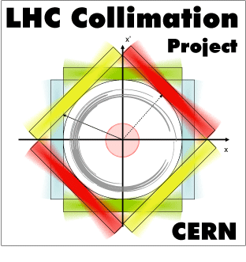
2nd EuCARD2 ColMat HDED annual meeting wrap-up
GSI, Dec. 4-5, 2014

Slide 2
Wrap-up
F. Carra: HL-LHC scenario, CuCD major failure, CFC and MoGr minor damage
SR: MoGr and CuCD mandatory to achieve -50% impedance for HL-LHC scenario
MT: remarked differences in behaviour of graphite in MoGr and CFC
O. Sacristan: latest results of thermo-mechanical characterization of MoGr and CFC, CuCD samples missing
Action: provide CuCD samples before Christmas (M. Kitzmantel)
Important outcome: different resistance in the 2 planar directions of CFC (previously considered as transversally isotropic material)

Slide 3
Wrap-up
L. Peroni: dynamic characterisation of collimator material at high temperature
limited heating up to 1000°C by the stainless steel equipments
CuCD can be tested in the facility devised for brittle materials
strong tension/compression asymmetry found in Inermet180
Next step: improvement of setup to test brittle material (ex: MoGr, CuCD, CFC..)
E. Quaranta: failure scenarios for TCTs and SixTrack simulations with advanced collimator
impact distribution coordinates in TCT for different scenarios available for FLUKA and AUTODYN simulations
compare with FLUKA and other codes composite parameters used to model MoGr and CuCD in SixTrack
AlexR: take into account electronic contribution to energy deposition calculated by FLUKA

Slide 4
Wrap-up
M. Tomut: results of irradiation tests at GSI on LHC collimator material samples
irradiated carbon fibers showed strong radial contraction
beneficial effect of heat treatment on MoGr radiation-induced deformation
thermal diffusivity degradation in MoGr very fast at low fluencies with respect to CuCD, but plateau reached at higher fluencies. Much better behaviour than pure graphite
Intermediate material meeting in February to discuss latest results more in details before the milestone due in May 2015
Marilena to continue and finalise characterisation of irradiated samples

Slide 5
Wrap-up
A. Ryazanov: results on MoCuCD
N. Simos: results of irradiation tests at BNL on LHC collimator material samples
wait for the most radioactive samples to cool down before can be handle for measurement
Action: complete analysis of irradiated samples (student from CERN will be sent in February to follow them up)

Slide 6
Actions
Simulations Federico: need to review impact parameters for HiLumi. Find worst case in therms of impacting beam sizes (after ongoing tests with old reference case).
Action for RHP: new samples for characterization by end 2014.
Action CERN and Graz: finalize proposal for microphone measurements for HRM tests, with clear responsibilities for different experiments.
CuCD tests at polito with samples without screw threads?

Slide 7
Actions
Beam tests GSI:
plan and prepare well tests during short run after summer 2015 (New samples, final grades, for final feedback on prototype)
need to compile a list of available data, with action plan for detailed analysis. Who/how other teams can help?
Important for official EU documents due in 6 months.
Beam tests BNL:
Same as second point for GSI.
What is the impact of different grades of MoGr, as samples older than 2 years were irradiated?
Strategy for analysis to be defined in order to optimize the exploitation of beam tests. How do we analyse the X-ray data?

