Slide 1
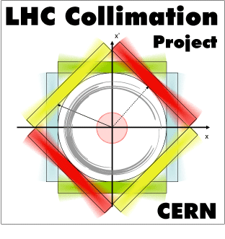
2nd EuCARD2 ColMat HDED annual meeting day 2
GSI, Dec. 4-5, 2014
Adriana Rossi on behalf of

Slide 2
Programme Day 2
Present and discuss different methods to calculate DPA
Is DPA a valid and comprehensive figure of merit for damage? If not what else?
Equivalent damage from different beams (ion, proton, energy, flux, fluency), will give similar values of DPA?
A DPA value has the same meaning for different materials?
Is DPA dependent on how fast energy is deposited? And on temperature during tests?
How can we extrapolate to different conditions (LHC in particular)?
What values for LHC nominal case (7TeV – nominal losses)?
Outcome of the meeting should be a consensus on how calculate DPA and a planning for future studies and extrapolations.

