Slide 1
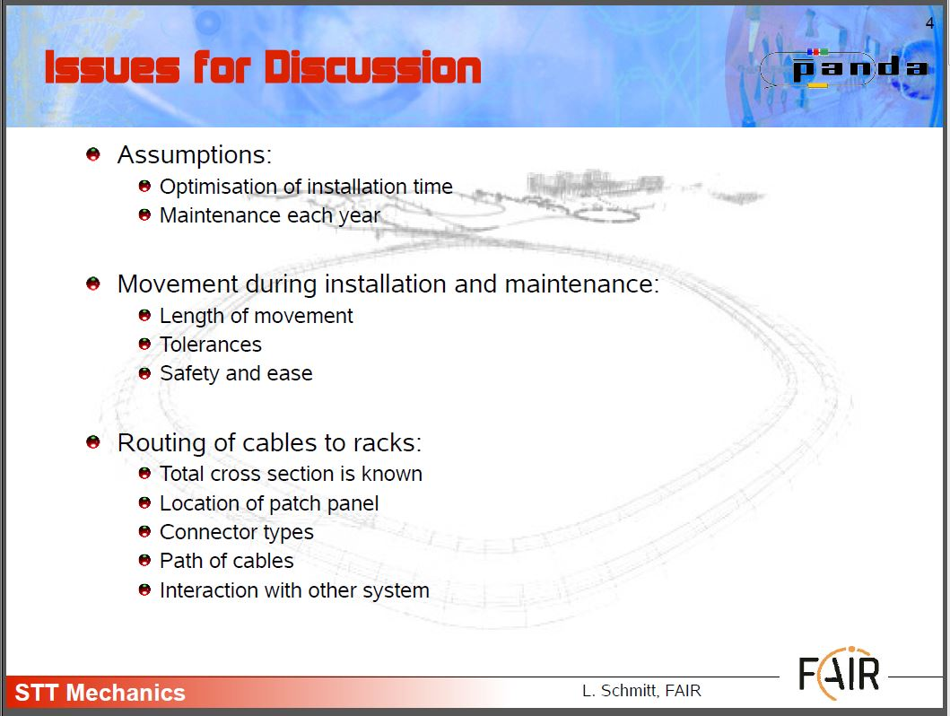
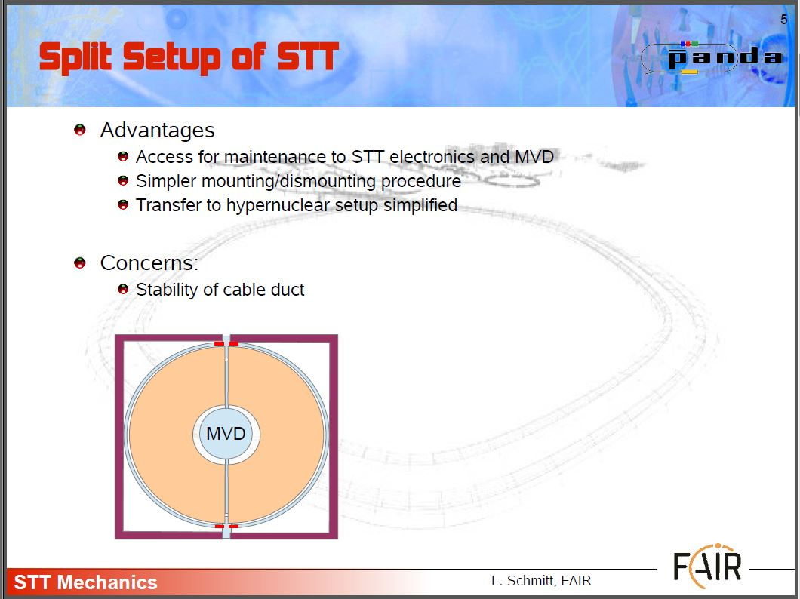
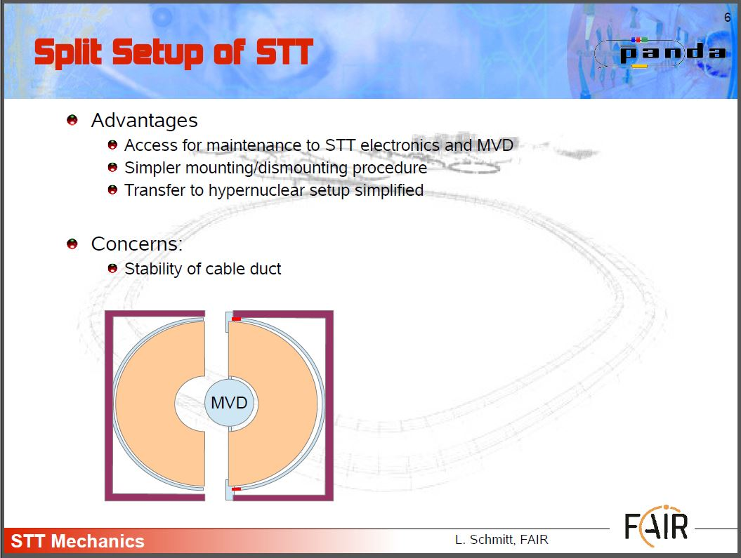
- RECOMMENDATIONS MADE BY LARS DURING THE LAST FRASCATI MEETING……..
SPLIT SETUP OF STT…
…… ACCESS FOR MAINTENANCE EASY & SMART
… TRYING TO GIVE AN ANSWER TO LARS REQUEST ...
THAT'S A PRELIMINARY PROPOSAL FOR A DIFFERENT
SOLUTION OF ASSEMBLY OF CENTRAL TRACKER).
OCTOBER 27-28 / GSI / PANDA WS / D. ORECCHINI (LNF-INFN)

Slide 2
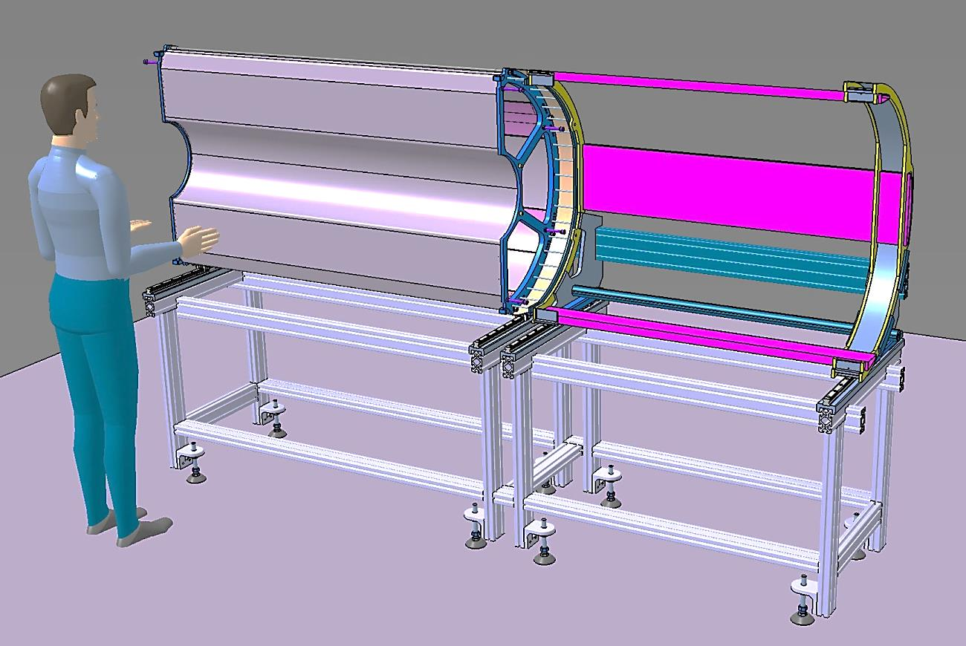
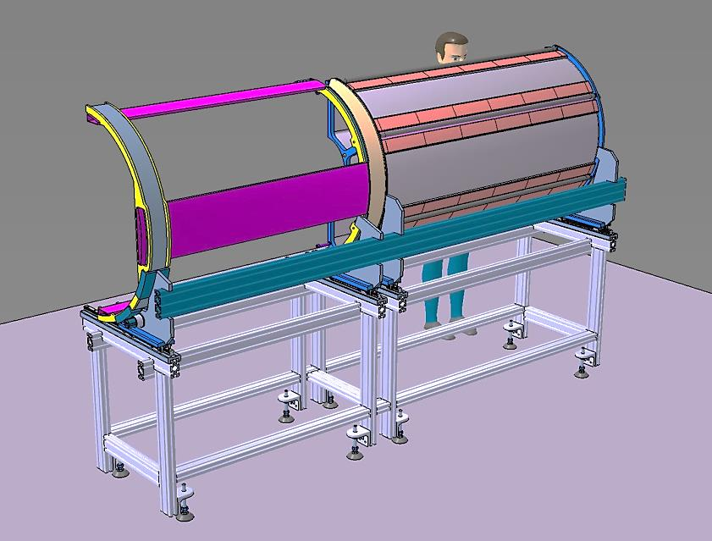
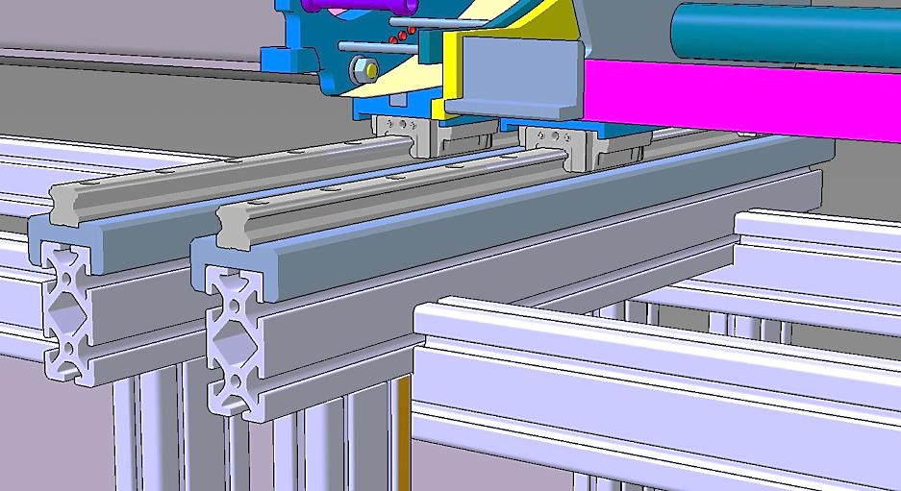
- STT ASSEMBLING AND HANDLING TOOL: BASIC CONCEPTS……..
- HALF ST_TRACKER
- HALF SERVICES WITH SUPPORT FRAME
THE STT ASSEMBLING AND HANDLING TOOL
IS FORMED BY:
- A RIGID AND PRECISE SUPPORT TABLE;
- A SHIFTING SYSTEM WITH RAILS AND
SKATES.
THE STT HALVE IS FIXED ON THE HANDLING TOOL.
THE SERVICES FRAME IS FIXED ON THE HANDLING TOOL.
ALL THE CABLES AND THE GAS PIPES ARE ASSEMBLED. (CABLES PATH ARE NOT SHOWED)
INSIDE VIEW
- IMPROVEMENT
THE SERVICES ASSEMBLING MENAGEMENT APPEARS OPTIMIZED.
- CONCERN
THE STABILITY OF CABLE DUCT HACE TO BE VERIFIED.
RAILS AND SKATES DETAILS
OUTSIDE VIEW
OCTOBER 27-28 / GSI / PANDA WS / D. ORECCHINI (LNF-INFN)

Slide 3
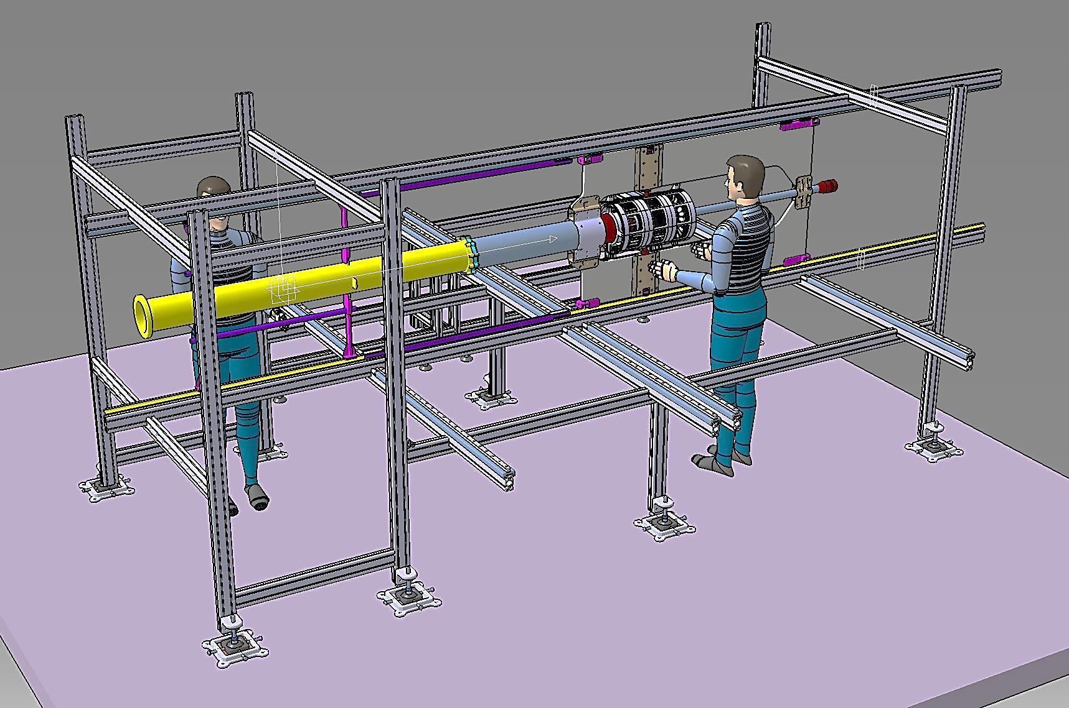
- THE AUXILIARY SUPPORT STRUCTURE: BASIC CONCEPTS …..
AUXILIARY SUPPORT STRUCTURE
CENTRAL SUPPORT FRAME
VERTEX
CROSS PIPE
PIPE SECTOR 1
RAILS SYSTEM FOR SHIFTING
THE CROSS PIPE, THE VERTEX WITH SERVICES, AND THE PIPE SECTOR 1, ARE ASSEMBLED ON THE “AUXILIARY SUPPORT STRUCTURE”.
- A RAILS SYSTEM HAS BEEN IMPLEMENTED.
OCTOBER 27-28 / GSI / PANDA WS / D. ORECCHINI (LNF-INFN)

Slide 4
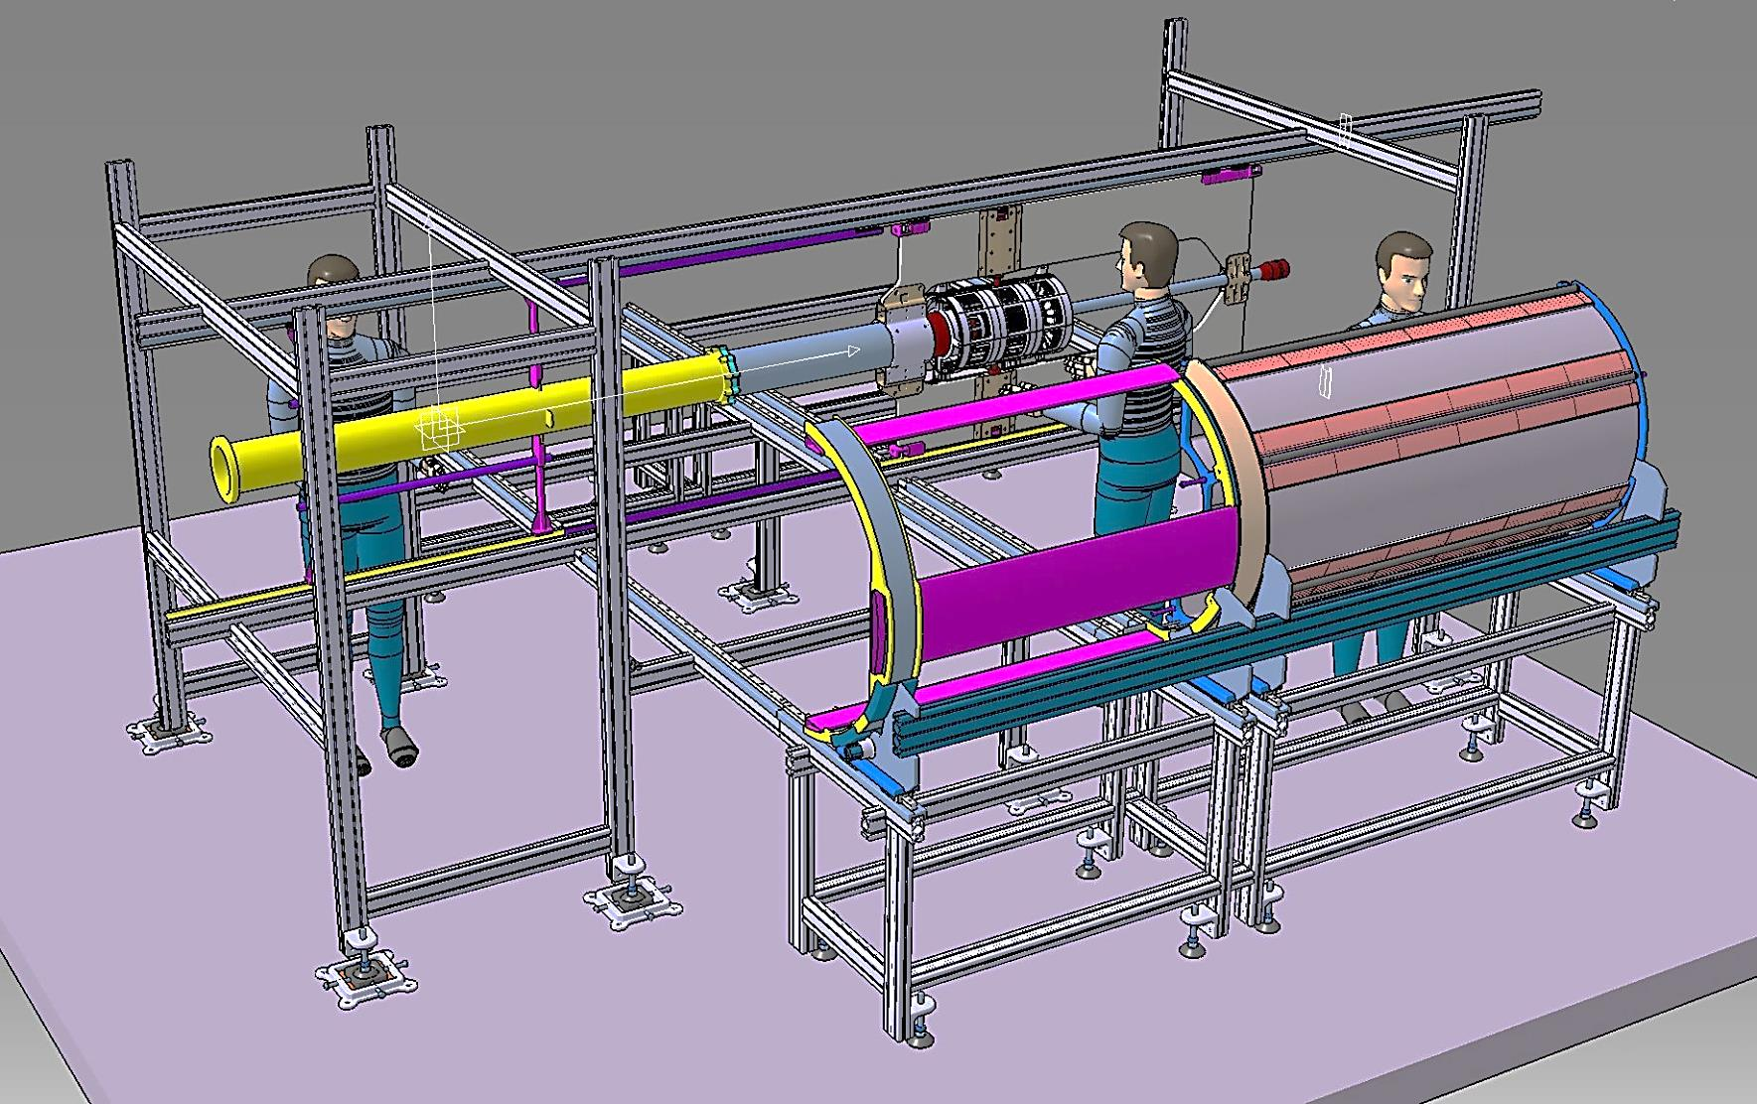
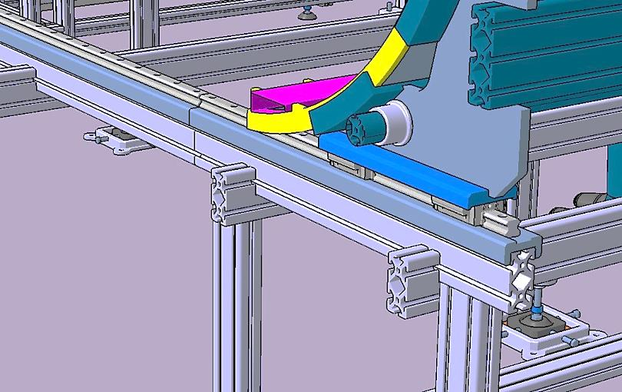
- COUPLING PHASE BETWEEN THE “AUXILIARY SUPPORT STRUCTURE” AND THE “STT HANDLING TOOL” ……….
AUXILIARY SUPPORT STRUCTURE
STT HANDLING TOOL
THE STT HANDLING TOOL IS LOCATED BESIDE THE “AUXILIARY STRUCTURE”.
THE RAILS OF THE TWO SYSTEMS ARE ALIGNED.
OCTOBER 27-28 / GSI / PANDA WS / D. ORECCHINI (LNF-INFN)

Slide 5
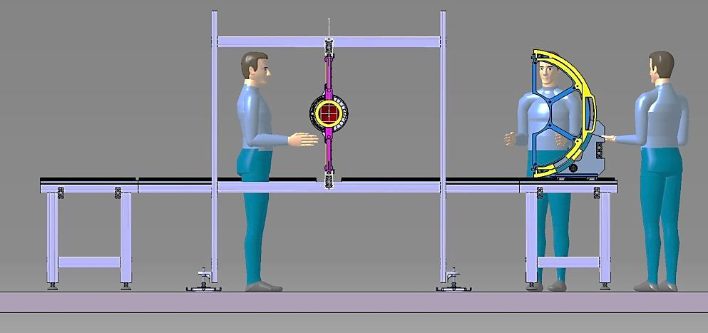
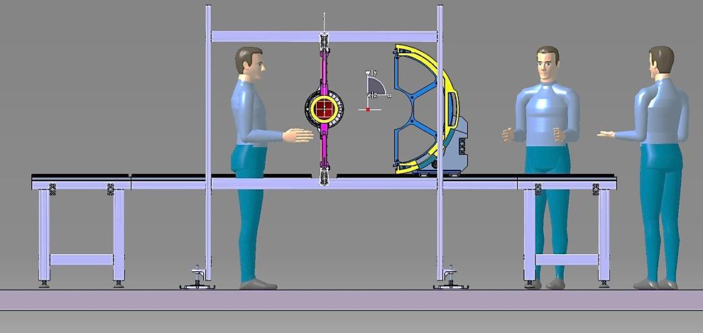
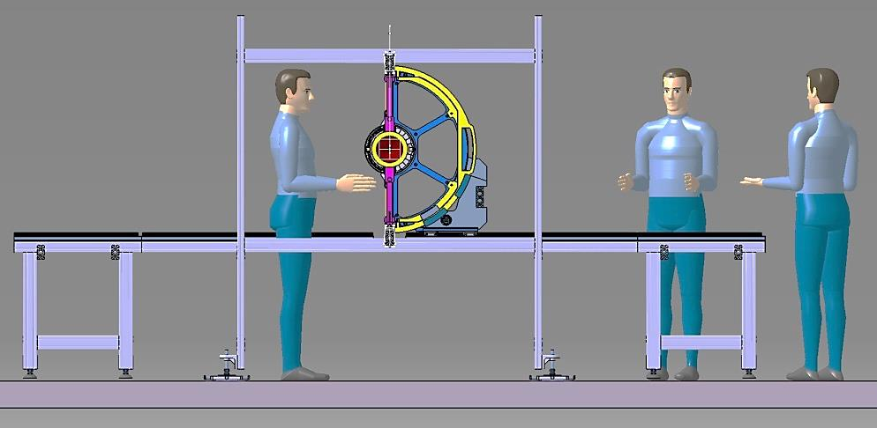
- STT AND SERVICES FRAME: ASSEMBLY PHASE ON AUXILIARY SUPPORT SCTRUCTURE ……..
1 STEP
THE STT HANDLING TOOL IS PLACED NEAR THE
AUXILIARY STRUCTURE, ALIGNED AND FIXED ON IT.
STT HANDLING TOOL
2 STEP
THE “STT SYSTEM” (STT PLUS SERVICES FRAME) IS
SHIFTED TOWARD THE “CENTRAL FRAME”.
3 STEP
THE “STT SYSTEM” IS CONNECTED ON THE
CENTRAL FRAME.
OCTOBER 27-28 / GSI / PANDA WS / D. ORECCHINI (LNF-INFN)

Slide 6
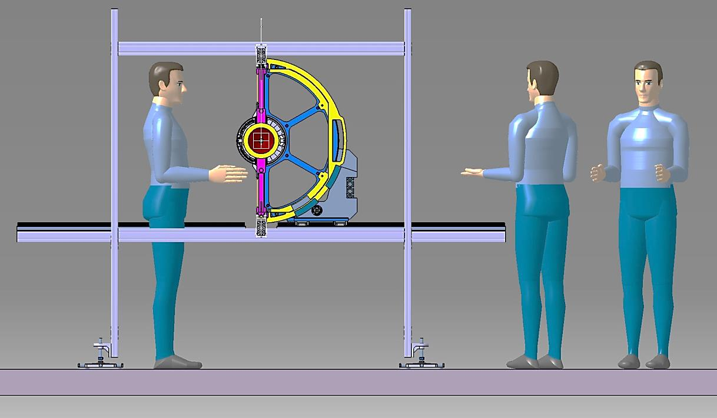
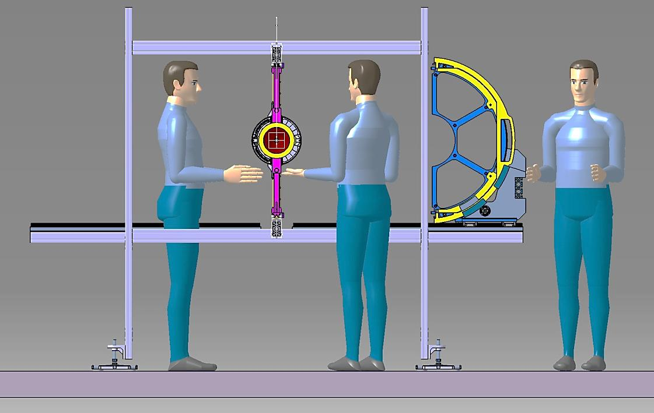
- CENTRAL TRACKER OPENING SYSTEM DURING THE MAINENTANCE PHASE……..
1 STEP
THE STT AND SERVICES FRAME ARE
DISCONNETED FROM THE SUPPORT FRAME
2 STEP
THE STT AND SERVICES FRAME ARE SHIFTED
TOGHETER ON THE RAIL SYSTEM
AUXILIARY SUPPORT STRUCTURE
NB. IF IT IS NOT 'NECESSARY TO CARRY OUT THE STT, THE
HANDLING TOOL IS NOT NEEDED.
OCTOBER 27-28 / GSI / PANDA WS / D. ORECCHINI (LNF-INFN)

Slide 7
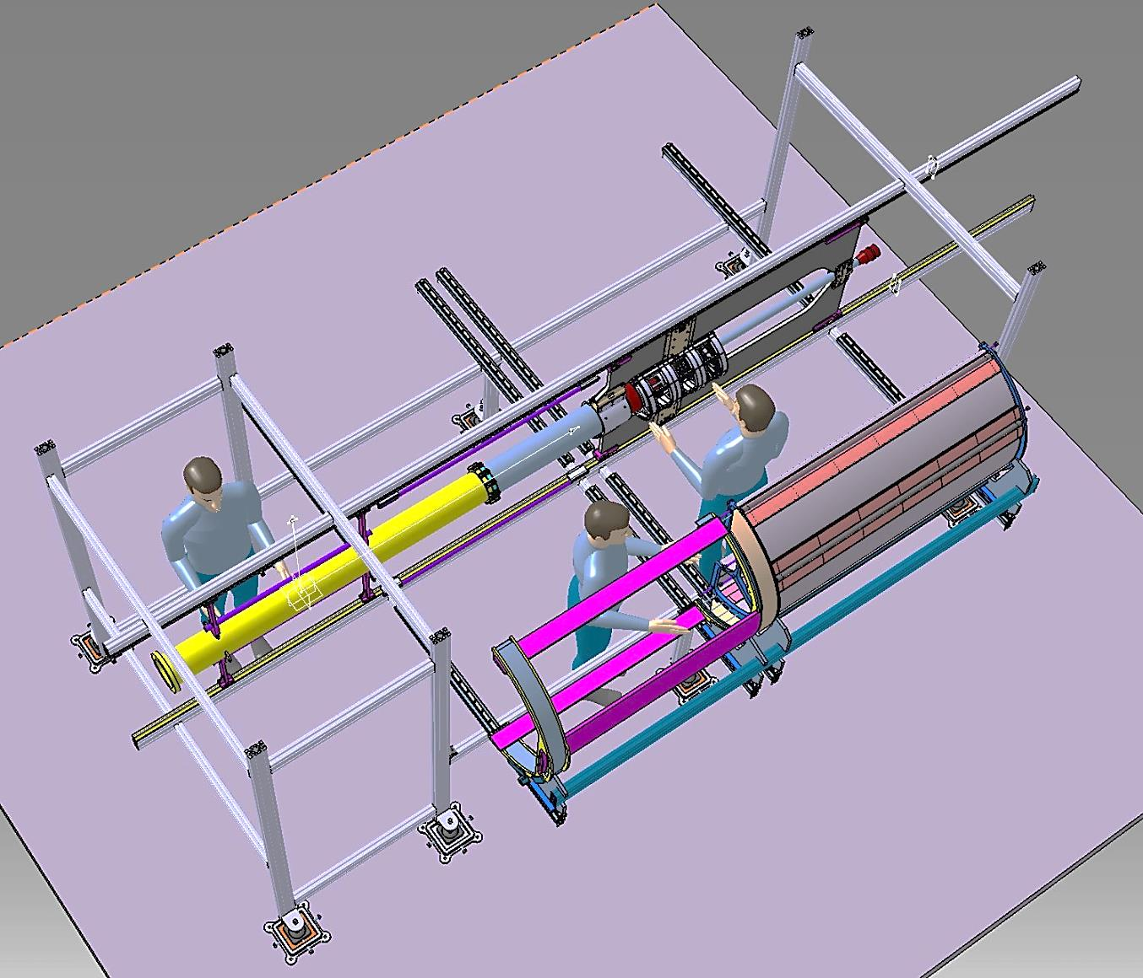
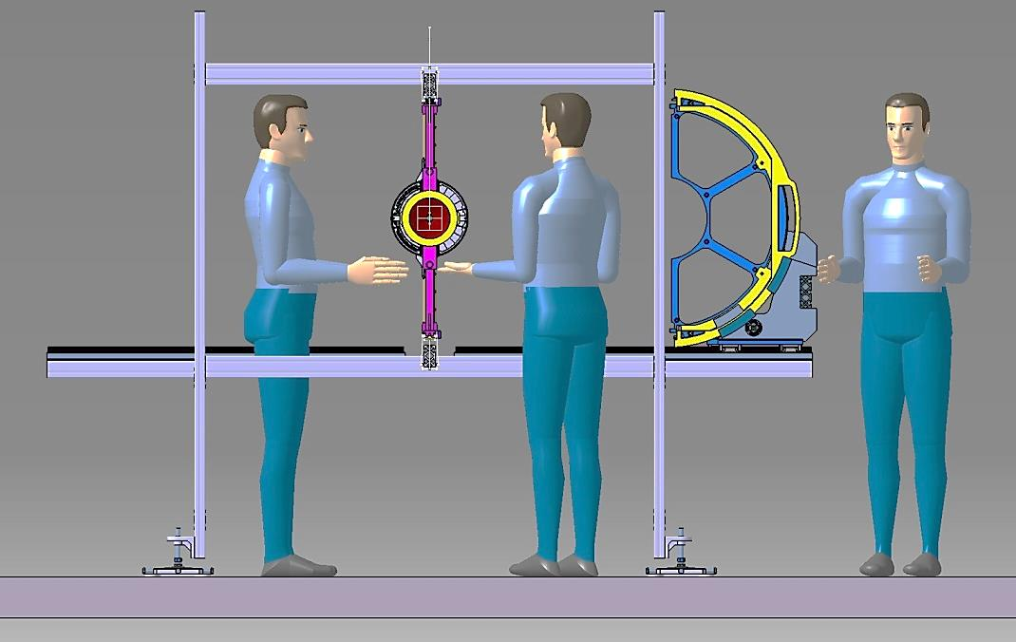
- CENTRAL TRACKER OPENING SYSTEM DURING THE MAINENTANCE PHASE……..
AUXILIARY PLATFORM
STT AND SERVICES FRAME ARE SHIFTED TOGHETER ON THE RAIL SYSTEM
FREE SPACE TO OPERATE AT THE SAME TIME ON THE VERTEX AND ON THE STT.
AUXILIARY SUPPORT STRUCTURE
OCTOBER 27-28 / GSI / PANDA WS / D. ORECCHINI (LNF-INFN)

Slide 8
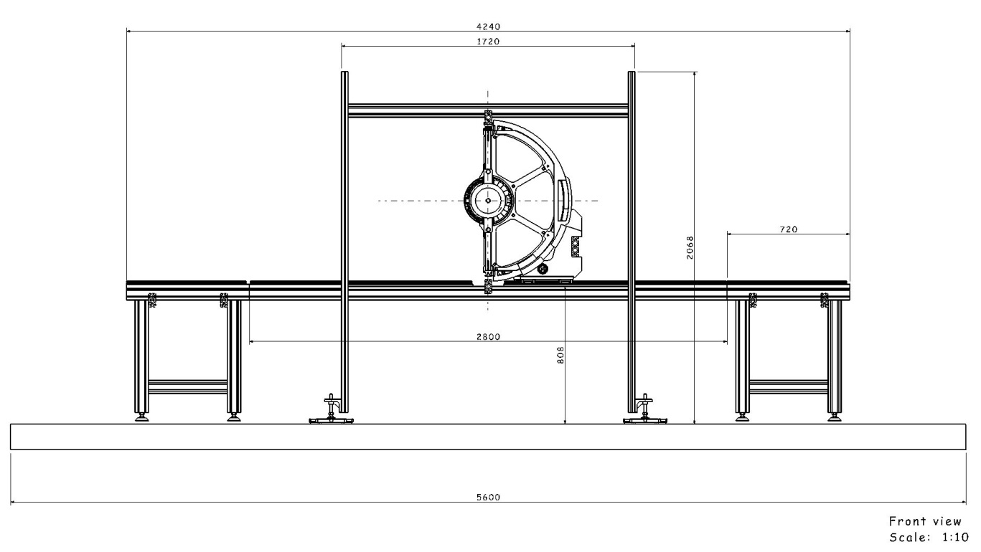
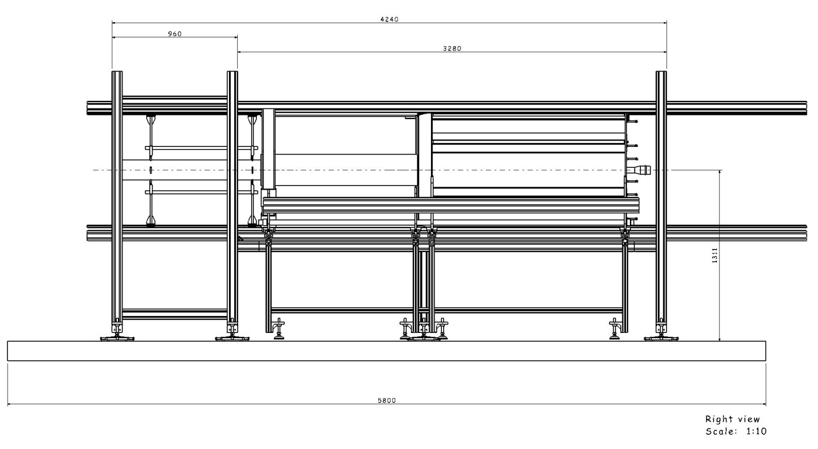
- AUXILARY SUPPORT STRUCTURE PLUS STT ASSEMBLING AND HANDLING TOOL MAIN DIMENSIONS ……..
4300mm
FRONT VIEW
4500mm)
LATERAL VIEW
OCTOBER 27-28 / GSI / PANDA WS / D. ORECCHINI (LNF-INFN)

Slide 9
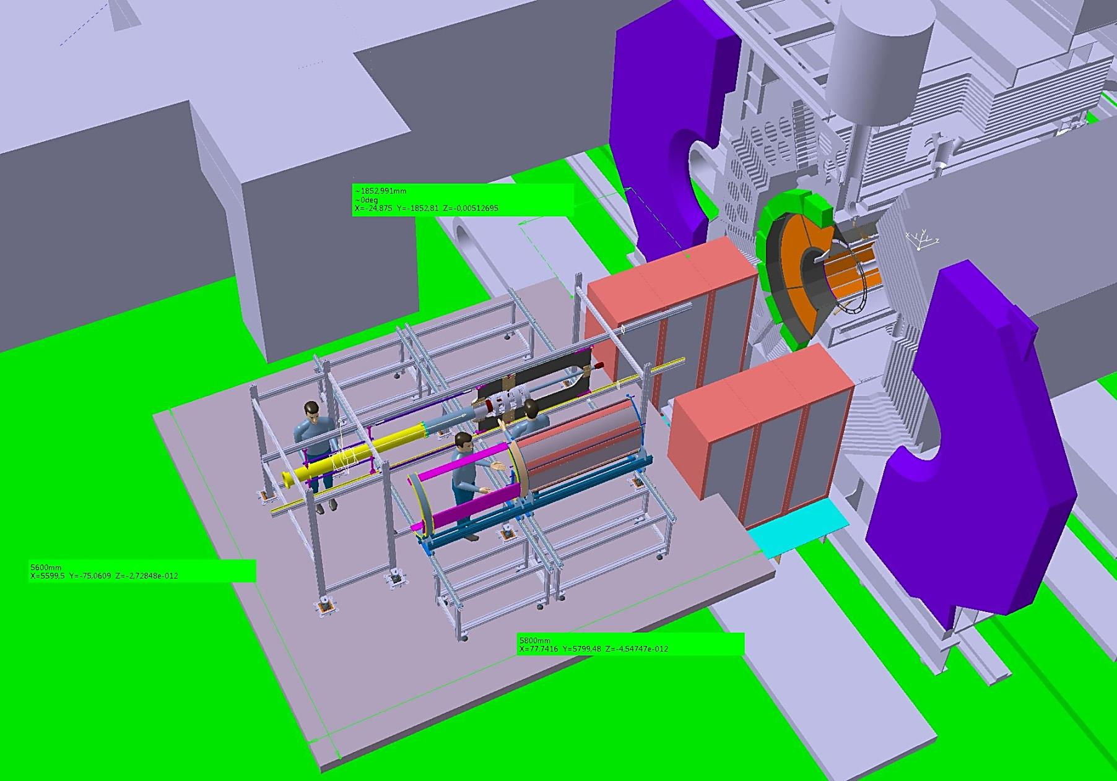
- CENTRAL TRACKER INSERTION SYSTEM IN EXPERIMENTAL HALL ……..
PICTORIAL FRONT VIEW
IT DEPENDS ON THE ARRANGEMENT OF THE RACKS
1800mm (DISTANCE PLATFORM / MAGNET DOORS)
AUXILIARY PLATFORM
5600mm (PLATFORM
DIMENSION)
5800mm (PLATFORM
DIMENSION)
AUXILIARY SUPPORT STRUCTURE
- TO BE AGREED WITH THE EMC-BW PEOPLE
OCTOBER 27-28 / GSI / PANDA WS / D. ORECCHINI (LNF-INFN)

Slide 10
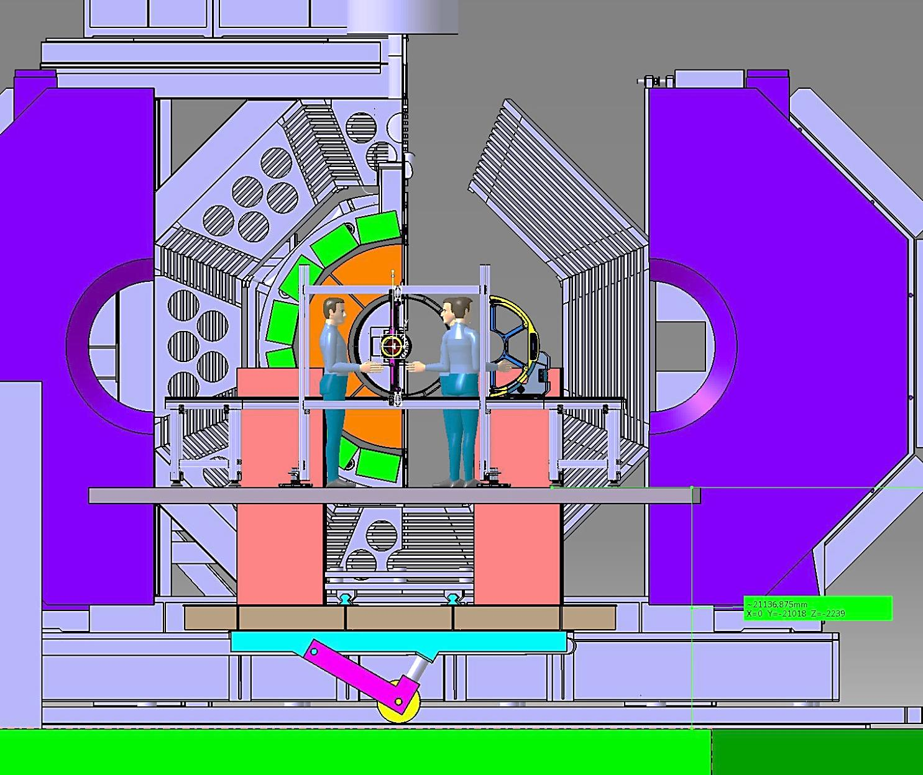
- CENTRAL TRACKER INSERTION SYSTEM IN EXPERIMENTAL HALL ……..
PICTORIAL FRONT VIEW
AUXILIARY SUPPORT STRUCTURE
AUXILIARY PLATFORM
2240mm (DISTANCE PLATFORM/HALL FLOOR)
- TO BE AGREED WITH THE EMC-BW PEOPLE
OCTOBER 27-28 / GSI / PANDA WS / D. ORECCHINI (LNF-INFN)

Slide 11
- SUMMARY OF THE MAIN OPERATIONS……..
1. STT SYSTEM (THE TWO SEPARATED HALVES) IS PREASSEMBLED INCLUDED THE ELECTRONIC CARDS (IN JUELICH OR FAIR).
(~ 3 months for electronic tests , that should be done before the mechanical installation).
2. EACH “STT HALVE” AND THE RELATIVE “SERVICES SUPPORT FRAME” ARE FITTED ON THE “ASSEMBLING AND HANDLING TOOL” (IN FAIR LABORATORY ).
3. THE CABLES, GAS PIPES AND ALL OTHER SERVICES ARE ASSEMBLED.
OPERATIONS ON “STT TRACKER”
2. THE SERVICE PLATFORM IS MOUNTED IN FRONT OF THE MAGNET.
3. THE “CT AUXILIARY STRUCTURE “ IS POSITIONED ON THE PLATFORM, AND THE RAIL SYSTEM IS ALIGNED AND CONNECTED WITH THE MAGNET
INNER RAILS.
4. THE CENTRAL SUPPORT FRAME WITHOUT ANY DETECTORS ATTACHED IS USED AS A “JIG” WITH THE AIM:
-TO REALIZE THE GENERAL ALIGNEMENT.
-TO ADJUST THE COUPLING WITH THE TARGET PIPES.
5. THE “AUXIIARY STRUCTURE” IS DISMOUNTED BUT THE “ALIGNEMENT FEETS” REMAIN FIXED ON THE PLATFORM.
“PRELIMINARY OPERATIONS IN EXPERIMENTAL ALL”
1. THE “AUXILIARY STRUCTURE” AND THE “CENTRAL SUPPORT FRAME” ARE MOVED IN THE DEDICATED LABORATORY (IN FAIR AREA) WHERE:
-THE CROSS-PIPE IS MOUNTED ON THE CENTRAL SUPPORT FRAME.
-THE MVD HALVES ARE ASSEMBLED ON THE CENTRAL FRAME.
-THE MVD CABLES AND SERVICES ARE INSTALLED ON THE CROSS PIPE.
-THE MVD CABLES AND SERVICES ARE INSTALLED ON THE PIPE SECTOR 1.
OPERATIONS ON “CROSS PIPE AND VERTEX ”
1. THE “AUXILIARY STRUCTURE” WITH ASSEMBLED ON IT: “CSF” – “VERTEX” – “CROSS PIPE”- “PIPE SECTOR_1” – “ALL THE “VERTEX SERVICES “CABLED, ARE
MOVED 0N “THE SERVICES PLATFORM” .
2. A QUICK CHECK OF ALIGNMENT IS DONE .
3. THE “STT HALVE” AND THE RELATIVE “SERVICES SUPPORT FRAME” FIXED ON THE “ASSEMBLING AND HANDLING TOOL” IS LOCATED BESIDE THE “AUXILIARY
STRUCTURE” .
4. THE “STT SYSTEM” IS SHIFTED ON THE “CENTRAL FRAME” AND FIXED ON IT.
5. ALL THE “CENTRAL TRACKER” IS SHIFTED INSIDE THE MAGNET.
6. THE SUPPORT SYSTEM OF THE “CROSS PIPE SECTOR 1” CAN BE DISMOUNTED AND EXTRACTED.
“FINAL OPERATIONS IN EXPERIMENTAL ALL”
OCTOBER 27-28 / GSI / PANDA WS / D. ORECCHINI (LNF-INFN)

Slide 12
- NEW AND OLD PROBLEMS YET TO BE RESOLVED……..
- CONSEQUENCES ARISING FROM THE CHANGES MADE-
1. DUE TO THE MODIFICATION OF MANY COMPONENTS, I MUST PROCEED TO VERIFY LOADS AND MECHANICAL BEHAVIOUR.
2. THE FUNCTIONAL ASPECTS OF THE PROPOSED SOLUTIONS HAVE TO BE FURTHER VERIFIED.
3. THE PROPOSED EQUIPMENT TO ASSEMBLY AND HANDLING HAVE TO BE IMPROVED AND THEIR GEOMETRY OPTIMIZED.
4. THE WHOLE STEP OF INSERTION MUST BE CHECKED AND IMPROVED DUE TO THE SCENARIO THAT IS DRASTICALLY CHANGED ……:
- INSTEAD OF INSERT ONLY THE CENTRAL TRACKER,THE CURRENT SCENARIO INVOLVES THE INSERTION OF A SORT OF TRAIN.
- FRICTION AND LOADS ARE TO ANALYZE AGAIN.
- ALL PHASES THAT INVOLVE THE CROSS PIPE ARE STILL TO BE ADDRESSED.
- OTHER ITEMS TO BE SOLVED -
- ALL PHASES THAT INVOLVE THE PIPE SECTOR_1 ARE STILL TO BE ADDRESSED.
- ……….. AND SURELY MANY OTHER ISSUES THAT I AM FORGETTING TO PUT IN EVIDENCE.
OCTOBER 27-28 / GSI / PANDA WS / D. ORECCHINI (LNF-INFN)

Slide 13
BACK UP SLIDES

Slide 14
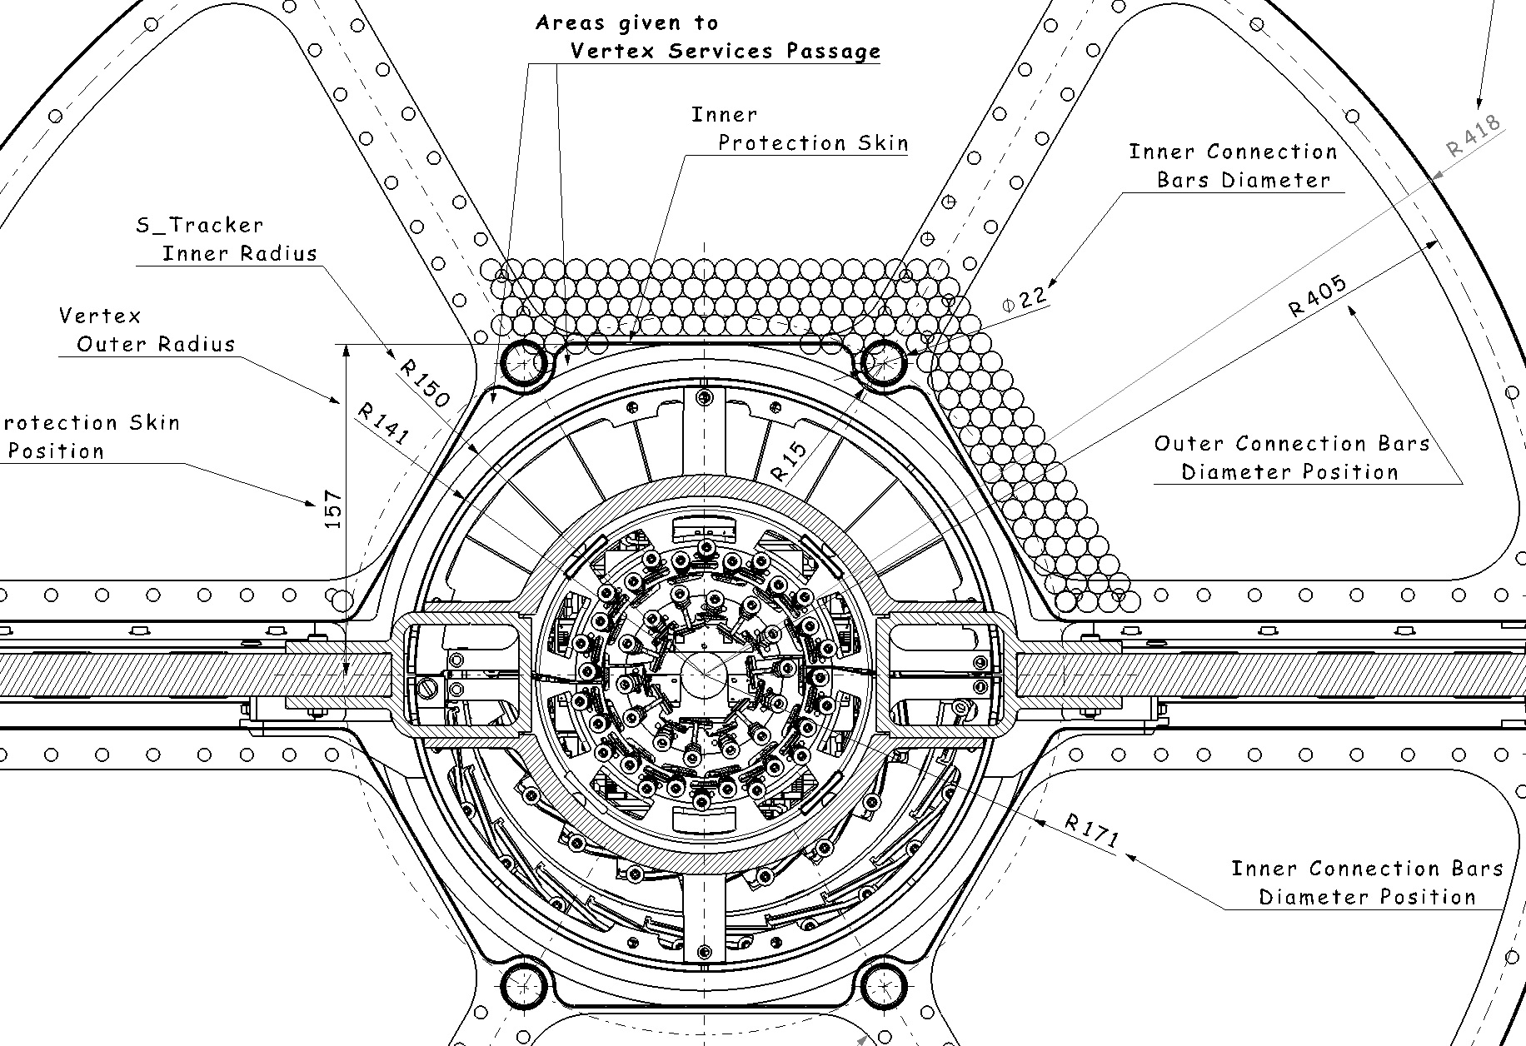

Slide 15
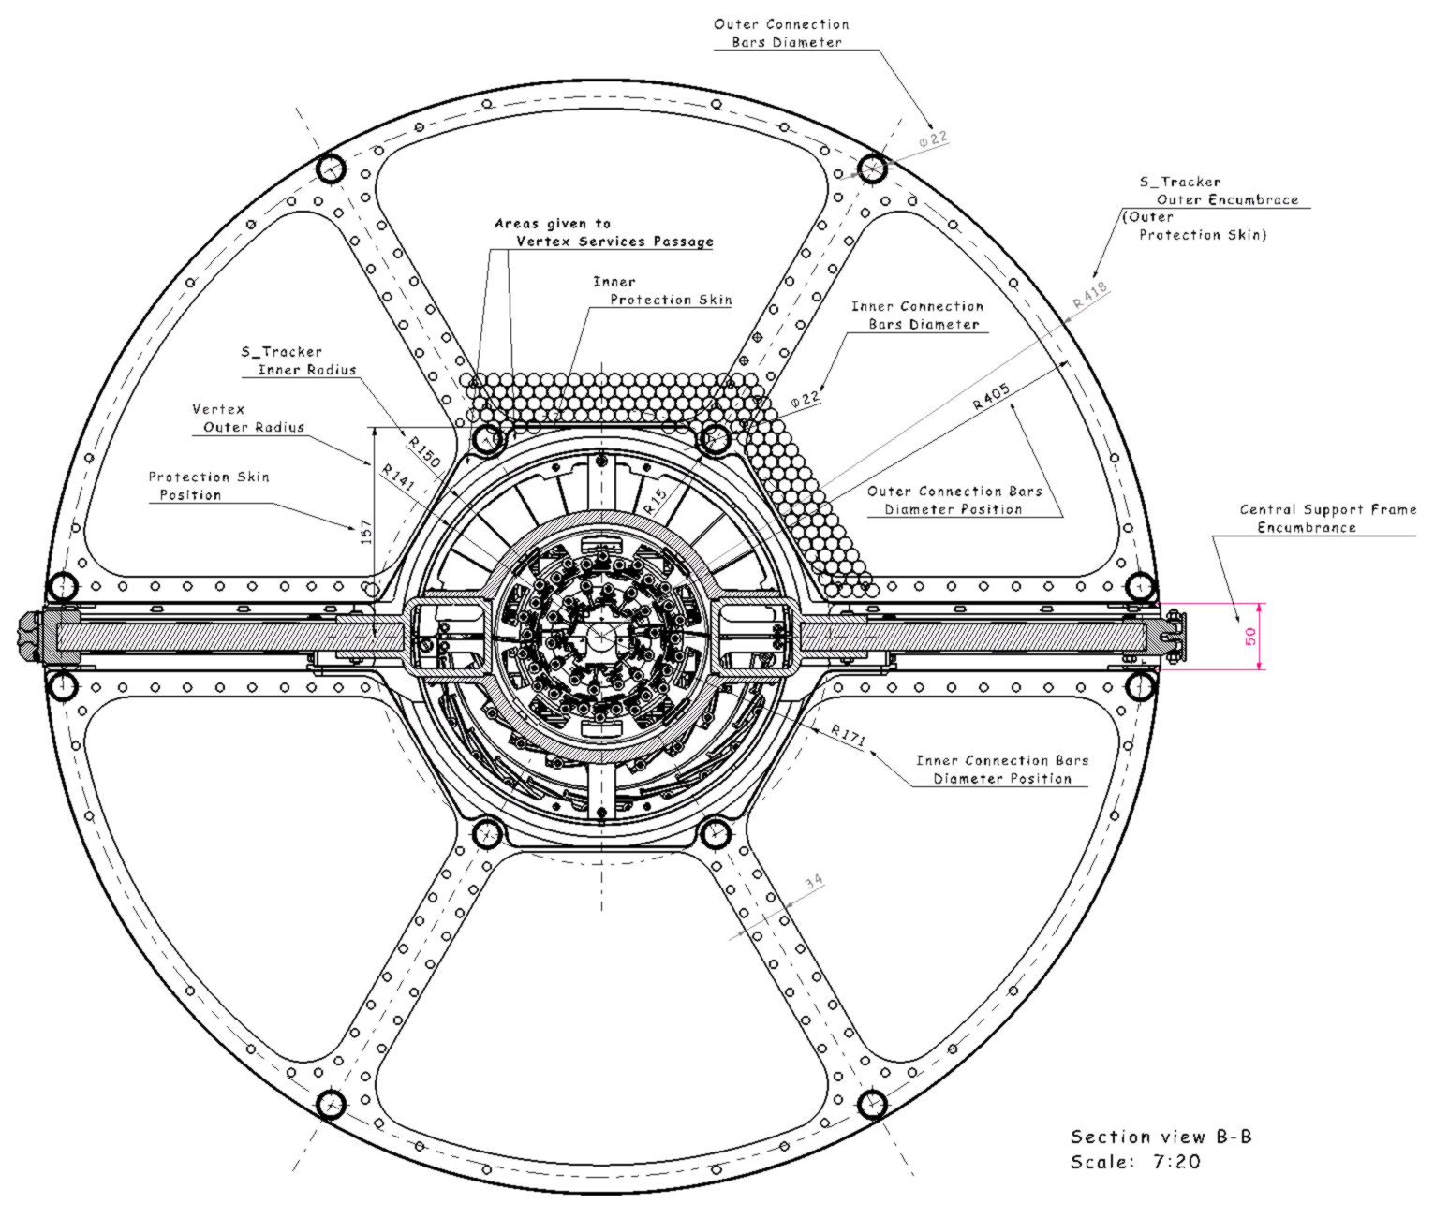

- STRAW TUBES TRACKER : Assembly with VERTEX -
“ST_TRACKER:
INNER RADIAL ENCUMBRANCES
150mm
(STT Inner Encumbrance)
NB. THE STT IS 90° ROTATED.
THE VERIFICATION OF THE INTERFERENCES BETWEEN THE STT AND THE VERTEX IT’S OK.
THE STT INNER RADIAL ENCUMBRANCE MUST BE CONSIDER FROZEN.
GSI / TB – JUNE 2014 - D.Orecchini / P.Gianotti

Slide 16
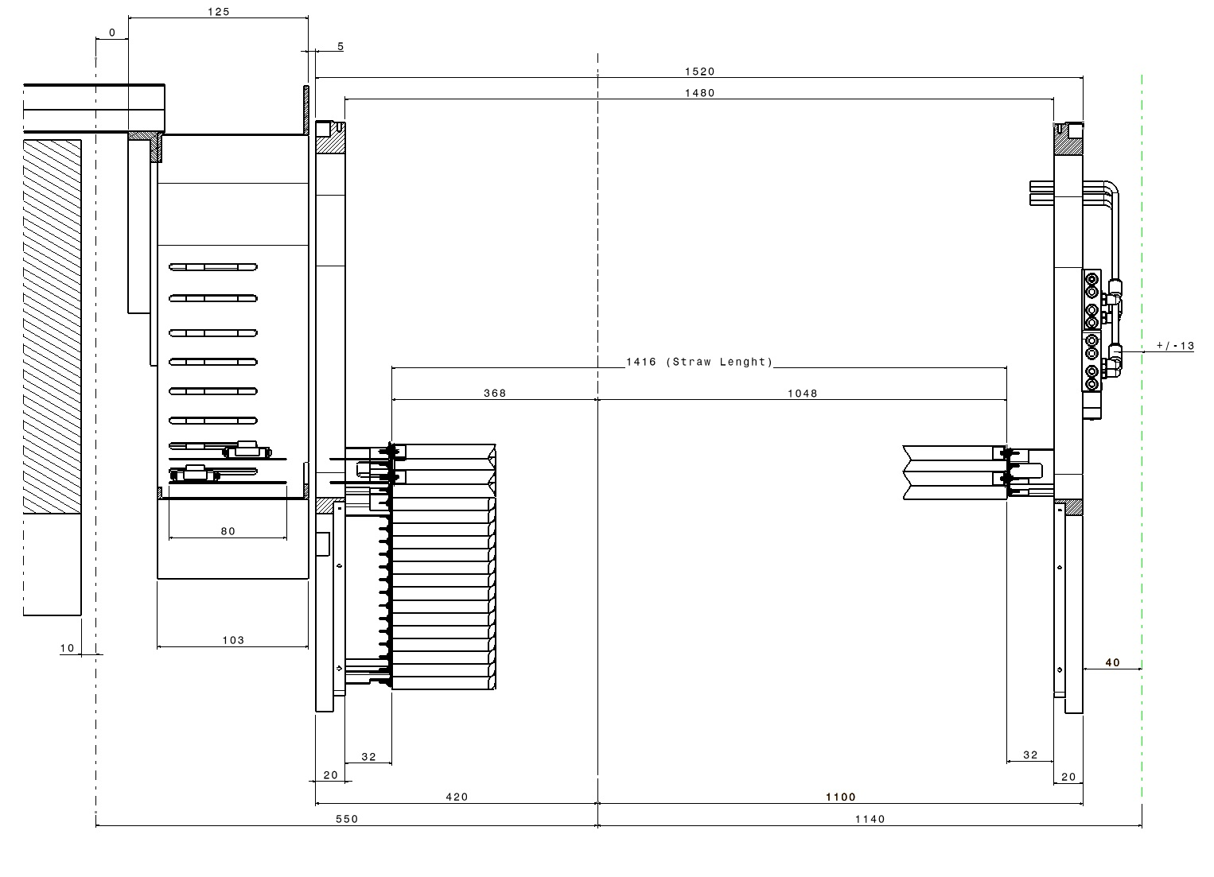
- STRAW TUBES TRACKER : General layout along Z axis -
EMC backward
“STT TRACKER:
LONGITUDINAL ENCUMBRANCES
BW_EMC
540
1150
1500
1460
IP
GEM Forward
TUBE LENGTH: 1400mm
350
1050
GAS MANIFOLD
AREA
E_BOARDS AREA
140
30
30
50
400
1100
THE VERIFICATION OF THE INTERFERENCES WITH B_EMC AND F_GEM IT’S OK.
THE LONGITUDINAL STT GENERAL LAYOUT MUST BE CONSIDER FROZEN.
GSI / TB – JUNE 2014 - D.Orecchini / P.Gianotti

Slide 17
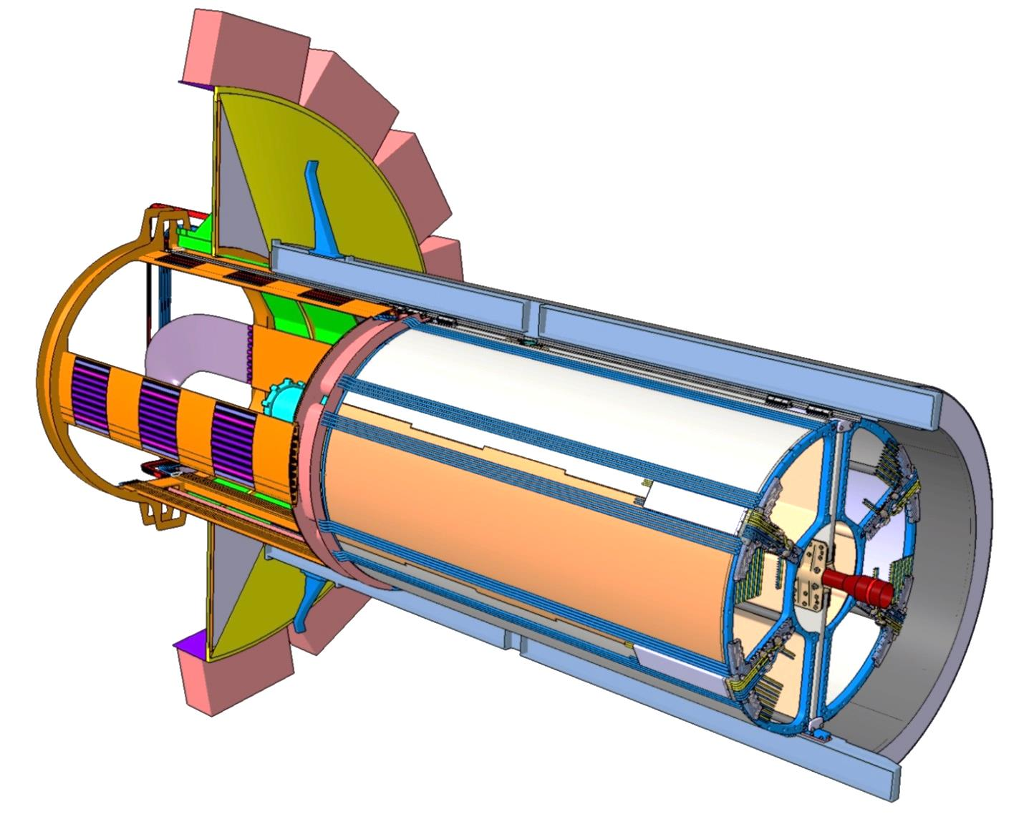
- S_TUBES TRACKER AREA: Radial main encumbrance -
“STT TRACKER:
OUTER RADIAL ENCUMBRANCES
Gas supply lines.
They are placed externally to the STT encumbrance .
R 431mm
(STT GAS SYSTEM Outer Encumbrance)
GAS SYSTEM RADIAL ENCUMBRANCE: R 431mm
448-431=17mm (Clearance)
INNER DIRC RADIAL ENCUMBRANCE: R 448mm
STRAW TRACKER RADIAL ENCUMBRANCE: R 418mm
THE VERIFICATION OF INTERFERENCES BETWEEN THE STT GAS SYSTEM ANT THE INNER DIRC IT’S OK.
THE STT OUTER RADIAL ENCUMBRANCE MUST BE CONSIDER FROZEN.
GSI / TB – JUNE 2014 - D.Orecchini / P.Gianotti

Slide 18
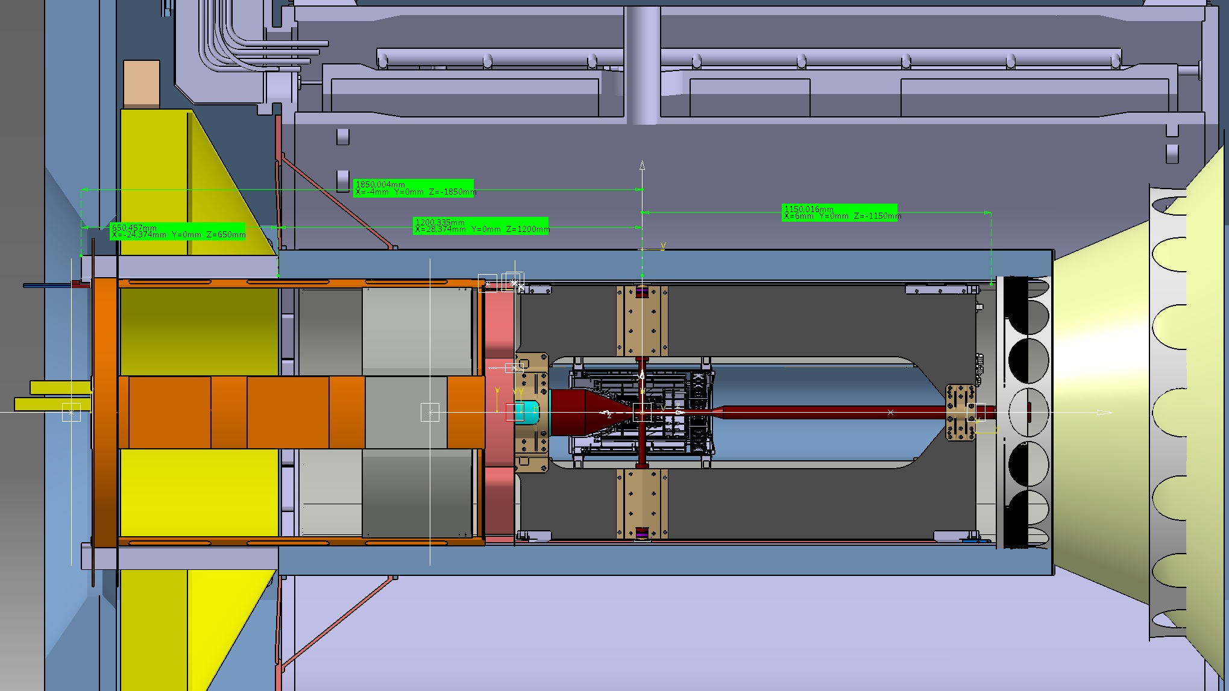
- ST_TRACKER: “STT Detector / STT Routing Frame: Main encumbrance along Z Axis -
SUPPORT BEAM LIMIT
1300mm
540mm
1150mm
“STT_SERVICES ROUTING FRAME
TOTAL LENGHT
1690mm
“ST_DETECTOR TOTAL LENGHT
3500mm
THE LONGITUDINAL DIMENSIONS MUST BE CONSIDER FROZEN.
GSI / TB – JUNE 2014 - D.Orecchini / P.Gianotti

Slide 19
STT SERVICES / CABLE ROUTING FRAME.

Slide 20
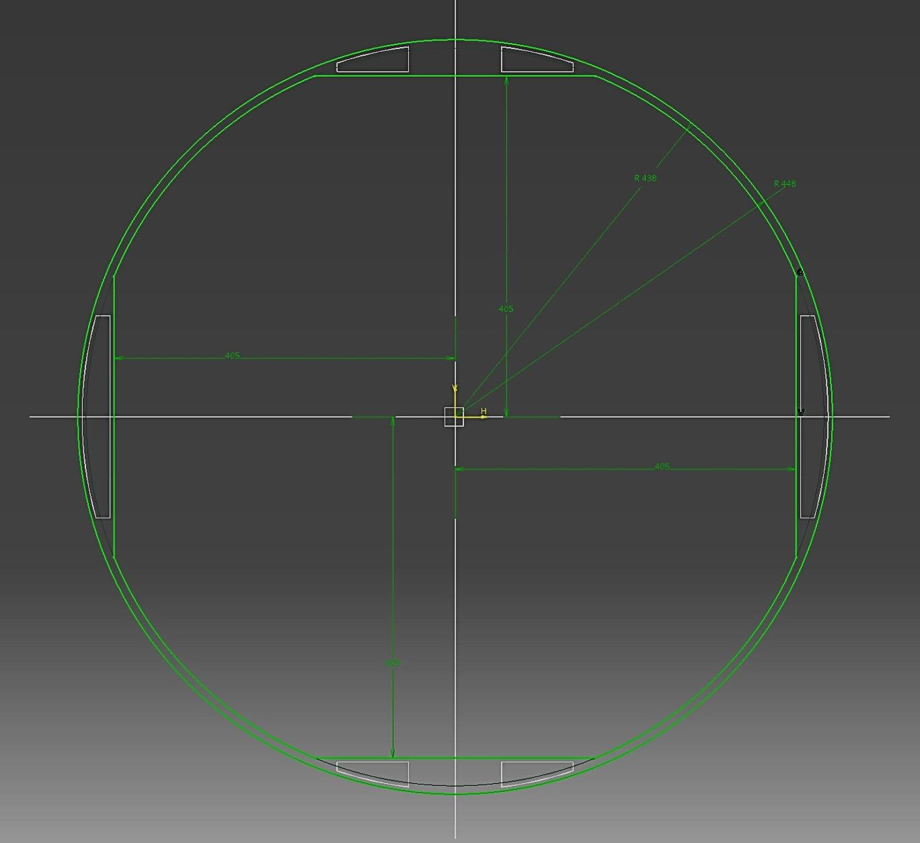
- ST_TRACKER SERVICES ROUTING FRAME: BW-EMC / INNER DIRC final arrangement -
1800mm^2
1800mm^2
DIRC inner radius: 448mm
Top & Bottom Routing way.
Available Cross Section
STT SERVICES ROUTING FRAME
Outer radius: 443mm
EMC-BW outer radius:
438mm
EMC-BW flat side: 405mm
5800mm^2
5800mm^2
STT SERVICES ROUTING FRAME
Inner flat side: 410mm
- FREE SPACE AT BOTH SIDES:
ONLY 5mm
Lateral Routing way.
Available Cross Section
Top & Bottom Routing way.
Available Cross Section
1800mm^2
1800mm^2
Four regions are available for the STT services: Top and Bottom,
Left and Right.
- Signal cables will be routed in the Left/Right cutouts,
- HV and gas pipes will be routed in the Top/Bottom.
GSI / TB – JUNE 2014 - D.Orecchini / P.Gianotti

Slide 21
CENTRAL TRACKER MOUNTING SEQUENCE.

Slide 22
- CENTRAL TRACKER: Mounting sequence 1° Phase -
- 1st PHASE MAIN STEPS:
STT SYSTEM (THE TWO HALVES) IS PREASSEMBLED. FUNCTIONAL DETECTOR TESTS ARE COMPLETED IN JUELICH / FAIR).
(~ 3 months for electronic tests , that should be done before the mechanical installation).
2. THE SERVICE PLATFORM IS MOUNTED IN FRONT OF THE MAGNET.
(It means that all the final steps of the CT assembling procedure must be done in front of the apparatus)
3. THE AUXILIARY S UPPORT STRUCTURE IS POSITIONED ON THE PLATFORM, AND THE RAIL SYSTEM IS
ALIGNED AND CONNECTED WITH THE MAGNET INNER RAILS.
4. THE CENTRAL SUPPORT FRAME WITHOUT ANY DETECTORS ATTACHED IS USED AS A “JIG” WITH THE AIM:
-TO VERIFY THE GENERAL ALIGNEMENT;
-TO ADJUST THE COUPLING WITH THE TARGET PIPES.
THE CROSS-PIPE IS MOUNTED ON THE CENTRAL SUPPORT FRAME .
THE MVD HALVES ARE MOUNTED ON THE CENTRAL FRAME.
THE MVD CABLES AND SERVICES ARE INSTALLED.
THE STT HALVES ARE MOUNTED ON THE CENTRAL FRAME.
GSI / TB – JUNE 2014 - D.Orecchini / P.Gianotti
Notes:
WE NEED TO KNOW IF THE FORWARD SIDE OF THE MAGNET IS ACCESSIBLE DURING THIS PHASE

Slide 23
- ST_TRACKER SERVICE ROUTING FRAME: Mounting sequence 2° Phase -
- 2st PHASE MAIN STEPS:
THE STT SERVICE ROUTING FRAME IS MOVED CLOSE TO THE STT AND FIXED TO IT .
THE CABLES AND SERVICES PREVIOUSLY ROUTED IN THE SERVICE ROUTING FRAME, ARE
CONNECTED TO THE STT.
2. THE WHOLE CENTRAL TRACKER IS SHIFTED INSIDE THE MAGNET.
3. THE STT CABLES AND OTHER SERVICES (GAS PIPES) ARE CONNECTED TO THE RACKS.
GSI / TB – JUNE 2014 - D.Orecchini / P.Gianotti

Slide 24
- CENTRAL TRACKER INTEGRATION: About STT Services in PANDA Hall -
PANDA HALL (CLOSE TO THE MAGNET):
N. 2 READOUT RACKS.
N. ½ RACK FOR DCS/HV.
N. 1-2 RACKS (?) FOR THE GAS SYSTEM (MIXING / DISTRIBUTION).
PATCH -PANELS (?)
INTO PANDA HALL
OPTICAL LINKS (FOR READ OUT , CDS).
GAS SUPPLY LINES (ARGON, C02, N2, SPARES…)
ADDITIONAL SIGNAL LINES (SENSORS, TEST SIGNALS, …….)
GSI / TB – JUNE 2014 - D.Orecchini / P.Gianotti

