Slide 1
Cryogenic flow scheme for the PANDA magnet
Panda meeting

Slide 2
Topics
General remarks
Changes with respect to the version send in August 2014
PFD proposal
Operating modes
Open topics

Slide 3
General remarks
  The cryogenic scheme send to CERN by Evgeny Koshurnikov on 17-8-14, was compliant with the discussions we had at CERN during the meeting on 22-1-14.
  The cryogenic scheme proposed in this document revises several of the comments made by CERN during the meeting in January.

Slide 4
Changes compared to discussions in January 1 of 2
Removal of the subcooler
  Forced flow cooling is no longer deemed essential.
Removal of the by-pass between screen circuit and cold circuit.
  No advantage identified, may cause problems in operation if leaking.
Current leads removed from the two phase vessel
  Current lead design does not foresee integration in the 2-phase vessel.
Only four cold interface lines to the magnet cryostat
  According to the magnet design.

Slide 5
Changes compared to discussions in January 2 of 2
Including only control valves into the cryogenic circuit.
  Preferred for connecting, pressurisation etc.
No 300k line for warm-up to the cold circuits.
  Only needed if the magnet needs to be warmed up independently of the cold box.
  Risk of parasite heat load.
Thermal shielding for the cryostat of the control dewar.
  The estimated heat load to the 4.5 K level is estimated to ~ 6 W without shielding. ~ 40% of magnet.
A rigid compound transfer line with thermal shielding between cold box and cryostat.

Slide 6
PFD proposal
The proposed Process Flow Diagram includes:
  Magnet cryostat
  Control dewar cryostat
  All other elements only for information.
A minimum level of instrumentation is proposed for the control dewar cryostat.
  The instrumentation for magnet and current leads is not included

Slide 7
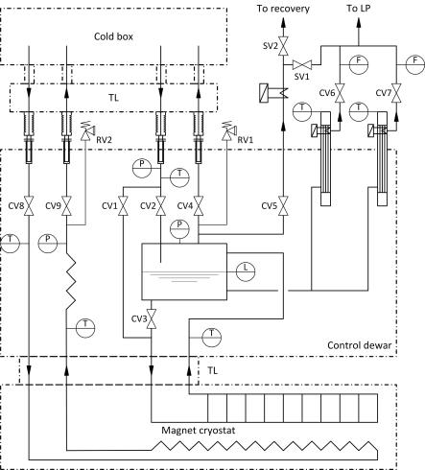
PFD proposal
Cryostat equipment

Slide 8
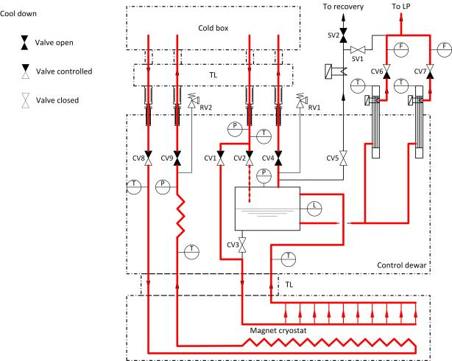
Cool-down

Slide 9
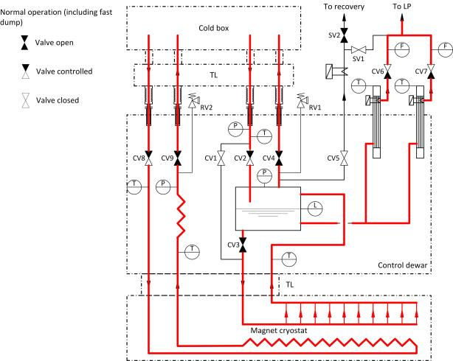
Nominal operation

Slide 10
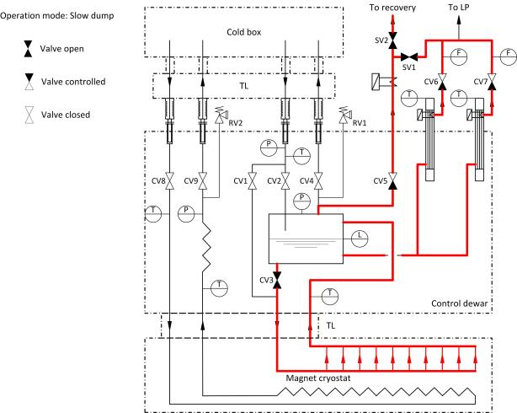
Slow dump

Slide 11
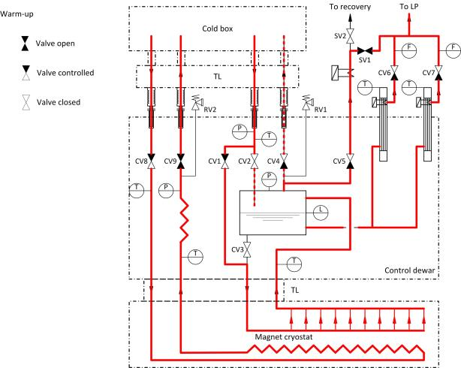
Warm-up

Slide 12
Open Questions
Heat budget
  Total value and contingency.
  One common approach or different for each consumer?
Magnet
  Magnet instrumentation
  Operating limits for Cool-down and warm-up
Current leads
  Instrumentation
General system
  Recovery and gas cleaning; is there an existing infra structure ?
  A separate recovery system for PANDA might not be worth while economically.
Transfer lines between refrigerator and cryostat
  Length; design?

