Slide 1
Update on the conductor analysis for the PANDA solenoid
Gabriella Rolando
Herman ten Kate
Alexey Dudarev
Helder Pais Da Silva
19 September 2014

Slide 2
Outline
Conductor layout
Conductor cost
Coil dimensions & field quality
Magnetic force between yoke and cold mass
Thermosiphon – preliminary calculation
2

Slide 3
Conductor layout
To minimize the risk of coil training and quenches due to unexpected heat loads, we specified a temperature margin ΔT > 2.4 K.
For ΔT = 2.4 K we need 26 strands.
Parameter | New layout | Old layout
Number of strands | 26 | 20
Strand diameter [mm] | 0.8 | 0.8
Cu : nonCu ratio | 1.2 | 1.5
Rutherford dimensions [mm] | 9.7 x 1.5 | 8 x 1.15
Conductor bare dimensions [mm] | 24.6 x 3.40 | 24.6 x 3.40

Slide 4
Conductor cost
A budgetary offer has been requested to Furukawa on July 31; and yielded a shocking high price of 267 $/m; some 90% higher than expected!
 | Unit | Minimum unit length
Unit length for downstream coil | m | 3200
Unit length for center coil | m | 1500
Unit length for upstream coil | m | 3200
Total conductor length | m | 7900
Based on the costs quoted to Fermilab for the Mu2e solenoid conductors, the expected cost of the Panda conductor is 120-140 $/m!

Slide 5
Conductor cost
After serious complaints and inquiry about cost drivers, Furukawa made a second offer on August 29 of 191 $/m; much better, but still 36% higher than expected.
After a second complaint about cost and request to mention cost drivers, on September 15 they mentioned the conductor unit length for Panda much longer than for Mu2e.
 | Unit | Minimum unit length NEW | Minimum unit length OLD
Unit length for downstream coil | m | 2 x 1600 | 3200
Unit length for center coil | m | 1500 | 1500
Unit length for upstream coil | m | 2 x 1600 | 3200
Mu2e has unit lengths of 1750 m, 1660 m, 1280m, 1100 m and 750 m.
We requested shorter unit lengths for downstream and upstream coils, thus accepting and extra layer jump joint.

Slide 6
Conductor cost – Next steps
We are waiting for a confirmation that the offer now is in the expected range of 120-140 $/m; answer is awaited in the coming days. Likely they will reduce cost but probably not entirely to the level we wish as they still need a margin for the real tender (with Hitachi as competitor).
Enquiry at FNAL: it seems the companies have underestimated the effort and may not making profit, which can be part of the explanation.
Also, Furukawa has requested a face-to-face meeting for further discussion of the conductor price by early October, date to be agreed.
Next:
Cost may be 150-170 $/m in budget offer, further down with the competitive tender.
Finalize the conductor specification based on new unit length, issue these documents.
Need budget availability confirmation to start the tender by early October.
Need confirmation of the organization issuing the tender (FAIR in the draft agreement).
Start to draft the commercial tendering documents and send tender by October.

Slide 7
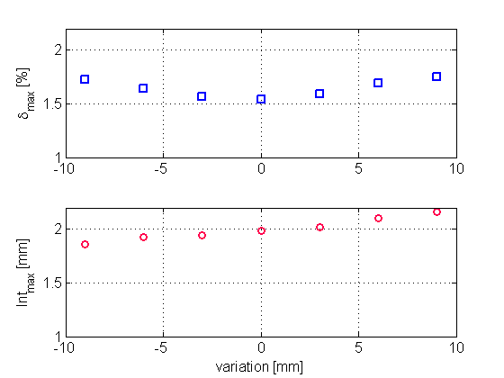
Coil dimensions & field quality – Radial dimensions
Assess the effect of radial dimension errors of the coils on the field quality within the tracker region.
The coils thickness is fixed at the nominal value, i.e. 50 mm.
The radius of a coil is varied in the ± 9 mm range.
The present coil radius is optimized for field homogeneity.
Small reductions of the coil radii are allowed. However, increase of the radii will result in the integral of the radial field component to exceeding the maximum allowable value of 2 mm.

Slide 8
Coil dimensions & field quality – Axial dimensions
Assess the effect on the field quality within the tracker region of small deviations in the axial dimensions of the coils.
The length of the coils is increased by half or one turn at each coil end plane (upstream & downstream).
Extra length | |δ|_{max} [%] | Int_{max} [mm]
Criterion: | < 2.0 | < 2.00
Default, perfect shape | 1.55 | 1.99
+½ turn - upstream | 1.6 | 2.04
+1 turn - upstream | 1.6 | 2.04
+½ turn - downstream | 1.6 | 2.12
+1 turn - downstream | 1.6 | 2.12
The eventual loss of one turn, and thus the need to increase the coil length, brings the integral of the radial field component just above the allowed threshold.
The increase is larger when the extra length is added towards the downstream side of the detector.

Slide 9
Magnetic force on the cold mass by the yoke
Cross-check of the axial force between cold mass and yoke:
Reference values are in the table following R. Parodi and H. Orth (2012).
 | F_{x} [kN] | F_{y} [kN] | F_{z} [kN]
Nominal position @ maximum current | - | - | -40
Under tolerable misalignment | ±45 | ±45 | ±100
Calculations of the axial force at
nominal position and - operating current:
The two 2D are consistent, and
the two 3D calculations as well!
The 2D calculation results agree with the
reference value
Not clear what the origin of the difference between the 2D and 3D results is. Investigation of the issue is ongoing.
Model | F_{z} [kN]
ANSYS 2D | -41
ANSYS 3D | -60
Opera 2D | -38
Opera 3D | -57

Slide 10
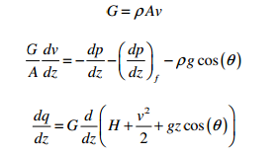
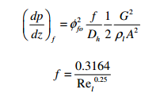
Thermo-siphon – preliminary calculation
Preliminary assessment of the feasibility of thermosiphon cooling of the Panda coils:
Homogenous model as used for the preliminary study for CMS in ‘Experimental and theoretical study of a two phase helium high circulation loop’ P. Bredy et al. AIP Conf. Proc. 823 (2006) 496-503.
Continuity, momentum and energy equations:
Two-phase friction correlation:

Slide 11
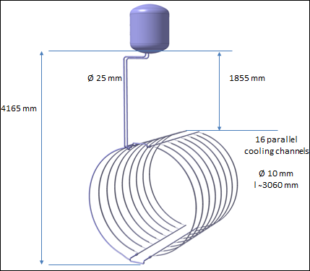
Thermo-siphon – preliminary calculations
Main approximations:
Pressure drop at singularities neglected. In preliminary CMS studies, this was found to be one of the dominant terms. It could lead to a reduction of the order of ̴30% in the computed mass flow (and consequent increase in vapor fraction).
Difference between outflow flow and liquid level in the dewar neglected.
Heat load Q = 57 W (from TDR)
Mass flow rate ṁ = 112 g/s
Vapor fraction x = < 3%
Based on these numbers we expect that the thermo-siphon mode will work for the present pipework layout and dimensions.

