Slide 1
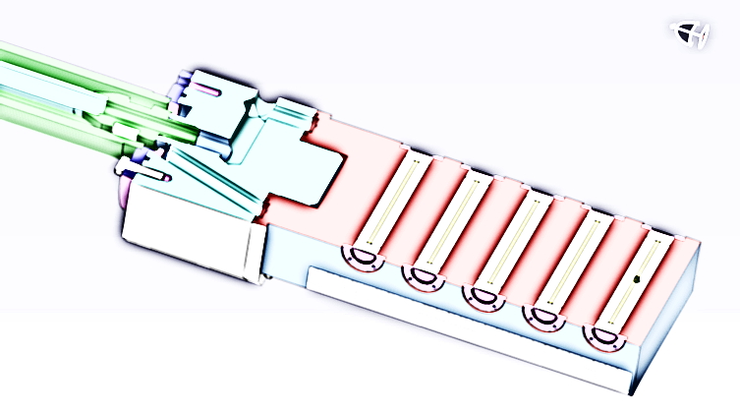
Status of the FAIR pbar target:
Target handling study
(M. Helmecke)

Slide 2
Outline
General overview of the pbar separator
The layout of the target station
Activation of target and magnetic horn
Content of the target transportation study
How will be the activated components handled?
Outlook

Slide 3
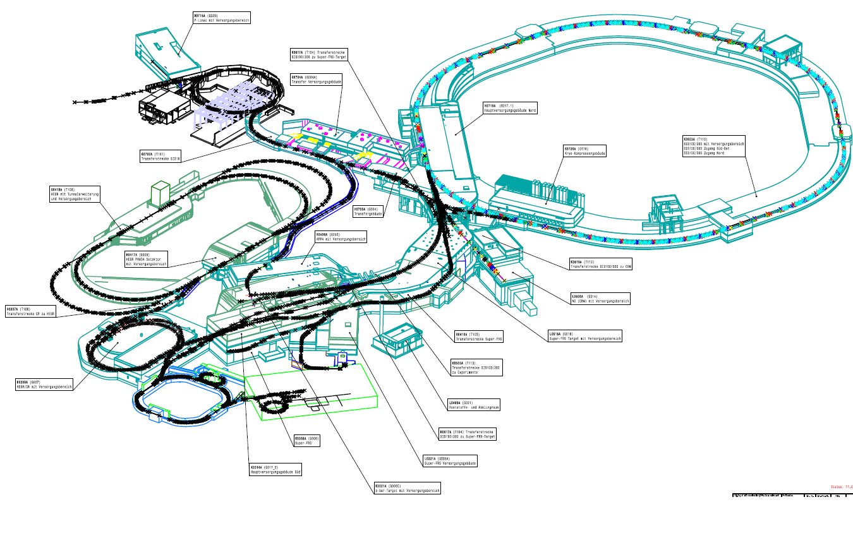
Overview
Super-FRS Building
Building 6c
Anti-Proton-Separator

Slide 4
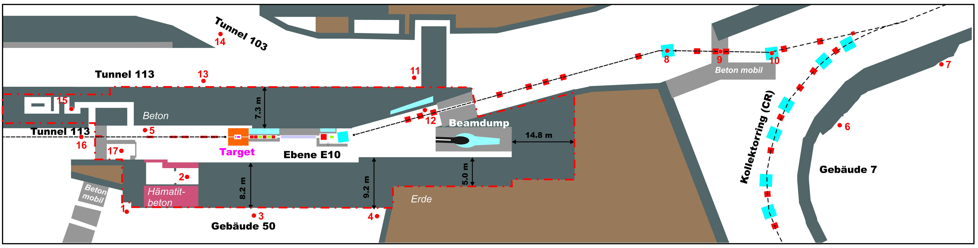
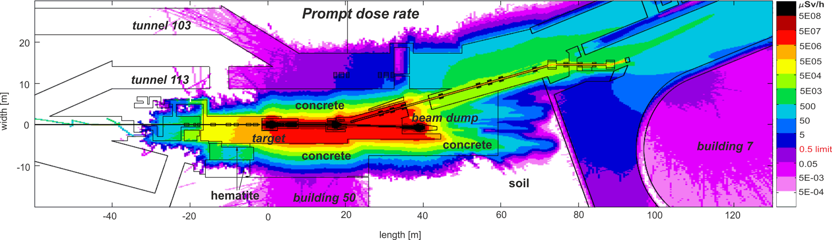
Sections of the pbar separator
PS01 (vac.)
PS01 (air)

Slide 5
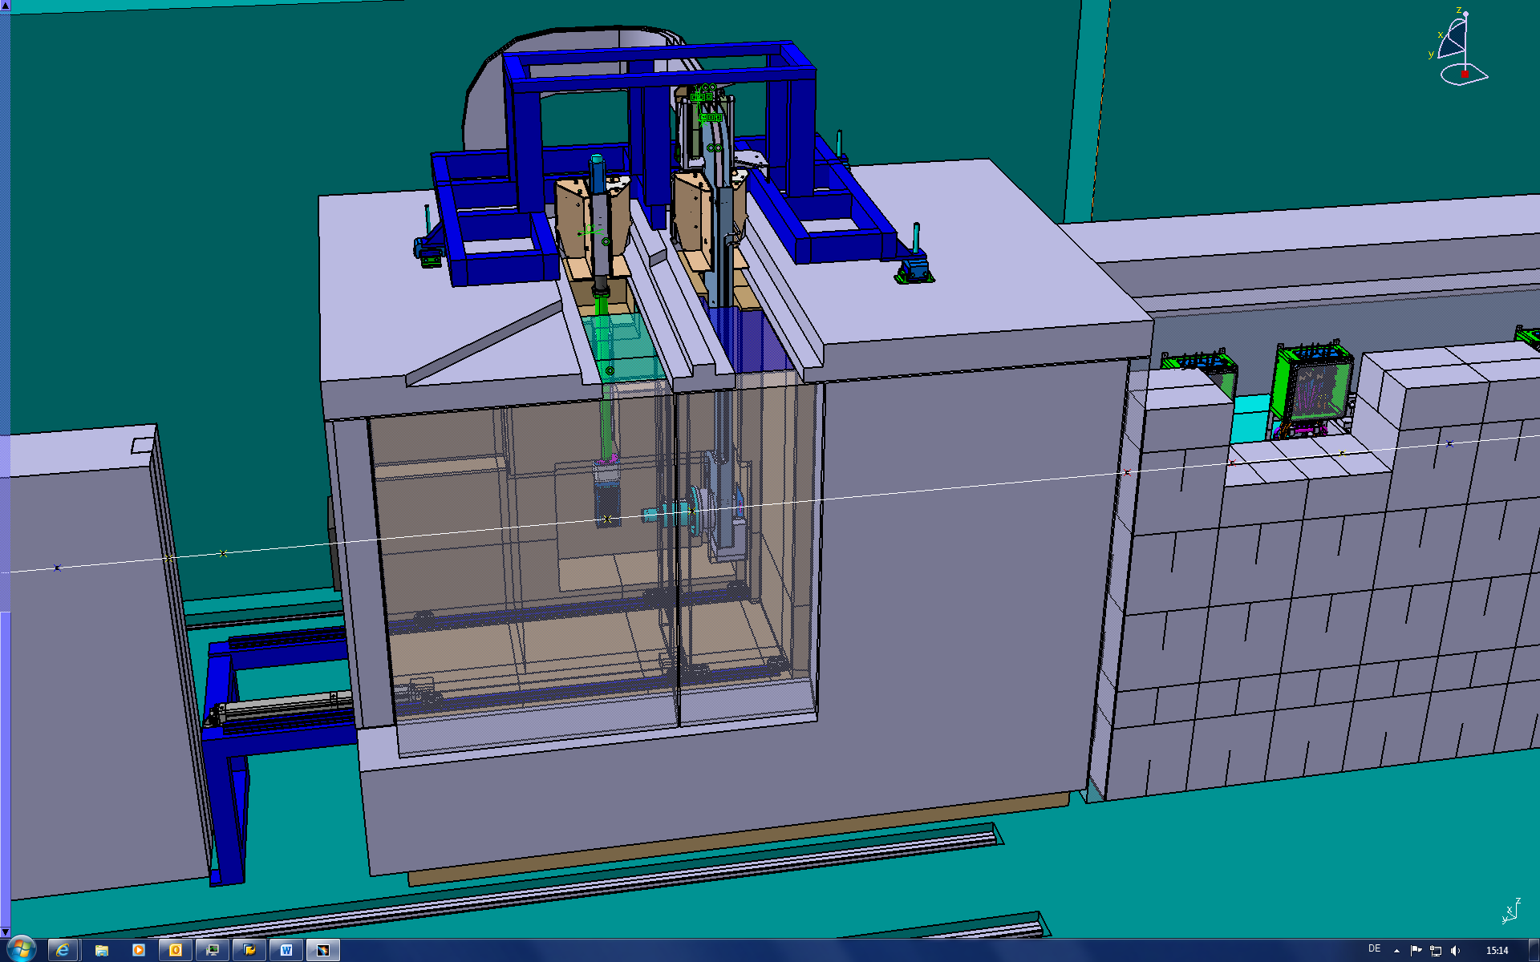
Target station with mounted target and magnetic horn
BEAM

Slide 6
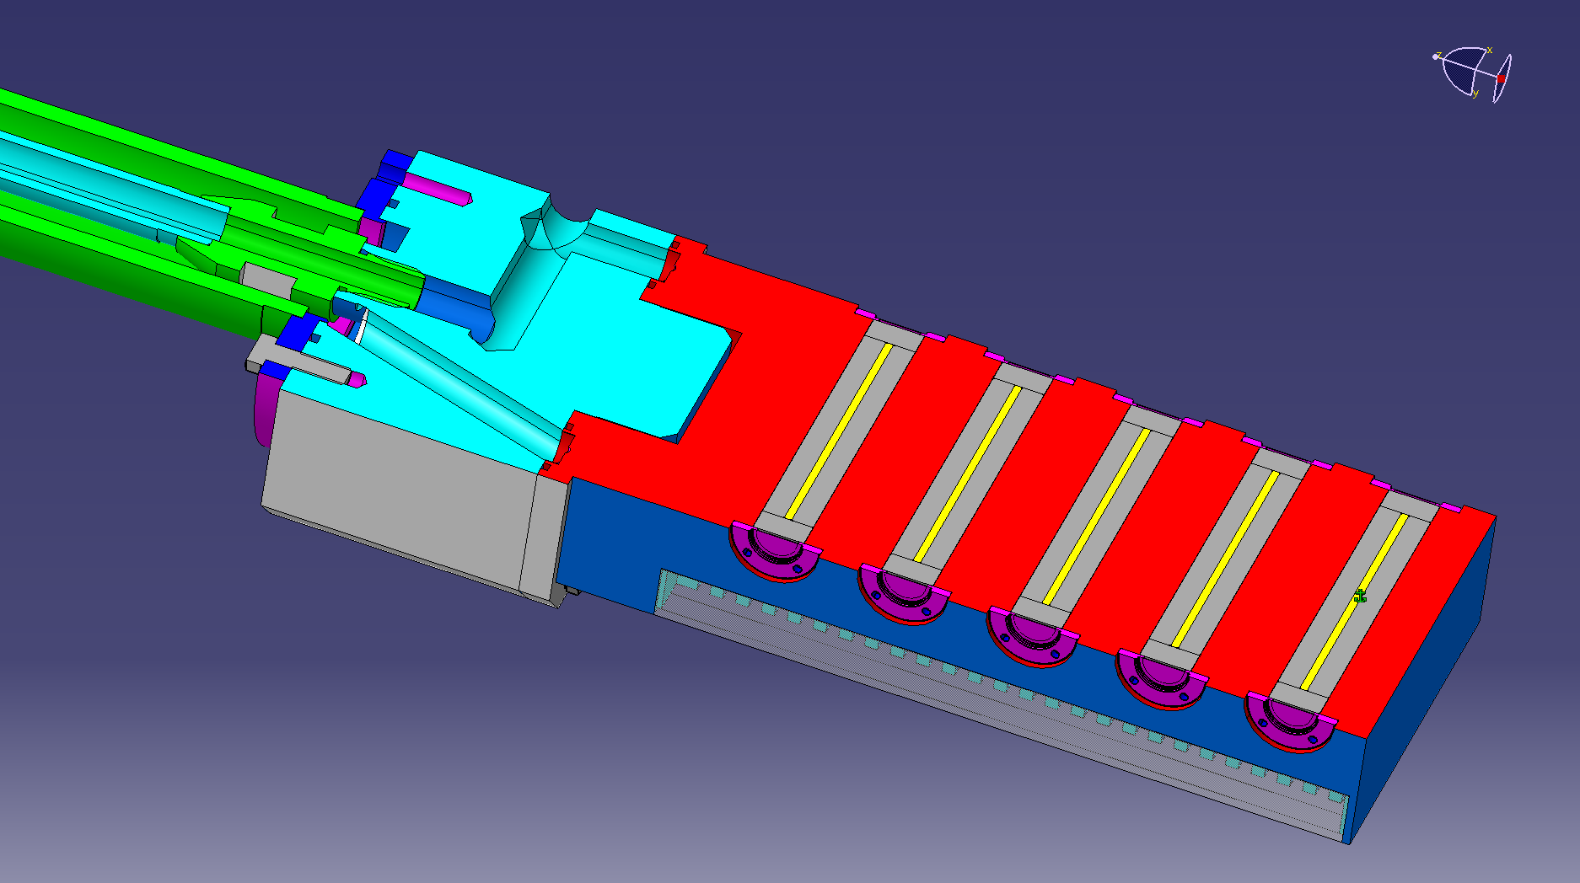
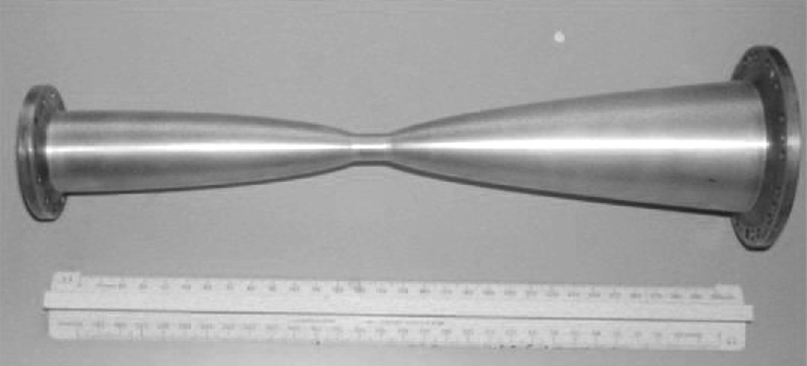
Target and magnetic horn in detail
5 Nickel rods (3mm diameter, 100 mm length)
surrounded by graphite
in aluminum block, titanium windows
CERN ACOL Horn- inner conductor
I= 400 kA

Slide 7
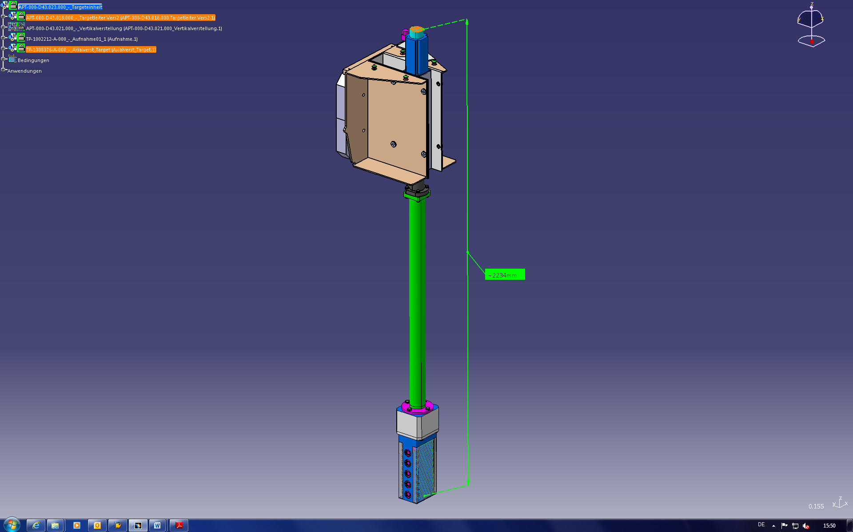
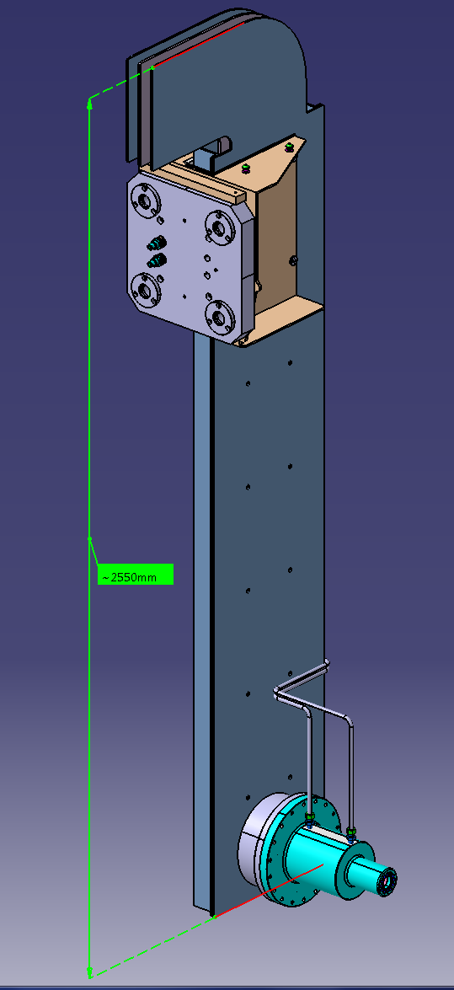
Assemblies to be disposed
Activation of
about 10¹¹ Bq!
I= 400 kA
m ≈ 70 kg
m ≈ 120 kg

Slide 8
Equivalent dose rates during operation: Horizontal Cut

Slide 9
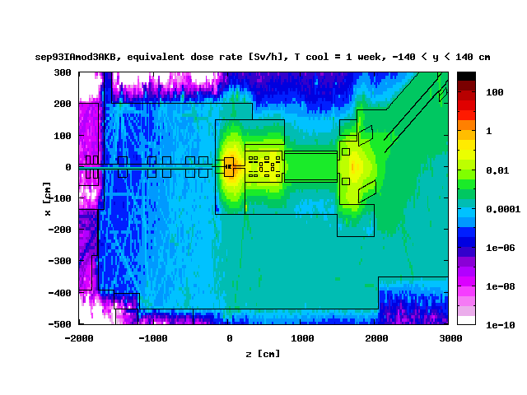
Residual dose rate around target station I
According to
Radiation protection law („Strahlenschutzverordnung“):
Critical value for professionals: 20 mSv/a
The dose has to be As Low As Reasonable Achievable (ALARA)!
BEAM
concrete
air
iron
Restricted area („Sperrbereich“)
concrete
Controlled area („Kontrollbereich“)
Handling Area
air
Monitored area
(„Überwachungsbereich“)

Slide 10
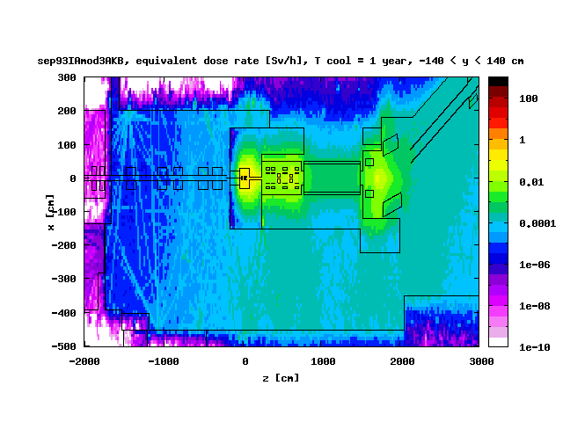

Residual dose rate around target station II
Most problematic isotopes:
⁵⁴Mn (T_{1/2} = 312.13 d)
⁵¹Cr (T_{1/2} = 28 d)
^{48,49}V (T_{1/2} = 16 d, 329 d)
^{56,60}Co (T_{1/2} = 77 d, 5.3 yr)
According to Kraftanlagen Heidelberg even after a cooling time of 1 week remote handling is necessary!

Slide 11
Activity/Dose after Cooling
⁵⁶Co, t_{1/2} = 77 d

Slide 12
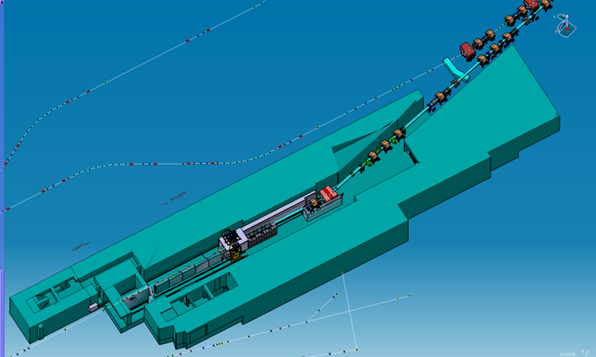
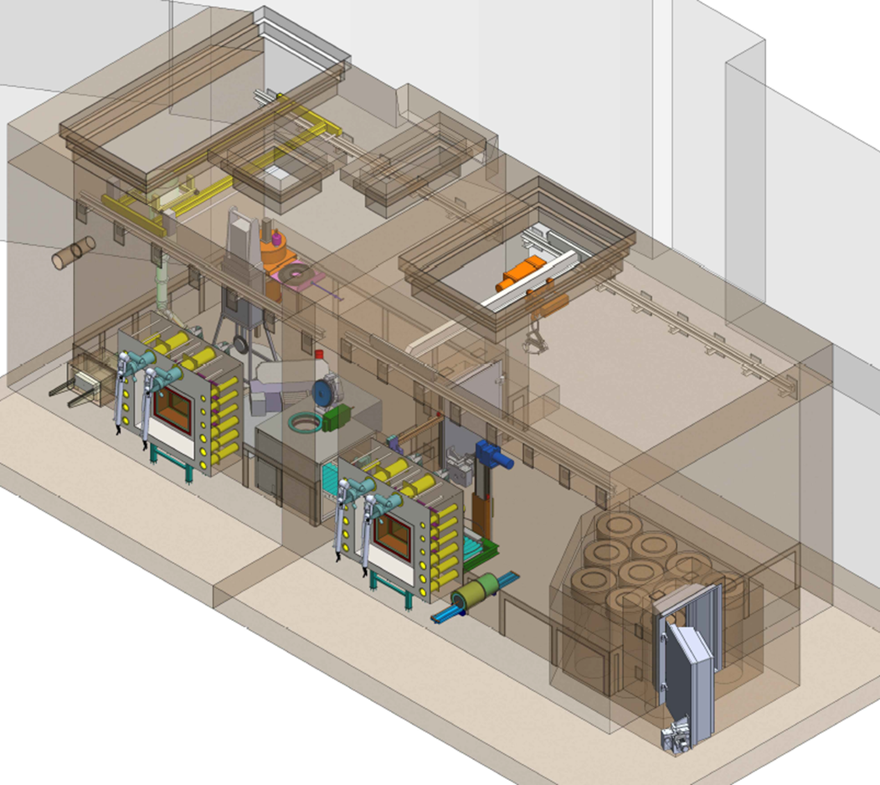

How to transport the components to the hot cell?
End point
Start point

Slide 13
Overview
Super-FRS Building
Building 6c
Anti-Proton-Separator

Slide 14
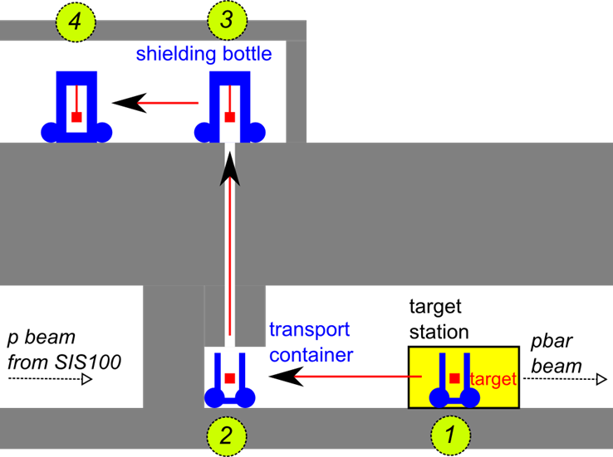
Transport concept in building 6c
Transport container moves to the shaft (1-2).
Crane of carrying frame of the shielding flask lifts up the component (3).

Slide 15
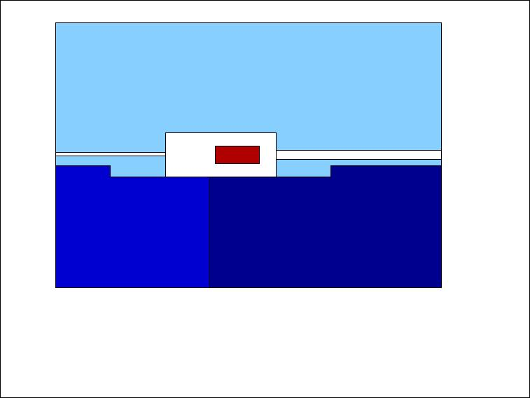
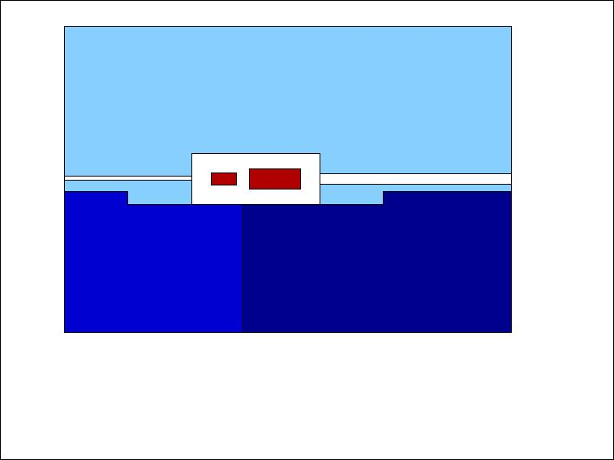
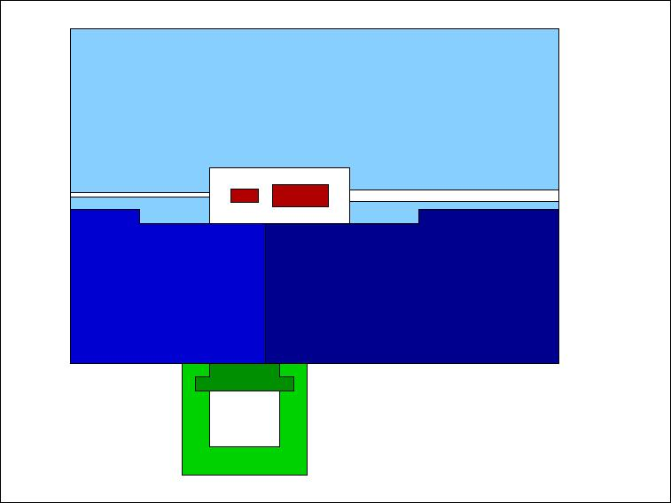
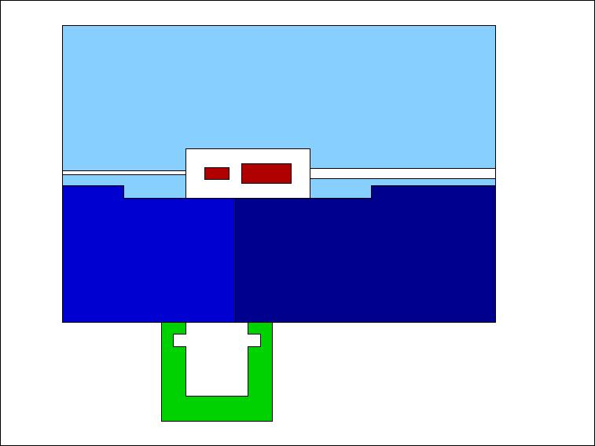
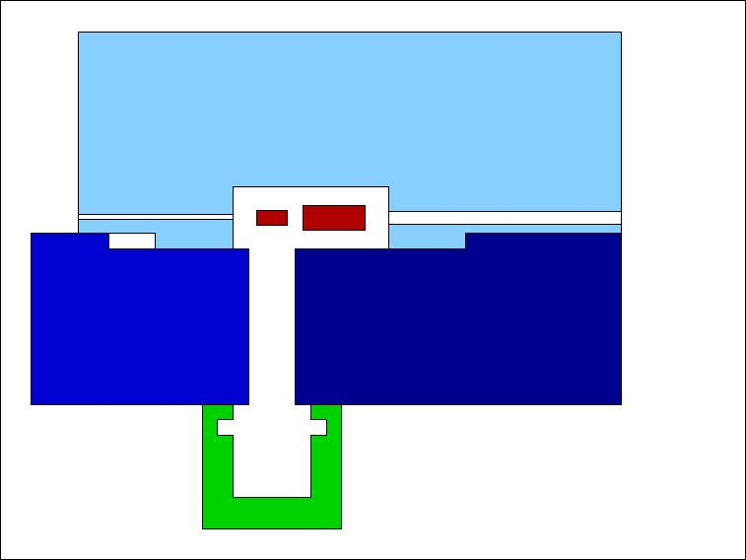
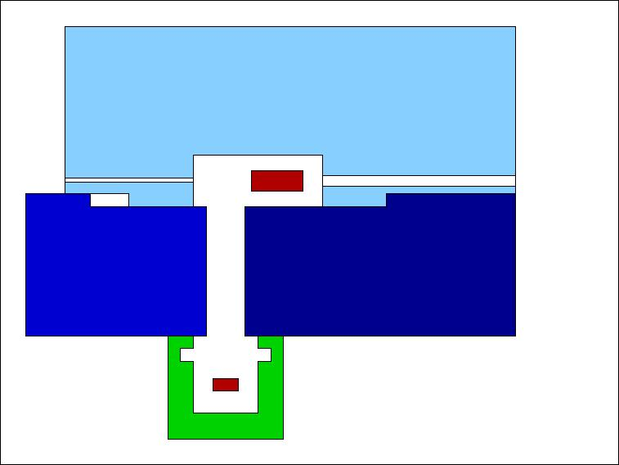

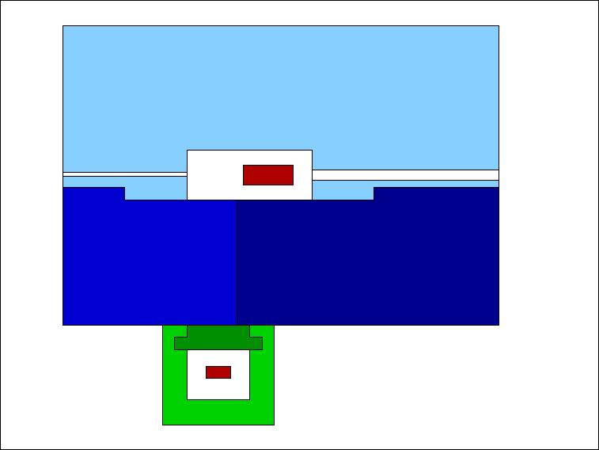
Bring the target out of the target station
Top view, beam from left to right. Inner part of target station is always shielded

Slide 16
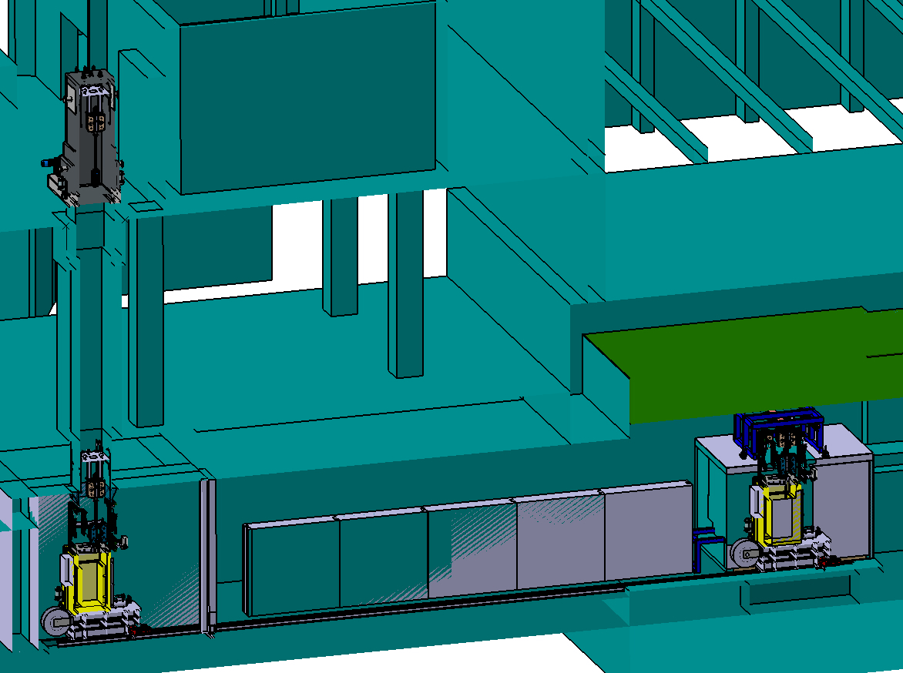
Overview of transport in building 6c
3
1
2

Slide 17
Transportation study of Kraftanlagen Heidelberg
Analysis of our handling concept
  expected radiation exposition
  legal aspects („Genehmigungsfähigkeit“)
  case of intervention
Functional specifications of components
  transportation container
  transport trolley
  shielding flask
Required follow-up studies

Slide 18
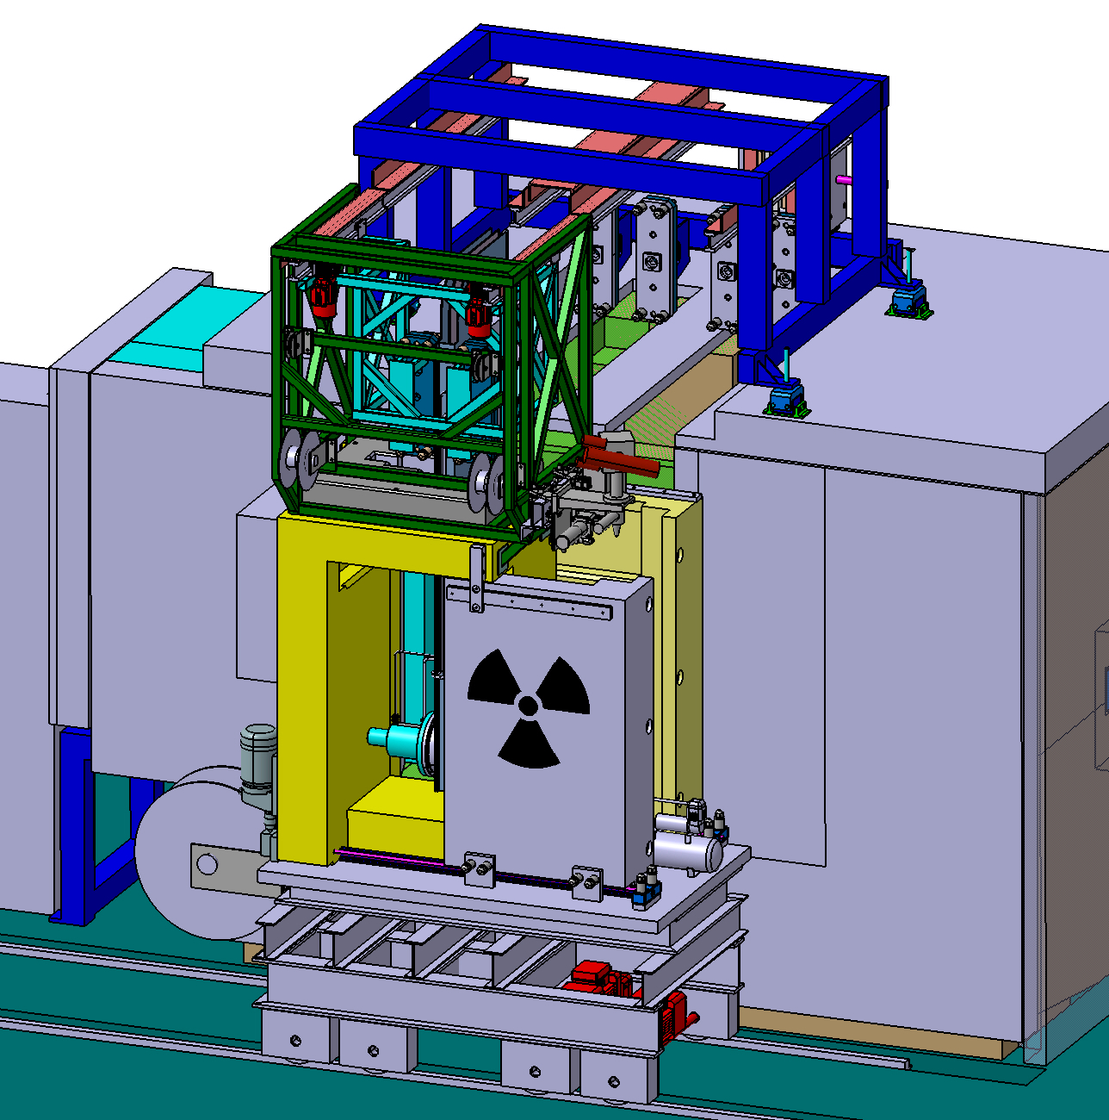
Target station and transport container in tunnel (E 10)
Rail system
Process sequence:
Transport container is placed in front of target station.
Door of target station and transport container are opened.
Component is gripped by a quick coupling system.
Trolley moves the component via rail system into the transport container.
Doors are closed.
Coupling
system
Trolley
Inner door
Front door (for
intervention only)

Slide 19
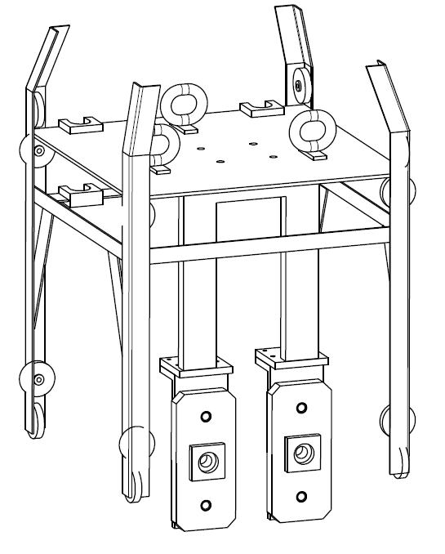
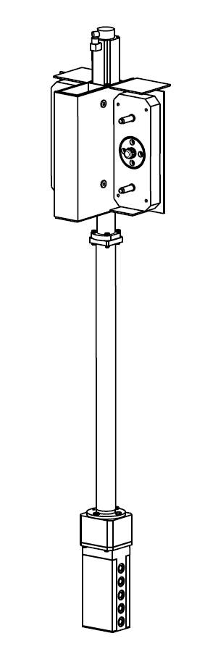
Overview of transport in building 6c II
3
1
2

Slide 20
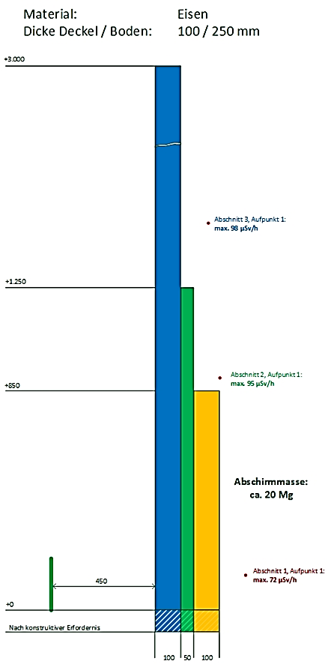
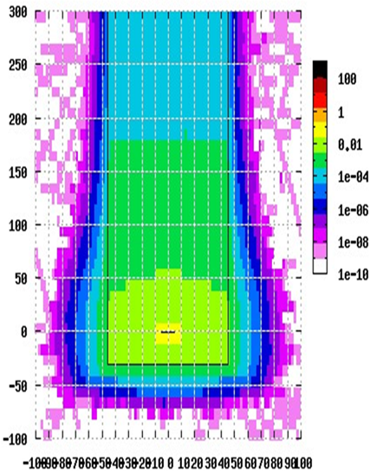
Shielding flask: dose rate calculations
Agreement: Design according to a dose rate at the surface of max.100 µSv/h.
FLUKA
Cross-check with Microshield
[Sv/h]
part 3: 1250mm-3000mm
max. 98 µSv/h
part 2: 850mm-1250mm
max. 95 µSv/h
part 1: 0-850mm
max. 72 µSv/h

Slide 21
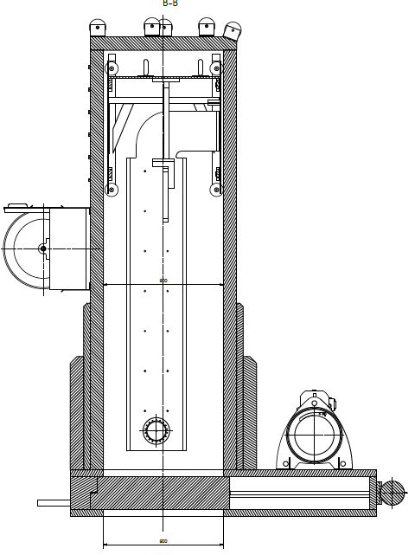
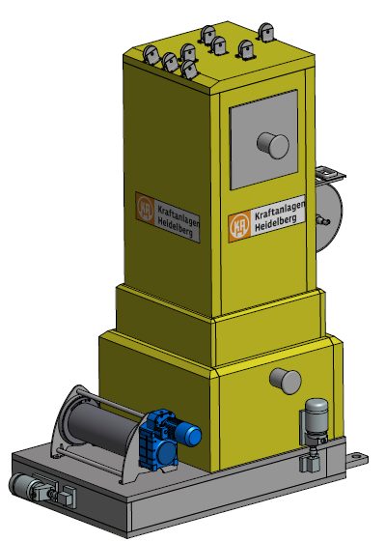
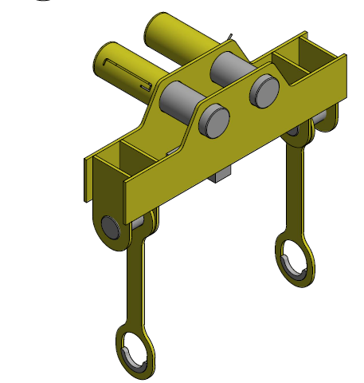
Shielding flask: technical design
Subsystems:
Carrying frame
Traverse for crane
Mobile operator panel
weight: 25 tons

Slide 22
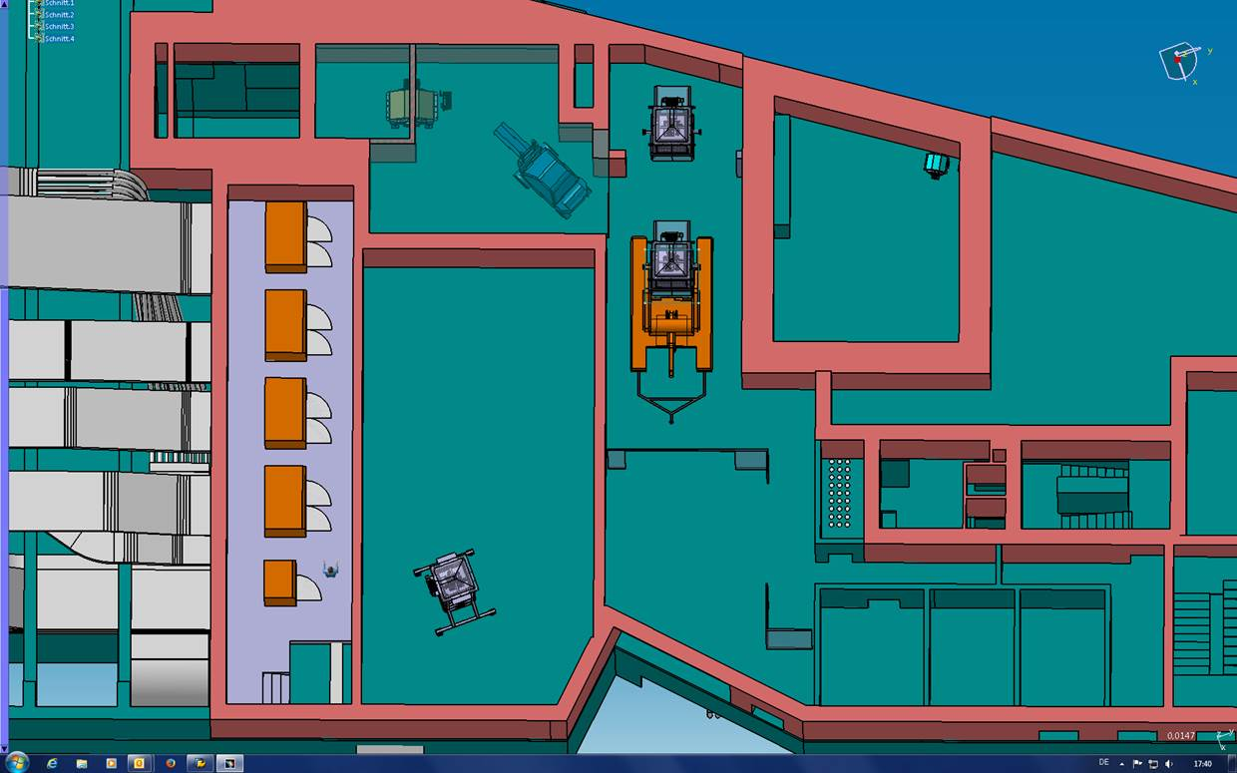
Transport in E20 (ground level)

Slide 23
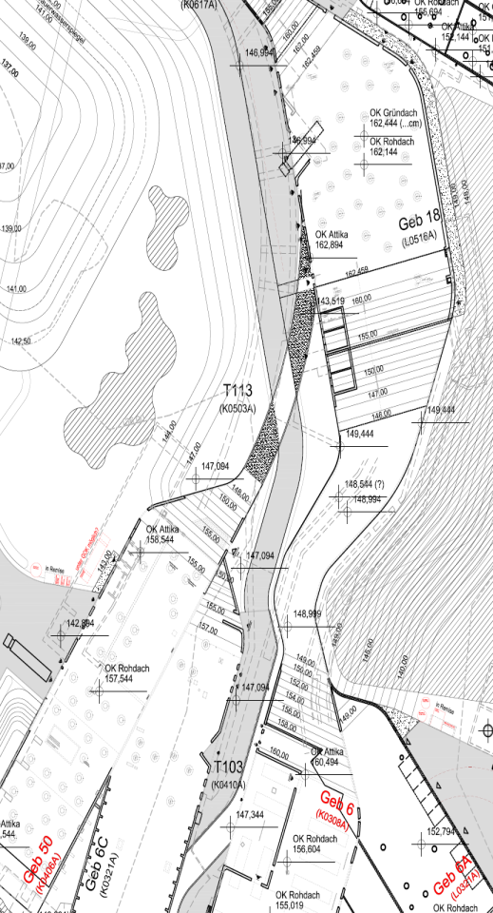
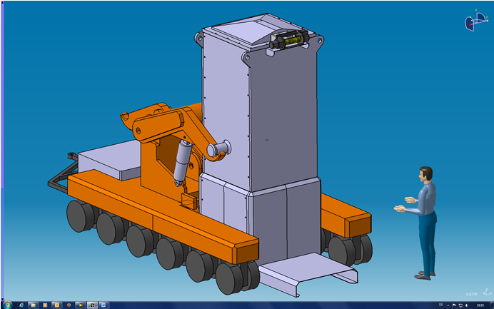
Transport outside of the building
200 m
flat surface
Special design for trailer necessary;
no standard vehicle avaliable.
First positive statement of authorities for transportation concept
is already obtained.

Slide 24
Layout of hot cell in Super FRS building

Slide 25
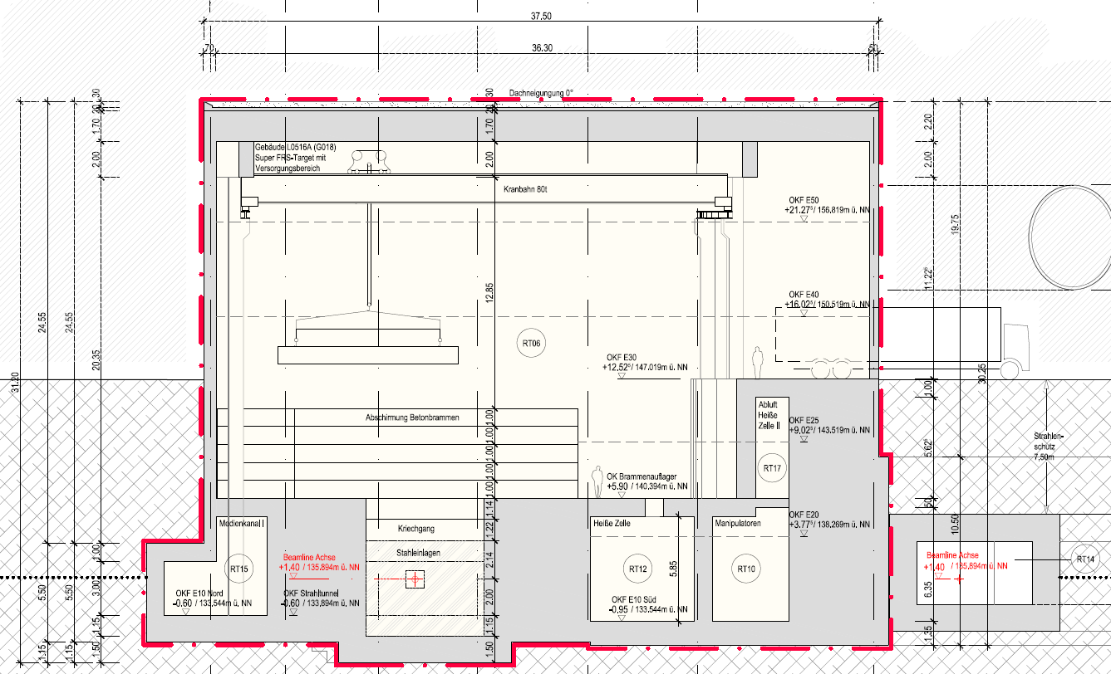
Hot cell of Super FRS: Side view

Slide 26
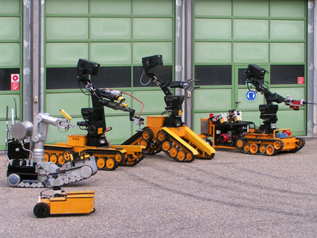
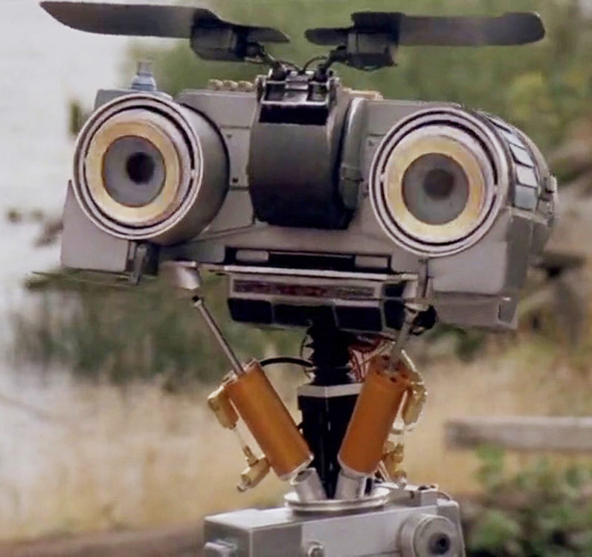
Strategy for the case of intervention
Collaboration with Kerntechnischer Hilfsdienst (KHG) is planned. Own equipment would not be cost-efficient.
More detailed analysis only possible, when actual plans of the building and the manipulators are available.
www.khgmbh.de

Slide 27
Outlook & follow-up-tasks
Following study on target station starts this month:
- Detailing of the transfer concept (target station -> transport container -> shielding flask)
- Concept of mounting and media (dis)connection for target and magnetic horn
Preparation of detailed specifications of handling components is in progress
Detailing of intervention concept, when plans are avaliable
Infrastructure requirements on Super FRS building
Thank you for your attention!

Slide 28
Appendix
 | FAIR | CERN (AC+AA) | FNAL
E(p), E(pbar) | 29 GeV, 3 GeV | 25 GeV, 2.7 GeV | 120 GeV, 8 GeV
acceptance | 240 π mm mrad | 200 π mm mrad | ≈ 30 π mm mrad
protons / pulse | 2 × 10¹³ | 1 - 2 × 10¹³ | ≥ 5 × 10¹²
pulse length | single bunch (50 ns) | 5 bunches in 400 ns | single bunch 1.6 µs
cycle time | 10 s | 4.8 s | 1.5 s

Slide 29
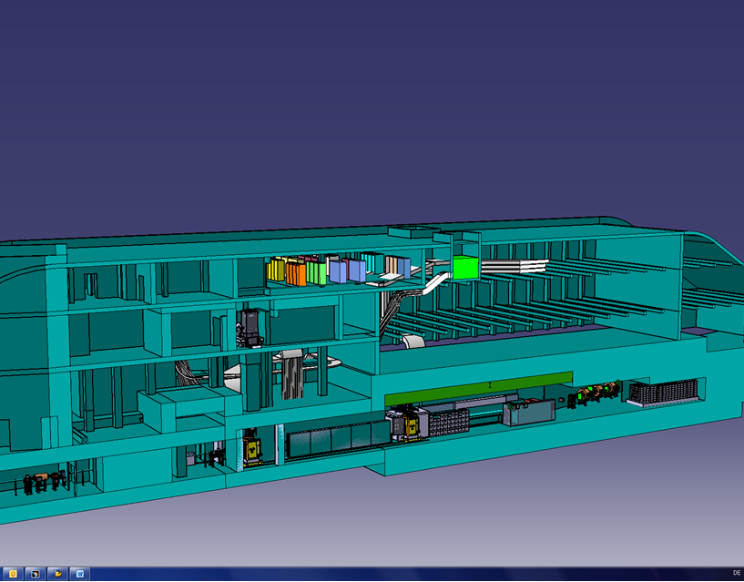

Slide 30
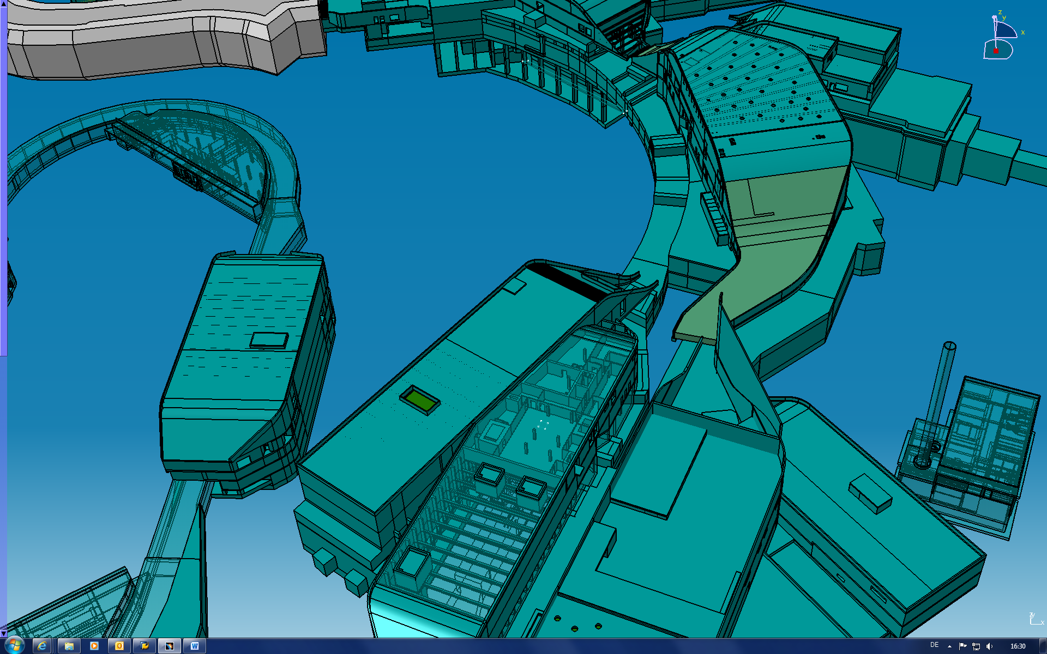

Slide 31
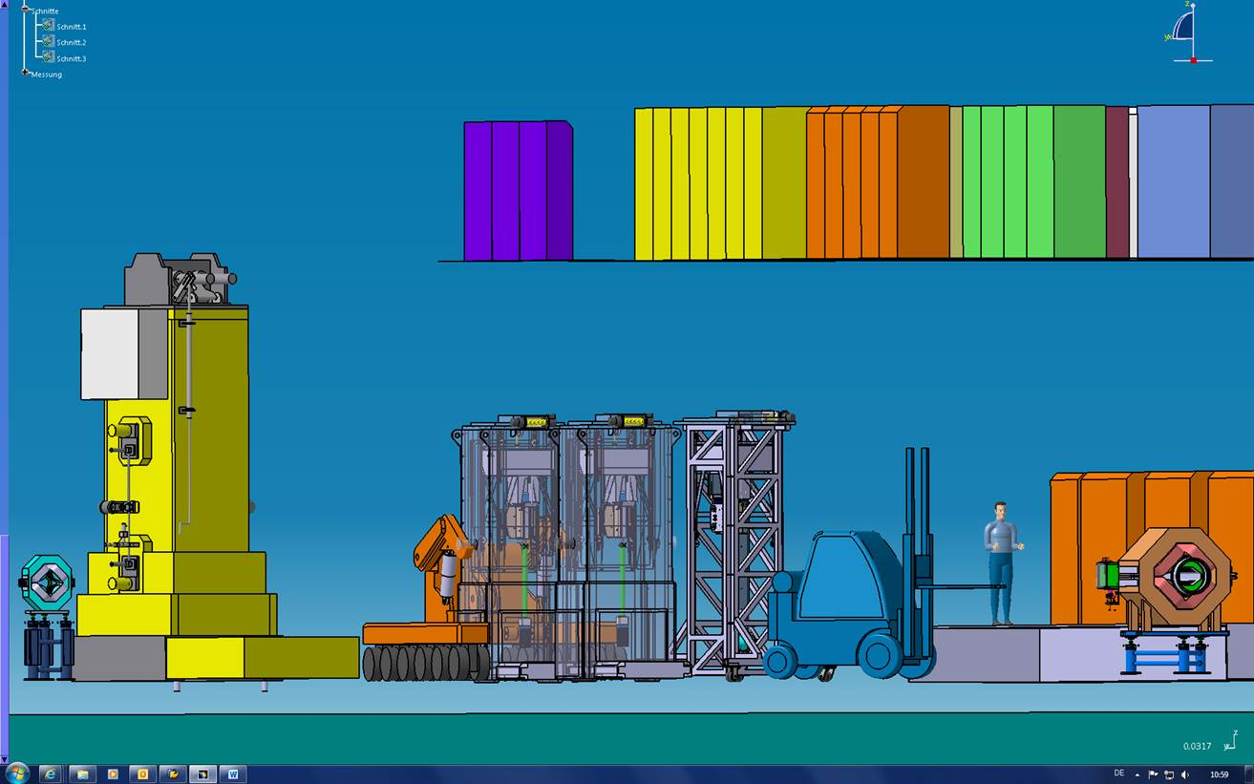
PSI

Slide 32
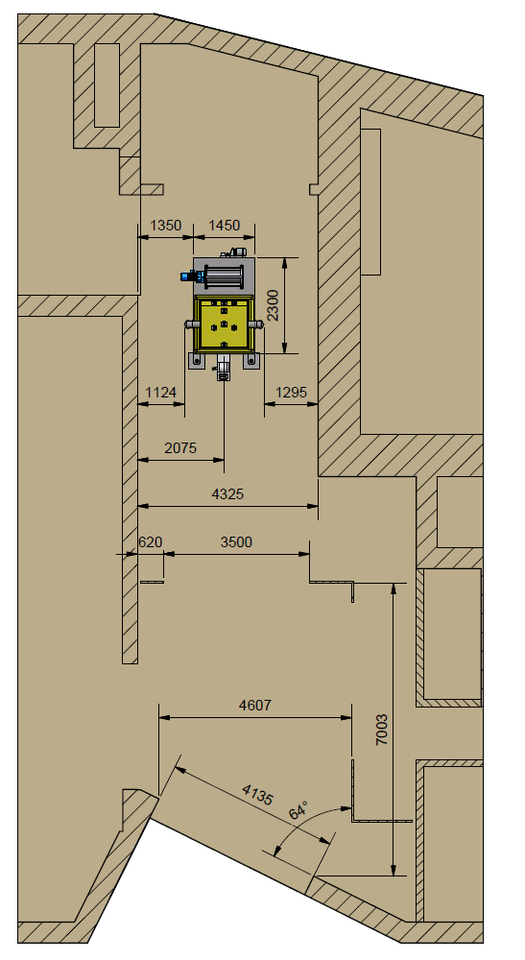

Slide 33
The Magnetic Horn
B ∼ 1/r
primary beam does not hit the horn
reactio products

