Slide 1
Marina Dolinska
28th August , 2014
Stochastic Cooling:
Approaches for studies

Slide 2
Cooling methods
Electron (SIS18, ESR, RESR, NESR, HESR)
Stochastic (ESR, CR, RESR, HESR)
Laser (ESR ??, HESR ??)
.....other

Slide 3
Why do we need cooling ?
Aim of cooling is reduction of emmitances (transverse and longitudinal)
Increase the phase space density of particles

Slide 4
Outline
Basic principle of stochastic cooling
- Time domain approach
Other approaches (short overview)
Cooling at CR (preliminary results of simulations)

Slide 5
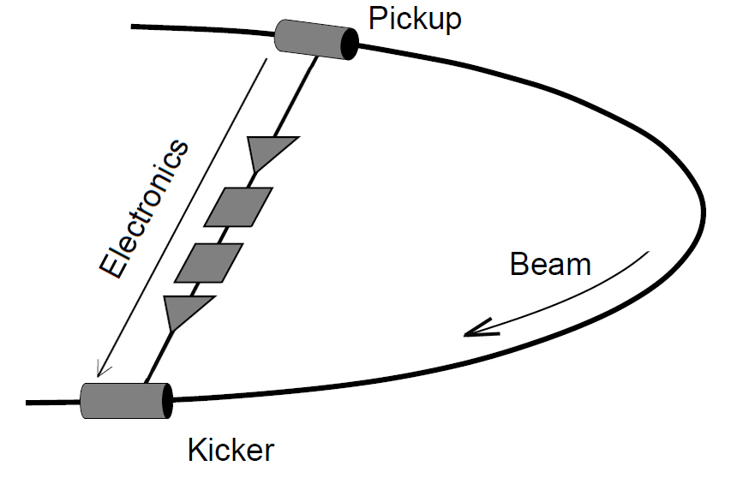
Stochastic cooling system
Pickup – detect the beam parameters
Electronics – transfer signal, filter, amplify
Kicker – correct
These devises are places in storage ring, which parameters are important for stochastic cooling system

Slide 6
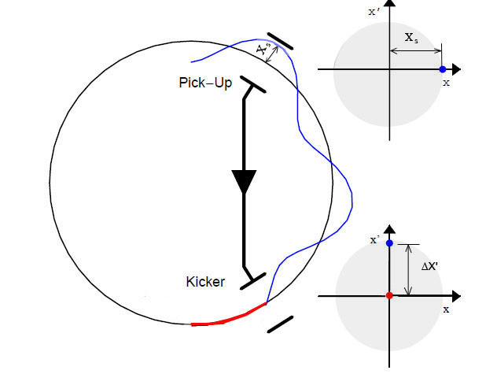
Basic principle of stochastic cooling
Measure position and apply a correction.
One particle consideration:
One particle passing with maximal position at PU
Requirement: particle crossing the reference orbit at kicker with maximal angle
Closed orbit of the ring
(trajectory of the ideal particle)
Trajectory of not ideal particle
ΔX‘=gX_{s},
g – normalized gain
[0<g≤1]
Kicker eliminates angle deviation

Slide 7
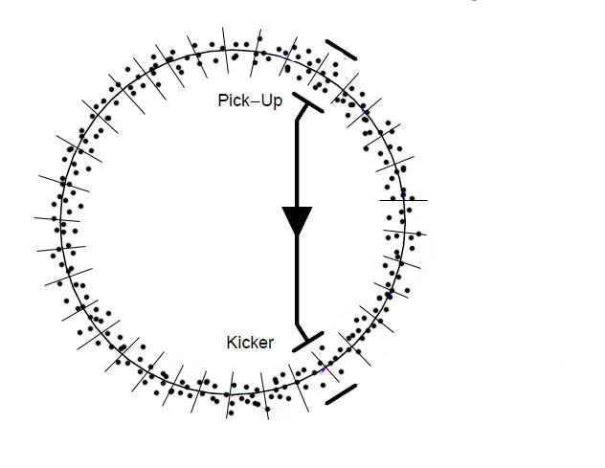
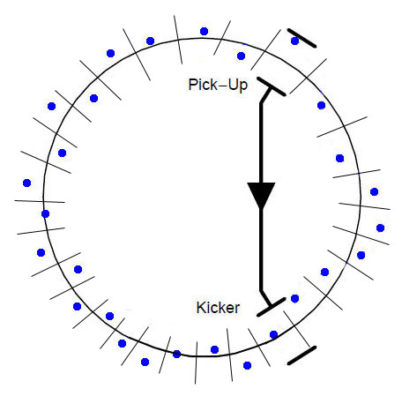
Basic principle of stochastic cooling
The coasting beam is sampled. The number of samples and its time length
is defined by frequency range [f₁ ; f₂] of SC. Bandwidth W=f₂-f₁
Nominal value for the CR of W=2-1=1 GHz
Mean value of sample
samples
Center of gravity of one sample Position with respect to the reference orbit. Pick-up detects the value of this displacement and forms the signal.

Slide 8
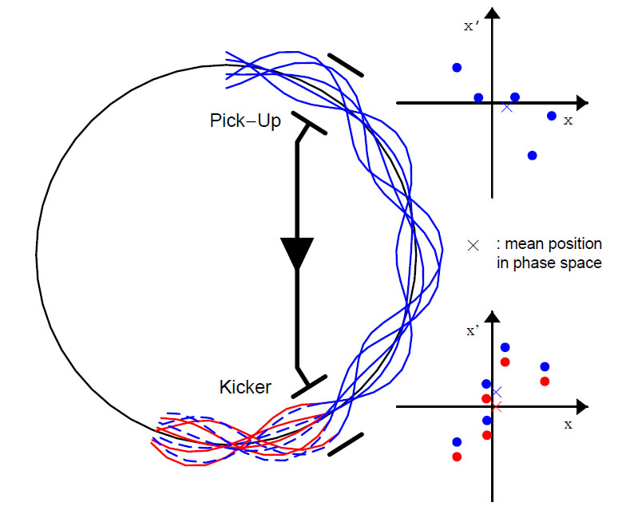
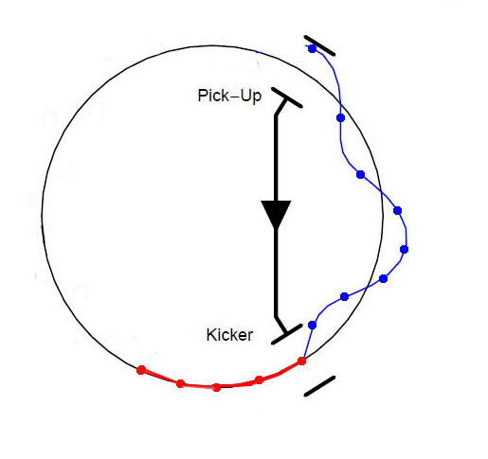
Basic principle of stochastic cooling
A sample of particles passing the kicker gets correction of the mean position.
The individual particle coordinate is reduced by the mean value of ensemble. After one turn one has not full cooling.

Slide 9
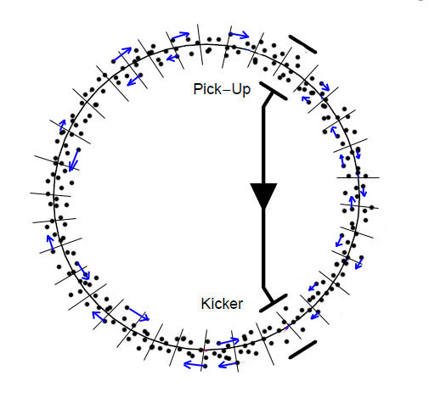
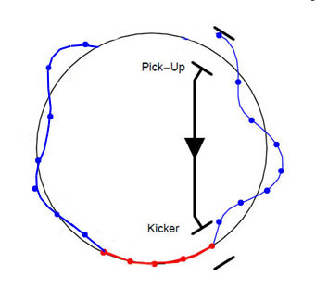
Mixing
All particles migrate from one sample to another one. This particle migration is called “mixing”.
mean value evolution of one sample
mean value appears
Because of mixing the new mean value of sample is formed.
At the next turn the pick-up detects this value and then the kicker corrects it again

Slide 10
Theoretical study
This process is repeated turn by turn and cooling takes place.
For quantitative description of this process the time domain consideration can be used. It gives more better understanding of cooling process and parameters of SC system.
The special computer code is developed, where the time domain approach is applied.

Slide 11
The main ideas of time domain approach
The beam dynamic is calculated by particle tracking in a ring a turn by turn
Beam sampling (or binning) is applied.
- Complete pick-up, electronic and kicker characteristics, which are defined in the frequency domain, are introduced via inverse Laplase transformation to define the kicker response, which acts on particles.

Slide 12
Time domain approach
Lattice and SC system parameters
Particle generation
Analyses of distributions ( Δp/p_{rms} and ε_{rms} )
Pick-up action
Mixing on the way Pick-up – Kicker
Kicker action
Mixing on the way Kicker – Pick-up
Stop after N turns
one turn

Slide 13
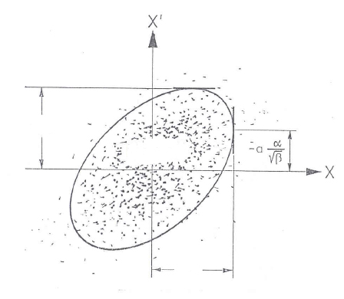
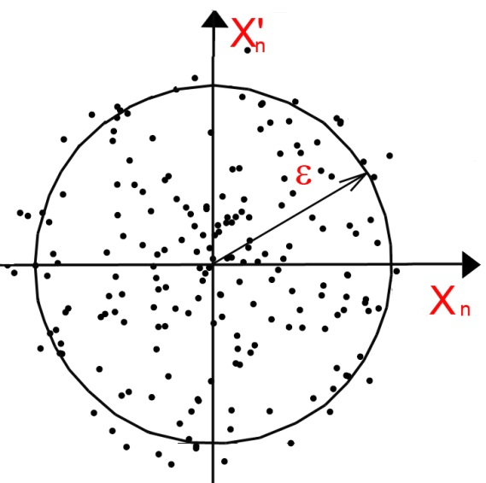
Particle generation
The ensemble of N particles is generated in 6D phase space.
Each particle has the six coordinates (x, x‘, y, y‘, Δp/p, t)
Number of particles N > 10⁴
transformed to normalized phase space
simulation becomes simpler

Slide 14
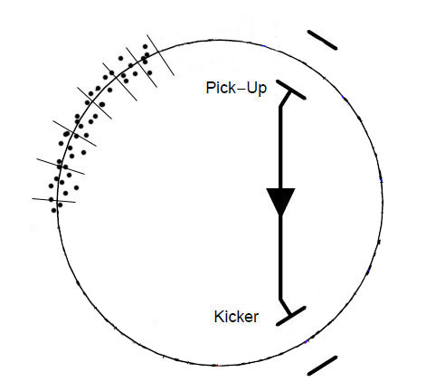
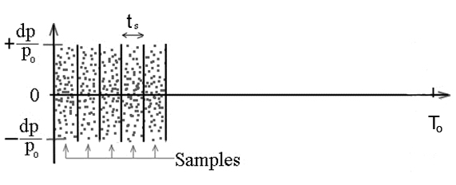

Sampling
T_{w}
T_{w}
Revolution time
The particles are generated in a certain time-window: T_{w}=n_{s}t_{s}
Number of samples must be n_{s} > 5
The momentum spread is distributed over this time.
Additionally each particle is assigned to certain bin (or sample).
The time-window of one bin t_{s} is defined by a frequency bandwidth W
of the stochastic cooling system
$$t_{s}=\frac{1}{2W}$$
Example of CR
W=W_{max}-W_{min}=10⁹ Hz
t_{s}=0.5 ps

Slide 15
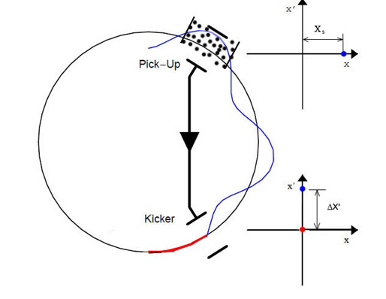
Pick-up action
At Pick-up the each sample is analyzed.
The average value of each sample is calculated
s - sample number (max n_{s})
N_{s} – number of particles in some sample

Slide 16
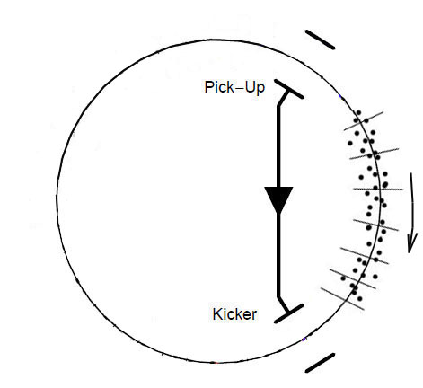

On the way from Pick-up to Kicker
On the way from Pick-up to Kicker mixing takes place.
The particles migrate from sample to sample, which means the time coordinate of each particle is changed by Δt
bad mixing
-0.011 (pbar optics)
0.18 (RIB optics)
D(s) - dispersion function
ΔL – path length
ρ – bending radius of dipole

Slide 17
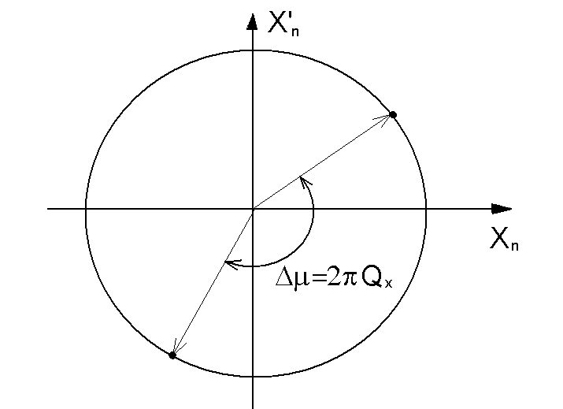
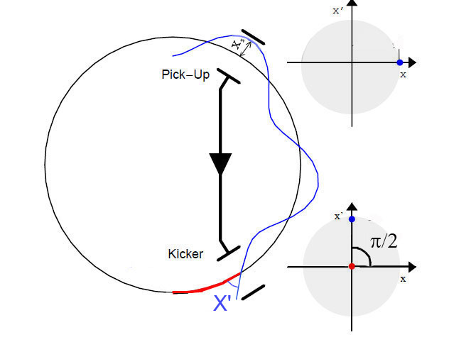
On the way from Pick-up to Kicker
Betatron oscillation
The particle coordinate is changed due to betatron oscillation in the ring.
In the normalized transversal phase space it is simple rotation
The phase advance Pick-up→Kicker must be close

Slide 18
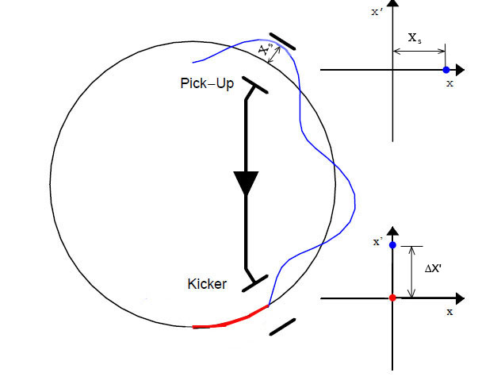
Kicker action
At the kicker correction is applied. All particles of sample get the kicker correction and energy change
g – is normalized gain [0 < g ≤ 1]

Slide 19
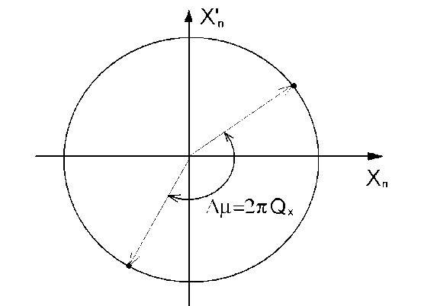
On the way from Kicker to Pick-up
Mixing takes place. The particles migrate from sample to sample, which means the time coordinate of each particle is changed by Δt
good mixing
In transverse plane the coordinates are recalculated
Here Δµ can be any

Slide 20
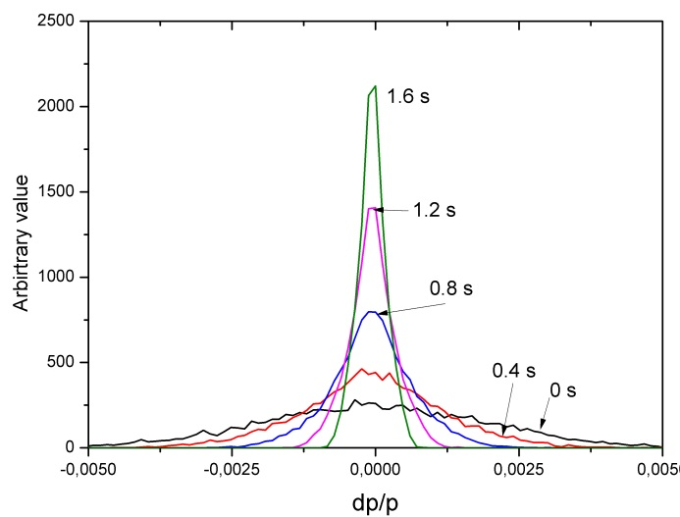
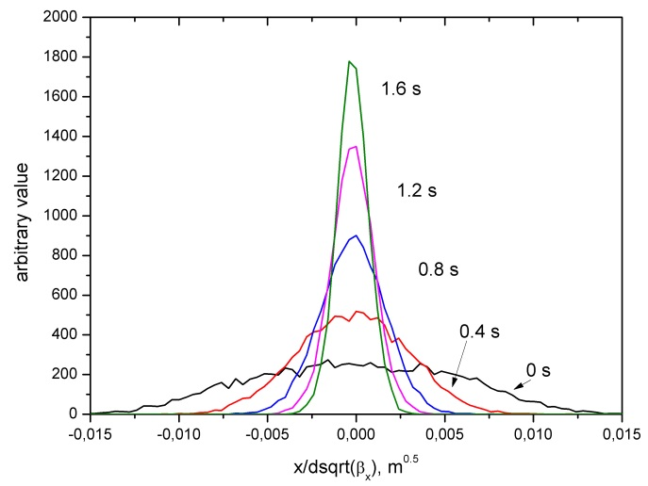
cooling effect
The procedure is repeated from turn to turn. Due to such repetition the cooling effect takes place. One can see evolution of particle distribution in transverse and longitudinal spaces
The rms values of amplitudes distribution are calculated.

Slide 21
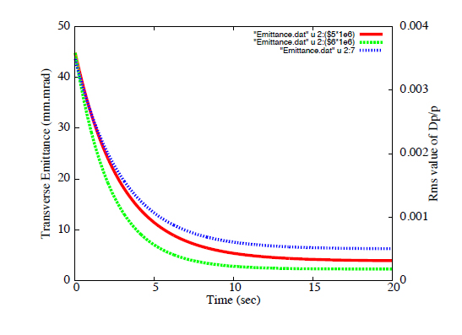
cooling effect
Evolution of the Rms values of the Emittances and Momentum spread during SC
Cooling time
Δp/p
Rms Emittance
ε_{x,y}

Slide 22
cooling effect in time domain treatment
cooling effect in ideal case is calculated by simple formulae:
Mixing:
Palmer method
In reality one has to take into consideration the pick-up-kicker loop geometry
with specific frequency characteristic of all components of SC.
Then the given formulas must be modified according to this SC system .
Let‘s look how the signal is proceed in the SC system.

Slide 23
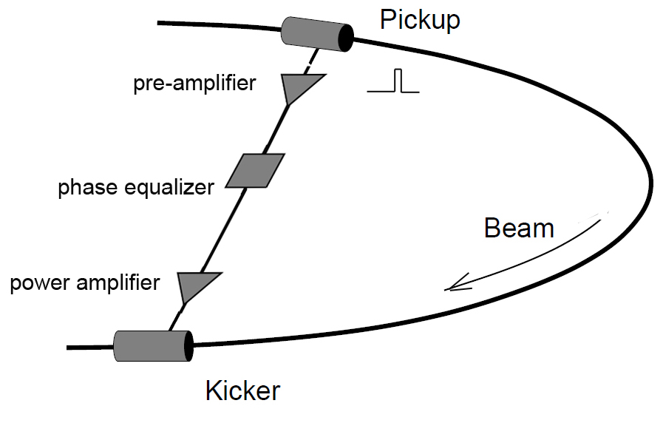
Noise of signal
δ_{noise}
Noise in the time domain treatment
is still a subject of study :
how to calculate δ_{noise}
Up to now the analytical approach is used

Slide 24
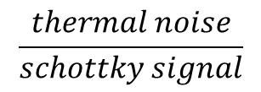
Noise of signal
damping factor α is introduced
D.Möhl, Stochastic Cooling of particle beams, Springer-Verlag 2013.
noise-to-signal ratio :
$$\frac{thermal noise}{schottky signal}$$
λ – sensitivity of SC system. Many construction details are hidden λ

Slide 25
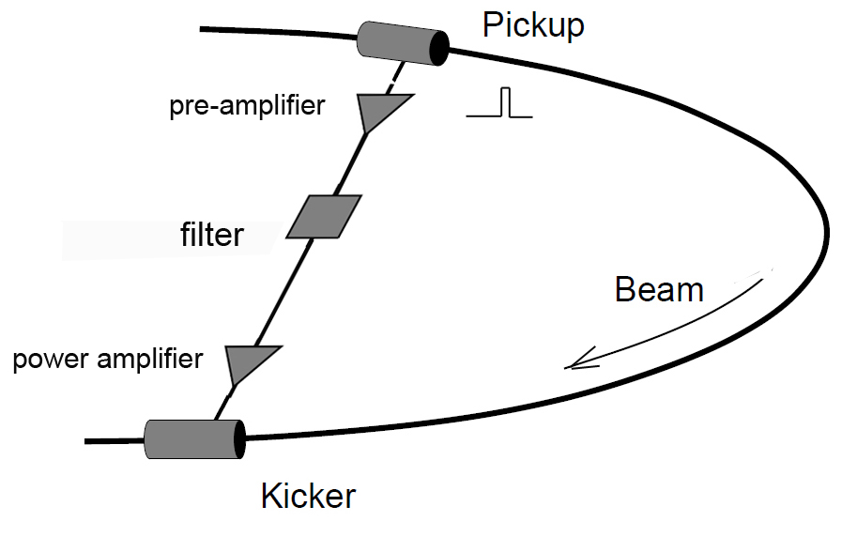
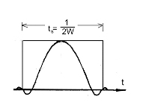
Kicker response
inverse Laplase transformation

Slide 26
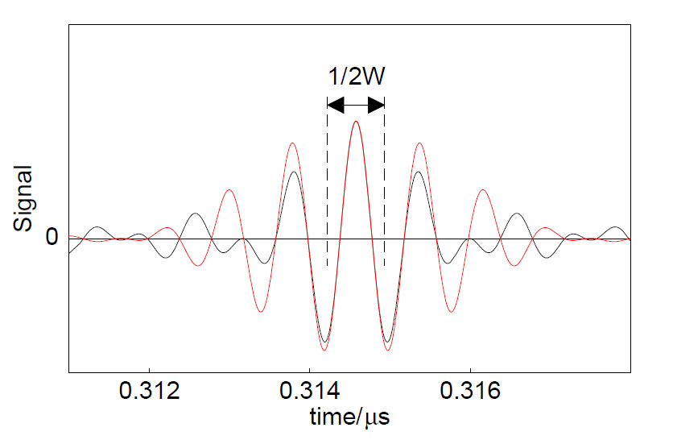
Kicker response
signal shape at kicker
inverse Laplase transformation
1
s(t)
the normalized gain is transformed according to shape of signal in the kicker.
s(t) – is formalized function (max is 1)

Slide 27
cooling effect in time domain treatment
These formulae for calculation of cooling in time domain approach

Slide 28
Other approaches
(short overview)
Analytical formulae
Solution of Fokker Plank equation

Slide 29
Analytical formulae
Momentum spread and emittance evolution are calculated by
Here the cooling rates 1/τ are calculated by formulae

Slide 30
Analytical
W, g, N – const
W – bandwidth [Hz]
g – normalized gain factor [0 - 1]
N – number of particles
M, B, U – parameters. Here the parameters of hardware are included.
M – mixing factor [1 - ∞ ]
B – parameter of signal shift [0 – 1]
U – noise to signal ratio [0 - ∞ ]

Slide 31
Analytical
M - the mixing factor.
for the homogenous distribution
for the Gaussian distribution
For analytical formula it is an average value, because Δp/p is not constant
In reality M = M(t) is time dependent function.

Slide 32
Fokker-Plank equation
The general Fokker-Planck Equation (FPE) for Nv variables X = (x1; x2; : : : xN ):
Fi - drift vector
Dij - diffusion tensor
ψ - Probability Density Function (PDF) is calculated
X =Δp/p, ε_{x} ε_{y}
In general, the FPE is very complicated and can not be solved analytically, therefore one has to use numerical algorithms. Most simplest way is one dimensional FPE (only dp/p, or ε_{x} or only ε_{y} )

Slide 33
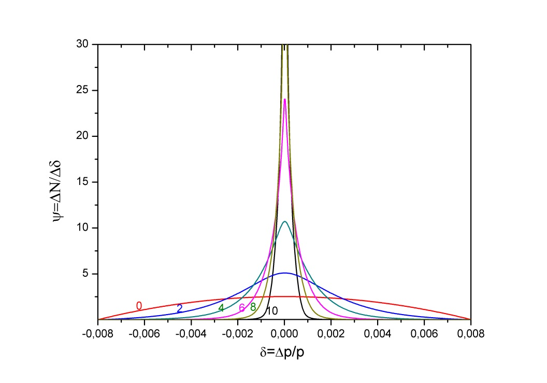
Fokker-Plank equation (1D)
Ψ=ψ(z,t)=ΔN/Δz - particle density
z=Δp/p
F=F(z,t) - cooling force (cooling)
D=D(z,t) - diffusion term (heating)
Δp/p

Slide 34
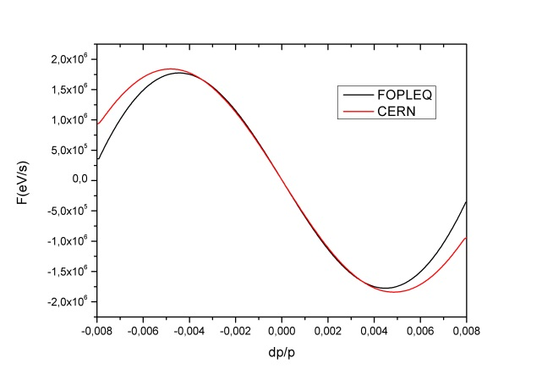
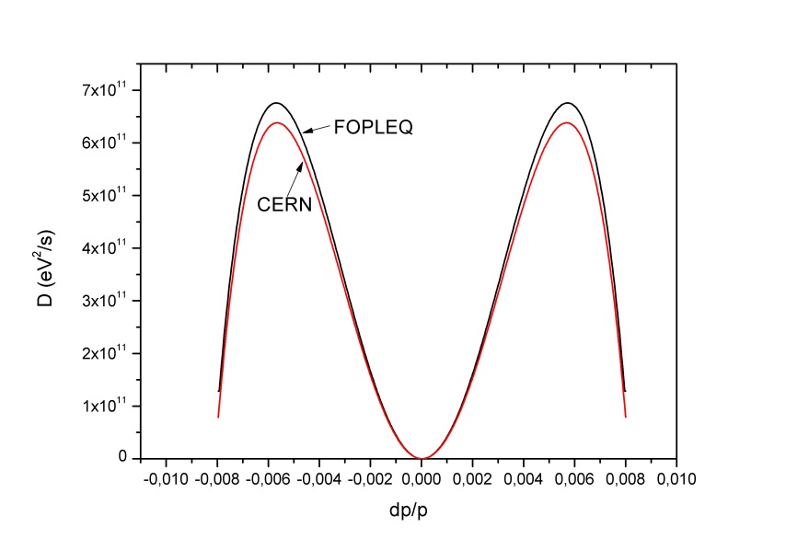
Fokker-Plank equation (1D)
Coefficients F and D include
parameters of Stochastic Cooling
Coherent effect (cooling)
Incoherent effect (heating)
F
D

Slide 35
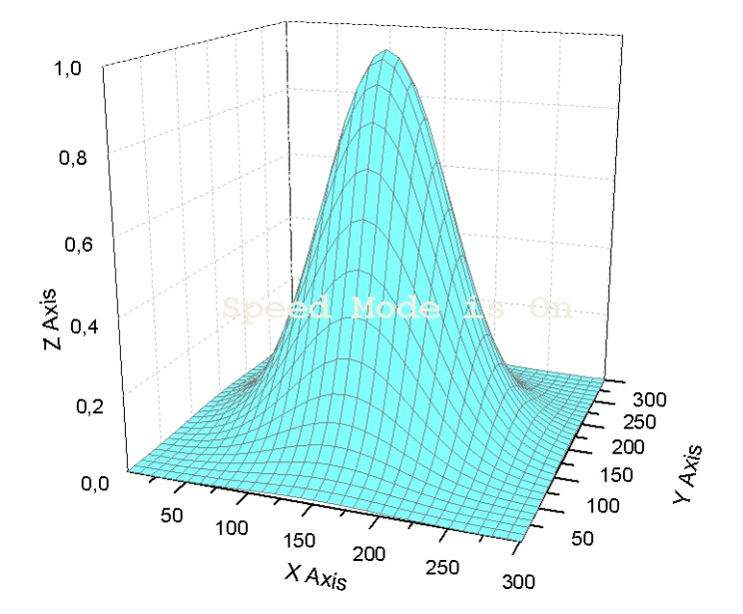
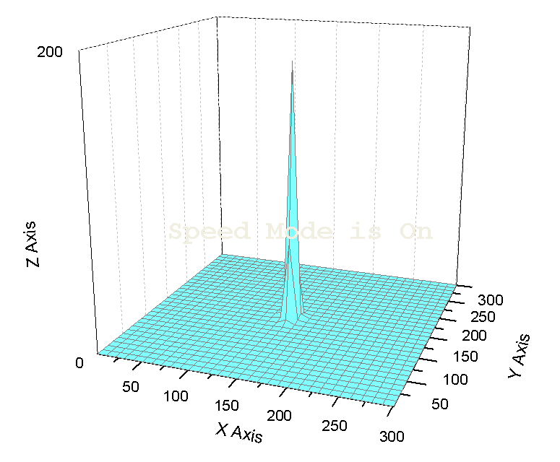
Fokker-Planck equation 2D
x₁=Δp/p, x₂=ε_{x}
t=0
t=5 s
emittance
emittance
dp/p
dp/p

Slide 36
Codes for simulations
Computer codes for numerical simulations
FOPLEQ-1D (Fokker-Planck one dimension)
FOPLEQ-2D (Fokker-Planck two dimensions)
MPT-6D (TIME-Domain approach six dimensions, still under development)

Slide 37
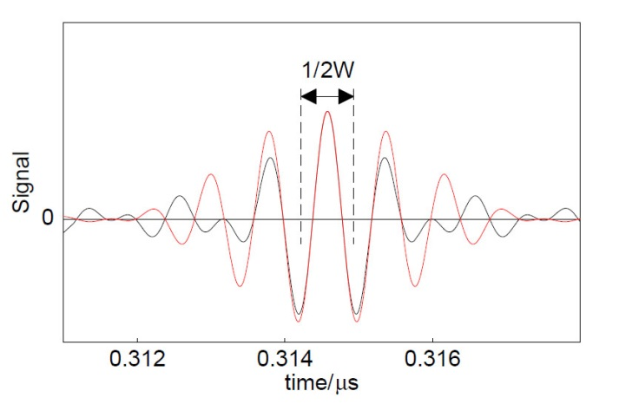
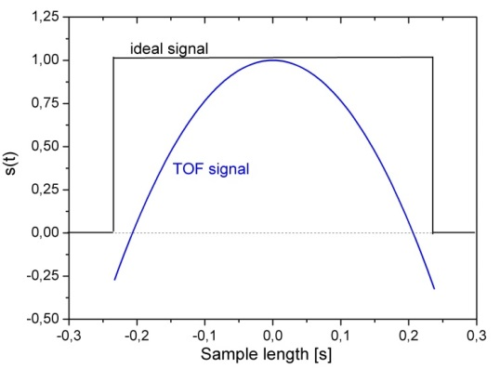
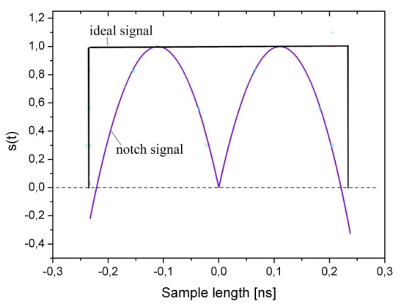
MPT-6D code
s(t) – kicker response
turn by turn the coordinates are recalculated
t_{s}=
Instead of inverse Laplase transformation
simple analytical approximations are used
g – normalized gain [ < 1]
Noise
N=10⁴ macro-particles
n_{s}= 5 samples
t_{s}
t_{s}
TOF, Palmer
Notch filter

Slide 38
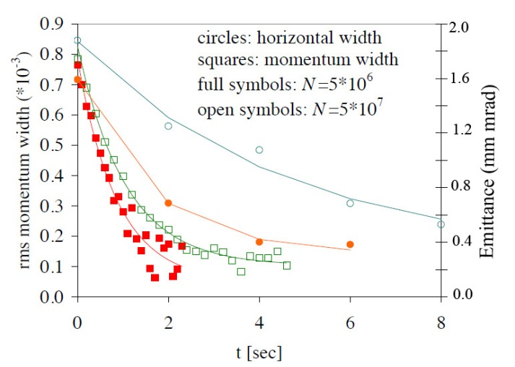
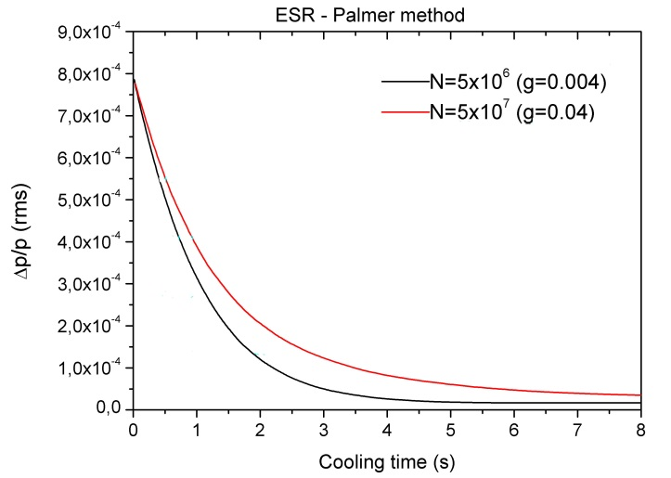
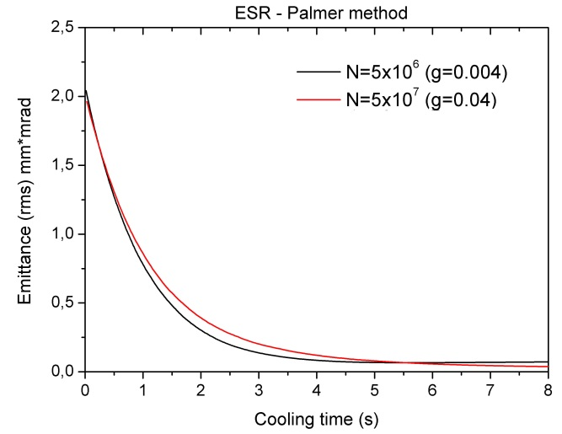
Benchmarking of MPT-6D
Measured emmitance and Δp/p at ESR using PALMER method
Argon beam : ³⁶Ar¹⁸⁺,
E=400 MeV/u
W=0.8 GHz
η = 0.31
F. Nolden, et. al. Proceedings of EPAC 2000,conference
MPT-6D calculations
gain g and parameter of noise α are adjusted

Slide 39
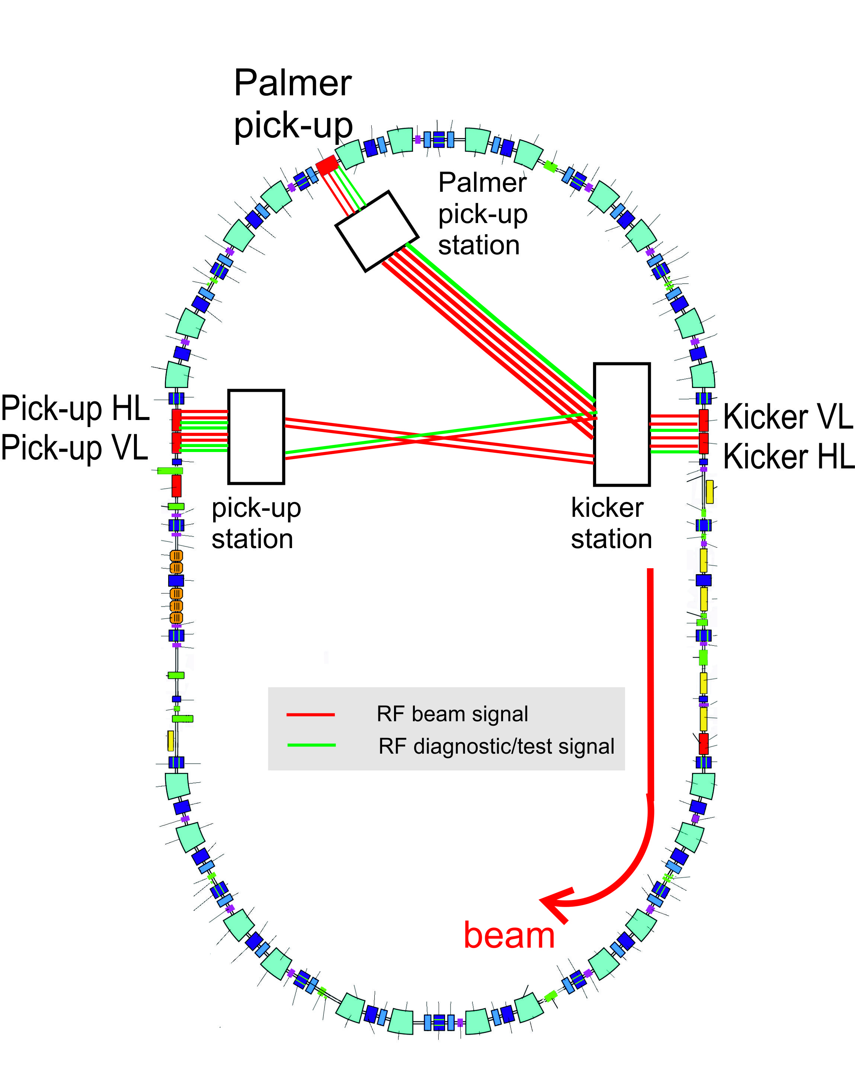
Cooling of ions at CR
Palmer method
System bandwidth W= 1 GHz
Uranium beam ²³¹U⁹²⁺
Energy 740 MeV/u
η=0.17

Slide 40
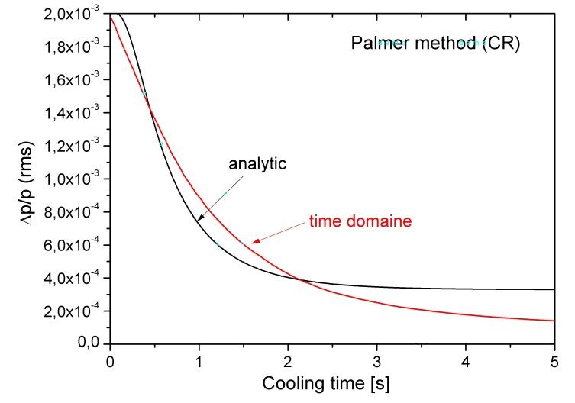
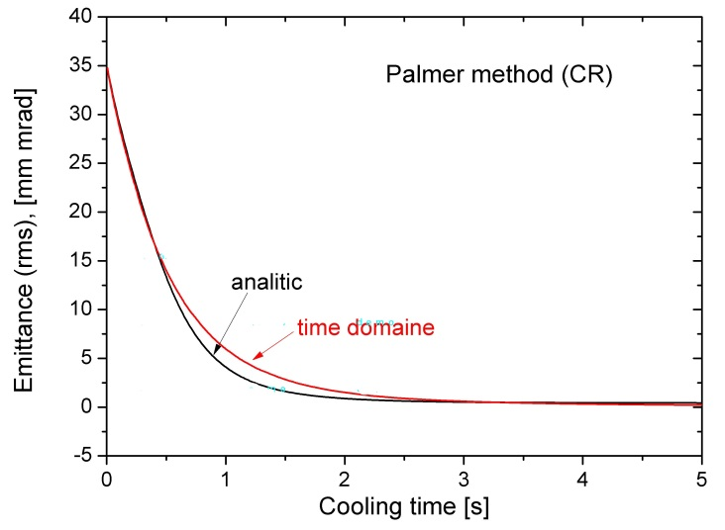
Cooling of ions at CR
MPT-6D and analytical calculation of cooling with Palmer method
N=10⁴ macro-particles
n_{s}=5 number of samples

Slide 41
Cooling of antiprotons at CR
Notch filter method
System bandwidth W= 1 GHz
Antiprotons
Energy 3000 MeV/u
η=0.011

Slide 42
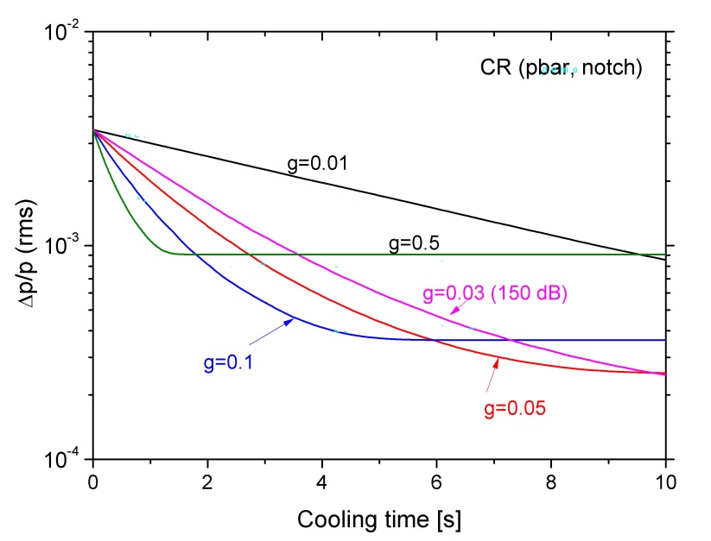
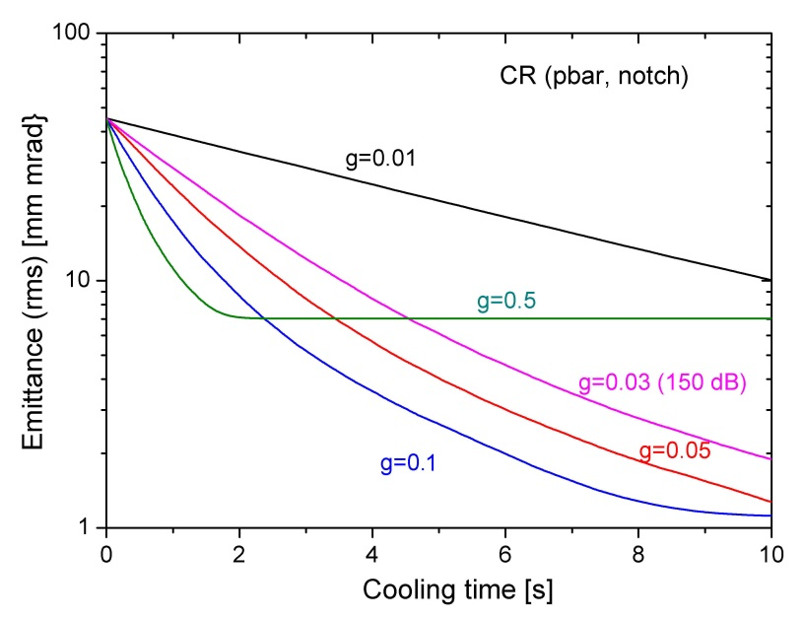
Cooling of antiprotons at CR
Gain parameter is varied to find optimal value
2.5x10⁻⁴
1.2 mm*mrad
Still the noise parameter must be more correct interpreted
Kicker response should be calculated via inverse Laplase transformations

Slide 43
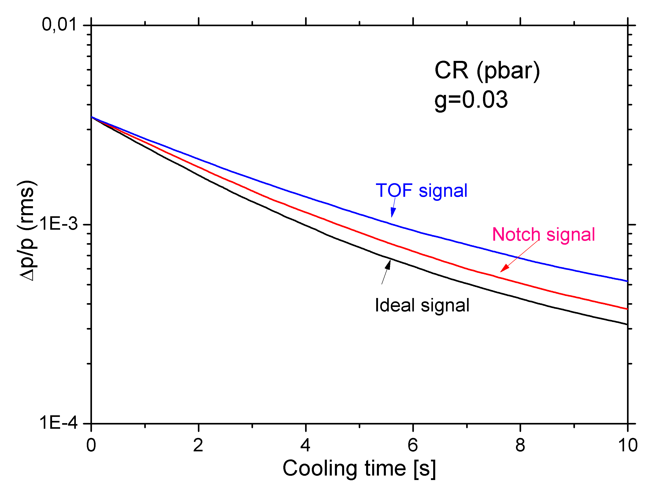
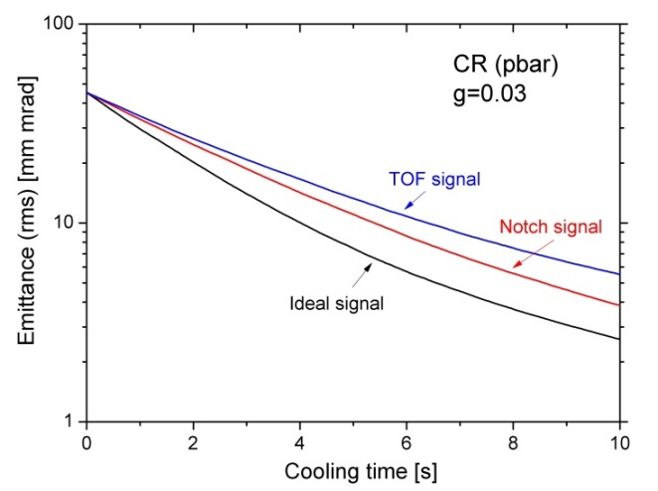
Cooling of antiprotons at CR
MPT-6D code and analytical formulae are used for calculation of cooling
N=10⁴ macro-particles
n_{s}=5 number of samples

Slide 44
Conclusion
Time domain approach is more advanced method
(simpler, multi-dimension, mixing simulation close to reality, other effects can be easy integrated, simulation time is reasonable (10-30 min depending on N)
Next steps:
Kicker response
Frequency characteristic of electronics
Plunging of electrodes
Combination of different methods (Palmer + Filter for ions)
Other effects can be included (IBS, target effect, RF-cavity (bunch rotation, barrier bucket), other...?).

