Slide 1
Genetic algorithms and SIS multi-turn injection
Sabrina Appel, GSI

Slide 2
Outline
Numerical optimization
  Single and multi-objective
Genetic algorithms (GA)
  Cycle and GA operators
  GA implementation
Multi-turn injection into SIS
Improvement of MTI quality due to GA (first results)
Summery and Outlook

Slide 3
Numerical optimization
Optimization problem for single objective:
f(x) evaluated by simulation code (or measured in the machine) with only few iteration steps
Gradient-based methods (traditional):
May get stuck in a local minimum/maximum (and never come out)
Require local gradients
Work if initial guess is already close to the optimum
Scan
Gradient
Parameter scans (traditional):
Only applicable for 1D or 2D parameter spaces
Accelerator problems:
  Multi-dimensional, nonlinear, multi-objective, contradicting optimums
Several ‘optimum’ solutions (choice of the designer is required)

Slide 4
Numerical optimization
General:
The optimization problem is multi-objective
Solution space
optimal for
(several criterions to optimize)
Pareto front
The criterions can be contradicting
  Improving one criterion means worsening others
Imagined best solution
optimal for
Find a set of optimal solutions instead of a single solution (Pareto front)

Slide 5
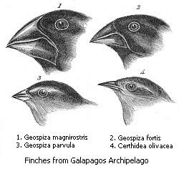
Genetic algorithms
Inspired by natural evolution
Search for solutions using techniques such as mutation, selection, and crossover
Genetic algorithms are smart parameter scans
They are very flexible and can solve multi-objective problems (wide range of different algorithms)
Can be combined with gradient-based methods (for refinement)
Darwin Finches
J. Gould, Voyage of the Beagle
Individual in the population
One point in the search area
Fitness
Measure how good an individual is adapted to the optimization problem
(fulfills constraints)
(n – parameters)
Selection
The survival of the fittest leads to an optimization of the properties
Variation
Recombination and mutation generated variety over the individuals

Slide 6
Genetic algorithms: Cycle
Initialize population
Evaluate fitness
Parents
Properties determined by genes
Reproduction
Genes are copied, combined, and mutated
Selection
Choice of new parents
Offspring
New properties due to new genes
Evaluate fitness (n-times)
End condition

Slide 7
Genetic operators
Crossover
Discovering promising areas (Exploration)
Parent 1
Parent 1
x
x
Parent 2
Parent 2
Child 1
Child 1
Child 2
Child 2
1 (n) – point crossover
uniform crossover
Mutation
Optimizing within a promising area (Exploitation)
Parent
Alter each gene with probability p=1/l
At least one bit on average should mutate
Child
-> To find the optimum a combination of both is needed

Slide 8
Genetic operators
Selection (single-objective optimization)
Choose the most promising individual to created the next generation
Prevent the population to be dominated by a single individual (local optimum) by allowing individuals with poor fitness to take part at the creation process
Techniques are fitness proportional selection, ranking selection, tournament selection, …
Roulette wheel technique
A_{50%}
Assign to each individual a part of the roulette wheel (The size is proportional to its fitness)
Spin the wheel n times to select n individuals
B_{37.5%}
C_{12.5%}

Slide 9
Genetic operators
Selection (multi-objective optimization)
Non-dominated selection (Selection of solution near to the Pareto front)
B
A
A dominates B+C but not D
D dominates C but not A+B
B + C do not dominate
A + D are non-dominated (near Pareto front)
C
D
NSGA-II (Non-dominated sorting genetic algorithm)
P_{n}
Non-dominated ranking
Crowding distance sorting
P_{n+1}
The next generation is selected from parents and children
The solutions are ranked according to their non-domination level and combined to sets
The best non-dominated solutions are selected directly for the new generation
Solutions which violate criteria or are of low rank are rejected
P
C
Rejected

Slide 10
Genetic algorithm implementation
Parallel algorithms
  Implementation of genetic operators and algorithms
  Use MPI to establish a master/slave model
    The master performs genetic operations
      Generate population, selection, crossover, mutation
    The slaves evaluate fitness function for each individual
      Accelerator simulation code
      “Bottleneck” -> Will be called for each individual at each generation
It sounds like a lot of work
  Not, if you use available genetic algorithm packages for Python, Java, Matlab, …
  And decouple the genetic algorithm from accelerator simulation code
MPI/Server manger
n * m-times
Code
pyORBIT, Elegant
Genetic algorithm

Slide 11
Multi-turn injection into SIS
Layout of injection region
Cathode
300 kV
Anode
SIS electrostatic injection septum
The linac beam is injected in horizontal phase space until the machine acceptance is reached
MTI has to respect Liouville’s theorem: Injected beams only in free space
Loss (at septum + acceptance) should be as low as possible due to activation, damage, vacuum
Previous study indicated analytically description for the model variables, but the model is underrepresented
For MTI simulations we use pyORBIT (A. Shishlo, S. Cousineau, J. Holmes et al.)
https://code.google.com/p/py-orbit/
Python + C⁺⁺ + MPI
Teapot tracking
2D/3D space charge models
Notes:
Altitude

Slide 12
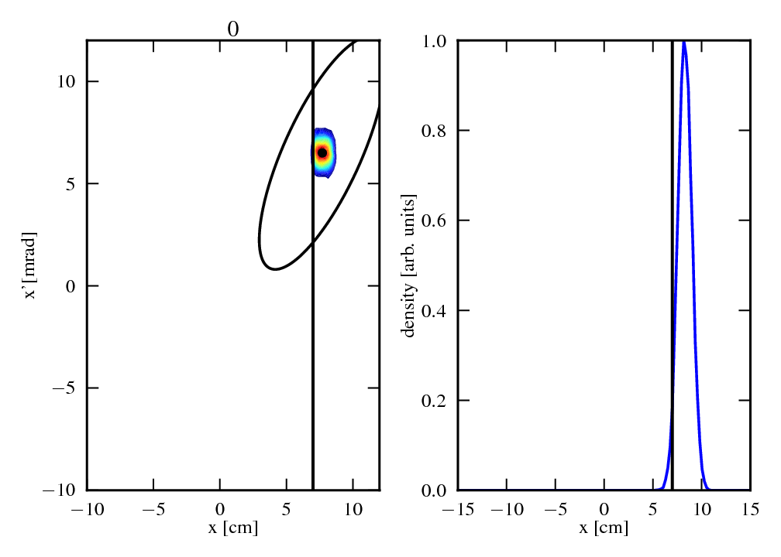
Multi-turn injection into SIS: Movie
Loss at septum is the major loss source
  Loss of incoming beam
  Later loss of stored beam
  Second loss source is the acceptance
The analytically description characterize:
The position of incoming beam
Input mismatch
And the depending of one variable on other variables
But the model is underrepresented
  A few variables can be choose freely from a value range

Slide 13
Multi-turn injection into SIS
Multi-objectives:
  stacked current (maximize)
  beam loss (minimize)
output
1-2 m
Constraints:
  Position of septum
  Machine acceptance
  Closed orbit (bumper kick)
Model in
simulation code
(fitness function)
Parameters:
  Position of incoming beam at septum
  Initial bump amplitude and its decreasing
  Injected turns
  Horizontal tune
  Horizontal emittance
  Current from linac
t
Notes:
Altitude

Slide 14
Improvement of the SIS MTI quality
Single object:
ε = 5 mm mrad
min (loss)
Fixed parameters:
Variables:
(beam)
(orbit bump)
Genetic algorithms is better than the traditional approach:
1 turns
The parameter set of the best individual are in the same area as the analytically description are suggested
Due to an other combination of the freely selectable variables give the GA are more ideally solution than analytically description
Notes:
12.9 or 13.8

Slide 15
Improvement of the SIS MTI quality
Multi-object:
max(intensity)
and min (loss)
ε = 5 mm mrad
Fixed parameters:
Variables:
(beam)
(orbit bump)
+
(inj. time)
Pareto front
Genetic algorithms is better than the traditional approach
A more better Pareto front have been found
Loss could minimized and intensity maximized

Slide 16
Other examples of applications of GA
Dynamic aperture maximization
A. Hofler et al., Innovative applications of genetic algorithms to problems in accelerator physics Phys. Rev. ST AB, 16 (2013)
Magnet design optimization
S. Ramberger, S. Russenschuck, Genetic algorithms for the optimal design of superconducting accelerator magnets EPAC (1998)
Magnet sorting in a storage ring.
Chen, J., Wang, L., Li, W.-M., & Gao, W.-W. ,Optimization of magnet sorting in a storage ring using genetic algorithms, Chinese Physics C (2013)
Linac settings for high intensity
Pang, X., & Rybarcyk, L. J., Multi-objective particle swarm and genetic algorithm for the optimization of the LANSCE linac operation. NIMA 741 (2013)
Real machine based optimization in a storage ring
L.Yang, et al. , Global optimization of an accelerator lattice using multiobjective genetic algorithms, NIMA, 609 (2009)

Slide 17
Summary and Outlook
Summary
  Numerical optimization
  Genetic algorithms (GA)
  Improvement of MTI quality due to GA (first results)
  Various applications for accelerators
Outlook
  Include in GA optimization more parameters like tune, current
  Use of other algorithms like particle swarm optimization
  Improvement of MTI simulation model due to measurements (analysis is in progress)

Slide 18
Thank you for your attention

