Slide 1
Proton injector status for FAIR and measurements at BETSI test bench (CEA/Saclay) 2014
H4F Physics Day 2014 C.Ullmann

Slide 2
Overview
Proton injector status
BETSI test bench @ CEA/Saclay
Scintillator screen measurements
4-grid Analyzer measurements
Simulations
Outlook
H4F Physics Day 2014 C.Ullmann

Slide 3
Proton Injector Status
Delivered
@ CEA/Saclay
Faraday cage, HV platform
Solenoids, ACCTs
Ion source
Extraction system
Turbo pumps, valves, gauges
LEBT chamber
accelerating column
@ GSI/Darmstadt
Iris/ SEM-grid
In production- CEA/Saclay
Allison scanner
Wien filter
Commissioning
CEA/Saclay
Q2/2015
Expected in Q4 ’14/Q1 ‘15
Puller electrode power supply
Repeller electrode power supply
Coil power supplies
HV power supply
H4F Physics Day 2014 C.Ullmann

Slide 4
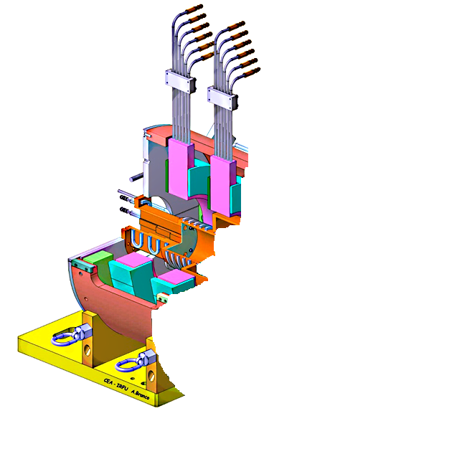
Proton Injector Status - Ion Source
Ion Source
RF-injection (2,45 GHz)
Gas inlet
Coils
Plasma chamber (d=90mm; l=100mm)
Extraction system
Pentode system:
Plasma electrode (95 kV)
Puller electrode (55 kV)
Ground electrodes
Repeller electrode (-3kV)
ion source
extraction system top view
H4F Physics Day 2014 C.Ullmann

Slide 5
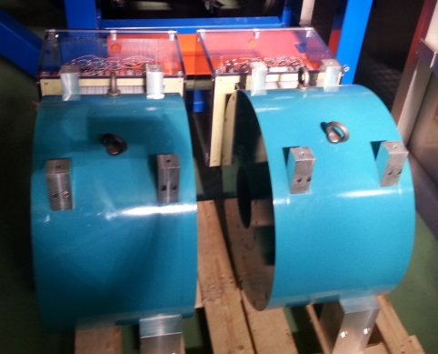
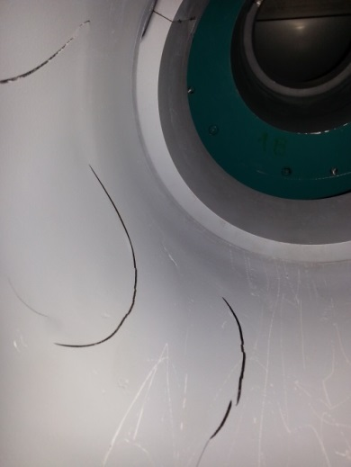
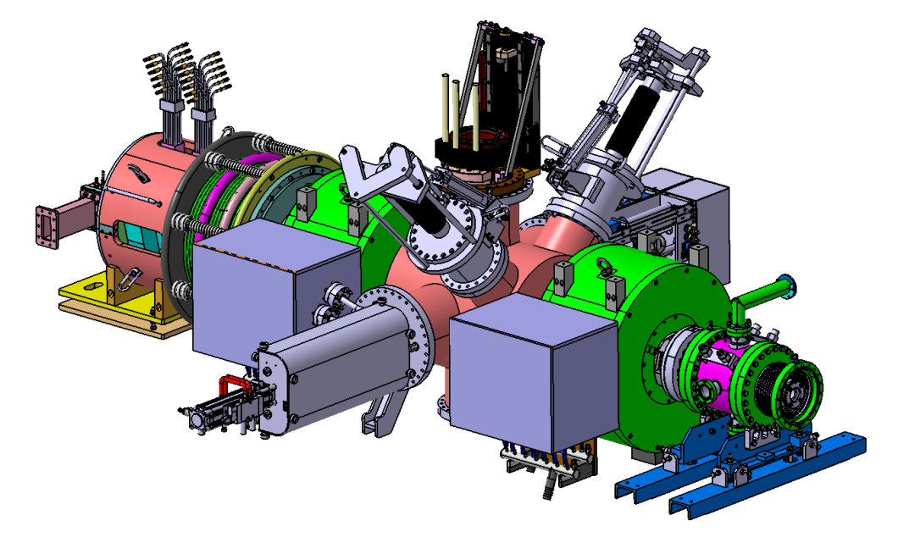
Proton Injector Status - LEBT
Diagnostic chamber
IRIS
SEM grid
Wien filter
beam stopper
4-grid Analyzer
solenoids with steerers
diagnostic chamber
diagnostic chamber
Solenoids
maximum induction: 500 mT
water cooled
heat damage detected during first view
combined with steerers
ion source
heating damage inside solenoids
solenoids with steerers
chopper
H4F Physics Day 2014 C.Ullmann

Slide 6
Overview
Proton injector status
BETSI test bench @ CEA/Saclay
Scintillator screen measurements
4-grid Analyzer measurements
Simulations
Outlook
H4F Physics Day 2014 C.Ullmann

Slide 7
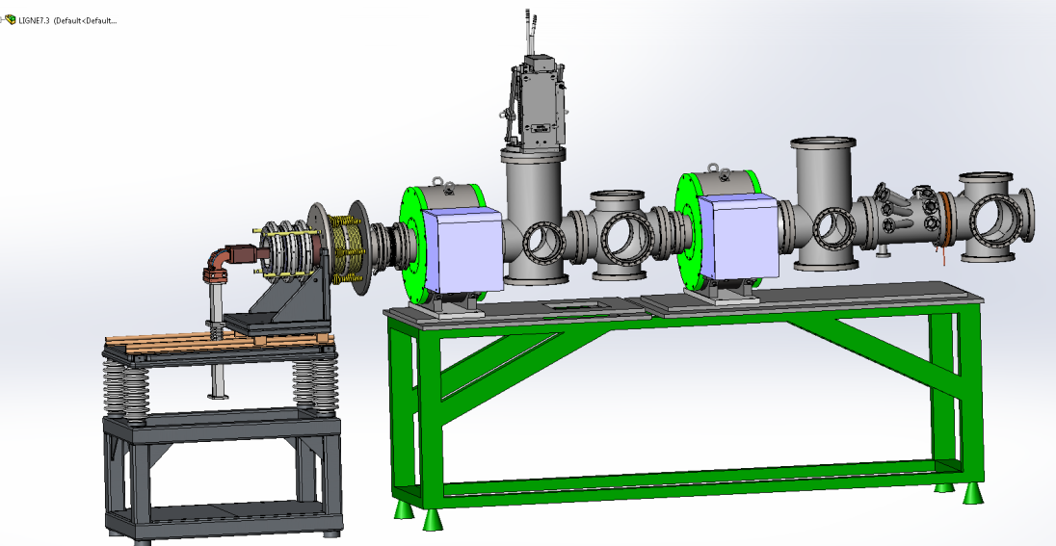
BETSI test bench
BETSI ion source
~80% H⁺/~15%H₂⁺/~5%H₃⁺ extrapolated difference between extracted and measured current (beam stopper)
pentode extraction with puller switched off during measurements due to sparking problems!
ion source
pentode extraction
4-grid analyzer
scintillator screen
BETSI LEBT
Solenoids similar to p-linac solenoids
Allison scanner mounted behind chopper
solenoids with steerers
chopper
beam stopper
Allison scanner
H4F Physics Day 2014 C.Ullmann

Slide 8
KBr scintillator screen
CCD camera
Scintillator screen in the beamline
CCD camera installed from top
KBr scintillator installed from side with a small angle
beam
Scintillator screen
H4F Physics Day 2014 C.Ullmann

Slide 9
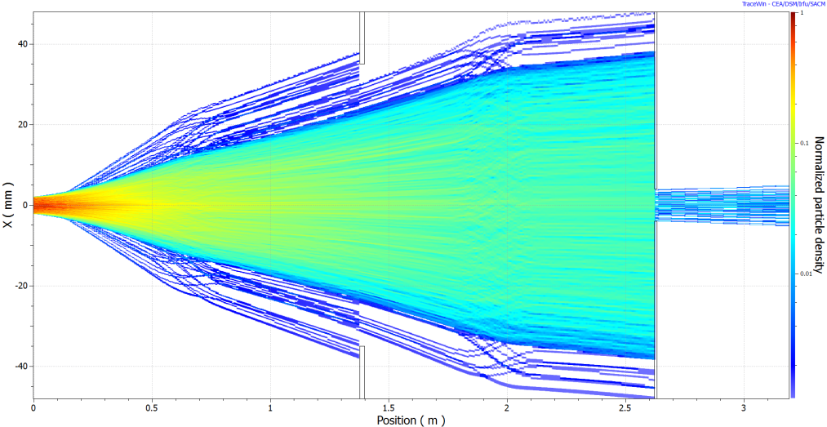
Scintillator measurements
1.
2.
3.
4.
5.
6.
TraceWin Simulation – BETSI LEBT
Drift
1st solenoid (max. 200 A)
diagnostic chamber
2nd solenoid (max. 500 A)
Drift
Chopper
Scintillator screen measurements
Extraction voltage: 25kV
estimated current: ~60mA
Foccussing animation
1st focus at 132.5 A (H⁺)
2nd focus at 187.5 A(H₂⁺)
H4F Physics Day 2014 C.Ullmann

Slide 10
4-grid Analyzer schematic view
measurement of space charge compensation
φ
beam tube
beam potential
P
4-grid Analyzer
ion
intensity
beam diameter
P
P
measured voltage via data acquisition
S
Faraday Cup
grid 3[V]
dI/dV
via derivation
Shielding
Estimated beam potential
grid 3: retarding potential
grid 2: neg. pot.
grid 4: neg. pot.
grid 1: ground
grid 3 [V]
H4F Physics Day 2014 C.Ullmann

Slide 11
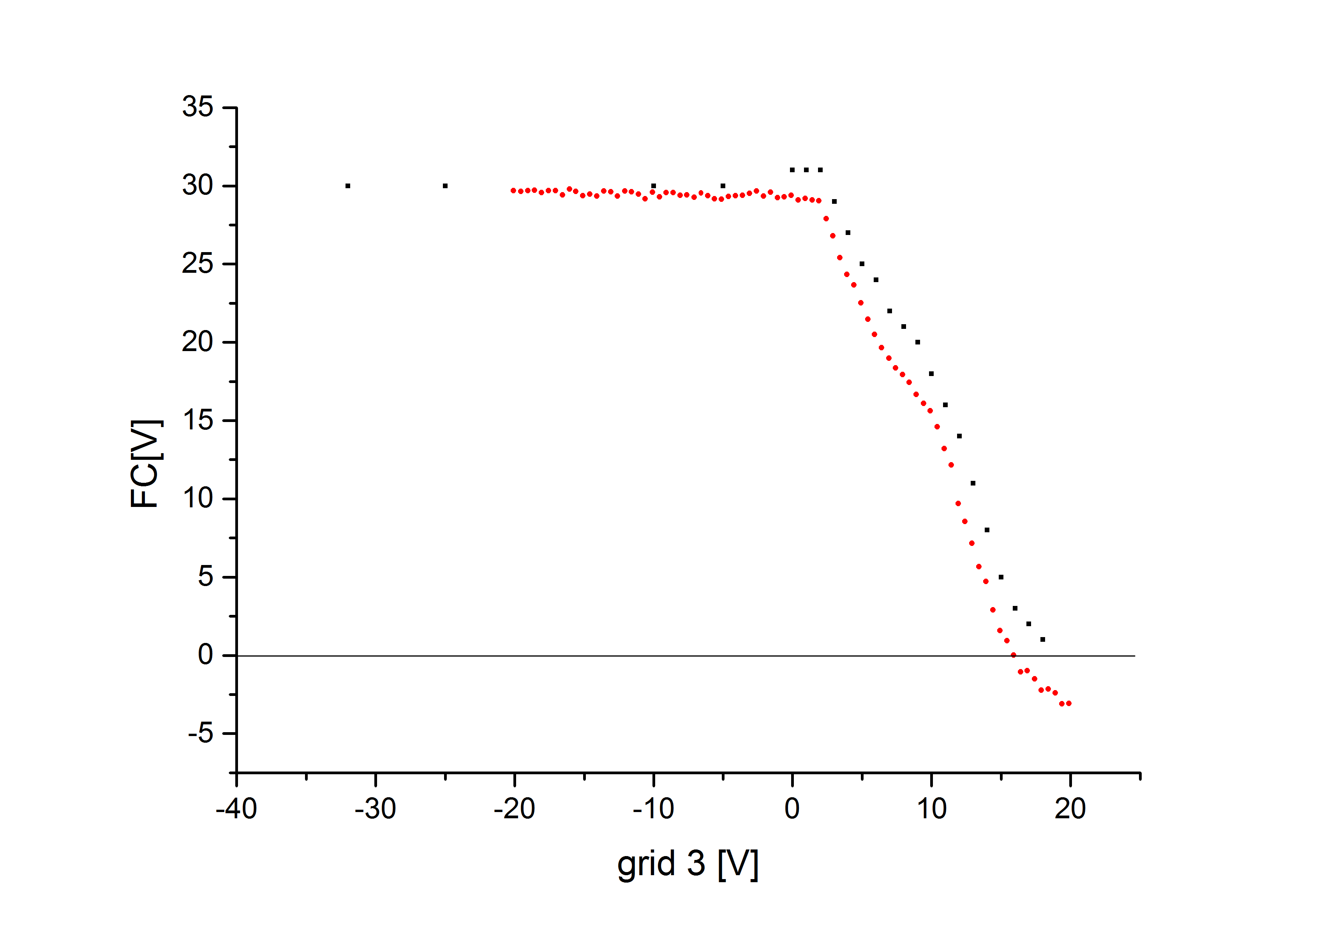
4-grid Analyzer measurements
Measurement 1
solenoid 1: 152A
red curve: data acquisition; black curve: measurements with oscilloscope (R=1MΩ)
all ions pass through
start of ion filtration
ions are filtered via potential
no more passing of ions
1.
2.
3.
4.
negative offset in data acquisition!?
H4F Physics Day 2014 C.Ullmann

Slide 12
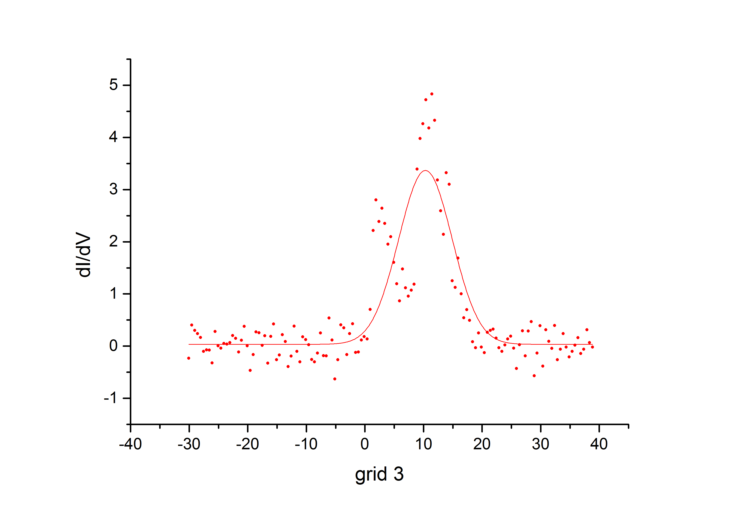
4-grid Analyzer results
Result 1
uncompensated beam potential: Δφ= 390V
estimated beam compensation: 97%
huge error
[V]
H4F Physics Day 2014 C.Ullmann

Slide 13
4-grid Analyzer outlook
optimize 4-grid analyzer for pulsed beams
Measurements with the 4-grid Analyzer @ GSI (Darmstadt)
vary the energy of the beam
decompensate beam before device
measurements with superconducting solenoid
compensation with additional auxiliary gas
Improvement of the data acquisition (in cooperation with Franck Senée from CEA/Saclay)
new measurements at BETSI after upgrade of the ion source
H4F Physics Day 2014 C.Ullmann

Slide 14
Outlook
Proton injector status
BETSI test bench @ CEA/Saclay
Scintillator screen measurements
4-grid Analyzer measurements
Simulations
Outlook
H4F Physics Day 2014 C.Ullmann

Slide 15
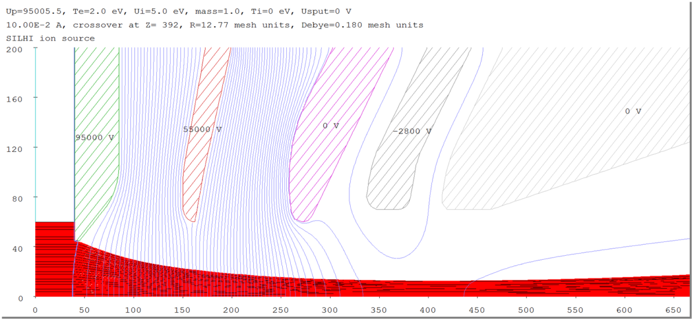
Simulations – IGUN
IGUN simulation- Extraction
simulation only with H⁺
Plasma electrode: 95kV
Puller electrode: 55kV
Shield electrode: -3kV
H4F Physics Day 2014 C.Ullmann

Slide 16
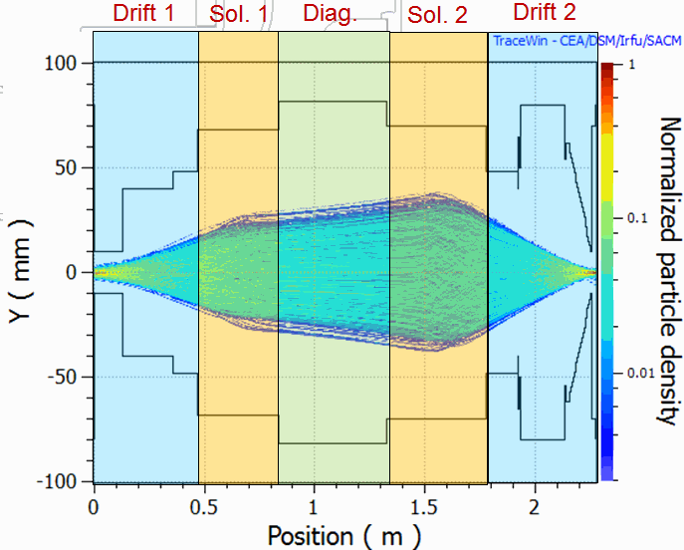
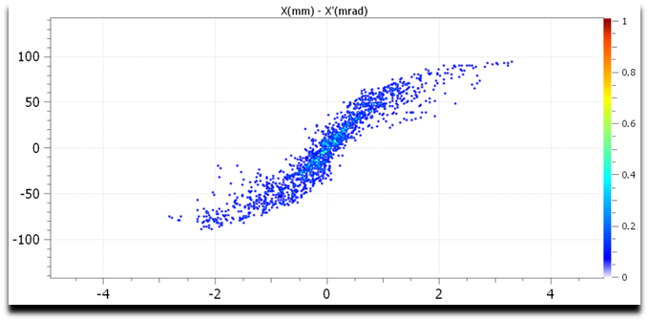
Simulations – TraceWin
TraceWin Simulation - LEBT
simulation only with H⁺
Solenoid settings matching for RFQ entrance
no active chopper
simulation with 4000 particles
input parameters from AXCEL-INP (CEA/SACLAY)
Emittance at RFQ entrance:
ε_{rms}= 0.1 π mm mrad
IBSIMU
example emittance plot before RFQ entrance
H4F Physics Day 2014 C.Ullmann

Slide 17
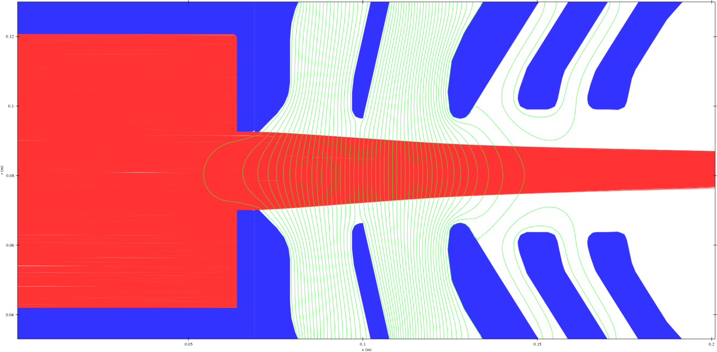
Simulations - IBSIMU
plasma electrode
95kV
ground electrodes
puller electrode
55kV
screening electrode
-3kV
plasma chamber
IBSIMU
3D code
open source
ongoing development via worldwide community
IBSIMU- in progress
implementation of 3D construction files
design of an user interface
simple and user friendly change of parameters
H4F Physics Day 2014 C.Ullmann

Slide 18
Overview
Proton injector status
BETSI test bench @ CEA/Saclay
Scintillator screen measurements
4-grid Analyzer measurements
Simulations
Outlook
H4F Physics Day 2014 C.Ullmann

Slide 19
Outlook
Okt.-Nov. 2014 Measurements with 4-grid Analyzer @ GSI
Okt. 2014- 2nd Quarter 2015 Simulations with TraceWin and IBSIMU
2nd Quarter 2015 Commissioning of the proton injector @ CEA/Saclay
Ongoing Improvements for the proton injector
Preparations for commissioning of the proton injector
Simulation of extraction and LEBT of the proton injector with IBSIMU
H4F Physics Day 2014 C.Ullmann

Slide 20
Thank you for your attention!
H4F Physics Day 2014 C.Ullmann

